Slide 1
PRESENTATION ON SNAKE GAME
DEPARTMENT OF COMPUTER APPLICATION
Presented To- Presented By-
Priya Matta Ayushi Aggarwal
BCA-B
Roll no-09

Slide 2
Contents
Introduction on Project
History of Snake Game
Requirements
Objectives
ER Diagram
Features and About the Project
Computer Graphics
Testing
Future Scope of the Program
References

Slide 3
Introduction
Snake is the common name for a video game concept
where the player maneuvers a line which grows in length,
with the line itself being a primary obstacle. The concept
originated in the 1976 arcade game Blockade, and the
ease of implementing Snake has led to hundreds of
versions (some of which have the word snake or worm in
the title) for many platforms. After a variant was preloaded
on Nokia mobile phones in 1998, there was a resurgence
of interest in the snake concept as it found a larger
audience. There are over 420 Snake-like games
for iOS alone.

Slide 4
History
The Snake design dates back to the arcade game Blockade,developed and published by Gremlin in 1976. It was cloned as Bigfoot Bonkers the same year. In 1977, Atari released two Blockade-inspired titles: the arcade game Dominos and Atari VCS game Surround. Surround was one of the nine Atari VCS (later the Atari 2600) launch titles in the United States and was also sold by Sears under the name Chase. That same year, a similar game was launched for the Bally Astrocade as Checkmate.
The first known personal computer version, titled Worm, was programmed in 1978 by Peter Trefonas of the US on the TRS-80, and published by CLOAD magazine in the same year. This was followed shortly afterwards with versions from the same author for the Commodore PET and Apple II. A microcomputer clone of the Hustle arcade game, itself a clone of Blockade, was written by Peter Trefonas in 1979 and published by CLOAD. An authorized version of Hustle was

Slide 5
published by Milton Bradley for the TI-99/4A in 1980.In 1982's Snake for the
BBC Micro, by Dave Bresnen, the snake is controlled using the left and right
arrow keys relative to the direction it is heading in. The snake increases in
speed as it gets longer, and there's only one life; one mistake means starting
from the beginning.
Nibbler (1982) is a single-player arcade game where the snake fits tightly into a maze, and the gameplay is faster than most snake designs. Another single-player version is part of the 1982 Tron arcade game, themed with light cycles. It reinvigorated the snake concept, and many subsequent games borrowed the light cycle theme.
Starting in 1991, Nibbles was included with MS-DOS for a period of time as a QBasic sample program. In 1992, Rattler Race was released as part of the second Microsoft Entertainment Pack. It adds enemy snakes to the familiar apple-eating gameplay.
Meerca Chase is a snake game available on Neopets.
Slither.io (2016) and Little Big Snake are popular multiplayer interpretations of Snake.
In 2017, Google released their version of the game as an easter egg, whenever the phrases "snake", "play snake", "snake game" and "snake video game" are typed.

Slide 6
Requirements
Snake Classic System Requirements (2021) - full specs, system checker and the gaming PC setup you need: Can I Run Snake Classic?
Snake Classic system requirements
Memory: 4 GB
Graphics Card: ATI FireGL T2-128
CPU: Intel Pentium 4 2.00GHz
File Size: 20 MB
OS: Windows 7/8/10
Snake Classic minimum requirements
Memory: 4 GB
Graphics Card: ATI FireGL T2-128
CPU: Intel Pentium 4 2.00GHz
File Size: 20 MB
OS: windows 7/8/10
Automatically test your computer against Snake Classic system requirements. Check if your PC can run the game with our free, easy-to-use detection tool or enter your system manually.

Slide 7
Objectives
This campaign is designed for primary schools and aims to encourage children, parents and teachers to adopt walking, cycling, public transport or car sharing when travelling to and from school.
With this two-week campaign, we aim to break down negative perceptions, such as the concern about road safety, and promote sustainable modes as fun and healthy for both parents and children. The Traffic Snake Game was developed for primary schools. Every school can participate: big or small.
By walking and cycling, children become more aware of their surroundings and develop road safety skills as well as improve their ability to anticipate other users of the road. Furthermore, walking and cycling contributes to the recommended amount of daily exercise that children need. It also reduces congestion and parking pressure in school environment.

Slide 8
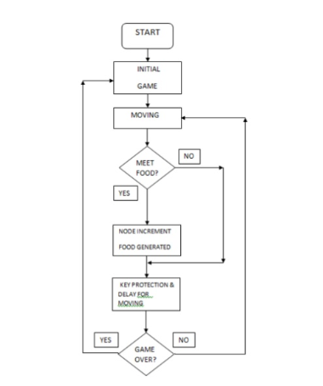
ER Diagram

Slide 9
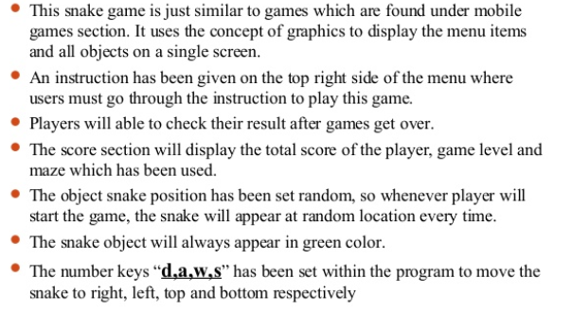
Features and About the Project

Slide 10
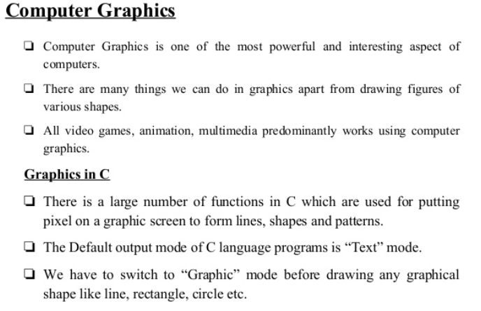
Computer Graphics

Slide 11
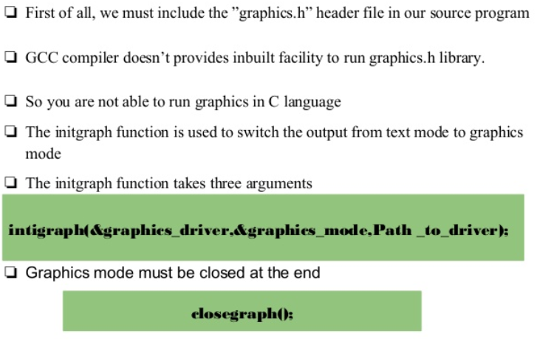

Slide 12
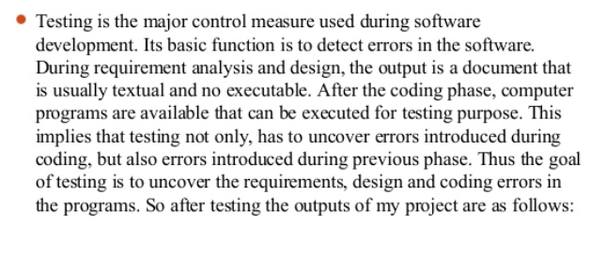
Testing and Screenshots

Slide 13
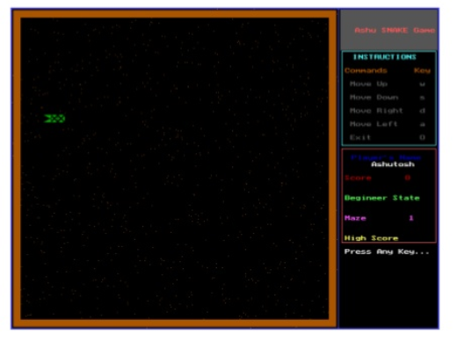
Main Menu

Slide 14
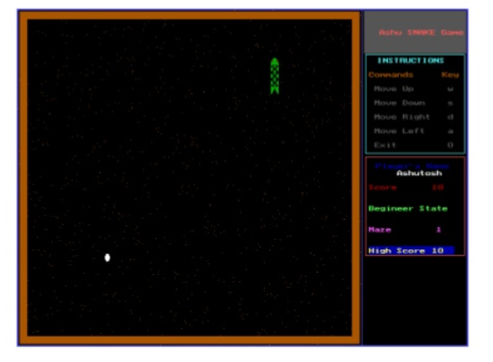
Playing

Slide 15
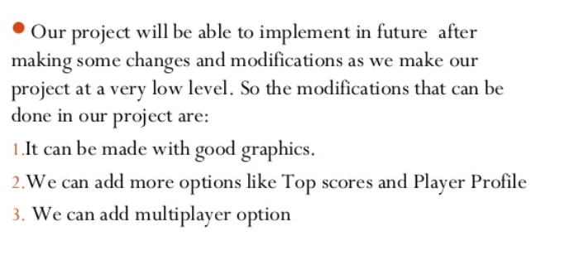
Future Scope of Project

Slide 16
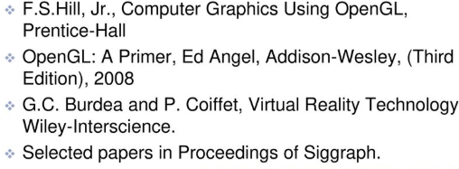
References

Slide 17
Thank You

