Slide 1
MODULE 1 (SDLC)
PRESENTED BY :- AYUSH DHABALIYA

Slide 2
WHAT IS SOFTWARE ?
Software is a collection of information, instruction, and data software is required to run any application. This requires different type of software for different types of applications.
WHAT IS SOFTWARE ENGINEERING ?
Software engineering is work of design, system, development, maintain system. Software engineering is team work and software engineering is done for some time and limited budget and space to create different type of software.

Slide 3
THERE ARE MAINLY FIVE TYPES OF SOFTWARE
1. Application software
2. System Software
3. Programming Software
4. Driver Software
5. Middleware

Slide 4
APPLICATION SOFTWARE
This software requires to run applications. There are mainly three types of software.
1] Desktop applications :-
Example, Visual studio, Quick heel, Microsoft 360, Notepad etc..
2] Mobile application :-
Example, G-pay, MX player, VLC, Spotify, etc..
3] Web application :-
Example, Web browser like Google chrome, Opera, Mozilla, Firefox etc..

Slide 5
2. SYSTEM SOFTWARE
Software that requires for system
OPERATING SYSTEM { OP }
Operating system like Window, Linux, IOS, Microsoft, etc…
3. PROGRAMMING SOFTWARE
Programming software is required for program to run specific task.
For example :- Complier, Interpreter.

Slide 6
4. DRIVER SOFTWARE
Driver is main part of any software. Without driver software doesn’t work.
Driver software examples like Character driver, Block driver, BIOS driver, etc..
5. MIDDLEWARE
Middleware is mandatory software between to two or more applications or software.
They are interconnected between two software or applications
For example Database

Slide 7
WHAT IS SDLC
PLANNING
ANALYSIS
DESIGN
MAINTENANCE AND UPDATE
TESTING
IMPEMENTATION
SDLC means software development cycle.
SDLC is refer to methodology of process making high quality software.
SDLC has some phases of software development.

Slide 8
PHASES SOFTWARE DEVELOPMENT
1] PLANNING :-
Which means you have to gather information of your project from client, what he/she want on his/her project. Some basic project based on and about security on software and many other things.
2] ANALYSIS :-
After some planning and knowing about the project details, you have to analysis on market about things you put on and main thing is how software word like admin authority user details, user need etc….

Slide 9
PHASES SOFTWARE DEVELOPMENT
3] design :-
Design is main thing in any software development. Means we have to create a best design of software.
How software looks like, means login page, web page design colours on it, fonts, etc…
4] IMPLEMENTATION :-
Implementation means after finalizing the design now we have to start working on it. For making entire software there are mainly two types of group of engineers worked like designing and UI side front end developer worked and for process of software that how software works inside which means inside process is done by backhand developer. This whole team makes one complete software.

Slide 10
PHASES SOFTWARE DEVELOPMENT
5] TESTING :-
Once software development is completed, the software is going to be tested.
The software testing is done by tester but not by the software developer. So if there is any bugs or errors in software, will be repaired instantly. And so the software would smoothly.
6] MAINTENANCE :-
Finally our software is ready for production. But after production it is necessary to make our software updated by time to time. That’s why the maintenance is needed. Like some feature, security, patches, them changes version. This all are part of maintenance. We can also say that software updated (upgradation of software.)

Slide 11
This 6 phases completes the cycle of one software. Without any of this phase software can not be run.

Slide 12
WHAT IS DFD ?
DFD means data flow diagram. This shows the all over data of any application or a software.
By DFD it is very easy to understand the flow of data and in on going process.
Thus includes the entity side flow, inside process, admin side and data base flow.
The data flow and data store is different things, data store means the storage of data, also called database.
Here flow means the data or some process is going from one to other. And this is called data flow.
There are some symbols is here to represent their different functions.

Slide 13
There are some elements of DFD as follows:-
1] External entities
2] Process
3] Data flow
4] Data store
DFD are of types:-
1] Zero or context level DFD :-
It means it’s only shows the external entity of process. And zero level DFD not contains any data store.
2] 1 or 2 level DFD :-
1 level DFD includes all the entity, data flow and data store.
This DFD shows all the data flow of process which connected to data store.
Like we can sat and login is linked to user and database and futher process.

Slide 14
DFD SYMBOLS
1] External entity
2] Process
Input output
3] Data flow
4] Data store
Admin
login
I’D

Slide 15
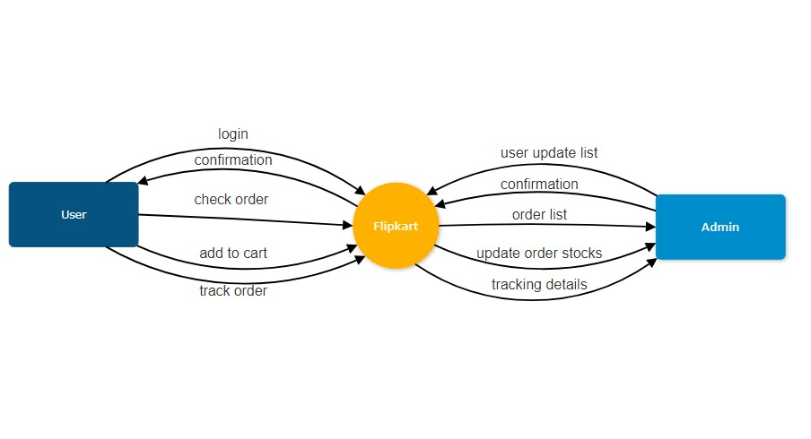
Zero Level DFD

Slide 16
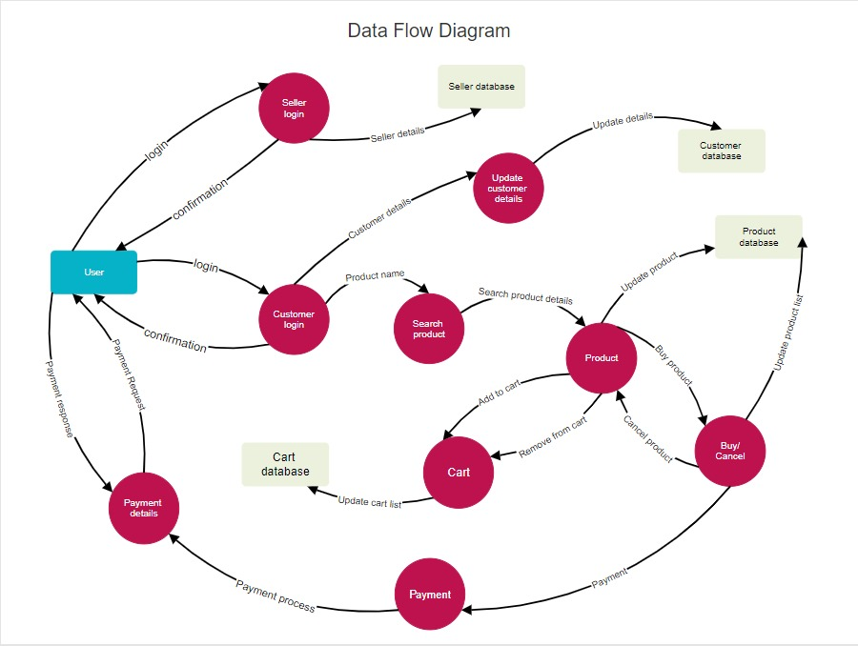
1 Level DFD

Slide 17
FLOW CHART
Flow chart is used to show the algorithm of process. It can give solution of any application.
The flow chart was made by John Von Newman in 1945.
We can say that the flow chart is very older process to entire flow of application.
This is also use in computer formulating.
Flow chart is also used in communication between programmers and business people.
Pictorial view of process.
Flow chart plays an important role in programs and quite helpful in difficult and lengthy programs.

Slide 18
FLOW CHART
These programs are in three format.
1} Linear or Sequence.
2} Branching.
3} Looping.
Res = num1 + num2
FLOW CHART SYMBOL
1] Start or End
2] Process
Start
End
Res = num1 + num2

Slide 19
3] Input or Output
4] Decision Making
5] Flow lines
int
num1, num2
If
num1 > num2

Slide 20
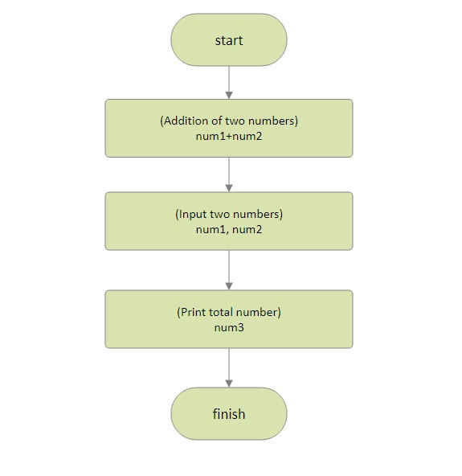
Flow Chart Diagram

Slide 21
INTERACTION MODEL
This interaction model is describe how object in system cooperates to achieve results.
Interaction model also shows the authority of user side and admin side.
Interaction model also we can say use case.
Use case focus on the functionality of system .
For example what system does for user.

Slide 22
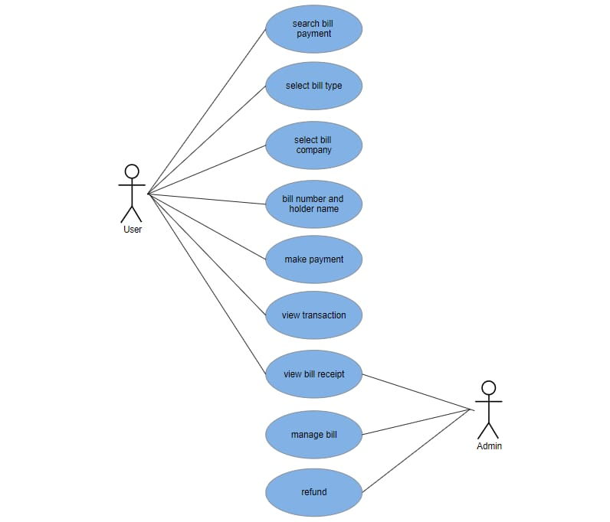
Use Case Diagram

Slide 23
Thank You ☺

