Slide 1
Parallel Processing and GPU Optimization
By:
AYUSH ISHAN
DEV RAJ R

Slide 2
Part-I
GPU Optimisation in Tensorflow

Slide 3
TensorFlow multiple GPUs support
If a TensorFlow operation has both CPU and GPU implementations.
TensorFlow will automatically place the operation to run on a GPU device first.
If you have more than one GPU, the GPU with the lowest ID will be selected by default.
However, TensorFlow does not place operations into multiple GPUs automatically.
To override the device placement to use multiple GPUs, we manually specify the device that a computation node should run on.

Slide 4
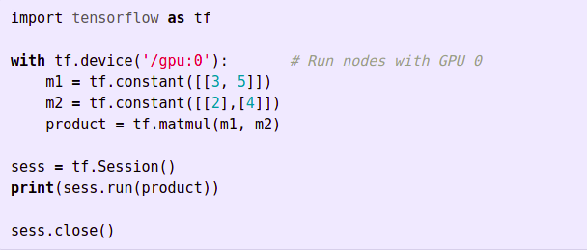
GPU PLACEMENTS
Placing all operations on a specific in a specific GPU only.

Slide 5
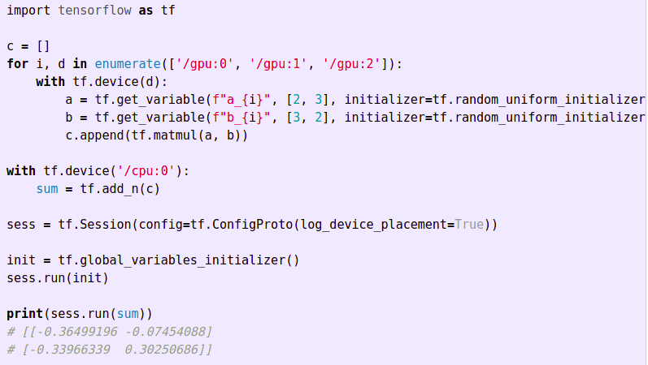

2. Multiple GPUs
The code below allows operations to run on multiple GPUs. We use 3 GPUs to compute 3 separate matrix multiplication. Each multiplication generates a 2x2 matrix. Then we use a CPU to perform an element-wise sum over the matrices.

Slide 6
SOFT PLACEMENTS
To handle multiple devices configuration, set allow_soft_placement to True.
It places the operation into an alternative device automatically. Otherwise, the operation will throw an exception if the device does not exist.

Slide 7
PARALLELISM
Parallelism is the idea of running our tasks concurrently in multiple different processing units (GPUs in our case). And in the case of TensorFlow there are two types of parallelism. These are :
Model Parallelism - in this different part of the code is executed by different by different GPUs, the data passes through all GPUs. This type of parallelism is similar to an Assembly line. As the data can be in different stages of processing
Data Parallelism - in this all the GPUs perform the same processing on different batches of data passed through them.
Roughly this can be thought of as in model parallelism, the model is split between different GPUs and in data parallelism data is split.

Slide 8
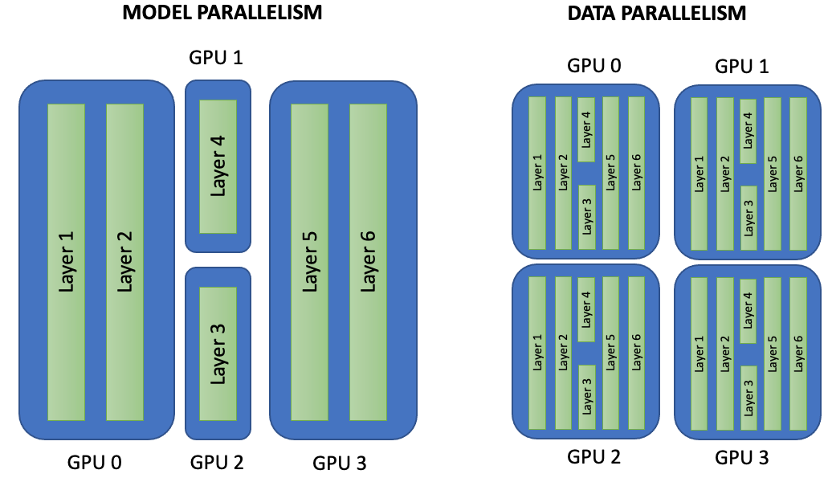

Slide 9
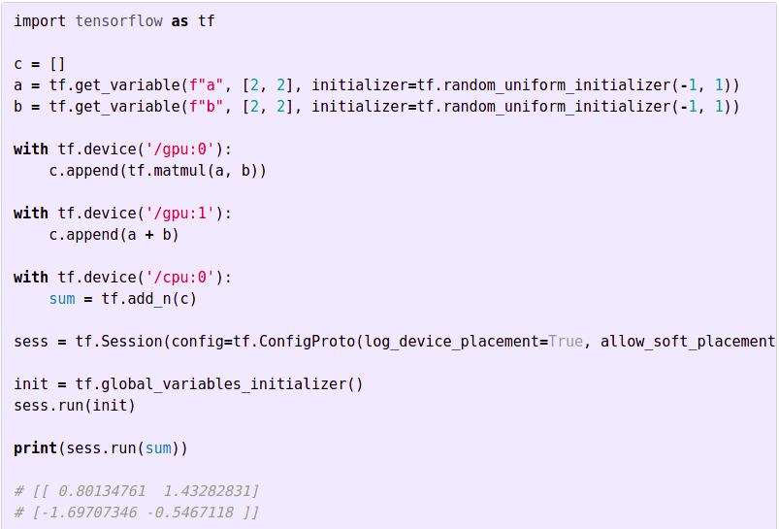
MODEL PARALLELISM
Here, in code shown below. GPU 0 is responsible for the matrix multiplication and GPU 1 is responsible for the addition.

Slide 10
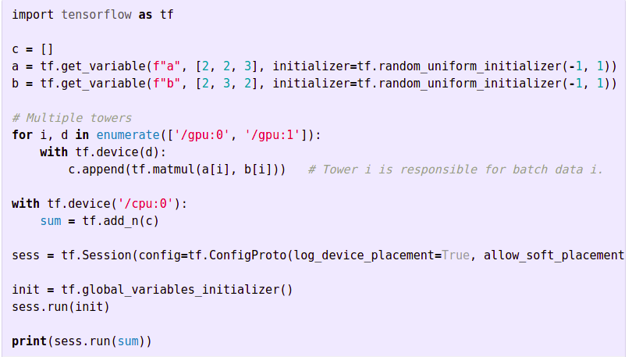
DATA PARALLELISM
We run multiple copies of the model (called towers). Each tower is assigned to a GPU. Each GPU is responsible for a batch of data.

Slide 11
GPU MEMORY - MANUAL ALLOCATION
TensorFlow requests nearly all of the GPU memory of all GPUs to avoid memory fragmentation (since GPU has much less memory, it is more vulnerable to fragmentation).
This may not be desirable if other processes are running on other GPUs.
In the next slide we present the different ways of GPU memory that Tensorflow offers.

Slide 12


TensorFlow can grow its memory gradually by (if desired):
2. To specify that we want say 40% of the total GPUs memory.

Slide 13
MOVING TOWARDS MACHINE LEARNING
APPLICATIONS
We will discuss here, the general approach towards how to design a full-fledged machine learning model, how to optimise it and how to use it for further tasks.
However, you can watch this video to get more intuition.
link.

Slide 14
Placing Variables on CPU
If all GPU cards have the same computation and memory capacity, we can scale the solution by using multiple towers each handle different batches of data.
If the data transfer rate between GPUs are relative slow, we pin the model parameters onto the CPU.
Otherwise, we places the variables equally across GPUs. The final choice depends on the model, hardware and the hardware configurations.
Usually, the design is chosen by benchmarking. In the diagram below, we pin the parameters onto the CPU.

Slide 15
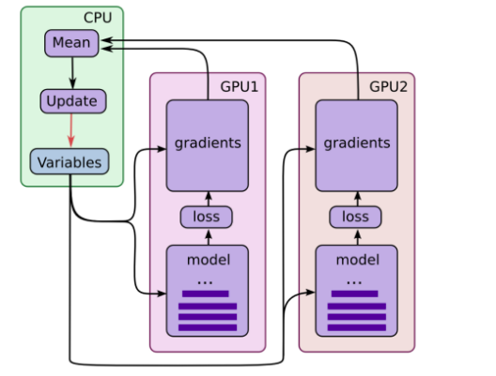

Slide 16
Explanation of previous diagram
Each GPU computes predictions and gradients for a specific batch of data.
This setup divides a larger batch of data across the GPUs.
Model parameters are pinned onto the CPU. The CPU waits for all GPU gradient computations, and the averaged the result.
Then CPU computes the new model parameters and updates all GPUs.

Slide 17
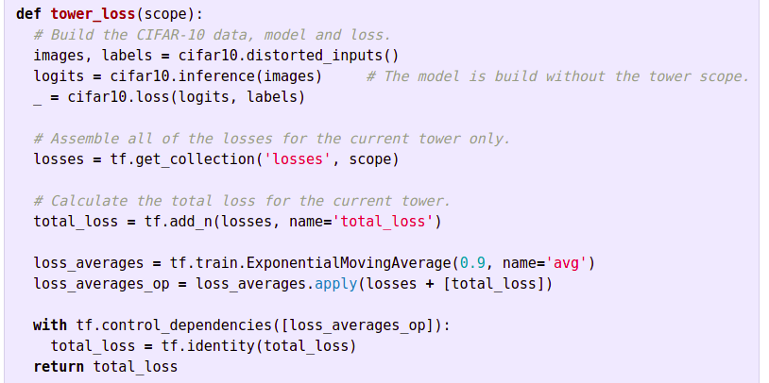
Computing loss for a tower - in code below
Build a CIFAR-10 model with parameters shared by all towers.
Compute the loss for a single tower.

Slide 18
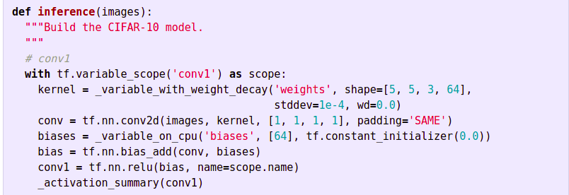
Inference function
In cifar10.inference, all variables are instantiate using tf.get_variable without the tower scope. Hence all model parameters are shared among towers.

Slide 19
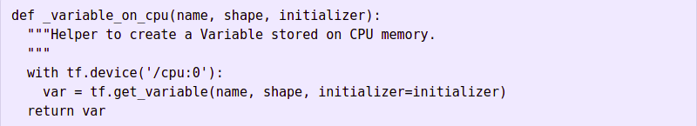
Putting all variables in CPU
Also all variables are created with _variable_on_cpu which pins the variables onto the CPU 0.

Slide 20
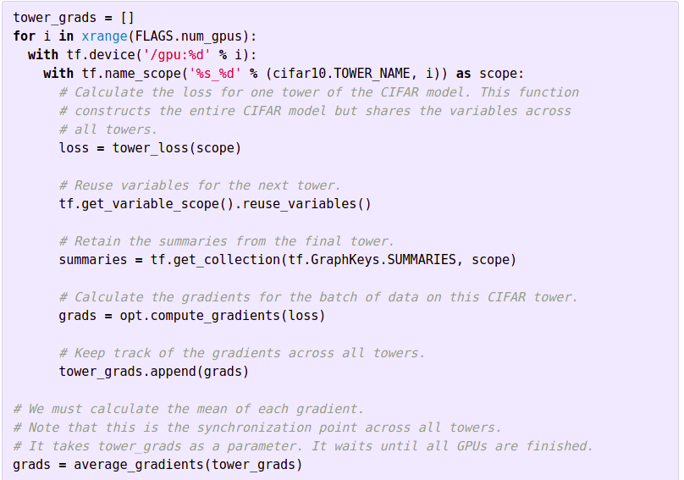
Training Model with Multiple GPUs
To train the model with multiple GPUs, we assign the operations to specific GPUs.

Slide 21
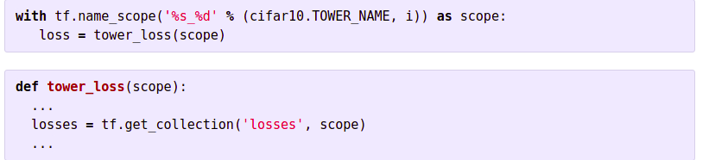
Getting Loss of a particular tower and building the final Loss function
We use name scope to retrieve the loss for a specific tower:

Slide 22
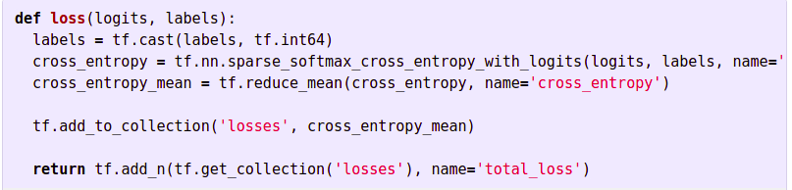
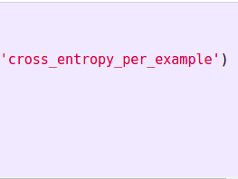
The final loss function construction

Slide 23
PLACEMENT DECISIONS
How to handle variable placement (on CPU or equally shared in GPUs) depends on the model, hardware, and the hardware configuration.
For example, for two systems built with NVIDIA Tesla P100s but one using PCIe and the other NVLink may have different recommendations.
Below is some recommendations from the Tensorflow documentation:
Tesla K80: If the GPUs are on the same PCI Express and are able to communicate using NVIDIA GPUDirect Peer to Peer, we place the variables equally across the GPUs. Otherwise, we place the variables on the CPU.
Titan X, P100: For models like ResNet and InceptionV3, placing variables on the CPU. But for models with a lot of variables like AlexNet and VGG, using GPUs with NCCL is better.

Slide 24
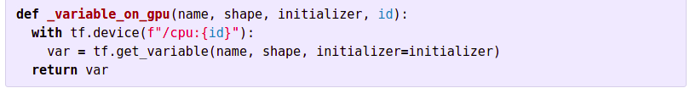
Placing Variables on GPUs
We can place variables on GPU devices similar to CPU.
The major difference is that we may have 1 CPU but many GPUs. So we may manually rotate the GPU assignment:

Slide 25
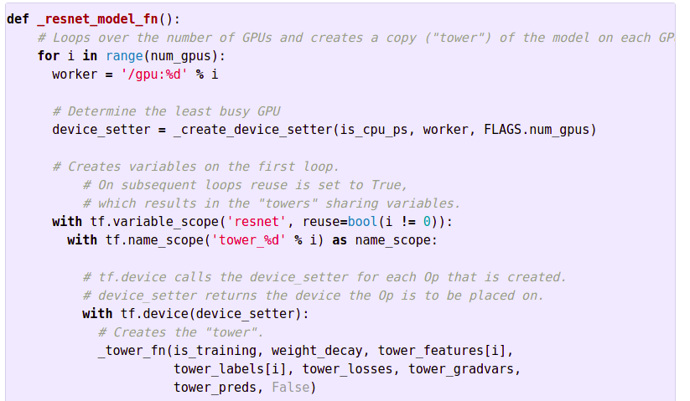
tensorflow.device(device_setter) - tf.device calls the device_setter for each Op that is created and it returns the least busy device to place the op.

Slide 26
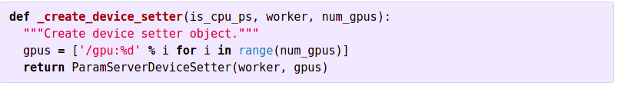
Designing _create_evice_setter() function :-
_create_device_setter returns the device the Op is to be placed on:

Slide 27
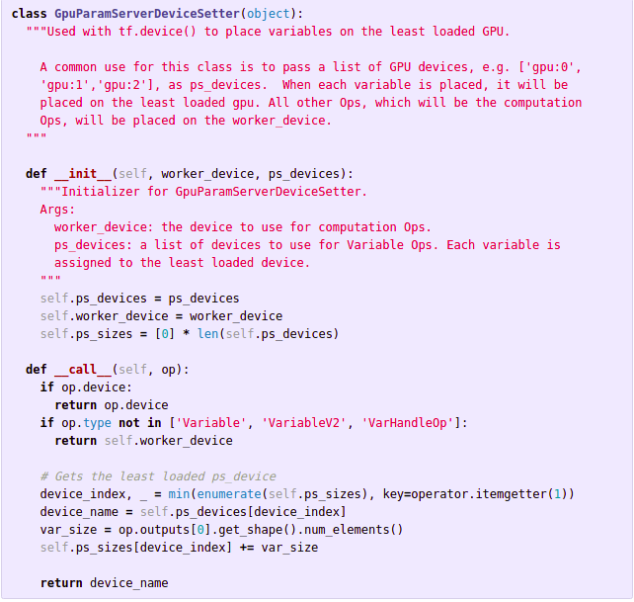
Determining the device - to determine the device on which we are currently.

Slide 28
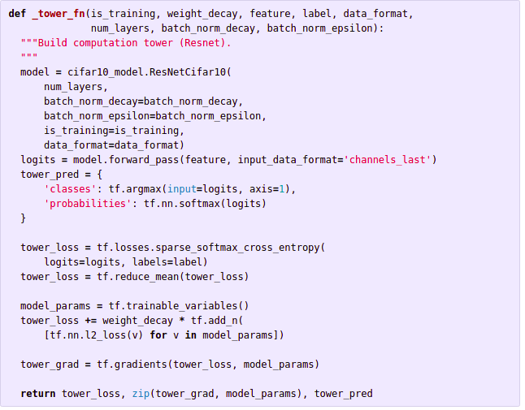
Building the tower - Building the whole model on a single tower.

Slide 29
Part-II
Parallel processing in Pandas

Slide 30
In pandas performing an operation on a DataFrame can take a lot of time, especially if the dataset is big or the processing operation very intensive.
This is can be very much improved by using multicore processing, which for pandas is available through a library called pandarallel.
The pandarallel library gives adds a method to the classes of pandas called parallel_apply() which is analogous to apply() method already present.
Note : pandarallel improves efficiency by running on different physical cores, hyperthreading may not improve performance.

Slide 31
Using pandarallel
from pandarallel import pandarallel
pandarallel.initialize()
.
.
df.parallel_apply(fun)

Slide 32
pandarallel.initialize(cls,shm_size_mb=None,nb_workers=NB_WORKERS,progress_bar=False,verbose=2,use_memory_fs=None)
shm_size_mb : deprecated
nb_workers : Number of workers(CPUs) used, default is all available CPUs
progress_bar : Display progress bars
use_memory_fs: Use Memory file system to transfer data between main process and workers.

Slide 33
pandas.DataFrame.parallel_apply(func,axis=0,raw=False,result_type=None,args=(),**kwargs)
Same function signature as pandas.DataFrame.apply()
func : function(rec: pd.Series/array, args,**kwargs) -> Any Function to apply to each or columns
The function is applied to each column and the result is returned according to the value in result_type.
Values passed as arguments for args and **kwargs will be forwarded to the function.
Read about pandas.DataFrame.apply

Slide 34
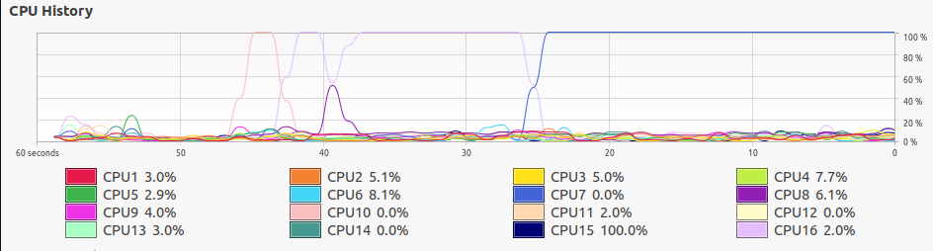
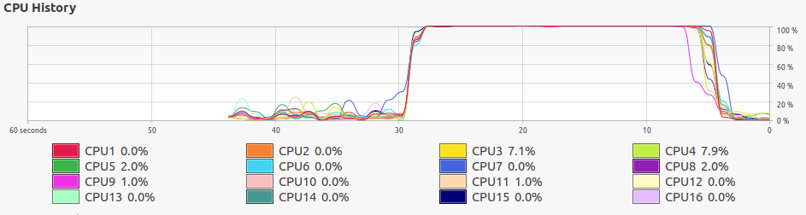

Slide 35
Part-III
Multithreading and Multiprocessing

Slide 36
MULTI THREADING
Thread-based parallelism
Multithreading is a model of program execution that allows for multiple threads to be created within a process, executing independently but concurrently sharing process resources.
Depending on the hardware, threads can run fully parallel if they are distributed to their own CPU core.

Slide 37
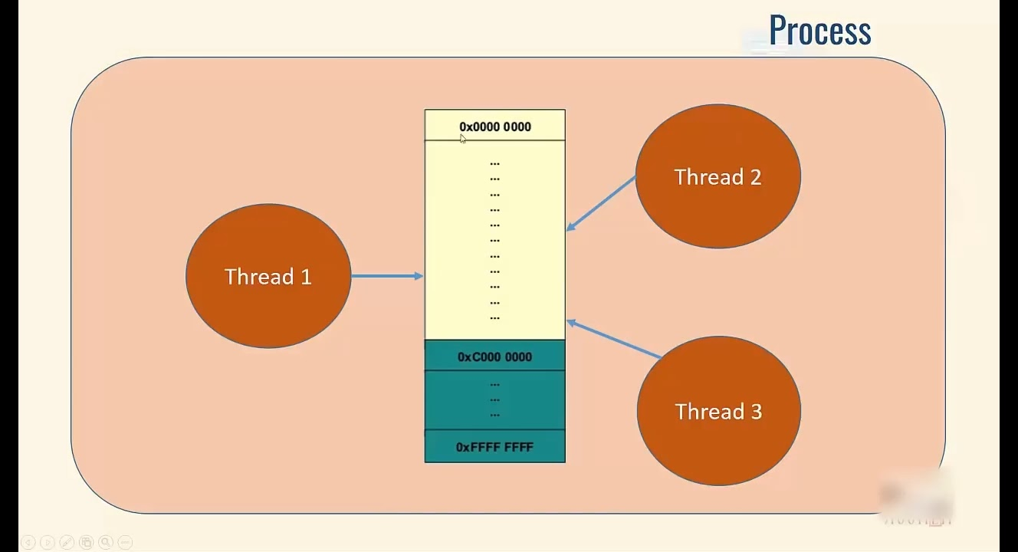

Slide 38
MULTI THREADING IN PYTHON
In python, we have modules and some inbuilt function which perform the task of multi-threading.
Here, is a link to get some idea regarding that module-Threading.
However, we wil give a quick overview of the ‘threading’ module in python.
If you want to go much more deeper applications of threading, then here is the official documentation of python on threading — Thread-based parallelism.

Slide 39
THE ‘threading’ MODULE
In the latest versions of Python, It had been supported by very powerful threading module.
The threading module exposes all the methods of the thread module and provides some additional methods −
threading.active_count() − Returns the number of thread objects that are active.
threading.current_thread() − Returns the number of thread objects in the caller's thread control.
threading.enumerate() − Returns a list of all thread objects that are currently active.
However, this is not the limit, there are many to explore.

Slide 40
Thread Class - a class under ‘threading’ module
Syntax:
class threading.Thread(group=None, target=None, name=None, args=(), kwargs={}, *, daemon=None)¶
This constructor should always be called with keyword arguments. Arguments are:
group should be None; reserved for future extension when a ThreadGroup class is implemented.
target is the callable object to be invoked by the run() method. Defaults to None, meaning nothing is called.
name is the thread name. By default, a unique name is constructed of the form “Thread-N” where N is a small decimal number.
args is the argument tuple for the target invocation. Defaults to ().
kwargs is a dictionary of keyword arguments for the target invocation. Defaults to {}.
If not None, daemon explicitly sets whether the thread is daemonic. If None (the default), the daemonic property is inherited from the current thread.

Slide 41
Some important functions associated with ‘Thread’ class
start() - Starts the thread activity.
run() - Method representing the thread activity.
join(timeout=None) - Wait until the thread terminates. This blocks the calling thread until the thread whose join() method is called terminates – either normally or through an unhandled exception – or until the optional timeout occurs.
name - A string used for identification purposes only. It has no semantics. Multiple threads may be given the same name. The initial name is set by the constructor.
NOTE- Refer .ipnyb file for applications.

Slide 42
A Simple Example of Multi-Threading in Python
import threading:
def cube(num):
return num*num*num
def square(num):
return num*num
If __name__ == “__main__”:
a = threading.Thread(target = square, args = (10, )) # creating thread
b = threading.Thread(target = cube, args = (10, )) # creating thread
a.start() # starting thread 1
b.start() # starting thread 1
a.join() # wait until thread 1 is completely executed
b.join() # wait until thread 2 is completely executed
print(“Done”)

Slide 43
MULTI-PROCESSING
Process-based parallelism
multiprocessing is a package that supports spawning processes using an API similar to the threading module.

Slide 44
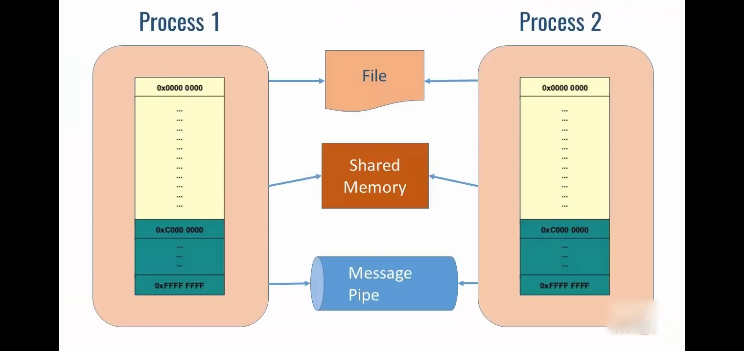

Slide 45
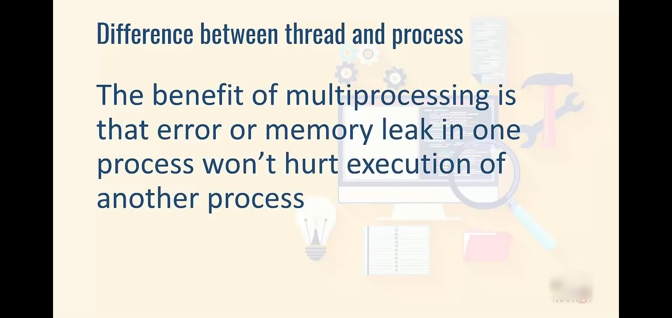

Slide 46
Map and Reduce:
The next two slides are based on use of Map and Reduce functions in Multiprocessing.
However, you will see their practical applications in the link below.
Some basic applications - link (also explore below from highlighted area)
A bit advanced applications - link

Slide 47
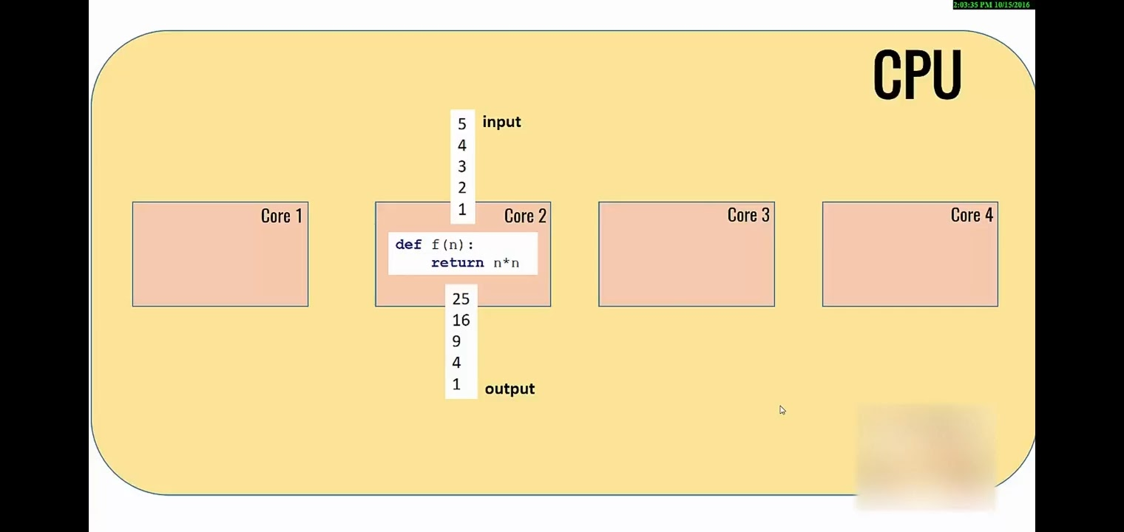

Slide 48
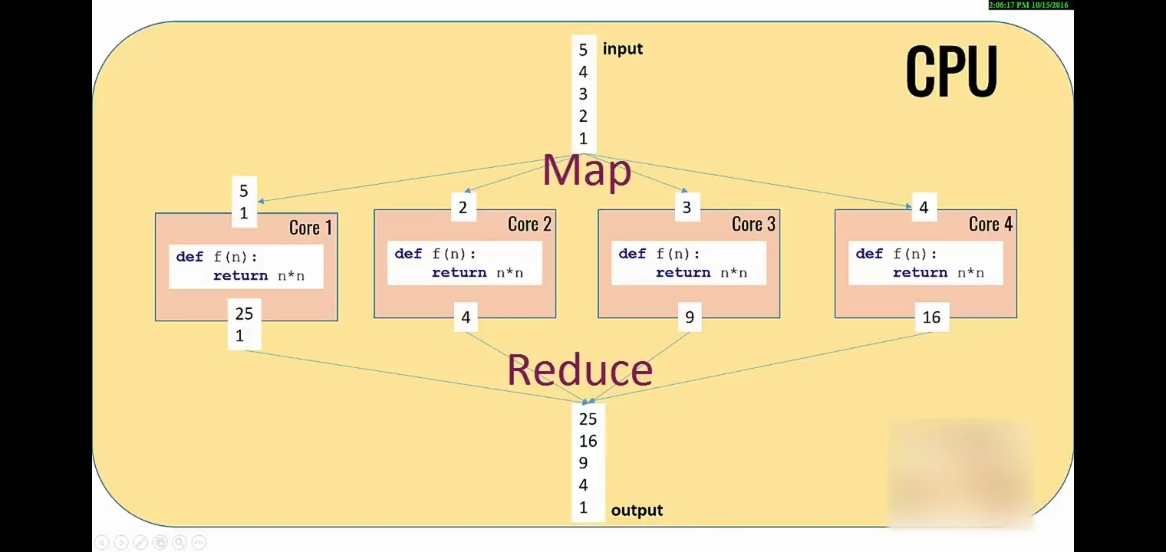

Slide 49
multiprocessing module
This package supports the spawning of parallel process with an API similar to the threading module. Due to this, the multiprocessing module allows the programmer to fully leverage multiple processors on a given machine. It runs on both Unix and Windows.
A good example of this is the Pool class which can be used to perform a single function on a set of input values. Here’s an example:
from multiprocessing import Pool def f(x): return x*x if __name__ = ‘__main__’: with Pool(4) as p: print(p.map(f,[1,2,3,4,5]))
The processing of this will be similar to what is shown in the previous slides
However there a few caveats...

Slide 50
regarding multiprocessing.Pool
An instance of this class have the following methods at their disposal.
map(func,iterable[,chunksize]): This is like a parallel implementation of python’s inbuilt map. This method divides the iterable into (approximately) of length chunksize and submits into the worker processes. Note : this in reality only works with lists and internally converts iterable into a list, and for longer iterable it may consume more memory as all the values are held in memory.
map_async(func,iterable[, chunksize[,callback][,error_callback]]]) : This is a variant of map returns an AsyncResult object from which the result can obtained by calling the get() method on the object. (AsyncResult.get() is blocking)
imap(func,iterable[,chunksize]) : it is a version of map which directly returns an iterable whose values are assigned as the process completes. If you try to access a value that is not yet complete, the program needs to wait till the value is calculated.
imap_unordererd(func,iterable[,chunksize]): same as imap but order of returned iterable is in the order in which the calculation is finished.

Slide 51
startmap() & starmap_async() are analogs of map and map_async in which multiple arguments can be passed to func, the iterable passed should contain iterables (i.e like List of tuples etc )
apply(func[,args[,kwds]]) && apply_async(...), they are similar to their map counterparts with difference being that they call func once with the arguments passed as args and kwds.

Slide 52
An example
The following two slides contain examples of Process class in use, the code shows the same dataset (a numpy array) being processed.
In the first slide the function applied to each case has a for loop to artificially increase computation time, while the second has does not have this for loop

Slide 53
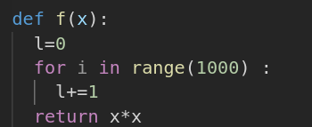
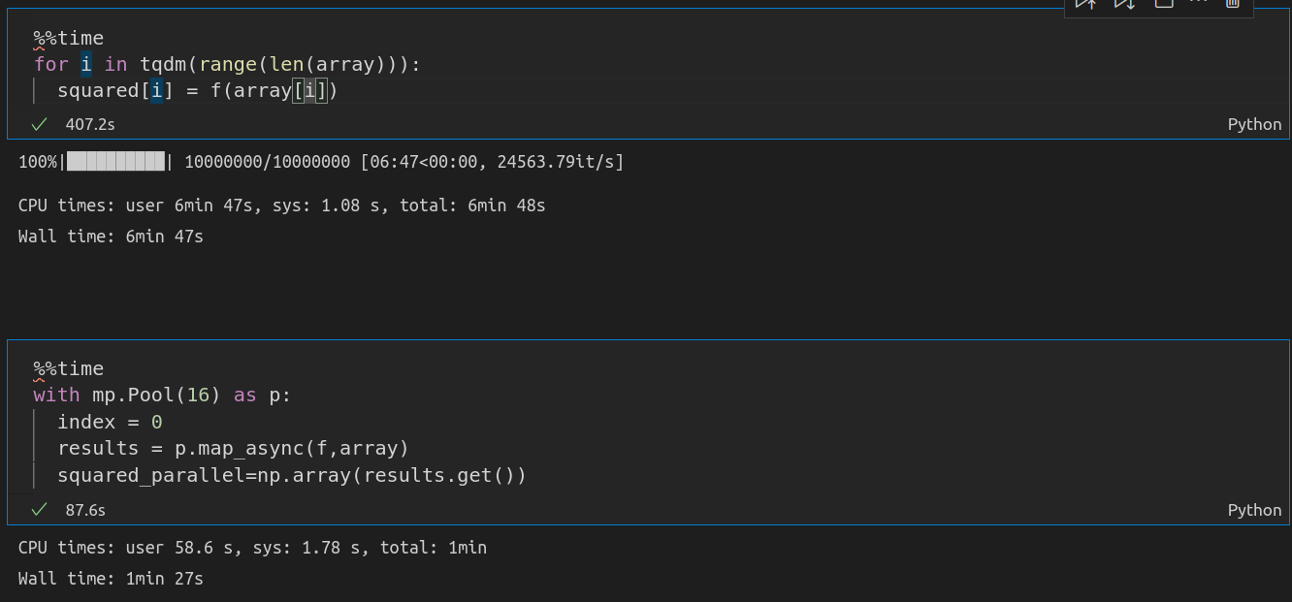

Slide 54
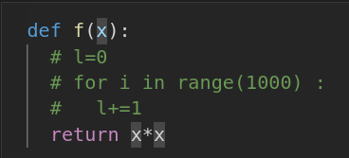
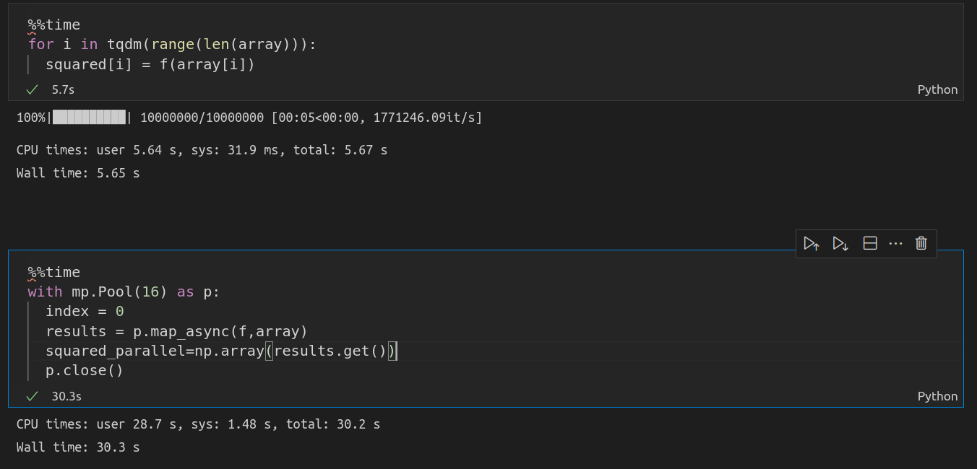

Slide 55
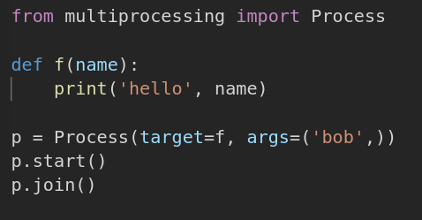
multiprocessing.Process()
Here’s an example code that is using Process()
We can see that for this class we create an object by attaching a function to target parameter and passing the arguments for the target function in the args parameter (as a tuple). The process is started by calling the start method, the join([timeout]) method makes the program wait till the the child process is complete.

Slide 56
Sharing Memory between processes
Although it is best to avoid shared state as far as possible in multiprocessing, there still a few ways to do it and they are using multiprocessing.Array() and multiprocessing.Value()
multiprocessing.Value() is for a single variable while multiprocessing.Array() is for an array of values
The shared variables can be created like a = Value(‘d’,2.1) b = Array(‘i’,range(10))
The first argument is something called a typecode which indicates the type of the variable. A list of type codes can be found here : typecodes
Arbitrary ctype objects can be created with the help of the multiprocessing.sharedctypes

Slide 57
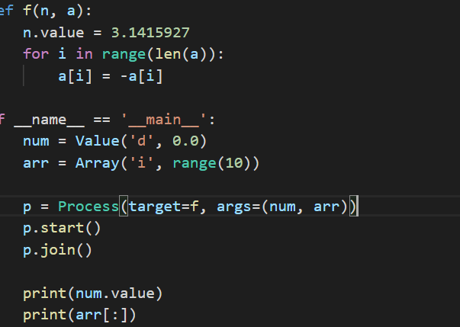

An Example

Slide 58
Communicating between processes
The multiprocessing module supports two types of communication channel between processes, Queue and Pipe
multiprocessing.Queue() works similar to a normal Queue() with the methods put() and get() to add and retrieve data respectively. The methods also have additional positional arguments block and timeout, which determines whether the method is blocking or not.
Pipe() returns a pair of Connection objects (conn1,conn2) that represent the ends of a pipe. Both the objects have a send() and recv() method that can be used to send and receive objects. recv() will block until there is something to receive

Slide 59
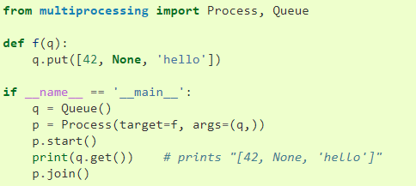
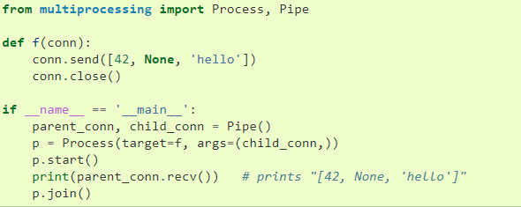

Slide 60
Multi-Processing in Tensorflow - 2
Model.fit( x=None, y=None, batch_size=None, epochs=1, verbose="auto", callbacks=None, validation_split=0.0,
validation_data=None, shuffle=True, class_weight=None,
sample_weight=None, initial_epoch=0, steps_per_epoch=None,
validation_steps=None, validation_batch_size=None,
validation_freq=1,
max_queue_size=10,
workers=1,
use_multiprocessing=False,) # If True, use process-based threading.

Slide 61
Some useful links if you want to explore more.
1 . Multiprocessing and Multithreading in Python
2 . Tensorflow with multiple GPUs
3. (Additional) Scaling Tensorflow 2 to Multiple GPUs
4. For pandarallel

