Slide 1

[Samsung PRISM] Preliminary Discussion
Develop a Quality Assurance framework for Image Generation Models
Team
College Professor(s): Dr. Antony Louis Piriyakumar, Prof Geetha R
Students:
Ayush Kumar Singh / ayushkumar.20aiml@cambridge.edu.in
Akash V / akash.20aiml@cambridge.edu.in
Girish Chandra Saxena / chandrasaxena.20aiml@cambridge.edu.in
P Aaditya / padditiya.20aiml@cambridge.edu.in
Department: AI&ML
Date: 8 Jan 2024

Slide 2


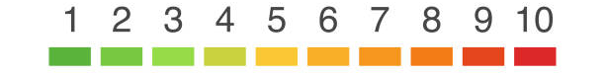

Develop a Quality Assurance framework for Image Generation Models
Problem Statement
Expectations
Context
Undertaken Tasks
Develop a comprehensive framework for conducting equitable and standardized comparisons of image generation models, ensuring 'apple-to-apple' assessments. This framework should establish consistent evaluation metrics, benchmark datasets, and evaluation protocols to facilitate a fair and meaningful comparison of various image generation techniques. The goal is to advance the field of computer vision by providing a reliable means of model assessment and selection.
Exhaustive Literature Survey of Image Generation Metrics [CLIP, FID, SFS, CHAIR & etc]
Develop a fixed framework for Quality Assurance & Identify SOTA Benchmark Levels
Statement
Currently Image Generation Models’ QA is mainly subjective in Nature, Building a Framework consisting of SOTA metrics will enable easier comparison of Image Generation Models
KPI
Framework should consider all possibilities & parameters of the Image Generation Space
Worklet Details
Pranal Prasad Dongare
+91-7022250561
pranal.p@samsung.com
2
6
Timeline
Tushar Madaan
+91-9205301569
tushar.m2@samsung.com
Kick Off < 1st Month >
Milestone 1 < 2nd Month >
Duration (Months)
Members Count
Mentors
Problem Briefing
Check Feasibility
R&D on Image Generation Metrics
Identify a framework which accurately evaluates Image Generation Models
Pre-Requisite
Familiar with Coding predominantly Python
Familiar with Diffusion Models & Evaluation Metrics
Complexity
Notes:
https://nv-tlabs.github.io/DIB-R/

Slide 3
Work-let Name: Develop a Quality Assurance framework for Image Generation Models
Worklet Details
Worklet ID: 23RSG25
College Name: Cambridge Institute of Technology, Bangalore
KPIs achieved till now
Any Challenges/ Issues faced
Research papers for literature survey have been studied.
Implemented Metrics – CLIP and FID.
Newer Metrics for research-LPIPS, SSIM, MSSIM, PSNR,CHAIR, POPE, Q-ALIGN,EXPLORING CLIP FOR ASSESSING.
Lack of reference on implementation
Next Steps
Key Achievements/ Outcome till now
More research paper for literature survey to be studied.
Implementing the new found metrics
Found out new metrics form research
Date:28 Nov 2023

Slide 4
Literature survey and study
EVALUATING OBJECT HALLUCINATION IN LARGE VISION-LANGUAGE MODELS
Investigates object hallucination in Large Vision-Language Models (LVLMs) and its relationship with visual instruction datasets.
Proposes POPE (Polling-based Object Probing Evaluation.), a new evaluation method addressing limitations of existing evaluation approaches for LVLMs.
Demonstrates the impact of visual instruction datasets on hallucination severity and introduces POPE as a superior evaluation method.
Acknowledges limitations in computational resources and model comparison while highlighting the potential for future LVLM development.

Slide 5
CHAIR(Caption Hallucination Assessment with Image Relevance)
1. CHAIR Metric: It's an evaluation method designed to assess object hallucination in LVLMs by examining whether mentioned objects are hallucinated in the generated captions. It's based on exact matching, focusing on parsing generated captions to extract predicted objects and assess their consistency with the image.
2. Limitations of CHAIR: This evaluation method is sensitive to prompts, relies on human-crafted rules, and can be influenced by the style and length of the generated captions, leading to less reliable evaluation results.

Slide 6
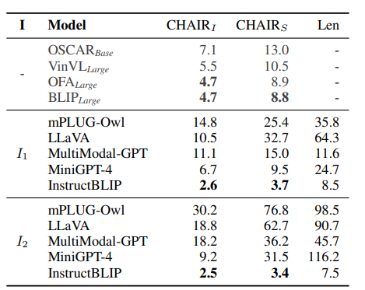
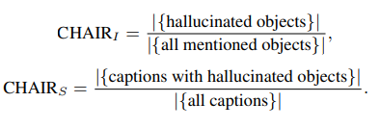
Literature survey and study

Slide 7
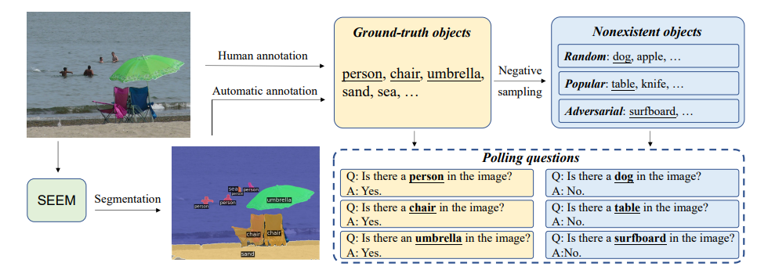
Literature survey and study
POPE(Polling-based Object Probing Evaluation)

Slide 8
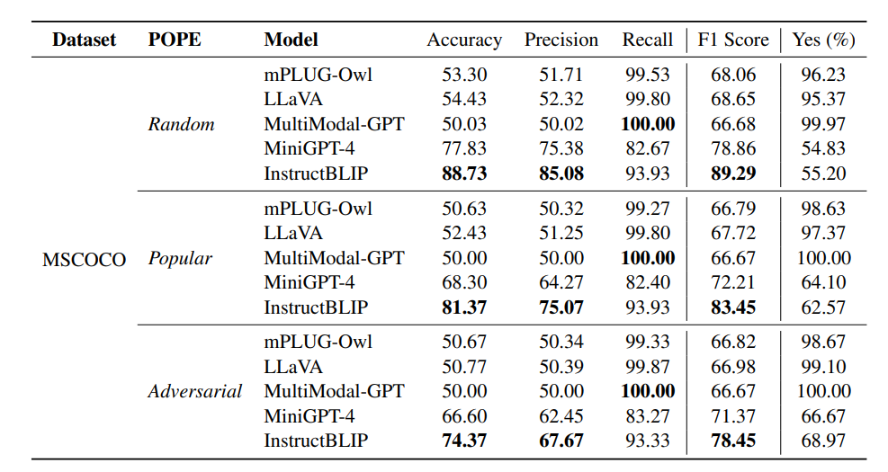
Literature survey and study

Slide 9
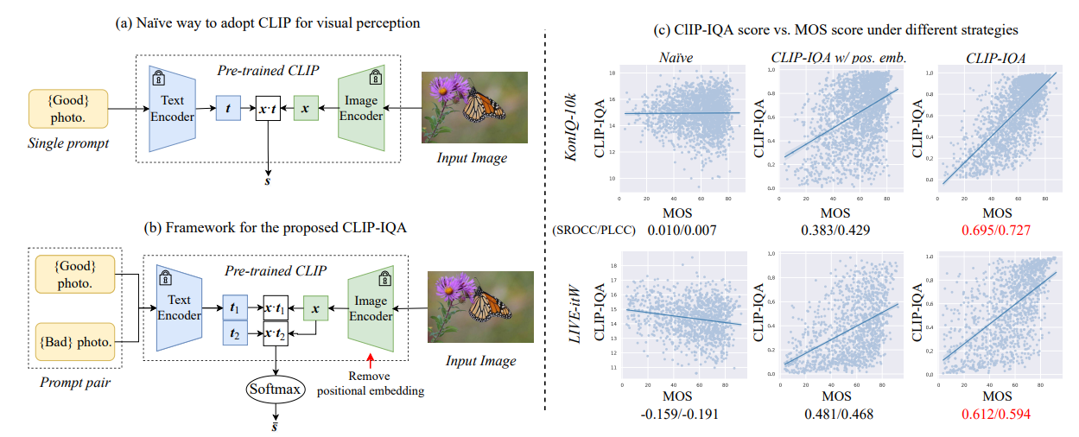
Literature survey and study
EXPLORING CLIP FOR ASSESSING THE LOOK AND FEEL OF IMAGES
The look and feel are two contributing factors when humans interpret an image, and the understanding of these two elements has been a long-standing problem in computer vision. The look of an image is often related to quantifiable attributes that directly affect the content delivery, such as exposure and noise level.

Slide 10
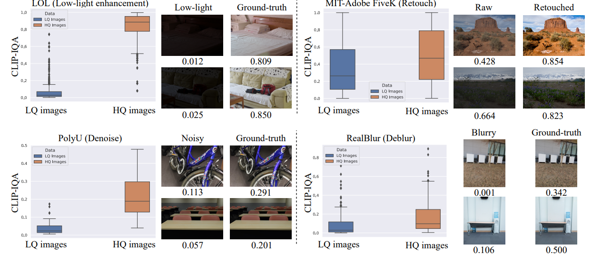
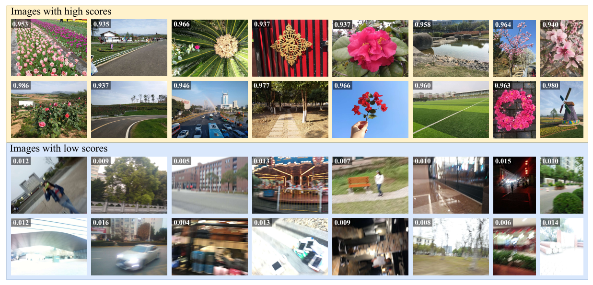

Slide 11
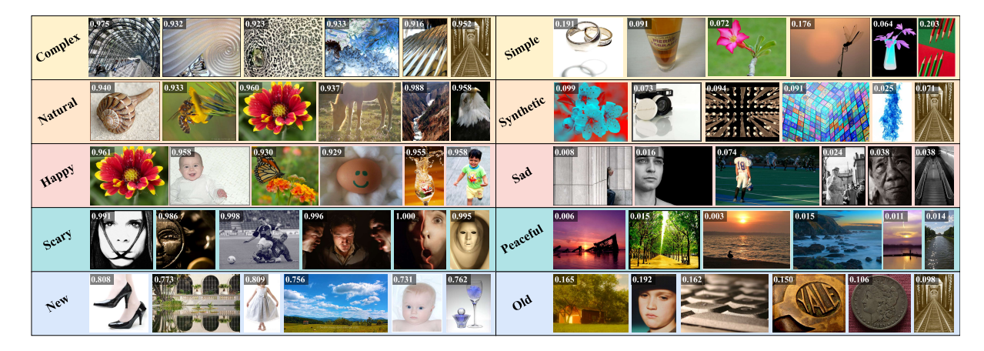
ABSTRACT PERCEPTION
Emotions and aesthetics are readily comprehensible by humans, the understanding of such concepts remains non-trivial for machines. This section investigates the competence of CLIP-IQA in interpreting abstract perception.

Slide 12
Learning Generalizable Perceptual Representations for Data-Efficient No-Reference Image Quality Assessment
Key Methods:
Quality-Aware Contrastive Loss:
Encourages the model to learn low-level features that are agnostic to specific distortion types.
Promotes generalizability to unseen distortions.
Vision-Language Model Fine-tuning:
Leverages the ability of vision-language models to extract high-level information from text prompts.
Fine-tunes a pre-trained vision-language model with prompts related to image quality.
Extracts relevant quality features.

Slide 13
Learning Generalizable Perceptual Representations for Data-Efficient No-Reference Image Quality Assessment
Combined Feature Representation and Regression:
Features extracted from both pathways (contrastive learning and vision-language model) are combined.
A simple regressor is trained on the combined features to predict image quality scores.
Key Advantages:
Data efficiency: Achieves good results with limited training data.
Zero-shot capability: Predicts quality for unseen distortions without retraining.
Superior accuracy: Outperforms state-of-the-art models on diverse datasets and distortions.

Slide 14
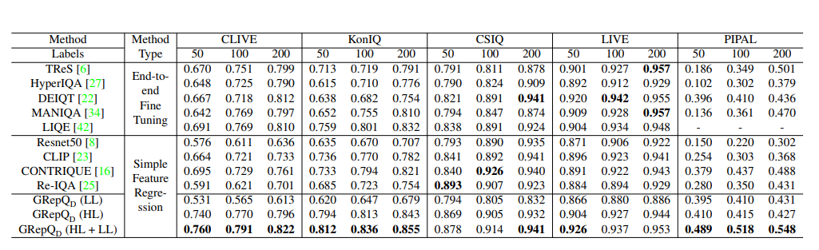

Slide 15
Q-ALIGN: Teaching LMMs for Visual Scoring via Discrete Text-Defined Levels
Problem: IQA models trained on continuous scores are data-hungry, struggle with unseen distortions, and lack human-like understanding.
Solution: Q-ALIGN introduces a human-inspired training process using discrete text-defined levels ("bad," "mediocre," "good," "excellent").
Key features:
Syllabus-based learning: LMMs classify images into pre-defined levels, mimicking human evaluation.
Custom loss function: Optimizes the LMM's ability to distinguish between different levels.
Unified Model: OneAlign handles both IQA and IAA with a single syllabus, improving efficiency and versatility.

Slide 16
Q-ALIGN: Teaching LMMs for Visual Scoring via Discrete Text-Defined Levels
Benefits:
Improved accuracy and generalizability: More accurate than traditional methods, especially for unseen data.
Data efficiency: Requires less training data.
Unified task handling: One model tackles multiple tasks.
Results: Q-ALIGN outperforms state-of-the-art models on IQA benchmarks and achieves comparable performance to task-specific models with the OneAlign approach.

Slide 17
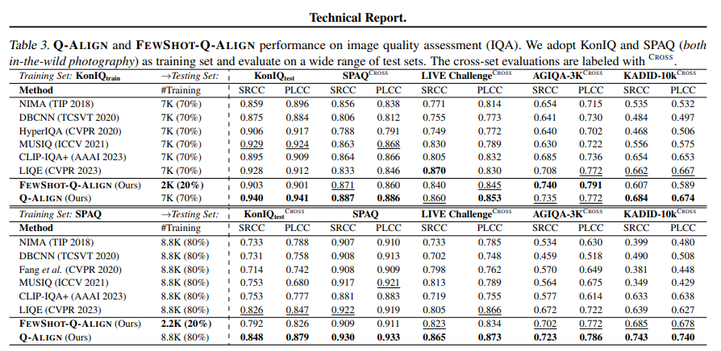

Slide 18
Thank you

