Slide 1
CRAVIFY
(FOOD DELIVERY PLATFORM)
(202512098) Parin Makwana
(202512030) Ayush Soni
(202512009) Nevil Nandasana
(202512042) Hitarth Shah

Slide 2
THE PROBLEM
Too many apps, too little loyalty." Customers jump between Swiggy, Zomato & others with no unified experience or incentive to stay
It's 9 PM.
You're exhausted.
And you're hungry.
You open your phone hoping to find your favorite biryani or a late-night burger — but instead, you're stuck juggling three different apps, wondering which restaurant is actually open, whether your order even reached the kitchen, and why the delivery partner's location hasn't moved in 20 minutes.
Sound familiar?
"My menu changed again." Restaurants struggle to update items, prices & availability across platforms instantly
What did I even earn today?" Delivery partners have no clear breakdown of trips, distances, or daily income

Slide 3
OUR SOLUTION
INTRODUCING YOU CRAVIFY
ONE PLATFORM. FOUR POWERFUL MODULES. ZERO FRICTION.
🛒
🍽️
🛵
⚙️
CUSTOMER
RESTAURANT
DELIVERY
ADMIN
Browse, order, track & review — all in one seamless journey
Manage menus, accept orders & grow with real-time analytics
Navigate routes, track earnings & manage availability on the go
Oversee users, approvals, campaigns & platform health

Slide 4
USER STORIES
ID
As a user, I want to...
So that...
US001
Register using mobile number or email
I can securely access the platform
US002
Log in with OTP or password
I can quickly access my account
US003
Search & filter restaurants by cuisine, rating or delivery time
I can find food that matches my preferences
US004
View restaurant menus with item details and prices
I can make informed ordering decisions
US005
Add items to cart from a single restaurant
I can prepare my order before checkout
US007
Choose from multiple payment methods
I can pay using my preferred option
US008
Track my order in real-time
I know exactly when my food will arrive
US010
View my order history
I can reorder my favourite meals easily
US011
Rate and review restaurants and delivery partners
I can share my experience and help others
US012
Save multiple delivery addresses
I can order to different locations conveniently

Slide 5
CONT…
ID
As a user, I want to...
So that...
US013
Register my restaurant with complete details
Customers can discover my business
US014
Manage my menu by adding, editing or removing items
My offerings stay current
US015
Mark items as unavailable temporarily
Customers only see what I can prepare
US016
Accept or reject incoming orders
I can manage my kitchen workload
US017
Update order preparation status
Customers & delivery partners know when food is ready
US018
View customer ratings and reviews
I can improve my service quality
US019
Access order history and analytics
I can track my business performance

Slide 6
CONT…
ID
As a user, I want to...
So that...
US020
Register with my vehicle and license details
I can work as a delivery partner
US021
Receive order assignment notifications
I can accept delivery requests
US022
View pickup location and delivery address
I can plan my route efficiently
US023
Update delivery status at each stage
Customers can track their order accurately
US024
View my delivery history and earnings
I can track my income
US028★
Toggle my availability between online and offline
I only receive requests when I am ready to deliver

Slide 7
CONT…
US025
Approve restaurant registrations after verification
Only legitimate businesses join the platform
US026
Approve delivery partner applications
Only verified partners deliver orders
US027
Monitor all orders across the platform
I can identify and resolve issues quickly
US029★
Manually cancel any order on the platform
I can resolve disputes and handle exceptions
US030★
Create and manage promotional campaigns
I can drive user engagement and offers

Slide 8
LET’S BEGIN WITH THE CUSTOMER MODULE…
Implements secure user registration and login with authentication protocols
Manages user profile details including saved addresses for faster checkout
Displays and filters restaurant listings based on location and search queries
Provides an intuitive interface to browse restaurant menus and item details with promo codes.
Enables users to add, update, and remove items from a dynamic shopping cart
Handles the complete checkout flow from address confirmation to order placement
Shows real-time order tracking so customers know exactly where their order is
Maintains a full history of past orders for easy reordering and reference
Allows customers to rate restaurants and write reviews after delivery

Slide 9
NOW RESTAURANT MODULE…
Allows restaurants to register on the platform and set up their public profile
Provides a dedicated dashboard giving vendors a complete overview of operations
Enables full menu management — adding, editing, and deleting items with ease
Let’s vendors mark items as available or unavailable and set preparation times
Notifies restaurants instantly when a new order arrives on the platform
Gives vendors the ability to accept or reject incoming orders with a reason
Allows step-by-step order status updates from preparation to ready for pickup
Displays historical order data and analytics to track performance over time
Shows customer feedback and ratings to help vendors improve their service

Slide 10
NOW DELIVERY PARTNER MODULE…
Handles delivery partner onboarding with document upload and verification flow
Provides a dedicated mobile application built specifically for delivery partners
Notifies available partners instantly when a new delivery is assigned nearby
Lets partners accept or reject delivery requests based on their preference
Integrates GPS navigation with route optimization for faster deliveries
Supports multi-stage status updates — Picked Up, On the Way, and Delivered
Maintains a complete log of all past deliveries for partner reference
Calculates and displays daily and weekly earnings with a trip-wise breakdown
Allows partners to toggle their availability between online and offline modes

Slide 11
NOW ADMIN MODULE…
Provides secure admin login with role-based access control to protect the panel
Enables admins to view all registered users and block or unblock accounts
Reviews and approves or rejects restaurant registration requests on the platform
Verifies delivery partner credentials and approves them before they go live
Displays a live dashboard showing all active, pending, and completed orders
Allows admins to manually cancel any order across the platform when needed
Generates detailed analytics reports on orders, revenue, and platform activity
Creates and manages promotional campaigns and discount offers for users
Provides controls to configure platform-wide settings and operational parameters

Slide 12
WORK DISTRIBUTION
NAME | WORK DISTRIBUTED
(202512098) Parin Makwana | RESTAURANT MODULE
(202512030) Ayush Soni | CUSTOMER MODULE
(202512009) Nevil Nandasana | DELIVERY PARTNER MODULE
(202512042) Hitarth Shah | ADMIN

Slide 13
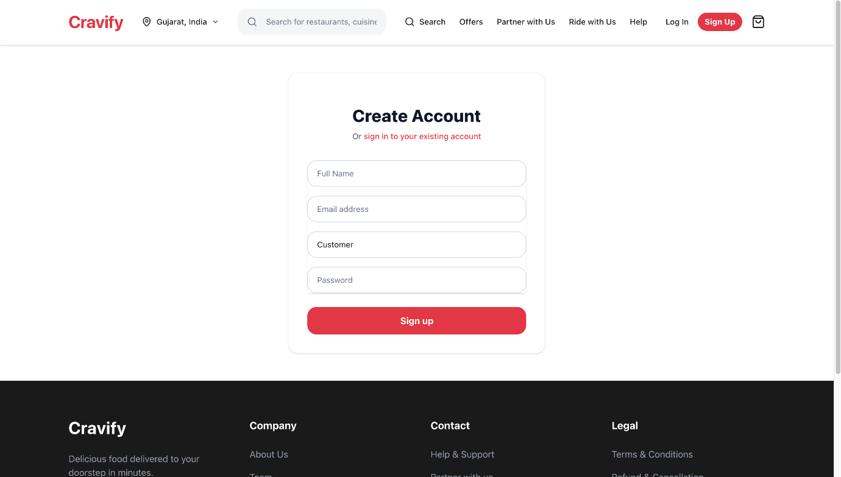
UI/UX FOR CUSTOMER MODULE

Slide 14
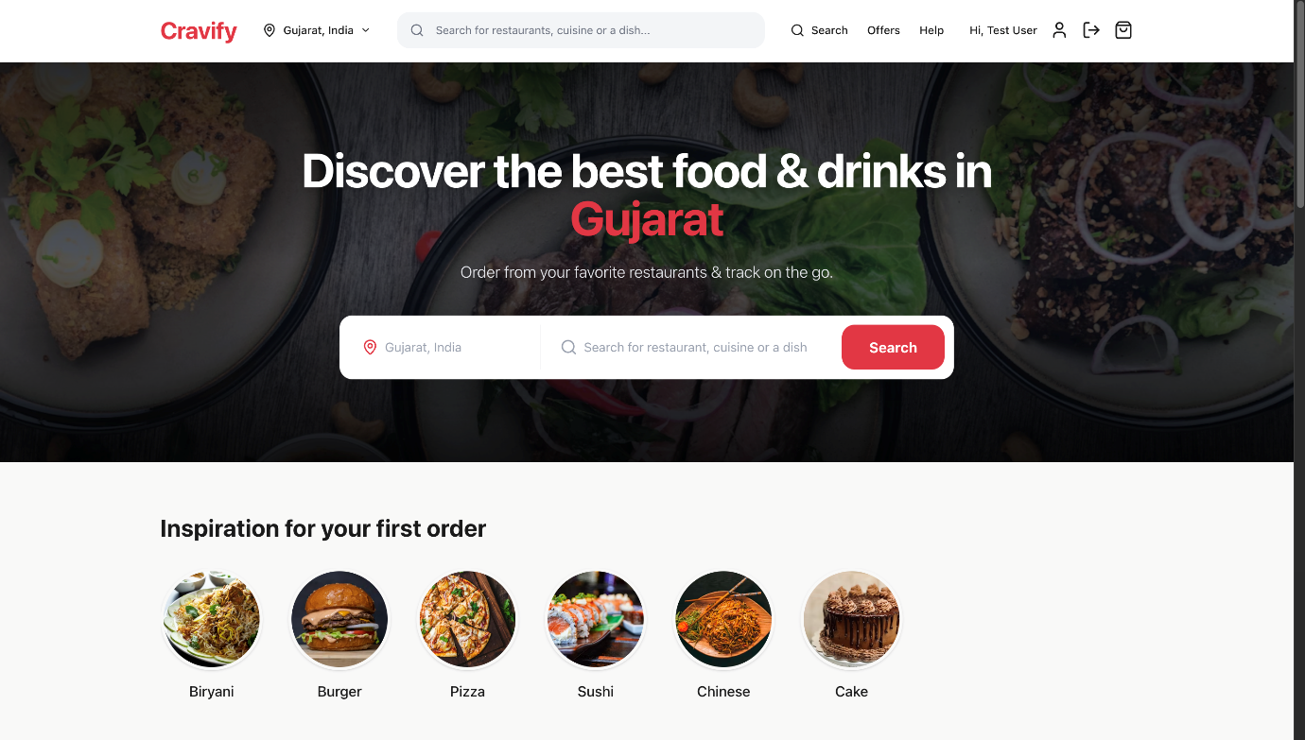

Slide 15
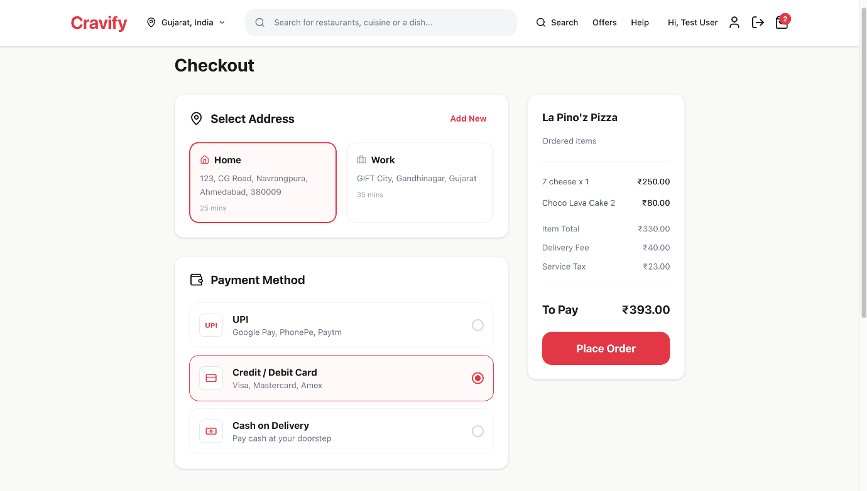

Slide 16
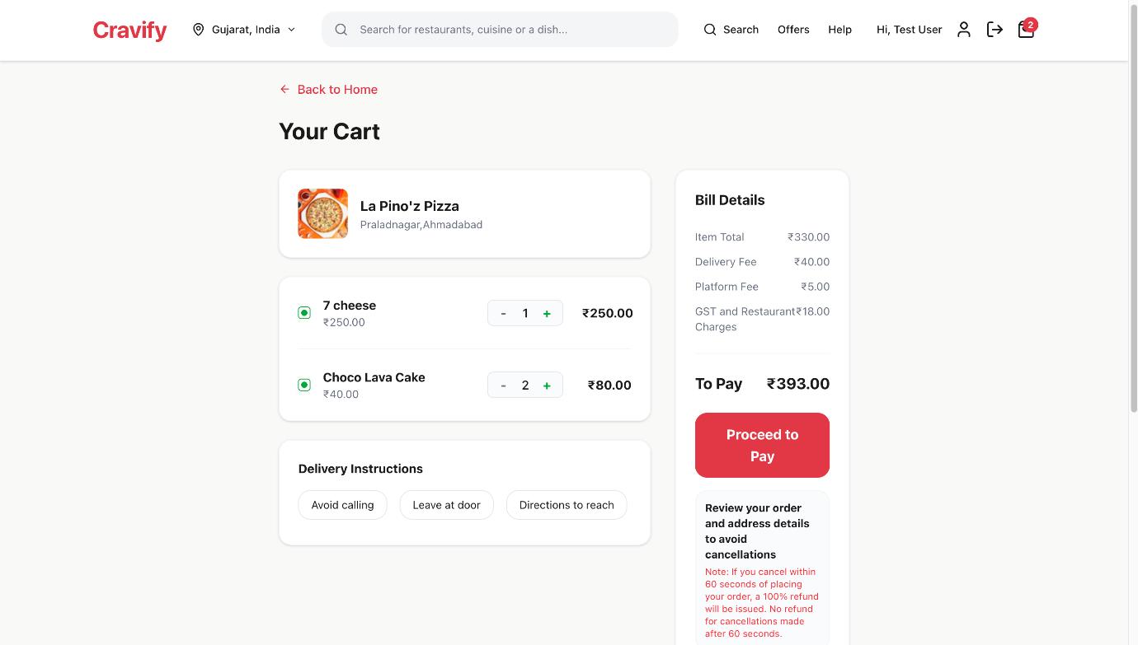

Slide 17
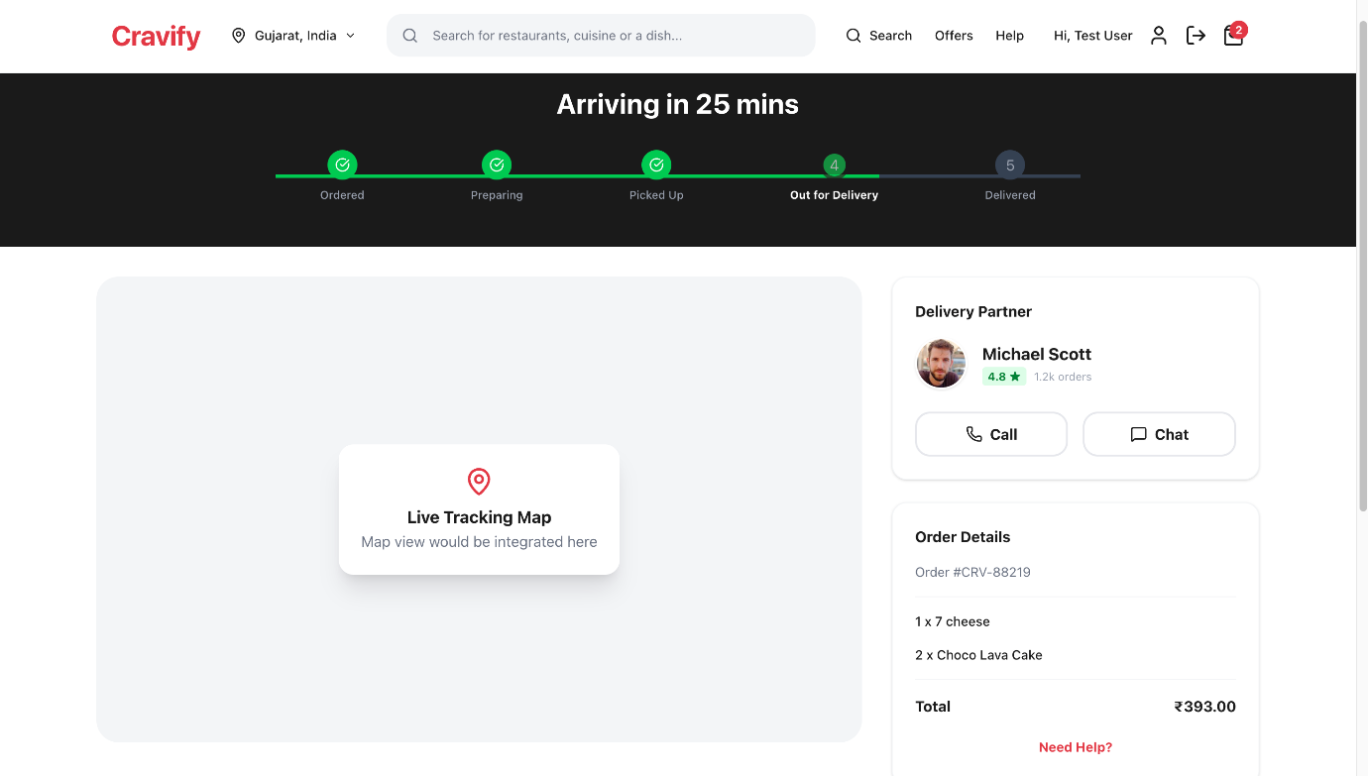

Slide 18
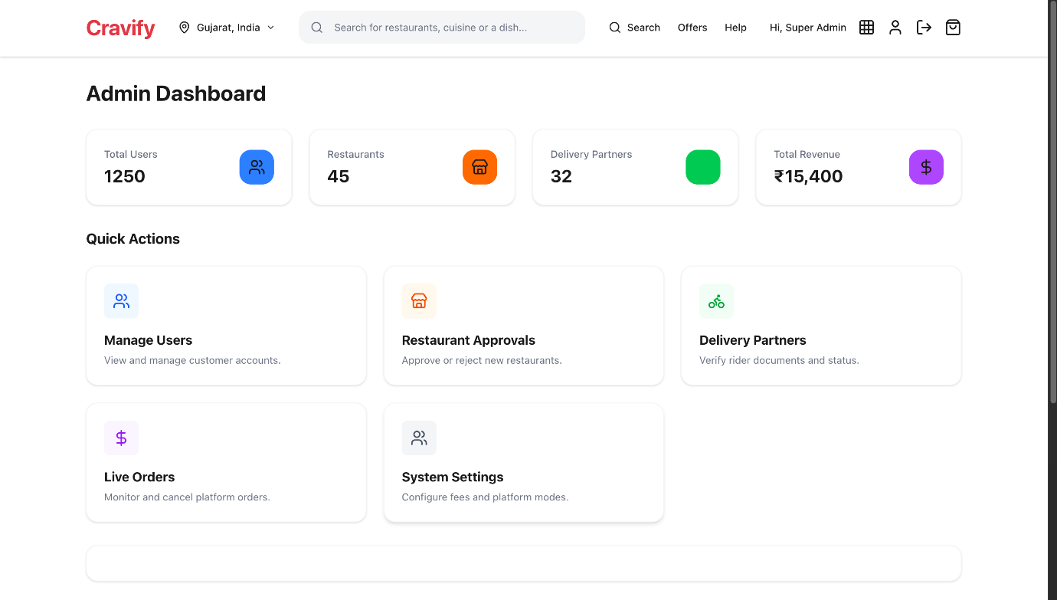
UI/UX FOR ADMIN MODULE

Slide 19
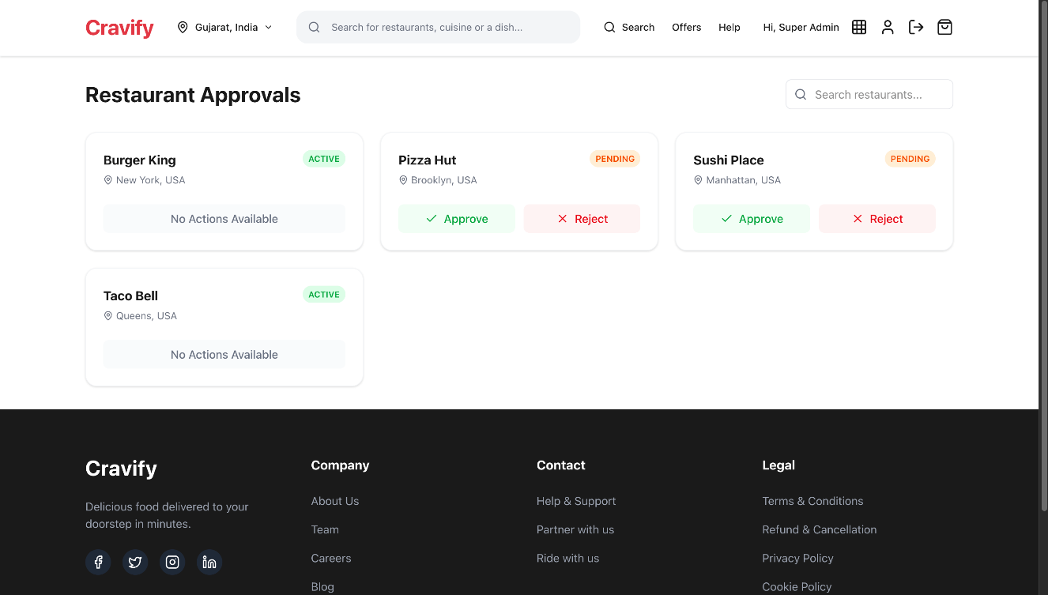

Slide 20
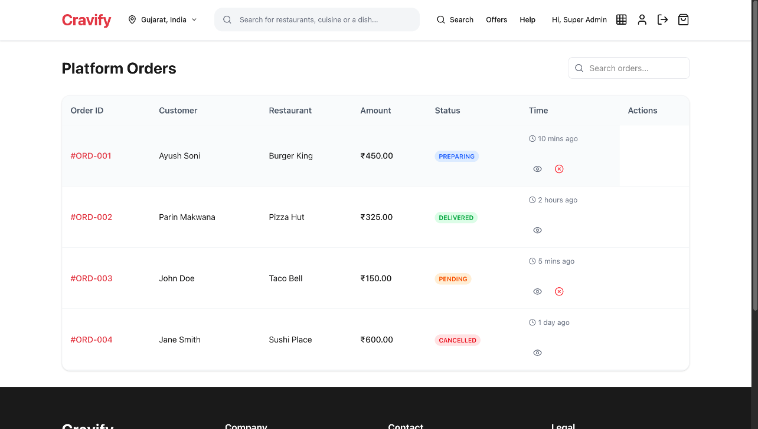

Slide 21
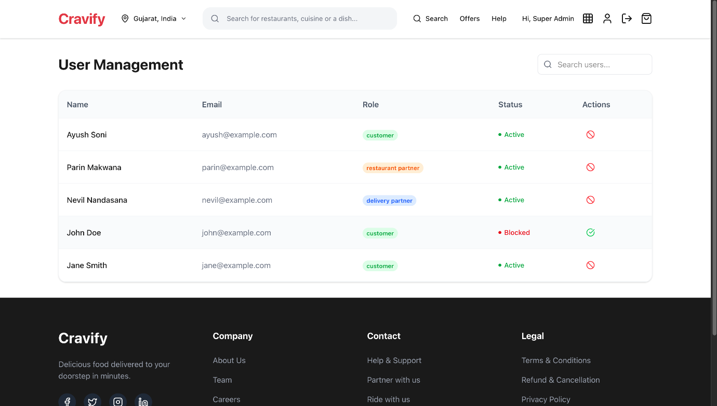

Slide 22
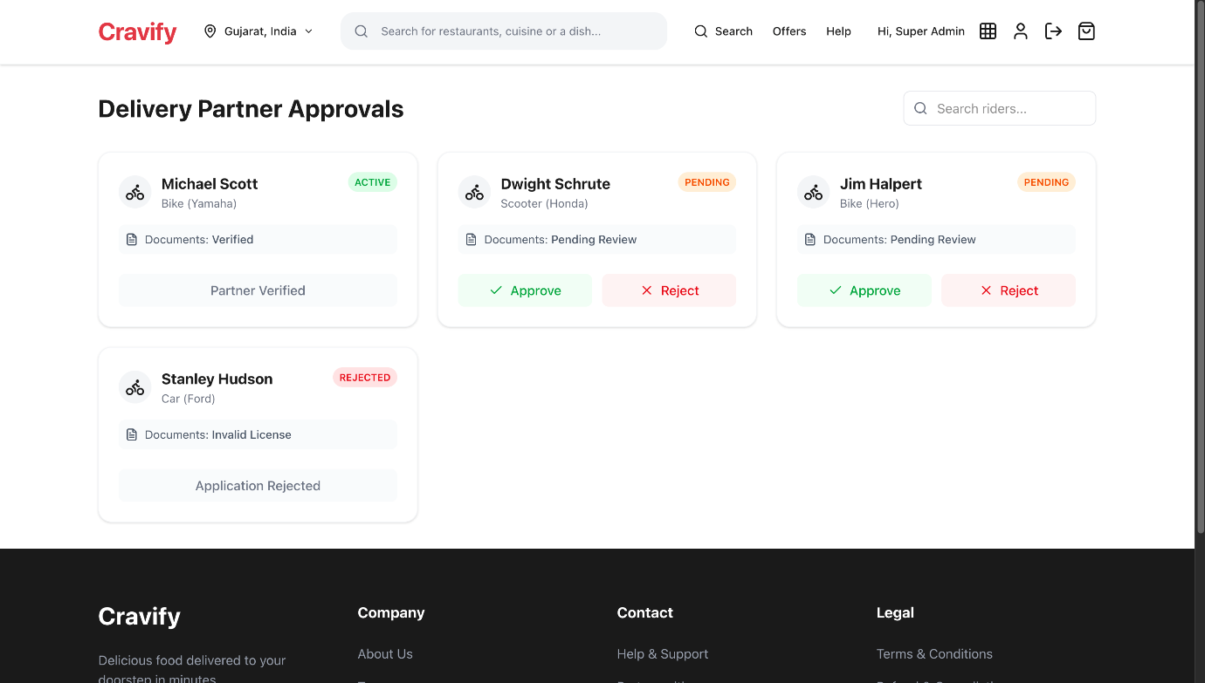

Slide 23
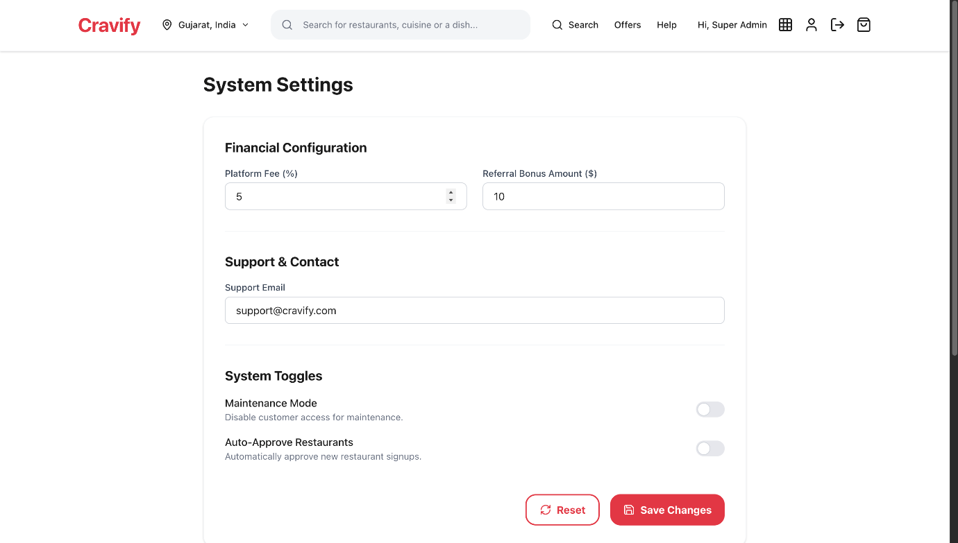

Slide 24
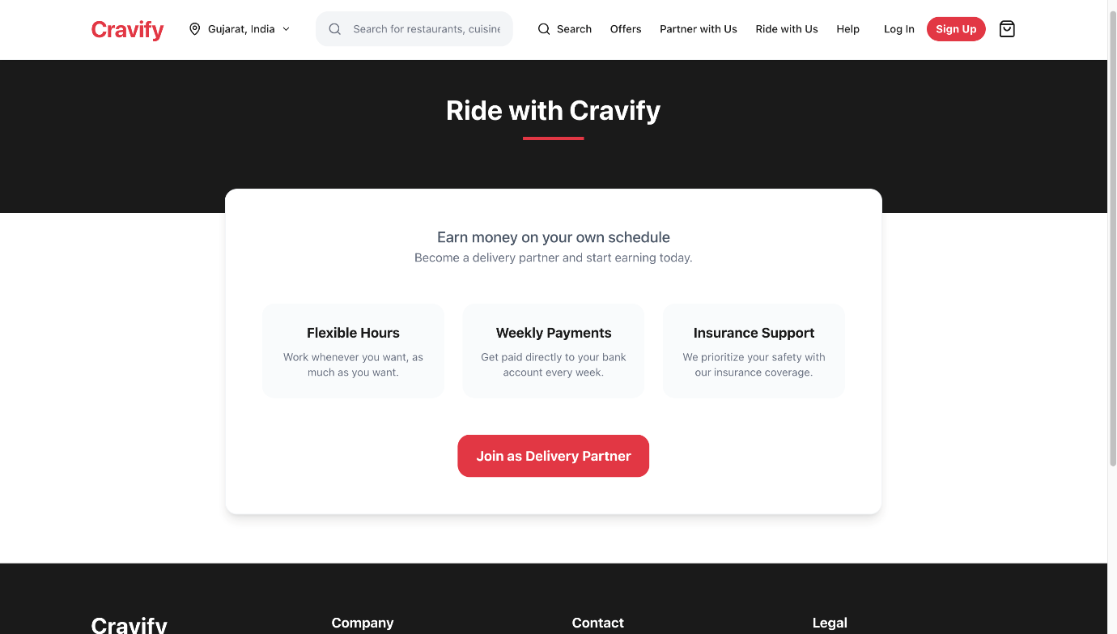
UI/UX FOR DELIVERY PARTNER

Slide 25
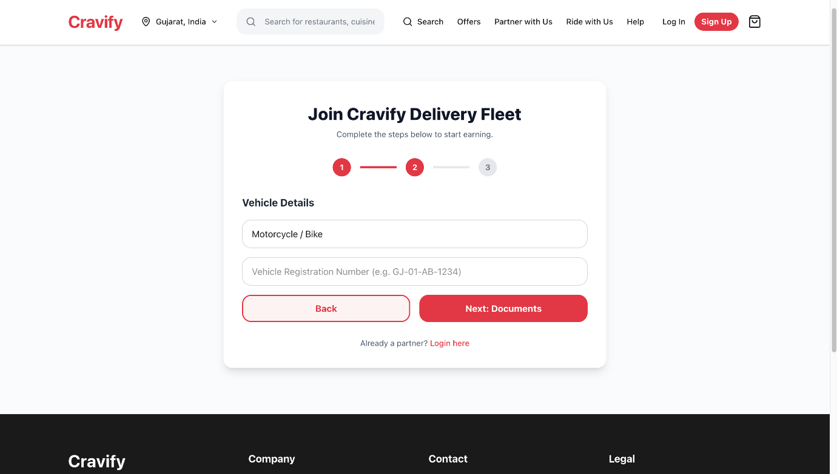

Slide 26
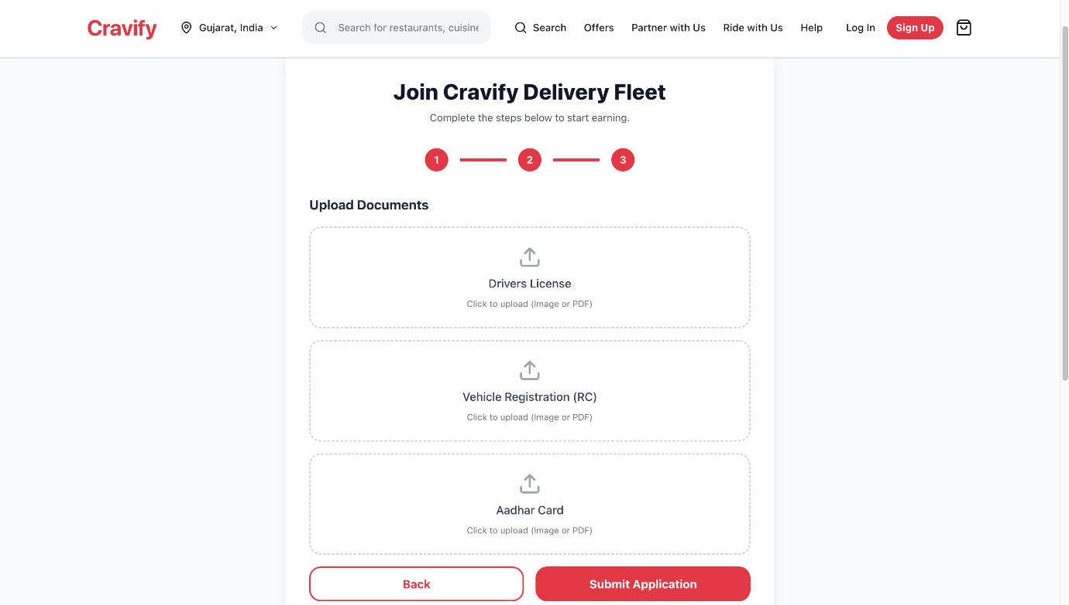

Slide 27
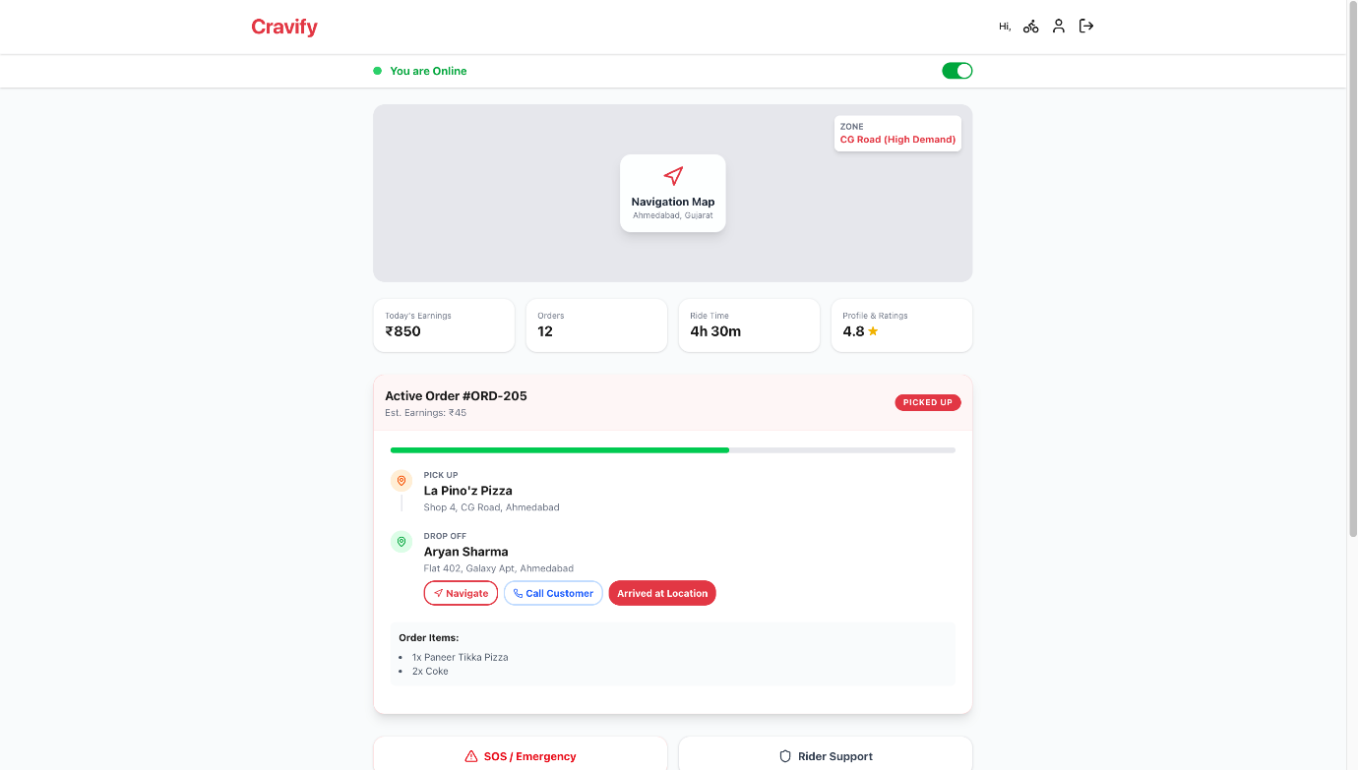

Slide 28
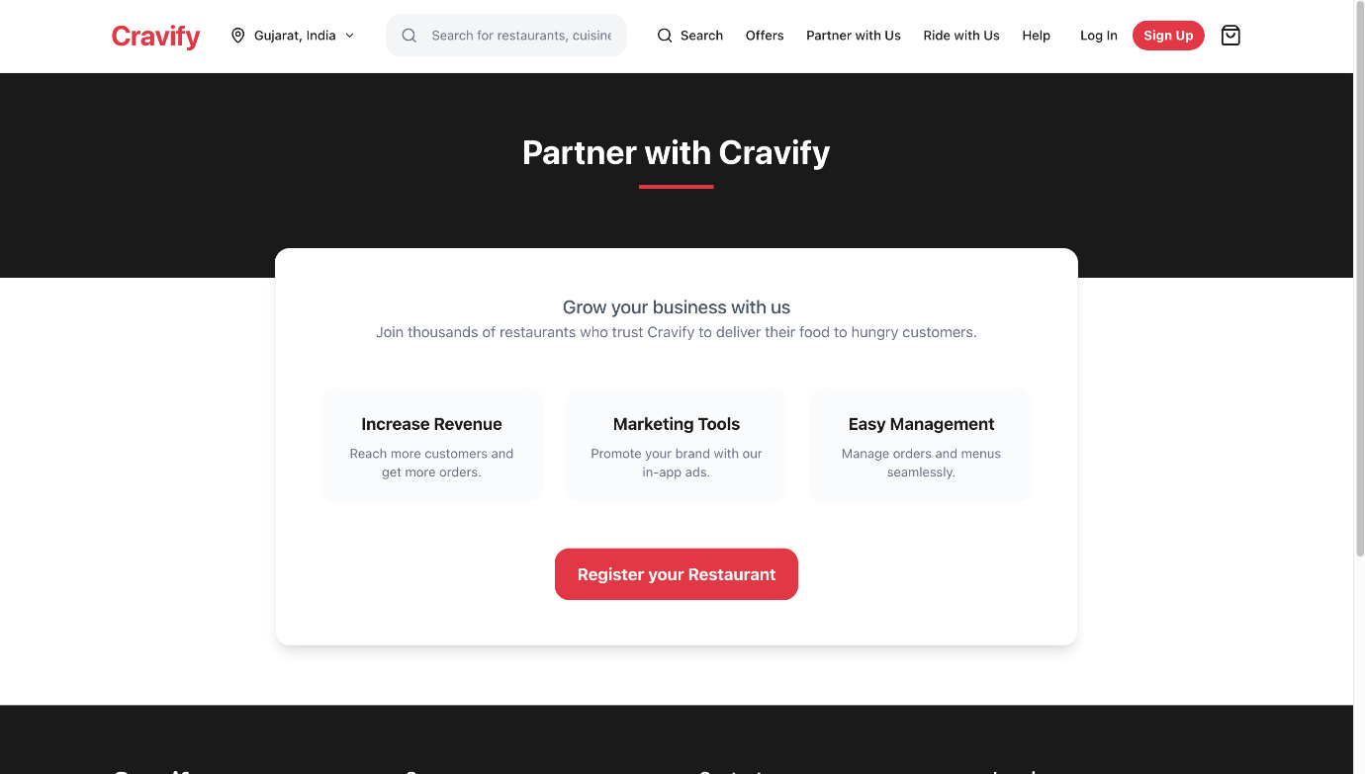
UI/UX FOR RESTAURANTS

Slide 29
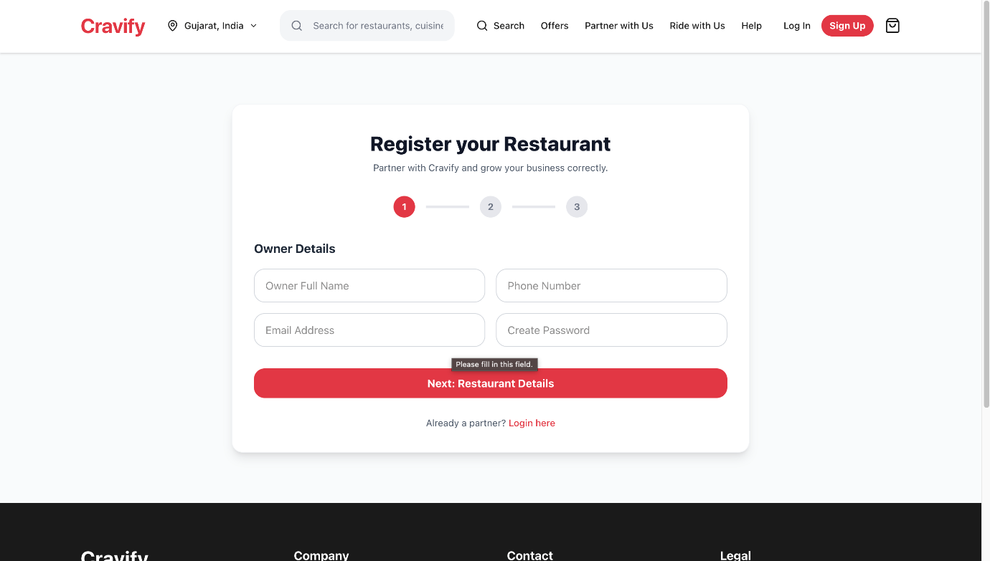

Slide 30
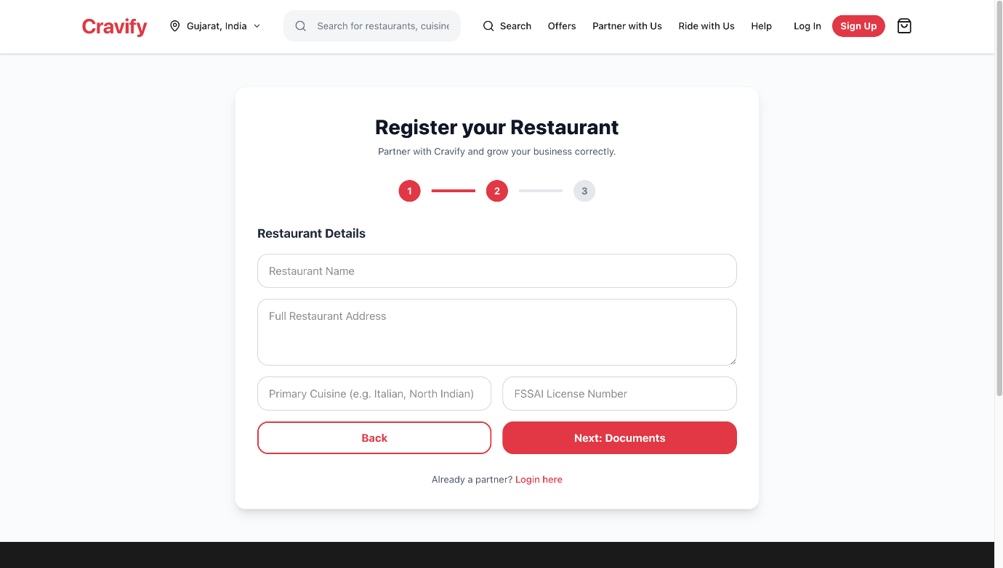

Slide 31
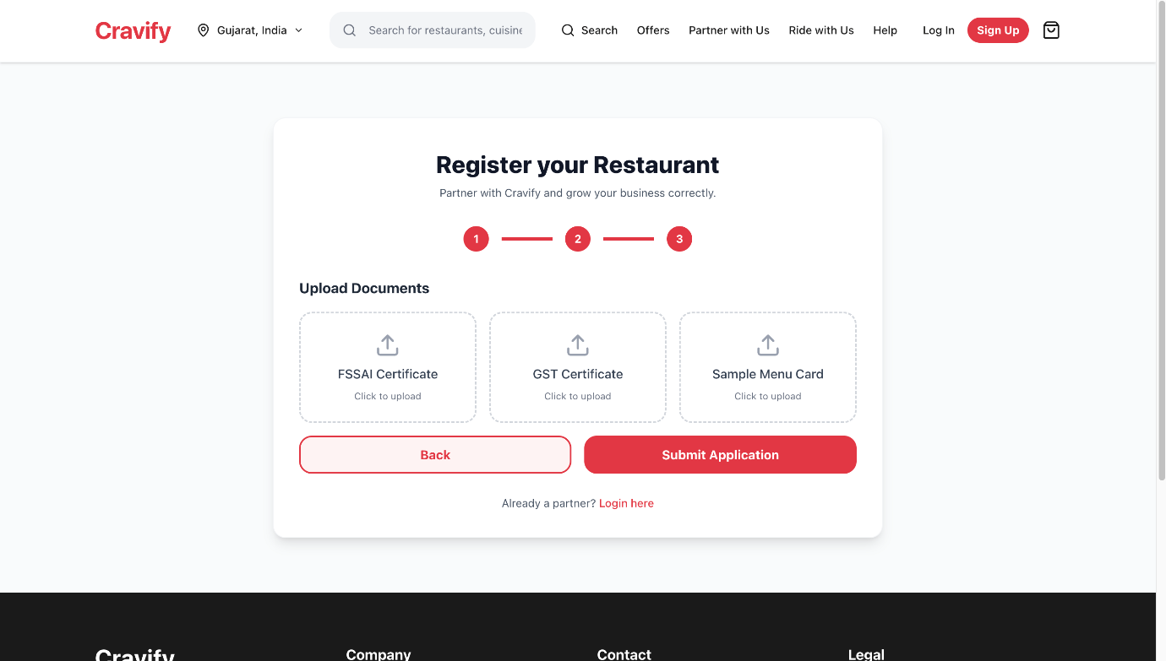

Slide 32
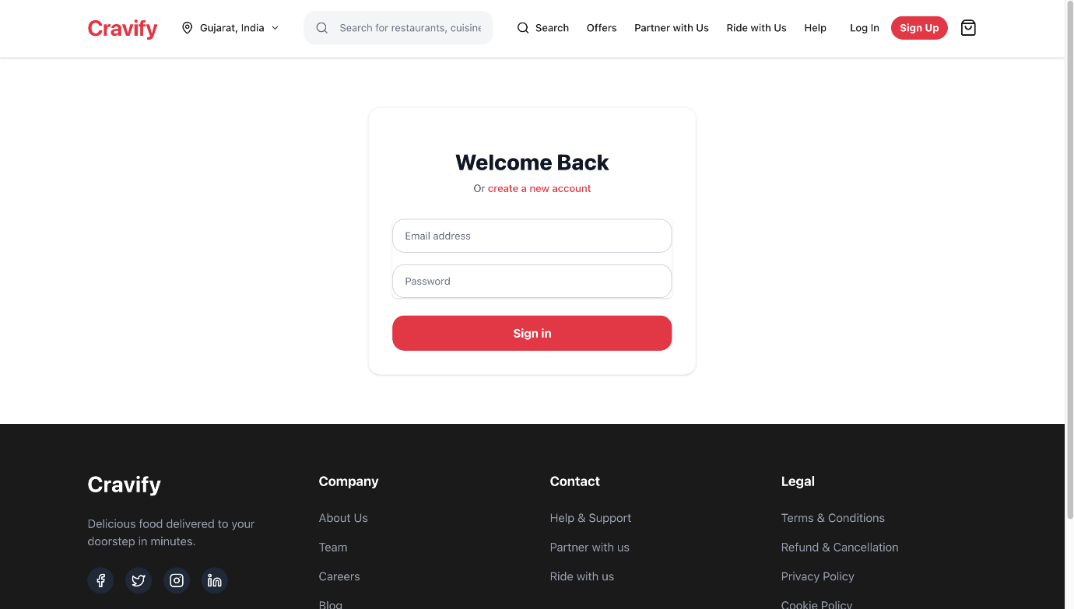

Slide 33
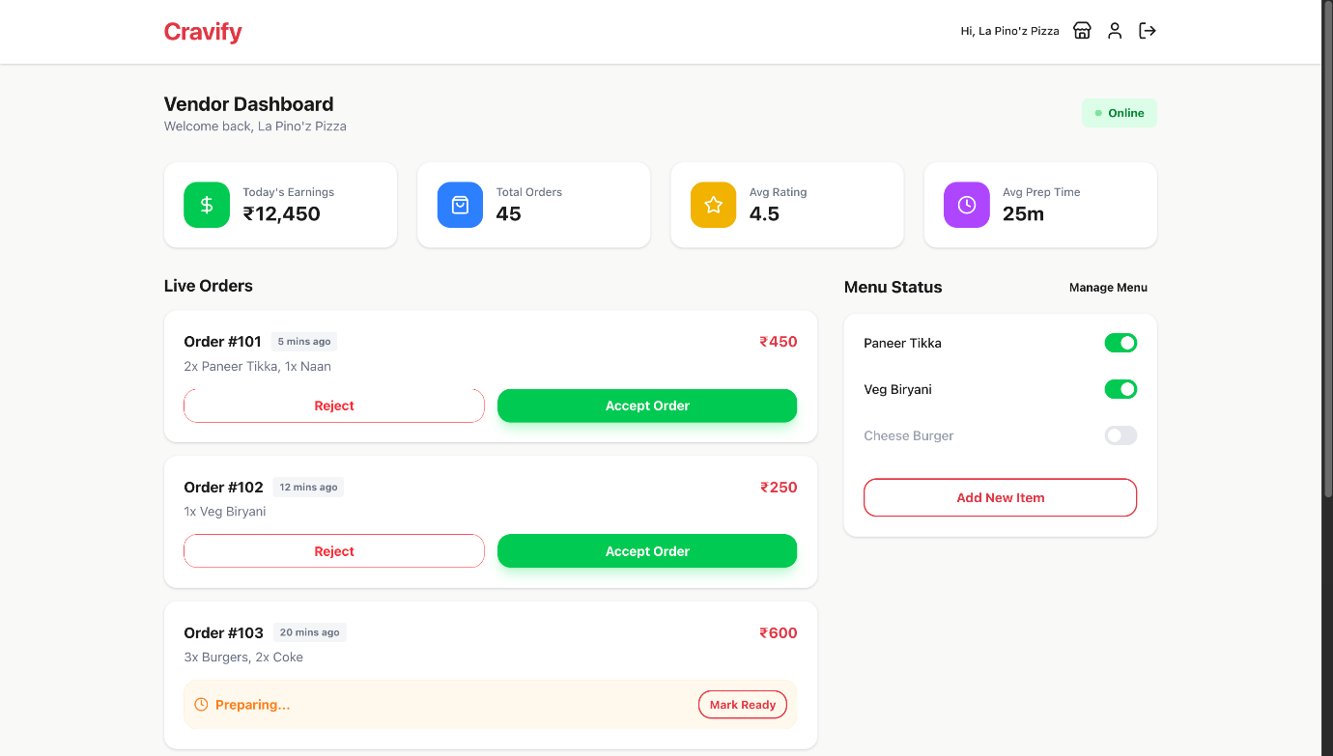

Slide 34
USE CASE DIAGRAM

Slide 35
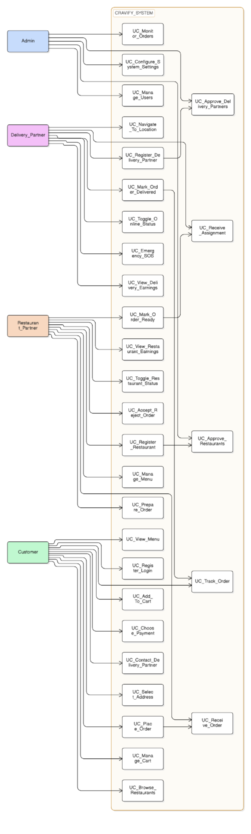

Slide 36
FUTURE WORK
Backend development and full API integration
Secure payment gateway integration
Real-time order tracking with GPS
Advanced analytics and reporting dashboards
Smart recommendations and order assignment
Cloud deployment with scalability and security enhancements

Slide 37
THANK YOU !

