Slide 1
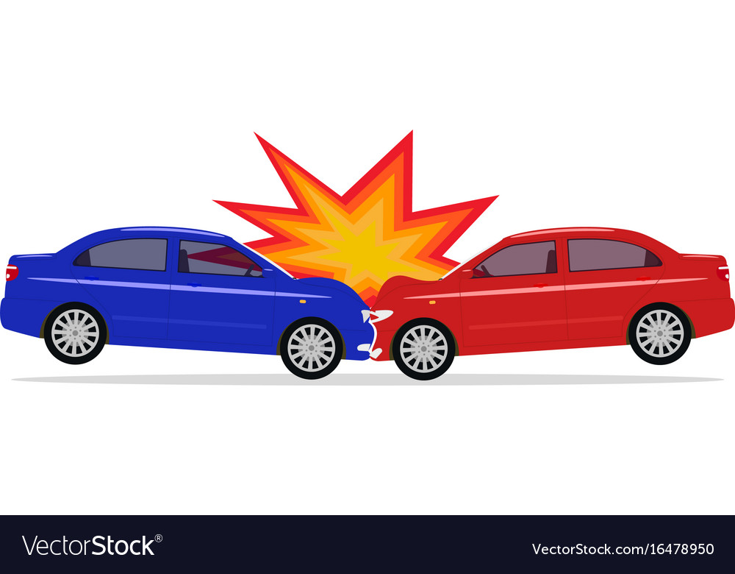
CAR ACCIDENT SEVERITY
PROJECT

Slide 2
Introduction to Problem
The Car Accident Severity project aims to understand the effects of various factors on the likelihood and severity of car accidents using a Machine Learning Model.
In an effort to reduce the frequency and the sverity of car collisions in a community, an algorithim must be developed to predict the severity of an accident given the current weather, road and visibility conditions.
When conditions are prone to fatal accidents, the model developed will allow drivers to be alerted to the likelihood of an accident and to be reminded to drive carefully.

Slide 3
Data acquisition and cleaning
The dataset used for this project is a public dataset and illustrates the circumstances in which car accidents take place in Seattle, Washington, from 2004 to 2020.
After gaining an understanding of the problem, the data had to be transformed to a form on which a machine learning model could be implemented. The first thing that was done was to check the data types of each variable and then explore how many variables were missing some entries.

Slide 4
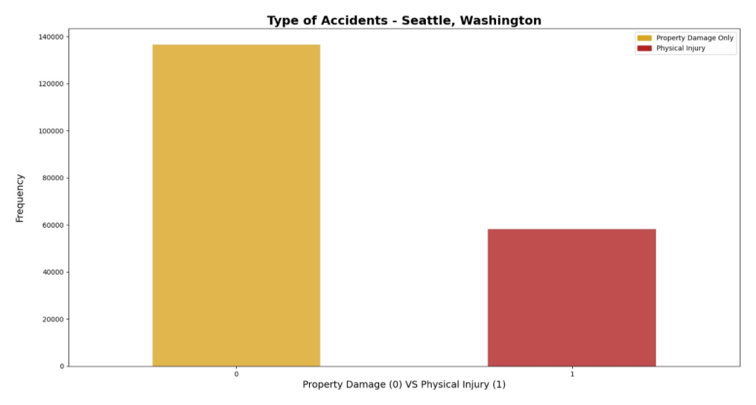
This graph for Property Damage vs Physical injury shows the damage to any property in an accident for Seattle and Washington.
0 represents 'Property damage only' while 1 represents 'Physical injury'.

Slide 5
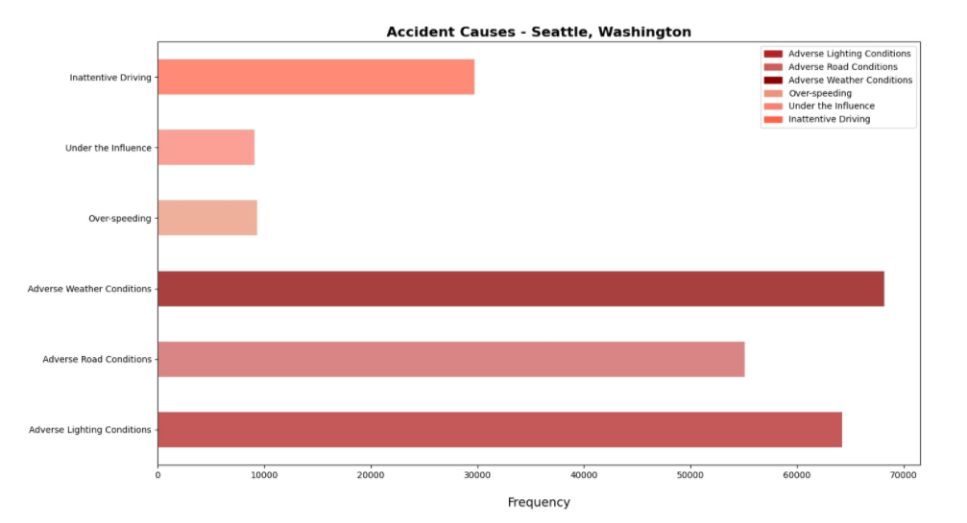
Because the data was in a cleaner state now, it was easy to re-confirm that the predictor variables we had chosen by intuition were relevant whilst making the prediction and this was confirmed by the above visualization - most accidents had adverse conditions with respect to all the chosen variables.

Slide 6
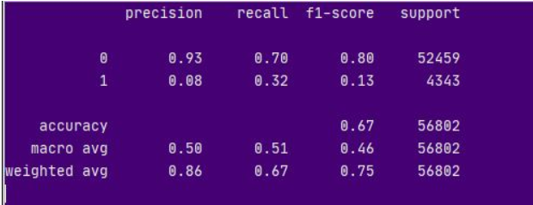
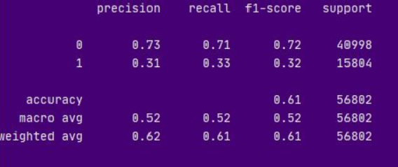
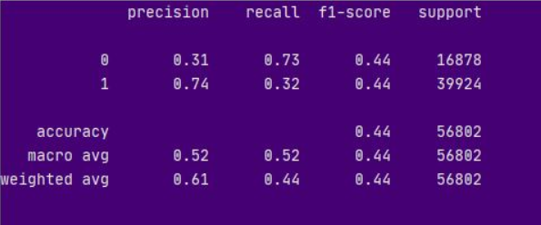
Using various Classification techniques
KNN :
Decision Tree :
Logistic Regression :

Slide 7
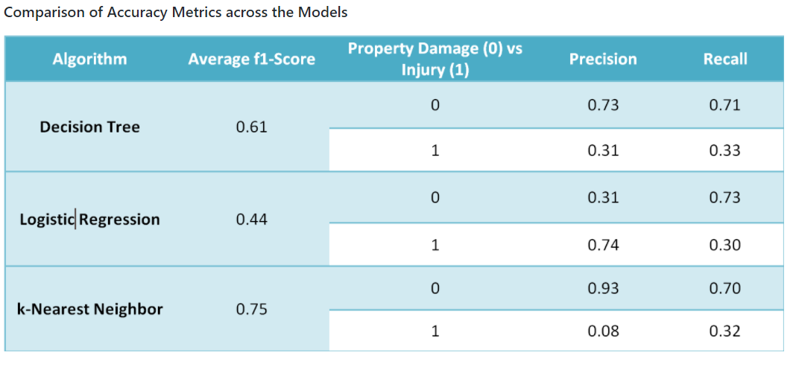

Slide 8
Comparing the results
KNN: This model has the highest weighted average F1 Score. It is highly accurate while predicting negatives but performs poorly when it has to predict the positives.
Decision Tree: This algorithm predicts in a more balanced manner than KNN. Like KNN, it also predicts the 0s with a higher degree of accuracy, but it can also predict the 1s with a greater accuracy than the KNN implementation.
Logistic Regression: This machine learning classifier has the lowest weighted average F1 score at 0.44 but it has the most balanced prediction. It classifies both 0s and 1s similarly and has the same F1 score for both.

Slide 9
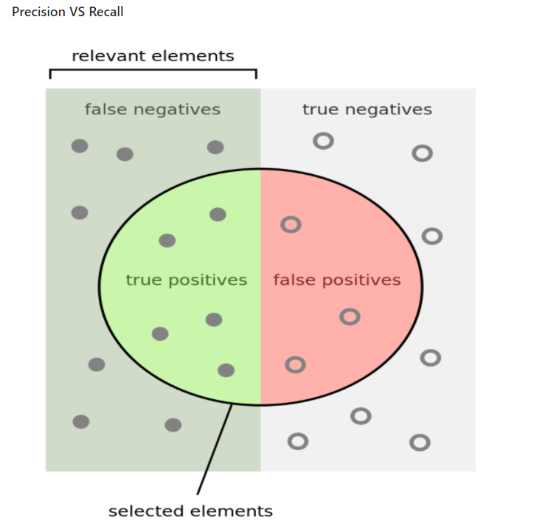
Precision: How many selected elements are relevant?
Recall: How many relevant elements are selected?

Slide 10
Conclusion
It is evident by the models' accuracy ratings that there is still room for improvement. I believe that better models could have been made if the data at hand was more comprehensive and had less unknown and missing values. The analyses done could also have held more value if greater target variable class-data was available and was not limited to property damage only and physical injury. That way, whether an accident would happen in the first place could have been better predicted. It would also have possibly meant that the algroithms implemented would have given more accurate predictions as the correlations between predictor and predicted variable could have been stronger.

