Slide 1
AI RECRUITMENT CHALLENGE
Built to win
Redrob Scout
Top-heavy ranking tuned for NDCG@10 / NDCG@50.
A deployed candidate-ranking console that makes hiring smarter by finding production AI/search builders instead of keyword-stuffed resumes.
Explicit honeypot and anti-signal defenses.
https://ai-recruitment-ayush.vercel.app/
Auditable reasoning for manual review.
Live recruiter-style product demo.
CANDIDATE POOL
VALID OUTPUT
RUNTIME
100K
100
197s
offline profiles scanned
ranked CSV rows
CPU-only, no APIs
Live demo: ai-recruitment-ayush.vercel.app
01

Slide 2
1. CHALLENGE TACKLED
AI Recruitment: smarter candidate discovery and ranking.
Among the three hackathon tracks, this project tackles the hiring problem: how to identify truly relevant, reachable candidates from a noisy talent pool.
The challenge
The trap
The real goal
Find the top 100 candidates for a Senior AI Engineer founding-team role from 100,000 profiles.
The right answer is not who lists the most AI keywords. Non-ML profiles can look artificially strong.
Surface production search, retrieval, ranking, and evaluation builders who recruiters can actually contact.
Live demo: ai-recruitment-ayush.vercel.app
02

Slide 3
2. SOLUTION
Redrob Scout is an offline ranker plus recruiter review console.
It turns raw profiles into a validated shortlist, with transparent evidence and risk flags for every recommended candidate.
A
Deterministic scorer
B
Explainable CSV
C
Recruiter console
Scores career evidence, skills, role fit, behavior, logistics, and penalties in one pass.
Writes the exact challenge schema with candidate-specific reasoning for manual review.
Lets judges search, filter, inspect breakdowns, and download the final ranked CSV.
Why this matters: recruiters do not need another black box. They need a shortlist they can trust, inspect, and act on.
Live demo: ai-recruitment-ayush.vercel.app
03

Slide 4
HOW IT WORKS
A scoring pipeline designed around the JD, not generic similarity.
The ranker rewards proof of production retrieval/ranking and down-weights candidates who only look good in the skills list.
Read
Evidence
Score
Defend
Output
>
>
>
>
Stream candidates.jsonl
Parse title, career, skills, assessments, signals
Weight technical, role, experience, behavior, logistics
Flag traps and apply penalties
Top-100 CSV + dashboard payload
Competition edge: hidden scoring is top-heavy, so the system protects the top 10 from keyword-stuffers, stale profiles, services-only careers, and impossible timelines.
Live demo: ai-recruitment-ayush.vercel.app
04

Slide 5
3. USER JOURNEY
A recruiter can move from shortlist to decision in minutes.
The product behaves like a review cockpit: rank first, then inspect why, then act.
Open live demo
1
Recruiter lands on the ranked shortlist and sees top-fit candidate evidence immediately.
Filter intent
2
Adjust score, open-to-work, notice period, India fit, or keyword search.
Inspect candidate
3
Read reasoning, breakdown bars, behavior signals, skills, and career evidence.
Export shortlist
4
Download a valid CSV for submission or recruiter workflow.
Live demo: ai-recruitment-ayush.vercel.app
05

Slide 6
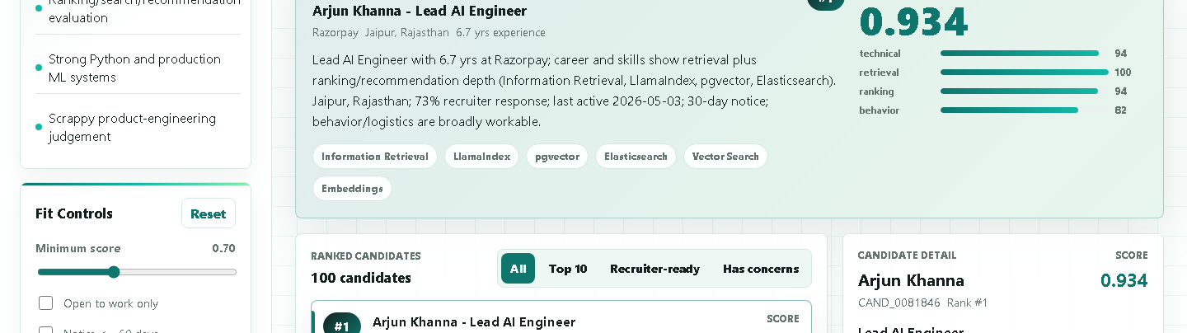
4. MOCKUP / LIVE PRODUCT
The deployed dashboard proves the idea is real.
This is not just a model artifact: the shortlist is browsable, searchable, filterable, and ready for review at the Vercel URL.
Live demo: ai-recruitment-ayush.vercel.app
06

Slide 7
WHY THIS CAN WIN
The product is optimized for the parts judges actually score.
It combines a strong top-heavy ranking strategy with reproducibility, human-readable reasoning, and a deployed review UX.
TOP SCORE
CUTOFF
READY
INDIA FIT
0.928
0.696
41
98
best-fit composite
rank-100 threshold
recruiter-ready profiles
India-based shortlist
NDCG@10 focus: strongest production AI/search builders are placed at the top.
Manual-review focus: every row includes specific facts and honest concerns.
Reproduction focus: Python standard library, CPU-only, no network calls.
Live demo: ai-recruitment-ayush.vercel.app
07

Slide 8
SUBMISSION-READY PACKAGE
Clean repo, deployed demo, final CSV, and this pitch deck.
Everything is structured so a judge can reproduce, inspect, and defend the work without guessing.
Deliverables in repo
Final judge message
outputs/redrob_scout_submission.csv
Redrob Scout makes hiring smarter by ranking for real production evidence, recruiter reachability, and explainability - then proving it with a live dashboard.
outputs/redrob_scout_hackathon_pitch.pptx
README.md + docs/approach.md
Live demo: ai-recruitment-ayush.vercel.app
08

