Slide 1
redrob | H2S
INDIA.RUNS
Build what next India runs on
Team Name : AD-Redrob Scout
Team Leader Name : Ayush Dhangar
Problem Statement : AI Recruitment - Intelligent Candidate Discovery and Ranking
Live Project : https://ai-recruitment-ayush.vercel.app/
A deployed, explainable ranker that finds real production AI/search engineers from a noisy 100K candidate pool.

Slide 2
redrob
| H2S
INDIA.RUNS
Solution Overview
Redrob Scout converts raw candidate data into a recruiter-ready top-100 shortlist.
Proposed solution: an offline deterministic ranker plus a deployed review dashboard.
Differentiator: it scores career evidence, production search depth, behavior, logistics, and anti-signals instead of only matching AI keywords.
Result: judges can inspect every recommendation, see why it ranked, and download the valid CSV.
SCANNED
OUTPUT
READY
RUNTIME
100K
100
41
197s
profiles from candidates.jsonl
valid ranked candidates
open, responsive, <= 60d notice
CPU-only, no network APIs
02

Slide 3
redrob
| H2S
INDIA.RUNS
JD Understanding and Candidate Evaluation
The JD is explicit: this role needs a shipper with deep retrieval/ranking systems experience.
Key JD requirements
Most important signals
Beyond keywords
Embeddings and vector or hybrid search
Career text showing shipped systems
Keyword stuffing is penalized.
Ranking/recommendation evaluation
Title, tenure, skill duration, assessments
Pure research without deployment drops.
Production Python and ML systems
Recency, response rate, notice period
Services-only and stale profiles fall.
03

Slide 4
redrob
| H2S
INDIA.RUNS
Ranking Methodology
A transparent scoring model combines evidence, fit, availability, and risk.
1
Retrieve
2
Score
Stream all profiles and build a normalized evidence blob from title, summary, career, skills, and signals.
Weighted components: technical depth, role fit, experience band, product-company signal, behavior, and logistics.
3
Penalize
4
Rank
Anti-signals reduce suspicious profiles: weak AI claims, timeline mismatch, long notice, stale activity, services-only paths.
Keep a bounded top-candidate heap, sort deterministically, and write exactly 100 valid rows.
Final ranking goal: maximize useful top-10 quality for NDCG@10 while keeping the whole top 100 defensible.
04

Slide 5
redrob
| H2S
INDIA.RUNS
Explainability and Data Validation
Every recommendation includes a reason that can be checked against the profile.
How decisions are explained
How hallucinations are avoided
Reasoning cites title, years, company, location, matched skills, response rate, active date, and notice period.
No LLM calls during ranking; explanations are generated only from candidate fields.
Inconsistent or suspicious profiles are flagged as concerns instead of being praised.
Score breakdowns show technical, retrieval, ranking, behavior, logistics, and penalties.
05

Slide 6
redrob
| H2S
INDIA.RUNS
End-to-End Workflow
Complete flow from JD input to ranked candidate output.
1
Read JD
Extract must-have retrieval, ranking, evaluation, location, and availability expectations.
2
Score pool
Run CPU-only scorer across 100,000 candidates with deterministic rules.
3
Validate CSV
Write candidate_id, rank, score, reasoning and run the challenge validator.
4
Review UI
Publish dashboard so judges can search, filter, inspect, and download output.
06

Slide 7
redrob
| H2S
INDIA.RUNS
System Architecture
Simple by design: reproducible ranking core, generated dashboard payload, static deployed frontend.
Input
Ranker
Outputs
Live product
candidates.jsonl
job description
Redrob signals
>
Python standard library
feature extraction
weighted scorer + penalties
>
top-100 CSV
ranking-data.js
reasoning + breakdown
>
static dashboard
Vercel deployment
CSV download
Deployment: https://ai-recruitment-ayush.vercel.app/
07

Slide 8
redrob
| H2S
INDIA.RUNS
Results and Performance
The result is a valid, inspectable shortlist that meets the compute constraints.
TOP SCORE
CUTOFF
INDIA FIT
CLEAR RISK
0.928
0.696
98
72
best-fit composite
rank-100 threshold
India-based shortlist
no major anti-signal
Ranking quality insight: the top candidates are Lead/Senior AI, ML, NLP, and Search engineers with retrieval/ranking production evidence.
Runtime constraint: one deterministic CPU pass over 100K profiles completed locally in about 197 seconds, with no network or hosted LLM calls.
Validation: the generated CSV passes the challenge validator with exactly 100 ranked rows.
08

Slide 9
redrob
| H2S
INDIA.RUNS
Technologies Used
Each technology was selected to keep the solution reproducible, fast, and judge-friendly.
Python
JSONL + CSV
HTML/CSS/JS
Standard-library ranker for CPU-only reproducibility.
Simple challenge-native input and output formats.
Static recruiter console, no backend dependency.
Vercel
PowerPoint
Chrome screenshot
Live deployment for judges and reviewers.
Submission deck following the Redrob template structure.
Real deployed-product proof inside the mockup slide.
09

Slide 10
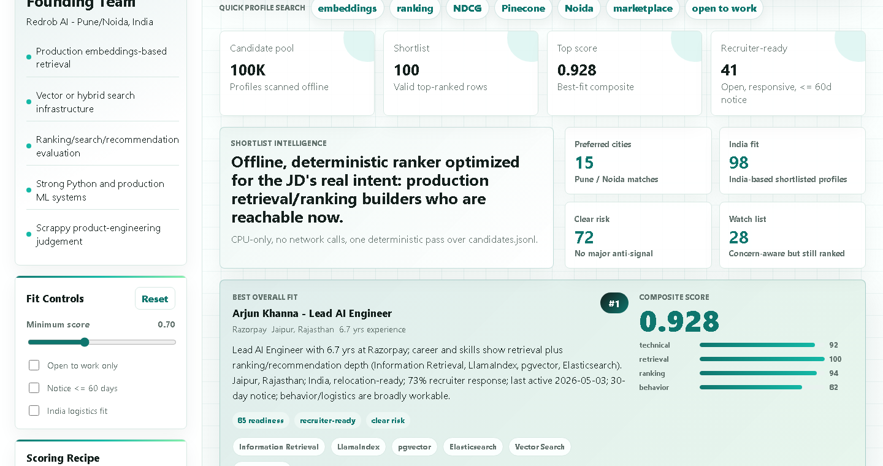
redrob
| H2S
INDIA.RUNS
Submission Assets
Live demo, final CSV, source repo assets, and product proof are ready for judges.
Links and files
Live demo: ai-recruitment-ayush.vercel.app
CSV: outputs/redrob_scout_submission.csv
Code: scripts/rank_candidates.py + site/
Docs: README.md + docs/approach.md
10

Slide 11
redrob | H2S
INDIA.RUNS
Build what next India runs on
THANK YOU
Redrob Scout makes hiring smarter: evidence-first ranking, honest explanations, deployable workflow.
Live demo: https://ai-recruitment-ayush.vercel.app/

