Slide 1
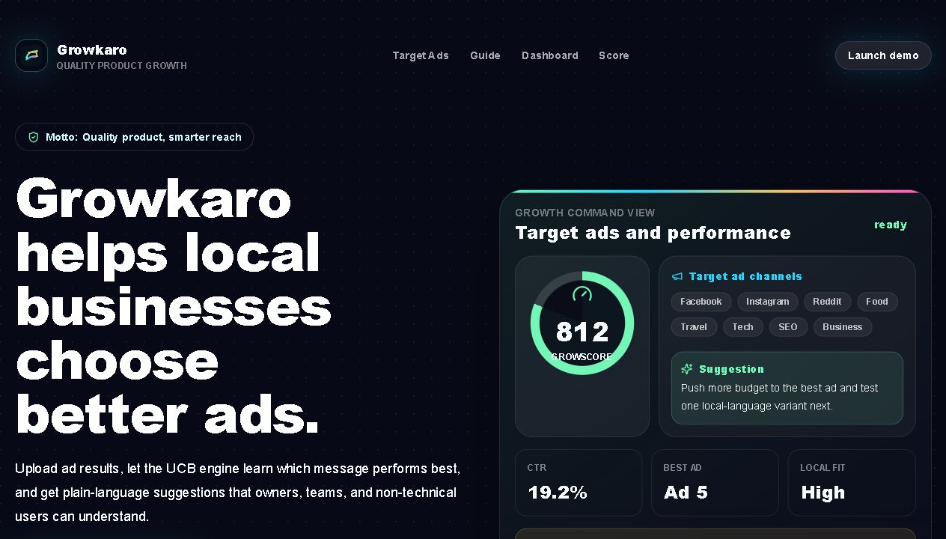
PRODUCT OVERVIEW
Ad performance becomes a decision, not a spreadsheet.
GrowKaro ranks every ad, explains what the numbers mean, and turns a total budget into an actionable allocation.
Verified GrowKaro product UI
10
100%
1 click
ads ranked
user-specific
PDF result
GrowKaro product overview | Local project sources
01

Slide 2
THE PROBLEM
Small advertisers do not need more metrics. They need the next move.
WHAT ARRIVES
WHAT GROWKARO RETURNS
Anonymous rows, binary responses, disconnected columns
#1 Ad 5
Highest observed CTR
Ad 1
1
0
0
INR 30,524
Ad 2
0
0
1
UCB
Suggested share from an INR 100,000 budget
Ad 3
0
1
0
Ad 4
0
0
0
Spend first
Which ad deserves the next rupee?
A plain-language recommendation, saved with the analysis and exportable as PDF.
GrowKaro reduces the interpretation burden: rank, reason, budget, action.
Source: GrowKaro workflow and result behavior
02

Slide 3
CLIENT JOURNEY
Protected results
One protected workflow takes a user from upload to action.
01
02
03
04
05
Authenticate
Add data
Validate
Learn
Act
Individual login protects every result.
Upload CSV/XLSX or enter ads manually.
Check columns, rows, and usable response data.
UCB and bandit models rank performance.
Review all ads, budget, history, and PDF.
USER RECEIVES
Ranked CTR | budget split | saved history | detailed PDF
Source: GrowKaro authentication, analysis, history, and export flow
03

Slide 4
PERFORMANCE PROOF
In the 10,000-row sample, Ad 5 captures the strongest signal.
RANKED CLICK-THROUGH RATE
Ad 5
26.95%
BUDGET TRANSLATION
Ad 8
20.91%
INR 100,000
Ad 1
17.03%
Illustrative total budget allocated across all ranked ads.
Ad 2
12.95%
Ad 4
11.96%
Ad 7
11.12%
Ad 5
30.5% | INR 30,524
Ad 9
9.52%
Ad 3
7.28%
Ad 8
21.3% | INR 21,315
Ad 10
4.89%
Ad 6
1.26%
Remaining eight ads
48.2%
0%
30%
The leading two ads earn 51.8% of the suggested budget because the allocation combines CTR strength with rank.
Source: dataset.csv, 10,000 rows; allocation uses GrowKaro rank-weighted CTR logic
04

Slide 5
PLATFORM SYSTEM
GrowKaro separates a simple client journey from a rigorous learning stack.
CLIENT EXPERIENCE
SERVICE LAYER
LEARNING LAYER
Next.js application
FastAPI services
Bandit intelligence
Login and signup Dashboard and upload All-ad results Guides and history
JWT authentication Dataset validation Training and analytics Simulation and leaderboard
Upper Confidence Bound Thompson Sampling Epsilon-greedy Softmax and random baselines
OPERATIONS FOUNDATION
SQLAlchemy database
Redis + Celery jobs
Docker + Kubernetes
PDF result delivery
WHY IT MATTERS
Easy adoption
Isolated histories
Scalable experiments
Source: GrowKaro frontend, backend, model, and deployment structure
05

Slide 6
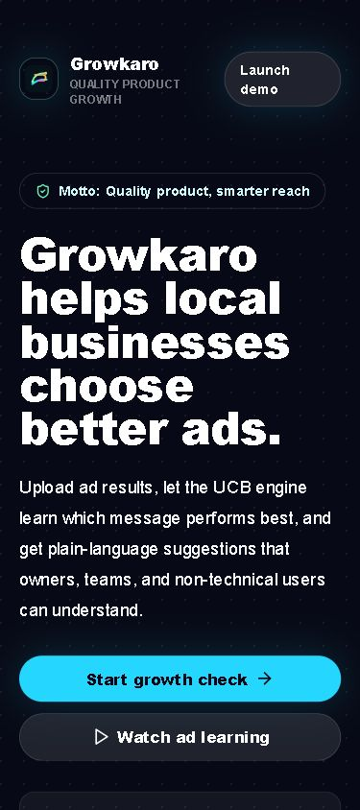
SERVICE READINESS
The product supports both client delivery and operator control.
CLIENT LANE
1
2
3
4
5
Account
Saved analysis
All-ad result
Budget plan
PDF
ADMIN LANE
1
2
3
4
5
Users
Datasets
Analysis history
System view
Full access
GUIDANCE BUILT IN
Promoter targeting guide
Better onboarding means fewer support questions and faster client action.
Ad creation guide
Responsive product experience
Source: GrowKaro user, admin, history, guide, and export features
06

Slide 7
STRATEGIC DIRECTION
GrowKaro can grow from uploaded data to a continuous campaign decision system.
NOW
NEXT
SCALE
Client-ready optimization workflow
Connected campaign feedback
Continuous managed decisioning
Authenticated uploads, ranked all-ad results, budget allocation, saved histories, guidance, and PDF delivery.
Add direct ad-platform connectors, conversion events, and scheduled refreshes so recommendations follow live outcomes.
Deploy alerts, multi-client operations, experiment governance, and learning loops that improve with every campaign.
Available in the current application
Product expansion opportunity
Long-term platform direction
Pilot with real campaign data. Measure decisions, not dashboard visits.
GrowKaro | Current product capabilities and future roadmap
07

