Slide 1
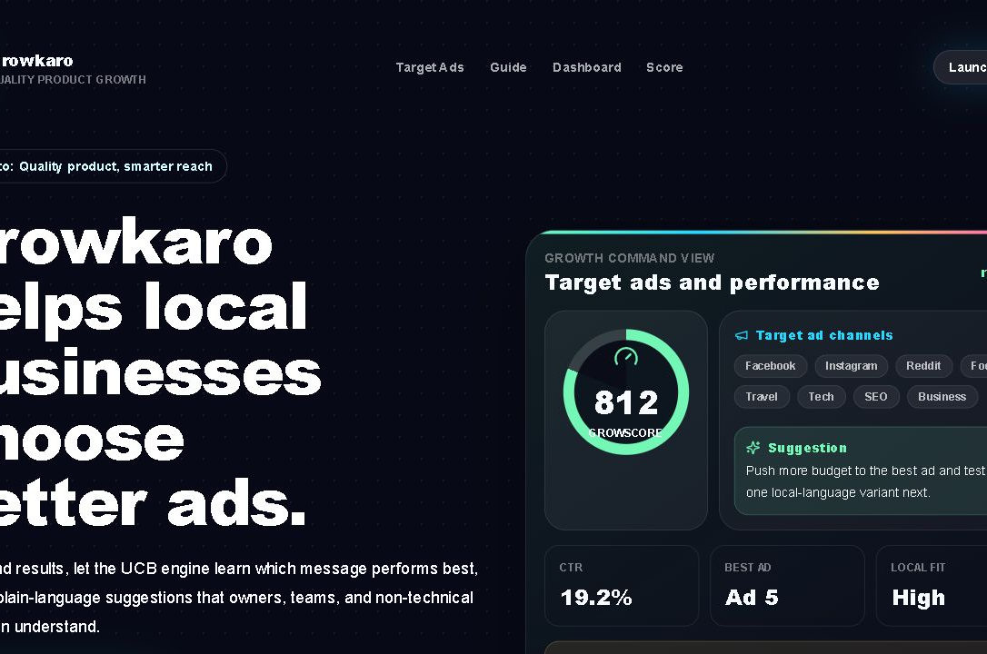
HACKATHON PITCH
GrowKaro turns click history into smarter ad budget decisions.
A full-stack reinforcement-learning platform that helps local businesses upload ad results, learn the strongest creative, and explain the next budget move in plain language.
Product proof from the current repo UI
10,000
10
Ad 5
UCB
impressions tested
ad variants
winner found
explainable RL
included dataset.csv
binary click columns
highest observed CTR
confidence + reward
Sources: repository screenshot, dataset.csv, backend UCB model
01

Slide 2
PROBLEM
Local businesses waste budget because ad learning is slow and hard to explain.
Most small teams know which campaign spent money, but not which message deserves the next rupee of budget.
01
02
Too many guesses
Static reports
Owners test Facebook, Instagram, local-language copy, and offers without a reliable learning loop.
Traditional dashboards show CTR after the fact, but do not decide what to test next.
Hackathon problem statement
Build a practical optimization layer that learns from click/no-click data, recommends the strongest ad, and keeps the explanation simple enough for non-technical business users.
03
04
Weak explanation
Budget leakage
A recommendation fails if the owner cannot understand why one ad should get more budget.
Manual allocation keeps spending on underperforming creatives longer than necessary.
Sources: README/project purpose, frontend product copy
02

Slide 3
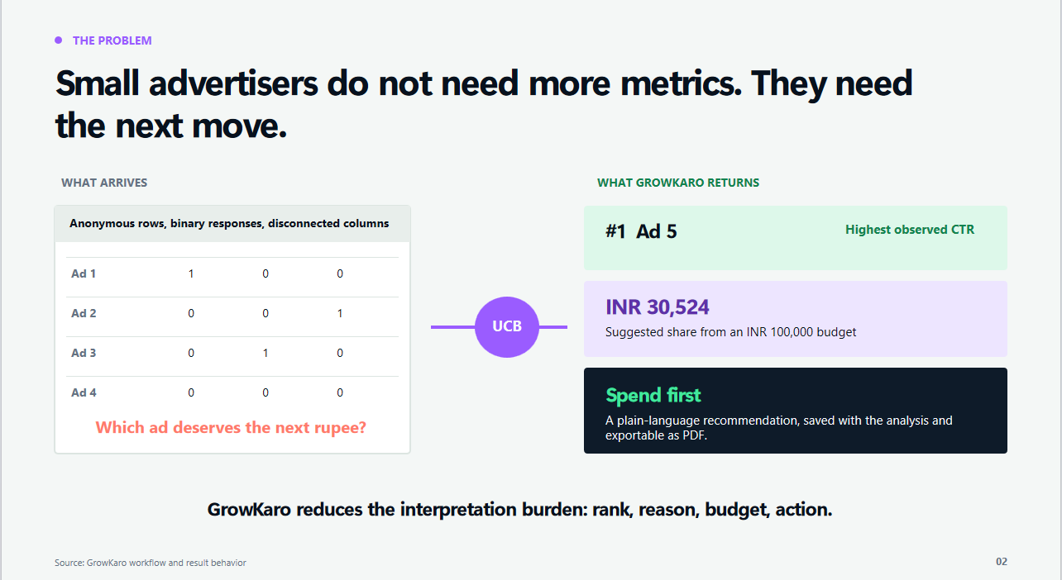
SOLUTION
An explainable confidence engine picks the best ad while still learning.
Upper Confidence Bound
1
Upload
2
Score
CSV/XLSX click data enters the backend.
UCB computes reward plus uncertainty.
upper_bound = average_reward + sqrt((3 / 2) * log(n + 1) / selections)
The score increases when an ad performs well and also when uncertainty is high, so the model can explore early and exploit once enough evidence arrives.
3
Learn
4
Explain
Selections and rewards update each round.
Dashboard returns best ad, CTR, regret, and insight.
explore untested ads
rank by confidence
recommend winner
Source: backend/app/ml_models/ucb.py
03

Slide 4
WORKFLOW
The MVP is a deployable full-stack optimization loop, not only a notebook.
Next.js dashboard
FastAPI API
Dataset service
Bandit engine
React, TypeScript, Tailwind, Recharts, GSAP UI for owners and analysts.
Auth, dataset upload, train-model, analytics, simulation, leaderboard, reports.
Validates CSV/XLSX binary click matrices and stores metadata/statistics.
UCB plus Thompson, epsilon-greedy, softmax, and random baseline comparison.
Architecture path: user action -> API validation -> learning engine -> stored result -> dashboard/report recommendation
Persistence
Async scale
Deployment
SQLAlchemy schema for users, datasets, experiments, model results, analytics, reports, simulations, audit logs.
Redis and Celery worker scaffold for background training workloads.
Docker Compose for local full stack; Kubernetes manifests for API, worker, frontend, services, ingress.
Sources: backend API routes, requirements.txt, frontend/package.json, Docker Compose, Kubernetes manifest
04

Slide 5
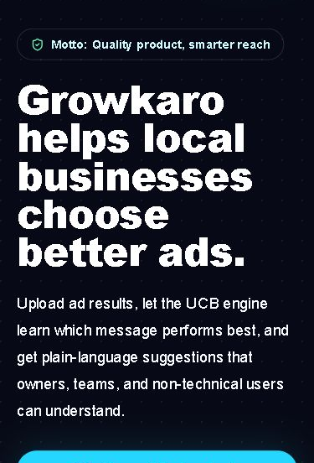
FEATURES
GrowKaro converts ML output into actions teams can use.
User
Product capabilities
Hackathon value
Owner
Plain-language recommendation, GrowScore, best-ad suggestion, PDF result report.
Knows where to put budget without reading ML charts.
Analyst
Dataset upload, UCB training, confidence intervals, CTR/regret trends, model comparison.
Can defend why an ad won and keep challengers live.
Operator
Simulation endpoint, leaderboard, auth/admin routes, persisted experiments.
Can test workflows and keep campaign history organized.
Built-in algorithms: UCB, Thompson Sampling, Epsilon Greedy, Softmax, Random Baseline
Endpoints: upload-dataset, train-model, results, analytics, simulate, leaderboard, compare-models
Sources: API routes, frontend demo data, repo screenshots
05

Slide 6
VISION
From hackathon MVP to growth copilot: optimize, explain, and scale.
now
next
scale
future
Working MVP
Live pilots
Budget copilot
Learning network
Upload click data, run UCB, compare models, show best ad, export report.
Connect real campaigns and run guarded A/B allocation for local merchants.
Recommend budget shifts, creative tests, and channel mix with confidence.
Insights by segment, season, category, and regional language.
Hackathon ask: validate with 3-5 local businesses, plug in live campaign exports, and measure click lift plus owner trust in the recommendation.
Why it can win
It combines real ML logic, a working product interface, deployment thinking, and a user-friendly explanation layer for a market that usually gets dashboards instead of decisions.
Sources: project architecture, production notes, computed benchmark gaps
07

