Slide 1
WINTER INTERNSHIP
Name : Ayushi S. Patel
Er.No:210410116081
Sub : python development

Slide 2
Purpose And Objective
Learning outside the boundaries of course curriculum.
I like problem solving so this is the main reason behind choosing programming field.
The main objective is to develop skill ,strong resume.
To build responsive web sites.

Slide 3

Company Over View
Thatsend PVT. LMT. is a Service based PRIVATE LIMITED company.
Website: https://www.thatsend.com/get-in-touch/
Address : ThatsEnd, 3rd Floor, Matru Kunj, Beside Alaknanda Apartment, Kalapeshi Street - Behind Allahabad Bank, Athugar Street, Nanpura - 395001, Surat, Gujarat, India.

Slide 4
Internship Overview
Duration Of Internship
3 months
Tasks
Task-1:connect database in python
Task-2:create crude model based mini project
Task-3:e-commerce project
Task-1:Landing page

Slide 5
Tools Used
Bootstrap
SVG
Django
My Sql
HTTP
Task-1:Landing page

Slide 6
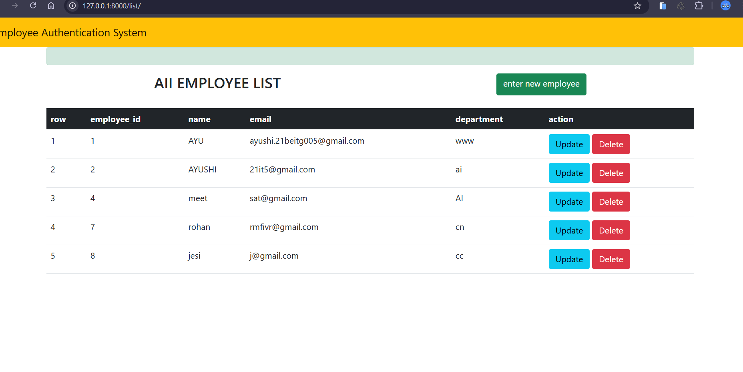
Small Project:It company employee management system The crude operation based employ management webapplication with th eauthentication precess.

Slide 7
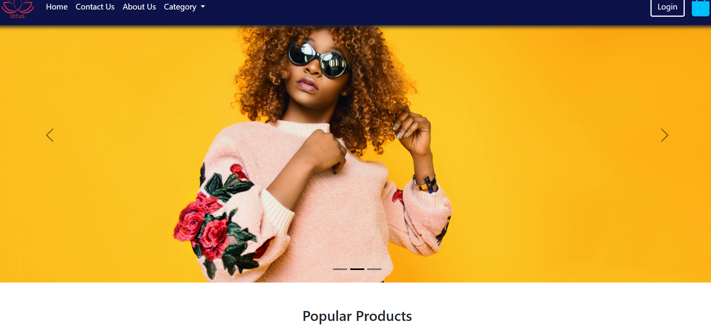
Main Project : E-commerce Website
- The E-commerce web application for clothes
- Which contains the navbar,home page, complete authentication system ,category wise choices .
- It mainly contains add to cart and payment feater.

Slide 8
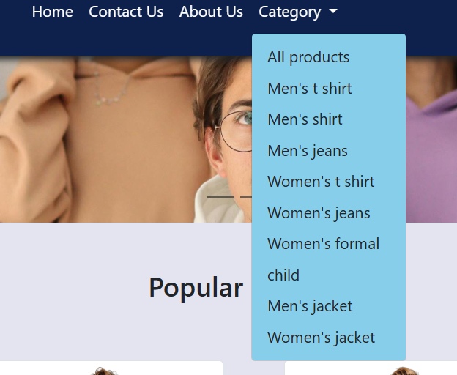
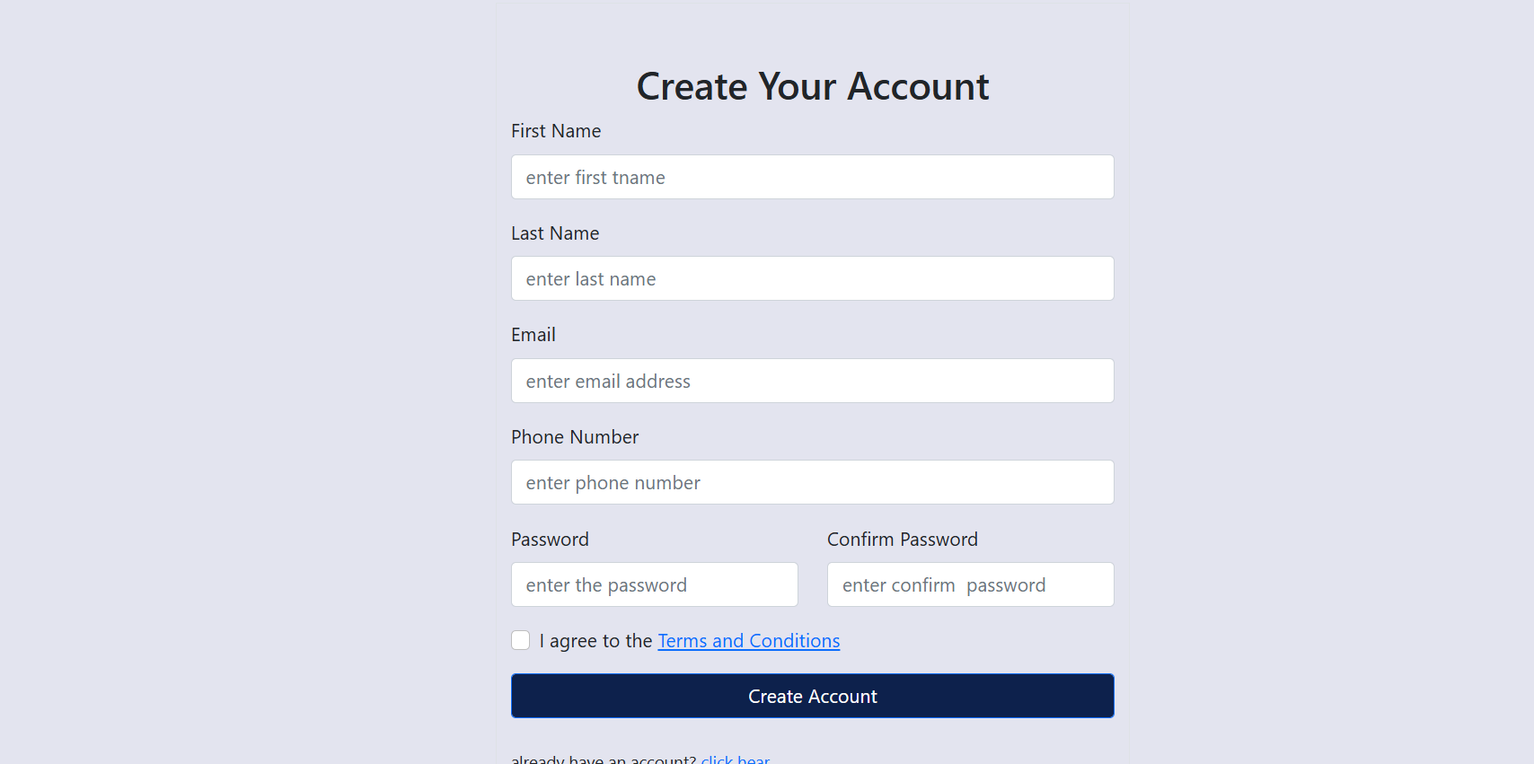
.
Product Categories
You can see the navigation bar in the picture which is done by bootstrap navigation bar properties and values. hover effect is also given to the each navigation link

Slide 9
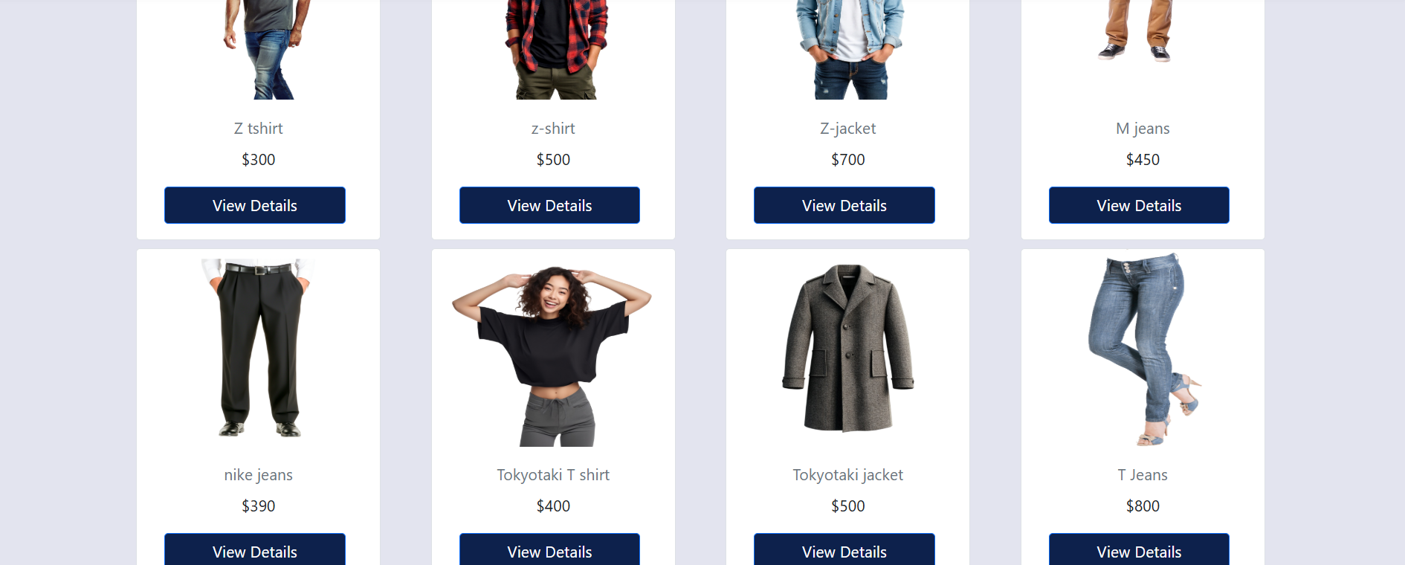
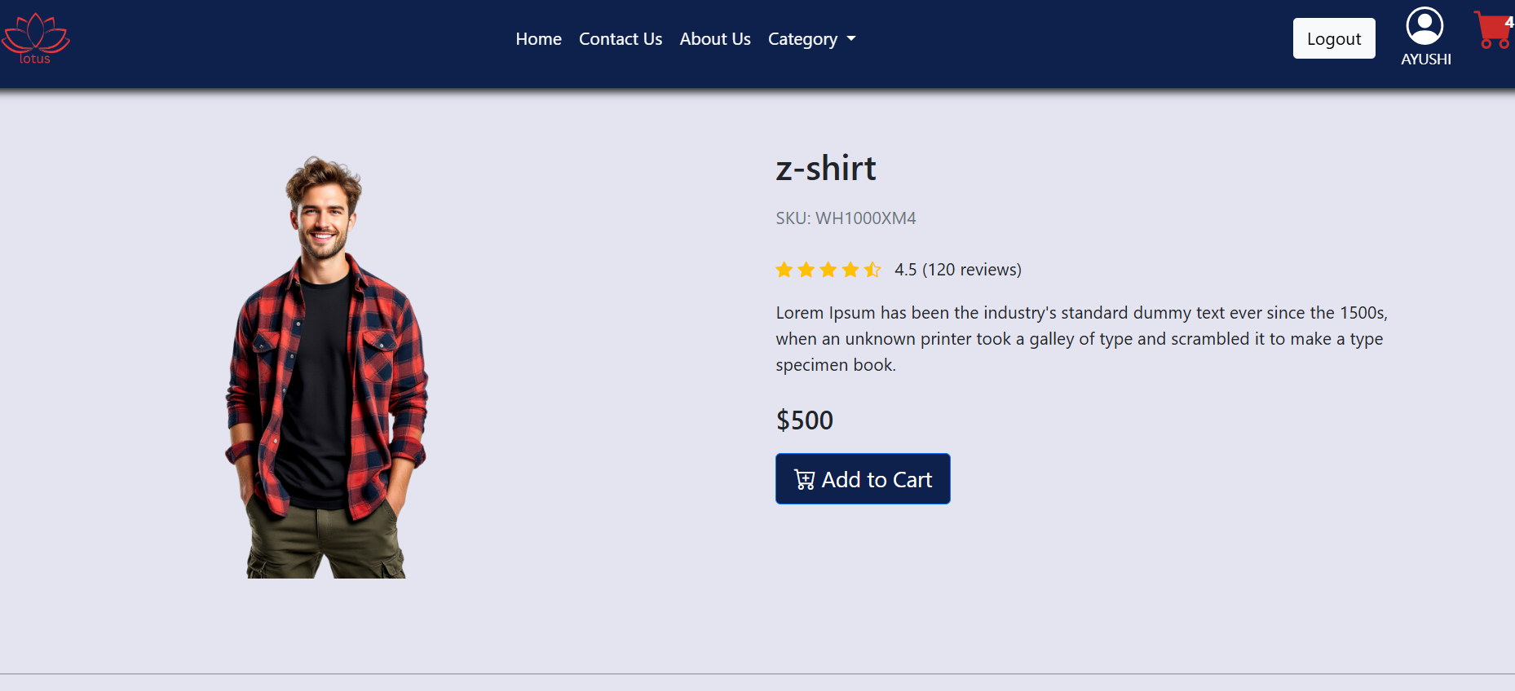
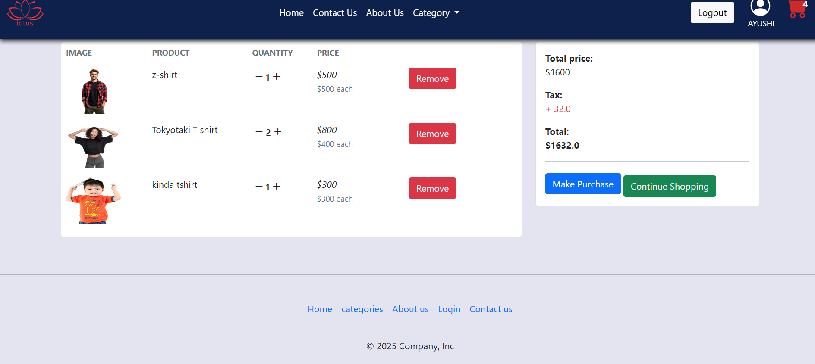
Product details andcart page
In this section I’ll get knowledge about advanced crude
operstionto add imajes in the section for shoping new
cloths.

Slide 10
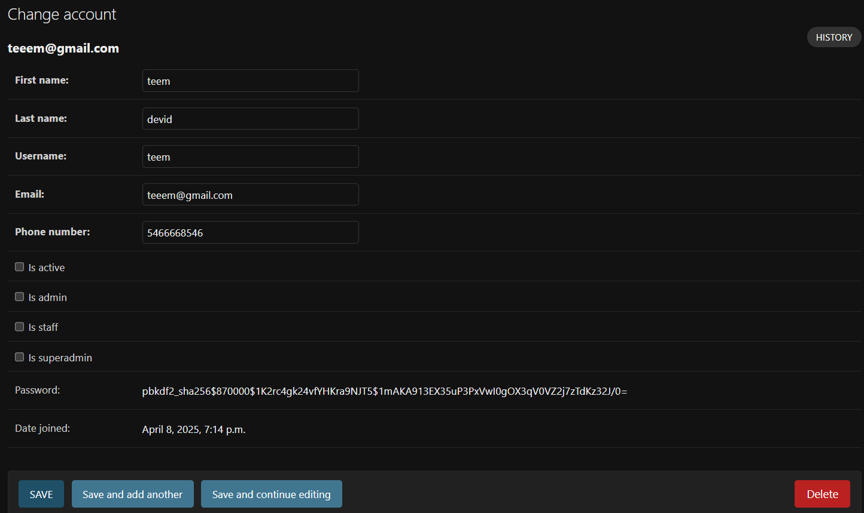
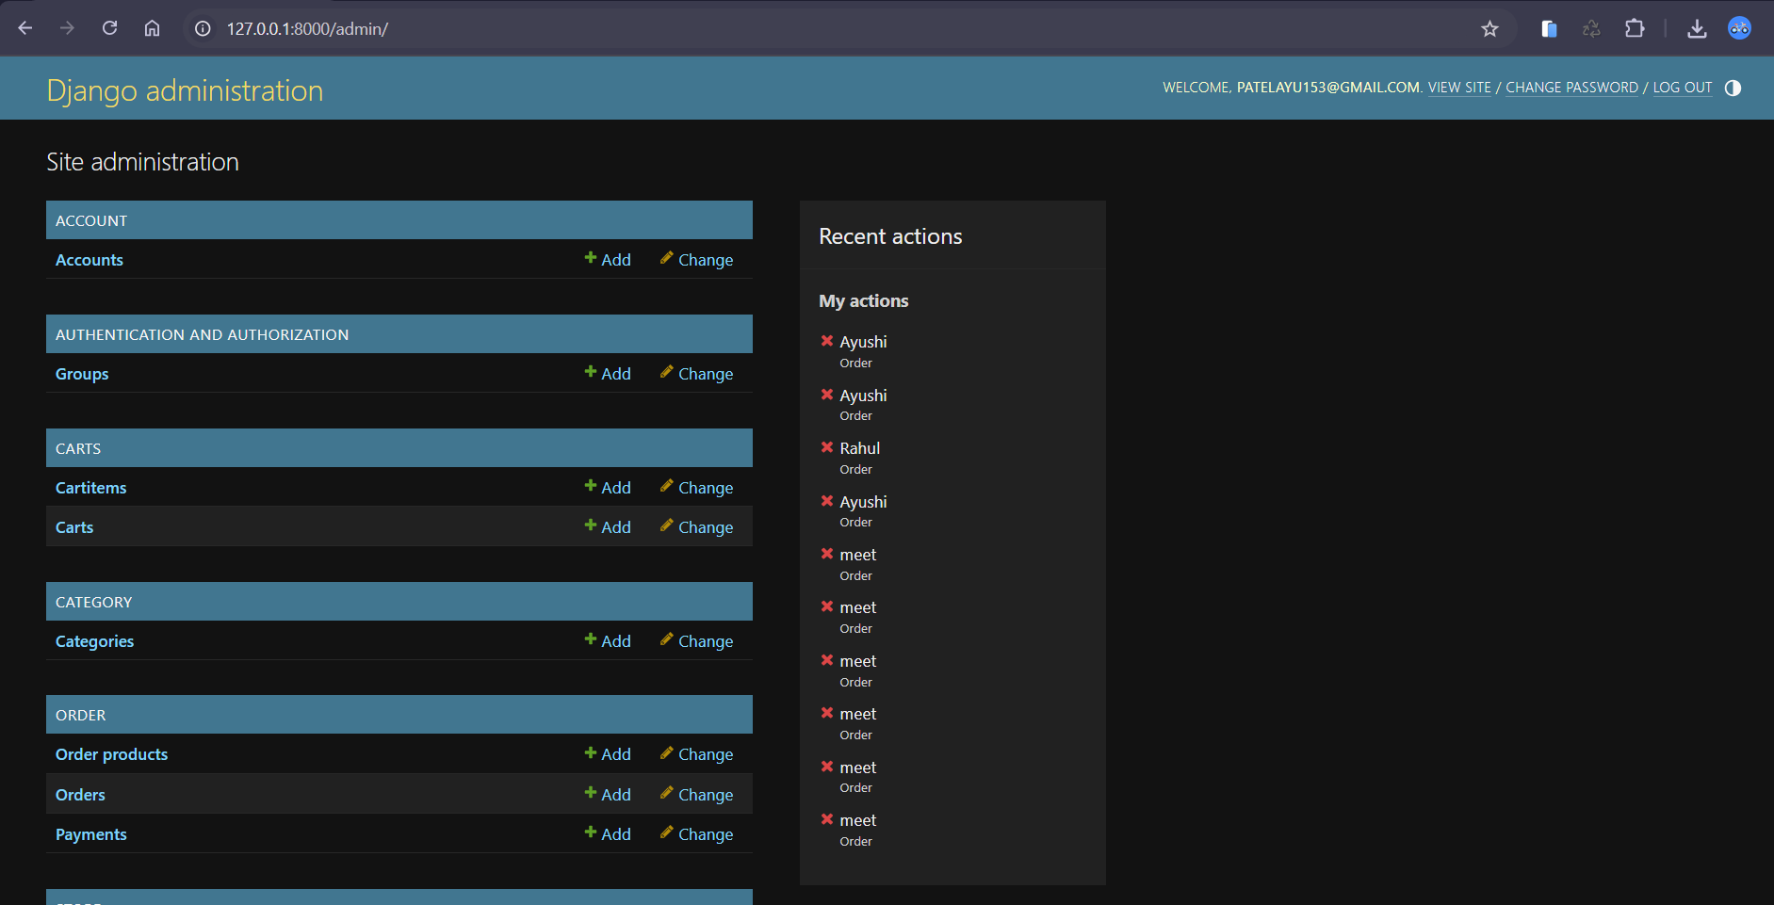
Admin panal is only accessed by the super user or admins according to their roles in website
Admin Panal

Slide 11
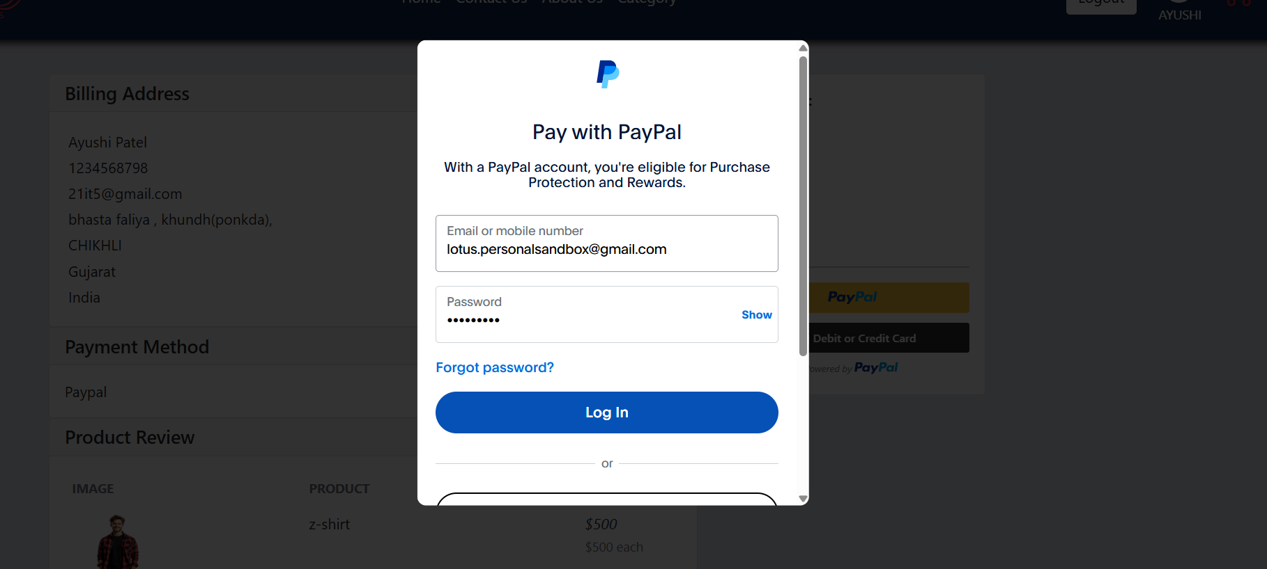
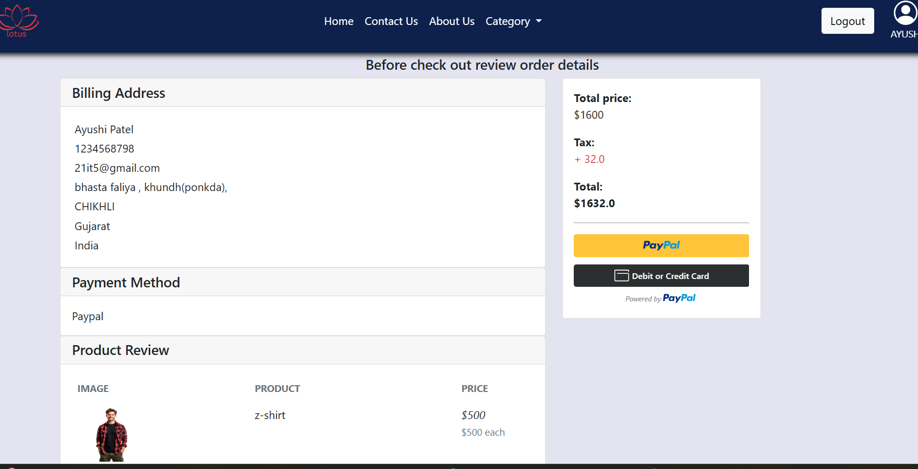
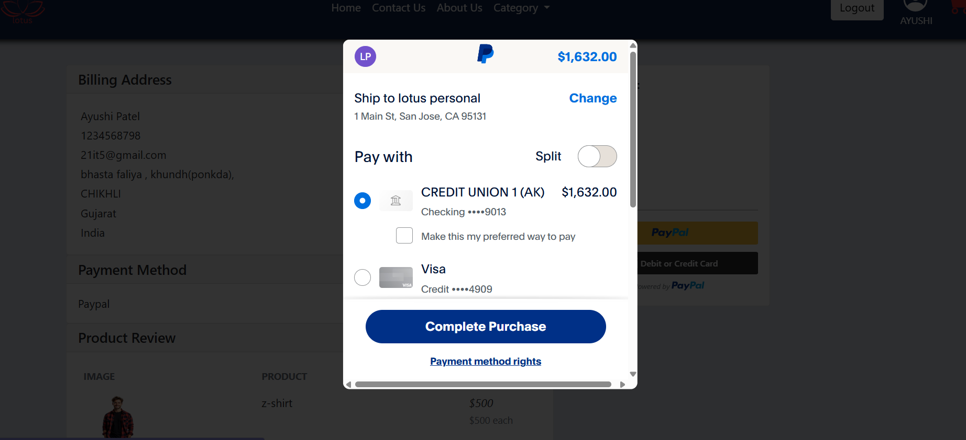
Chechout Page
In this section user can review the cart
product and address and then can chechout.

Slide 12
Conclusion
During my three-month online web development internship at Thatsend PVT. LMT.
I had the opportunity to immerse myself in the practical aspects of python development. The experience was incredibly enriching and provided a comprehensive understanding of both the technical and professional dimensions of the field.

Slide 13
Thank you

