Slide 1
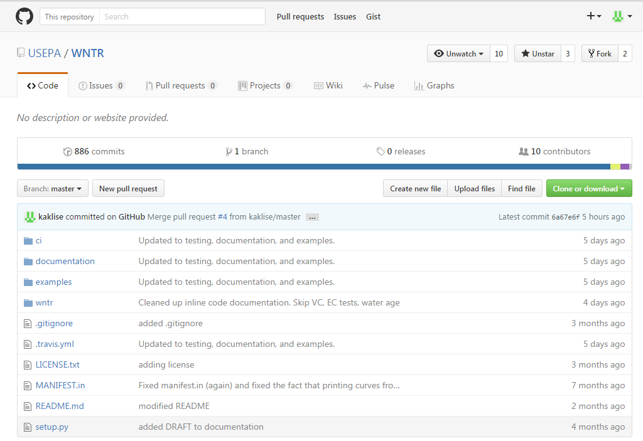
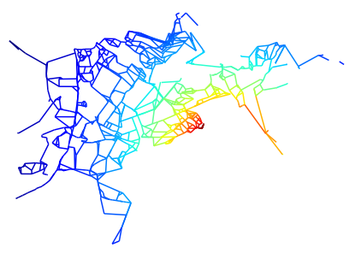
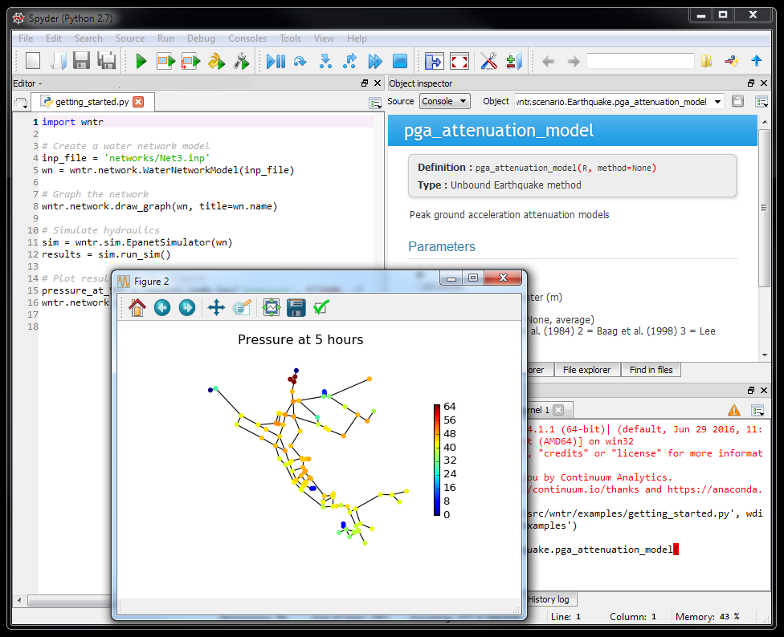
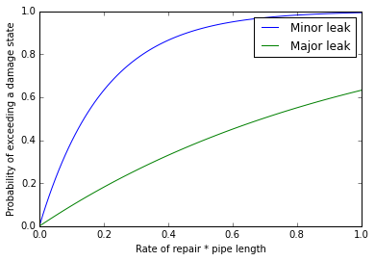
Epicenter

Slide 2
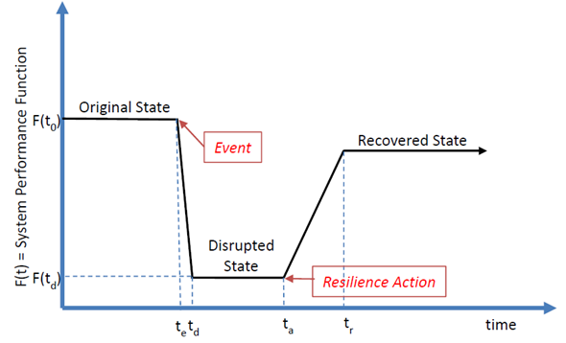
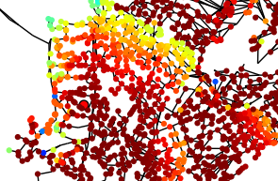
State Transition plot for time-series metrics Network graphic for spatially distributed metrics

Slide 3
Node Name
Link Name
Node Name
Link Name
Node Name
Link Name
Time step
Time step
Node Attribute
Link Attribute

