Slide 1
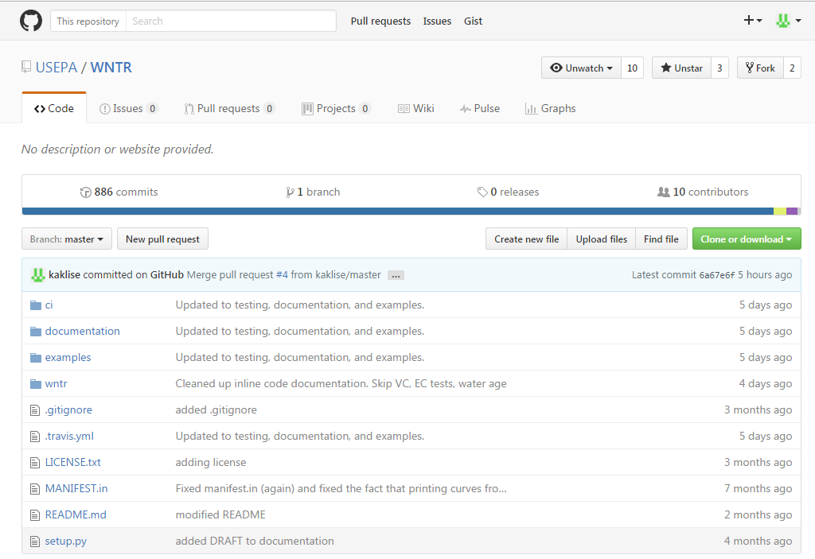
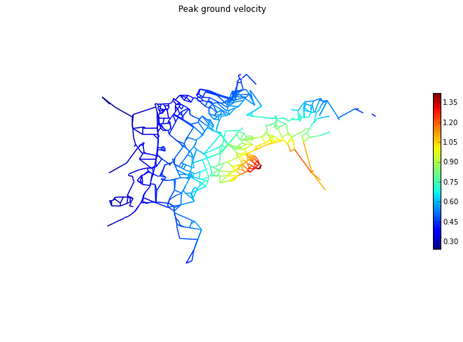
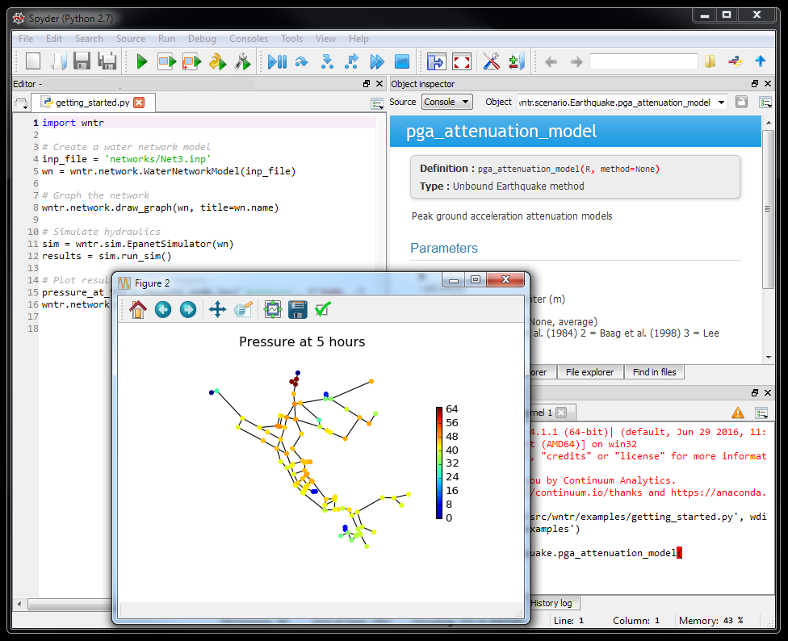
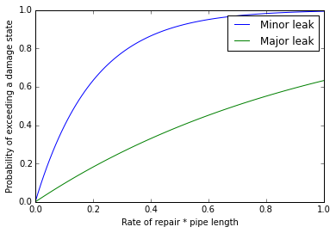
Epicenter

Slide 2
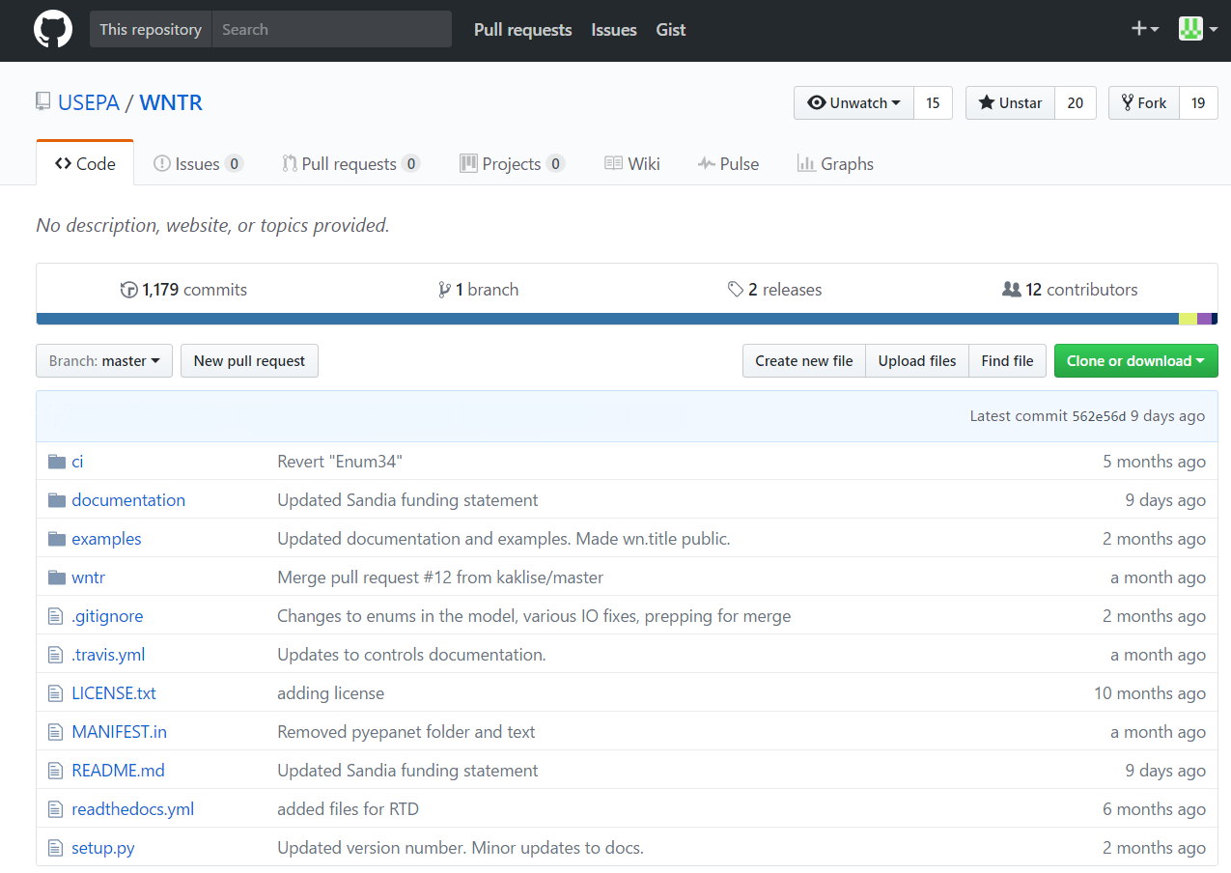
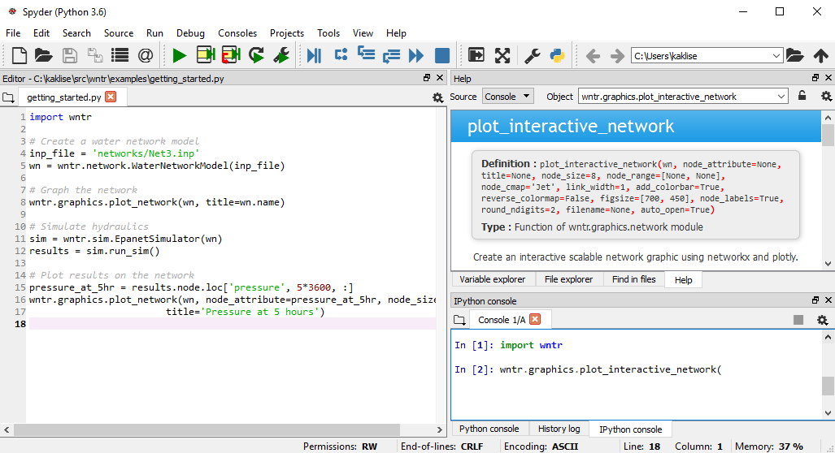
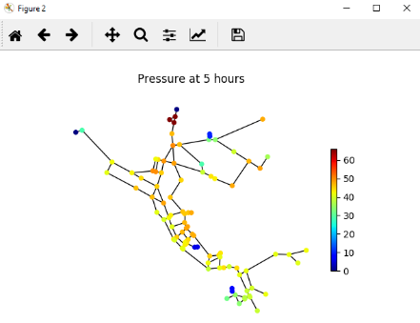
Epicenter

Slide 3
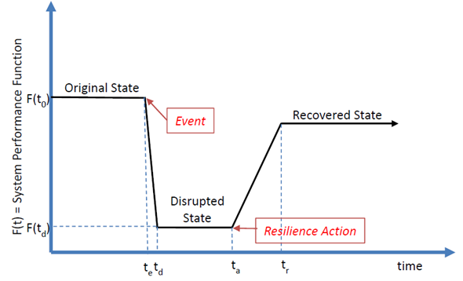
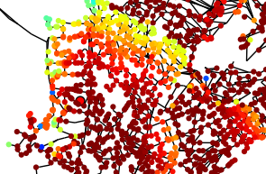
State Transition plot for time-series metrics Network graphic for spatially distributed metrics
Incident
Resilience Action

Slide 4
Node name
Link name
Node name
Link name
Node name
Link name
Time step
Time step
Node attribute
Link attribute

Slide 5
Simple
Complex
START
Generate a water network model
Define fragility curves for failure and available resources for recovery
Run a hydraulic and water quality simulation
Compute topographic metrics
Modify the network structure and operations
Compute resilience metrics
Simulate environmental change from a disaster
Modify the network structure
Add a disruptive incident and recovery action based on historical data
Add a disruptive incident and recovery action based fragility curves and available resources
Save the modified network as an EPANET INP file
For multiple stochastic scenarios
Rerun the hydraulic and water quality simulation
Recompute topographic metrics
Run a hydraulic and water quality simulation
Recompute resilience metrics
Compute resilience metrics
END
Analyze results and generate graphics

