Slide 1
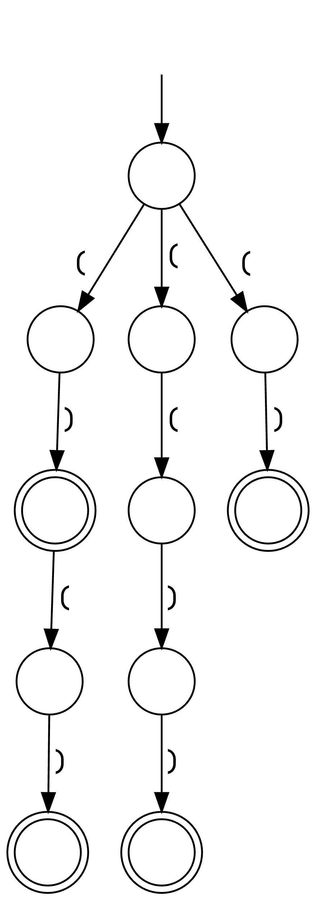
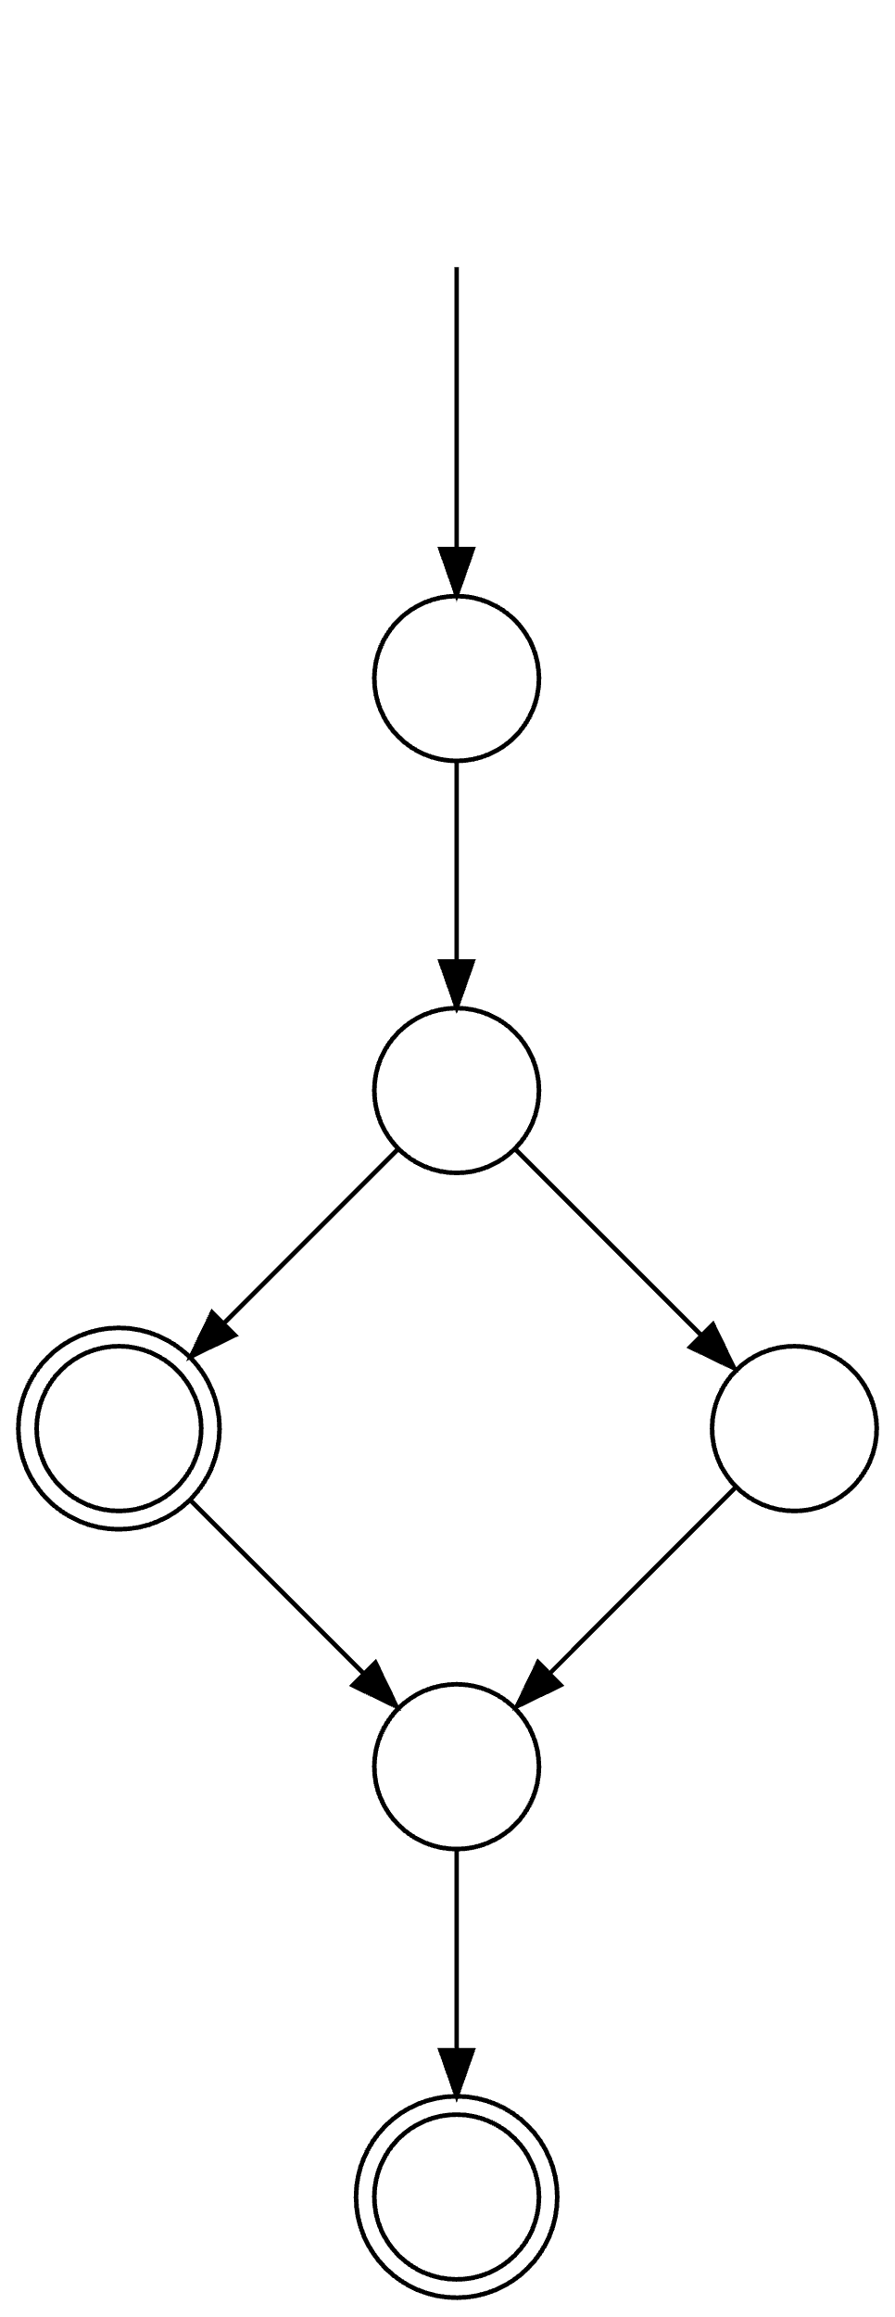
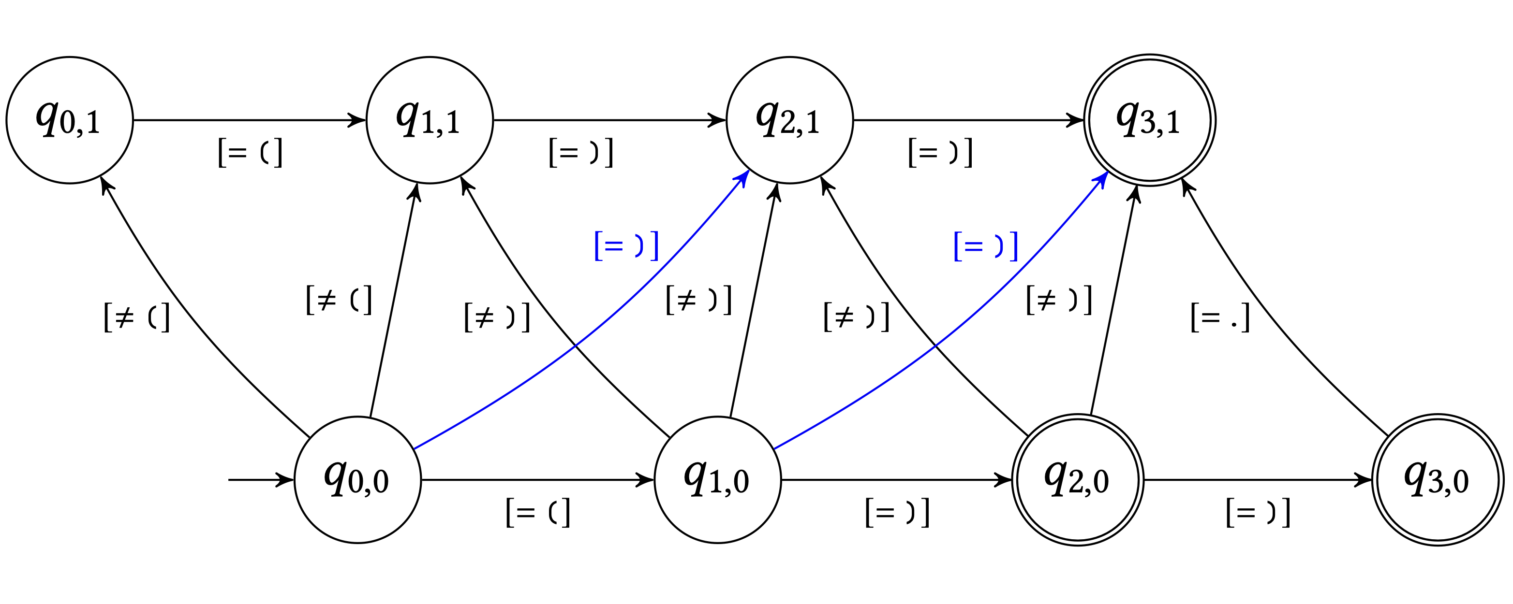
Syntax CNF Grammar
DFA
DFA*
∩-Grammar
S → ( ) | ( S ) | S S
S → L R
S → L F
S → S S
F → S R
L → (
R → )
⟶
Decoded Repairs
⟶
S → q₀₀Lq₁₀ q₁₀Rq₃₁ S → q₀₀Lq₂₁ q₂₁Rq₃₁ S → q₀₀Lq₀₁ q₀₁Fq₃₁ S → q₀₀Lq₁₀ q₁₀Fq₃₁ S → q₀₀Lq₁₀ q₁₀Rq₂₀ S → q₀₀Sq₂₀ q₂₀Sq₃₁
( )
( ) ( )
( ( ) )
(
⟶
⟶
⟶
)
(
Code Edit automaton
q₁₀Bq₃₁ → ) q₁₁Bq₂₁ → ) q₂₀Aq₂₁ → ( q₂₀Aq₃₀ → ( q₂₁Bq₃₁ → ) q₃₀Bq₃₁ → ) q₁₀Bq₃₁ → ) q₁₁Bq₂₁ → ) q₂₀Aq₂₁ → ( q₂₀Aq₃₀ → ( q₂₁Bq₃₁ → ) q₃₀Bq₃₁ → )
⟶
q₂₀Sq₃₁ → q₂₀Lq₂₁ q₂₁Rq₃₁ q₂₀Sq₃₁ → q₂₀Lq₃₀ q₃₀Rq₃₁ q₀₀Sq₂₀ → q₀₀Lq₁₀ q₁₀Rq₂₀ q₀₁Fq₃₁ → q₀₁Sq₂₁ q₂₁Rq₃₁ q₀₁Sq₂₁ → q₀₁Lq₁₁ q₁₁Rq₂₁ q₁₀Fq₃₁ → q₁₀Sq₂₁ q₂₁Rq₃₁ q₁₀Sq₂₁ → q₁₀Lq₁₁ q₁₁Rq₂₁ q₀₀Sq₃₁ → q₀₀Lq₁₀ q₁₀Rq₃₁ q₀₀Sq₃₁ → q₀₀Lq₂₁ q₂₁Rq₃₁
(
)
)
( ) ( ) ✅
) ) ) ❌
( ) ) ✅
...
( ( ) ❌
( ( ) ) ✅
( ) )
⟹
)
)

