Slide 1




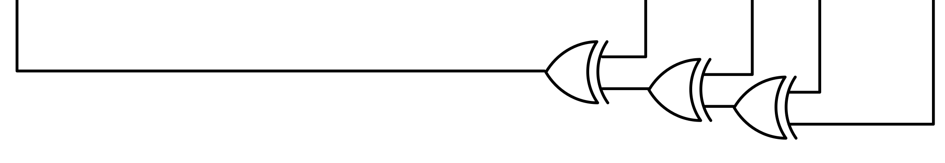




d = sum([foo(i] for i in vals))
S → ID | ID ( S ) | S , S | + S
S → S | [ S ] | S . S | ( S )
S → S if S else S | S for S in S
①
①
③
②
②
d = sum([foo(i) for i in vals])
d = sum([ (i) for i in vals])
d = sum([foo.i for i in vals])
d = sum([foo(+i) for i in vals])
⑤
④
d = sum([foo(i) for i in vals])
⑥

Slide 2
Invalid Snippet
BNF Parser
Lexical Tokenization
Context-Free Grammar
Levenshtein Automaton
Chomsky Normal Form
Levenshtein-Bar-Hillel Construction
Tree Sampler
CPU #1
…
CPU #N
Online Ranker
Sorted Repairs

