Slide 1
MGB-SA HYDROLOGICAL MODELLING
Suspended-sediment transport in the Magdalena basin
under contrasting ENSO phases
La Niña 2011 vs El Niño 2015–16 · focus: the hydrology
Universidad Militar Nueva Granada — EMINES
Advisor: Prof. Briceño Zuluaga
Team: TWILL · yben409 (model) · Omar (data)

Slide 2
MOTIVATION
Why the Magdalena, why ENSO
The Magdalena carries one of the world's highest specific sediment yields — key for reservoirs, the delta and water quality.
Its discharge and sediment show strong interannual variability driven by ENSO (La Niña wet, El Niño dry).
The ENSO–sediment link is known observationally (Restrepo et al.), but never reproduced with a distributed, process-based model over the whole basin.
This work builds and validates the hydrology first — the foundation any sediment model must stand on.
~257,000
km² basin area
~144 Mt/yr
suspended load (Calamar)
2
contrasting ENSO years

Slide 3
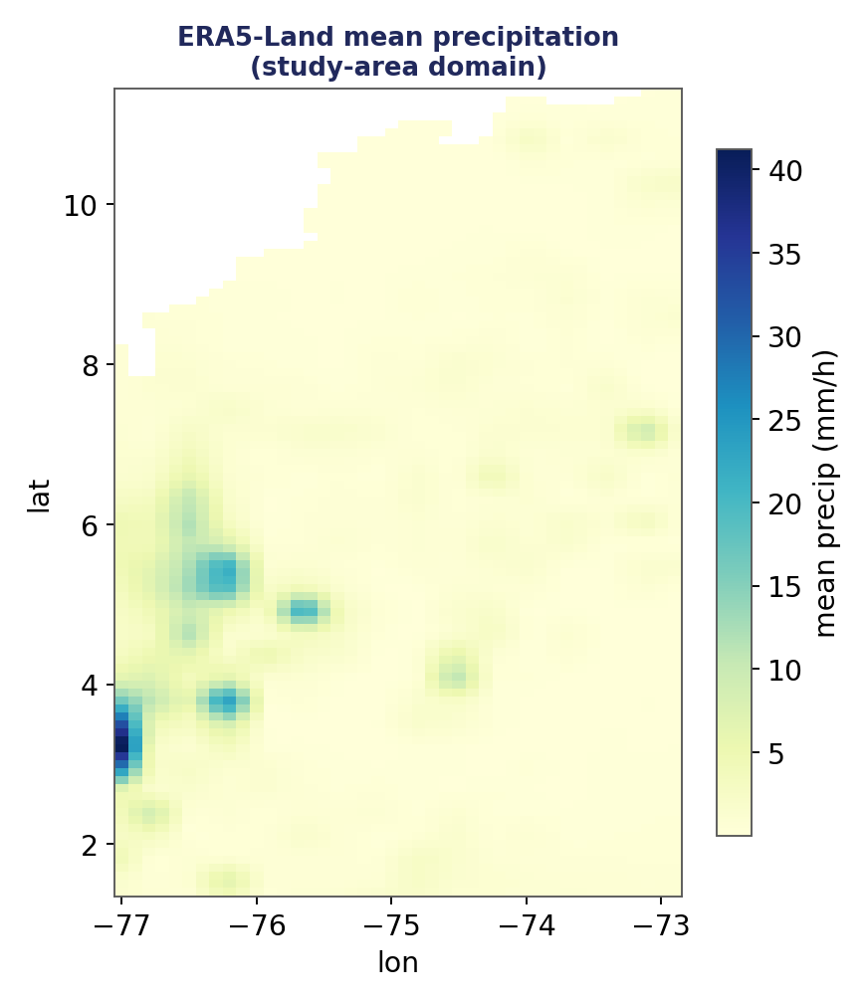
BASIN
Study area & domain
Whole Magdalena–Cauca basin, hydrographic codes 21–29.
Andean headwaters (Alto Magdalena, Cauca) to the Caribbean delta; outlet gauge at Calamar.
Climate/terrain grids on the basin box; the ERA5 field (right) shows the wetter Andean flanks.
Open item: the east edge (−72.9°) clips the upper Sogamoso/Chicamocha — domain to be enlarged before re-download.

Slide 4
RESEARCH QUESTION
Objective, hypothesis & novelty
1
Objective
2
Hypothesis
3
Novelty
Quantify and explain the difference in sediment fluxes between a La Niña and an El Niño year with a calibrated MGB-SED — starting from a calibrated hydrology.
Contrasting ENSO phases produce a detectable, physically interpretable difference the model can reproduce.
First MGB-SED application to the Magdalena; process-based, spatial attribution beyond existing statistical correlations.

Slide 5
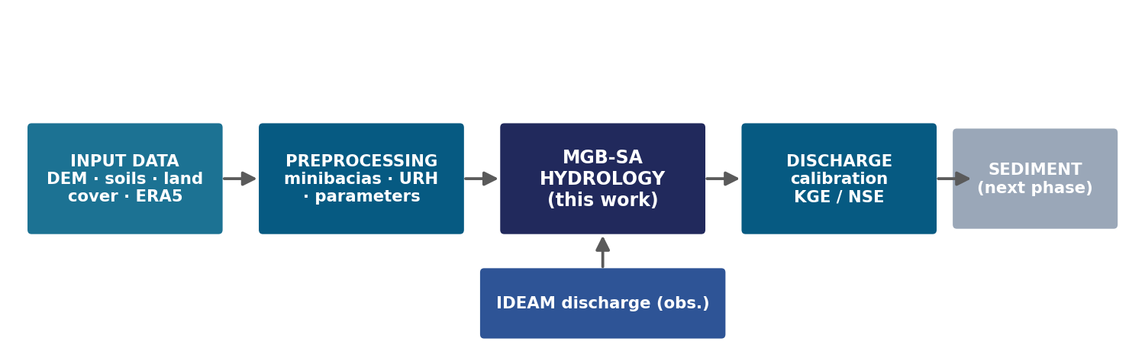
HOW IT FITS TOGETHER
Methodology roadmap
Inputs → preprocessing → MGB-SA hydrology (this work) → discharge calibration. Sediment is the next phase.

Slide 6
MODEL CHOICE
The model: MGB-SA (hydrology)
Semi-distributed
URH / HRU
Basin split into minibacias (unit-catchments) with upstream→downstream topology.
Each minibacia split into soil × land-cover response units.
Physically based
Already implemented & tested
Water balance, saturation-excess runoff, Penman–Monteith ET, routing.
A from-scratch Python MGB-SED (yben409): mass/water balance closes; 64 conservation tests pass.

Slide 7
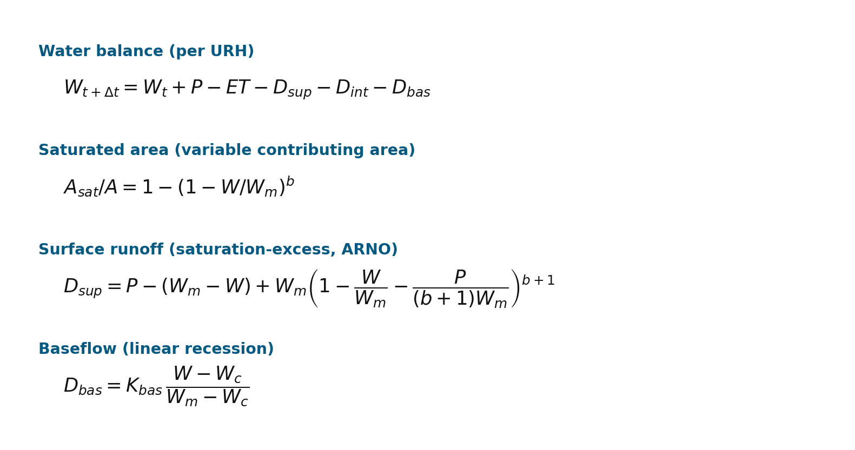
MODEL — EQUATIONS (1/2)
Water balance & runoff generation
One soil store of capacity Wm per URH.
Runoff is saturation-excess: it forms where the soil is full, over a variable saturated area set by b.
b, Kbas (and interflow) are the calibrated parameters.
Wm comes from the soils; P and ET from ERA5.

Slide 8
MODEL — PARAMETERS (2/2)
Every parameter has a source
Symbol | Parameter | Source
A, L, S | area, river length, slope | DEM
Wm | max soil water storage | Soils (SoilGrids → pedotransfer)
LAI, α, rs | vegetation (ET, interception) | Land cover
Rn, es−ea, ra | radiation & atmosphere (ET) | ERA5
P | precipitation | ERA5 + IDEAM (bias-corrected)
b, Kint, Kbas | runoff / interflow / baseflow | calibrated on discharge
Cs, Ci, Cb | reservoir delays (routing) | calibrated

Slide 9
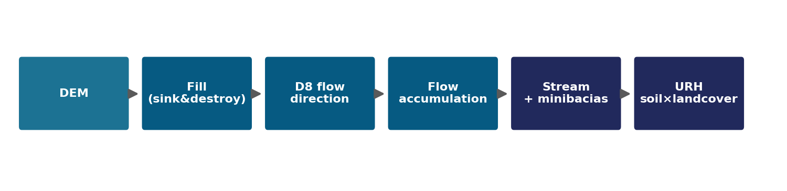
METHODOLOGY
Preprocessing pipeline
DEM → fill (sink & destroy) → D8 flow direction → accumulation → stream network → minibacias.
URH = soil-group × land-class overlay (pixel-by-pixel; Fréchet bounds for the crossing).
SoilGrids raw texture → pedotransfer → K, Wm, hydrologic soil groups.
WorldCover reclassified to 8 hydrological classes; ERA5 aggregated hourly→daily and bias-corrected.

Slide 10
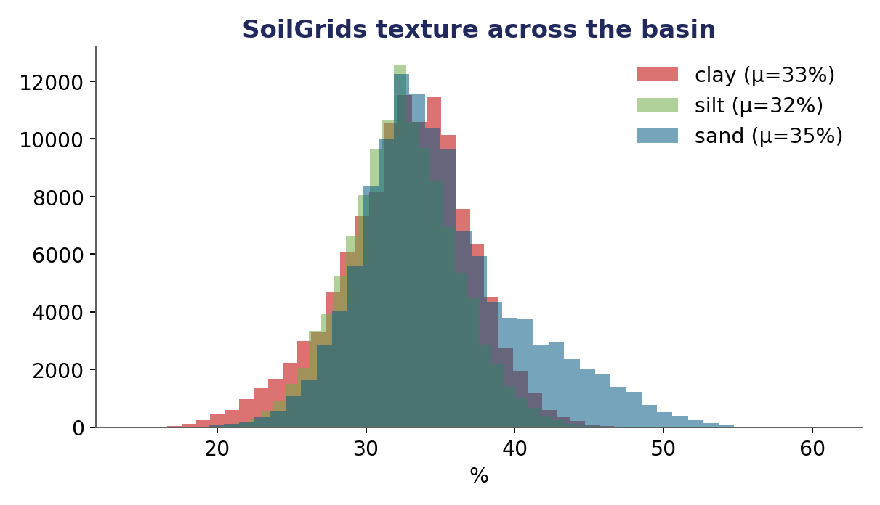
METHODOLOGY — DATA
Soils → model parameters (pedotransfer)
Raw texture = clay / sand / silt %, plus SOC and bulk density.
A pedotransfer function converts them into model inputs:
→ USLE K (erodibility), Wm, saturated conductivity, soil groups.
250 m coarseness is removed by averaging pixels within each minibacia.

Slide 11
METHODOLOGY — DATA
Climate forcing — ERA5-Land
7 variables: precipitation (the driver) + temperature, dewpoint, radiation, wind, pressure (→ PET).
Aggregated hourly → daily to force the soil water balance.
Known limitation: ERA5 under-represents orographic rain in the Andes.
Mitigation: bias-correct precipitation against IDEAM gauges (factor or quantile mapping).

Slide 12
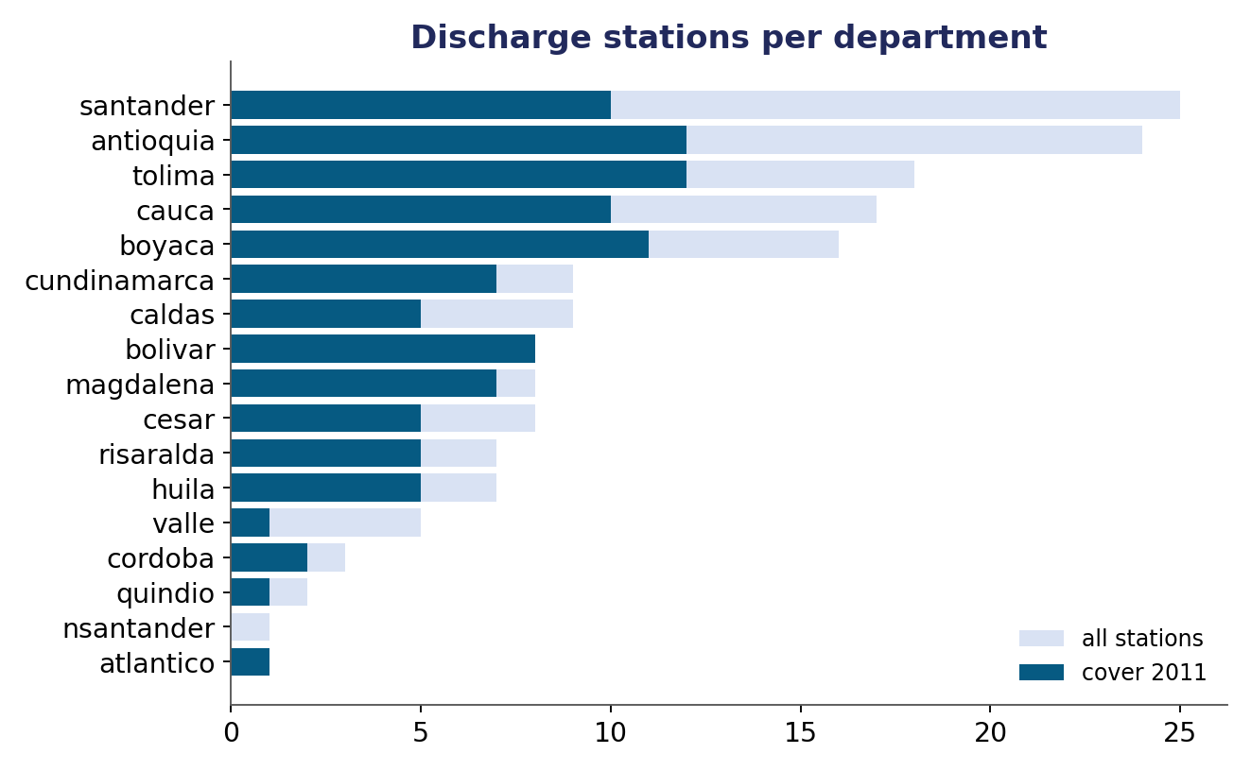
DATA (THIS IS WHAT UNBLOCKS IT)
Calibration data — discharge collected
167
discharge stations (Caudal medio diario), códigos 21–29, catalogue-verified
Downloaded via the DHIME portal (not the open API) — this is exactly the data the model was waiting for.
101 stations cover 2011, 94 cover 2015–16.
Every batch cross-checked against the official IDEAM station catalogue.

Slide 13
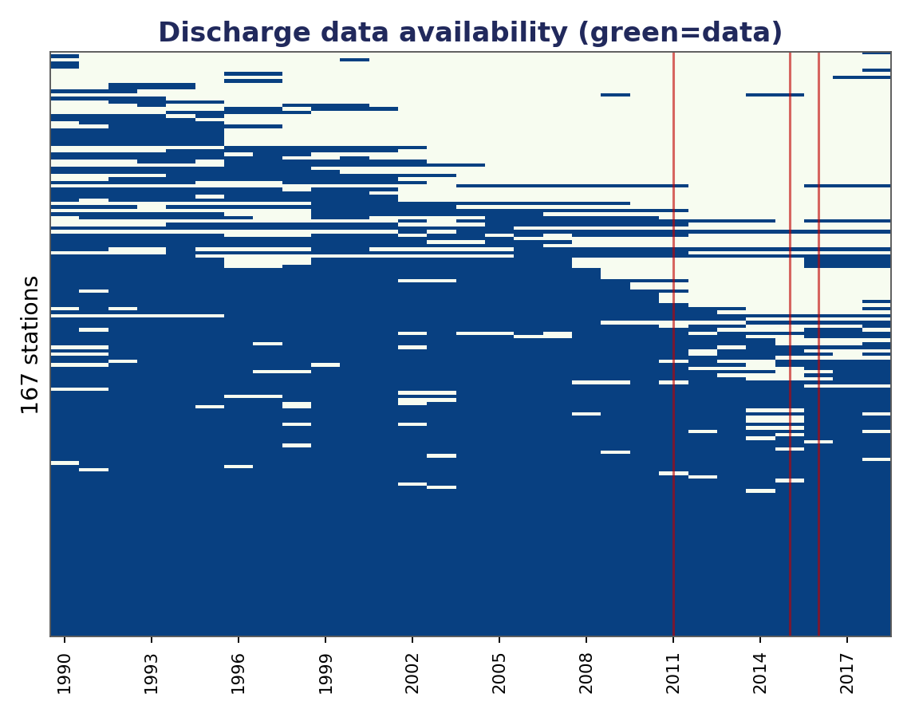
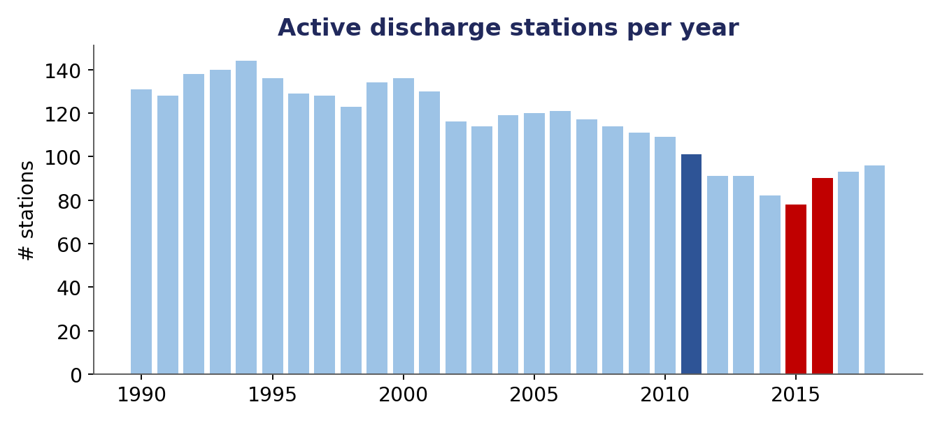
DATA
Coverage & data quality
Dense but patchy records → neighbour-regression gap-filling planned.
A stable network of ~100+ stations through the study years — enough for robust calibration.

Slide 14
METHODOLOGY — HOW
Calibration & validation strategy
Hydrology first — sediment only after discharge is calibrated.
Split-sample: calibrate on one period, validate on another (blocked, no leakage).
Study years 2011 & 2015–16 kept as a clean validation / scenario run.
KGE
1 − √[(r−1)²+(α−1)²+(β−1)²]
NSE
1 − Σ(sim−obs)² / Σ(obs−mean)²
PBIAS
100·Σ(sim−obs)/Σ obs

Slide 15
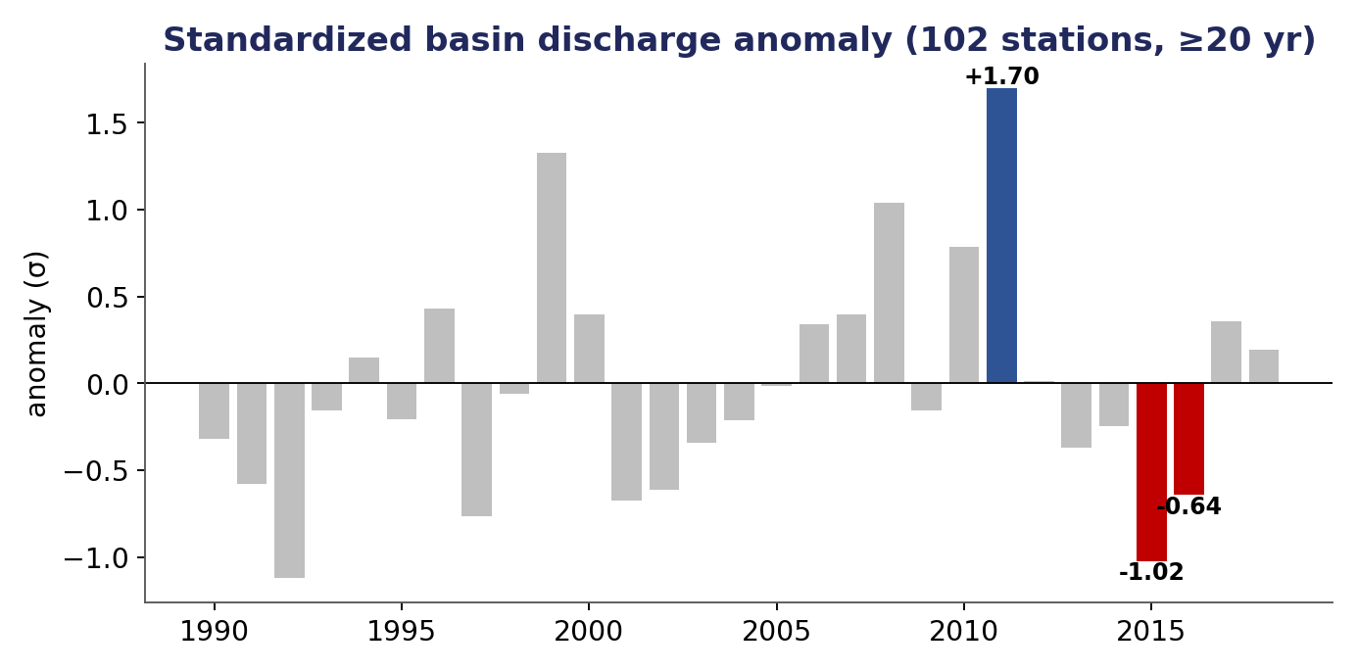
VALIDATION — THE KEY RESULT
Our data confirm the ENSO contrast
Standardized discharge anomaly (102 stations):
2011 = +1.70 σ (wet · La Niña)
2015 = −1.02 σ (dry · El Niño)
2016 = −0.64 σ (dry · El Niño)
Robust across 86–133 stations.

Slide 16
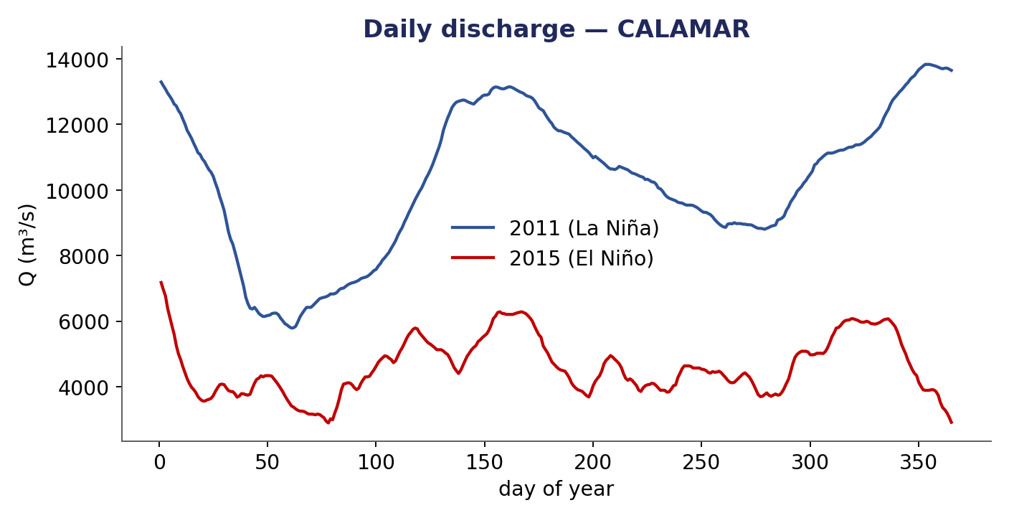
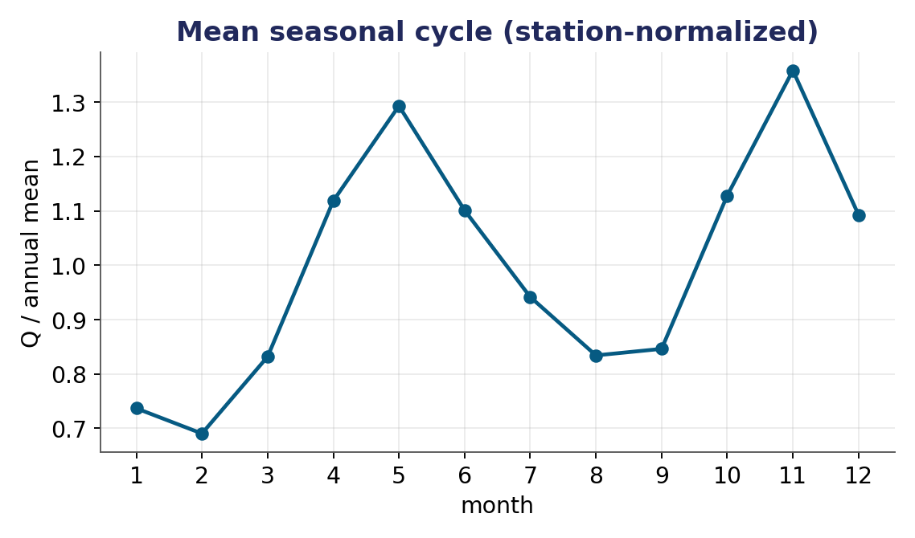
VALIDATION
The contrast, seen directly
La Niña 2011 runs higher all year (left); the basin's bimodal Andean regime (right).

Slide 17
SYNTHESIS
Two halves meet: model + data
MODEL
DATA
Full MGB-SED implemented & tested (yben409). Was blocked by 'no sediment/discharge data'.
calibration-ready
167 discharge + 77 sediment stations collected via DHIME & verified — exactly what the model needed.
He built the model that was waiting for data; we collected the data the model was waiting for.

Slide 18
EXECUTION
Team & division of work
1
Model engine
2
Data & hydrology
3
Data collection
yben409
TWILL
Omar + colleague
MGB-SED in Python: water balance, routing, MUSLE, calibration, tests.
Discharge/sediment acquisition, catalogue verification, inventory & EDA, hydrology setup.
Downstream departments & sediment (CM variable) by department.

Slide 19
EXECUTION — TIMELINE
Work plan — how we will do all this
M0
M1
M2
M3
M4
M5
M6
M7
M8
M9
Finish acquisition + domain box
Preprocessing (minibacias, URH, params)
Hydrological calibration & validation
Sediment calibration (next phase)
ENSO scenario runs (2011 vs 2015-16)
Analysis & report
The hydrology track (M1–M5) is the focus of this talk; sediment follows once discharge is calibrated.

Slide 20
EXECUTION
Risks & mitigations
Sediment data on the mainstem
ERA5 orographic precip bias
Tributary rating curves + direct concentration comparison (model outputs C).
Bias-correct against IDEAM gauges before forcing.
Whole basin at 30 m infeasible
Eastern domain box clips Sogamoso
90 m whole-basin (cell-limit justified).
Enlarge box before re-downloading rasters.

Slide 21
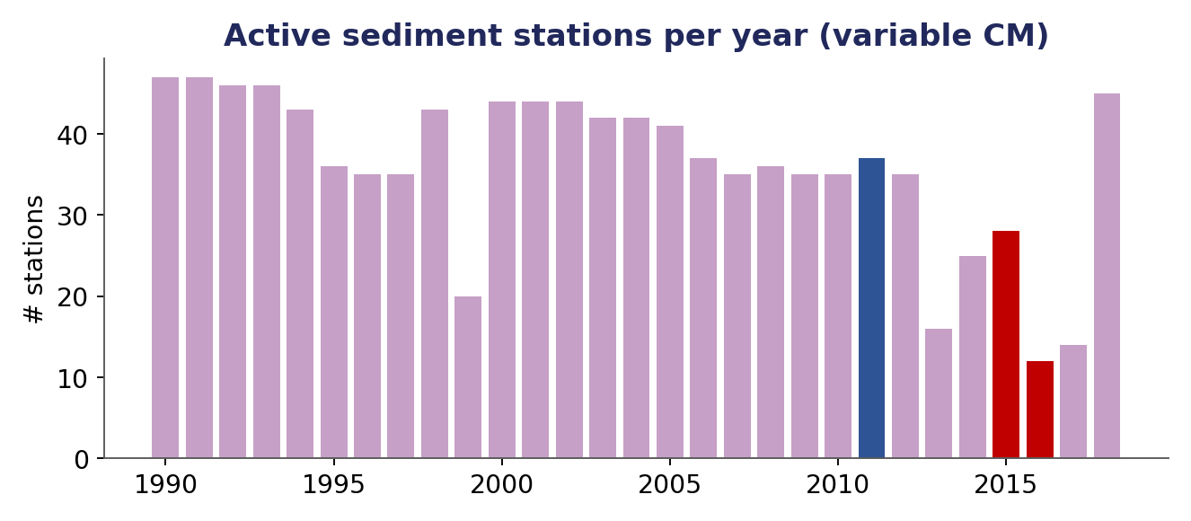
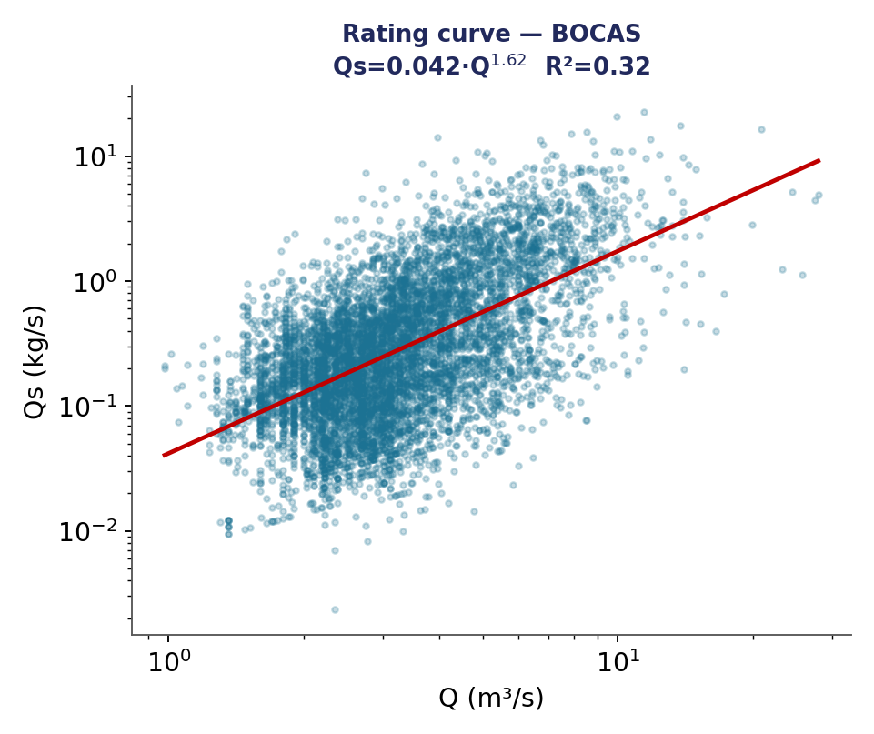
NEXT PHASE
Outlook — the sediment phase
Sediment data already collected (77 CM stations) and rating-curve-ready (median R² ≈ 0.5).
Honest scope: absolute loads are uncertain; the defensible outputs are RELATIVE comparisons (2011 vs 2015-16) — bias cancels in a ratio.

Slide 22
Contribution & next steps
First calibrated MGB-SED for the Magdalena; a process-based, spatial reading of the ENSO sediment signal.
Hydrology foundation in place: model built & tested, discharge data collected & validated, ENSO contrast confirmed.
Next: finish ERA5 + domain box → preprocessing → discharge calibration → sediment.
Key references: Fagundes et al. (2020–2026) · Collischonn et al. (2007, MGB-IPH) · Restrepo & Kjerfve (2000) · Bates et al. (2010) · Briceño et al. (ERA5 bias)

