Slide 1
Journey to digital self-sovereignty

Slide 2

Who am I?
Jordan Bravo
Pleb
Software Developer (but you don’t need to be one)
I don’t have anything to sell you

Slide 3
What is digital self-sovereignty?
Ownership over your computing and data: the ability to decide what to do with your data, and with whom to share it.

Slide 4
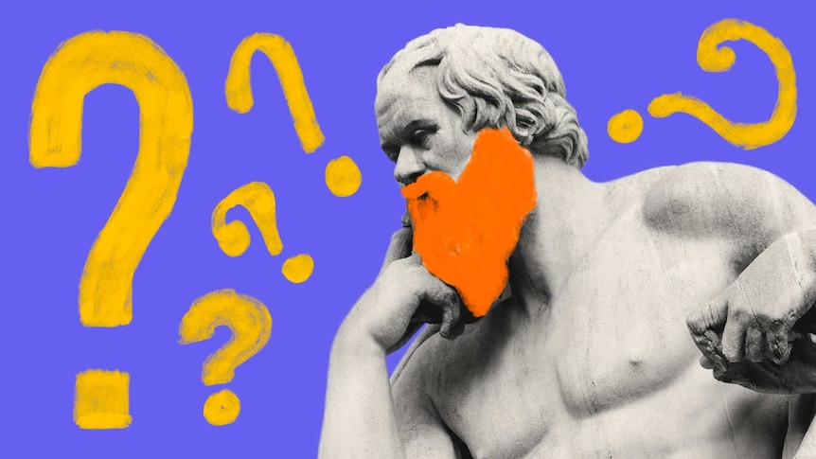
Why?
Why did I start my journey to digital sovereignty and privacy?

Slide 5

Why?
Decentralization
Privacy
Censorship resistance

Slide 6

Why?
I want to own my own data, I don't want to rent someone else's computer
Own vs. rent

Slide 7

Why?
When using Big Tech cloud, your data is sold and/or given to others (Snowden revelations)

Slide 8
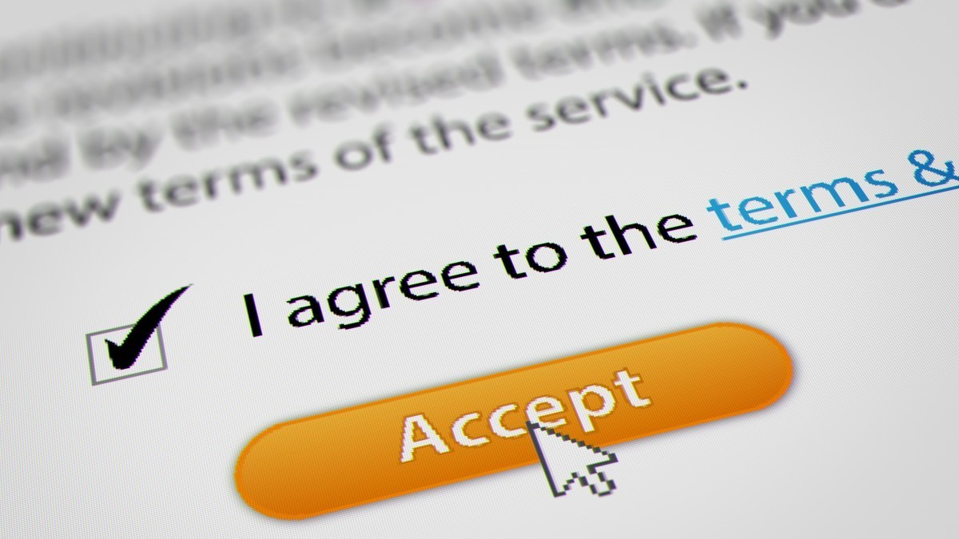
Why?
Subject to changing terms of service, e.g. Google Suite 2022

Slide 9
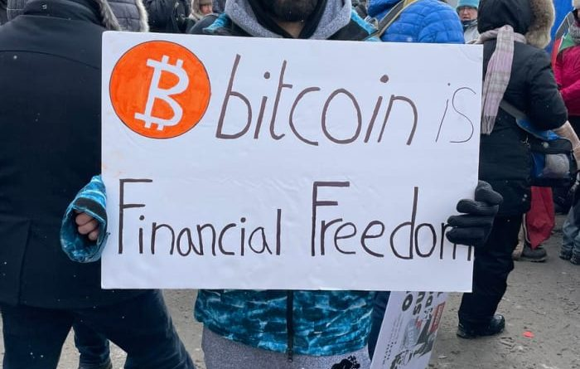
Why?
Overlaps with Bitcoin and financial privacy.
Data on someone else's computer is like having your Bitcoin on an exchange: you must be given permission to access it, that permission can be denied at any time (Canadian truckers)

Slide 10
Goals
Reduce or eliminate reliance on third parties
If using third parties, prefer zero knowledge implementations (end to end encrypted)
Open source
Self hostable

Slide 11


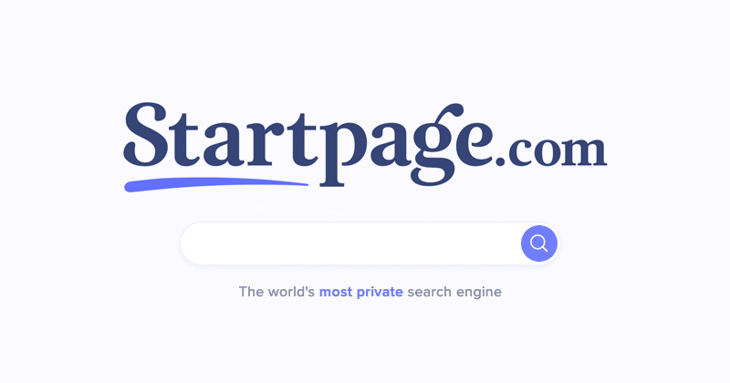

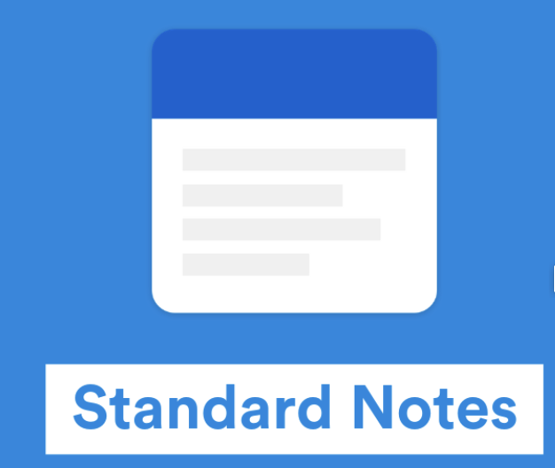




Steps taken so far
Replace invasive, proprietary Big Tech products & services
Email: Gmail -> self hosted domain name (e.g. Namecheap as registrar)
Storage: Google Drive / iCloud / Photos / contacts / calendars -----------------> Nextcloud
Search: Google Search -> Startpage, DuckDuckGo
Notes: Keep/Notes -> Standard Notes
Passwords: LastPass ----------------------------------------------> Bitwarden
Office suite: Google Docs -> Only Office
Web browser: Chrome ---------------------------------------------> Brave/Firefox

Slide 12



Steps taken so far
Install browser extensions:
uBlock Origin
Decentraleyes
xBrowserSync

Slide 13
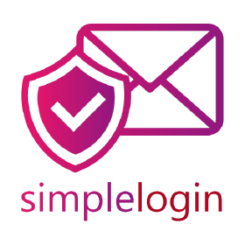
Steps taken so far
Don’t give out email address, use alias service such as SimpleLogin
Example:
walmart@mydomain.com
wellsfargo@mydomain.com
Etc.

Slide 14

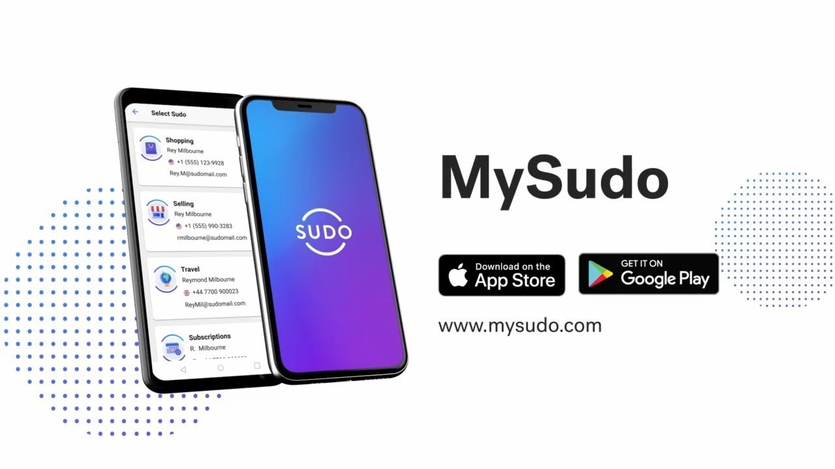
Steps taken so far
Don’t give out phone number
For one time verification, use TextVerified
For continual use, MySudo

Slide 15
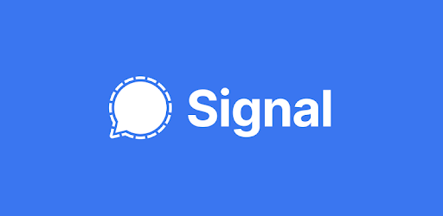
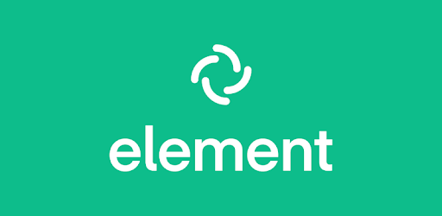
Steps taken so far
Messaging: use a private messenger with end to end encryption
Replace SMS / iMessage / Telegram / WhatsApp / Facebook Messenger
#1 recommendation is Signal
Honorable mention: Element (Matrix protocol)

Slide 16
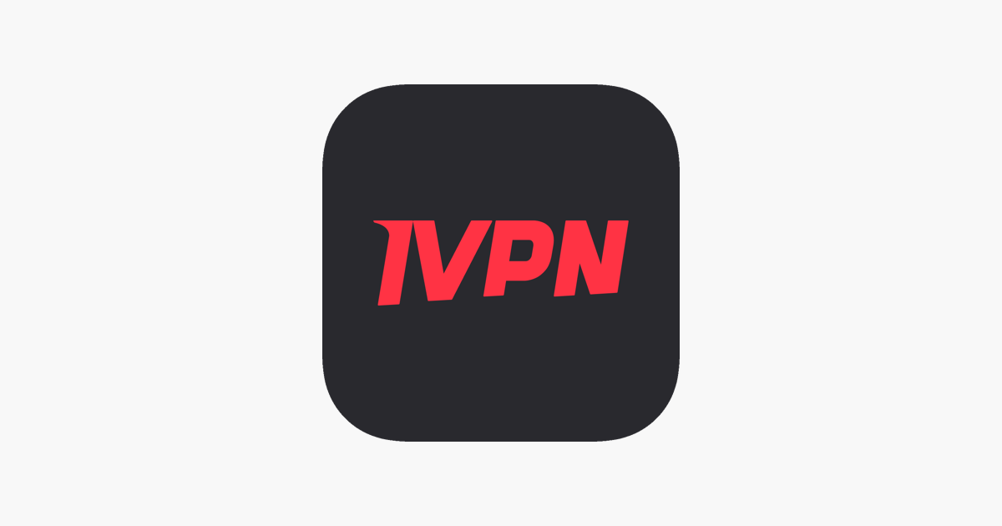

Steps taken so far
VPN: use a no log VPN outside “14 Eyes” jurisdiction, pay with Bitcoin
IVPN
ProtonVPN

Slide 17


Steps taken so far
Replace Windows with Linux
Tw0 good options:
Ubuntu
Fedora

Slide 18
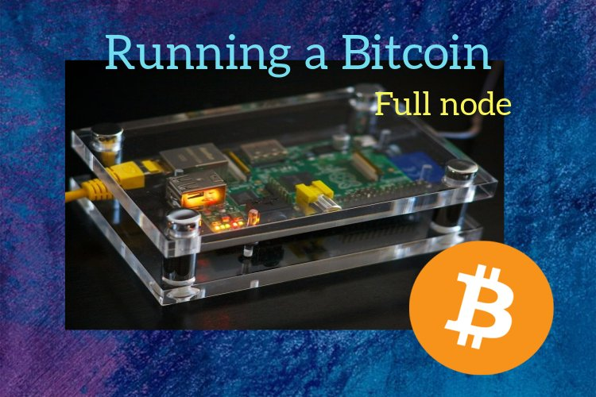
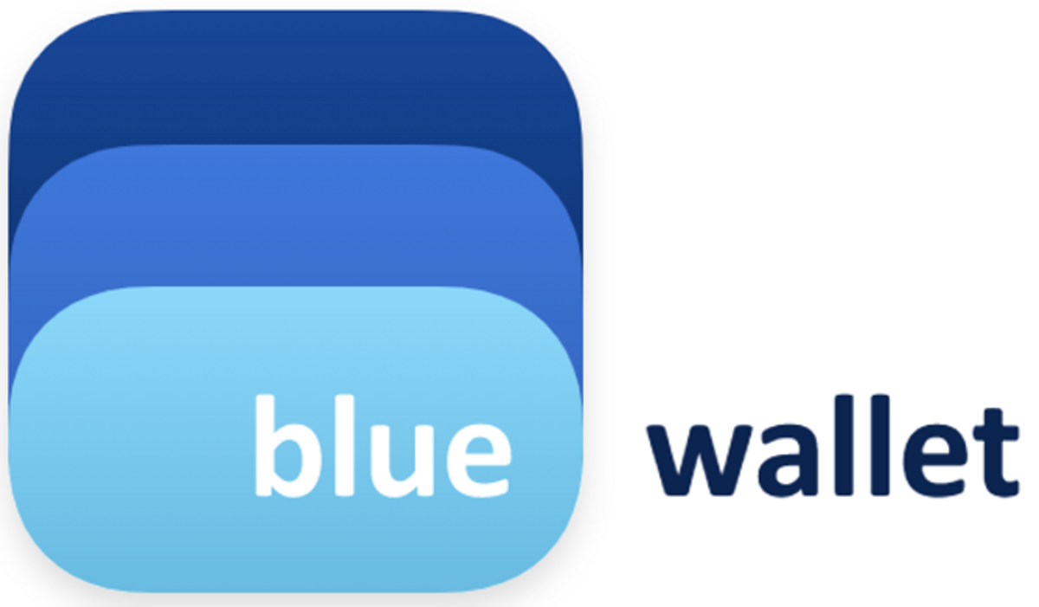
Steps taken so far
Bitcoin
Run a Bitcoin full node and point my wallet software at it (e.g. Raspberry Pi)
Pay with Lightning when possible
Acquire non-KYC Bitcoin (see next slide)

Slide 19





Steps taken so far
Bitcoin
Acquire non-KYC Bitcoin
KYC = Know Your Customer
Get paid in Bitcoin
Trade face to face at Bitcoin meetups
Mining
Bitcoin ATMs (some have little-to-no KYC)
Peer to peer exchanges:
AgoraDesk
Hodl Hodl
Bisq

Slide 20
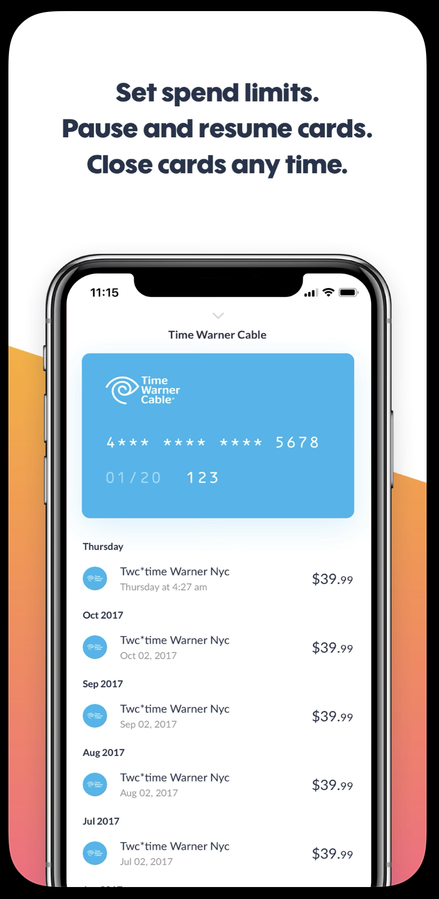
Steps taken so far
Virtual Debit Cards
Privacy.com

Slide 21
Steps taken so far
Self-hosting
Level 0: Use third party provider of software as a service (SaaS)
Level 1: Self-host software but rent hardware (VPS)
Level 2: Self-host software on self-owned hardware
Easy options such as the Start9 Embassy

Slide 22
Future steps to take
Get rid of KYC Bitcoin (more precisely, replace KYC Bitcoin w non-KYC Bitcoin)
Replace iOS with Calyx or Graphene
Replace MacOS with Linux
Try out coinjoin (Samourai wallet (mobile), Sparrow wallet (desktop))
Replace mobile carrier in my name with MVNO, prepaid anonymously
Get standalone GPS for car
Get my own hardware to self-host on

Slide 23
Lessons learned
Avoid being overwhelmed: start gradually and make incremental improvements
Don't let perfect be the enemy of good
Everyone must tailor their privacy tradeoffs to their individual preferences/situations

Slide 24
Action Items
Start using a password manager. Recommendation: Bitwarden
Use Signal Messenger as your primary means of communication
Try Proton Mail / Drive instead of Gmail / Google Drive
Get your Bitcoin off exchanges, try acquiring some non-KYC Bitcoin

Slide 25



Thank you
Matrix: @jordanbravo:matrix.org
Twitter: @thejordanbravo
Telegram: @jordan_bravo
Recommended resources:
Non-KYC Bitcoin: kycnot.me
Privacy Journey: privacyguides.org
Software Guides: techlore.tech/resources

