Slide 1
Design Patterns in UML
Introduction to Design Patterns

Slide 2
Contents
Design Patterns
History
Documentation
Unified Modeling Language
Pattern classes
Object-oriented concepts
Advantages of patterns

Slide 3
Design Patterns
A design pattern is
  A solution to a common problem in architecting a computer program
  Is one of many possible solutions
  Proven to be a good solution
  Implementable in any object-oriented language
  A way to learn from other people’s experience
  A way to name software architectural techniques

Slide 4
Patterns in Software Development
Computer language
  Primitive data structures and operations
Data structures
  How to combine primitives to make complex data structures
Algorithms
  Solutions to common problems like searching or sorting
Patterns
  Solutions to how to structure programs in the best way

Slide 5
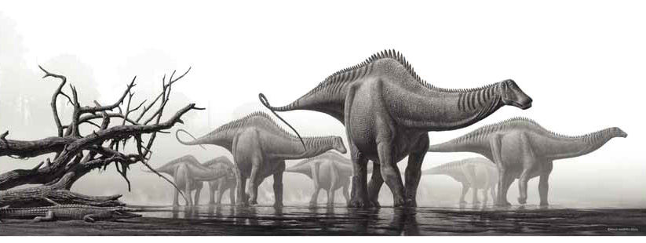
Before Patterns …
A primitive world
  Architecture learned by reading code or experience
  Architecture not taught in school
  No names which could be used to discuss architecture
Actual Software Development Environment before patterns

Slide 6
Patterns in Physical Architecture
Christopher Alexander is an architect who designs buildings and cities
He recognized that in the design of cities there are common patterns which work well
In 1977-79 he wrote a book of architectural patterns
This became the basis for software design patterns

Slide 7
Patterns in Software
In 1987 Kent Beck and Ward Cunningham began experimenting with using patterns in software
In 1994 the book Design Patterns: Elements of Reusable Object-Oriented Software was published
This popularized the use of design patterns
In the ensuing years
  All new areas develop patterns
  Patterns have become a standard teaching technique
  Patterns provide a way to discuss architecture

Slide 8
The Gang of Four
The book Design Patterns: Elements of Reusable Object-Oriented Software is often called the gang of four book, after its authors
The authors were working in GUI software when they wrote the book
While many of the patterns are widely applicable, some are applicable largely to GUI software

Slide 9
What Design Patterns Are Not
New solutions
  All of the patterns were well-known before they were written down
  They just didn’t have names
Comprehensive
  The GOF book lists 23 patterns
  Hundreds of patterns have been described
  Hundreds more remain to be described

Slide 10
Benefits of Patterns
Promotes teaching of design
Provide a language to use when discussing designs
Promotes use of proven designs
Makes the design of software more apparent and improves readability
Reduces design time and improves quality

Slide 11
Documentation
This is the way in which a design pattern is described
Different authors use slightly different notations and there is no universal agreement
We will look at the documentation used by the GOF

Slide 12
GOF Documentation
Name and classification
  The name of the pattern and the class to which it belongs
Intent
  The goal of the pattern
Also known as
  Aliases for the pattern
Motivation
  The problem which needed this pattern

Slide 13
GOF Documentation
Applicability
  Situations in which this pattern can be used
Structure
  A graphical representation of the problem such as class diagrams or interaction diagrams
Participants
  The classes and objects used in the pattern

Slide 14
GOF Documentation
Collaboration
  How classes and objects in the pattern interact with one another
Consequences
  The results and side effects
Implementation
  How to write the code for the pattern
Sample code
  How to use the pattern in a programming language

Slide 15
GOF Documentation
Known uses
  Examples of how the pattern is used in the real world
Related patterns
  Other patterns which are related to this one
  Other patterns which should be considered before selecting a pattern for use

Slide 16
Unified Modeling Language
UML is a graphical notation for specifying the design of software
It is a standard overseen by the Object Management Group
Two of the many UML diagrams are used in the description of patterns
  Class diagrams
  Interaction diagrams

Slide 17
Class Diagrams
Class diagrams can show
  The data members of a class
  The methods of a class
  The relationships between classes
    Relationships which do not generate code
    The specialization / generalizations
    The has-a relationships where one class contains an instance of another class or a reference to another class
      Composition where the container holds an instance of the contained class
      Aggregation where the container holds a reference to the contained class

Slide 18


Class Diagrams
Depiction of a general relationship between classes with roles and cardinality
Depiction of an aggregation relationship with cardinality shown

Slide 19
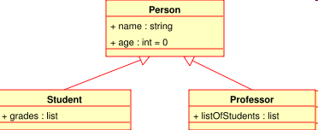
Class Diagrams
A specialization / generalization relationship showing the
derivation of subclasses from a parent class

Slide 20
Interaction Diagram
This is better known as a UML Sequence Diagram
It shows the method calls between a series of object to perform some operation
It demonstrates how you would use these methods to do something useful
In this way, it acts as rapid documentation for the methods

Slide 21
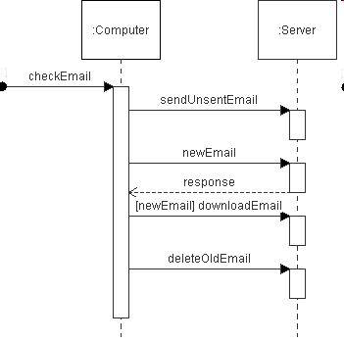
Interaction Diagram
A UML Sequence Diagram

Slide 22
Extending Classes
Often, we want to create a new class by extending an existing class
This can be done in two ways
  By deriving a new class from the existing class
    This is called specialization
  By adding an instance of another class as a member of this class
    This is called composition or aggregation

Slide 23
Specialization vs. Composition
Specialization
  Creates a subtype which inherits all the properties of the parent type
  This creates an is-a relationship where the derived type is a special case of the base type
Composition
  Adds an instance of another class as a field of a class
  This creates a new type, not a subtype
  This creates a has-a relationship since the owning class has an instance of the owned class

Slide 24
Specialization vs. Composition
Vehicle
Vehicle
Bicycle
Car
WheelDesc
In specialization, each derived
class shares common properties
with the parent class.
In composition, the new field
is added to a list of fields to
create an entirely new type.
The new field is contained
within the owning type.

Slide 25
Composition
In composition
  The owned object is destroyed when the owning object is destroyed
  The owning object physically contains the owned object
class Wheel {
double diameter;
double width;
enum {
rubber,
wood,
metal
} material;
};
class Vehicle {
//…
Wheel wheelDesc;
};

Slide 26
Aggregation
In aggregation
  The owned object is not necessarily destroyed when the owning object is destroyed
  This is usually implemented by having the owning object store a pointer or reference to the owned object
class Wheel {
double diameter;
double width;
enum {
rubber,
wood,
metal
} material;
};
class Vehicle {
//…
Wheel *wheelDesc;
};

Slide 27
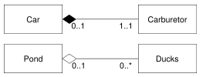
Composition and Aggregation in UML
aggregation
composition

Slide 28
Favouring Composition over Inheritance
While inheritance is a convenient way to change the behaviour of a class it suffers from problems
  You tend to make assumptions about the parent class
  This creates a tight-coupling between the base and derived classes
  As a result, the derived class is not re-usable in other situations

Slide 29
Favouring Composition over Inheritance
When you use composition
  You plug in some object which implements an interface
  The plugged-in object knows almost nothing about the class into which it is plugged
  It makes no assumptions about where it is plugged in
  This creates less coupling
  The plugged-in component could be plugged into other objects, whereever the behaviour is needed

Slide 30
Favouring Composition over Inheritance
Inheritance creates a parent-child relationship
  The child extends the capabilities of the base class
  The derived class can only modify the behaviour of one class – its base class
Composition does not create a rigid relationship
  The base object has a hook for a certain type of object
  Any object with the right interface can be plugged in
  An object with the right interface can be plugged into any other object with the connection
  You can unplug one object and plug in another at any time, changing behaviour dynamically

Slide 31
Favouring Composition over Inheritance
The is-a relationship of inheritance
  Is created at compile time
  Cannot easily be changed
  Can create huge numbers of subclasses
  Creates static relationships
The has-a relationship of composition
  Creates lower coupling
  Allows the relationship to be determined at run-rime
  Allows the relationship to change dynamically
  Does not change any class hierarchy

Slide 32
Favouring Composition over Inheritance
Inheritance breaks encapsulation
  A class which extends the functionality of another class should not know about the internals of the other class
  With inheritance, the base class has access to more of the methods in the base class and the developer usually has access to the code in the base class
  This causes derived classes to take advantage of that knowledge, increasing coupling
  Composition knows nothing about where an object will be plugged in and has lower coupling
  The object being plugged in presents an interface and that is all we know about the object, resulting in lower coupling

Slide 33
Favouring Composition over Inheritance
Favouring composition
  Maintains encapsulation
  As a result, each class is focussed on one task
  This keeps class hierarchies smaller and more manageable
On the other hand, composition tends to create more objects, if fewer classes

Slide 34
Composition vs. Inheritance
We have several types of employees
  Hourly-paid employees
  Salaried employees
  Contract employees
We design a class hierarchy to model this situation

Slide 35
Composition vs. Inheritance
Employee
HourlyEmployee
SalariedEmployee
ContractEmployee

Slide 36
Composition vs. Inheritance
This appears to work well until
  One of the salaried employees is needed to do an extra project and is paid as a contractor
  A new benefit plan is introduced which hourly and salaried employees can join optionally join
Thus, we modify our hierarchy to take the changes into account

Slide 37
Composition vs. Inheritance
Employee
HourlyEmployee
SalariedEmployee
ContractEmployee
SalariedEmployeeWithContract
HourlyEmployeeWithBenefits
SalariedEmployeeWithBenefits
SalariedEmployeeWithBenefitsContract

Slide 38
Composition vs. Inheritance
Suddenly, our simple hierarchy is a mess
  Too many classes
  Ridiculous inheritance
Now, let’s assume we are interested in calculating wages paid
Each class could
  Have a getWages() method
  We could use composition and plug in any class which implements WageCalculator

Slide 39
Composition vs. Inheritance
public interface WageCalculator
{
double getWages();
}
We could have several classes which implement this interface

Slide 40
Composition vs. Inheritance
Implements WageCalculator
  HourlyCalculator
  SalariedCalculator
  ContractCalculator
  HourlyWithBenefitsCalculator
  SalariedWithBenefitsCalculator
  SalariedWithBenefitsAndContractCalculator
  SalariedWithContractCalculator

Slide 41
Composition vs. Inheritance
So what’s the difference?
  Composition creates many small classes and it is easy to create more
  Inheritance has to create new classes
    The inheritance hierarchy becomes much more complex
    The hierarchy becomes more difficult to change the more complex it becomes
    We end up creating so really strange classes

Slide 42
Delegation
When a manager delegates responsibility, they pass some of their work off to another person
This person is the delegate and is capable of performing some task
Many different people could act as the delegate, as long as they know how to do the task
We use the same concepts in object-oriented design

Slide 43
Delegation
Consider the situation where you want to find the minimum of any two objects
Comparable min(Comparable& a,
Comparable& b) {
if(a.less(b)) {
return a;
}
return b;
}

Slide 44
Delegation
This means we have to write a comparable class
Let’s try to write the base class
class Comparable {
void *data;
Comparator *comp;
public:
BOOL less(Comparable& c) {
return (comp->compare(this->data, c.data)) < 1;
}
}

Slide 45
Delegation
In this case we have
  Created a Comparable class which uses delegation to represent any type
    The data is stored as void*
    The comparator is stored as an instance of the Comparator class
    The Comparator class implements a compare method
    We delegate the comparison to this class which knows how to do it
    This let’s us write code without having to know the types we will be comparing

Slide 46
Delegation
But, we could do this with inheritance
In this case, yes
In other cases, single inheritance limits what you can inherit and composition makes sense
You use composition when there are too many classes you would need to inherit from

Slide 47
Delegation
Now, we have to write a Comparator class which provides a compare method
class IntComparator: Comparator {
public:
int compare(int a,
int b) {
if(a < b) return -1;
if(a == b) return 0;
return 1;
}
};

Slide 48
Interfaces
Interfaces are similar to, but different from inheritance
An interface specifies a list of methods a class must implement
OO languages have
  Single inheritance + interfaces
  Multiple inheritance
Multiple inheritance causes many problems due to naming clashes

Slide 49
Interfaces
Single inheritance is much easier
However, you often want to be several things
For example, a dog is both a pet and an animal
Dog could inherit from animal and implement pet
There is no limit on the number of interfaces which could be implemented

Slide 50
Interfaces
If your language does not have interfaces
  Use an abstract class with pure virtual functions and have subclasses implement the methods
  The language must have multiple inheritance if the same capabilities are to be provided

Slide 51
Parallel Class Hierarchies
Consider the case where you have to build a GUI which will run on multiple windowing systems
You develop a series of abstract classes which represent windows, buttons, sliders, etc.
There are then a series of real classes which implement these for different windowing systems
This results in a series of parallel class hierachies

Slide 52
Parallel Class Hierarchies
Windows
Hierarchy
X
Hierarchy
Macintosh
Hierarchy
Component
Component
Component
Window
Button
Window
Button
Window
Button
Slider
Slider
Slider

