Slide 1
Design Patterns in UML
Construction Patterns

Slide 2
Contents
Builder
Factory
Abstract Factory
Prototype

Slide 3
Builder

Slide 4
Builder Overview
Suppose you have to open several types of archive files
  zip, tar, rar
Each of these formats is both complex and different from one another
We want to write a program which can easily open any of the file types without worrying about the details of how to open each type

Slide 5
Builder Overview
The solution is to bury the complexity in a series of classes which know how to parse each file format
  A class to open zip files
  A class to open tar files
  A class to open rar files
All that is left for the main code is to
  Recognize the type of the file
  Create the right builder class to open the file

Slide 6
Builder Overview
The builder pattern
  Localizes logic on how to build complex objects into low-level classes
  Allows new classes to be added to handle new object types
  Simplifies top-level logic

Slide 7
Builder
Name
  Builder
Category
  Creational
Intent
  Separate the representation of a complex object from its construction so that the same construction process can be used to create different representations.

Slide 8
Builder
Also known as
  none
Motivation
  You are reading data in one format and need to be able to convert that data into several different formats.
  The solution is to create a series of converters which all share a common set of methods
  This lets the data reader create and use the converters without worrying about the target format

Slide 9
Builder
Applicability
  Use the builder pattern when
    The algorithm for creating a complex object or representation should be independent of the process which is directing the creation of the object
    The construction process requires that different representations of the complex objects be created

Slide 10
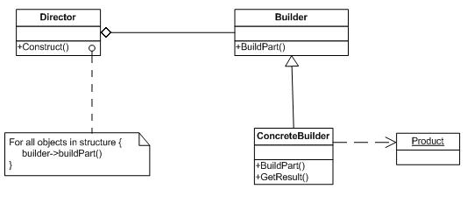
Builder
Structure

Slide 11
Builder
Participants
  Builder
    An abstract interface shared by all of the concrete builders
  ConcreteBuilder
    A concrete subclass of builder which makes the actual representations
  Director
    The program which is creating and using the builders
  Product
    The complex object or representation being built

Slide 12
Builder
Collaborations
  The client application
    A concrete builder
    Creates a director and configures it with the builder
  The director calls the builder to create the required parts
  The client application then retrieves the finished product from the builder

Slide 13
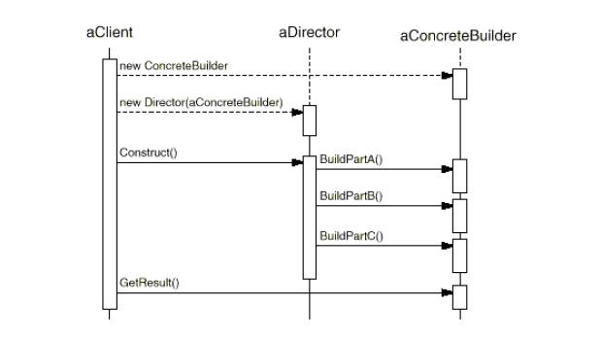
Builder

Slide 14
Builder
Consequences
  You can vary the internal representation of the product by selecting the correct factory for the job. This is now separated from the logic which decides that the object needs to be built in the first place.
  It gives fine grained control over the building process. The process can be broken into steps and the director can decide which steps to call and the order in which they should be called.

Slide 15
Builder
Implementation
  Since the builders must construct a variety of products, the abstract builder interface must be sufficiently general to handle the diversity of products
  The products produced by the builder are often so different that it is useless to try to derive them from a common superclass
  Implementing the builder methods as empty, rather than abstract, lets the subclasses override only the methods they need to

Slide 16
Builder
Known Uses
  The parser in a compiler recognizes parts of the language being built and uses a NodeBuilder to build a particular tree representation of the program

Slide 17
Builder
Related patterns
  Abstract factory is similar in that it can create a series of complex objects
  The builder often returns a composite

Slide 18
Factory Method

Slide 19
Factory Method Overview
A common problem in coding is
  Deciding which of several subclasses to build
  Constructing the correct subclass
  Performing the logic to initialize the new object
Consider an office suite building subclasses of Document
  Test documents
  Spreadsheet documents
  Drawing documents

Slide 20
Factory Method Overview
Sometimes there is considerable logic involved in deciding the class to build and how to initialize it
It helps to remove this logic into a single method called a factory method
This frees the top-level code from worrying about low-level details

Slide 21
Factory Method Overview
It also makes it easier to create frameworks
  When you create a new class hierarchy, you create a new factory for that hierarchy
  Now, programmers who want to use the class hierarchy don’t need to know the details of how to create the classes – they just use the factory
  This reduces learning time and costs
  It also aids in ensuring information hiding since no clients need to see the details to use the classes

Slide 22
Factory Method Pattern
Name
  Factory method
Category
  Creational
Intent
  To allow the creation of objects which can be one of several subclasses of a single class and whose exact type can be determined at run-time

Slide 23
Factory Method Pattern
Also known as
  Virtual constructor
Motivation
  To allow the creation of one of several subclasses which can only be determined at run-time
  In the more general sense to have a method which is responsible for the creation and initialization of a complex object so that this activity can be centralized

Slide 24
Factory Method Pattern
Applicability
  Often used in toolkits where one of several types of objects can be created
    Often sorting methods require the use of comparison method
    A factory could be used to create and return an object with the correct method in it
  Often used in parallel class hierarchies where an object in one category needs a method in a parallel class hierarchy

Slide 25
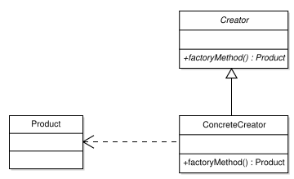
Factory Method Pattern
Structure

Slide 26
Factory Method
Participants
  Creator
    This is a base class or interface which declares a factory method to create instances of some class
    It is usually an abstract class which does not define the factory method
    If it does define the factory method, it will return a default type
  Concrete Creator
    This is a concrete class which defines the factory method
    There are usually several such classes, each of which defines a factory method to return a different type
    The actual concrete creator used is determined at run-time

Slide 27
Factory Method
  Product
    This is the object created by the factory method
    It is usually one of several subclasses of a common base class

Slide 28
Factory Method
Collaboration
  The application will determine which type of product it wants to create
  This could be determined by
    Reading a configuration file
    Determining the type required by the data being input to the application
    Being determined by some other factor such as time of day

Slide 29
Factory Method
Collaboration
  The application will then create a concrete factory which can create the type of product required
  The factory can then be used to create the required type of product
  The advantage of using the factories is that all factories have the same factory method and you can call that method without knowing which type of concrete creator you will be using

Slide 30
Factory Method
Consequences
  The result is the creation of a new object whose type is determined at run-time rather than when the program was written
  This could be done using a switch statement, but the addition of a new type to create would require modifying the switch statement
  Using the factory method, a new concrete creator can be created and added without changing the existing code

Slide 31
Factory Method
This can be used to create parallel class hierarchies where the type of object created from the parallel hierarchy is determined at run time

Slide 32
Factory Method
Implementation
  The creator can be
    An interface which the concrete creators will implement
    An abstract superclass without a body for the factory method
    A concrete superclass whose factory method returns a default type
  The concrete creator returns a single type from its factory method
  The factory method could be passed initialization parameters for the new object

Slide 33
Factory Method
Implementation
  The concrete creator is accessed by pointer or reference so that any type of concrete creator can be used
  Since the products are all subclasses of a common type, they can be treated the same as well

Slide 34
Factory Method
Known Uses
  Toolkits are software libraries which contain classes devoted to some task
  Factory methods are pervasive in these toolkits
  Often, security toolkits provide multiple implementations of a security algorithm from different vendors
  All of the algorithms have the same interface and a factory is used to create the implementation from the desired vendor

Slide 35
Factory Method
Known Uses
  It is also used in frameworks
  Frameworks might have to deal with multiple implementations of the same classes for different platforms
  The factory method provides one solution to this problem

Slide 36
Factory Method
Related Patterns
  Abstract factory
    This pattern is often implemented with factory methods
  Template Method
    A factory method is usually called within a template method
  Prototypes
    There are similarities with this pattern

Slide 37
Abstract Factory

Slide 38
Abstract Factory Overview
Sometimes you are faced with parallel class hierarchies
These are hierarchies which implement the same abstract classes, but in different ways
This happens when
  You are implementing controls for Windowing systems
    Microsoft windows
    X windows
    Mac Windows

Slide 39
Abstract Factory Overview
  Implementing security classes for
    Hash algorithms, digital signatures, encryption
    From various vendors with different implementations of the algorithms or equivalent algorithms
In these situations you want to
  Implement all classes from the same type or vendor
  Be able to switch types of vendors at run-time

Slide 40
Abstract Factory Overview
The solution to this is to create an abstract factory
The abstract factory
  Is an abstract class
  Has methods to create many different classes
  Is subclasses for each type or vendor to produce classes for that type or vendor
  Allows selecting the appropriate factory at run-time

Slide 41
Abstract Factory Overview
To use an abstract factory
  Select
    the window type you want or
    The vendor of algorithms
  Create
    A factory to produce that type of class
  Use
    The factory to create the instances you want

Slide 42
Abstract Factory
Name
  Abstract Factory
Category
  Creational
Intent
  To allow the creation of factories which produce different types of objects depending on the factory which was created.

Slide 43
Abstract Factory
Also known as
  kit
Motivation
  The client application wants to create and use members of parallel class hierarchies
  The hierarchy used will be determined at run time
  It must be possible to write the client code before the actual class hierarchy is known
  Therefore, the task of creating instances of the class hierarchy is delegated to an abstract factory.

Slide 44
Abstract Factory
Applicability
  Consider the case of writing a GUI application which can be implemented on a variety of windowing systems
  Each windowing system has a class which implements the button, slider, window, etc. for that windowing system
  There is a separate factory that knows how to construct the components for each windowing system
  The main application then creates the factory for the windowing system it wants

Slide 45
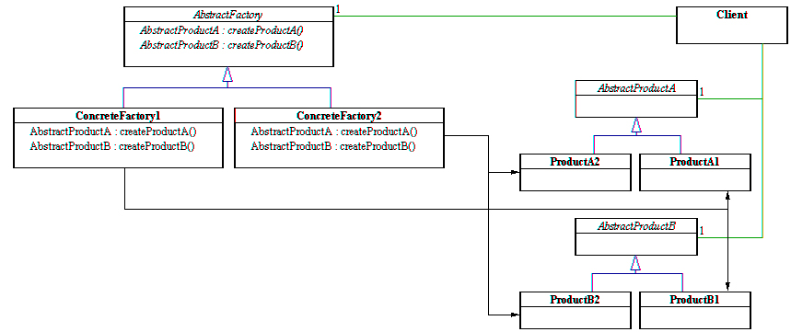
Abstract Factory
Structure

Slide 46
Abstract Factory
Participants
  Client
    Program which uses the AbstractFactory to create AbstractProducts
  AbstractFactory
    Defines the create methods for the concrete factories
  ConcreteFactory
    A subclass of AbstractFactory which has concrete create methods to produce one type of concrete objects

Slide 47
Abstract Factory
Participants
  AbstractProduct
    The superclass of all products
  ConcreteProduct
    A series of concrete subclasses derived from AbstractProduct
    Created by ConcreteFactory

Slide 48
Abstract Factory
Collaborations
  Usually, a single ConcreteFactory is created at run-time and it is used to create all instances of ConcreteObjects
  The actual ConcreteFactory which is created is determined at run-time

Slide 49
Abstract Factory
Consequences
  It isolates the client from the concrete classes
    The actual concrete classes created are determined by the factory
    This means that the client is no longer concerned with the actual type of the concrete classes
  It is easy to change concrete class families
    Changing from one concrete class hierarchy to another is as easy as changing abstract factories

Slide 50
Abstract Factory
Consequences
  It promotes consistency
    Since you want to be able to switch hierarchies, there is a strong incentive to use such hierarchies and make them all identical
  Supporting new hierarchies is difficult
    If you have a new product with new classes, extending the factory to handle this is difficult

Slide 51
Abstract Factory
Known uses
  Used by portable GUI systems to handle differences between actual windowing systems

Slide 52
Abstract Factory
Related patterns
  Factory method
    Usually implemented using factory methods
  Singleton
    A concrete factory is often a singleton

Slide 53
Prototype

Slide 54
Prototype Overview
A prototype is something
  that is simpler than the real thing
  Can be used as a template to build the real thing
Suppose you are creating a drawing program to draw lines, circles, rectangles, etc.
You need buttons to draw each of these things

Slide 55
Prototype Overview
Each button could
  Connect to code to create a line, circle, etc.
But this means creating different code for each button
What if
  You gave each button a prototype of an object
  It called clone() on that object and that was what it created

Slide 56
Prototype Overview
Now
  You initialize the buttons once with the prototypes
  All the buttons simply call clone() on their prototypes
  You can change the class a button creates at any time without having to change the code for the button
  Coding is simplified

Slide 57
Prototype
Name
  Prototype
Category
  Creational
Intent
  To allow the creation of a new object from an existing object which acts as a prototype. This can be done when it is too expensive to use new and initialize the object.

Slide 58
Prototype
Also known as
  none
Motivation
  You are writing a graphical editor and want to
    Create a variety of shapes (square, circle, etc.) all derived from Shape
    Have a toolbar of tools to create these shapes
  The problem is “How do you associate each tool with the shape it should create”?
  One solution is to create subclasses of tool that know the shapes, but this is a lot of subclasses

Slide 59
Prototype
    A better solution is to create one tool and have it own a single instance of the shape it should create.
    When it needs to create a shape, it simply makes a clone of the prototype it was provided.

Slide 60
Prototype
Applicability
  Use the prototype pattern when
    You have a series of objects to be created by a series of tools and you want an easy way to associate the objects with the tools
    You have constructed an object that takes time and effort to create. Rather than setting up a new object from scratch, it is easier to copy the existing object.

Slide 61
Prototype
    You have created some type of object. You now want to allow the user to start with that object as a base and make modifications from there to create a new object. So, you make a copy of the existing object and then modify it.

Slide 62
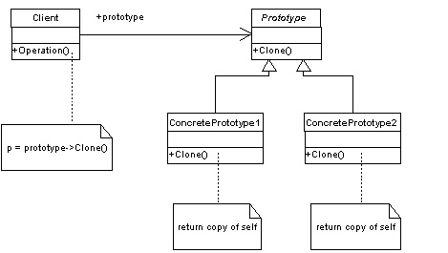
Prototype
Structure

Slide 63
Prototype
Participants
  Prototype
    A superclass for all of the classes which can be copied as prototypes. It declares a method for cloning the class.
  ConcretePrototype
    This is a concrete subclass from which a prototype can be created
  Client
    This uses a prototype to create clones of itself.

Slide 64
Prototype
Collaborations
  The client uses the clone() method of a prototype to create a new instance of the prototype class.

Slide 65
Prototype
Consequences
  The identity of the actual class the client is making a copy of is hidden from the client
  It is easy to add or change prototypes by simply registering a new prototype with the client
  New prototypes can be created by changing the values of attributes of the current prototypes. This is useful for setting the color of a line, and having the property persist for all new copies.

Slide 66
Prototype
Consequences
  Some prototypes are complex objects with other objects attached to them. This structure can be varied between prototypes to build exactly what the user needs.
  The pattern reduces the amount of subclassing required. The tools which ask the prototypes to clone themselves do not need to be subclasses but can simply be associated with different prototypes.

Slide 67
Prototype
  The pattern allows the prototype classes to be determined dynamically. The user can make selections at run time which alter the prototypes being used and result in the production of new objects.

Slide 68
Prototype
Implementation
  Rather than have the client store all the prototypes or create them when needed, use a prototype manager. This will store all the prototypes created and return references to them on request. This avoids having to create the same prototype several times.
  Depending on the complexity of the object, a shallow clone might not be sufficient. This means that a deep clone must be implemented by writing custom code.

Slide 69
Prototype
Implementation
  Often, the client will not want an exact copy of the prototype but will want to make modifications to it. It is impractical to add parameters to the clone method since different clients will want to modify different attributes. Therefore, an initialize operation should be provided which can alter attributes right after the clone is created.

Slide 70
Prototype
Related patterns
  There are many similarities with abstract factory and you will have difficulty choosing between them
  Prototype can be used with designs which make use of composite and decorator

