Slide 1
ICS-344: Information Security | KFUPM | Term 252
DVSA Vulnerability
Discovery & Remediation
Serverless Security in AWS — Lessons 1, 2, 3, 9 & 10
AWS Region: us-east-1 | OWASP DVSA (Damn Vulnerable Serverless Application) | April 2026

Slide 2
Agenda
01
02
Lesson 1 & 9
Lesson 2
Event Injection + Vulnerable Dependencies
Broken Authentication (JWT Forgery)
03
04
Lesson 3
Lesson 4
Sensitive Data Exposure (S3 Receipts)
Broken Auth — Admin Function JWT Bypass
05
Lesson 5
S3 Bucket Public Access Misconfiguration

Slide 3
LESSON 1 & 9
Event Injection
Vulnerable Dependencies + Remote Code Execution via node-serialize

Slide 4
Lessons 1 & 9 — Evidence & Fix
Evidence: CloudWatch Log
FILE READ SUCCESS: You are reading the contents of my hacked file!
Before (Vulnerable)
After (Fixed)
const serialize = require('node-serialize');
const body = serialize.unserialize(event.body);
// No input validation
const body = JSON.parse(event.body);
if (!['new','orders','get',...]
.includes(body.action)) {
return 400 error;
}

Slide 5
LESSON 2
Broken Authentication
JWT Signature Bypass — Impersonating Any User

Slide 6
Lesson 2 — JWT Forgery Attack
JWT Structure:
HEADER
.
PAYLOAD
.
SIGNATURE
Step 1: Capture Token
Step 2: Decode Payload
Log in as User B, open DevTools Network tab, copy JWT from Authorization header.
Base64-decode the middle section to extract username and sub fields.
Step 3: Forge Identity
Step 4: Send Forged Token
Replace username and sub with victim User C's identifier. Re-encode with original signature.
API accepts the modified token. Returns User C's full order list — no credentials needed.

Slide 7
Lesson 2 — Fix & Verification
Vulnerable Code
Fixed Code (Signature Verified)
// Only decodes — never verifies!
var sections = auth.split('.');
var data = base64.decode(sections[1]);
var token = JSON.parse(data);
var user = token.username; // TRUSTED!
// Fetch Cognito JWKS & verify
verifyCognitoJwt(jwt)
.then((claims) => {
var user = claims.username
|| claims.sub;
// Only trusted after verify
})
.catch(() => resp(401,
{msg:'invalid token'}));
Post-Fix Result: {"status": "err", "msg": "invalid token"} — Forged token rejected ✓

Slide 8
LESSON 3
Sensitive Data Exposure
Accessing Private Receipts via Direct Lambda Invocation

Slide 9
Lesson 3 — Unauthorized Receipt Access
DVSA-ADMIN-GET-RECEIPT relies on API Gateway for authorization. Invoking it directly via AWS CLI bypasses all authorization checks and returns a pre-signed S3 URL to download any user's receipt.
Normal Path
Attack Path
Impact
User → API Gateway → Auth check → Lambda → Pre-signed URL (admin only)
Attacker → AWS CLI → Lambda directly (no auth) → Pre-signed URL returned
Attacker downloads receipt ZIP containing private order & billing data for any user
aws lambda invoke --function-name DVSA-ADMIN-GET-RECEIPT --payload '{"order-id":"..."}' output.json

Slide 10
LESSON 4
Broken Authentication
JWT Signature Bypass — Admin Function Authorization Failure

Slide 11
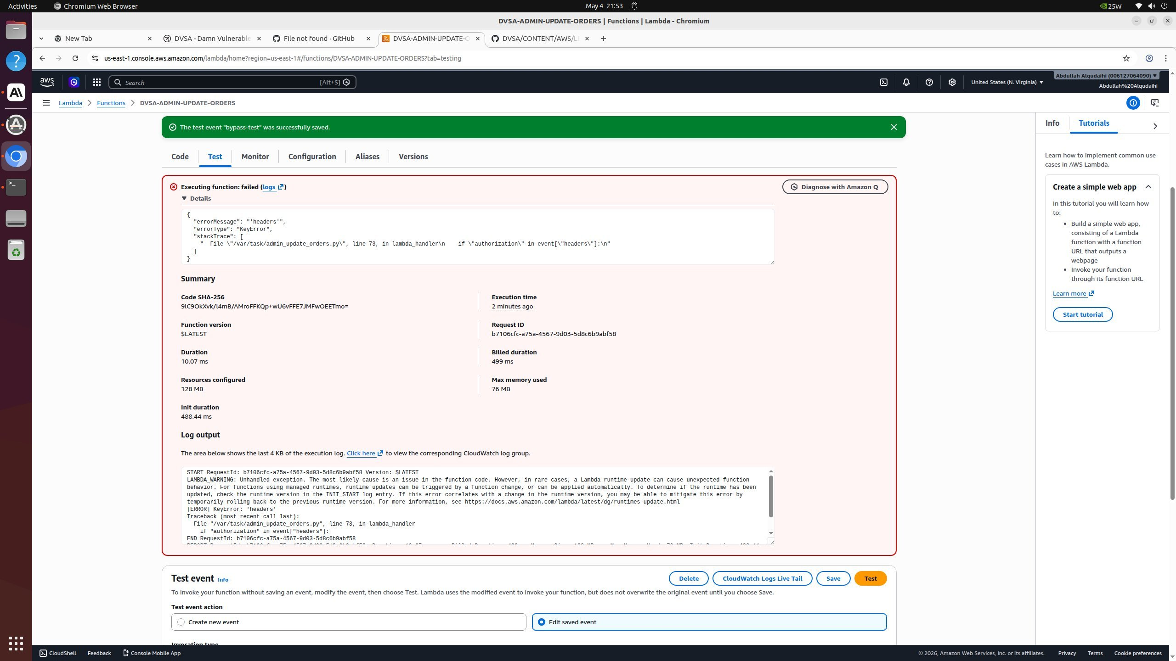
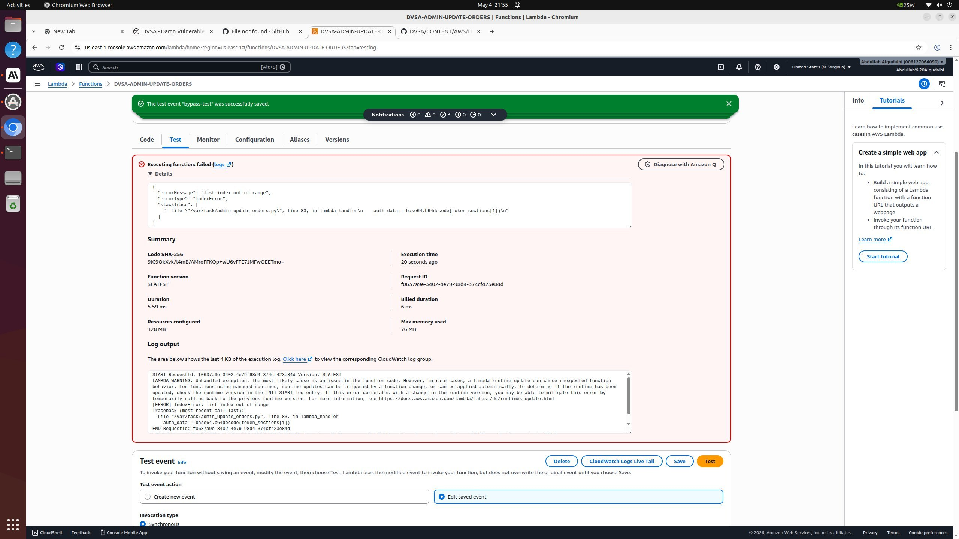
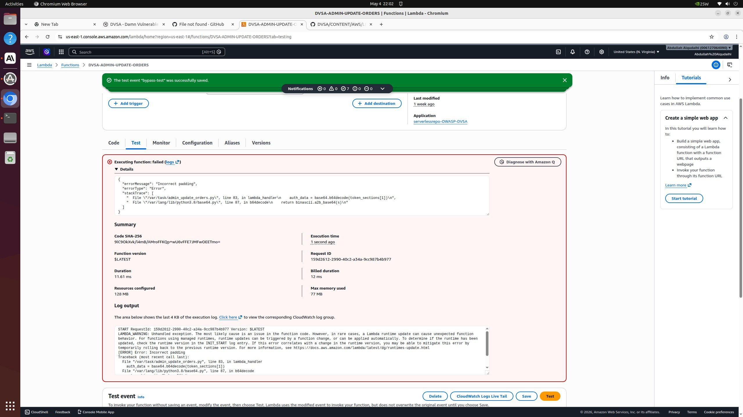
Lesson 4 — JWT Bypass on Admin Update Function
Vulnerable Code (DVSA-ADMIN-UPDATE-ORDERS)
Attack Progression — Lambda Test Results
# Line 73: No auth header check
if "authorization" in event["headers"]:
# Line 83: Raw base64 decode, no verify
auth_data = base64.b64decode(
token_sections[1])
# No signature verification!
Fixed Code (Cognito JWKS Verification)
# Verify JWT via Cognito JWKS
jwks = fetch_cognito_jwks(region, pool_id)
claims = jwt.decode(token, jwks,
algorithms=["RS256"])
if not claims.get("custom:isAdmin"):
return 403_response()
Errors: KeyError (no headers) → IndexError (no JWT) → Padding error (forged token) — each reveals attack surface

Slide 12
LESSON 5
Sensitive Data Exposure
S3 Bucket Misconfiguration — Public Access Enabled

Slide 13
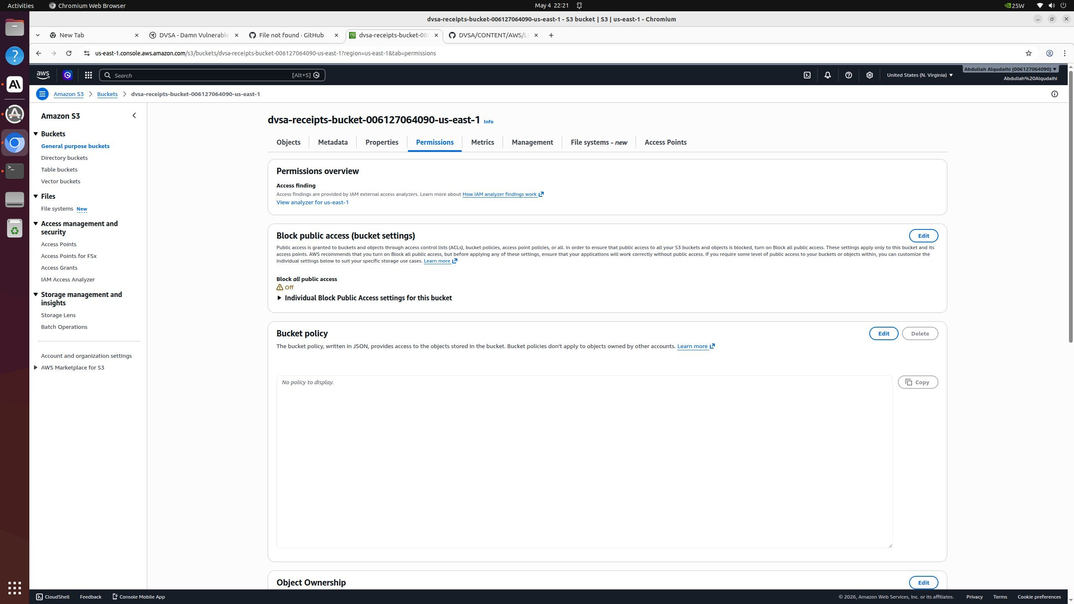
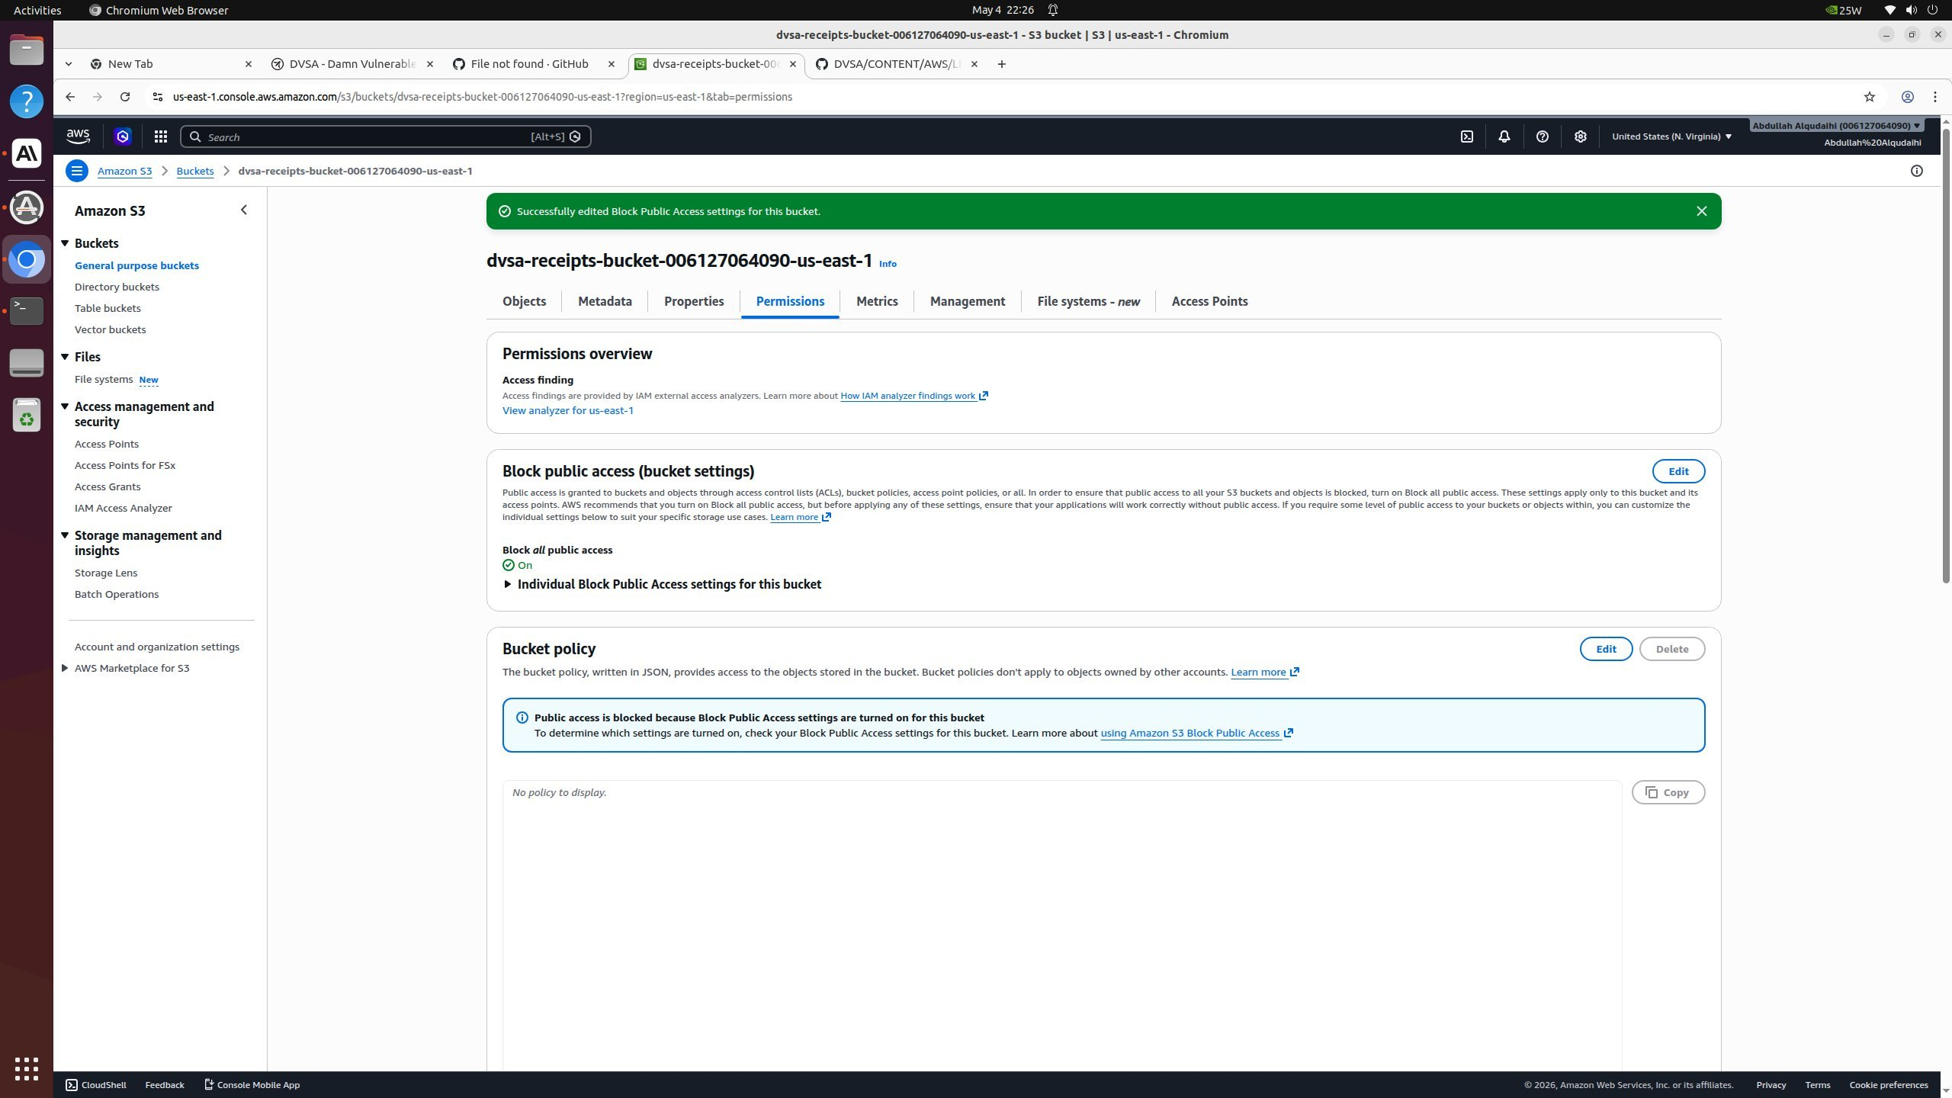
Lesson 5 — S3 Bucket Public Access Misconfiguration
Vulnerability — Block Public Access: OFF
AWS S3 Console — Before vs After Fix
The dvsa-receipts-bucket had Block All Public Access set to OFF. Any bucket policy or ACL could expose receipt objects to the public internet without warning.
Fix Applied — Block All Public Access: ON
Block All Public Access enabled. Bucket policy now explicitly blocks public access. No ACL or policy can override this setting. Receipts remain private and accessible only via pre-signed URLs generated by authorized Lambda functions.
BEFORE: Block All Public Access = OFF (Vulnerable)
Key Lesson: S3 Block Public Access is a safety net — always enable it on sensitive buckets regardless of bucket policy. Defense in depth.
AFTER: Block All Public Access = ON (Fixed ✓)

Slide 14
LESSON 10
Unhandled Exceptions
Stack Trace Leakage — Exposing Internal Implementation Details

Slide 15
Lesson 10 — Stack Trace Exposure
Leaked Response (Returned to Client)
"errorMessage": "'bool' object has no attribute 'lower'"
"errorType": "AttributeError"
"stackTrace": ["File \"/var/task/get_order.py\", line 32 — is_admin = json.loads(event.get(\"isAdmin\", \"false\").lower())"]
Root Cause
Fix Applied
.lower() called on boolean isAdmin field.
No try-except block around handler.
Python propagates exception to client response.
Handle bool/str isAdmin safely.
Wrap handler in try-except.
Return only generic error to client.
Log full details to CloudWatch only.

Slide 16
Summary — Vulnerabilities Covered
Event Injection
L1 & 9
✓
Fix: Replace node-serialize with JSON.parse() + input allowlist
Broken Authentication
L2 & 4
✓
Fix: Cognito JWKS JWT signature verification on all functions
Sensitive Data Exposure
L3 & 5
✓
Fix: Internal admin check + Block S3 Public Access + restrict Lambda policy
Unhandled Exceptions
L10
✓
Fix: Wrap handler in try-except, return generic errors only

Slide 17
Thank You
ICS-344: Information Security | KFUPM | Term 252
DVSA — Damn Vulnerable Serverless Application
Questions?

