Slide 1
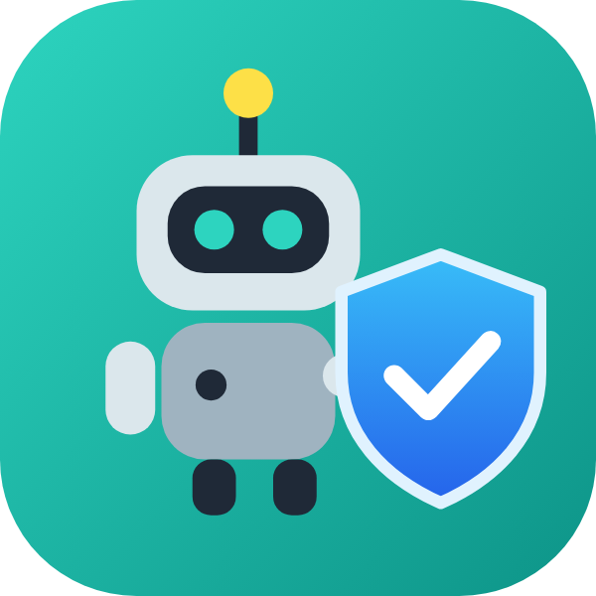

DataMon
A quality gate for robot training data.
Bad demonstrations stop here.
ROBOTICS & HARDWARE TRACK
HACKACHUSETTS
BUILT WITH KIRO
Team: Ahmed Salah · Jesse Silva
hackachusetts-datamon.streamlit.app
Notes:
[0:00-0:08] Robots learn by copying recorded demonstrations. And one bad demonstration quietly teaches a robot the wrong move.

Slide 2
THE PROBLEM
Bad robot data fails silently
Sensor & timing faults
Missing or nonsense labels
Found too late
Frozen readings, dropped frames, glitchy timestamps and impossible values slip into datasets.
A demonstration the robot was never told the point of teaches it nothing useful.
Problems usually surface after an expensive training run, when the data is hardest to fix or recollect.
Garbage in, garbage out. Except here, the garbage learns to drive a robot arm.
DataMon · Hackachusetts · Robotics & Hardware
2
Notes:
[0:08-0:20] A frozen sensor. A timing glitch. A recording nobody labelled. The robot learns from all of it, and nobody notices until after an expensive training run. Garbage in, garbage out. Except here, the garbage learns to drive a robot arm.

Slide 3
THE SOLUTION
Every recording is scored, explained and routed
One score from 0 to 100, with the reasons behind it. The thresholds are yours to set.
ACCEPT
REVIEW
REJECT
Clean staging store
Held for a human
Quarantined
Ready for training.
The gate isn't sure, so it asks.
Integrity failures never reach training.
Every decision is written to an append-only audit log, keyed by the recording's content ID.
DataMon · Hackachusetts · Robotics & Hardware
3
Notes:
[0:20-0:30] DataMon is a quality gate for robot training data. Every recording gets a score from zero to a hundred, with the reasons, and goes one of three ways: clean, held for a human, or quarantined.

Slide 4
HOW IT WORKS
Four checks, in plain terms
1 Integrity
2 Labels
3 Unusualness
4 Route + log
Is the timing steady? Any dropped frames, frozen channels or values out of range?
Was the robot told what it was doing? Missing or gibberish task text is flagged.
How different is it from known-good recordings of the same task? A rank, not a probability.
Accept, review or reject, and record why. History is never overwritten.
Works live too: a collector adapter streams frames from a running robot into the same gate, and per-robot profiles store each rig's expected rate and limits.
DataMon · Hackachusetts · Robotics & Hardware
4
Notes:
(Optional explainer slide. In the video this is covered during the live demo.) Four checks: integrity, labels, an unusualness rank against known-good recordings, then routing with an audit trail. The anomaly number is a rank, not a probability.

Slide 5
LIVE DEMO
See it working
hackachusetts-datamon.streamlit.app
Sign in: judge / Hello World!
Real public data: 100 DROID recordings and a BridgeData V2 sample, in the open LeRobot format.
DataMon · Hackachusetts · Robotics & Hardware
5
Notes:
[0:30-1:35] LIVE DEMO (screen recording). 1) Sign in as judge: 'Here it is live, on real public robot data from DROID and BridgeData. The loading screen is actually scoring every recording, and telling robot jokes while it works.' 2) Ingest gate, stream the reject episode: 'I'll replay a recording frame by frame, as if it's coming off a robot right now... and it's rejected. You see the verdict, and you hear it.' 3) Review queue: 'When the gate isn't sure, it asks. I can promote this one, reject it, or send it back to be recorded again. Every decision lands in an audit trail that's never overwritten.' 4) Dataset quality: 'The report card for the whole dataset: a score, a verdict and the reasons for every recording.' 5) Label / coverage: 'And here, recordings with missing or nonsense task labels. The robot was never told what it was doing.'

Slide 6
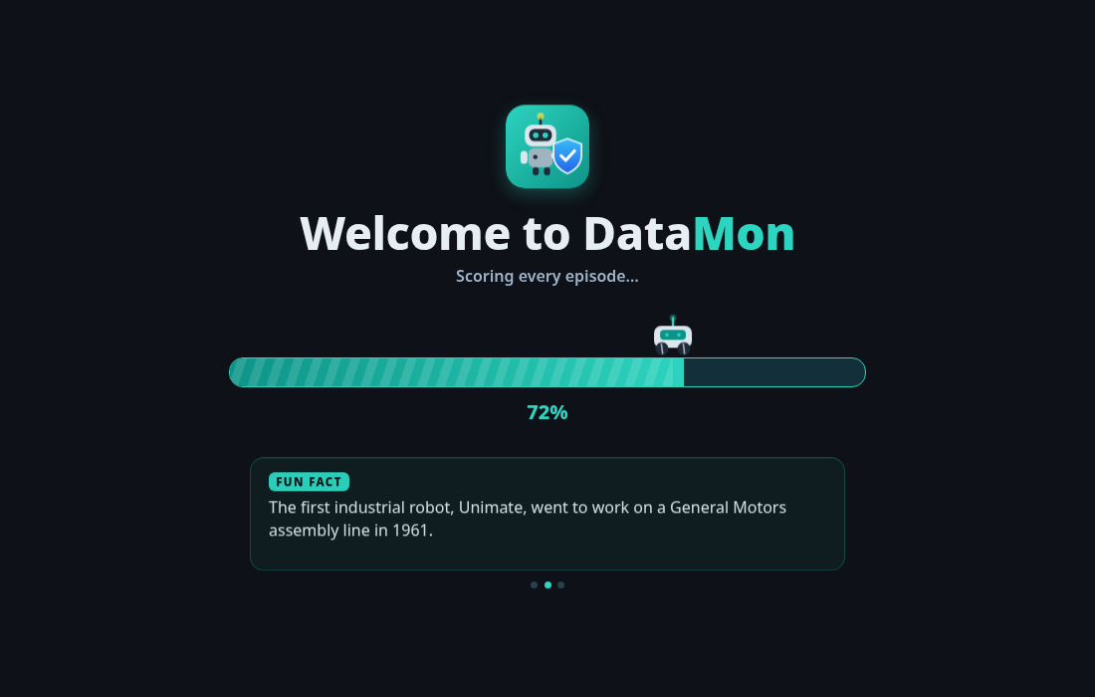
BUILT FOR EVERYONE
Accessible, and fun to use
Narrated guided tour
11 steps. Voice, captions and a pointing arrow, so it works with or without sound.
Grounded help assistant
Answers only from DataMon's own docs, so it never invents an answer.
See it and hear it
Rejections show a colour-coded verdict and play an alert sound.
Reduced motion
The loading screen does real work (it loads and scores the data) and passes the time with robotics jokes and fun facts.
Every animation switches off for people who turn off motion in their system settings.
DataMon · Hackachusetts · Robotics & Hardware
6
Notes:
[1:35-1:55] (Show ~5 s of tour step 1 first.) We built it so nobody's left out: a narrated tour with captions and a pointing arrow, a help assistant that only answers from our own docs, and reduced-motion support throughout.

Slide 7
IMPLEMENTATION
How we used Kiro
Kiro Crew · local laptop
Kiro Web · cloud sandbox
Set up Python and the virtual environment
Ran the app and the tests on the real machine
Shipped every feature as its own branch, pull request and merge
No internet to install Streamlit, so it read the library's source on GitHub
Playwright power (MCP) rendered and screenshotted the UI
GitHub CI ran the full test suite on every pull request
Specs
Steering
21
129
requirements, design and tasks for core features
2 docs: test before merge, no overclaiming
merged pull requests
tests passing on Python 3.9 & 3.13
Full write-up and specs: the /.kiro folder in our repo.
DataMon · Hackachusetts · Robotics & Hardware
7
Notes:
[1:55-2:30] We built all of it with Kiro, using two of its tools. Kiro Crew on a laptop set up Python, ran the app and tests, and shipped each feature as its own pull request. Kiro Web worked in a cloud sandbox that couldn't install Streamlit, so it read Streamlit's source on GitHub, let CI run the tests, and used the Playwright power to screenshot the interface before shipping. Specs defined our core features, and two steering docs kept every session honest and tested. Twenty-one pull requests, a hundred and twenty-nine passing tests.

Slide 8
POTENTIAL VALUE
Who benefits, and how it scales
Robotics labs
Data-collection teams
Dataset publishers
Stop wasting training runs on broken demonstrations.
Catch a bad recording while the robot and operator are still there to redo it.
Ship a quality report and an audit trail with every release.
Built to scale
Reads the open LeRobot format, so any dataset published that way works with no conversion
Streams from a live robot through a transport-agnostic collector adapter (ROS 2, WebSocket, robot SDKs)
Per-robot profiles and per-task baselines, so new rigs and tasks slot in
DataMon · Hackachusetts · Robotics & Hardware
8
Notes:
[2:30-2:45] DataMon reads the open LeRobot format, so it works on any dataset published that way, and live robots can stream straight in. Labs, data-collection teams and dataset publishers catch bad data while it's still cheap to fix.

Slide 9
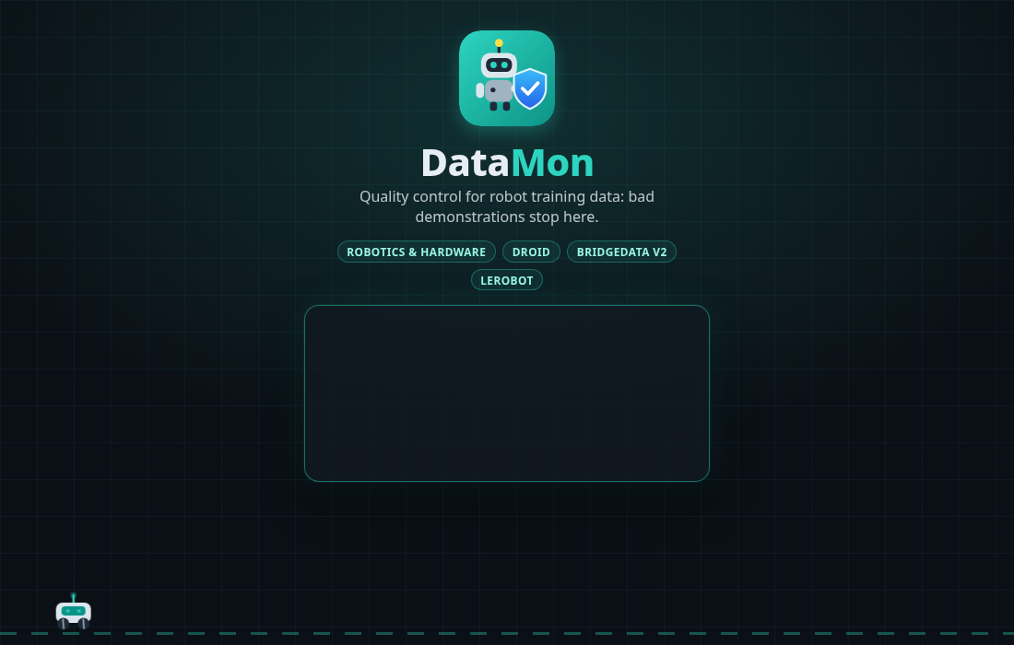
Try DataMon
Good data in. Bad data out.
LIVE SITE
hackachusetts-datamon.streamlit.app
SIGN IN
judge / Hello World!
CODE + KIRO SPECS
github.com/AZALAH/HackachusettsR3
The DataMon sign-in page
Thank you!
DataMon · Hackachusetts · Robotics & Hardware
9
Notes:
[2:45-2:52] Good data in. Bad data out. That's DataMon.

