Slide 1
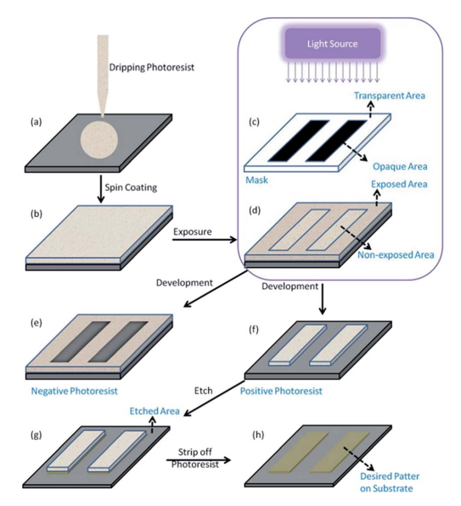
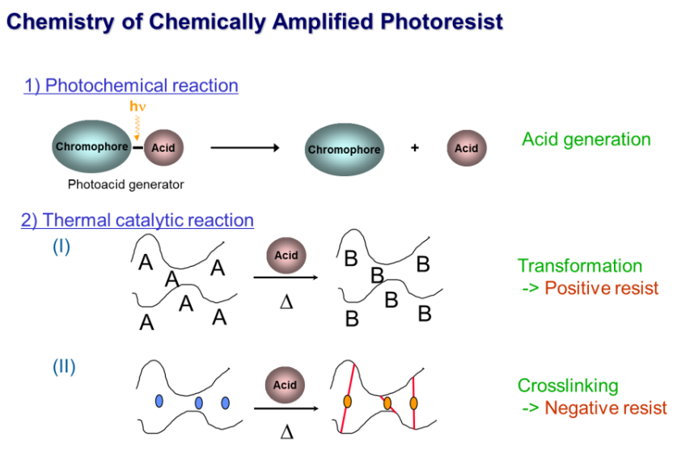
Extreme ultraviolet (EUV) lithography
[1] R. D. Allen, U. Schaedeli, D.R. McKean, S.A. MacDonald, Polym. Mater. Sci. Eng., 61, 185 (1989)
[2] D. R. McKean, U. Schaedeli, P. H. Kasai, S. A. MacDonald, Polym. Mater. Sci. Eng., 61, 81 (1989)
[3] K. L. Covert, D. J. Russell, J Appl. Polm. Sci., 49, 657 (2002.)
Introduction
EUV lithography process
*RSC Adv., 2020, 10, 8385
Photochemical reaction
Photo acid generator (PAG)
Thermal catalytic reaction
Negative
Positive
Transformation → Positive resist
Resin
Cross-linking → Negative resist

Slide 2
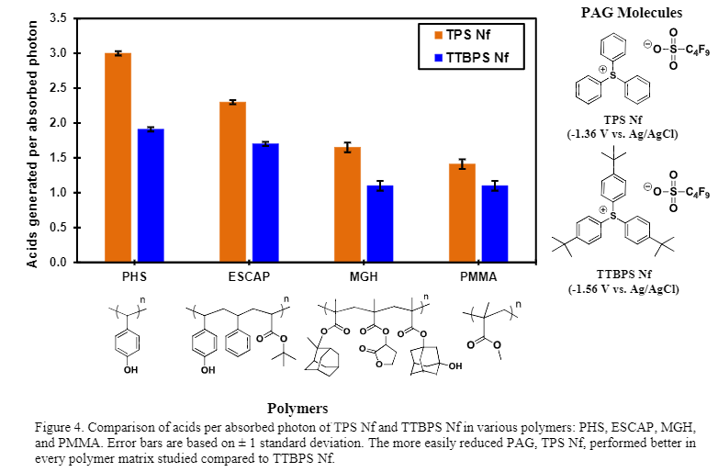
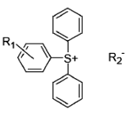


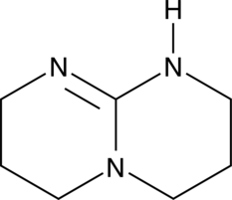
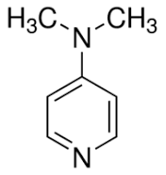
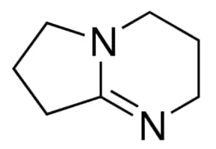
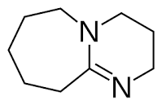
Extreme ultraviolet (EUV) lithography
Introduction
Photoresist composition
Resin structures
PAG structures
(Ionic)
(Non-ionic)
PHS (poly-hydroxystyrene)
ESCAP (PHS+PS+PtBA)
Triarylsulfonium
Diaryliodonium
Sulfonic acid ester
Quencher structures
TBD
DMAP
DBN
DBU

Slide 3
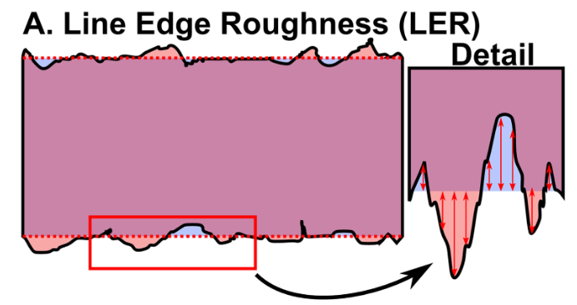
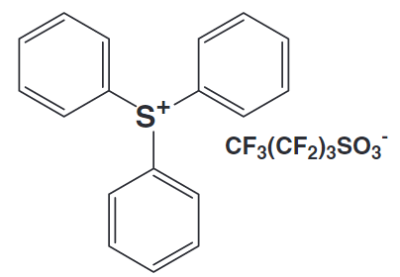
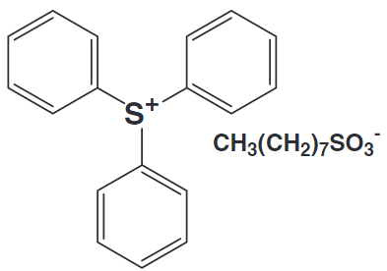
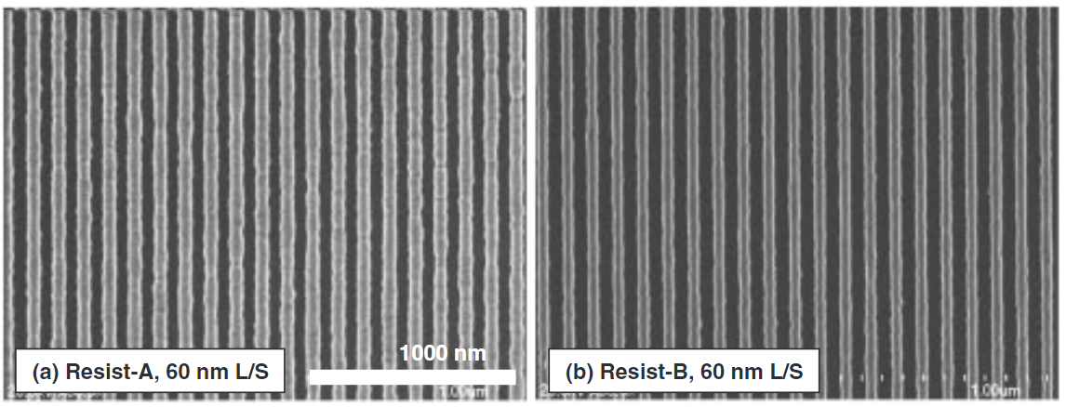
Extreme ultraviolet (EUV) lithography
Introduction
Line Etch Roughness (LER)
Definition of LER
PAG dispersity effect
more homogeneous
PAG-1 (TPS-PFBS)
PAG-2 (TPS-nOS)
less LER
: Real shape
: Ideal shape
LER: 7.7 nm
LER: 5.1 nm
→ LER: Deviation of a feature edge from an ideal shape
*PLOS ONE, 2015, 10, e0133088
** Jpn. J. Appl. Phys., 2005, 44, 5484-5488
EUV 공정을 통해 나타나는 패턴 산포에서 패턴 거칠기(LER)가 중요 요소일 것으로 예상됨
선행 연구에서 photoresist 내 PAG 의 균일한 분포성이 LER 개선에 효과가 있음을 보임

