Slide 1

SignSVM Learner
Learner interface
Inclusion of SignSVM learner into the Competitive Workflow

Slide 2
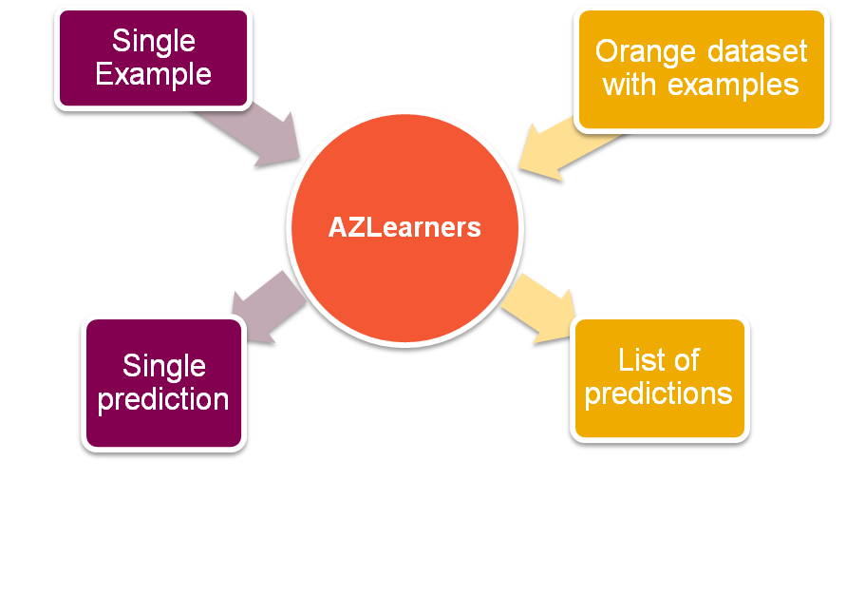
Modification to AZOrange Learners
specialType = 0
Pedro Almeida | 25 September 2012
AZOrange | Learners

Slide 3
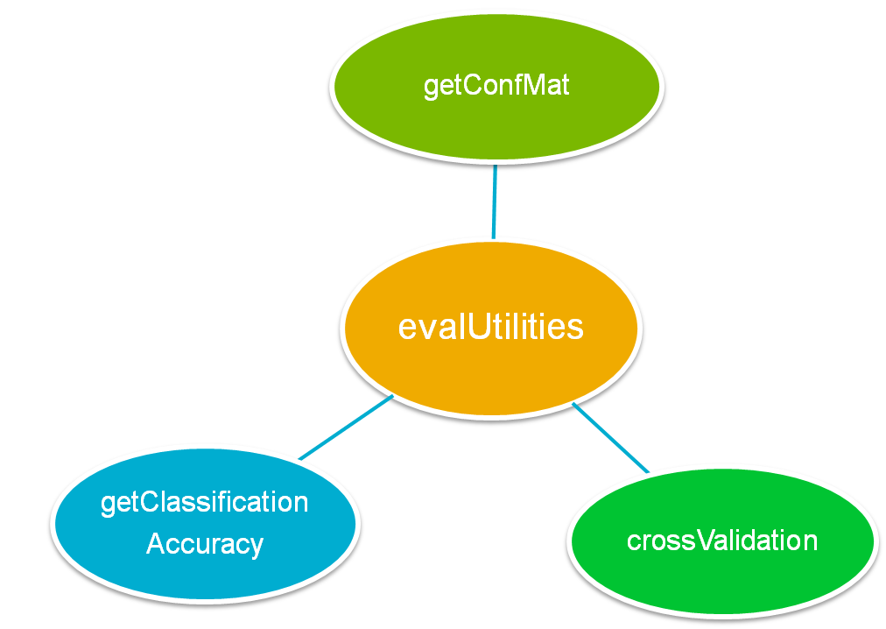
Modification to some evalUtilites methods* in order to use bulk prediction method
* Methods used by competitive workflow and getUnbiasedAccuracy modules
Pedro Almeida | 25 September 2012
AZOrange | Learners

Slide 4
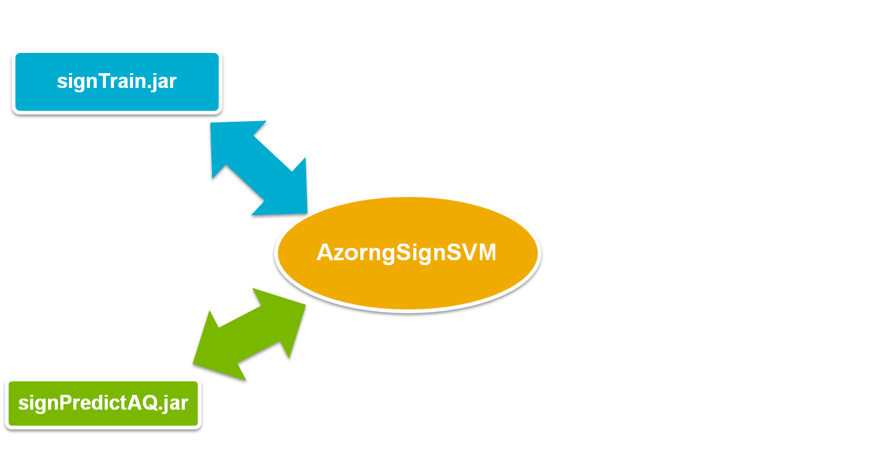
Interfacing java SignSVM ML
optimizePars(data, folds)
Priors
Save Model
Load Model
Compatible with AZBaseClasses model type detect
specialType = 1
Requires SMILES attribute and class
From data with more attributes, it will detect SMILES and Response, and ignore all other attributes.
Pedro Almeida | 25 September 2012
AZOrange | Learners

Slide 5
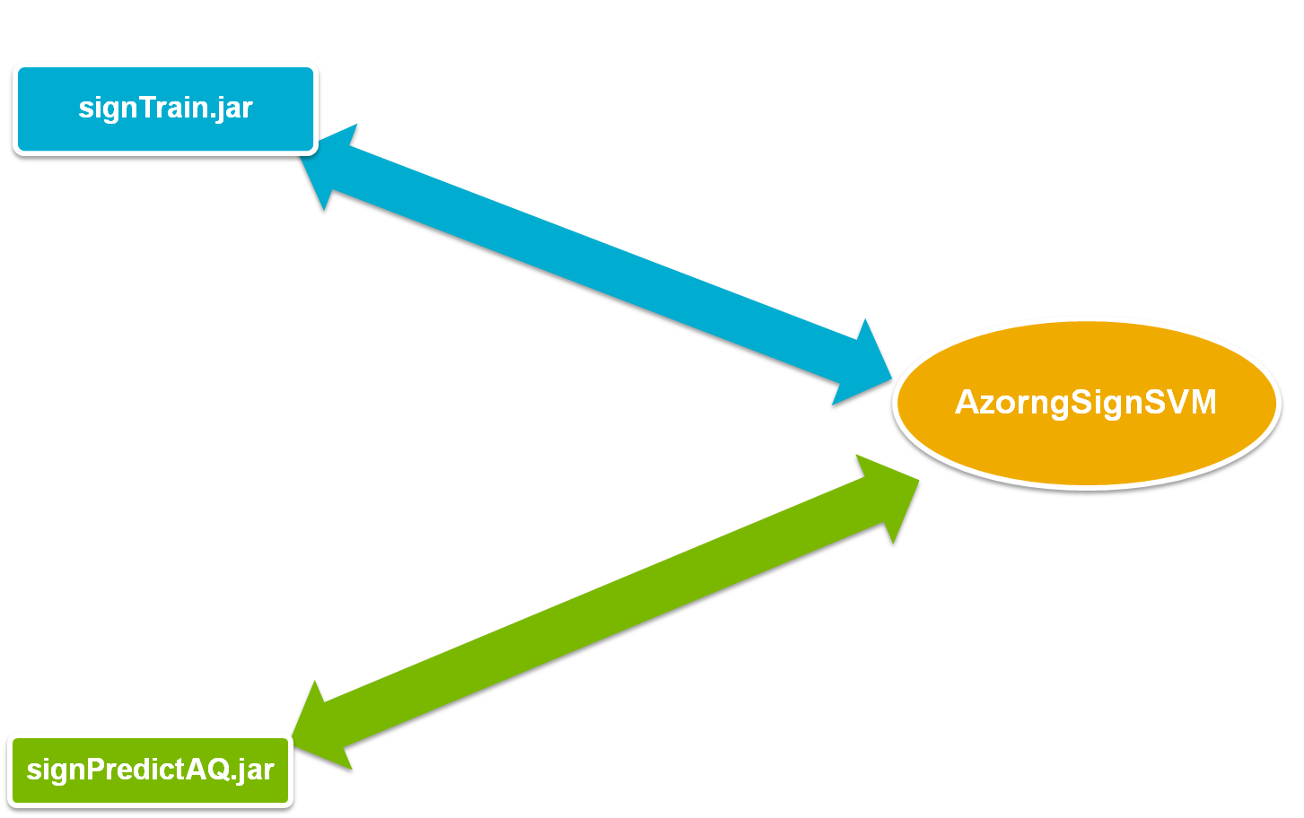
Interfacing java SignSVM ML
Create RunningDir
Create Configuration file
Create SDF file using sdfilter
Fix SDF adding Property
Pedro Almeida | 25 September 2012
AZOrange | Learners

Slide 6





Detect SMILES attribute and Response variable
(Will deselect all other attributes)
Set the number of folds for grid search (user defined):
-1: (Auto)
< 1000 : 10
< 20000 : 7
< 50000 : 4
>=50000 : 2
Set the number of threads (user defined):
0: (Auto)
nCores/2 (for machines with more that 2 cores)
Create a running Dir:
Train.SDF
  Using extraUtilities.makeTempSDF(…)
    Uses sdfilter with –d rh flags for removing hydrogen's
  Using dataUtilities.fixSDF(…)
    Includes response property in each molblock (named as classVar name)
TrainSettings.txt
Author | 00 Month Year
Set area descriptor | Sub level 1

Slide 7



Call java train
(Providing trainSettings.txt path)
It will create at the running dir:
  Model.txt
  Signatures.txt
  Train.txt
Extracts from the output the grid search results (stored into variable optInfo):
  Acc
  c
  gamma
Model can now be stored as a regular AZO model for later be used as a regular AZO model
Stored by saving the Running Dir and usual AZO model info
Can be loaded using: AZorngSignSVM.SignSVMread() AZOrangeBaseClasses.modelRead()
Author | 00 Month Year
Set area descriptor | Sub level 1

Slide 8





Create a running Dir:
SDF file with SMILES for predict
  Using extraUtilities.makeTempSDF(…)
    Uses sdfilter with –d rh flags for removing hydrogen's
predictSettings.txt
  Provide paths for training files (from training or saved):
    Model.txt
    Train.txt
    Train.sdf
    Signatures.txt
    trainSettings.txt
      startHeight
      endHeight
    path for SDF file with SMILES for predict
Call java predict
(Providing predictSettings.txt path)
Extracts from the output predictions:
  Prediction
  Significant Signature (only one)
    Center atom
    Gradient value
    height
Returns a usual AZO prediction response
Author | 00 Month Year
Set area descriptor | Sub level 1

Slide 9


Overridden:
  Only the TOP 1 most significant Signature is returned
  Returns in same syntax (in a dictionary) and extra info:
    molStr
    Atoms (just the center atom)
    height
AZOrangePredict.py will be expecting these extra info on learners with specialType = 1 to be used for highlighting.
Author | 00 Month Year
Set area descriptor | Sub level 1

Slide 10
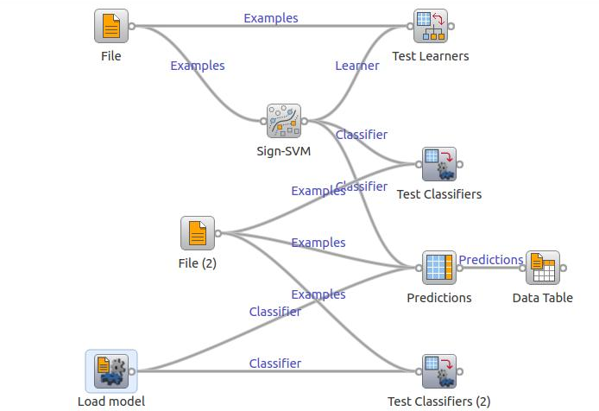
GUI for SignSVM ML
Pedro Almeida | 25 September 2012
AZOrange | Learners

Slide 11
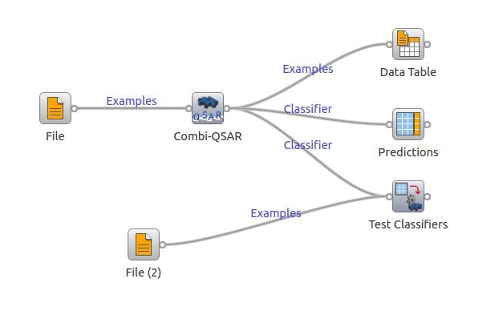
Competitive Workflow including SignSVM
Will detect if SMILES are present in data, and include SignSVM ML
Pedro Almeida | 25 September 2012
AZOrange | Learners

Slide 12
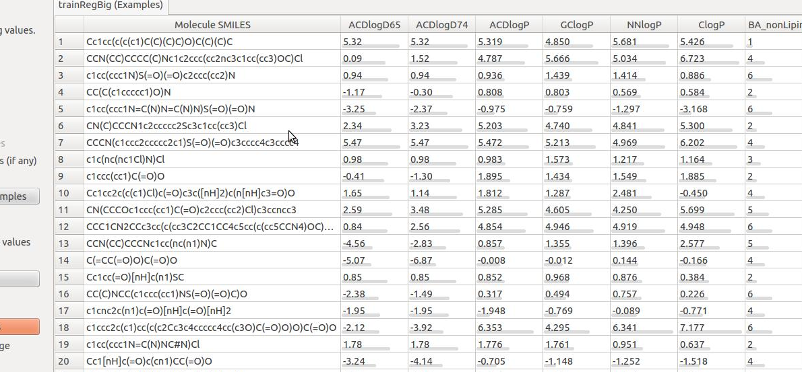
Competitive Workflow including SignSVM
Input Data
Pedro Almeida | 25 September 2012
AZOrange | Learners

Slide 13
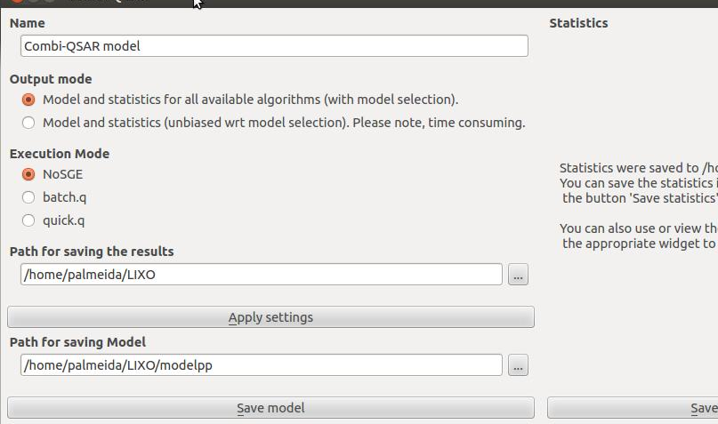
Competitive Workflow including SignSVM
Widget GUI
Pedro Almeida | 25 September 2012
AZOrange | Learners

Slide 14
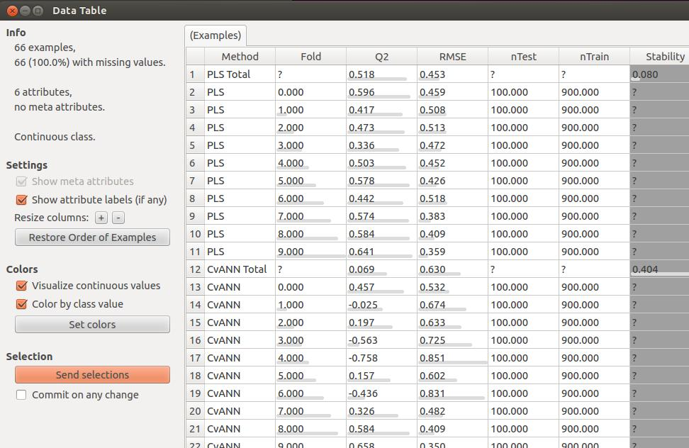
Competitive Workflow including SignSVM
Statistics
Pedro Almeida | 25 September 2012
AZOrange | Learners

