Slide 1
DAY 2 MORNING
Day 1 covered the full path from Python to Data Science
The review is broader than coding basics: students practiced data investigation, simulation habits, and an end-to-end classification workflow.
Notebook and Python basics
Jupyter workflow; numpy, pandas, and matplotlib; variables, expressions, types, functions, lists, and arrays.
Exploring real flu data
Loaded Arizona flu hospitalizations, inspected tables, smoothed noisy daily counts
Visualization
Used line, bar, histogram, scatter, box, and heat-map views; practiced loops, conditionals, accumulators, while-loops, and Fibonacci.
Introduction to ML
Framed data science, AI, ML, and deep learning; compared ML types, supervised problem types, and traditional modeling versus ML.
ML project lifecycle
Worked through data import, processing, visualization, model training, comparison, and evaluation.
Heart disease classification
Built binary classifiers with logistic regression, random forests, and neural networks with one or multiple hidden layers.

Slide 2
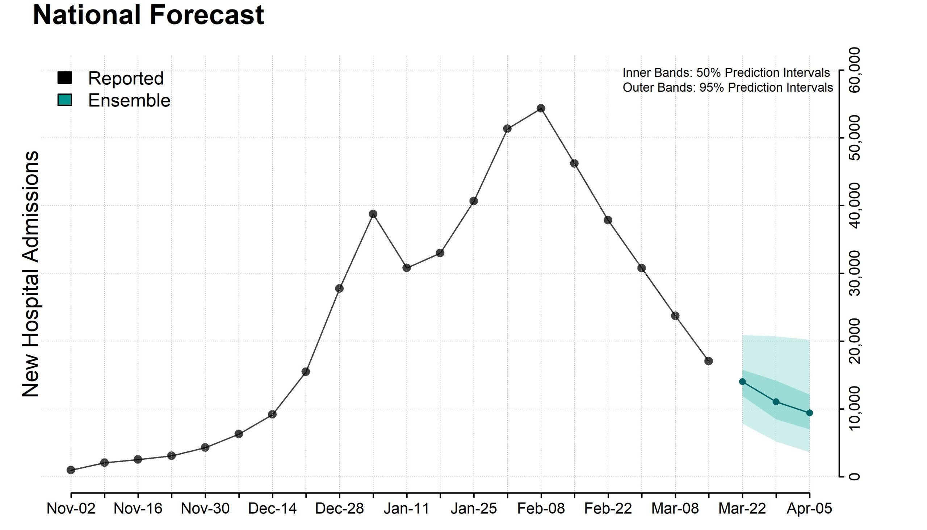
Why Flu Forecasting Matters
Public Health Impact
Annual burden in the U.S.:
~9–41 million illnesses
~140,000–710,000 hospitalizations
~12,000–52,000 deaths (Source: CDC, varies by season)
Why Forecasting Helps
early warning and prevention
optimized resource allocation
informed decision-making
reduced economic and health impact
enhanced public awareness
future preparedness
Challenges of Flu Forecasting
Seasonal variation: timing, peak, and intensity change each year
Multiple circulating strains
Delays and noise in surveillance data
Geographic heterogeneity: weather and human behavior

Slide 3
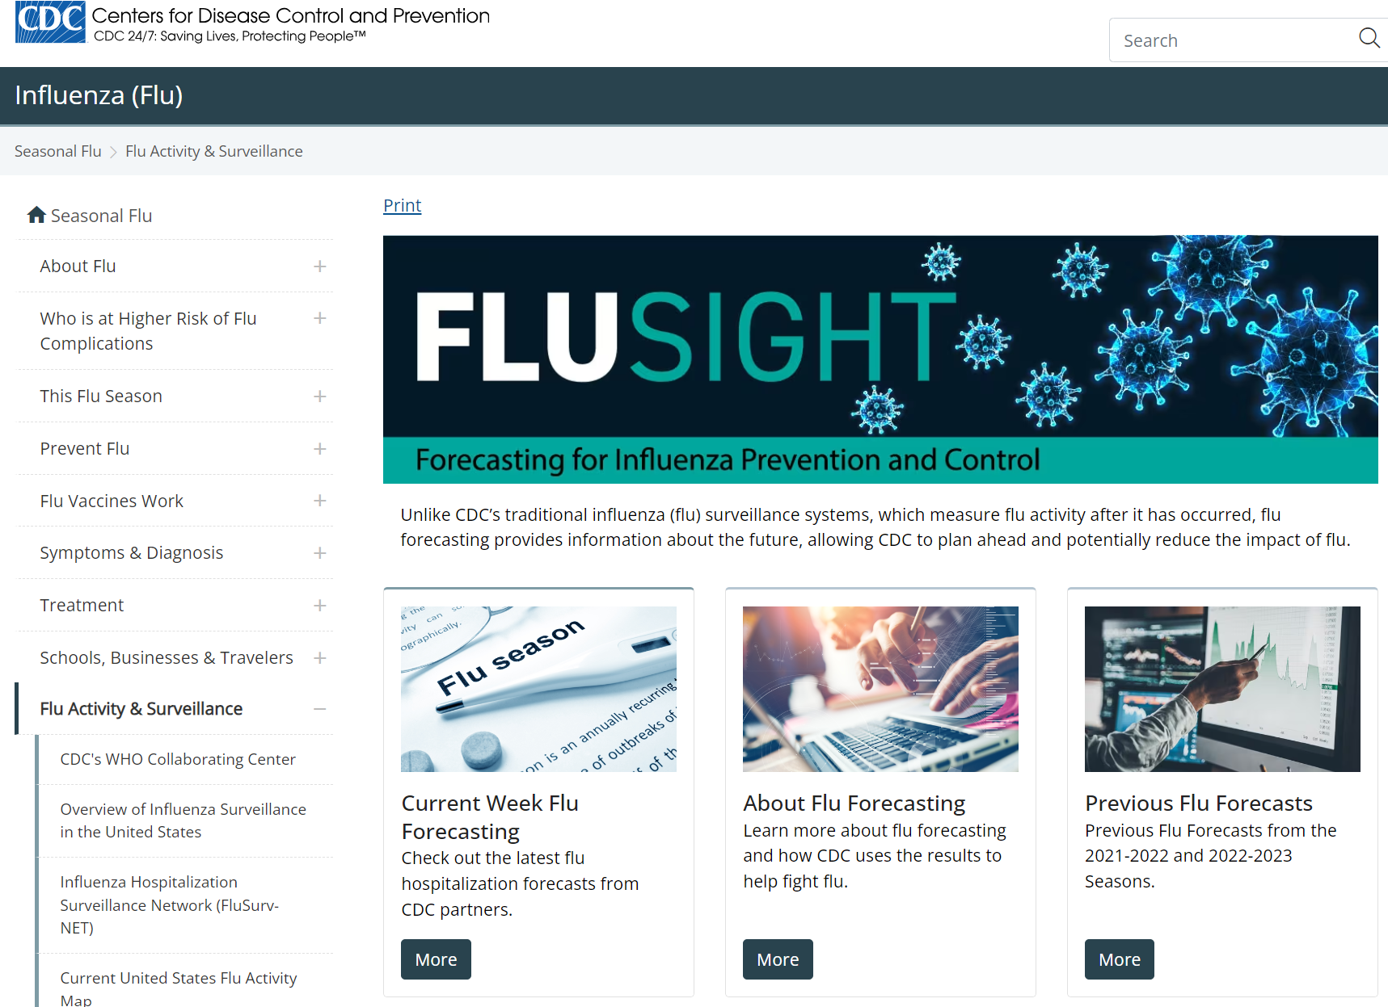
CDC’s FluSight Challenge
What It Is
An annual forecasting challenge hosted by the CDC since 2013
Brings together academic teams, government labs, and private groups
Aims to improve real-time forecasts of seasonal influenza in the U.S.
Goals of the Challenge
Evaluate the accuracy and reliability of flu forecasts
Improve tools for public health preparedness
Encourage innovation in epidemiological modeling
What Forecasts Are Submitted
Onset week: When flu season begins
Peak week: When flu activity will be highest
Peak intensity: How high activity will be
1–4 weeks ahead of hospitalization case counts
State level and national level
https://www.cdc.gov/flu-forecasting/data-vis/current-week.html

Slide 4
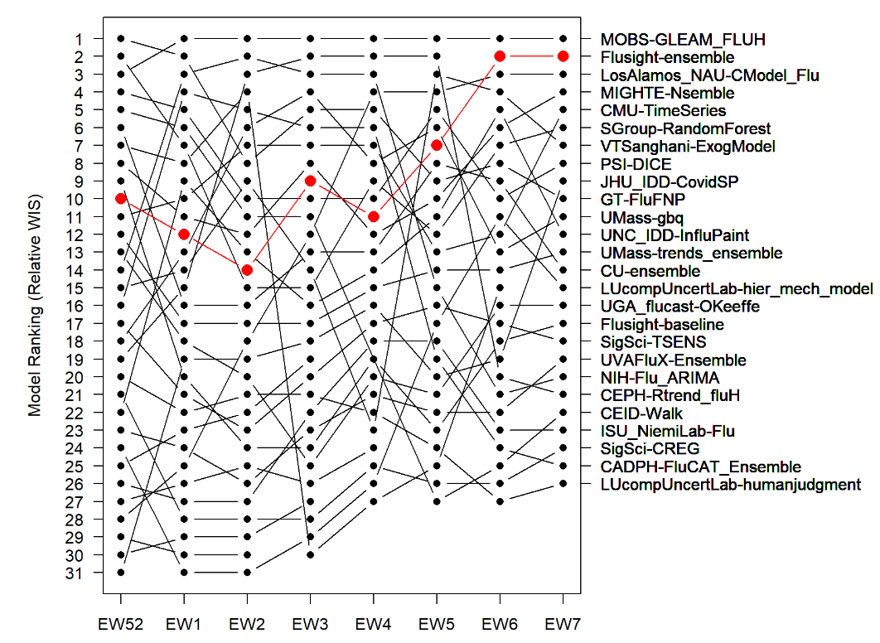
Overview of Real-Time Forecasting Approaches
Mechanistic models
Statistical models
Machine Learning models
Phylodynamic models
Digital Surveillance models
Ensemble models
Averaging across all forecast targets, the FluSight ensemble is the 2nd most accurate model measured by WIS in 2021–22 and the 5th most accurate in the 2022–23 season.
Real-time forecast: 9h from data release to result submission

Slide 5
DAY 2 MORNING
Day 2 turns mechanisms into fitted forecasts
The agenda follows the same question all day: how do we choose parameters that make a model agree with data?
Session 1
Simulating dynamical systems
ODEs, Euler's method, logistic growth, and two-dimensional dynamics.
Session 2
Compartmental epidemic models
SIR structure, infection and recovery rates, and drawing larger models.
Session 3
Grid search with real flu data
Train/forecast split, loss function, beta-gamma grid, and loss surface.
Session 4
Optimization and gradient descent
Automatic differentiation and gradient descent on the model loss.
By the end of Day 2, you have fit an SIR model to flu hospitalization data and seen two parameter-search strategies.

Slide 6
