Slide 1


Q3.The factors
13001603 Group Only

Slide 2
Contents
1、About us
2、Question
3、Discussion
4、Conclusion

Slide 3

1
About us
SECTION

Slide 4
Wenxiao Li
Jiawen Li
Linlun Wu
Junwu Wang
Wenze Jiang

Slide 5
2
Question
SECTION

Slide 6

In the course of growth of individuals, what factors are necessary and indispensable, according to your knowledge?

Slide 7
What factors are necessary in the growth according to your knowledge?

Slide 8
3
Discussion
SECTION

Slide 9

Wenze
Wenxiao
Family
Friend
Education
Skill
Jiawen
Effort

Slide 10
Linlun
Junwu
Love
Social experience
Difficulty

Slide 11
4
Conclusion
SECTION

Slide 12
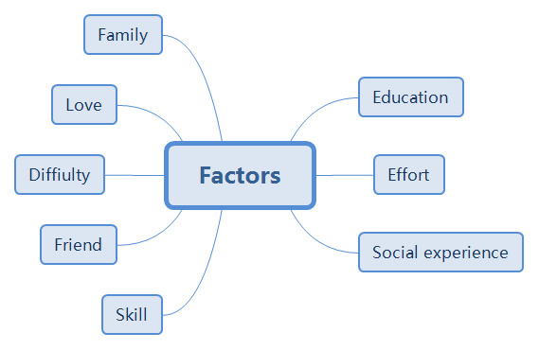

Slide 13
Thanks

