Slide 1
Advancements in Augmented Reality
Md. Azharullah Shariff
160317742013

Slide 2
Agenda
Augmented Reality (AR)
Virtual Reality (VR)
AR vs VR
Microsoft Hololens (AR)
Oculus Rift (VR)

Slide 3
Augmented Reality (AR)
AR = Physical world + CGSI
Gives the user a composite view and offers an enriched experience
Environment becomes interactive and digitally manipulatable

Slide 4
AR - Working and Applications
Hardware: Processors, Display, Sensors, etc.
Software: Computer vision and Video tracking techniques for recording, processing and rendering
Applications: Medical, Manufacturing, Military Aircraft, Entertainment, etc.

Slide 5
AR - Issues and Challenges
Spam, Security and Interoperability issues
Performance and Interaction issues
Technological limitations
User Interface limitations

Slide 6
Virtual Reality (VR)
Creates an environment simulated by multi-projected environments to generate realistic media
Completely replaces the real world with a computer generated three dimensional one
Virtual environment becomes interactive and digitally manipulatable

Slide 7
VR - Working and Applications
Hardware: HMD, Image and Sound generators, Motion and eye tracking sensors
Software: Media rendering and motion tracking techniques
Applications: Design, Architecture, Entertainment, Training and simulation

Slide 8
VR - Issues
Cost prohibitive hardware
Still an experimental experience and steep learning curve for developers and manufacturers

Slide 9
AR - Microsoft Hololens
Hololens: Pair of mixed-reality head-mounted smart glasses
Hologram is the basic entity
Holographic objects pinned to the real physical world
World's first computer running Windows mixed-reality platform powered by windows 10

Slide 10
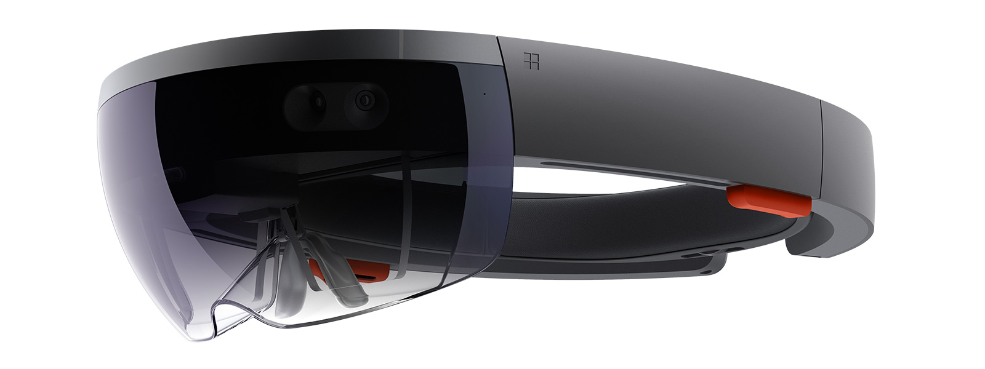
AR - Microsoft Hololens

Slide 11
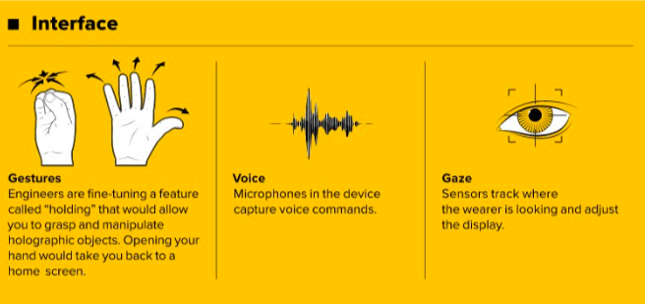
Hololens - Components
Lenses and Display
Sensor
Computer
Camera
Vent
Control buttons

Slide 12
Hololens - Applications
Remote Instruction
3D Aided Computer Design
Education
Gaming and Entertainment
Architecture and Decorations
Heads-up GPS

Slide 13
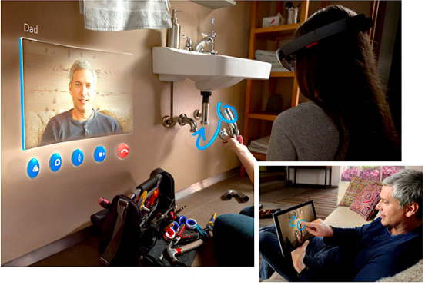
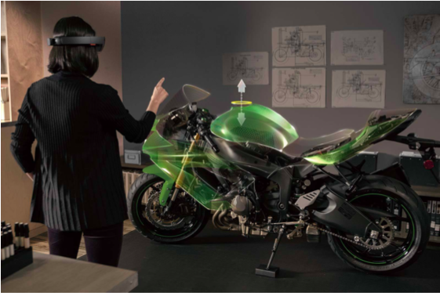
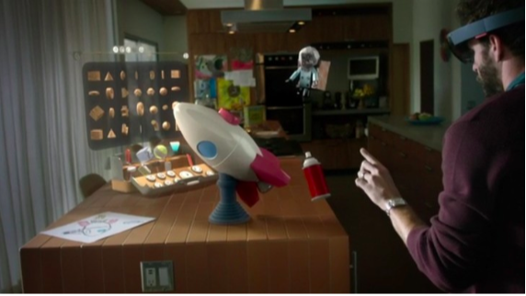
Hololens - Applications

Slide 14
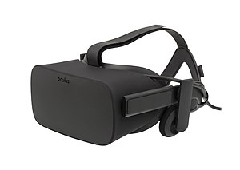
VR - Oculus Rift
A Virtual reality headset developed by Oculus VR.
Most advanced VR system currently

Slide 15
Oculus Rift - Components
OLED Panel
Constellation
Touch controllers
Requires a PC with an i5 processor, 16G RAM and NVIDIA GTX 970 Graphic card

Slide 16
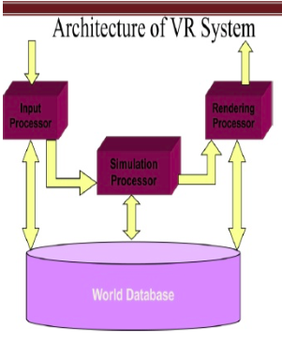
Oculus Rift - Working
Input Processor
Simulation Processor
Rendering Processor
World Database

Slide 17
Oculus Rift - Applications and Scope
Gaming
Media
Social Applications
Industrial Applications
Medical Training: Laparoscopy Surgery
Virtual Conferencing

Slide 18
Thank you!

