Slide 1

Exploratory Data Analysis
<G2M Case Study>
<7/13/2022>

Slide 2

Agenda
Executive Summary
Problem Statement
Approach
EDA
Recommendations

Slide 3
Executive Summary
The Cab Industry experienced remarkable growth in the last few years, our client, XYZ is going to invest in this industry. They need to understand the two cab companies that domain the cab markets to make their investment decisions.
Our goal is to come out with insights based on EDA process and dive into different dimensions to figure out the best company to invest in.

Slide 4
Problem Statement & Approach
Data Understanding
There are four datasets, their time range is from 31/01/2016 to 31/12/2018.
Cab_Data – the transaction for 2 cab companies
Customer_ID – contains the customer’s demographic details
Transaction_ID – the transaction to customer mapping and payment mode
City – list of US cities, their population, and number of cab users
There are no null values in these datasets
After generating some new columns, and tables, visualizations together with prediction methods are used to analyze profit, user coverage, geometric coverage and time series dimensions.

Slide 5
Problem Statement & Approach
Data Processing
The four datasets are combined into one final dataset based on the shared column contents, which is called new.
Some new columns are generated for analysis,
Priceperkm - the price charged with a unit of Kilometers the journey covers
Additionalfees - the difference between the price charged and costoftrip, this might contain the fees generated by company charges, tax, tips, etc.
State – extracted the state the journey happened from the city column
Year – extracted year from existing column Dateoftravel
Month - an extracted month from exist column Dateoftravel
Season – generated with the respective month
Some new tables for analysis,
Yellow/Pink - separate the table ‘new’ with respect to different companies
Yellow2016-2018/Pink2016-2018 - based on Yellow/Pink separate table into years

Slide 6
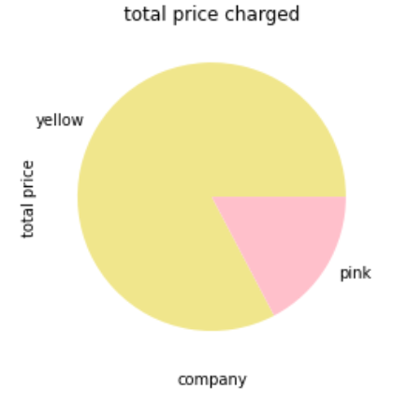
EDA
Profit analysis
The accumulated total price charged by two companies in three years.
It is easy to find that Yellow Cab takes most parts of the company, approximately 82% of the cab markets’ revenue.
82.70%
17.30%

Slide 7
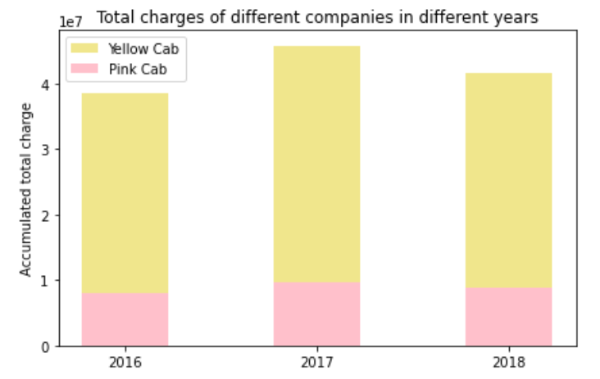
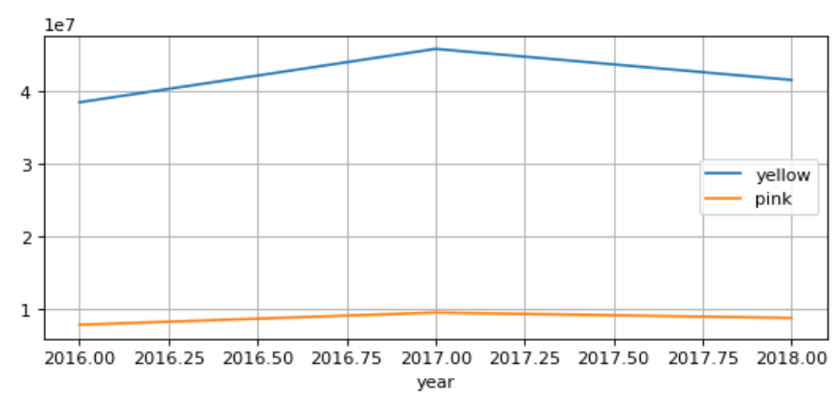
EDA
Profit analysis
Total charges in different years in two companies
82.71%
82.95%
82.46%
17.05%
17.29%
17.54%
The conclusion is similar to the previous part, Yellow Cab takes most part of the cab market, and from the growth rate table, in 2018, though the two companies all experienced a decline, the growth rate of Yellow Cab is still higher than Pink Cab. The market share of Pink Cab becomes a little bit larger in 2018.
Year | Yellow Cab | Pink Cab
2017 | 0.1743 | 0.1601
2018 | -0.0834 | -0.1026
Growth rate

Slide 8
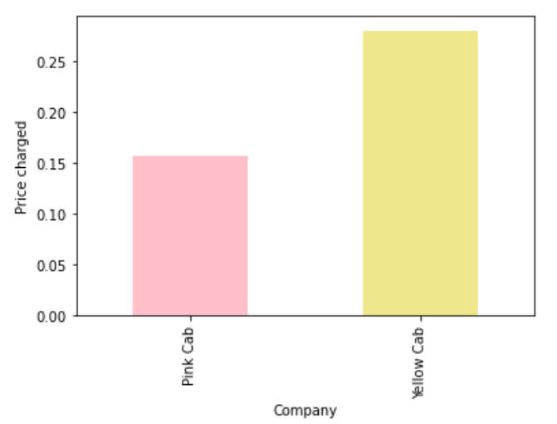
EDA
Profit analysis
The additional fees collected by the two companies
Except for the mileage fee and basic fees generated by calling a cab, cab companies might charge additional operating fees, taxes, or tips. The difference between ‘Priced charged’ and ‘Cost of trip’ could cover these fees.
Yellow Cab collects more additional fees than Pink Cab.
(The total accumulated price charged by Yellow Cab is much more than Pink Cab, to make sure the analysis is fair, the y-axis indicates the mean value of additional fees divided by the total price charged)

Slide 9
EDA
Profit analysis
Overall, from the overall profit, yearly profit, growth rate, and additional charged analysis, Yellow Cab has a better performance.

Slide 10
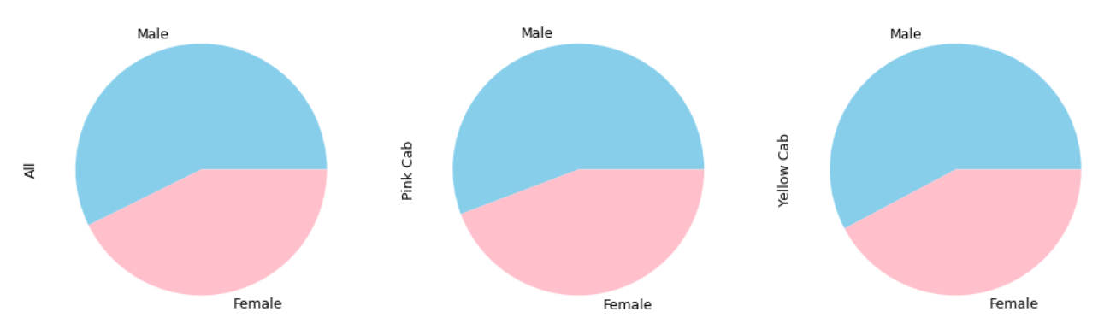
EDA
User demographic information analysis
Gender
57.29%
55.76%
57.77%
There are more male users in these three dimensions. But in Yellow Cab, male users take up more percentage than that in Pink Cab.

Slide 11
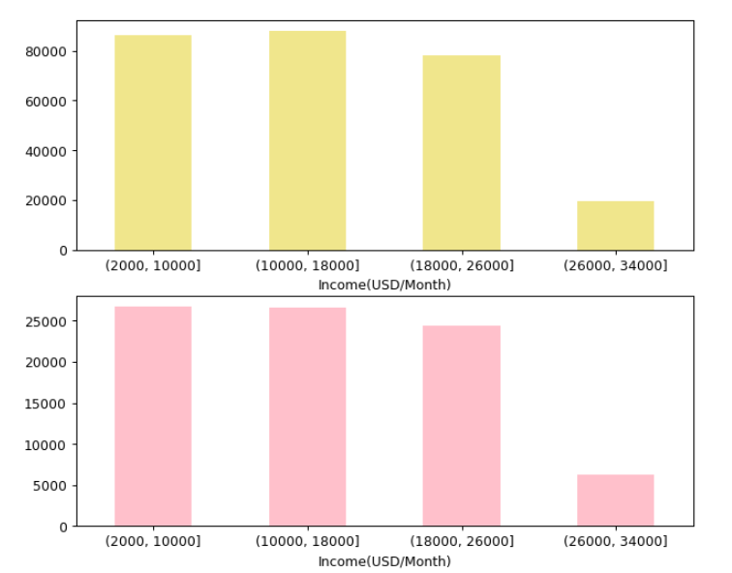
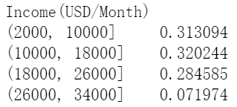
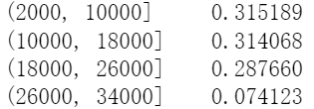
EDA
User demographic information analysis
User Income
People with relatively less income are more likely to call a cab.
The user constitutes of Pink Cab involves a higher percentage of people with higher incomes.

Slide 12
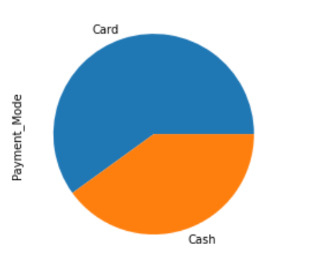
EDA
User demographic information analysis
Payment methods
In general, people prefer to pay by card.

Slide 13
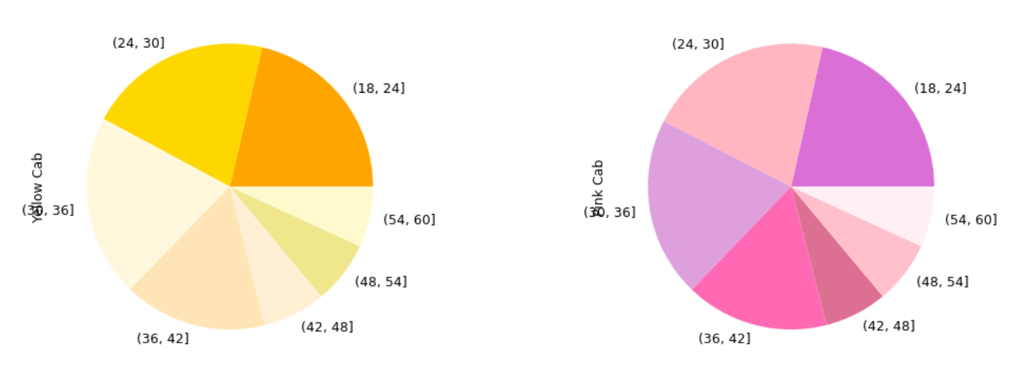
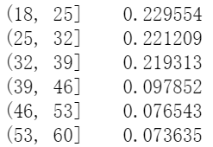
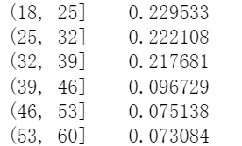
EDA
User demographic information analysis
Age
The composition of age looks similar in the two companies.
In both of the companies, users are mainly under 36 years old, cabs are more popular among the youngest. While in the Yellow Cab, users aging from 46-60 has a percentage of 15.01%, the percentage in the Pink Cab is 14.81%, Yellow Cab could reach out to more people in the elder age group.

Slide 14
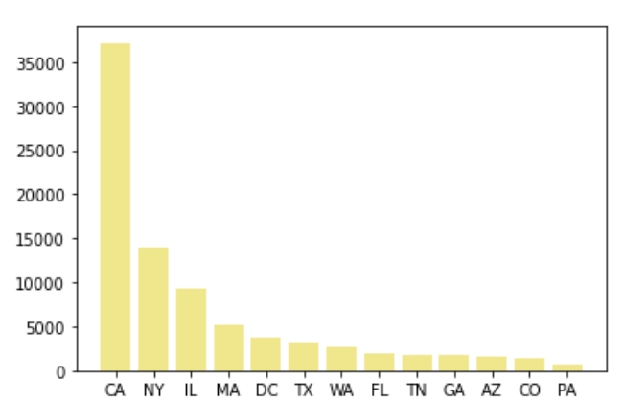
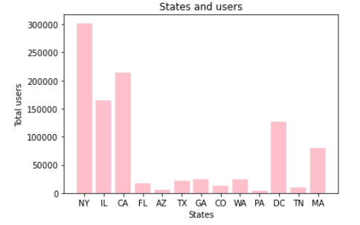
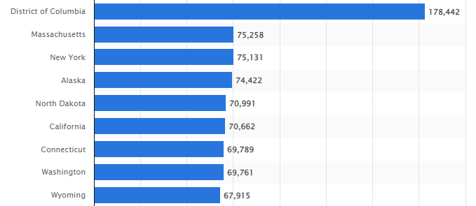
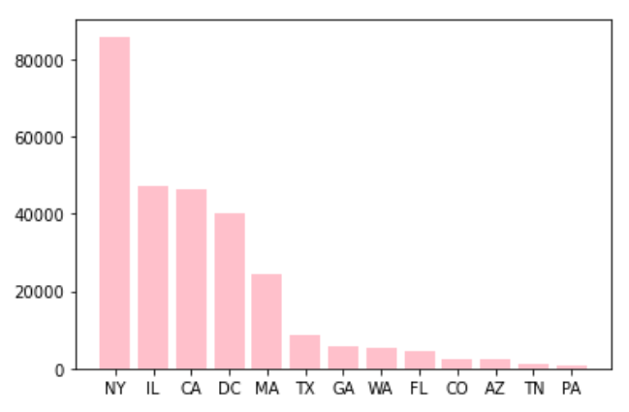
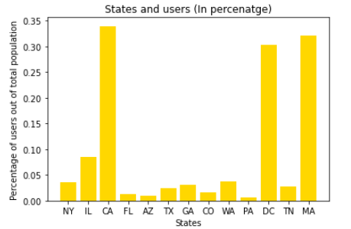
EDA
User preference
Geographic coverage
Top 9 States with their GDPs
Though CA, NY, IL, MA, DC are the main areas the two companies cover, Yellow cab appeals to more users in the CA area.
States with more users:
NY, CA, IL, DC, MA
States with the most conversion rate:
(derived by the number of users/population)
CA, MA, DC, IL, NY
States with the highest population to users conversion rate are generally with higher education levels and have higher GDPs.
GDP data source: https://www.statista.com/statistics/248063/per-capita-us-real-gross-domestic-product-gdp-by-state/

Slide 15
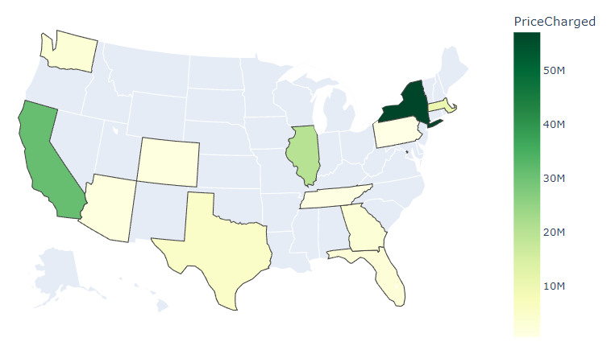
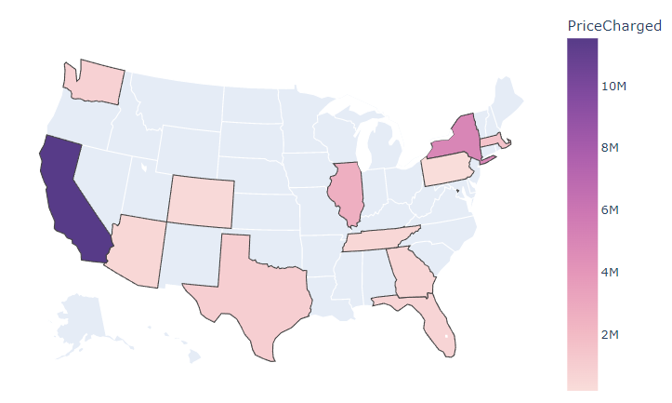
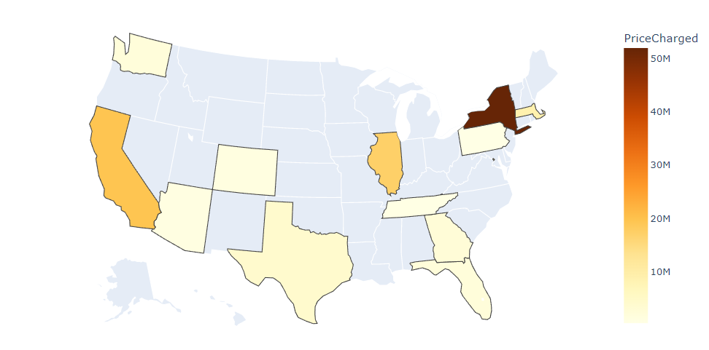
Total price charged by each company in different regions
All cab companies
Pink Cab
From the heat maps, on the east coast, Yellow cab is more welcomed, and charged more in total, while Pink cab is more welcomed on the west coast.
Combined with previous region analysis, NY, CA, IL, DC, and MA have the most users and their conversion rates are also high, for more profits, then we need to mainly focus on the company are welcomed in more regions, that would be the Yellow Cab
Yellow Cab

Slide 16
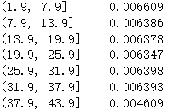
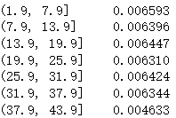
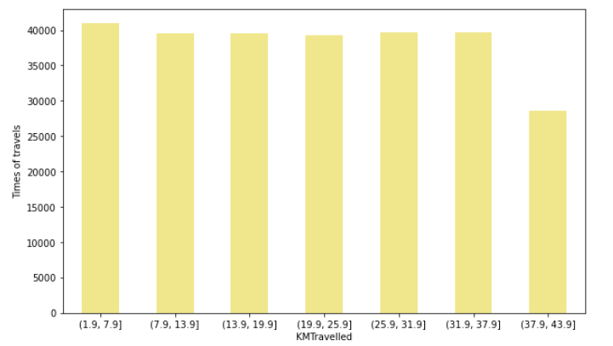
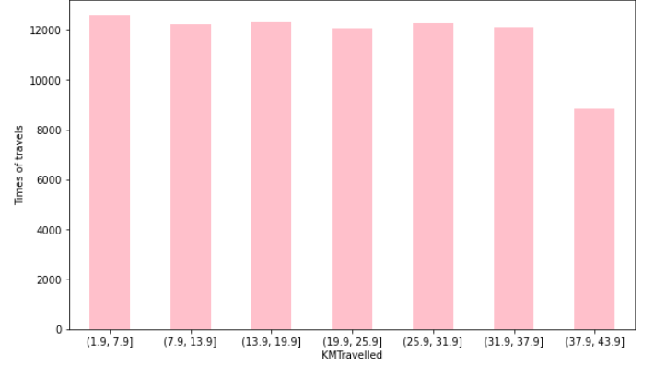
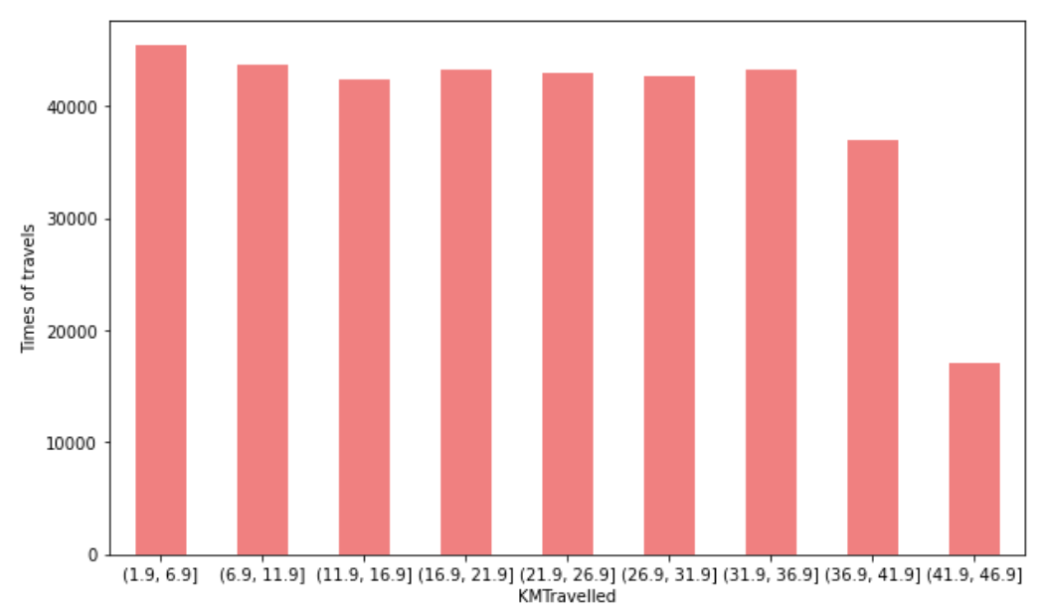
EDA
User preference
KM vs. Trips
As expected, the trips with respect to KM follow a uniform distribution. And the distance is all within the access to the airport from their downtowns.
The two companies share the a similar distance preference, there is no big differences in the dimension of distance

Slide 17
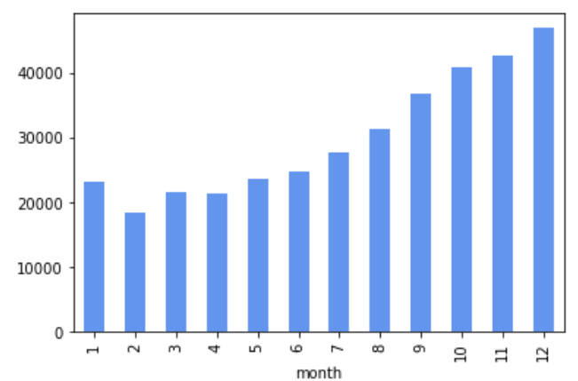
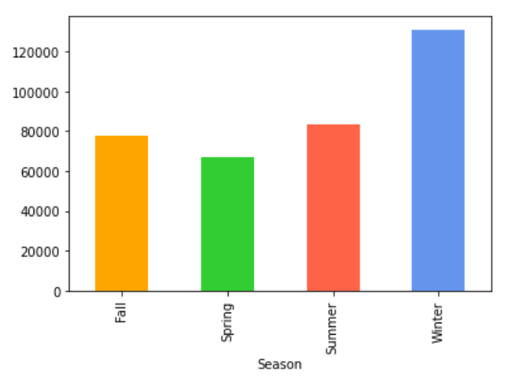
EDA
Time preference & time series analysis
From the bar chart, people tend to take a cab in winters, and in spring when the weather is generally better, the total number of rides is smaller.
Methodology: Seasons are separated by their months. In different regions, the season may differ, in this case, with respect to the five dominant states, most of them have winter starts from November to February, Spring from March to May, Summer from June to August, and Fall from September to October.
The total rides in different months also show when the weather gets colder, people tend to take a cab.

Slide 18
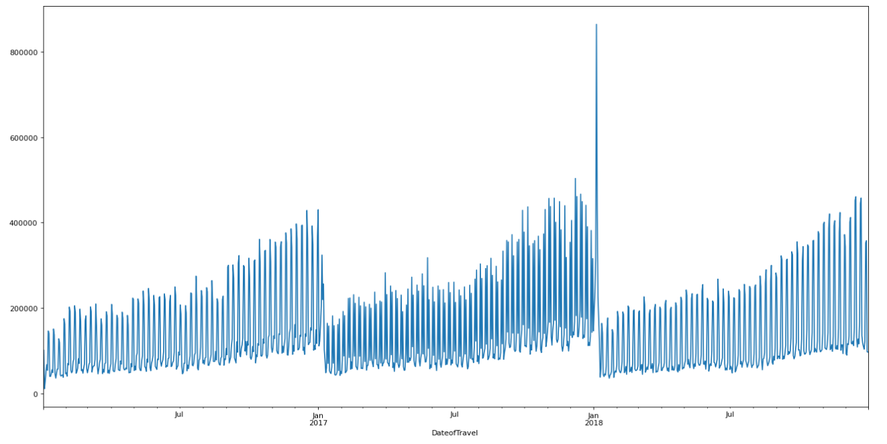
EDA
Time preference & time series analysis
From the time series plot, there is obvious seasonality and also an upward trend each year when winter comes

Slide 19
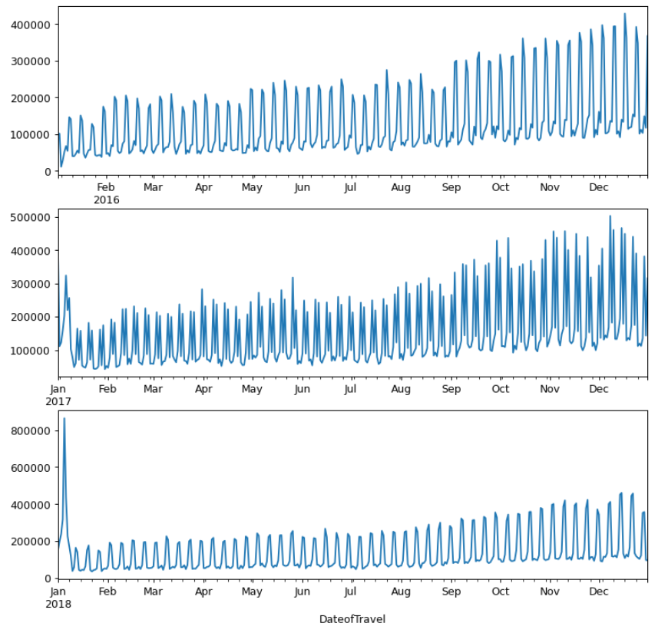
EDA
Time preference & time series analysis
When zoom in each year, the upward trend is more obvious. And there is also seasonality in each month.

Slide 20
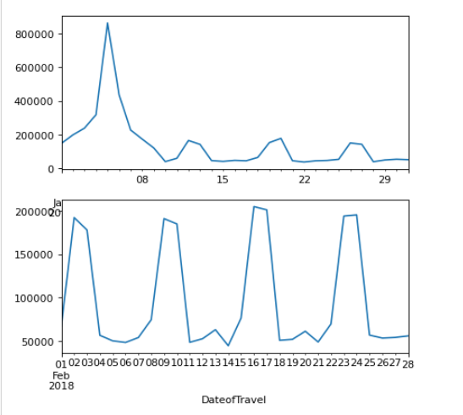
EDA
Time preference & time series analysis
Take January and February in 2018 as examples. The pattern is repeated each week, 5-7, 12-14 of Jan, 2-4 of Feb, are all weekends. The needs for cabs are much higher than on work days.

Slide 21
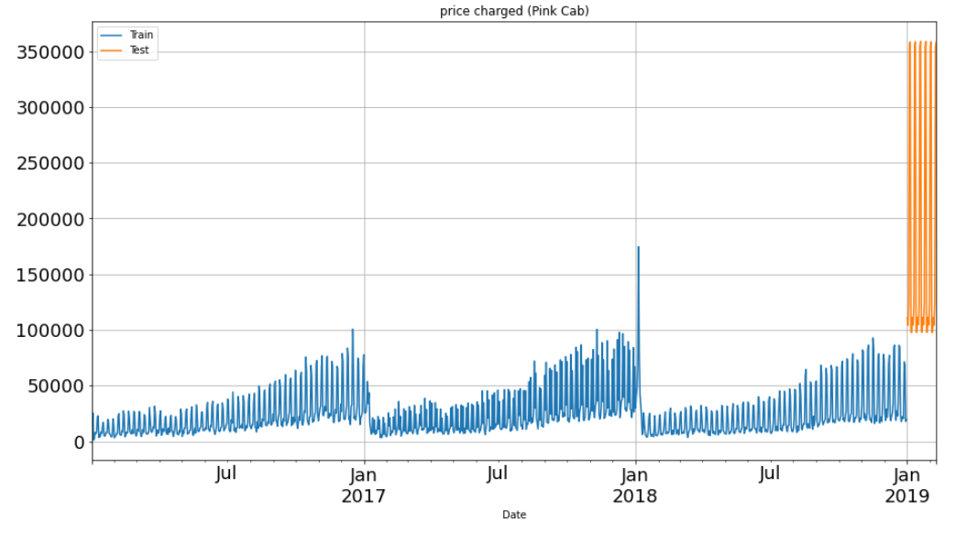
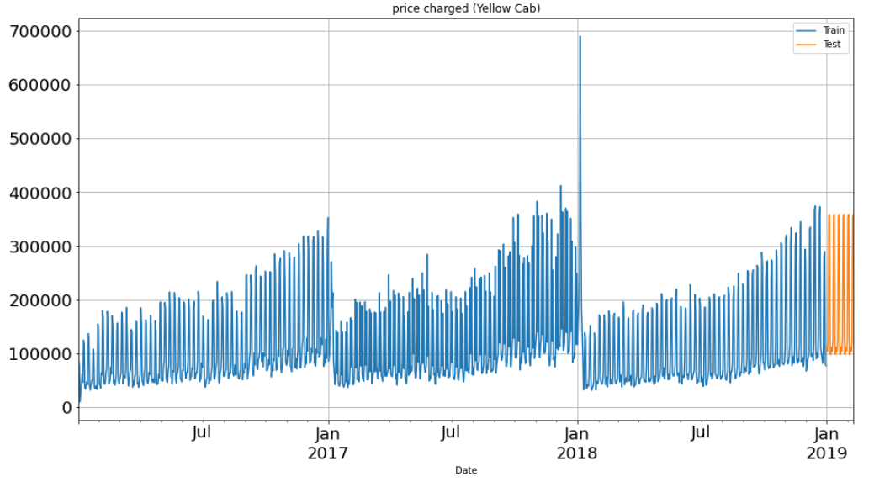
EDA
Predictions
The predictions for each of the companies are generally from 100,000 to 350,000, but the maximum predicted total charge is higher in Yellow Cab

Slide 22
Recommendations
In general: Yellow Cab is a better choice for investment.
Growth rate: Based on the growth rate, Yellow Cab does a better job than the Pink Cab
Profit: Though in 2018, the market share of Pink Cab becomes larger than in previous years, Yellow Cab still takes the majority part of the market, with a percentage of 82%. Further, the additional fees collected by Yellow Cab are far more than the Pink Cab, this might indicate the special marketing and charging strategy of Yellow Cab.
The user reaches out:
Geographically: on the east coast, Pink Cab takes the lead. But Yellow Cab still holds the overall leading position in the cab industry
Age: the composition of age is similar in the two companies, while Yellow Cab could reach out to more people in the elder age group, with a 0.2% higher percentage.
Gender: the Yellow Cab has a 2% higher composition in Male than the Pink Cab.
Income: the Pink Cab is more attractive to people with higher incomes than the Yellow Cab
To sum up, the Yellow Cab generally reaches out to more people in special groups and is more likely to be introduced to potential customers. From the aspect of total profit, market share, growth rate, and prediction, Yellow Cab is more worth to be invested.

Slide 23
Agenda
Executive Summary
Problem Statement
Approach
EDA
EDA Summary
Recommendations

Slide 24
Thank You

