Slide 1
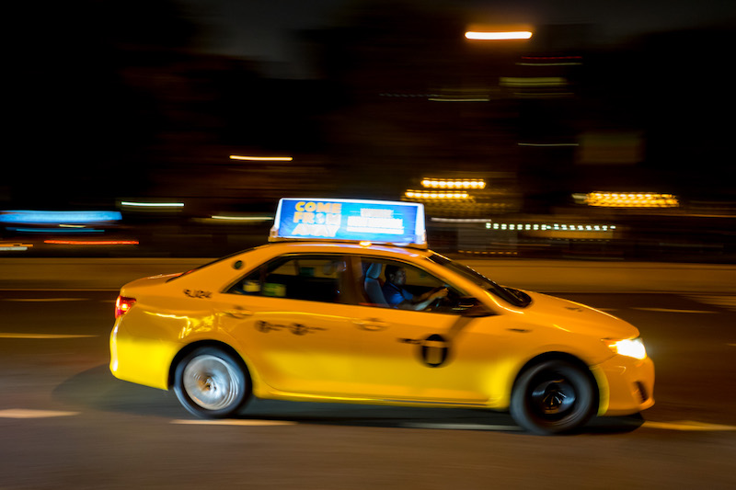
Project Iterations

Slide 2
Summary
4 iterations – NOT DEADLINES
Self-assign work each iteration
Graded based on individual contributions, following instructions, and milestones

Slide 3

Iterate iterate iterate
Two/three week iterations
Repeat… 4 iterations
Plan
Implement
Reflect
This is an Agile-like process.
Refer back to that lecture.

Slide 4
Each iteration
Plan
Discuss iteration goals with team.
Graded: Assign issues to each person on GitHub by start of iteration.
Implement
Implement the assigned tasks. Adapt as needed. Communicate with team frequently.
Additional tasks will be added by us later.
Graded: Individual contributions, following instructions, working application, etc.
Reflect
Think about and discuss how the iteration went.
Graded: Post on GitHub a bullet point list of what you planned to do, what you did, and what you didn’t do.

Slide 5
Planning!
Talk to your group
Decide what needs to be done over 2-3 weeks
Big picture: Is this 1/4th of the project?
Break up work into small tasks
Tasks should describe functionality, not code
Assign tasks to individuals
3-6 tasks per person is a rough estimate
I’ll give you some class time to meet
No, 3 minor bugs or tiny “features” doesn’t count!

Slide 6
Example!
This iteration, I will…
Connect the create account page to the db
Implement the backend functionality for logging
Update each page to display user info after they login
Fix bug that occurs when user logins for first time
Bad example: I will use Foobar class in Xyz class
Too small
Describes code, not functionality

Slide 7
Be descriptive!
Describe functionality, not code
Give details and examples
I should be able to understand every task

Slide 8
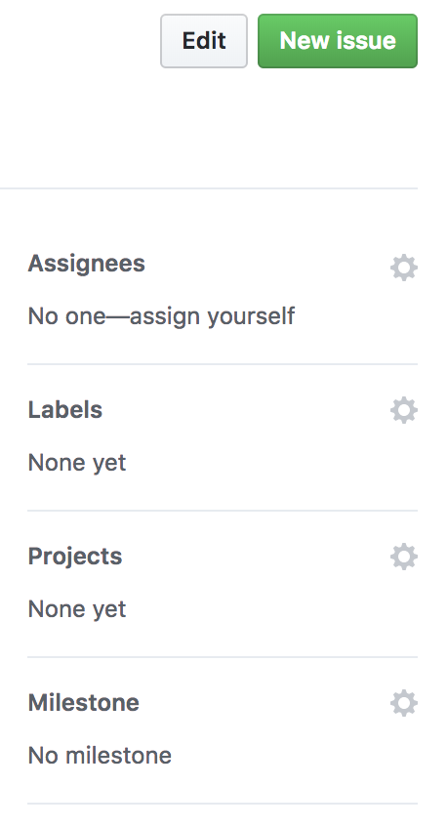
Tracking Tasks
Use GitHub’s Issue feature
Helps team keep track
Graded based on this!!!
No issues? Zero ☹
Assign it!
Iteration #

Slide 9
Link commits to issues!
Use the issue # in the commit message
E.g., “Adds the button for #15”
Can link multiple commits to the issue
With last commit, close it
E.g., ”Implements user login. Fixes #15”

Slide 10
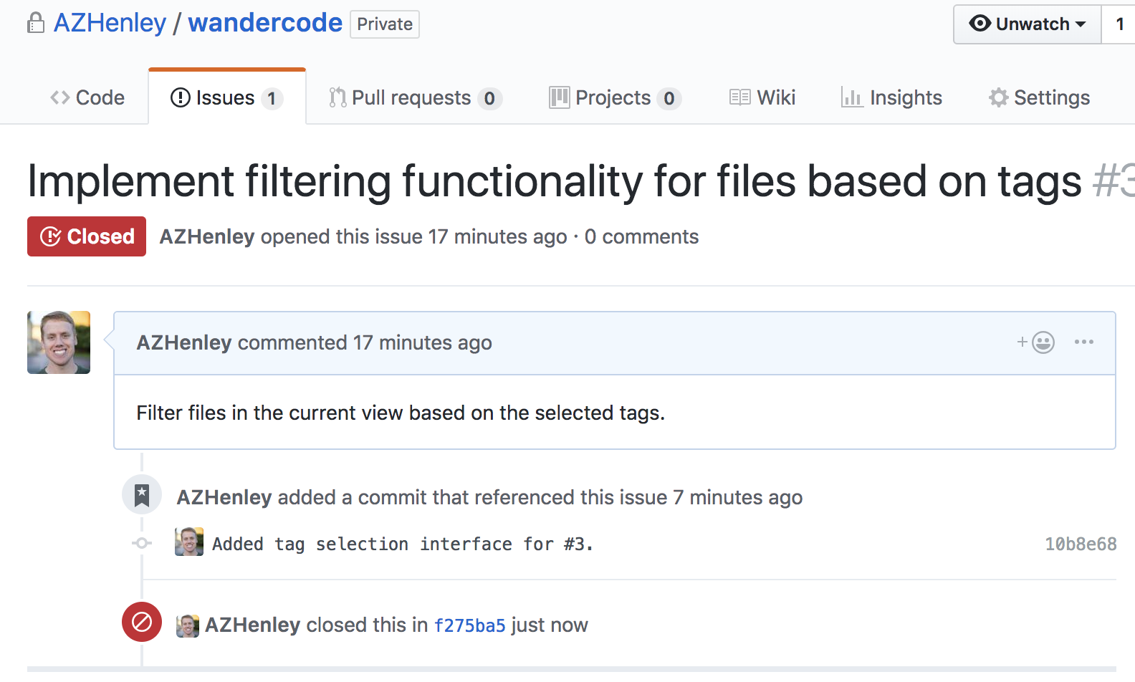
Link commits to issues!

Slide 11
Prep for first iteration
Starts next Thursday, September 16th
Have issues created and assigned by end of 15th
Teams should be settled by this weekend
If you did team PR you should have a repo now
Otherwise we will be assigning you to random teams

Slide 12
First iteration!
3 weeks instead of 2
First week is “practice” – we will give feedback and a grade (that won’t count)
The following 2 weeks are graded as normal
Expect it to not go according to plans; adapt!
Adjust your tasks as needed

Slide 13
Expectations and grades
Create several issues
Assign them and set the milestone
Link commits
Work incrementally and frequently
Iterations are NOT deadlines
Commit every 3-4 days using the right GitHub account
Heavily penalized for committing [mostly] at the end
Later we will assign additional tasks (e.g., code reviewing and unit tests)
Output and reflection
Application should always be runnable from main
Post your individual reflection by end of iteration

Slide 14
A note
We will only grade commits that are linked to issues that are assigned to you, closed, and have the iteration set.

Slide 15
Demo Days
Unsure if we can do Demo Days
We will figure it out later…
☹

Slide 16
My advice
Meet with your group! Setup a group chat
Create issues for all basic features of your app
Schedule to have them completed by iteration 2
Use iteration 3 & 4 for bugs, final features, polishing
Estimating is hard
MAKE SURE YOUR COMMITS ARE USING YOUR GITHUB ACCOUNT

Slide 17
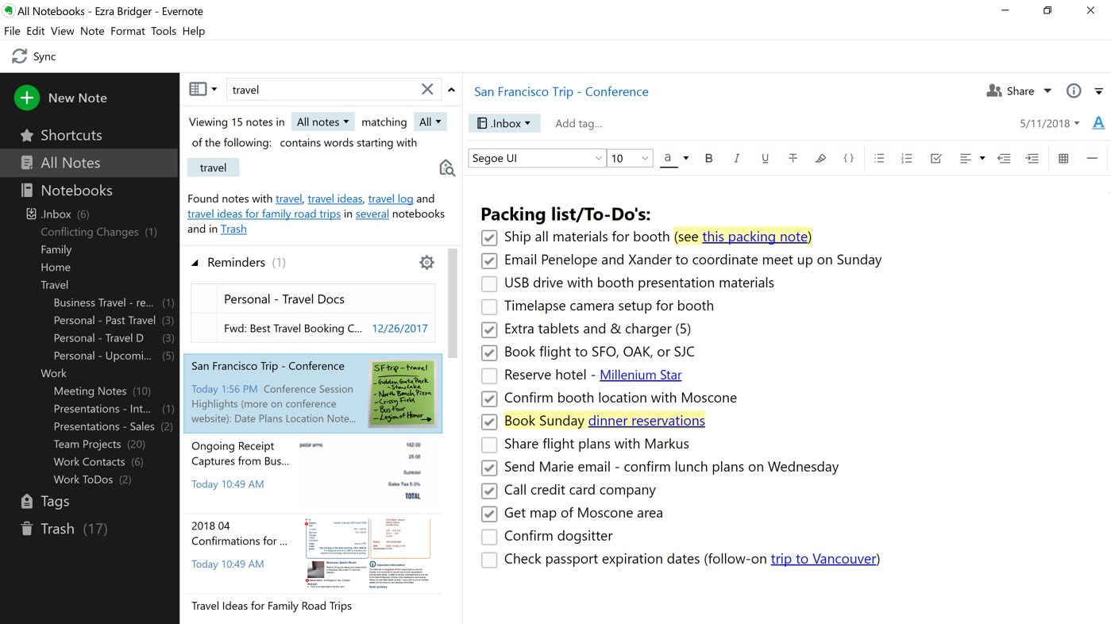
Example: Note Taking App
Iteration 1
Allow simple text input for a single note
Automatically save/load file to hard drive
Iteration 2
Support multiple notes
Support rich text editing (e.g., bold, bullet points, links, images)
Display list of notes with timestamps
Iteration 3
Support sharing notes using some web API
Fancy UI
Password protection and encryption
Iteration 4
Label, organize, and search notes
Spellcheck

Slide 18
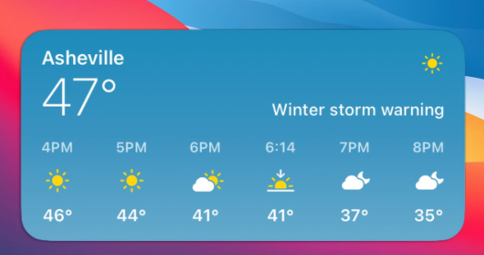
Example: Weather App
Iteration 1
Use API to fetch weather forecast
Display 7 forecast as text
Iteration 2
Set location
Pretty formatting
Notifications and popup alerts
Iteration 3
Detailed forecast view
Save and switch between locations
Cache the results
Iteration 4
Add bad weather days to my calendar
Gracefully handle internet issues

Slide 19
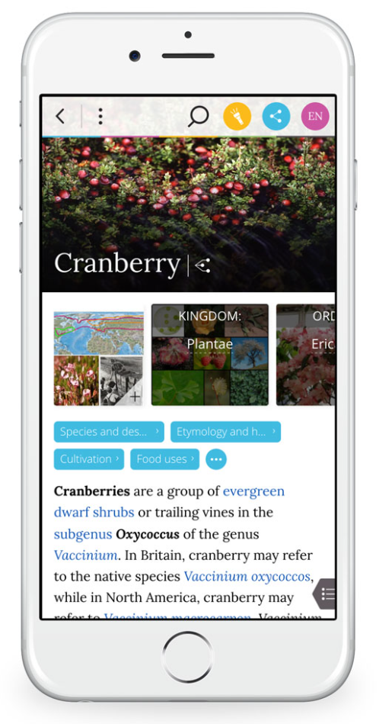
Example: Wiki Reader
Iteration 1
Use API to fetch article contents
View a hardcoded Wikipedia article
Text only
Iteration 2
Visit any article
Follow links to other articles
Show images
Iteration 3
Pretty formatting
Show tables
Search for articles
Search within article
Iteration 4
See outline and navigate to sections
Cache pages

Slide 20
More info…
On the course website…
Project Details document
Iteration Guide document
Iteration Grading Rubric (by next week)

Slide 21

Have fun!

