Slide 1

Planning and Estimation

Slide 2
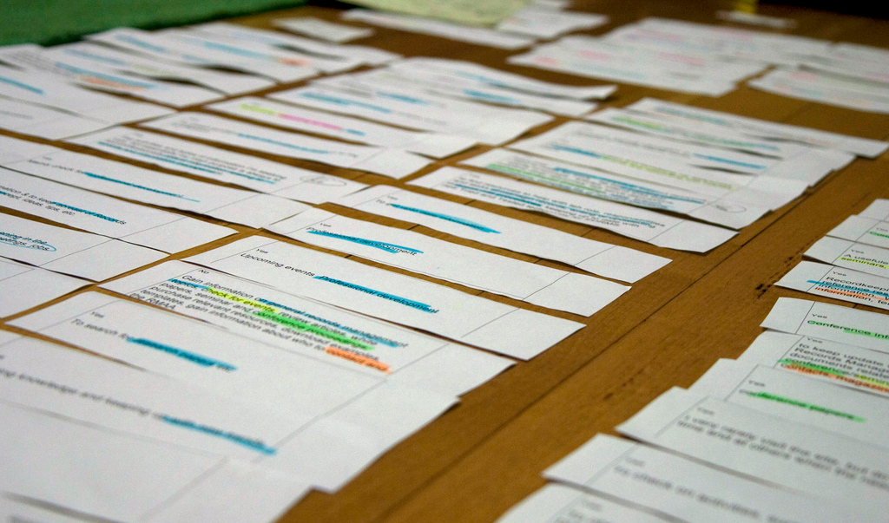
You have a bunch of user stories, so what’s next?

Slide 3
Iterative Development Process
We are here
Analysis
Design
Implementation
Requirements
Planning
Initial Planning
Testing
Evaluation
Deployment

Slide 4
Developer
Customer
Requirements
Create USs
USs
Check USs
Corrections/Clarifications
Fix USs
Add Estimates
USs + Estimates
Add Priorities
USs + Estimates + Priorities
Choose USs for Iteration
Divide Chosen USs into Tasks
Estimate Tasks
Assign Tasks to Workers
Get to Work!

Slide 5
Developer
Customer
Requirements
Create USs
USs
Check USs
Corrections/Clarifications
Fix USs
Add Estimates
USs + Estimates
Add Priorities
USs + Estimates + Priorities
Choose USs for Iteration
Divide Chosen USs into Tasks
Estimate Tasks
Assign Tasks to Workers
Get to Work!

Slide 6
Estimating Time
http://xkcd.com/1658/

Slide 7
Hofstadter's Law
It always takes longer than you expect, even when you take into account Hofstadter's Law.
— Douglas Hofstadter, Gödel, Escher, Bach

Slide 8
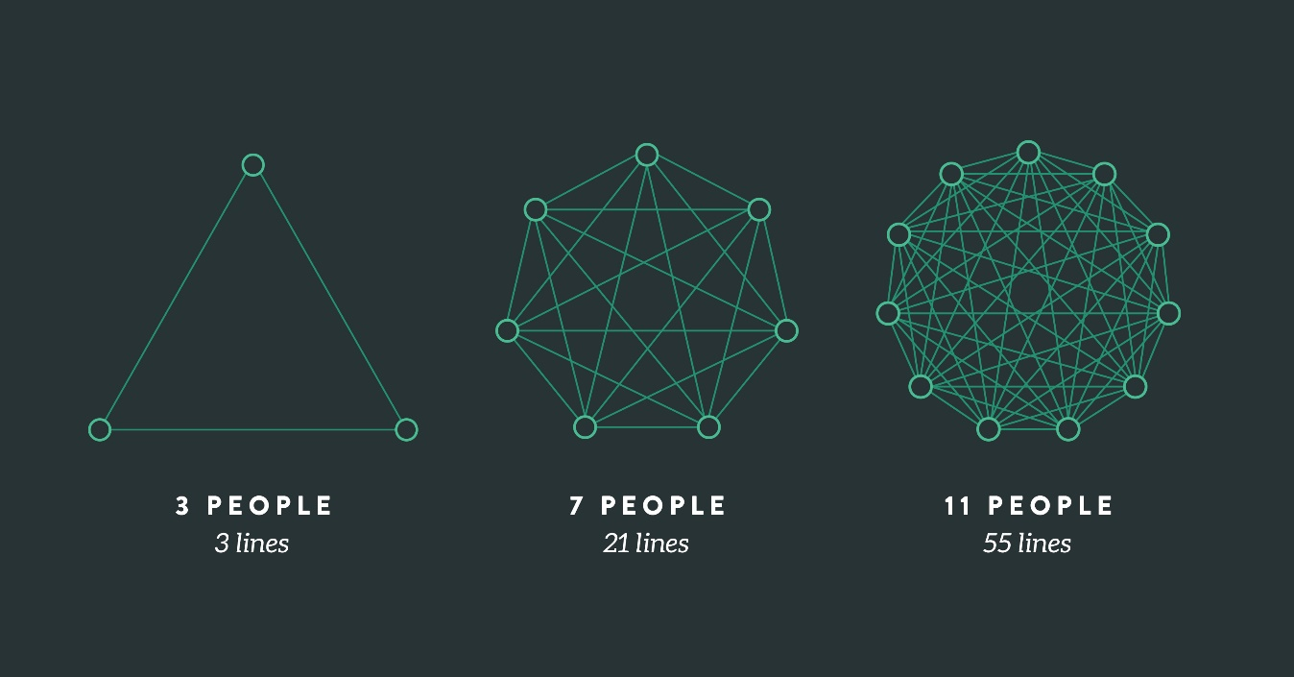
Mythical Man Month
“Adding manpower to a late project makes it later.”
Group communication grows very fast
n(n – 1) / 2

Slide 9
Mythical Man Month
“Adding manpower to a late project makes it later.”
Group communication grows very fast
n(n – 1) / 2
“How does a large project get to be one year late?”
“One day at a time.”
Lot of small milestones miss deadlines by a bit

Slide 10
Principles for Estimation
Principle: Past performance is the best indicator of future performance
Approach: Track your outcomes; refine your estimates
Principle: Wisdom of the crowd
Goal: Predict how events will unfold
Think event planning
Problem: Easy to miss something
Solution: More brains = more opportunities to catch eventualities

Slide 11
Principles for Estimation
Principle: Past performance is the best indicator of future performance
Approach: Track your outcomes; refine your estimates
Principle: Wisdom of the crowd
Goal: Predict how events will unfold
Think event planning
Problem: Easy to miss something
Solution: More brains = more opportunities to catch eventualities
How did the first
Iteration go??

Slide 12
Planning Poker!

Slide 13
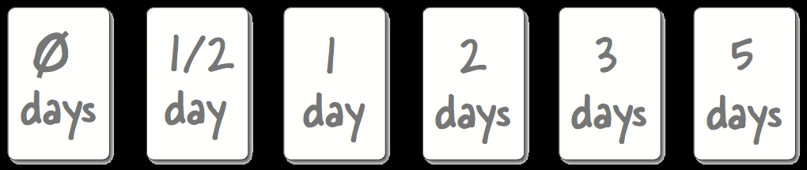
Estimation with Planning Poker
Cards with units of work: 0,1/2,1, 3, 5, 8, 13, 21, 34…
Assume team can do X units in an iteration
Units can be hours or days
For each US:
Discuss work involved
Flip cards
Repeat until consensus
Efficiency in estimating is important
Don’t expect your estimates to be super accurate

Slide 14
Let’s watch this video to find out what planning poker is all about:
http://youtu.be/0FbnCWWg_NY

Slide 15
More Estimation Principles
Engineers refine estimates; customers refine expectations
Estimates are basis for customer’s cost assessment
Give honest estimates that customers can trust
Don’t do this: https://youtu.be/t9SVhg6ZENw
Work at a sustainable pace
No heroes, no all-nighters, no super-human feats
Either you get the code done like a human being, or you don’t

Slide 16
Developer
Customer
Requirements
Create USs
USs
Check USs
Corrections/Clarifications
Fix USs
Add Estimates
USs + Estimates
Add Priorities
USs + Estimates + Priorities
Choose USs for Iteration
Divide Chosen USs into Tasks
Estimate Tasks
Assign Tasks to Workers
Get to Work!

Slide 17
Principle: Customer sets priorities
Ensures alignment with customer goals
Helps customer feel in control
Project isn’t going “off the rails”
Estimates help customer maximize cost-benefit

Slide 18
Priority Numbering Scheme
P0 – drop everything, critical task, often fatal bugs
P1 – high priority, others depend on this
P2 – should be completed during iteration
P3 – only complete if time permits
P4 – low value or superficial, don’t spend time on it

Slide 19
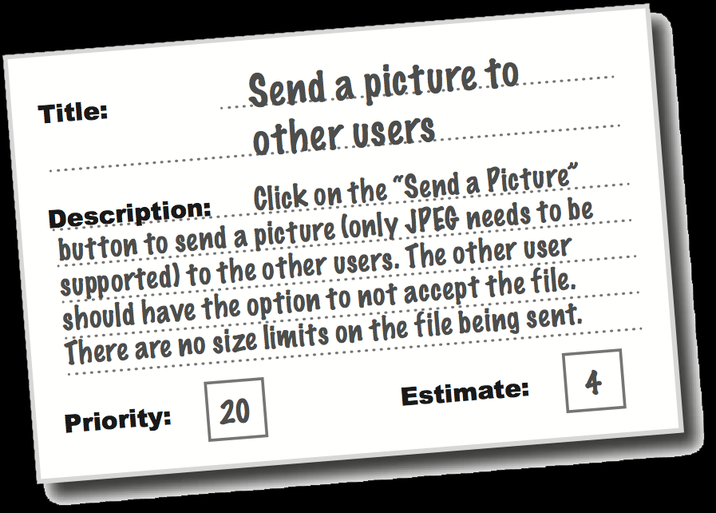
So now you have…
Collection of user stories
With estimates
And customer priorities
What’s next?

Slide 20
Let’s try it out
Go to your GitHub issues
If they are lacking details, add to the description
Add a comment:
Estimate the hours it will take you
Add a priority level

Slide 21
Developer
Customer
Requirements
Create USs
USs
Check USs
Corrections/Clarifications
Fix USs
Add Estimates
USs + Estimates
Add Priorities
USs + Estimates + Priorities
Choose USs for Iteration
Divide Chosen USs into Tasks
Estimate Tasks
Assign Tasks to Workers
Get to Work!

Slide 22

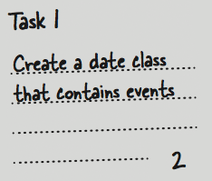
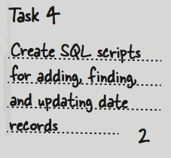
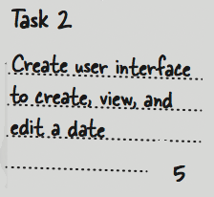
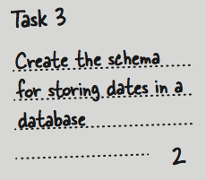
From USs to Tasks
User Story
Estimate

Slide 23
Incremental Development Principle
Each task produces running code
Unit tests count

Slide 24
Task design strategy
Make tasks build upon one another
First task makes subset of US work (e.g., partial form)
Second task makes bit more work (e.g., add persistence)
Etc…

Slide 25
Planning Process
Part 1: Estimate USs
Use Planning Poker
Start designing
Part 2: Collect customer priorities
Assign number each US
Also note any corrections/clarifications
Part 3:
Choose tasks for the iteration
2 weeks worth of work
Fill out iteration plan with what each team member will do
Everyone codes
Tasks must be verifiable and executable

