Slide 1

Software Testing

Slide 2
Can you create bug-free software?
What can you do to discover bugs?
For practical purposes, no!
Goal: Reduce the number of bugs
Most common ways in practice:
Software testing
Code reviews
Notes:
In real software, there are thousands and thousands of lines so it is very difficult to create a program that is 100% bug free.

Slide 3
“Testing can only show the presence of errors, not their absence”
-Dijkstra

Slide 4
Testing-Related Terminology
Testing: Execute code to reveal defects
Given some input, does it produce expected output?
Does it behave as expected?
Test/Test Case: One execution of code that may expose bug
Test Suite: Set of test cases
Often used to group related tests

Slide 5

How do you completely test a program?
Think of simple example:
UNIX file operation
Takes file name as argument
Each character an 8-bit byte

Slide 6
How do you completely test a program?
Think of simple example:
UNIX file operation
Takes file name as argument
Each character is a byte
Exhaustive Testing: Try all possible inputs

Slide 7
Can exhaustive testing be done in practice?

Slide 8
Can exhaustive testing be done in practice?
No!
How many tests cases to exhaustively test simple UNIX file command?
If you limit file name to 10 characters, there are 256¹⁰ different test cases
Even if you can run 1000 tests per second, it would still take over 1013 years!
And that's just varying the file's name, not its contents!
Clearly, exhaustive testing not feasible…
Notes:
=((2^8)^10)/(1000*60*60*24*365)

Slide 9
The Testing Problem:
How to choose set of test cases that reveals all errors?
Fundamental research problem
Essentially unsolvable in general case

Slide 10
Design Decisions for Tests
What subset of system to test?
How to choose test cases?

Slide 11
What subset of system to test?
larger subset
System testing: Test the complete system
Integration testing: Test groups of collaborating units
Unit testing: Test modules in isolation; smallest “units” of code
smaller subset

Slide 12
Unit versus Integration Testing
Problem: Definition of “unit” varies (class? method?)
Common distinctions:
Unit test | Integration test
Repeatable (context independent) | May involve system time, machine name, etc.
Deterministic | May involve threads, random numbers, etc.
In memory | May involve file system, DB
Fast (less than 0.5 seconds) | May be slow
Tests one property | May test multiple properties

Slide 13
Design Decisions for Tests
What subset of system to test?
How to choose test cases?

Slide 14
Equivalence Partitioning
Possible inputs
Possible outputs
Application
Test cases
Correct outputs
Test cases

Slide 15
Common ways to choose test cases
Black-box testing
White-box testing
Regression testing

Slide 16
Black-Box Testing
Choose based on module’s possible inputs and outputs (i.e., its interface)
Do not use internal code
Often test boundary cases
Example: Values at 0, 1, and -1 (around the zero boundary)

Slide 17
White-Box Testing
Uses internal logic to choose tests
Different levels of code coverage
Example: Cover all statements
Aka glass box testing, clear box testing

Slide 18
Regression Testing
Prevent working code regressing to broken state
Tests code to detect breakage
Run frequently or at regular intervals
Might include tests that reveal bugs found in wild
Circumstances that caused bug may cause it to recur!
May include black-box or white-box tests

Slide 19
More testing techniques
Test-Driven Development
Acceptance Testing
Functional Testing
Performance Testing
Usability Testing
Briefly cover now.
Will cover this soon.

Slide 20
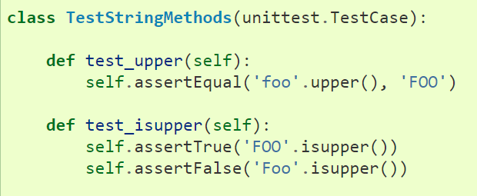
What is a unit test?
Code that tests code
A unit test creates objects and calls method
Given an input, is the result as expect?
Automatically ran
Still helpful to test obvious cases.
Just because it works now doesn’t mean it will work later!
Notes:
Demo on unit tests later.

Slide 21
Test-Driven Development
Write tests
Write code
Refactor
”red, green, refactor”
Write tests that fail
Write code that passes tests
Refactor to make the code better

Slide 22
Test-Driven Development
No product code except to make a failing test pass.
Write test cases before product code
Initially, all tests will fail since the code it is testing does not yet exist.
Keep tests small.
Write simplest code to pass the tests.
After all tests pass, refactor!

Slide 23
Summary
Testing terminology
The Testing Problem
Unit, integration, and system testing
Black-box, white-box, and regression testing

