Slide 1
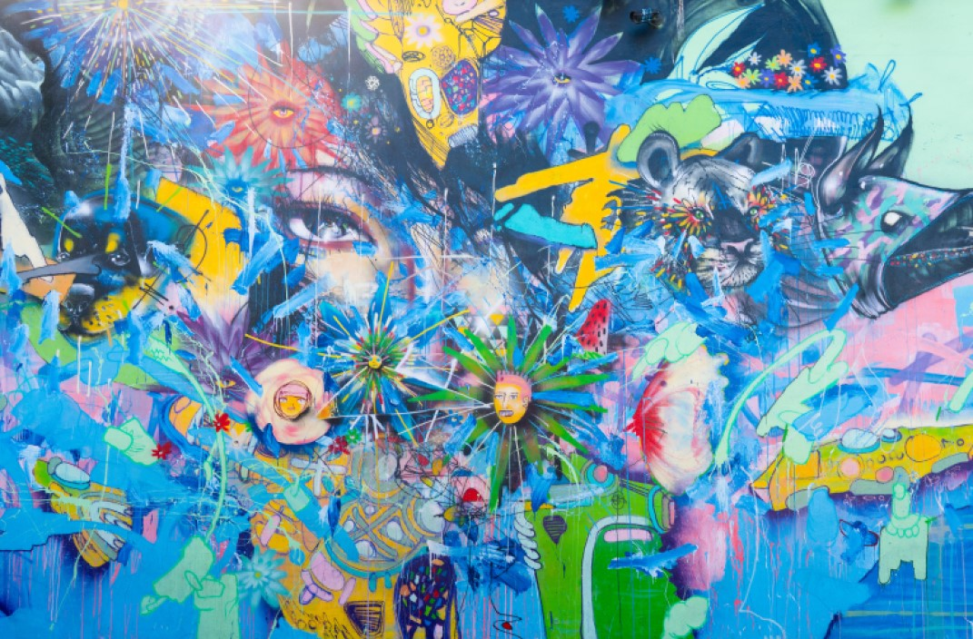
Object-Oriented Programming

Slide 2
Iterative Development Process
Analysis
Design
Implementation
Requirements
Planning
Initial Planning
Testing
Evaluation
Deployment

Slide 3
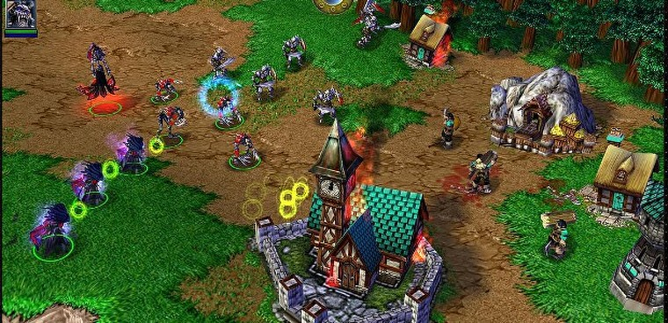
You may have used OOP before…

Slide 4

Questions you may have about your project
How do you organize your code?
When do you create a new function?
When do you start a new file of code?
How do you keep up with a lot of state info?

Slide 5
Object-Oriented Programming (OOP)
Organize code and data using objects
Objects are nouns
Each object has its own state
Objects can perform actions
Actions are verbs
Can also use other objects in the action

Slide 6
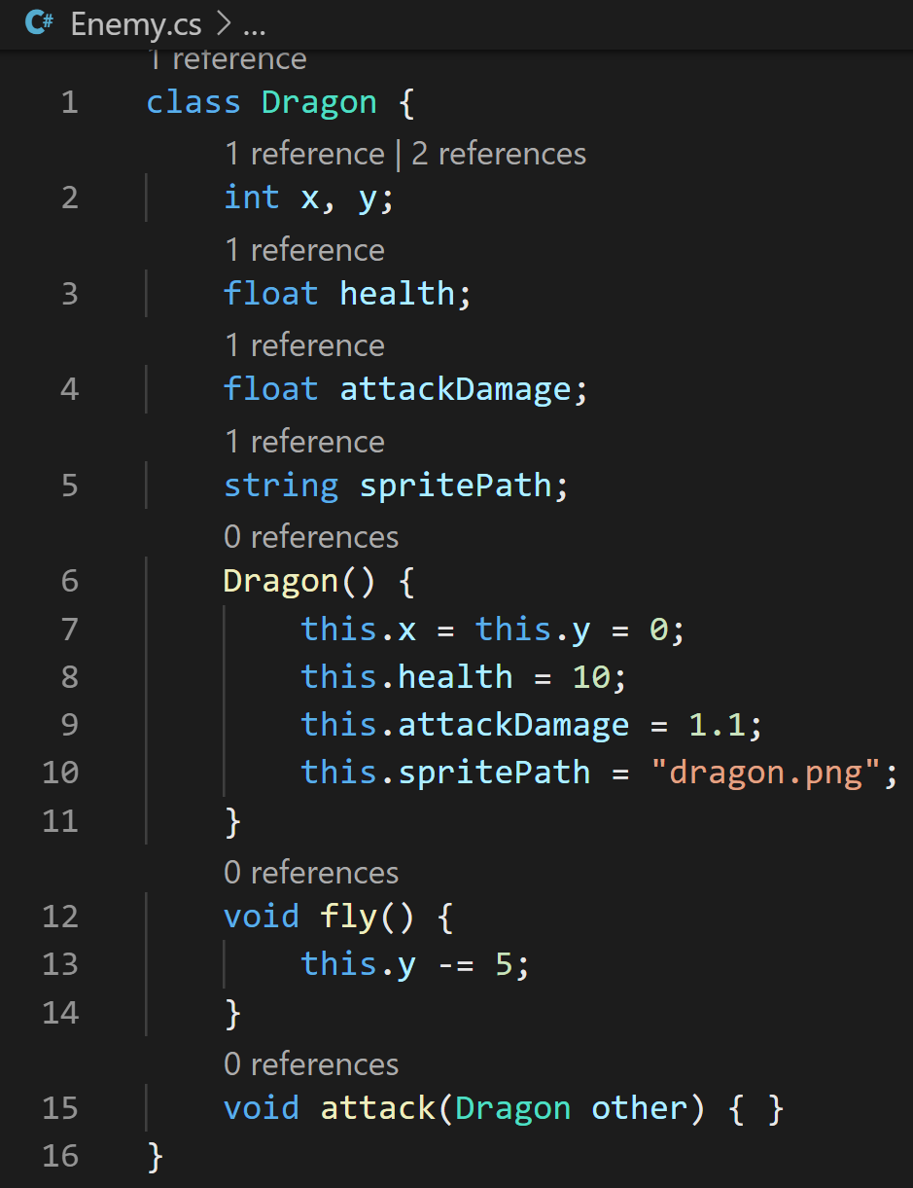
So what does it look like?
class
member variables
methods

Slide 7
Basic OOP
Define your own types with classes
Instantiate your type
Dragon petDragon = new Dragon();
Create as many as you want!
Will call a special function, constructor, to initialize object
Perform actions on objects by using methods
petDragon.fly();

Slide 8
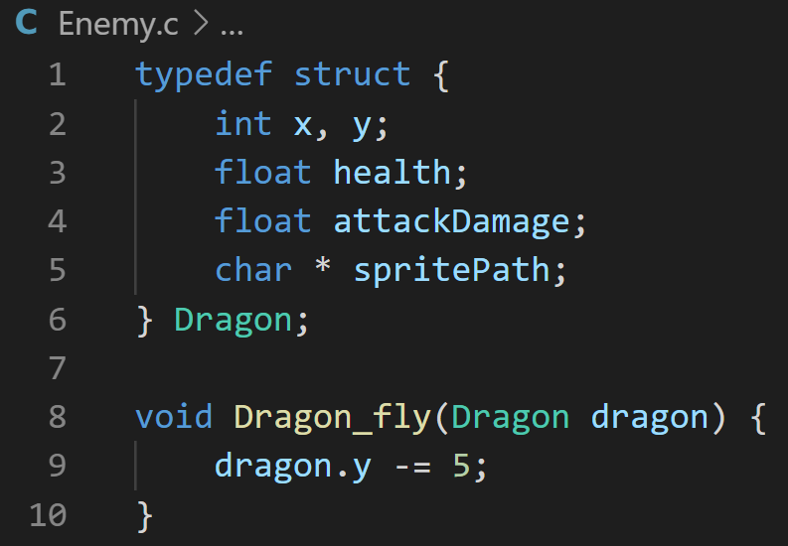
And yes, you can use OOP in C
But code gets ugly
Less help from language and compiler

Slide 9
What classes should we make?
ghoul
house
town hall
tree

Slide 10
We will come back to this…
Let's get into the ideas behind OOP

Slide 11
Three main concepts behind OOP
Inheritance+composition
Encapsulation
Polymorphism

Slide 12

Relationships: “is a” and “has a”
This car has 4 wheels and two electric motors
This car is a sedan and an automobile

Slide 13
Composition
“Has a” relationship
The components that make up a class
Often other objects
Our Dragon class is composed of:
X, y position
Health
An attack
What if dragons could wear armor?
Add an Armor object to Dragon

Slide 14
Example of Composition
Button has…
Position
Size
Text content
Background color
Is enabled?
Is visible?
Click event
Hover event

Slide 15
Inheritance
“Is a” relationship
Can reduce redundant code
A Dragon is a Creature
Now create a Creature class that contains:
X,y position
Health
Dragon “inherits” from Creature
Unicorn “inherits” from Creature

Slide 16
Example of Inheritance
Widget has…
Position
Size
Is visible?
Draw()
Click event
Button inherits Widget
Button also has…
Text content
Click animation

Slide 17
What classes should we make?
ghoul
house
town hall
tree

Slide 18
What classes should we make?
Unit
Environment
Building

Slide 19
A possible organization…
Entity
Position, health, 3d model, select event, …
Building : Entity
Cost, damage effects, upgrades, …
Unit : Entity
Speed, animation, attack, …
Worker : Unit
Hero : Unit

Slide 20
A possible class hierarchy
Entity
Building
Environment
Unit
HQ
Producer
Worker
Hero
Housing
Tower
Ranged
Flying
Caster
Melee

Slide 21
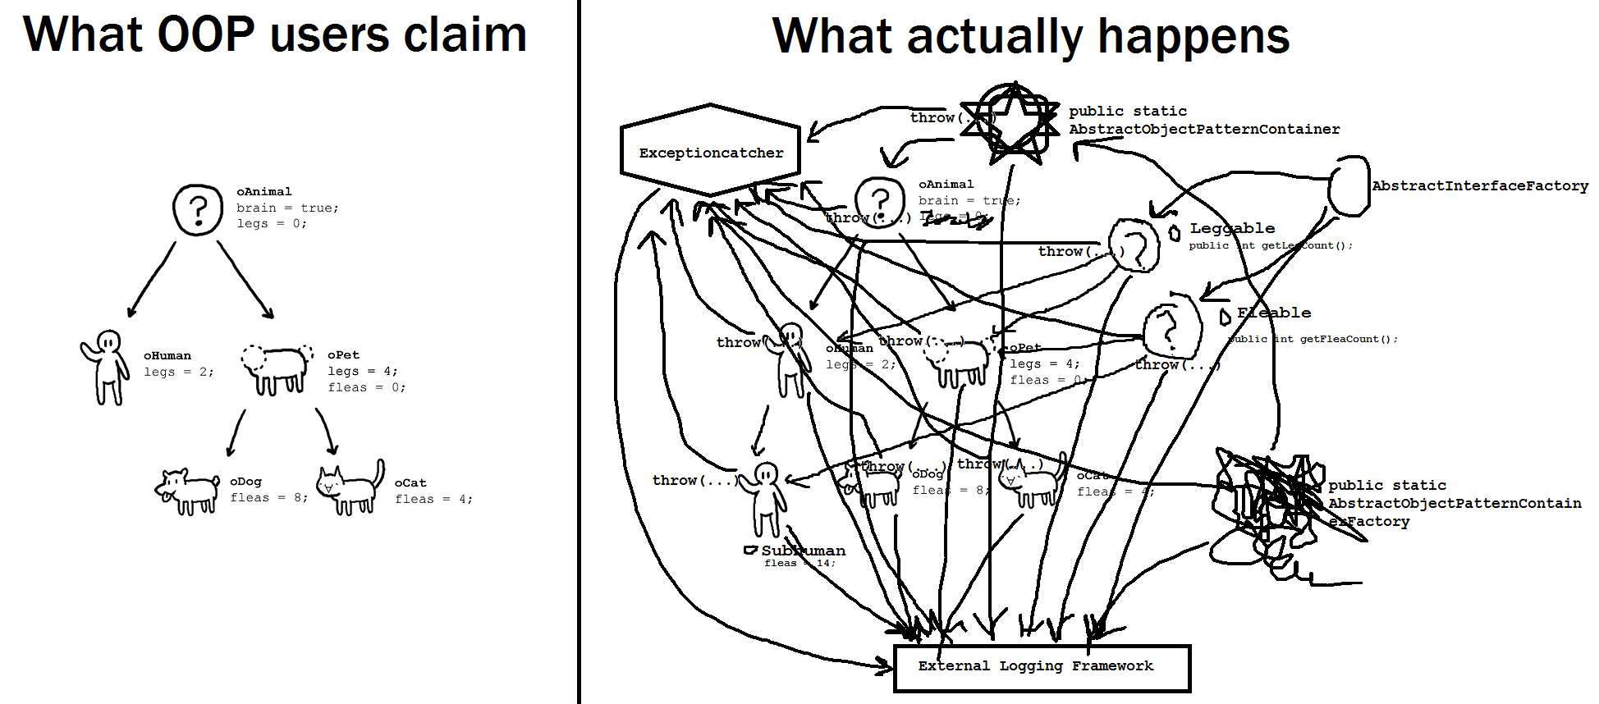
A warning against OOP

Slide 22
Encapsulation
Restrict access to object’s data
Maintain own state
Concept of “data hiding”
Classes should NOT know how other classes work
Example: Our Dragon’s position should be not accessible to anyone
Instead, it needs to move()

Slide 23
Applying Encapsulation
Public, protected, private
Python you use _foo or even __foo
Setters and getters
float getHealth();
void setHealth(float h);
bool move(float x1, float y1);
void attack(Entity other);

Slide 24
Example of Encapsulation
private float x, y;
public bool move(float x1, float y1) {
if( x1 > 0 && y1 > 0) {
this.x = x1;
this.y = y1;
return True;
}
return False;
}
Now x and y are only set internally or by move()
Easier to manage and debug!

Slide 25
Three main concepts behind OOP
Inheritance+composition
Encapsulation
Polymorphism

Slide 26
Poly morph say what?
Polymorphism (subtyping) lets us treat any of our subtypes as the same type
Back to our Warcraft example:
Destroy() should work on Unit or Building or Environment
void Destroy(Entity obj) { }
Because these inherit from Entity, we can pass any of them as an argument and Destroy() will work correctly!

Slide 27
Other concepts related to OOP…
Single responsibility principle
Each module should do one thing and only one thing!
Cohesion and coupling
Degree to which things belong together
Degree of dependence between modules
Principle of least knowledge
Should not know how other classes work internally
Only interact with close modules, not modules within modules

Slide 28
Other concepts related to OOP…
Composition over inheritance
Composition is easier to manage than complex inheritance
Keep inheritance minimal
Some languages disallow multiple inheritance or have “interfaces” instead
Open/closed principle
Modules should be open for extension
But closed for modification

Slide 29
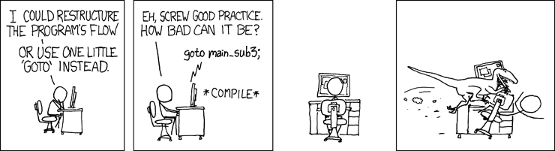
How is your app’s code organized?
Not good? That’s ok! Iteration is key.
Don’t get stuck in analysis paralysis… write bad code then make it better.
REFACTOR!

