Slide 1

Model-View-Controller

Slide 2
An architectural pattern
High-level structure of software system
Not classes, not implementation details
The components may be implemented different ways
May depend on language/framework
Each component may have one or more classes

Slide 3
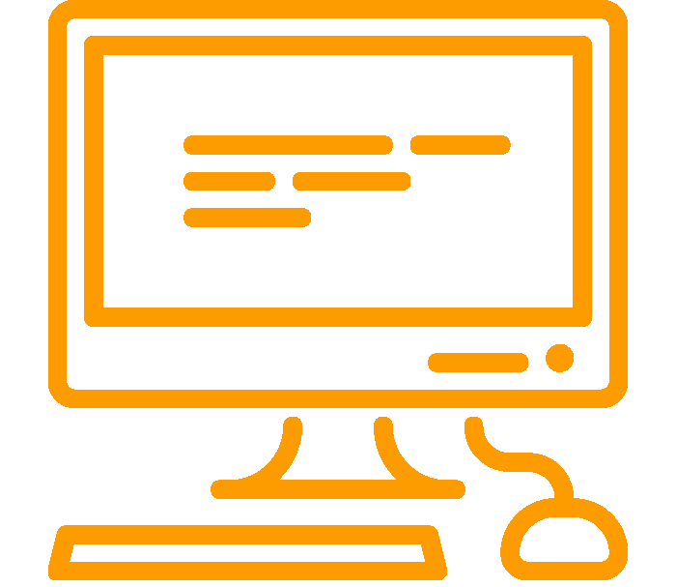

Interacting with an app
input
Lets break this down
output

Slide 4
Model-View-Controller
Controller
Model
View

Slide 5
Responsibilities
Controller
Handles input
Mediator
Model
Logic and state
Domain objects
View
User interface
Display info
Controller
Model
View
DB

Slide 6

Responsibility-Driven Design
Frames object design as deciding
How to assign responsibilities to objects
How objects should collaborate
What role each object should play in a collaboration
http://flic.kr/p/btp5ZK

Slide 7
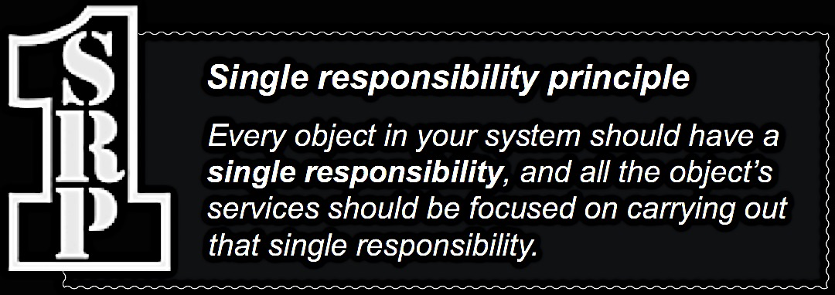

Slide 8
Responsibilities
Controller
Handles input
Mediator
Model
Logic and state
Domain objects
View
User interface
Display info
Controller
Model
View
DB

Slide 9
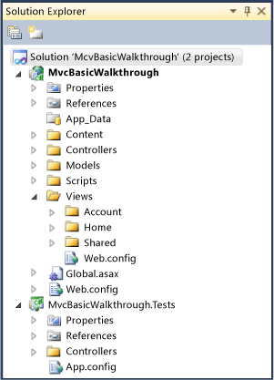
Example: Contacts App
Controllers
Person
Models
Person
Views
Create
Edit
Delete
List
Details

Slide 10
Benefits of MVC
Separates logic from UI and data
GUI programming gets horrible without it
Changing the GUI is easy
Making “skins” or porting is easy
Without it…
A small change to the data or logic will break everything
User interface is dependent on backend

Slide 11
Downsides of MVC
Unneeded complexity?
Simple forms may become 3 or more classes
Scatters the code
Must maintain more code
Remember: this is just a pattern, not a law

Slide 12
A note about MVC…
Many different interpretations
E.g., View and Model communicate
Has evolved since its original meaning
Big takeaway: separate UI from logic
Many variations
MVVM, model-view-viewmodel
MVP, model-view-presenter
HVMC, hierarchical model-view-controller
PM, presentation model
…

Slide 13
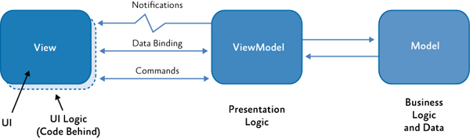
Model-View-ViewModel

Slide 14
So how do we use it?
Depends on your GUI library
Django uses MVC
WPF uses MVVM
Tkinter uses nothing
Use something!

