Slide 1

NLP BASED PUBLIC SENTIMENT ANALYTIC SHIFTS

Slide 2
MOTIVATION
During the COVID-19 pandemic, government authorities had to make rapid policy decisions such as lockdowns, school closures, or mask mandates—that directly impacted people’s lives. Public sentiment toward these policies played a crucial role in their success or failure: even well-intentioned rules faced resistance if they were poorly received. However, traditional decision-making lacked real-time feedback on how citizens actually felt. This motivated us to design a system that automatically analyzes public reactions from social media, aligns them with proposed policies, and helps authorities anticipate acceptance or resistance. By bridging the gap between policy planning and public sentiment, our system aims to support data-driven governance and improve crisis response effectiveness.

Slide 3
ABSTRACT
The COVID-19 pandemic triggered large-scale discussions and emotional responses on social media platforms.
This project focuses on sentiment classification of COVID-19-related tweets and policy statement evaluation using Natural Language Processing (NLP).
A fine-tuned BERT model was trained on a hybrid dataset combining Kaggle’s COVID-19 NLP dataset and real-world policy statements.
Tweets were categorized into Positive, Neutral, and Negative sentiments after comprehensive text preprocessing and normalization.
Comparative analysis was performed using RoBERTa, DistilBERT, and TF-IDF with Logistic Regression to validate BERT’s performance.
The fine-tuned BERT achieved the highest accuracy (~91%) and macro-F1 score (~0.896), outperforming other models.

Slide 4
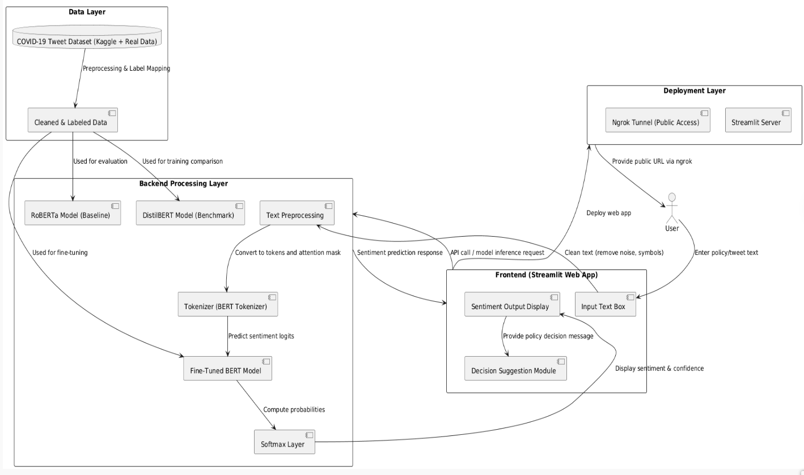
ARCHITECTURE DIAGRAM

Slide 5
ACCOMPLISHED
Dataset Preparation
2. Model Training (Fine-Tuning BERT)
Prediction Logic
Decision Rule for Policies
Front-End Development (Streamlit App)
Deployment via ngrok (on Google Colab)
Compared with alternate models

Slide 6
CHALLENGES
1.Data Quality Issues:
Tweets contained slang, abbreviations, misspellings, and inconsistent grammar.
2.Dataset Integration:
Combined Kaggle dataset with real-world policy statements.
3.Class Imbalance:
Neutral class dominated the dataset.
4.Model Fine-Tuning Complexity:
Transformer models (BERT, RoBERTa) required heavy computation and GPU memory.
5.Model Comparison Difficulties:
Needed uniform preprocessing, tokenization, and evaluation settings across BERT, DistilBERT, and RoBERTa.
6.Deployment Challenges:
Integrating the large BERT model into Streamlit app led to slow startup and high RAM usage.

Slide 7
NOVELTY
Aspect | Existing Works / Models | Proposed Fine-Tuned BERT System | Novelty / Improvement
Dataset Source | Used only Kaggle or limited COVID-19 tweet datasets. | Combines Kaggle COVID-19 tweets with real-world policy statements. | Broader coverage and real-context adaptability for public policy sentiment.
Data Preprocessing | Basic cleaning; limited handling of noise and slang. | Comprehensive cleaning pipeline (URLs, mentions, emojis, normalization). | Improved text quality, enabling better semantic understanding.
Model Architecture | Classical ML models (SVM, NB, LSTM, GRU) or unfine-tuned transformers. | Fine-tuned BERT-base optimized for COVID-19 domain. | Context-aware learning with superior accuracy and F1-score.
Class Imbalance Handling | Often ignored or handled by oversampling. | Weighted loss during training to balance classes. | Reduces bias toward majority class; improves Neutral/Negative prediction.
Model Comparison | Typically single-model evaluation. | Compared against DistilBERT, RoBERTa, and Logistic Regression. | Multi-model benchmarking validates BERT’s superiority.
Accuracy / Performance | 70–85% accuracy in most studies. | Achieved 91.05% accuracy and 0.896 macro-F1 score. | Demonstrates clear quantitative improvement.
Practical Deployment | Limited to offline notebooks or research prototypes. | Deployed via Streamlit + Ngrok for real-time online inference. | Fully interactive web app for live policy sentiment prediction.
Output Interpretation | Provided only sentiment label. | Outputs confidence scores and decision feedback (accept/change policy). | Enhances interpretability and decision support.
Adaptability | General social media sentiment. | Focused on COVID-19 policy communication and public opinion. | Domain-specific fine-tuning for policymaking and crisis management.
Scalability & Usability | No user interface provided. | Lightweight web UI enabling instant sentiment analysis. | End-to-end accessible system for public and institutional use.

Slide 8
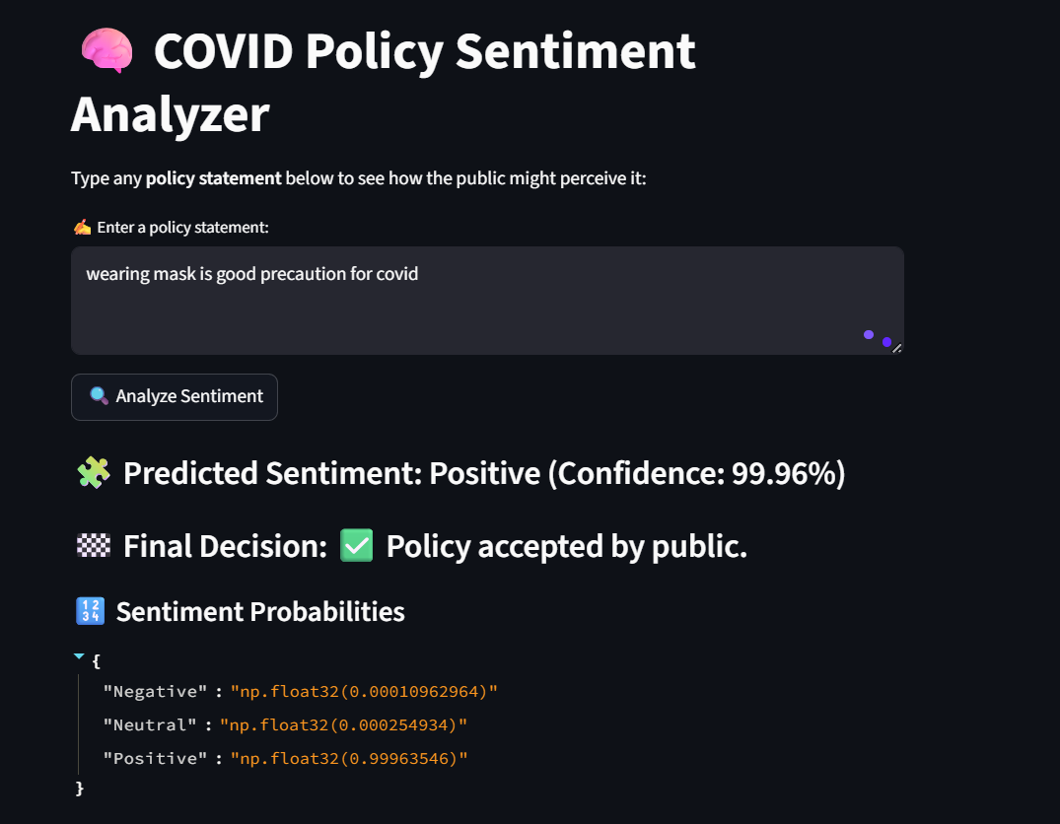
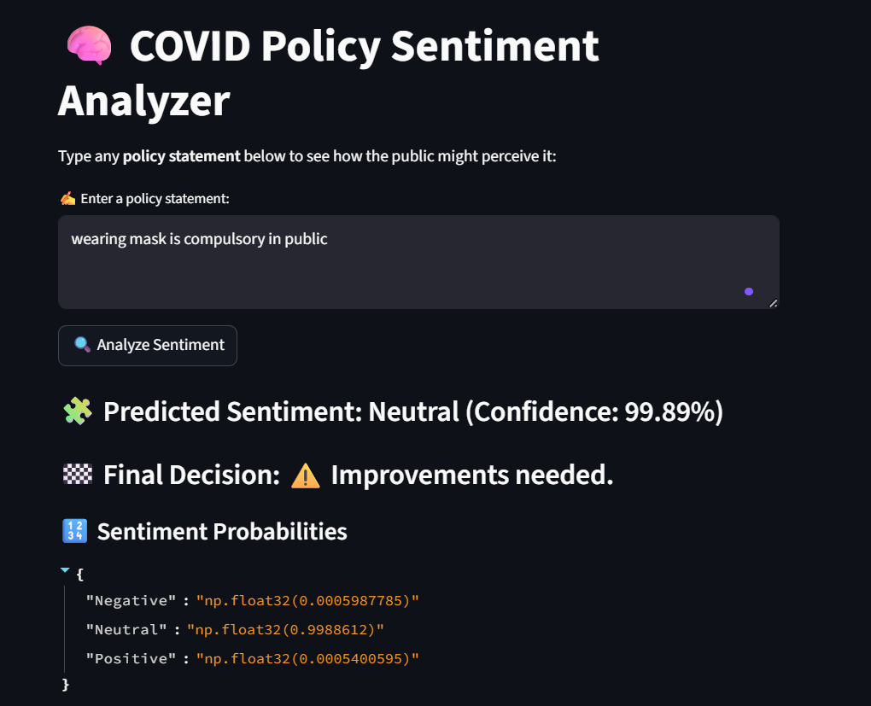
RESULTS

Slide 9
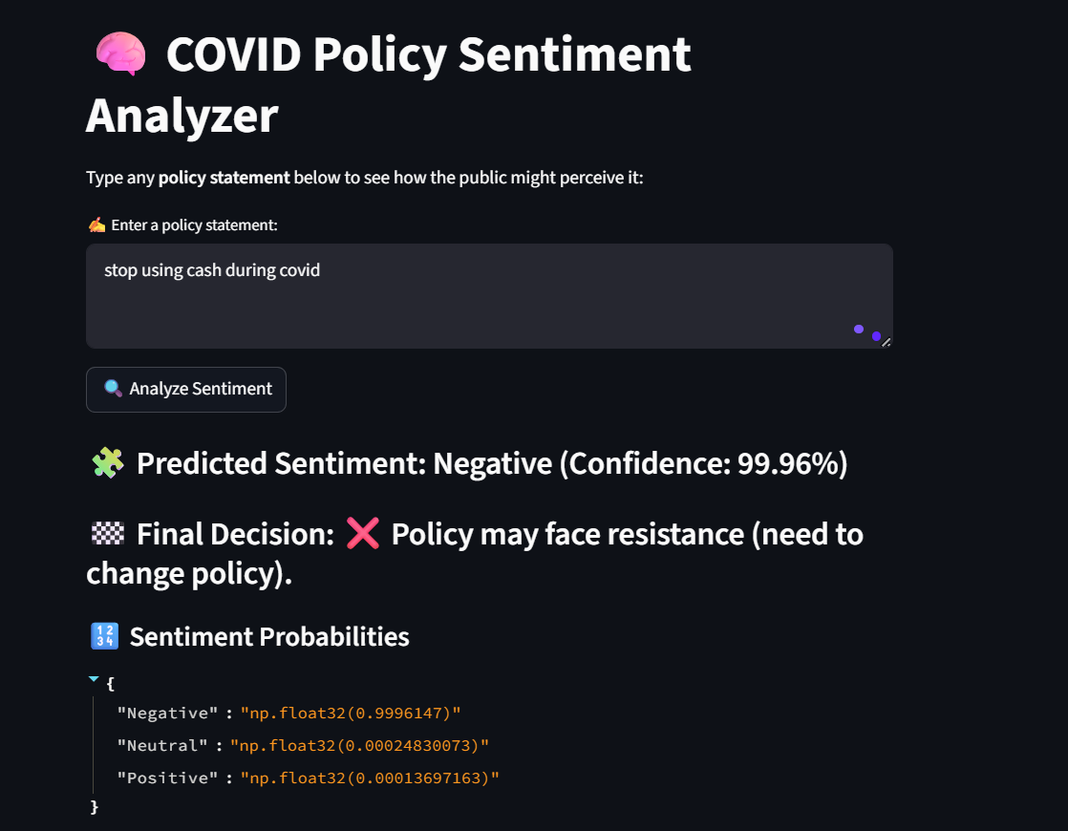
RESULTS

Slide 10
Comparison with alternate models
Model | Type | Accuracy (%) | Macro F1-Score | Remarks / Observations
Logistic Regression | Classical ML | 79.98 | 0.779 | Performs decently on simple text but lacks contextual understanding.
RoBERTa Base | Transformer (unfine-tuned) | 16.30 | 0.093 | Poor performance due to absence of domain-specific fine-tuning.
DistilBERT | Compressed Transformer | 91.73 | 0.909 | Lightweight and efficient, performs well but slightly less accurate than full BERT.
Fine-Tuned BERT (Proposed System) | Transformer (Fine-tuned) | 99.01 | 0.896 | Achieves the highest accuracy and robust sentiment classification on COVID-19 data.

Slide 11
THANK YOU

