Slide 1


Wander Wise
Highlights smart and thoughtful travel planning.

Slide 2
PROJECT STATEMENT
This project aims to solve this problem by developing an Android application, Wander Wise, which allows users to input a destination and receive a smart, well-structured itinerary that includes:
Top places to visit
Ratings and reviews
Entry fees and food expenses
Best time to visit and expected time needed
Weekly off days
Overall budget calculation
Seamless Google Maps navigation
By simplifying travel planning and offering all necessary trip information in one place, this application enhances user convenience and supports smarter travel decisions.

Slide 3
MODULE DESCRIPTION
1. User Interface (UI) Module
Features:
Displays a destination input field and a city dropdown for users to choose their location.
Shows details about tourist places, including ratings, time needed, and best time to visit.
Displays a visually appealing and user-friendly interface with smooth navigation.
2. Destination Processing Module
Features:
Reads data from a CSV file or database to fetch travel details.
Retrieves information like Google rating, best time to visit, time needed, and weekly off days.
Sends processed data to the UI module for display.

Slide 4
3. Cost Estimation Module
Features:
Retrieves entry fees of all places in the selected city.
Computes the total estimated cost based on individual entry fees.
Displays the total budget required on the UI.
4. Google Maps Integration Module
Features:
Retrieves location coordinates of tourist places.
Displays a map with markers for all places in the selected city.
Provides a navigation button to open Google Maps for directions.

Slide 5
5. Data Management Module
Features:
Stores city and travel place details in a CSV file or database.
Ensures efficient data retrieval to optimize app performance.
Updates and manages place details dynamically.

Slide 6
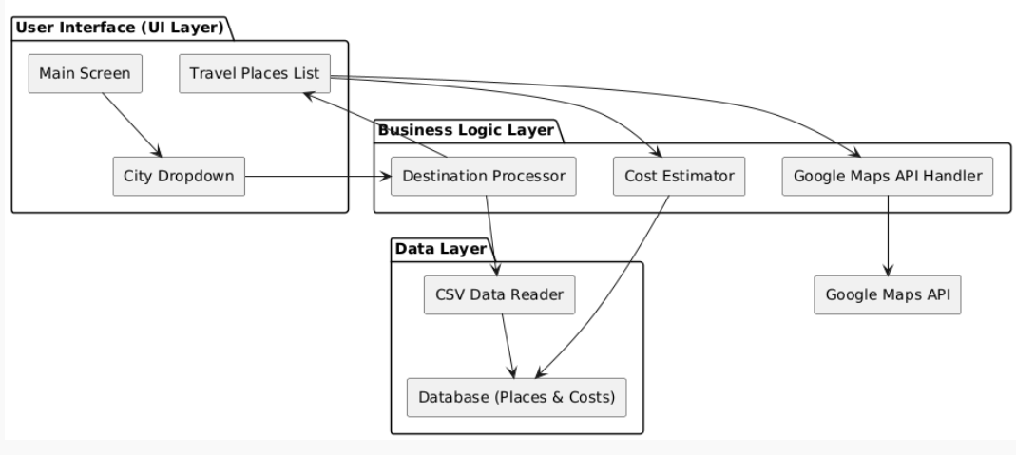
ARCHITECTURE DIAGRAM

Slide 7
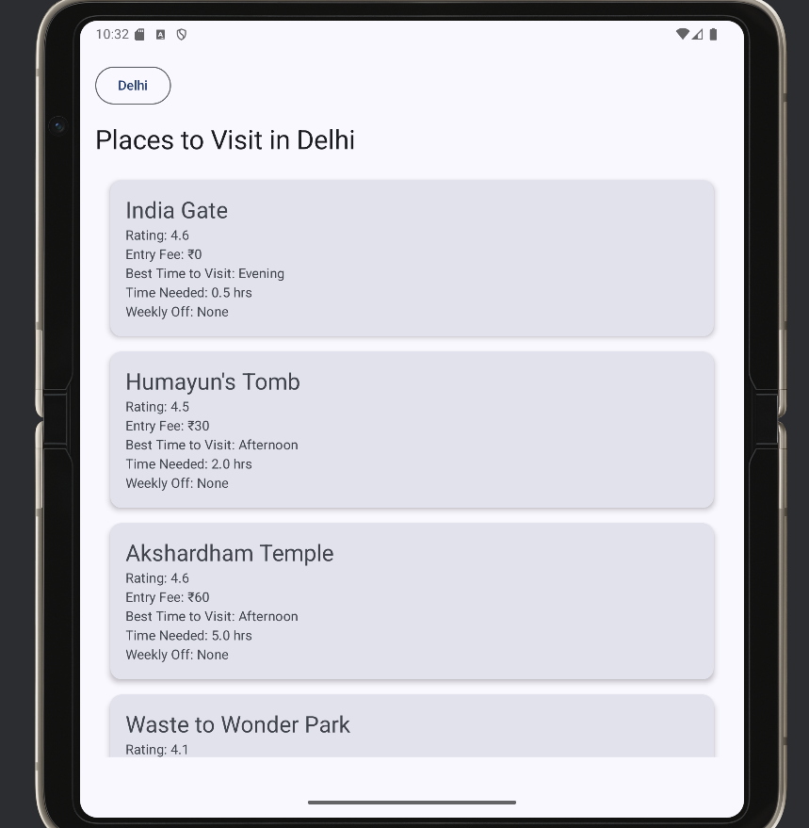
OUTPUT

Slide 8
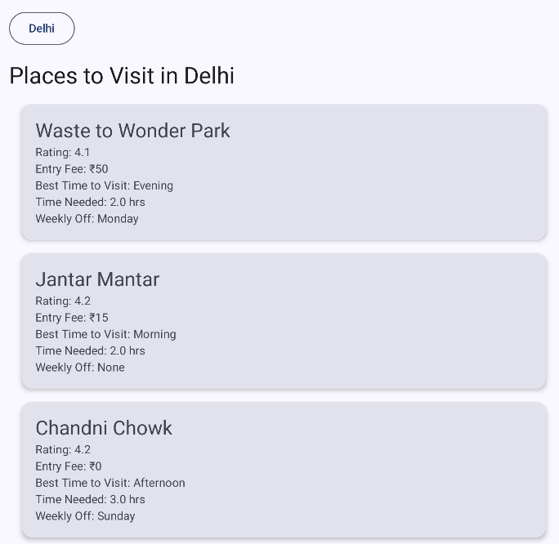
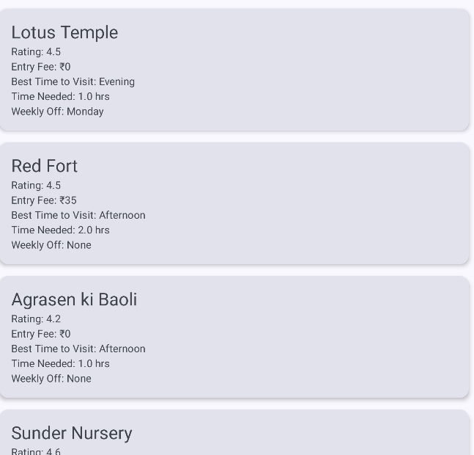
OUTPUT

Slide 9
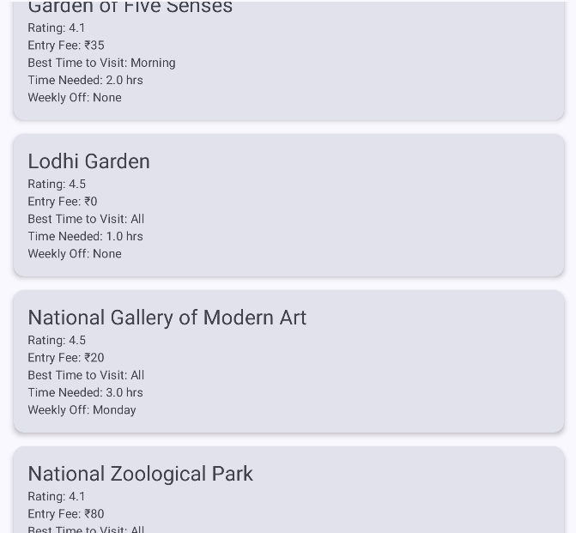
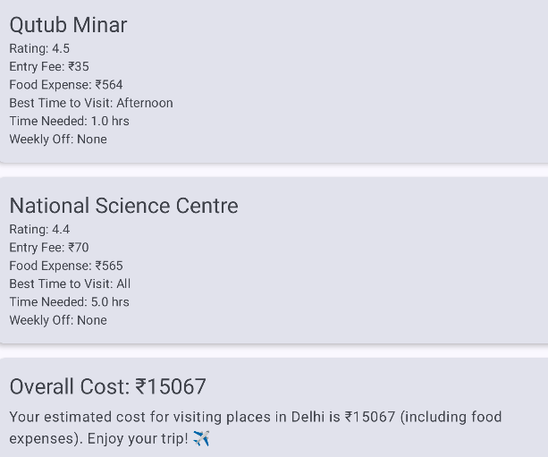
OUTPUT

Slide 10
Benefits of the Project
1. Personalized Travel Experience
Users receive a custom itinerary based on the city they select.
Details like best time to visit, food costs, and weekly offs help travelers plan efficiently.
2. Time and Cost Efficiency
By providing entry fees, food expenses, and time needed at each place, users can:
  Estimate their daily budget
  Avoid overspending
  Cover more attractions in less time

Slide 11
3.Integrated Navigation
With Google Maps integration, users can navigate from one place to another seamlessly.
Saves time and reduces the chances of getting lost in a new city.
4.Great Use Case for Students & Solo Travelers
Especially helpful for:
  Students planning low-budget trips
  First-time solo travelers
  Families trying to manage a full-day itinerary

Slide 12
Future Scope
1. Machine Learning for Smart Itinerary Planning
Use Machine Learning models (like Random Forest, K-Means) to:
  Predict crowd levels at places
  Optimize the order of visit based on user preference (e.g., relaxed vs. adventure)
  Recommend places based on user behavior or reviews
2. Real-Time Crowd and Weather Data
Integrate APIs to:
  Show live crowd density
  Provide real-time weather updates to help users change plans on the go
3. User Authentication and Profiles
Allow users to:
  Log in and save their trips
  View their past itineraries
  Get personalized recommendations

Slide 13
4.Offline Mode
Allow itinerary access even without internet (offline map snapshots and cached data)
5.Emergency Services Integration
Show nearest hospitals, police stations, and embassies
Add an emergency contact button for solo travelers

Slide 14
SUMMARY
Wander Wise is a smart Android-based travel planning application designed to help users explore top destinations in India with ease and efficiency. By simply entering a destination, the app generates a personalized itinerary showcasing all the must-visit places in that location. For each place, it provides detailed information including the rating, entry fee, food expenses, best time to visit, time required, and weekly off status.
One of the standout features of the application is its ability to calculate the overall budget for the trip. This includes the sum of entry fees, food expenses, and other costs associated with visiting all suggested places, helping users plan trips that suit their financial preferences—whether they are looking for luxury, moderate, or cost-effective travel experiences.

Slide 15
To enhance user experience, Google Maps integration is provided to guide travelers from one destination to another seamlessly. The clean interface, organized itinerary, and offline potential make it a helpful companion for students, solo travelers, families, and tourists alike.
With a foundation that’s both functional and scalable, Wander Wise sets the stage for future enhancements like machine learning-based crowd prediction, real-time updates, hotel recommendations, and voice assistant features—making it a truly intelligent travel planner.

Slide 16
REFERENCE PAPERS
https://www.irjmets.com/uploadedfiles/paper//issue_11_november_2024/63487/final/fin_irjmets1731075400.pdf
https://ijarsct.co.in/Paper11254.pdf
https://www.irjet.net/archives/V10/i12/IRJET-V10I1272.pdf
https://ijarsct.co.in/Paper3537.pdf
https://www.irjmets.com/uploadedfiles/paper//issue_11_november_2024/63381/final/fin_irjmets1731412810.pdf

