Slide 1
Credit Card Fraud Detection
Abdulraouf Zabalawi
A
Project & ML Lead
Model, FastAPI, Model Card, MLflow
From a DVC pipeline to a monitored API in the cloud
MAI201 MLOps · Phase 2 Final Presentation
Mohamed Roble
M
Engineering Lead
Docker, Render deployment, CI/CD
Public HTTPS API on Render
Docker image, built and smoke-tested in CI
Someyah Balashi
GitHub Actions: lint, tests, deploy
S
Documentation Lead
EvidentlyAI drift reports + retraining
EvidentlyAI, retraining, slides
Kaggle / ULB dataset · 284,807 transactions · 0.17% fraud
Notes:
ABDULRAOUF (0:40). Good morning. We are presenting Phase 2 of our credit card fraud detection project. In Phase 1 we built a reproducible training pipeline with DVC and MLflow. In Phase 2 we took that trained model and put it into production: a FastAPI service, a Docker image, a live deployment on Render, automated CI/CD, and drift monitoring with a retraining path. I am Abdulraouf, project and ML lead. Mohamed handled the container, the cloud deployment and CI/CD. Someyah handled monitoring, retraining and documentation. We will each take our own part.

Slide 2
The problem, and the data
Abdulraouf
284,807
492
0.1727%
transactions over two days
of them fraudulent
fraud rate — one in every 580
What makes this hard
The 30 inputs the API accepts
Accuracy is useless here. Answering "legitimate" to everything scores 99.83%, so we judge the model on precision, recall, F1 and PR-AUC instead.
Only 492 fraud rows exist in total. A handful of transactions moves recall by a full percentage point.
V1–V28 are PCA components published in place of the real fields, so no feature has a human-readable meaning.
Time
seconds since the first transaction
V1 – V28
anonymised PCA components
Amount
transaction value, 0 to 25,691.16
Class
the label — never sent to /predict
Notes:
ABDULRAOUF (0:50). The dataset is real card transactions from European cardholders over two days in 2013. 284,807 transactions, 492 of which are fraud — that is a fraud rate of 0.1727%, roughly one in 580. That imbalance drives every decision we made. Accuracy is meaningless: a model that says legitimate to everything already scores 99.83%. So we report precision, recall, F1 and PR-AUC. The inputs are Time, the 28 PCA components V1 to V28, and Amount. Class is the label and is never sent to the API — the API rejects a request that includes it.

Slide 3
Phase 1 recap: DVC pipeline + MLflow
Abdulraouf
1
prepare
2
train
3
evaluate
→
→
quality report, drop 1,081 duplicates, stratified 80/20 split
scale Time and Amount inside the pipeline, then RandomForest
imbalance-aware metrics on the held-out 56,746 rows
Baseline on the held-out test set
Tracked, not remembered
Precision
0.8846
D
DVC
dvc.yaml wires the three stages; dvc.lock pins data, code and model hashes.
Recall
0.7263
F1
0.7977
M
MLflow
Baseline plus two experiments, logged to a local SQLite store.
ROC-AUC
0.9567
P
params.yaml
PR-AUC
0.7854
One config file feeds every stage, so a change re-runs only what it affects.
Notes:
ABDULRAOUF (0:55). A quick recap of Phase 1, because Phase 2 sits directly on top of it. The DVC pipeline has three stages. Prepare loads the raw CSV, writes a data quality report, removes 1,081 duplicate transactions and does a stratified split — stratified because with 0.17% positives an ordinary split can leave the two sets with different fraud rates. Train builds a scikit-learn Pipeline: a StandardScaler on Time and Amount only, since V1 to V28 are already PCA outputs, followed by a Random Forest with class_weight balanced. The scaler lives inside the pipeline, so it is fitted on training rows only and there is no leakage. Evaluate scores the held-out set. Precision 0.88, recall 0.73, PR-AUC 0.79. Everything is tracked by DVC and logged to MLflow, so these numbers are reproducible rather than remembered.

Slide 4
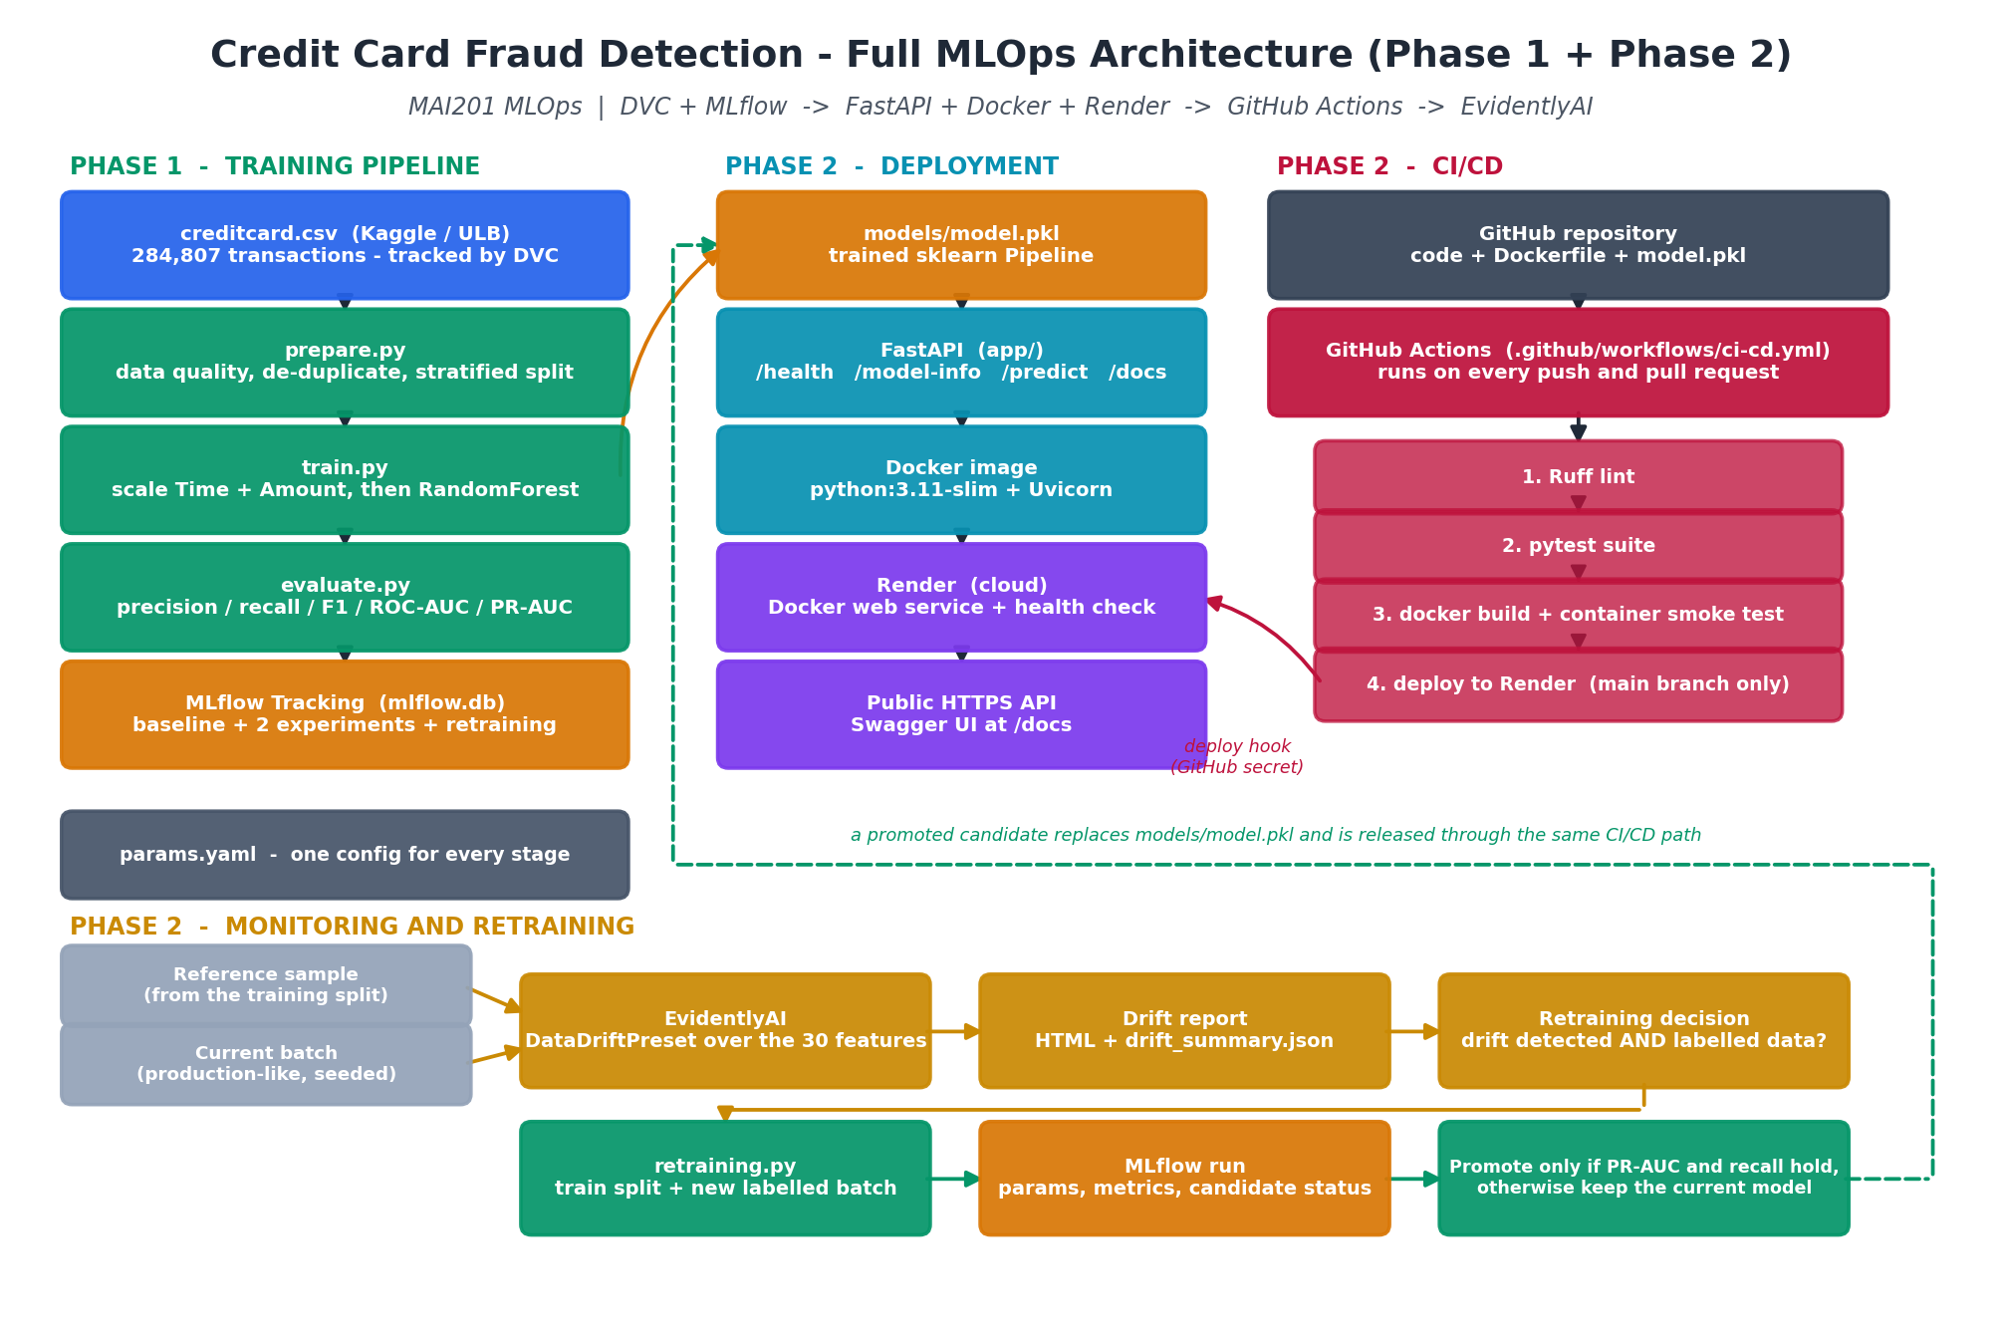
What Phase 2 added
Mohamed
Notes:
MOHAMED (0:45). This is the whole system on one slide. On the left is the Phase 1 training pipeline Abdulraouf just described, ending in models/model.pkl. The middle column is what Phase 2 added on the serving side: that same pickle is loaded by a FastAPI application, the application is baked into a Docker image, and the image is deployed to Render as a web service with a public HTTPS URL. On the right is CI/CD — every push runs lint, tests and a container smoke test in GitHub Actions, and only then does it deploy. Along the bottom is the monitoring loop: EvidentlyAI compares live-shaped batches against the training distribution, and if it finds drift and we have labelled data, retraining produces a candidate that has to earn its promotion. I will take the deployment and CI/CD parts.

Slide 5
Serving the real model with FastAPI
Abdulraouf
/
what this service is
A real request against the deployed service
POST /predict
{
"Time": 406.0,
"V1": -2.3122, "V2": 1.9520,
... "V28": -0.0210,
"Amount": 0.0
}
/health
200 only when the model is really loaded, 503 otherwise
/model-info
model type, 30 features, hyperparameters, artifact hash
/predict
one transaction in, class and fraud probability out
response
/docs
Swagger UI, generated from the Pydantic schema
{
"predicted_class": 1,
"label": "fraud",
"fraud_probability": 0.969592,
"decision_threshold": 0.5,
"is_fraud": true
}
Two details that matter
The whole sklearn Pipeline is served, not just the forest — so scaling at inference is identical to training.
The model is loaded once at startup, not per request.
A genuine fraud row from our own test split.
Notes:
ABDULRAOUF (0:55). The API exposes five routes. Health is the one worth calling out: it returns 200 only when the model actually loaded, and 503 otherwise. A health check that says healthy while the service cannot score anything is worse than no health check at all. Predict takes exactly the 30 training features, validated by Pydantic — a missing field, a wrong type, or an extra field like Class all come back as 422. Two implementation details. First, we serve the entire scikit-learn Pipeline, not just the classifier, so the Time and Amount scaling at inference is byte-for-byte what it was at training. Second, the model is loaded once at startup and reused. On the right is a real request and the real response: a fraud row from our test split, scored at 0.9696. The service root also serves a small browser dashboard that posts to this same endpoint, and that is what we will demo.

Slide 6
Containerised and deployed
Mohamed
1
python:3.11-slim
2
Pinned requirements
Small base. Only the serving dependencies go in — no DVC, MLflow or Evidently.
requirements-api.txt is fully pinned, so the container loads model.pkl with the scikit-learn that fitted it.
3
Uvicorn on $PORT
4
No secrets, non-root
Render injects the port; the container honours it and falls back to 8000 locally.
The image holds code and a 1.9 MB model. The deploy hook lives in GitHub secrets.
Live now
https://mai201-fraud-api.onrender.com
/health -> {"status":"healthy","model_loaded":true,"model_path":"/srv/app/models/model.pkl"}
Browser demo at https://mai201-fraud-api.onrender.com · Swagger UI at https://mai201-fraud-api.onrender.com/docs · released automatically by CI/CD
Notes:
MOHAMED (0:55). The container is deliberately small. It starts from python 3.11-slim and installs only what serving needs — FastAPI, Uvicorn, scikit-learn, pandas, numpy. DVC, MLflow and Evidently are training and monitoring tools, so they stay out of the image. requirements-api.txt is fully pinned, and that matters more than it sounds: model.pkl is a pickled scikit-learn object, so the container has to install the same version that fitted it, otherwise loading it is a gamble. The container runs as a non-root user, holds no secrets, and listens on the port Render injects. It is deployed on Render as a Docker web service with the health check pointed at /health, and that is the public URL on the screen. It is live right now: /health comes back healthy, with model_loaded true and the model path inside the container. This version was released by the CI/CD pipeline, not by anyone clicking deploy. We will hit it live in a moment.

Slide 7
CI/CD with GitHub Actions
Mohamed
1
2
3
4
Ruff lint
→
pytest
→
docker build
→
deploy
the whole repo, clean
37 tests against the real model
then the container is started and probed
Render deploy hook, main branch only
The container is tested, not just built
Pull request vs. main
CI starts the image it just built, waits for it to come up, and checks /health reports the model as loaded.
It posts a real transaction to /predict and asserts the probability is between 0 and 1.
It sends a malformed body and asserts a 422 comes back.
PR
Pull request
Lint, tests and the container smoke test run. Deployment is skipped.
M
Push to main
The same checks run first; only if they all pass does the deploy job fire.
Render auto-deploy is switched off on purpose — CI is the only route to production.
Latest main-branch CI/CD run — all three jobs green: lint and test, build and smoke-test the image, deploy to Render.
Notes:
MOHAMED (0:50). The workflow is one file, .github/workflows/ci-cd.yml, and it runs on every push and every pull request. Four things happen in order. Ruff lints the whole repository. Pytest runs our 37 tests against the real model artifact, not a stub. Then Docker builds the image — and this is the part I want to highlight — CI does not just build it, it starts the container, waits for it, checks that health reports the model as loaded, posts a real transaction to predict and asserts the probability is in range, and sends a broken payload to confirm it gets a 422. Only if all of that passes, and only on the main branch, does the deploy job fire the Render deploy hook, which is stored as a GitHub secret and never appears in the code. We deliberately turned Render's own auto-deploy off, so nothing reaches production without passing CI first. The run on screen is the latest successful one on main, where all three jobs passed and the deploy job released the version that is serving right now.

Slide 8
Drift monitoring with EvidentlyAI
Someyah
OK
Healthy batch
Untouched rows from the test split. Evidently flags 0 of 30 columns, share 0.000 — no dataset drift. This is the control: it shows the monitor is not simply alarmed by everything.
!
Simulated drift
A seeded shift applied to 17 columns — larger amounts, later timestamps, moved PCA components. Evidently flags 17 of 30, share 0.567, above the 0.5 threshold, so dataset drift is reported. Clearly labelled as simulated — it is not real customer traffic.
How the comparison is set up
Reference: a fixed 10,000-row sample of the training split.
Current: 5,000 production-shaped rows.
30 numeric features compared with Evidently's DataDriftPreset. In the generated reports Evidently selected normalized Wasserstein distance, threshold 0.1. Class is excluded because the API never receives the label.
Notes:
SOMEYAH (1:00). Monitoring answers one question: is the traffic still shaped like what the model learned from? We use EvidentlyAI with the DataDriftPreset over the 30 input features. The reference is a fixed 10,000-row sample of the training split. We exclude Class, because the API never receives a label at prediction time. Evidently picks the test itself from the data - at these batch sizes it chose normalized Wasserstein distance with a threshold of 0.1, and that choice is recorded in our JSON summary next to every score. We ran two scenarios. The first is a control: untouched rows from the test split. Evidently flags zero of 30 columns — no drift, which tells us the monitor is not just alarmed by everything. The second is a deliberately drifted batch: we applied a seeded shift to 17 columns, simulating larger amounts, later timestamps and moved components. Evidently caught exactly those 17, a share of 0.567, which is above the 0.5 threshold, so it reports dataset drift. I want to be clear that this second batch is simulated for demonstration and labelled that way in the repository — we do not have real production traffic. Both reports are committed as HTML plus a JSON summary.

Slide 9
Retraining, and the Model Card
Someyah
Retraining needs labels
Production requests arrive unlabelled — training on our own predictions would teach the model its mistakes.
The script refuses a batch with no Class column, or with only one class in it.
The test split is never used as training data.
MODEL_CARD.md
Says plainly what the model is for and what it is not for: it misses 26 of 95 frauds, its probabilities are not calibrated, the data has no demographic fields so we cannot make a fairness claim, and none of it should touch a real payment decision without proper validation and governance.
Promotion is earned, not automatic
A candidate replaces the deployed model only if PR-AUC is at least as good and recall has not dropped by more than 0.02. This one earned it: PR-AUC 0.7854 → 0.7865, recall 0.7263 → 0.7368. If it had failed, the old model would have stayed.
Notes:
SOMEYAH (1:00). When drift is detected, retraining does not just run. It needs labelled data, and that is a deliberate design decision: the API only ever sees the 30 features, and whether a transaction turned out to be fraud is confirmed days later by a chargeback. If we retrained on our own predictions we would just be teaching the model its own mistakes. So the script refuses a batch without a Class column, and refuses one that contains only a single class. It trains a candidate on the original training split plus the new batch, using the same Random Forest and the same parameters — the model family never changes — and then scores both the candidate and the currently deployed model on the test split, which is never used for training. The candidate is promoted only if PR-AUC holds up and recall has not dropped by more than 0.02. In our run it did earn promotion, and the whole decision is logged to MLflow. On the right is the Model Card, which states the limits honestly: this model misses 26 of 95 frauds, its probabilities are not calibrated, and the dataset has no demographic fields, so we cannot claim it is fair.

Slide 10
Live demo
Someyah
1
Open the public browser demo
What we would do next
https://mai201-fraud-api.onrender.com
Set the threshold from the cost of a missed fraud versus a false alarm.
Log live requests so drift runs on real traffic, not a simulation.
Schedule the drift check instead of running it by hand.
2
Call /health
200, model_loaded: true
3
Analyze a real fraud transaction
expect 0.9696 and label fraud
4
Show the GitHub Actions run
Everything is in the repo
latest main-branch run — all three jobs green
https://github.com/AZabalawi/MLops-credit-card-fraud
5
Open the Evidently drift report
17 of 30 columns flagged
Phase 1 trained a model we could reproduce. Phase 2 made it something we could run, test, deploy and watch.
Notes:
SOMEYAH (0:40 plus about 1:30 of demo). Let me show it working. [Demo: open the public browser demo, call health and show model_loaded true, analyze the fraud transaction and show the 0.9696 probability, then the legitimate one at 0.000235, then the latest successful GitHub Actions run with all three jobs green, and finally the Evidently report with 17 of 30 columns flagged.] To close: Phase 1 gave us a model we could reproduce. Phase 2 turned it into a service we can run, test, deploy and watch. If we carried this further, the three things we would do are set the decision threshold from the actual cost of a missed fraud versus a false alarm, log real requests so drift is measured on live traffic instead of a simulation, and put the drift check on a schedule. Thank you — we are happy to take questions.

