Slide 1

Experiential Learning Project Assessment-I on
“Tie Tac Toe Game.”
under the course
Python Programming Language (N-PCCCM304P)
Presented By: Aarushi Jambhulkar [CM25001]
Under the Guidance of
Mrs. Mayuri Getme
Session:2026-27 (ODD )
Department of CSE(AI&ML)
S. B. JAIN INSTITUTE OF TECHNOLOGY MANAGEMENT AND
RESEARCH,NAGPUR
An Autonomous Institute, Affiliated to RTMNU, Nagpur
)

Slide 2
Contents
Problem statement
Objectives
Algorithm
Flowchart/pseudocode
Understanding of Python logic
GitHub account, repository creation, uploading code, meaningful commits, collaboration, individual contribution
S. B. Jain Institute of Technology Management and research

Slide 3
1. Problem Statement
Traditional Tic Tac Toe requires a clear board and rule-based turn management.
Players need an interactive way to enter moves and see the current game state.
Invalid inputs, such as occupied or out-of-range positions, must be handled safely.
The program must determine whether X or O wins after every valid move.
If all nine positions are filled without a winner, the game should declare a draw.
The project should allow a new game after completion.
The aim is to demonstrate practical Python logic through a simple, user-friendly game.

Slide 4
2. Objective
.
To develop a Python-based Tic Tac Toe game using a 3×3 grid.
To allow two players to play alternately using X and O.
To validate user input and prevent invalid or repeated moves.
To implement winner detection using rows, columns and diagonals.
To identify draw conditions when the board becomes full.
To provide an option to start a new game.
To understand and apply core Python concepts such as lists, loops, functions and conditional statements.
To practice GitHub-based version control and collaboration.

Slide 5
3. Algorithm
Start the program.
Create a 3×3 board with empty positions.
Set the current player as X.
Display the board and ask the player for a valid position.
Place the player's symbol in the selected empty position.
Check all rows, columns and diagonals for a winning combination.
If a winner is found, display the winner and end the game.
If the board is full without a winner, display Draw and end the game.
Otherwise switch the player from X to O or O to X and repeat.
Offer the option to start a new game.
.

Slide 6
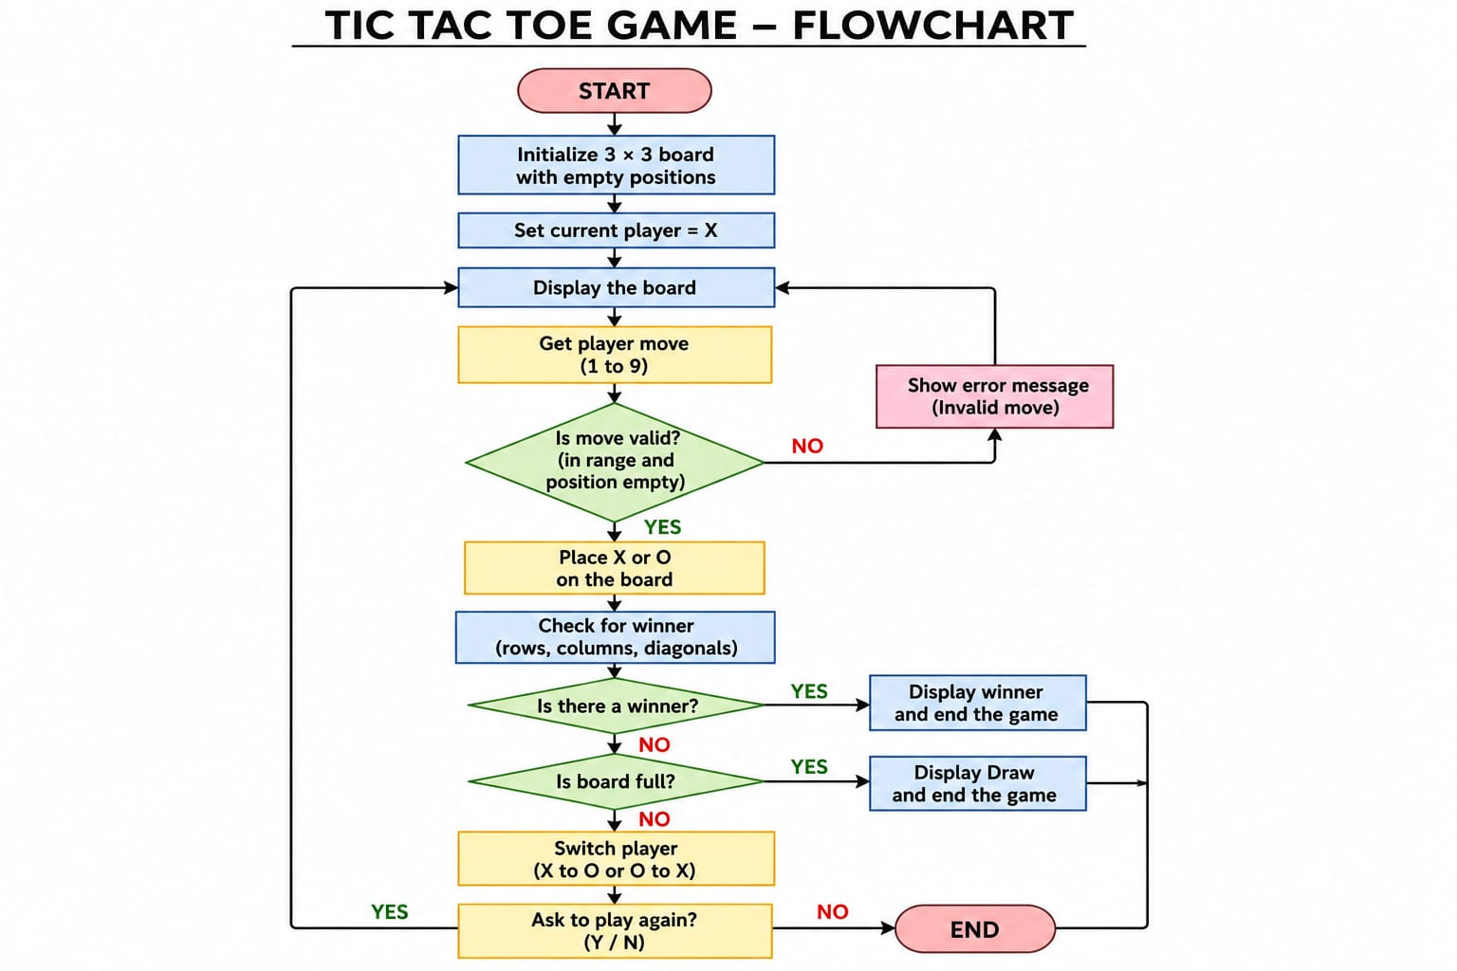
4. Flowchart

Slide 7
5. Understanding of python logic
board = [" "] * 9
winning = [
(0,1,2), (3,4,5), (6,7,8),
(0,3,6), (1,4,7), (2,5,8),
(0,4,8), (2,4,6)
]
for a, b, c in winning:
if board[a] == board[b] == board[c] != " ":
winner = board[a]
board = [" "] * 9
winning = [
(0,1,2), (3,4,5), (6,7,8),
(0,3,6), (1,4,7), (2,5,8),
(0,4,8), (2,4,6)
]
for a, b, c in winning:
if board[a] == board[b] == board[c] != " ":
winner = board[a]
board = [" "] * 9
winning = [
(0,1,2), (3,4,5), (6,7,8),
(0,3,6), (1,4,7), (2,5,8),
(0,4,8), (2,4,6)
]
for a, b, c in winning:
if board[a] == board[b] == board[c] != " ":
winner = board[a]
• Functions organize tasks such as display_board(), get_move() and check_winner().
• while loops keep the game running until a winner or draw occurs.
• if / elif / else handle validation, win conditions and draw conditions.
• for loops check every possible winning combination.
• Input is converted and validated before updating the board.
• The current-player variable switches between X and O.
• Lists represent the nine board positions.
(0,1,2), (3,4,5), (6,7,8),
(0,3,6), (1,4,7), (2,5,8),
(0,4,8), (2,4,6)
]
for a, b, c in winning:
if board[a] == board[b] == board[c]lkkkk != " ":
winner = board[a]

Slide 8
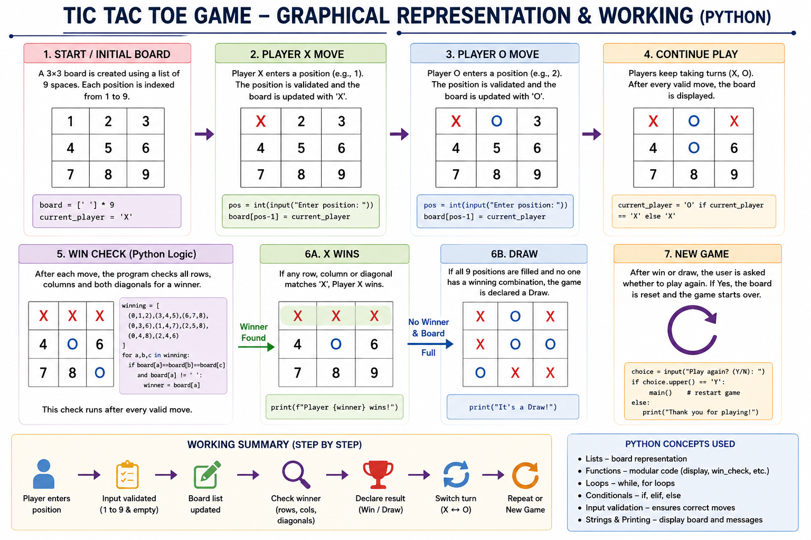
6. Graphical Representation and Working

Slide 9
7. GitHub Account, Repository & Collaboration
Create GitHub Account – Set up a personal GitHub account.
Create Repository – Tie Tac Toe Game.
Upload Code – Upload the Python project files.
Meaningful Commits – Save changes with clear commit messages.
Collaboration – For teamwork, use repository sharing, branches or pull requests.
Individual Contribution – Each member contributes and commits their work.
Track Changes – Use GitHub to manage and track project updates.

Slide 10
8. Individual Contribution
• Problem Analysis – Understood the requirements of the Tic Tac Toe game.
• Algorithm Design – Designed the steps for turns, validation, winner detection and draw handling.
• Python Coding – Implemented the game board and core game logic in Python.
• Testing – Tested winning combinations, draw condition and invalid inputs.
• GitHub Contribution – Created/managed the repository, uploaded code and made meaningful commits.
• Documentation & PPT – Prepared project explanation, flowchart and presentation slides.

Slide 11
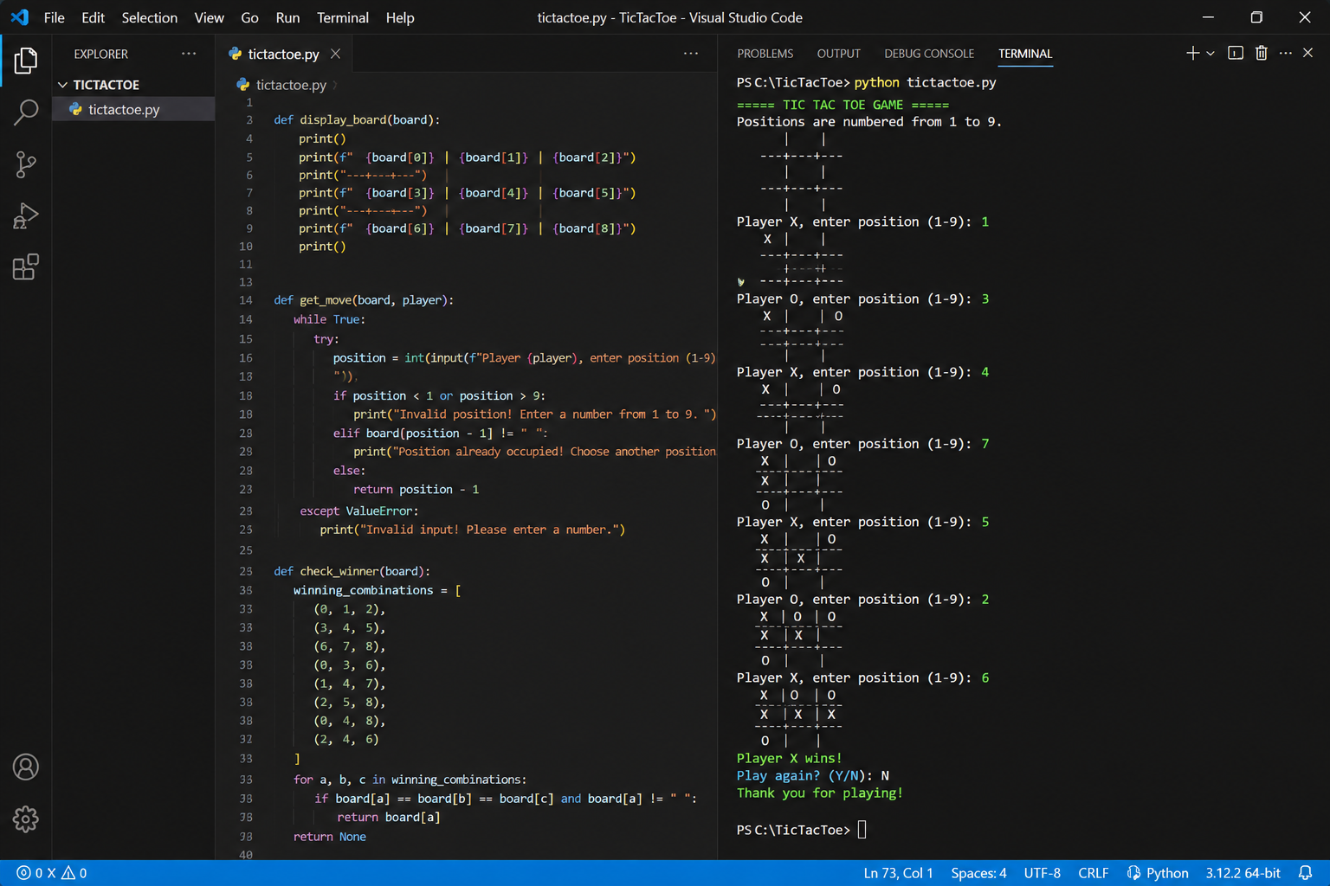
9. Result / Expected Output

Slide 12
Thank You
Tie Tac Toe Game.
-Aarushi janbhulkar.

