Slide 1

SDGs in the Classroom: Engaging Students in Global Challenges
Welcome to this presentation exploring how to integrate the United Nations' Sustainable Development Goals (SDGs) into high school science classrooms. These 17 goals address pressing global issues like climate change, poverty, and inequality, and we'll discuss how to effectively teach them, engage students, and measure progress towards a sustainable future.
TACTIC TECH

Slide 2
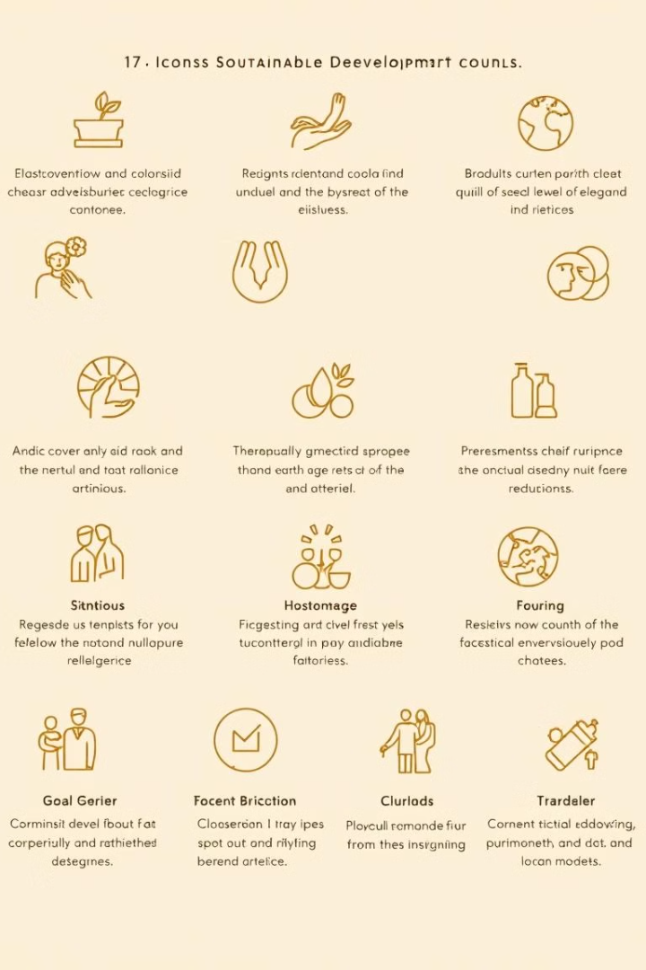

Background: The 17 Sustainable Development Goals (SDGs)
No Poverty
Zero Hunger
End poverty in all its forms everywhere.
End hunger, achieve food security and improved nutrition, and promote sustainable agriculture.
Good Health and Well-being
Quality Education
Ensure inclusive and equitable quality education and promote lifelong learning opportunities for all.
Ensure healthy lives and promote well-being for all at all ages.

Slide 3




EO4SDG: Earth observation data for the SDGs
Earth observation (EO) data plays a crucial role in monitoring and achieving the SDGs. By leveraging satellite imagery, sensors, and other technologies, EO4SDG provides valuable insights into environmental changes, resource management, and societal development.
Monitoring Progress
Informed Decision-Making
Supporting Research and Innovation
Facilitating Collaboration
EO data helps track progress towards SDG targets by providing real-time information on deforestation, pollution, urban sprawl, and other environmental and societal indicators.
Data from EO helps policymakers and stakeholders make informed decisions based on evidence, leading to more effective interventions and sustainable practices.
EO data empowers researchers to analyze trends, understand complex systems, and develop innovative solutions for sustainable development challenges.
EO data fosters collaboration among governments, organizations, and individuals, enabling them to share information, coordinate efforts, and work towards common goals.

Slide 4
Objectives: Teaching SDGs through Science
1
Teach SDGs in Science Unit
2
Incorporate Tools and NASA Data
3
Measure Progress Towards the SDGs
Incorporate relevant SDGs into existing science units, seamlessly integrating global issues into the curriculum. For example, exploring climate change through the lens of SDG 13 (Climate Action) within a unit on weather patterns.
Utilize interactive tools and NASA data to engage students in hands-on learning experiences. For example, utilize NASA's EarthData search portal to analyze satellite imagery related to deforestation (SDG 15) and explore the impact on biodiversity.
Integrate assessments and projects that measure student understanding of the SDGs and their impact. Encourage students to develop solutions or propose actions that contribute to achieving specific SDG targets.

Slide 5




Choosing a Passionate SDG Topic
Selecting a compelling Sustainable Development Goal (SDG) for your science unit is crucial for engaging students and fostering a deeper understanding of global challenges. Encourage students to choose a topic that sparks their interest, aligns with their personal values, and allows them to explore relevant scientific concepts. By selecting an SDG that they are passionate about, students are more likely to be invested in the learning process and motivated to take action.
Personal Connection
1
Students are more likely to be engaged in learning about an SDG if they feel a personal connection to it. Ask students to reflect on their own experiences and values and consider which SDGs are most relevant to them.
Science Connections
2
Each SDG has a strong foundation in science, providing opportunities to explore various disciplines such as biology, chemistry, physics, and environmental science.
Global Impact
3
Emphasize the global impact of the SDGs and how individual actions can contribute to creating a more sustainable world.
Actionable Steps
4
Encourage students to identify actionable steps they can take to contribute to the chosen SDG. This could involve conducting research, designing solutions, or advocating for change.

Slide 6
Hands-on Activities to Engage Students
Hands-on activities are essential for making SDGs relevant and engaging for students. These activities allow them to actively participate in the learning process, develop critical thinking skills, and understand the real-world implications of global challenges.
Data Analysis with NASA EarthData
Simulations and Role-Playing
Students can use NASA's EarthData search portal to access satellite imagery and analyze environmental trends related to their chosen SDG. For example, they can examine deforestation patterns in the Amazon rainforest (SDG 15) or monitor changes in sea ice levels in the Arctic (SDG 13).
Simulations and role-playing activities provide students with a practical understanding of the complexities of global issues. For example, they can role-play as policymakers negotiating an international climate agreement (SDG 13) or participate in a simulation of a sustainable city development project (SDG 11).
Community-Based Projects
Creative Expression
Encourage students to engage in community-based projects that address local issues related to the SDGs. For example, they can organize a school recycling program (SDG 12) or conduct a local environmental cleanup (SDG 14).
Students can express their understanding of the SDGs through creative mediums such as art, music, writing, or film. This encourages them to think critically and communicate their perspectives on global challenges.

Slide 7



Conclusion: Empowering Students to Take Action on Global Challenges
Knowledge and Understanding
By integrating the SDGs into their science education, students gain a deeper understanding of global challenges and the interconnectedness of our world. They become empowered with the knowledge and tools to make informed decisions and take responsible action.
Action and Impact
Empowered students can then translate their newfound knowledge into tangible actions, leading to positive change in their communities and beyond. They can participate in local initiatives, advocate for policy changes, or develop innovative solutions to address pressing global issues.
Global Changemakers
Ultimately, the goal is to inspire a new generation of global changemakers, driven by a deep understanding of the SDGs and a commitment to creating a sustainable future.

