Slide 1
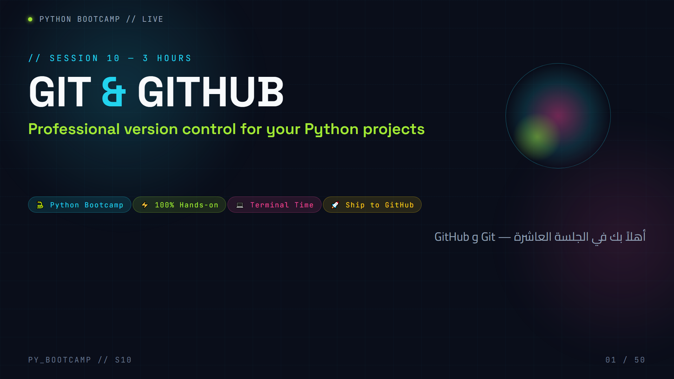
Notes:
**Slide 1 — Cover (2 min)**
- Welcome students warmly. Today they graduate from "code that only lives on one laptop" to "code the world can see."
- Say: "By the end of today, every one of you will have a live project on GitHub. That is your coding CV."
- Set expectations: this is the most hands-on session yet — we will type commands, a LOT.
- Arabic tip: اطمئن الطلاب أنه لا يوجد حفظ خاطئ بعد اليوم — Git سيتولى الحفظ عنهم.
- Emphasise: session is 3 hours, keep energy high, follow along.

Slide 2
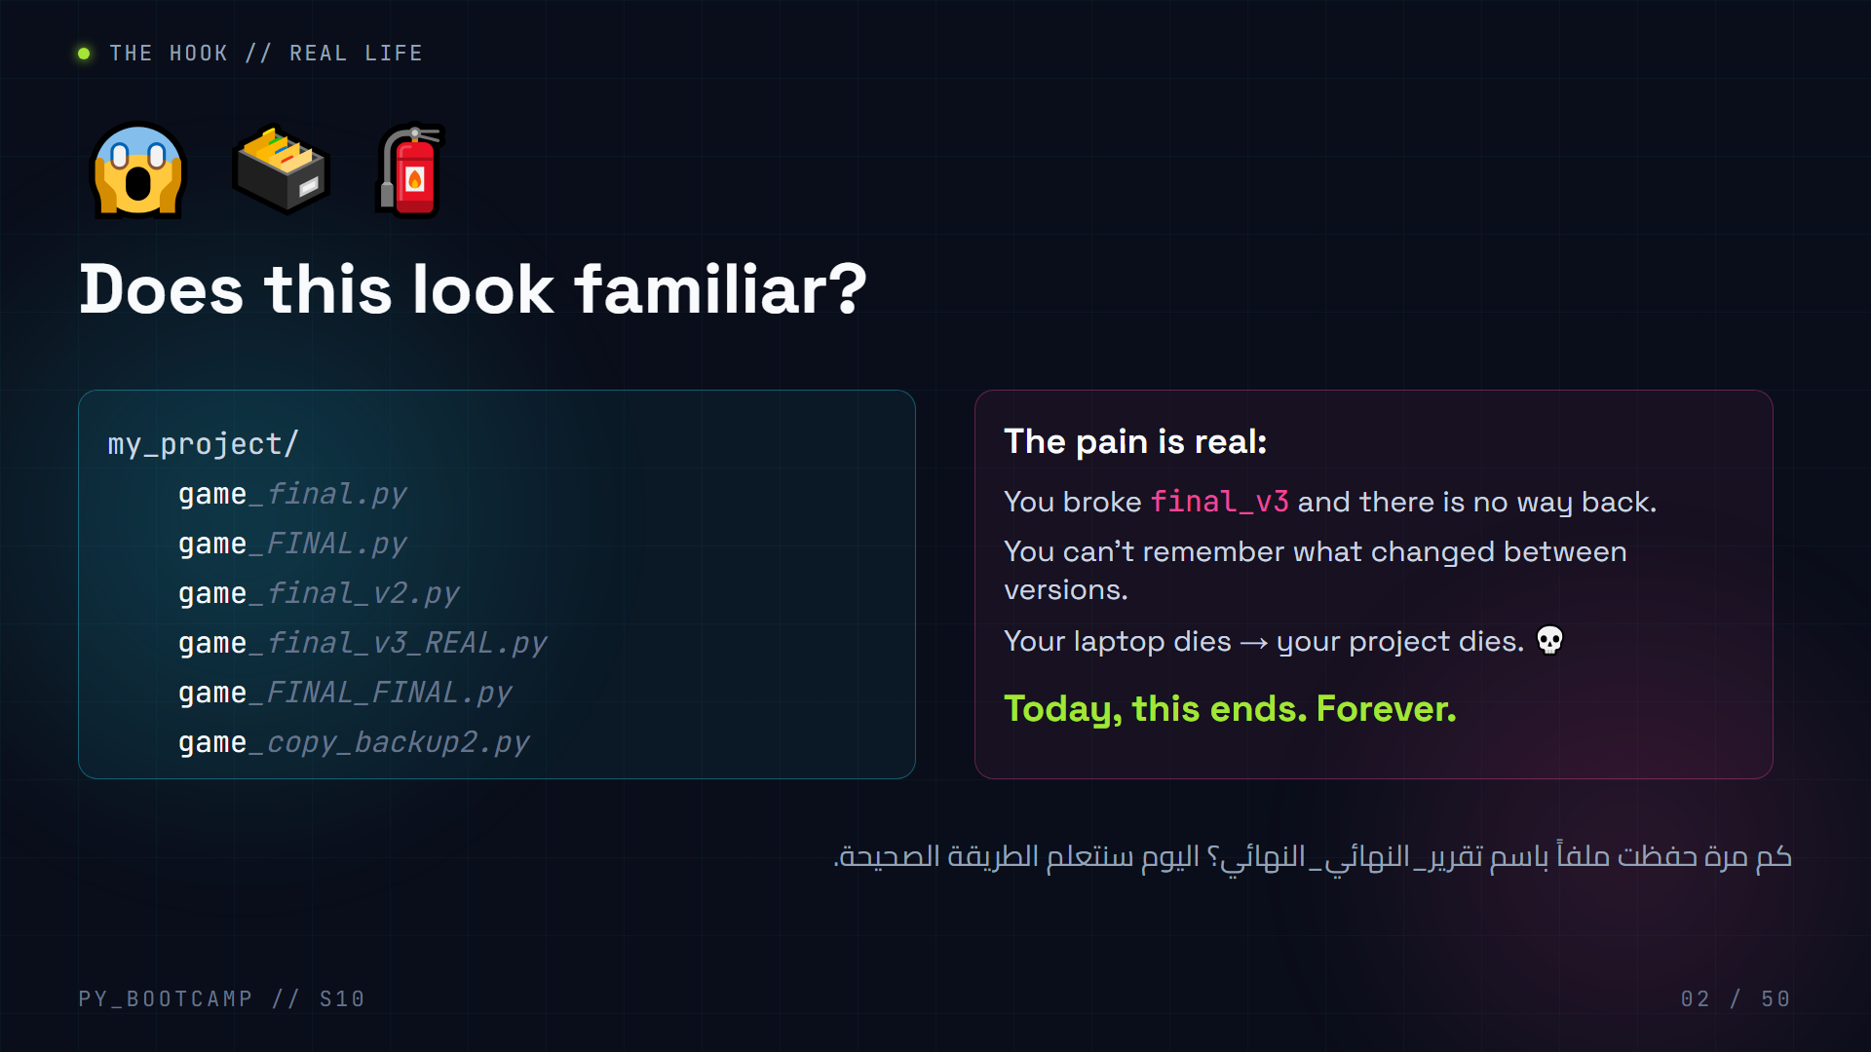
Notes:
**Slide 2 — Hook (3 min)**
- Ask the room: "Raise your hand if you have a file called `final_FINAL_v2.py` on your laptop right now." Almost everyone will raise a hand — laugh with them.
- Walk through the classic nightmare: you "fixed" a feature, it broke, and you cannot undo because you overwrote the only good copy.
- Key emotional line: "Version control is an UNDO button for your whole project — and a backup that lives on the internet."
- Arabic tip: اسألهم بالعربية: "من فقد ملفاً بسبب تعطّل حاسوبه؟" — اربط الحاجة بمشاعرهم.
- Transition: "Let's build the fix. First, understand the problem we're solving."

Slide 3
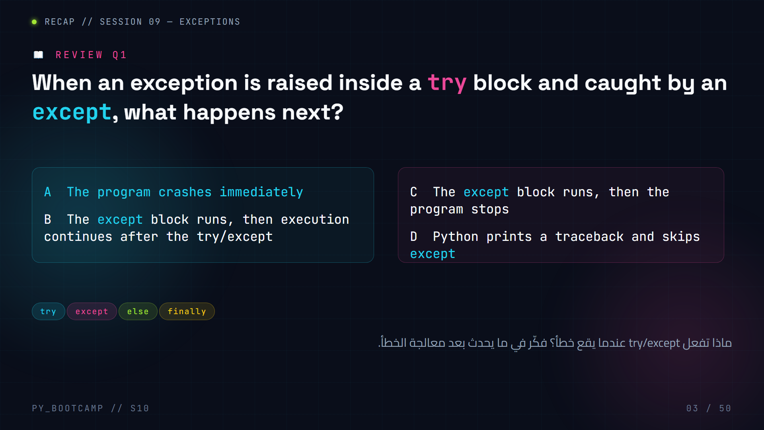
Notes:
**Slide 3 — Review MCQ 1 (2 min) — Exceptions**
- Give 30 seconds of thinking time, then poll the room (A/B/C/D by show of hands).
- **Correct answer: B.** The except block runs, then execution continues normally after the try/except construct.
- Common misconception: students think an exception always kills the program. Remind them: that is the whole point of catching — you keep the program alive.
- Quick demo: `try: x = int("abc") except ValueError: x = 0` then `print(x)` → 0.
- Arabic tip: اشرح "إمساك الخطأ" بالعربية: الإكسيبشن هو كرة، وtry/except هي اليد التي تلتقطها قبل أن تتحطم على الأرض.

Slide 4
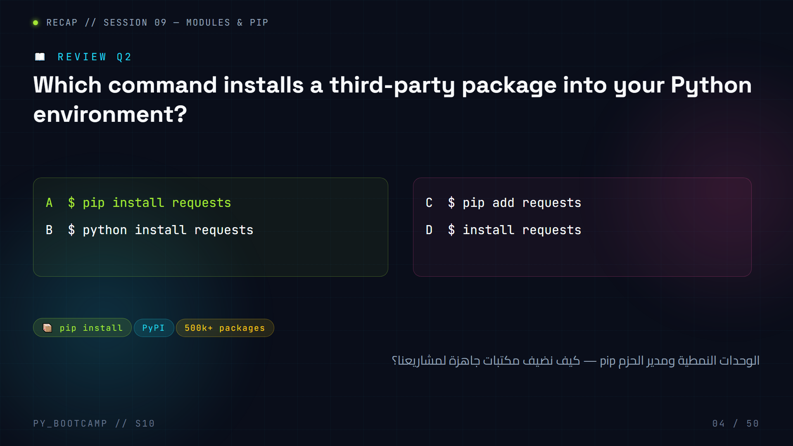
Notes:
**Slide 4 — Review MCQ 2 (2 min) — Modules & pip**
- **Correct answer: A.** `pip install requests` pulls the package from PyPI and installs it locally.
- B is wrong (`python install` is not a pip command), C uses the wrong verb (`add`), D is missing pip entirely.
- Reinforce: `import requests` works only AFTER `pip install requests`. This exact confusion will come back in the gitignore slide (venv/ folder).
- Arabic tip: ذكّرهم: "إذا نسي أحدهم تثبيت المكتبة، سيصرخ بايثون ModuleNotFoundError" — اربطها برسالة الخطأ الشهيرة.

Slide 5
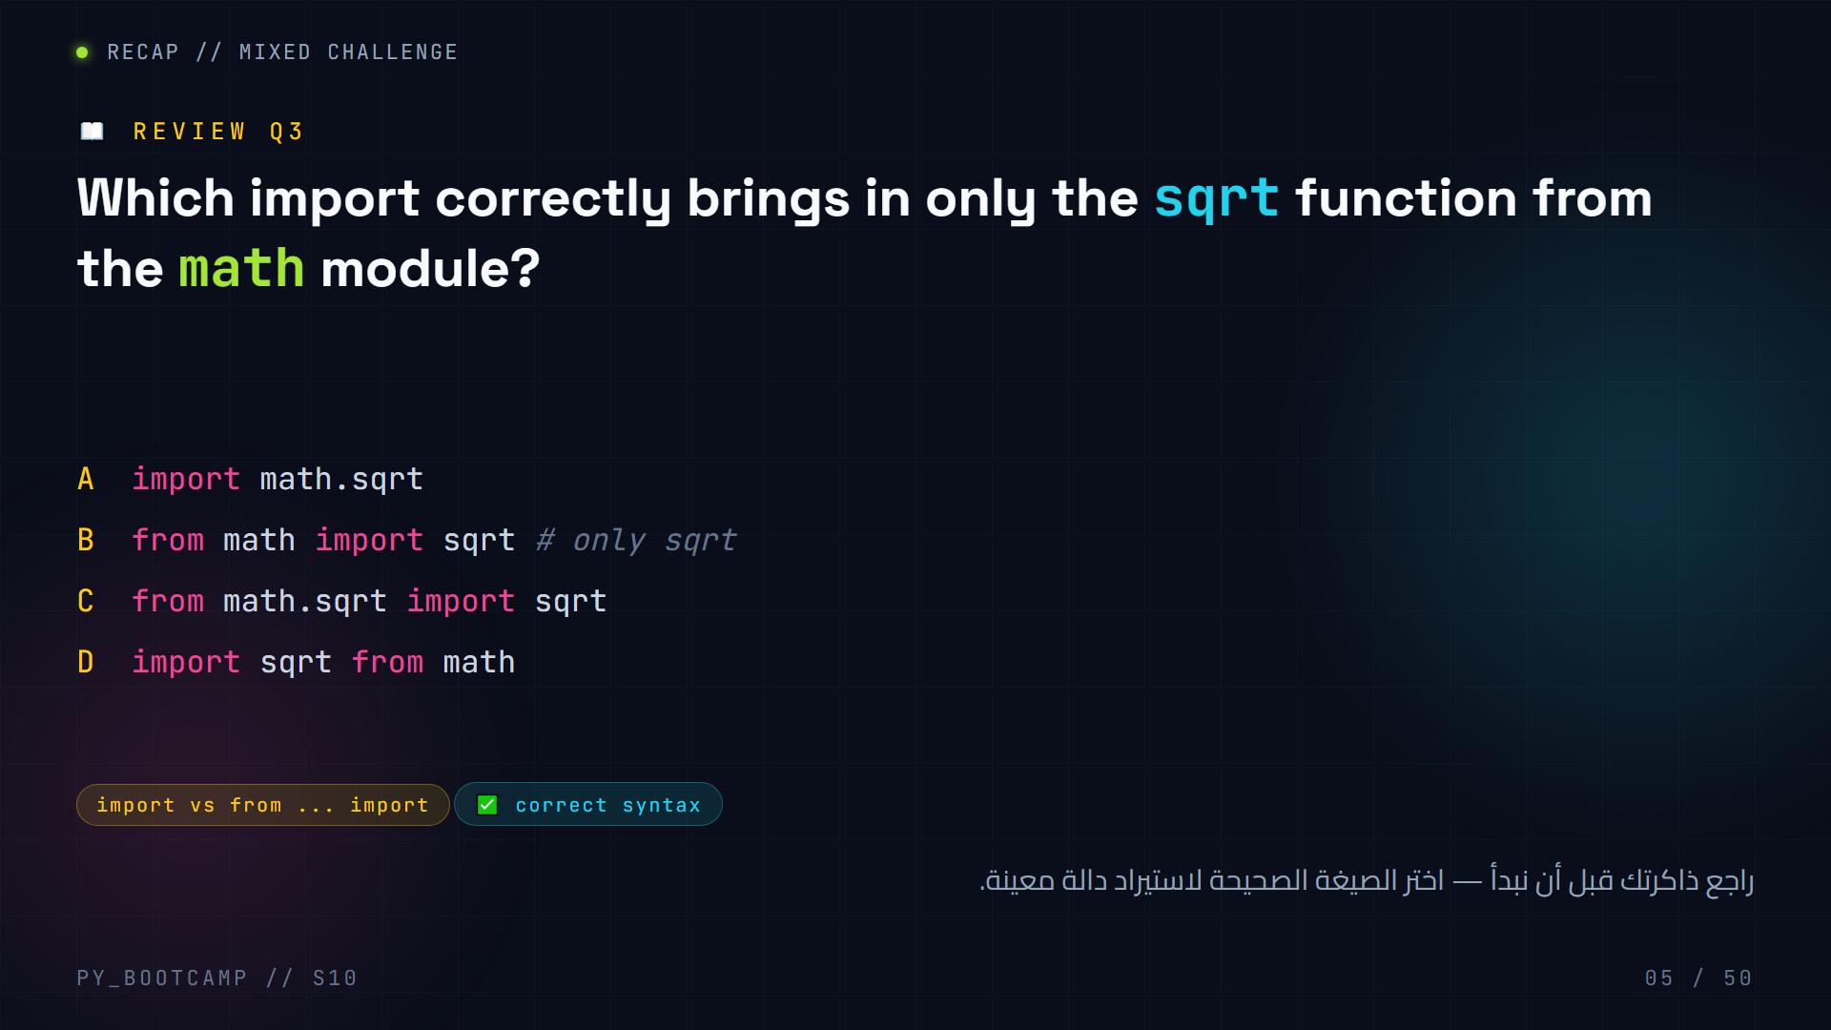
Notes:
**Slide 5 — Review MCQ 3 (2 min) — Mixed**
- **Correct answer: B.** `from math import sqrt` imports only the function, so you call `sqrt(16)` directly.
- A and C fail: `math.sqrt` is not a module — you cannot import a function as if it were a package.
- D has the wrong order — Python syntax is always `from module import name`.
- Bridging comment: "Version control is exactly the same skill as modules — organisation. You're organising your history now."
- Arabic tip: ذكّرهم بقاعدة الذاكرة: "من المكتبة ← استورد الاسم"، أي من math استورد sqrt.

Slide 6
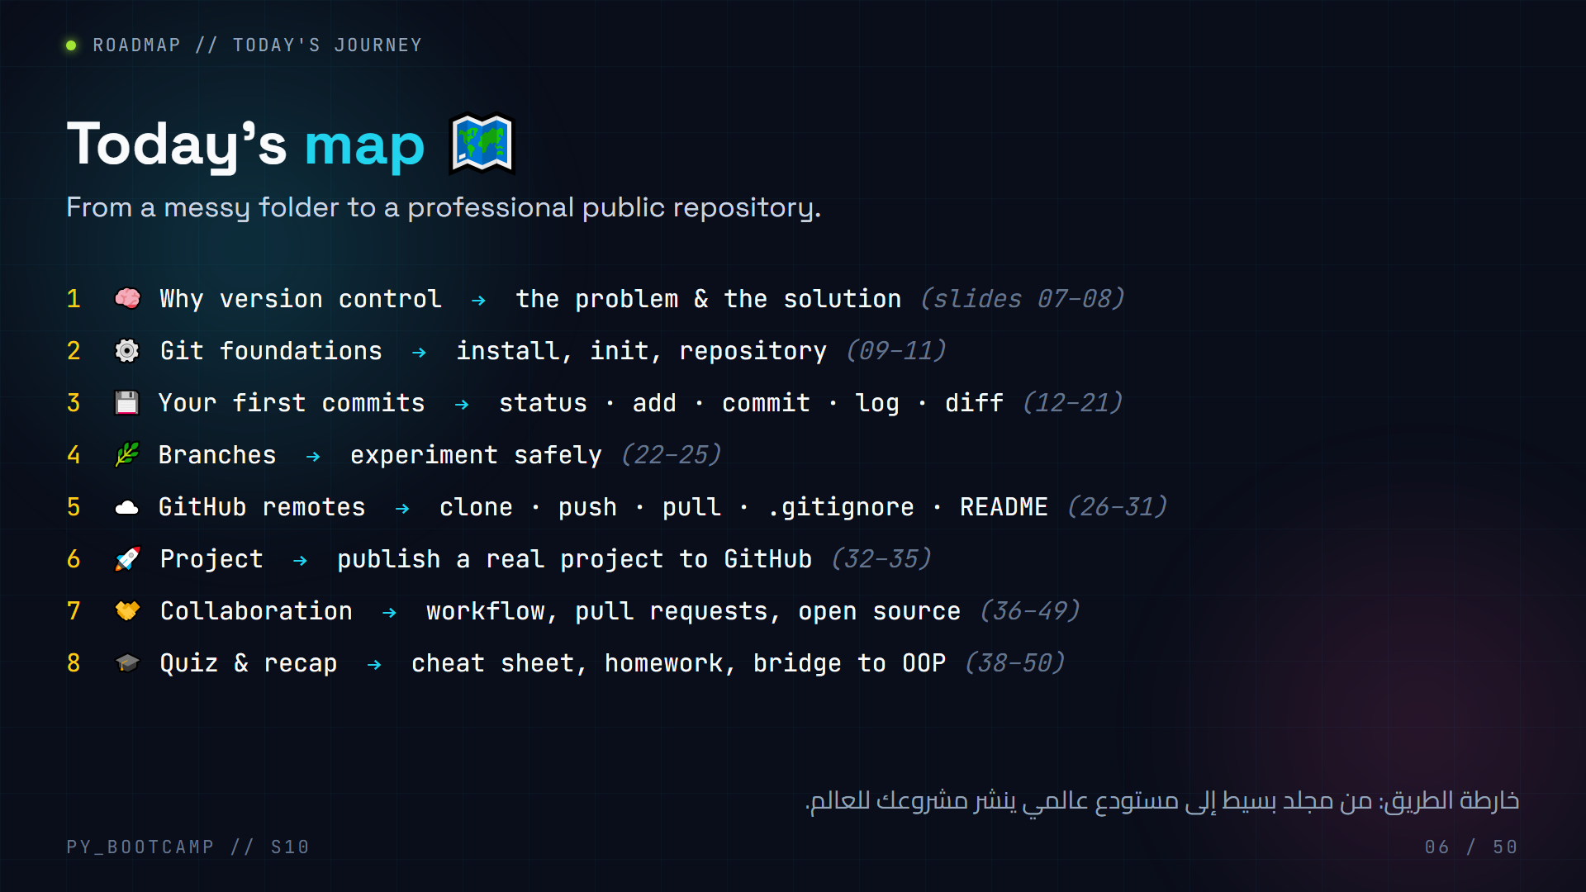
Notes:
**Slide 6 — Timeline (2 min)**
- Walk the map once, quickly. Do not read it verbatim — point at each step and say one sentence.
- Hook the journey: "Step 3 is where you feel the magic. Step 6 is where your project becomes public."
- Set a pace promise: "We stop for live demos twice — first commit and first push."
- Arabic tip: اجعل الطلاب يحفظون الأوامر الكبرى: init، commit، push — هذه هي الثالوث المقدس اليوم.
- There will be a break recommendation after slide 31 (before project) if time is tight.

Slide 7
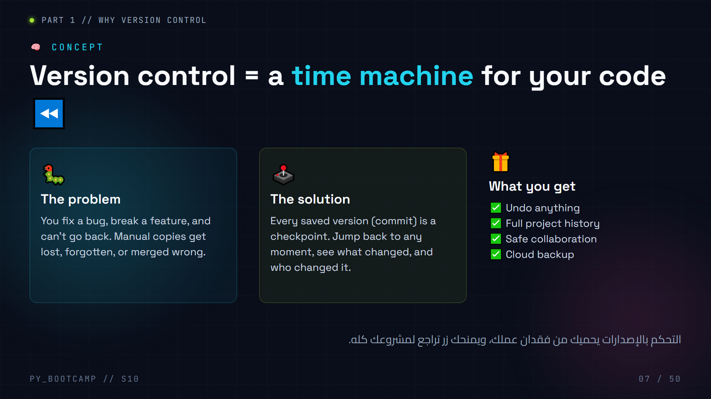
Notes:
**Slide 7 — Why version control (4 min)**
- Compare version control to game save points: "You don't finish a game without saving. Why code without saving?"
- Manual copies are NOT version control — they are chaos (reference the hook slide).
- Emphasise: a commit is like a checkpoint you can reload any time.
- Interactive: ask students "what's the worst thing that ever happened to your files?" Share 1–2 stories.
- Arabic tip: اشرح المعنى الحرفي: "التحكم بالإصدارات" = التحكم بتاريخ عملك؛ كل إصدار = نسخة قابلة للعودة إليها.

Slide 8
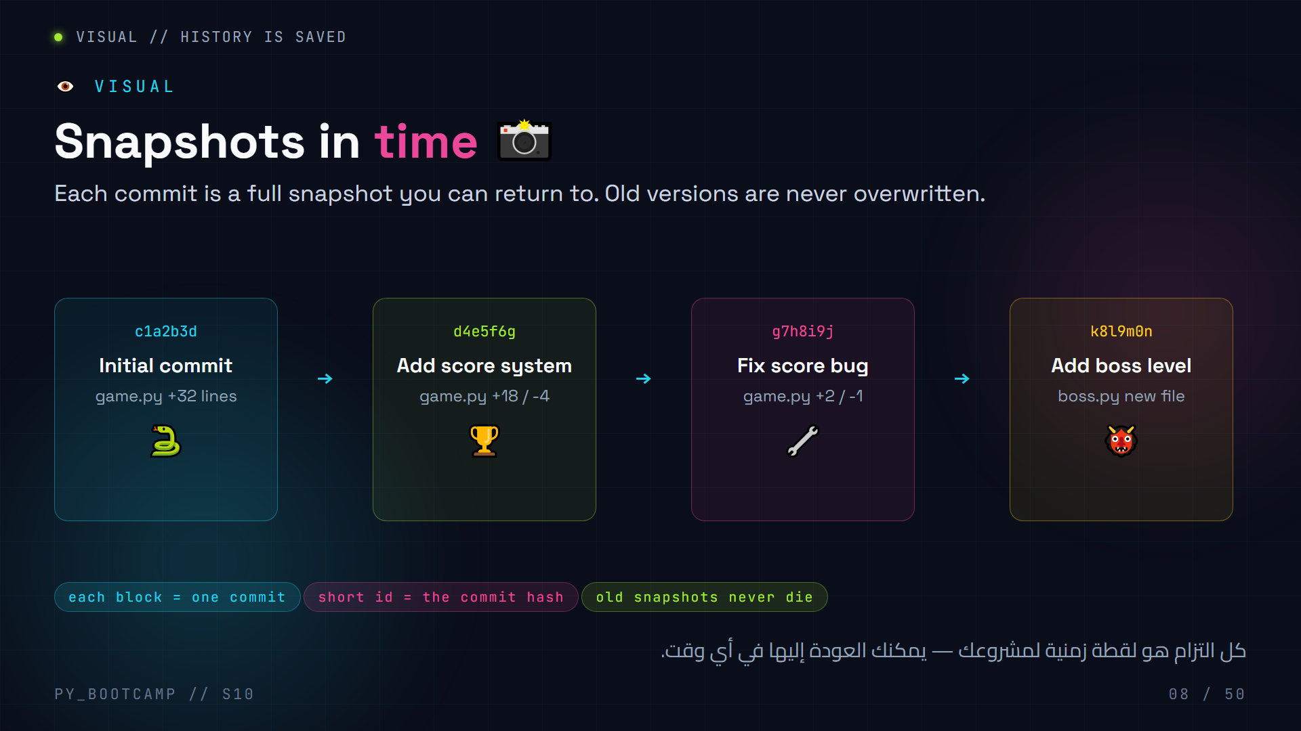
Notes:
**Slide 8 — Visual: snapshots (3 min)**
- Explain that each snapshot records the ENTIRE project state at that moment (Git actually stores differences, but the mental model is "full save").
- The short hash (e.g. `c1a2b3d`) is the commit ID — every commit gets a unique one.
- Point out "Fix score bug" only changed 3 lines — yet it's still a complete checkpoint.
- Interactive: "If 'Add boss level' broke the game, which commit do we jump back to?" → `k8l9m0n` or `g7h8i9j`.
- Arabic tip: شبّه الأمر بأرشيف كاميرات المراقبة: كل لحظة محفوظة، والكود هو الفيديو.

Slide 9
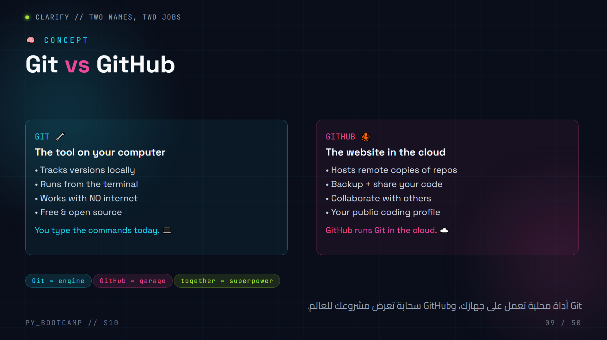
Notes:
**Slide 9 — Git vs GitHub (3 min)**
- Most beginners think they are the same thing. Make the difference crisp with an analogy:
- Git = the engine in your car. GitHub = the garage where you park it so others can see it.
- Key sentence: "Git works without internet. GitHub is where the internet version of your project lives."
- Fun fact: Git was created by Linus Torvalds (the Linux guy) in 2005.
- Arabic tip: استخدم تشبيهاً محلياً: "Git هو الكاميرا، وGitHub هو الألبوم السحابي".
- Bridge: "Now let's meet the star of the show — the repository."

Slide 10
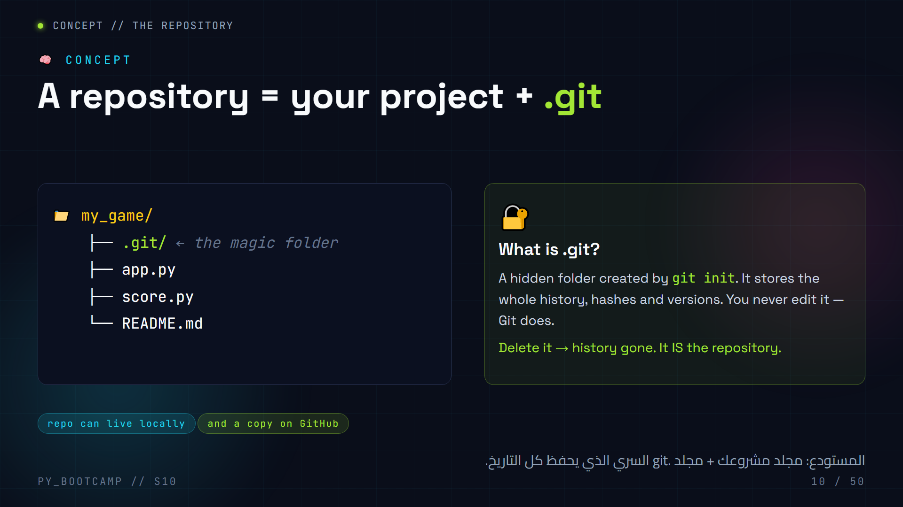
Notes:
**Slide 10 — Repository concept (4 min)**
- Say: "From today, the word *repository* (or *repo*) means: a folder Git is watching over."
- Stress: the `.git` folder is what makes a plain folder a repo. No .git, no history.
- Tell them .git is hidden by default — in Git Bash/terminal run `ls -la` to see it; on Windows Explorer enable "show hidden files".
- Warn: never delete .git, never open it and edit files inside.
- Arabic tip: "الريبو" هو مصطلح معروف حتى بالعربية في مجتمع المطورين — استخدمه بثقة.

Slide 11
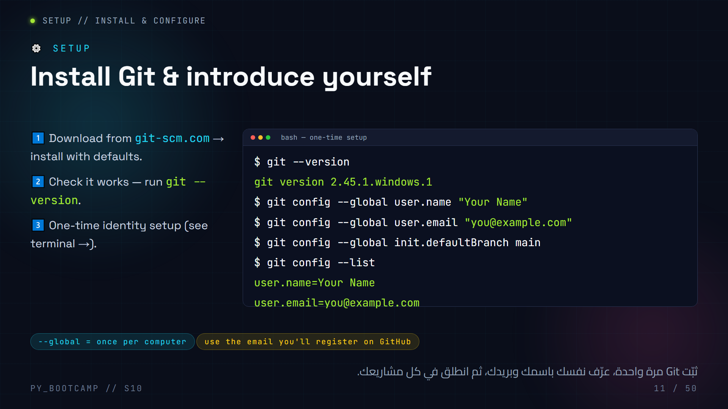
Notes:
**Slide 11 — Install & configure (live, 6 min)**
- LIVE: walk around to confirm everyone has Git installed (Windows: Git Bash; macOS/Linux: git is usually built in).
- `git --version` proves installation. If a student has an old version, don't panic — commands still work.
- `git config --global` stores your identity for ALL repos on that machine. Without it, commits have no author.
- `init.defaultBranch main` makes new repos default to `main` instead of the outdated `master`.
- COMMON MISTAKE: typing a fake email like `asdf@asdf` — GitHub then shows your commits as "unknown author". Encourage the real email they will use for GitHub.
- Arabic tip: اشرح كلمة "عالمي" في --global: الإعداد يُحفظ على مستوى الحاسوب وليس المشروع.
- Teacher: run the demo yourself first, then let students copy.

Slide 12
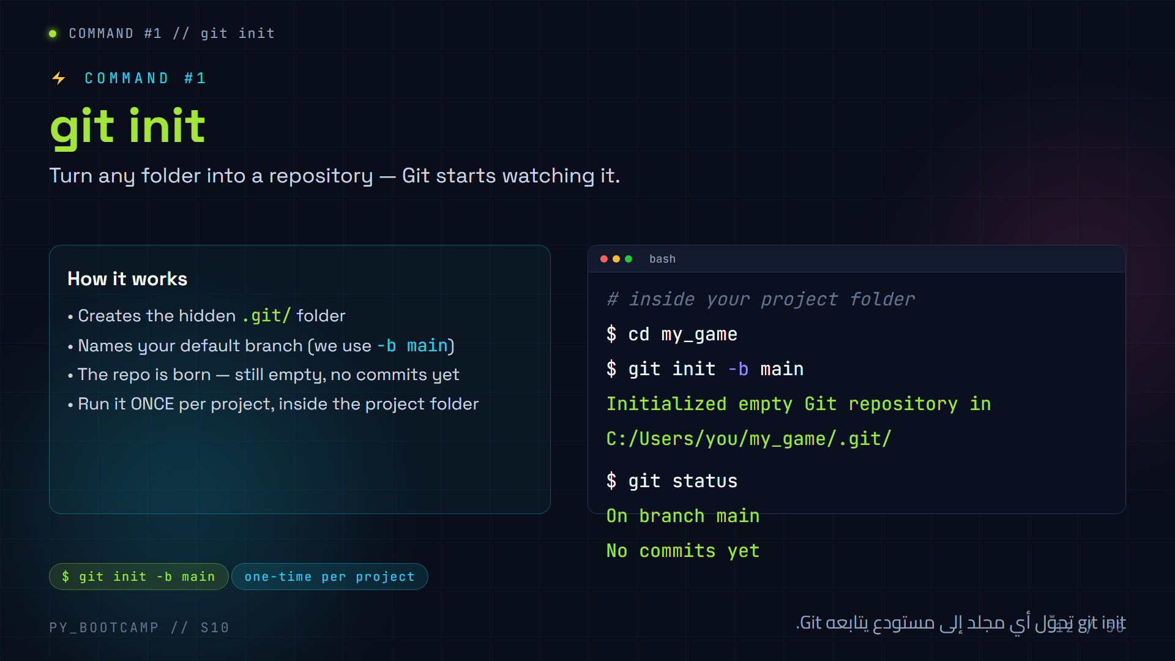
Notes:
**Slide 12 — git init (5 min)**
- Demo: create a folder, `cd` into it, run `git init -b main`.
- Show the output line "Initialized empty Git repository in ..." — celebrate it.
- Then run `git status` → shows "On branch main" + "No commits yet". This proves the repo exists.
- Tell them to check the hidden `.git` folder with `ls -la` (Git Bash) — a fun "behind the scenes" moment.
- Note: if they forget `-b main`, the branch is called `master`. Not a disaster — we'll mention fixing it with `git branch -M main` later.
- Arabic tip: العبارة "Initialized empty..." تعني "تم تهيئة مستودع فارغ" — اجعلهم يقرؤونها كأول نجاح.

Slide 13
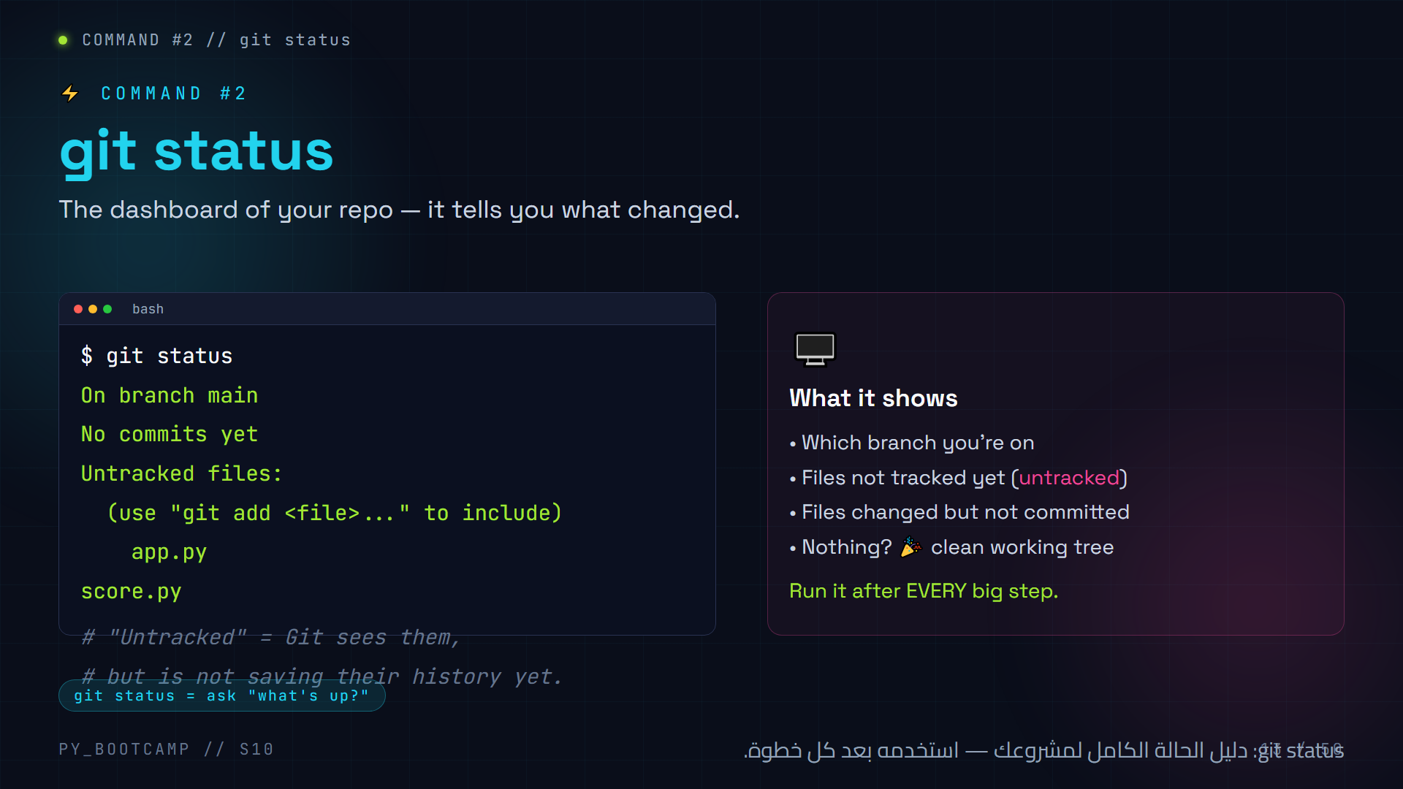
Notes:
**Slide 13 — git status (5 min)**
- Call it the "most-used command" — you will type it constantly.
- Explain "untracked": Git KNOWS the files exist but is not saving versions of them yet. Tracking starts when you `git add`.
- Have students run `git status` in their fresh repo with their game files — everyone should see their files listed as untracked.
- Pro tip: when lost, `git status` tells you exactly where you are. "When in doubt — status."
- Arabic tip: كلمة Untracked = "غير مُتتبَّع"؛ أي أن Git لا يتابع هذا الملف بعد.
- Encourage shouting the output: "No commits yet" means "history is empty — let's fix that!"

Slide 14
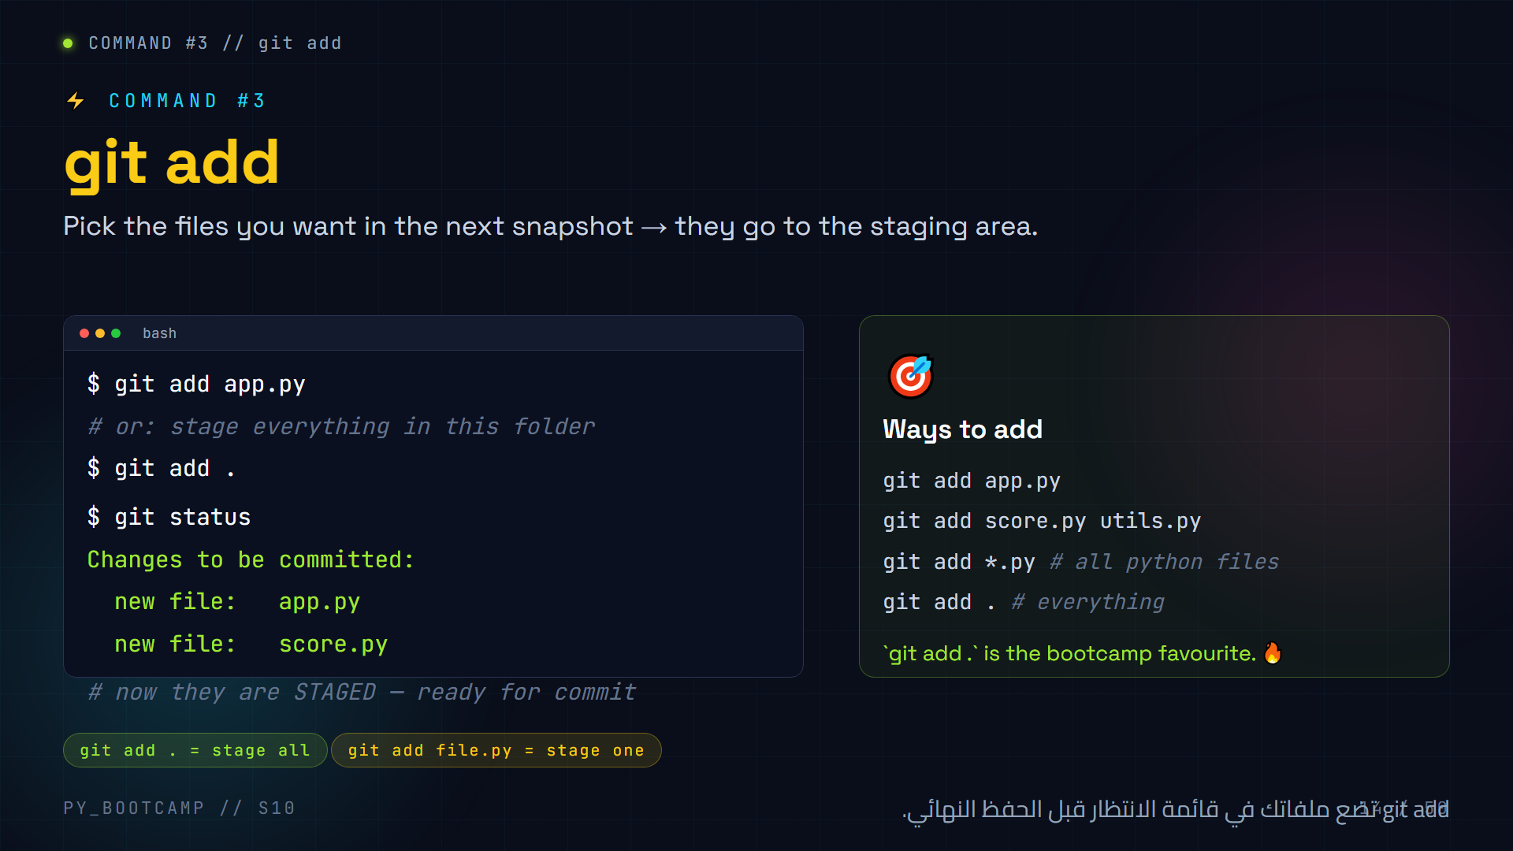
Notes:
**Slide 14 — git add (5 min)**
- Demo: `git add app.py`, then `git status` — show "Changes to be committed".
- Explain why it exists: so you can commit ONE logical change (e.g., only the bug fix, not the half-written feature).
- `git add .` is great for beginners but show the targeted form too.
- PREDICT-QUESTION for the room: "After `git add .`, what will `git status` say?" → files move to "Changes to be committed".
- Arabic tip: نطق "add" كما هو؛ اشرح معناه "أضِف الملفات إلى الحزمة القادمة".
- Common slip: students add, then forget to commit. Remind: add is only the first half.

Slide 15
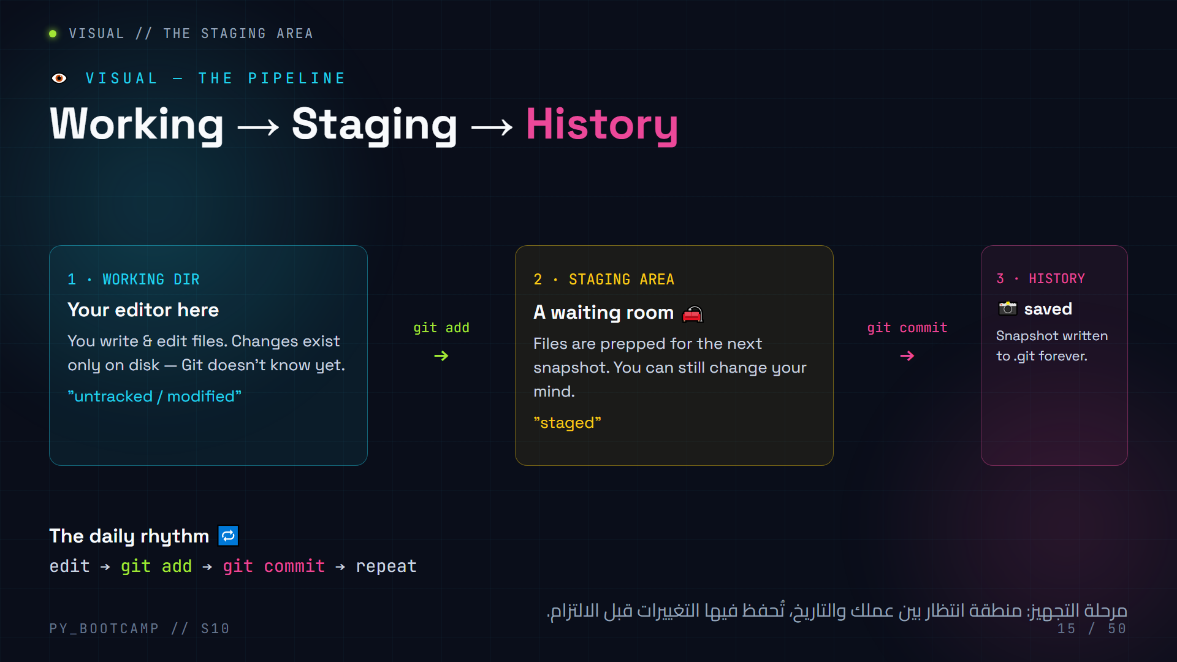
Notes:
**Slide 15 — Staging area visual (4 min)**
- This is THE core mental model of Git. Do not rush it.
- Three zones: working directory (your editor), staging area (waiting room), history (.git).
- `git add` moves files INTO the waiting room; `git commit` takes the whole waiting room and stamps it as one snapshot.
- Emphasise: a commit always captures the staging area, not whatever is open in the editor.
- Analogy: it's like preparing your suitcase (add) then sealing it with a label (commit).
- Arabic tip: استخدم استعارة "غرفة الانتظار": git add يُدخل الملفات لغرفة الانتظار، وgit commit يغلق الباب ويحفظ اللقطة.

Slide 16
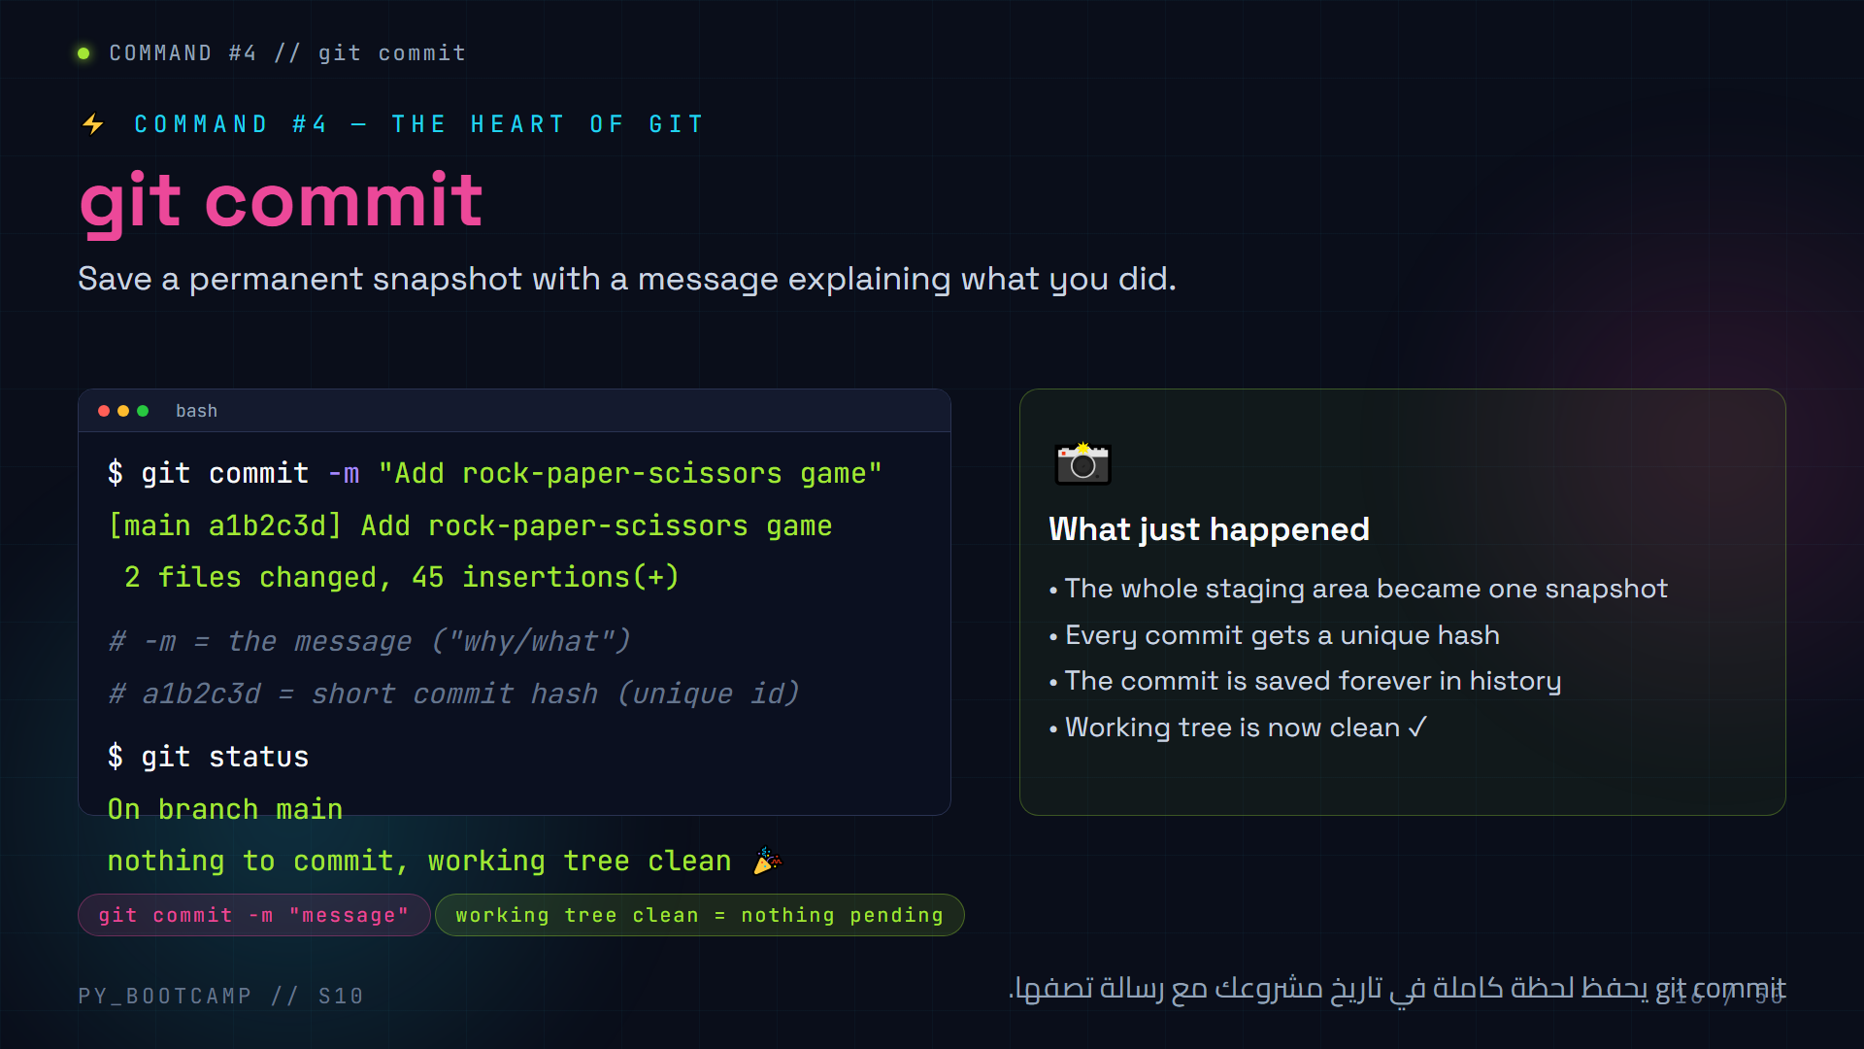
Notes:
**Slide 16 — git commit (6 min)**
- Demo the full moment: `git add .` then `git commit -m "Add rock-paper-scissors game"`.
- Read the output together: `[main a1b2c3d]` → branch, short hash, message; then "2 files changed, 45 insertions".
- Then run `git status` → "working tree clean". That green feeling = a saved checkpoint.
- WARNING (very common): `git commit` without `-m` opens Vim. Students panic. Teach: press `ESC`, type `:q!`, Enter to escape, then retry with `-m`. Mention troubleshooting slide later.
- Arabic tip: "commit" تعني "التزام" — التزم برسالة واضحة تصف التغيير.
- Encourage every student to complete their FIRST commit now — big class celebration.

Slide 17
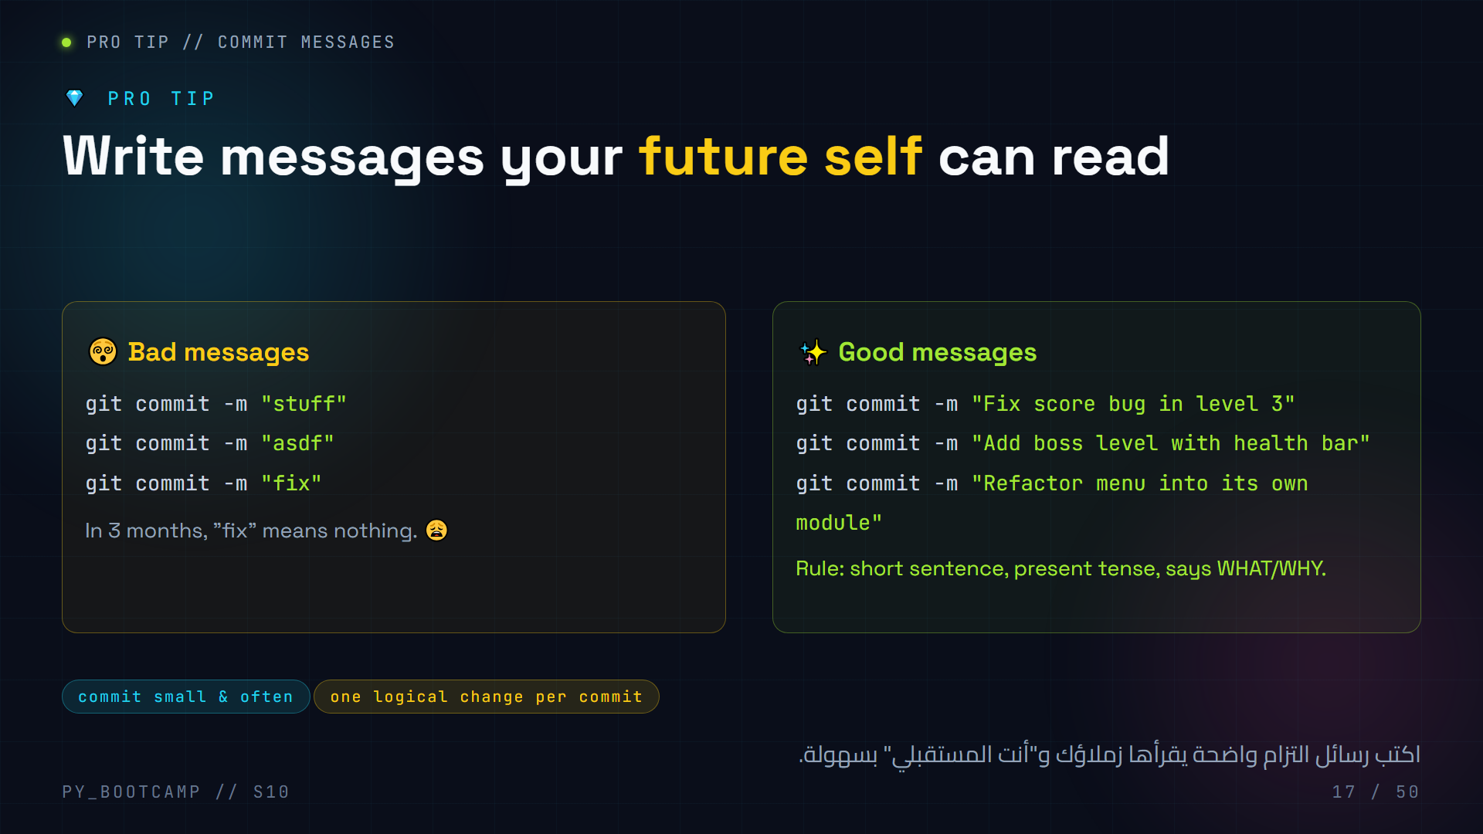
Notes:
**Slide 17 — Commit messages (3 min)**
- Make it memorable: "The person who reads your commits the most is YOU, six months from now."
- Show bad vs good side by side and read them aloud with drama.
- Golden rules: present tense ("Fix", not "Fixed"), short (under ~50 chars), explain the WHY when it's not obvious.
- Encourage committing small chunks: one feature or one bugfix per commit.
- MCQ prompt (answer in your head / discuss): which is a good message? → "Fix score bug in level 3".
- Arabic tip: القاعدة الذهبية: رسالة "التزام" تُخبر القارئ ماذا غيّرت ولماذا.

Slide 18
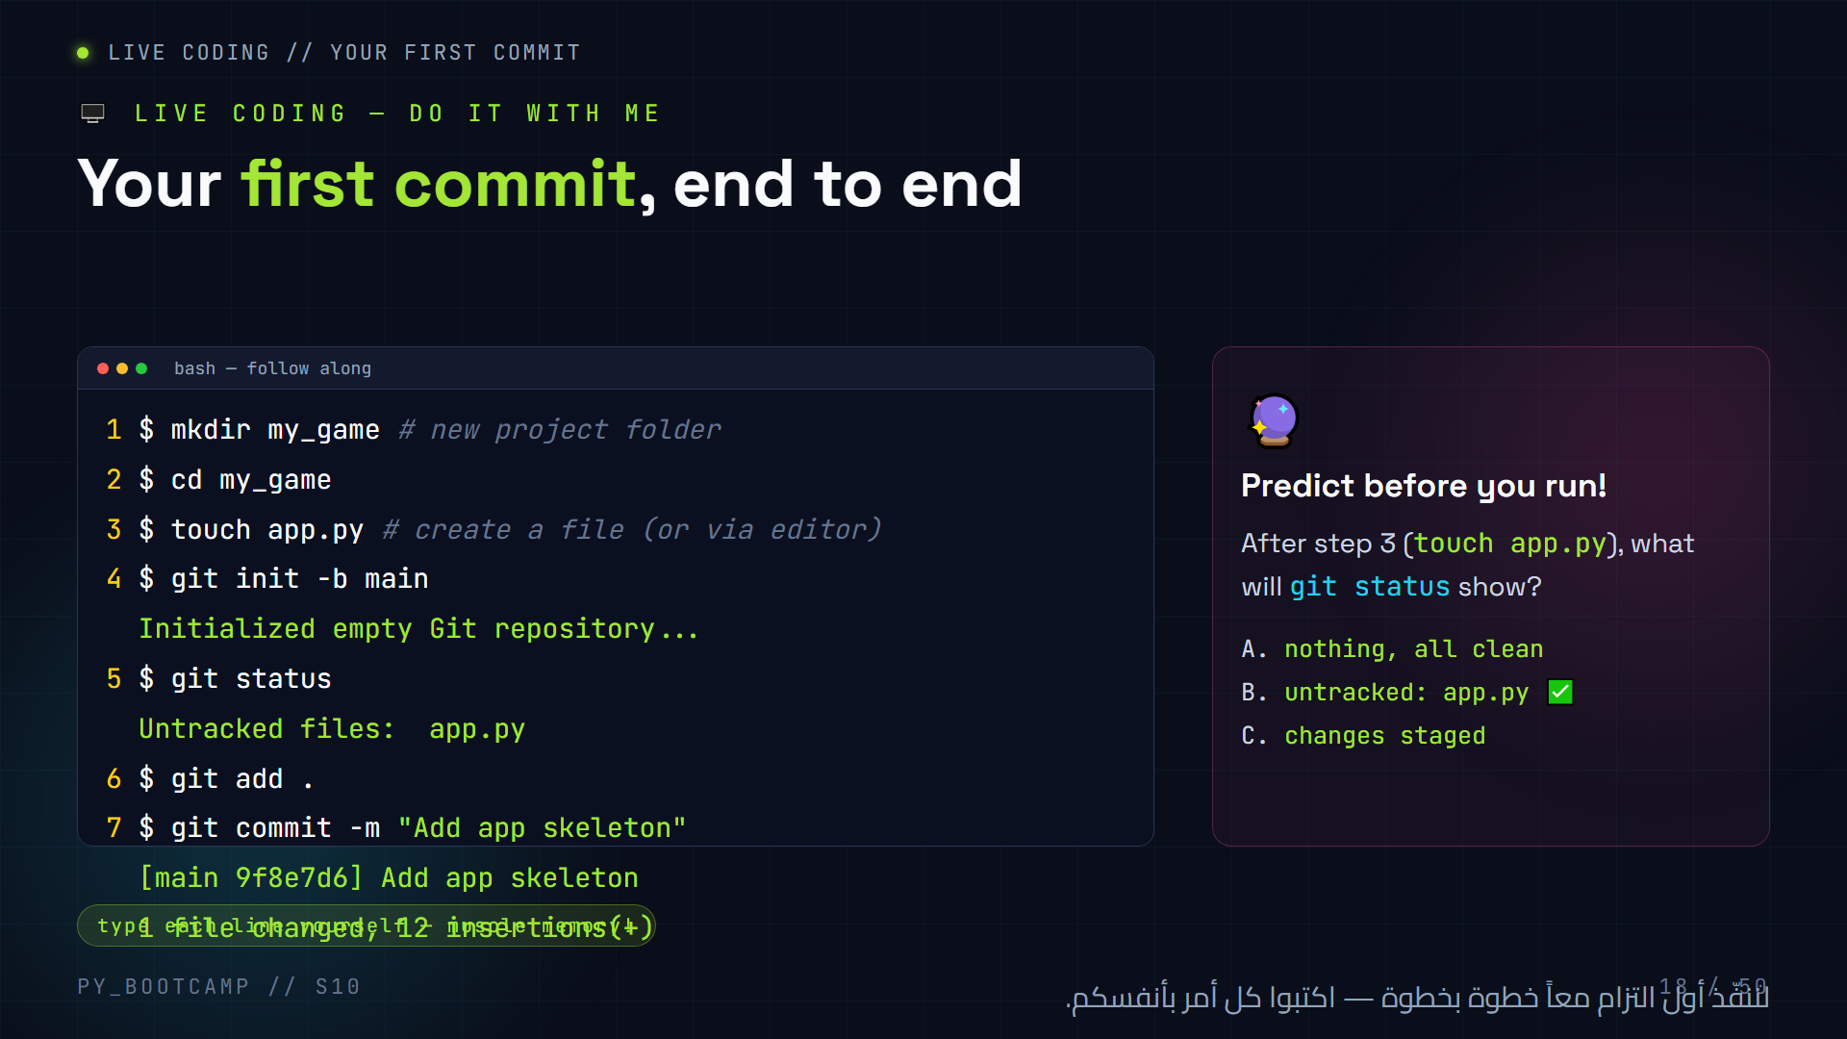
Notes:
**Slide 18 — LIVE CODING: first commit (15 min, THE key moment)**
- Run the whole sequence on the projector, pausing after each command.
- PREDICT: after `touch app.py`, ask "what will git status say?" → B: untracked: app.py.
- IMPORTANT: `touch` works in Git Bash on Windows; if using cmd/PowerShell, create the file via the editor instead.
- Walk slowly at step 4 (init) and 7 (commit) — these are the two big "aha" moments.
- Check the room: every student must see `[main ...]` and "1 file changed". Call out success.
- If someone opens Vim by mistake (no -m): ESC, :q!, Enter.
- Arabic tip: اجعل الطلاب يكررون التسلسل ذهنياً: أنشئ ← عرّف ← أضف ← التزم.
- Time-box: don't let them tweak code yet; the point is the workflow.

Slide 19
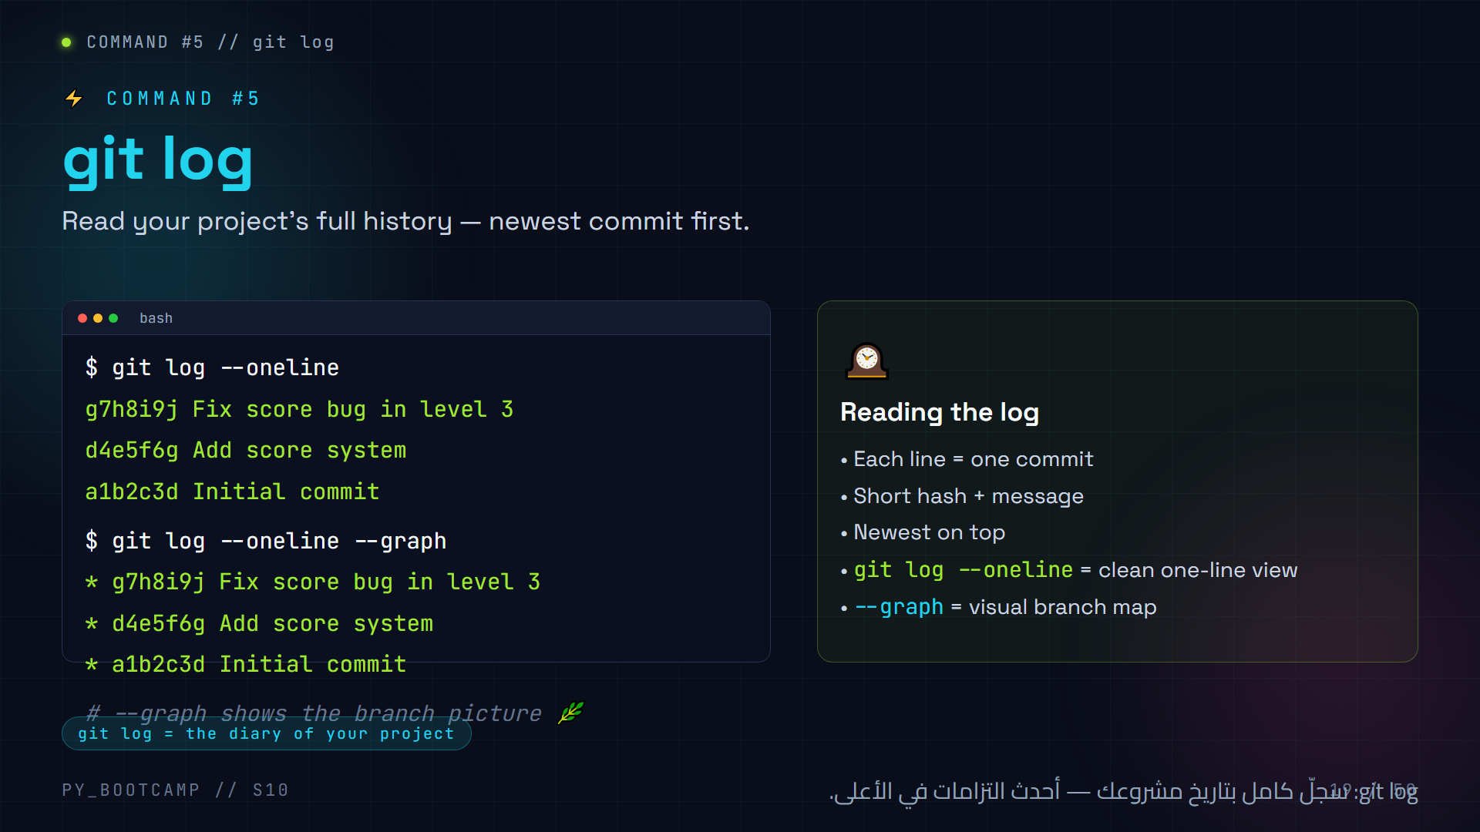
Notes:
**Slide 19 — git log (4 min)**
- Demo `git log --oneline` right after the live commit — students should see their "Add app skeleton" commit.
- Explain the "diary" framing: every commit you made today is now visible history.
- Show that `git log --oneline` prints newest first (top = most recent).
- `--graph` becomes exciting when we do branches — mention we'll revisit it in ~20 minutes.
- If a student sees "(HEAD -> main)" in the log — explain it means "this commit is where main currently points".
- Arabic tip: "log" = سجل — اعرض السجل كأنكم تفتحون يوميات مشروعكم.

Slide 20
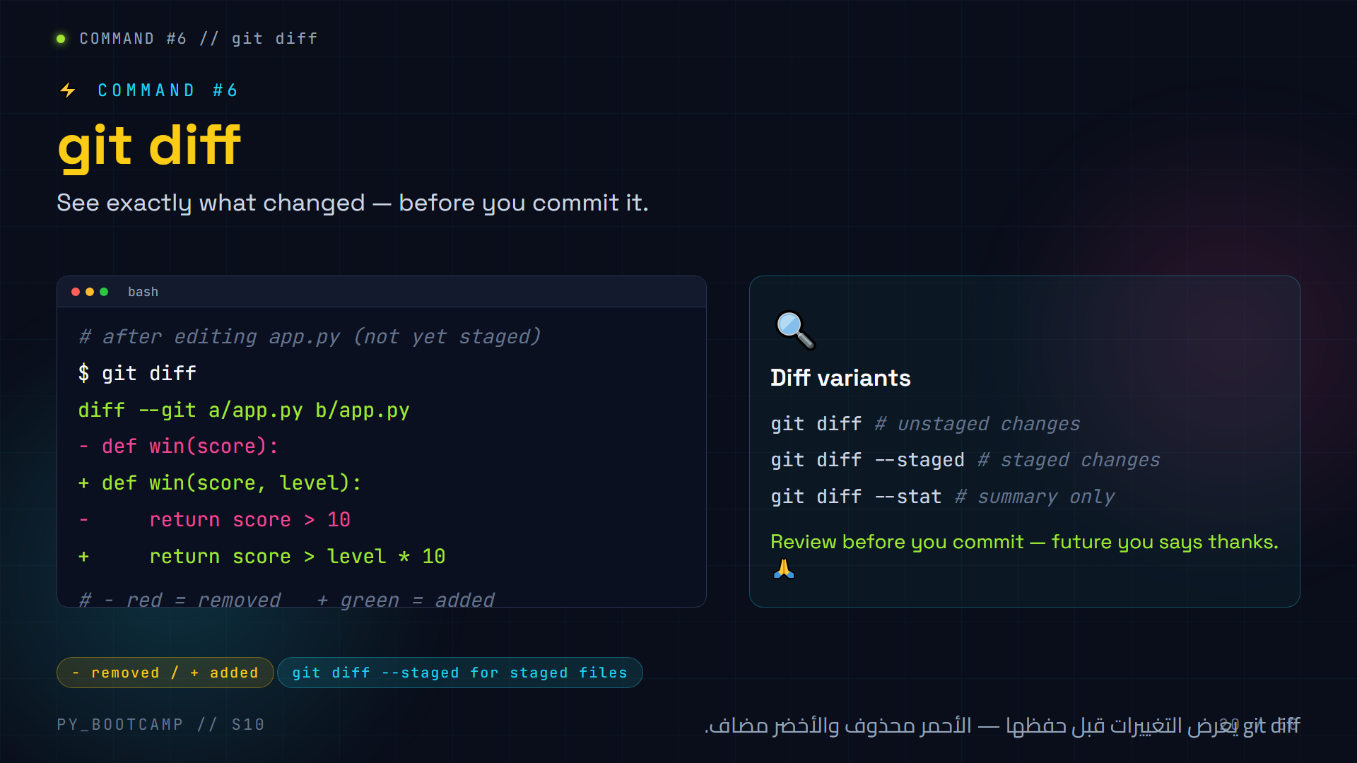
Notes:
**Slide 20 — git diff (4 min)**
- Live: edit a file, DON'T stage it yet, run `git diff`.
- Explain red (-) = lines removed, green (+) = lines added. Green is usually what you typed.
- Emphasise the habit: `git diff` before commit = proofreading your change.
- `git diff --staged` shows the diff of files already in the staging area (a common beginner confusion — they run plain `git diff` after staging and see nothing!).
- Warn: if `git diff` shows nothing after editing, the file is probably staged — use `--staged`.
- Arabic tip: اشرح أن diff اختصار difference = "الفرق"؛ يعرض الفرق بين ما كان وما أصبح.

Slide 21
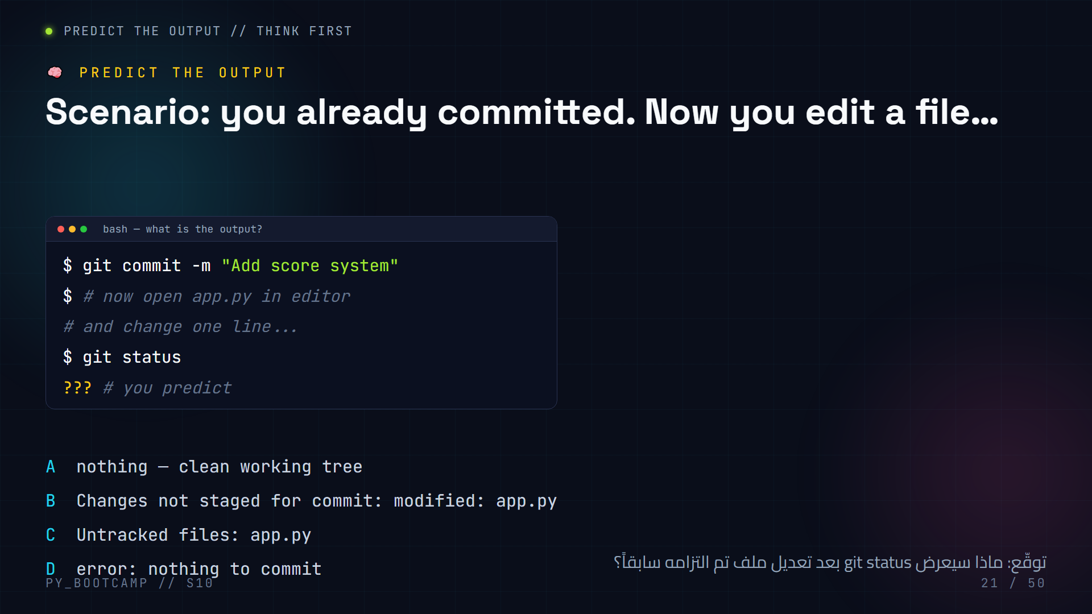
Notes:
**Slide 21 — Predict the output MCQ (3 min)**
- Pause: let students call out letters. **Correct answer: B** — the file is now "modified" and appears under "Changes not staged for commit".
- Walk through why each other option is wrong:
- A fails because the file differs from the last snapshot.
- C fails because the file was already tracked (it's not untracked anymore).
- D is wrong — git status never errors here; committing would complain, but status is fine.
- Reinforce the 3 states of a tracked file: modified → staged → committed.
- Arabic tip: ذكّرهم: "المعدّل" = تغيّر منذ آخر التزام، و"غير المتتبَّع" = ملف جديد لم يُضف قط.

Slide 22
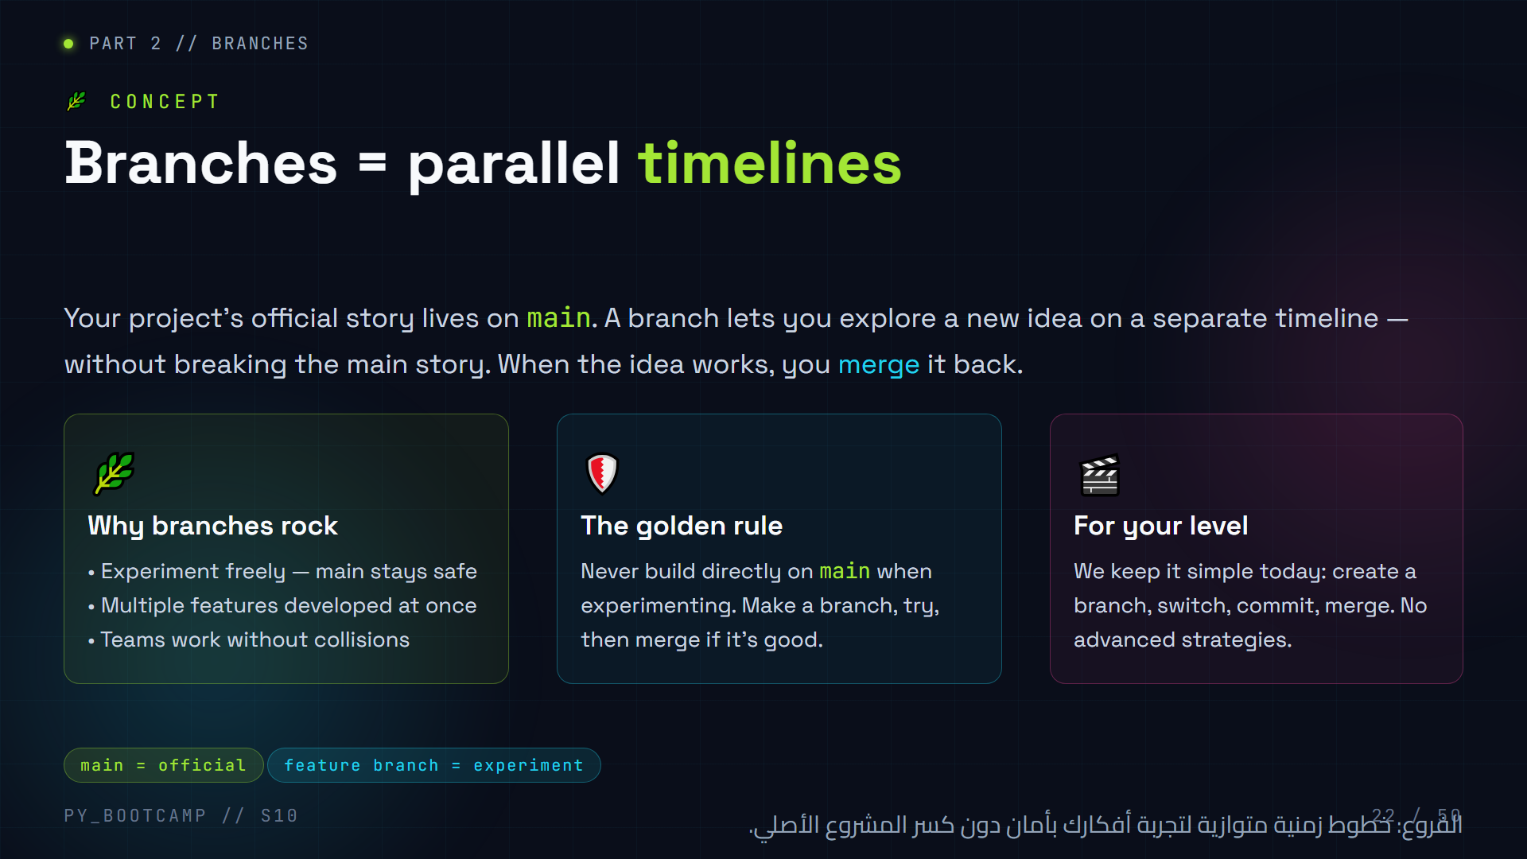
Notes:
**Slide 22 — Branches intro (3 min)**
- Analogy: a novel's main plot vs a "what-if" draft you write in another document. If the draft is great, you copy it into the main story.
- Stress safety: branches let you break things without breaking main. Great for the "boss level" experiment.
- Keep expectations grounded: today is basic branch + merge only (per prompt: no advanced branching strategies).
- Mention: default branch is `main` (that's why we used `-b main` at init).
- Arabic tip: "الفرع" كأنه ورقة تجارب منفصلة؛ النتيجة الناجحة تُنسخ إلى الدفتر الرئيسي.

Slide 23
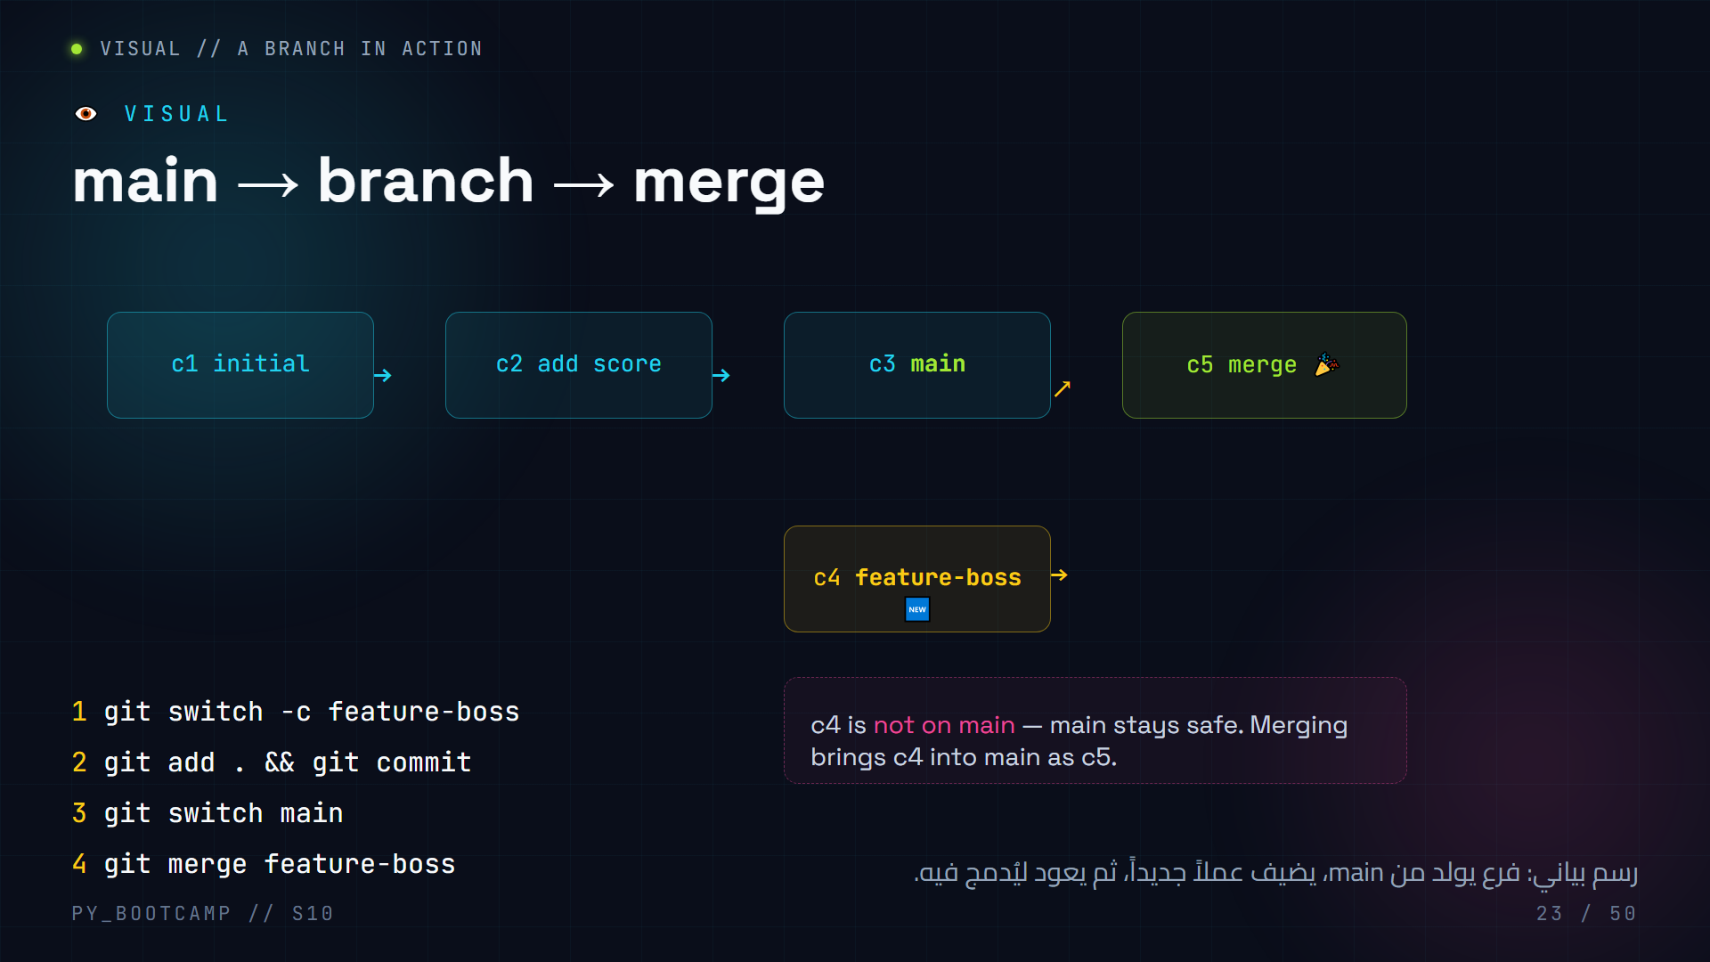
Notes:
**Slide 23 — Branch visual (4 min)**
- Draw the timeline live on the board as you talk.
- main: c1 → c2 → c3. Then "feature-boss" branches off from c3 and gets its own commit c4.
- The dashed box emphasises: main does NOT contain c4 until merge.
- Steps on the left summarise the exact commands they'll type on the next slide.
- Point at c5: after merge, main contains everything (c1+c2+c3+c4).
- Arabic tip: شبّه الفروع بشجرة حقيقية: جذع واحد (main) وأغصان تنمو ثم تعود للاندماج مع الجذع.

Slide 24
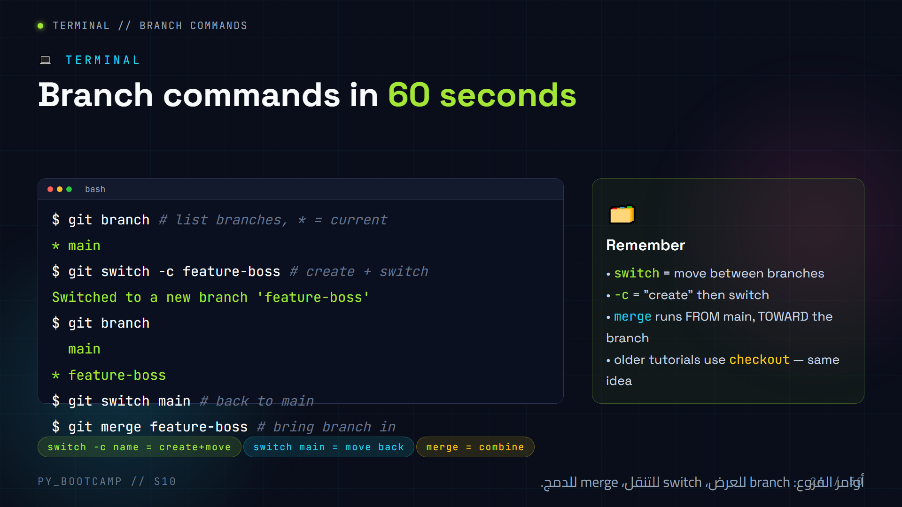
Notes:
**Slide 24 — Branch commands (live, 8 min)**
- LIVE: build a real branch on the projector. Add a tiny feature on `feature-boss`, commit, switch back to main, merge.
- Point out the `*` in `git branch` output — it marks your current branch.
- `git switch -c` is the modern way (Git ≥ 2.23). If a student's git is older, `git checkout -b feature-boss` works identically.
- Teach the mental rule: "you merge INTO the branch you're standing on." `git merge` must be run from main.
- Optional: delete the merged branch with `git branch -d feature-boss` (show once, don't stress it).
- Arabic tip: قل القاعدة بصوت عالٍ: "دمج = تعال أنت إليَّ". أي أننا نقف على main ونستدعي الفرع.

Slide 25
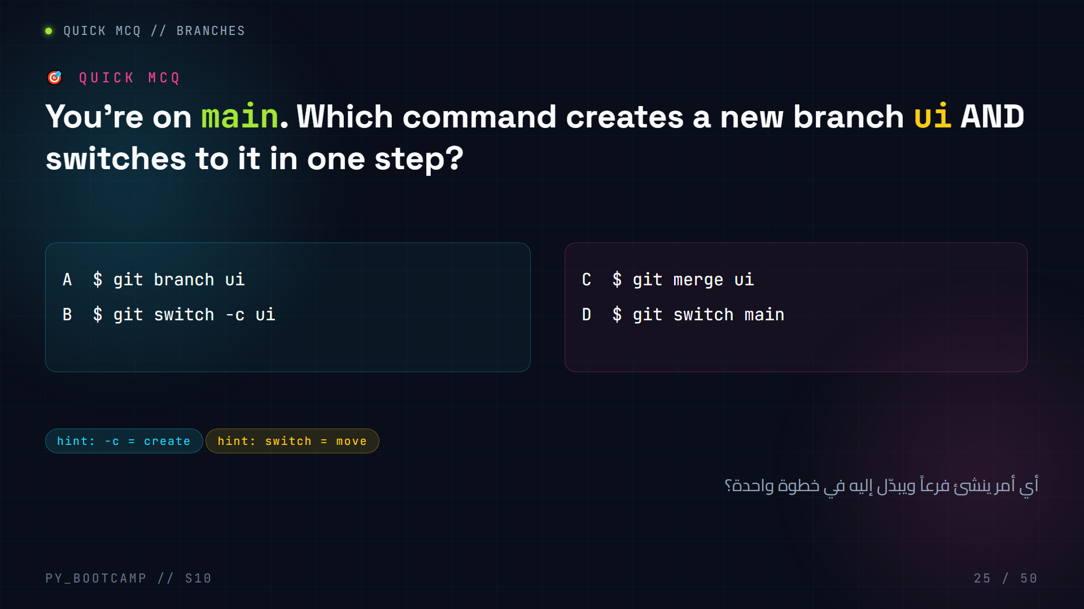
Notes:
**Slide 25 — Branch MCQ (2 min)**
- **Correct answer: B.** `git switch -c ui` creates the branch and moves you onto it.
- A (`git branch ui`) creates the branch but does NOT switch — you stay on main.
- C (`git merge ui`) fails — ui doesn't exist yet.
- D (`git switch main`) just moves you back to main.
- Quick follow-up question for the room: "How do you see which branch you're on?" → `git branch`.
- Arabic tip: اربط "-c" بـ"create/أنشئ"، و"switch" بـ"بدّل/انتقل".

Slide 26
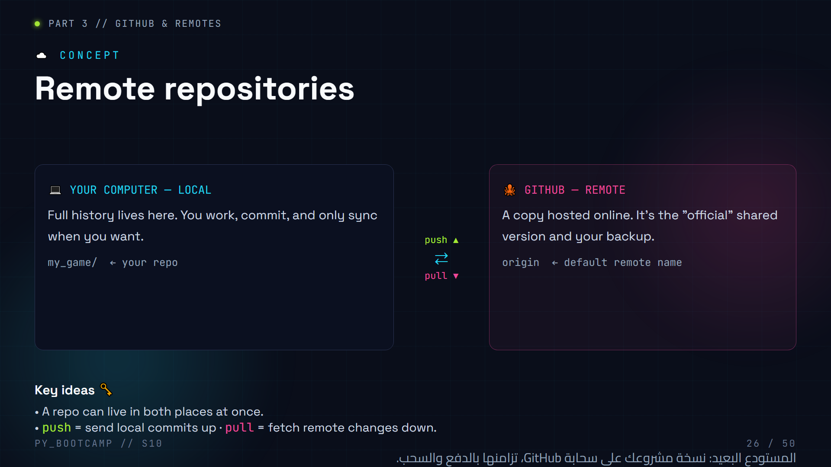
Notes:
**Slide 26 — Remote repositories (4 min)**
- Connect back to Git vs GitHub (slide 09): local Git repo + remote copy on GitHub.
- The word "remote" just means "not on this computer". `origin` is the conventional nickname for your GitHub copy.
- push = upload; pull = download. Revisit the arrow diagram — this is the heart of collaboration.
- Analogy: local is the draft folder, remote is the published folder; you choose when to publish (push) and when to refresh (pull).
- Arabic tip: "بعيد" = remote؛ أي نسخة موجودة على خادم بعيد عن جهازك.
- Bridge: "Now let's learn the three remote commands: clone, push, pull."

Slide 27
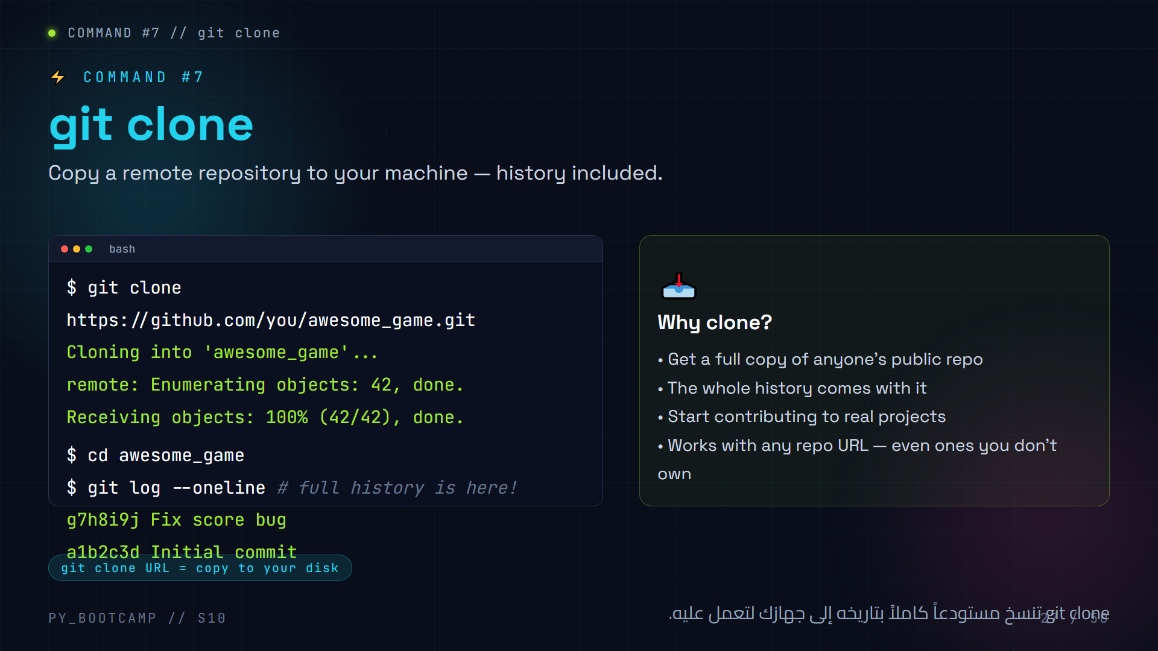
Notes:
**Slide 27 — git clone (4 min)**
- Demo: clone a real, public repo (e.g. a small GitHub repo) and open it — students love seeing someone else's history appear.
- Emphasise: cloning gives you the ENTIRE history, not just the files. Compare to Download ZIP (which has no .git).
- Note: you can clone repos you don't own — this is the door to open source (we revisit later).
- Where to find the URL: GitHub repo page → green "Code" button → HTTPS tab → copy.
- Arabic tip: الفرق بين التحميل والاستنساخ: الاستنساخ يجلب معه "تاريخ المشروع" (.git) وليس الملفات فقط.

Slide 28
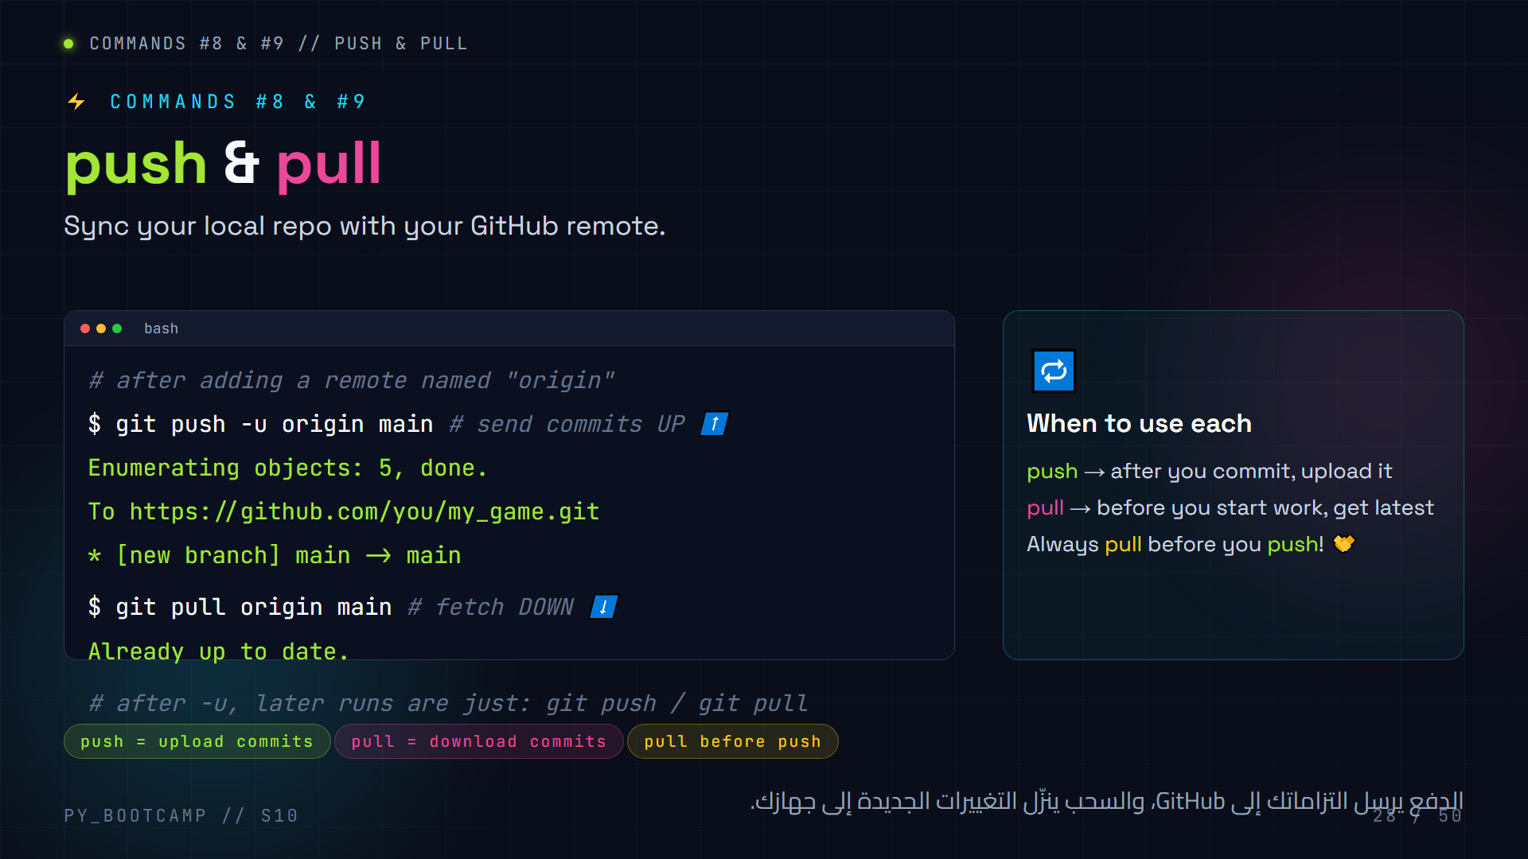
Notes:
**Slide 28 — push & pull (5 min)**
- Read both commands aloud with energy — this is the moment projects go public.
- `-u origin main`: sets upstream tracking so future commands are just `git push` / `git pull`.
- Golden habit: pull before you start work, and pull before you push. Avoids the "rejected" error we fix later.
- Clarify push does NOT happen automatically — commits stay local until you push. (Very common beginner confusion.)
- Arabic tip: قارن الدفع بالإرسال إلى الصندوق البريدي، والسحب بجلب الرسائل الجديدة.
- Note for teacher: on first push GitHub may ask for authentication (HTTPS token / credential manager). Have them sign in once.

Slide 29
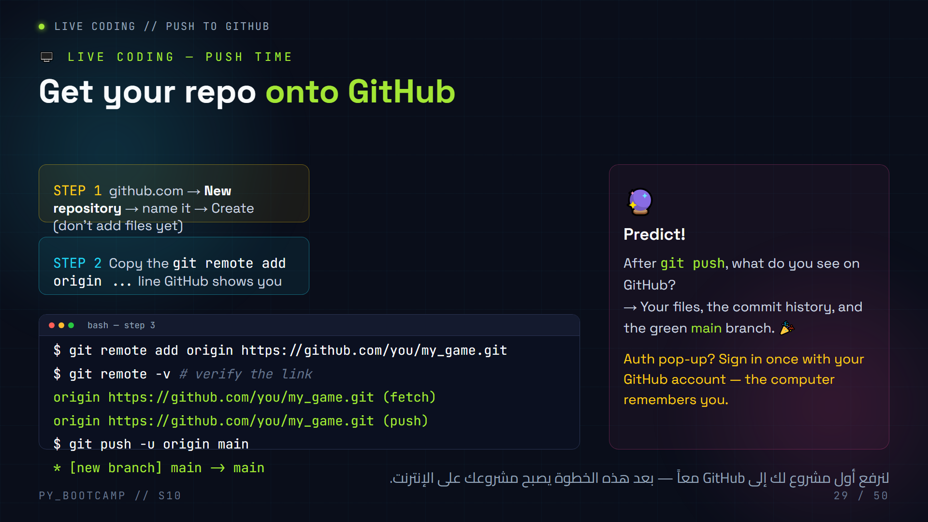
Notes:
**Slide 29 — LIVE CODING: push to GitHub (15 min)**
- Preparation: every student must have a GitHub account BEFORE this slide (tell them to sign up during the break).
- Step 1: create an empty repo on GitHub (do NOT tick "Add a README" — it creates an extra commit that causes conflicts later).
- Step 2: copy the exact `git remote add origin ` line GitHub offers.
- Step 3: run it locally, verify with `git remote -v`, then `git push -u origin main`.
- On first push GitHub asks for login — using the credential manager is fine for the bootcamp. Mention PAT/token only if advanced students ask.
- PREDICT: after push, GitHub shows files + commit list + "main" branch. Refresh the page together.
- If a student accidentally created README on GitHub: teach `git pull origin main` then push (or start clean).
- Arabic tip: بعد النجاح، ارفعوا أصابعكم وقل "شحننا!" — هذه أول لحظة فخر في الجلسة.

Slide 30
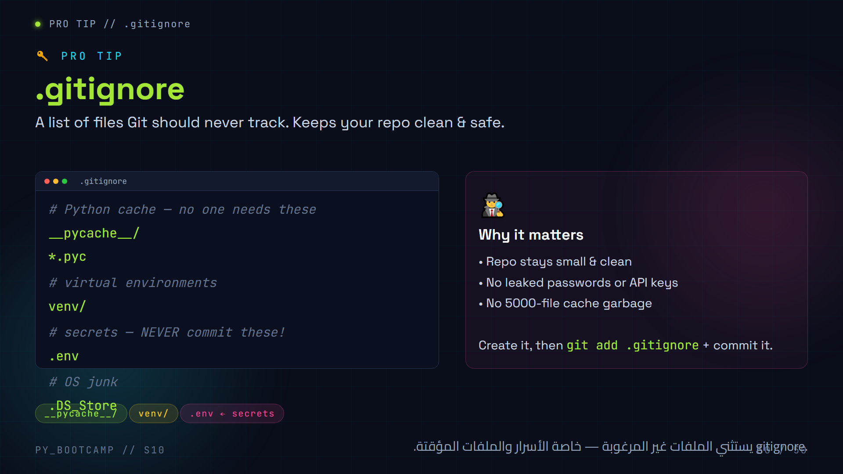
Notes:
**Slide 30 — .gitignore (5 min)**
- Demo: create `.gitignore`, add the common Python entries, commit it.
- Show the benefit live: create a `__pycache__` (run a python file once) → `git status` no longer lists it after adding to .gitignore.
- SECURITY emphasis: never commit `.env` files — real companies get hacked this way. Don't share passwords on GitHub.
- Note: patterns with `/` = folders; `*` = wildcard (e.g. `*.log`).
- Arabic tip: الاسم يعني "تجاهُل Git" — أي أن Git يتجاهل هذه الملفات تماماً.
- Common slip: creating `.gitignore.txt` (wrong). In Git Bash `touch .gitignore` creates it correctly.

Slide 31
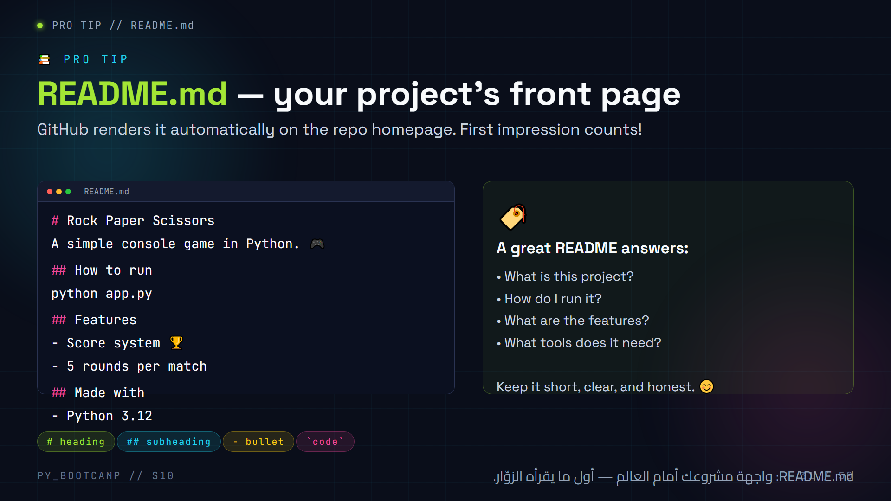
Notes:
**Slide 31 — README.md (5 min)**
- Ask: "When someone visits your GitHub repo, what's the first thing they see?" → the README, rendered below the file list.
- Walk the example line by line: title (#), run instructions, features, tech used.
- Markdown basics: `#` headings, `-` bullets, backticks for code. That's 90% of what they'll need.
- Encourage writing it BEFORE the project section — they'll need it on the next slides.
- Arabic tip: README = "اقرأني" — رسالة ترحيب تشرح مشروعك بسرعة ووضوح.

Slide 32
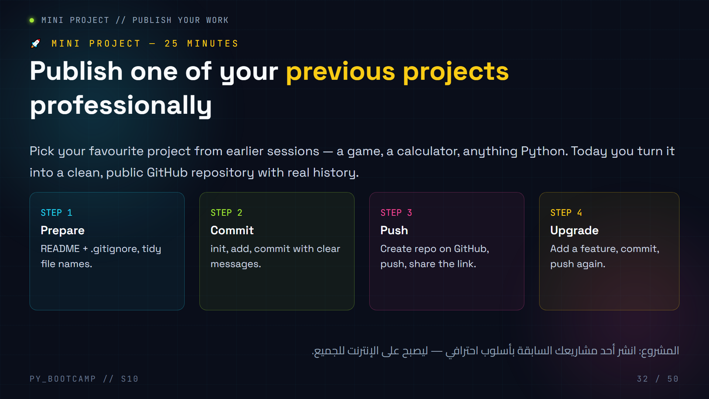
Notes:
**Slide 32 — Project intro (2 min)**
- Frame it as the payoff: "Everything you built before today becomes visible to the world."
- Each student picks ONE previous project (the one they're proudest of).
- Four steps preview: prepare → commit → push → upgrade. Slides 33–35 go through steps 1–3; step 4 is the challenge in exercises.
- Set a timer (25 min) and a clear deliverable: a shareable GitHub URL.
- Arabic tip: ذكّرهم أن أول مشروع على GitHub هو بداية "المحفظة البرمجية" (portfolio) الخاصة بهم.

Slide 33
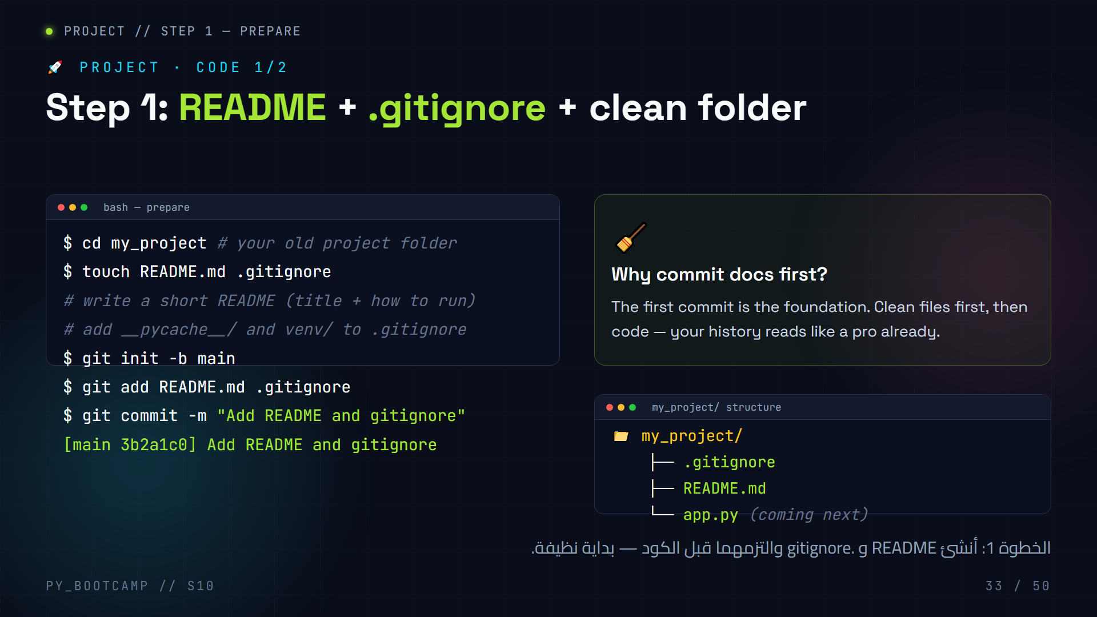
Notes:
**Slide 33 — Project code 1 (12 min)**
- Live: pick a demo project on the projector and do Step 1 with the class.
- Students do the SAME with their own project. Keep files minimal: one README + one .gitignore first.
- Remind them `touch` works in Git Bash; in other shells create the files in the editor.
- README checklist: title + "how to run" + features (from slide 31). .gitignore: `__pycache__/`, `venv/`, `*.pyc`.
- First commit is docs-only — praise that as a professional habit.
- Watch for: students naming it `readme.md` (works, but `README.md` is convention).
- Arabic tip: "النظافة قبل الكود" — اشرح أنها عادة المحترفين: يبدأون بسجل المشروع.

Slide 34
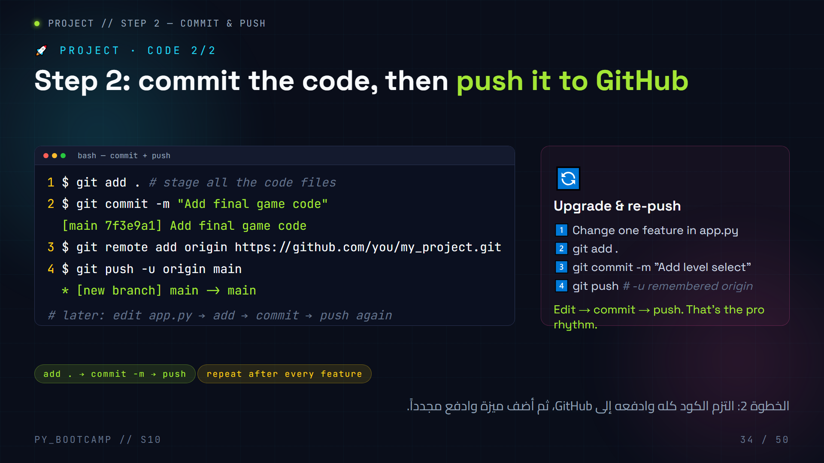
Notes:
**Slide 34 — Project code 2 (12 min)**
- Live the full flow: add all code → commit → create empty GitHub repo → add remote → push -u origin main.
- Insist on the correct order: remote add BEFORE push, commit BEFORE push.
- After the first successful push, have them add ONE small feature, then re-commit + re-push to feel the loop.
- Check everyone's GitHub URL is live. Collect 2–3 links and open them on the projector.
- Troubleshoot on the spot: "remote origin already exists" → `git remote set-url origin `.
- Arabic tip: الإيقاع المحترف: عدّل ← التزم ← ادفع. هذا كل شيء — البساطة قوة.

Slide 35
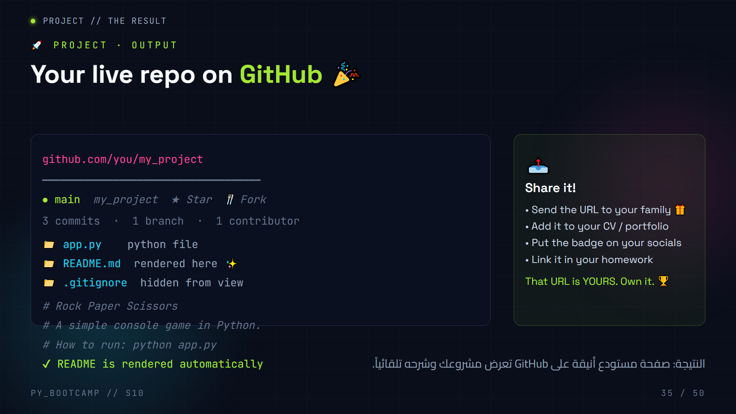
Notes:
**Slide 35 — Project output (3 min)**
- Open 2–3 student repos live on the projector. The room gets loud — enjoy it.
- Point out each element: commit count, README rendered, files list, branch name, contributor.
- Explain what visitors see: README is the landing page; the file list is the menu; commit history is the story.
- Encourage them to write the URL on a sticky note / send it to their phone.
- Arabic tip: اجعل لحظة "الرابط" احتفالية — أول رابط GitHub في حياة كل طالب هو إنجاز يُفتخر به.
- Transition: "Your project is public. Now — how do professional teams use this every day?"

Slide 36
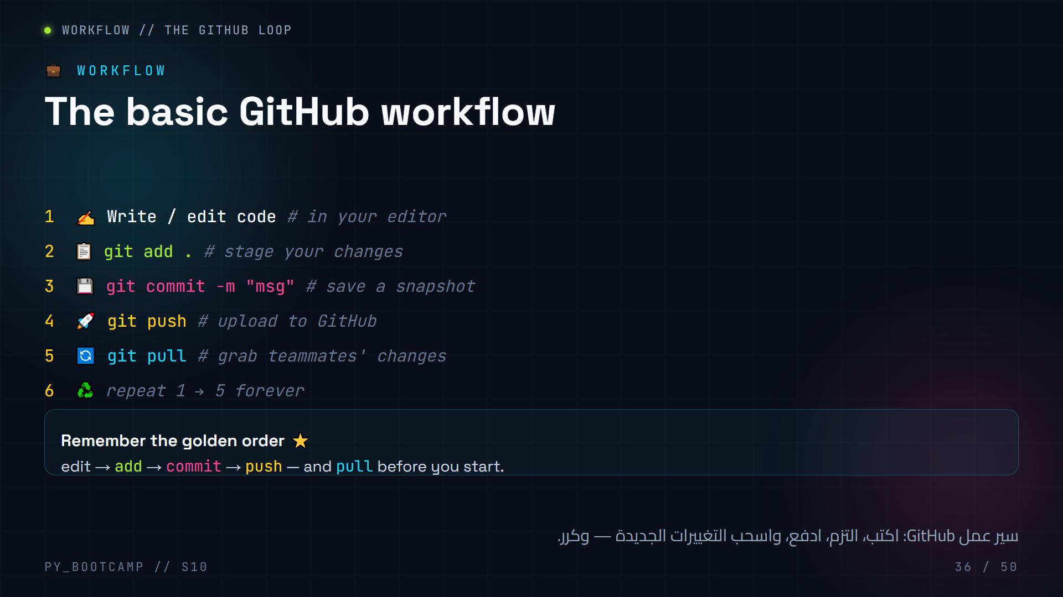
Notes:
**Slide 36 — GitHub workflow (3 min)**
- This is the routine students will live by. Drill it until it's reflex.
- Write the loop on the board: edit → add → commit → push, plus pull at the start.
- Emphasise pull-before-push to avoid the "rejected" error (we fix it on the troubleshooting slide).
- Compare to a game save + upload: save locally (commit), upload to cloud (push), download updates (pull).
- Arabic tip: اجعل الطلاب يرددون الإيقاع بصوت واحد: "عدّل، أضف، التزم، ادفع" حتى يحفظوه.

Slide 37
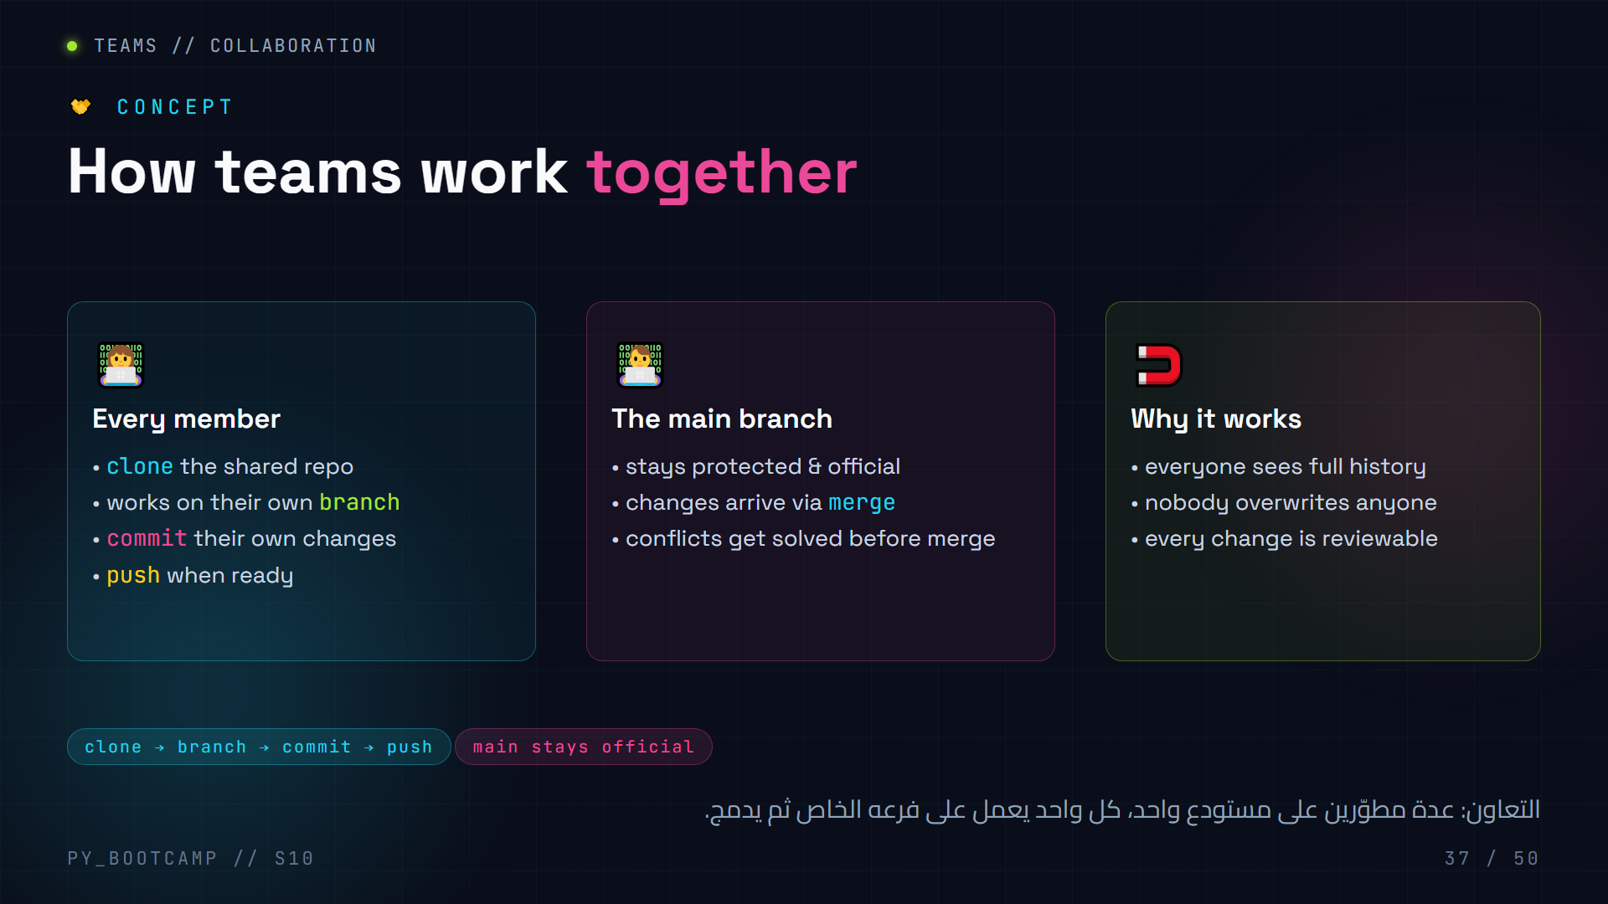
Notes:
**Slide 37 — Collaboration concept (3 min)**
- Real-world framing: at companies, hundreds of people work on one repo without stepping on each other.
- The recipe: every dev clones, branches, commits, pushes; the maintainer merges good work into main.
- Keep it light: we only INTRODUCE the concept — the pull-request workflow details are on slide 48–49.
- Arabic tip: اشرح المبدأ: "كل واحد في فرعه، والفرع السليم يندمج مع الرئيسي".
- No live demo here; the concept lands after they've pushed their own repo.

Slide 38
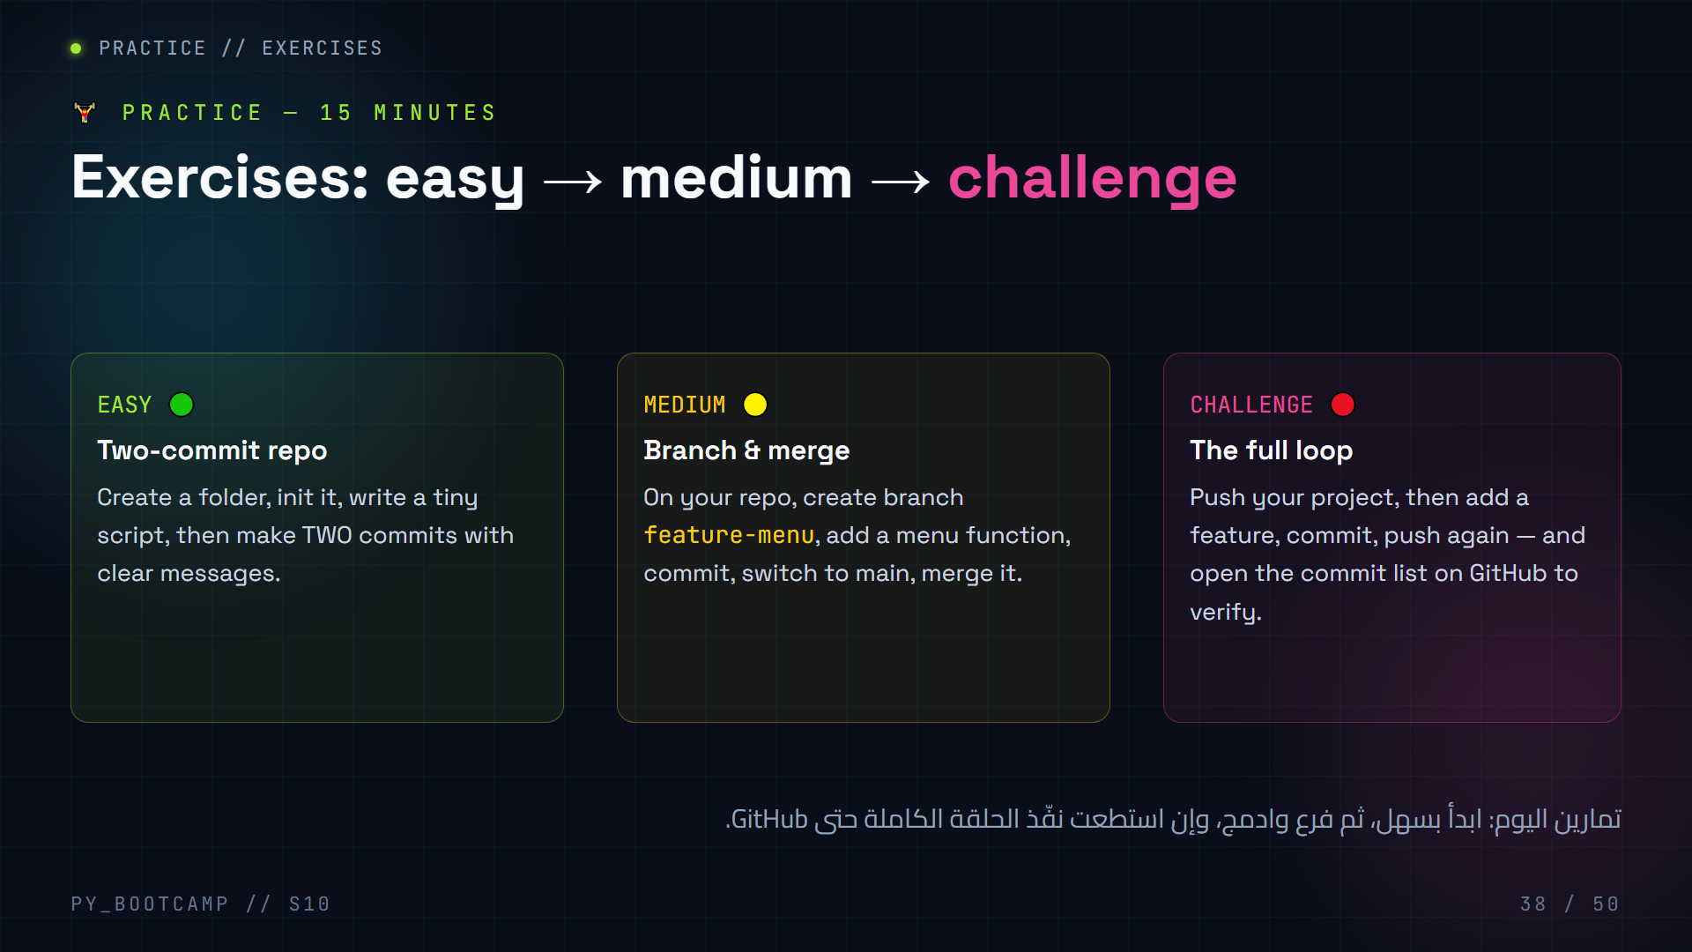
Notes:
**Slide 38 — Exercises (15 min)**
- Let students work at their own pace; the three levels keep everyone busy.
- Easy: check everyone completed two commits. Watch for "no commits yet".
- Medium: verify the branch was actually created (git branch shows feature-menu) and merged into main.
- Challenge: students push and open their GitHub commits tab — celebrate the log on screen.
- Circulate: fix "git commit without -m" (Vim panic) and "forgot to git add" (nothing staged).
- Arabic tip: شجع التنافس اللطيف: من ينهي التحدي أولاً يشرحه للبقية بالعربية.

Slide 39
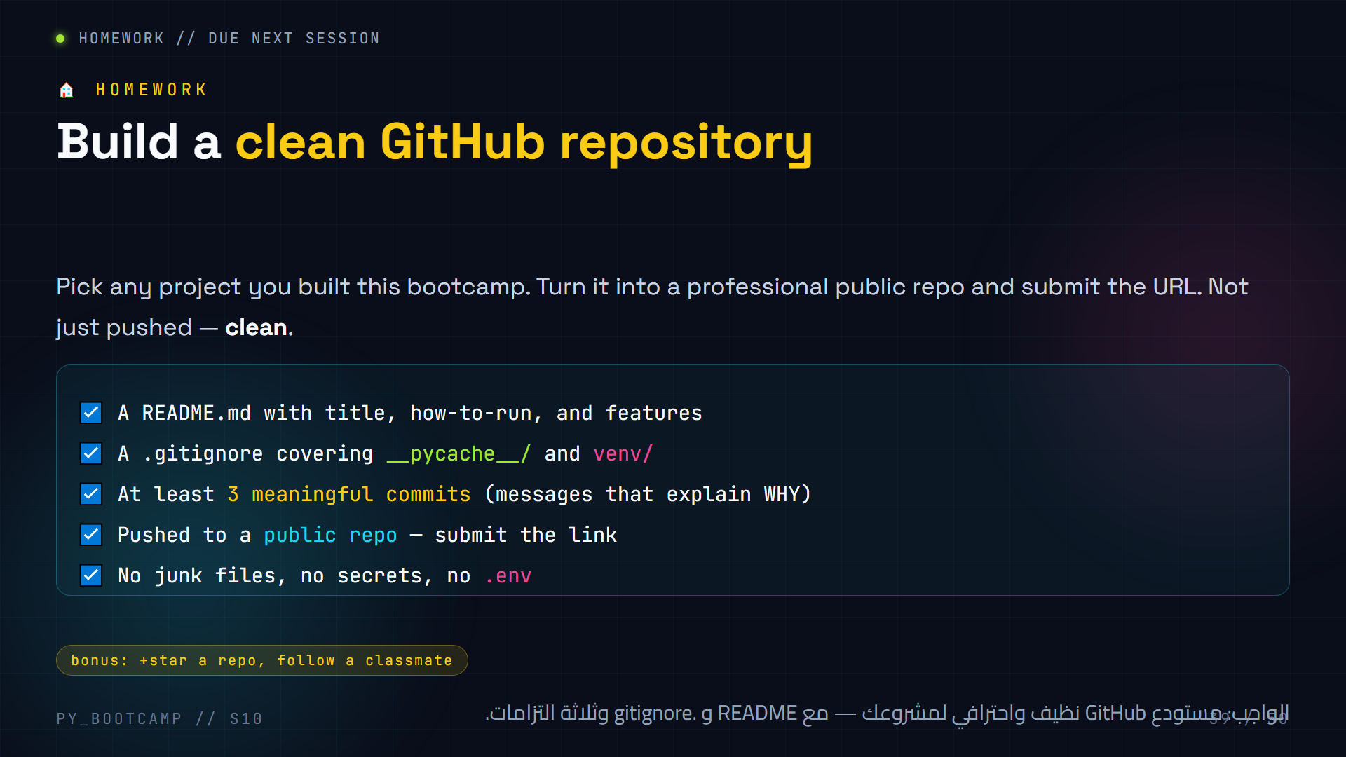
Notes:
**Slide 39 — Homework (2 min)**
- Deliverable is a URL — make the submission frictionless (a shared sheet or chat).
- Grading hints: README quality, .gitignore present, ≥3 clear commits, repo is public, no secrets/junk.
- Tell them this homework doubles as their first portfolio piece — quality over speed.
- Remind them to re-read their own README as a stranger would.
- Arabic tip: اشرح أن "نظيف" تعني: منظمة ملفات، رسائل واضحة، بلا أسرار وبلا ملفات مؤقتة.

Slide 40
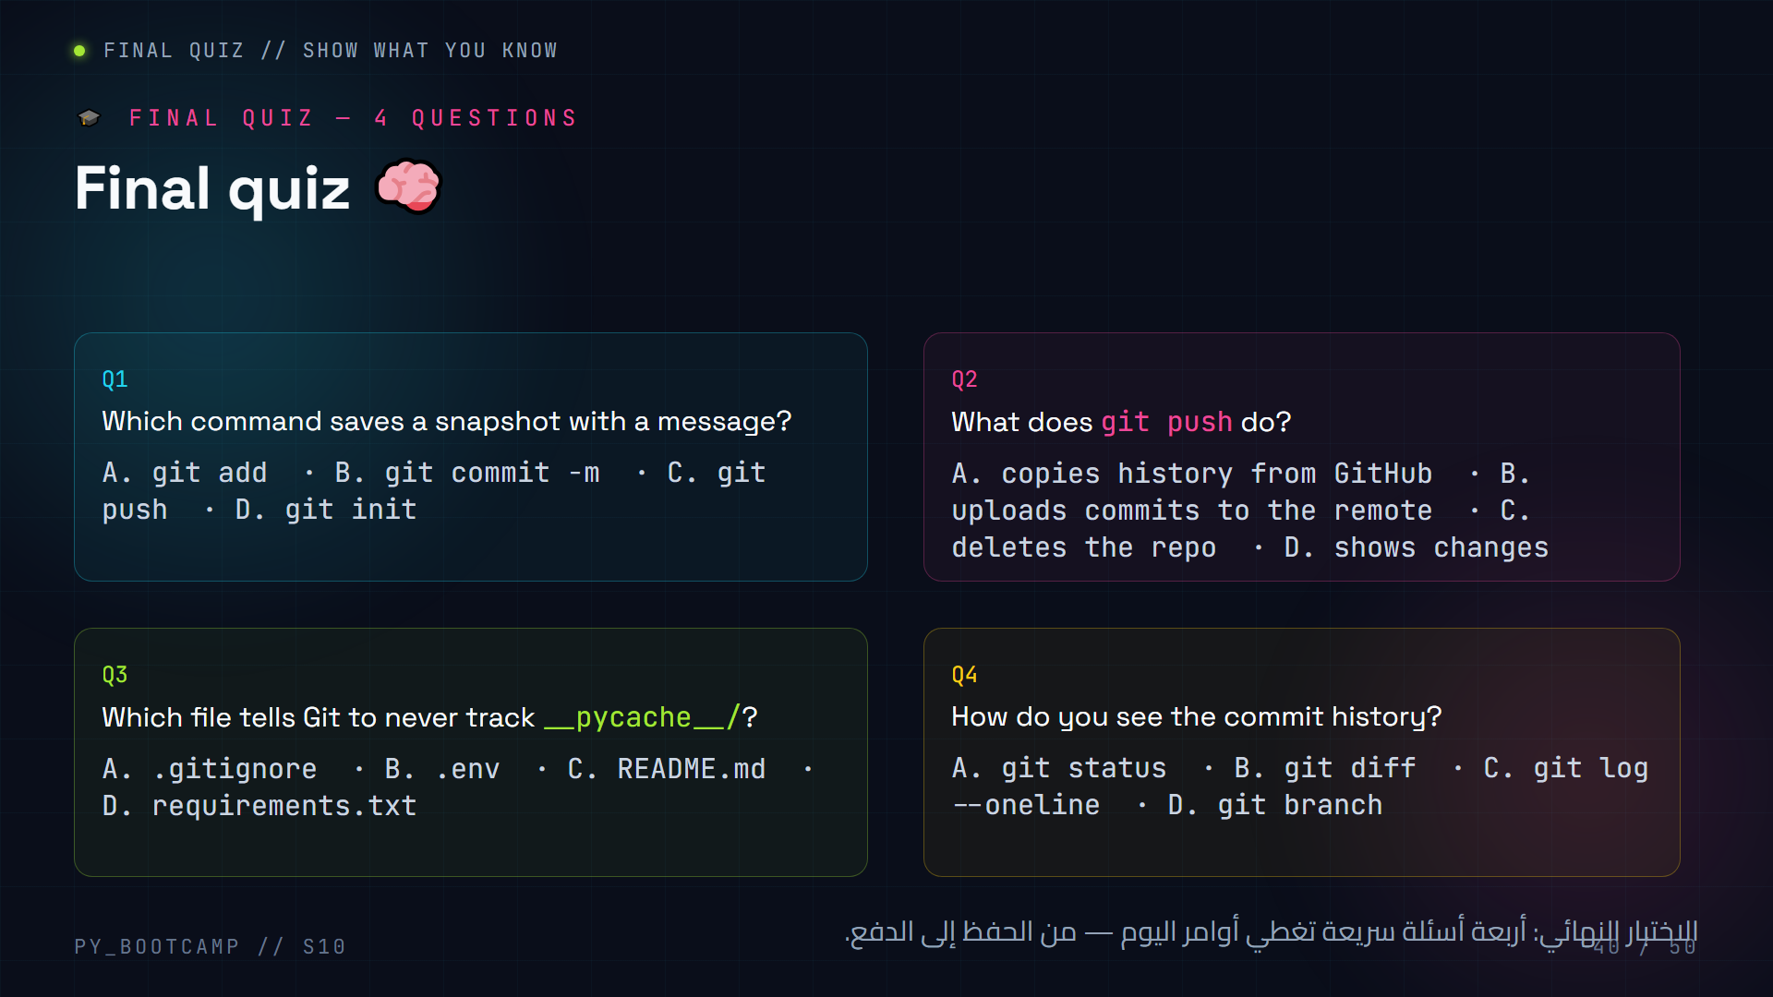
Notes:
**Slide 40 — Final quiz (5 min)**
- Run as a live poll, one question at a time.
- Answers: Q1 = B (`git commit -m`), Q2 = B (uploads commits to remote), Q3 = A (.gitignore), Q4 = C (`git log --oneline`).
- Explain each wrong option quickly (e.g. Q2 option A is actually `git pull`).
- If the class misses any question, revisit that slide briefly before moving on.
- Arabic tip: حوّل الاختبار إلى لعبة جماعية: كل إجابة صحيحة تسجل نقطة للفريق.

Slide 41
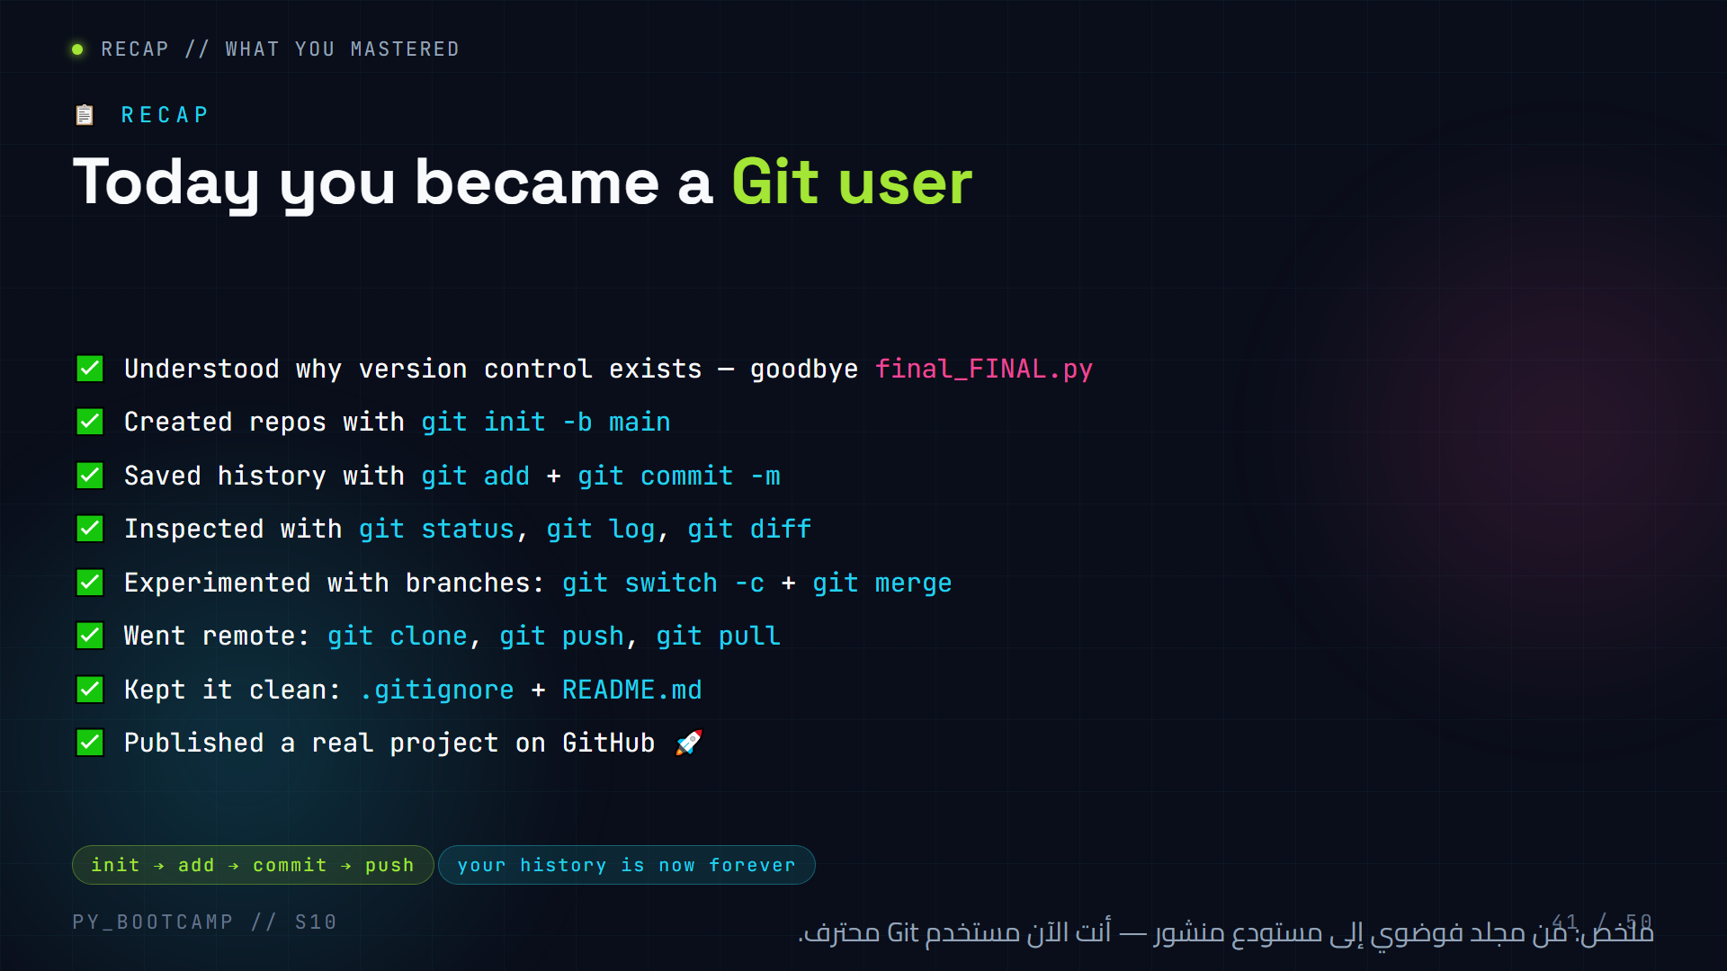
Notes:
**Slide 41 — Recap (2 min)**
- Speed-run the checklist with the class, letting them shout the commands back at you.
- Celebrate: everyone pushed a repo today. That is a real professional skill.
- Ask one "stand up if..." question: "Stand up if your project is live on GitHub right now."
- Arabic tip: لحظة فخر جماعية: "من وقف ومشروعه على GitHub؟" — كلهم يقفون.
- Bridge: "Git organises your history. Next, we organise your CODE — that's OOP."

Slide 42
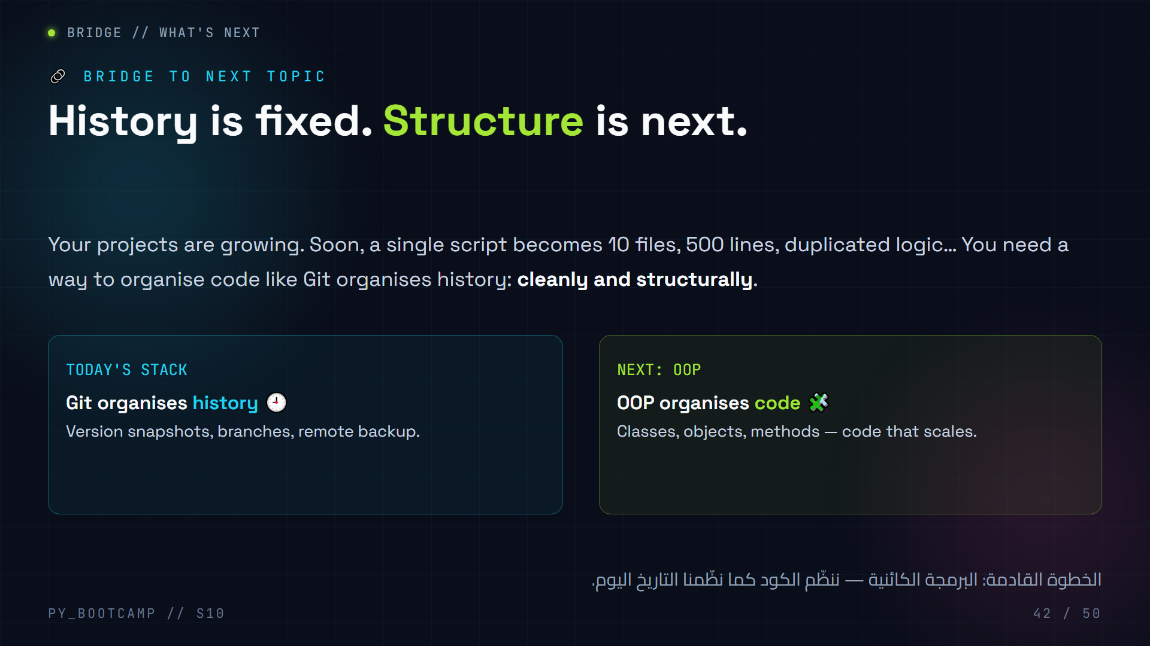
Notes:
**Slide 42 — Bridge to OOP (2 min)**
- Connect: today = organisation of TIME (history). Next = organisation of CODE.
- Ask the room: "Who has a project that got messy as it grew?" — plenty of hands.
- Promise: OOP makes big projects feel small again by grouping data + actions into classes.
- Mention: your new GitHub repo is the perfect place to publish OOP projects next session.
- Arabic tip: اشرح الربط: "اليوم نظمنا التاريخ، والأسبوع القادم ننظم الكود نفسه."

Slide 43
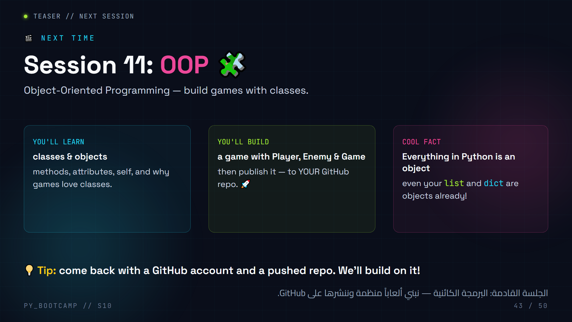
Notes:
**Slide 43 — Teaser (1 min)**
- Sell it: "Your games will go from one big script to clean objects you can reuse."
- The "everything is an object" fact usually blows minds — use it to create curiosity.
- Concrete promise: next session ends with another published OOP game on their repo.
- Arabic tip: اخلق حماساً: "الأسبوع القادم ستنشئ الأعداء في لعبتك ككائنات حقيقية!"

Slide 44
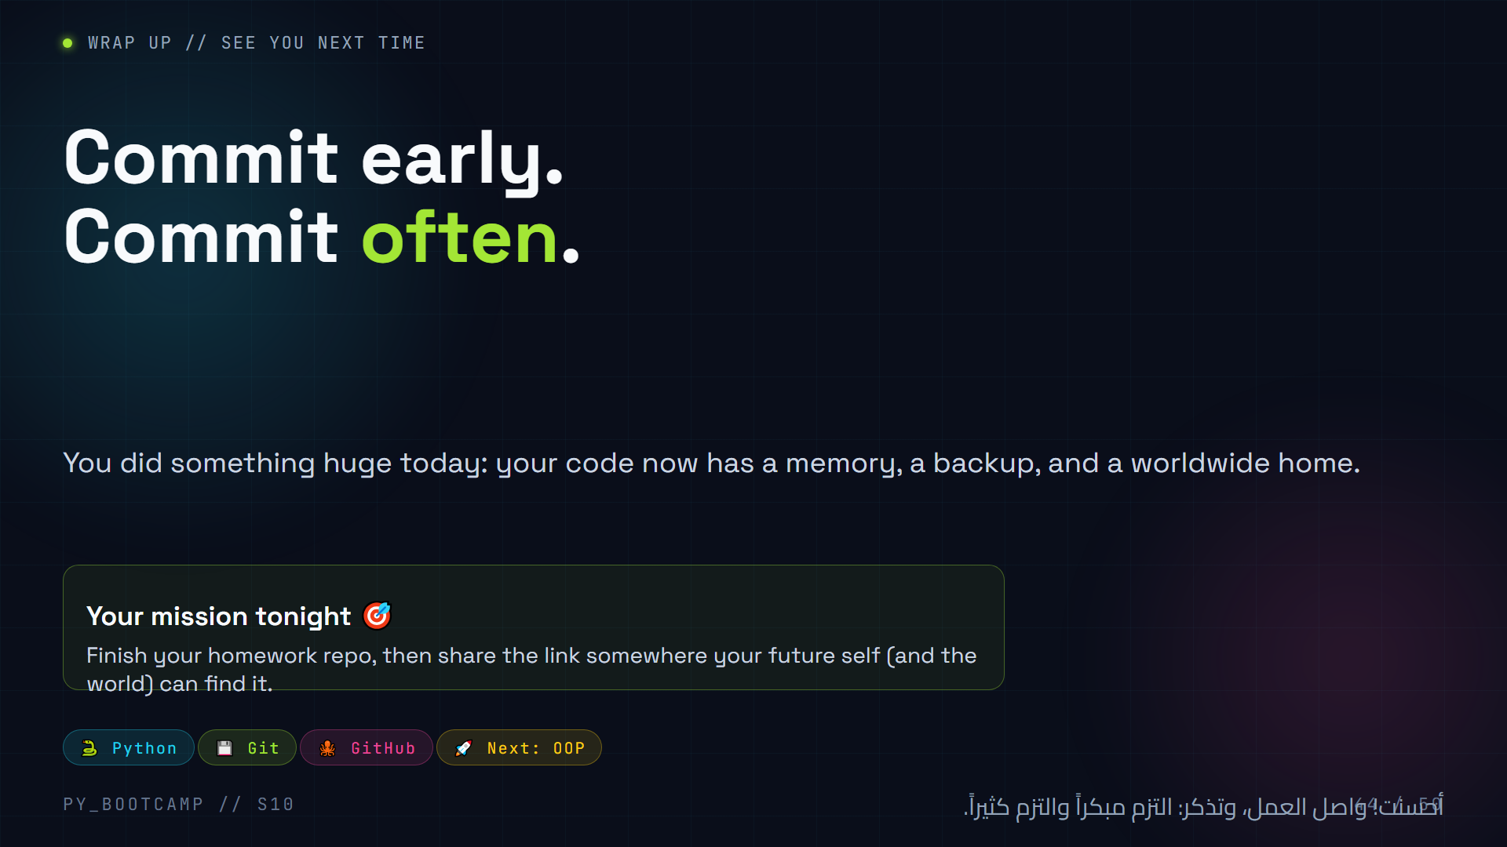
Notes:
**Slide 44 — Closing (1 min)**
- Read "Commit early. Commit often." slowly — that is the session's motto.
- Celebrate loudly. If possible, show the class repo collection (links on a shared board).
- Tonight's mission: homework + share the link.
- Arabic tip: أنهِ بكلمة "أحسنت" والعبارة الختامية: "كل التزام يقربك من أن تكون مبرمجاً محترفاً".

Slide 45
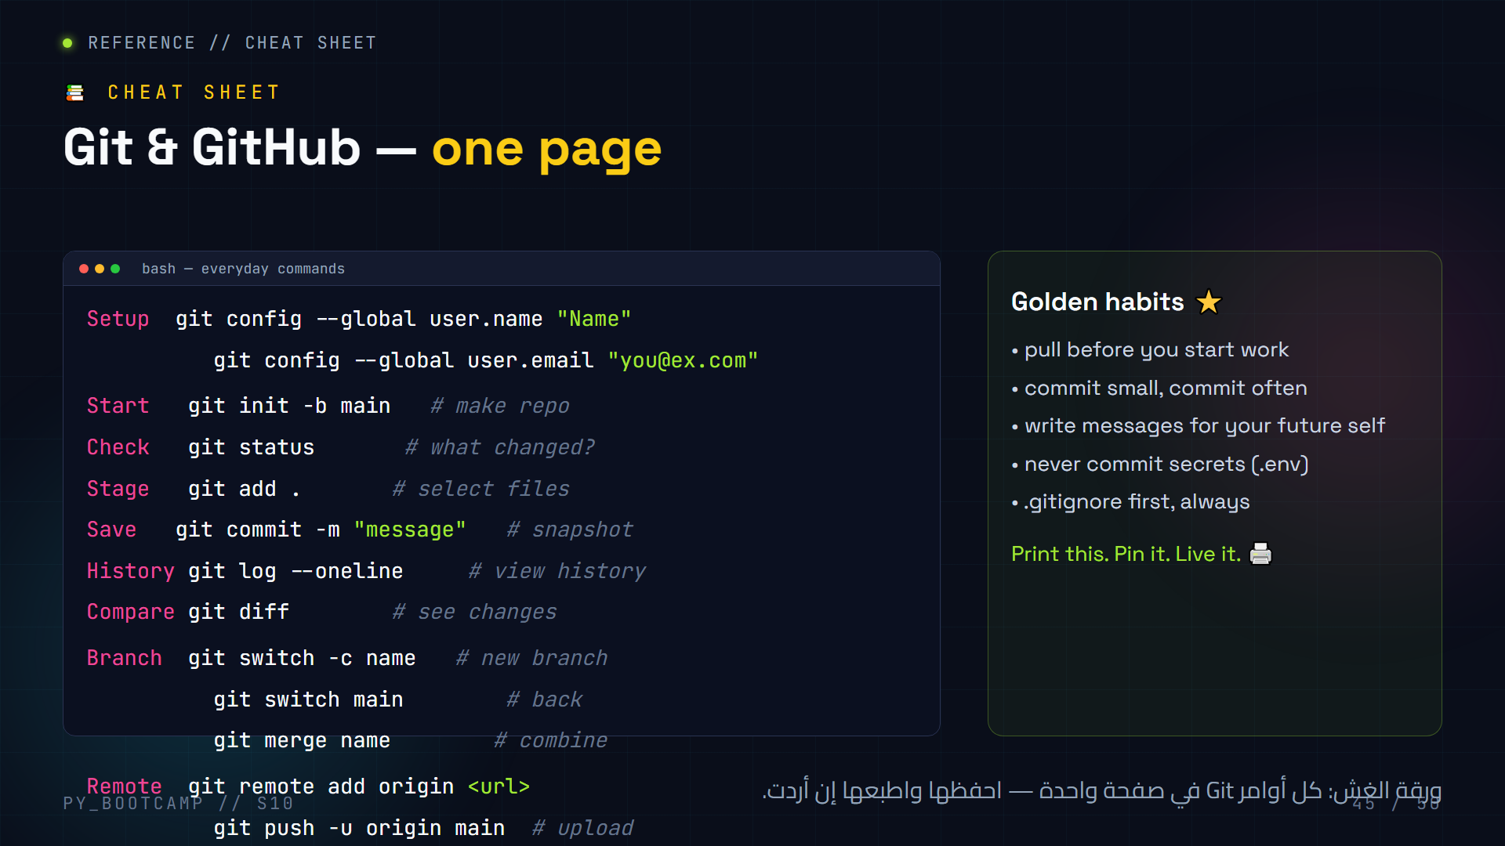
Notes:
**Slide 45 — Cheat sheet (hand-out, 1 min)**
- Have students screenshot this slide or copy the block — it's their take-home reference.
- Go down the list once at speaking pace; no explanation needed, just pointing.
- Reiterate the golden habits line as the takeaway.
- Arabic tip: شجعهم على وضع هذه الأوامر كخلفية أو ملصق بجانب الحاسوب خلال الأسبوع.
- Note: this stays on screen while the extended labs (46–50) follow; it's a great reference during them.

Slide 46
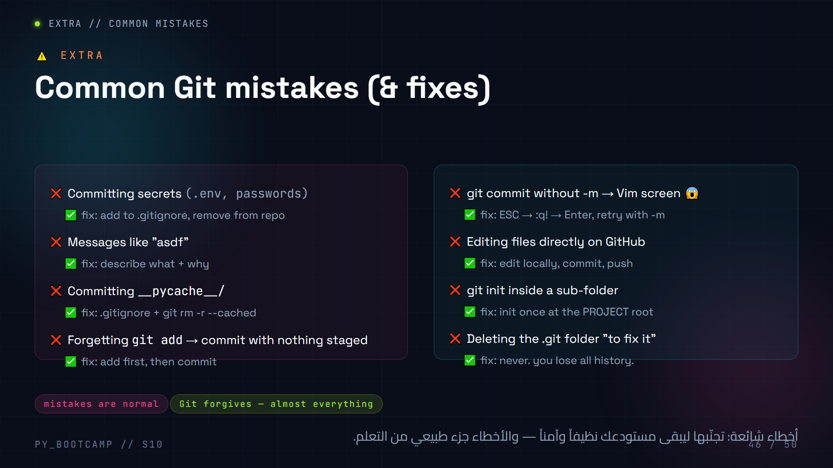
Notes:
**Slide 46 — Common mistakes (3 min)**
- Read each mistake like a confession students already know ("who has done #4? hands up").
- The Vim panic is the funniest and most common — demo it once so they're not afraid.
- `git rm -r --cached __pycache__` = untrack without deleting files (only if they already committed cache).
- Message: "Every mistake here is a badge of learning. You'll all hit several today."
- Arabic tip: اطمئنهم: "الخطأ ليس فشلاً؛ كل المبرمجين المحترفين وقعوا في الـ Vim يوماً ما".

Slide 47
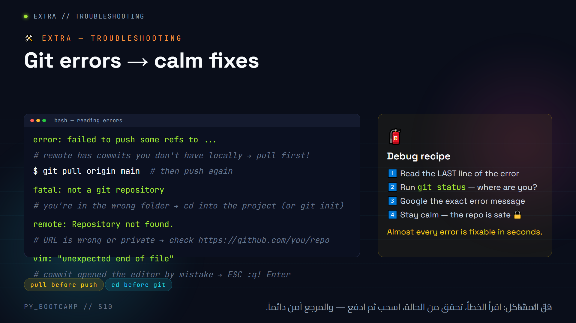
Notes:
**Slide 47 — Troubleshooting (4 min)**
- Live-demo the "failed to push" fix: two students push from different clones, second one hits the error, we pull then push.
- The #1 fix ("pull origin main") resolves the vast majority of beginner errors.
- "fatal: not a git repository" is almost always being in the wrong folder — demonstrate `pwd`/`ls`.
- Reassure: Git protects your data; even "failed" pushes never lose commits.
- Arabic tip: علّمهم العادة: عند أي خطأ → git status أولاً، ثم اقرأ آخر سطر من الخطأ.

Slide 48
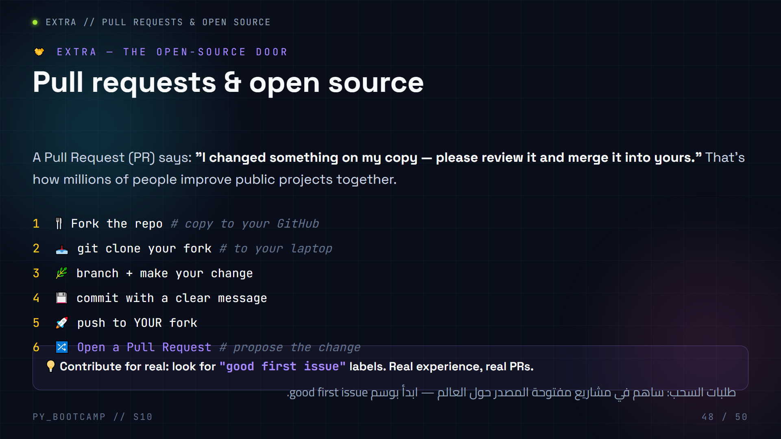
Notes:
**Slide 48 — Pull requests & open source (4 min)**
- Explain PR simply: "ask permission to merge your branch into someone else's repo."
- The fork→clone→branch→commit→push→PR flow is the standard open-source loop.
- Emphasise labels: `good first issue` = beginner-friendly tasks on real projects.
- Motivation: your first PR to a real open-source project is a legendary moment for a junior dev — put it on your CV.
- Arabic tip: عرّف المصطلحات: Fork = نسخة من المشروع في حسابك، وPR = طلب دمج تغييراتك.
- Next slide is the live version of this exact flow.

Slide 49
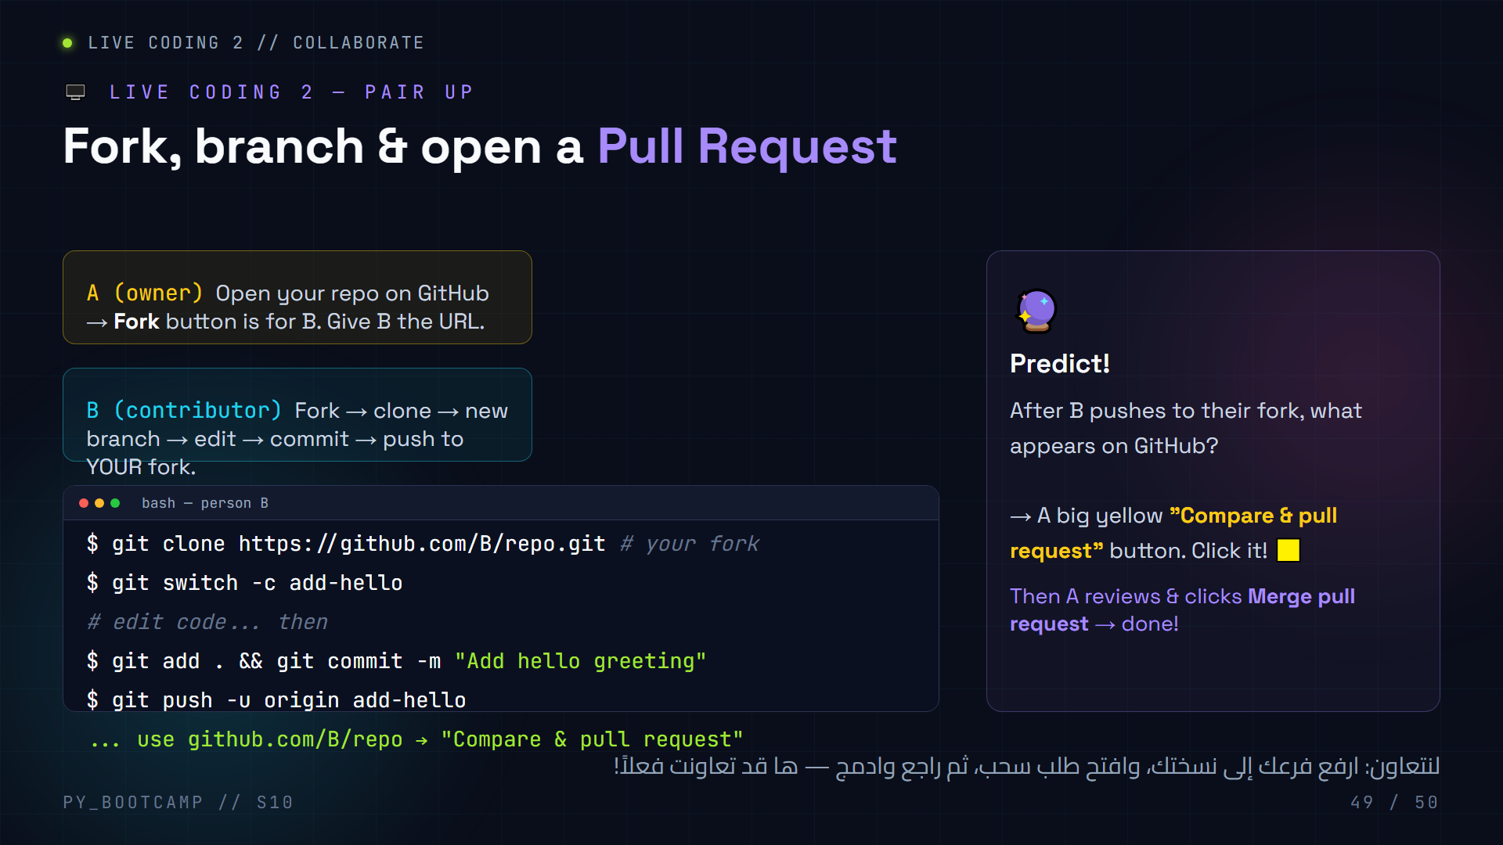
Notes:
**Slide 49 — LIVE CODING 2: collaborate via PR (15 min, optional/extra)**
- Pair students A & B. A is repo owner, B is contributor.
- B's flow: fork on GitHub → clone fork → `git switch -c` → edit → commit → push to fork.
- PREDICT moment: after push, GitHub shows the yellow "Compare & pull request" button on B's fork page (and as a banner on A's repo page).
- A reviews the PR (looks at the diff), clicks Merge. Celebrate the first PR merge!
- If time is short, do it as ONE live demo with the projector instead of pairs.
- Arabic tip: هذا الدرس يجعلهم يشعرون بالاحتراف: "أنت الآن تساهم في مشروع زميلك".
- Time check: if running late, compress this to a demonstration only.

Slide 50
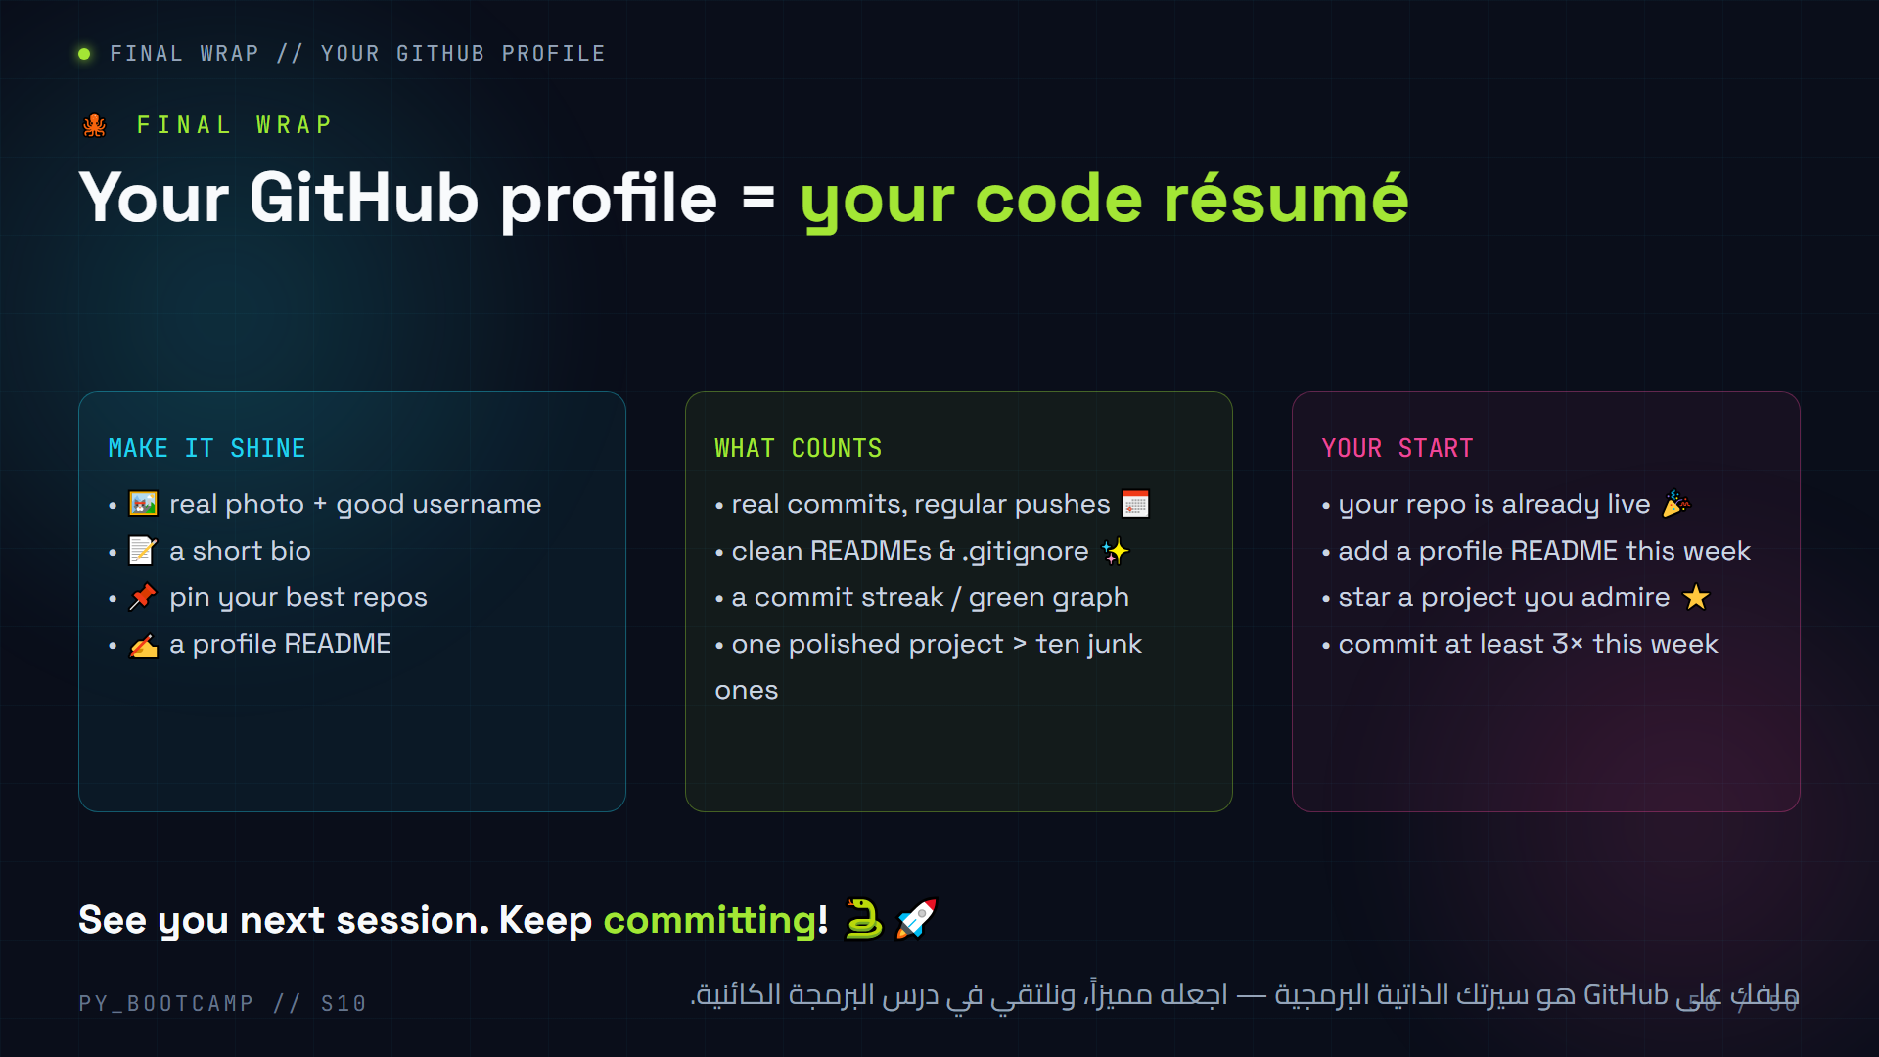
Notes:
**Slide 50 — GitHub profile = CV (3 min)**
- Frame: recruiters and teammates check your GitHub. Make it look like you.
- Profile README tip: create a repo named exactly `username/username` → GitHub renders it on your profile.
- The green contribution graph rewards consistency — small regular commits beat one giant push.
- Challenge: one polished project (today's!) already beats 99% of beginners.
- Arabic tip: اربط بين المكافأة والواقع: "الالتزام المنتظم كل أسبوع = ملف إنجازات ينمو معك".
- Close the session with energy; remind them of the homework URL submission.

