Slide 1
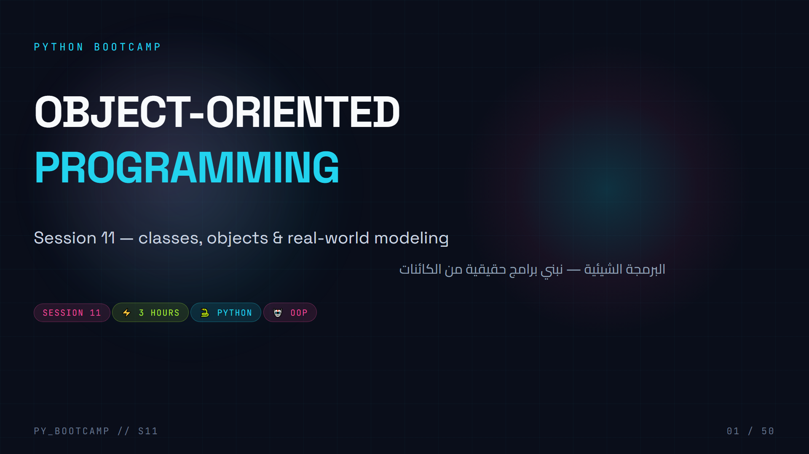
Notes:
**Welcome / hook (2 min):** "Up until now you've been writing *scripts* — today you learn to build *software*. Everything that matters in Python — pandas, Django, pygame — is built from classes."
- Say the arc out loud: 3 hours = ~1h theory, ~1h live project (PyBank), ~1h practice + quiz.
- Big energy moment: this is the session where they "level up" from functions to objects.
- Arabic tip: the term is «البرمجة الشيئية» (or الكائنية); tell them to remember "صنف/كائن" = class/object — we will use them constantly.
- Optional: poll the room — who has heard of OOP before? Who has ever used `class`?

Slide 2
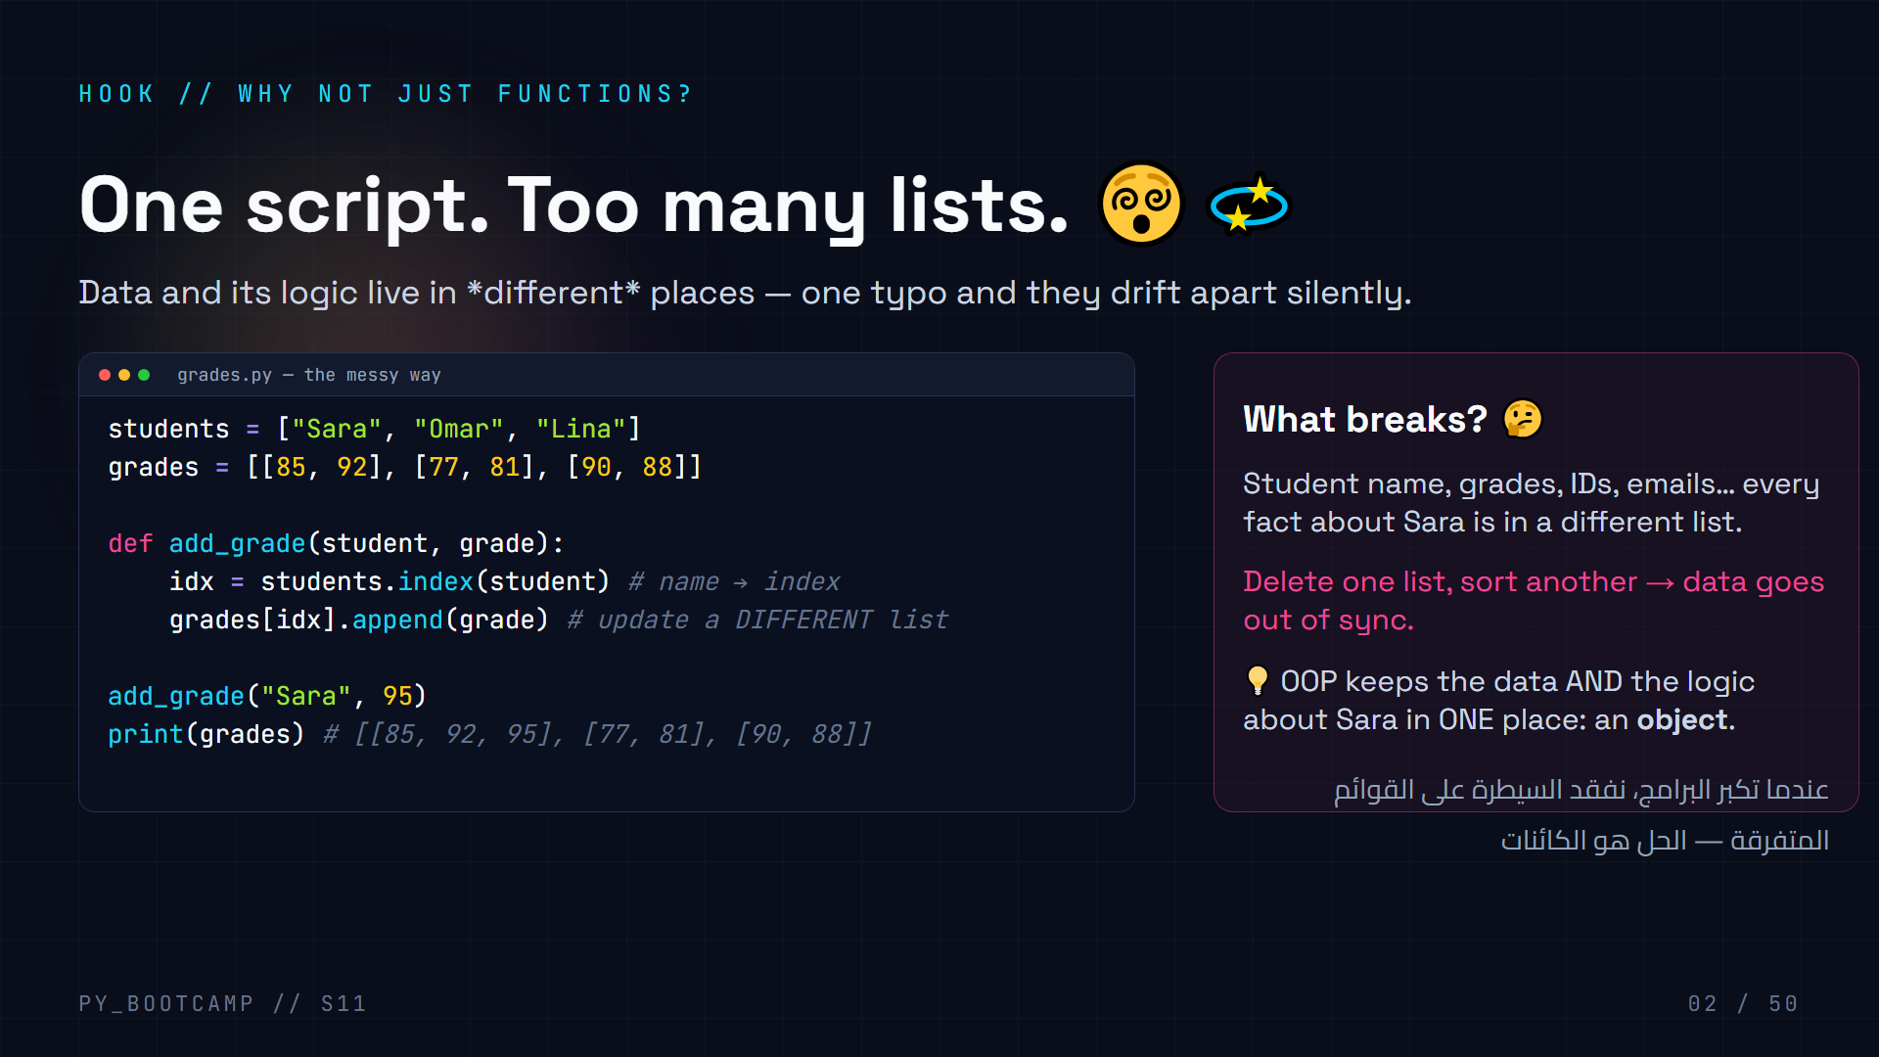
Notes:
**Teaching script:** Walk the code line by line. The bug is *structural*: `students` and `grades` must stay perfectly aligned, but nothing enforces it.
- Ask: "What happens if someone sorts `students` alphabetically but forgets `grades`? 💥"
- Ask: "What if Sara changes her name? We'd need to update every list."
- Foreshadow: "A class puts Sara — her name, her grades, and her average() — in one box that can't drift apart."
- Arabic tip: «كل شيء عن الطالبة في مكان واحد» — this is the *spirit* of OOP.
- Transition: "Let's see why OOP was invented at all."

Slide 3
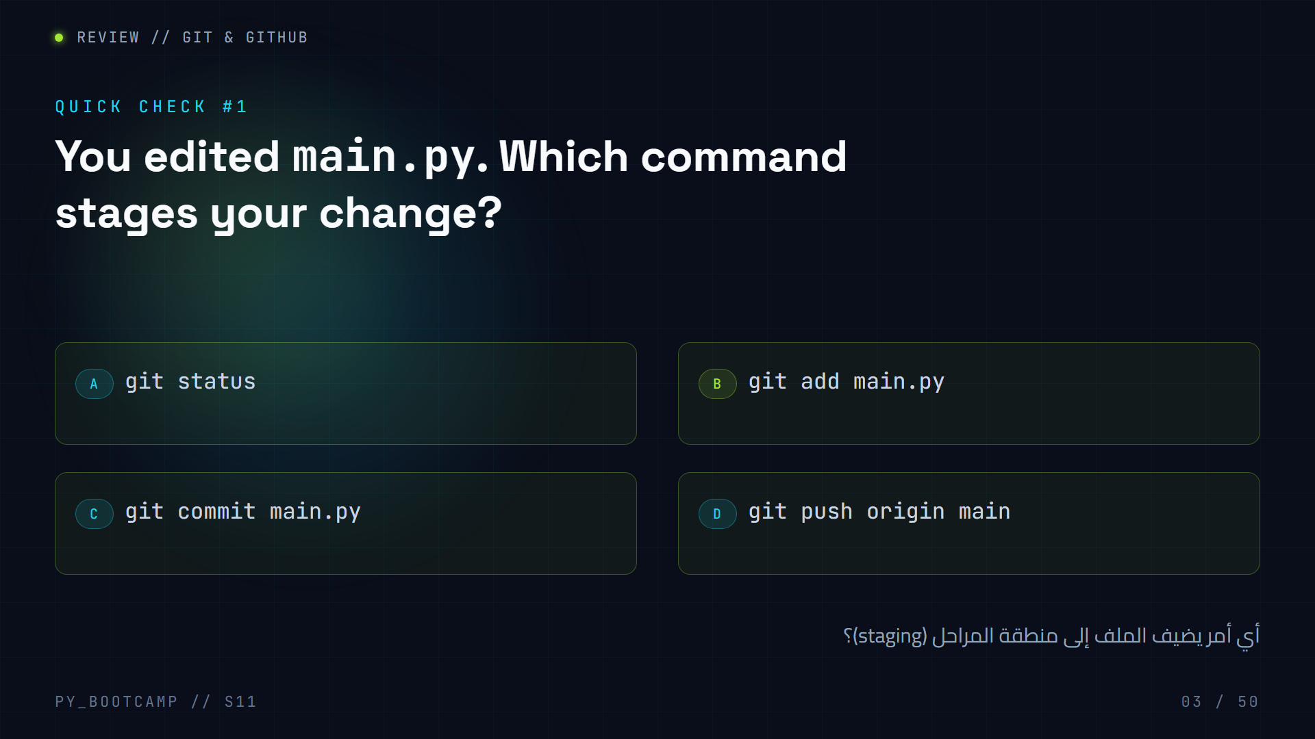
Notes:
**Answer: B — `git add main.py`.** `add` puts changes into the staging area; `commit` snapshots them; `push` uploads; `status` only shows state.
- Recap the pipeline on the board: **working dir → `git add` → staging → `git commit` → local → `git push` → remote**.
- Common confusion: students try to `commit` directly. Remind them: commit only commits *staged* changes.
- Tip: `git add .` stages everything; `git add main.py` stages one file.
- Arabic tip: «المرحلة» = staging area — like a shopping cart before checkout.
- Move on: "You remember Git — we'll use it in homework to ship the Library project."

Slide 4
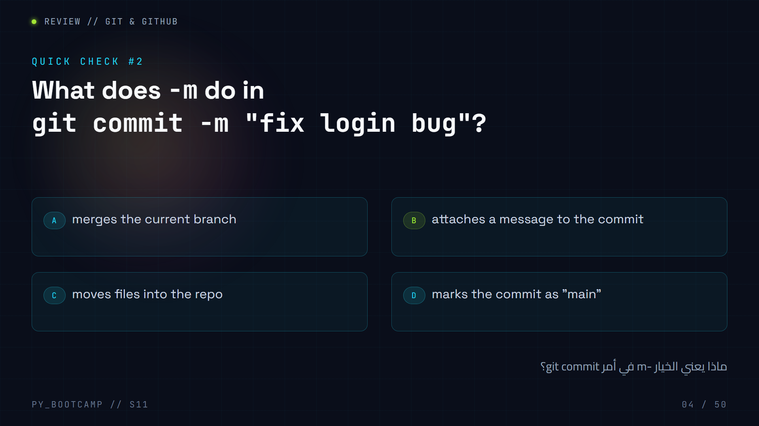
Notes:
**Answer: B — `-m` = message.** Every commit needs a message explaining *what* changed (and ideally *why*).
- Demo: run `git commit` without `-m` → it opens an editor (confusing for beginners!). `-m` keeps it one-liner friendly.
- Best practice: short, imperative message: `git commit -m "fix login bug"`.
- Arabic tip: «رسالة الـ commit» — اكتبها واضحة حتى يفهمها فريقك لاحقًا.
- Bridge: "Next one — staying in sync with teammates."

Slide 5
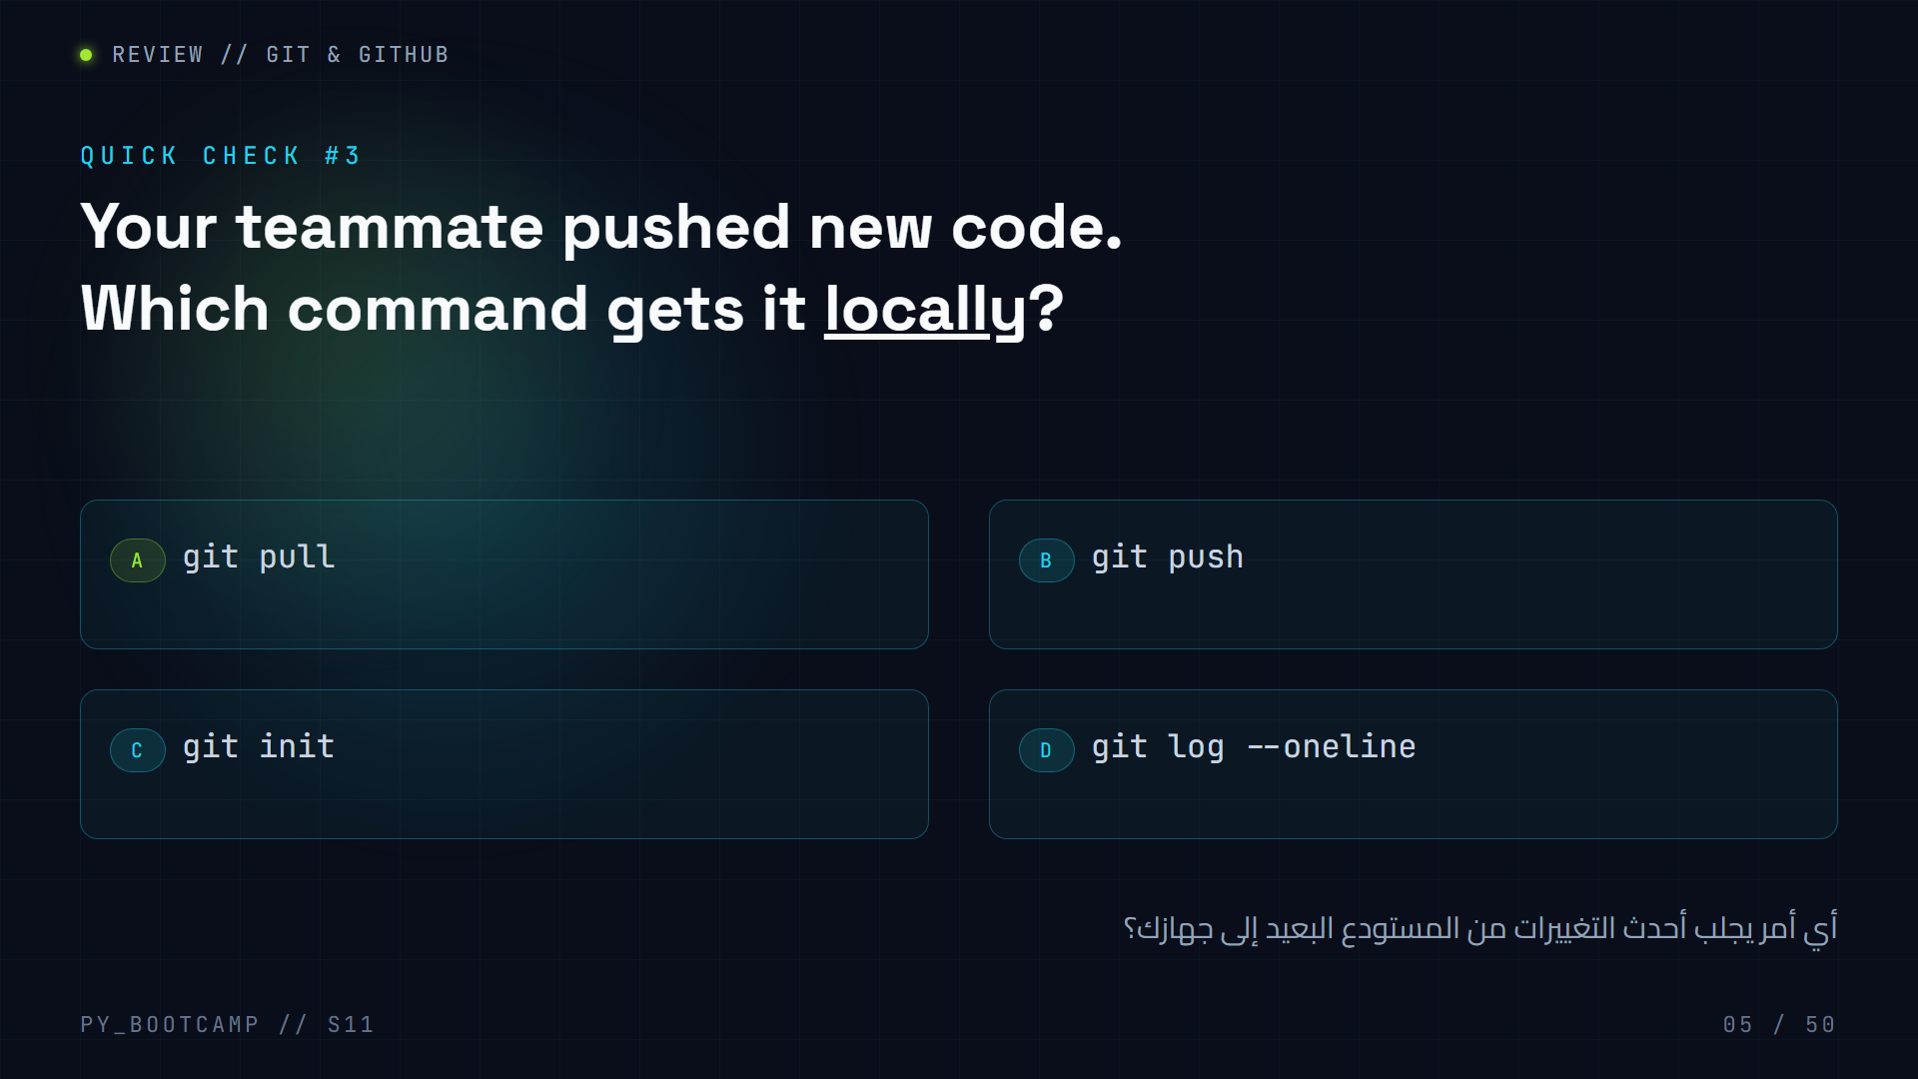
Notes:
**Answer: A — `git pull`.** `pull` downloads remote changes (fetch) and merges them into your branch. `push` is the opposite direction.
- Memory hook: **push = upload, pull = download.**
- `git log --oneline` only *reads* history — it never changes your files.
- Warn them: pull before you start working each day to avoid merge conflicts.
- Arabic tip: «الدفع» push و«السحب» pull — تذكّر: الدفع يرسل، والسحب يستلم.
- Transition to today: "Git is your safety net for the Library homework. Now — objects."

Slide 6
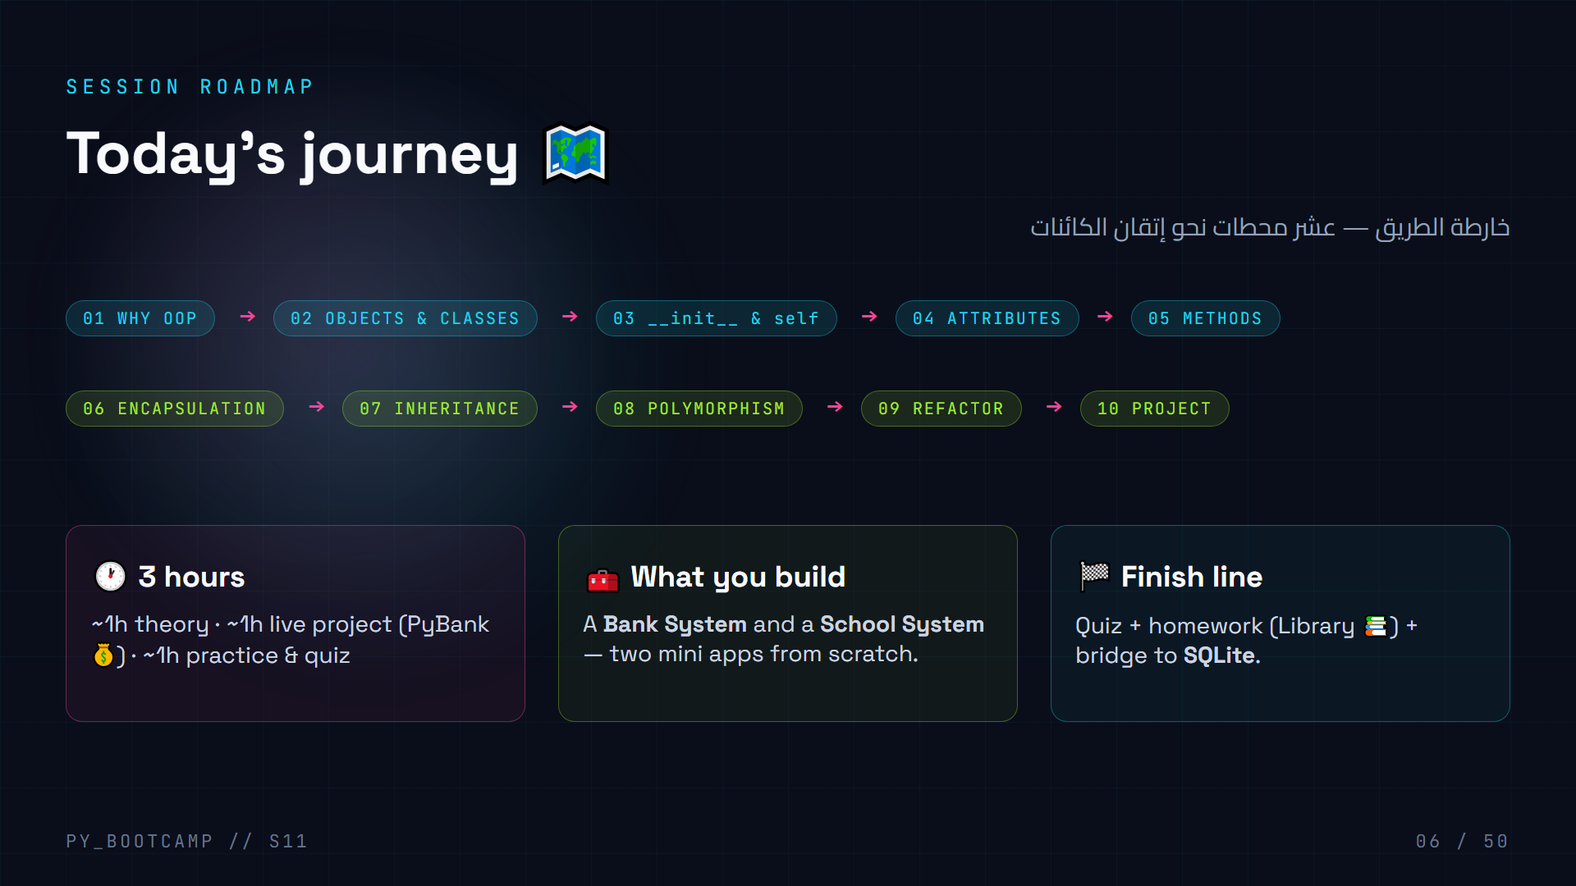
Notes:
**Orientation slide.** Read the roadmap out loud so students can track where they are.
- Promise them: "By the end, you'll build two apps and understand 90% of how big Python projects are structured."
- Note the arc: first 5 stops are vocabulary, next 3 are the big principles (encapsulation, inheritance, polymorphism), then we refactor, then we build.
- Arabic tip: «المحطة» = station — we stop at each one today.
- Keep this slide under 1 minute — it's a map, not the lesson.

Slide 7
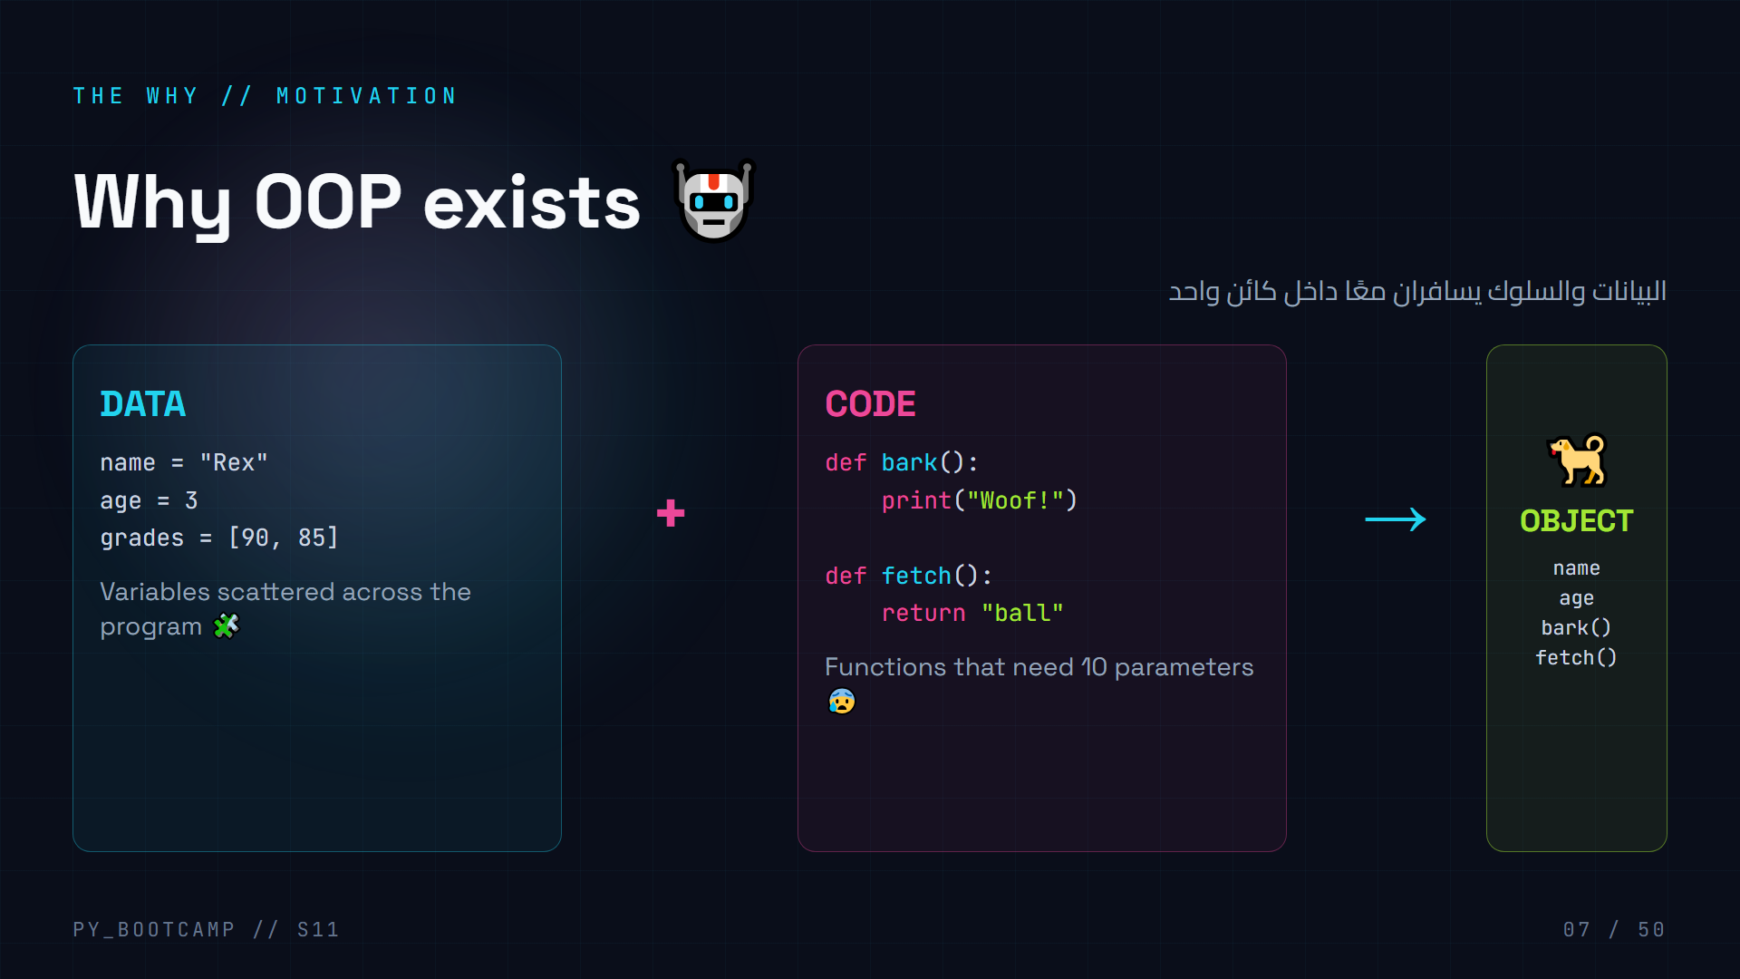
Notes:
**Core idea of the session.** OOP exists because real things bundle data AND behavior.
- Analogy: a dog isn't just "a name" in one list and "bark" in another file. The dog is the name + the bark together.
- Contrast with what they know: procedural code = data in variables, behavior in functions, connected by *convention* (you must remember which function edits which list). OOP = the connection is structural.
- History note (30s): OOP grew out of simulation projects in the 60s (Simula) — modeling real-world entities.
- Arabic tip: «البيانات والسلوك في صندوق واحد» = data and behavior in one box.
- Ask: "Can you think of a program that models things with state?" (bank, game player, library book).

Slide 8
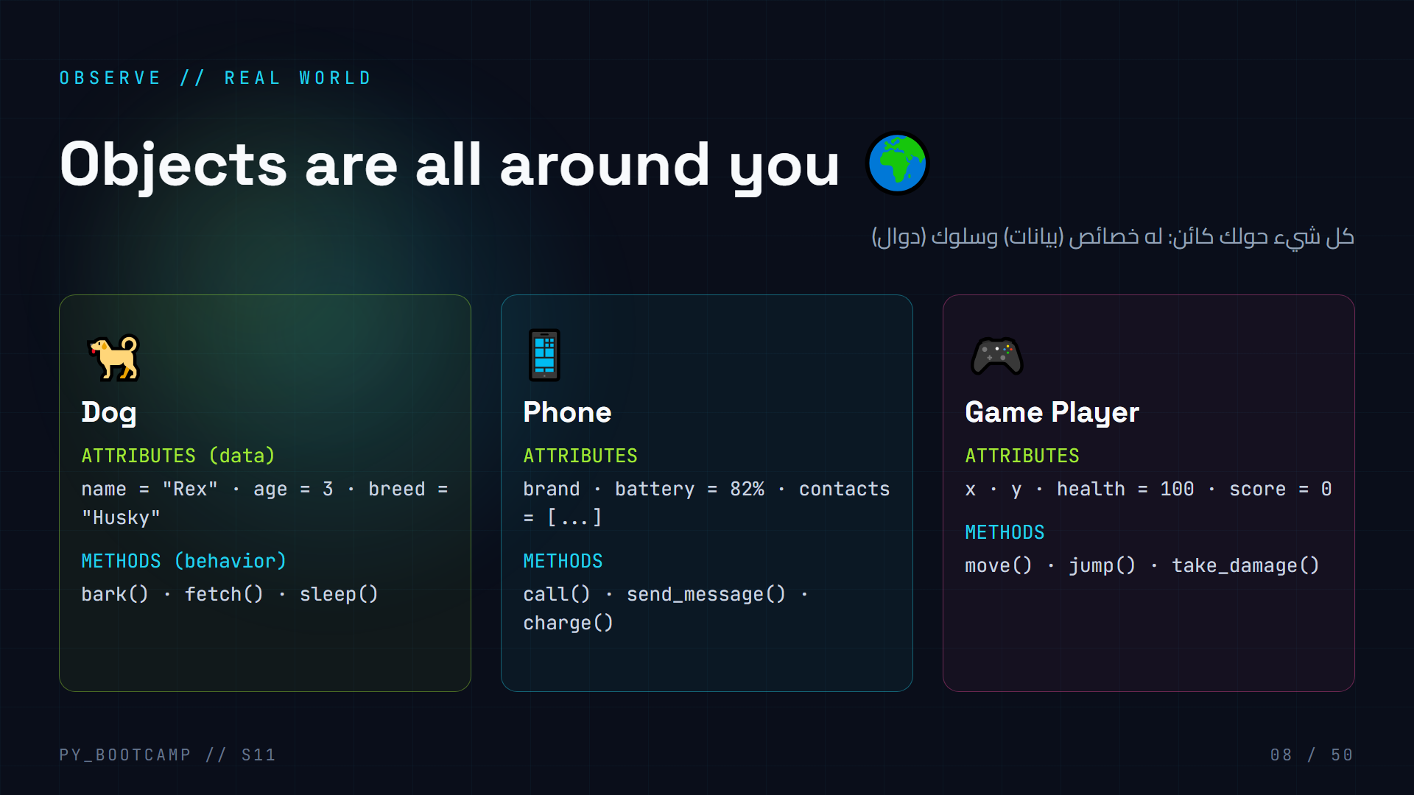
Notes:
**Pattern-spotting slide.** Every real object has *attributes* (nouns — data) and *methods* (verbs — behavior).
- Have the class shout examples: "A car! A book! A pizza! A student!" then pick one and enumerate its attributes + methods together.
- This slide plants the vocabulary: **attribute = property/خاصية**, **method = behavior/سلوك**.
- Rule of thumb they'll reuse: "If you can describe it with adjectives → attribute. If it's something it does → method."
- Arabic tip: الخصائص (attributes) نتعامل معها كصفات، والسلوك (methods) كأفعال.
- Transition: "Great — now the two words that unlock all of this: class vs object."

Slide 9
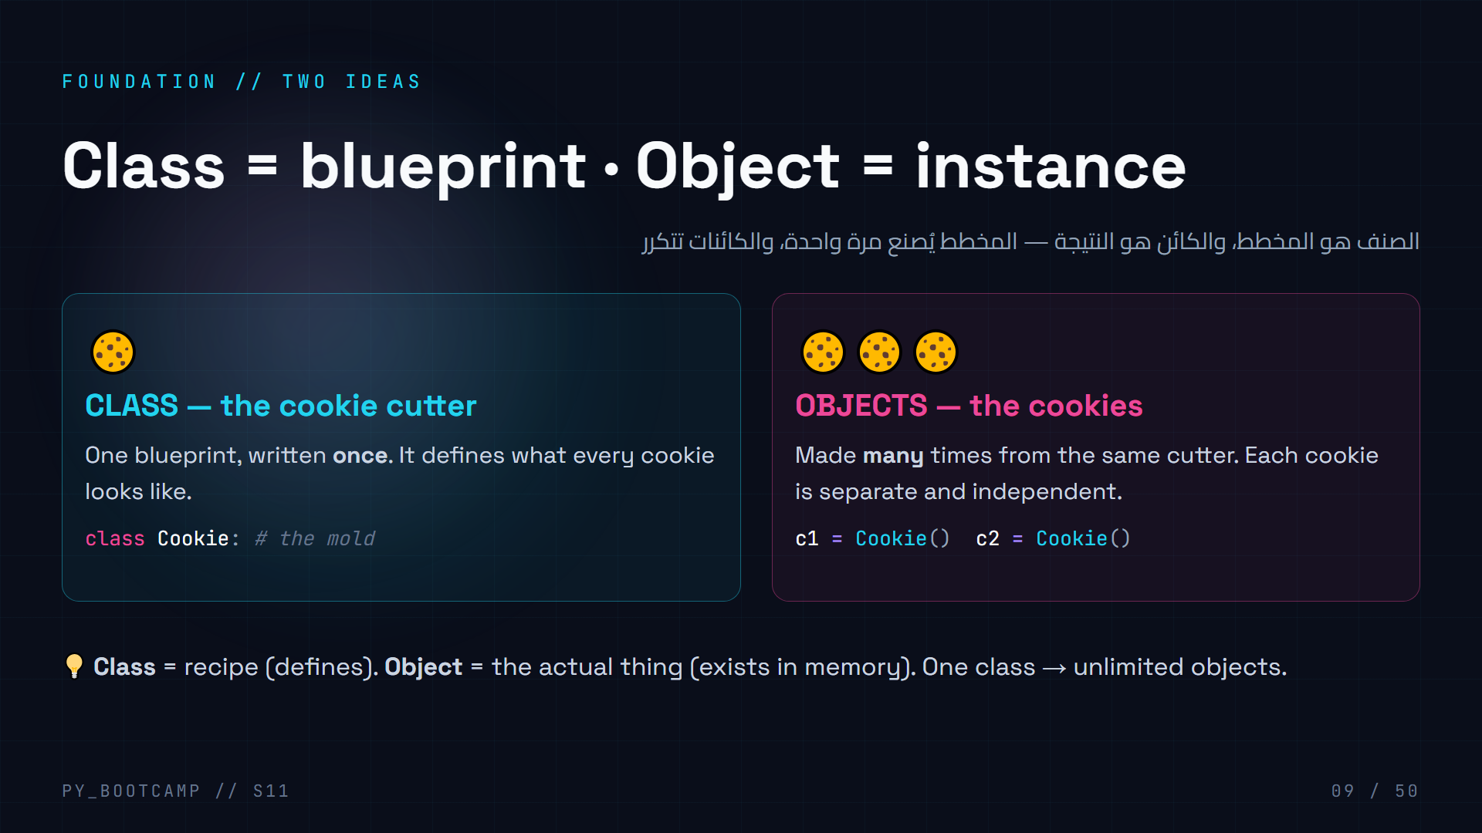
Notes:
**The single most important distinction of the session: class vs object.**
- Cookie cutter analogy works well — the cutter is the class, each cookie is an object. Same shape, different cookies.
- Alternate analogies: house blueprint vs the houses; car design vs the cars on the road; game character template vs the actual character you control.
- Key sentence to memorize: "A class is a blueprint; an object is something built from it."
- Arabic tip: «الصنف = المخطط، الكائن = الناتج» — repeat it aloud.
- Check for understanding before moving on — everything else builds on this.

Slide 10
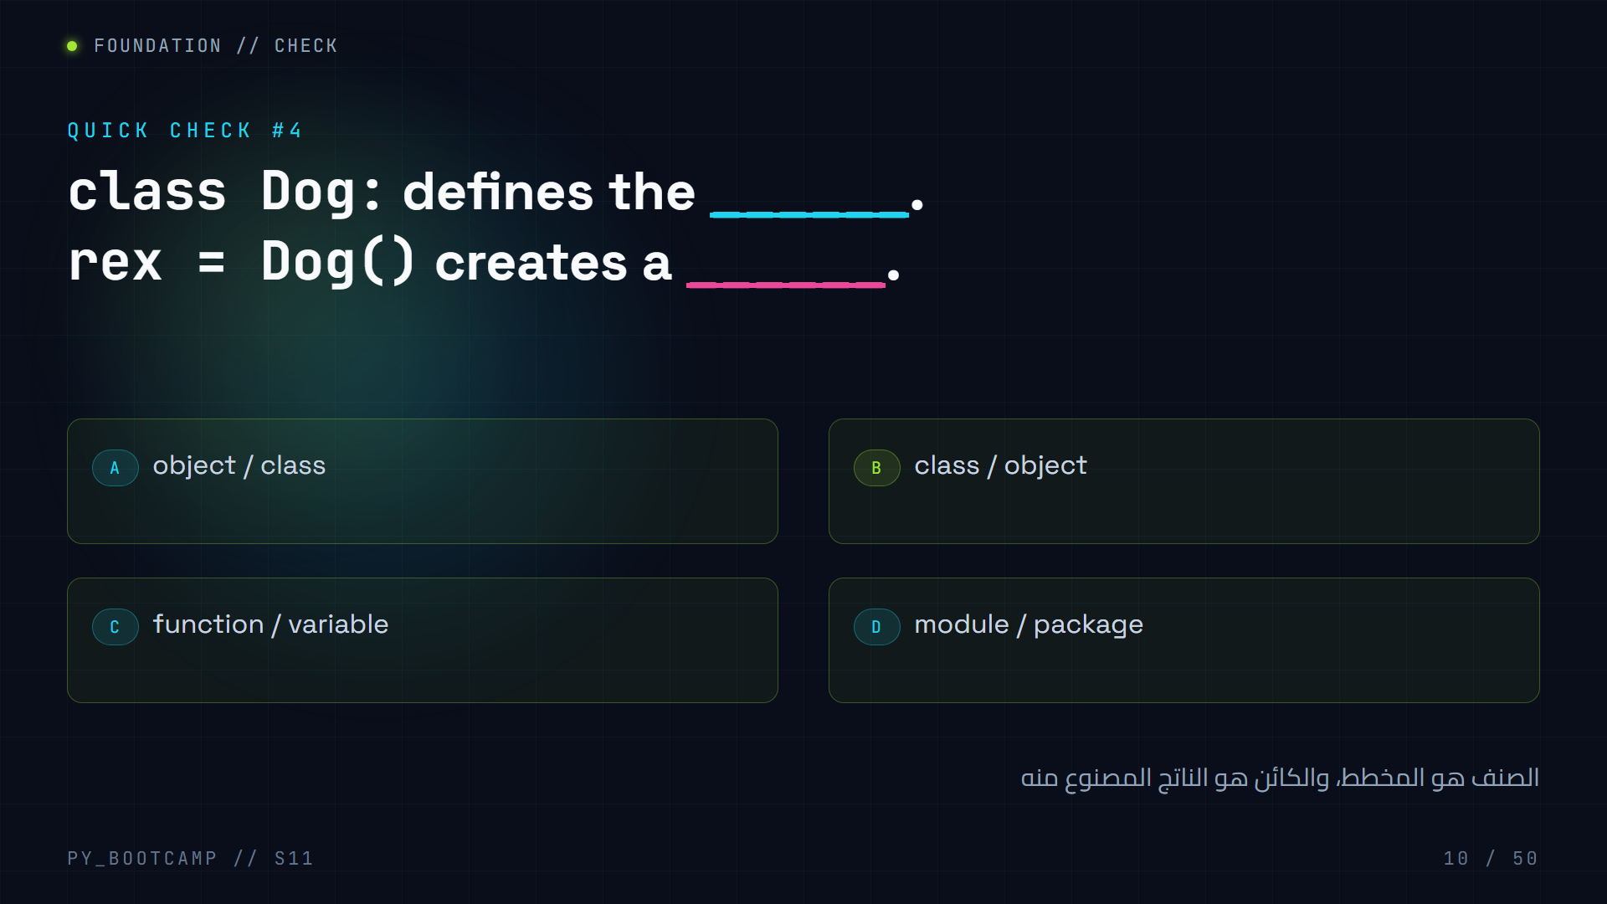
Notes:
**Answer: B — class / object.**
- `class Dog:` is the blueprint (the cutter). `rex = Dog()` calls the class to build an actual instance in memory.
- Reinforce: `Dog()` is a *constructor call* — it looks like calling a function, but it builds an object.
- Quick follow-up question for the room: "If I make 3 dogs, how many objects exist? How many classes?" → 3 objects, 1 class.
- Arabic tip: «الصنف واحد، والكائنات كثيرة» = one class, many objects.
- If many students miss it, re-run the cookie analogy before continuing.

Slide 11
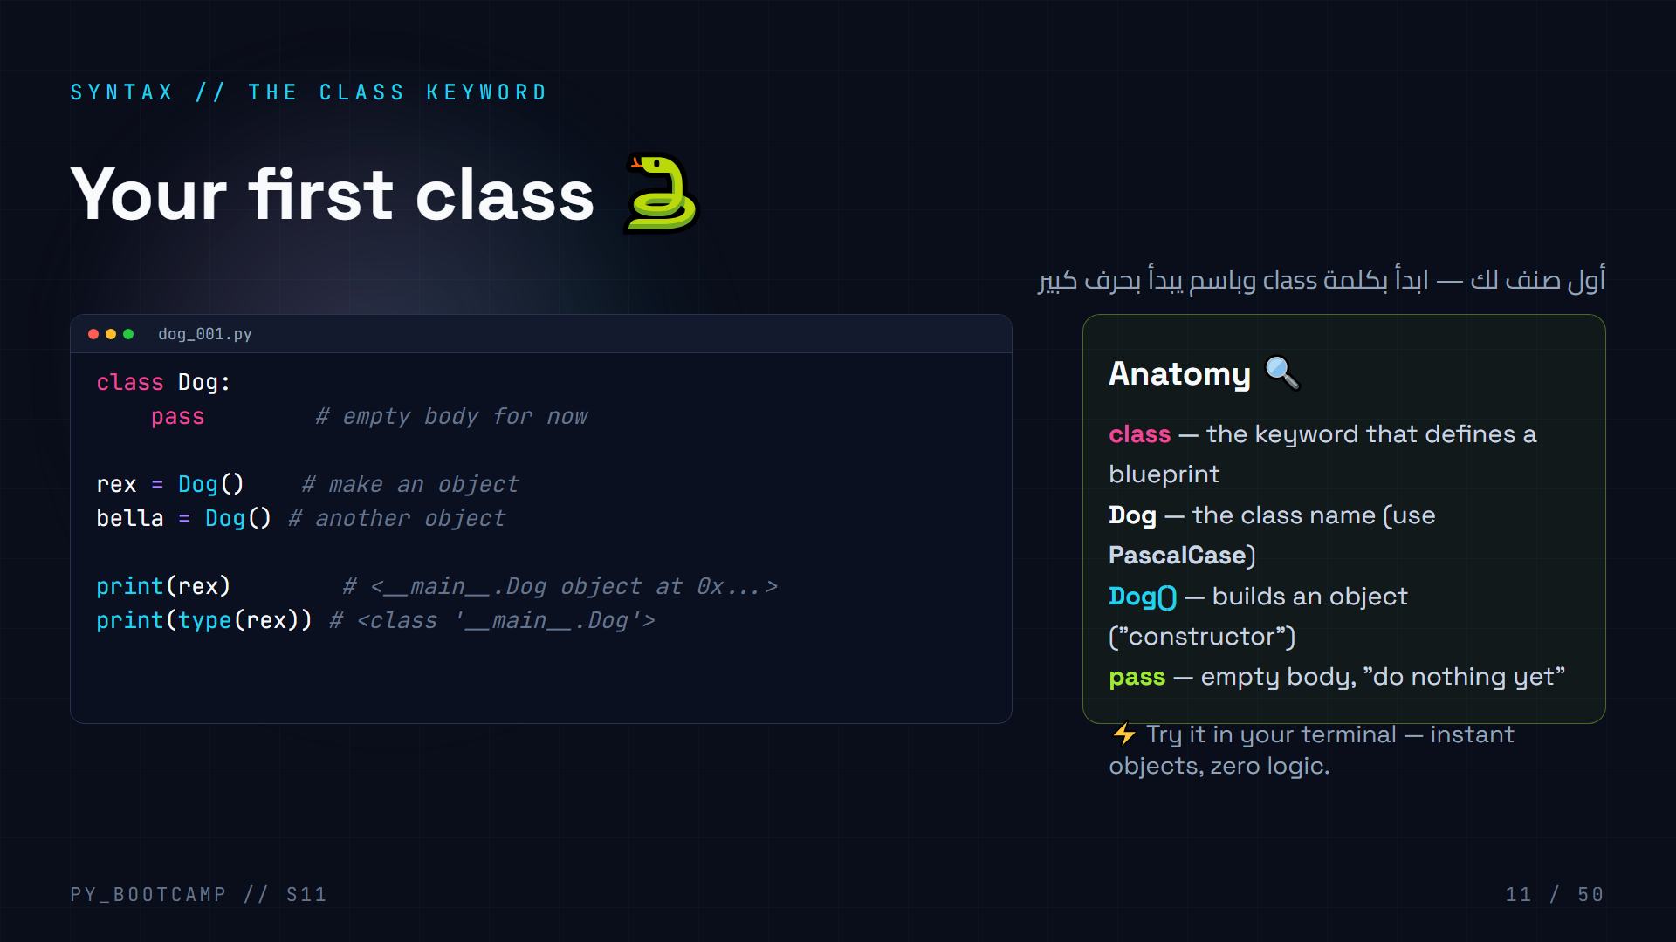
Notes:
**First code slide — have students type along.**
- Steps: create `dog_001.py`, write the class, run it, see the `` output. Explain the memory address in the repr is just Python's internal id.
- `pass` = valid empty body. Why? Python requires indented content after `:` — `pass` is a no-op placeholder.
- Naming rule: classes use **PascalCase** (`MyClass`, `DogHouse`), variables/functions use snake_case (`my_class`).
- Each `Dog()` call makes a *distinct* object: `rex is not bella` → `True`. Demo that live.
- Arabic tip: اسم الصنف يبدأ بحرف كبير دائمًا — «قاعدة التسمية» بالـ PascalCase.
- Common mistake to flag: naming a class with lowercase (works, but breaks convention).

Slide 12
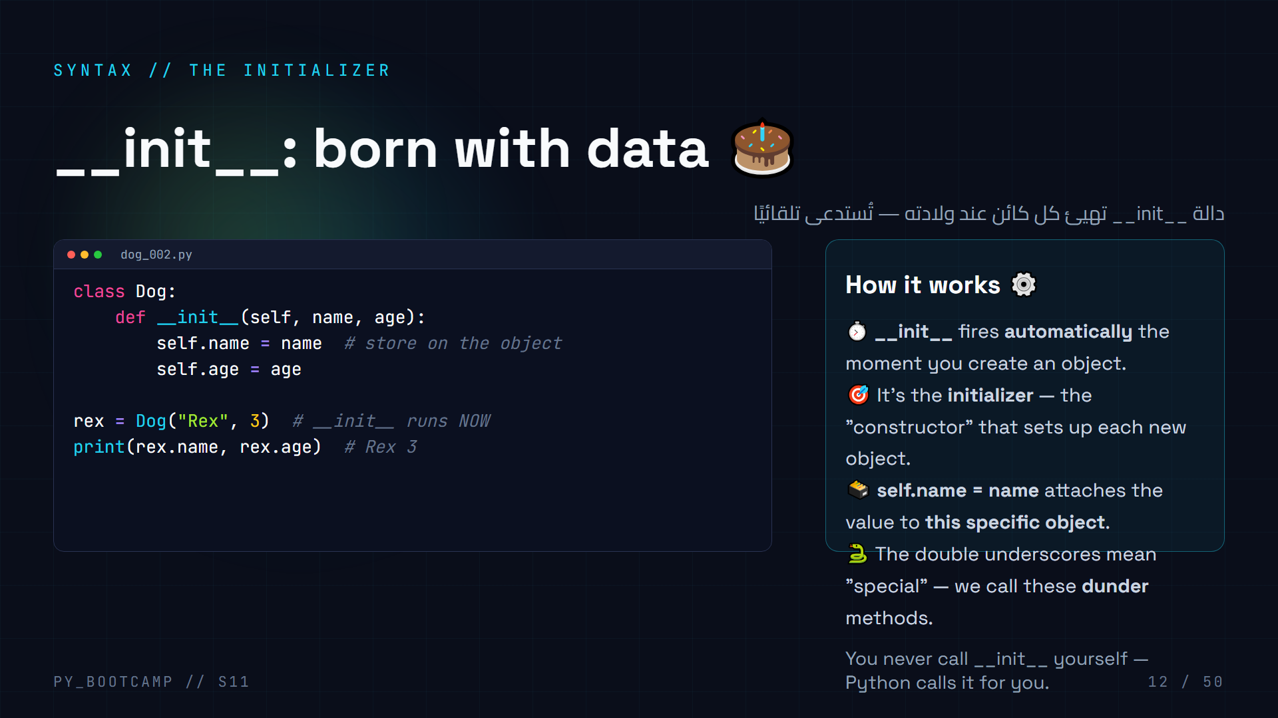
Notes:
**Live demo.** Type this together. Emphasize that `__init__` is called automatically.
- Trace it: `Dog("Rex", 3)` → Python allocates an object, then calls `__init__(self, "Rex", 3)` where self is the new object.
- Then run `Dog("Rex", 3)` with the wrong number of args → TypeError. This is a feature: the blueprint *forces* every dog to have a name and age.
- Vocabulary: "dunder" = double underscore. `__init__` is the most famous dunder.
- Make one object per student name on screen — `Dog("Sara", 17)`, `Dog("Omar", 16)` — to show each object carries its own values.
- Arabic tip: «تهيئة» = initializing; __init__ تعني "أنا أجهز الكائن".
- Common mistake: misspelling it `__init__` → objects get created but never initialized (silent bug!). Show it.

Slide 13
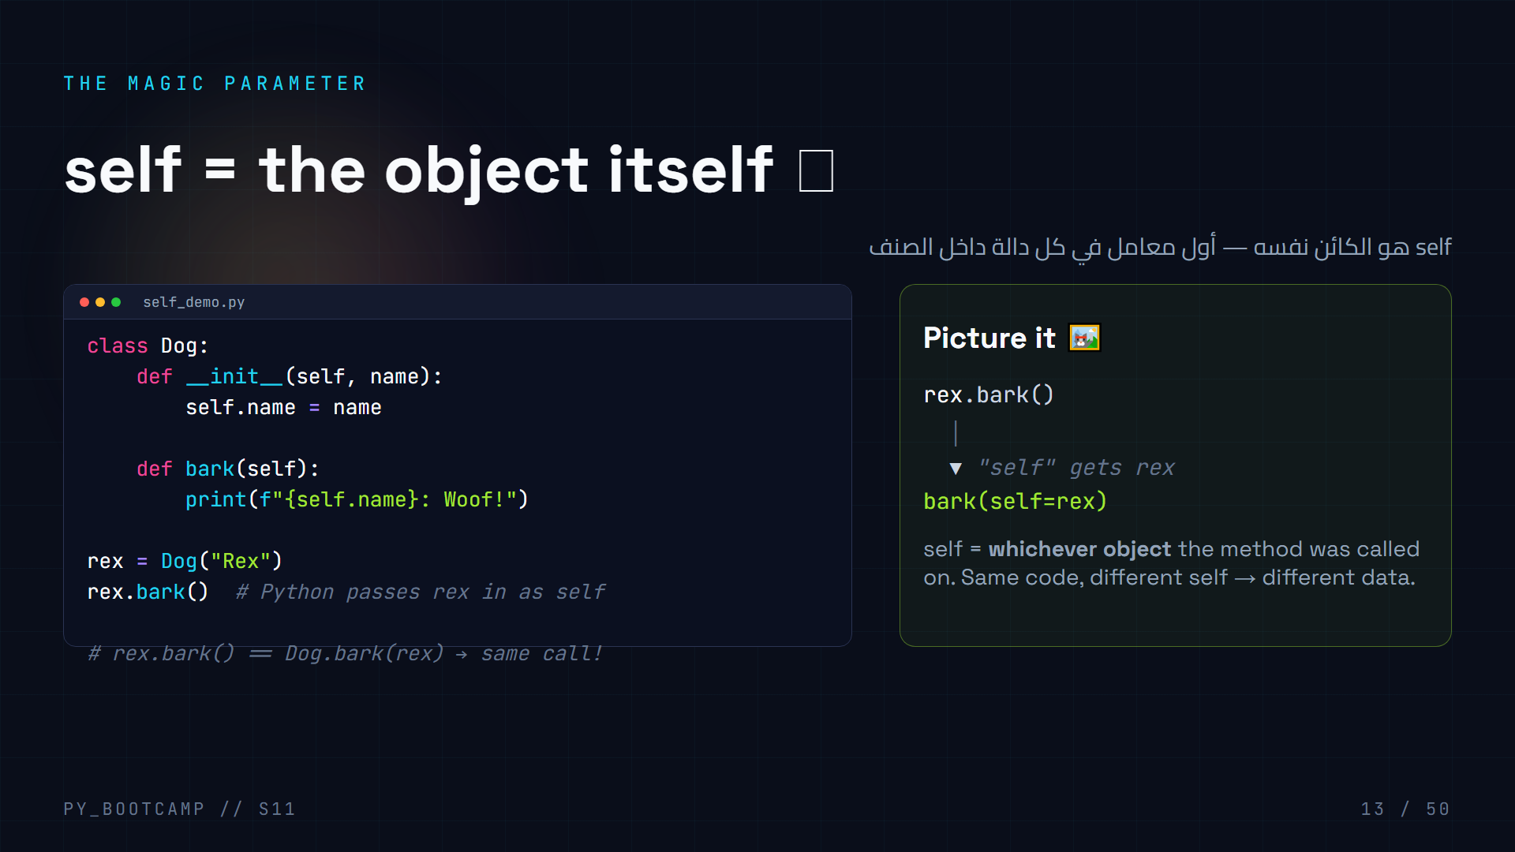
Notes:
**Key insight: `self` is not magic — it's just the current object.**
- `rex.bark()` is sugar for `Dog.bark(rex)`. Python always passes the object as the first argument automatically.
- `self.name` reads the attribute stored *on that particular object*. Two dogs, two names, same code.
- Arabic tip: «self يعني "أنا"» — الكائن يتحدث عن نفسه.
- Common beginner error: writing `bark()` with no `self` parameter → "takes 0 positional arguments but 1 was given". Fix: add self.
- Optional live trick: rename self to `me` in one class and show it still works (proves it's a convention, not a keyword).

Slide 14
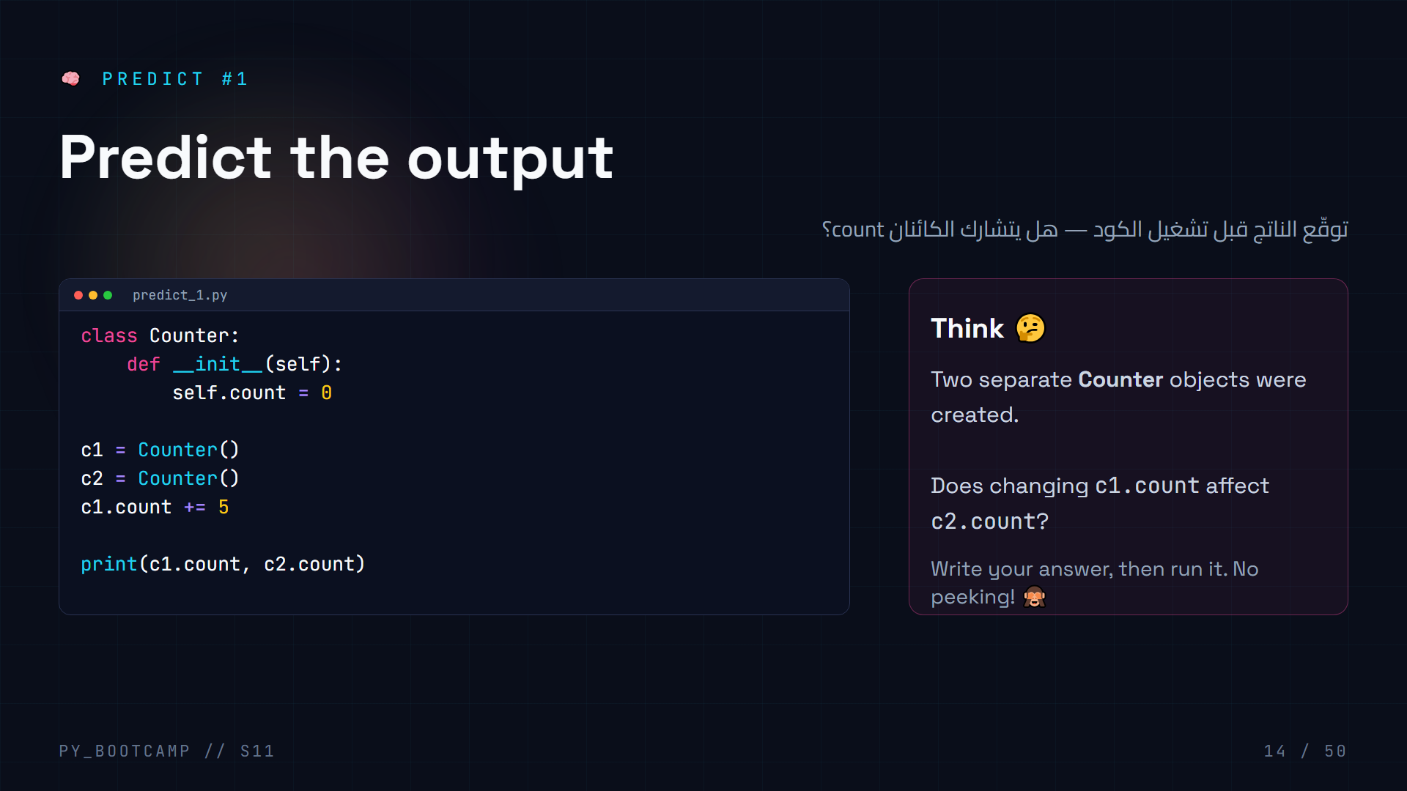
Notes:
**Answer: `5 0`.** c1 and c2 are independent objects — each has its own `count` attribute (each `__init__` ran separately).
- Have students vote before revealing: "hands up for 5 5, hands up for 5 0".
- Explain: `c1.count += 5` is exactly like `c1.count = c1.count + 5` — it only touches c1's attribute.
- This is the *state* idea: an object remembers its own data. That's why you don't pass a "counter" parameter around — the object IS the counter.
- Arabic tip: «كل كائن يحمل دولته الخاصة» — each object carries its own state.
- This sets up the mental model for methods that modify an object (deposit/withdraw later).

Slide 15
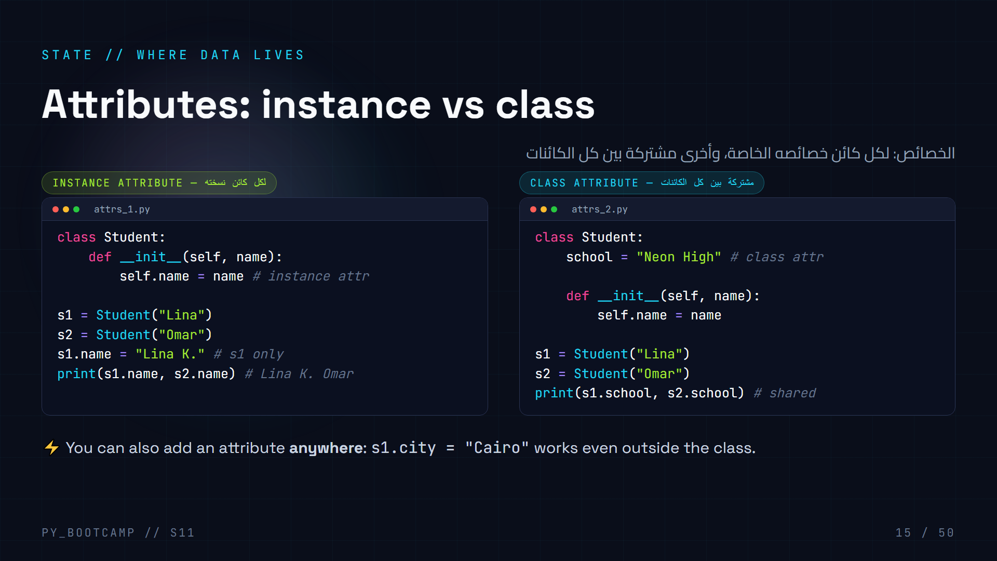
Notes:
**Two kinds of attributes — keep them separate.**
- Instance attributes (`self.name`) live on the *object*; each object owns its own copy. Set them in `__init__` → every object is born with them.
- Class attributes (defined at class level, no self) are *shared* by every instance — great for constants like `school`, `max_speed`.
- Reading `s1.school` when it's a class attribute works via the class. But beware: **assigning** `s1.school = "X"` creates a NEW instance attribute and hides the class one (we cover this in common mistakes).
- Arabic tip: «خصائص الكائن» instance vs «خصائص الصنف» class.
- Challenge the class: add `school` as a class attribute, then change `Student.school = "Cairo High"` and show every student updates at once.

Slide 16
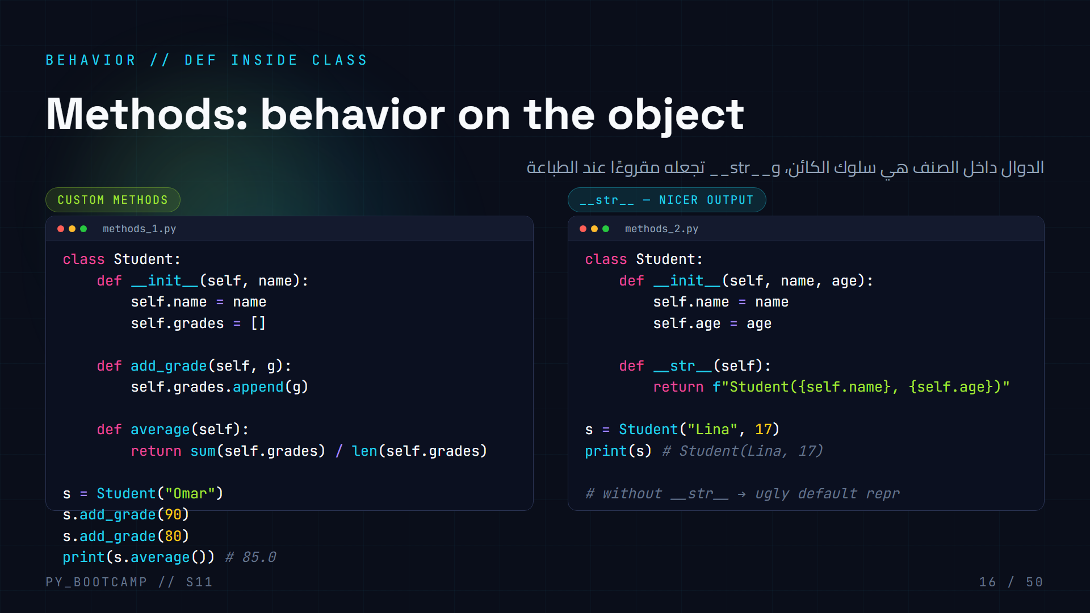
Notes:
**Methods = functions that live inside a class and always take self.**
- Point out: `s.add_grade(90)` stores the grade in *s's own* list — no global variable needed. Compare to the messy parallel-list code from the hook slide!
- `average()` computes from self.grades — the object "knows" its own data.
- `__str__`: Python calls it whenever you `print(obj)` or `str(obj)`. It returns the *string representation* for humans.
- Before __str__: `print(s)` shows ``. After: `Student(Lina, 17)`. Demo the before/after live.
- Arabic tip: __str__ = «التمثيل النصي للكائن».
- Extra: `__repr__` exists too but keep it optional — don't overload today.

Slide 17
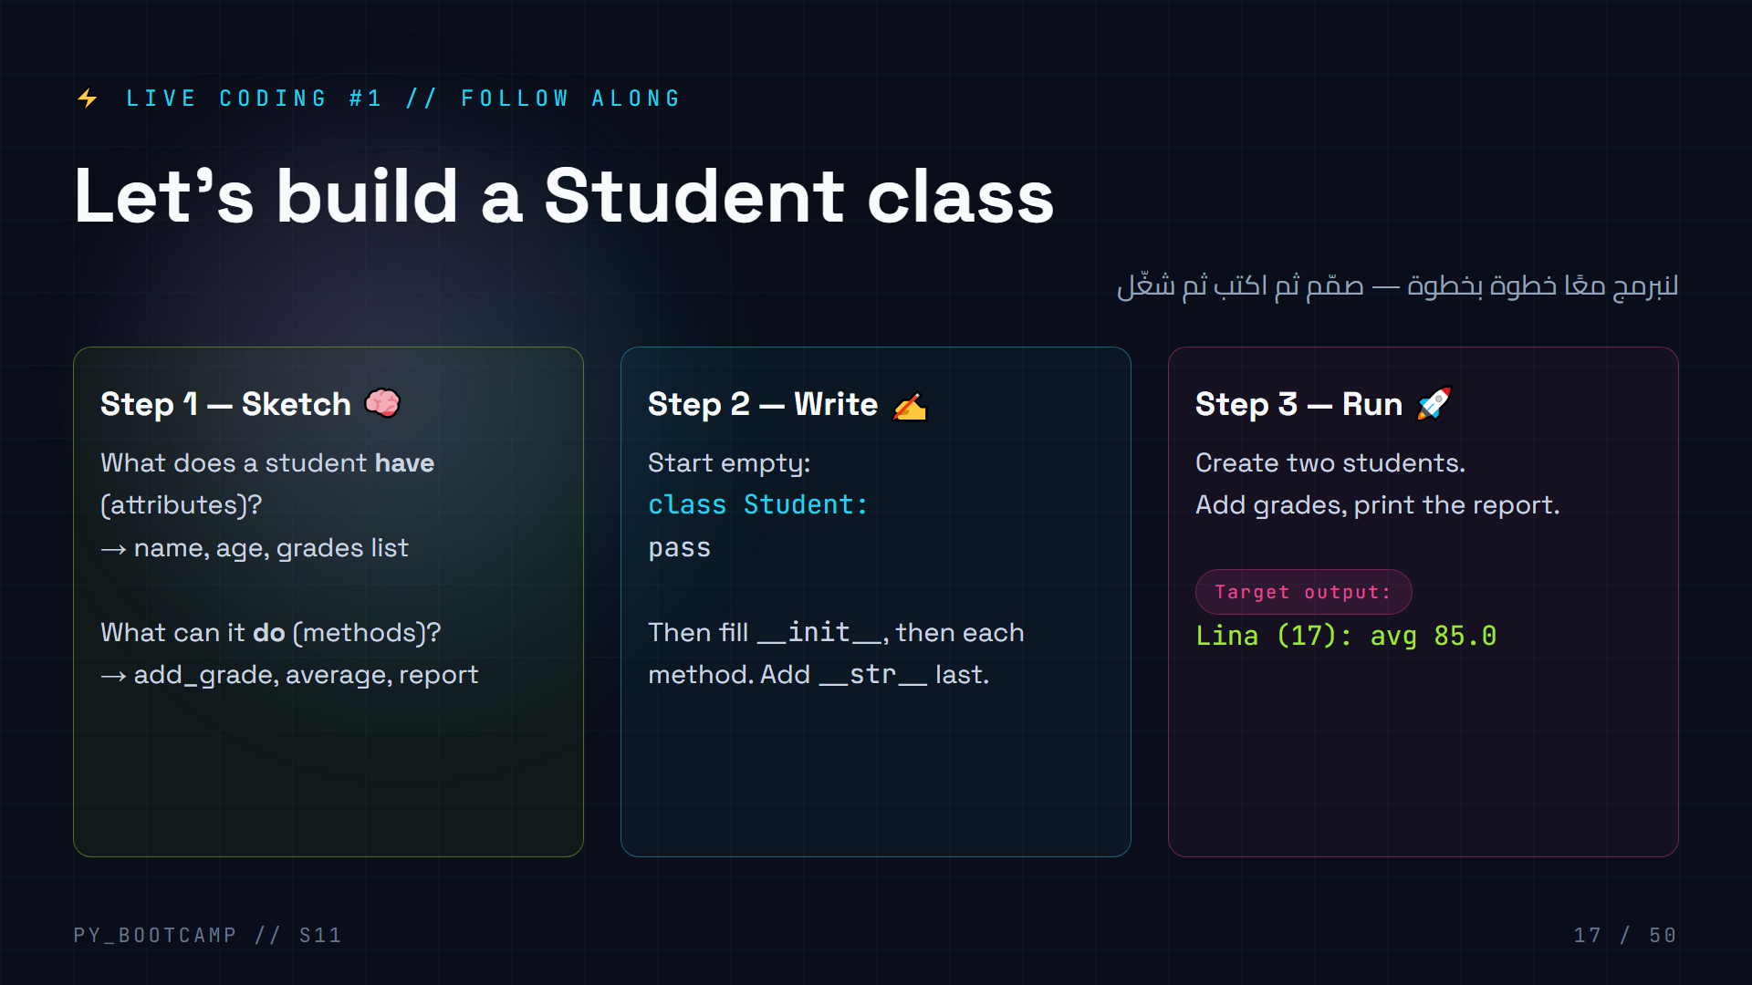
Notes:
**Live-coding session #1 — the instructor writes, students follow in their editors.**
Step-by-step delivery (speak while typing):
1. `class Student:` + `pass` → run (empty but valid).
2. Add `__init__(self, name, age)` storing self.name, self.age, and `self.grades = []`.
3. Add `add_grade(self, g)`.
4. Add `average(self)` — guard: `if not self.grades: return 0`.
5. Add `report(self)` returning the f-string. Add `__str__` returning the same.
6. Instantiate `s = Student("Lina", 17)`, add 90 and 80, print `s.report()`.
Common live mistakes to model and fix: forgetting self, forgetting `:` after def, spelling `__init__` wrong.
At the end ask each student to make *their own* student and print a report — 2 minutes, everyone shows output.
Arabic tip: «صمّم ثم نفّذ» — design before you code.

Slide 18
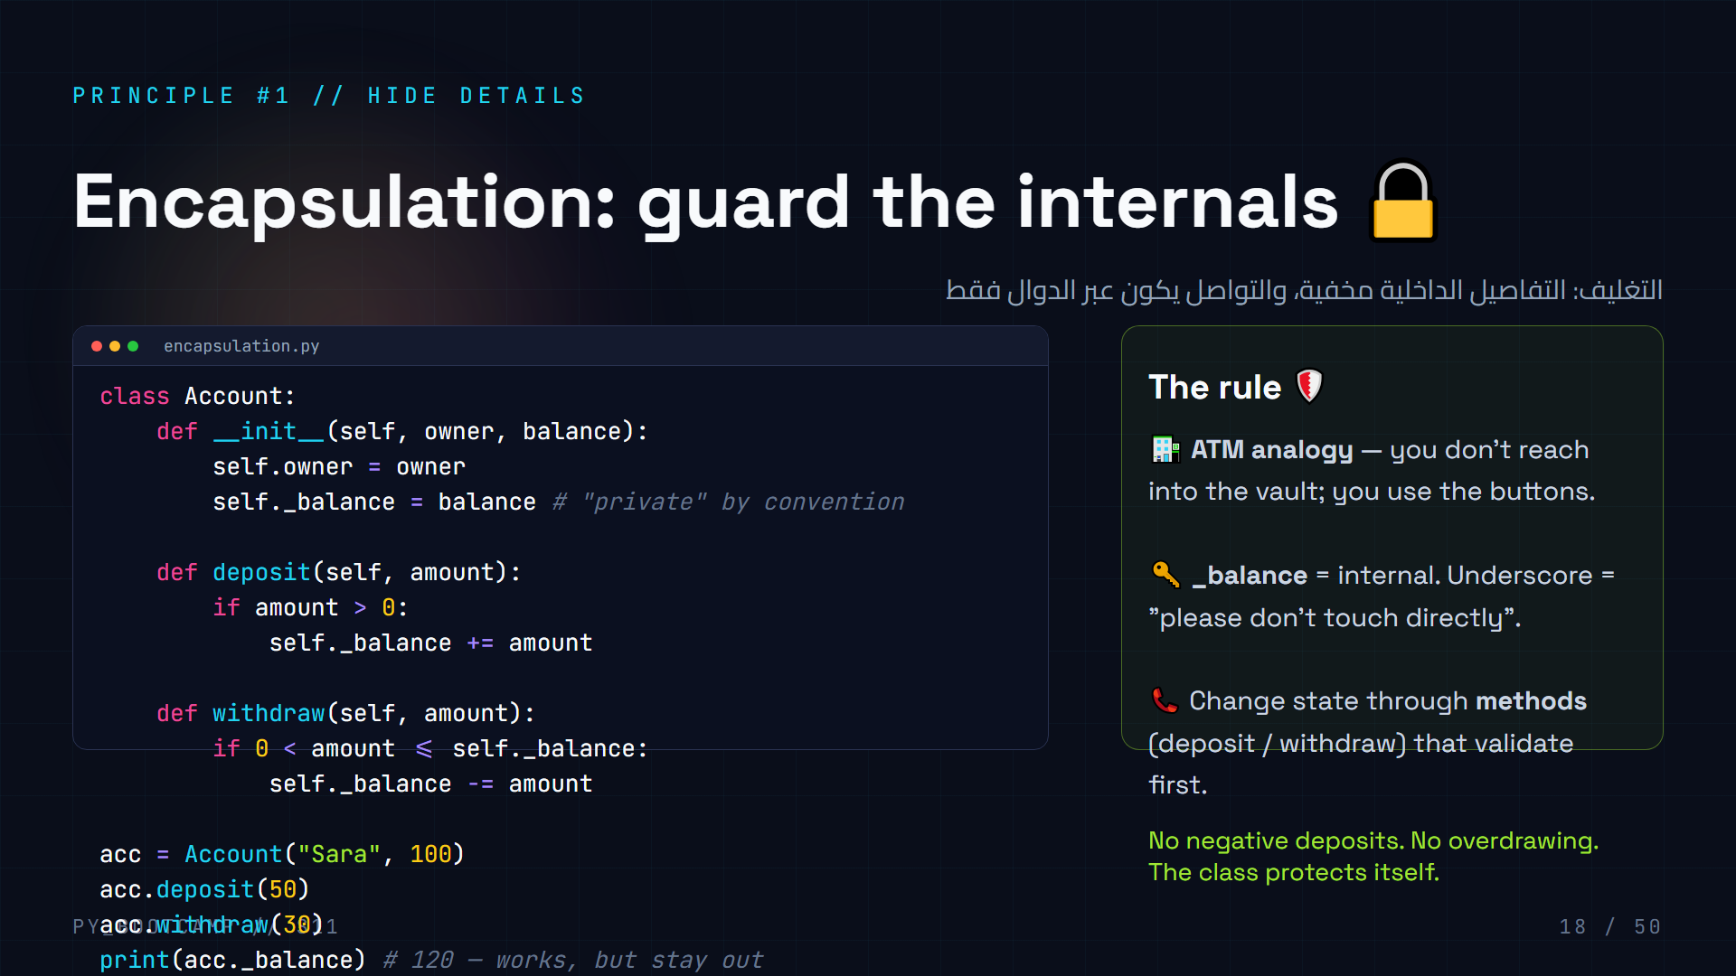
Notes:
**Encapsulation = bundling data + the code that safely operates on it, hiding the internals.**
- Walk the code: `_balance` starts with underscore → Python convention for "internal". Not enforced, but respected by the community.
- The real protection is that `deposit`/`withdraw` *validate*. Direct access `acc._balance = -500` bypasses rules — which is exactly why we hide it.
- Demo live: try `acc.withdraw(1000)` → nothing happens (balance can't go negative). Then show `acc._balance` is still accessible but "you shouldn't".
- ATM analogy lands well with 15-22 year olds.
- Arabic tip: «التغليف» = encapsulation — إخفاء الداخل، وإظهار زر واحد فقط.
- Next slide: the professional way to expose `balance` — properties.

Slide 19
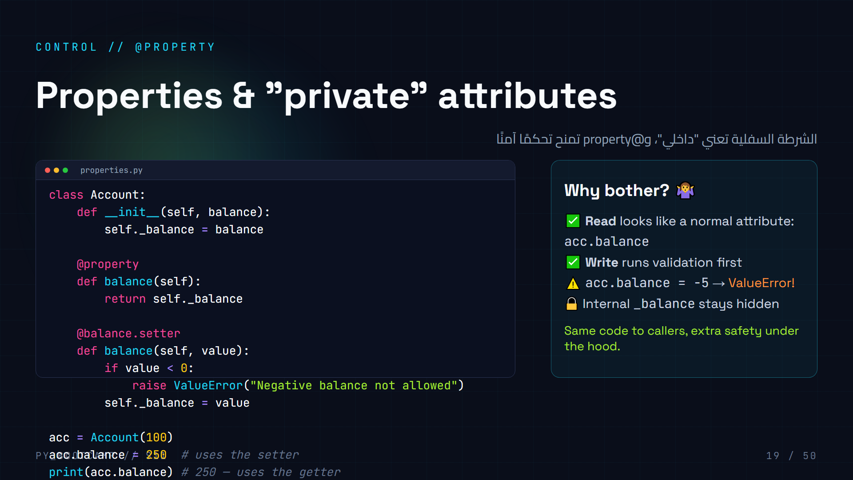
Notes:
**Properties = methods that pretend to be plain attributes.**
- Show getter + setter. `@property` on the getter; `@x.setter` on the setter. Callers keep using `acc.balance` on both sides.
- Demo the guard: `acc.balance = -5` → the setter runs, raises ValueError. Show the red traceback on purpose (it's a good thing!).
- This is the "professional" form of encapsulation vs the simple underscore convention on the previous slide.
- Don't over-explain — this is a "nice to know" they'll meet in real codebases. If time is short, say: "properties let you add rules to attributes without changing how code uses them."
- Arabic tip: property = «خاصية» تُدار عبر دوال.
- Common trap: getter/setter name must match (`balance`), internal is `_balance`.

Slide 20
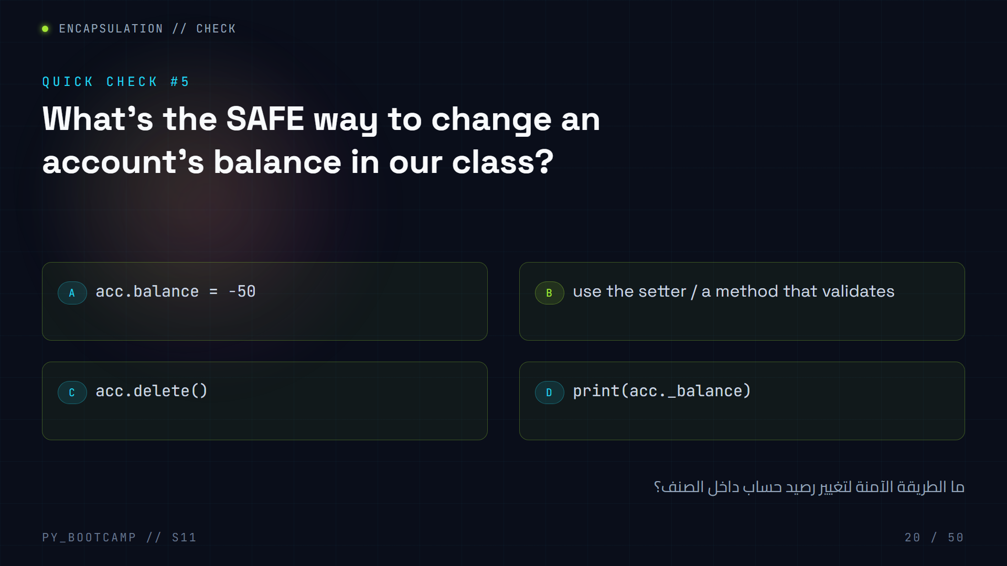
Notes:
**Answer: B — go through the setter / a validating method.**
- A is unsafe: direct assignment skips validation (negative balance becomes possible).
- D is just *reading* (and touching internals) — not changing.
- Recap the "ATM" idea: the buttons (methods/setters) are the safe interface; the vault (internals) stays hidden.
- Ask a follow-up: "What should `withdraw` do if amount > balance?" → reject/return False (we'll see this pattern in the project).
- Arabic tip: «غيّر من خلال الدالة لا مباشرة» — change via methods, not directly.
- Transition to the second big principle: inheritance.

Slide 21
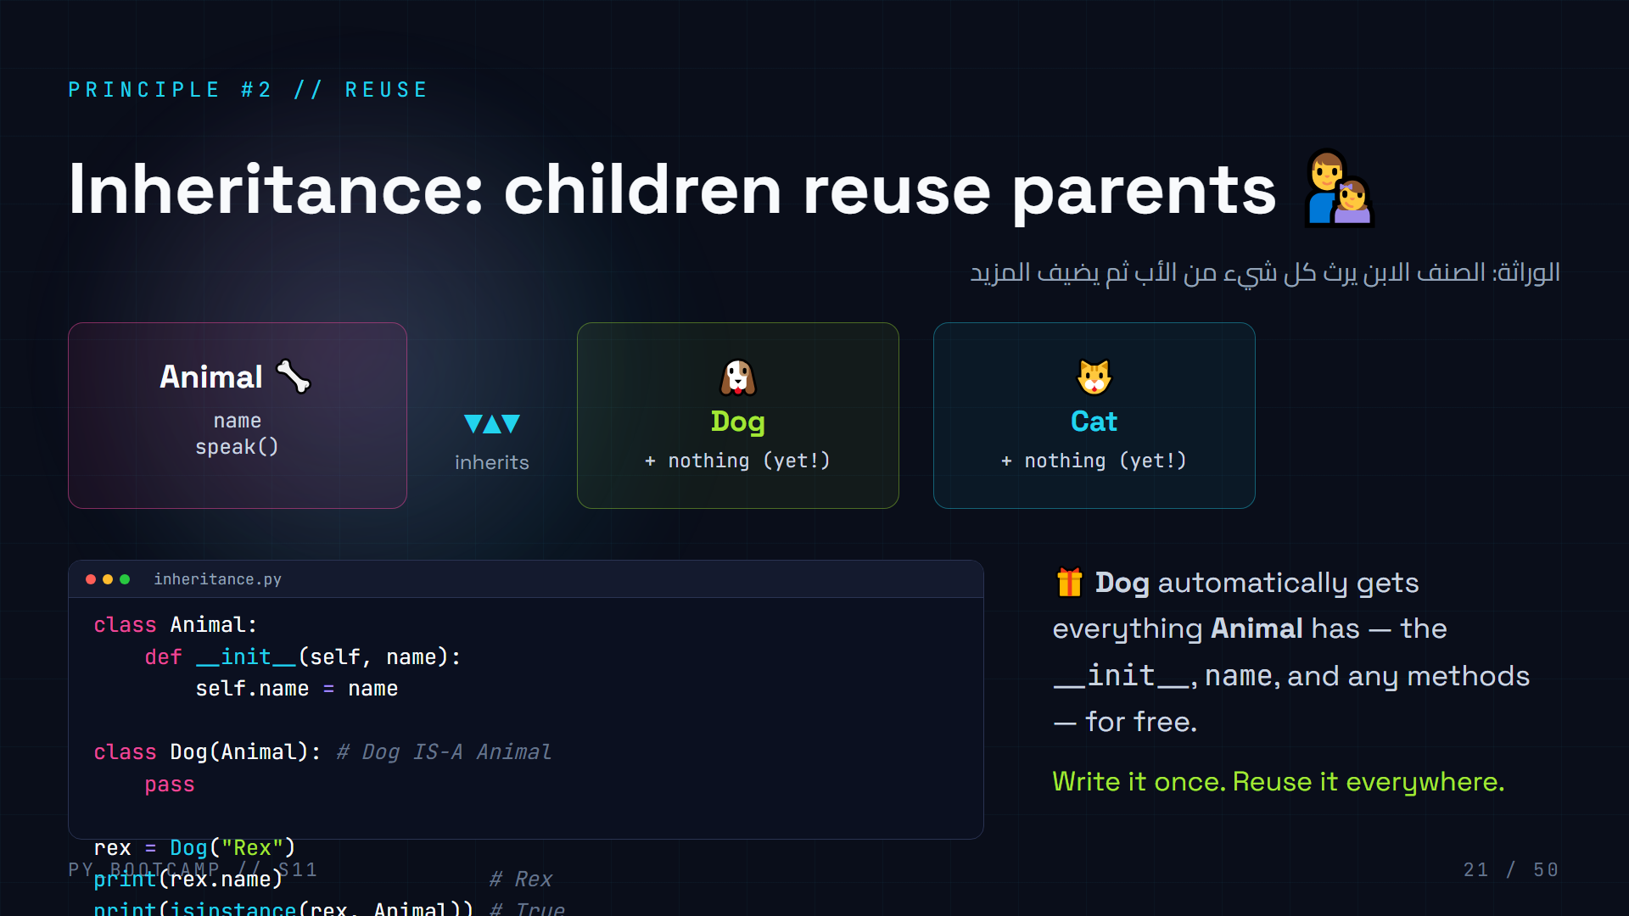
Notes:
**Inheritance = reuse.** The child class (`Dog`) is declared with the parent in parentheses: `class Dog(Animal):` → "Dog IS-A Animal".
- Demo live: create `Dog("Rex")` and call inherited behaviors. `rex.name` works even though Dog defines nothing.
- `isinstance(rex, Animal)` → True. Because a Dog *is* an Animal.
- Analogy: family tree / genes. The child inherits traits from the parent, then adds its own.
- Arabic tip: «الابن يرث من الأب» — the child inherits from the parent. Use family-tree language, it maps perfectly.
- This is the foundation for the next three slides: super(), overriding, and polymorphism.
- Emphasize DRY (Don't Repeat Yourself): inheritance exists so you never copy-paste code between similar classes.

Slide 22
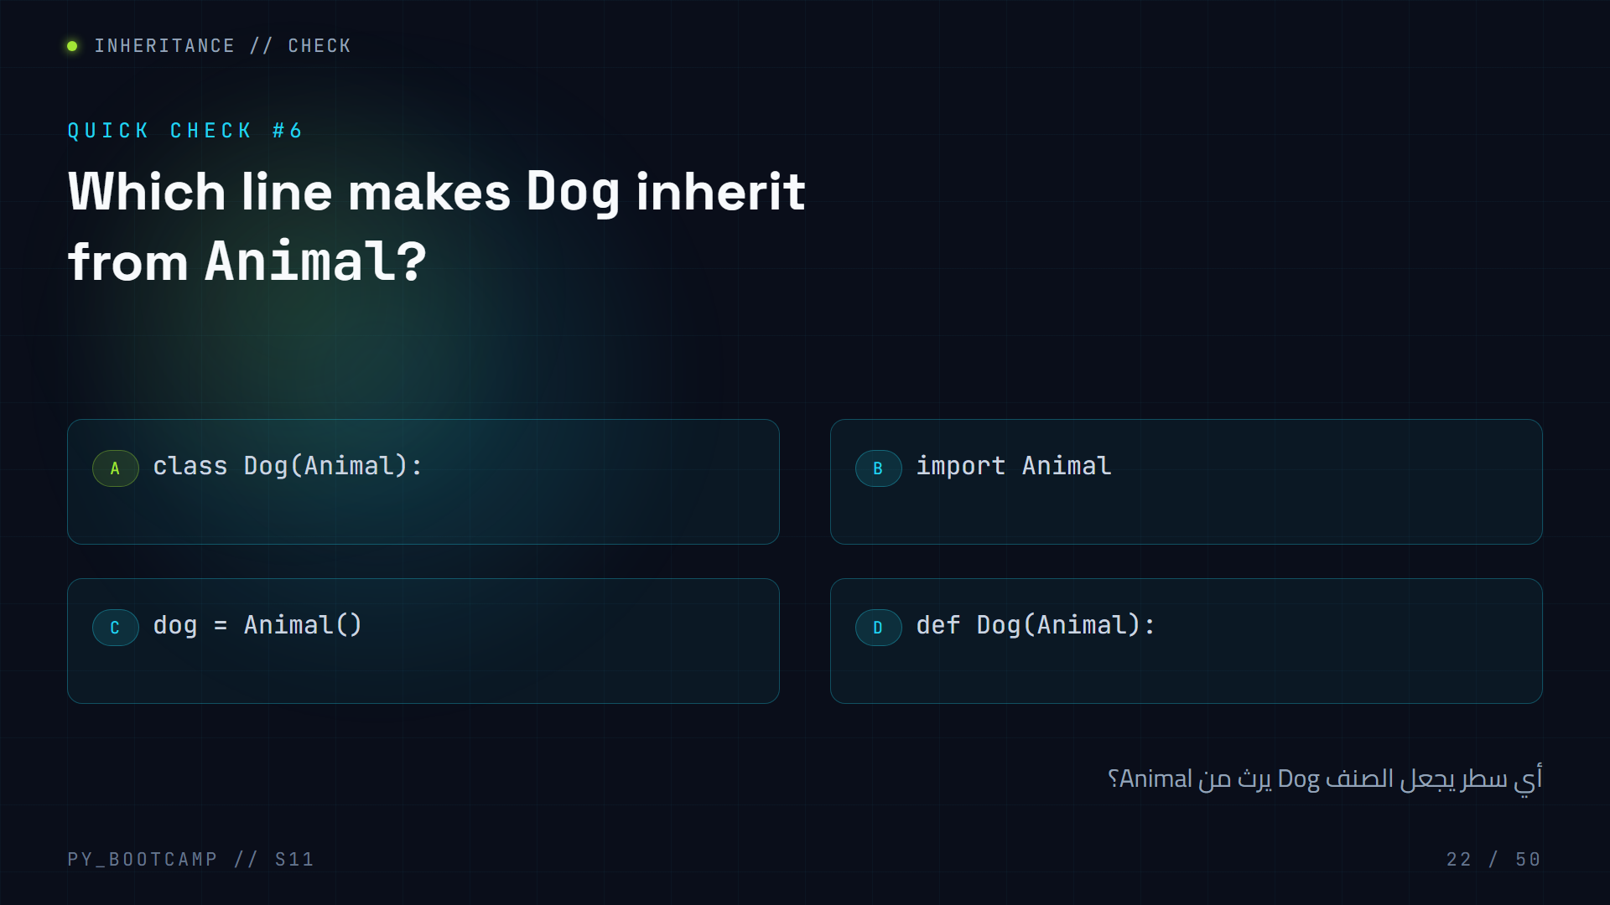
Notes:
**Answer: A — `class Dog(Animal):`.** The parent class goes in parentheses after the child's name.
- B is wrong (that's for importing modules), C creates an *instance* (not a subclass), D is invalid syntax (def makes functions).
- Point at the diagram from the previous slide: the `(Animal)` is the arrow pointing up to the parent.
- Drill the phrasing: "Dog IS-A Animal" → name in parens.
- Arabic tip: «الصنف الابن يكتب اسم الأب بين قوسين» — child class writes the parent's name in parens.
- Quick oral drill: "How would you make `SavingsAccount` inherit from `Account`?" → `class SavingsAccount(Account):`.

Slide 23
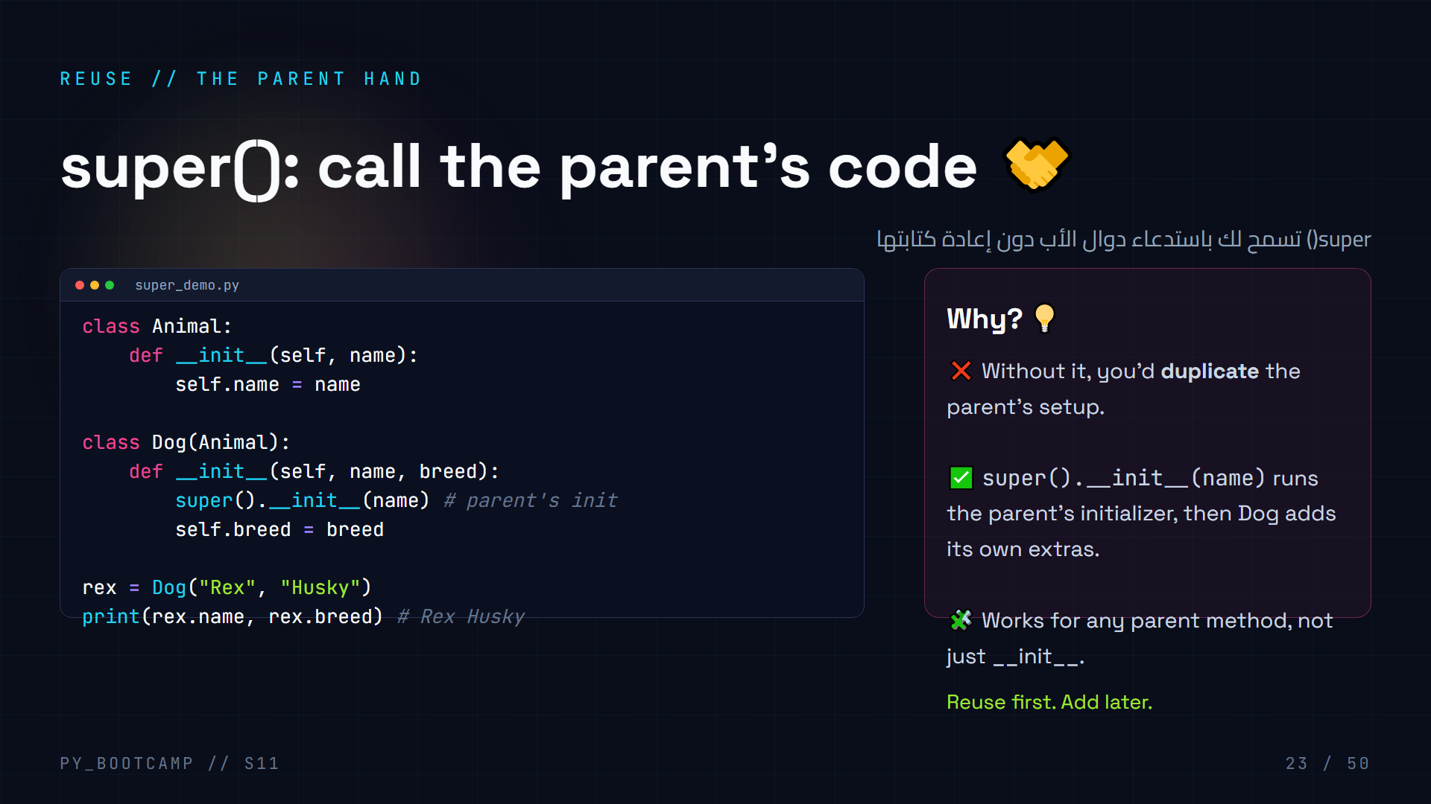
Notes:
**super() = "the parent".**
- When the child overrides `__init__` (defines its own), the parent's `__init__` does NOT run automatically. `super().__init__(name)` calls it explicitly.
- Trace the flow: `Dog("Rex", "Husky")` → Dog's `__init__` → super().__init__ sets self.name → then self.breed is set.
- If you forget super(): `rex.name` → AttributeError. This is mistake #3 on the common-mistakes slide — flag it now.
- Analogy: "You do everything your parents taught you, then add your own skills." In Arabic: «أكمل ما بدأه الأب ثم أضف إضافاتك».
- Show that super() also works in other methods: `super().some_method()`.
- Practice: have them write `class Cat(Animal)` with a `lives=9` attribute using super().

Slide 24
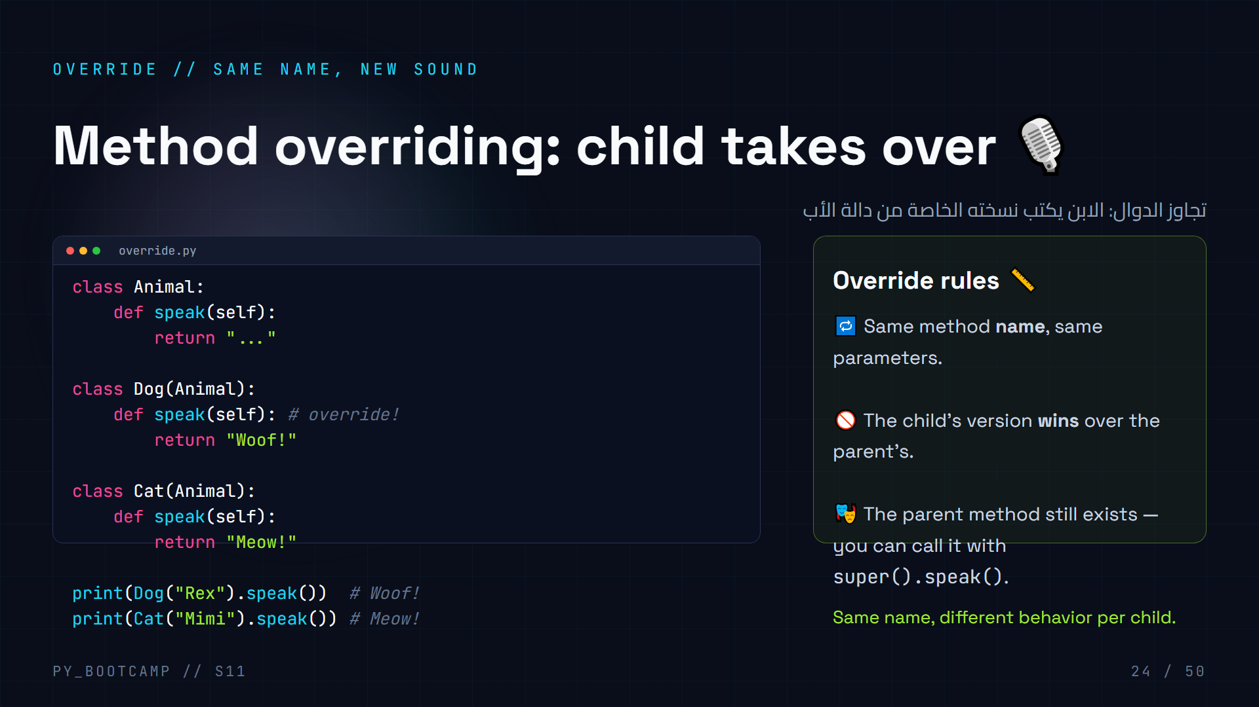
Notes:
**Overriding = redefining an inherited method in the child.**
- Each child defines its own `speak` — the "..." default is replaced.
- Key point: the *callers* don't change. `pet.speak()` just works and gives the right sound. This is what enables polymorphism (next slides).
- Demo live: run the file, then ask "what if Dog didn't override speak()?" → prints "..." (inherits parent's).
- Combine with super(): show a version where Dog.speak() does `return super().speak() + " Woof!"` to *extend* instead of replace.
- Arabic tip: «التجاوز» = override — الابن يغيّر سلوك الأب.
- Transition: "Now the payoff — same call, different results."

Slide 25
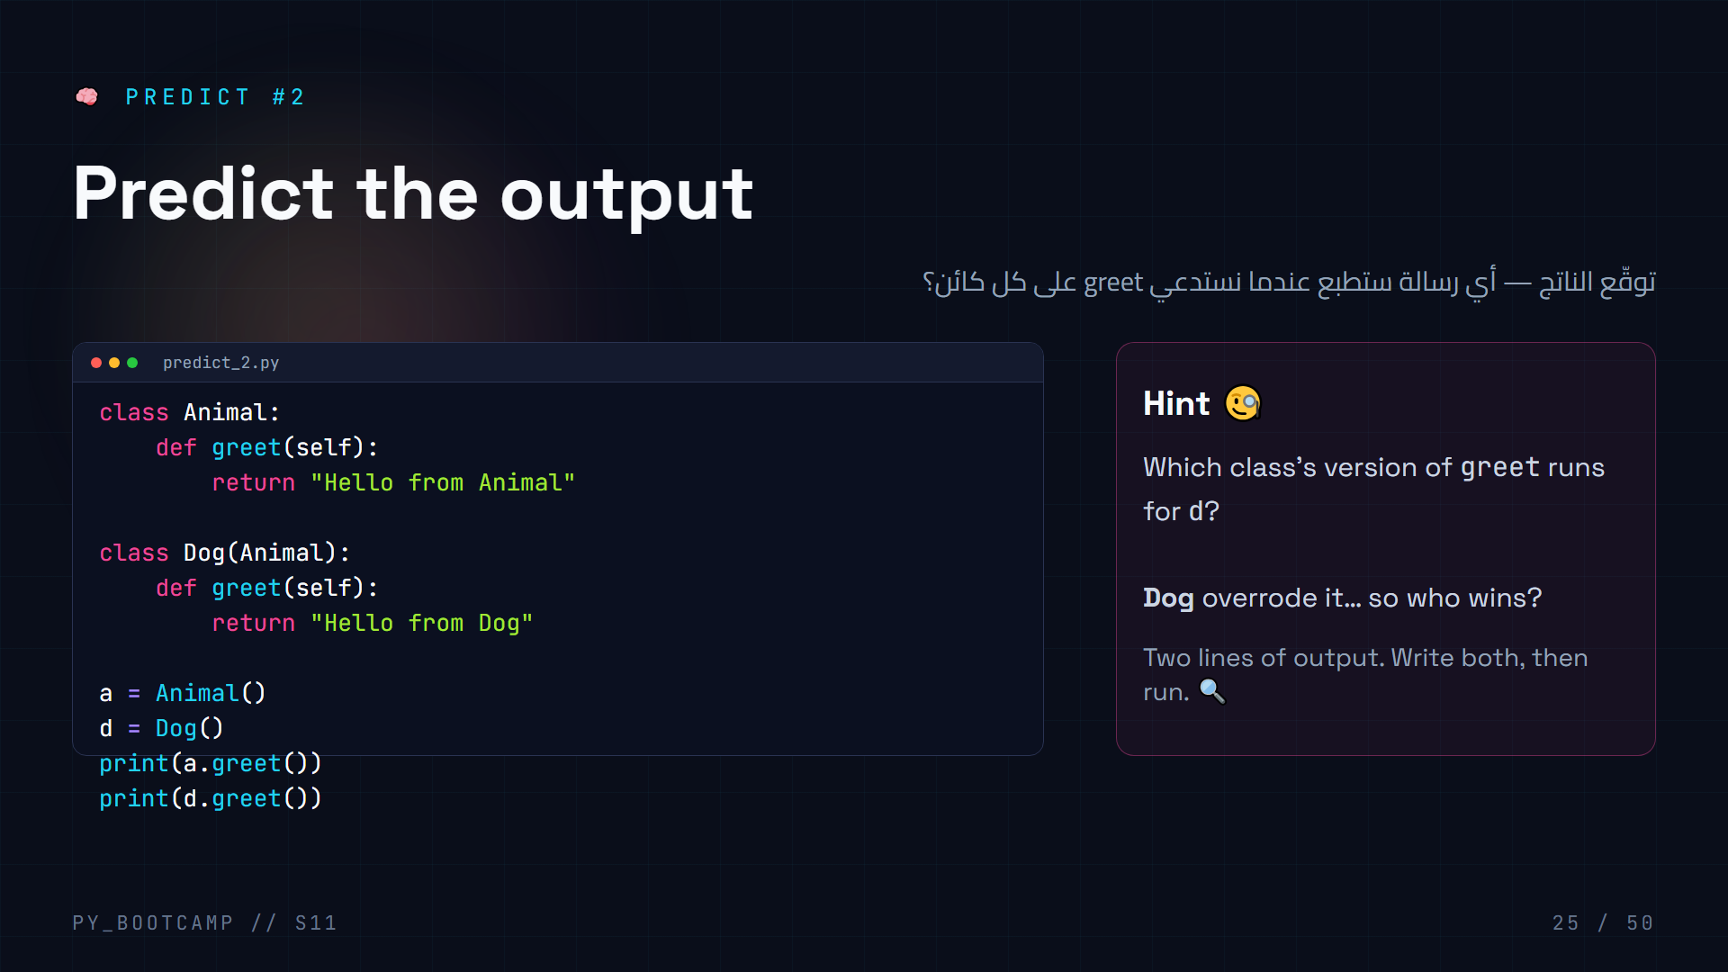
Notes:
**Answer:**
```
Hello from Animal
Hello from Dog
```
- `a` is an Animal → runs Animal.greet. `d` is a Dog → the *override* runs Dog.greet.
- Reinforce: Python looks up the method on the *object's class first*, then walks up the hierarchy (Dog → Animal → object).
- This is "dynamic dispatch" — but you don't need the jargon; just say "Python checks the child first".
- Ask a student to explain WHY before revealing. Reward a clear explanation.
- Arabic tip: «بايثون يبحث في الابن قبل الأب» — Python checks the child before the parent.
- This directly powers the polymorphism slide coming up.

Slide 26
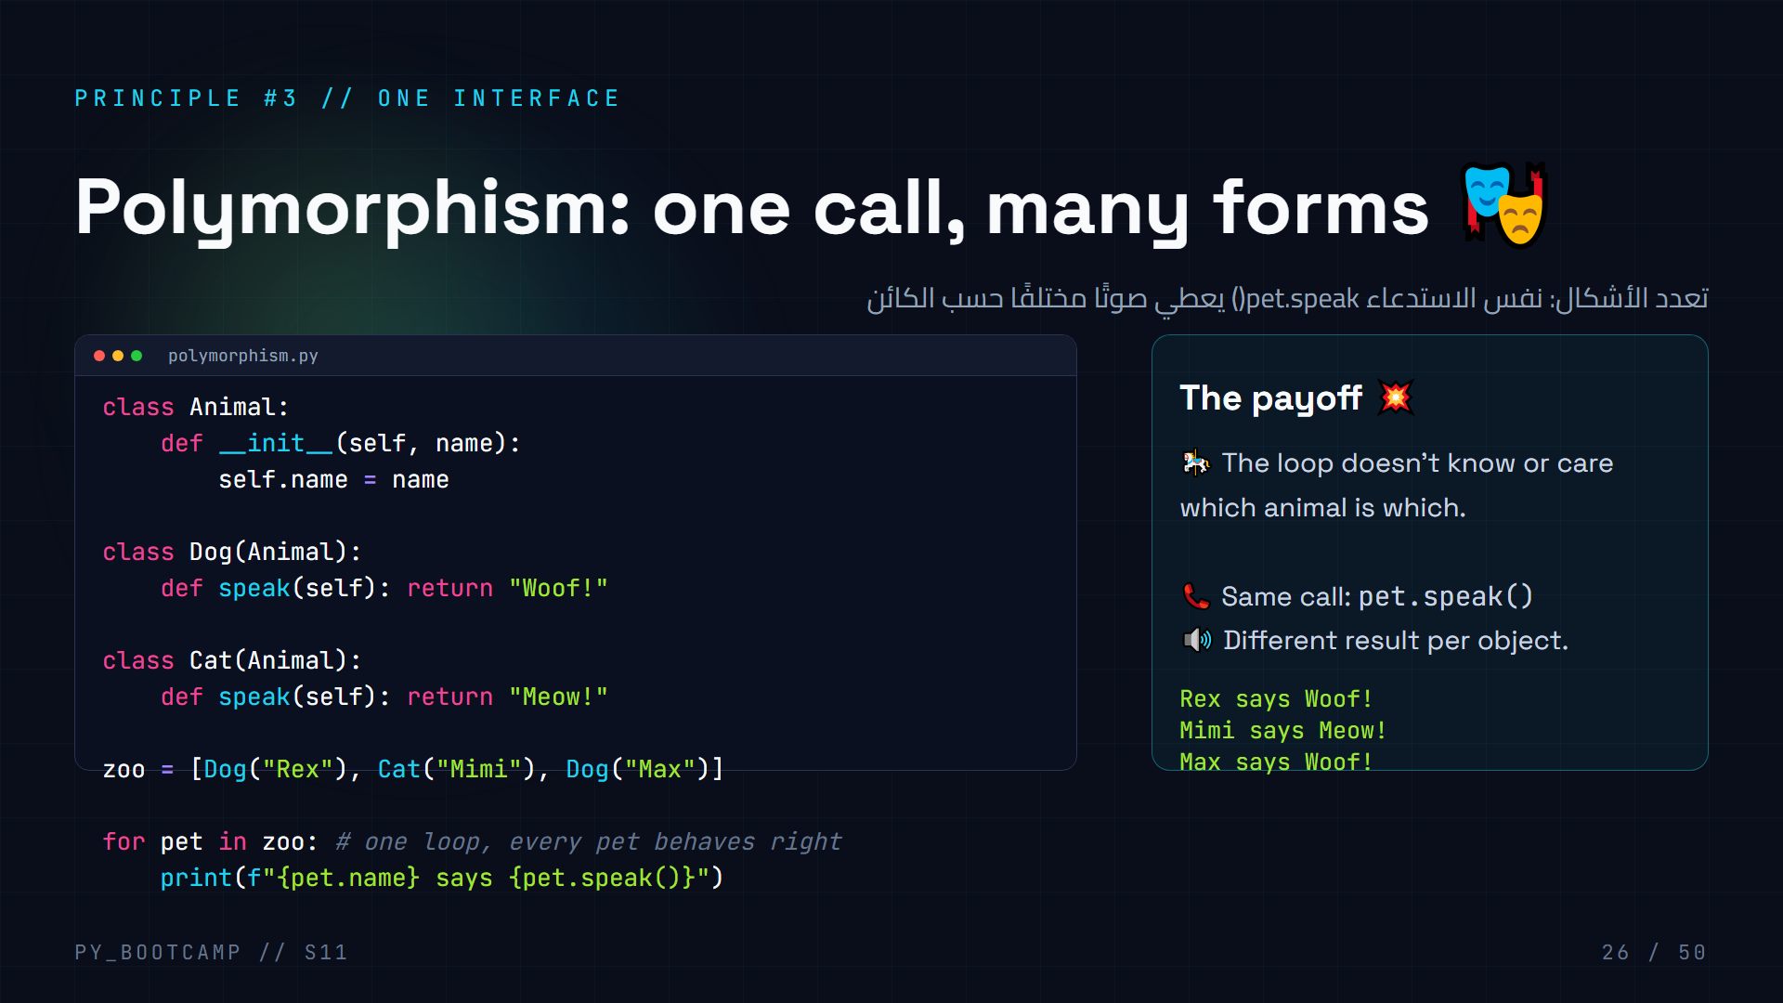
Notes:
**Polymorphism = "many forms".** The same method name behaves differently depending on the object it's called on.
- The magic: the loop is generic. It can handle any future animal you add (a `Duck`, a `Pig`) without changing the loop.
- This is the biggest practical benefit of inheritance + overriding together.
- Demo live: add a `class Duck(Animal)` with `speak()` returning "Quack!" — add it to zoo, nothing else changes, output just works.
- Word origin (quick, fun): poly = many, morph = form.
- Arabic tip: «تعدد الأشكال» = polymorphism — اسمٌ واحد، أشكالٌ متعددة.
- This "program to the interface, not the implementation" idea is what they'll see in every framework.

Slide 27
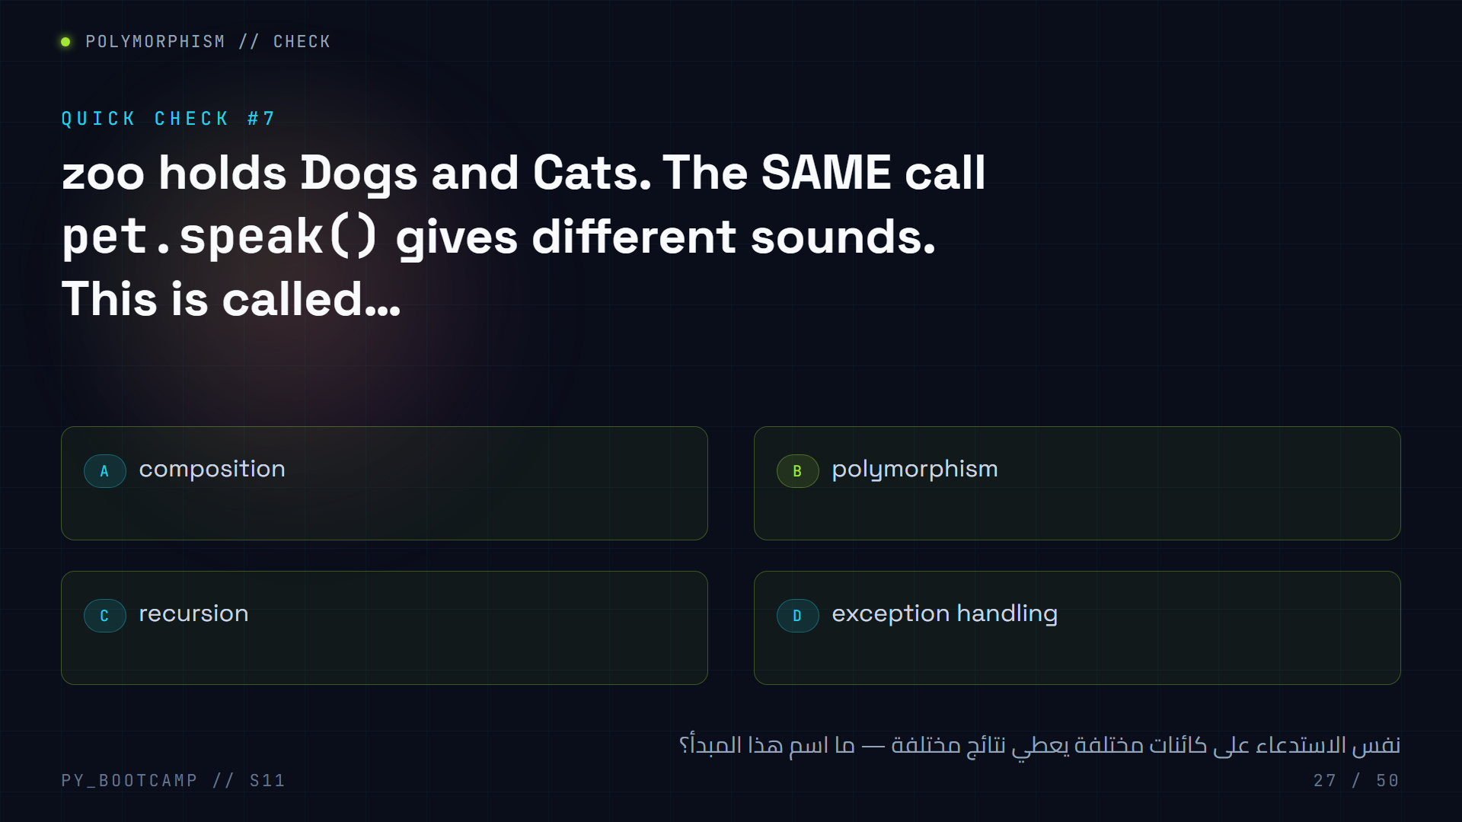
Notes:
**Answer: B — polymorphism.** Same method call, object-specific behavior.
- Reinforce with the phrase: "the caller writes the call once; each object decides what it means."
- Contrast with A (composition = has-a, next slide) and C (recursion = a function calling itself).
- Quick memory hook: «نفس الكلمة، نطق مختلف» — same word, different pronunciation.
- If time allows, extend the zoo with a `Duck` and show nothing else changes — the strongest proof of polymorphism.
- Keep moving — composition is next, then the big design-practice section (when to use OOP, refactoring).

Slide 28
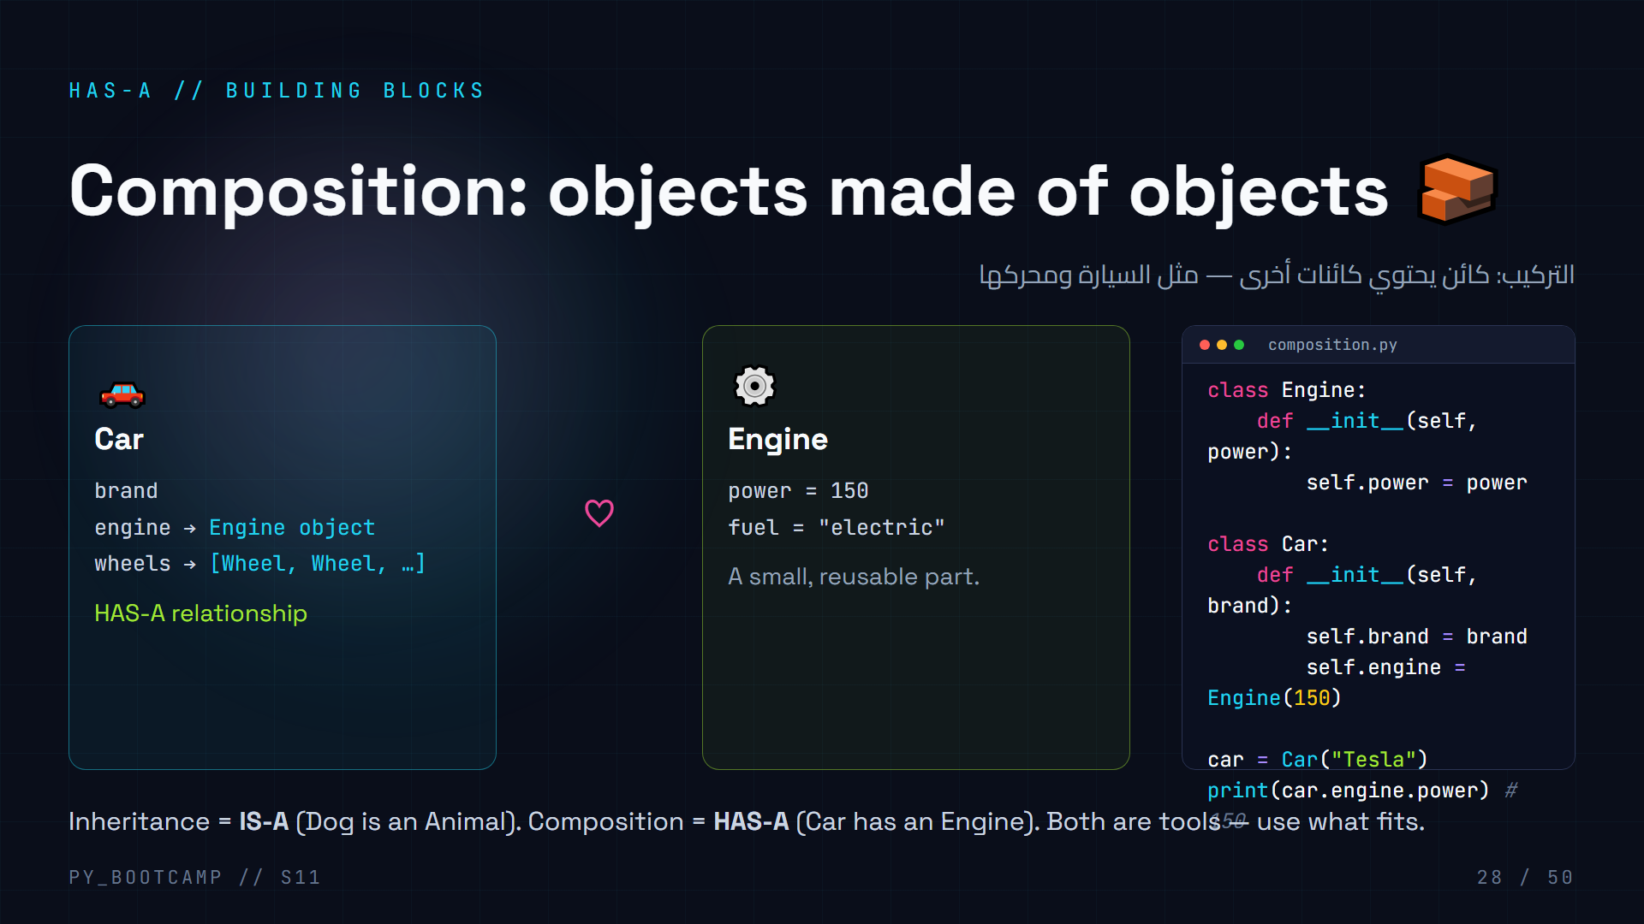
Notes:
**Composition = building objects out of other objects.**
- Compare with inheritance: IS-A vs HAS-A. "Is a Dog an Animal?" yes → inheritance. "Does a Car have an Engine?" yes → composition.
- Rule of thumb: prefer composition for *parts*, inheritance for *kinds*.
- The code shows `self.engine = Engine(150)` — the Car contains an Engine object, and you navigate with `car.engine.power`.
- Real examples in their world: a Student HAS courses (a list of Course objects); a Library HAS books; a Game HAS players.
- Arabic tip: «الوراثة = هو/هي، التركيب = يحتوي» — inheritance = is-a, composition = has-a.
- This is a preview: the School System live-coding (slides 47-48) and the homework Library are both composition-heavy.

Slide 29
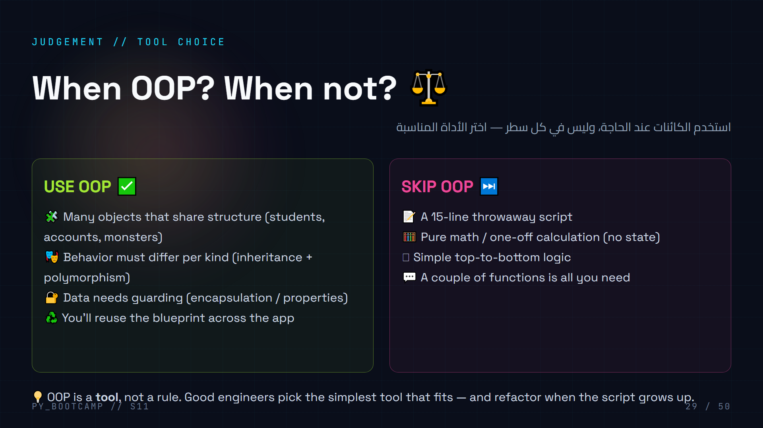
Notes:
**Engineering judgement.** OOP isn't "always" — it's *when state + behavior belong together*.
- Fight the misconception that "OOP = good code". A tiny script with classes is over-engineering; a big app without classes is spaghetti.
- The skill is recognizing when to *introduce* classes. Rule of thumb: "when you find yourself keeping parallel lists in sync, or passing the same 4 values everywhere — that's when a class is calling."
- Practical guidance for their level: start procedural, and when it gets messy → refactor into classes (next slide).
- Arabic tip: «الأداة المناسبة للعمل» — the right tool for the job.
- Reassure: this judgment comes with practice; the homework forces you to make this call.

Slide 30
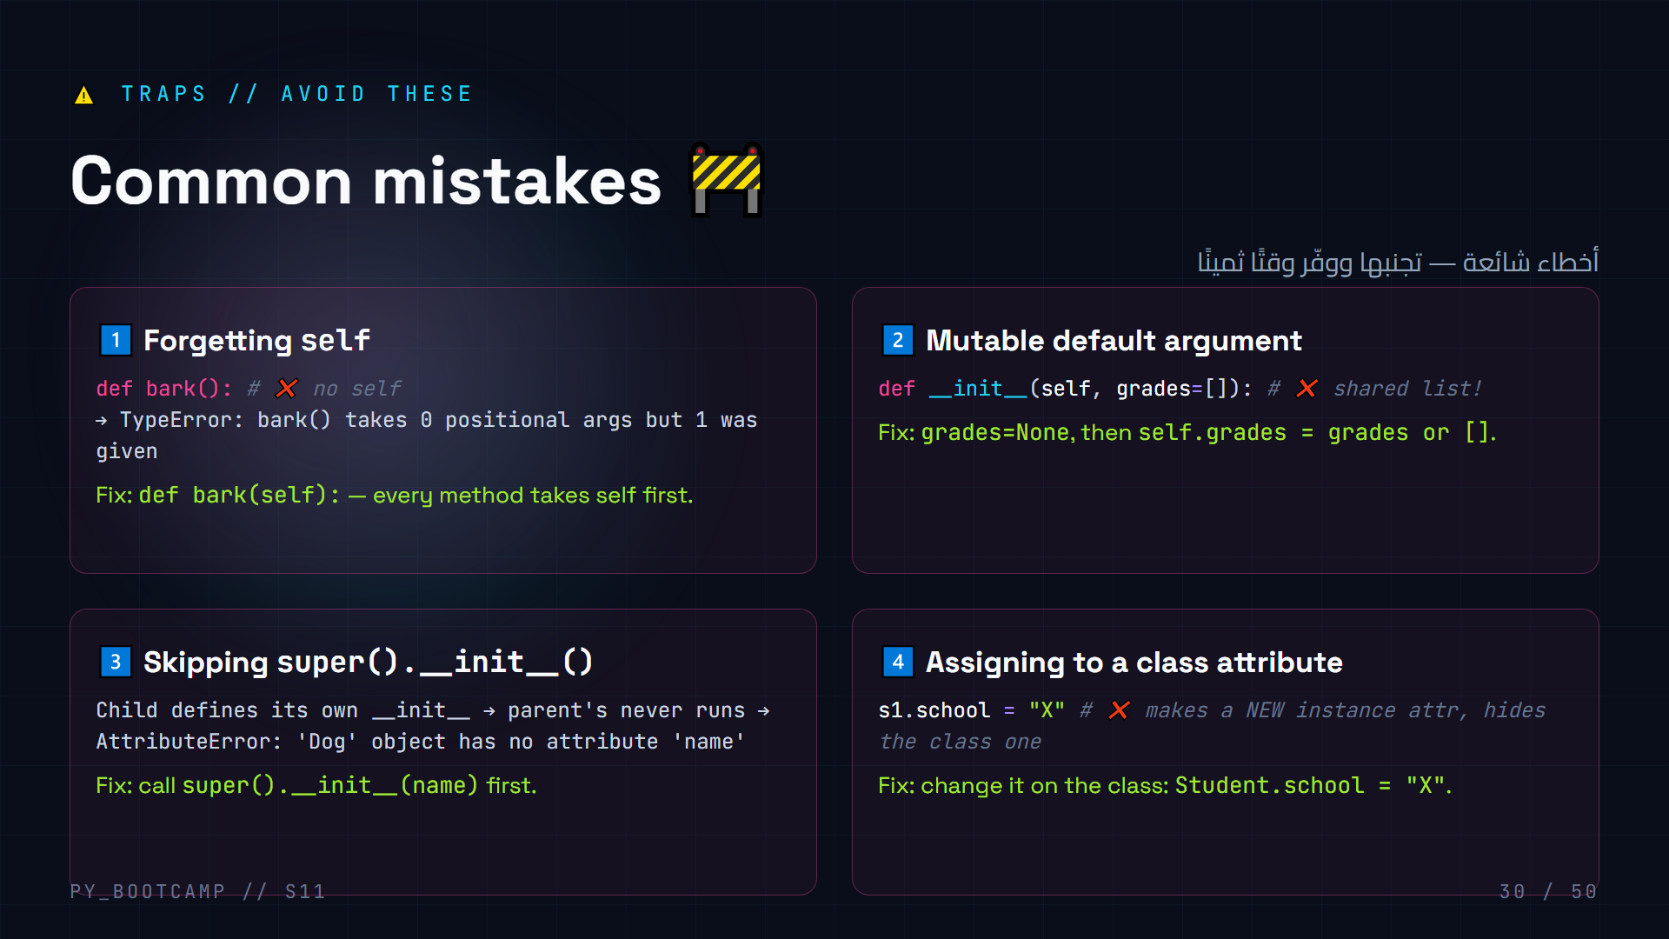
Notes:
**Walk each trap live — show the error, then fix it. These are the top mistakes you'll see in this class.**
1. Missing self → TypeError. Model fixing it in the editor.
2. Mutable default `grades=[]` → ALL students share ONE list (silent!). Demo: two students, add a grade to s1, s2 has it too. Fix with None.
3. Forgetting super() → AttributeError on `name`. Demo creating a Dog and touching rex.name.
4. `s1.school = "X"` creates an instance attribute; `Student.school` still "Neon High". Demo the confusion.
Arabic tip: «أربع حفر مشهورة» — four famous pitfalls.
Time check: this is a good spot for a stretch break. Then refactoring + the project.

Slide 31
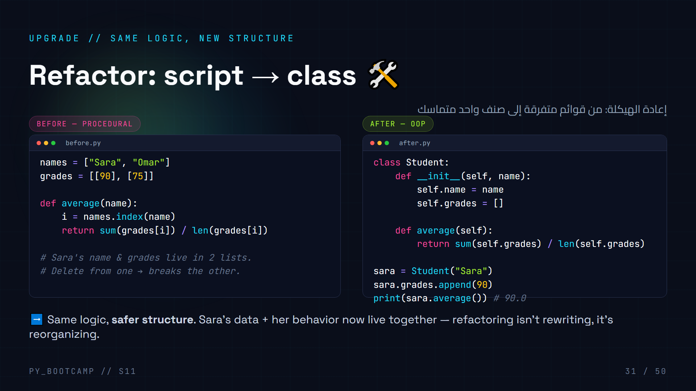
Notes:
**Refactoring = changing structure without changing behavior.**
- Walk both panels line by line: the "after" version computes the exact same average, but the data can't drift out of sync anymore.
- This is the answer to the hook slide: this is how you'd actually fix the messy `grades.py` from slide 02.
- Refactoring recipe (write on board):
1. Find the nouns → classes (Student).
2. Move each noun's data in (name, grades).
3. Move each verb in (average).
4. Run the tests — same output, better code.
- Arabic tip: «إعادة الهيكلة» = refactoring — change the shape, keep the meaning.
- Transition to the project: "Let's do this for real — a whole Bank."

Slide 32
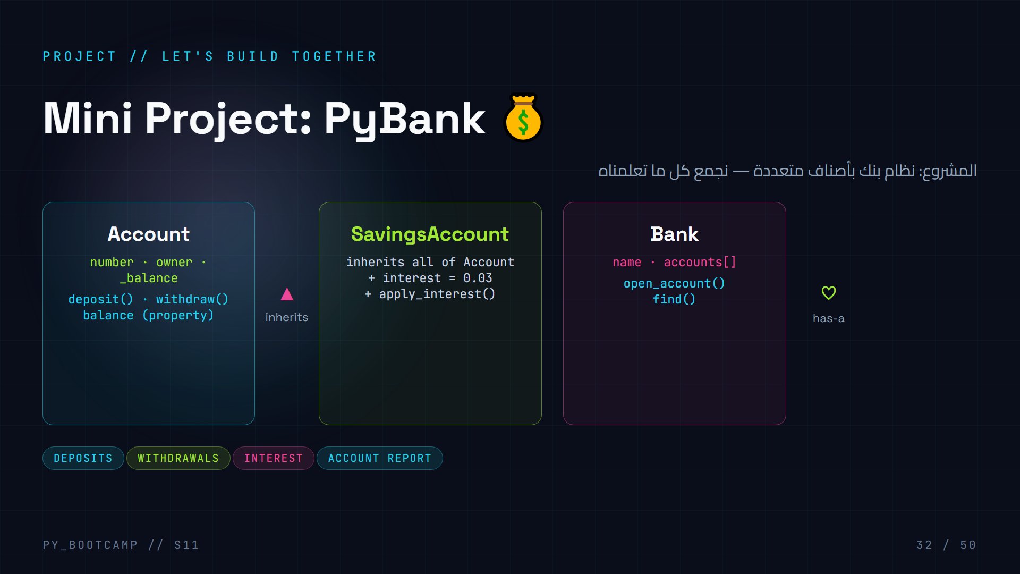
Notes:
**Project kickoff.** Present the design BEFORE any code — this is how real software starts.
- Three classes: Account (base), SavingsAccount (child — inheritance), Bank (container — composition).
- Point out we're using EVERYTHING: attributes, methods, property, super(), inheritance.
- Divide into two files like a real project: `bank_1.py` (classes) and `bank_2.py` (the demo).
- Rules for the live build: students type, you type, everyone runs together. Speed = one small step per student.
- Arabic tip: «صمّم المخطط قبل الكود» — draw the plan before coding.
- Get excited: "This is a real mini-application, not a toy."
- Next two slides are the code; third is the output. Keep momentum.

Slide 33
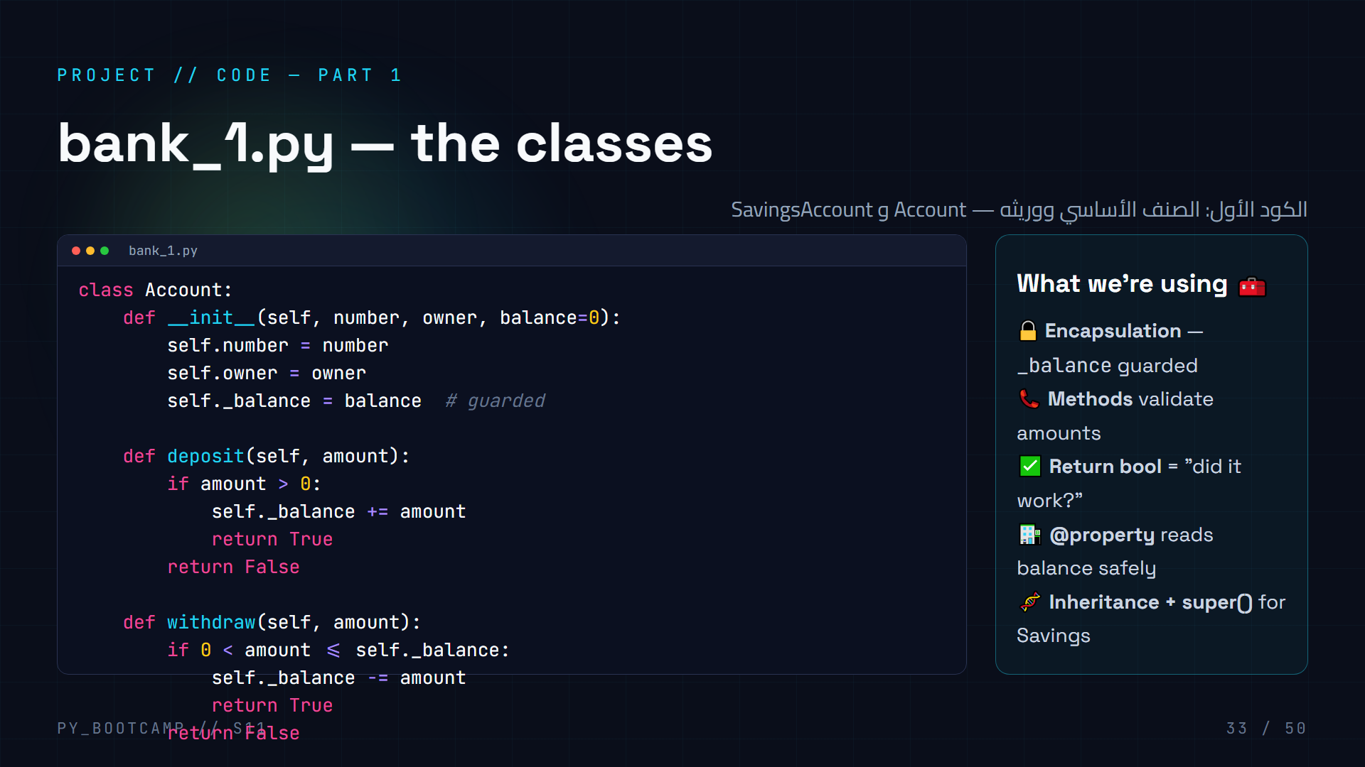
Notes:
**Live-build part 1 — every student types `bank_1.py`.**
- Write it line by line, pausing after each method. Ask what each returns.
- `withdraw` returns False when amount > balance → caller can check. This "bool result" pattern is idiomatic.
- Note `@property` here — reading `acc.balance` calls the getter (clean, read-only; no setter needed).
- SavingsAccount: only adds `interest` + `apply_interest`, everything else inherited. Point at super() reuse.
- Test each part as you go: create an account in the interpreter, deposit/withdraw, print balance.
- Arabic tip: «كل سطر نتأكد منه قبل أن نكمل» — verify each step before moving on.
- Don't write `bank_2.py` yet — next slide.

Slide 34
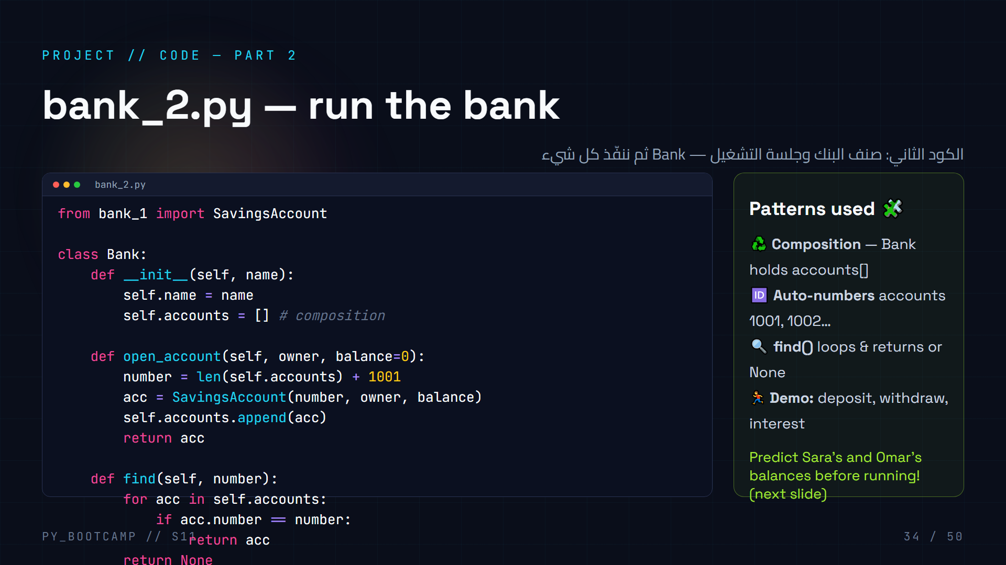
Notes:
**Live-build part 2 — `bank_2.py`.**
- `from bank_1 import SavingsAccount` — importing their own module. Both files in the same folder.
- Bank uses composition: `self.accounts = []`, filled by `open_account`.
- Auto-numbering: `len(accounts) + 1001` → 1001, 1002. Small, satisfying trick.
- `find()` demonstrates returning `None` when nothing matches — the caller can test it.
- Pause: **ask the class to predict the output** before running. Sara: 100 + 200 = 300. Omar: 50 − 20 = 30, then +3% → 30.9.
- Run it together. Celebrate the working app 🎉.
- Arabic tip: «توقّع قبل أن تشغّل» — predict before you run.
- This is the payoff slide — save a minute to let it land.

Slide 35
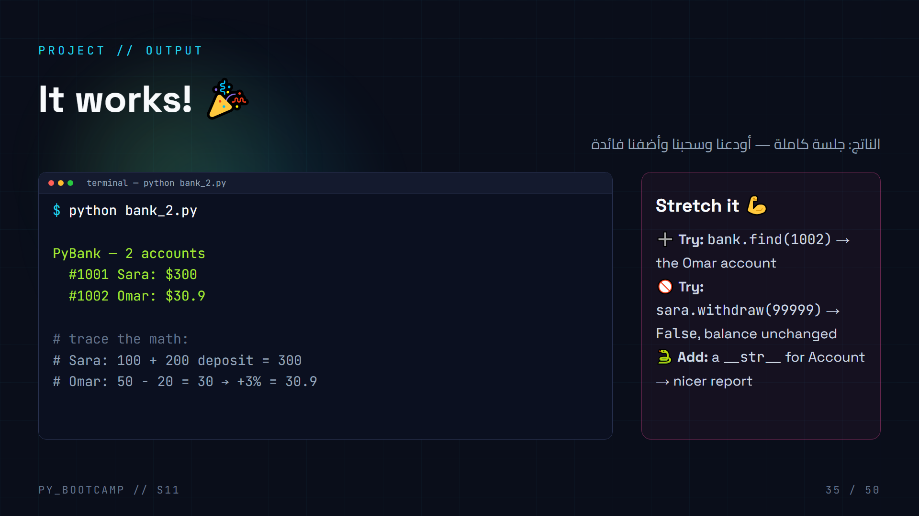
Notes:
**Celebrate the working mini-app — then stretch it.**
- Recap the trace: 100+200=300; 50−20=30; 30×0.03=0.9 → 30.9. Their prediction from last slide should match.
- Stretch tasks (2-3 min, pairs): call find(1002), attempt an over-withdrawal, add a `__str__` to Account.
- For over-withdrawal: `withdraw` returns False, balance stays. Great encapsulation demo — the bank "refuses".
- Show the "account" as an object: type(sara), sara is a SavingsAccount.
- Arabic tip: «الآن التطبيق يرفض العمليات غير الصالحة» — the app rejects invalid operations.
- Next: keep the energy — challenges, exercises, homework, quiz.

Slide 36
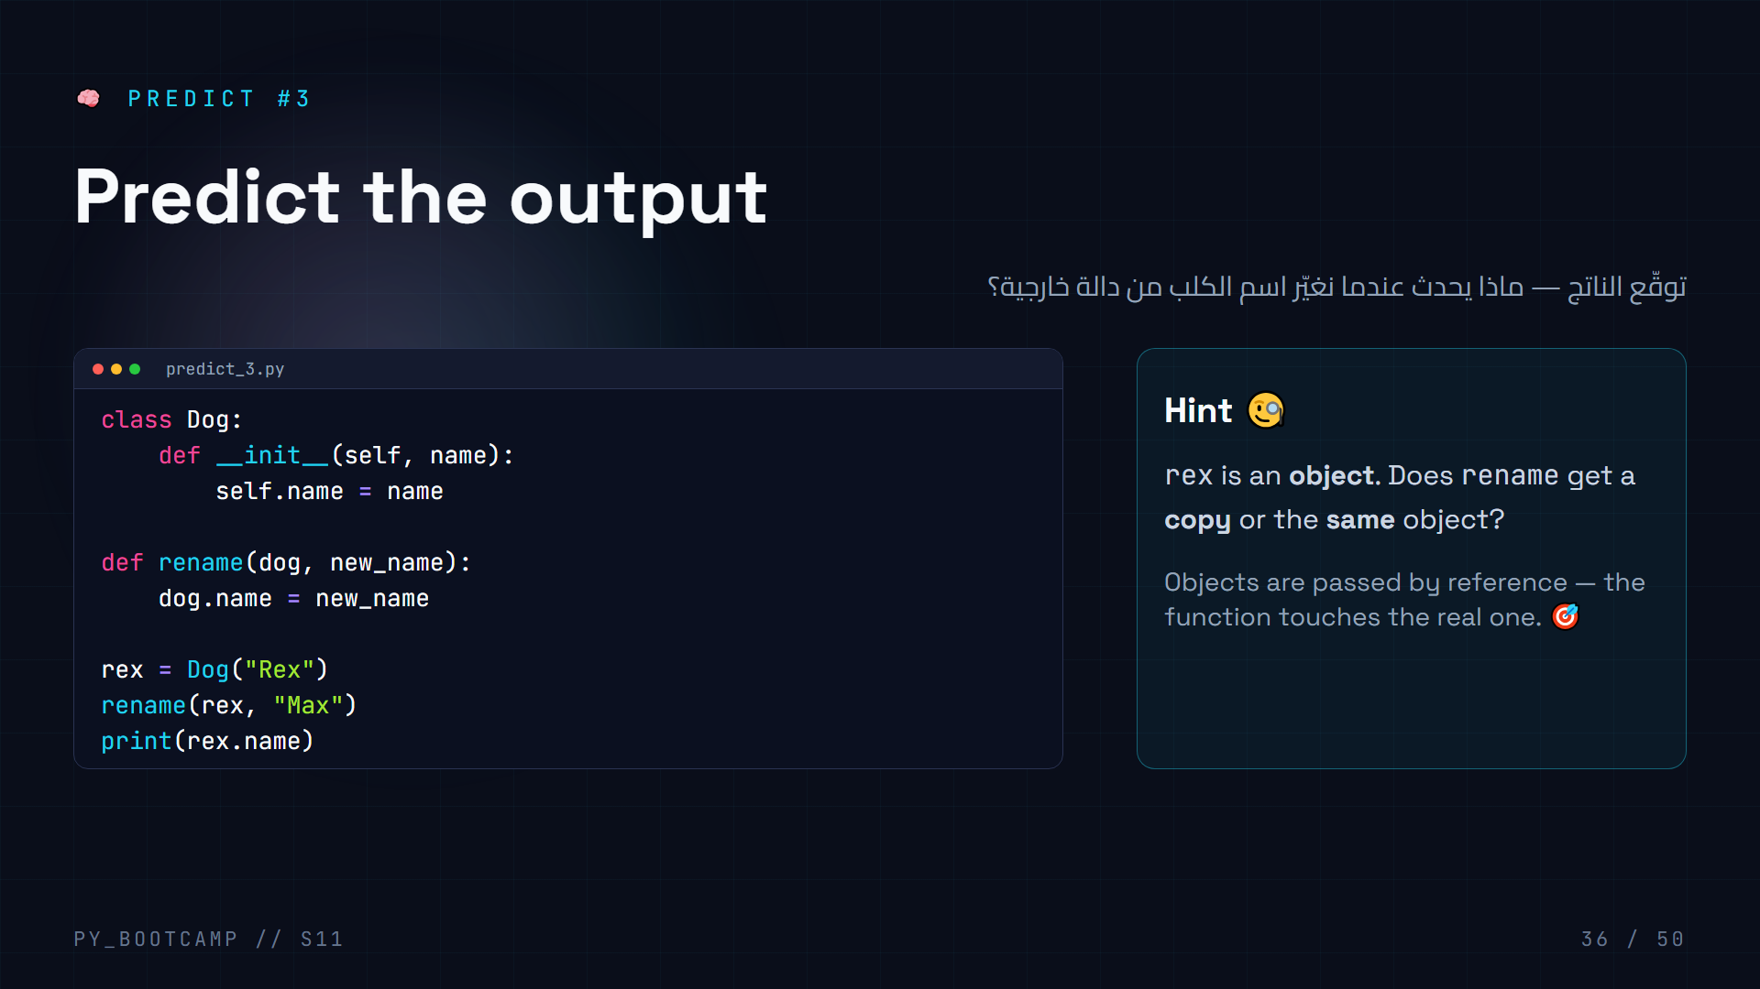
Notes:
**Answer: `Max`.**
- `rename(rex, "Max")` passes the *reference* to rex — mutating `dog.name` mutates the actual object, so rex.name becomes "Max".
- Contrast with immutable types: `int`, `str`, `tuple` are copied on assignment; lists/dicts/objects are shared by reference.
- Quick follow-up: "What if rename did `dog = Dog(new_name)` instead?" → that reassigns the local name and the original stays "Rex" (no effect).
- This is an important mental model for the project and for debugging.
- Arabic tip: «الكائنات تُمرَّر بالمرجع» — objects are passed by reference.
- If class is struggling, draw two boxes: local variable vs heap object.

Slide 37
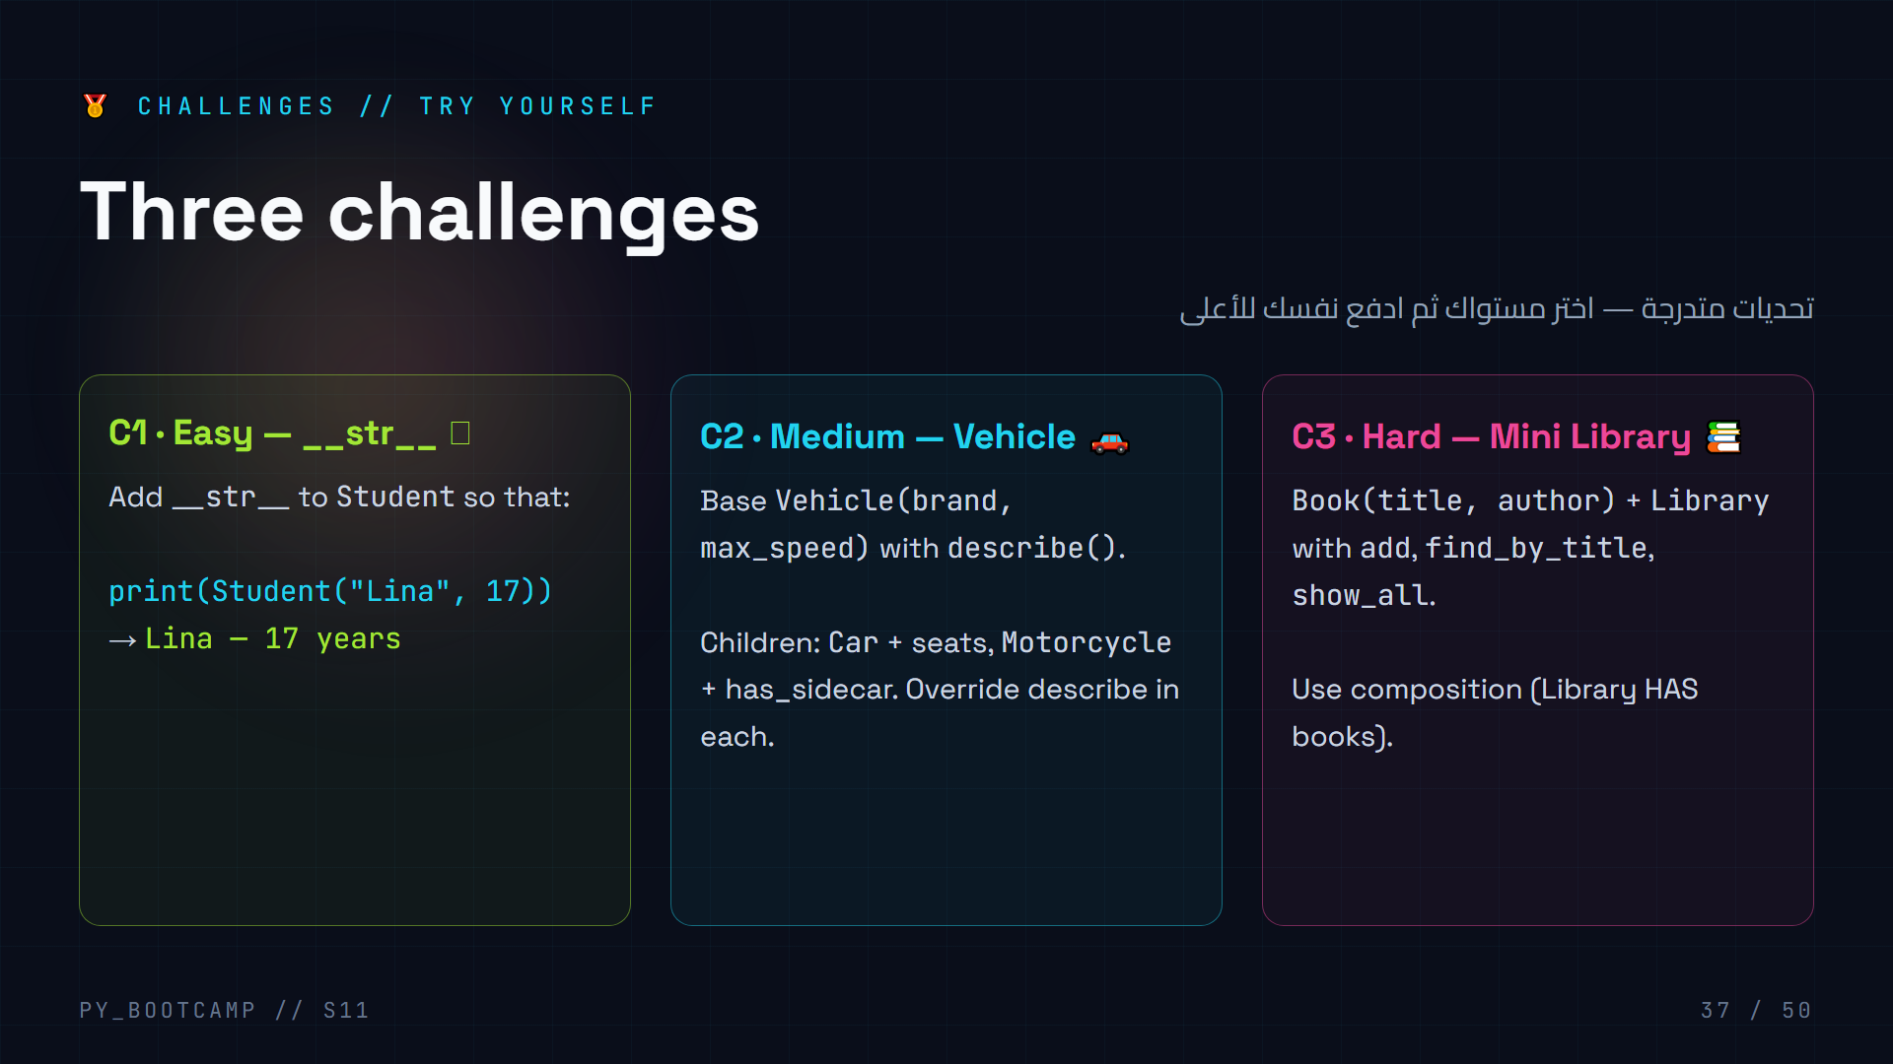
Notes:
**10 minutes, individual or pairs.** Everyone starts at C1, then goes as far as possible.
- C1 solution: `def __str__(self): return f"{self.name} — {self.age} years"`.
- C2 solution sketch: base sets brand/max_speed; Car adds seats and describe returns f"{brand} car with {seats} seats"; Motorcycle similar. Overriding demo.
- C3 solution sketch: Library holds `self.books = []`; add appends; find_by_title loops and returns book or None (same pattern as Bank.find); show_all loops and prints.
- Circulate and help: the most common blockers are forgetting self, and returning None vs printing.
- Arabic tip: «ابدأ السهل، واصعد» — start easy, climb higher.
- C3 is basically homework preview — completing it = homework half done.

Slide 38
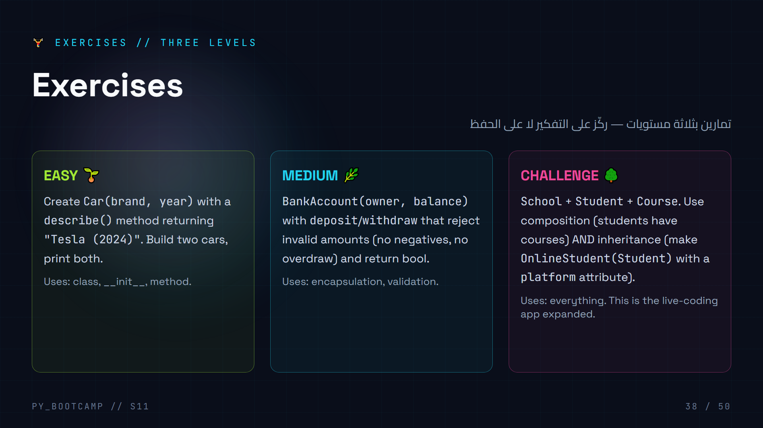
Notes:
**15 minutes, silent work, solo first.** Emphasize: think, then code.
- EASY solution: `class Car: def __init__(self, brand, year): self.brand=brand; self.year=year` + `def describe(self): return f"{self.brand} ({self.year})"`.
- MEDIUM: reuse the Account pattern from the project — validate amount>0 and amount<=balance, return bool.
- CHALLENGE: three classes, composition + inheritance. Students who finish C3 earlier can skip some homework steps.
- Circulate; when several finish, go through one solution at the projector quickly.
- Arabic tip: «التفكير قبل الكتابة» — think before typing.
- These exercises feed directly into the homework.

Slide 39
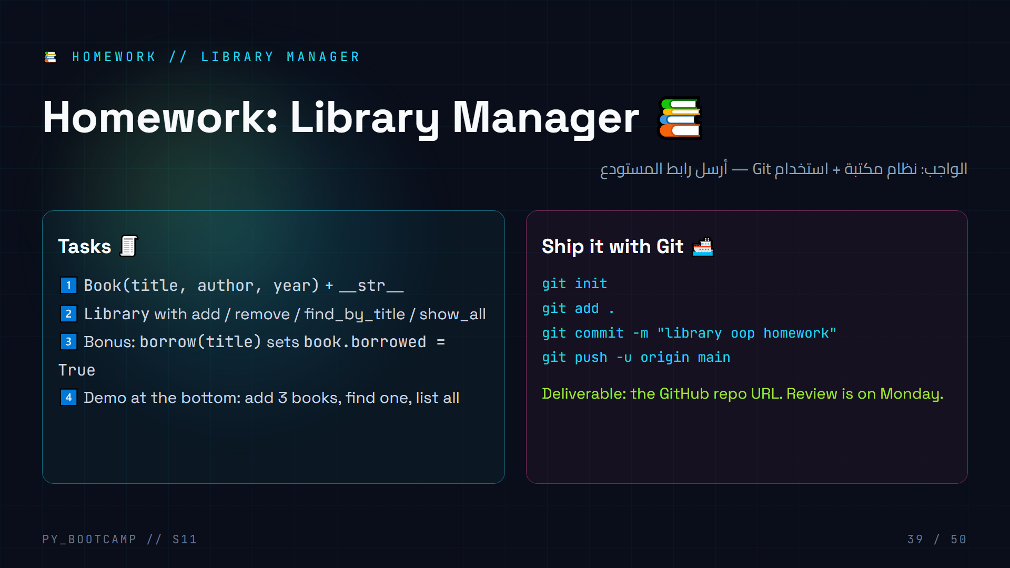
Notes:
**Homework = build a Library Manager, ship via Git. Ties the session to last week.**
- Go through the tasks; the Library structure mirrors Bank (composition + find returning None).
- Remind them of the review-MCQ answers from the start: add → commit → push.
- Deadline + submission: GitHub repo URL (in the chat / LMS). Monday review.
- Encourage: homework is graded on *working code that runs*, not perfect design. Running > elegant.
- Arabic tip: «أرسل رابط المستودع» — submit the repo link.
- Give the stretch: borrow() with a bool return, and preventing double-borrow.
- Quick check they know where to start: "What class first?" → Book (it's the leaf).

Slide 40
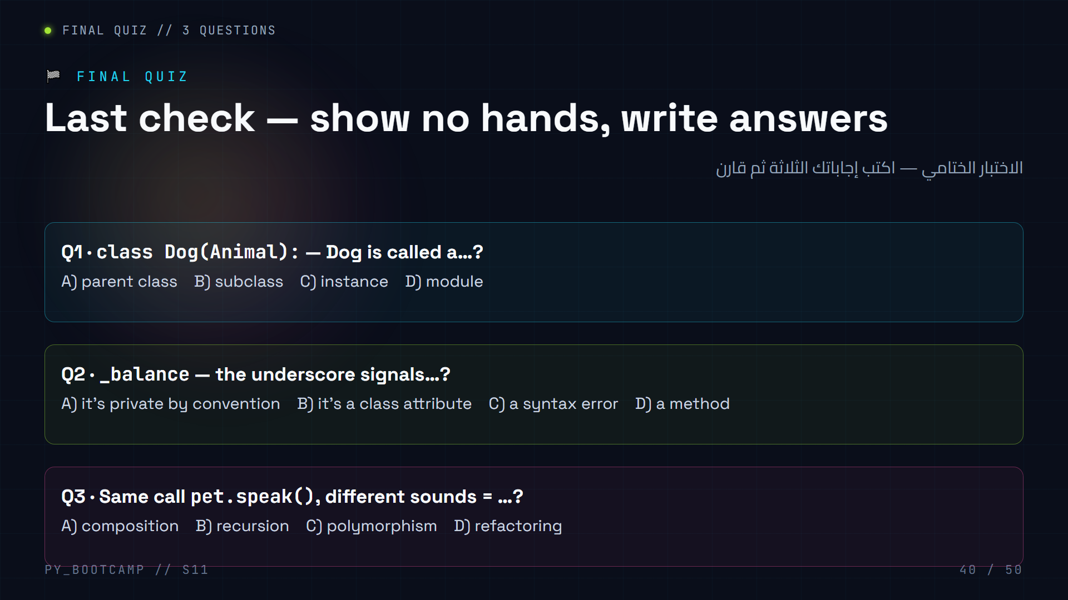
Notes:
**Answers: Q1 = B (subclass), Q2 = A (private by convention), Q3 = C (polymorphism).**
- Give 2 quiet minutes. Then "pair-check" with a neighbor before revealing.
- Q1 trick: "subclass" is the precise word for the child class. Some may pick "instance" — clarify instance = a single object, subclass = the class itself.
- Q2 trick: underscore is a *convention*, not enforced — reinforce that distinction.
- Q3 is the vocabulary of the day — everyone should get it.
- Arabic tip: «الابن = subclass، خاصية داخلية = private» — review the two words.
- Collect mental note of who's shaky; pair strong students with weak ones for the project stretch.

Slide 41
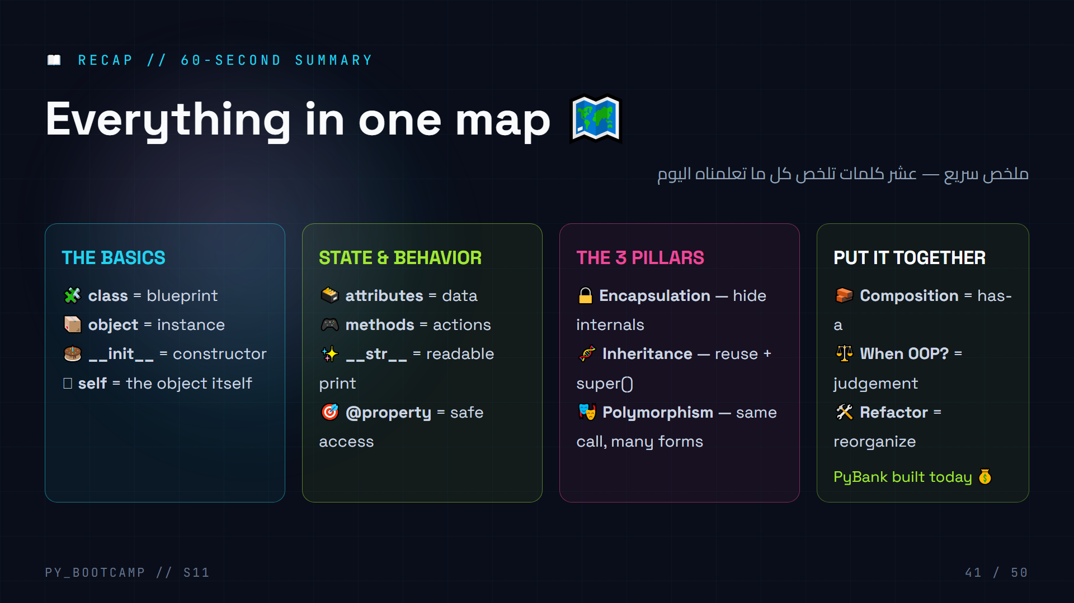
Notes:
**60-second recap — rapid-fire.**
- Go card by card, one word each: "class? blueprint. self? the object. Inheritance? reuse. Polymorphism? same call different result."
- Have the class *say* the words back — choral repetition locks vocabulary.
- Point at PyBank as proof: "We built a real app using every single card here."
- Arabic tip: اقرأ البطاقات الأربع بالعربية سريعًا: مخطط، كائن، دالة بناء، الوراثة.
- Timebox strictly: 60-90 seconds max. Then bridge to next session.

Slide 42
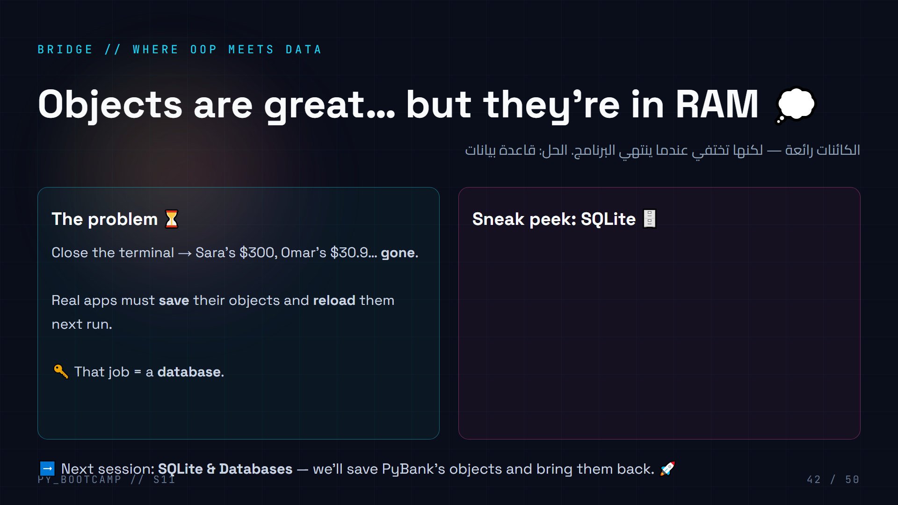
Notes:
**Bridge slide.** Point at the real limitation of what we built today: no persistence.
- Recap: Sara and Omar's balances vanish on exit. Real software persists state.
- The SQL snippet is a *taste* — don't teach it now. Just say: "next session you'll save objects to a file-backed database and load them back."
- This connects OOP (their mental model) to databases (where data lives) — objects ↔ rows.
- Arabic tip: «قاعدة البيانات» = database — المكان الذي تبقى فيه الكائنات بعد إغلاق البرنامج.
- Tease the mapping: one object ≈ one row. One class ≈ one table.
- Keep this slide short — the teaser slide follows.

Slide 43
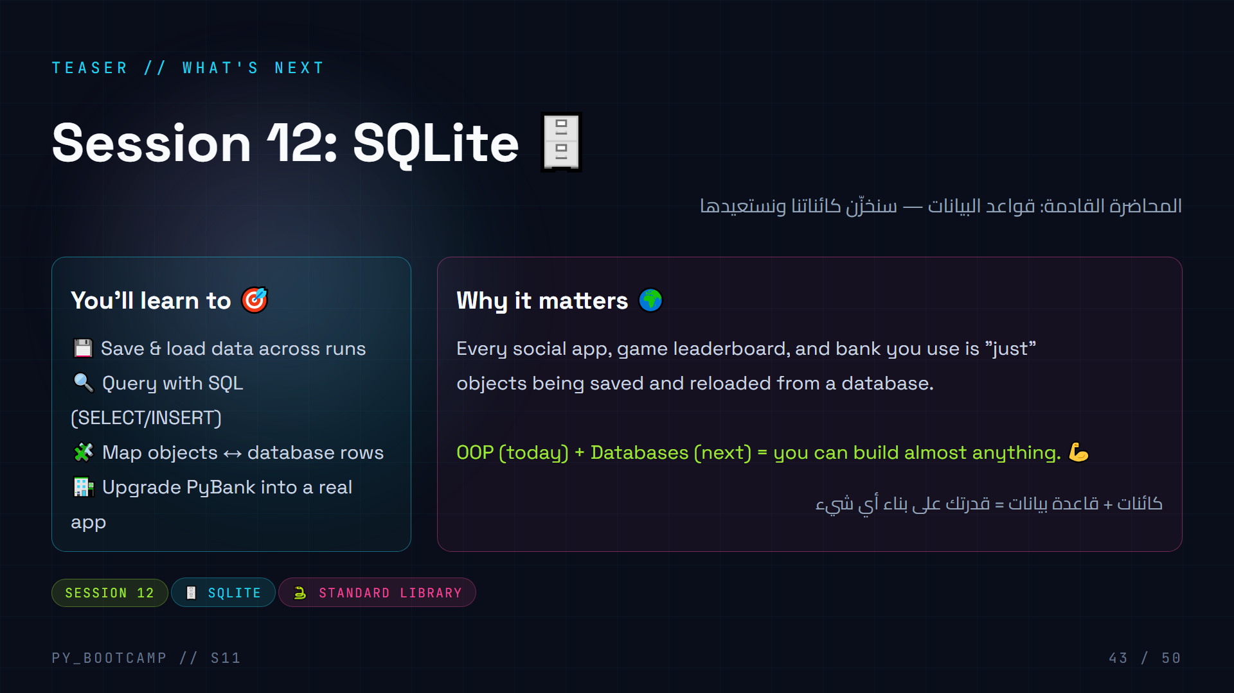
Notes:
**Teaser — get them excited for next week.** Build anticipation, no teaching.
- "Leaderboards, chats, your bank — they all just save objects and reload them."
- Announce the agenda of Session 12 (SQL, persistence, finishing PyBank).
- Tie to today: everything they learned today will be *used* next session — OOP is the mental model; SQL is the storage.
- Arabic tip: «الاستمرارية» = persistence — the data survives.
- End with a rhetorical question: "What would YOU build if your objects could survive a restart?"
- Quick 10-second breather before the closing slide.

Slide 44
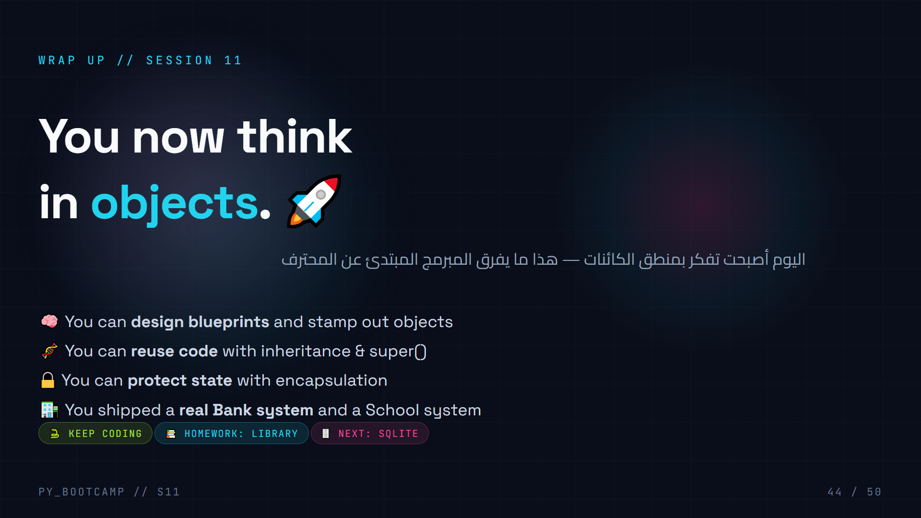
Notes:
**Closing slide — big emotional beat.**
- Slow down, make eye contact: "Three hours ago 'class' was a keyword you'd never used. Now you've built two apps."
- Recap what they *can do now* — let them hear it as a list of powers, not facts.
- Remind homework + deadline. Mention the repo URL requirement once more.
- End with one line: "Go build something. See you next session." — confident, not cheesy.
- Arabic tip: اختتم بعبارة قصيرة: «ابنِ شيئًا رائعًا».
- After class: collect questions, share slides, point to the cheat-sheet (next slide).

Slide 45
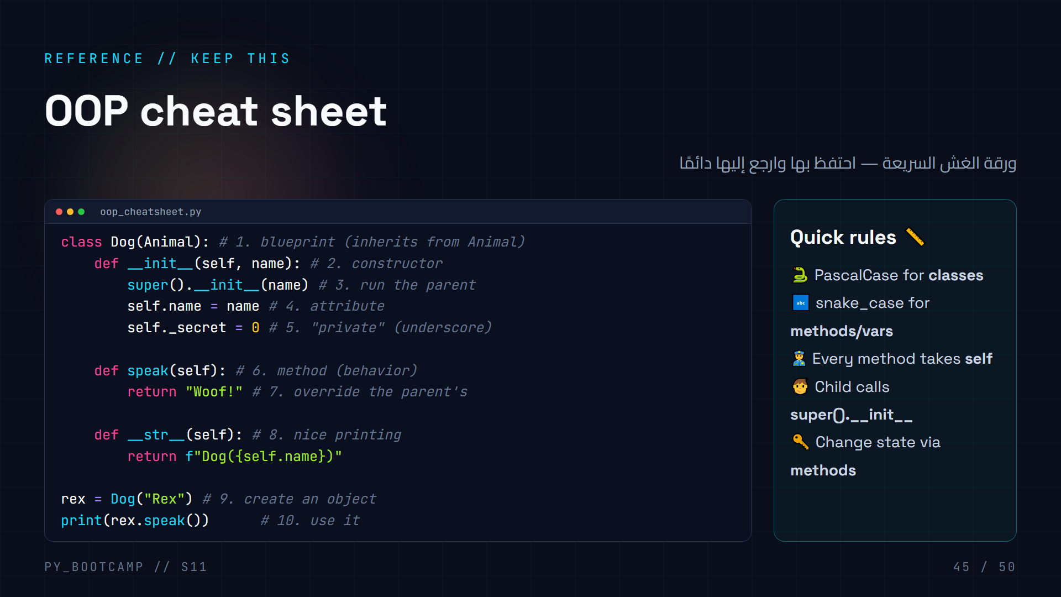
Notes:
**Cheat sheet — reference slide students keep.**
- Read through the 10 numbered lines fast; each maps to a slide from today.
- Point out this exact pattern is what the homework Library looks like.
- Tell them: "When stuck on homework, open this slide." (Share the deck file after class.)
- Arabic tip: «رقم 5: الشرطة السفلية تعني خاصية داخلية» — underscore = internal.
- Closing tip: the fastest way to get better is retyping this whole file from memory.
- Transition: a couple of extra prediction + live-coding slides follow — these are bonus review for fast finishers.

Slide 46
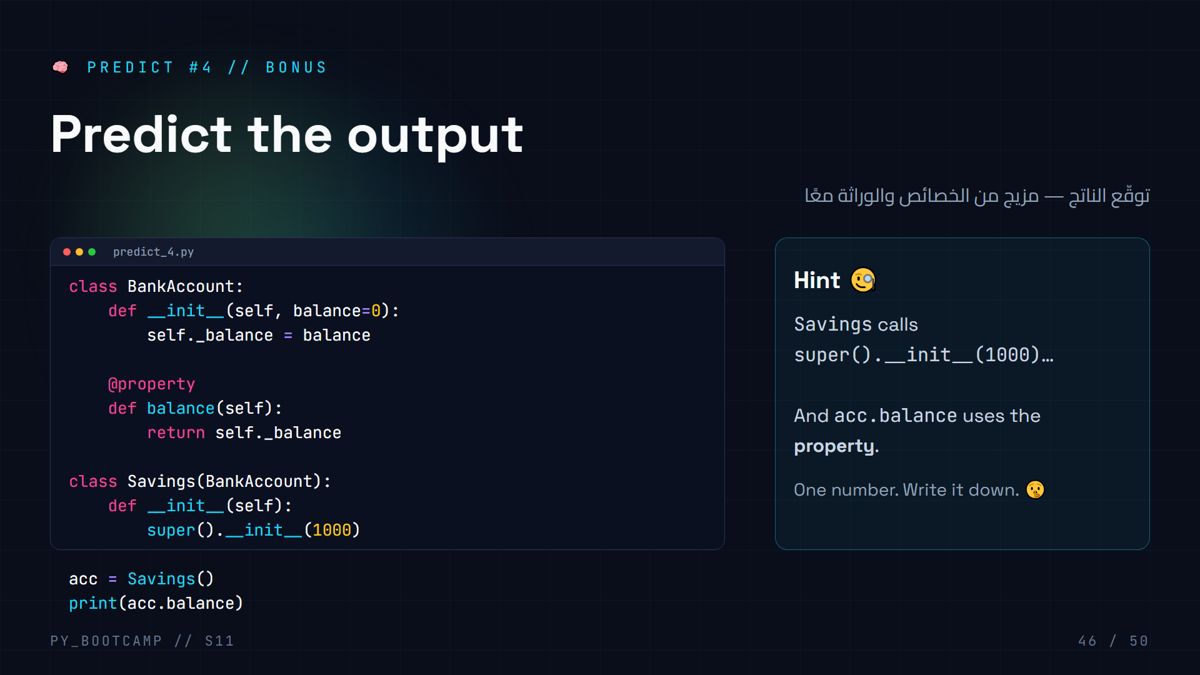
Notes:
**Answer: `1000`.**
- `Savings()` → its own `__init__` runs → `super().__init__(1000)` sets `_balance = 1000` on the parent's behalf.
- `acc.balance` → hits the inherited `@property` getter → returns `_balance` → 1000.
- Three concepts in one output: inheritance, super(), property. That's the whole day in 11 lines.
- If a student predicts an AttributeError, remind them the property is inherited, not lost.
- Arabic tip: «الخاصية والوراثة يعملان معًا» — properties and inheritance work together.
- This is optional/bonus — only run if the class wants one more brain teaser.

Slide 47
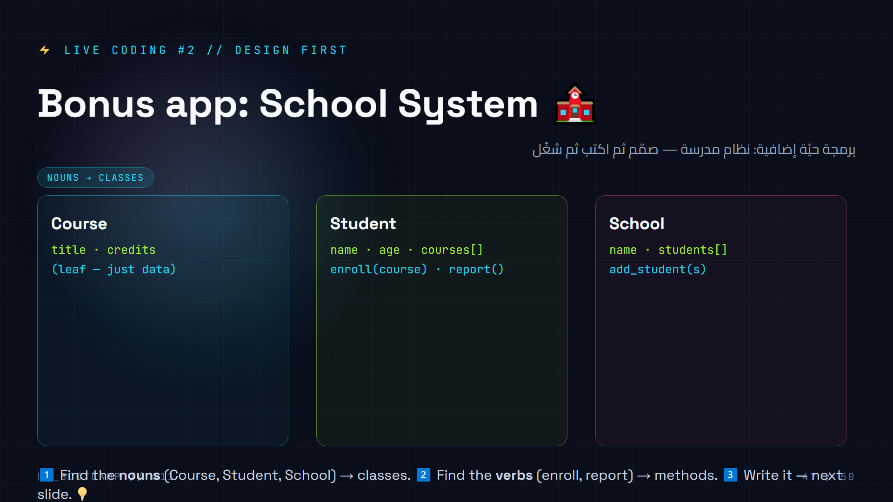
Notes:
**Bonus live-coding — full design-first flow. Repeat the "nouns → verbs" recipe they saw in refactoring.**
- Step 1 with the class: shout the nouns of a school system → Course, Student, Teacher, School, Room. Pick three for today.
- Step 2: verbs → enroll, report, add_student.
- Step 3 (next slide): write the three classes and run.
- Composition everywhere: Student HAS courses (list), School HAS students (list). Course is a leaf (data-only).
- Arabic tip: «الأسماء → أصناف، الأفعال → دوال» — nouns → classes, verbs → methods.
- This is fast — 10 minutes total for both slides. It cements the design skill better than anything else.
- If time is short: students write it solo from the design; you demo the run.

Slide 48
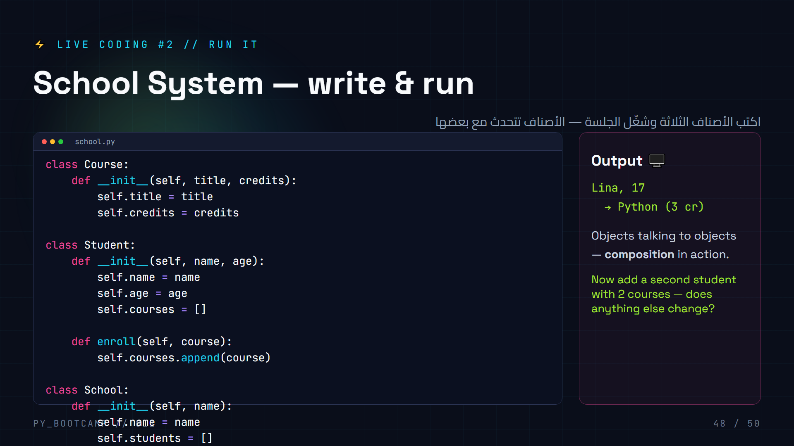
Notes:
**Write + run the school app live. This mirrors exactly the C3 challenge and homework structure.**
- Have students type the whole file, then run together. Celebrate output "Lina, 17 → Python (3 cr)".
- Ask the challenge question: add Omar with two courses — the loop already handles it. Nothing else changes. (That's composition + uniform interface.)
- Point out the "dot chains": `school.students` → objects, `s.courses` → objects, `c.title` → data. Objects containing objects containing data.
- Arabic tip: «كائنات تتحدث مع كائنات» — objects talking to objects.
- Fast finishers: convert Student to inherit from a `Person` base (name, age) — the live demo of inheritance inside composition.
- Wrap: "That's two apps in one session."

Slide 49
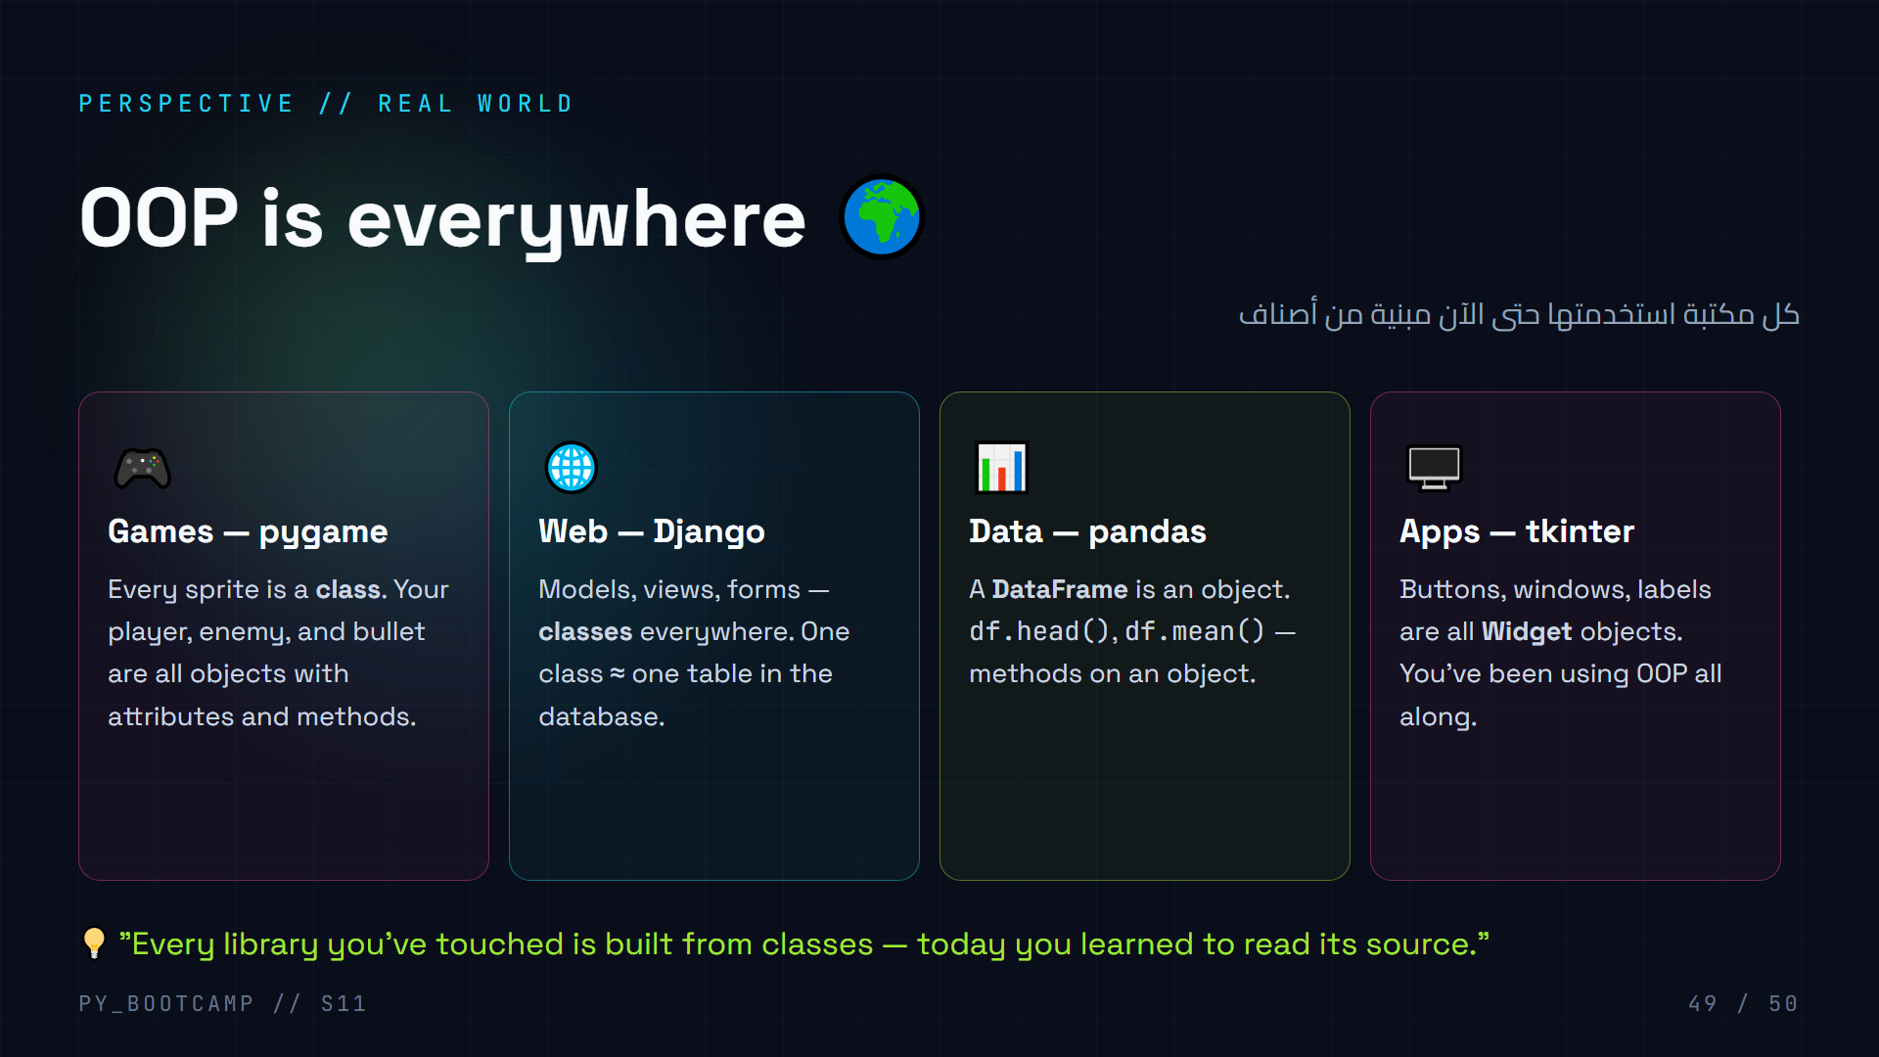
Notes:
**Perspective slide — why this session matters beyond the bootcamp.**
- Every example is something they've *already used* (or will soon): pygame sprites, Django models, pandas DataFrame, tkinter widgets. All classes.
- This is the "aha" moment for many: the dot after `df.head()` is exactly `self` in disguise.
- In Arabic: «أصبحت تقرأ سطورًا رأيتها طوال الوقت» — you can now read code you've only used.
- Optional homework link: read the source of one method you love (`list.append` is C, but pandas is Python).
- Keep energy high — one slide left, the full map.

Slide 50
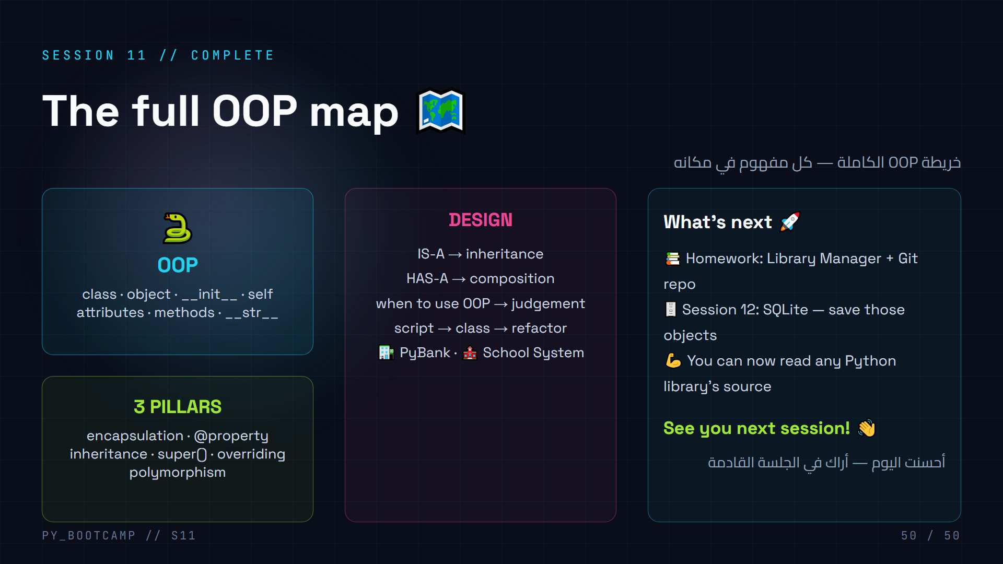
Notes:
**Finale — the whole session on one screen. End with confidence, not recap-drag.**
- Quickly trace the map: vocabulary → 3 pillars → design → what's next. ~45 seconds.
- Remind homework once more (Library + repo URL), then the send-off.
- Close the room loop: start was "one script too many lists" — end is "two apps + a map". Let them feel the growth.
- Arabic send-off: «أراك في الجلسة القادمة» — see you next session.
- Optional: keep the cheat-sheet (slide 45) visible as a parting screenshot.
- After class: thank them, remind to push homework, share the deck link.

