Slide 1
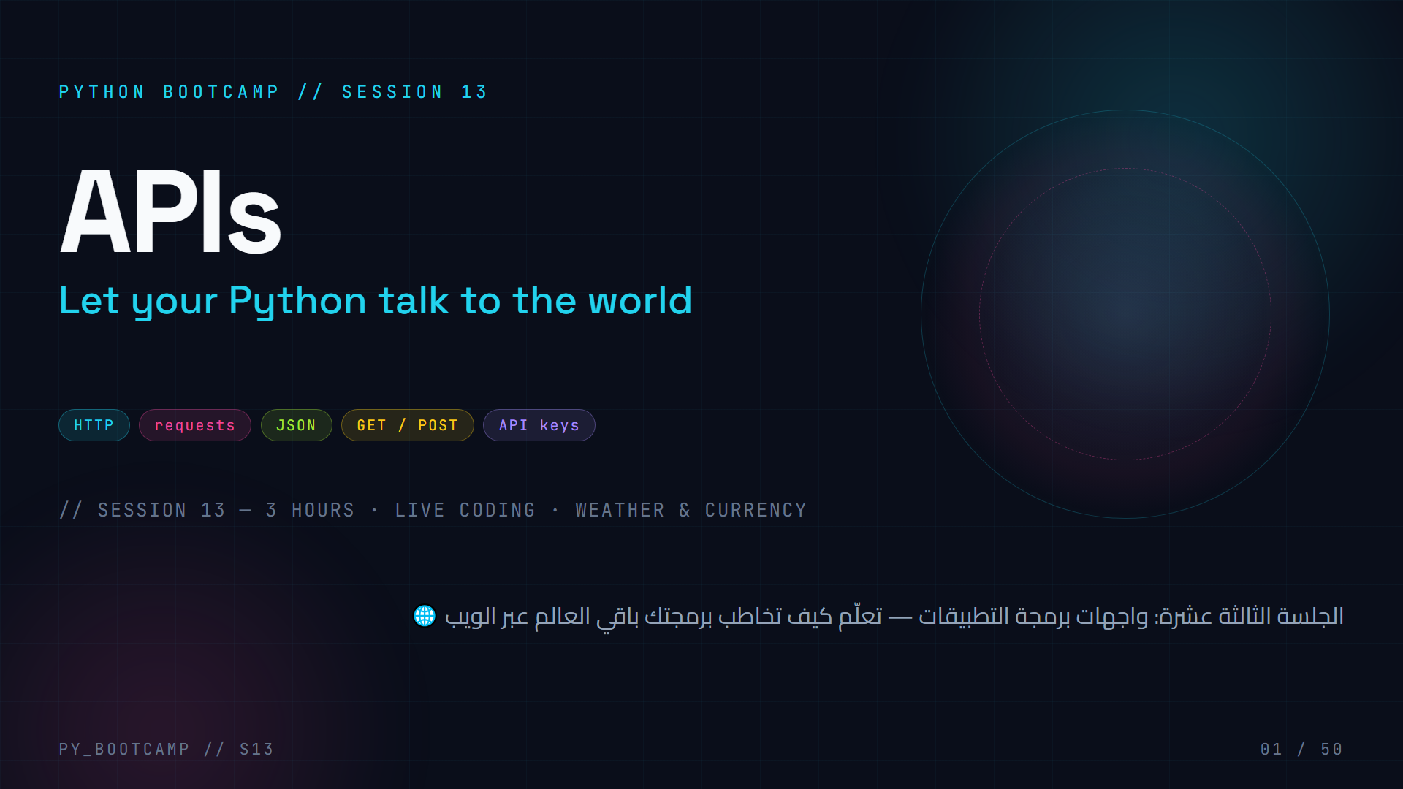
Notes:
Welcome to Session 13! Today we flip a switch: your Python programs stop living in a bubble and start talking to the whole Internet.
Agenda of the slide: pure hype + roadmapping. Tell them: "By the end of today, each of you will write Python code that asks a real weather server a question — and gets a real answer back."
Key motivational framing for ages 15–22: this is the session where code becomes *useful* — the same technique powers phone weather apps, price trackers, Discord bots, and ChatGPT's plugin layer.
Arabic tip: وضّح أن "API" اختصار لـ Application Programming Interface أي "واجهة برمجة التطبيقات"، وهي مجرد وسيلة منظمة لبرنامجين يتحدثان مع بعض.
Common misconception to pre-empt: an API is NOT a website. It is the *messaging channel* a program uses. Websites are for humans; APIs are for programs.

Slide 2
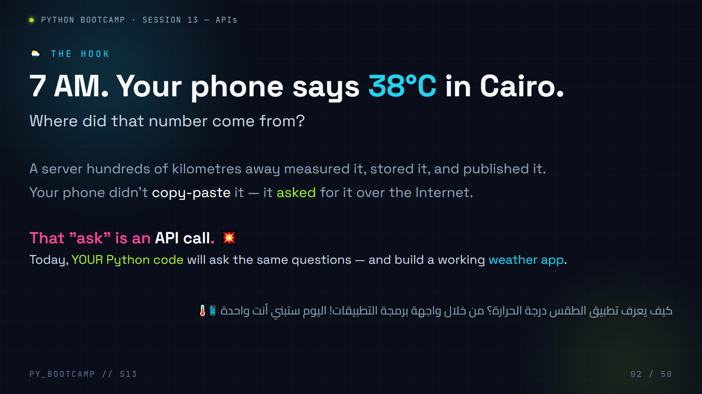
Notes:
The hook. Goal: make APIs feel personally relevant.
Ask the room: "Who checked the weather on their phone this morning?" Most hands go up. Then: "Who wrote that temperature by hand?" Silence. "So SOMETHING fetched it. Today, you become that something."
The hook shows the exact same flow we will code in slides 34–35: phone → server → answer.
Activity (2 min): have students shout the first API you might call to make the deck's own weather app — expect "weather API", "OpenWeatherMap", "something with the weather".
Common mistake to prevent later: students think a website and an API are the same. A website returns pretty HTML for humans; an API returns structured JSON for programs. We will hammer this in slides 23–24.
Arabic tip: اطرح السؤال: "من فتح تطبيق الطقس اليوم؟" ثم اربط الفضول بالدرس. عبارة قوية: "اليوم أنت مَن يصنع الإجابة."

Slide 3
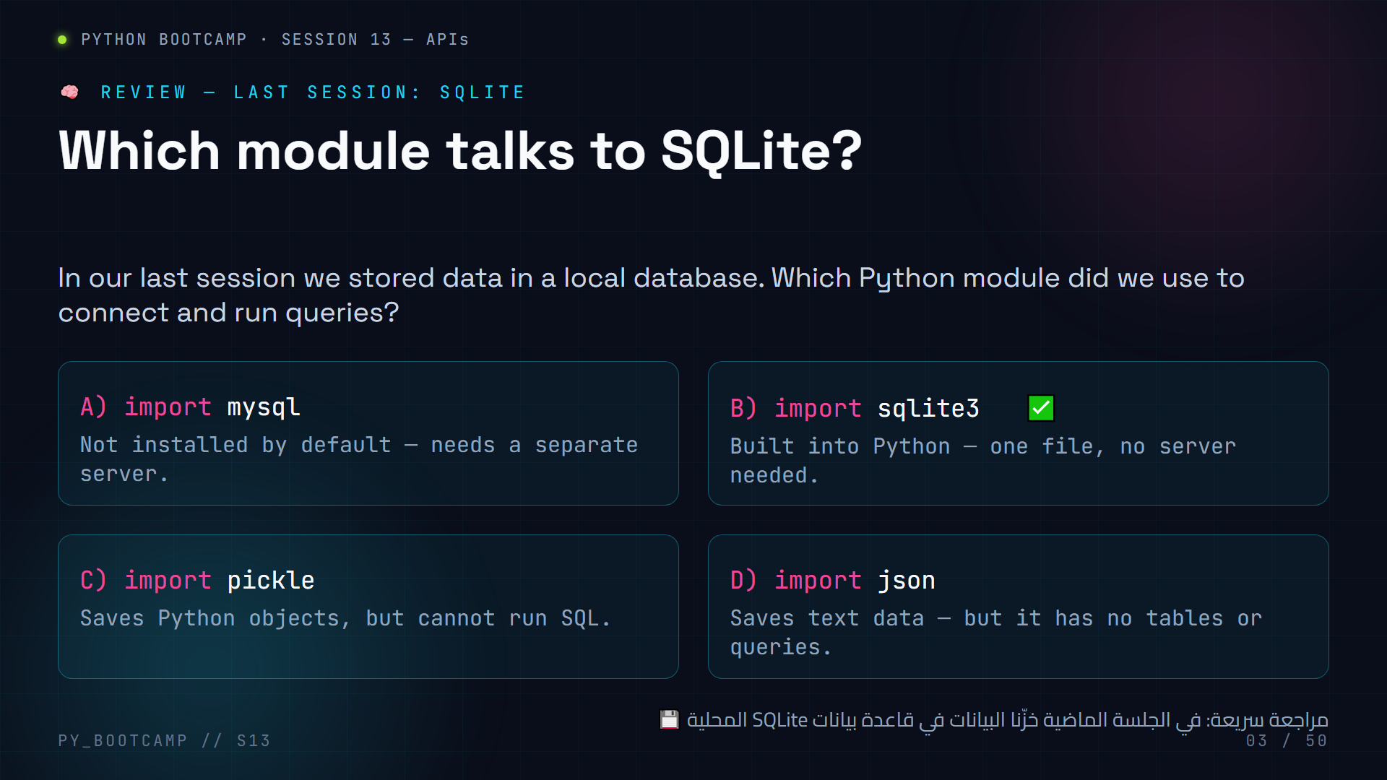
Notes:
MCQ 1 — review of SQLite (previous session). Answer: **B) import sqlite3**.
Why it matters today: last session we stored data *locally* (own database). Today we fetch data *remotely* (someone else's server). The module changes, but the mindset — "connect, run something, get data back" — is the same.
Pacing: 40 seconds of silence, then "hands up for A? B? C? D?", then reveal B. Explain: `sqlite3` ships with Python; MySQL needs an external server; pickle stores objects but cannot query; json is text-only.
Optional quick demo (20 s): run `import sqlite3; conn = sqlite3.connect("test.db")` and show the file appears on disk. Sets up today's contrast with remote data.
Arabic tip: اشرح أننا انتقلنا من "قاعدة بيانات على جهازك" إلى "بيانات على خادم بعيد" — الفكرة نفسها، لكن البيانات أصبحت تُجلب عبر الإنترنت.

Slide 4
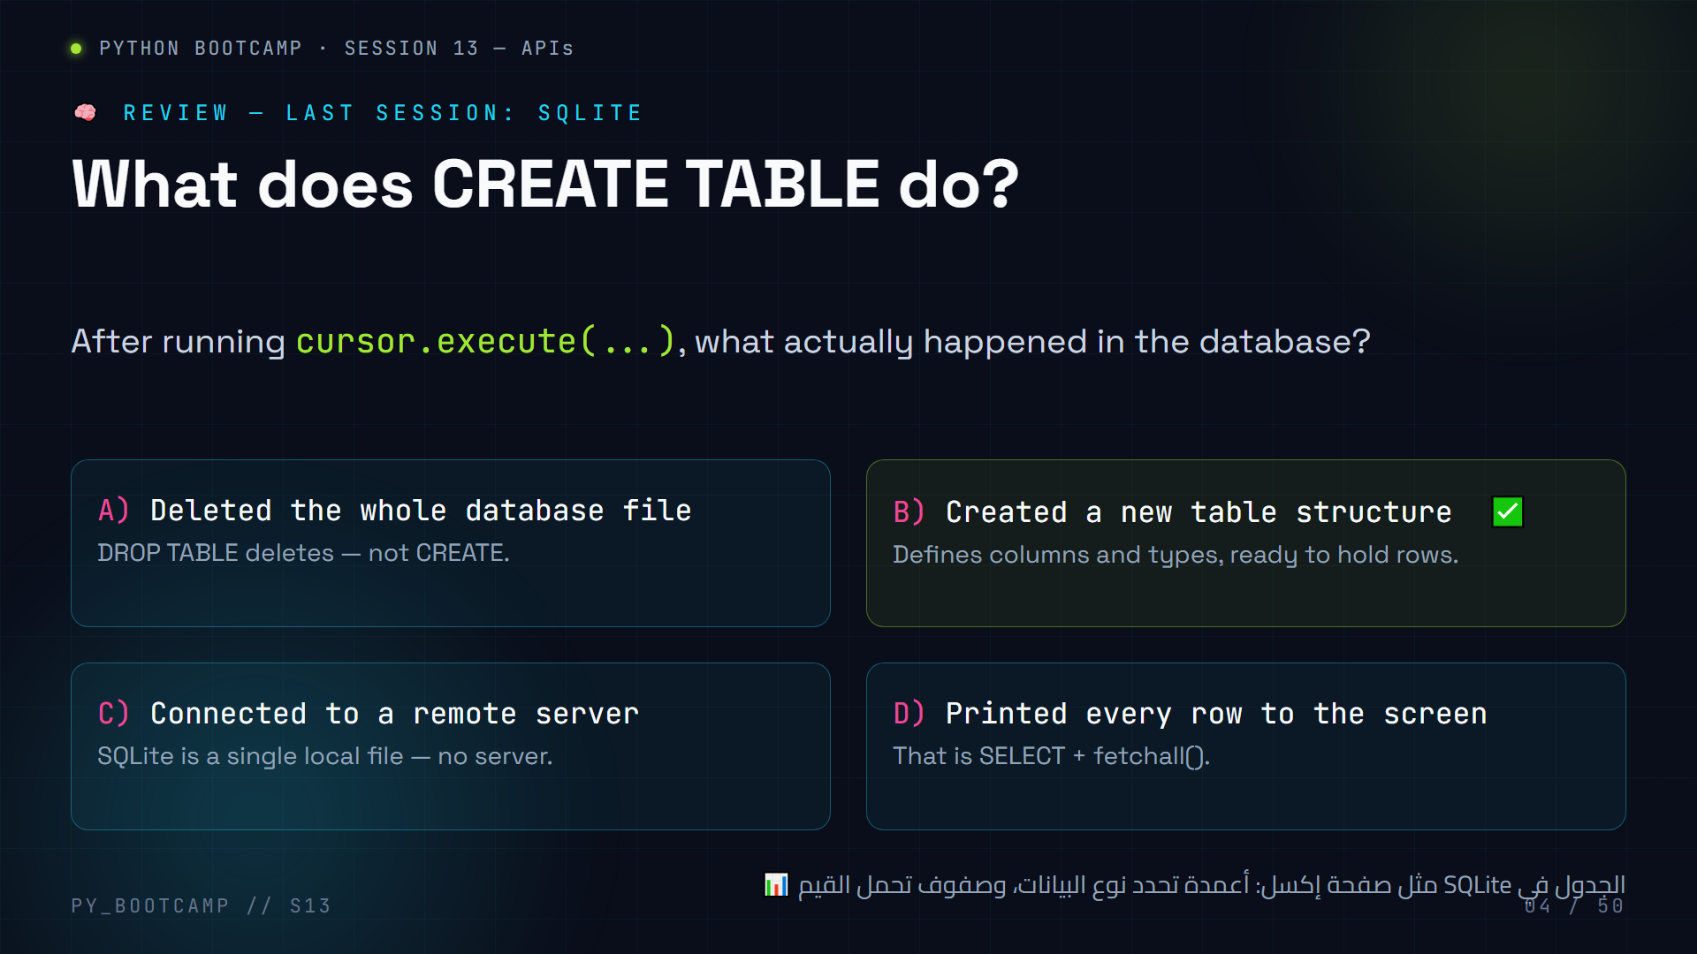
Notes:
MCQ 2 — SQLite review. Answer: **B) Created a new table structure**.
Concept to reinforce: a table is a *schema* first (columns + types) and *data* second (rows). Today we get the reverse: JSON arrives *already full of rows*, and we must figure out the "columns" ourselves.
Extra teaching point: `CREATE TABLE IF NOT EXISTS` — the `IF NOT EXISTS` guard. Good habit: ask "what would happen if we ran CREATE TABLE twice?" (error). Tie to today: with APIs, mistakes return error *codes*, not Python tracebacks.
Arabic tip: شبّه الجدول بملف إكسل — الأعمدة تحدد "الشكل"، والصفوف هي "المحتوى". وفي الـ APIs نستقبل المحتوى أولاً ثم نكتشف الشكل.

Slide 5
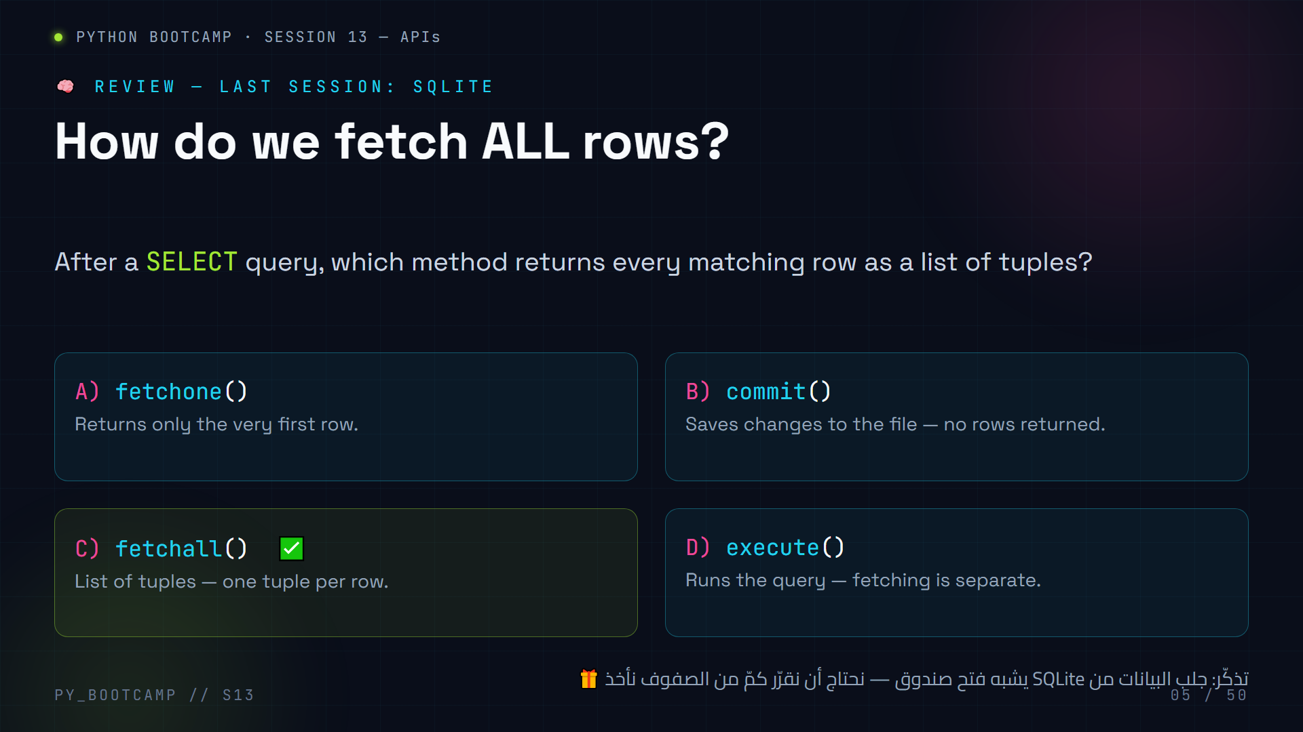
Notes:
MCQ 3 — SQLite review. Answer: **C) fetchall()**.
Bridge into today: `fetchall()` gives you a *list of rows* from SQLite. `resp.json()` gives you a *dict/list* from an API. Same mental move — "turn the thing I received into Python data" — different source.
If students are shaky on this, remind them of the row→tuple concept; today tuples become dictionaries with named keys, which are actually *nicer* to read: `row["name"]` instead of `row[2]`.
Transition sentence: "Enough local databases — let's open the door to the whole Internet." This lands on slide 06's roadmap.
Arabic tip: اشرح التشابه: `fetchall` يعيد صفوفاً من قاعدة بيانات محلية، بينما `resp.json()` يعيد بيانات من خادم بعيد — الدماغ نفسه، المصدر مختلف.

Slide 6
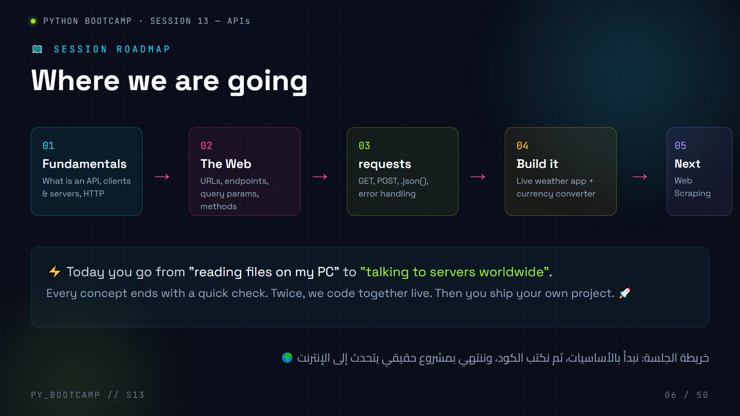
Notes:
Roadmap slide. Read the five steps out loud, then set expectations:
1. Fundamentals — what an API is, client/server, HTTP (slides 07–16)
2. The Web — URLs, endpoints, query parameters, methods, status codes (17–21)
3. requests — the Python library; GET, POST, JSON, errors (25–33)
4. Build it — live weather app together (34–35), then your currency converter project (38–41)
5. Next — a teaser of Web Scraping (47–48)
Pacing note: this session is 3 hours. Suggest ~20 min fundamentals, ~35 min web concepts, ~45 min requests + live coding, ~40 min project, rest for exercises/homework.
Expectation management: "You will NOT become experts in OAuth today. You WILL be able to fetch real data in under 10 lines." We deliberately avoid deep auth and backend development (that's a later session).
Arabic tip: اطلب من الطلاب تخمين "ما هي الخطوة الأهم برأيك؟" ثم أشر إلى أن كل خطوة مبنية على السابقة — الفهم يتراكم.

Slide 7
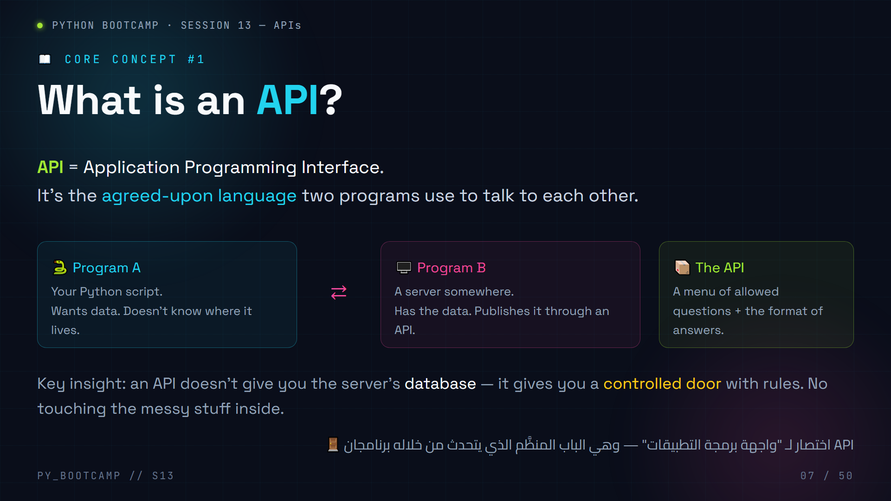
Notes:
Core concept 1 — What is an API.
Deliver as a story: You have two programs. Program A (your Python) wants data it doesn't own. Program B (a server) owns the data. The API is the *agreed rules* — "you may ask these specific questions, in this format, and I will answer like this."
Reinforce the three words: Application (a program), Programming (for developers), Interface (a boundary with rules).
Analogies students connect with:
- The API is the *menu* at a restaurant — you can't see the kitchen, you just pick from the menu.
- The API is the *checkout counter* — you don't wander into the warehouse.
Analogy preview: the next slide (08) is the restaurant analogy — use this slide to plant the seed, then go visual.
Arabic tip: الترجمة الحرفية "واجهة برمجة التطبيقات" مربكة؛ اشرحها كـ "اتفاقية محادثة بين برنامجين" — اتفقا على الأسئلة المسموحة وصيغة الإجابات.

Slide 8
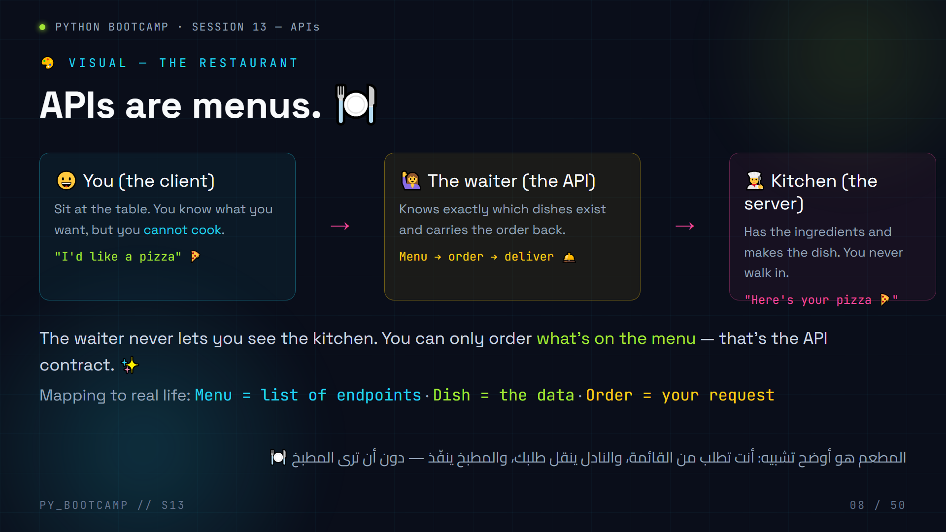
Notes:
The restaurant analogy — the visual anchor for the whole session.
Walk the diagram left to right: You (client) → Waiter (API) → Kitchen (server).
Repeat three times if needed; the analogy is the *master key* of the session. Whenever students get lost later, say "remember the waiter."
Key points:
- The menu = the documentation. You can only ask for what's listed.
- You never enter the kitchen = you never touch the server's database.
- The waiter enforces rules = the API validates your request and returns an error if invalid.
Memory hooks for students: "API = the waiter", "endpoint = menu item", "request = your order", "response = your dish".
Quick check (verbal): "If I want the weather, which 'dish' would I order? Where's the waiter?" — then continue to slide 09.
Arabic tip: اطلب من طالب أن يلخّص التشبيه بجملة واحدة بالعربية — التكرار بأسلوبهم يثبّت المفهوم.

Slide 9
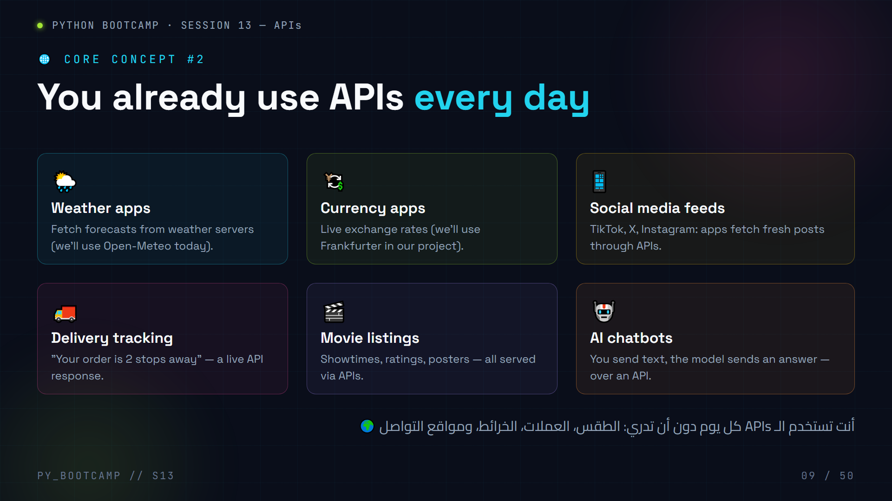
Notes:
Real-world API examples. Six cards — have the class count how many they personally use in one day (weather, social, delivery, movies, AI).
Point of the slide: APIs are not an obscure tech term — they power nearly every app students touch. "If a phone app shows live data, there's an API behind it."
Highlight the two we'll actually code with today:
- Open-Meteo (weather) — free, no API key.
- Frankfurter (currency rates) — free, no API key.
Also mention Google Maps, GitHub, and ChatGPT as famous ones — GitHub's API is a great self-study target ("what do my own repositories look like?").
Arabic tip: اسأل: "كم تطبيقاً على هاتفك يعرض بيانات 'حية'؟" — كلها تستخدم APIs. اربط المفهوم بحياتهم اليومية مباشرة.

Slide 10
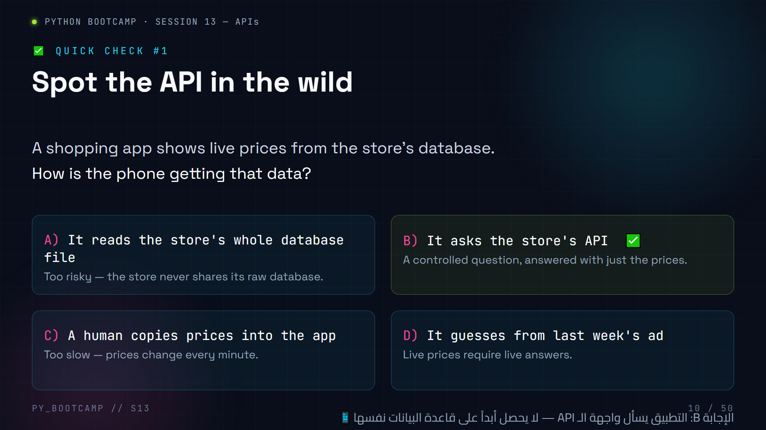
Notes:
Mid-deck MCQ 1 (real-world APIs). Answer: **B) It asks the store's API**.
This is the moment to solidify: data flows from a server to your device only through a controlled API — never by giving away the database itself.
If students pick A, probe: "Would any company give you its raw database?" — reinforces why APIs exist.
Transition: "Great. Now WHO is talking to WHOM? Let's name the two roles." → slides 11–12 (client vs server).
Arabic tip: ذكّرهم: "أنت لا تحصل على قاعدة البيانات، بل على إجابة سؤال محدّد" — هذه هي فلسفة الـ APIs كلها.

Slide 11
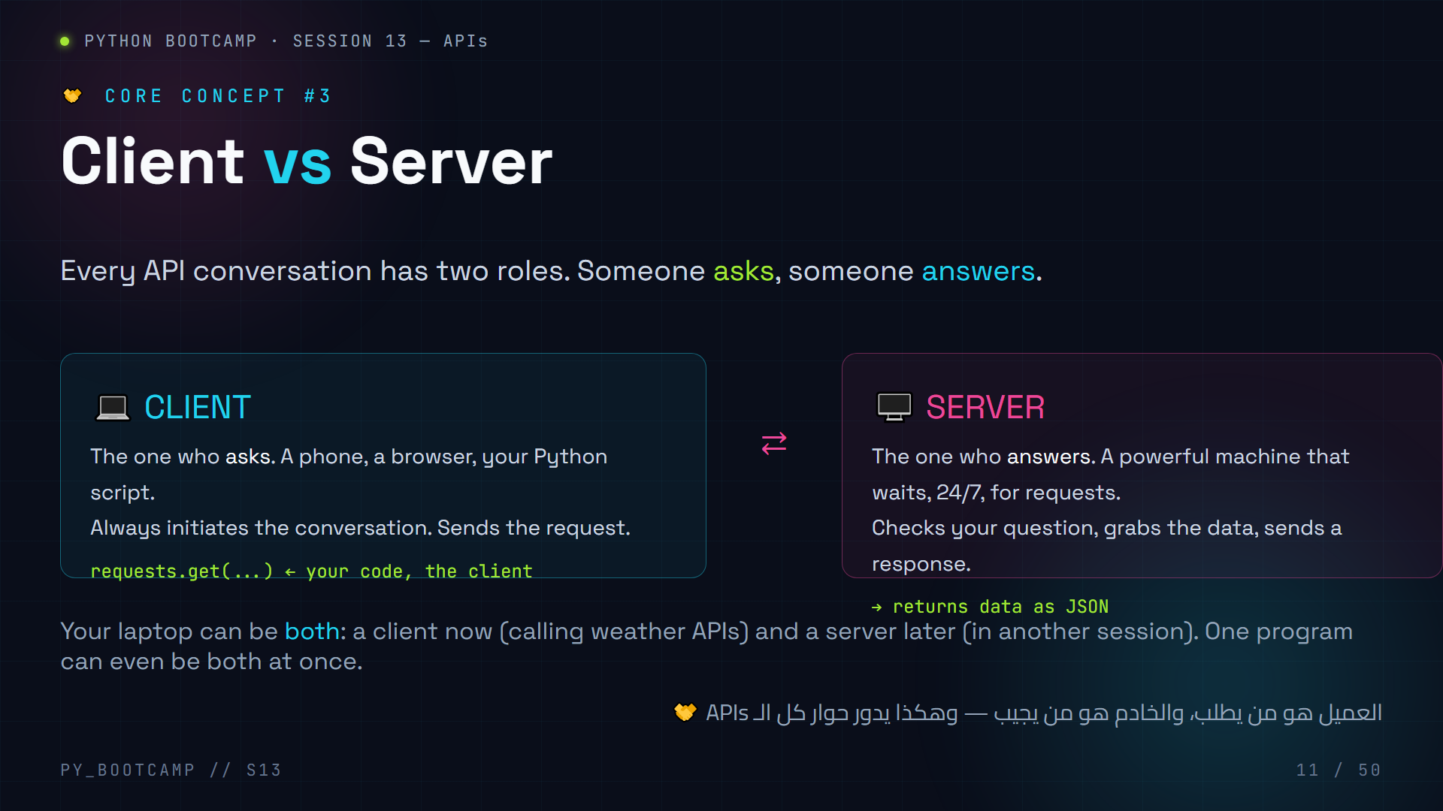
Notes:
Client vs server — two cards.
Emphasize the asymmetry: the client always *starts* the conversation; the server *waits*. That's why servers run on powerful machines with public addresses, while your laptop just knocks on the door.
Real talk: "Your Python script is the client today. When you run `requests.get(...)`, your script is literally a phone app asking for weather."
Extra: define "client" broadly — it's not just a browser. Any code making requests is a client.
Tease: next slide shows the full journey of a request.
Arabic tip: عبّر عنها بـ"سائل ومُجيب" — أدوار ثابتة في كل محادثة بين برنامجين.

Slide 12
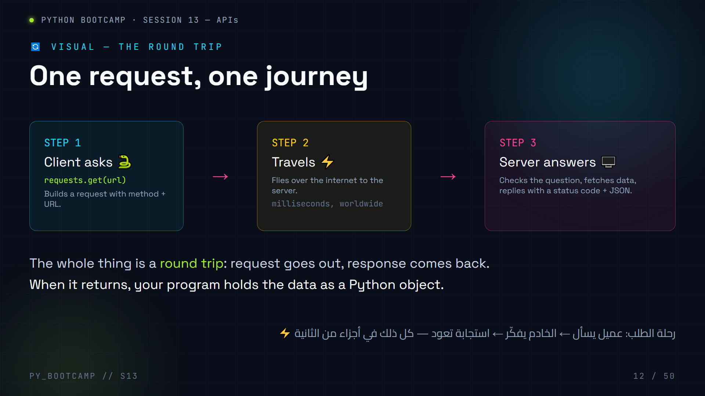
Notes:
Visual: the request round trip. Walk the 3 steps with hand motions (out → travel → back).
Explain that step 3 returns two things bundled together: a status code (did it work?) and a body (the actual data, usually JSON).
Activity: have students draw the triangle (client → internet → server → back) on paper in 30 seconds. Memory: "ASK — FLY — ANSWER."
This mental model is used on every later slide; when we call `requests.get()` in slide 26, point back to this diagram.
Arabic tip: ارسم المثلث على السبورة وكرر "يسأل، يطير، يجيب" — اجعل الطلاب يرددونها معك.

Slide 13
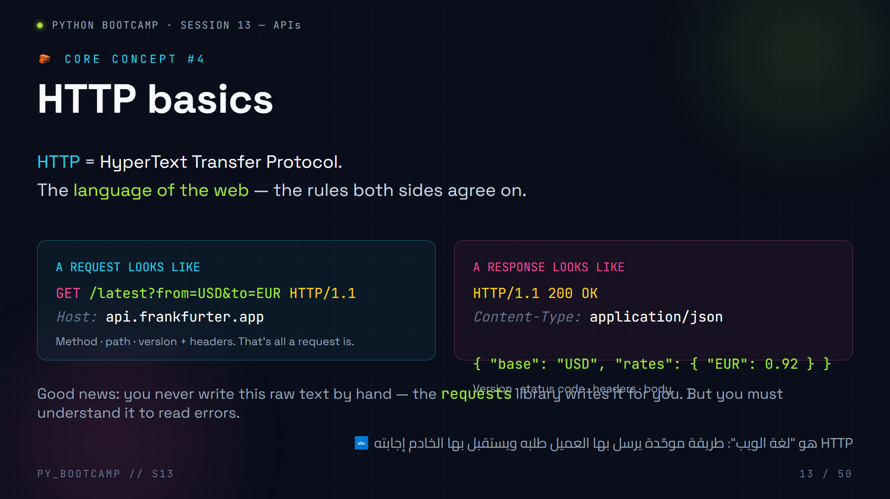
Notes:
HTTP basics. Two windows: a raw request and a raw response.
Point-by-point:
- Request line: METHOD + path + HTTP version. Headers after it.
- Response: version + status code (200 OK) + headers + body.
- We'll never type this by hand — `requests` does it. But knowing the shape helps read errors and debug.
Do a quick "literal HTTP" demo: read a request/response out loud in robot voice to make it stick.
Where we go next: the METHOD is the verb. Slides 15–16 cover GET/POST/PUT/DELETE; slide 14 shows request vs response visually.
Arabic tip: ترجم "Protocol" بكلمة "بروتوكول/اتفاقية" — أي قواعد متفق عليها مسبقاً بين الطرفين.

Slide 14
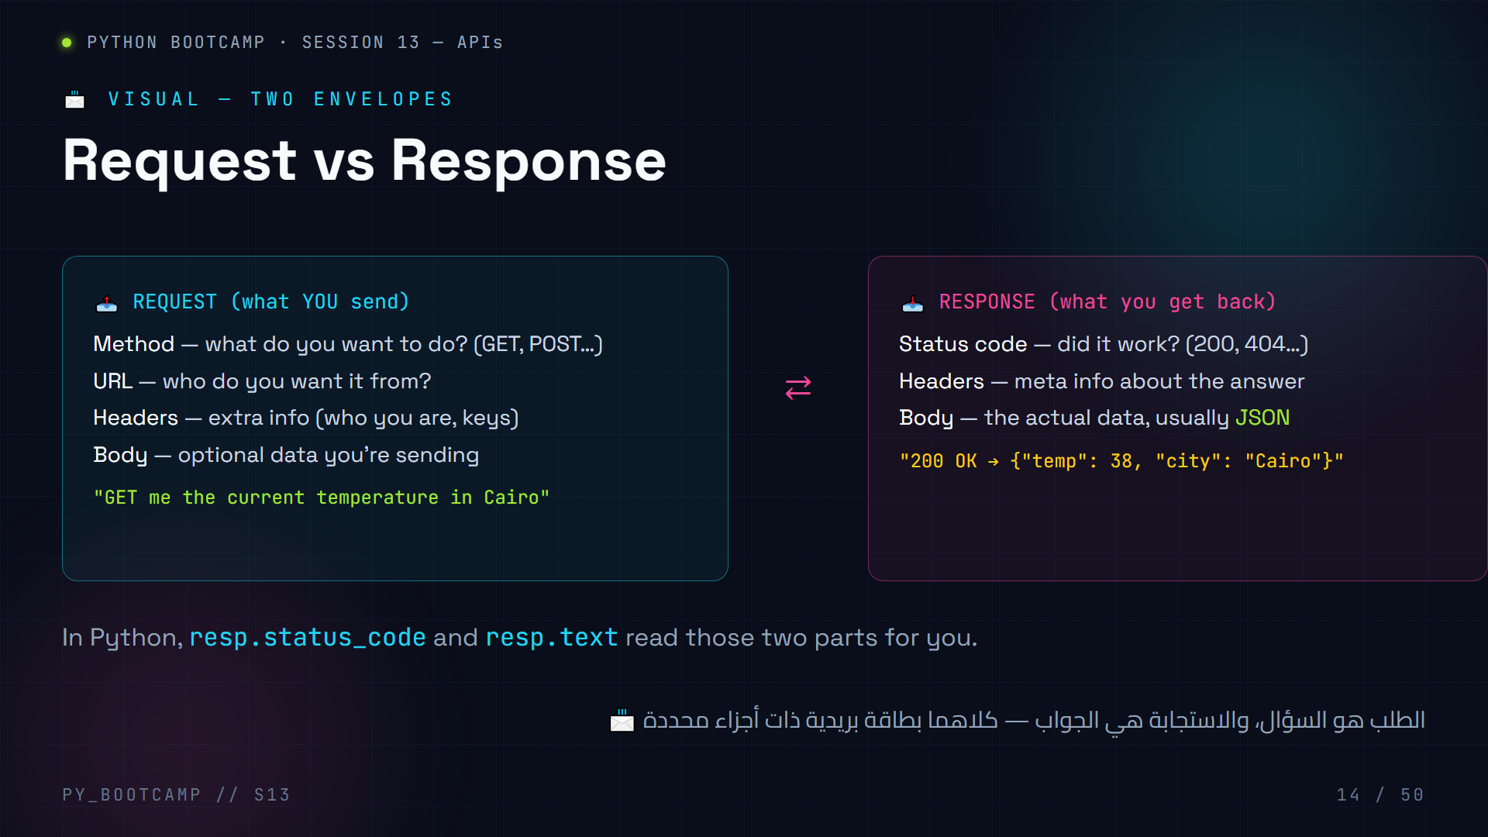
Notes:
Request vs response, visualized as two envelopes.
Point out the parts a request *can* have vs a response *must* have (a response always has a status code).
Emphasize: the response body in almost every API is JSON — that's the treasure. We'll dissect it in slides 23–24.
Quick pairing activity: students pair up, one pretends to be client and one server; client "sends" a request envelope, server "returns" a response envelope with a status code. 2 minutes.
Arabic tip: شبّه الأمر بإرسال رسالة واستلام رد: أنت تكتب السؤال والتفاصيل، والطرف الآخر يرد بكلمة حالة "تم" أو "غير موجود" مع المحتوى.

Slide 15
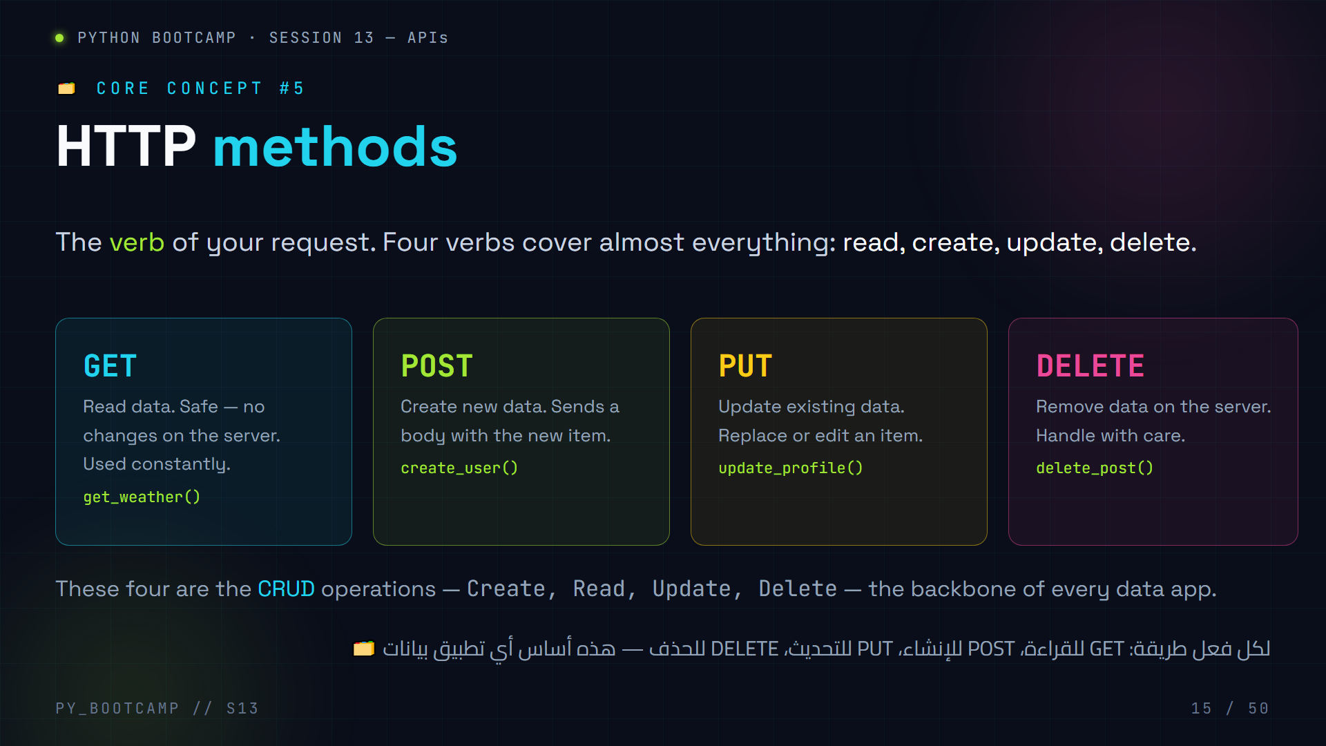
Notes:
HTTP methods — four colored cards.
Use real-life mapping:
- GET = look at the menu
- POST = place a new order
- PUT = change your order
- DELETE = cancel the order
Clarify nuance (keep simple): GET should never change data ("safe"); POST creates; PUT replaces/updates; DELETE removes. Today's session focuses on GET + POST — the other two exist in the same pattern.
Tie back: last session (SQLite) did the same CRUD with SQL commands; today the "database" is remote and the "SQL" is an HTTP method.
Arabic tip: ترجم CRUD إلى: أنشئ، اقرأ، حدّث، احذف — واطلب من الطلاب تسمية فعلٍ من حياتهم لكل واحدة.

Slide 16
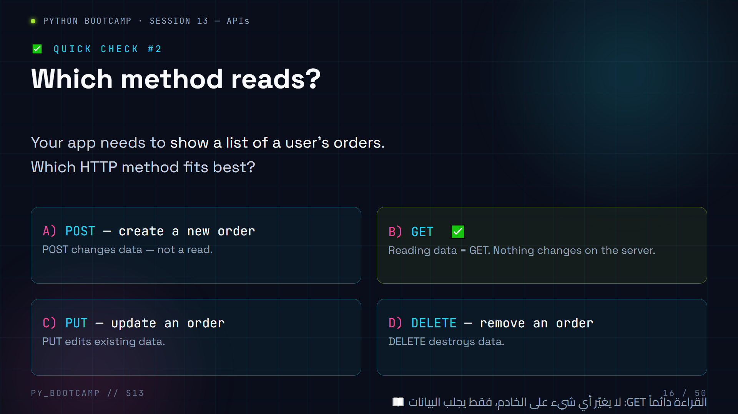
Notes:
Mid-deck MCQ 2 (HTTP methods). Answer: **B) GET**.
Rule to chant: "Read with GET, create with POST, update with PUT, delete with DELETE."
Pitfall to flag: students will later use `requests.get` for everything because it's the friendliest. That's fine for this session's read-only APIs; but remind them a POST exists for creating things (slide 31).
Arabic tip: أنشئ جملة حفظ سريعة: "اقرأ GET، أنشئ POST، حدّث PUT، احذف DELETE" وكررها مرتين.

Slide 17
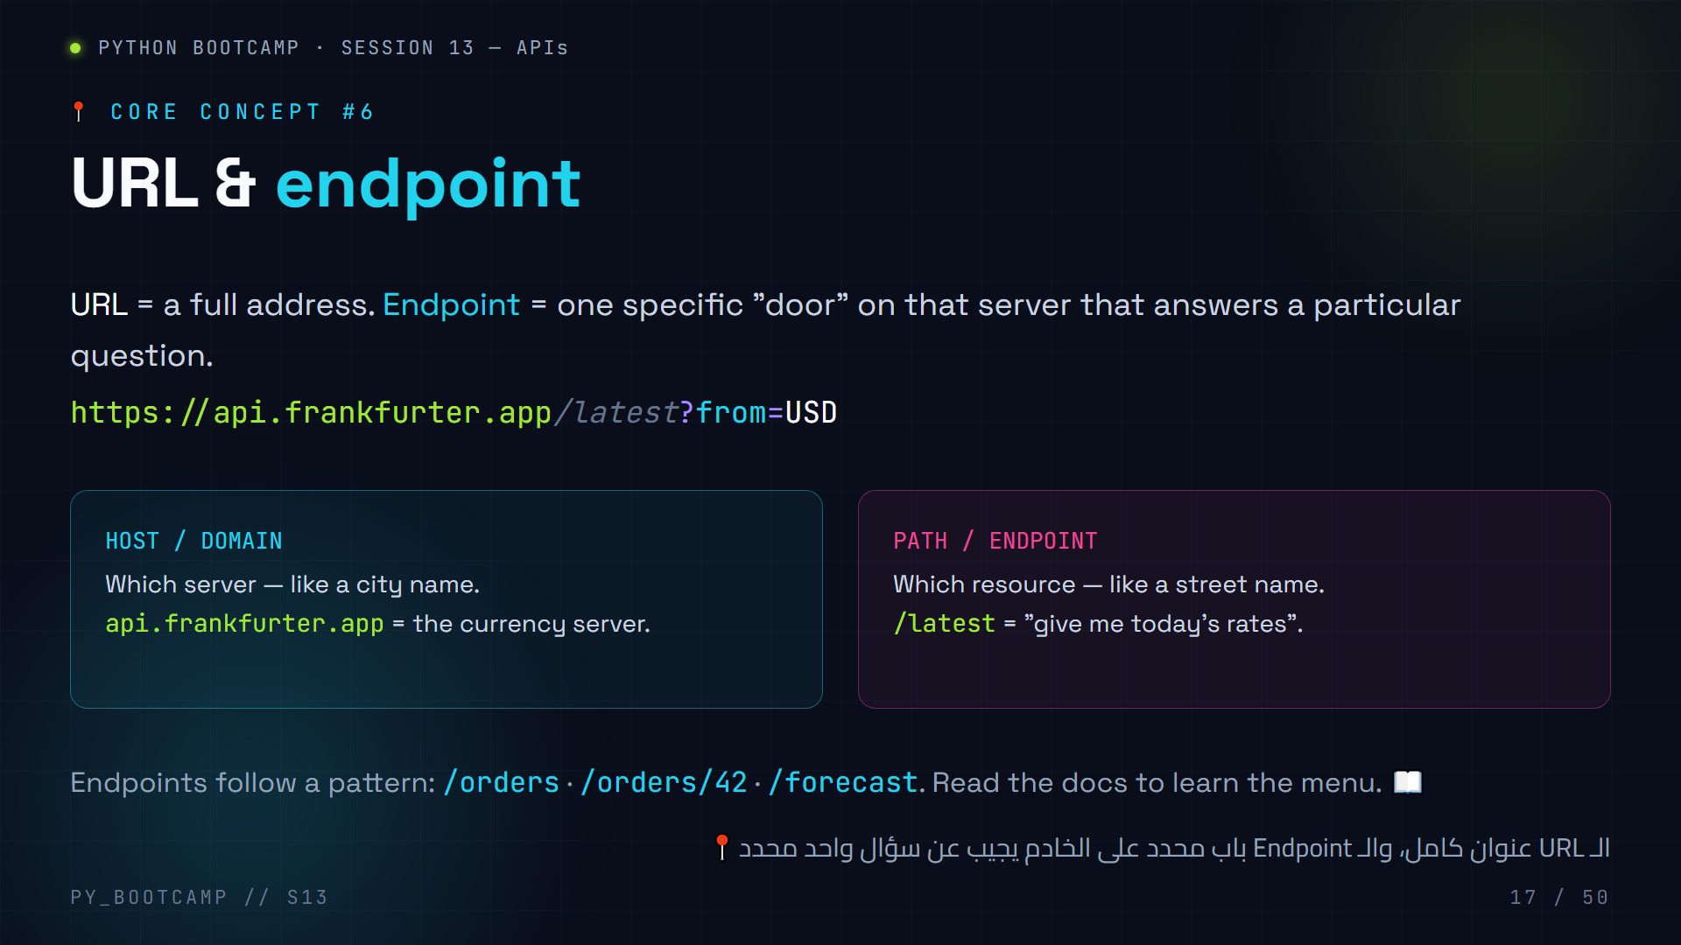
Notes:
URL & endpoint.
Two-part mental model: URL = address of the building (server), endpoint/path = which room/door (specific resource). Different endpoints = different "dishes" on the same restaurant menu.
Examples to write on the board:
- GET /latest → latest rates
- GET /2023-01-01 → rates on a specific date
- GET /forecast → weather forecast
Point out the pattern `/resource` and `/resource/id` — this is the most common API design convention.
Arabic tip: شبّه العنوان بـ"الحي" والمجرّد/المسار بـ"الشارع" — كلاهما لازم للوصول إلى المعلومة.

Slide 18
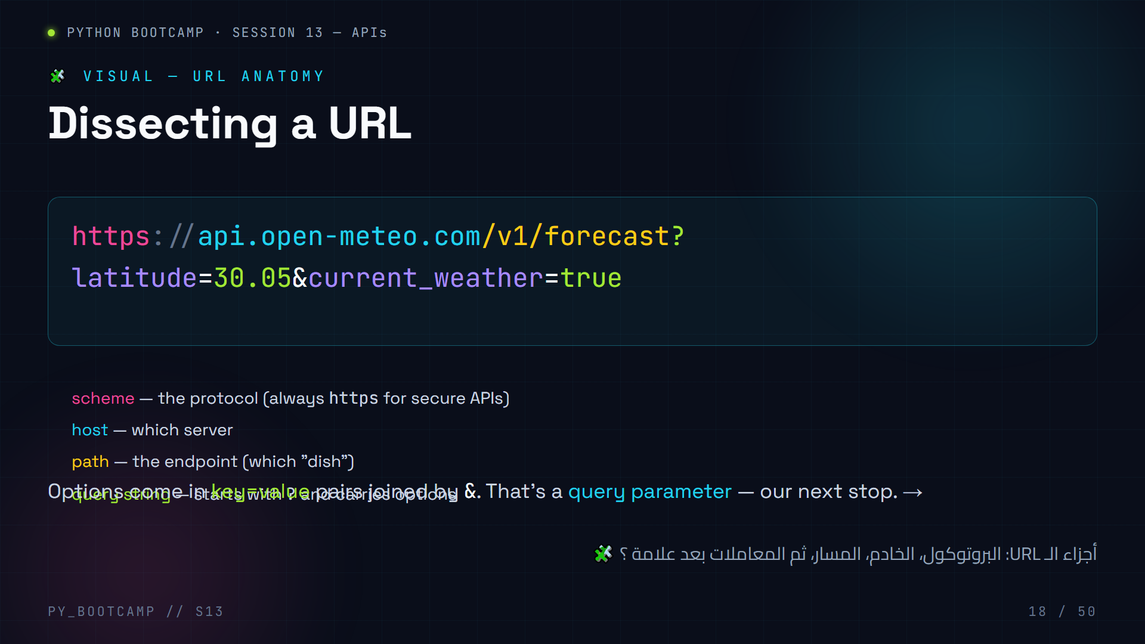
Notes:
URL anatomy — color-coded dissection. This exact URL (Open-Meteo forecast) is used in our live coding at slides 34–35, so make it stick.
Walk each colored segment: scheme, host, path, query string. Emphasize the `?` starts options and `&` separates them.
Pro tip: you can open this URL in a browser and see the raw JSON — the browser is a GET client. Let students do it (2 min) so they see that "an API call" is something they've already done as humans.
Arabic tip: اجعل طالباً يقرأ الـ URL بصوت عالٍ متوقفاً عند كل لون — التلوين يساعد في ترسيخ الأجزاء.

Slide 19
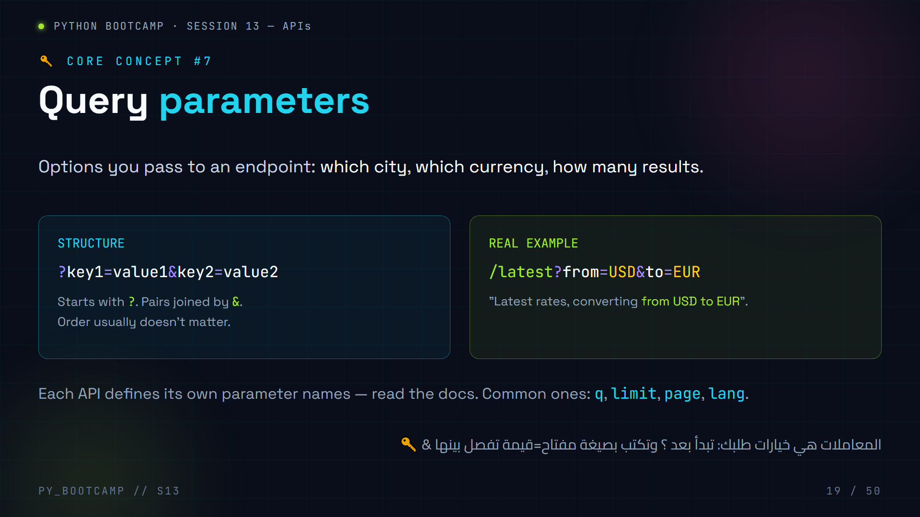
Notes:
Query parameters.
Rules to memorize (put on board):
1. Starts with `?` after the path.
2. `key=value` pairs.
3. Multiple pairs joined by `&`.
4. No spaces allowed — use `+` or `%20` if needed (requests handles this for you, slide 28!).
Why it matters today: query params are how we ask "Cairo, not London" or "USD to EUR". The weather live-coding slide 34 is all query params.
Show how Google uses them: `google.com/search?q=penguins` — students instantly connect.
Arabic tip: اذكر مثال "بحث جوجل": `search?q=مصطلح` — نفس الفكرة تماماً، حتى في متصفحك العادي.

Slide 20
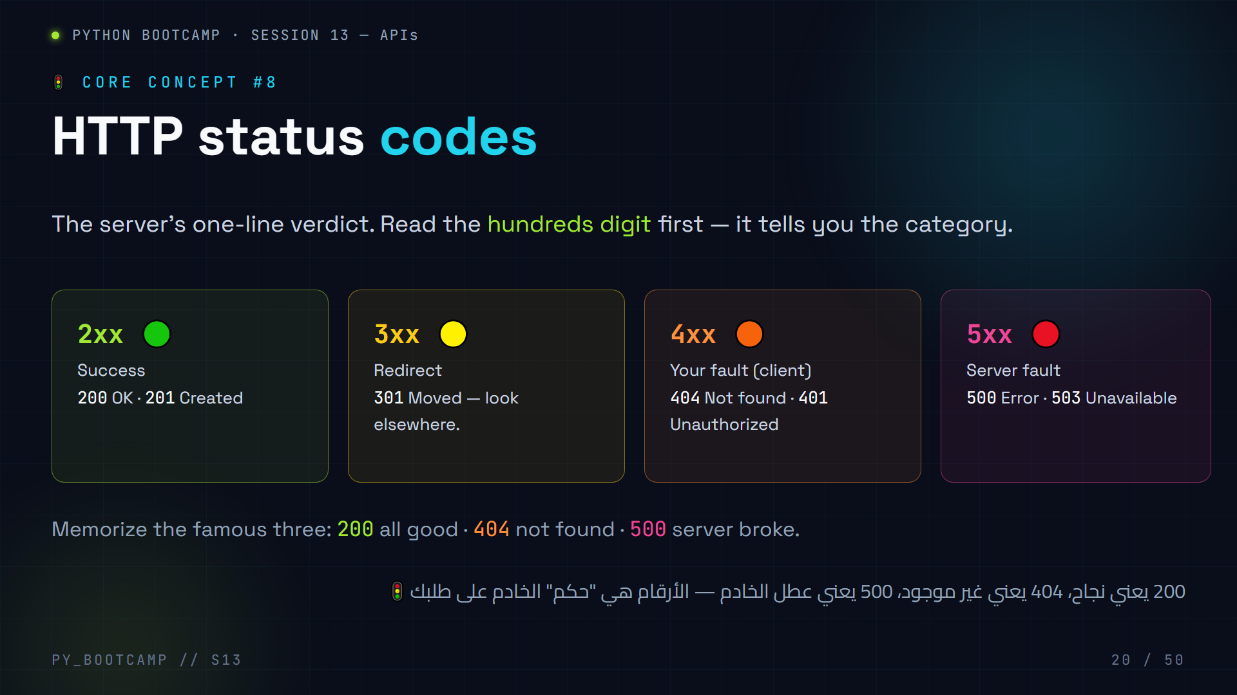
Notes:
HTTP status codes — the four color families.
Memory aids:
- 2xx = "2 good" → success (green)
- 3xx = "3 redirection" → follow the move
- 4xx = "4 problems on your side" → 404 Not Found, 401 Unauthorized, 429 Too Many Requests (we'll meet 429 again on the rate-limits slide 36!)
- 5xx = "5 servers suffer" → 500, 503
Do NOT list all codes — stick to the famous ones. Students will memorize 200/404/500 through repetition during live coding.
Emphasize: an API call that "fails" is not a crash — the server still replies, just with a 4xx/5xx code. This is the key to error handling on slide 33.
Arabic tip: اجعل الطلاب يحفظونها كـ "إشارات مرور": أخضر نجاح، برتقالي خطأ من طلبك، أحمر عطل الخادم.

Slide 21
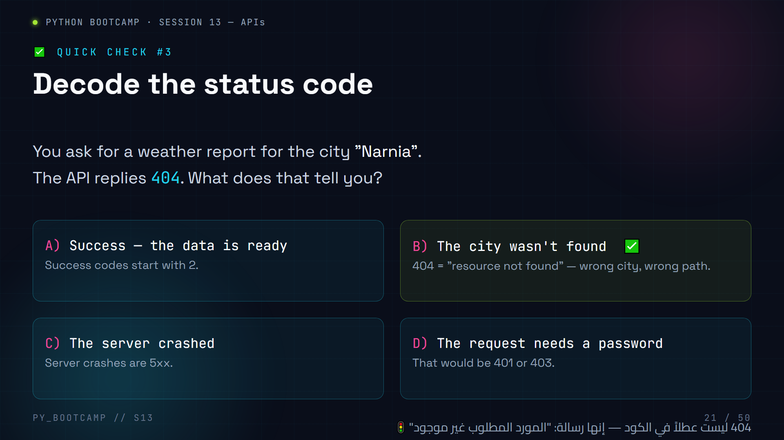
Notes:
Mid-deck MCQ 3 (status codes). Answer: **B) The city wasn't found**.
Teaching point: status codes are the server's way of saying "your request was received — but this thing doesn't exist" without crashing. 404 ≠ broken code; it's a *message*.
Extra: have students suggest what code they'd get if they typed the API URL wrong in a browser (404), or if the server was down (500/503). Connects the concept to everyday browsing ("404 page").
Arabic tip: اسأل: "كم مرة رأيتم صفحة 404 أثناء التصفح؟" — الآن تعرفون معناها الحقيقي!

Slide 22
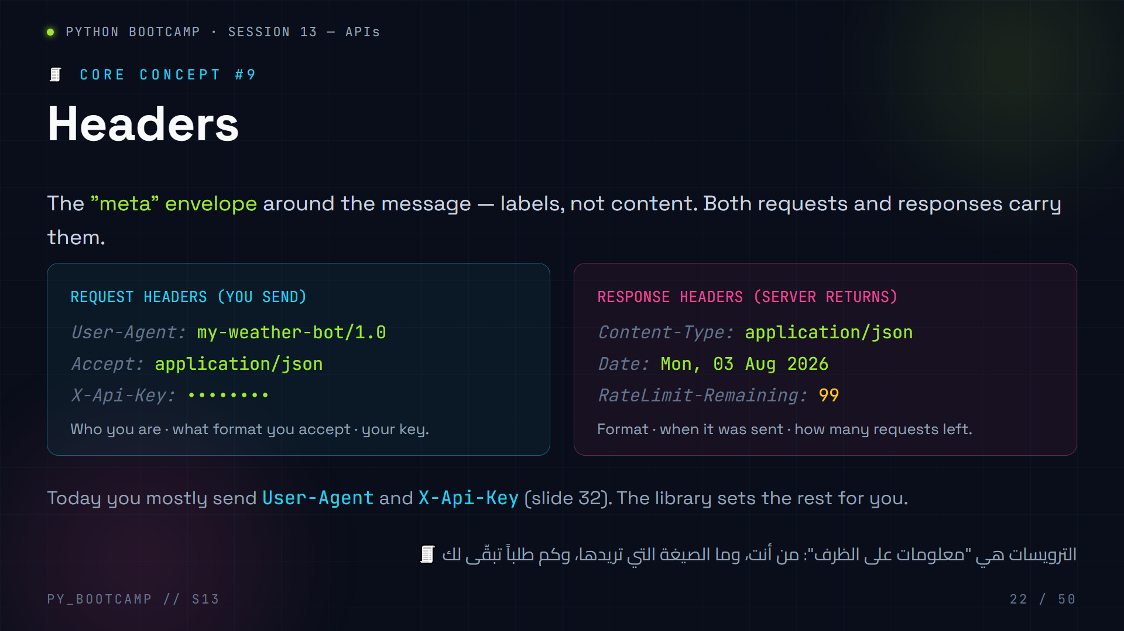
Notes:
Headers — the envelope labels.
Analogies: headers are like the outside of a postal envelope (from, to, stamps, priority) while the body is the letter inside.
Key headers students will actually use today:
- User-Agent: some APIs refuse requests without a real one (bots). requests sets a default; you can override.
- X-Api-Key: where API keys commonly go (slide 32).
- Content-Type: tells the server what format the body is in.
Response headers worth noticing: Content-Type (is it really JSON?), and rate-limit headers (slide 36).
Do NOT go deep into auth headers/OAuth — explicitly out of scope this session.
Arabic tip: "الترويسة" ترجمة حرفية؛ اشرحها كـ"بيانات الغلاف": معلومات إضافية خارج الرسالة نفسها.

Slide 23
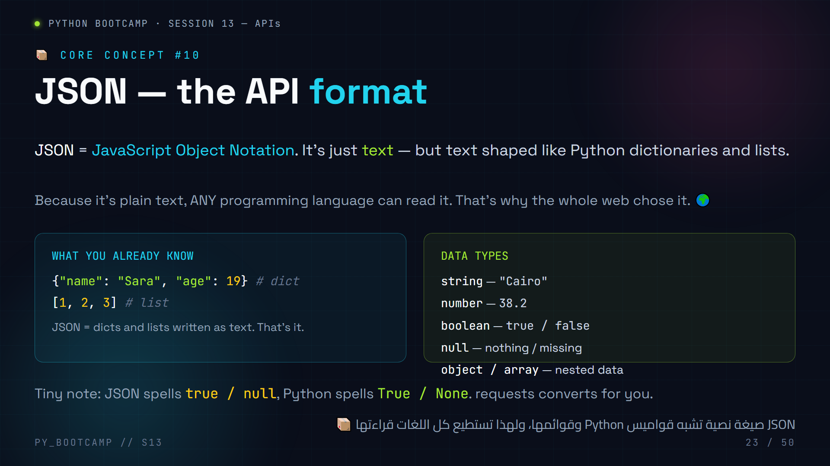
Notes:
JSON — concept slide.
Key reassurance: students already know dicts and lists from earlier sessions. JSON is just "the same thing as text" — that's the whole secret. Repeat: "A JSON response is a dictionary you haven't unpacked yet."
Data types table: strings, numbers, booleans, null, objects, arrays. Watch out for the casing difference (true vs True, null vs None) — requests converts automatically, but it's a classic confusion.
Why JSON won: it is language-neutral plain text. C, Java, Python, JavaScript — all parse it.
Preview: slide 24 shows a realistic response we will actually receive from Open-Meteo in live coding.
Arabic tip: "JSON ليست لغة برمجة، بل صيغة نصية" — نقطة يساء فهمها كثيراً، أكدها الآن.

Slide 24
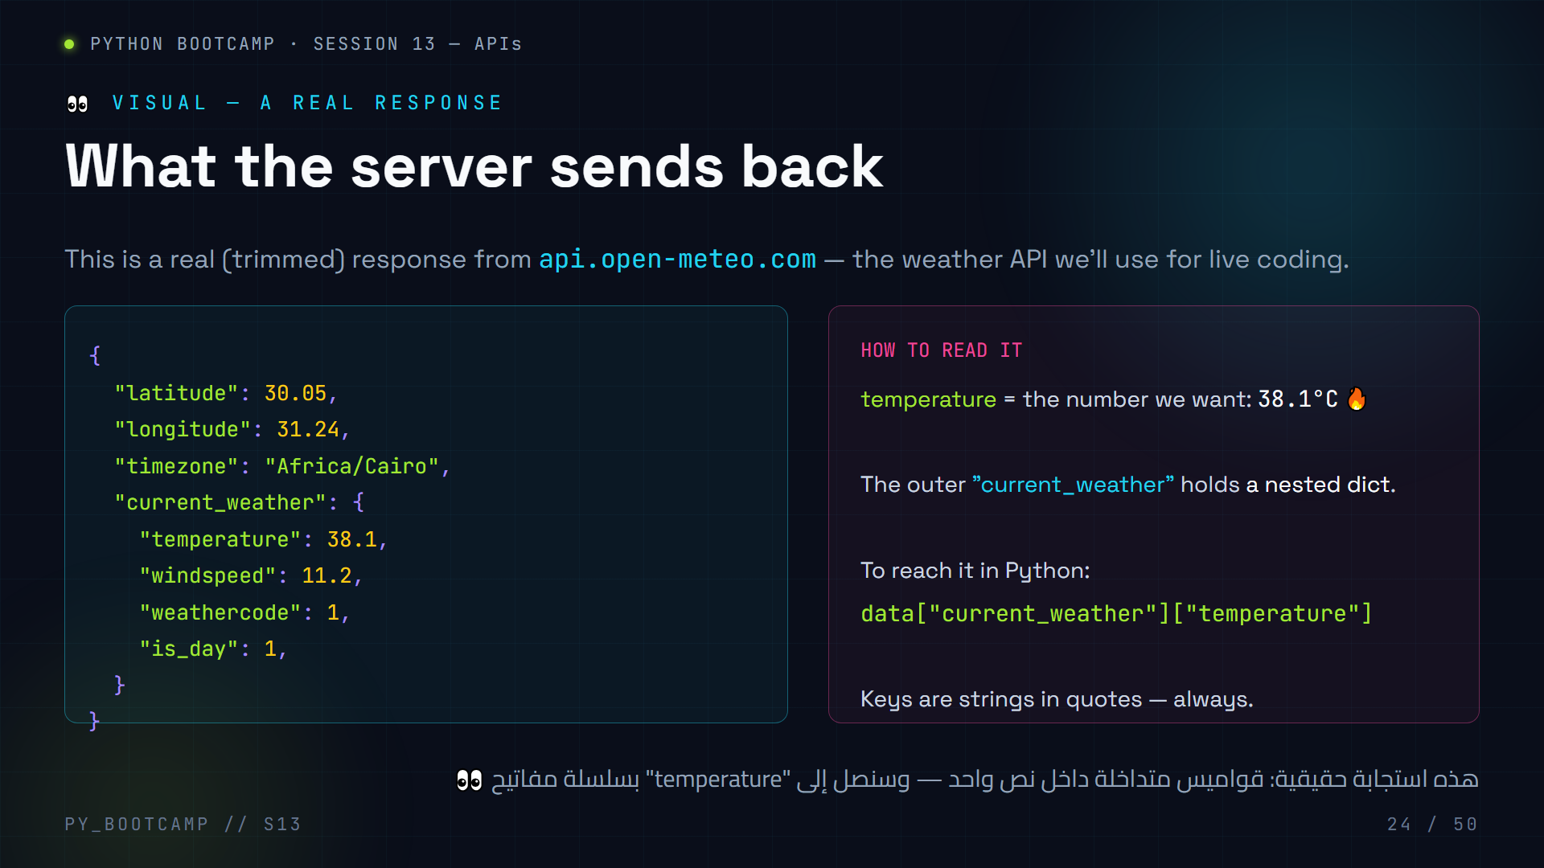
Notes:
Visual: a realistic Open-Meteo JSON response, trimmed for teaching.
Walk the nesting: outer dict → "current_weather" → nested dict → "temperature". Show the Python access path:
`data["current_weather"]["temperature"]` → 38.1
This exact structure returns in live coding (slides 34–35). If students can read this JSON now, live coding is smooth.
Activity (3 min): open the live URL in a browser (it needs internet) and compare with the trimmed version. Let them find "timezone" and "windspeed" in the real payload.
Mistake to pre-empt: forgetting that keys are strings with quotes → KeyError on `data[current_weather]`.
Arabic tip: علّمهم أن يقرؤوا JSON من "الداخل إلى الخارج": ابدأ من المفتاح الأعمق ثم اخرج. سلسلة مفاتيح مثل خريطة كنز.

Slide 25
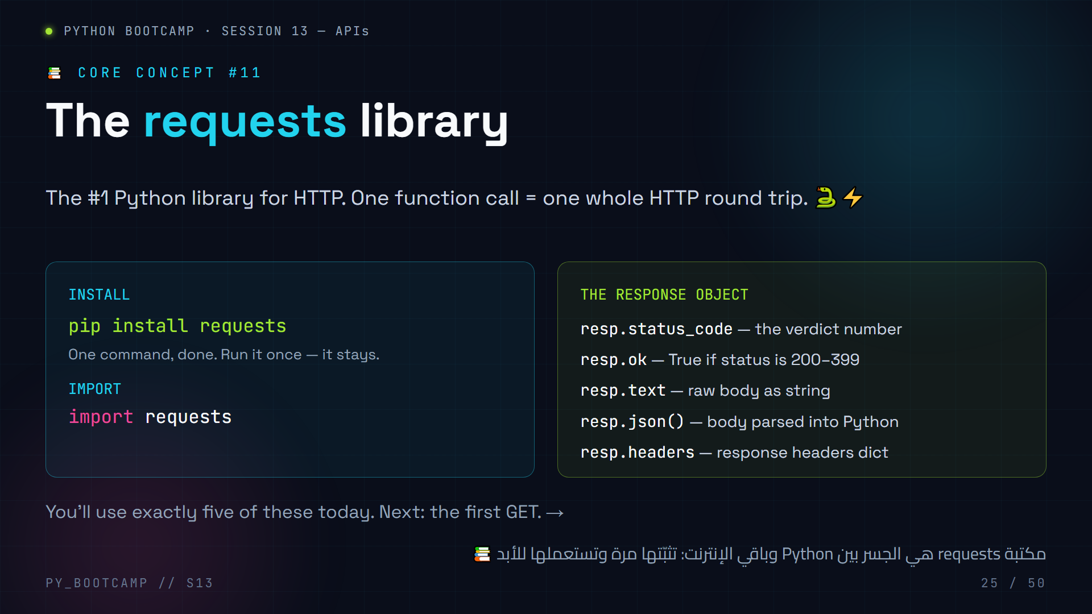
Notes:
The requests library — our main tool.
Demo install live (30 s): `pip install requests`. Then `import requests; print(requests.__version__)`.
The response object is the star. Drill the five attributes with a real call:
- status_code, ok, text, json(), headers.
Set up the next two slides: slide 26 = first GET (frankfurter), slide 27 = predict-the-output on those attributes.
Common mistake: forgetting to install, then a ModuleNotFoundError at import. Walk them through reading that error calmly.
Arabic tip: اشرح أن `requests` مكتبة خارجية تُثبَّت عبر `pip` — وفرّق بين المكتبات المدمجة (مثل sqlite3) والخارجية (مثل requests).

Slide 26
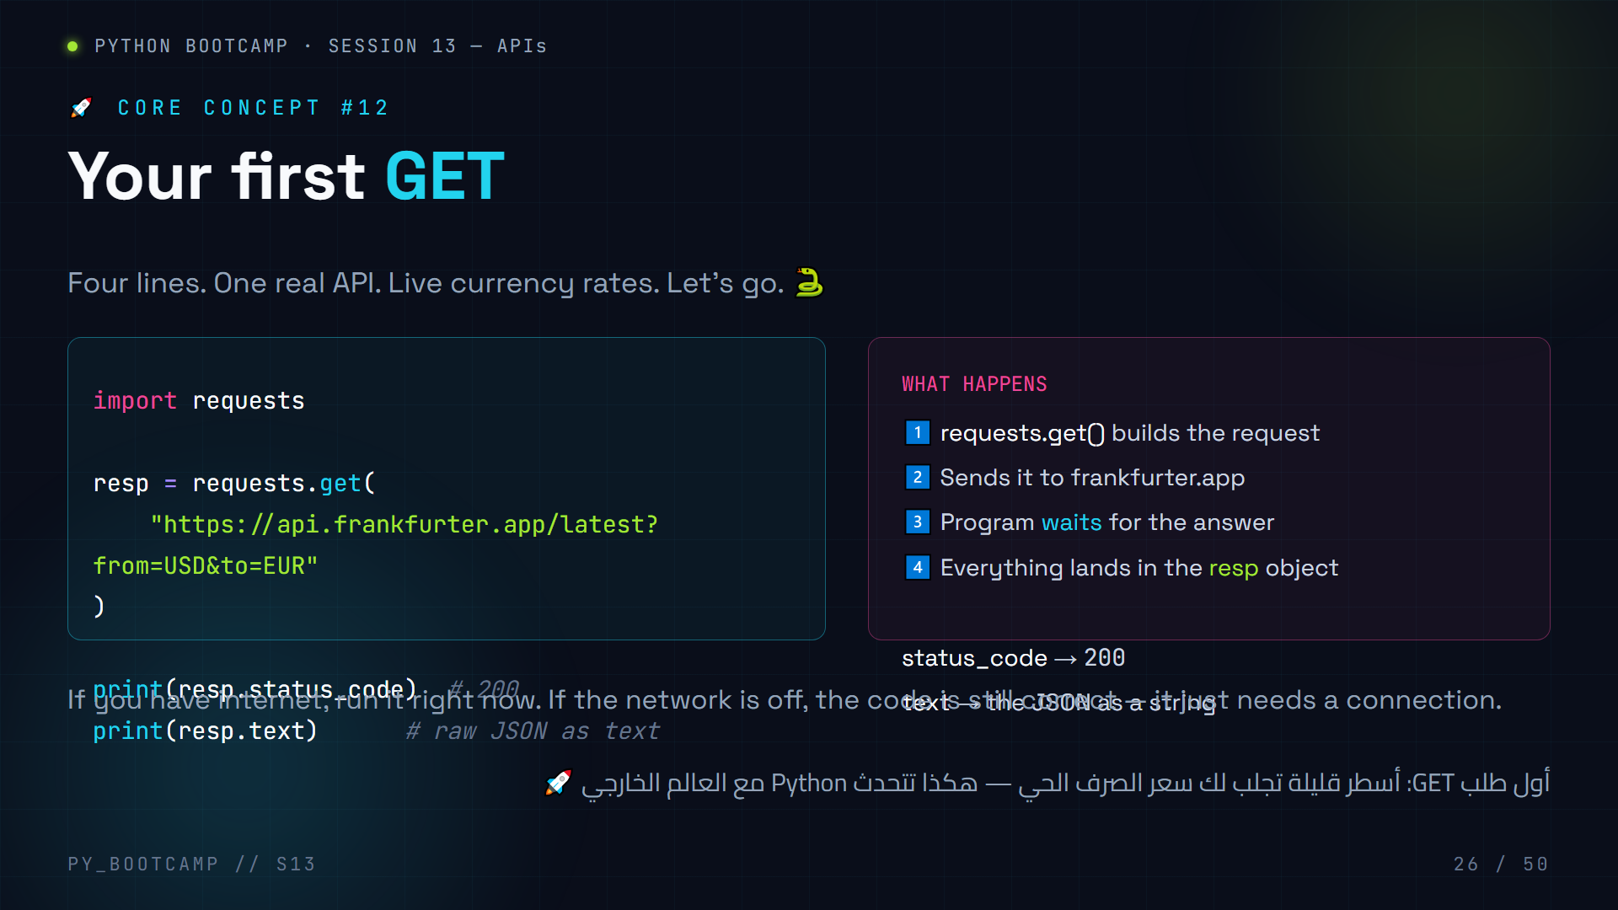
Notes:
First GET — live coding moment (5 minutes).
Walk through line by line:
1. import requests
2. requests.get(url) — note we pass the URL *with* query params inline here.
3. resp.status_code → 200
4. resp.text → raw JSON string
Then LIVE RUN it in the terminal. If no internet, show the expected output (printed on screen) and move on.
Expected output (approx):
```
200
{"amount":1.0,"base":"USD","date":"2026-08-03","rates":{"EUR":0.92}}
```
Common issue: ModuleNotFoundError → they forgot `pip install requests`.
This is the "hello world" of APIs. Celebrate it: "You just talked to a server in another country."
Arabic tip: هذا أول كود فعلي للجلسة — اجعل الطلاب يكتبونه بأيديهم، لا ينسخونه فقط. الكتابة اليدوية تثبّت التعلم.

Slide 27
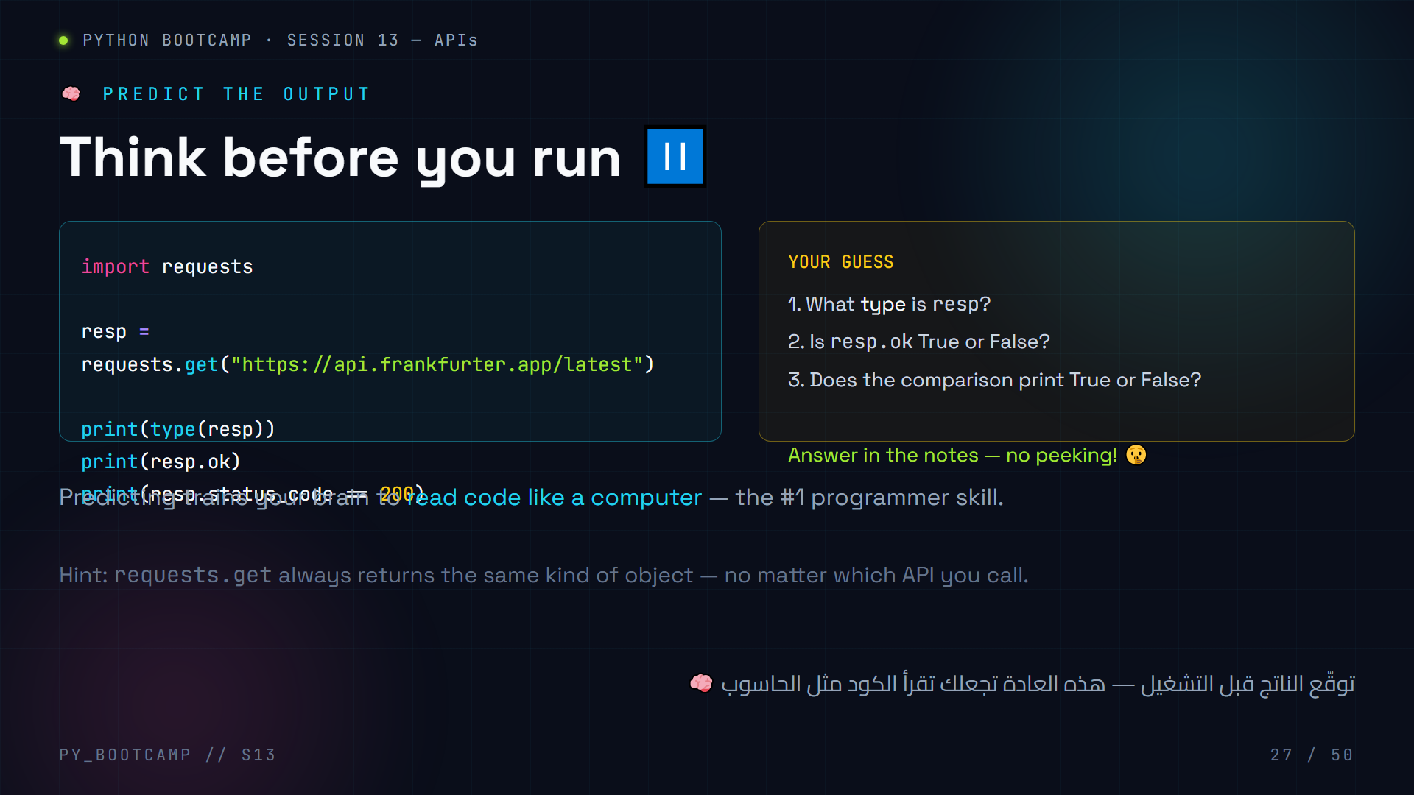
Notes:
Predict the output #1. Answers:
1. `` — resp is always a Response object.
2. `True` — status 200 is in the success range, so resp.ok is True.
3. `True` — 200 == 200.
Run it live after guesses. If offline, explain the answers from the printed slide.
Debrief: the point is that the *type* of the object never changes — only the data inside changes. That's why we can write one pattern and reuse it for any API.
Variation: ask what would change if the server were down → status_code 500, resp.ok False, comparison False.
Arabic tip: اشرح أن التوقع قبل التشغيل يبني "حدس المبرمج" — ثم نفّذ الكود ليتأكدوا من إجاباتهم.

Slide 28
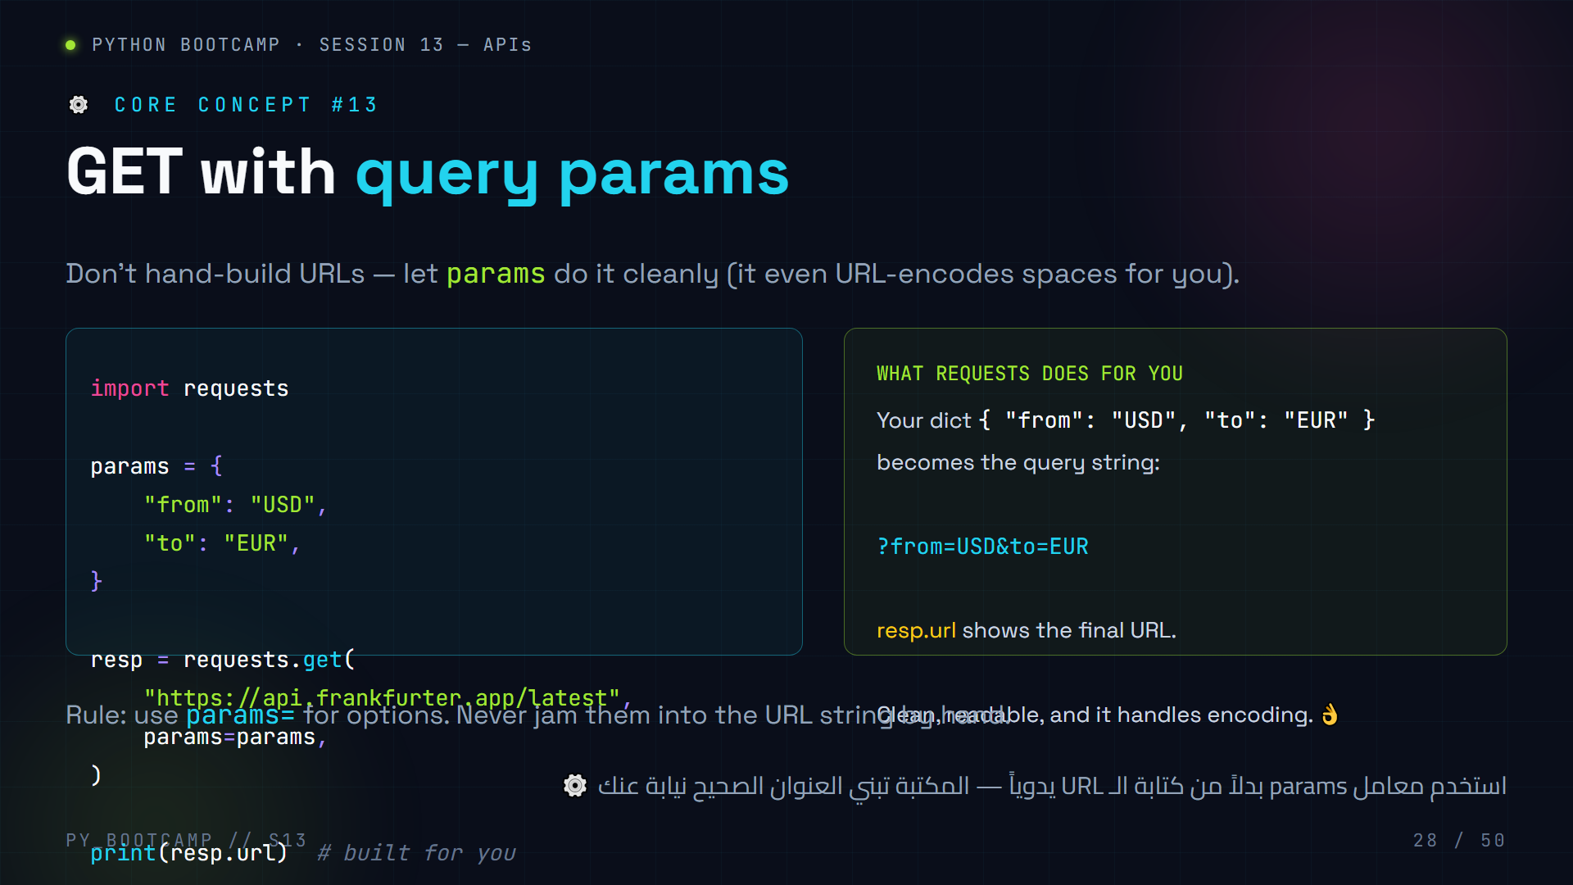
Notes:
GET with query parameters via the `params=` argument.
Point out the elegance: we give requests a normal Python dict, it builds the query string. Also mention URL encoding: if a value had a space, requests turns it into %20 automatically.
Live demo: print(resp.url) to show what was built — "see, it did the ? and & for us."
This is the exact technique the weather live-coding uses (slides 34–35), where params = {latitude, longitude, current_weather}.
Common mistake: passing params in the URL AND in params= — you'll get both; choose one.
Arabic tip: القاعدة: "المعاملات في القاموس، والرابط نظيف" — لا تكتب علامتي ؟ و& بنفسك أبداً.

Slide 29
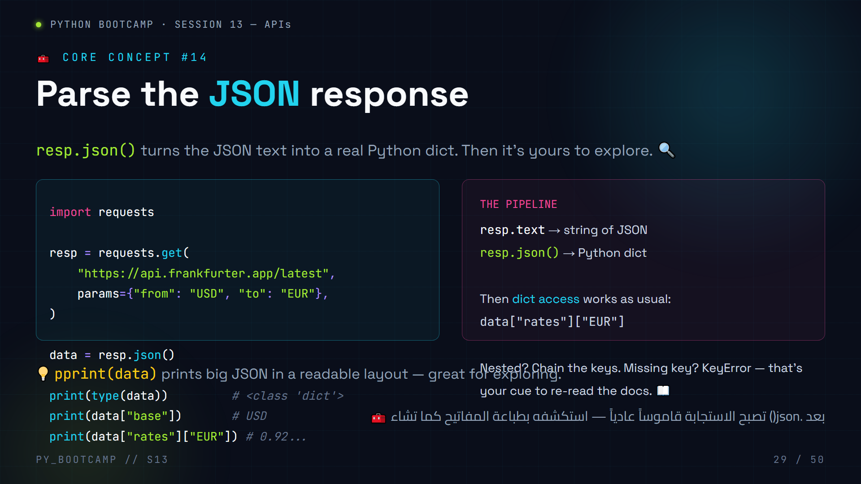
Notes:
Parsing JSON — the .json() moment.
Pipeline emphasis: text (string) → .json() → dict. Then everything is normal Python again (indexing, .get(), loops, nested access).
Live: after calling, show type(data) is dict, then print(data["rates"]) and data["rates"]["EUR"]. Also demo pprint(data) for readability.
Mistakes students will hit:
- data["rates"] gives a dict, and they forget the second key → they print a dict and wonder why "EUR" isn't there.
- KeyError from a typo like "Rates" (capital R) → tell them: JSON keys are case-sensitive, copy-paste from docs.
- resp.json() on a 404 body → error; solve with status check (slide 33).
Arabic tip: شبّه الأمر بفتح صندوق الشحن: .text هو الصندوق المغلق (نص)، و.json() يفتحه لتحصل على المحتويات المرتبة.

Slide 30
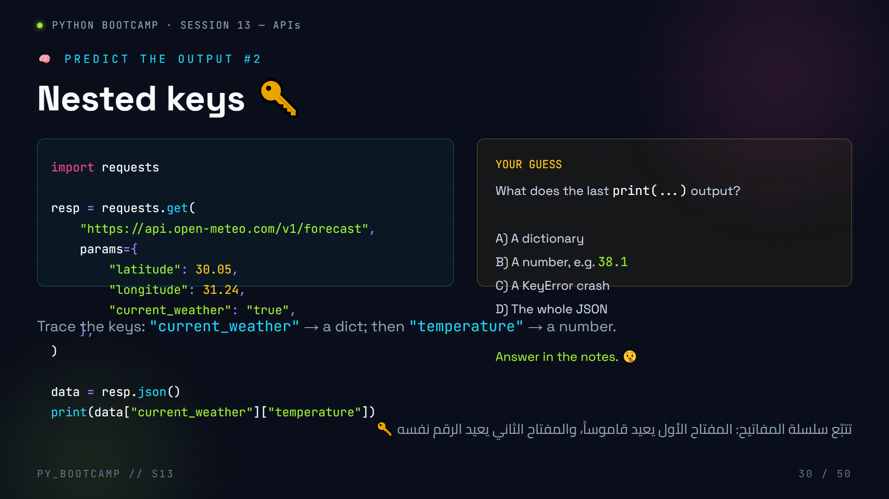
Notes:
Predict the output #2. Answer: **B) A number, e.g. 38.1**.
Trace: data["current_weather"] is a dict (because in JSON that key's value is an object), so data["current_weather"]["temperature"] is the float temperature value.
Why this matters: this exact snippet becomes the heart of our weather live coding in slides 34–35. Students who get this right are ready to build.
If someone guesses A: clarify the first key returns a dict, but the second key grabs the number inside it.
Extra challenge: ask them what would happen if the key were spelled "Temperature" → KeyError (case-sensitive).
Arabic tip: ذكّرهم بخريطة الكنز: كل مفتاح يقودك لمربع جديد حتى تصل إلى الرقم النهائي.

Slide 31
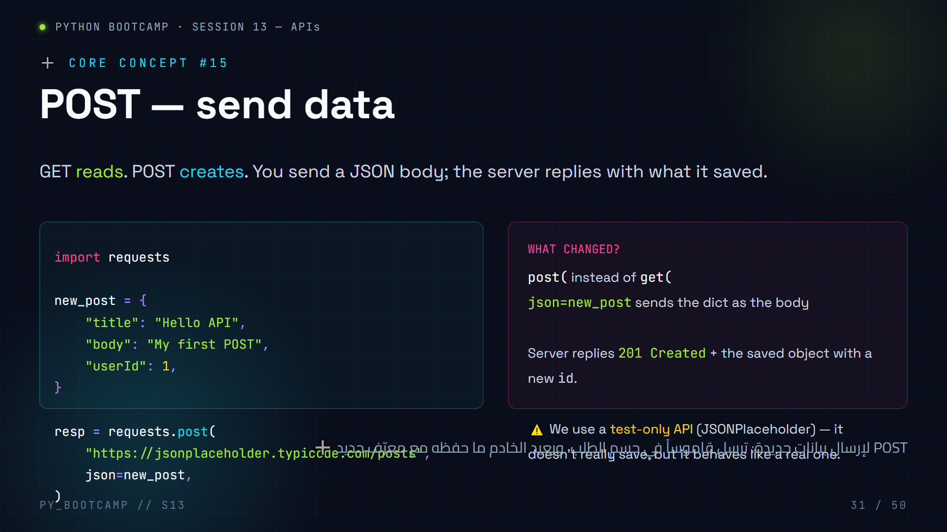
Notes:
POST requests — creating data.
Contrast with GET:
- GET: no body, read-only, answer is the data.
- POST: body = the new data, answer = the created resource (with an id).
Note the `json=` parameter name — requests serializes the Python dict to a JSON body automatically and sets Content-Type: application/json.
We use jsonplaceholder.typicode.com — a free fake API built for practice. Real POSTs would need auth/keys (a later session).
Live: run it; show 201 and the echoed object with id=101.
Pitfall: passing `data=` instead of `json=` — data sends form-encoded text; for APIs use json=.
Arabic tip: التمييز الذهبي: "GET يقرأ، POST يُنشئ" — و"json=" تنقل القاموس بأمان إلى الخادم.

Slide 32
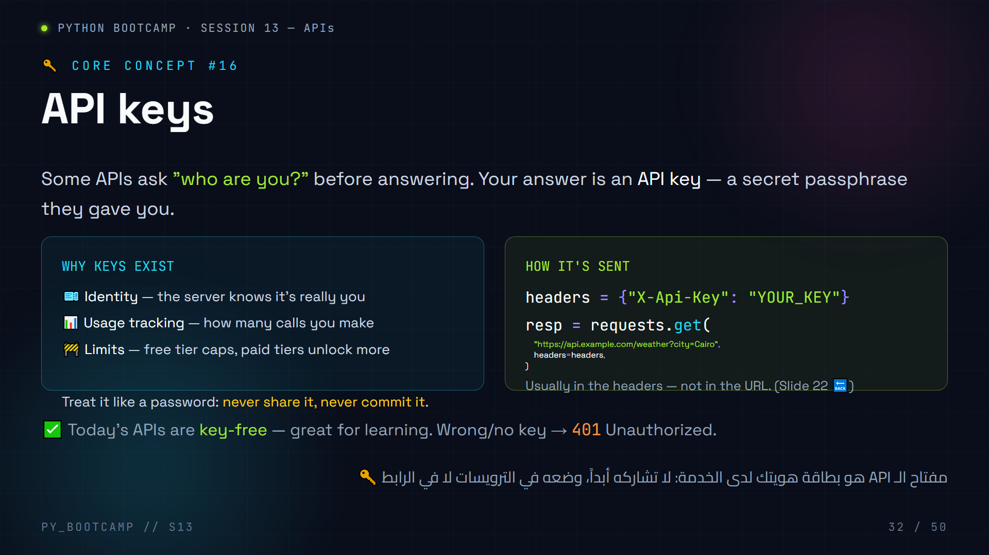
Notes:
API keys — identity for your requests.
Why keys: identify you, count usage, enforce free-tier limits. Emphasize security: never paste a real key into public code, never commit it to Git. Mention environment variables as the safe pattern (demonstrate `os.environ.get("KEY")`).
Reassure: today's weather & currency APIs need no key, so students can experiment freely. When they later use OpenWeatherMap or similar, the pattern is just headers + one URL.
Correlate with status codes: missing/wrong key → 401; forbidden permission → 403. Quick tie-back to slide 20.
Do NOT teach OAuth flows, token refresh, etc. — explicitly out of scope.
Arabic tip: شبّه المفتاح بكلمة مرور لحسابك: تُعطى لك بعد تسجيلك لدى الخدمة، وتحفظها كسرّ شخصي.

Slide 33
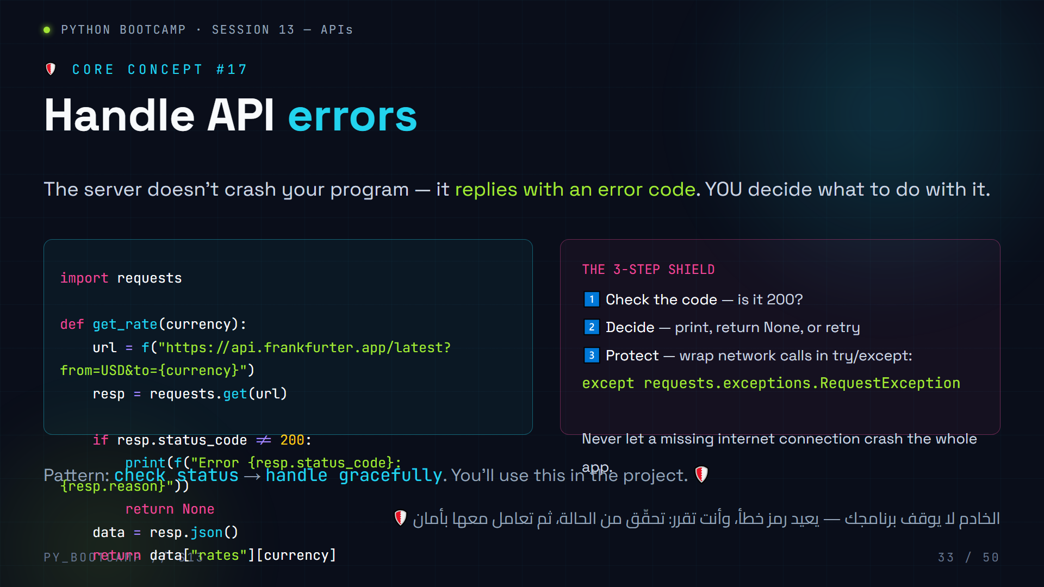
Notes:
Error handling — the 3-step shield.
Walk the code: check status_code != 200 first, print a friendly message + return None. Mention resp.reason gives "Not Found" text.
Two error layers students must distinguish:
1. HTTP errors (4xx/5xx) — caught by checking status_code.
2. Network errors (no internet, DNS failure) — these raise exceptions; catch with try/except requests.exceptions.RequestException.
Live demo idea: unplug/reload — call get_rate("XXX") (invalid code) → shows the graceful path returns None instead of crashing.
This pattern is required in the project (currency converter). Hammer it now.
Arabic tip: "احمِ برنامجك كأنه هاتفك — أنت لا ترميه عند انقطاع الإنترنت، بل تعالج الموقف" مثال واقعي قريب من حياتهم.

Slide 34
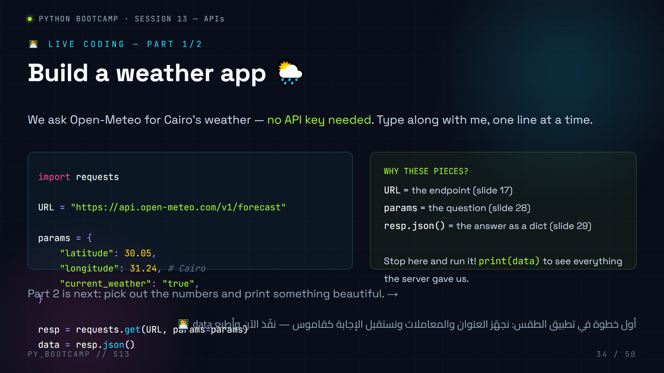
Notes:
LIVE CODING part 1 — weather app, Open-Meteo (no key).
Steps (10 min):
1. Open a new file `weather.py`.
2. `import requests`.
3. Copy the URL constant and params dict EXACTLY. Note coordinates for Cairo (30.05, 31.24).
4. Run `resp = requests.get(URL, params=params)` and `print(data)` to inspect the full JSON.
Pause here deliberately. Have students look at the printed dict and find keys like "current_weather", "temperature". This connects live code to the JSON visual from slide 24.
Expected data["current_weather"] keys: temperature, windspeed, winddirection, weathercode, is_day, time.
If network fails: show the offline fallback — hardcode a sample dict and continue; note that the code itself is correct.
Arabic tip: علّمهم قراءة المخرجات بصبر: "البيانات أمامك — اقرأ المفاتيح ثم استخرج ما تريد".

Slide 35
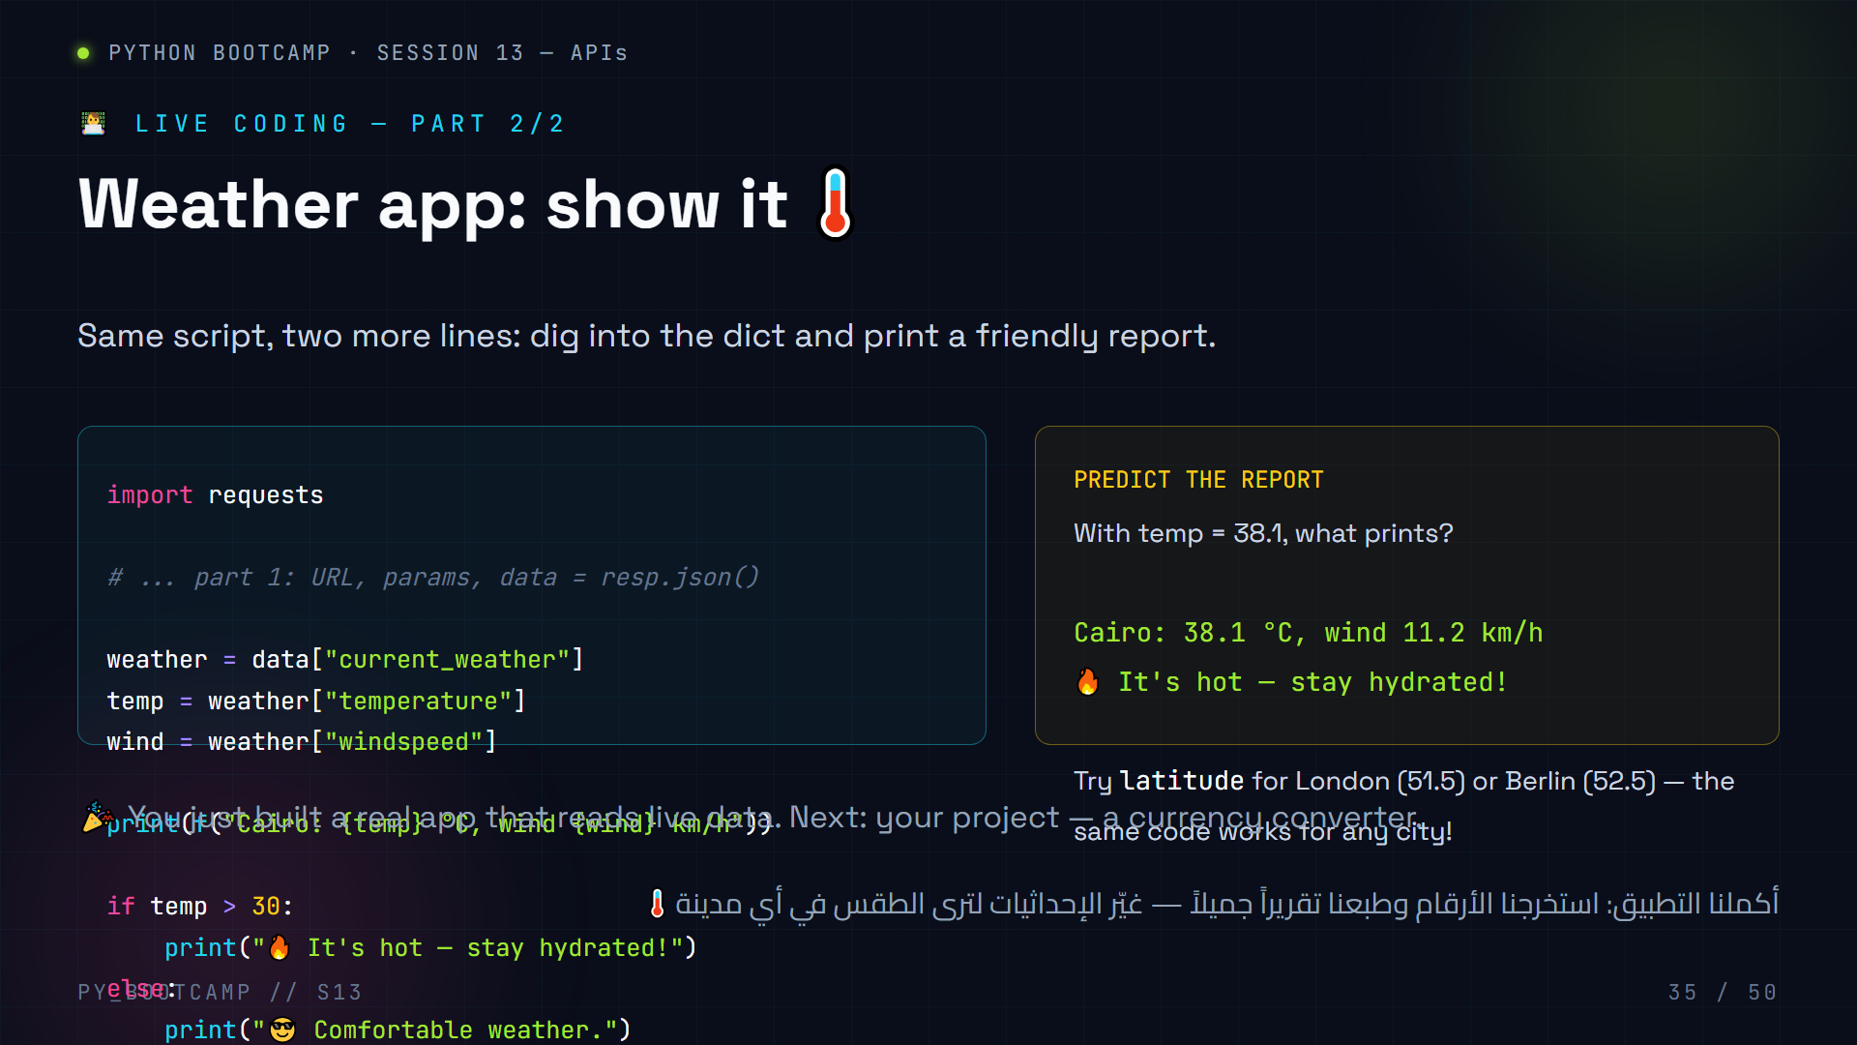
Notes:
LIVE CODING part 2 — finish the weather app.
Steps (10 min):
1. Continue weather.py.
2. Extract current_weather → weather dict, then temperature and windspeed.
3. Print the f-string report.
4. Add the if/else comment about temp.
Ask students to change the coordinates to their own city and re-run. This makes the lesson personal — expect excited reactions.
Common mistakes while typing:
- Forgetting the second index: data["current_weather"]["temperature"] written as data["current_weather"] then printing a dict.
- Typos in key names → KeyError. Remind: copy-paste keys from print(data).
Bonus if time: wrap in try/except from slide 33, or add a `while` loop asking for city names.
Offline plan: hardcode the sample dict from slide 24 and run the extraction part.
Arabic tip: اتركهم يجرّبون مدينتهم الخاصة — "التخصيص" يرفع الحماس ويرسّخ الفهم أكثر من أي شرح.

Slide 36
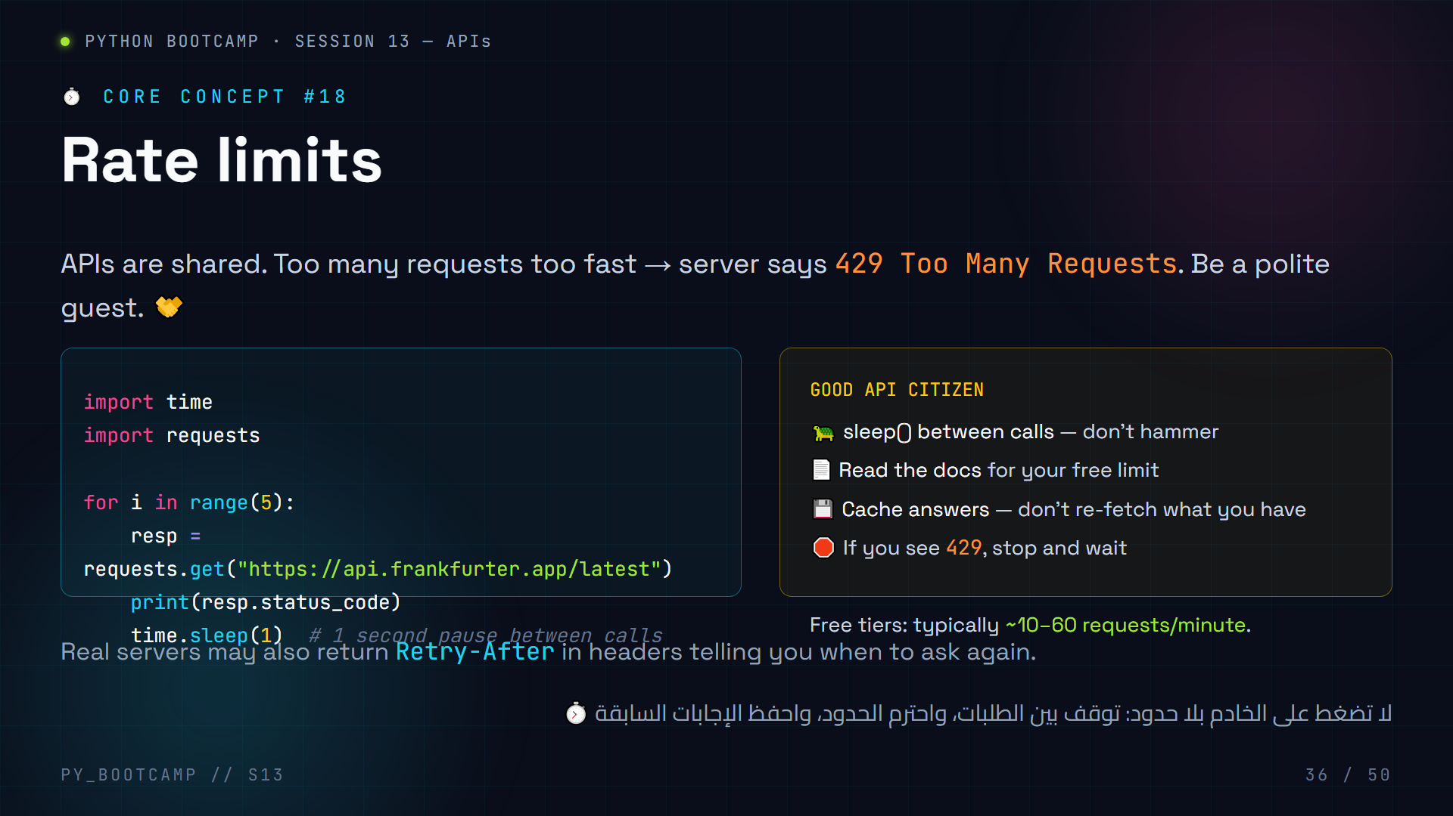
Notes:
Rate limits — being a good citizen.
Story: servers are shared. If 10,000 students all hit one API every 10 ms, it collapses. 429 is the server politely saying "wait a second."
Good habits (write on board):
- time.sleep() between requests in loops
- read the docs' rate-limit section
- cache: store what you fetched instead of re-fetching
- respect Retry-After headers when present
This slide connects to status codes (429 was mentioned on slide 20). Quick recall: which family is 429? (4xx — client error: too many requests.)
Arabic tip: مثال حي: عندما يتزاحم الجميع على باب واحد لا يدخل أحد — الـ 429 هو "قف قليلاً ثم عد".

Slide 37
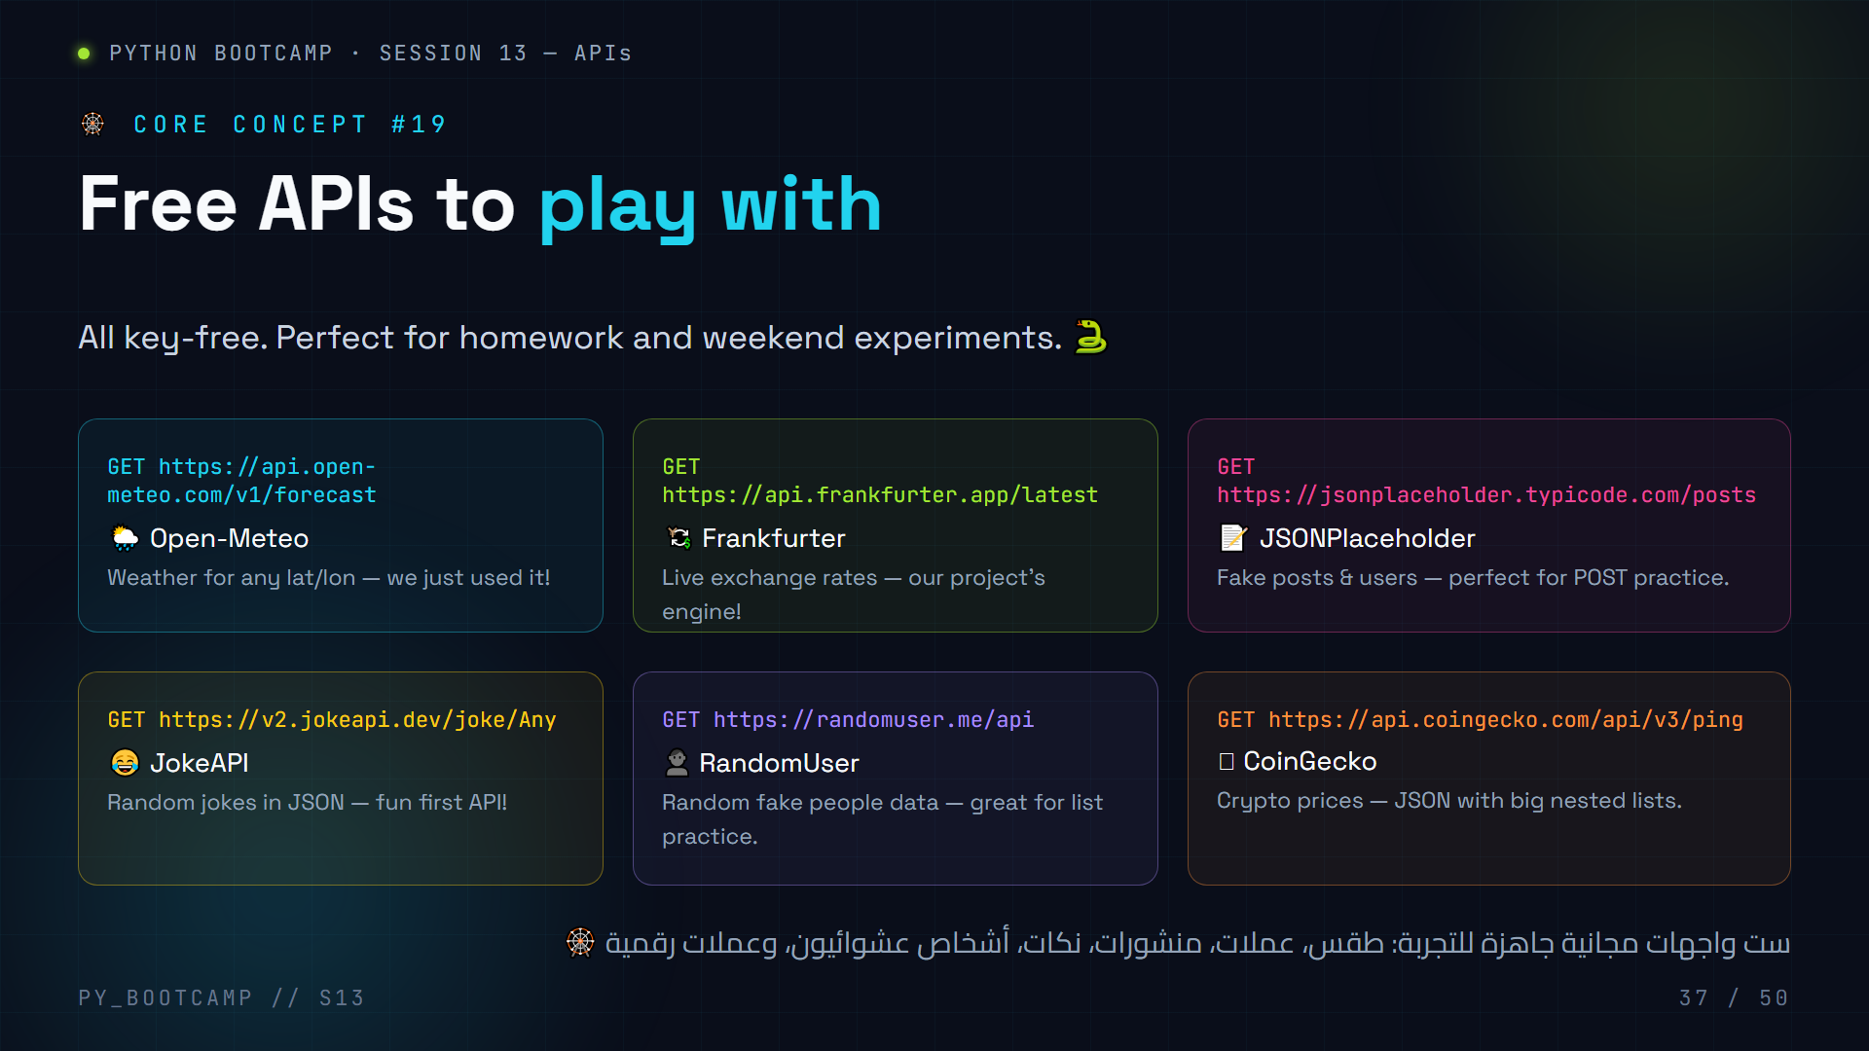
Notes:
Free public APIs — a playground menu (six cards).
Present this as the "toy box": everything here is key-free and free. Each card shows the real GET endpoint.
Suggest a 3-minute challenge: pick one API, GET it in a browser (you'll see JSON), then write the 4-line requests version. First five students done get a shout-out.
Careful teaching points:
- randomuser.me/api returns data["results"][0]["name"]["first"] — a great nesting exercise.
- jokeapi sometimes returns "setup" + "delivery" (two-part jokes) — handling both shapes is a nice if/else exercise.
- These URLs are real and keyless — verified working class of 2026.
Arabic tip: "صندوق ألعاب" حقيقي — دع الطلاب يختارون واحداً ويبنون منه شيئاً صغيراً اليوم أنفسهم.

Slide 38
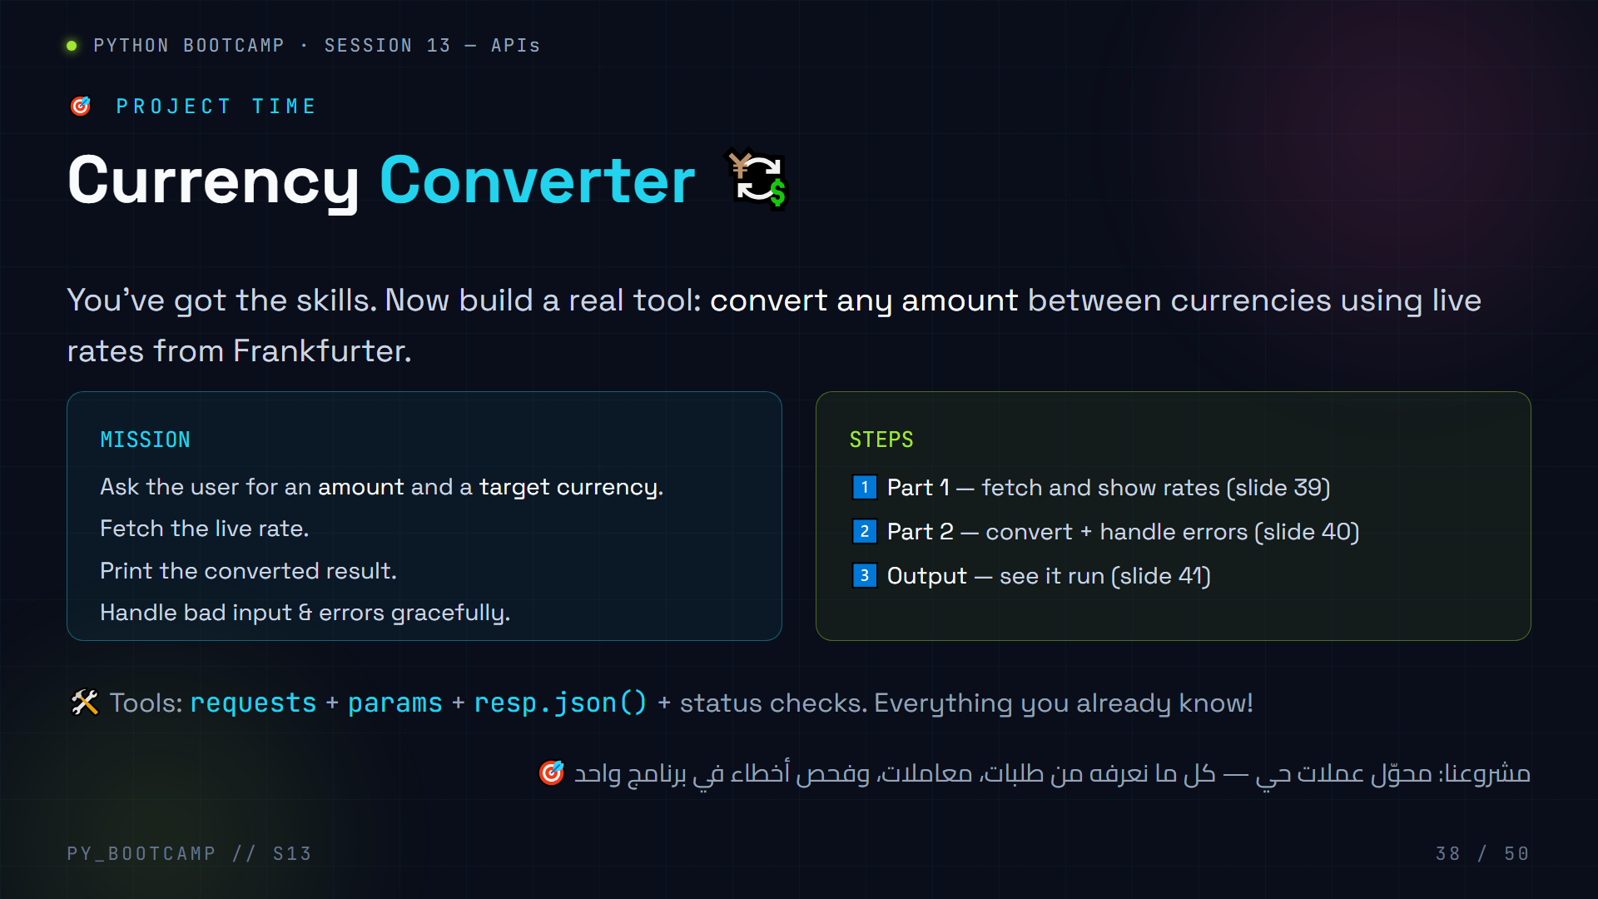
Notes:
Project intro — currency converter.
Set the goal: a real tool using the Frankfurter API (keyless, free). It combines almost everything taught: requests, params, JSON parsing, status checks, and input().
Project format: students build it in pairs or solo, following slides 39–41. 40 minutes total (15 read+write, 15 build, 10 debugging + sharing).
Expectations: working tool + graceful errors. "If your converter crashes when I type garbage, it's not done."
Time check: if the session is running long, project slides 39–41 are the core deliverable — do not skip. Exercises/homework can be shortened instead.
Arabic tip: اربط المشروع بحياتهم: "كم مرة احتجت تحويل دولار إلى جنيه وفتحت الإنترنت؟ الآن تبني الأداة بنفسك."

Slide 39
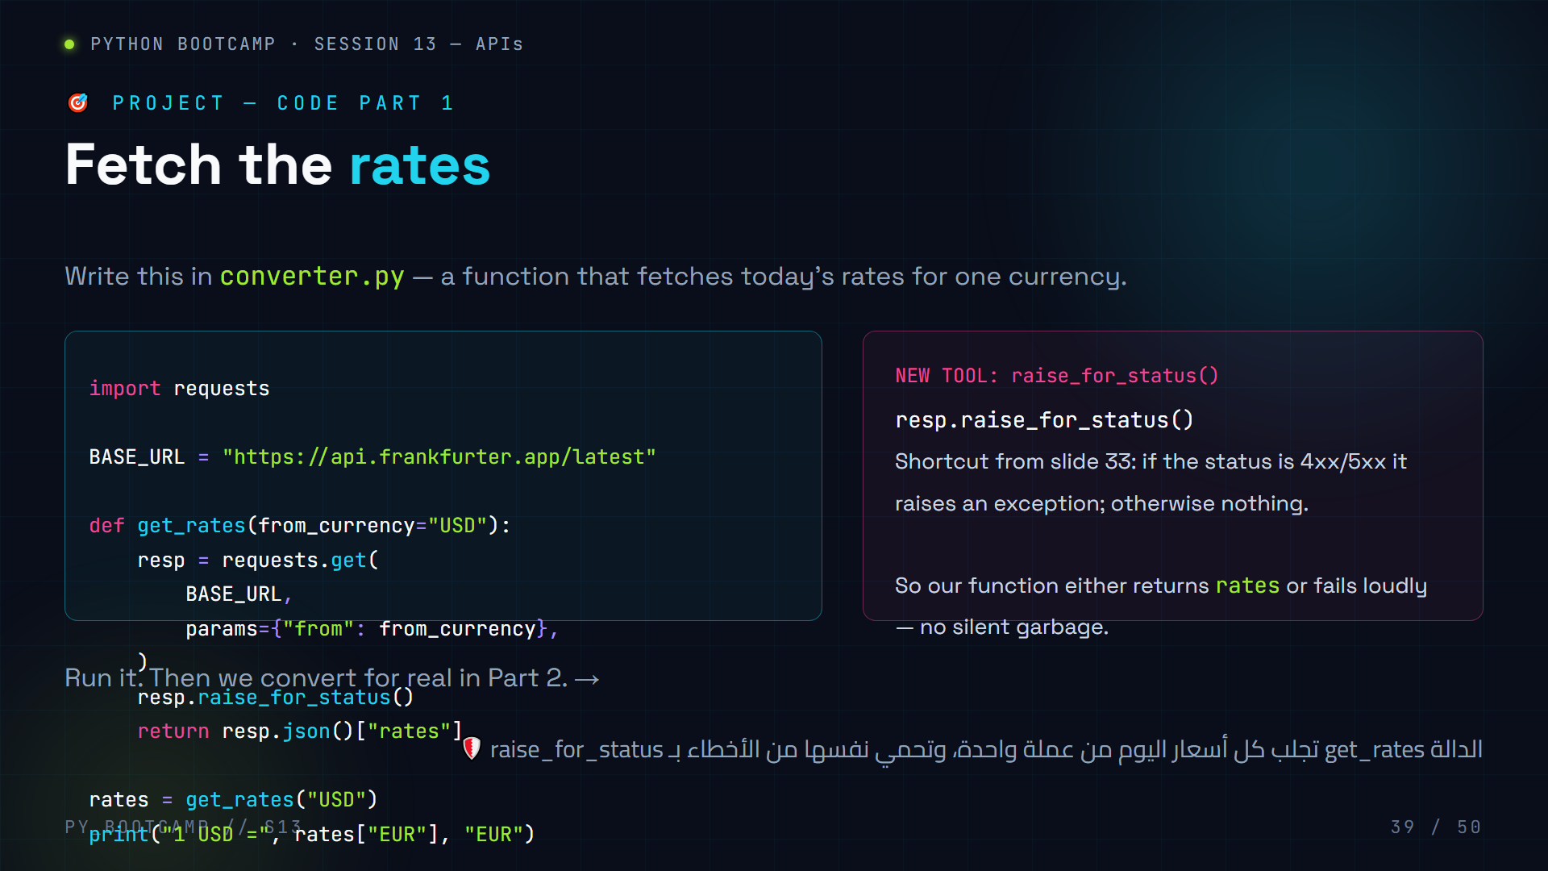
Notes:
PROJECT code part 1 — get_rates().
Teach the new tool raise_for_status(): one line that combines "check the code" + "raise on error". Explain it raises requests.HTTPError for 4xx/5xx.
Walk through the function:
- default from_currency="USD"
- params dict, pass to requests.get
- raise_for_status() guards
- return resp.json()["rates"] — the nested dict of rates
Expected output: `1 USD = 0.92 EUR` (approx).
Student pitfall: returning resp.json() (the whole object) instead of ["rates"] — then later code breaks. Have them print type(rates) → dict.
Arabic tip: اشرح raise_for_status كـ"إنذار فوري": إذا لم يكن الرد سليماً أطلق صفارة، لا تواصل بصمت.

Slide 40
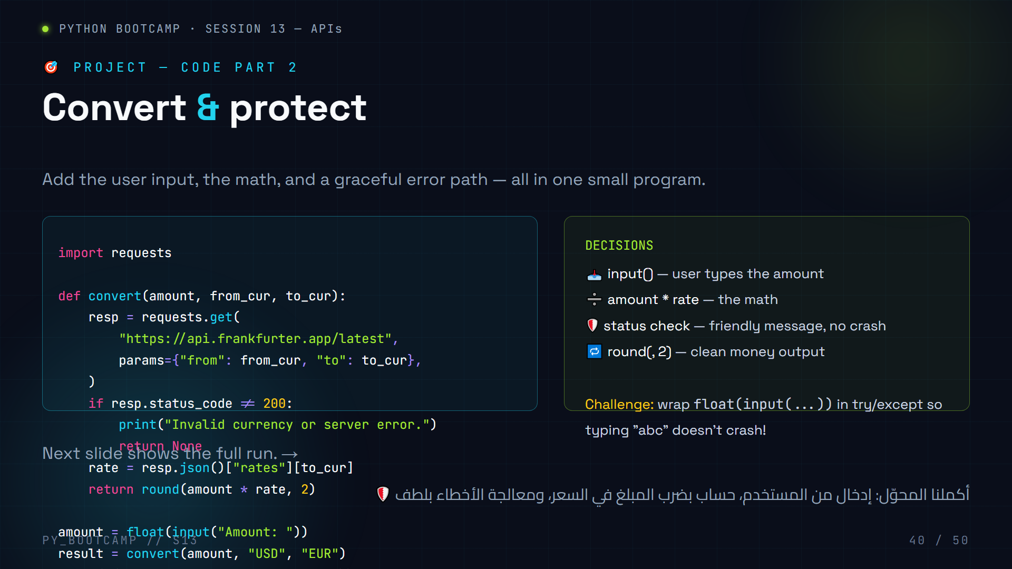
Notes:
PROJECT code part 2 — convert() + main flow.
Walk through:
- convert() takes amount, from, to.
- params get both currencies.
- status check returns None with a friendly message on failure.
- rate extracted, math done, rounded to 2 decimals.
- main: float(input()), call convert, print result.
Live: run with 100 USD → EUR. Show the output.
Challenge (5 min, optional): make it crash-proof for "abc" input with try/except around float(). Also allow the user to choose the target currency with input().
Expected pitfalls:
- float("abc") → ValueError crash (hence the challenge).
- params key "from"/"to" are fine to pass as dict keys in requests.
Arabic tip: اجعلهم يفكرون: "ماذا لو كتب المستخدم حروفاً بدل الأرقام؟" — اتركهم يجدون الحل بأنفسهم قبل أن تكشفه.

Slide 41
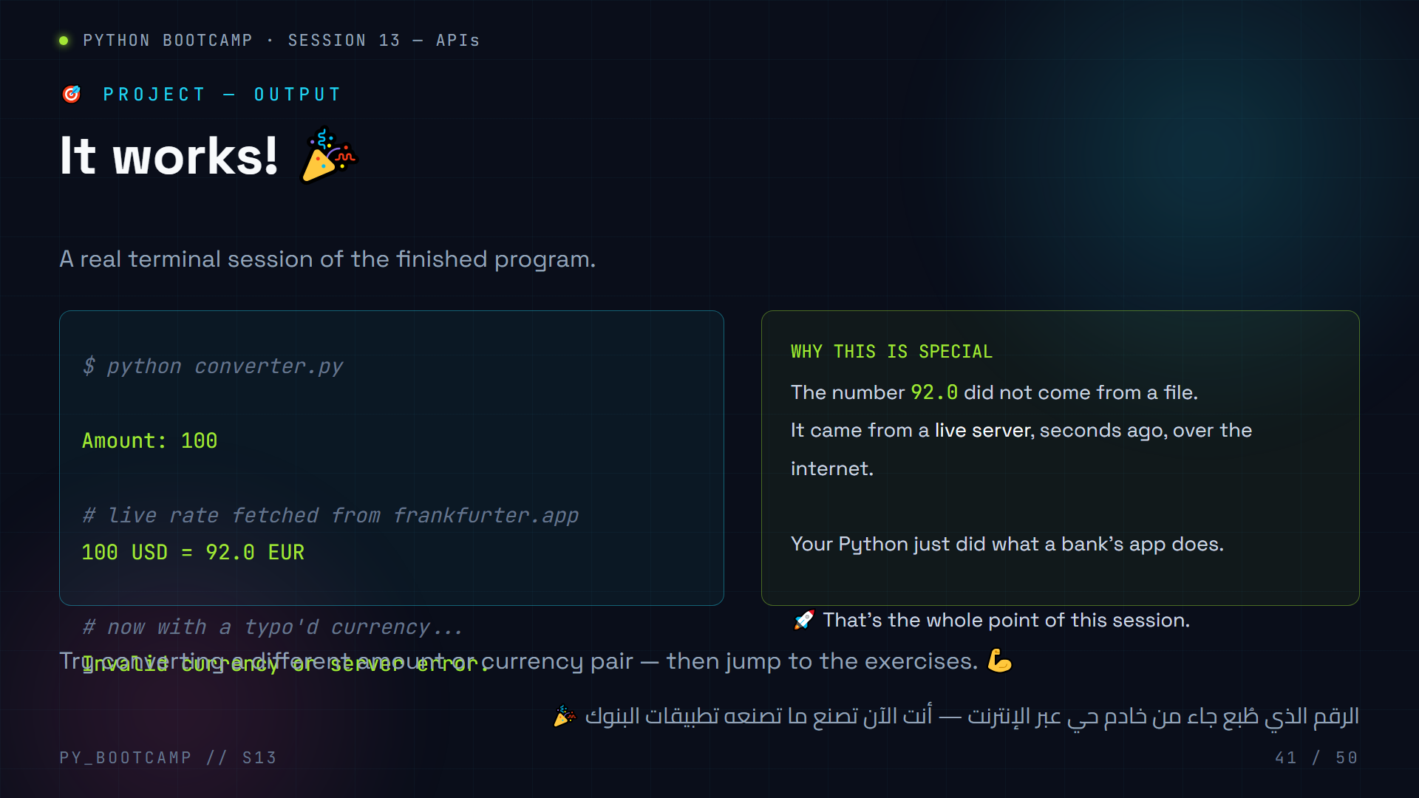
Notes:
PROJECT output — celebrate.
Show the actual terminal session: successful conversion (100 USD = 92.0 EUR) and the graceful error path.
Have 2–3 volunteers show their output to the class. Praise effort, not just success — the error-handling branch is as impressive as the happy path.
Emphasize the emotional beat: "The number on your screen is minutes old, from a server you never met. You did this with Python."
If time: quick showcase of a student who did the challenge (typing "abc" doesn't crash).
Arabic tip: لحظة الفخر مهمة: اجعلهم يعرضون شاشاتهم لبعضهم — النجاح المرئي يرفع ثقة المجموعة كلها.

Slide 42
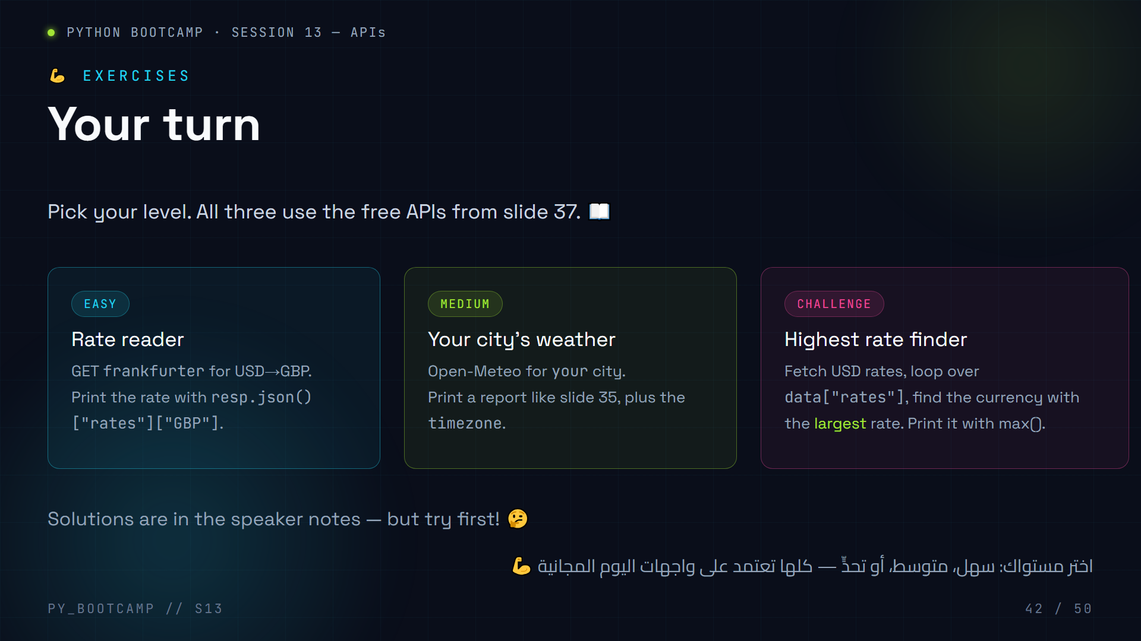
Notes:
Exercises — three levels. Give 15 minutes.
EASY solution:
```python
import requests
resp = requests.get("https://api.frankfurter.app/latest?from=USD&to=GBP")
print(resp.json()["rates"]["GBP"])
```
MEDIUM solution (example: Cairo):
```python
import requests
resp = requests.get("https://api.open-meteo.com/v1/forecast",
params={"latitude": 30.05, "longitude": 31.24, "current_weather": "true"})
data = resp.json()
w = data["current_weather"]
print(f"Your city: {w['temperature']} °C, wind {w['windspeed']} km/h")
print("timezone:", data["timezone"])
```
CHALLENGE solution:
```python
import requests
data = requests.get("https://api.frankfurter.app/latest?from=USD").json()
rates = data["rates"]
best = max(rates, key=rates.get)
print(best, rates[best])
```
Circulate: students who finish fast can help neighbors — pairs of "teacher/learner" reinforce mastery.
Arabic tip: اجعل من أنهى التحدي يشرح حله للصف — الشرح للآخرين أقوى تثبيتاً للمفهوم.

Slide 43
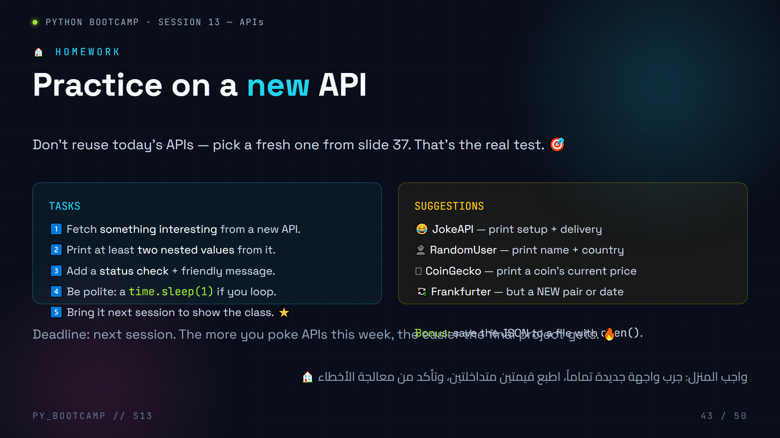
Notes:
Homework — practice on a NEW API.
Why "new": copying today's code is memory; using the pattern on an unseen API is understanding. State this explicitly to students.
Checklist to include in their submission: code file + a screenshot of output + the API they used. Next session: 3 volunteers present, 2 minutes each.
Give a concrete example of the "two nested values" requirement, e.g. RandomUser:
data["results"][0]["name"]["first"] and data["results"][0]["location"]["country"].
Arabic tip: اربط الواجب بالمكافأة: "من يعرض واجهة جديدة بنجاح يبدأ الجلسة القادمة بعلامة كاملة" — حافز بسيط وفعّال.

Slide 44
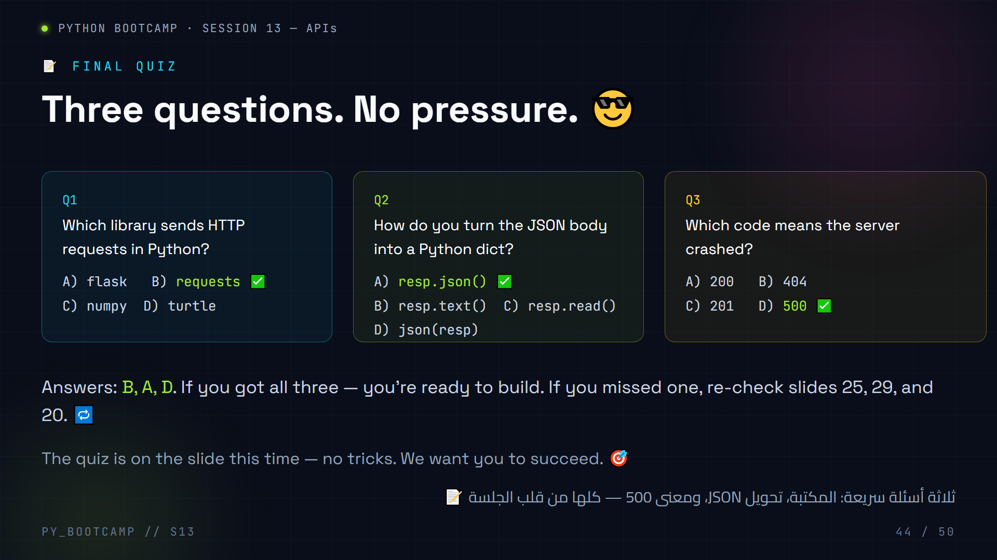
Notes:
Final quiz — answers on the slide: Q1=B (requests), Q2=A (resp.json()), Q3=D (500).
Read each question aloud, let students answer on paper or fingers (1–4), then reveal.
If someone struggles:
- Q1 → revisit slide 25 (the library that makes requests).
- Q2 → slide 29 (.json() pipeline).
- Q3 → slide 20 (5xx family).
Tone: encouraging, zero-pressure. The goal is confidence before the recap.
Extra oral question if time: "Which HTTP method would add a new user?" → POST.
Arabic tip: اطلب منهم تقييم أنفسهم بالإشارة فقط (بدون رفع اليد العلني) — يشعر الضعيف بالأمان ويشارك بصدق.

Slide 45
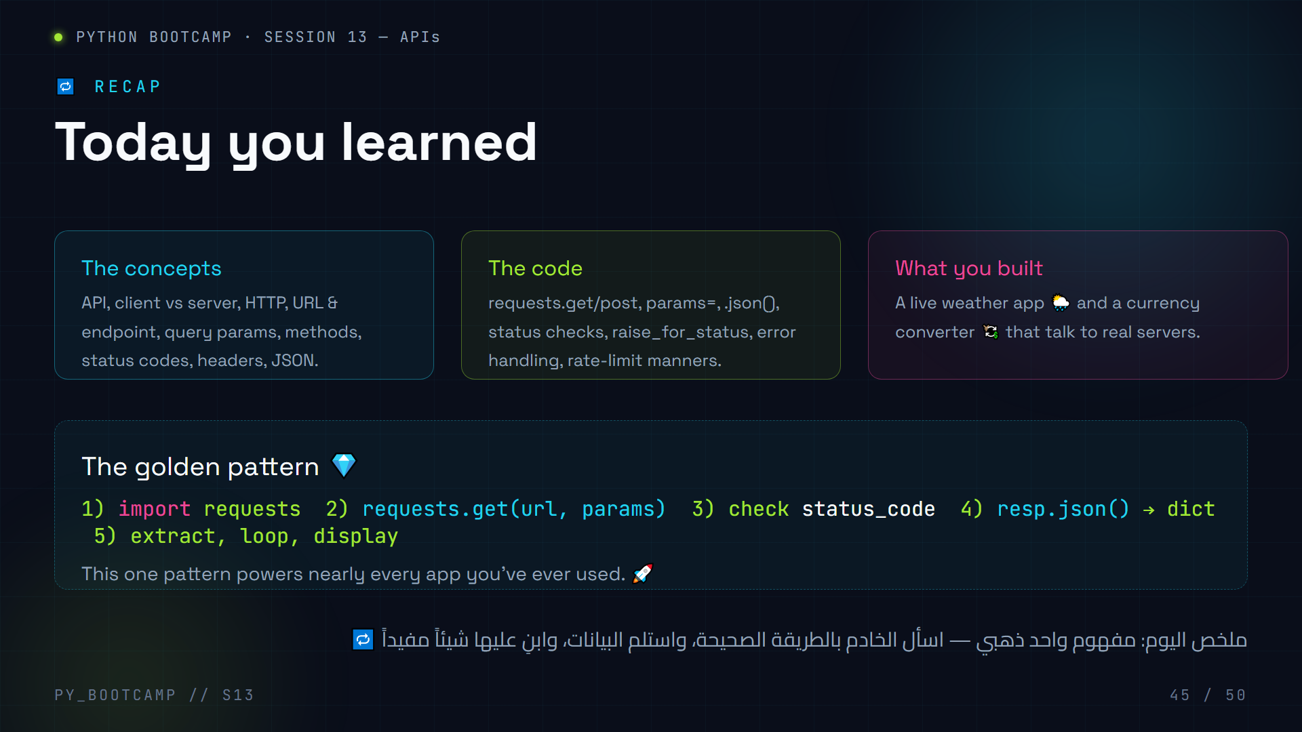
Notes:
Recap — consolidate the golden pattern.
Read the golden pattern out loud slowly; students repeat each step. This is the "one pattern" that powers everything: import → get → check → parse → use.
Reinforce what they built (weather + currency) — point out they are now doing "real developer work."
Ask a fast-fire round of recap questions (30 seconds each):
- What does 404 mean? (not found)
- What does resp.json() return? (dict)
- Which method reads? (GET)
- Why sleep between requests? (rate limits)
Then transition: "Today we asked APIs that websites generously open for us. What if we want data that has NO API?" → slide 46 (common mistakes) → 47 (bridge to scraping).
Arabic tip: اجعل التلخيص "حلقة سريعة": أنت تسأل، الطلاب يجيبون بسرعة — إنهاء الجلسة بطاقة عالية يثبّت كل شيء.

Slide 46
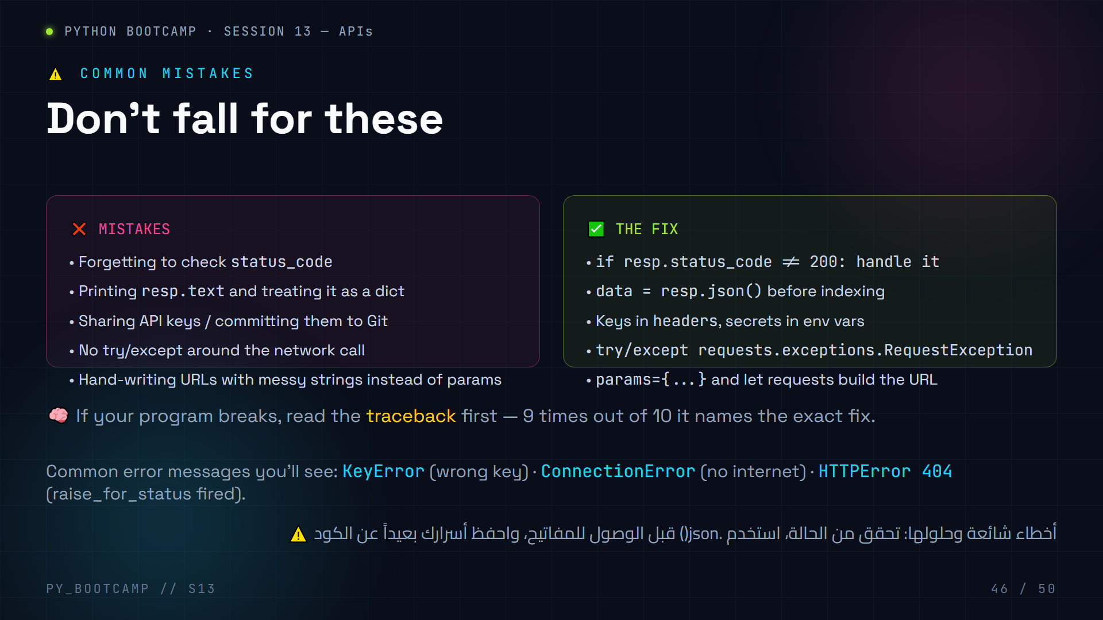
Notes:
Common mistakes — wrong vs right, side by side.
Walk each row: mistake → fix. Let students self-diagnose which mistake they nearly made today.
Emphasize the "three error messages" box:
- KeyError → wrong key name (case-sensitive!)
- ConnectionError → offline / bad domain
- HTTPError → raise_for_status() caught a 4xx/5xx
Quick activity: give one minute to find their own mistake from today's session and tell the class what they'd do differently.
Arabic tip: اجعلهم يتحلون بالأمانة: "من وقع في أي خطأ اليوم؟" — الاعتراف بالخطأ جزء من التعلم.

Slide 47
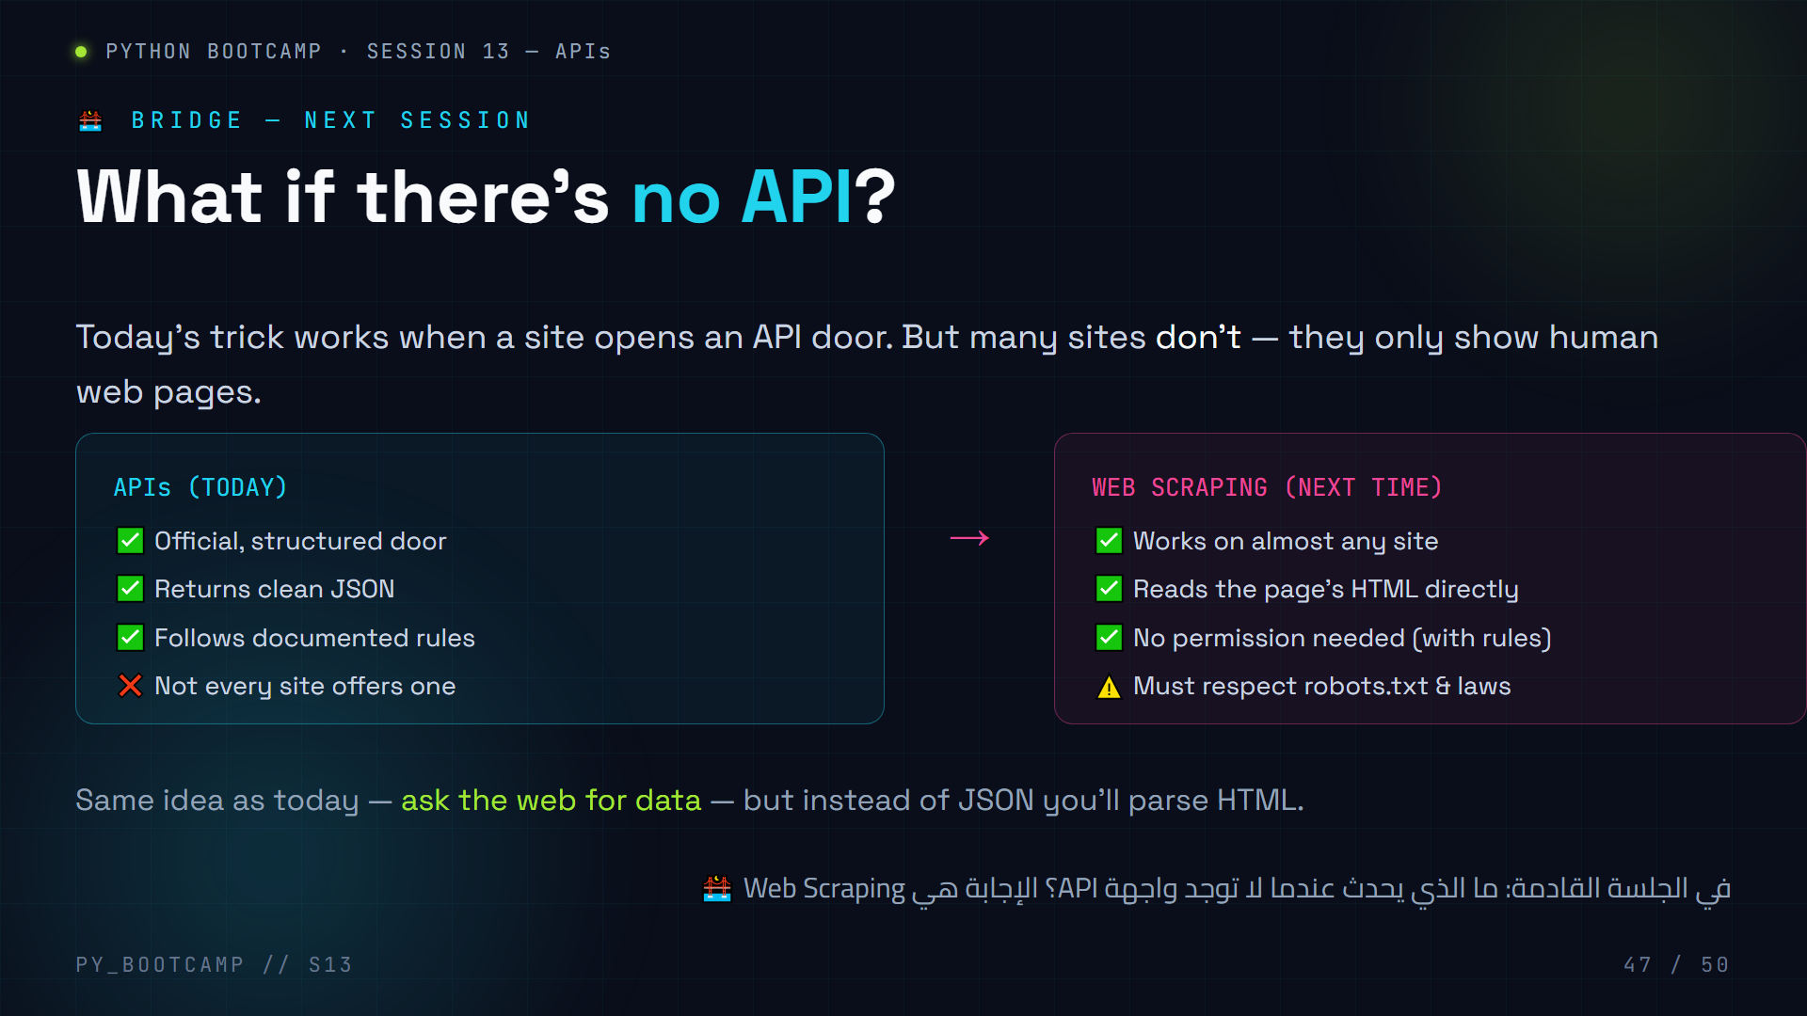
Notes:
Bridge to Web Scraping.
Set up the contrast: APIs are official doors; scraping is reading the page like a human browser. Both get data from the web; both use requests.
Ethics hook (important): scraping has rules — robots.txt, terms of service, be gentle, don't steal logins. We'll cover how to do it the right way next session.
Memory: "If there's a door (API), knock politely. If there's no door, next session we learn to read the sign outside."
Arabic tip: عبّر عنها بالمجاز: "اليوم فتحنا الباب الرسمي للبيانات؛ الجلسة القادمة سنتعلم قراءة اللافتات على أي بناء".

Slide 48
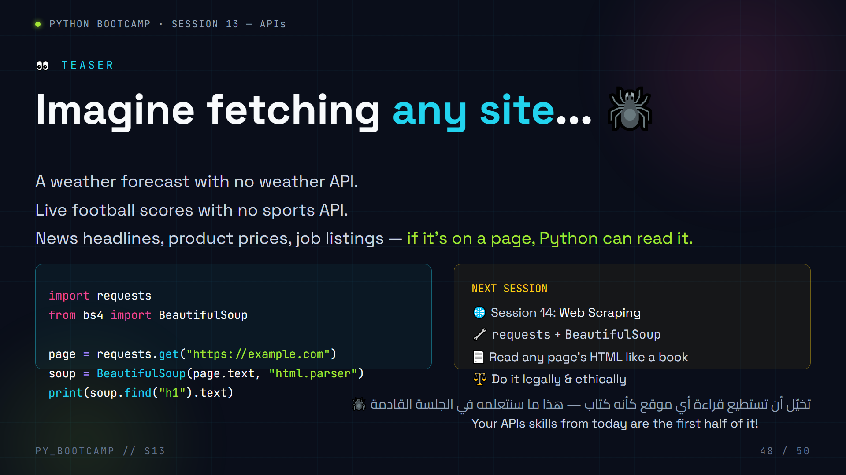
Notes:
Teaser for Web Scraping.
Keep energy high — this is the "coming soon" trailer. Show the code as pure hype (it's valid, but we don't build it today; bs4 is installed next session).
Story: "Anything a human can read on a page, a Python script can read too — and 10,000 times faster."
Ethics one-liner: "With great scraping power comes great responsibility — we learn the rules next time."
Do not run the code now (bs4 not installed); it's a teaser only. Note requests is reused — today's knowledge is directly transferable.
Arabic tip: "المعرفة تراكمية: ما تعلمته اليوم هو نصف المهارة القادمة" — هذا يشعرهم أنهم متقدمون بالفعل.

Slide 49
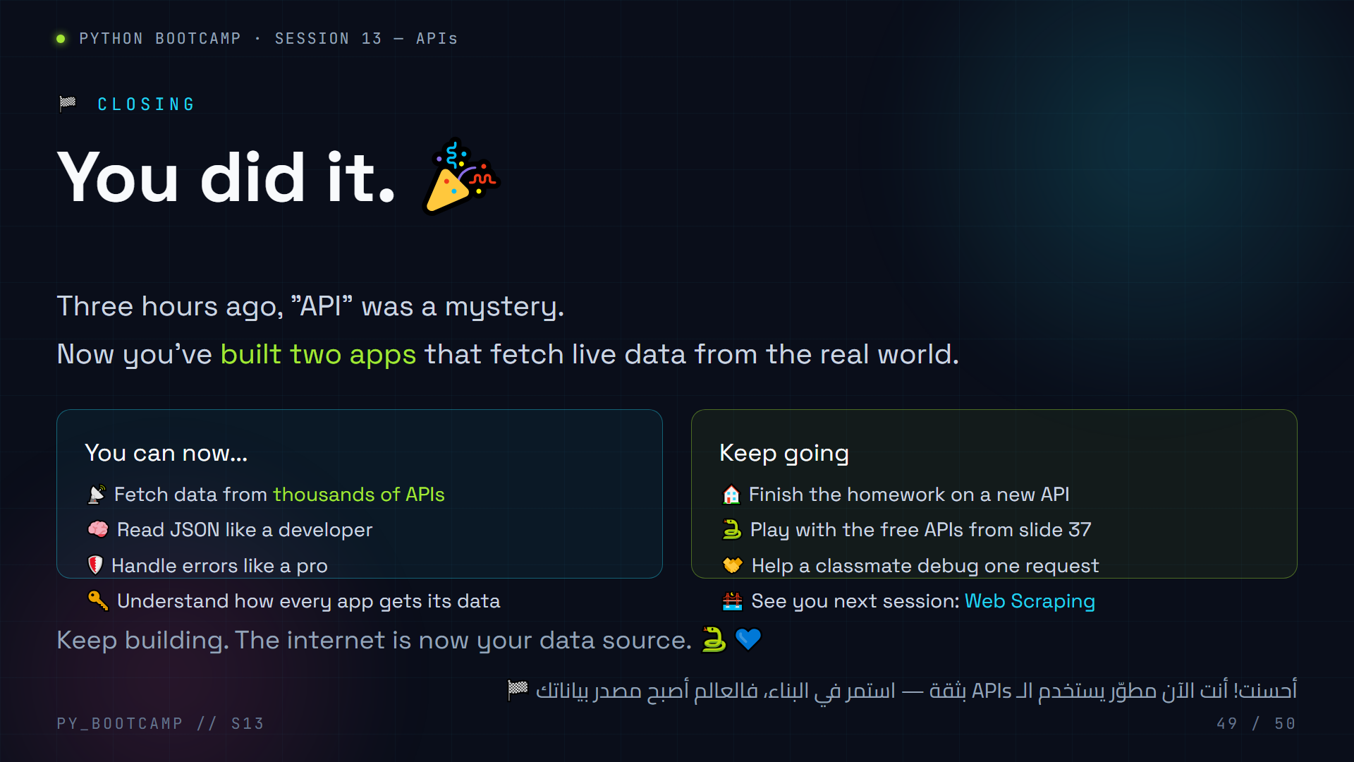
Notes:
Closing — celebration + next steps.
Praise specifics (not generic): name 2–3 things the class actually did today ("you parsed nested JSON", "your converter survived bad input").
Close the loop on the hook: "This morning the weather app told you 38°C. Now YOU know exactly how it got that number — because you wrote code that does it."
Final send-off: encourage the homework, preview Web Scraping with excitement, thank them, end on energy.
Arabic tip: أنهِ بعبارة حماسية قصيرة وواثقة — النهاية القوية تُبقى الحماس حتى الجلسة القادمة.

Slide 50
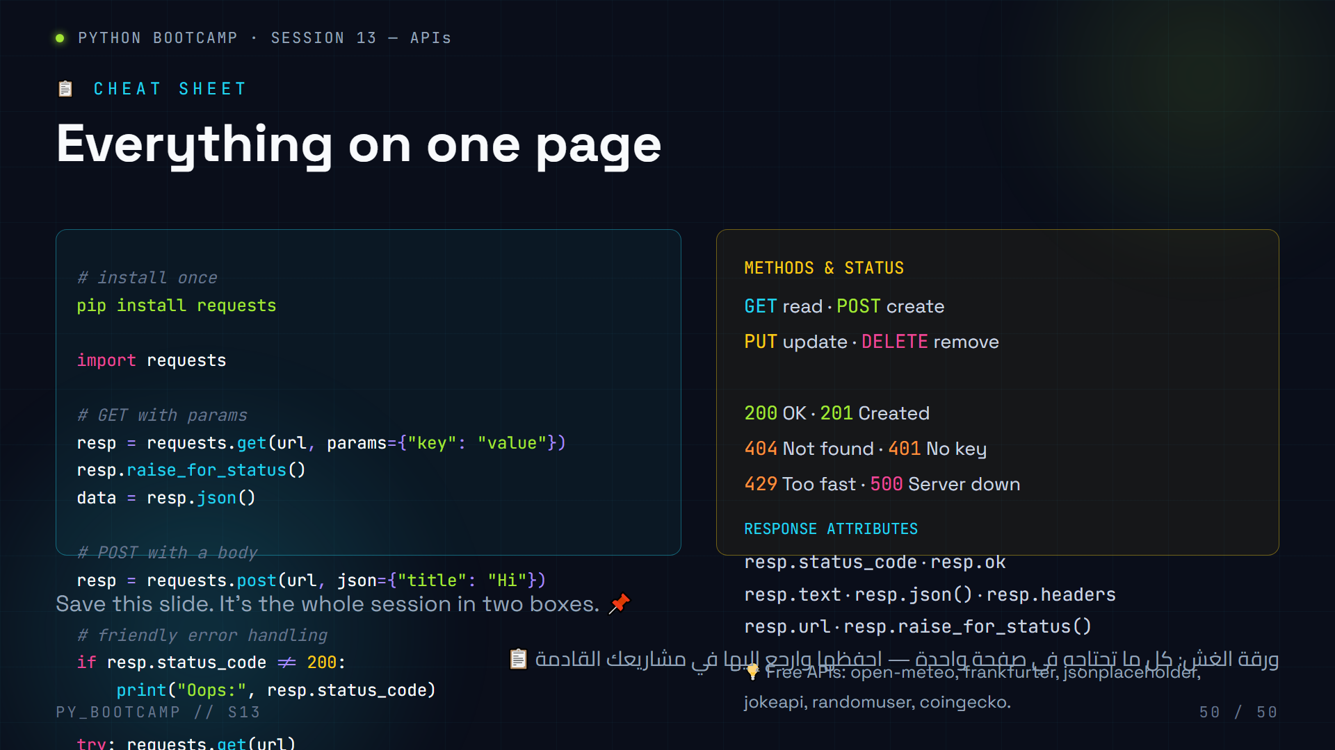
Notes:
Cheat sheet — the whole session in two boxes.
Left box: the reusable code pattern (install → import → GET/POST → raise_for_status → .json() → error handling).
Right box: methods, status codes, response attributes, and the free API list.
Advice for students: screenshot this slide, or copy it into their own notes. It's the reference they'll want for the homework and future projects.
Closing note for the teacher: remind students the cheat sheet exists as an HTML slide they can revisit any time.
Arabic tip: اطلب من الطلاب "التقاط" هذه الشريحة على هواتفهم — مرجع سريع يحملونه أينما كانوا.

