Slide 1
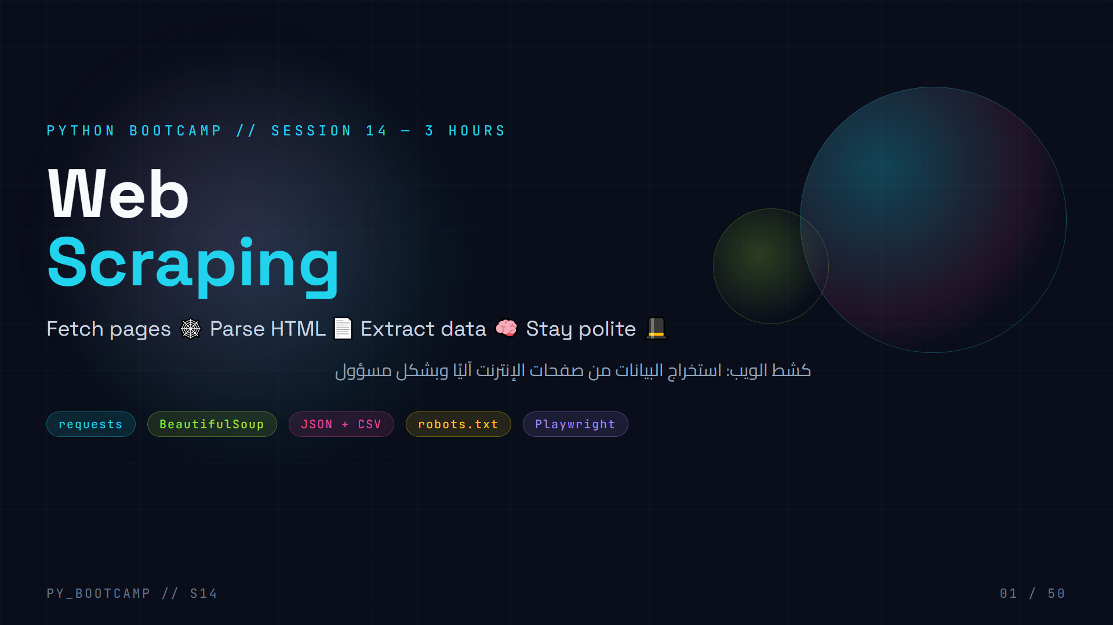
Notes:
Welcome to Session 14! Today we turn the whole internet into a data source.
Say: "Last session you talked to APIs. Today we talk to the web itself — no API key needed. We learn how websites are built, how to fetch them, and how to pull out the data you want, legally and politely."
Run the plan on the board: requests → BeautifulSoup → extract → clean → save → automate. Mention this is a 3-hour live session, ends with a mini project + homework.
Arabic tip: كشط الويب (web scraping) — explain the word "كشط/استخراج" and that مسؤول = responsible. Keep it motivational: "you already know Python; today we make it walk the web."

Slide 2
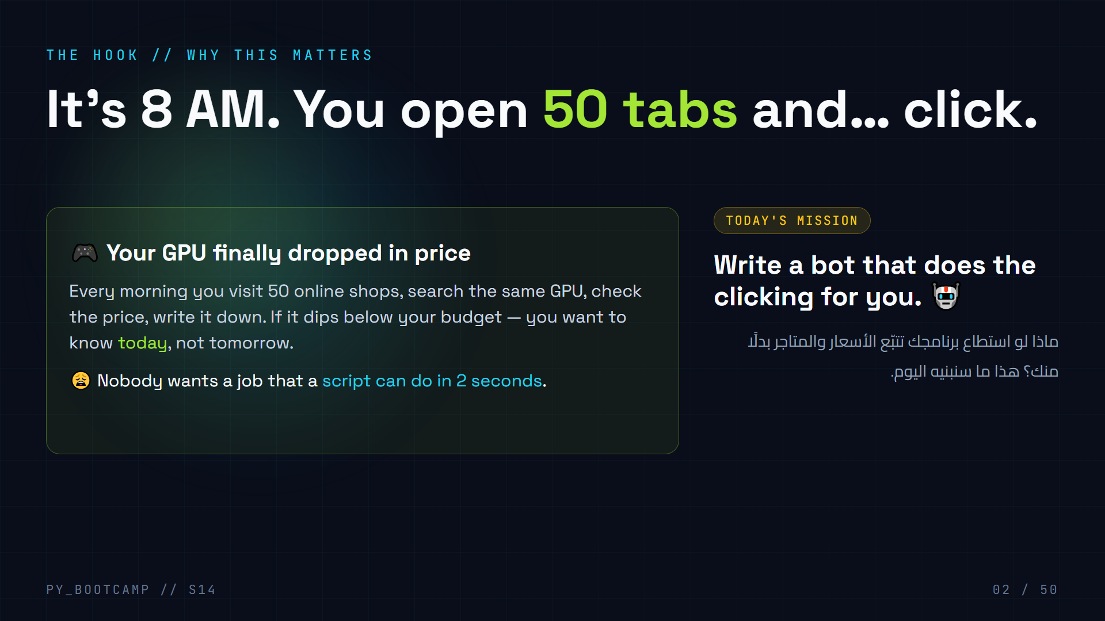
Notes:
Hook: real pain students relate to — price tracking.
Ask: "Hands up — who has manually checked a website for a price, a release date, an exam result?" Expect almost all hands.
Then: "That repetitive tab-clicking is literally a loop. And loops are what Python does best. Today you'll build the tool that replaces that morning routine."
Set the tone: scraping = reading, not attacking. We read pages politely. We never hack, never bypass locks, never steal private data.
Arabic tip: use مبادرة/تحدي wording — "اليوم تبني برنامجًا ينقر بدلًا منك". Keep energy high, this hook sets the motivation for the whole 3 hours.

Slide 3
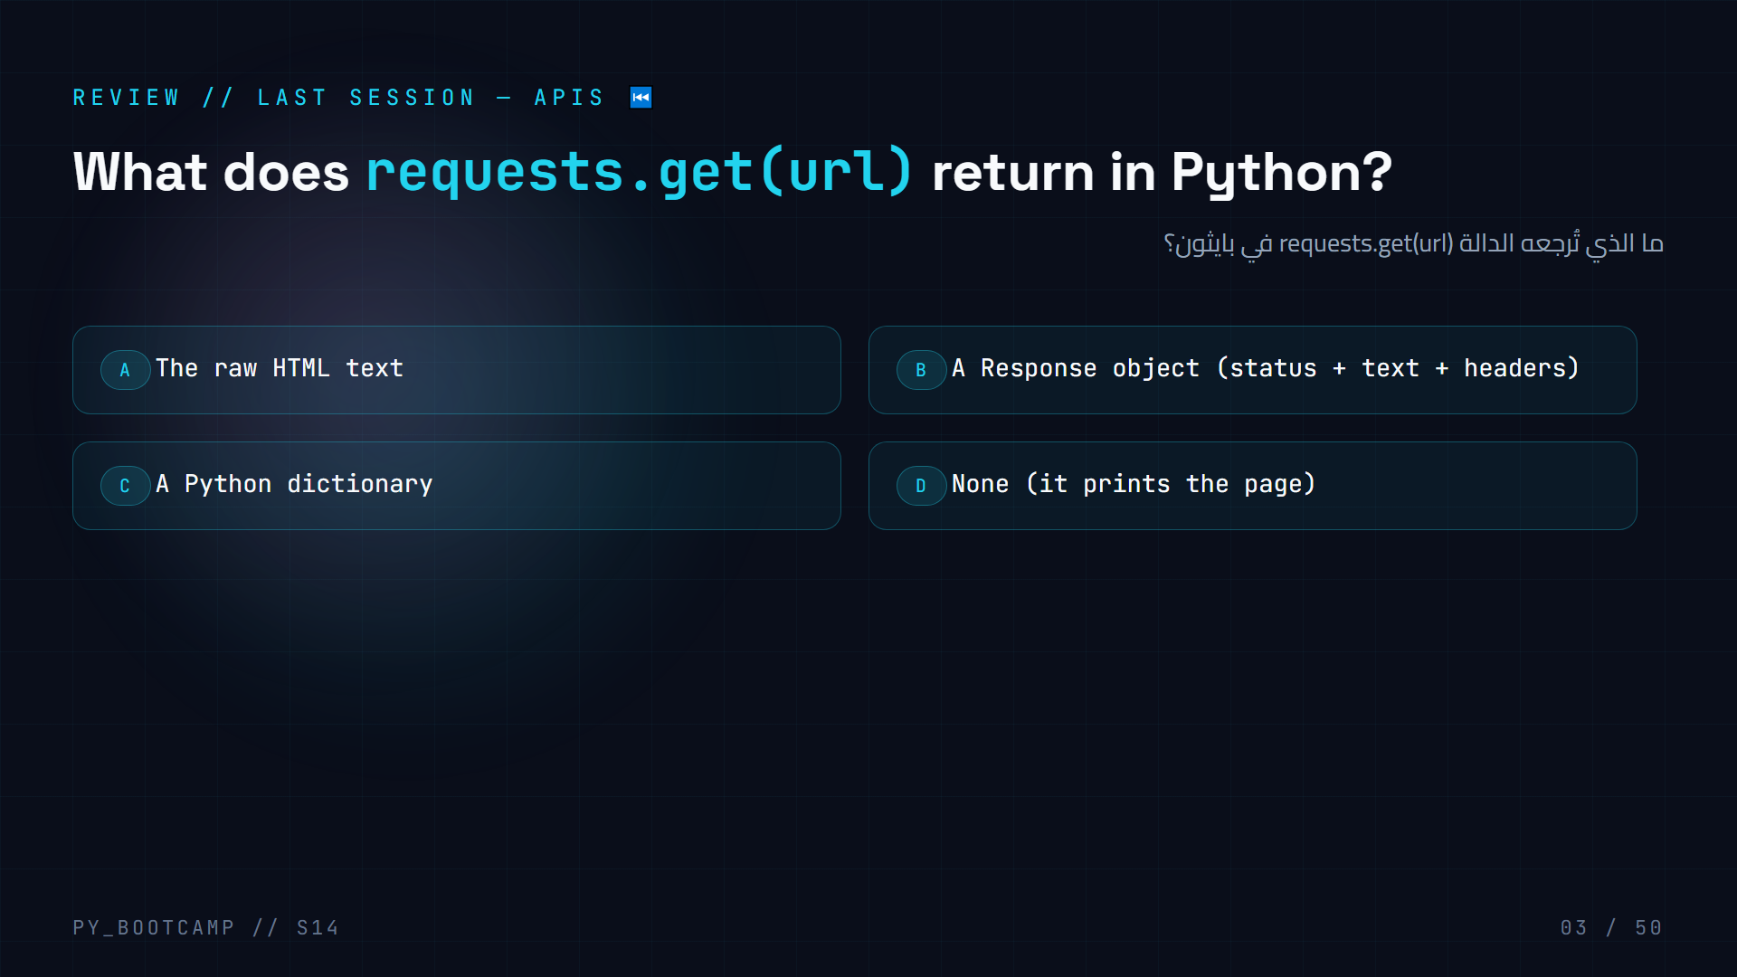
Notes:
Answer: B. `requests.get()` returns a `requests.Response` object. You read `.status_code`, `.text`, `.json()`, `.headers`.
Why we ask: today we call `.text` and hand it to BeautifulSoup — the same Response object is the bridge between "talking to APIs" (session 13) and "reading web pages" (today).
Ask: "What would `resp.json()` be useful for?" → API endpoints returning JSON.
Arabic tip: ذكّرهم أن الاستجابة Response = الطلب + النص + الحالة. اربط المعلومة القديمة بالجديدة.

Slide 4
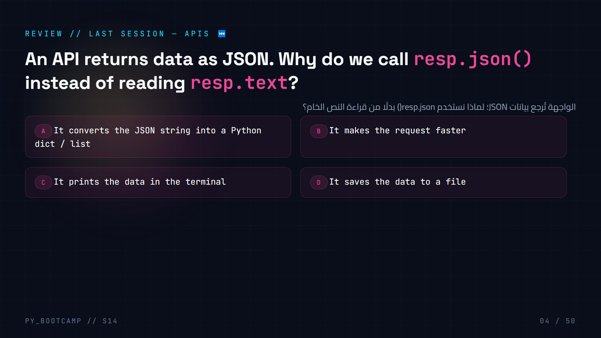
Notes:
Answer: A. `.json()` parses the JSON string into native Python objects (dict/list) so you can use `data["key"]`.
Key link to today: HTML pages are also just text. Later we parse HTML with BeautifulSoup — same idea, different "format": JSON → Python dict, HTML → navigable tree.
Show 5-second demo: `data = resp.json(); print(data[0]["title"])`.
Arabic tip: قارن: JSON يتحول إلى قاموس، وHTML يتحول إلى شجرة عناصر. التشبيه يجعل الفكرة جديدة مألوفة.

Slide 5
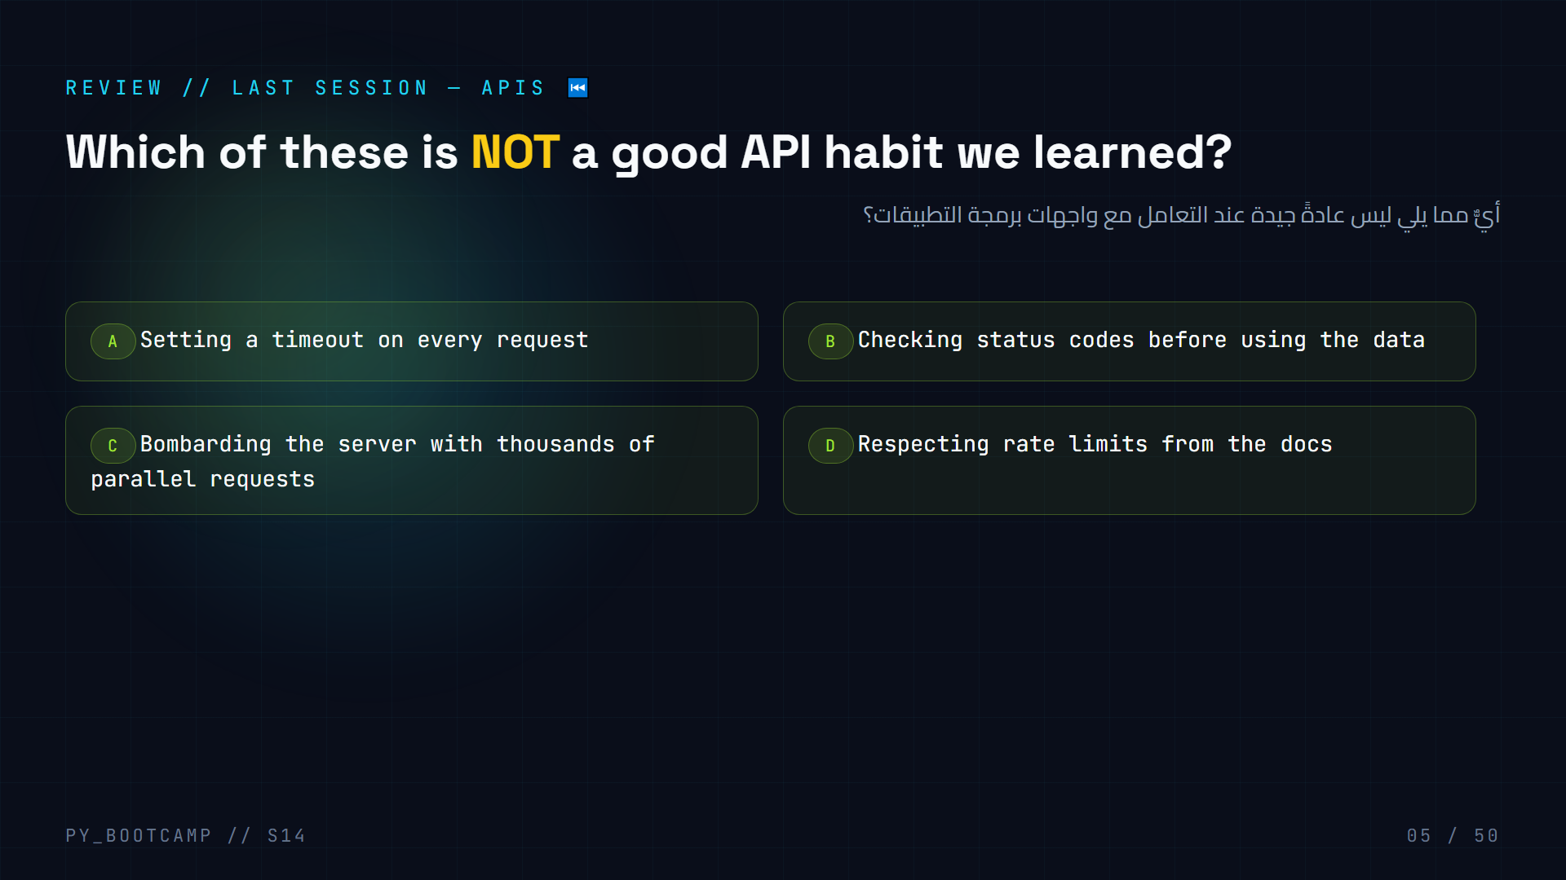
Notes:
Answer: C. Flooding a server is rude, gets you blocked, and can be illegal (DoS-ish behaviour). Timeouts, status checks and rate limits are the good habits.
Foreshadowing: "Today the same politeness applies to websites — we'll meet robots.txt and sleep() between requests."
Poll the room on each option to review quickly, then reveal C.
Arabic tip: مفتاح المراجعة: «الأدب مع الخادم» — نفس المبدأ ينطبق اليوم على المواقع. رسّخ كلمة الهدوء في الطلبات.

Slide 6
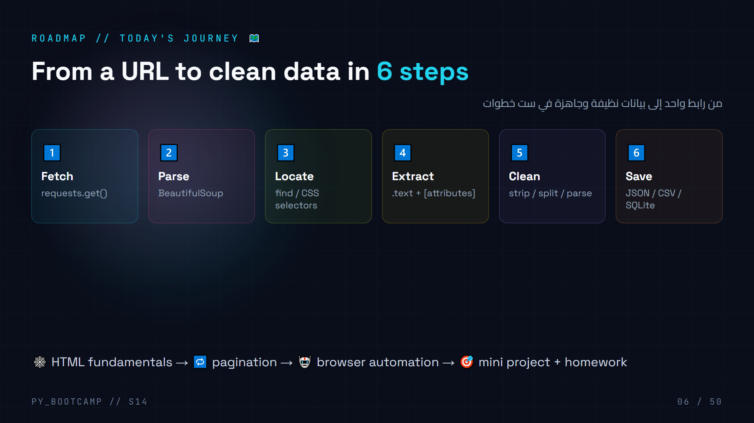
Notes:
Preview the whole journey so students know the map. Six steps: Fetch, Parse, Locate, Extract, Clean, Save. Then we extend to pagination and browser automation, and close with the project.
Ask students to repeat the six words after you. It becomes the mental model for every scraper you'll ever write.
Timing hint: steps 1-2 ≈ hour 1, steps 3-5 ≈ hour 1-2, save + project ≈ hour 2-3, automation + homework ≈ hour 3.
Arabic tip: اكتب المصطلحات الستة على السبورة عربيًا وإنجليزيًا: اجلب، حلّل، حدّد، استخرج، نظّف، احفظ.

Slide 7
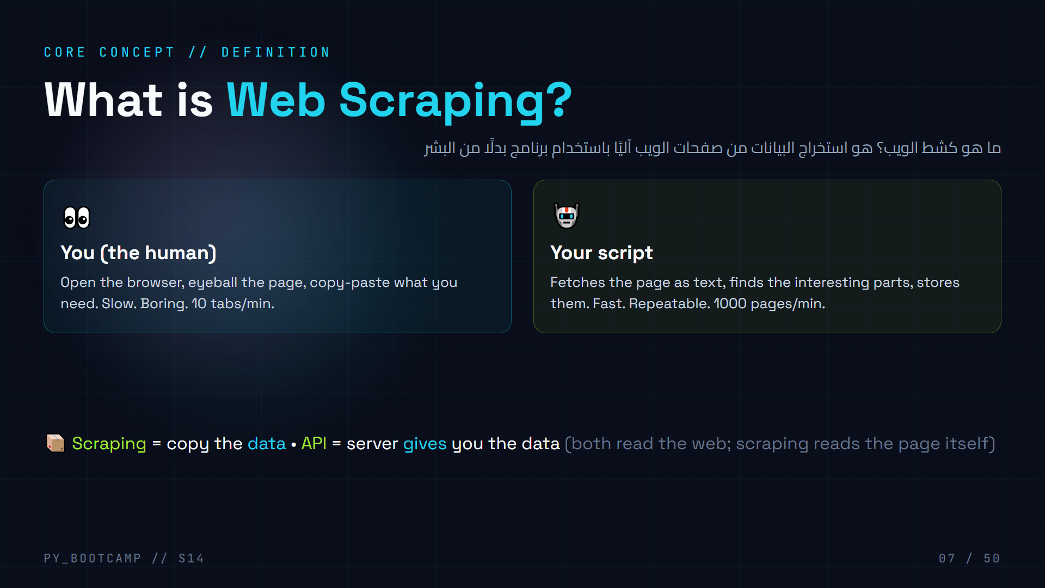
Notes:
Define web scraping simply: "a program that reads a website the way you would — but at machine speed."
Crucial distinction to plant: last session the server handed us JSON through an API. Today most sites won't give us a neat API — so we read the HTML page and extract from it. Both are valid; scraping is for when no API exists (or the page is the source of truth).
Mention real uses: price trackers, job boards, news monitoring, research datasets, search-engine indexes. Guard against misuse early: "scraping reads what's already public — it never breaks into locked data."
Arabic tip: كشط = استخراج. شبهها بقراءة كتاب في مكتبة عامة: تقرأ، تكتب ما يعجبك، لكن لا تمزّق الصفحات.

Slide 8
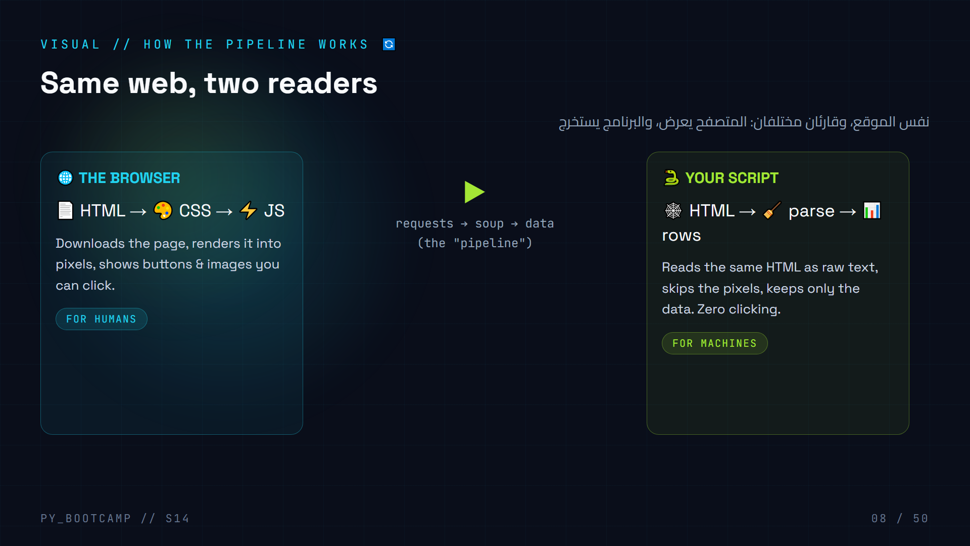
Notes:
Draw the mental picture: the browser and your script download the exact same HTML. The browser turns it into a pretty page; your script turns it into data.
Key insight for students: "When you scrape, you never see the website — you see the HTML text behind it. That's why we spend 20 minutes learning HTML."
Visual walkthrough: point at the two cards. Left = what you do all day. Right = what we build.
Arabic tip: المتصفح = عيون، الكاشطة = أداة قياس. كلاهما يقرأ نفس الملف، لكن الهدف مختلف.

Slide 9
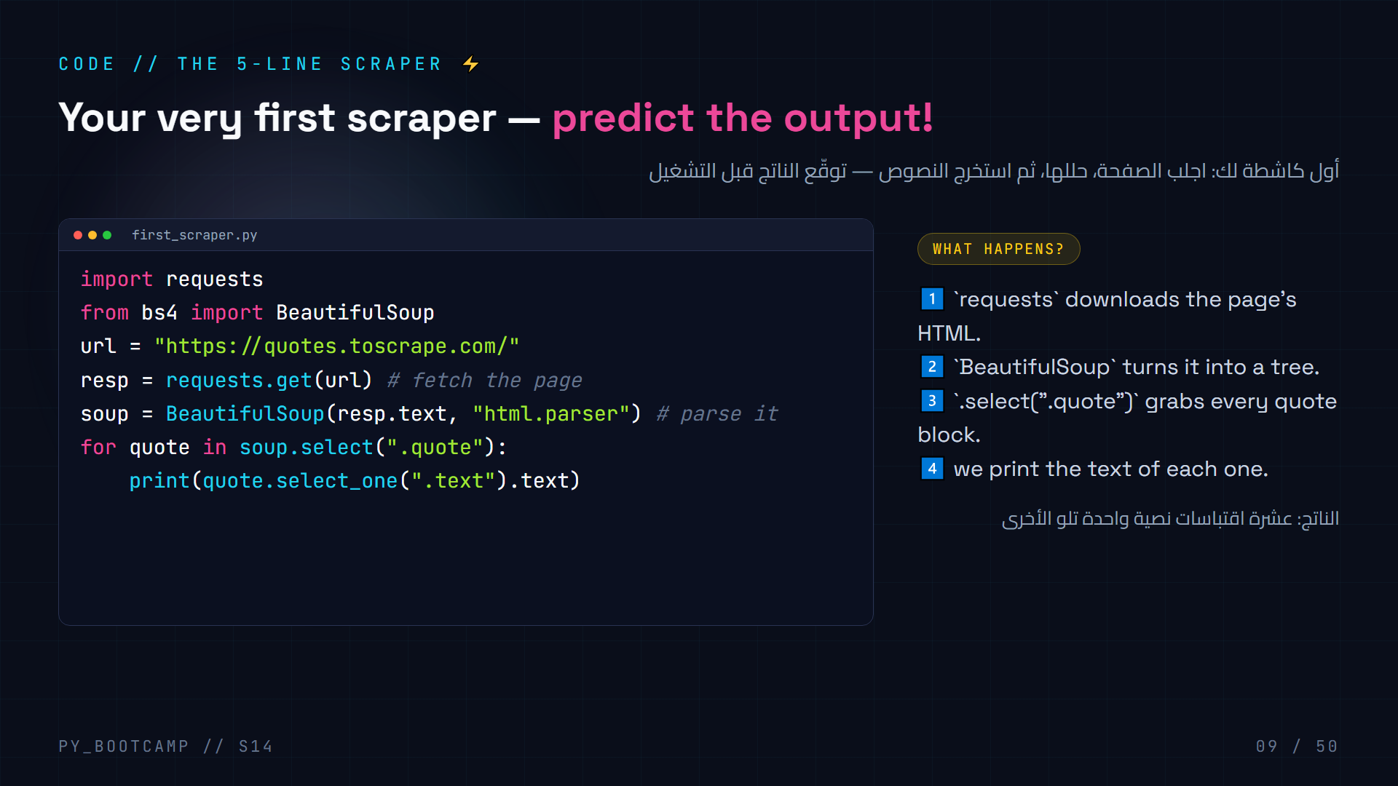
Notes:
Live demo NOW: run this exact file. Steps:
1. `pip install requests beautifulsoup4`
2. create first_scraper.py with the code
3. run it — 10 quotes print to the terminal.
Ask before running: "What do you think gets printed?" (the 10 quotes on the homepage). This is predict-the-output training.
Call out the two stars of the show: `requests` (brings the page) and `BeautifulSoup` (parses it). Everything else this session is a variation.
Common pitfall to name now: forgetting `pip install beautifulsoup4` → ModuleNotFoundError. We'll hit it, that's fine.
Arabic tip: اشرح أن الكود يطبع عشرة اقتباسات، واجعل الطلاب يتوقعون العدد قبل التشغيل.

Slide 10
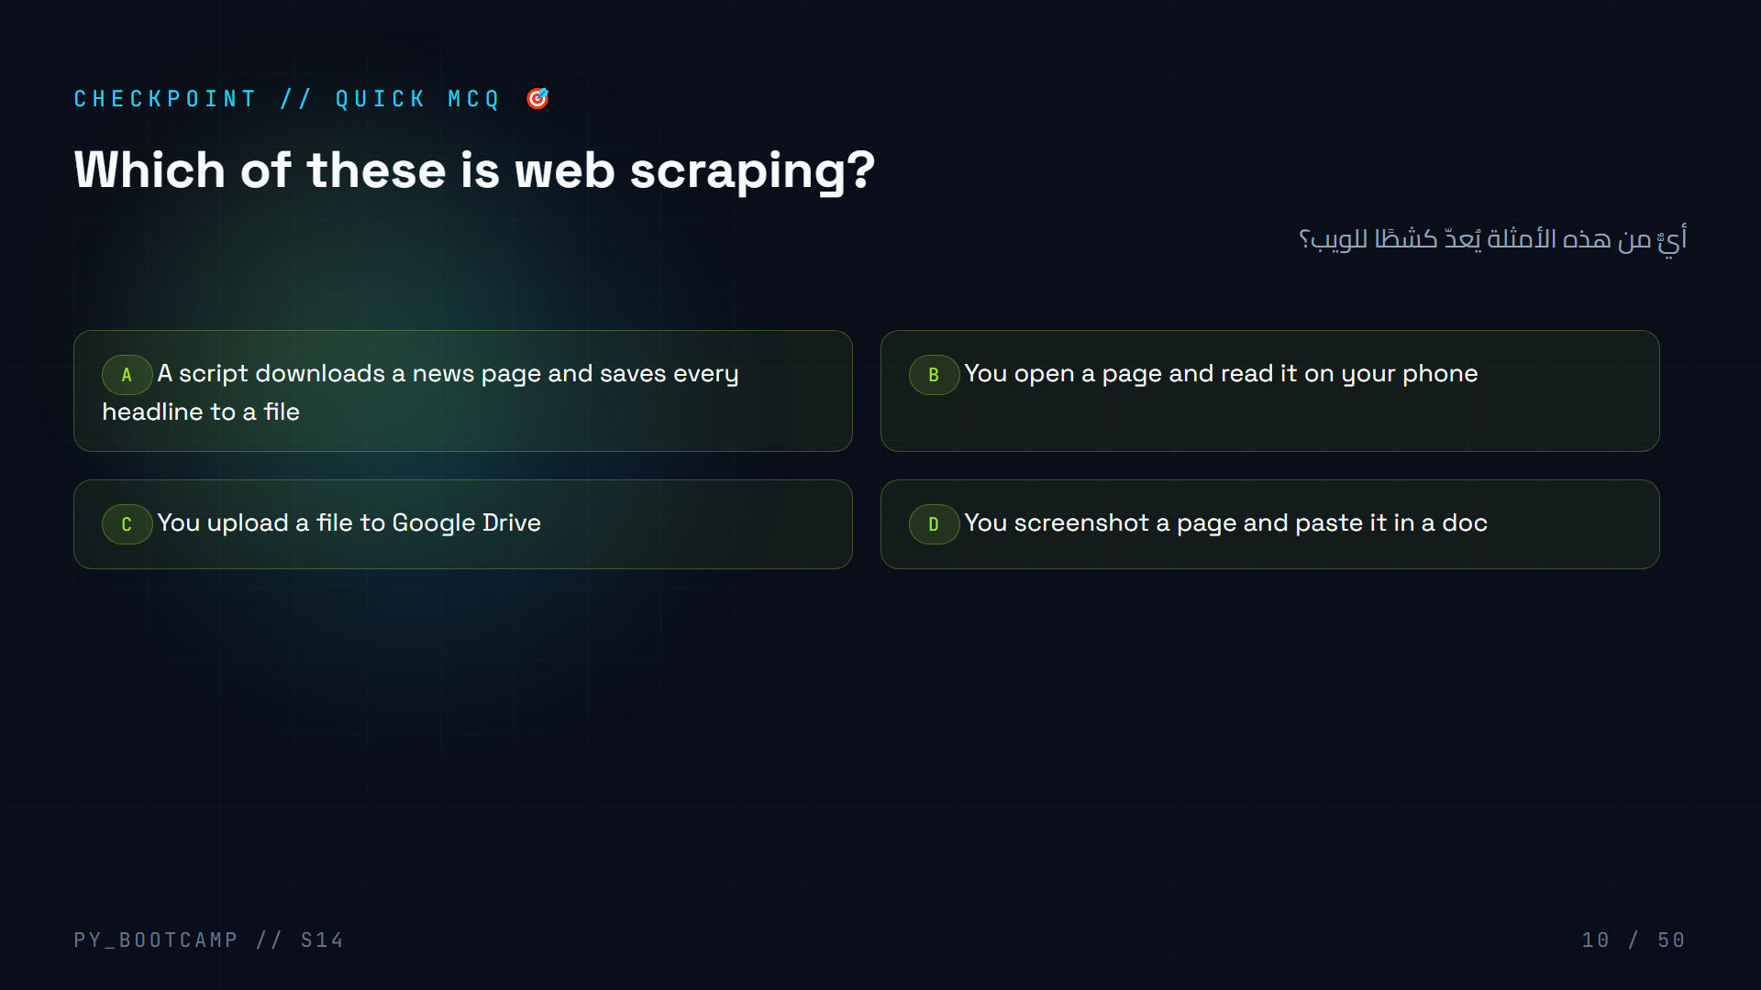
Notes:
Answer: A. Scraping = automated reading + extracting + saving. Options B and D are manual; C is file storage.
Quick discussion: why is D (screenshot) not scraping? It's a human, and it saves pixels, not structured data. A script extracts structured, reusable data.
Arabic tip: فرّق بين «القراءة اليدوية» و«القراءة الآلية». كشط الويب قراءة آلية بهدف استخراج البيانات.

Slide 11
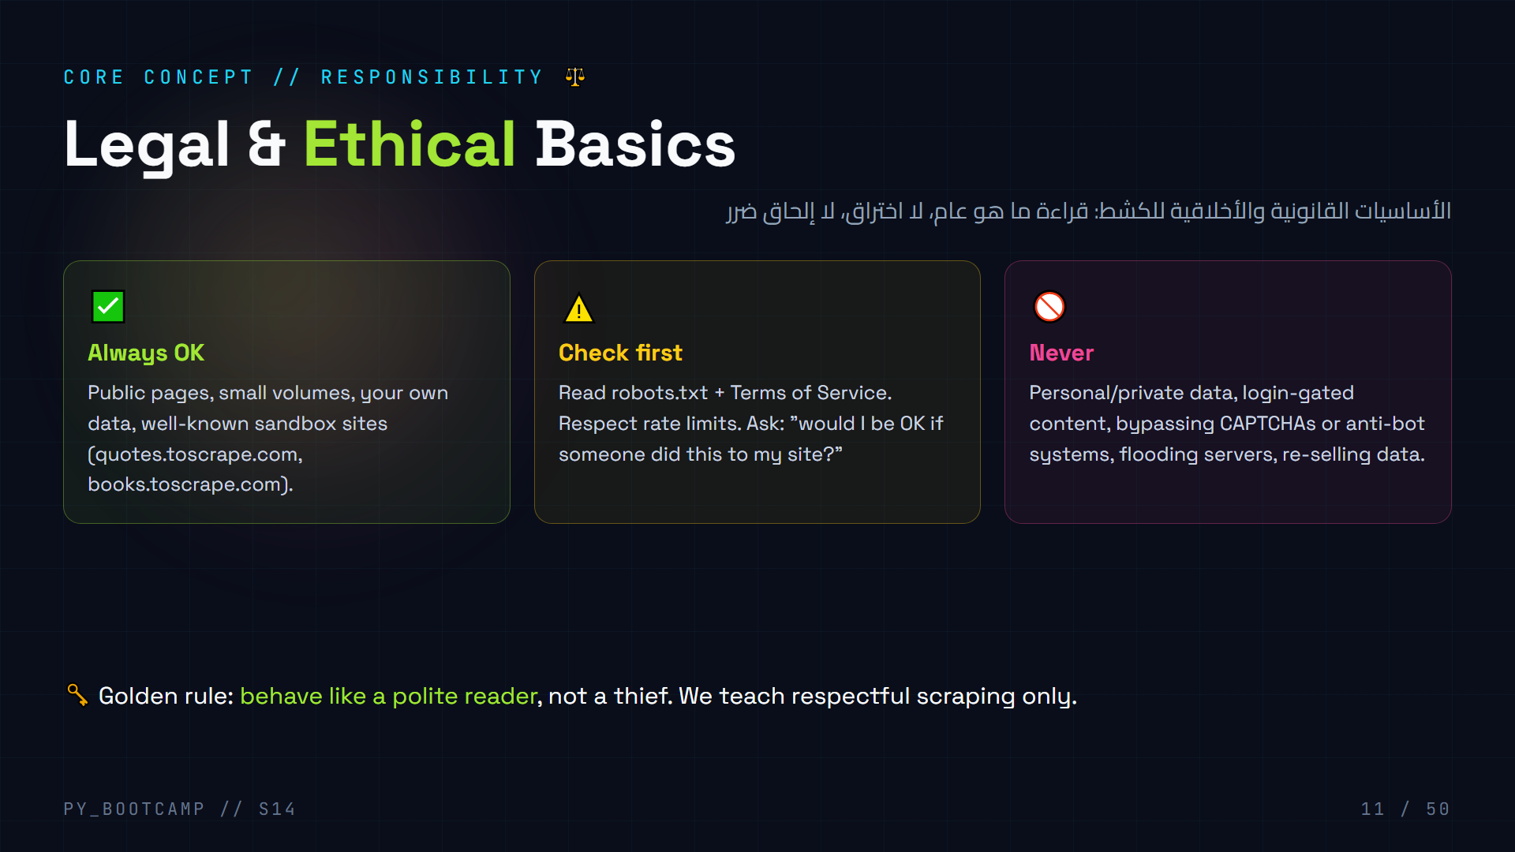
Notes:
The most important 5 minutes of the session. State clearly:
- Scraping public data for learning/analysis is normal and common.
- The line is crossed when: data is private, access is locked, servers are harmed, or terms are clearly violated.
- We will NEVER cover: CAPTCHA bypass, anti-bot evasion, or access-control bypass. That is not part of this course.
Why bother teaching legality at a bootcamp? Because a "great scraper" who is rude gets blocked (bad) or sued (worse). Responsible scraping is the professional skill.
Discussion prompt: "A shop shows prices publicly. Is tracking them with a script OK?" → usually yes if slow & respectful; check robots.txt.
Arabic tip: اشرح المقولة: «كشط محترم = قارئ مؤدب». المفتاح: لا تأخذ ما ليس عامًا، ولا تكسر أي قفل.

Slide 12
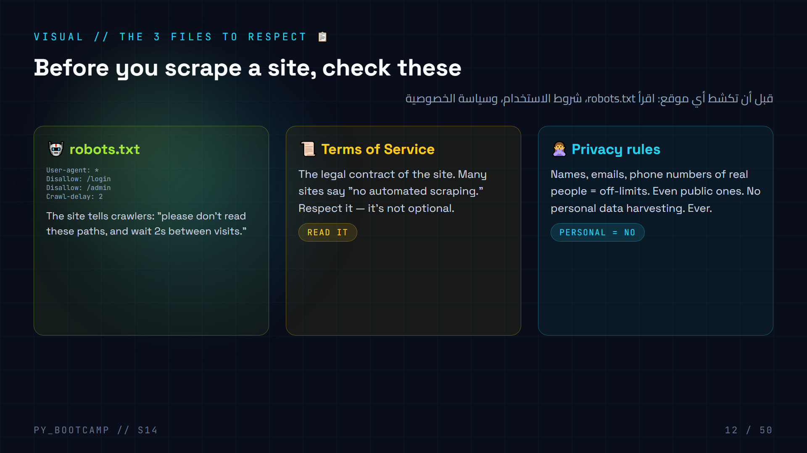
Notes:
Walk the three cards. Demo live: open `https://quotes.toscrape.com/robots.txt` and `https://books.toscrape.com/robots.txt` in the browser — show students a real robots.txt.
Explain the robots.txt grammar: `User-agent: *` (applies to everyone), `Disallow: /path` (don't fetch), `Crawl-delay` (seconds to wait).
Key teaching point: robots.txt is a polite request, not law. But pros follow it, and following it protects your IP from being blocked.
Arabic tip: robots.txt = «لافتة» يضعها الموقع لتعرف ما يُسمح بقراءته. اقرأ اللافتة قبل أن تدخل.

Slide 13
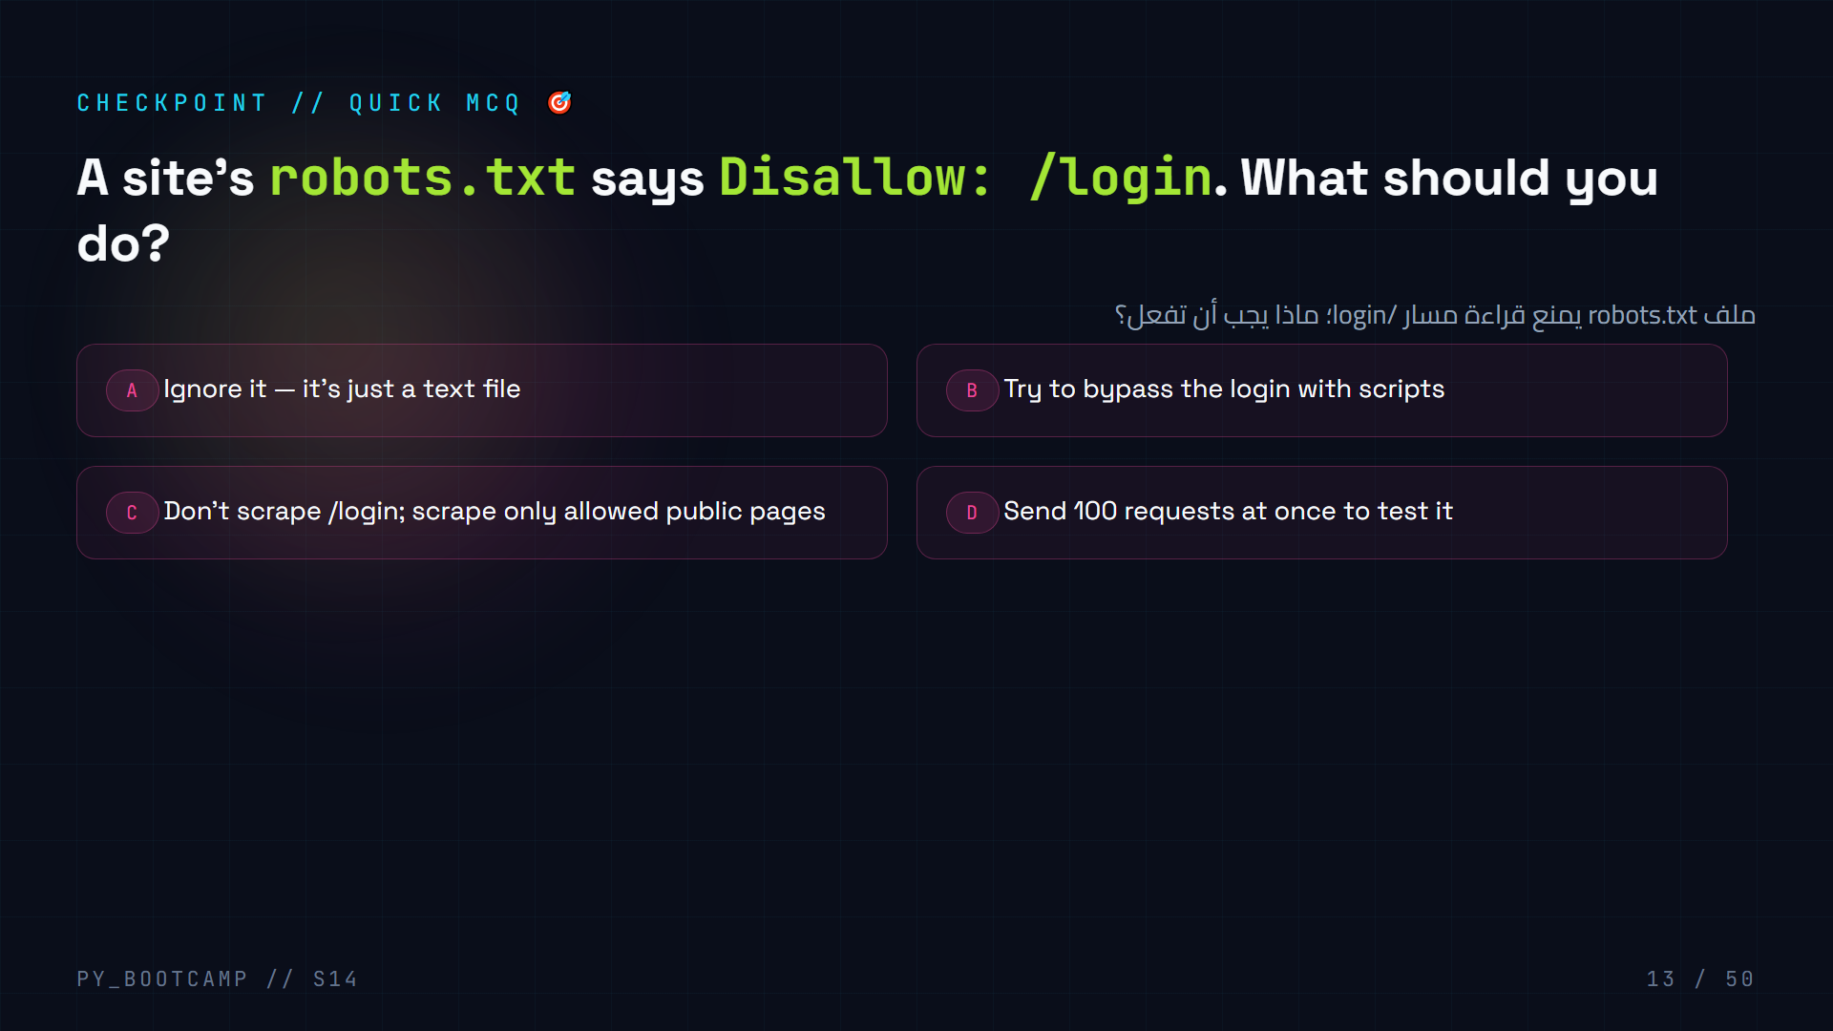
Notes:
Answer: C. Respect the robots.txt. /login is behind access control anyway — scraping it would mean bypassing login, which we never do.
Tie to the "golden rule": polite reader, not a thief. B (bypass login) is explicitly off-limits in this course; D is rude and gets you blocked.
Arabic tip: robots.txt مثل قائمة «الممنوع دخوله». احترمها، ولا تحاول «فتح القفل» — فذلك خارج نطاق تعلمنا.

Slide 14
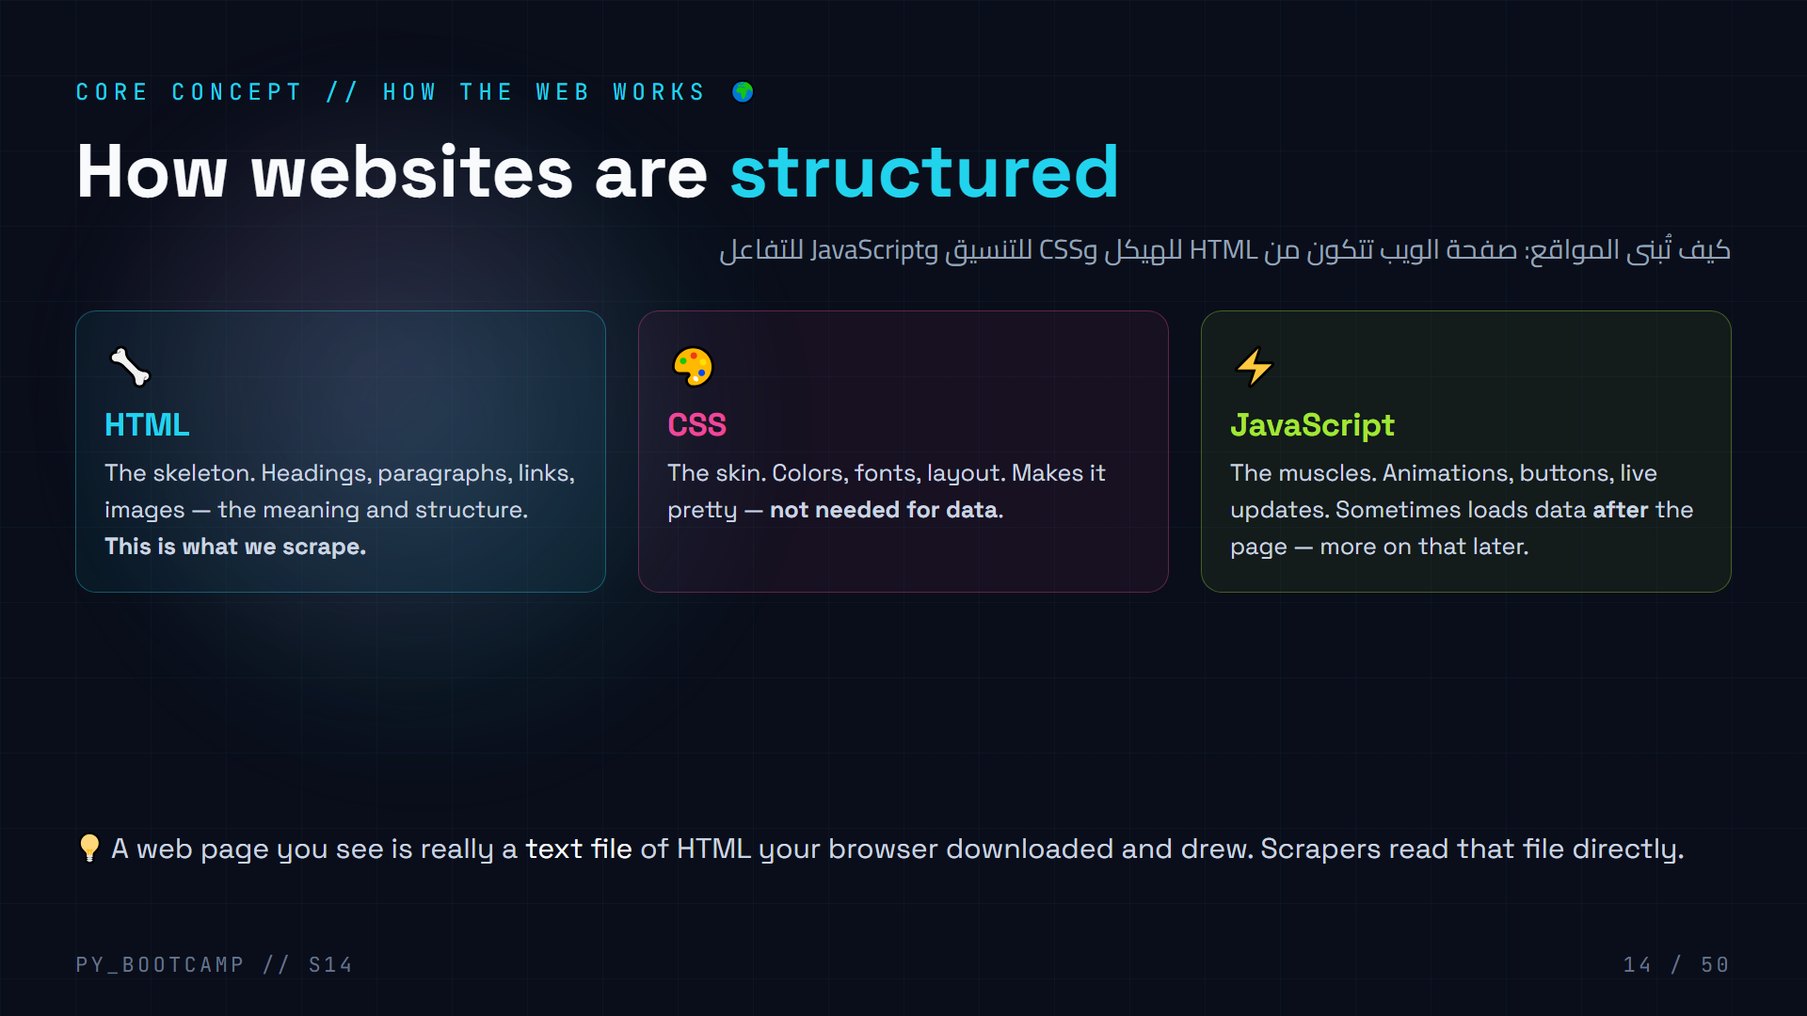
Notes:
Frame: "A website is three languages in one file." HTML = structure, CSS = looks, JS = behavior. When scraping we only care about HTML.
Live demo: press F12 in the browser → Elements tab shows the raw HTML of the page you're looking at. "This is the file your scraper will read."
Emphasize: JS-loaded content (feeds, "load more" buttons) won't be in the initial HTML — that's exactly why we later introduce browser automation.
Arabic tip: شبه الموقع بجسم الإنسان: الهيكل العظمي HTML، البشرة CSS، العضلات JavaScript. نحن نستخرج «الهيكل».

Slide 15
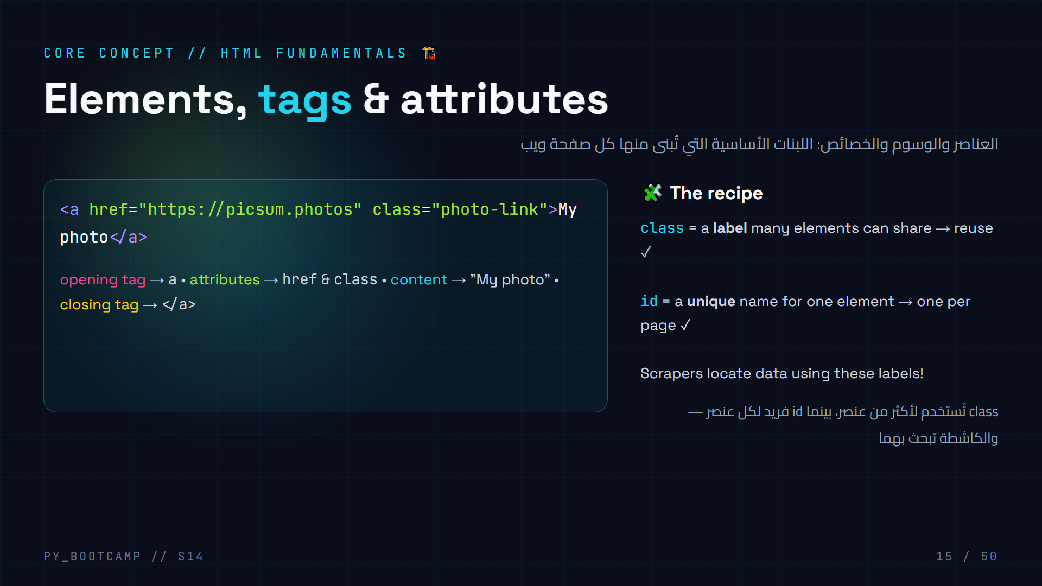
Notes:
Grammar lesson of HTML: element = opening tag + content + closing tag. Attributes live inside the opening tag.
The two attributes that matter most for scraping: `class` (many elements share it) and `id` (one unique element). We'll use both as "addresses" to find data.
Show the anatomy on the tag: name, href, class, content.
Live: in DevTools, right-click a headline → Inspect. Students see the tags and attributes for real.
Arabic tip: class = لافتة متكررة، id = اسم فريد. عندما تريد العثور على عنصر، تسأل: ما لافتته؟

Slide 16
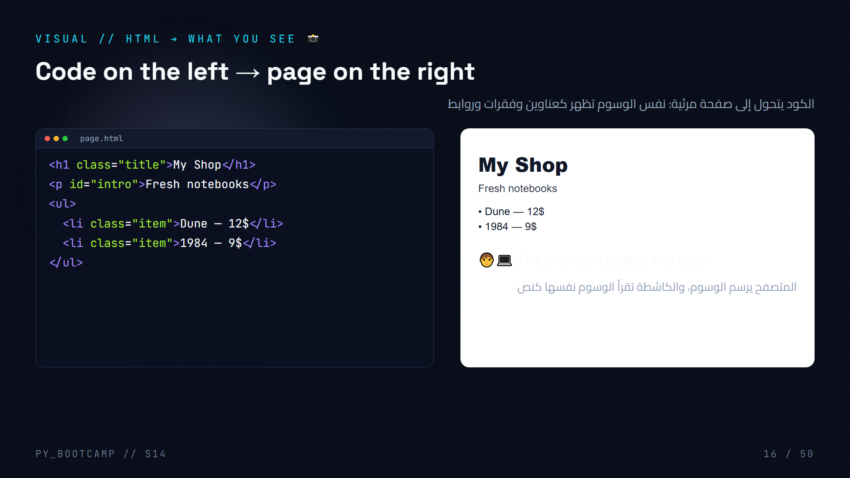
Notes:
The "aha" slide: same HTML becomes a pretty page in the browser. Your scraper skips the pretty part.
Point at the structure: h1.title = the big heading; p#intro = paragraph; li.item repeated = list items. Notice `class="item"` on BOTH list items — that's the hook a scraper uses to grab "all products".
Note: `id="intro"` appears once — a scraper uses it to grab "the intro specifically".
Arabic tip: العنصر المتكرر class = «الدفعة»، والعنصر الفريد id = «الشخص». نلتقط الدفعة كلها أو الشخص وحده.

Slide 17
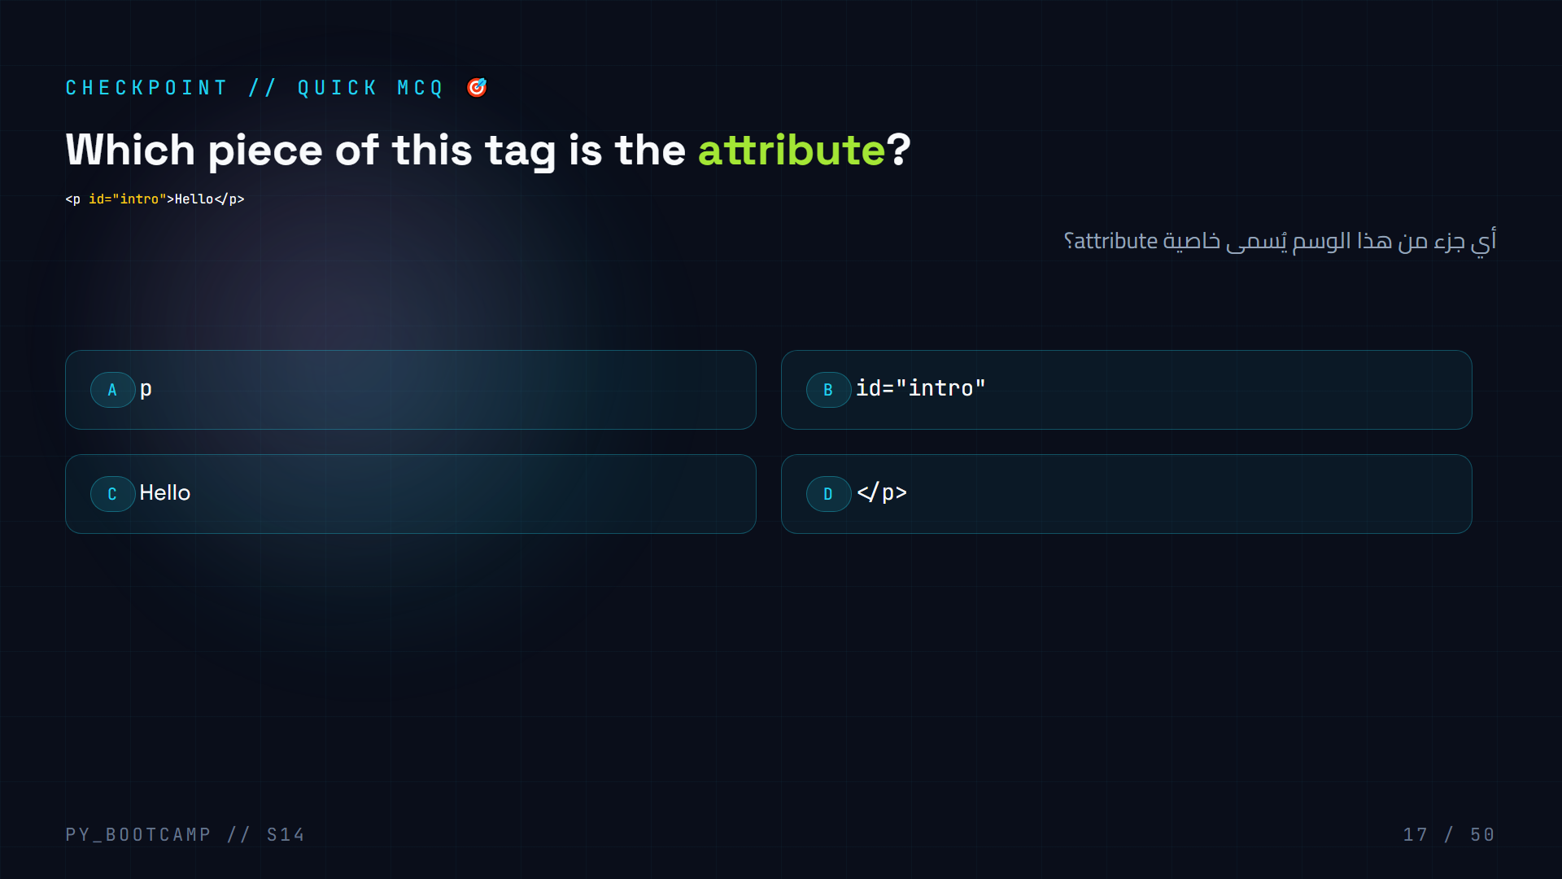
Notes:
Answer: B. `id="intro"` is the attribute (name="value" pair inside the opening tag). `p` is the tag name, "Hello" is content, `` is the closing tag.
Follow-up: "Which attribute would you use to grab ALL list items?" → class (shared). "Which to grab exactly one element?" → id (unique).
Arabic tip: الخاصية = معلومة إضافية داخل وسم البداية، مثل الاسم الذي يميّز العنصر.

Slide 18
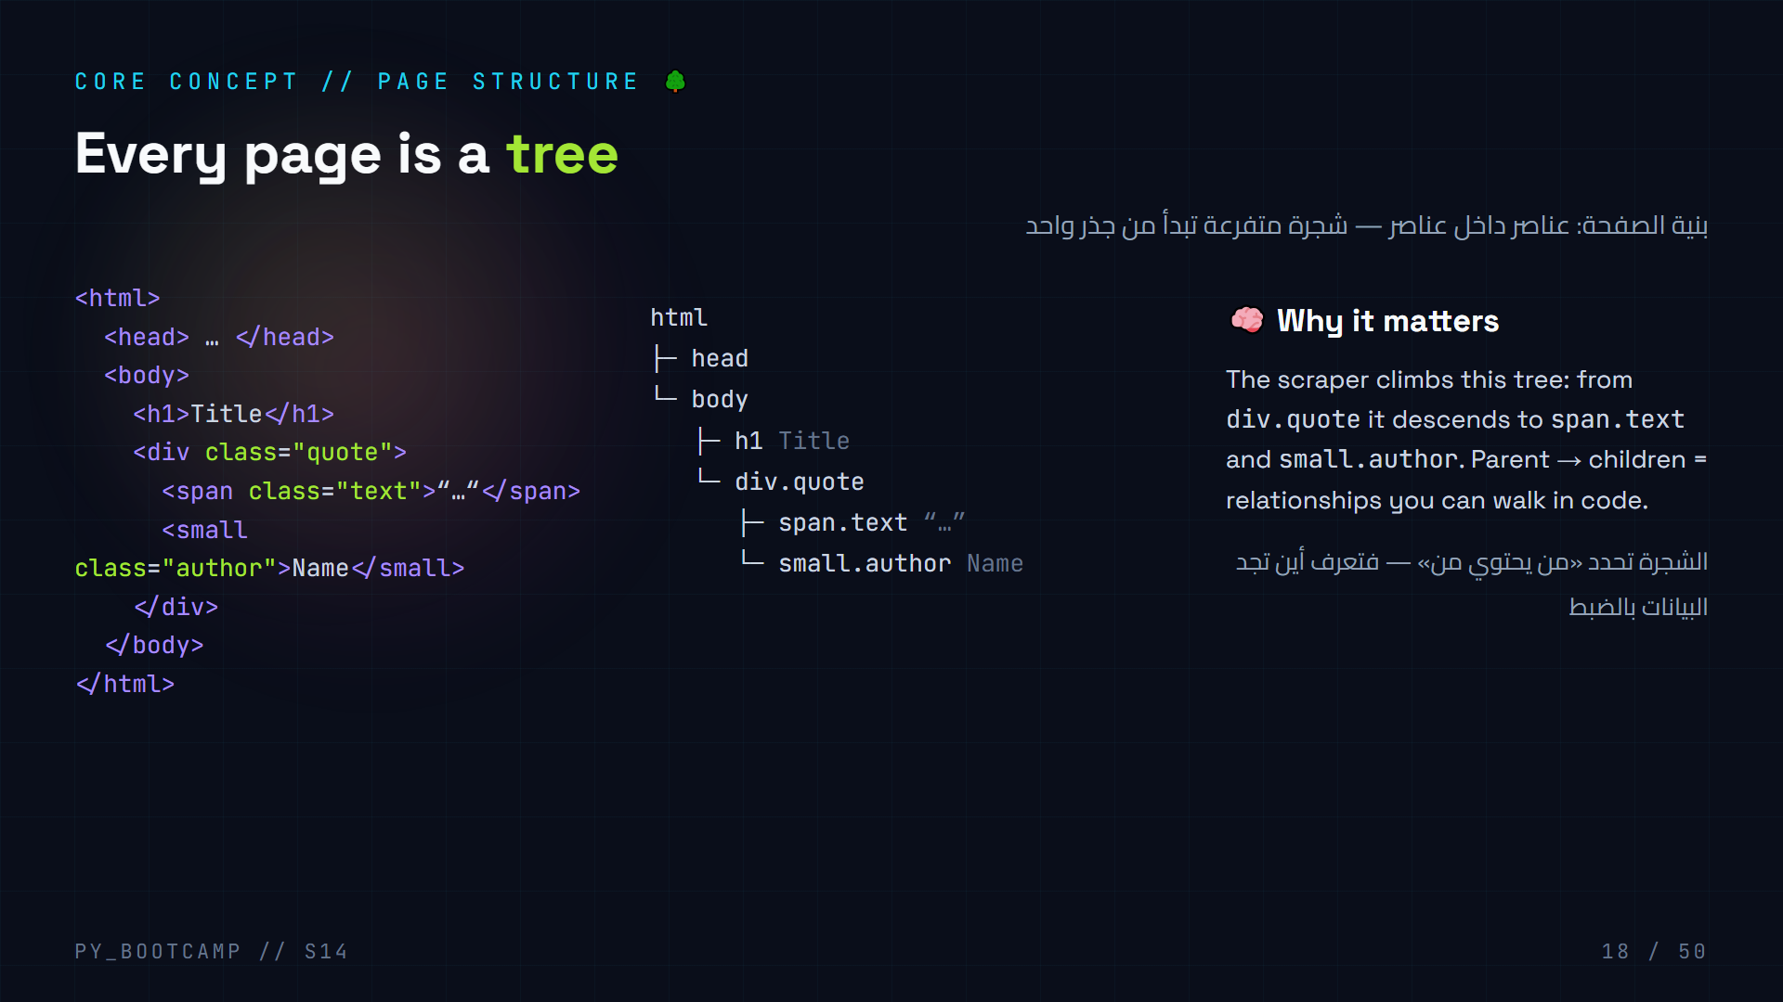
Notes:
Show the DOM tree: left = the actual HTML, right = the tree of nodes, far right = why we care.
Key vocab: parent (parent), child (child), descendant, sibling. `div.quote` is the parent of `span.text` and `small.author`. Each quote block repeats this mini-tree.
Do this live: open quotes.toscrape.com → inspect one `.quote` div → expand/collapse children in DevTools. Students see the tree for real.
Arabic tip: الشجرة = عائلة العناصر. الأب يحتوي الأبناء، وتجد المعلومات بالوصول من الأب إلى الابن.

Slide 19
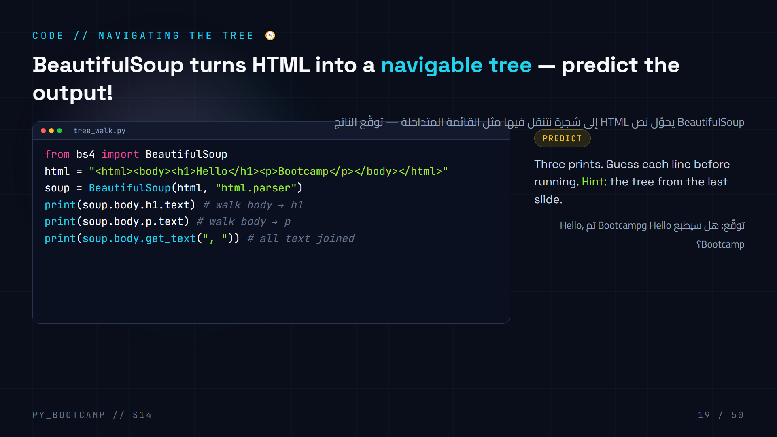
Notes:
Run it live: expect output `Hello`, `Bootcamp`, `Hello, Bootcamp`.
Live-coding flow: type it with them, run, compare with predictions. `.body.h1` reads as "inside body, the h1 tag". `get_text(", ")` collects every text node joined by commas.
Point out: we parse a *string* here — no internet needed. BeautifulSoup works on any HTML string, which makes it great for testing.
Arabic tip: المشي في الشجرة = التنقل من الأب إلى الابن عبر النقطة: soup.body.h1

Slide 20
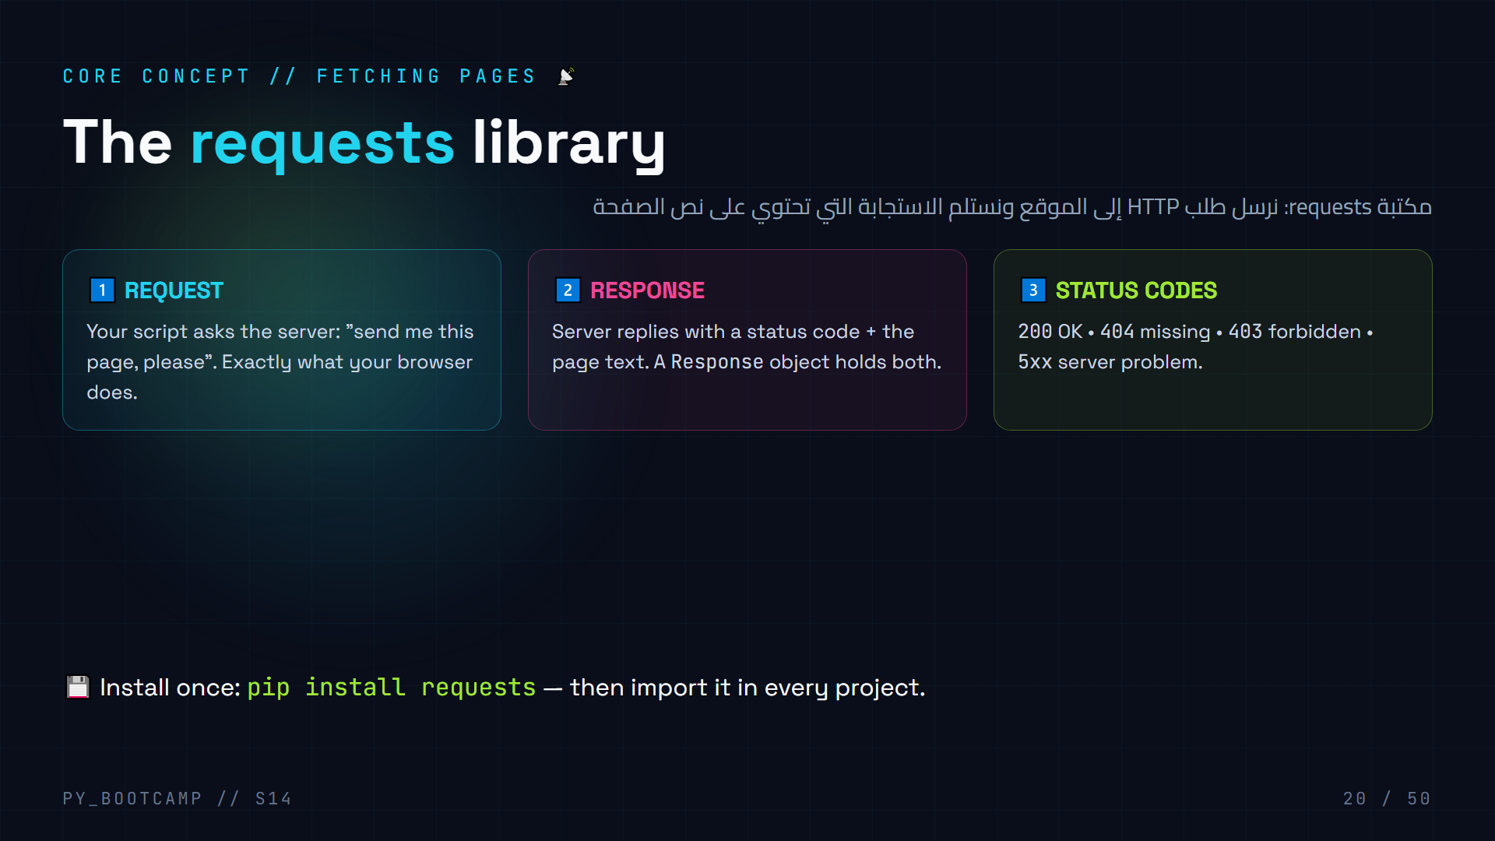
Notes:
Recap the request/response model from session 13, now applied to pages instead of APIs. requests.get(url) is the whole magic.
Read status codes like a doctor reading a body: 200 = healthy, 404 = page not found, 403 = refused entry, 500 = server sick. This is the first thing to check when a scraper "does nothing".
Demo: `pip install requests` — show it once, students do it once.
Arabic tip: الطلب = طلب الزيارة، والاستجابة = رد الموقع. رقم 200 يعني «أهلًا وسهلًا»، و404 يعني «لا يوجد هنا».

Slide 21
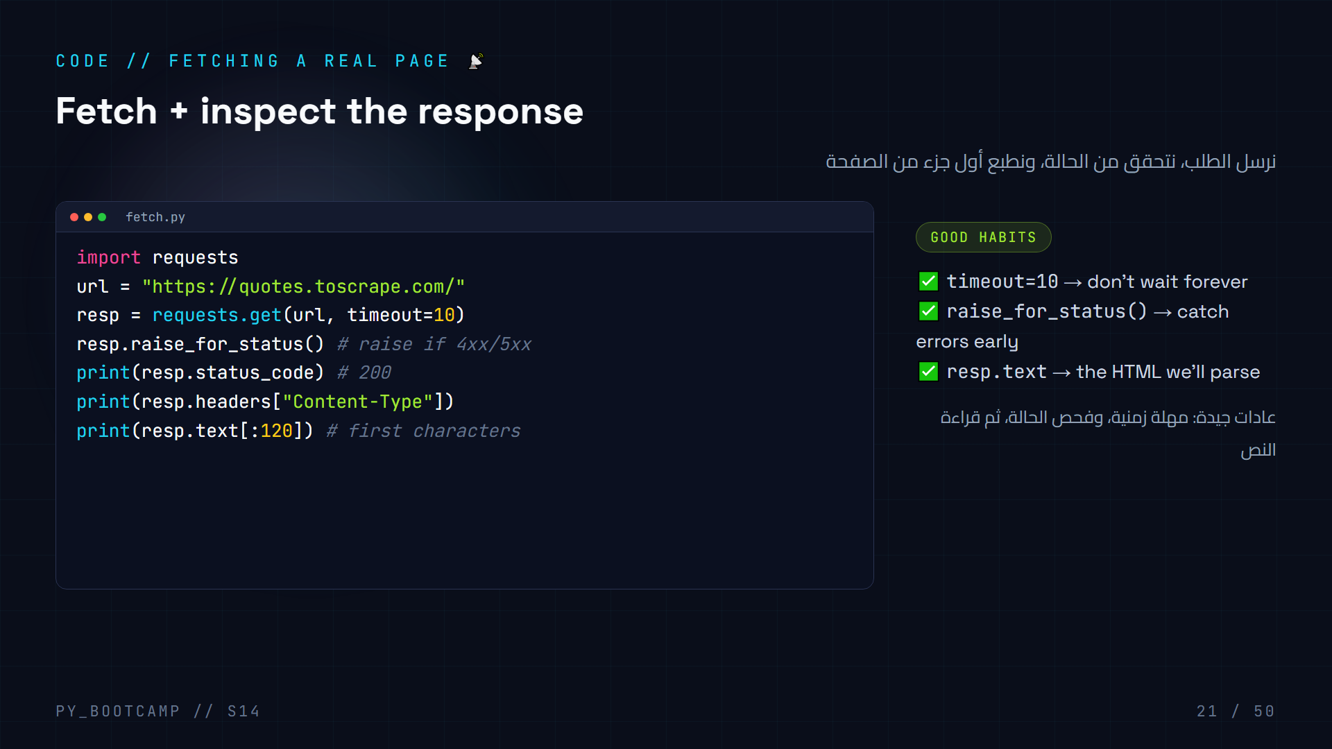
Notes:
Live: run fetch.py with internet. Expected output: 200, text/html; charset=UTF-8, then the first 120 chars of HTML.
Explain each print: status, content-type header, and a peek at the raw HTML text.
Why timeout? A dead server would otherwise hang your script forever. Why raise_for_status()? So a 404 doesn't silently give you an error page to parse.
Common mistake: forgetting the trailing slash on the URL, or printing resp.text fully (huge). We print [:120].
Arabic tip: فحص الاستجابة قبل التحليل = قراءة «حالة» الرد قبل فتح الرسالة.

Slide 22
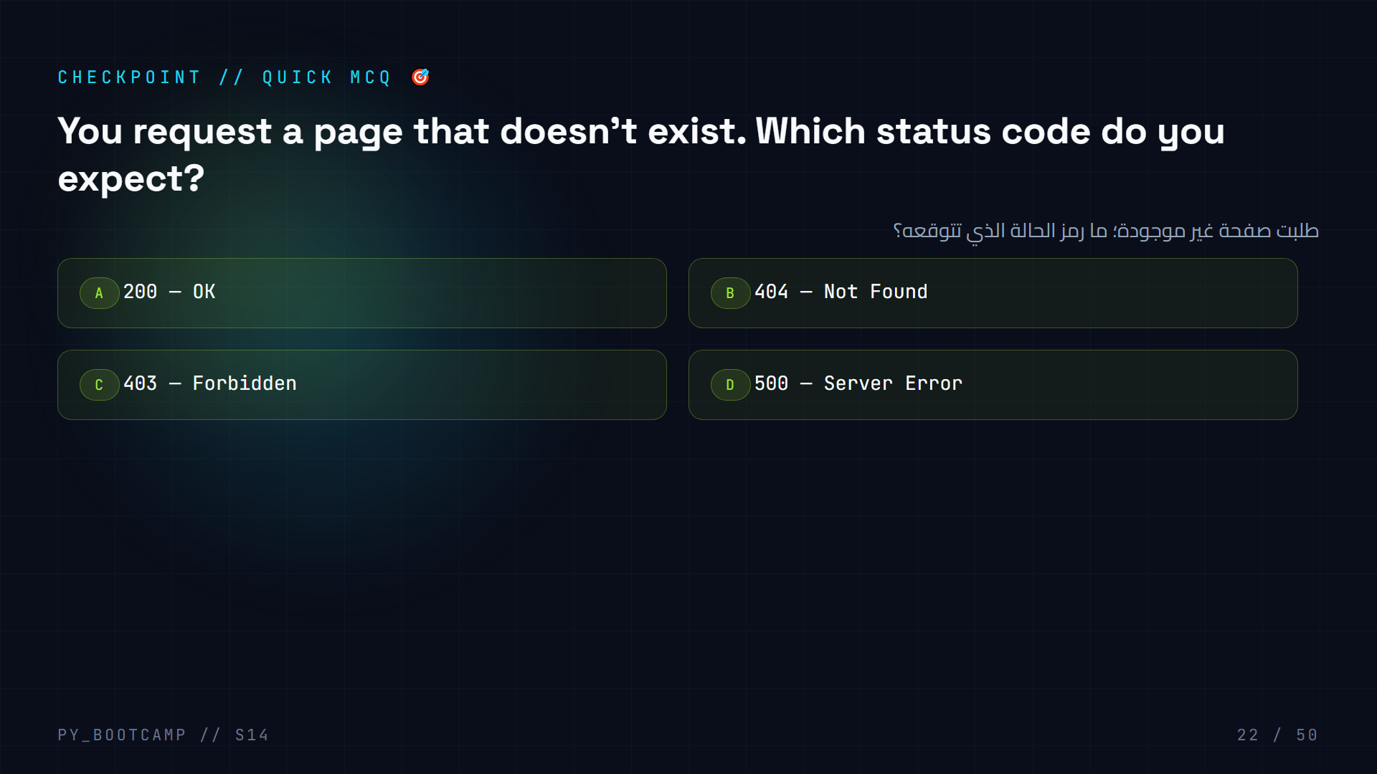
Notes:
Answer: B. 404 = Not Found. 403 means forbidden (you're not allowed), 500 means the server itself broke.
Demo: `requests.get("https://quotes.toscrape.com/nope")` → 404. Show that raise_for_status() would raise HTTPError.
Arabic tip: 404 = «العنوان خاطئ»، 403 = «ممنوع»، 500 = «الخادم مريض».

Slide 23
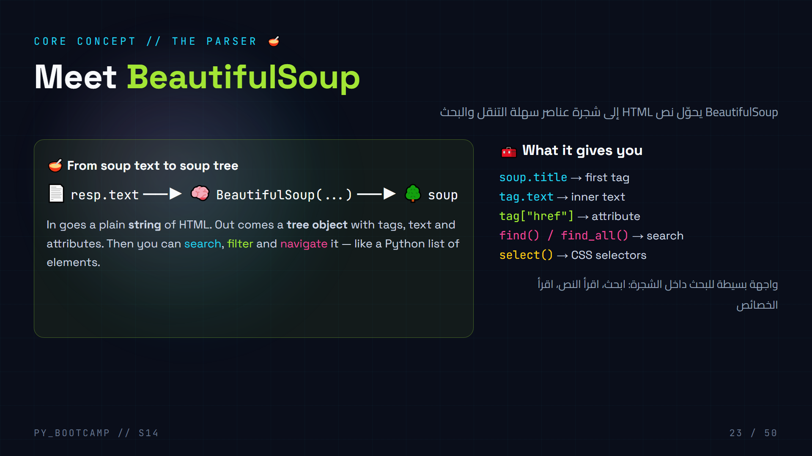
Notes:
BeautifulSoup = the parsing library. `pip install beautifulsoup4`, import name is `bs4`. Parser argument: "html.parser" (built-in, no extra install).
Mental model: it's like turning a block of text into a folder tree you can open. Every tag becomes a node.
Do NOT confuse: requests downloads, BeautifulSoup parses. Two libraries, one pipeline. If the page prints as raw text but selectors find nothing, usually the parse failed or content is JS-loaded.
Arabic tip: BeautifulSoup = «مفككة» الشجرة. أعطها نصًا، تحصل على هيكل قابل للتنقل.

Slide 24
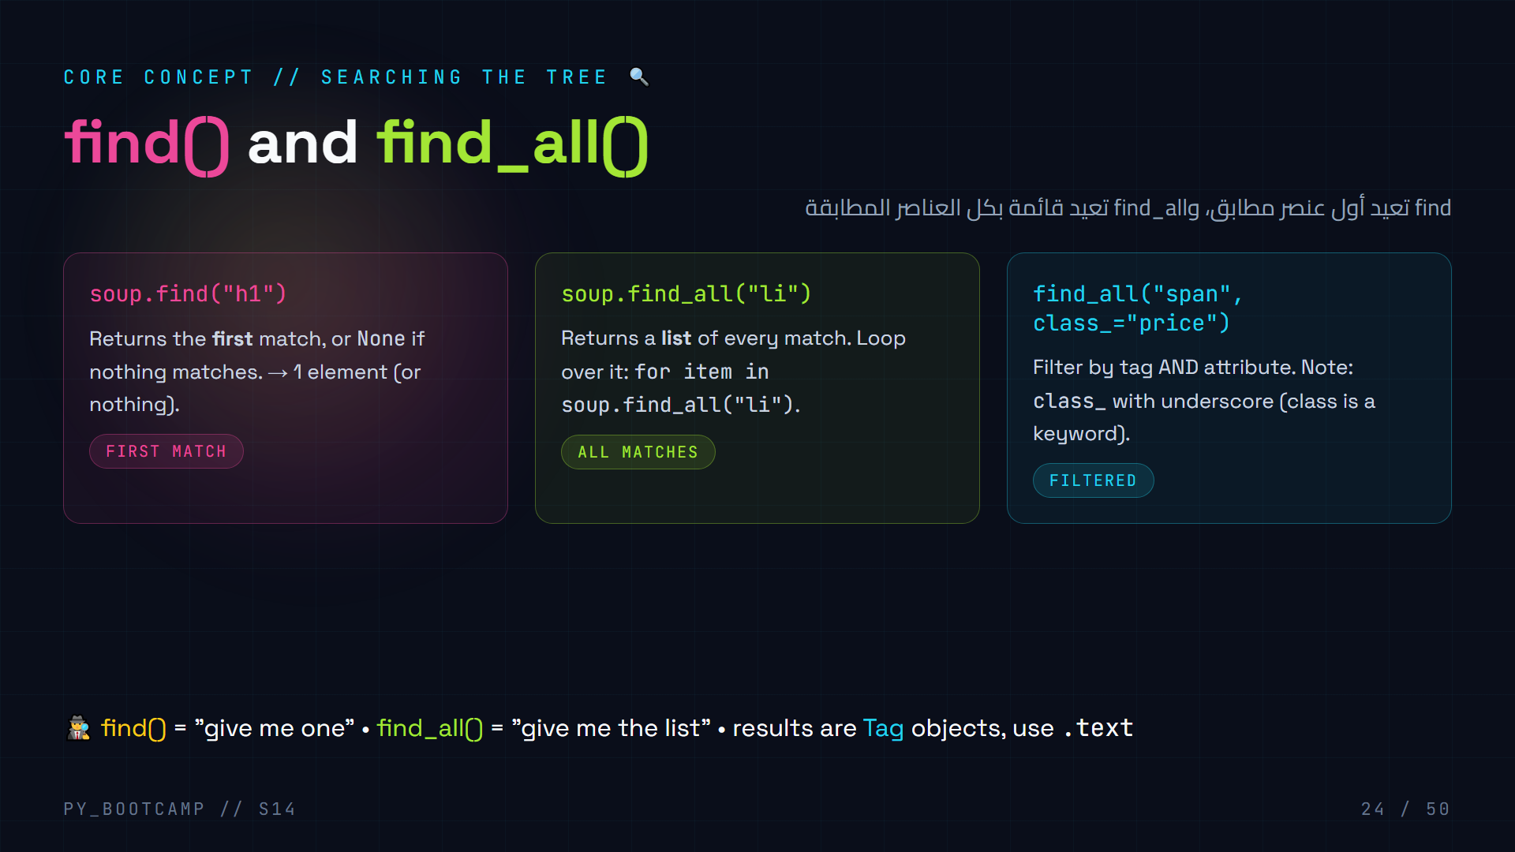
Notes:
The two workhorses. find() = first match or None (great when you KNOW there's one). find_all() = list (great for "every product", "every comment").
The classic bug: forgetting the underscore in class_. Python can't use class as a parameter name.
Analogies: find() = "show me the first person named Omar". find_all() = "show me everyone named Omar".
Arabic tip: find = أوّل تطابق فقط، find_all = كل التطابقات. تذكر الشرطة السفلية في class_!

Slide 25
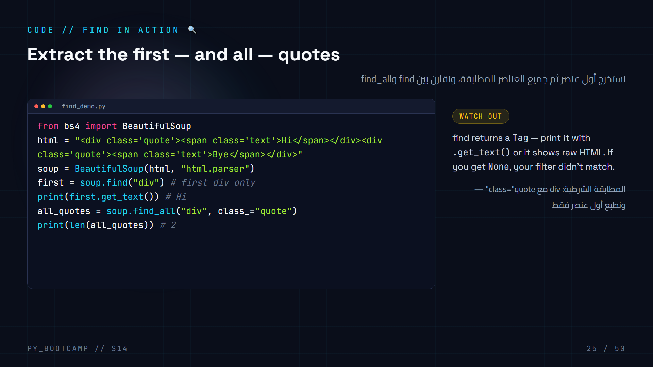
Notes:
Run and compare outputs: Hi (first div), then 2 (both divs matched). Show that find gives a Tag, not text — you must call .get_text().
Live variation: change find_all("div", class_="quote") → find_all(class_="quote") works too (any tag). Mention class_ keyword.
Arabic tip: اشرح أن print(first) يطبع الوسم كاملًا، بينما .get_text() يستخرج النص فقط.

Slide 26
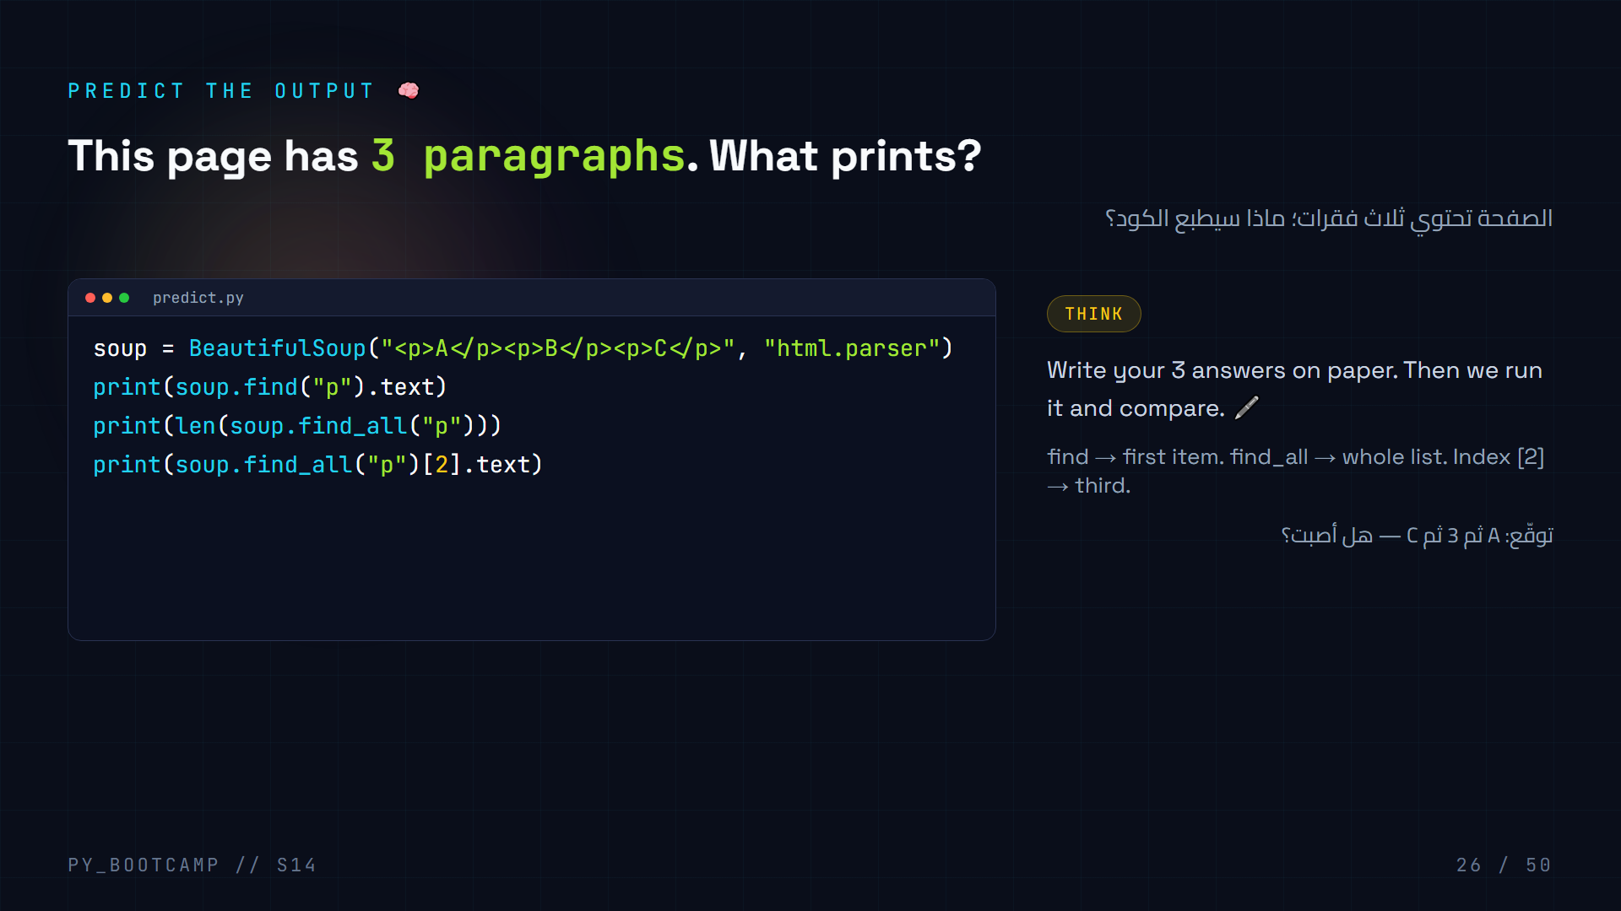
Notes:
Answer: `A`, `3`, `C`.
Teaching moment: find returns first (A). find_all returns a list of 3 tags → len 3. Indexing [2] (0-based!) gives the third paragraph C.
Ask students who answered 2 for the middle line — why? Because they may have counted find() also as "a find". Emphasize: find returns ONE tag; find_all returns the full list.
Arabic tip: الترقيم يبدأ من صفر: [0] الأول، [2] الثالث. عادة يفاجئ الطلاب.

Slide 27
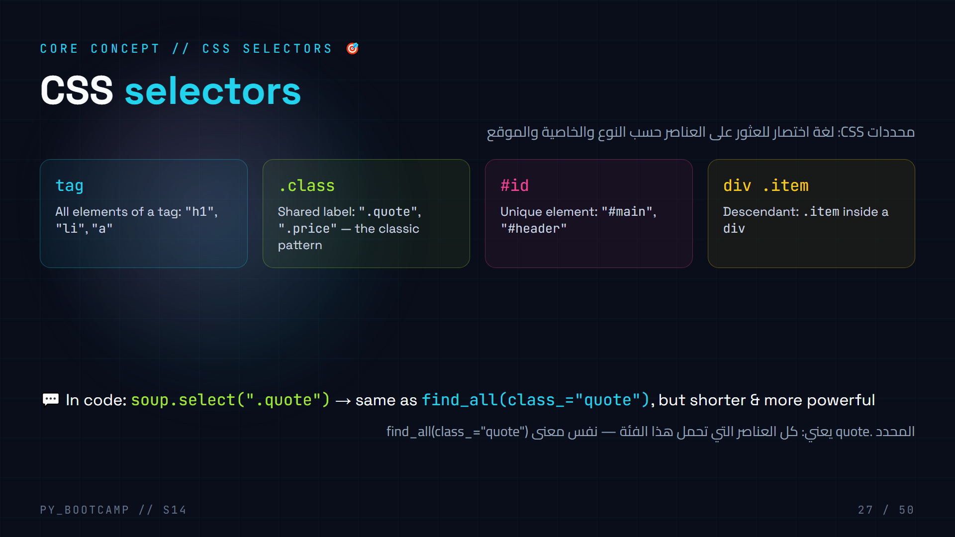
Notes:
CSS selectors are the power move: one short string that finds things. `.class` dot, `#id` hash, `tag` plain, and combinations with spaces = descendants.
This is the SAME selector language CSS uses for styling — so "class and id" (slide 15) now pays off.
Demo: in DevTools, Ctrl+F inside Elements panel accepts CSS selectors — instant preview of what a selector matches on a real page.
Arabic tip: نقطة = فئة، شبكة/علامة = معرّف فريد. اجعلهم يكتبون أمثلة: ".quote", "#main", "a".

Slide 28
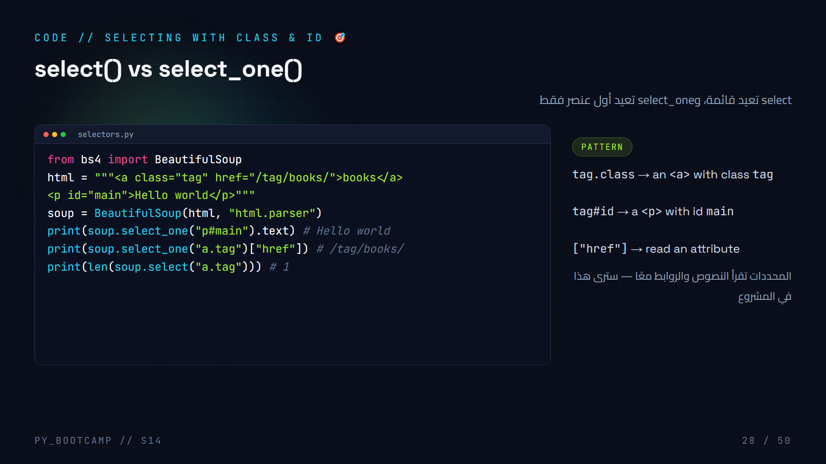
Notes:
Live-run selectors.py. Outputs: Hello world, /tag/books/, 1.
Highlight: select_one = single result (like find), select = list (like find_all). And `tag["href"]` returns the attribute value — the first taste of reading links, which is how scrapers crawl pages.
Extra demo: soup.select("p#main") returns a list with one element; select_one skips the list.
Arabic tip: حدّد بفئة أو معرّف ثم اقرأ نصه أو رابطته: هذا جوهر «استخراج» البيانات.

Slide 29
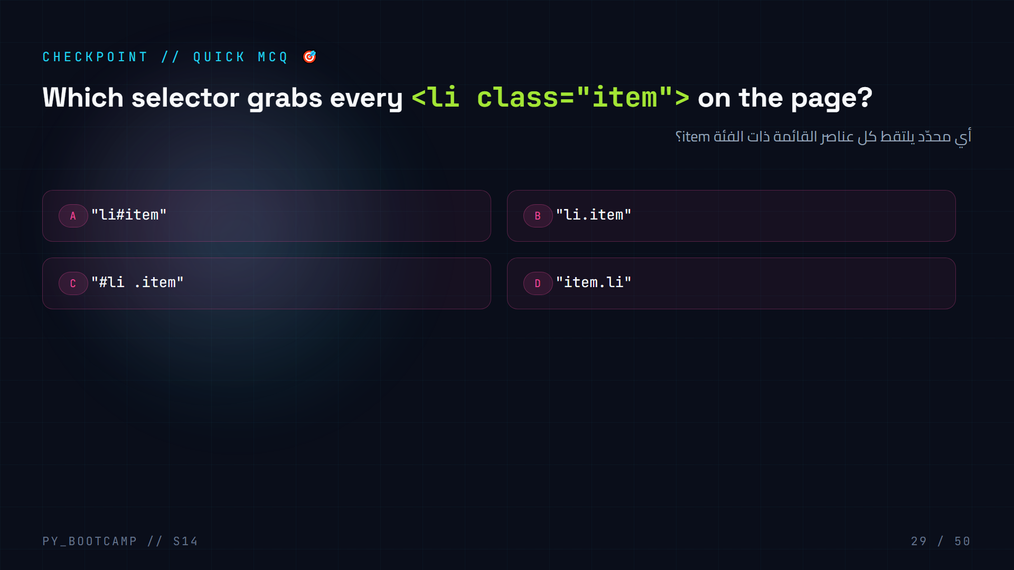
Notes:
Answer: B. `li.item` = tag li that has class item. `#` is for id, and order matters (tag.class, not class.tag).
Follow-up: "How would you get the FIRST such element?" → select_one("li.item").
Arabic tip: النقطة قبل الكلمة = فئة، فالتقط اللي الذي يحمل الفئة item. ترتيب الوسم ثم الفئة.

Slide 30
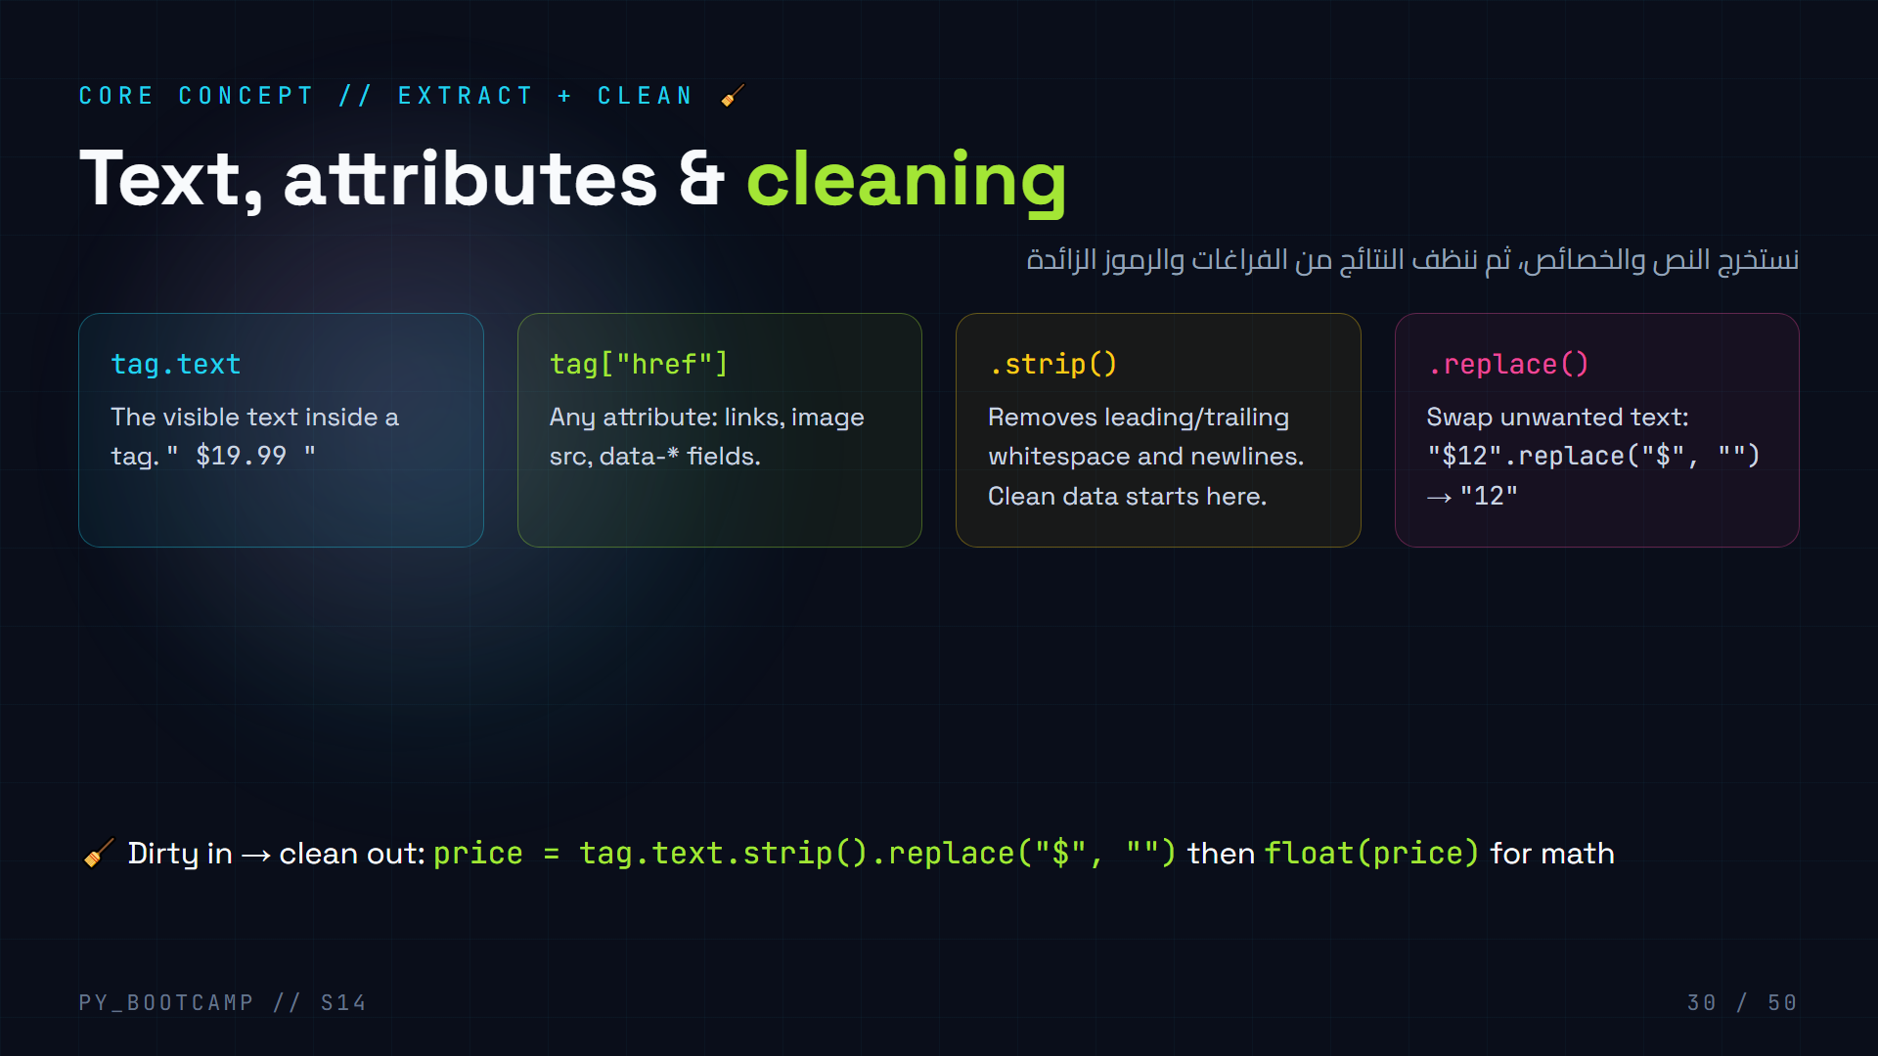
Notes:
Real-world data is messy: extra spaces, symbols, newlines. Extraction + cleaning always travel together.
The pipeline: .text → .strip() → .replace() → convert (int/float). Show a price "$19.99 " → strip → replace "$" → float.
Arabic tip: البيانات الخام فيها «قشور» — التنظيف = تقشيرها. strip يزيل الفراغات، replace يبدّل الرموز.

Slide 31
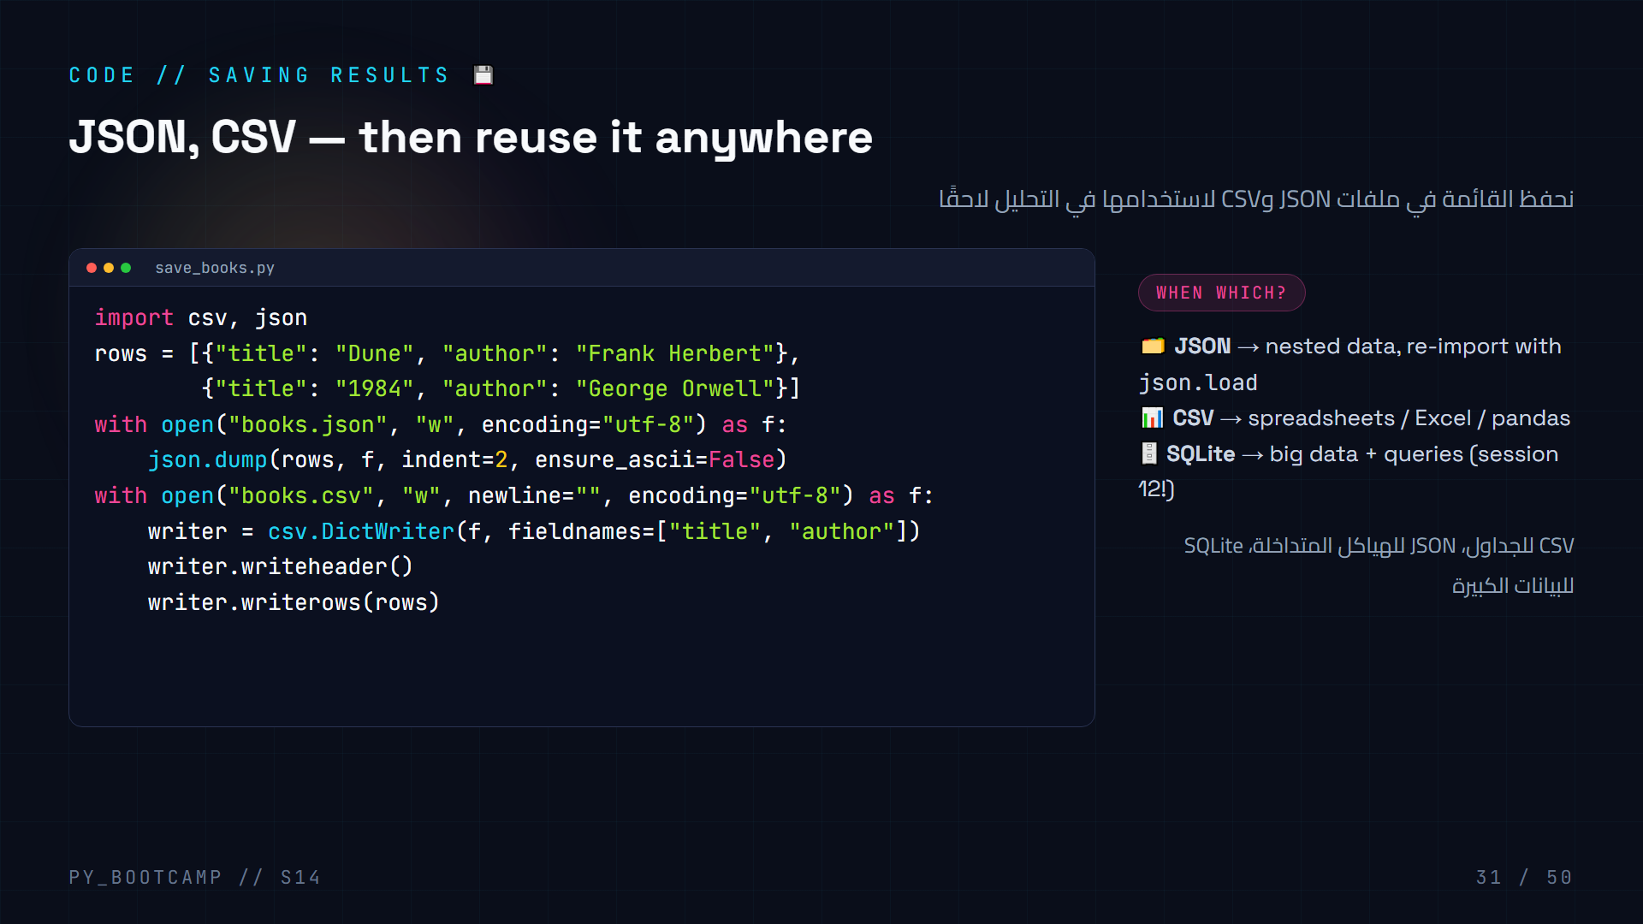
Notes:
Live: run save_books.py, then `type books.json` and `type books.csv` to show both files.
Explain options: encoding="utf-8" for Arabic/special chars (important!), ensure_ascii=False keeps real characters in JSON. newline="" avoids blank lines in CSV on Windows.
SQLite reminder: they already know sqlite3 from session 12 — we can store scraped rows with INSERT.
Arabic tip: utf-8 ضروري حتى لا تتشوه الأحرف العربية عند الحفظ. جرّبوا بدونها وستلاحظون الفرق.

Slide 32
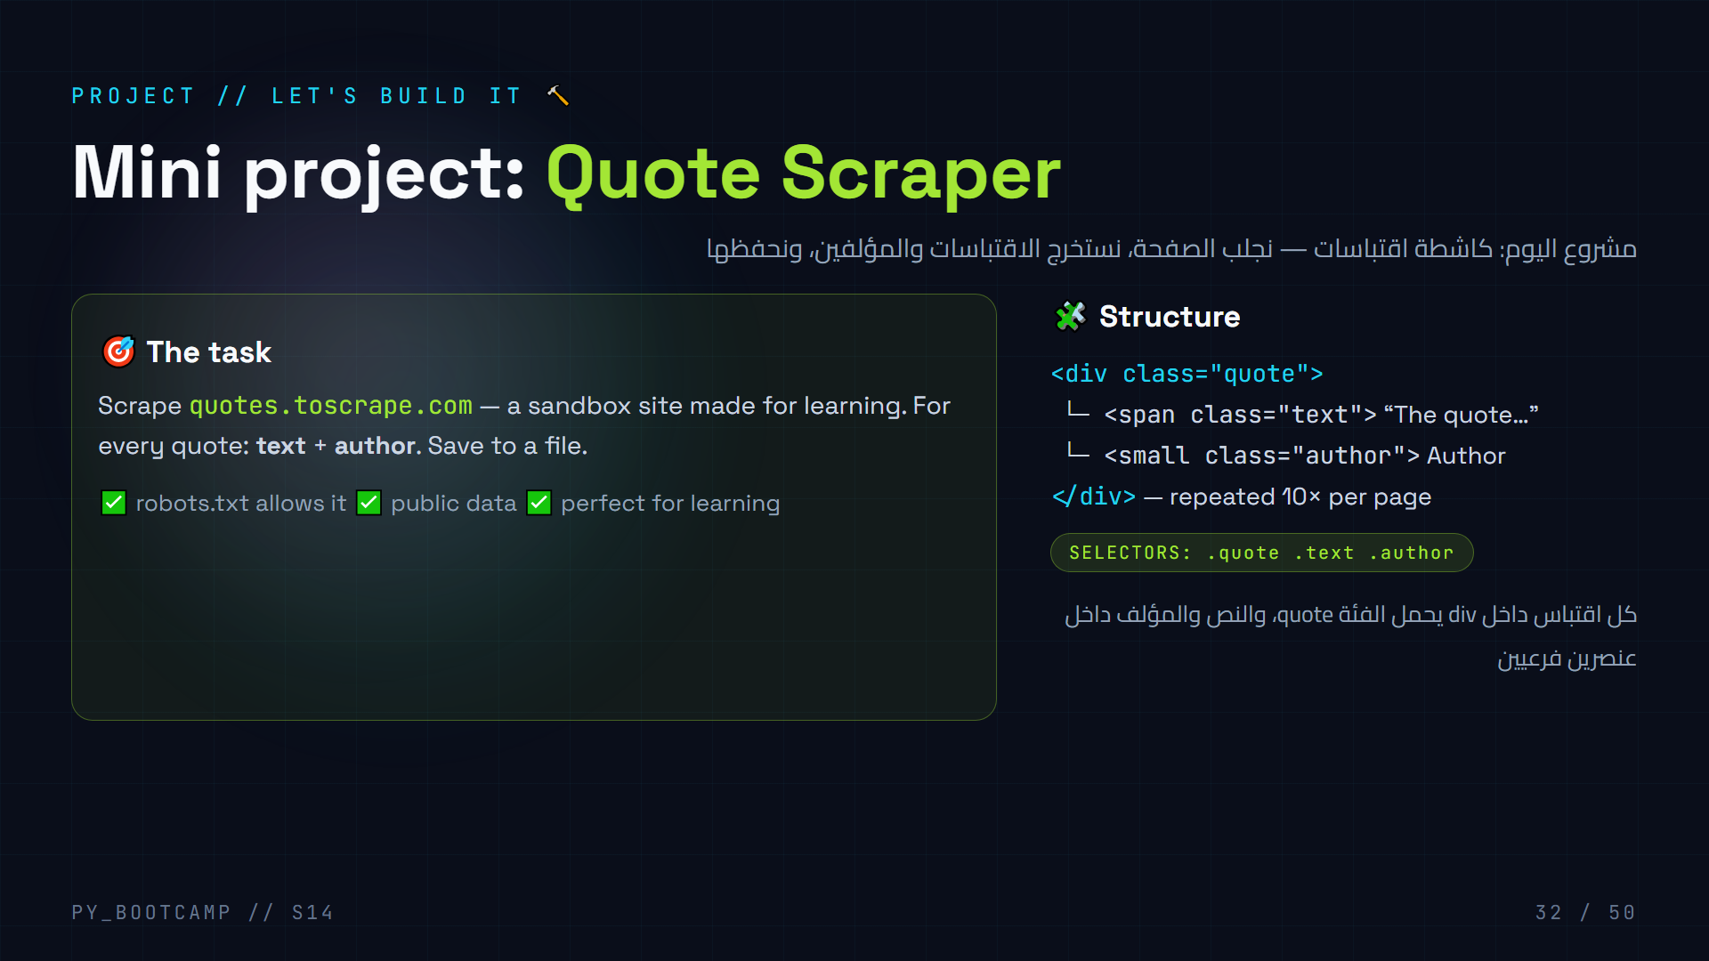
Notes:
Project kickoff. We build together, two code slides (33-34) + output (35).
Why quotes.toscrape.com? Built BY scraping teachers FOR scraping practice — zero ethical risk. This is the "gym" for scraping.
Show the page structure live: open the site, inspect one .quote div, count 10 per page.
Set the goal: by slide 35 you'll have a file with every quote + author from the homepage, saved as JSON.
Arabic tip: هذا الموقع «صالة تدريب» للكشط — بياناته عامة ومخصصة للتعلم، فتدربوا عليه بثقة.

Slide 33
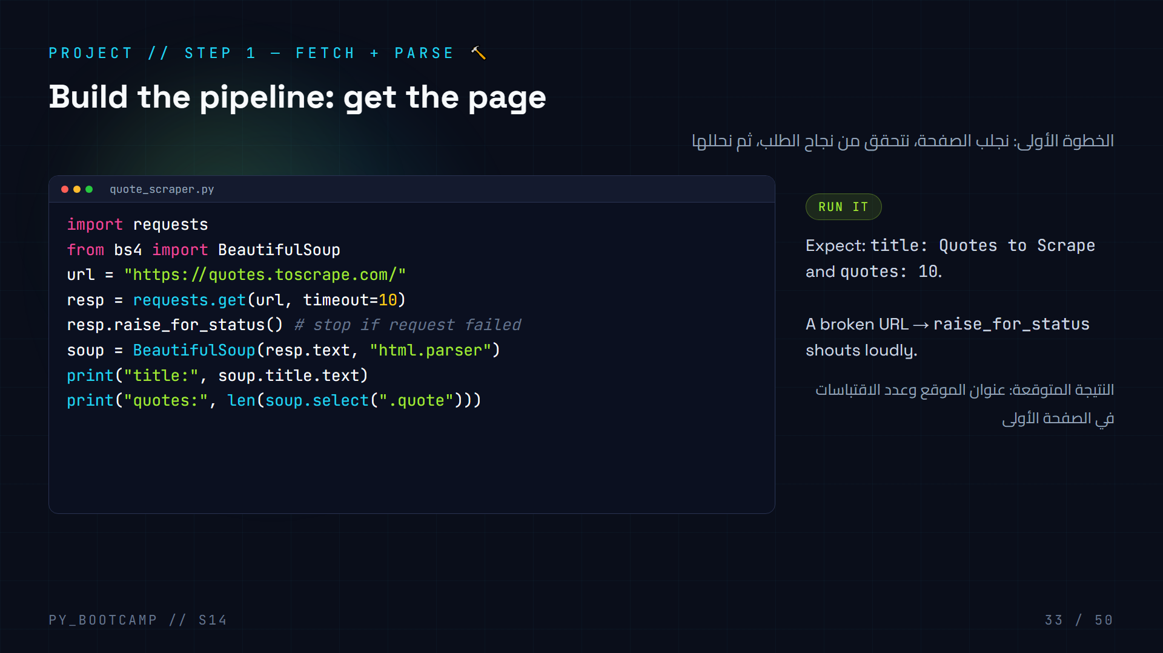
Notes:
Live-coding step 1. Write it together line by line, run it, confirm output.
Walking through each line: import, url, get with timeout, raise_for_status safety net, soup parse, then two sanity checks (title + count). Sanity checks tell you "am I on the right page?" before you write extraction logic.
If quotes: 0 → the page changed or got blocked; teach them to re-inspect rather than panic.
Arabic tip: «فحص الصحة» قبل الاستخراج يوفر ساعة من الحيرة. تأكد أنك في الصفحة الصحيحة أولًا.

Slide 34
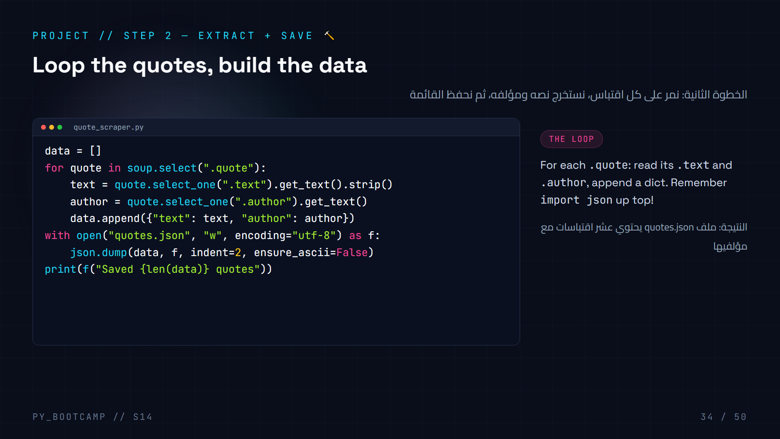
Notes:
Live-coding step 2. Add the loop and save logic to the previous file. Note the two imports at top: json + requests + bs4.
Debug moment: `.get_text()` on a missing element raises AttributeError. Show how `.text` vs `.get_text()` differ, and that select_one returns None → guard with if tag.
Stress .strip() for the quote text — real pages have newlines. And encoding="utf-8" + ensure_ascii=False for clean Arabic-compatible output.
Arabic tip: البناء داخل حلقة = «جمع البيانات». نقاوة النص من .strip ثم الحفظ.

Slide 35
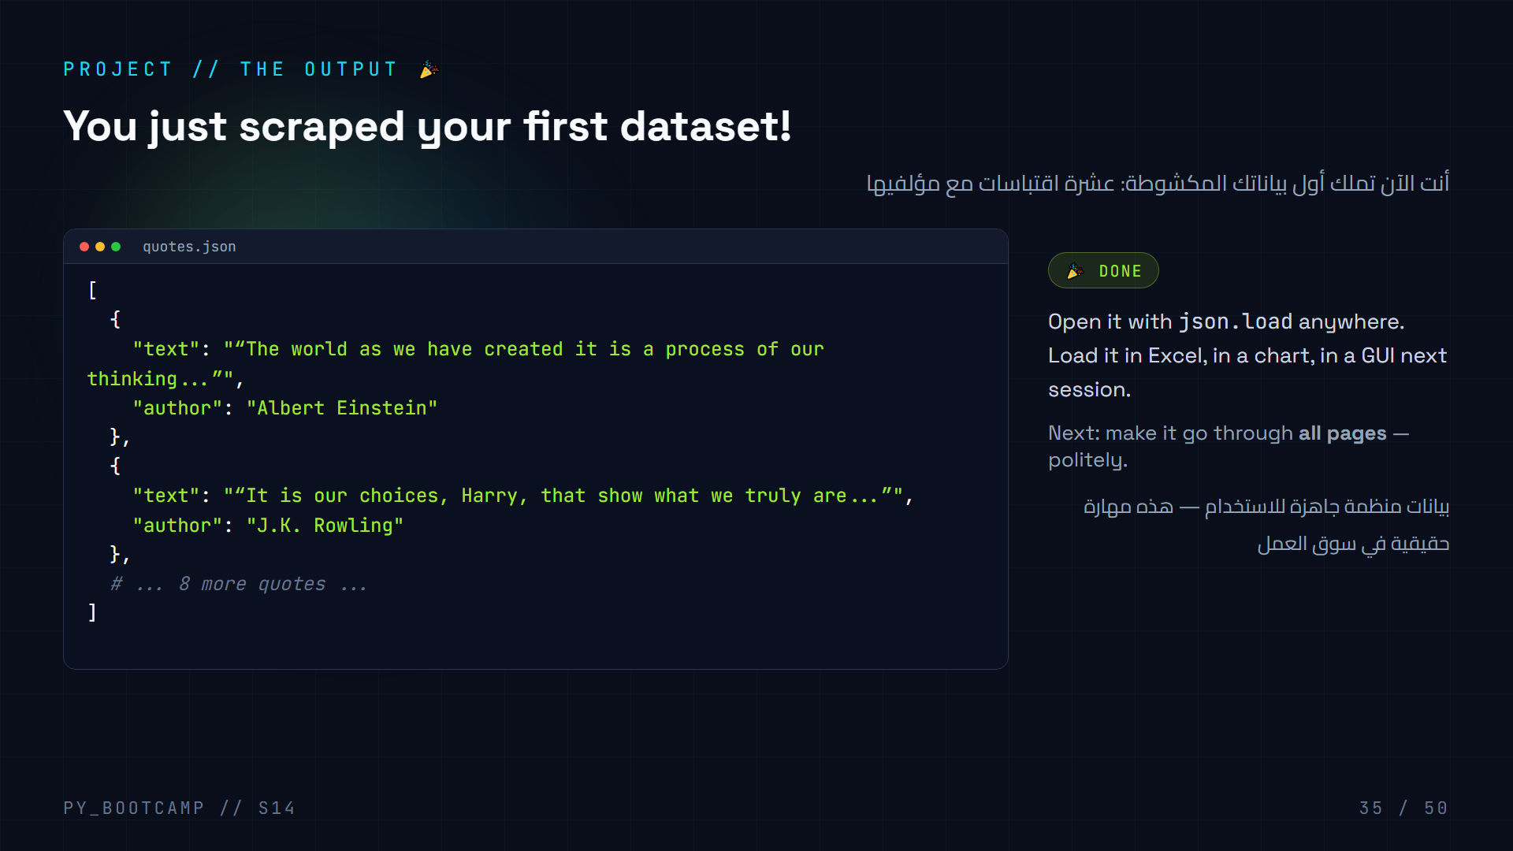
Notes:
Celebrate the win — students just built a real data pipeline. Show the JSON file, compare to what they saw in the browser.
Ask: "How many lines did this take? Now imagine 10 pages, 1000 quotes — same loop."
Road to pagination: the homepage shows page 1 only. Next slide shows the /page/N/ trick.
Arabic tip: قارن بين عرض المتصفح والـJSON: نفس المعلومات، لكن منظمة كبيانات قابلة للبرمجة.

Slide 36
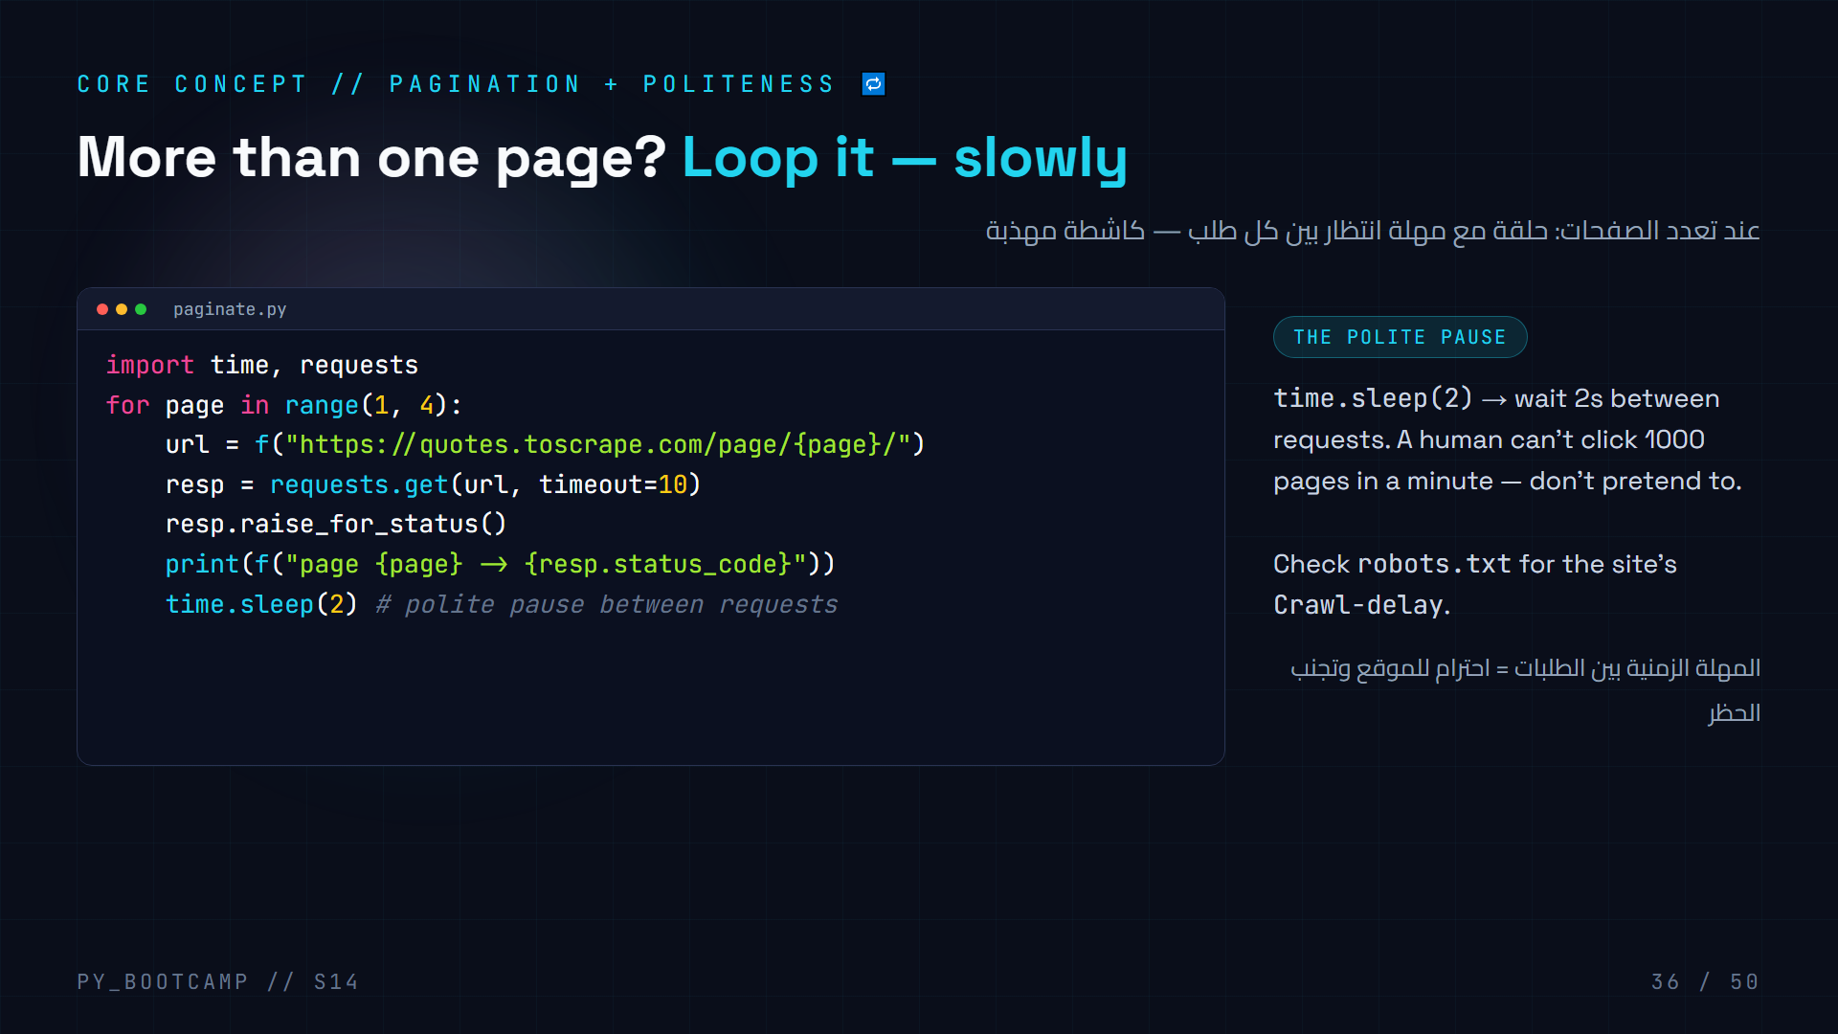
Notes:
Pagination = the same page repeated with /page/N/. Our loop just changes the number — that f-string is doing real work.
Why sleep(2)? Rate limiting is polite AND protects you: too-fast requests look like an attack and get your IP blocked. Many sites even publish their preferred delay in robots.txt (Crawl-delay).
Demo live: run paginate.py, watch pages 1→2→3 print with 2s gaps. Count the time with them.
Arabic tip: الصبر مع الموقع = أمان لبرنامجك. مهلة صغيرة بين الطلبات تجنبك الحظر.

Slide 37
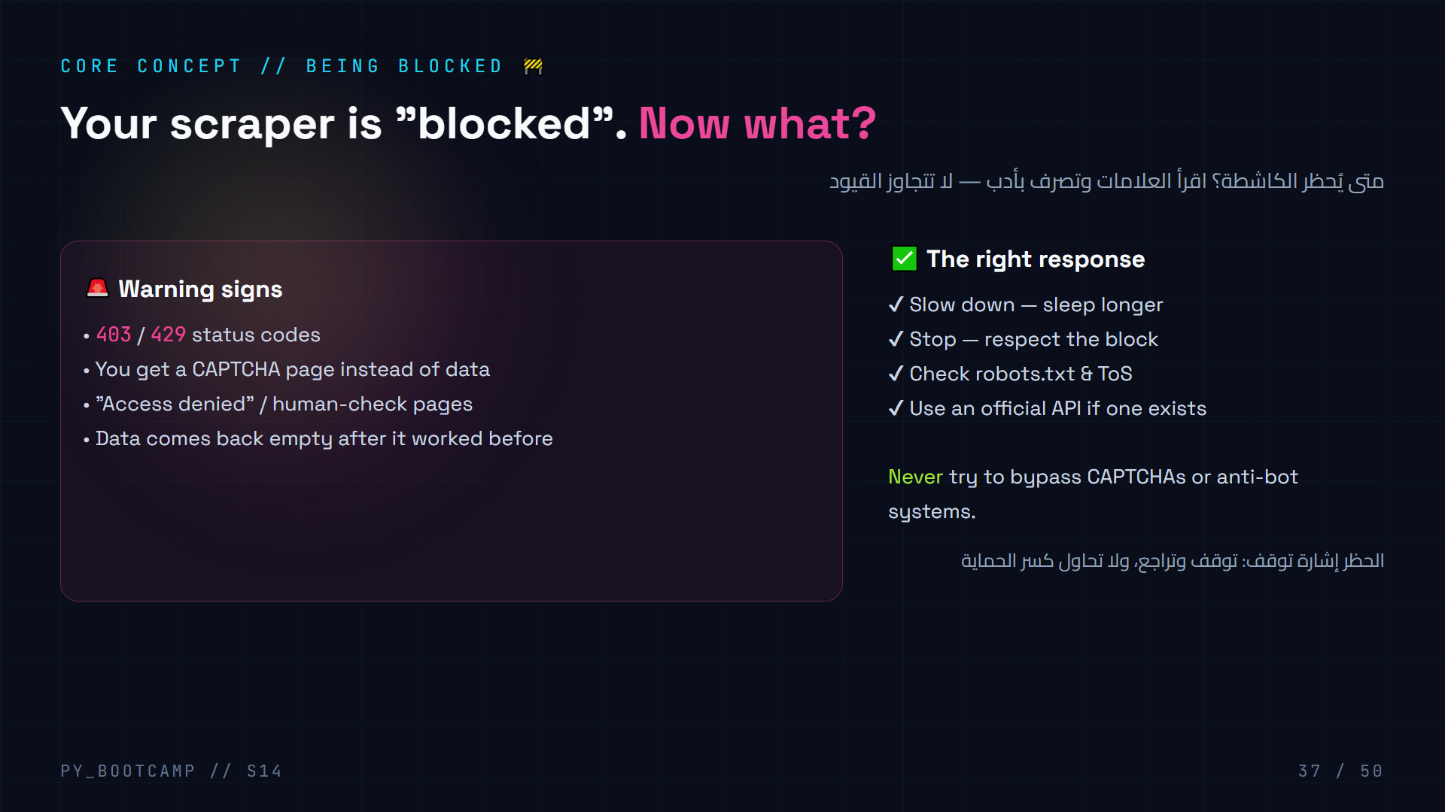
Notes:
This is the "grown-up" slide: blocks happen to everyone. Read the signals, then decide.
Core principle, repeated for safety: when a site blocks you, you STOP. Bypassing anti-bot systems is not part of this course and never will be. If data is important and the site offers an API, use the API.
Anecdote: real companies hit rate limits daily. The professional skill isn't breaking in — it's pacing, and knowing when to use an official channel.
Arabic tip: الحظر ليس تحدٍّ تقني، بل رسالة «توقف». الاحتراف = معرفة متى تستخدم الطريق الرسمي.

Slide 38
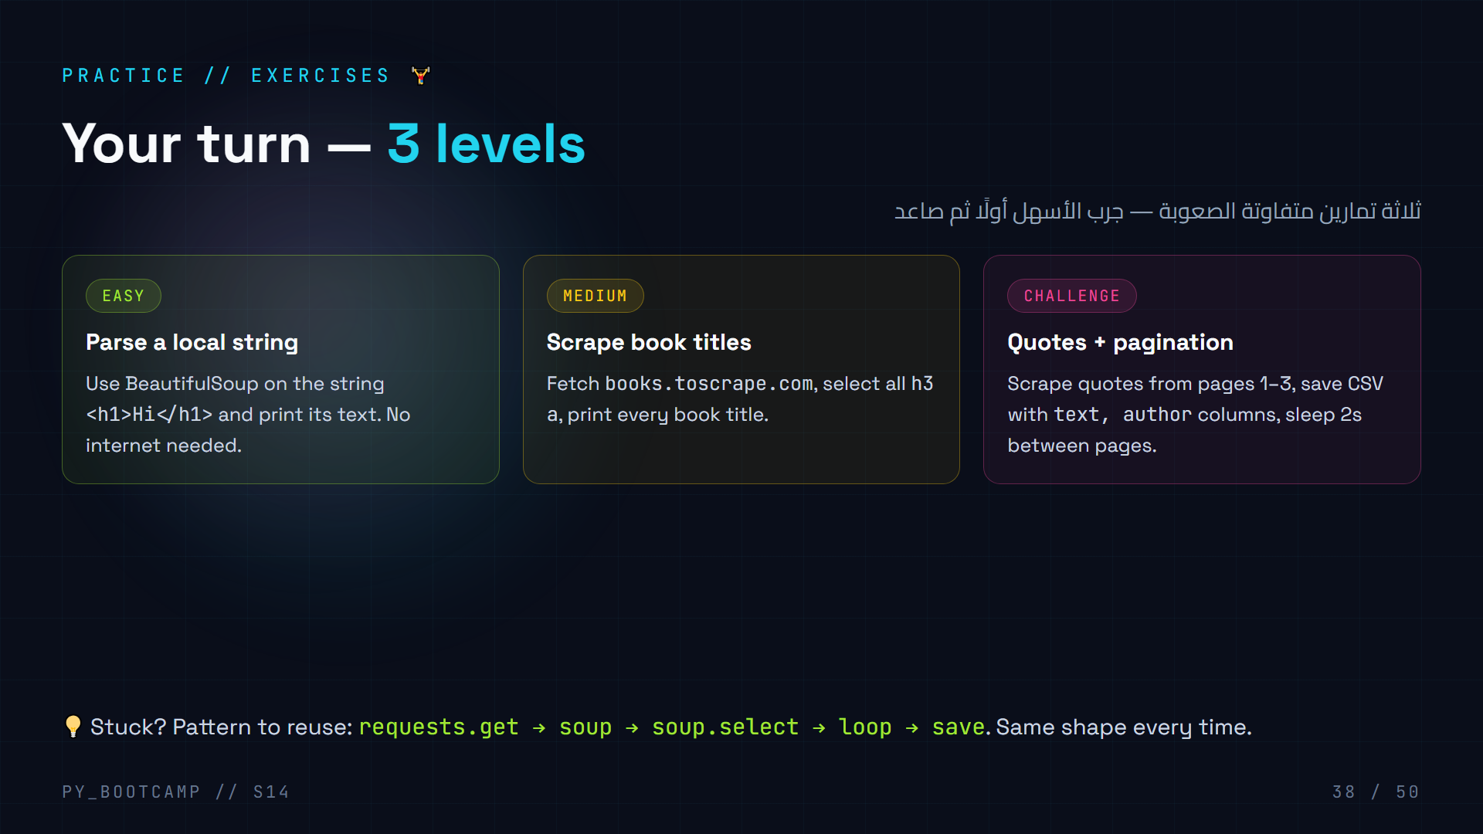
Notes:
15 minutes of solo practice. Walk around, help individually.
Solutions:
- Easy: `soup = BeautifulSoup("Hi", "html.parser"); print(soup.h1.text)` → Hi.
- Medium: books.toscrape.com — `for a in soup.select("h3 a"): print(a.get_text())`. First 20 books.
- Challenge: loop /page/1..3, `q.select_one(".text").get_text()` and `.author`, csv.writer rows, sleep(2) in loop.
Remind: if a selector returns nothing, print len() to debug, then re-inspect the page.
Arabic tip: ابدأ بالتمرين الأسهل حتى تثبت «شكل» الكود في ذهنك، ثم عدّل عليه تدريجيًا.

Slide 39
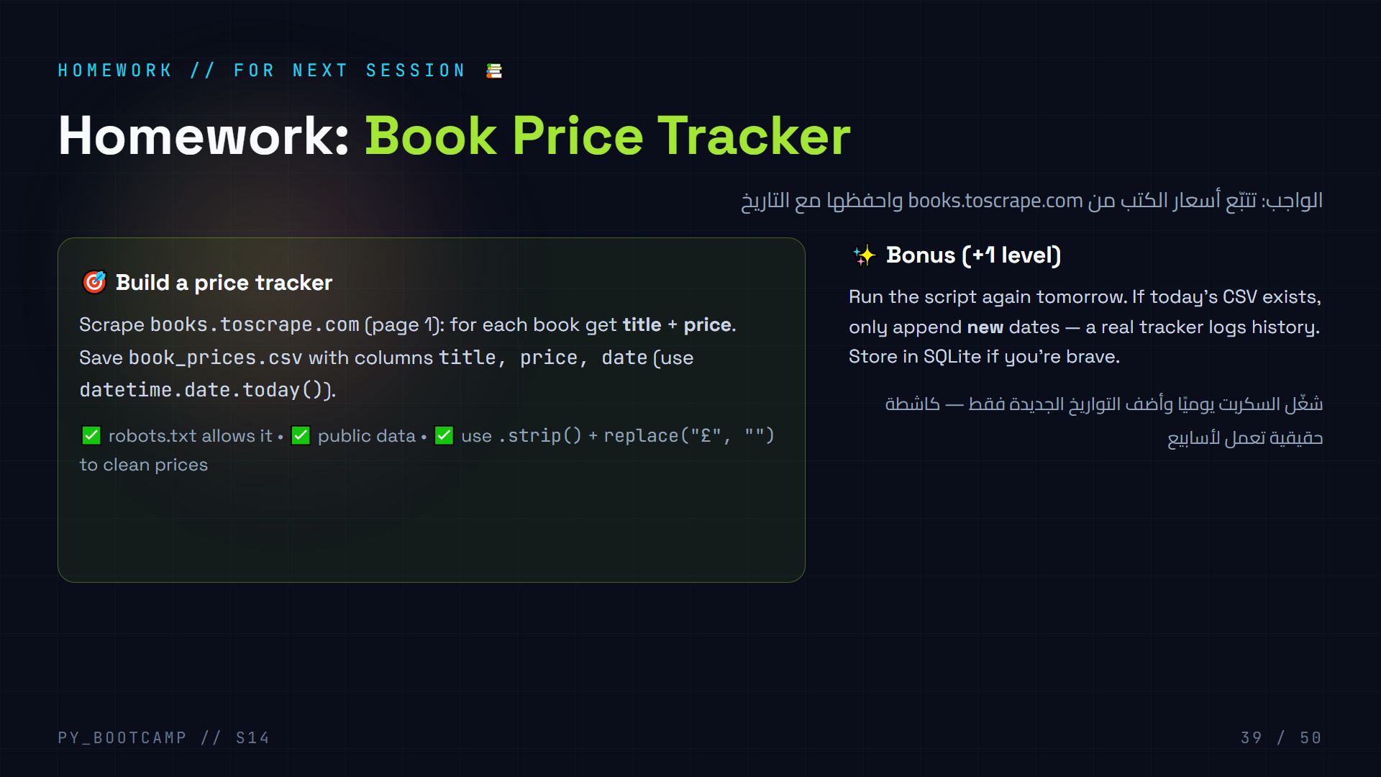
Notes:
Homework = small, doable, real. Price tracking is the classic first scraper project and it maps to next session (GUI: showing the prices in a Flet table!).
Give the starter:
```
import requests, csv, datetime
from bs4 import BeautifulSoup
resp = requests.get("https://books.toscrape.com/", timeout=10)
soup = BeautifulSoup(resp.text, "html.parser")
# TODO: select article.product_pod, extract h3 a text + p.price_color
```
Hint: prices look like £51.77 — strip the £ with .replace and keep as float.
Accept any reasonable structure; grade on: clean prices, date column, encoding utf-8.
Arabic tip: ذكّرهم أن التنظيف جزء من الدرجة: رقم السعر يجب أن يصل نقيًا بدون رمز العملة.

Slide 40
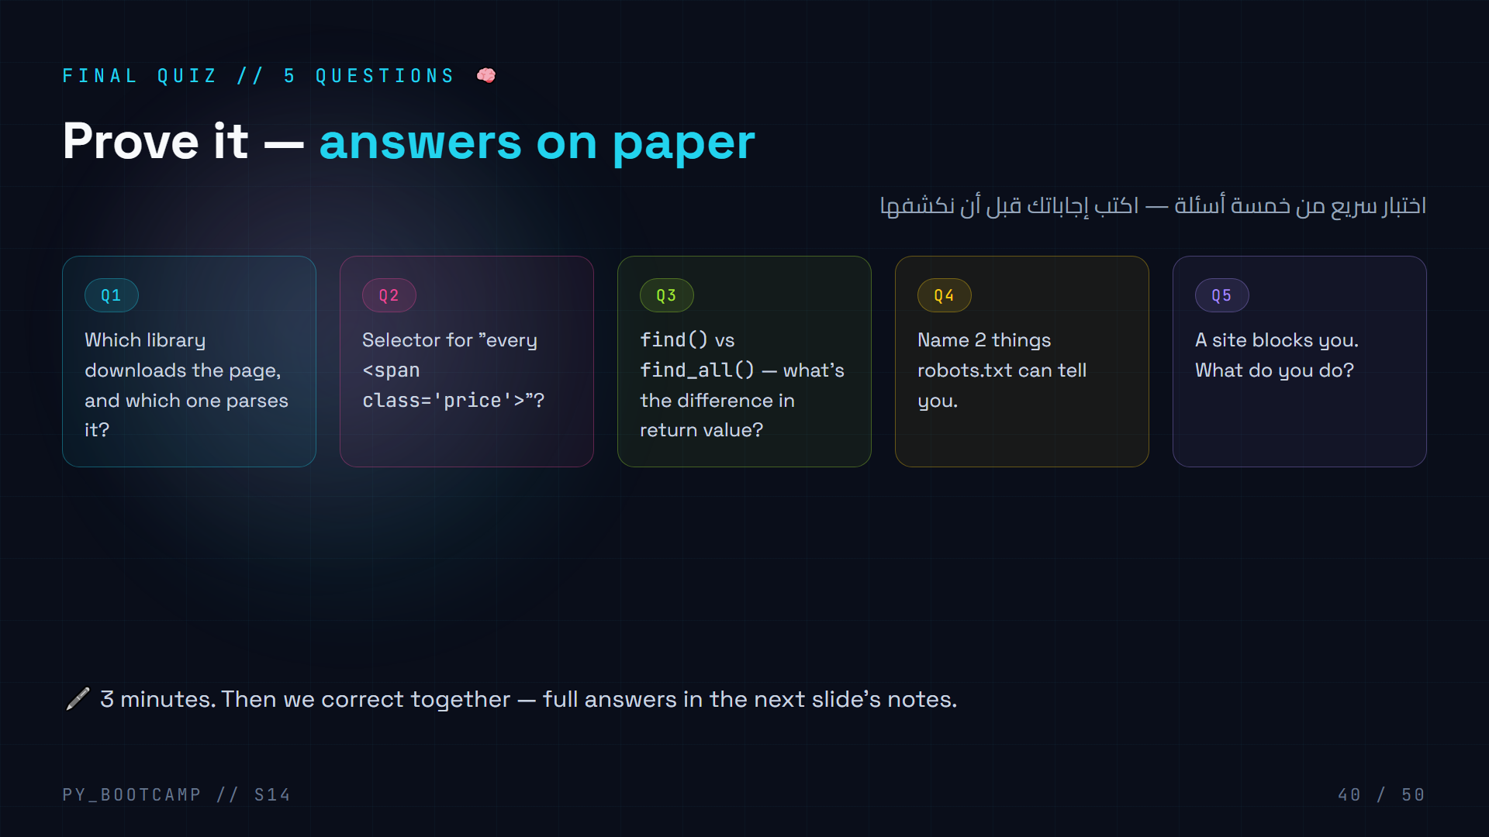
Notes:
Give 3 quiet minutes. Then reveal answers:
- Q1: requests downloads, BeautifulSoup parses.
- Q2: "span.price" (tag + dot + class).
- Q3: find → ONE Tag or None; find_all → a LIST (possibly empty).
- Q4: which paths are Disallowed, and Crawl-delay (plus User-agent rules).
- Q5: Stop, slow down, respect it, look for an official API.
Mark quickly with peer-checking. This quiz doubles as the recap pre-test for slide 41.
Arabic tip: راجع معهم أين أخطأوا: معظم الأخطاء في Q2 (نسيان النقطة) وQ3 (الفرق بين عنصر وقائمة).

Slide 41
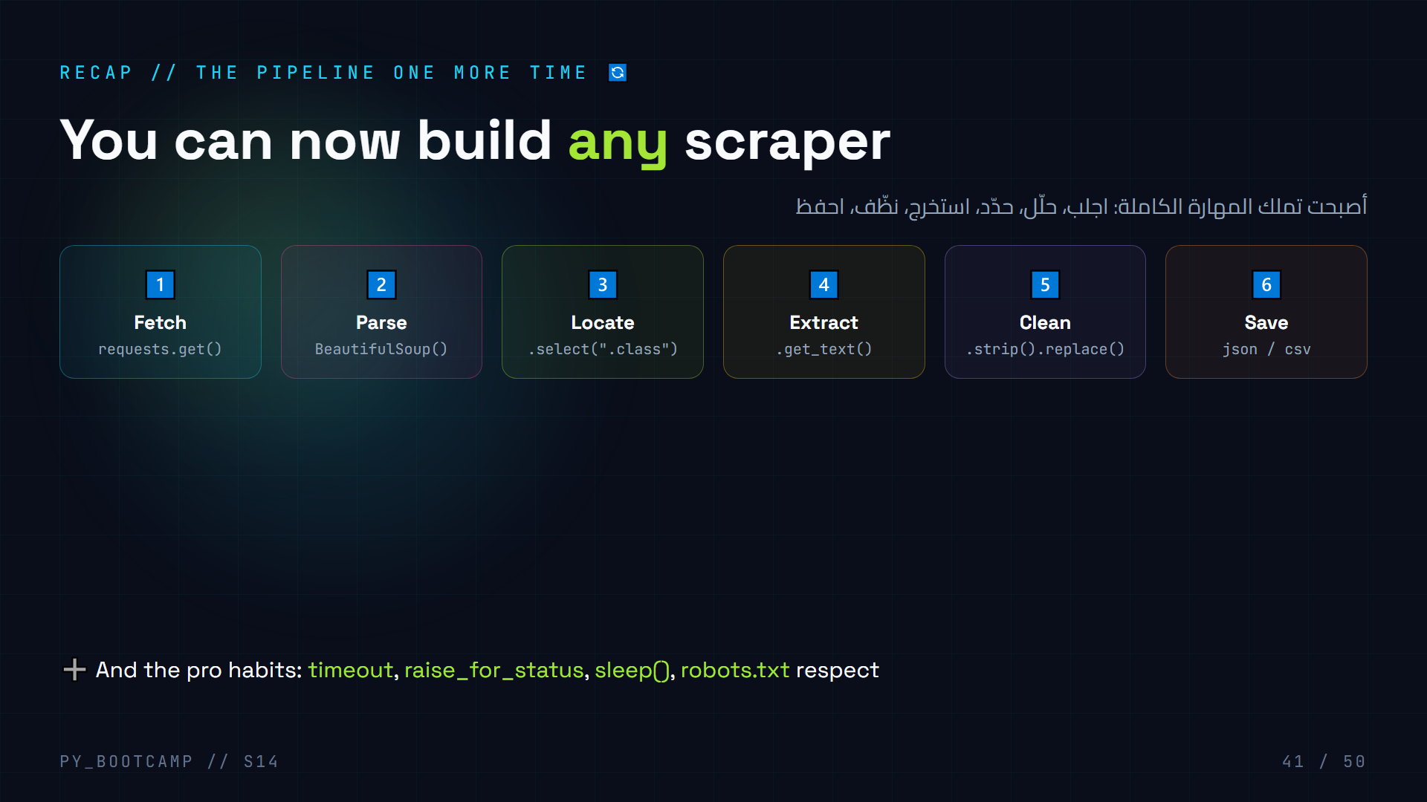
Notes:
Walk the 6 steps quickly — students recite them back. This is the reusable skeleton for every scraper.
Emphasize: they don't need to memorize syntax, they need to remember the SHAPE. Everything else is lookup.
Bridge into the last hour: "Next session you'll take this JSON/CSV data and show it in a real windowed app — a GUI." (Slide 42.)
Arabic tip: أعد قراءة الخطوات الست معًا بصوت واحد — التكرار يحوّلها إلى عادة.

Slide 42
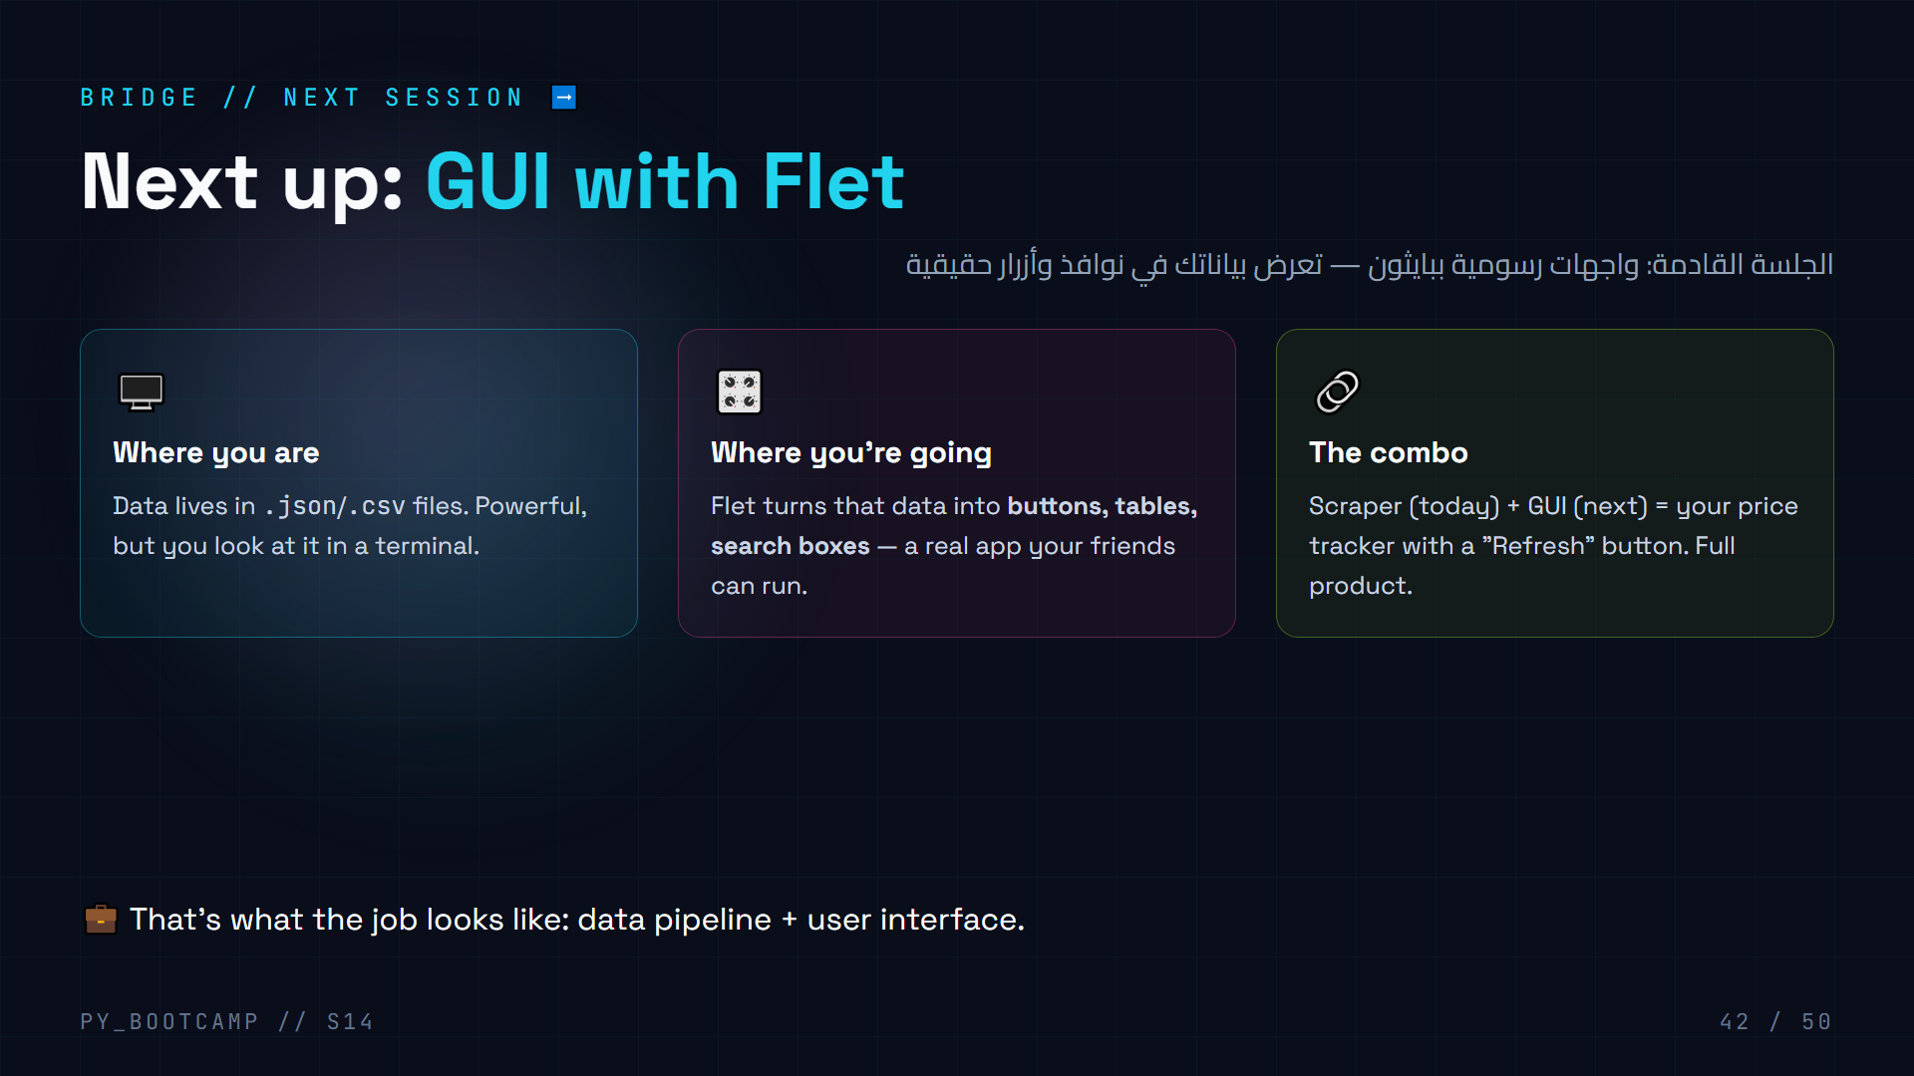
Notes:
Motivate the next session: Flet = Python GUI framework, pure Python (no HTML/CSS). Students already know tkinter is an option but Flet is modern and beautiful.
Show the arc: session 12 SQLite → 13 APIs → 14 scraping → 15 GUI. Every session feeds the next. Your homework data (book_prices.csv) will be the demo dataset in the Flet table next week.
Arabic tip: وضّح أنهم سيبنون «منتجًا» كاملًا: بيانات من الإنترنت + واجهة سهلة للمستخدم.

Slide 43
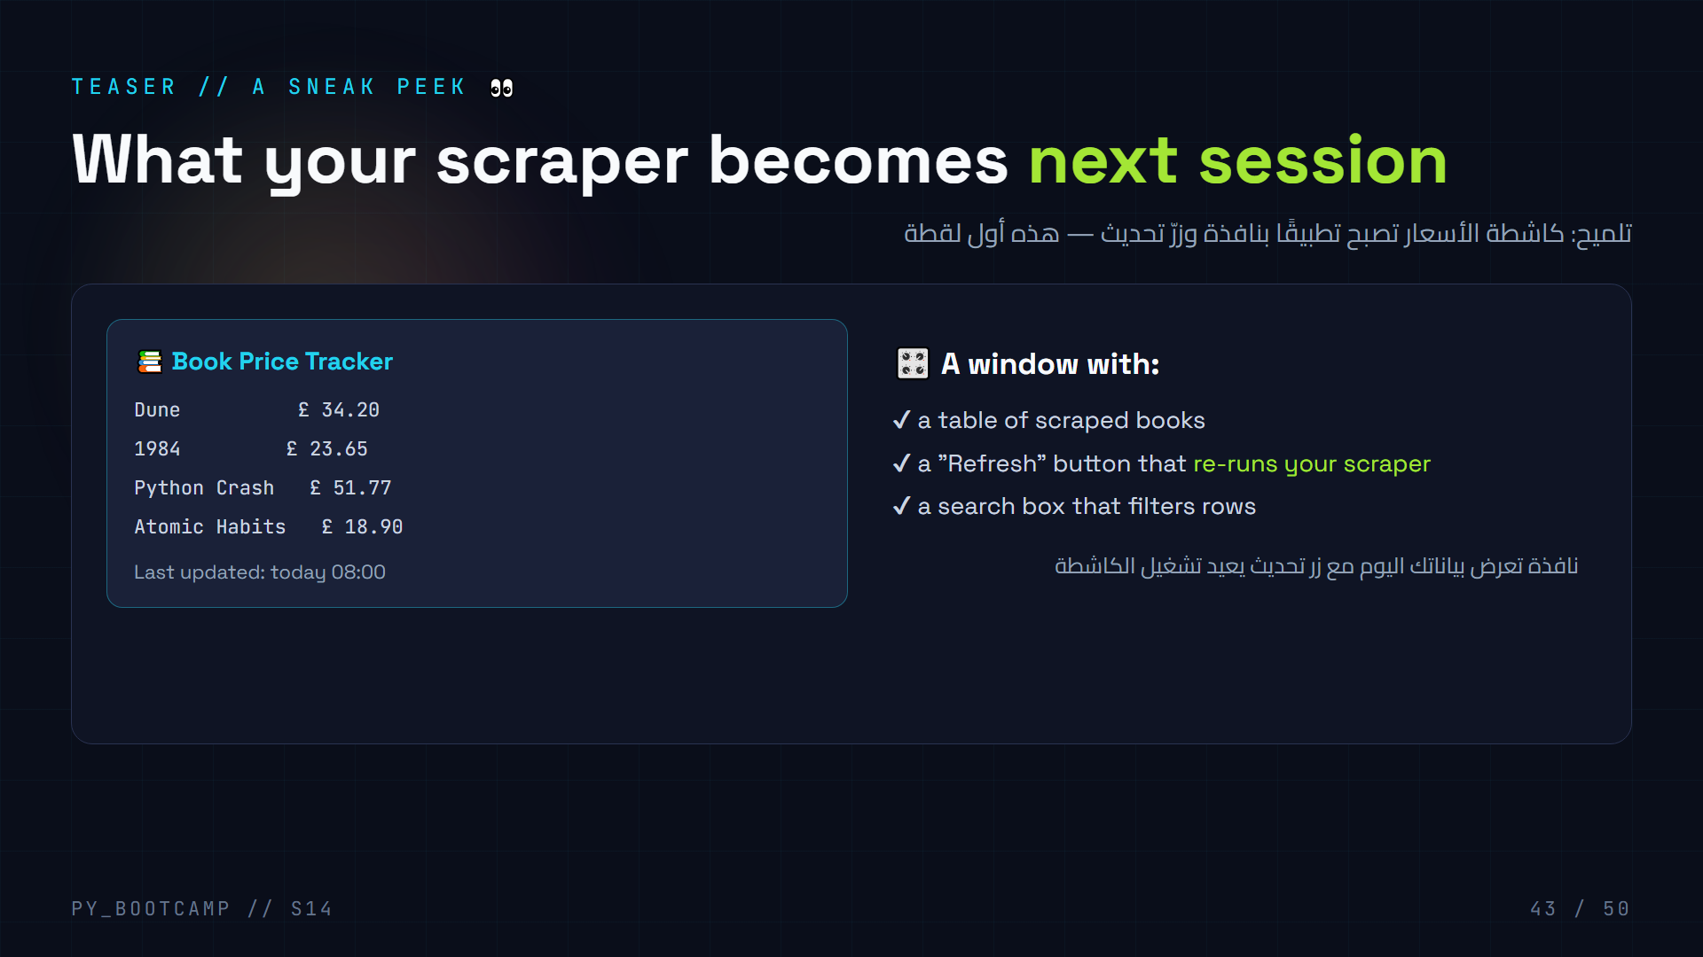
Notes:
Show the mockup: a mini window previewing the Flet app. The same data they scrape today becomes the table.
Excite them: "Your homework file will literally be imported and displayed next session. Come with data!"
Keep it 60 seconds — a teaser, not a lesson. Full details next session.
Arabic tip: أظهر لهم «المنتج النهائي» — رؤية الهدف ترفع الحماس للواجب المنزلي.

Slide 44
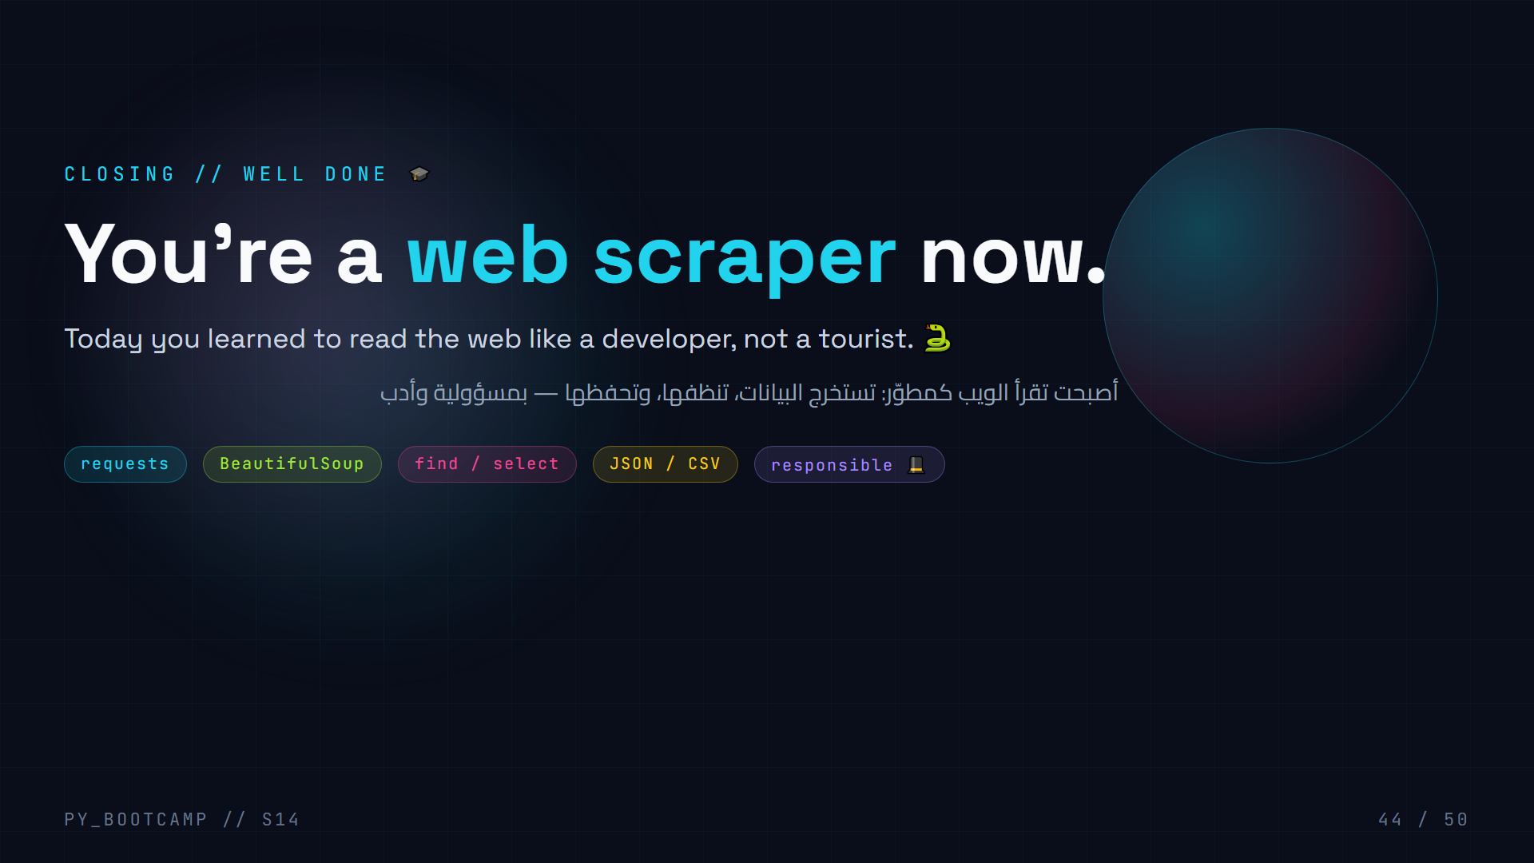
Notes:
Celebrate the milestone. Students now have a genuinely employable, hands-on skill.
Remind the code of conduct: "Use this power to read, not to break." A scraper is a tool; responsible people build price trackers and research datasets.
Homework reminder + next session (GUI/Flet). Quick applause moment — this was a dense session.
Arabic tip: أنهِ بعبارة تحفيزية: «الإنترنت مكتبة عامة، وأنت تعلمت القراءة الآلية».

Slide 45
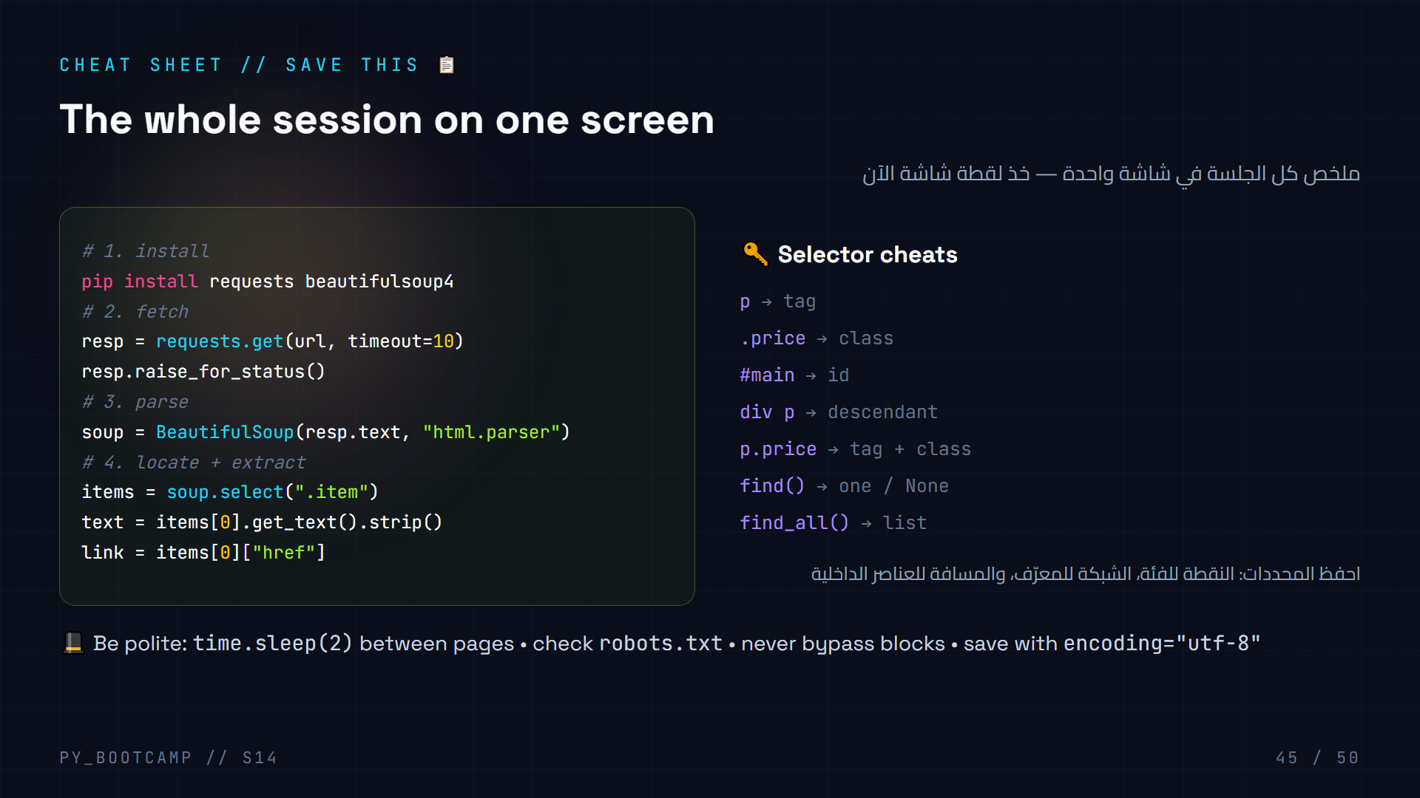
Notes:
This is the reference slide — students should screenshot it. It distills: install, fetch, parse, locate, extract + the selector grammar.
Tell them: "Everything after this session is 10% new syntax, 90% this pipeline."
Add the SQLite reminder: they can INSERT the rows into a table (session 12). Fits the "save" step.
Arabic tip: المحددات مثل «عناوين» العناصر — نقطة للفئة، شبكة للمعرّف، وسطر المحدد يعمل في DevTools أيضًا.

Slide 46
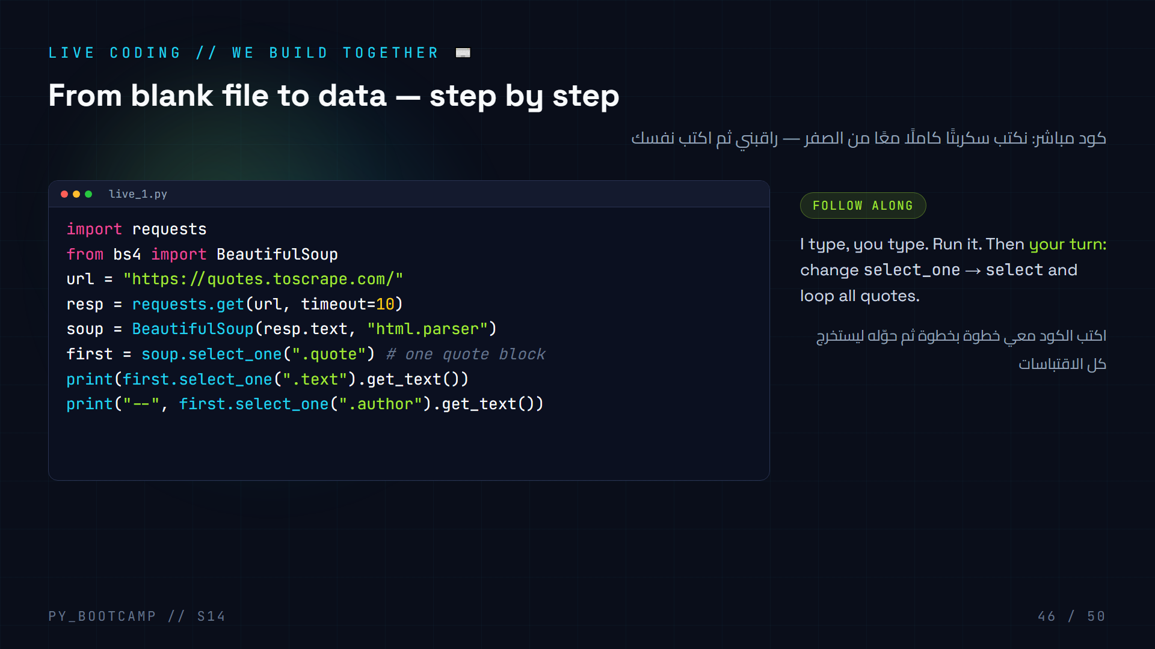
Notes:
Live-coding session #1 (15 min). Build live_1.py from scratch, narrating every decision:
- "Why timeout?" (hang prevention)
- "Why select_one for the first quote?" (we just want one to test the pipeline)
- Then challenge them to swap to select + for loop.
Pause frequently: ask "what do you expect to print?" before running. Fix errors out loud when they appear (they will — good teaching).
Arabic tip: الكود المكتوب بيديك يُحفر في الذاكرة — لا تنسخوا، اكتبوا معي حرفًا حرفًا.

Slide 47
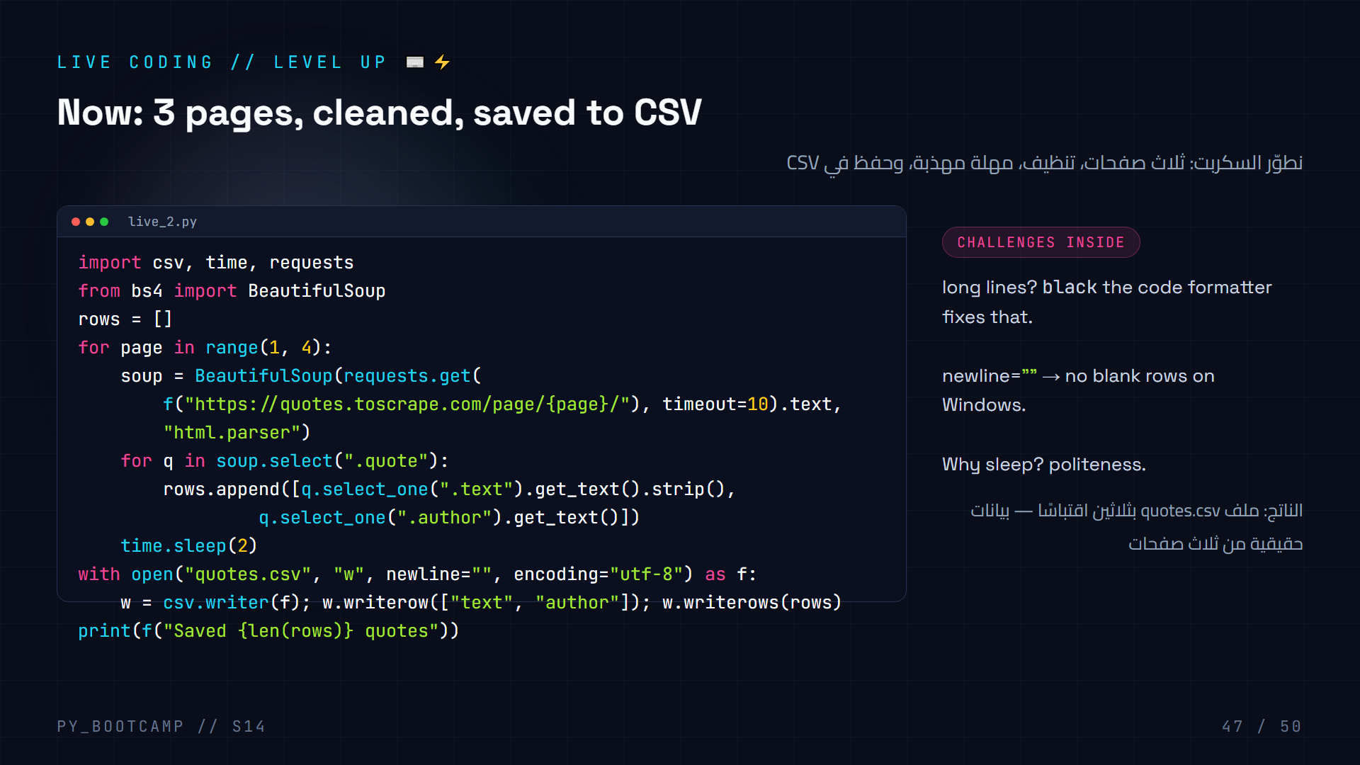
Notes:
Live-coding session #2 (15 min). Extend to the full pipeline. Show how we stay readable: multiline requests.get(...,) and CSV writer.
Run it: expect "Saved 30 quotes" (3 pages × 10). Then open quotes.csv in Excel/Notepad to celebrate.
Debug tips to demo: what if sleep was missing? Show the speed difference and why sites dislike it. What if encoding was missing? Show garbled Arabic/smart-quotes.
Arabic tip: newline="" مهم على ويندوز — بدونه تظهر أسطر فارغة في ملف CSV. جرّبوها لتروا الفرق.

Slide 48
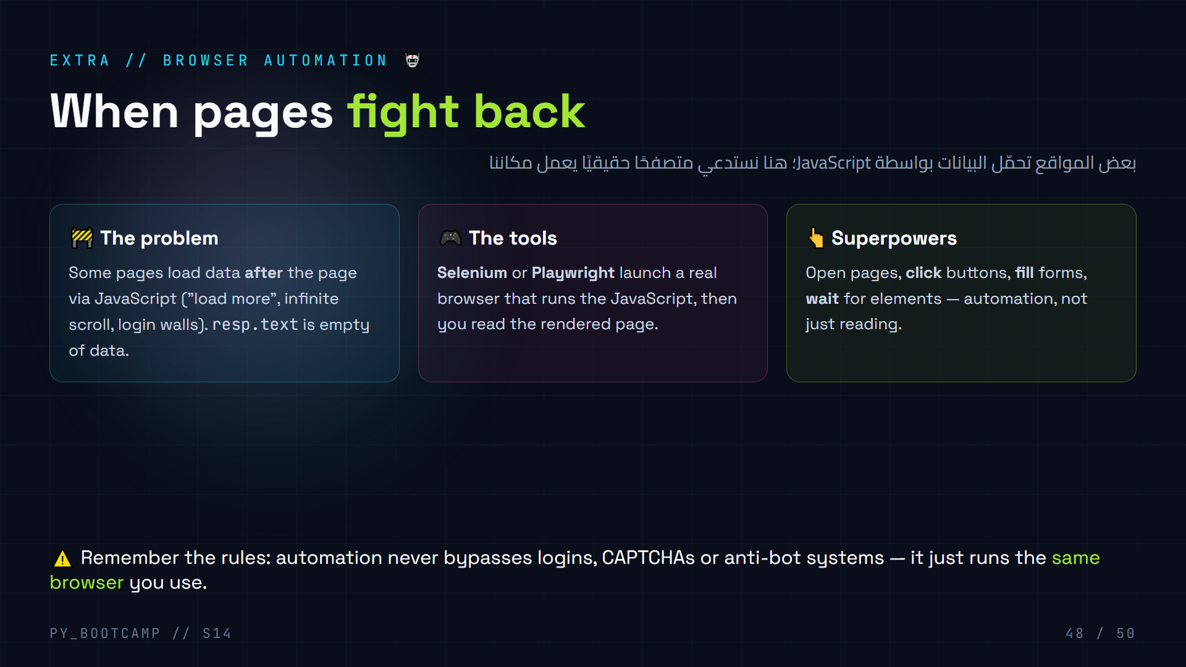
Notes:
Why browser automation exists: requests+BS4 reads the RAW HTML. If data is injected by JavaScript AFTER load, raw HTML won't contain it. Selenium/Playwright run a real browser → JS executes → page is complete.
Big clarification: automation still follows the same ethics. Using a browser does NOT make bypassing locks OK. We automate public, allowed flows (e.g. filling a public search form).
Playwright is our recommendation (modern, simple sync API, auto-waits). Install: pip install playwright && playwright install chromium.
Arabic tip: البيانات التي تولّدها JS لا تظهر في النص الخام — شبهها بمتجر يفتح صندوقه بعد وصولك، فتحتاج «متصفحًا» ينتظر الافتتاح.

Slide 49
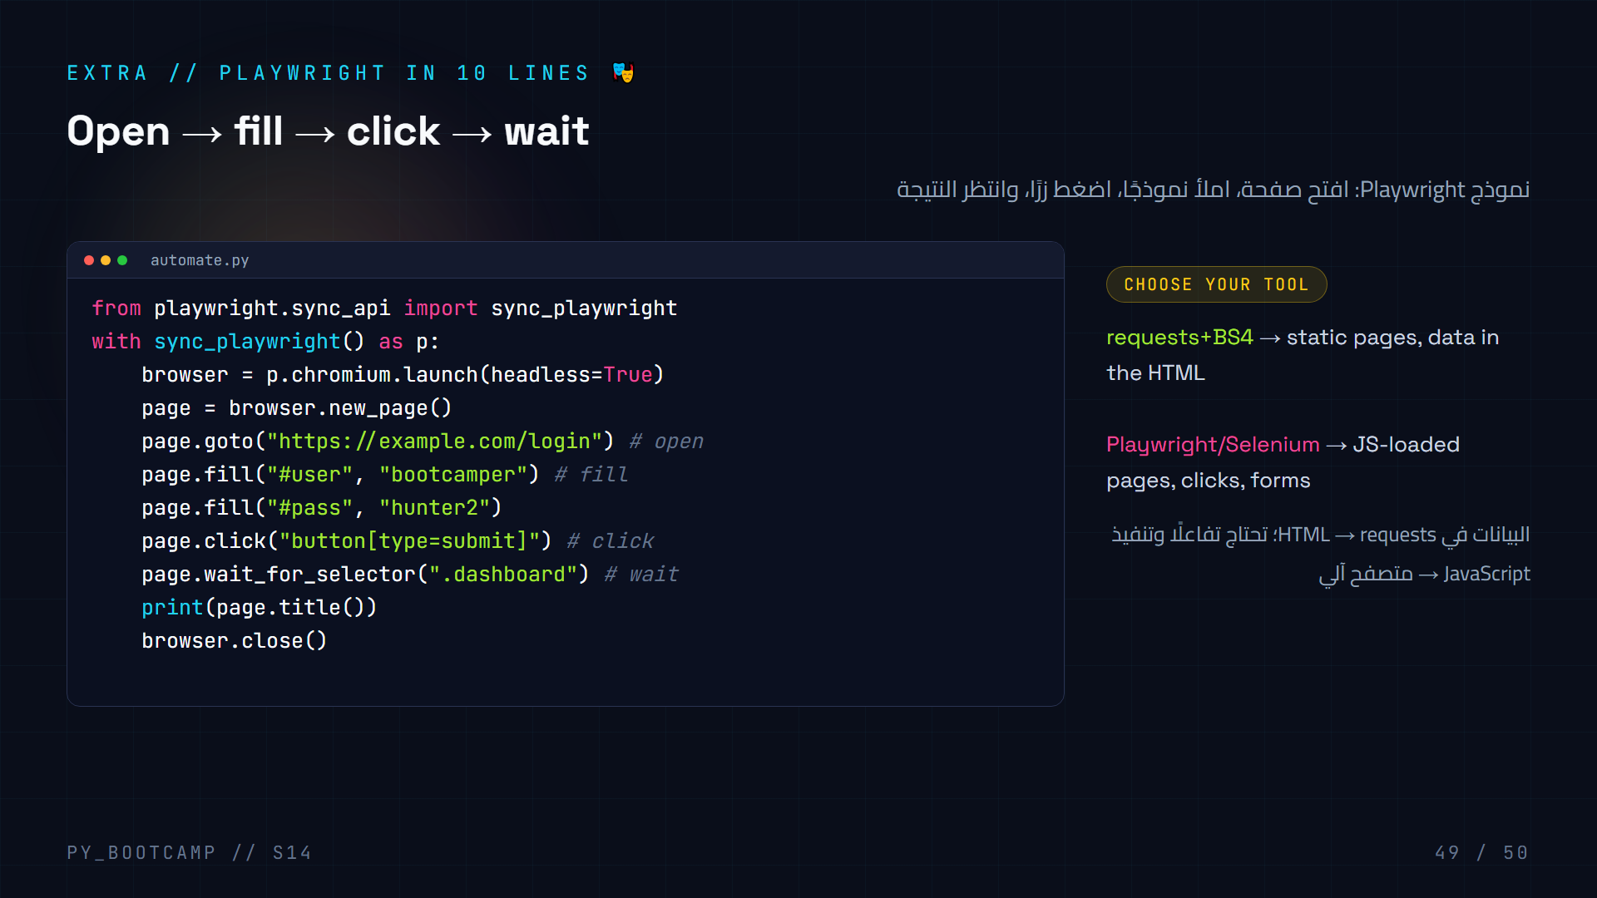
Notes:
Note: `example.com/login` is illustrative — always test on sandbox/sites you may automate. In a demo, use a public form (e.g. Wikipedia search).
Walk the four verbs: goto (open), fill (type into a field by selector), click (press a button), wait_for_selector (pause until the result element exists). Selectors work just like BS4's CSS selectors.
If no time: install playwright during break. `pip install playwright` + `playwright install chromium`. headless=True keeps it invisible; set False to WATCH the browser do it — very fun demo.
Arabic tip: wait_for_selector = «انتظر ظهور النتيجة». بدونها قد يقرأ البرنامج الصفحة قبل اكتمال التحميل.

Slide 50
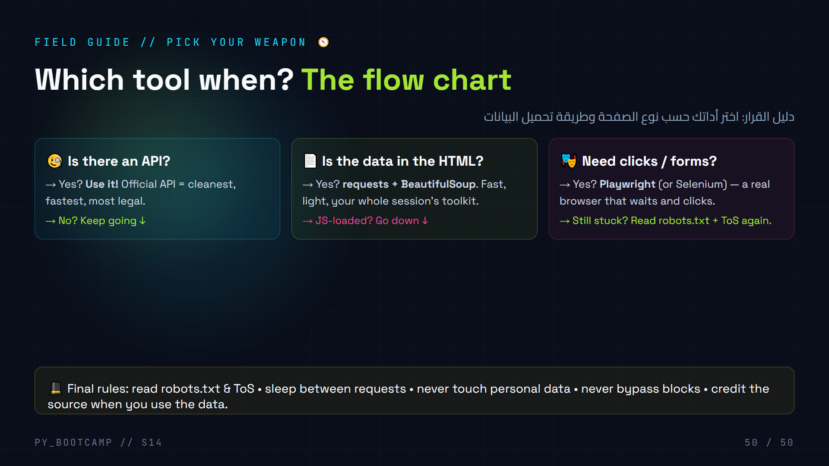
Notes:
Final decision guide — a flow chart students will use for years. Read it top to bottom: API first, then static scraping, then browser automation.
Close with the code of conduct once more (bottom bar). Reinforce: this session taught a SKILL and a MINDSET. The mindset = responsible automation.
Last words: homework due before next session; next week Flet GUI to display the scraped data. Thank them, and hint the teaser: "Your price tracker, clickable."
Arabic tip: اختتم بتذكير أخلاقي واحد: «القوة التي تعلمتها اليوم تُستخدم للقراءة لا للكسر».

