Slide 1

Notes:
Welcome students. Session 3: Loops — the foundation of automation.

Slide 2
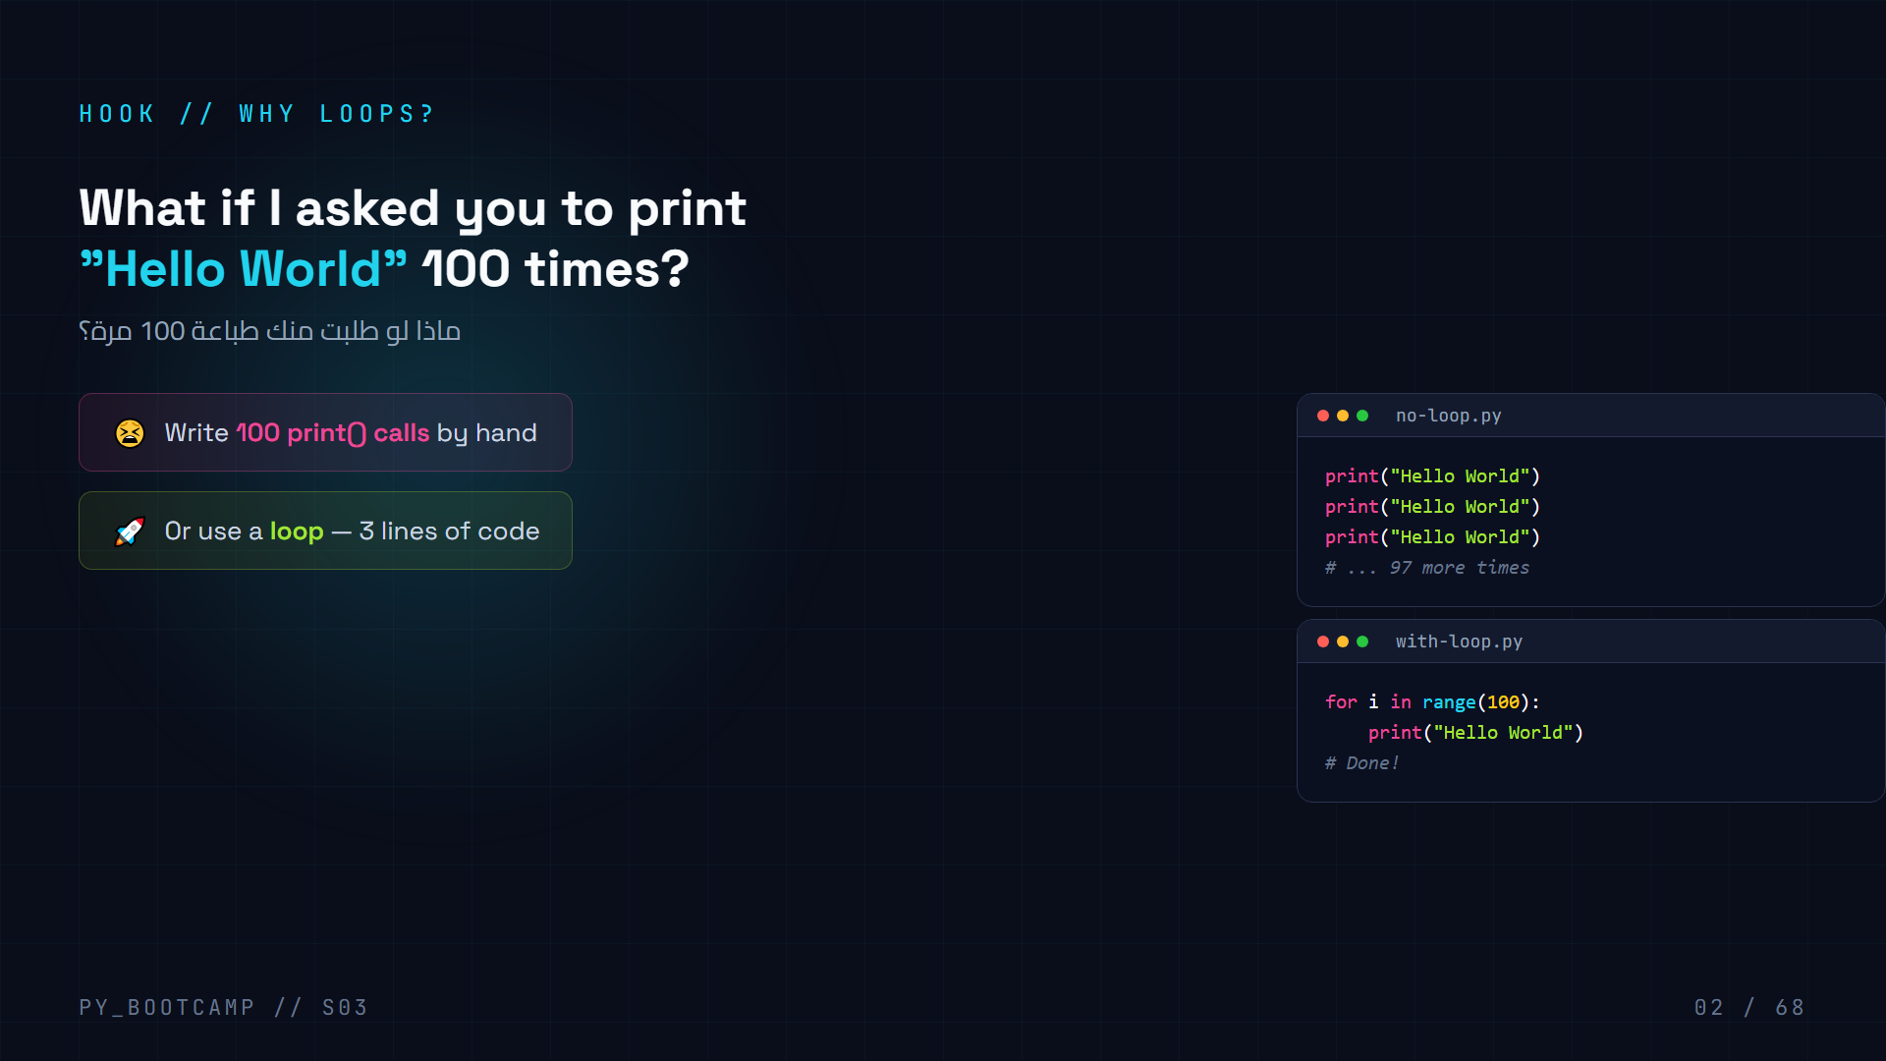
Notes:
Show the pain of repetition vs the loop solution.

Slide 3
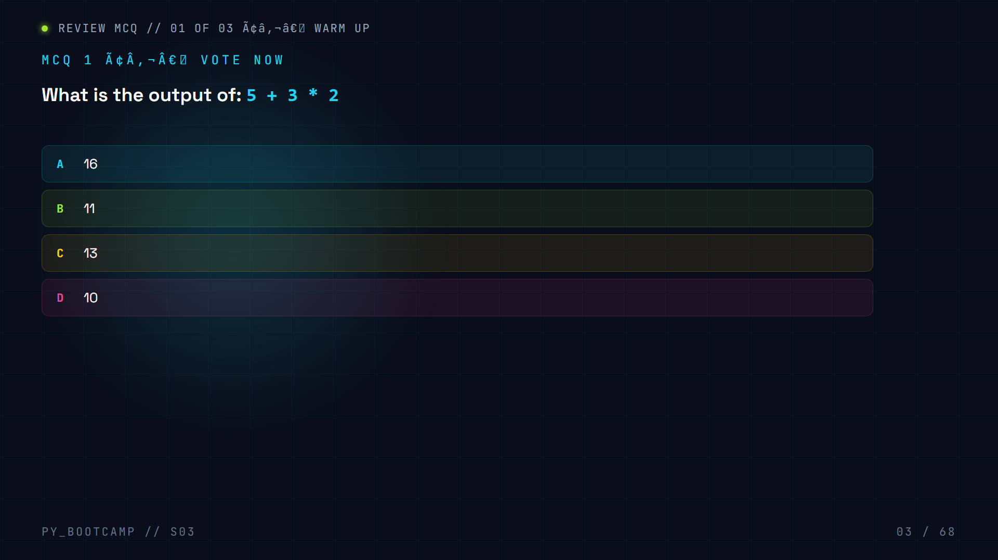

Slide 4
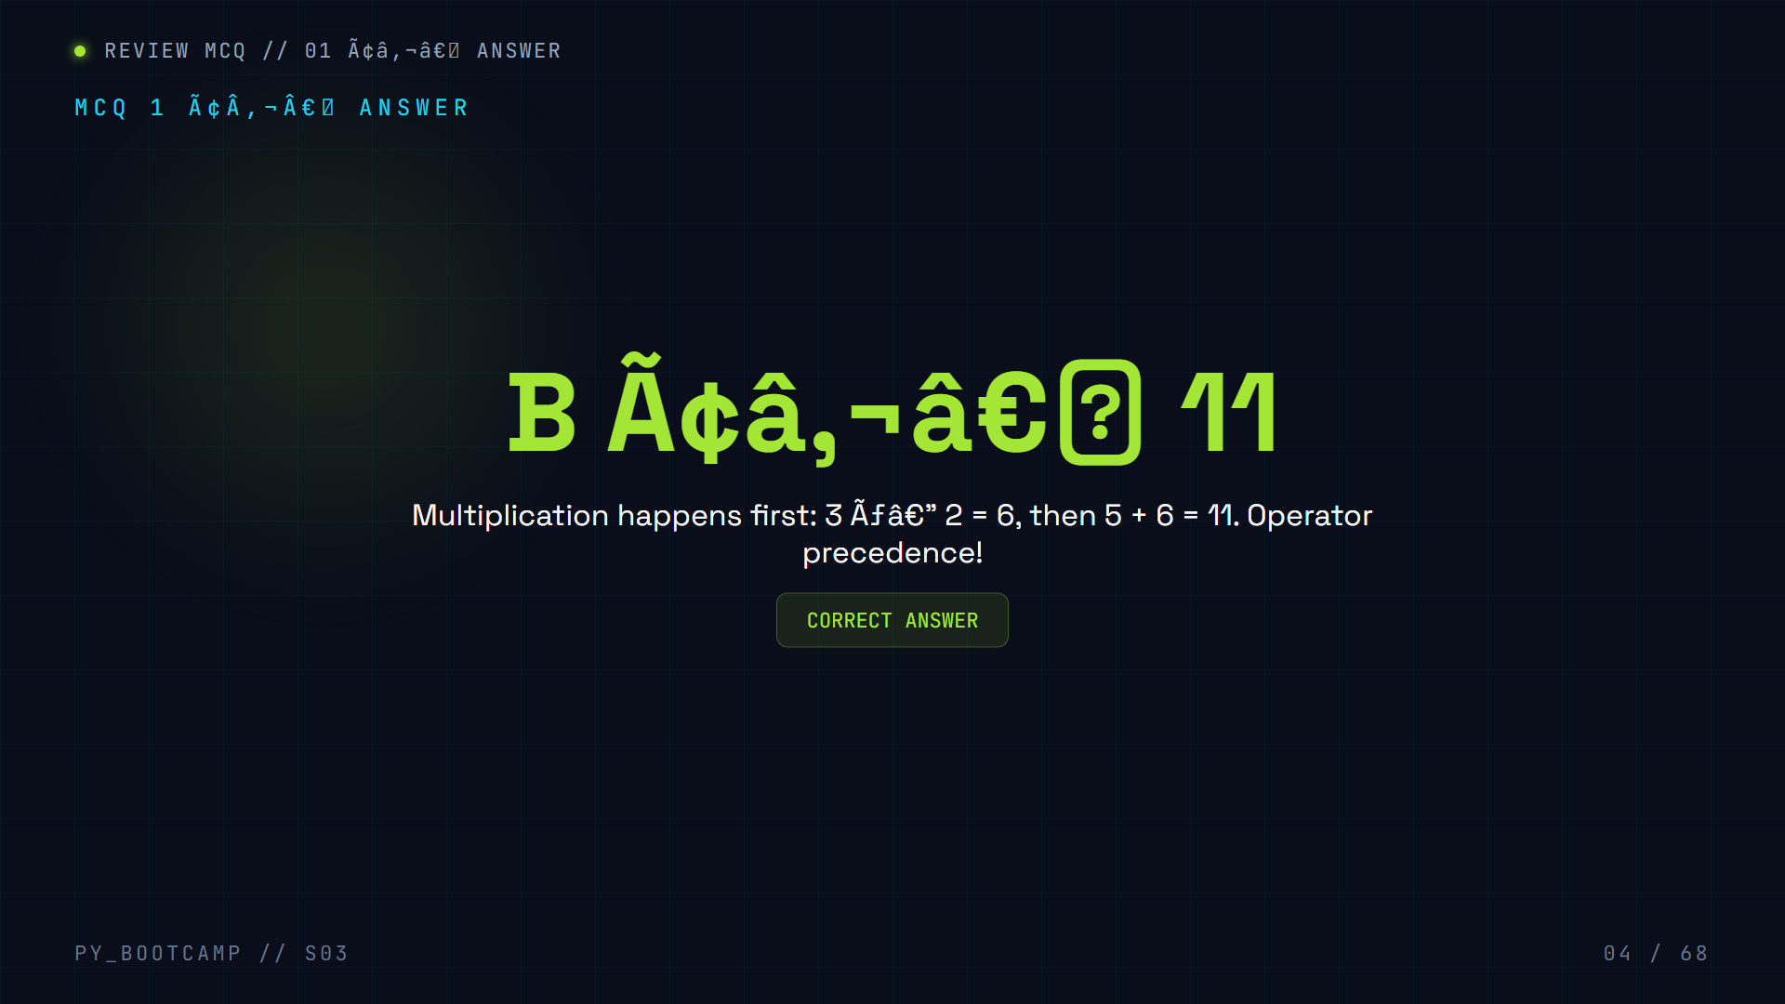

Slide 5
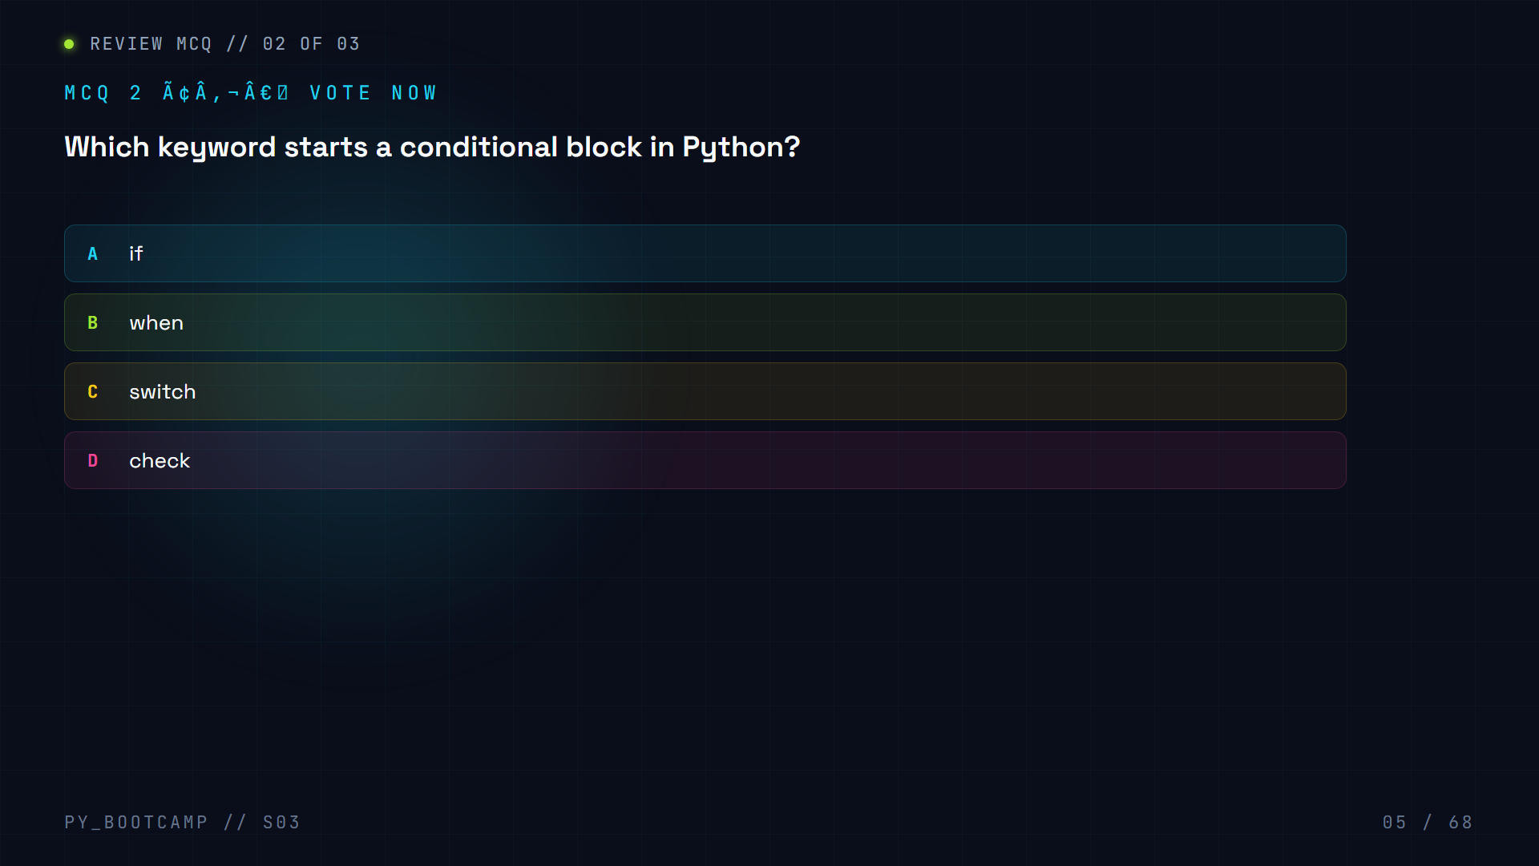

Slide 6
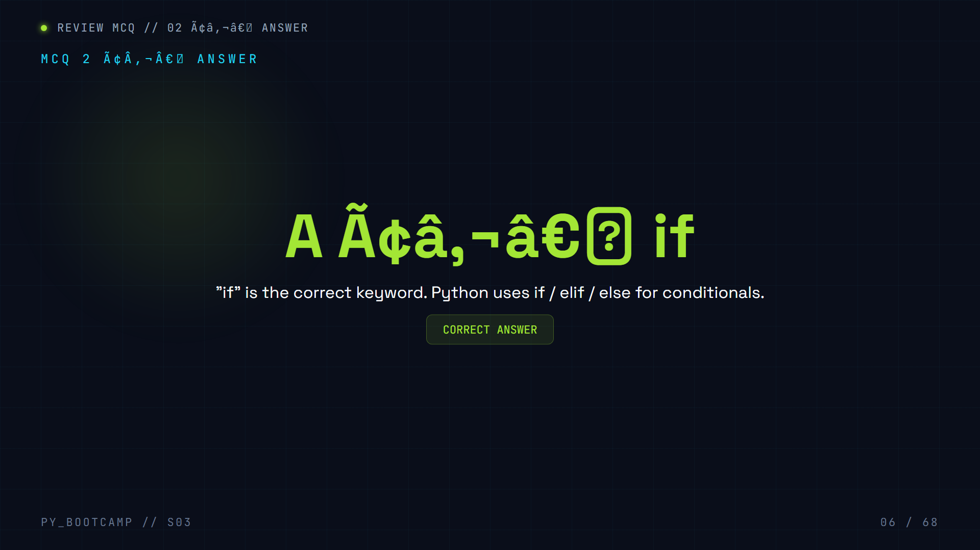

Slide 7
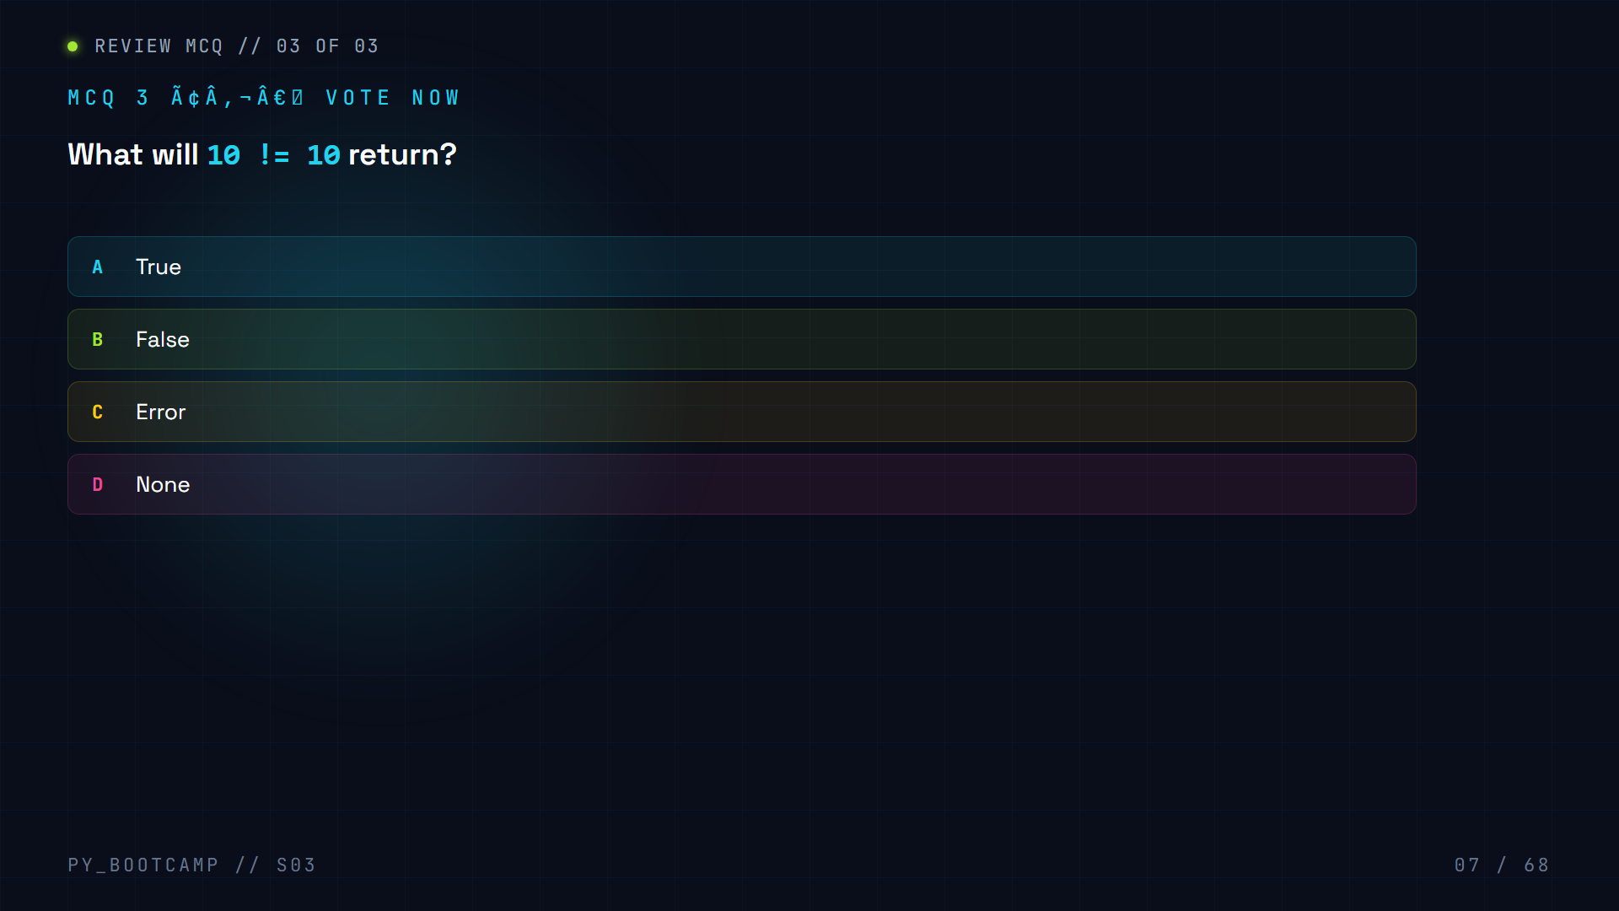

Slide 8
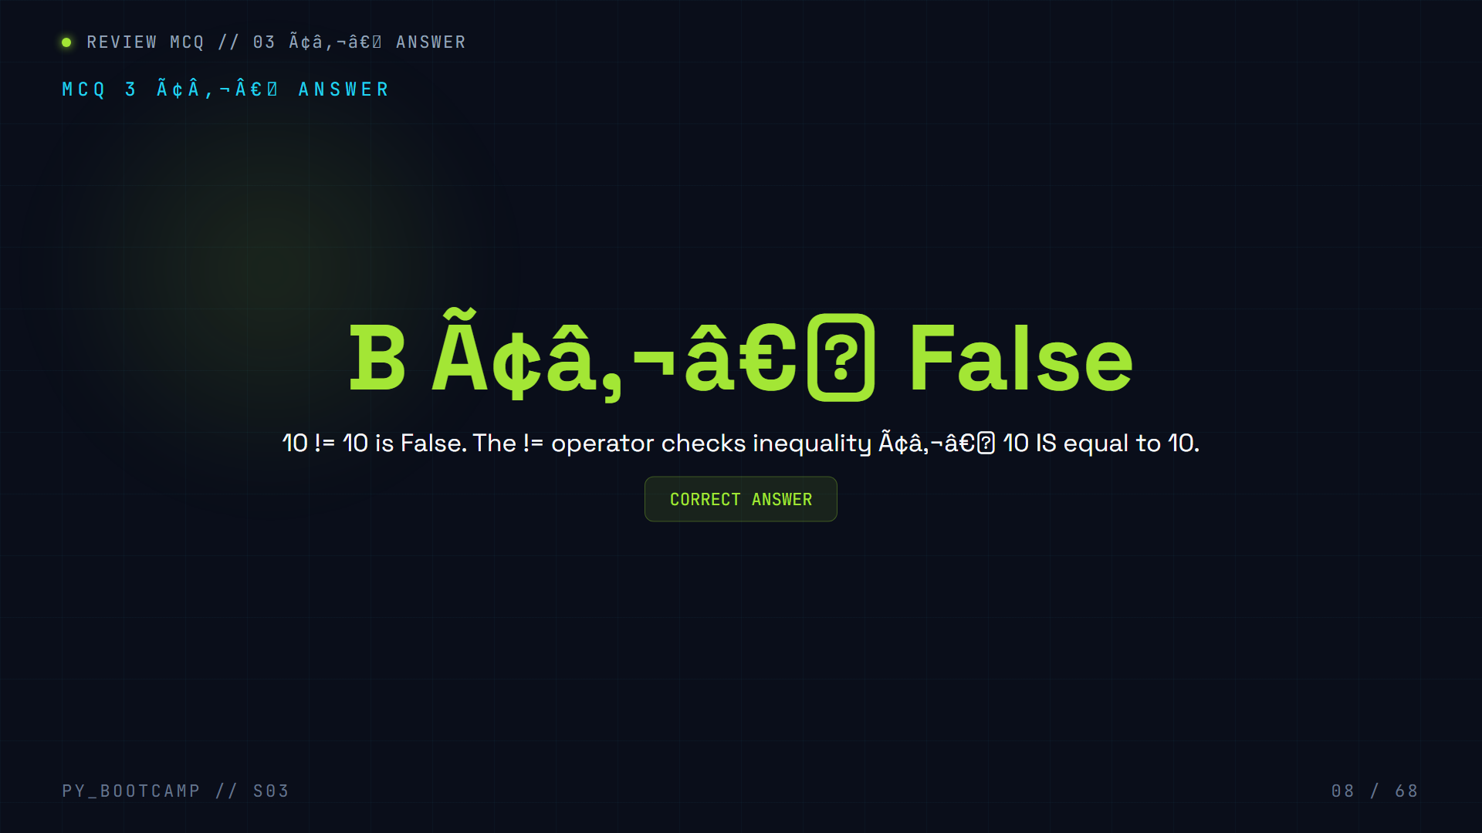

Slide 9

Notes:
Walk through the session timeline.

Slide 10


Slide 11
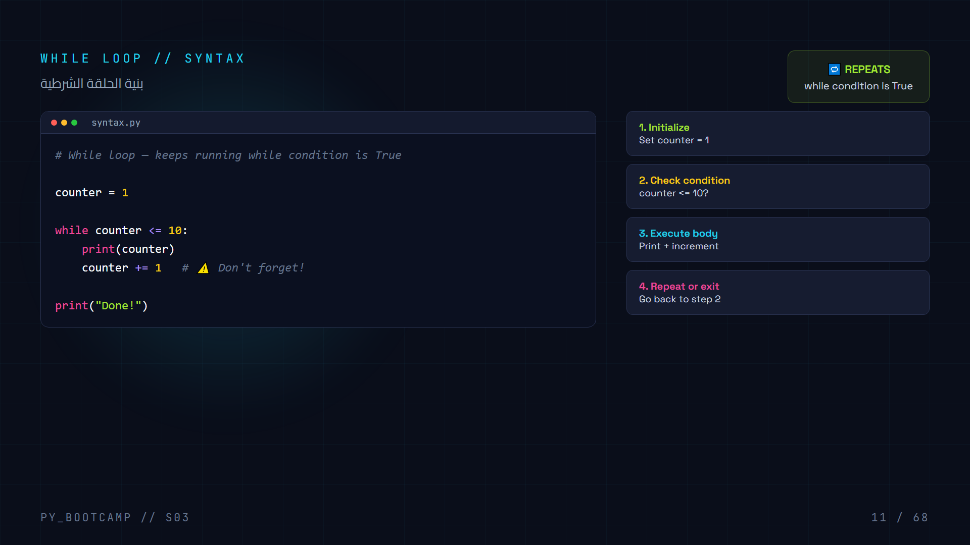
Notes:
Teach while loop syntax. Emphasize updating the variable.

Slide 12
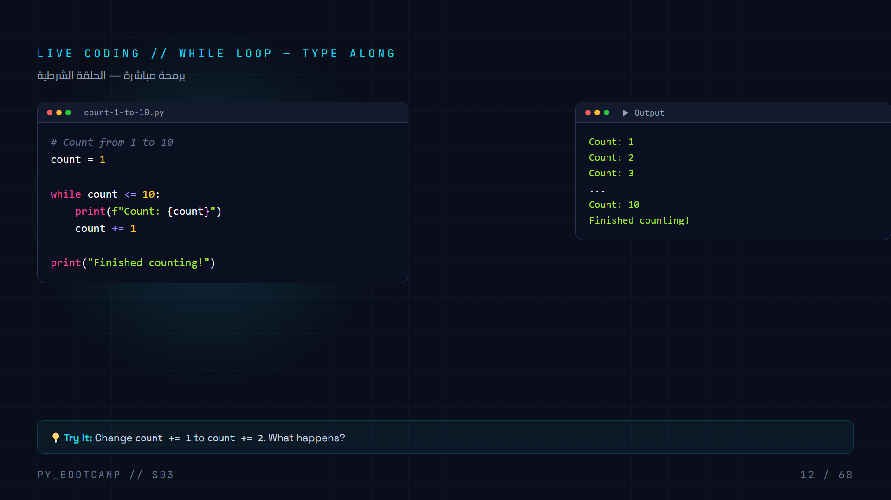
Notes:
Students type along. Counting 1 to 10.

Slide 13
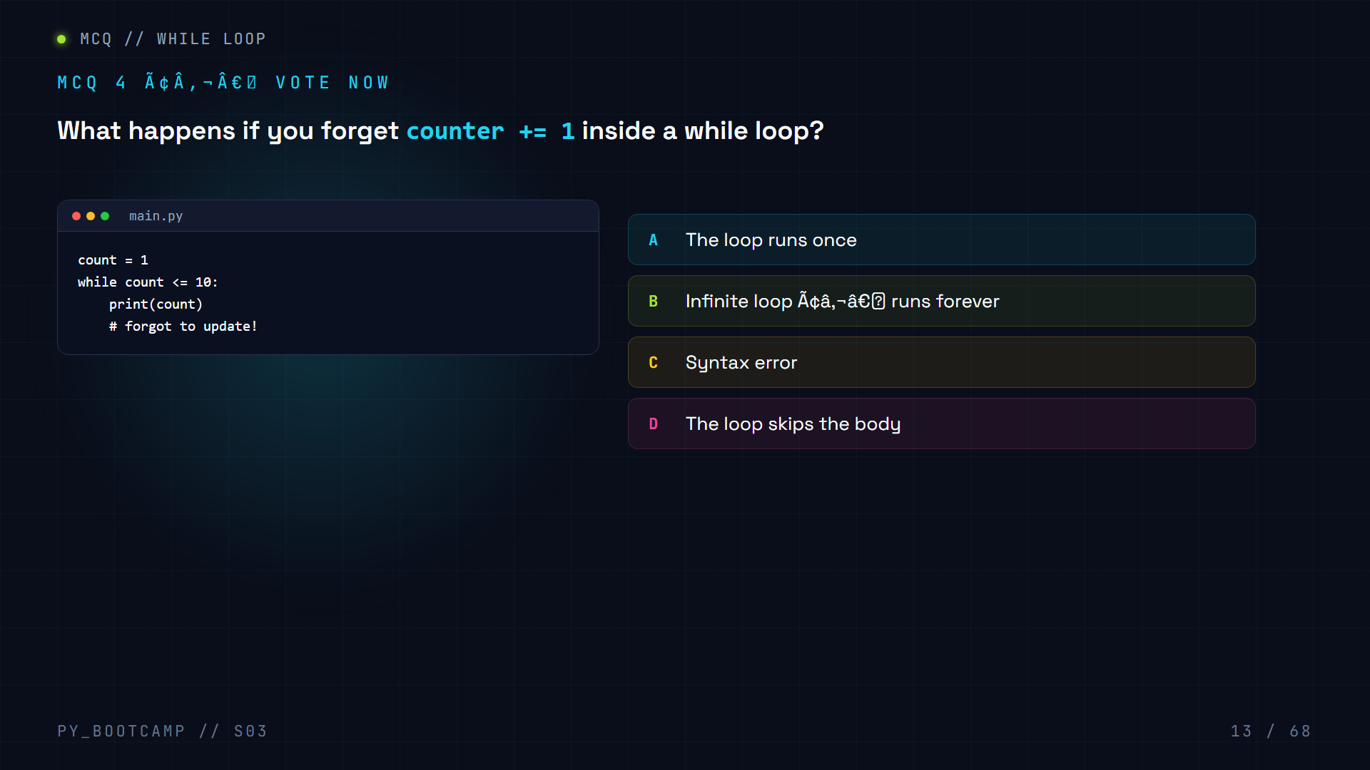

Slide 14


Slide 15
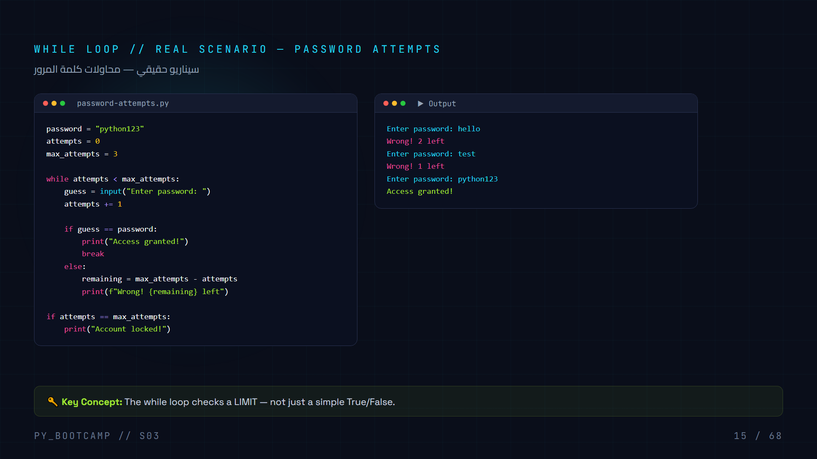
Notes:
Password attempt limiter. Shows while + if/else + break.

Slide 16
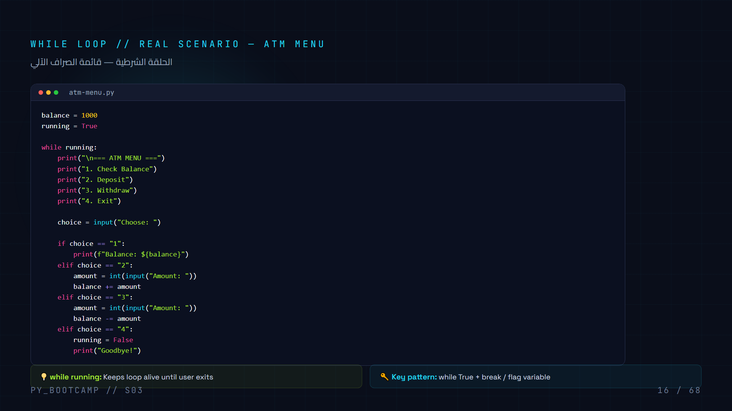
Notes:
ATM menu — classic while-loop use case.

Slide 17
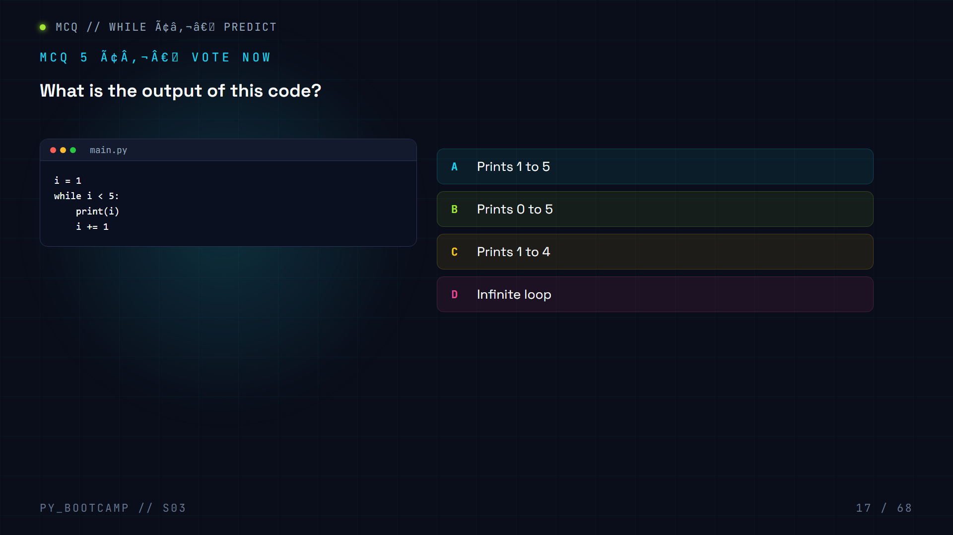

Slide 18
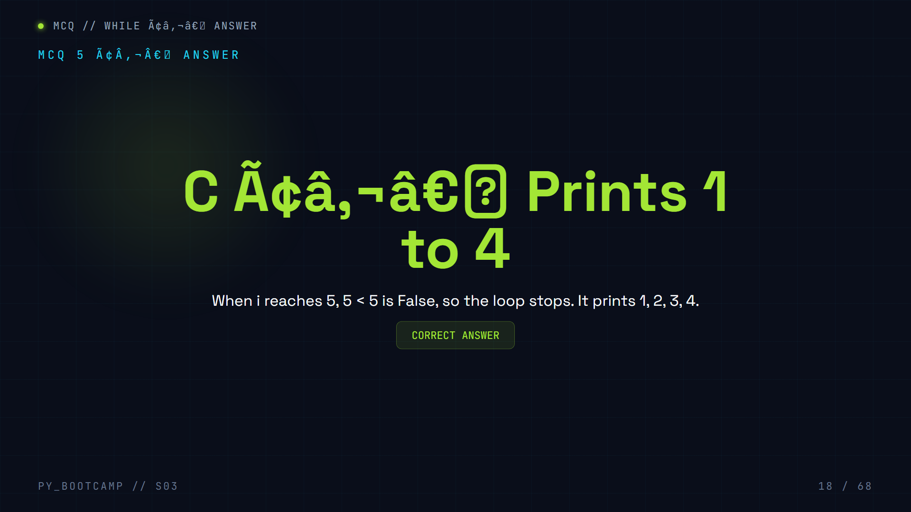

Slide 19
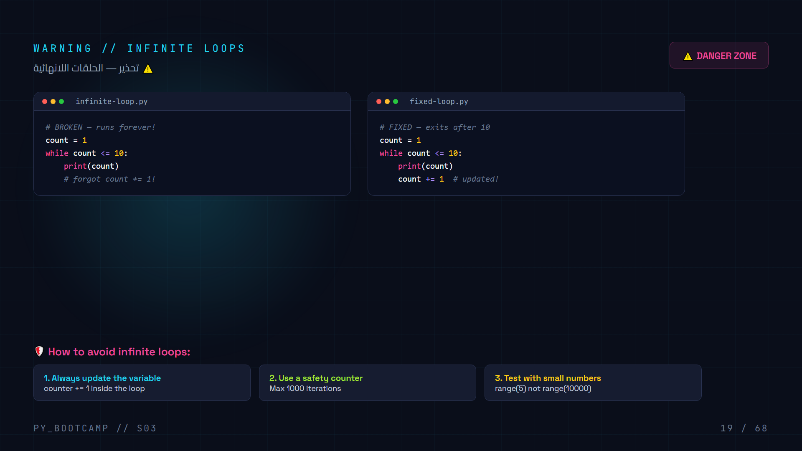
Notes:
Teach infinite loop dangers. Give Ctrl+C tip.

Slide 20


Slide 21
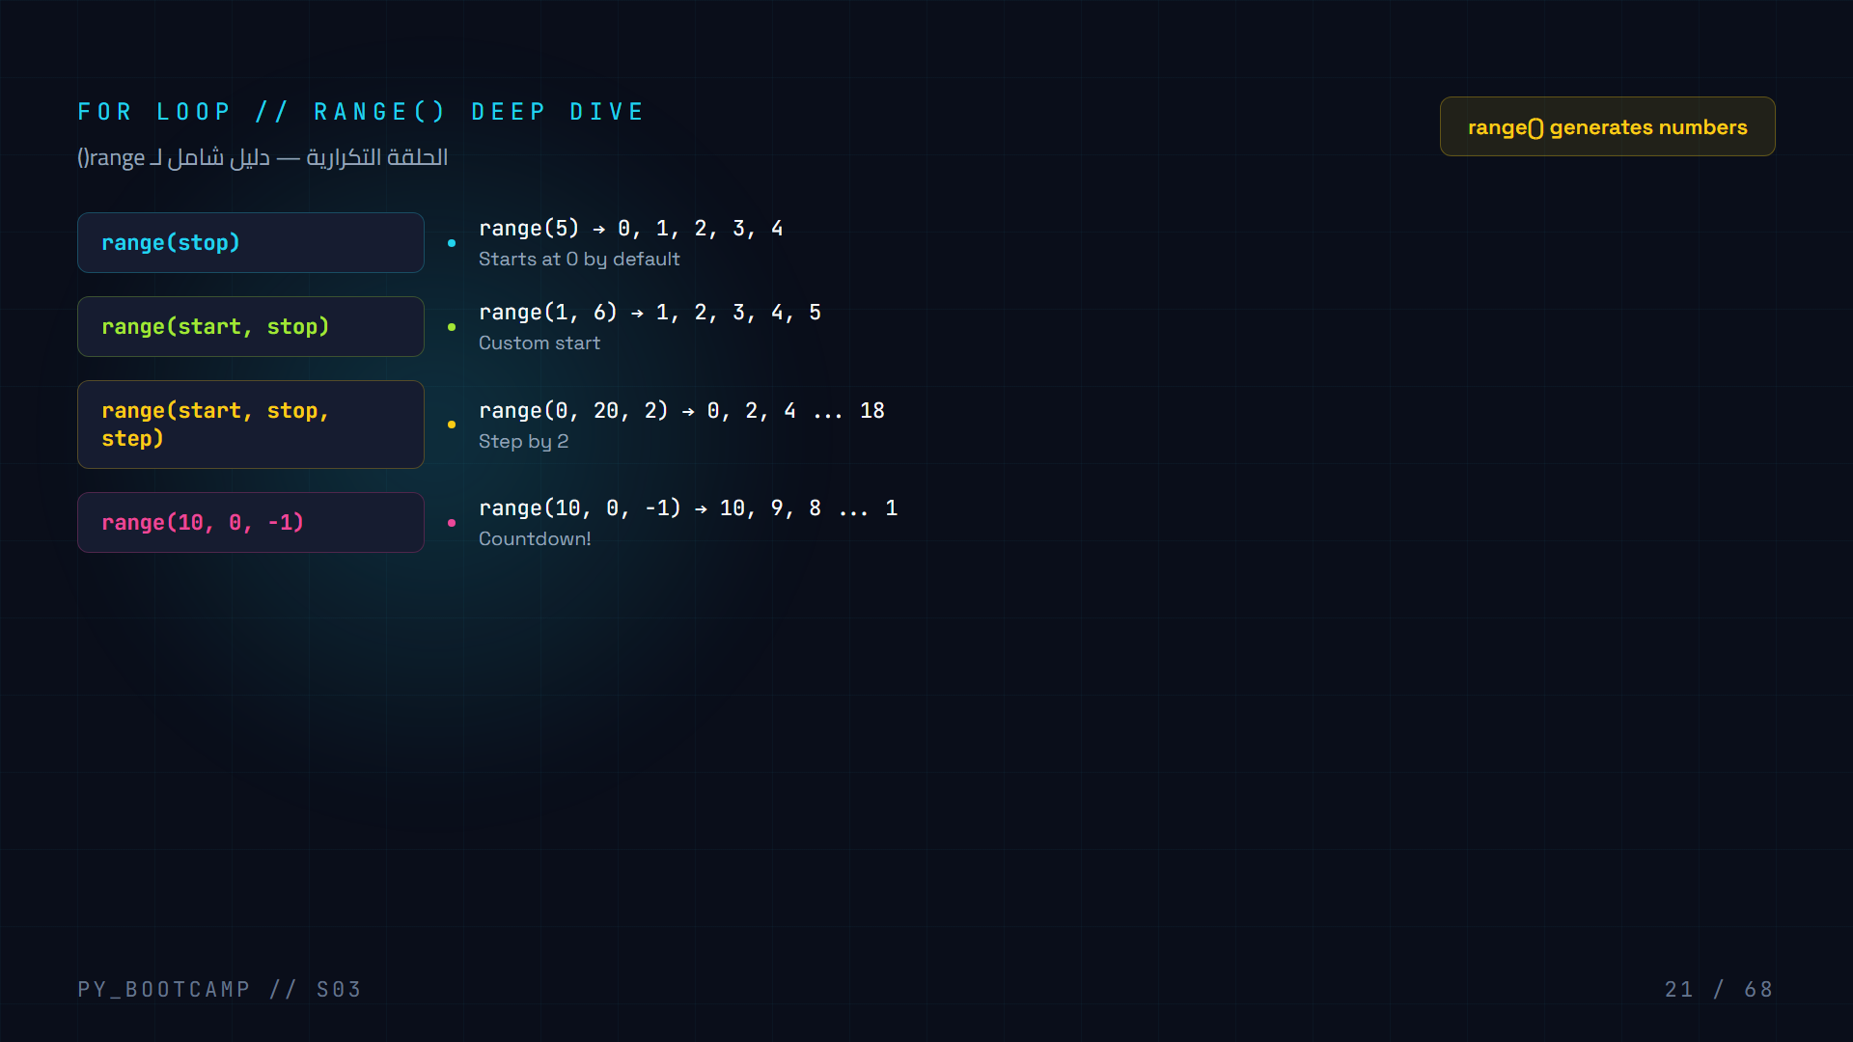
Notes:
Deep dive into range(). Show all 4 variations.

Slide 22
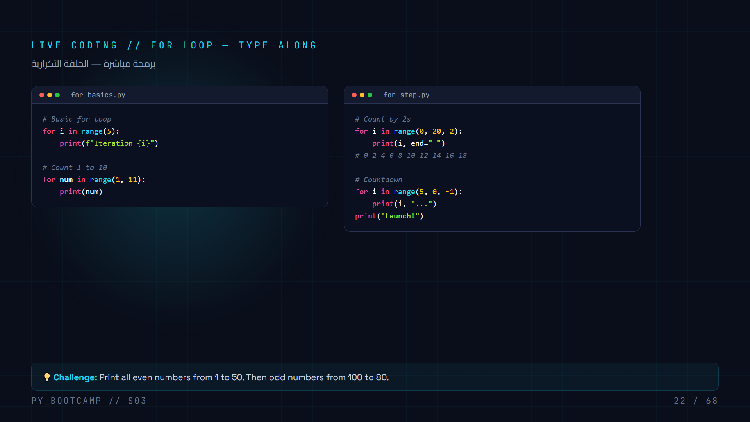
Notes:
Students type along. Basic for, counting, step, countdown.

Slide 23
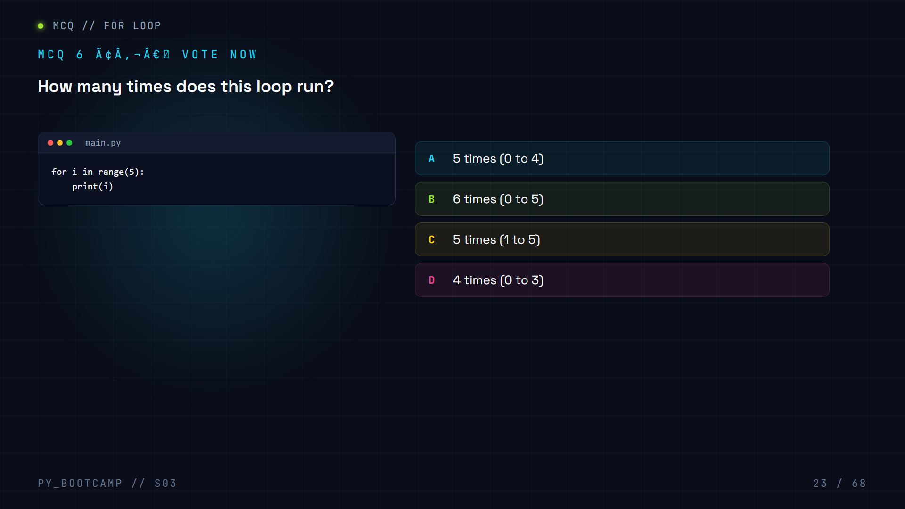

Slide 24
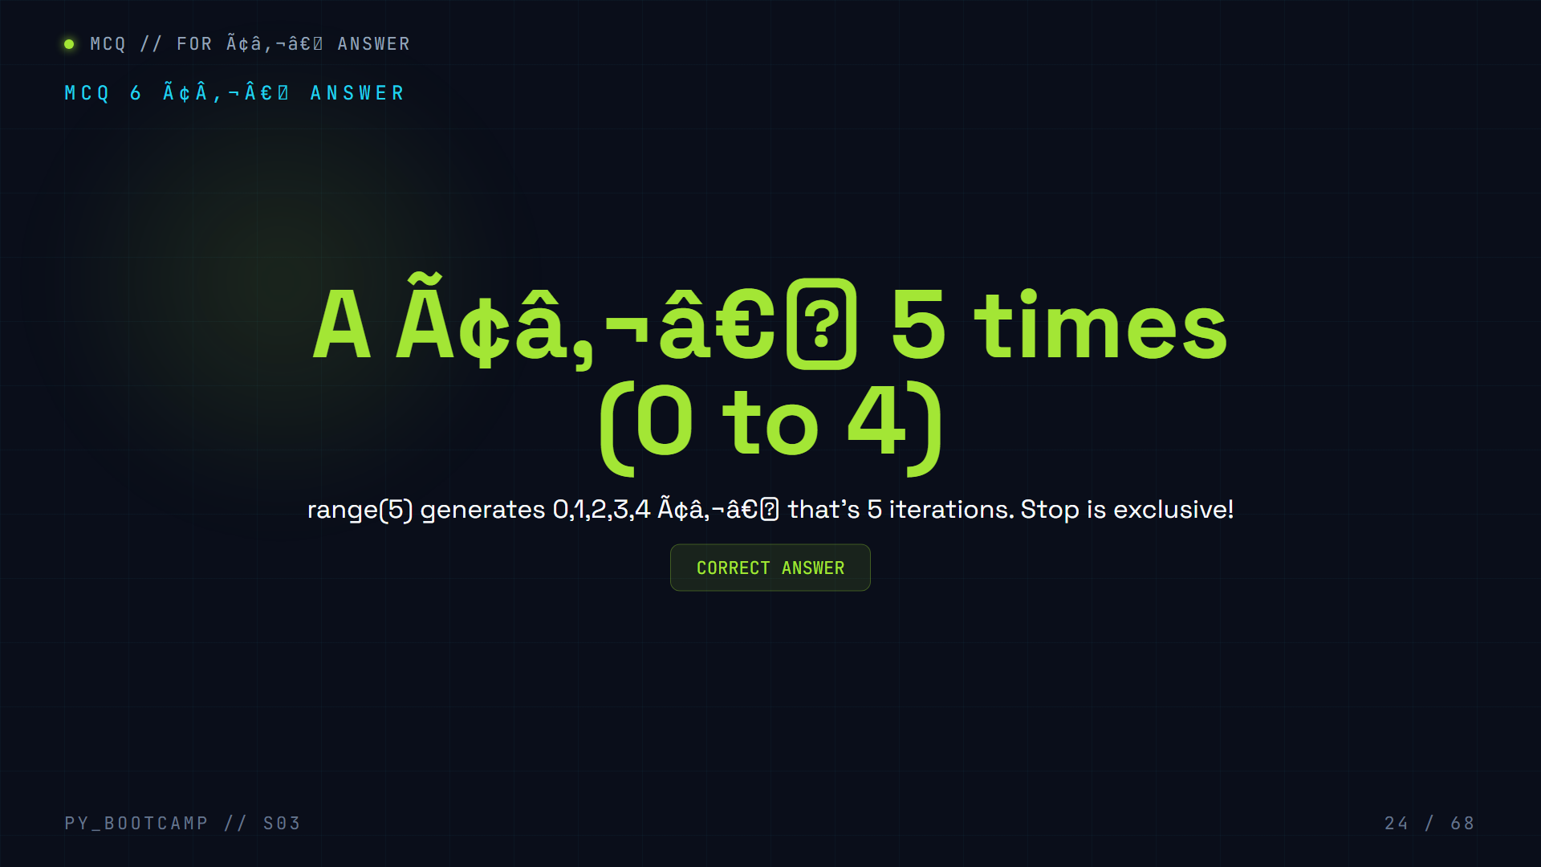

Slide 25
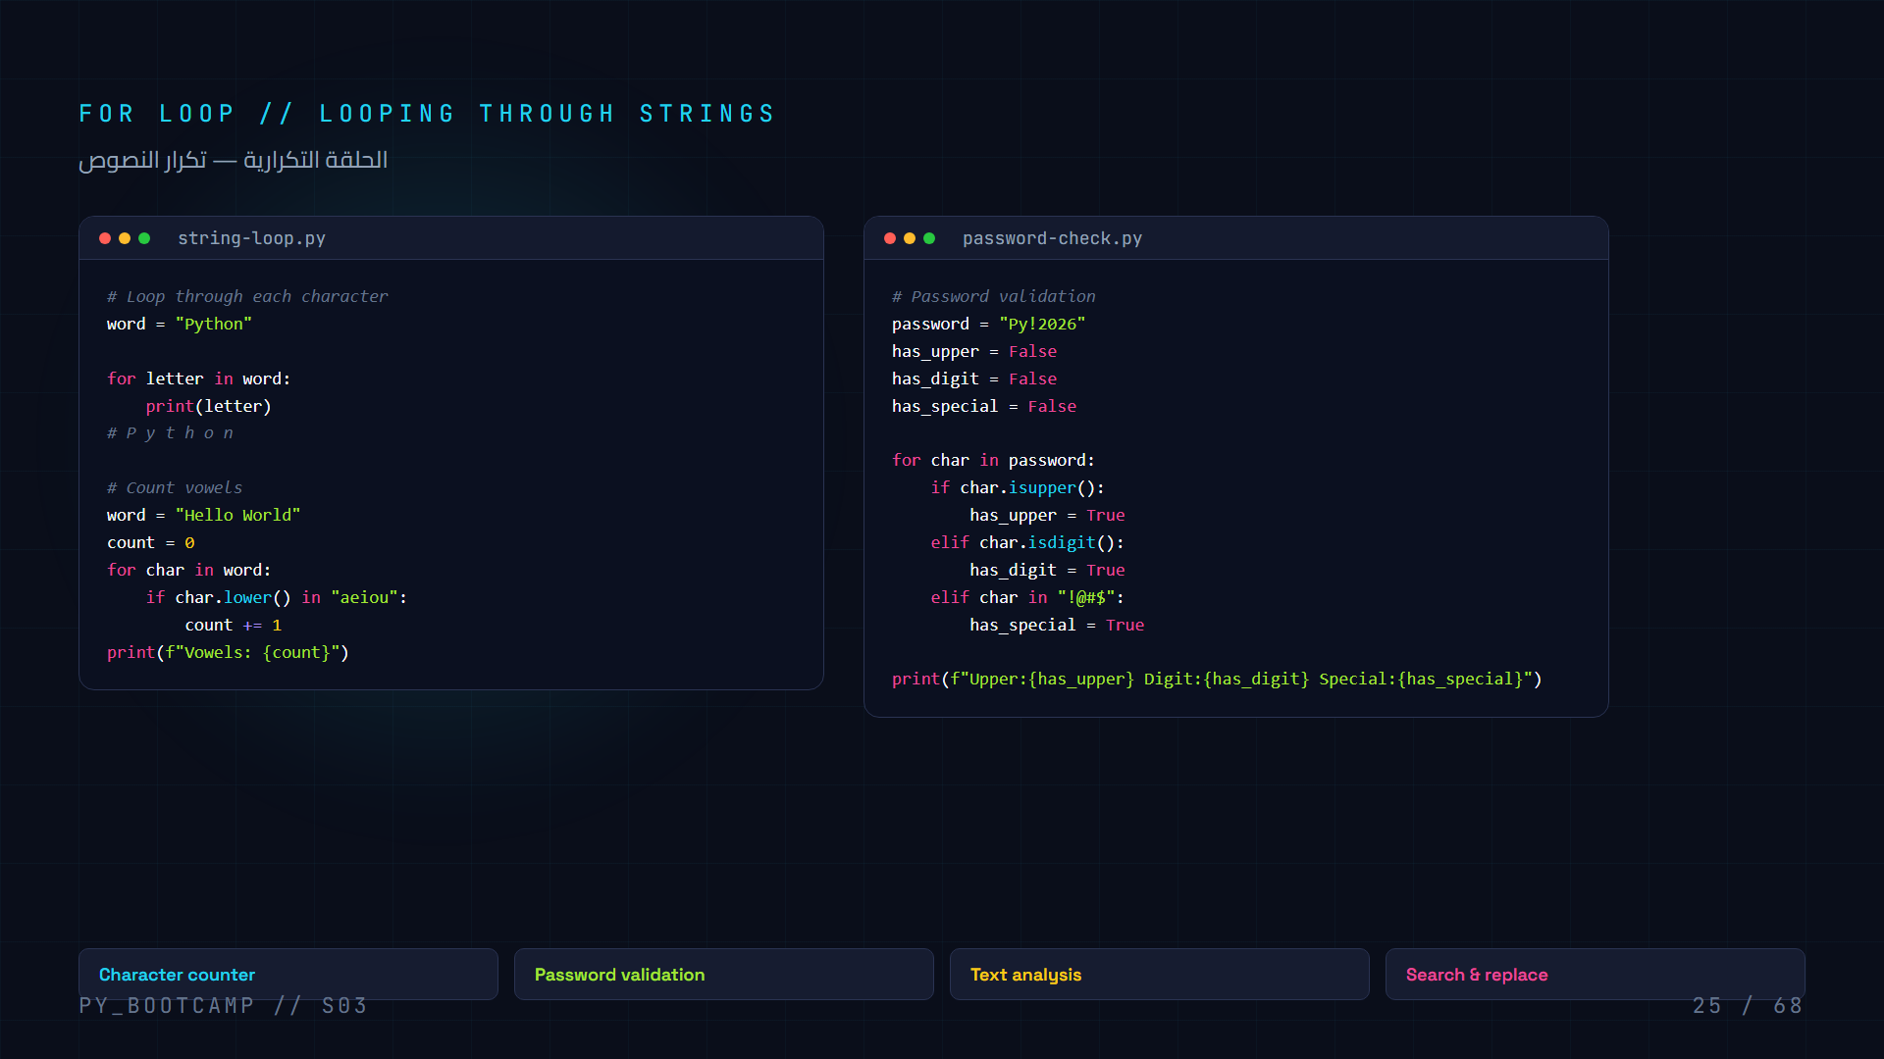
Notes:
For loops with strings. Vowel counter and password validation.

Slide 26
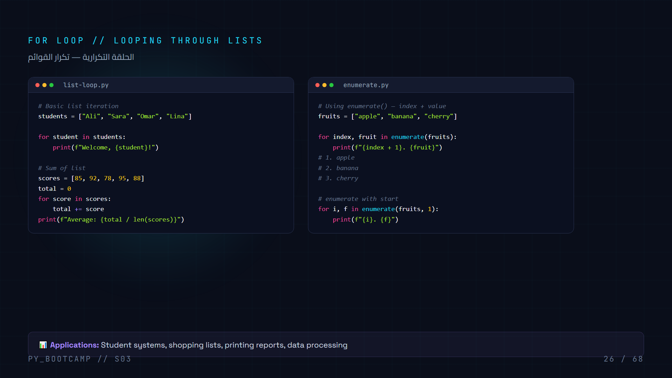
Notes:
List iteration + enumerate(). Show sum, average, numbered list.

Slide 27
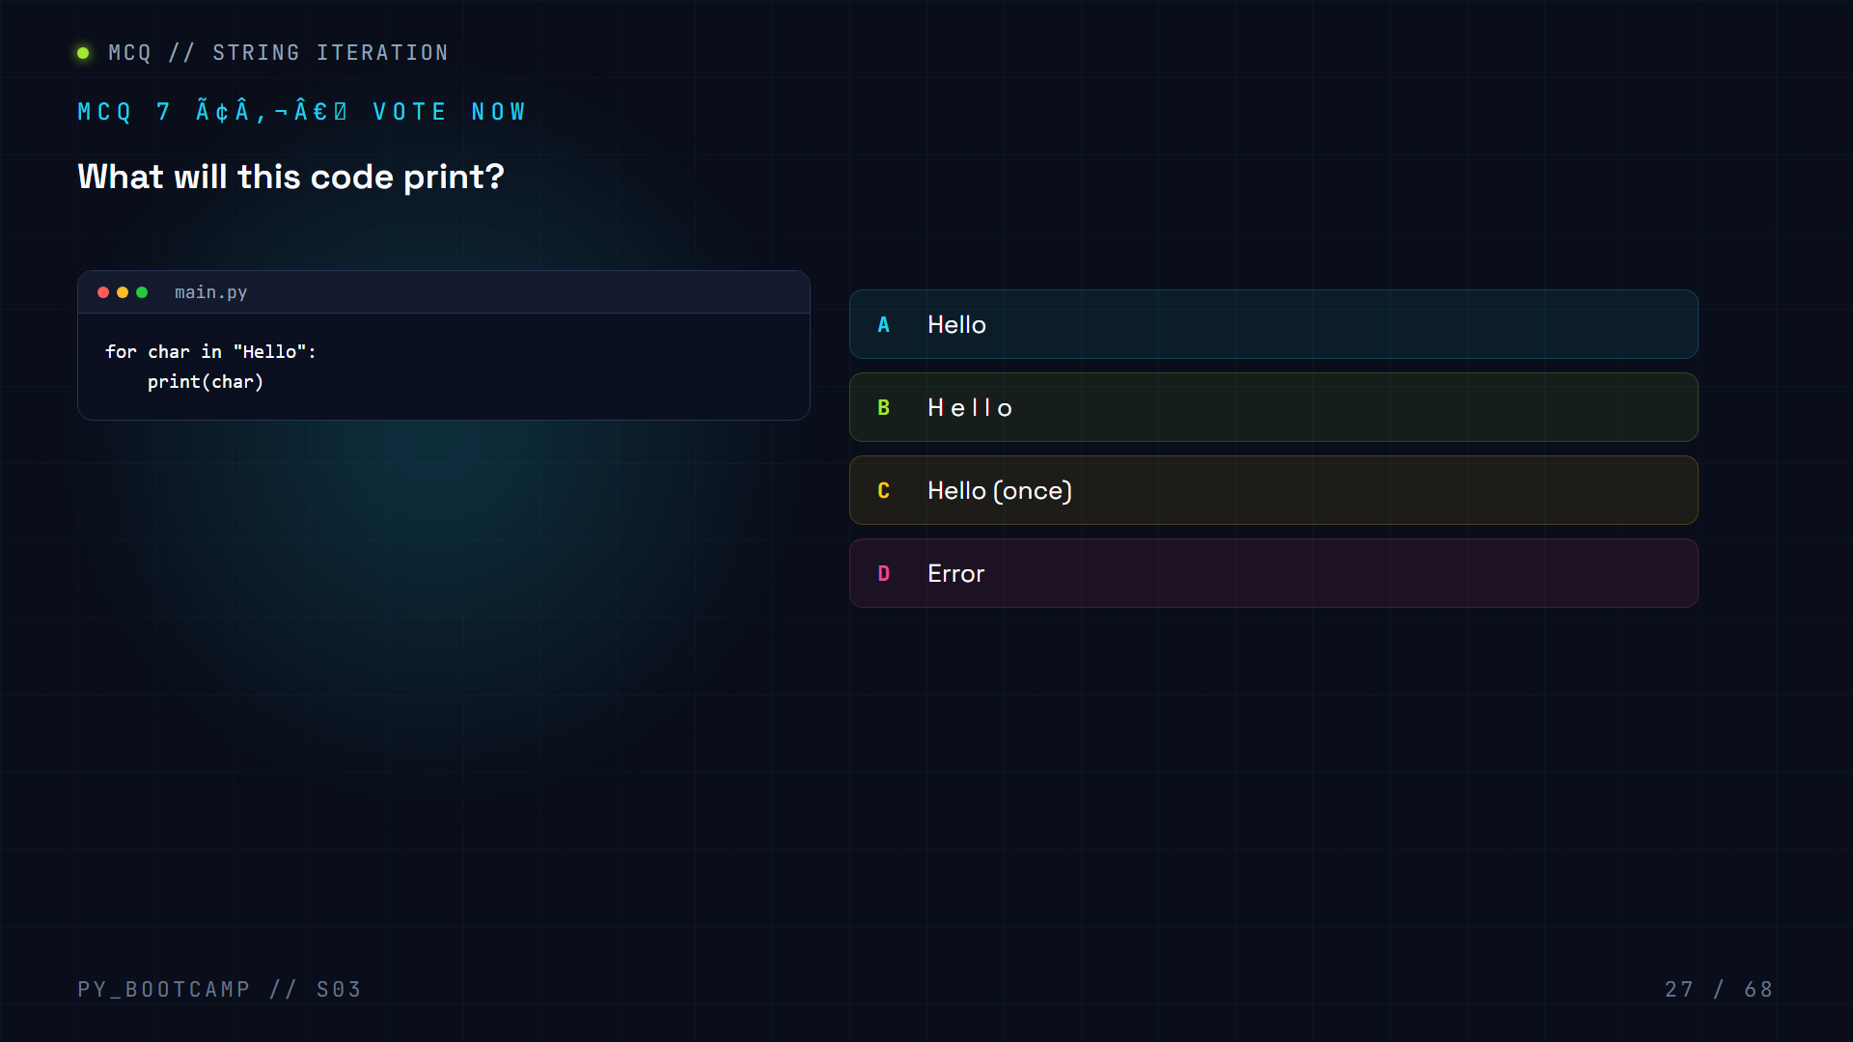

Slide 28
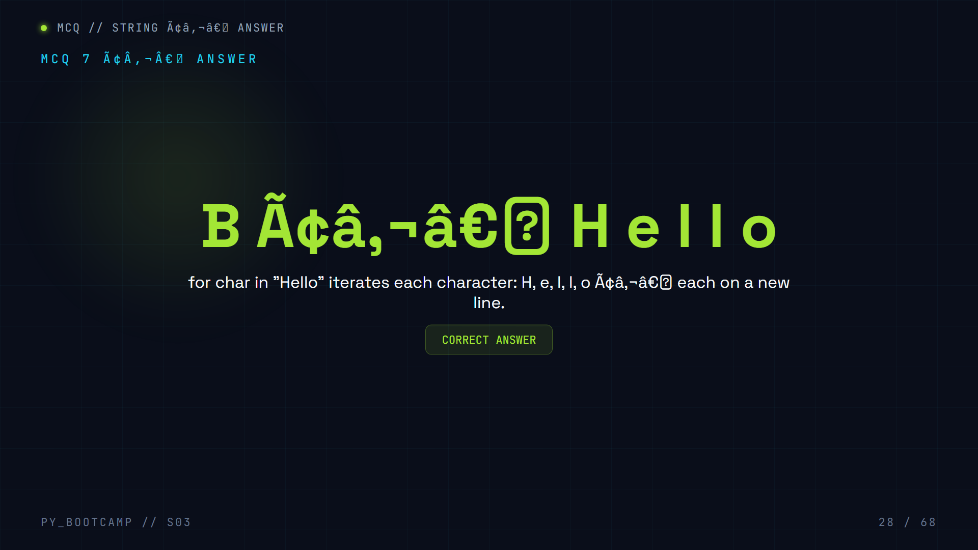

Slide 29
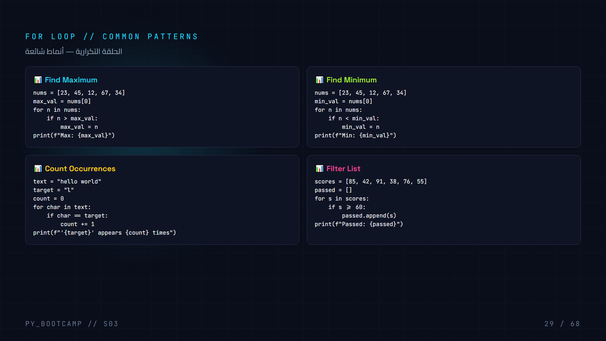
Notes:
Four common patterns: max, min, count, filter.

Slide 30
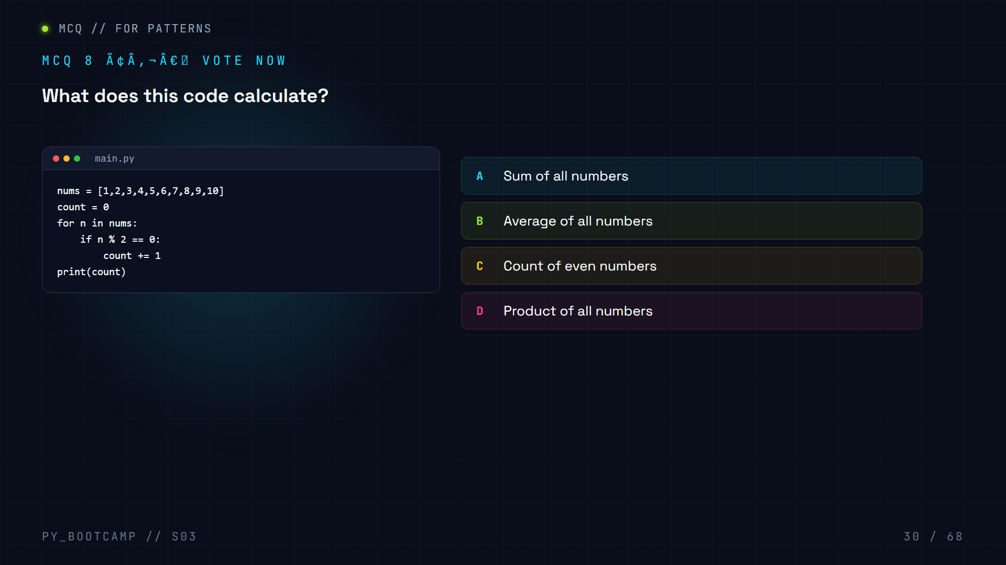

Slide 31
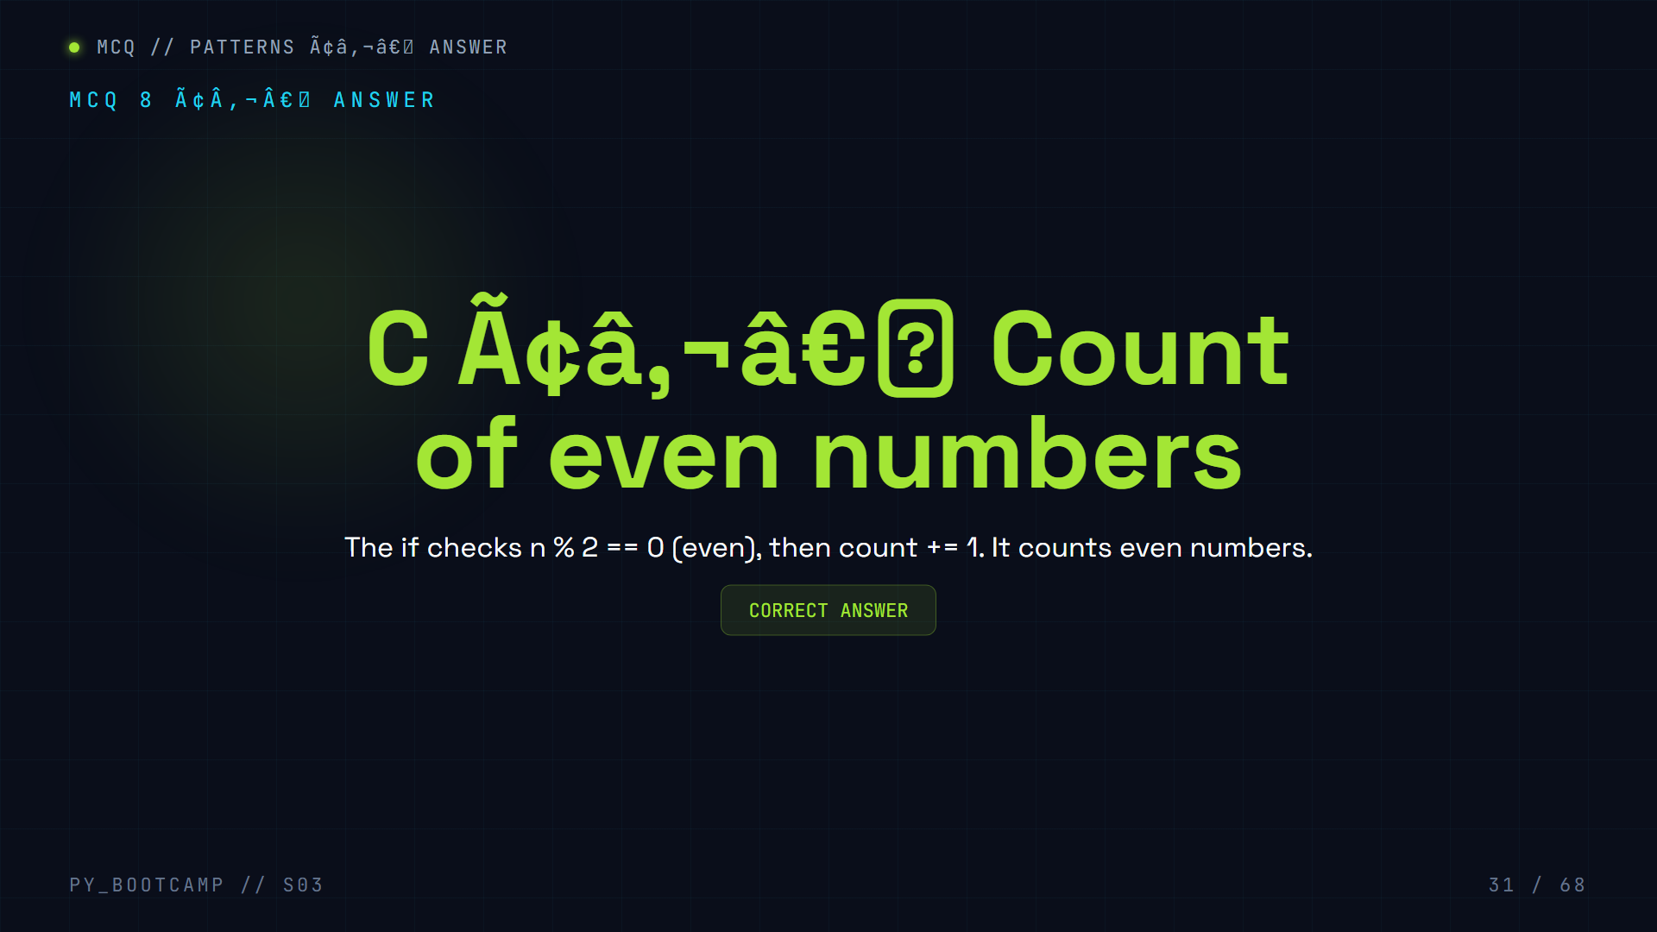

Slide 32
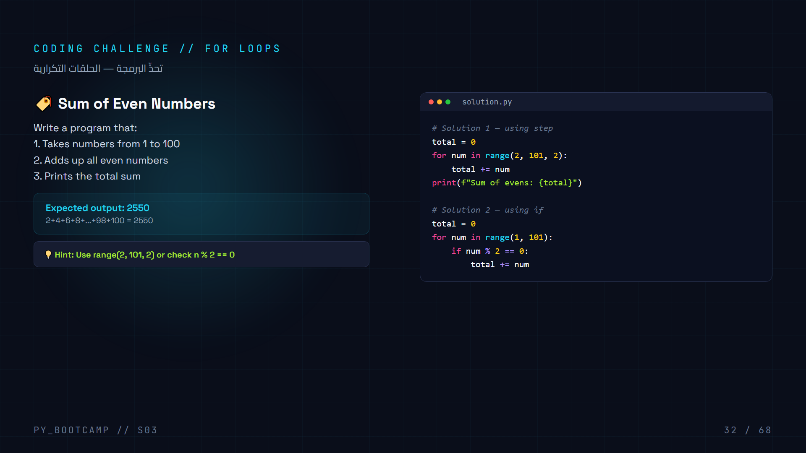
Notes:
Challenge: Sum of even numbers. Two approaches.

Slide 33

Notes:
Mid-session break.

Slide 34


Slide 35
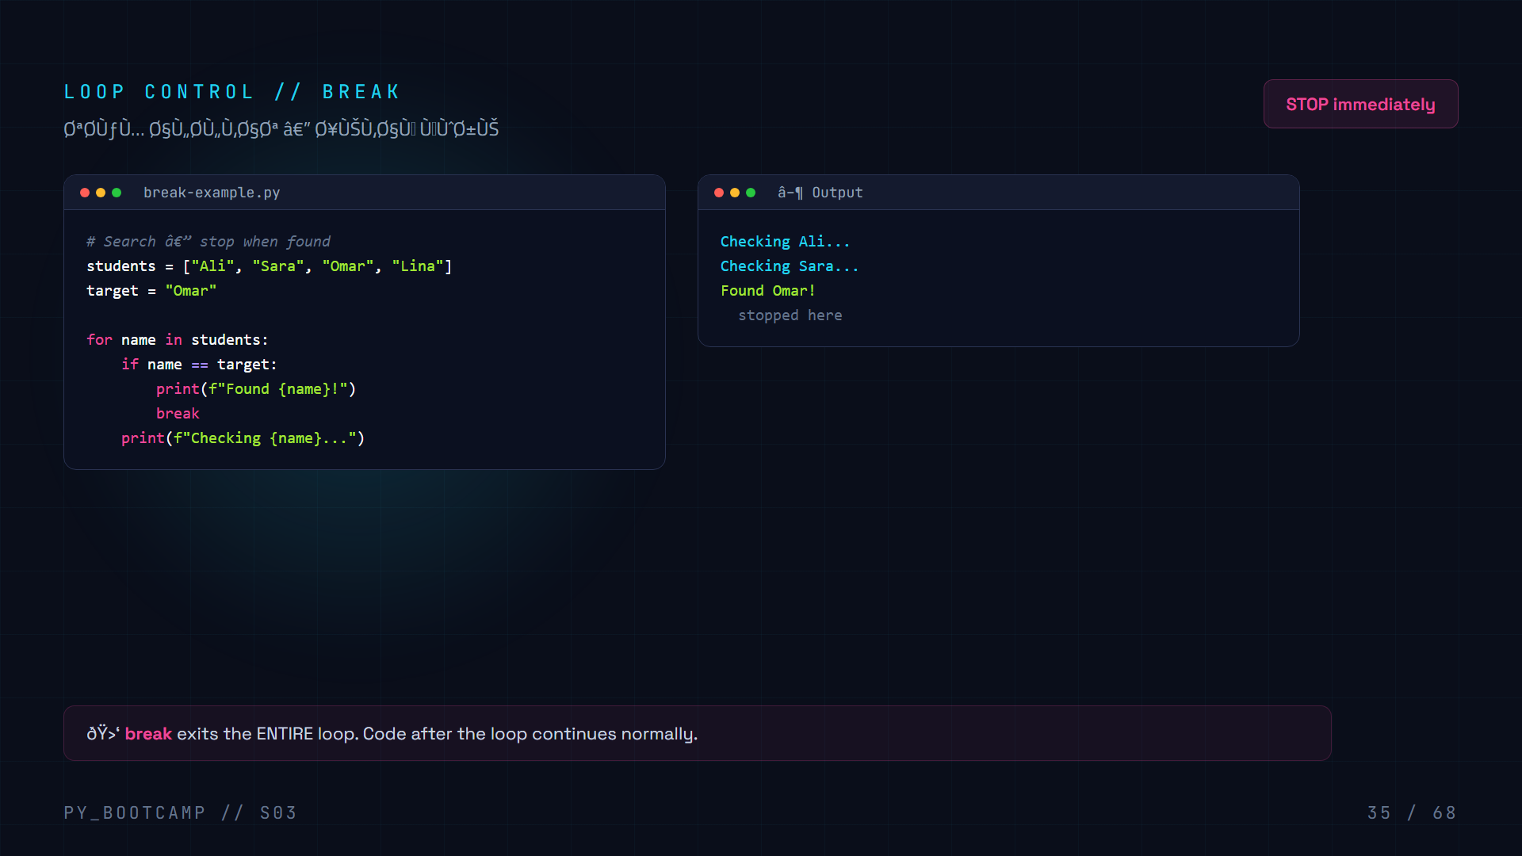
Notes:
Teach break with search example.

Slide 36
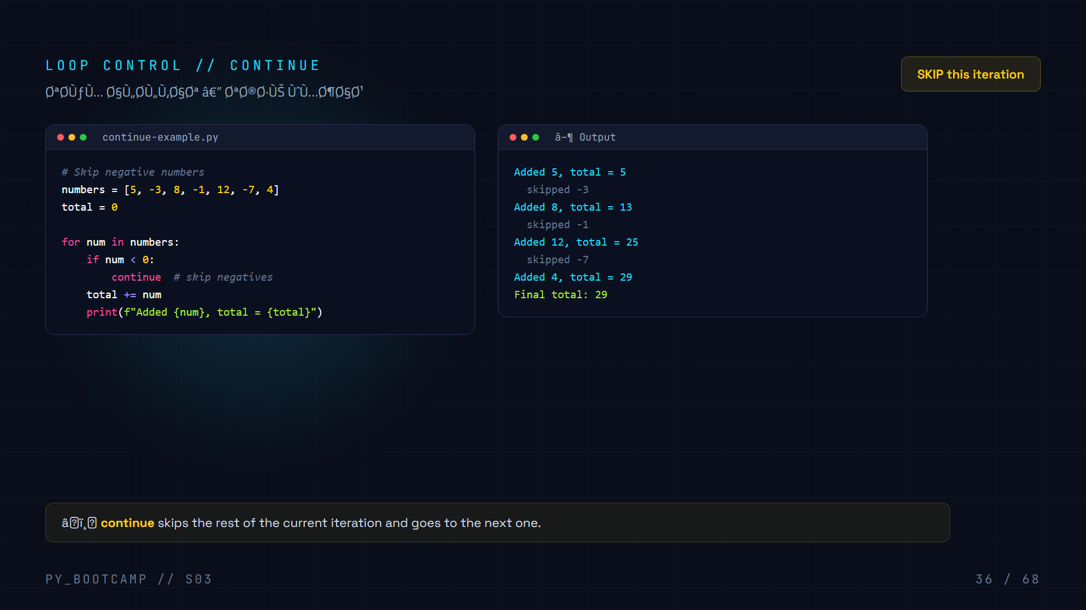
Notes:
Teach continue. Show how it skips but doesn't exit.

Slide 37
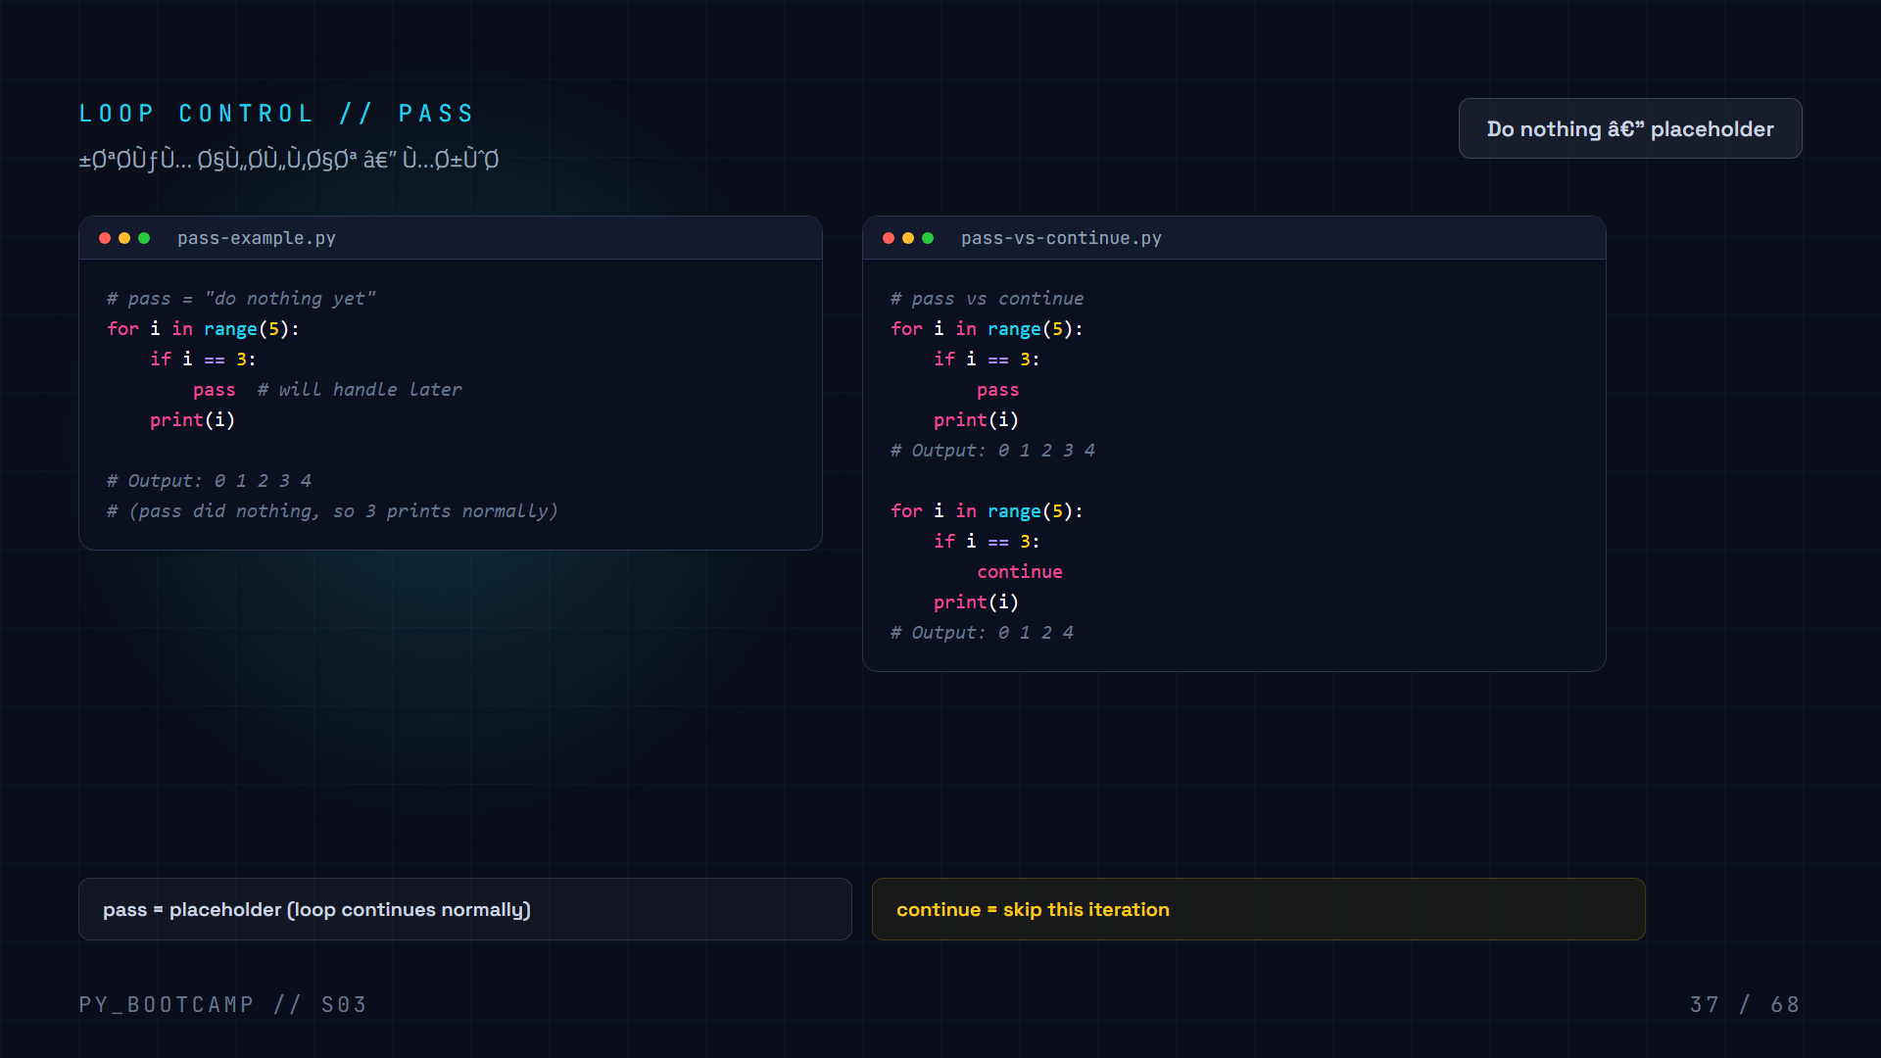
Notes:
Teach pass. Compare pass vs continue.

Slide 38
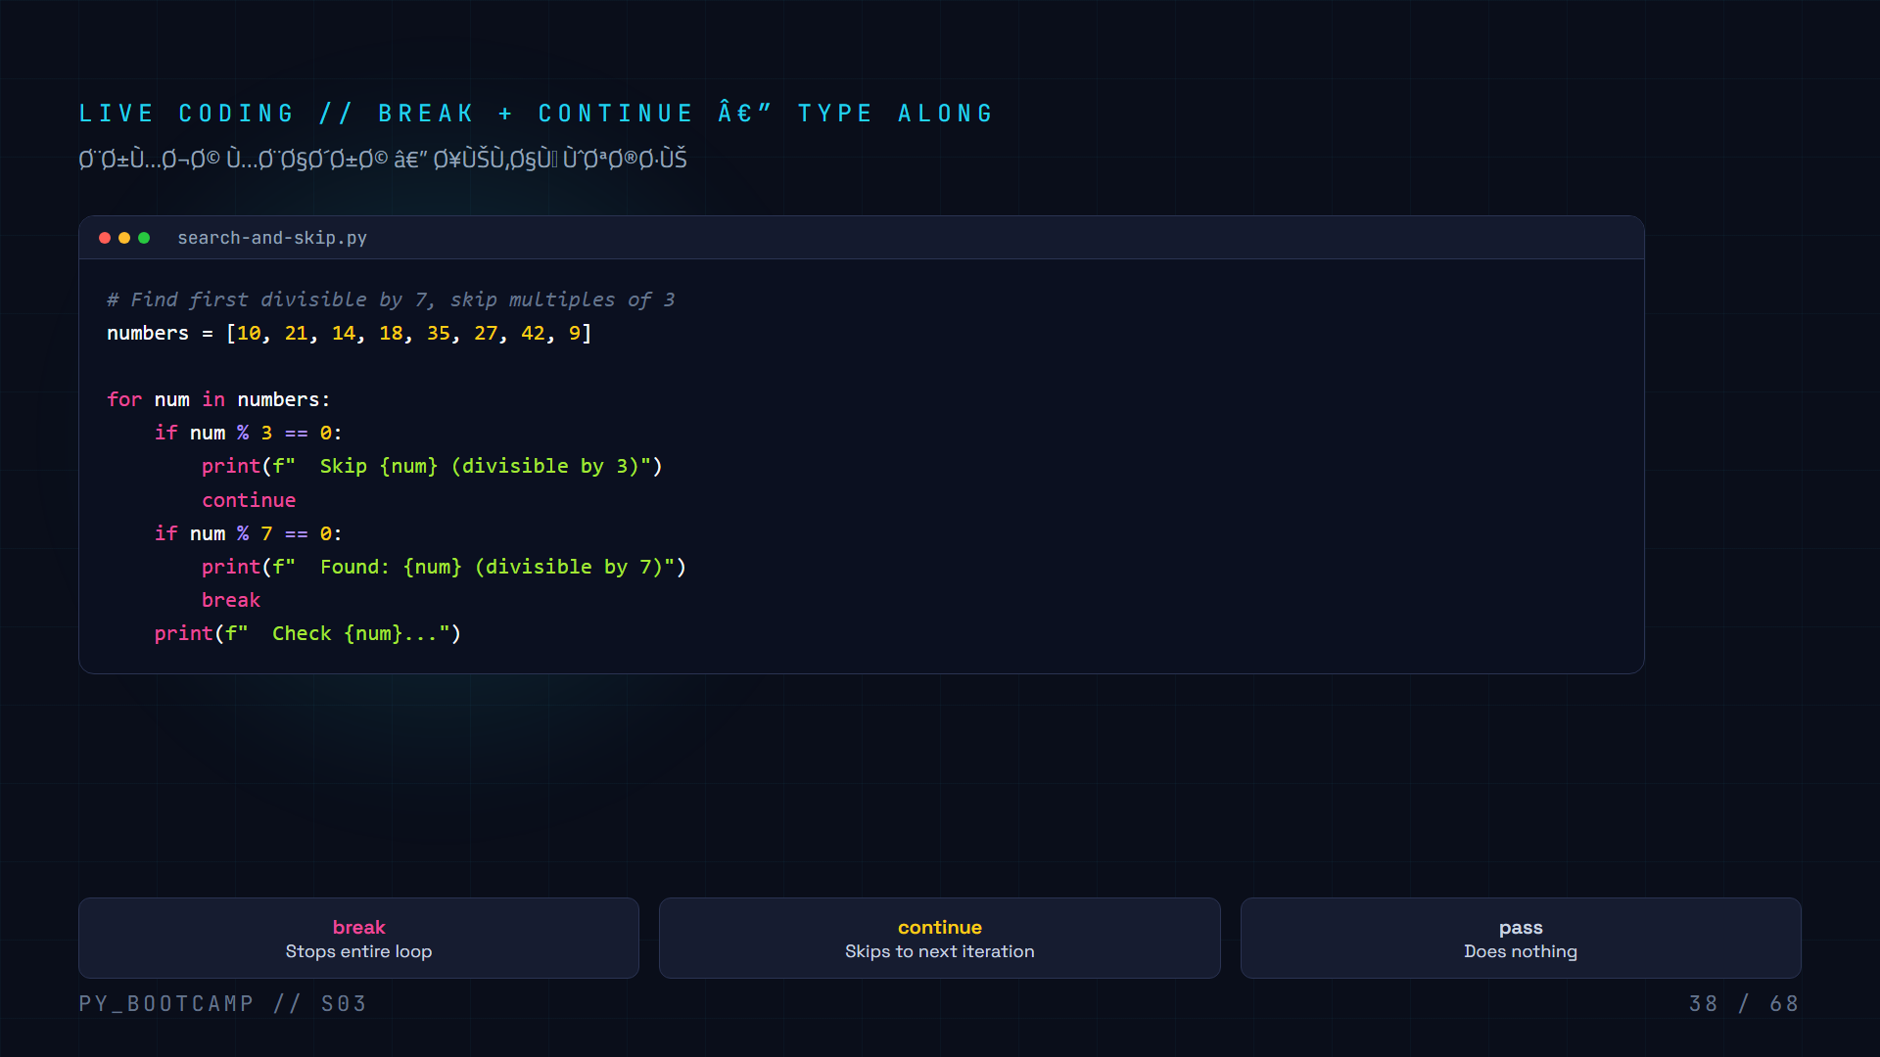
Notes:
Live coding combining break and continue.

Slide 39
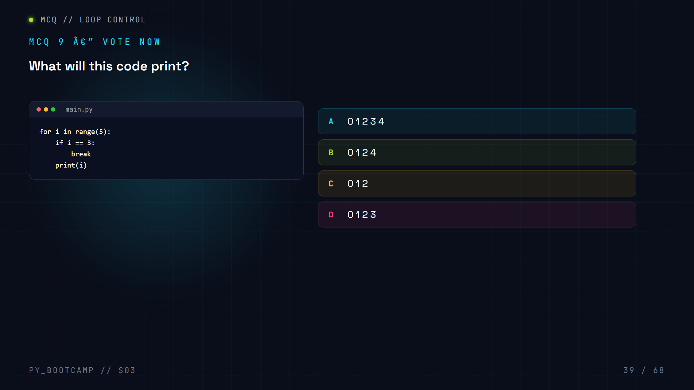

Slide 40
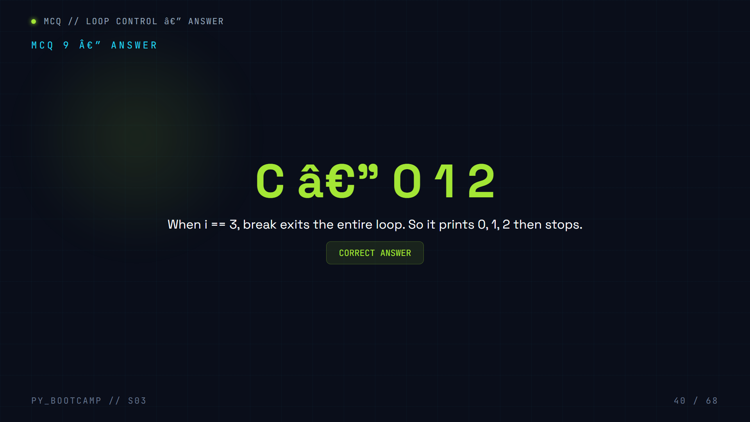

Slide 41


Slide 42
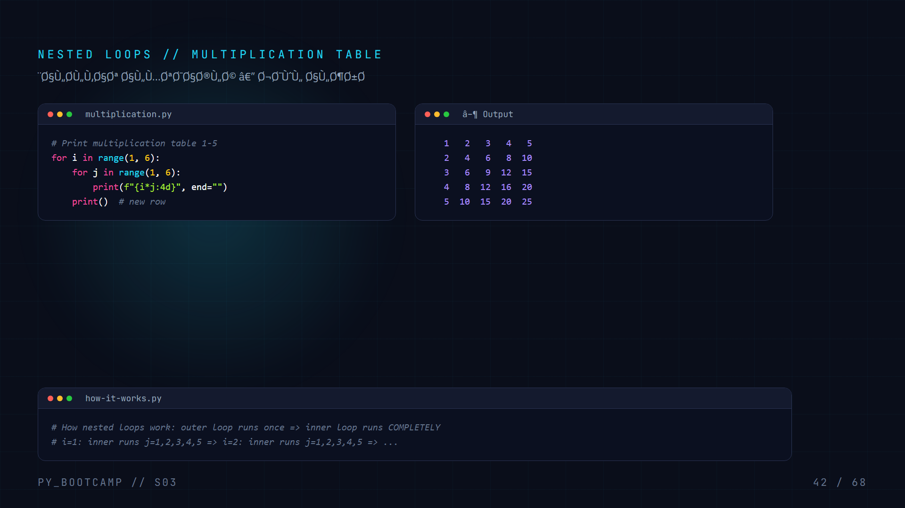
Notes:
Teach nested loops with multiplication table.

Slide 43
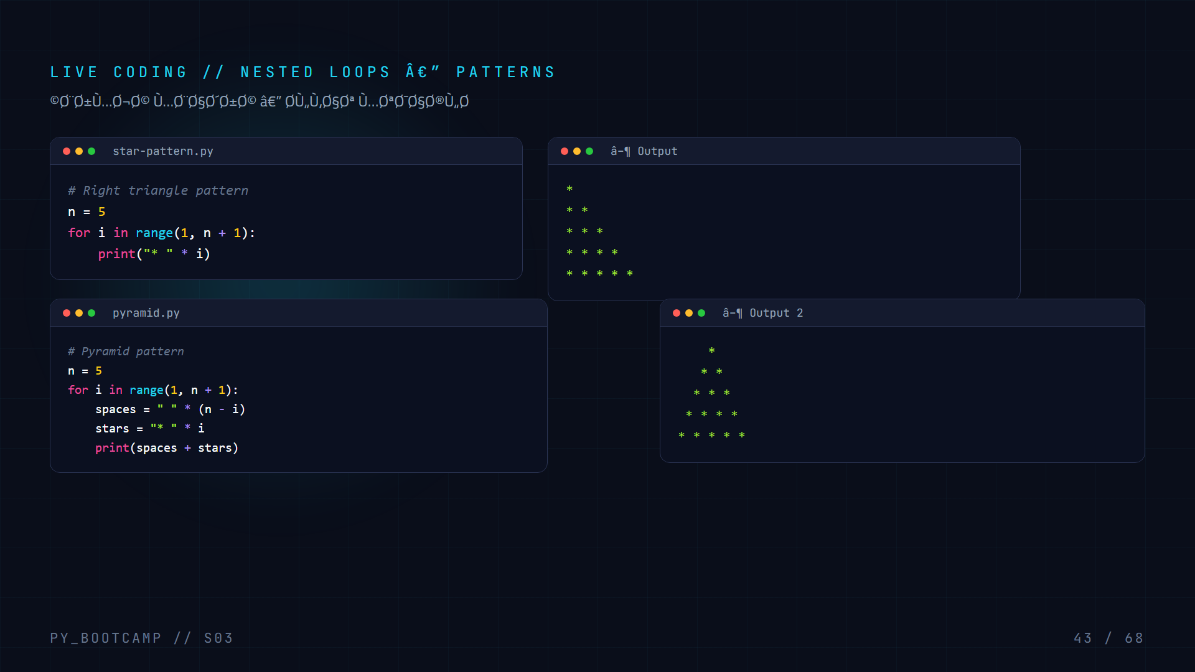
Notes:
Live coding patterns. Triangle then pyramid.

Slide 44
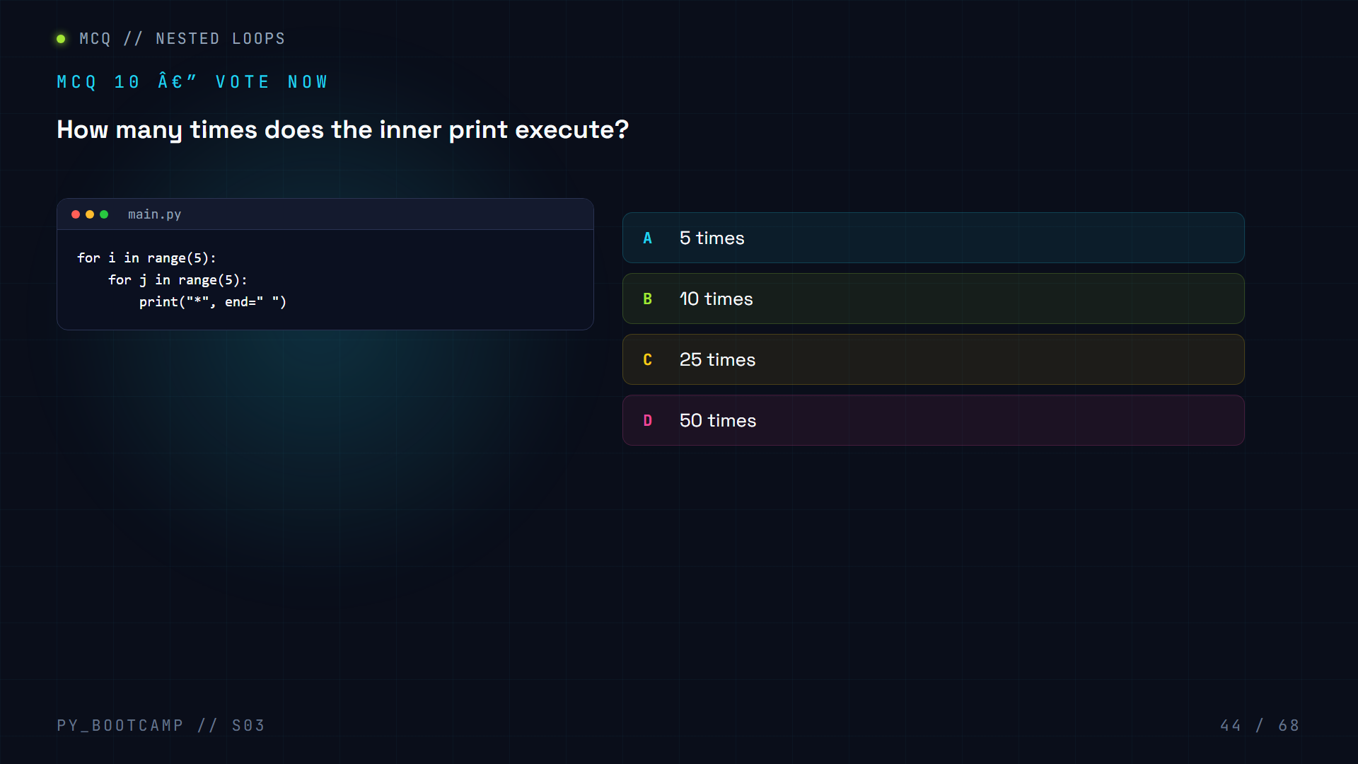

Slide 45
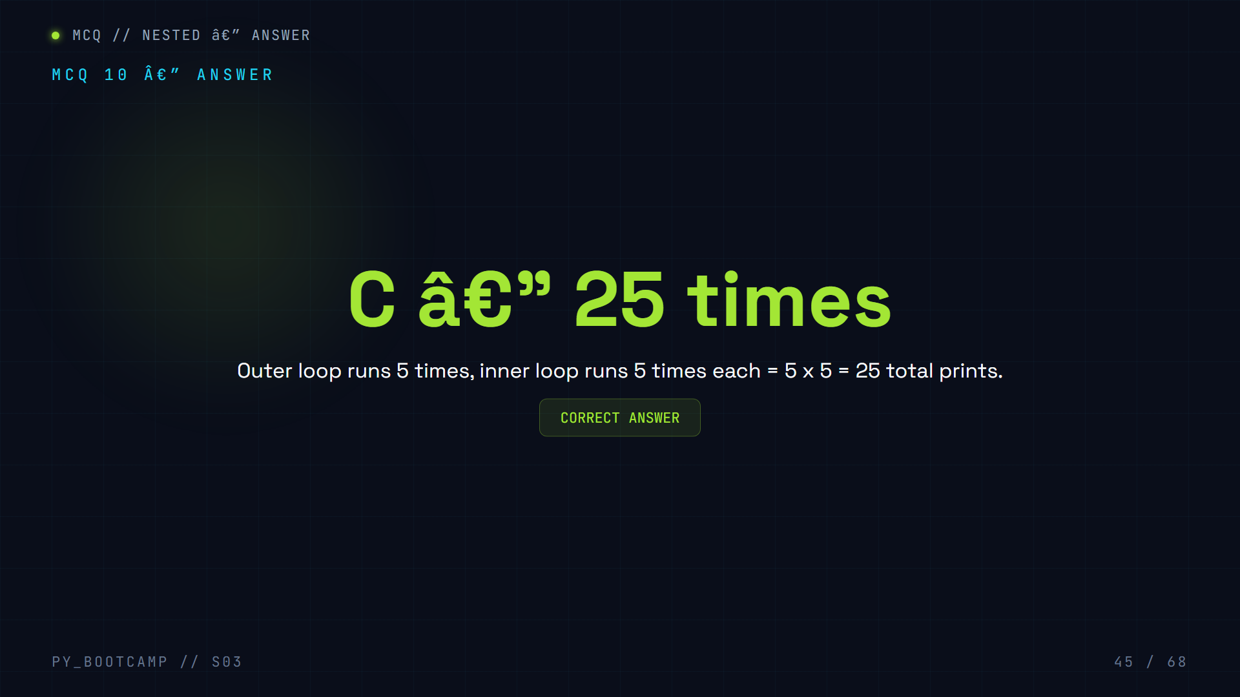

Slide 46
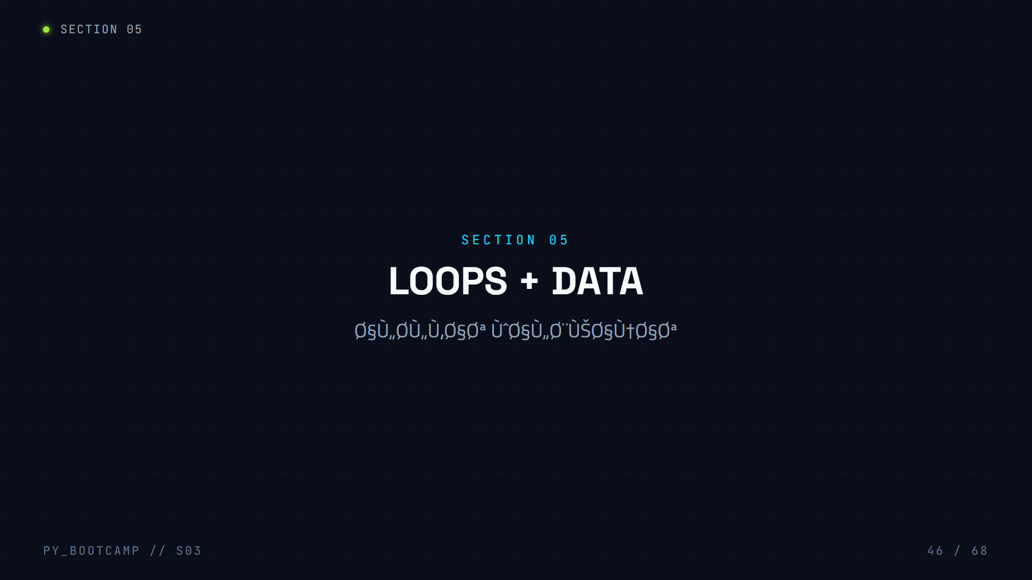

Slide 47
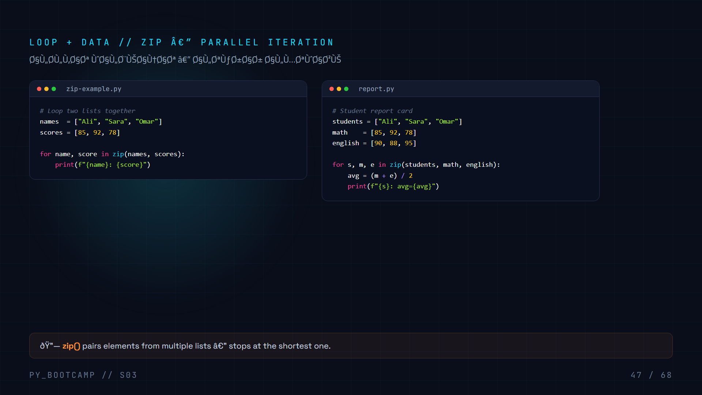
Notes:
Teach zip() for parallel iteration.

Slide 48
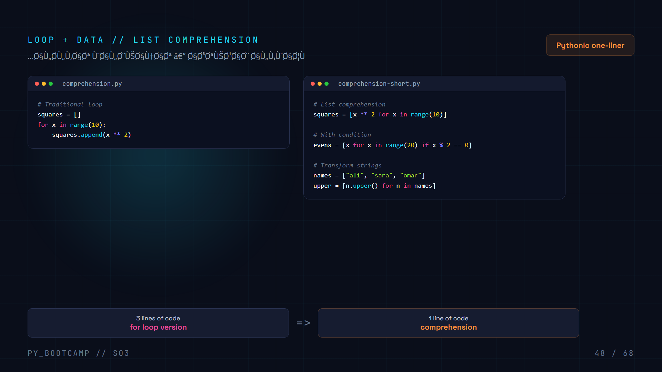
Notes:
Teach list comprehension. Before/after comparison.

Slide 49
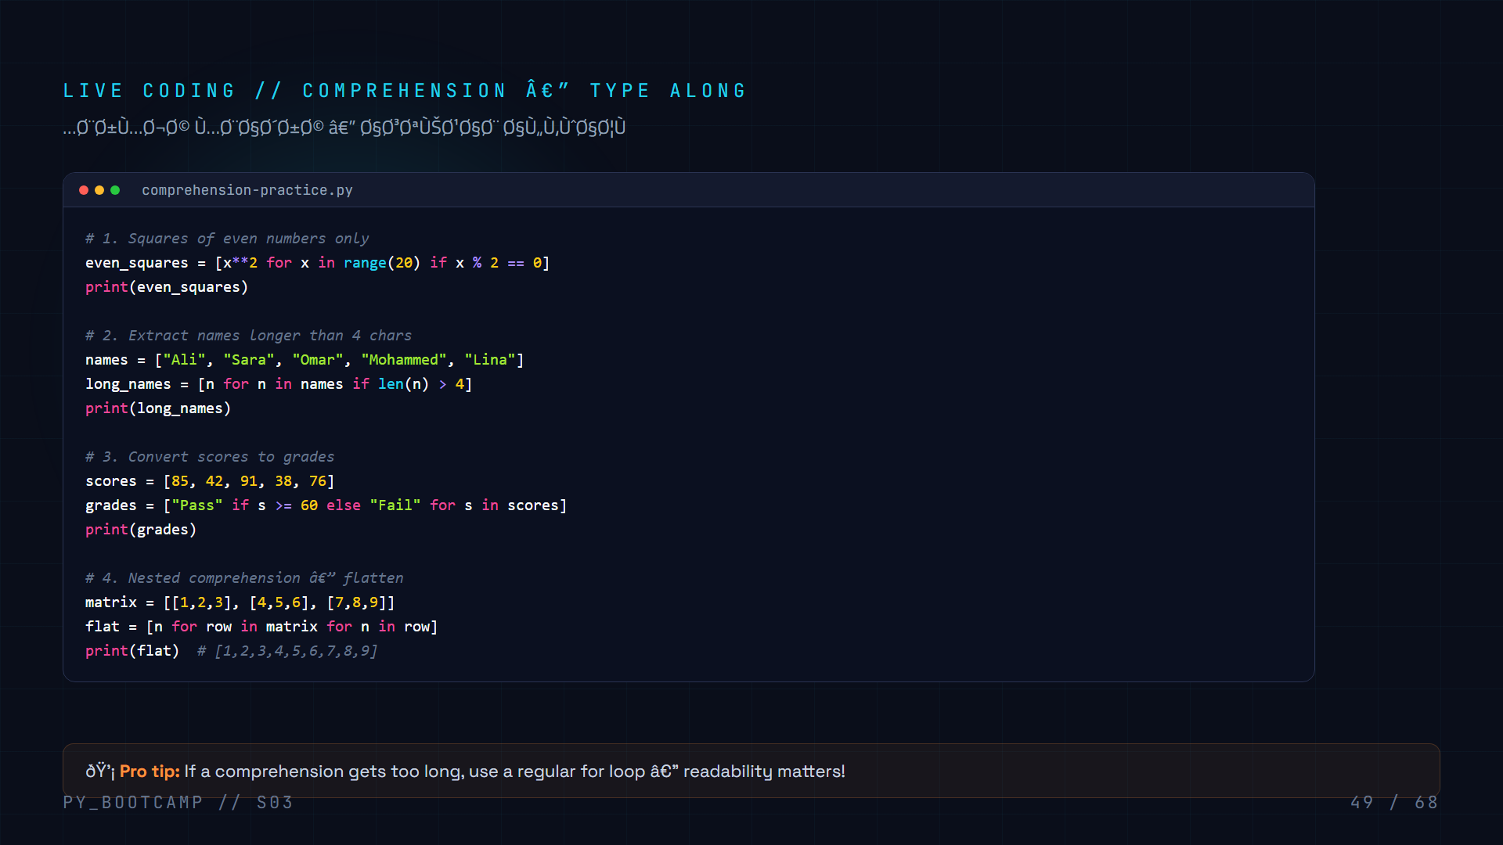
Notes:
Live coding comprehensions. Filter, transform, condition, nested.

Slide 50
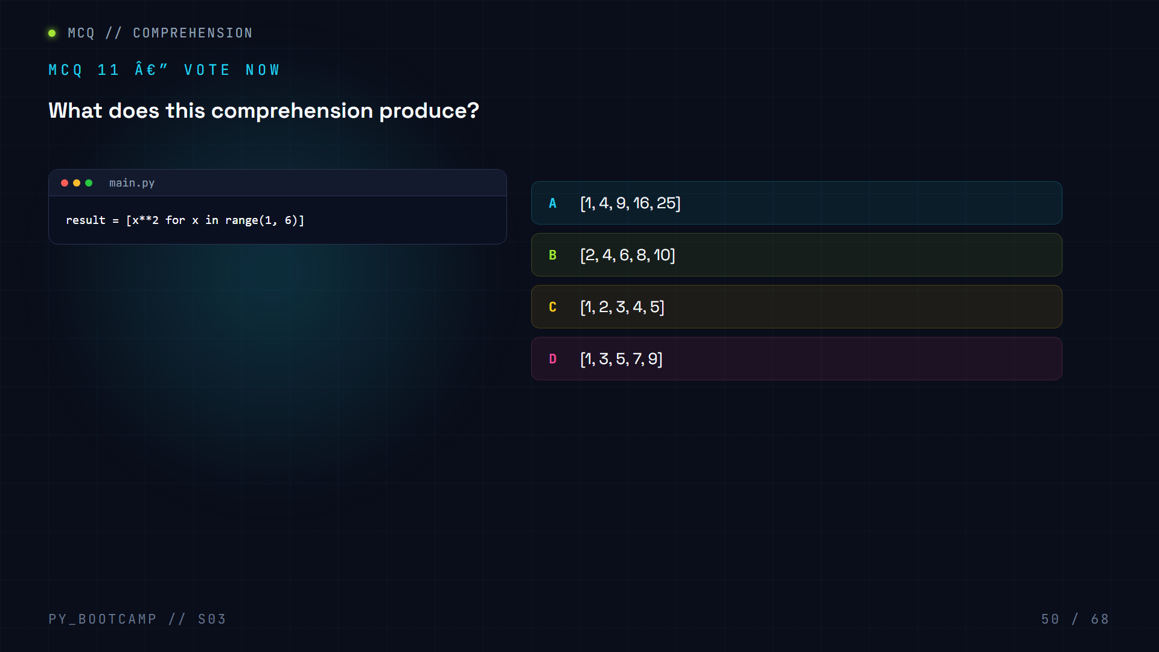

Slide 51
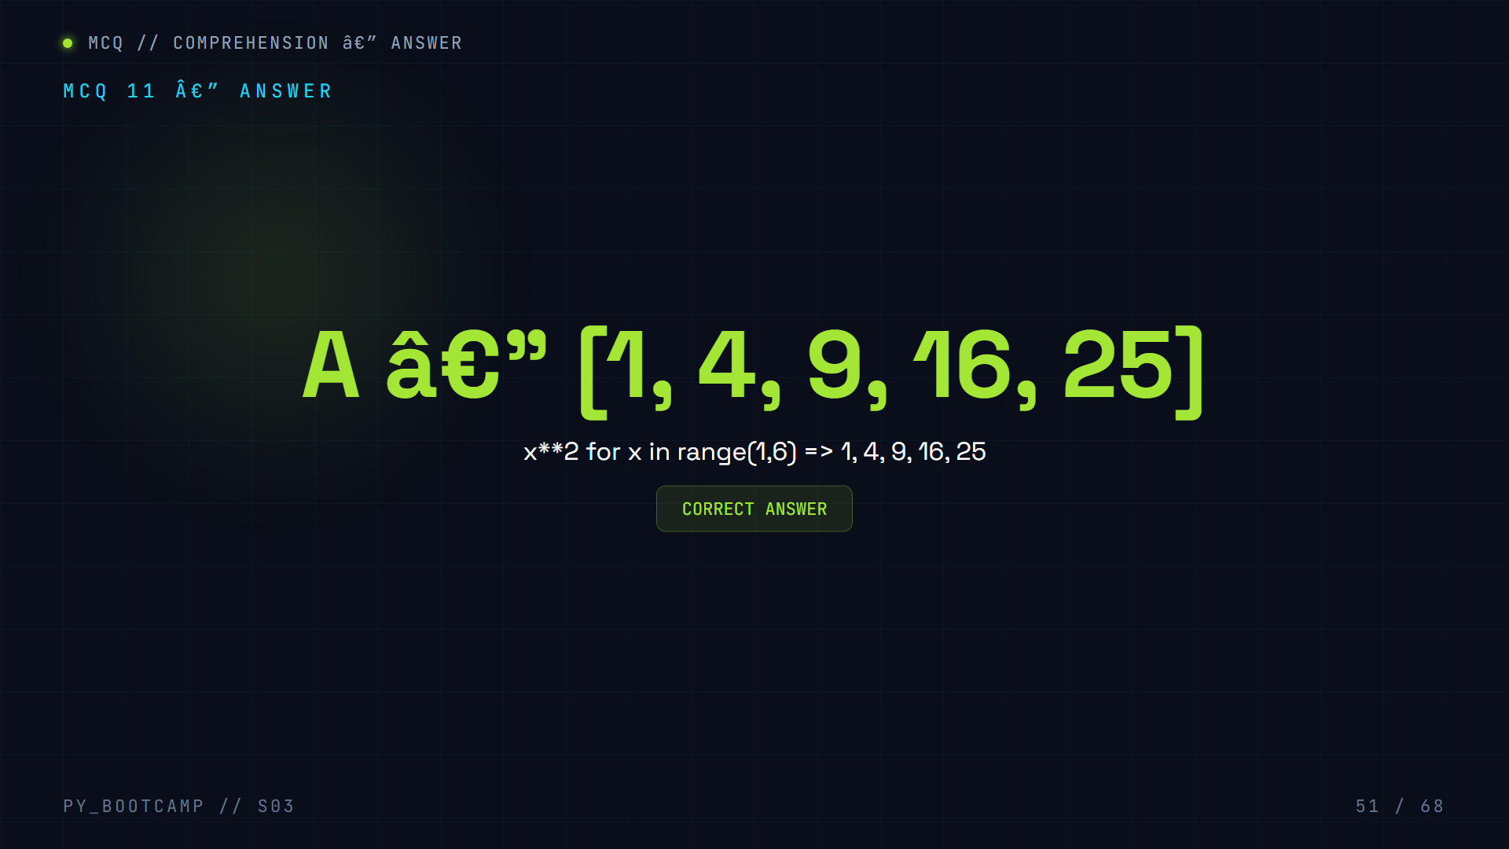

Slide 52
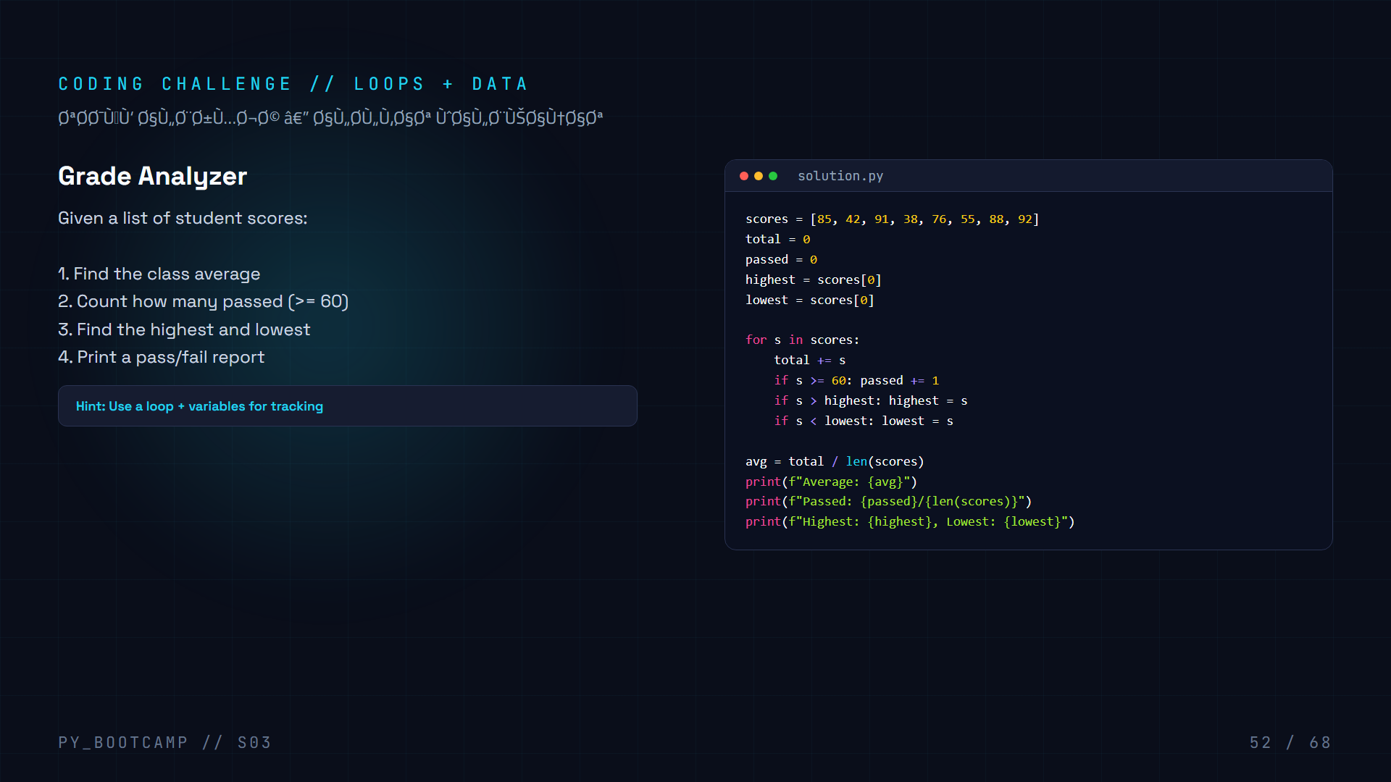
Notes:
Challenge: Grade analyzer.

Slide 53
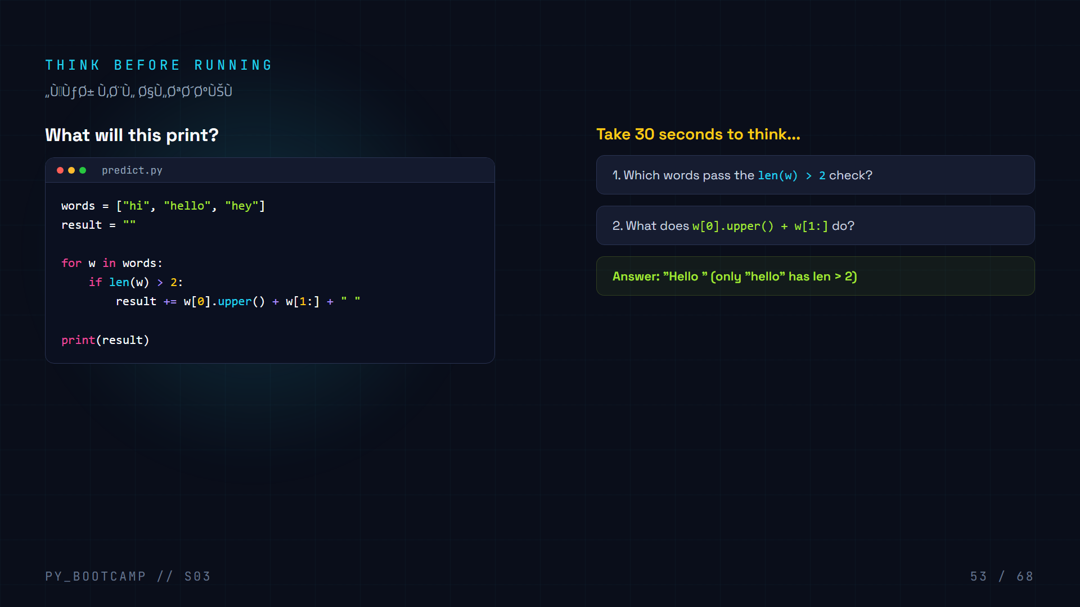
Notes:
Interactive prediction. Give students time to think.

Slide 54


Slide 55
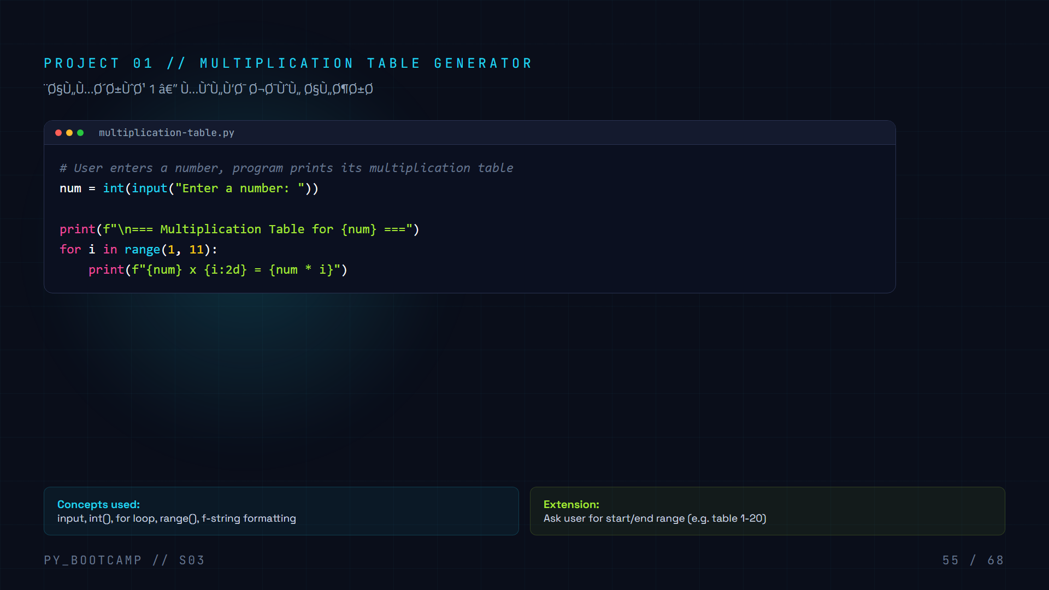
Notes:
Project 1: Multiplication table.

Slide 56
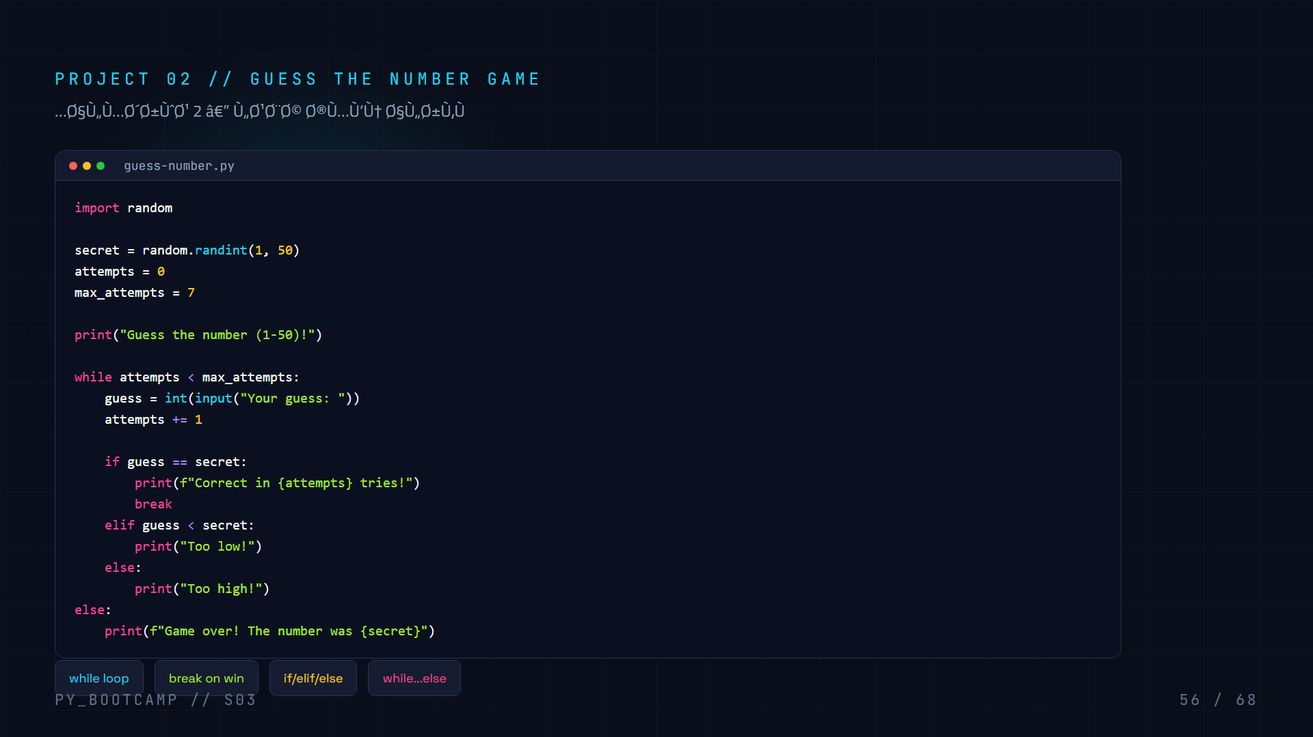
Notes:
Project 2: Guess the number.

Slide 57
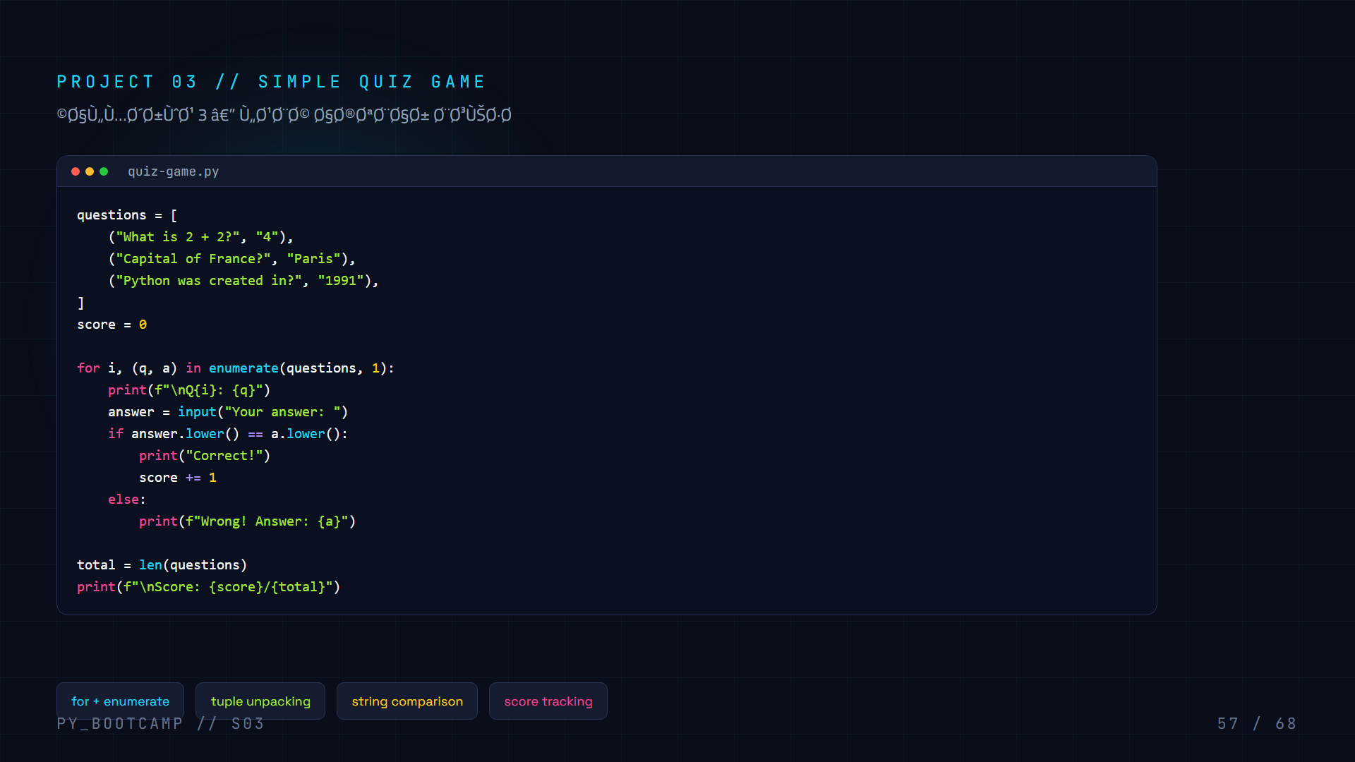
Notes:
Project 3: Quiz game.

Slide 58
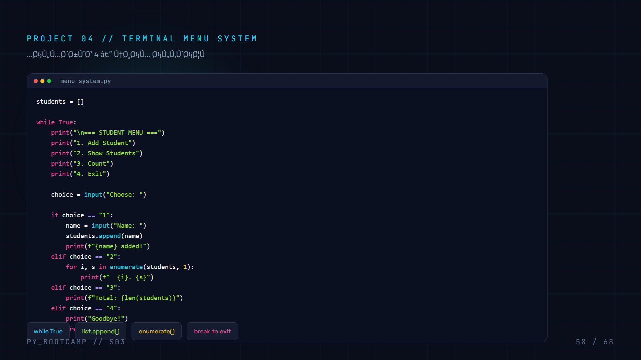
Notes:
Project 4: Terminal menu system.

Slide 59
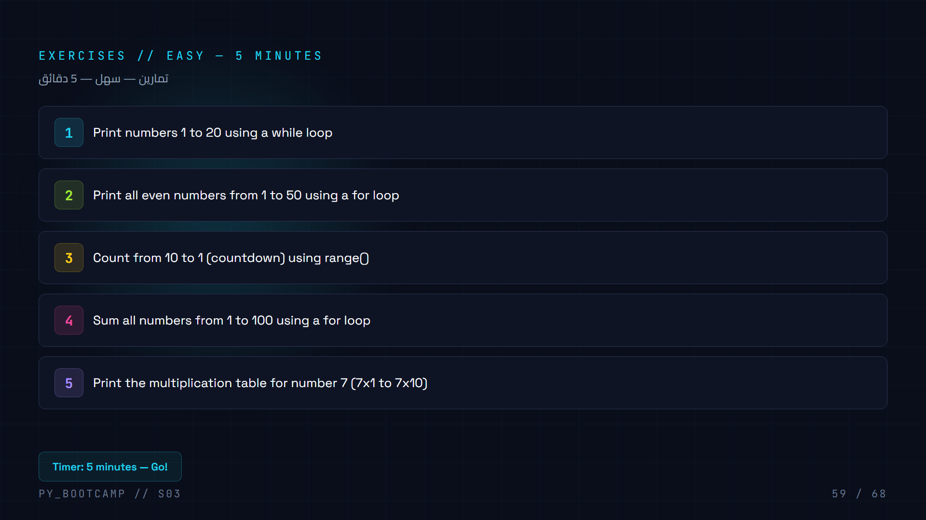
Notes:
Easy exercises. 5 minute timer.

Slide 60

Notes:
Medium exercises. 8 minute timer.

Slide 61

Notes:
Challenge exercise: diamond pattern.

Slide 62

Notes:
Common mistakes: infinite loop, off-by-one, list mutation, assignment vs comparison.

Slide 63

Notes:
Homework: progressive difficulty, ending with a project.

Slide 64

Notes:
Bonus homework challenges.

Slide 65

Notes:
Final quiz â€” all 10 questions on one slide for quick review.

Slide 66

Notes:
Session recap â€” 8 key concepts covered.

Slide 67

Notes:
Teaser for Session 4: Strings.

Slide 68

Notes:
Closing slide. Encourage practice.

