Slide 1
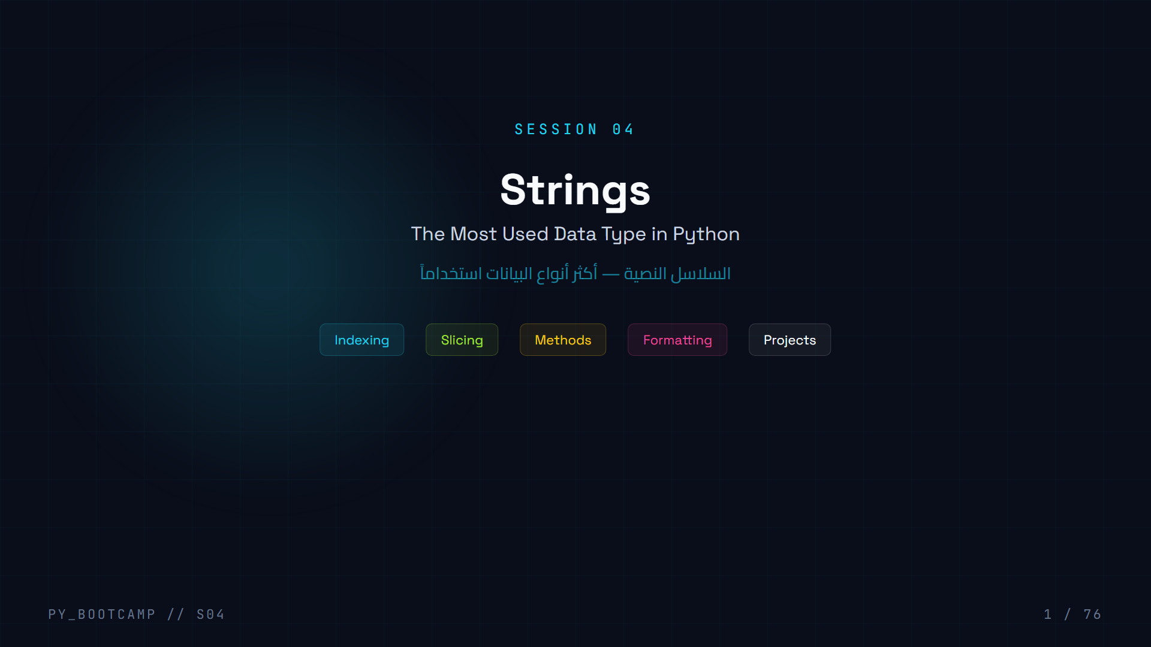
Notes:
Welcome to Session 04 — Strings. This is the most used data type in Python. We will cover indexing, slicing, methods, formatting, and build projects.

Slide 2
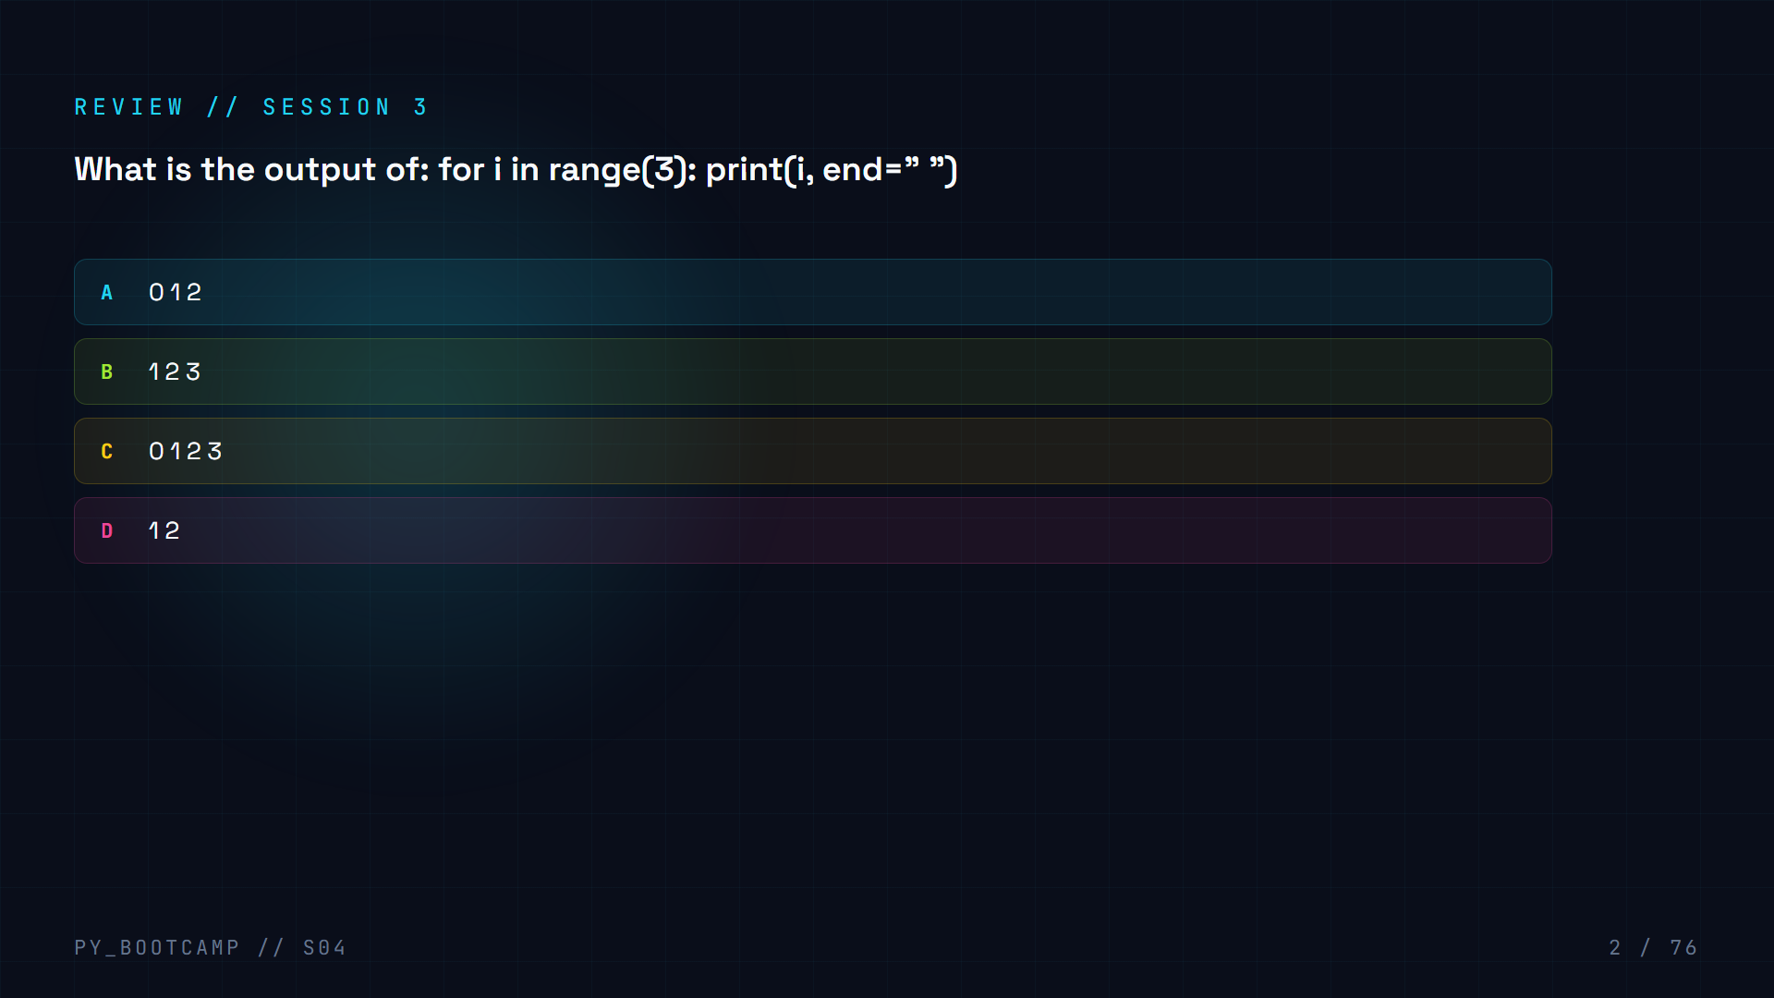

Slide 3
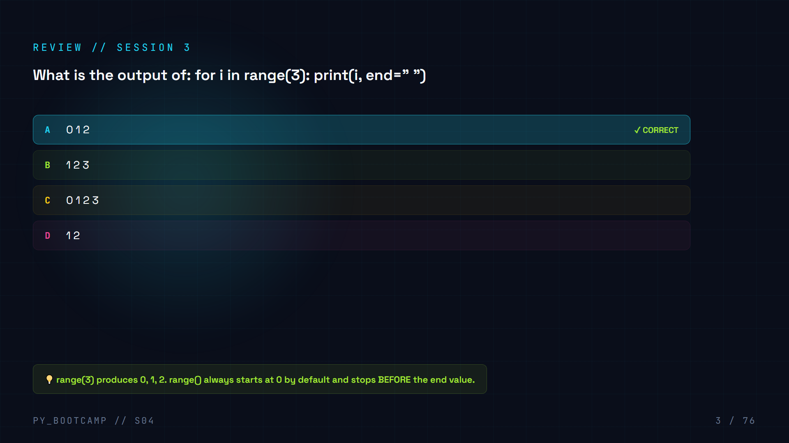

Slide 4
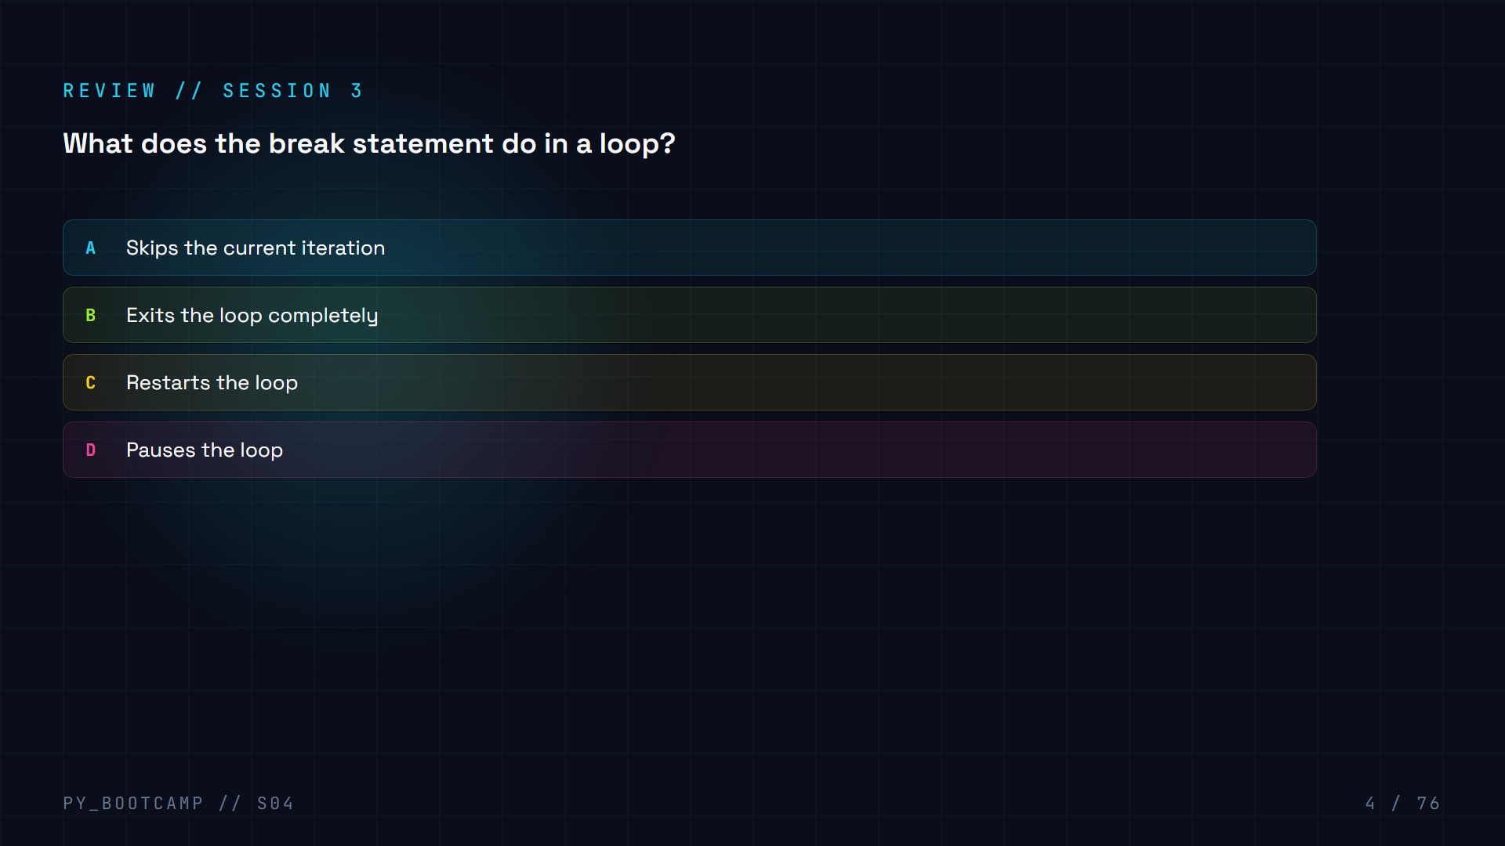

Slide 5
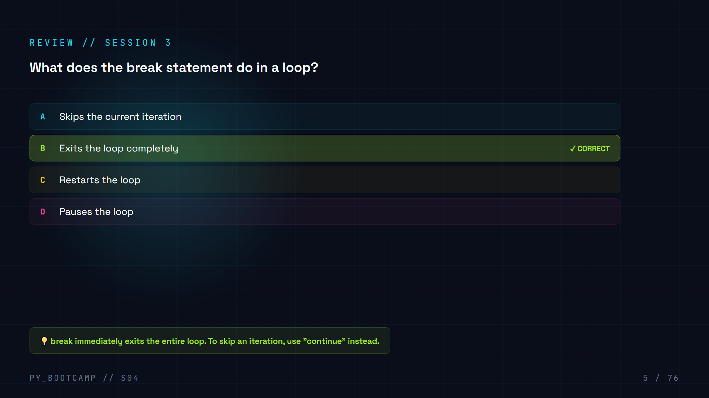

Slide 6
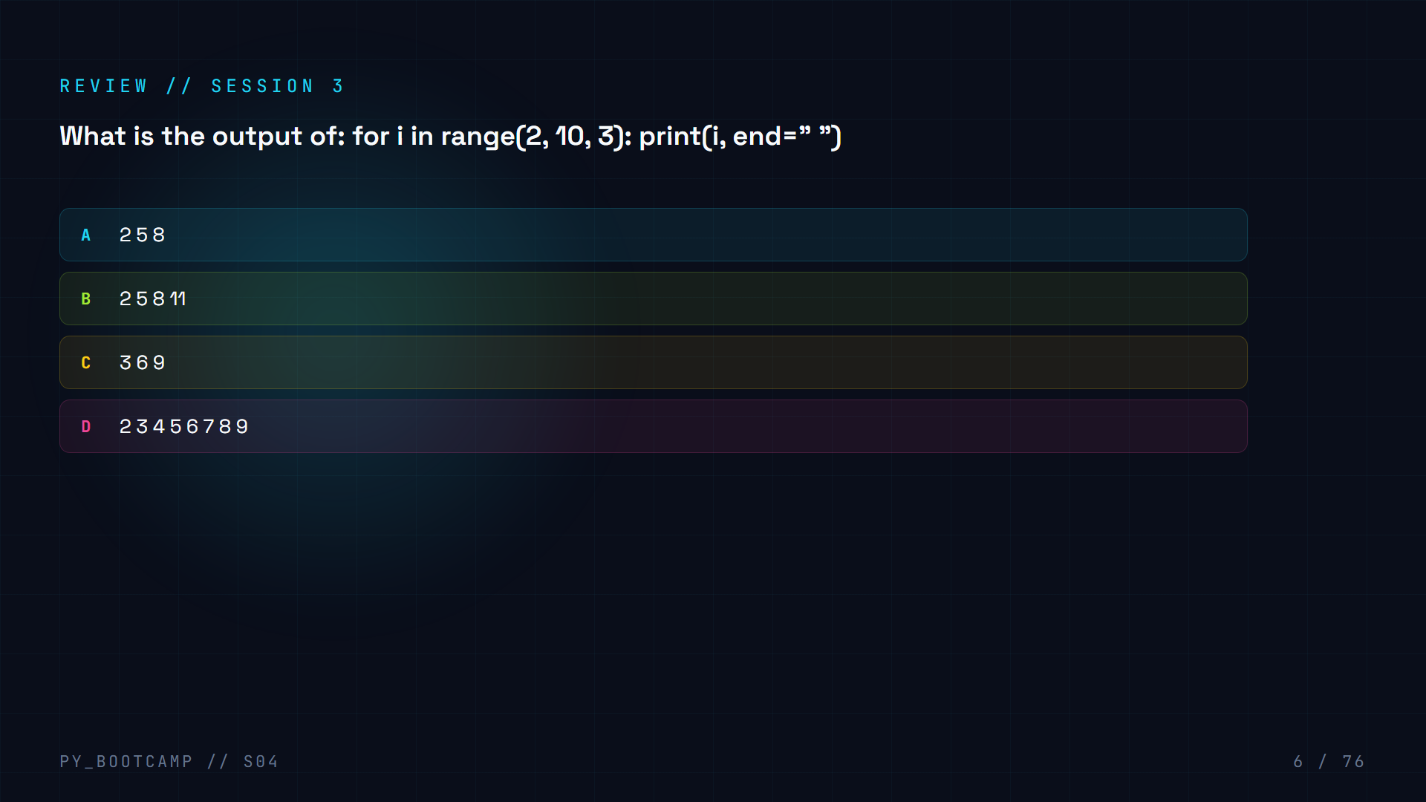

Slide 7
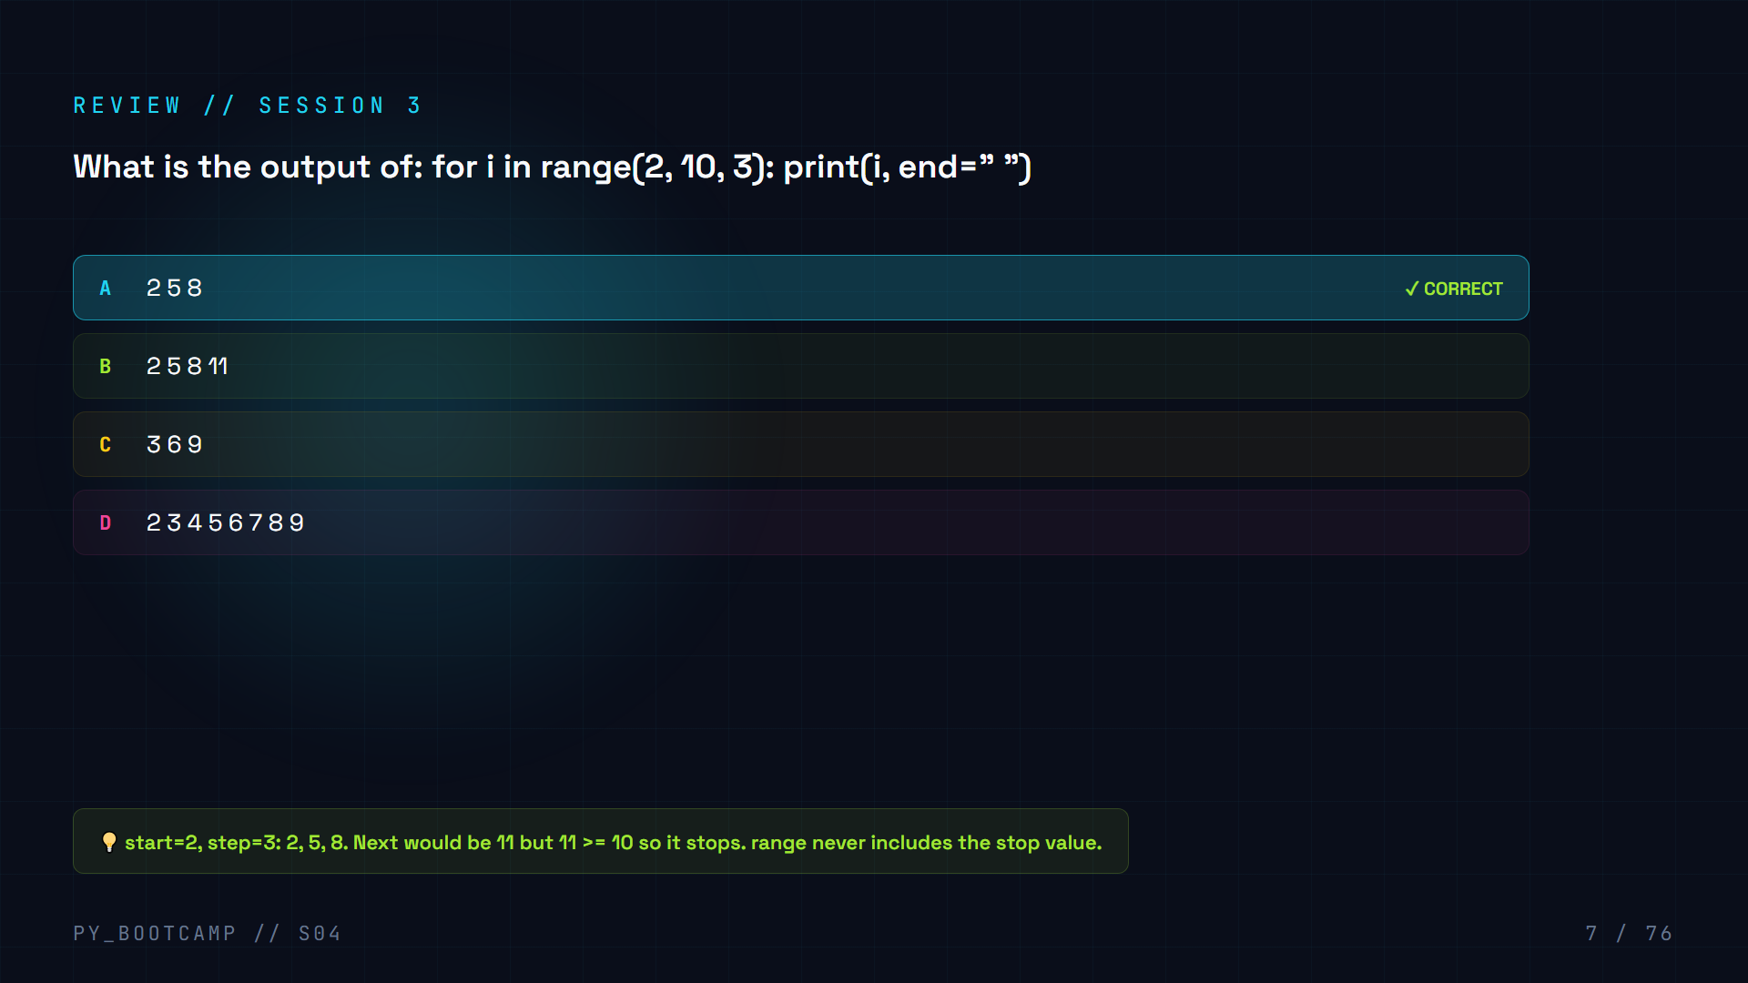

Slide 8
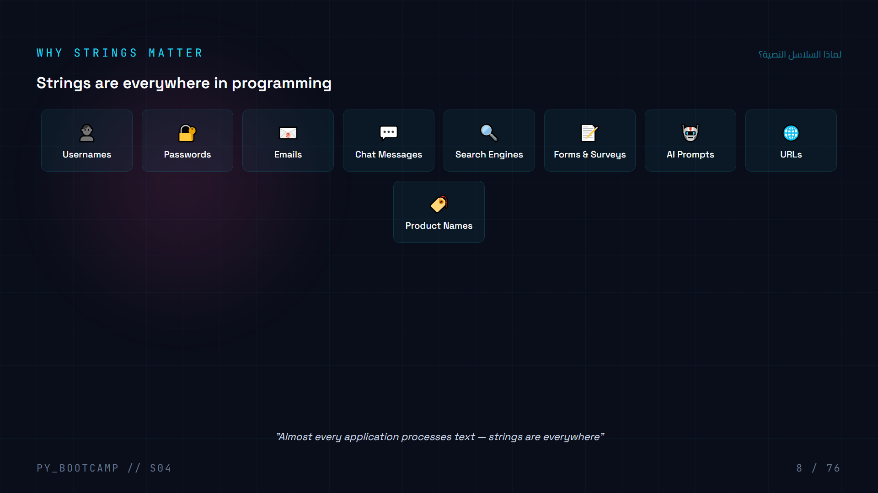
Notes:
Strings are the most commonly used data type. Nearly every application handles text in some form.

Slide 9
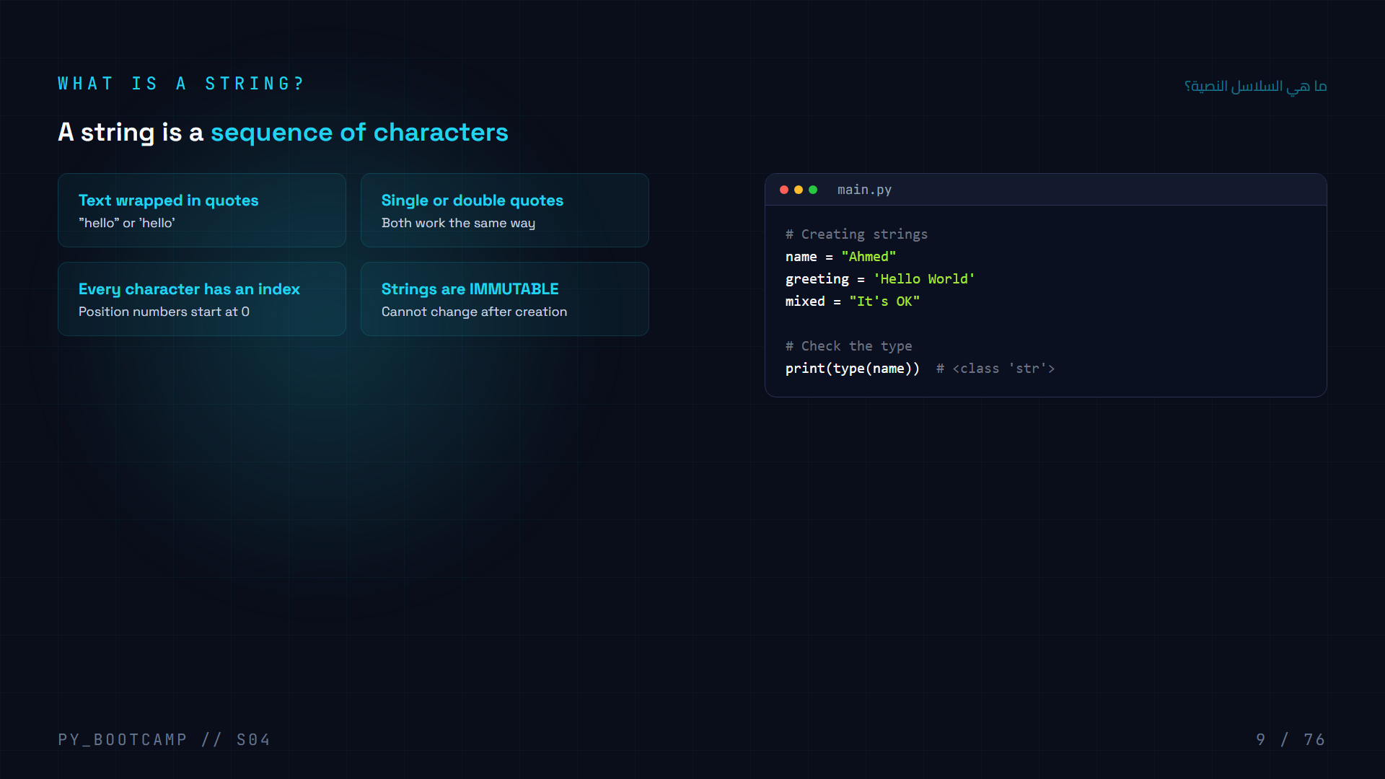
Notes:
A string is a sequence of characters wrapped in quotes. Strings are immutable meaning you cannot change individual characters after creation.

Slide 10
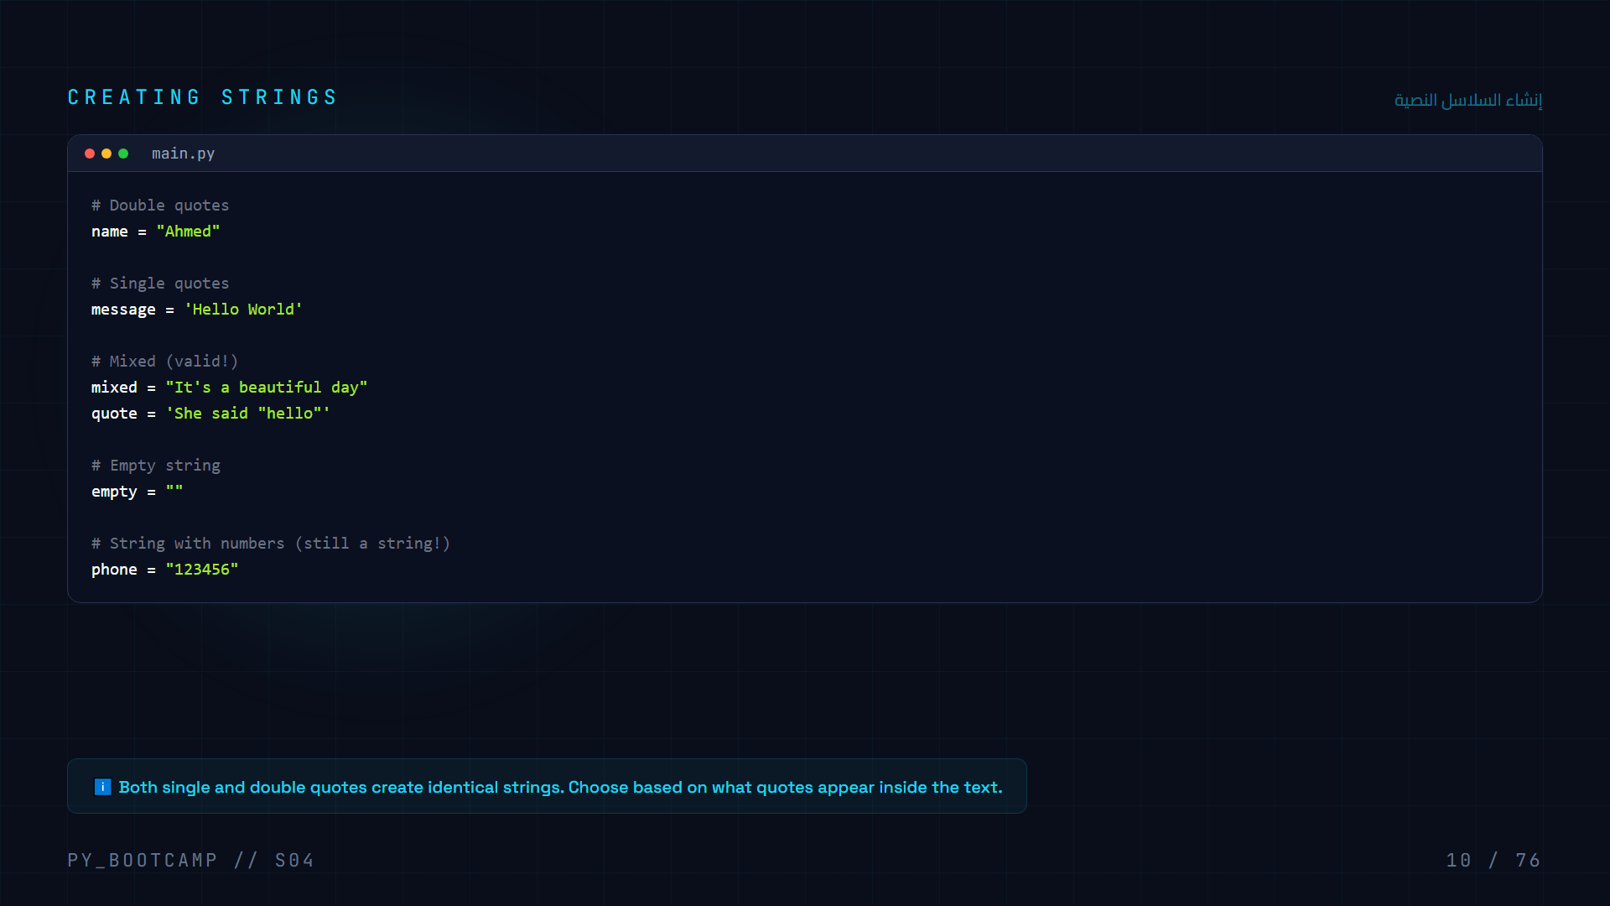
Notes:
Creating strings: use single or double quotes. Numbers in quotes are still strings.

Slide 11
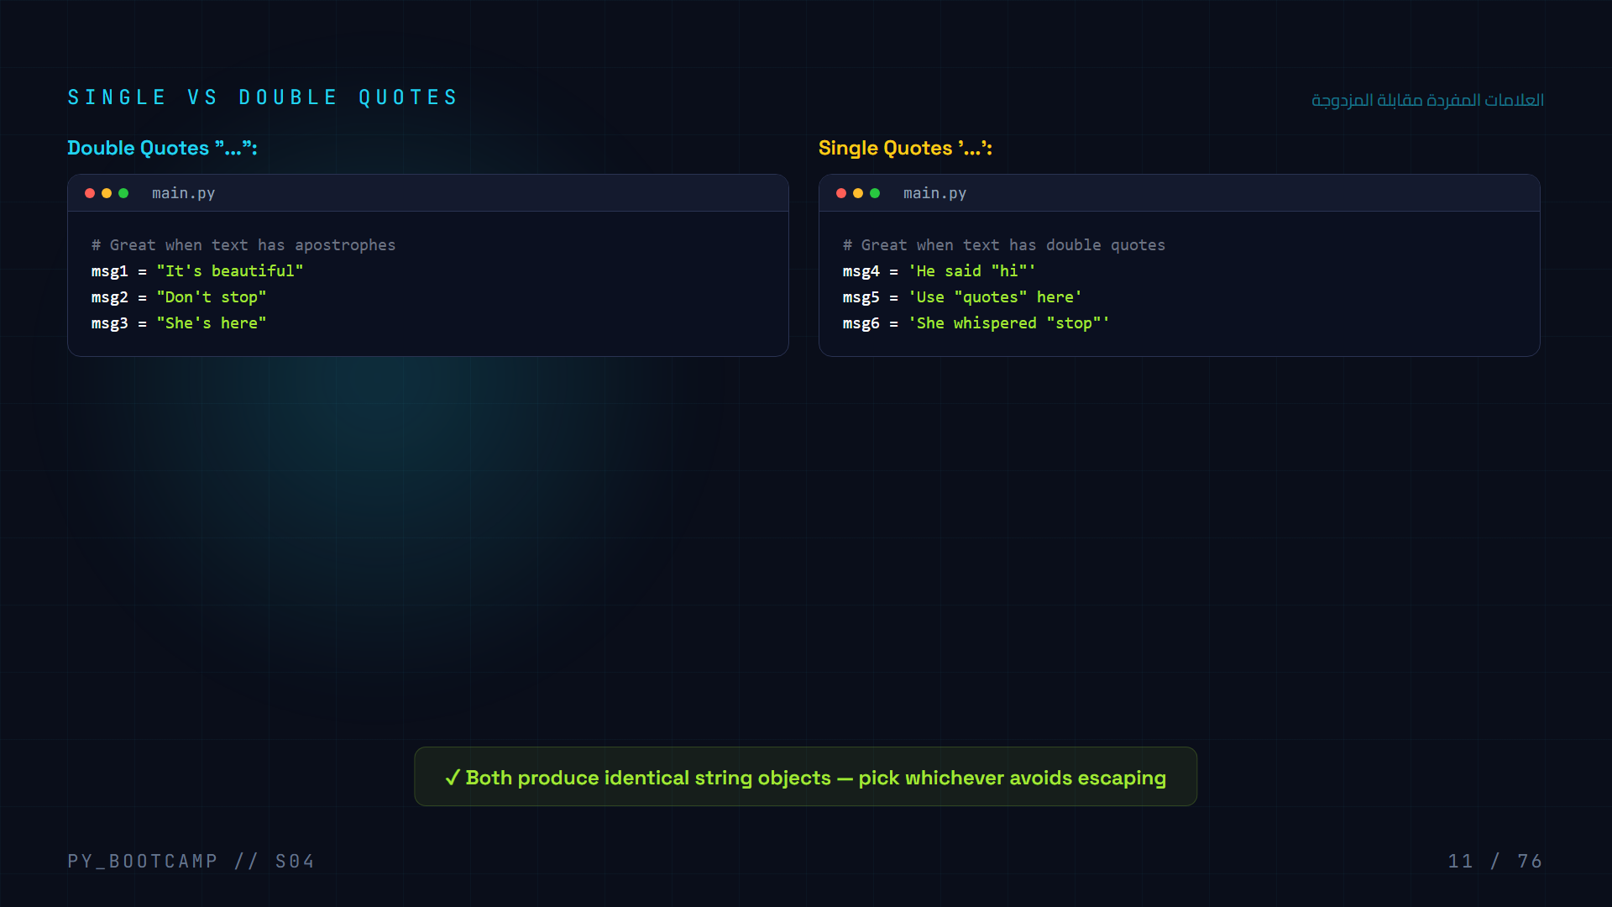
Notes:
Single and double quotes are functionally identical. Use whichever avoids the need to escape quotes inside the string.

Slide 12
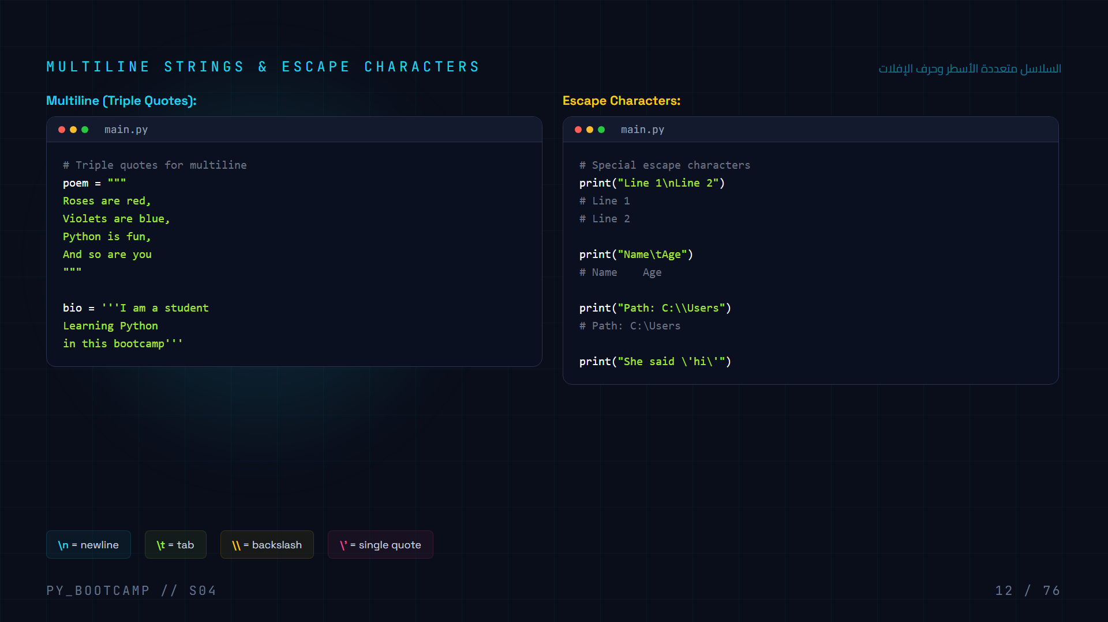
Notes:
Triple quotes create multiline strings. Escape characters let you include special characters in strings.

Slide 13
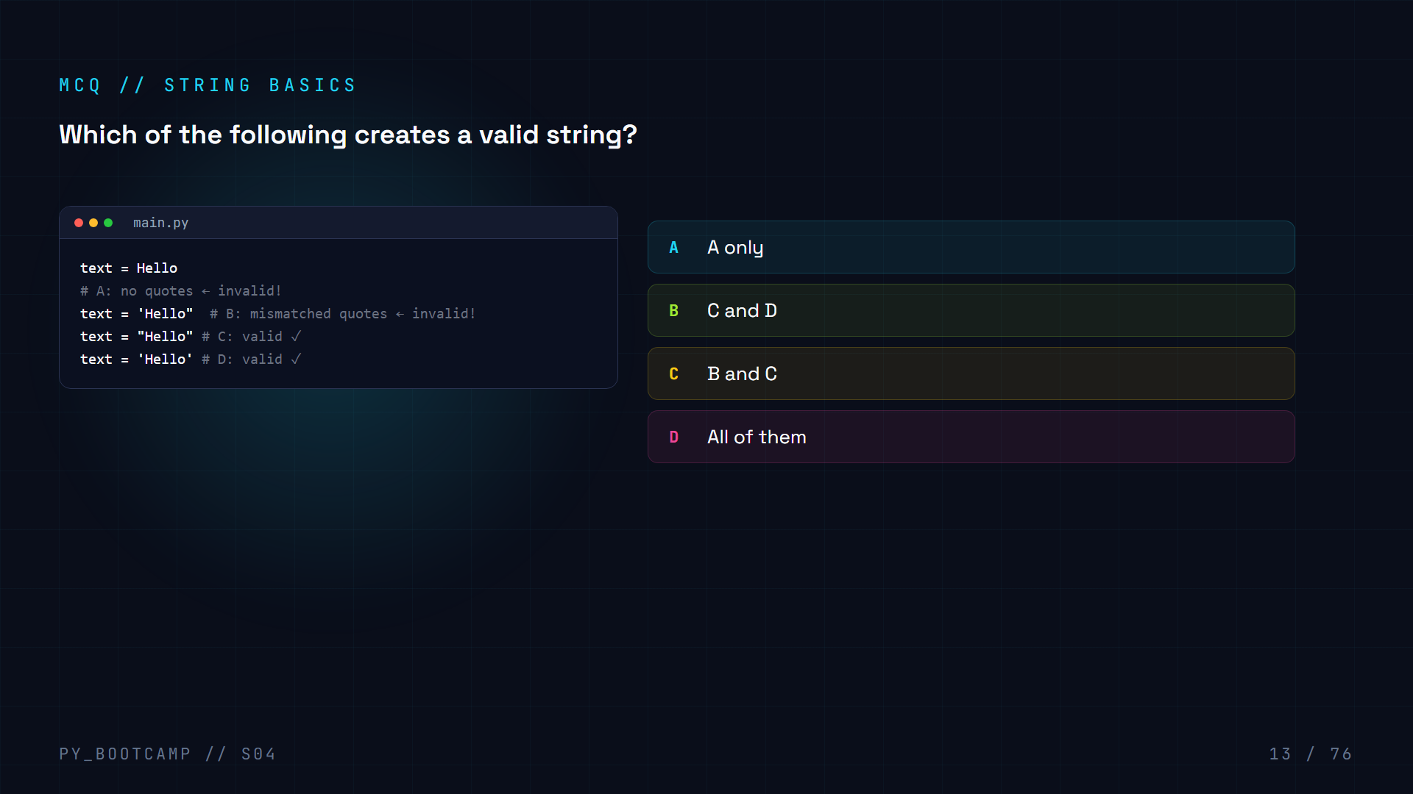

Slide 14
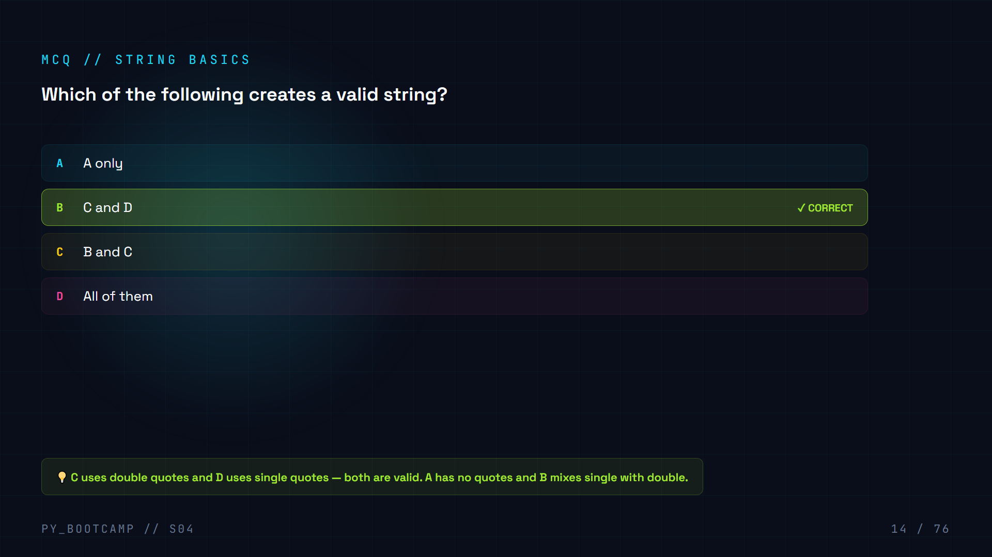

Slide 15
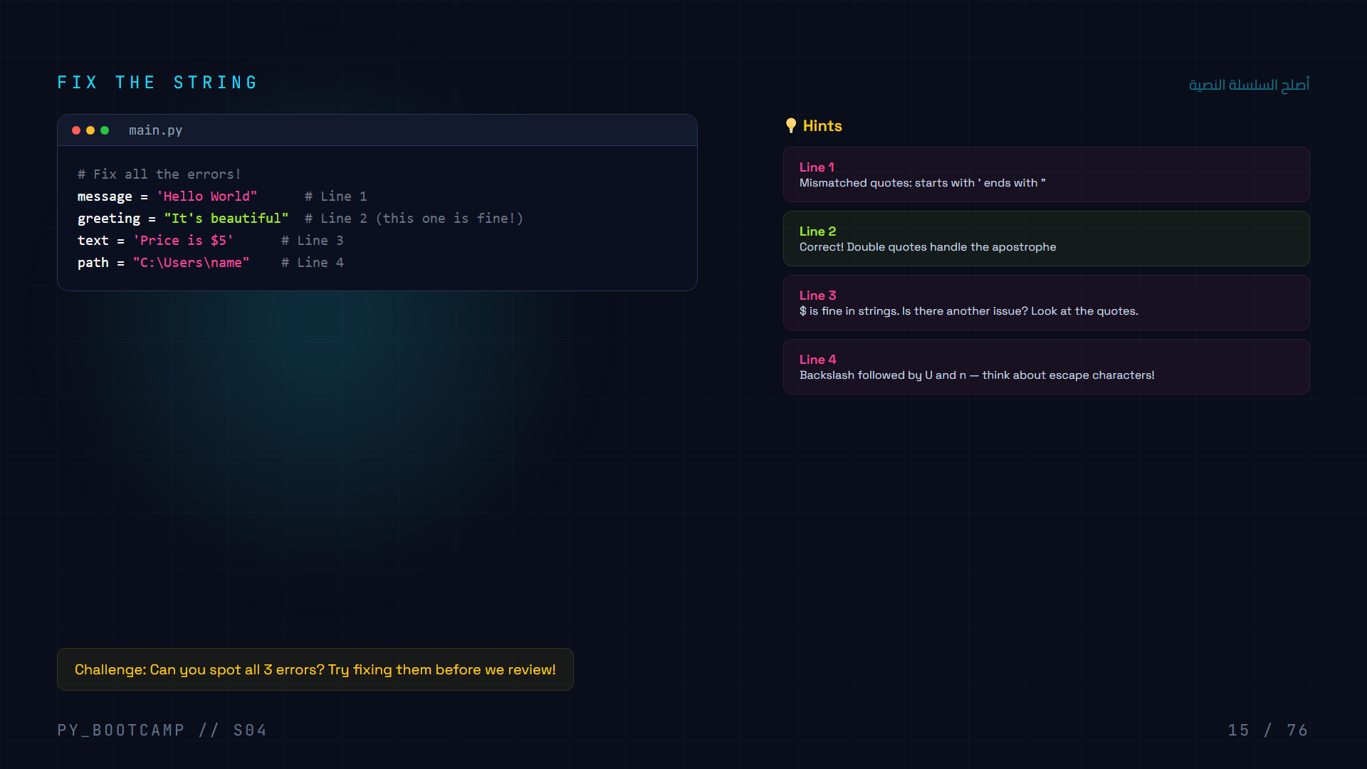
Notes:
Interactive exercise: students identify and fix the string errors on each line.

Slide 16
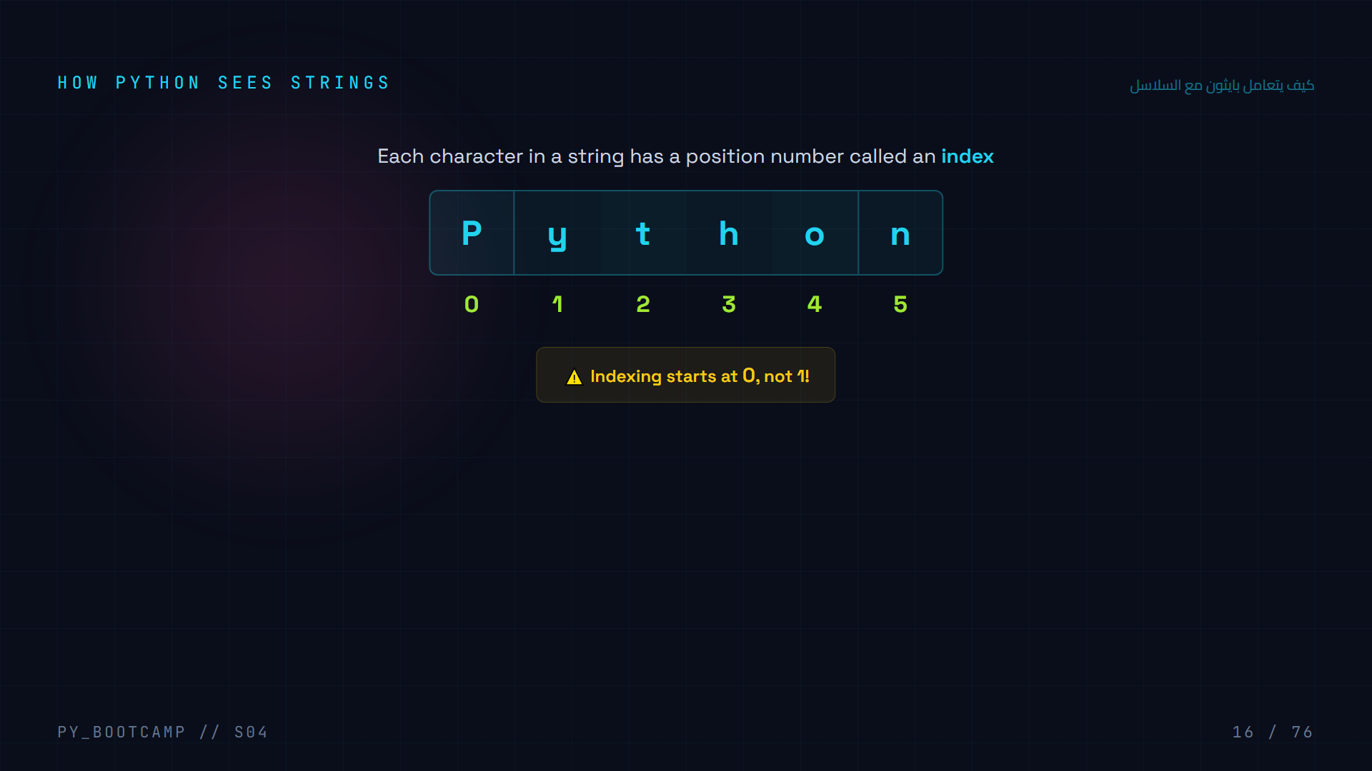
Notes:
Python assigns each character an index starting from 0. This lets you access individual characters by their position.

Slide 17
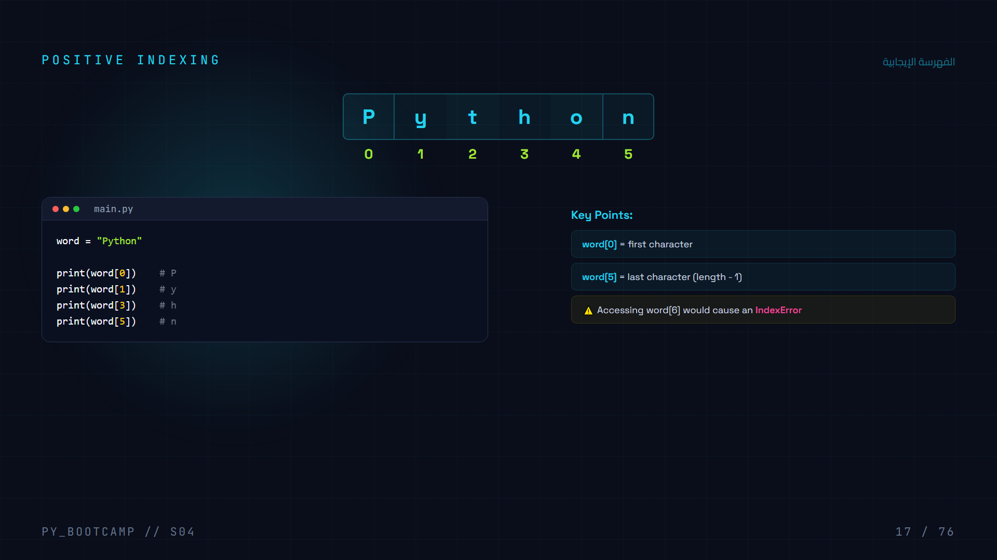
Notes:
Positive indexing starts at 0 and goes up to length-1. Accessing beyond gives an IndexError.

Slide 18
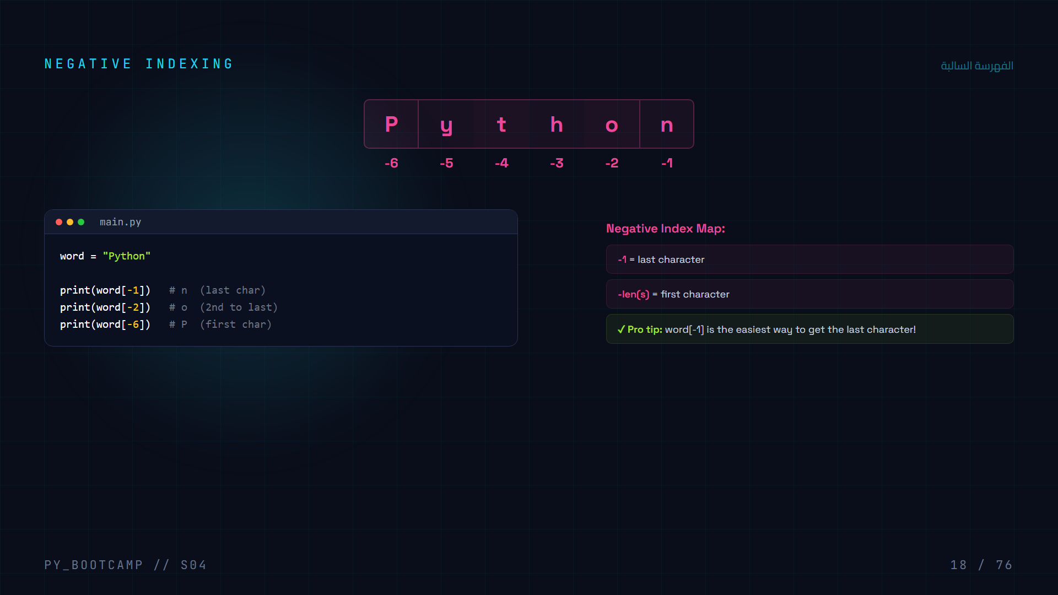
Notes:
Negative indexing counts from the end. -1 is the last character, -2 is second to last, and so on.

Slide 19
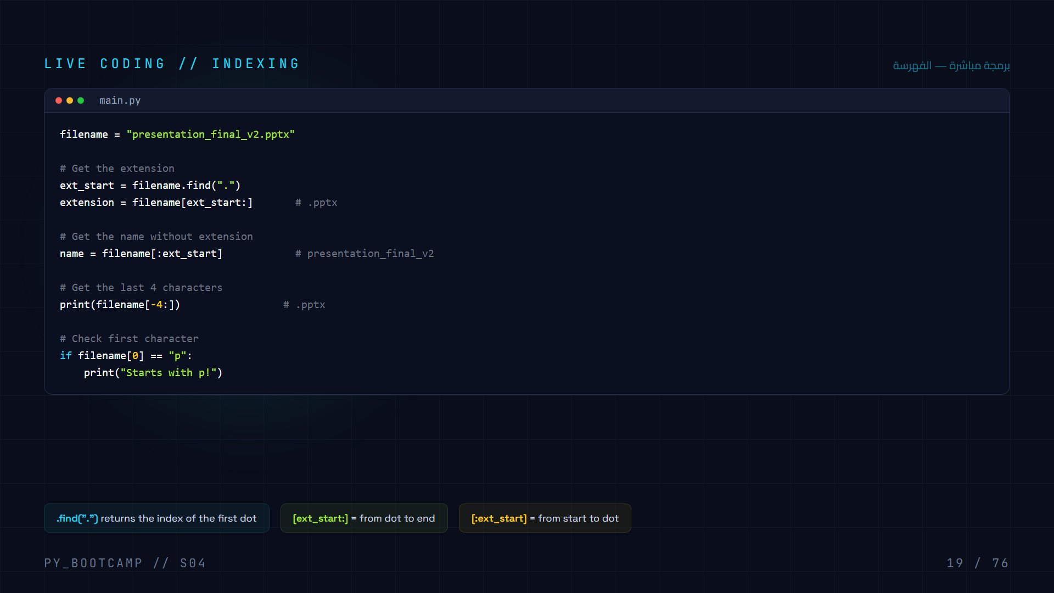
Notes:
Practical example: using indexing to parse a filename and extract its extension and base name.

Slide 20
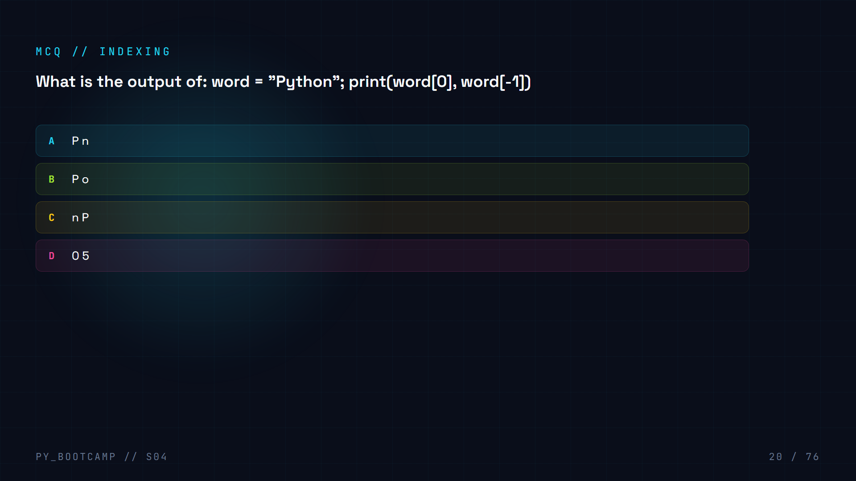

Slide 21
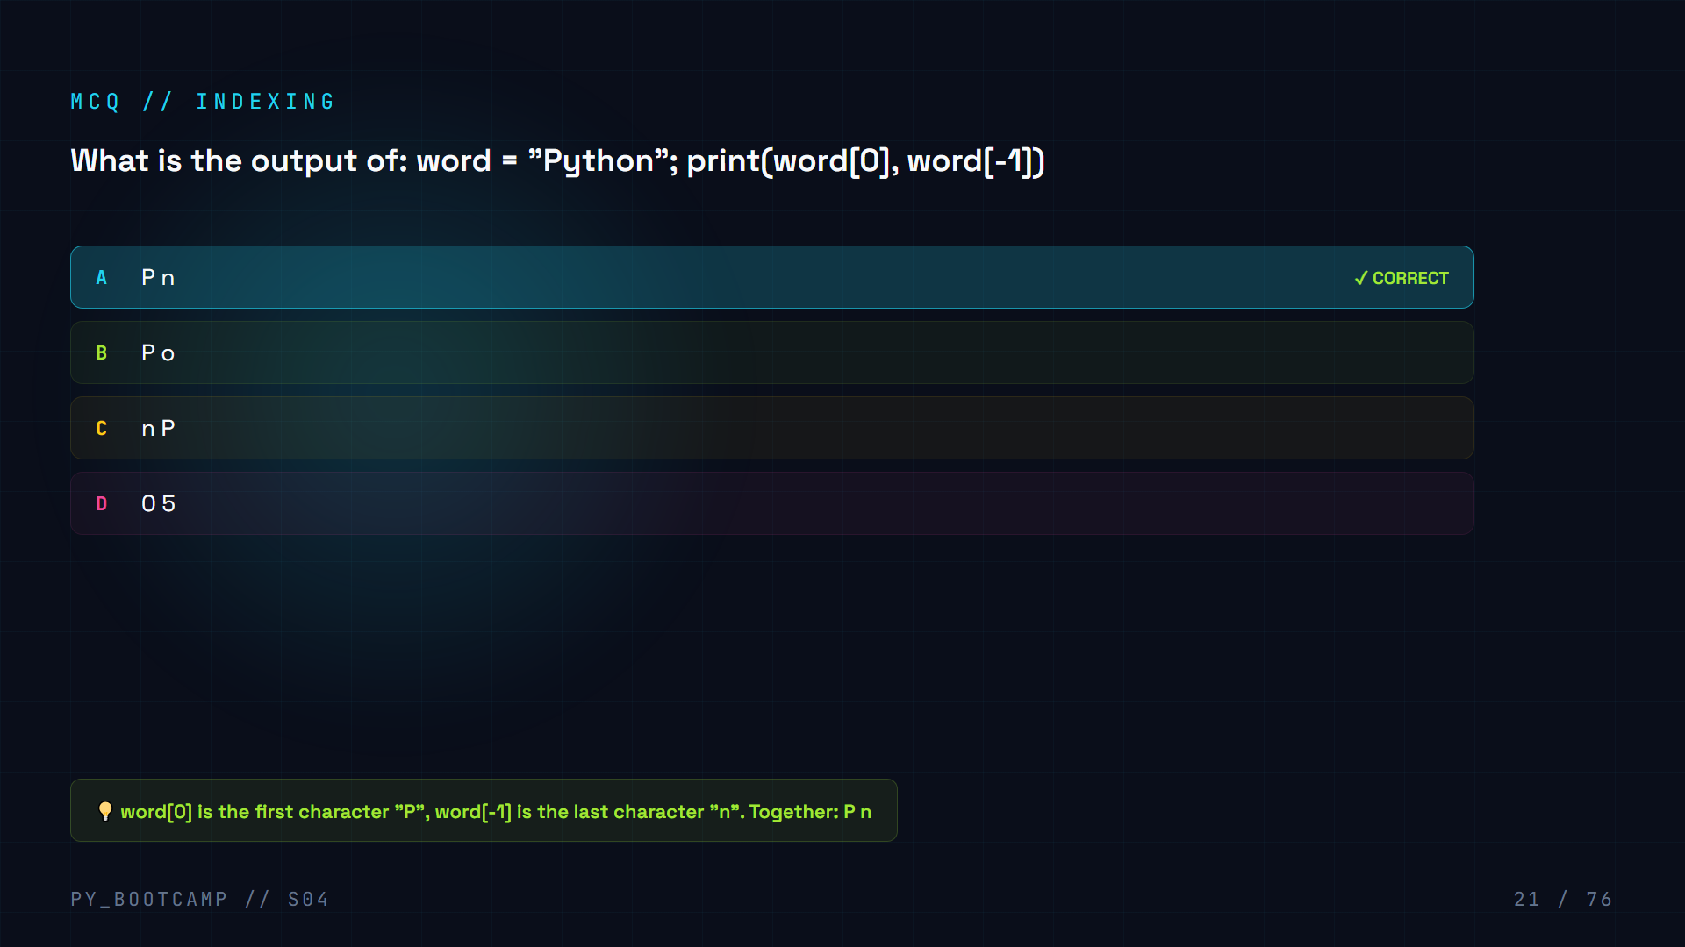

Slide 22
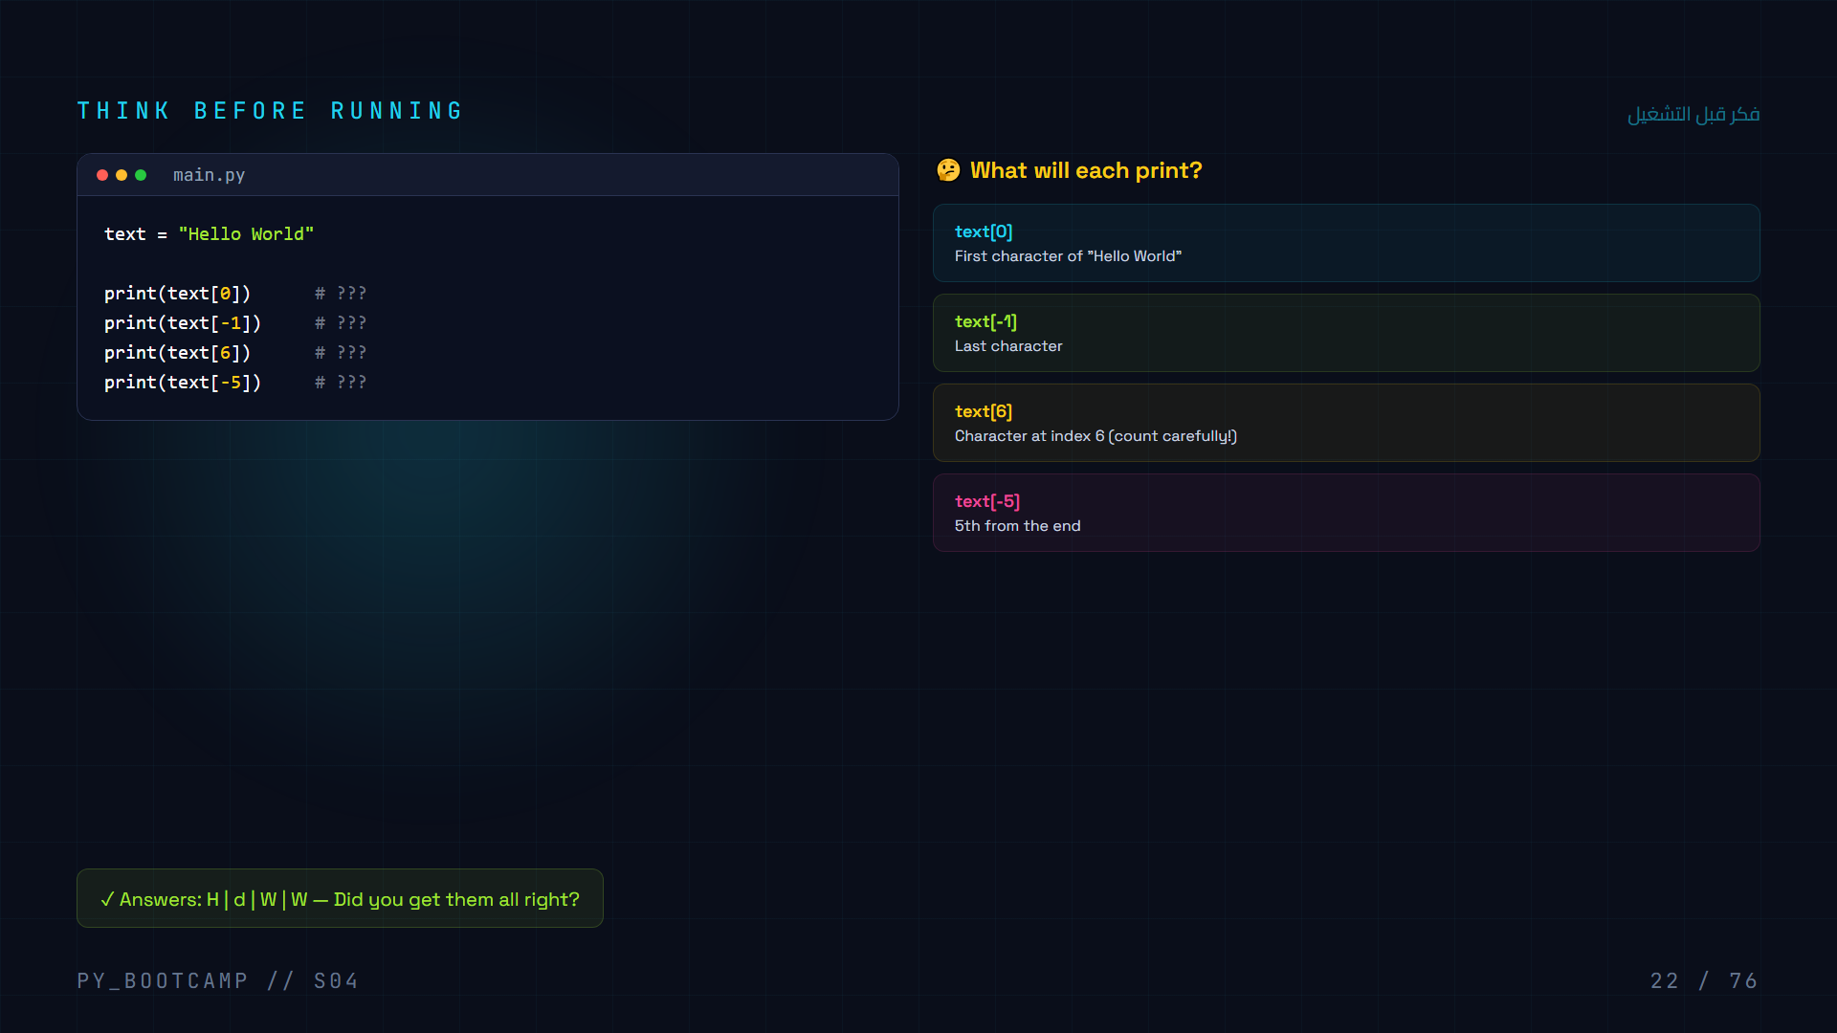
Notes:
Students predict the output before running. Great way to test understanding of both positive and negative indexing.

Slide 23
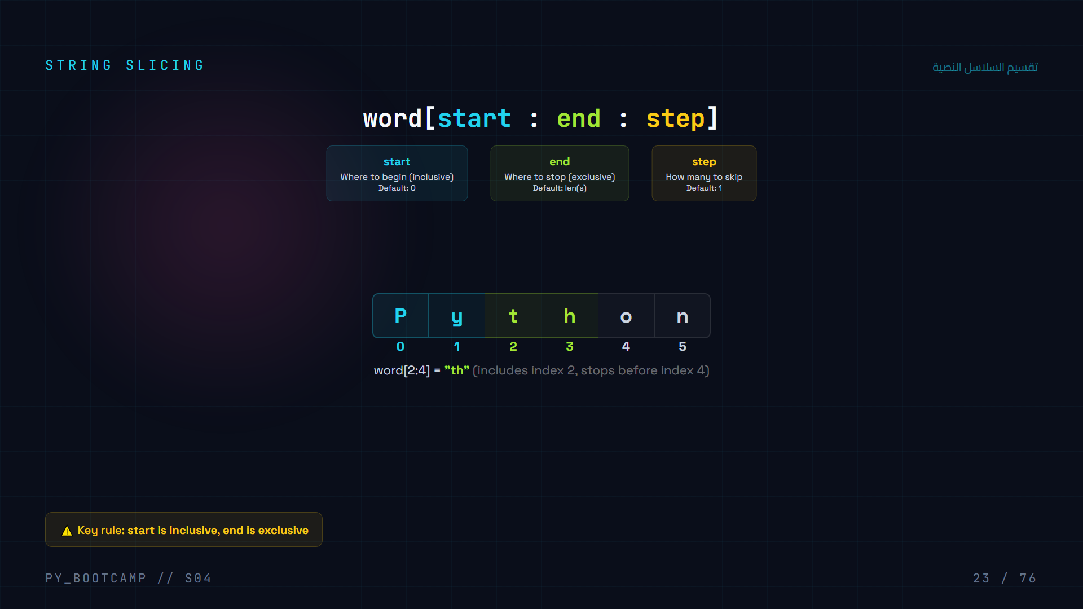
Notes:
Slicing extracts a portion of a string. The start index is included, the end index is excluded.

Slide 24
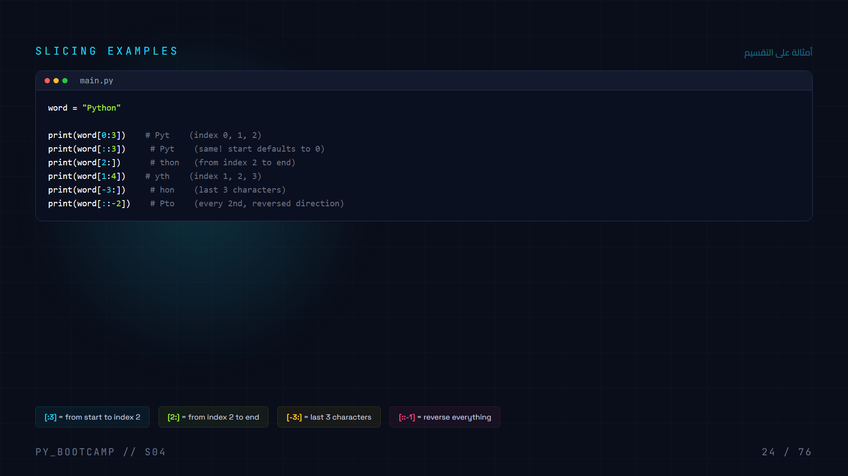
Notes:
Slicing examples showing various ways to extract substrings using start, end, and omitted values.

Slide 25
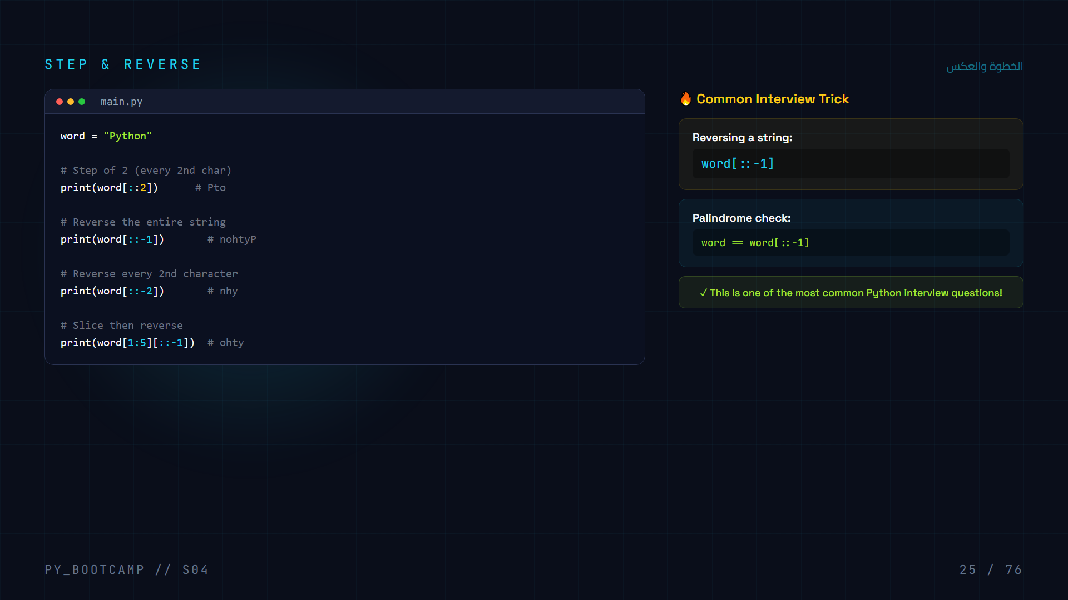
Notes:
The step parameter controls stride. A step of -1 reverses the string. This is a famous interview question.

Slide 26
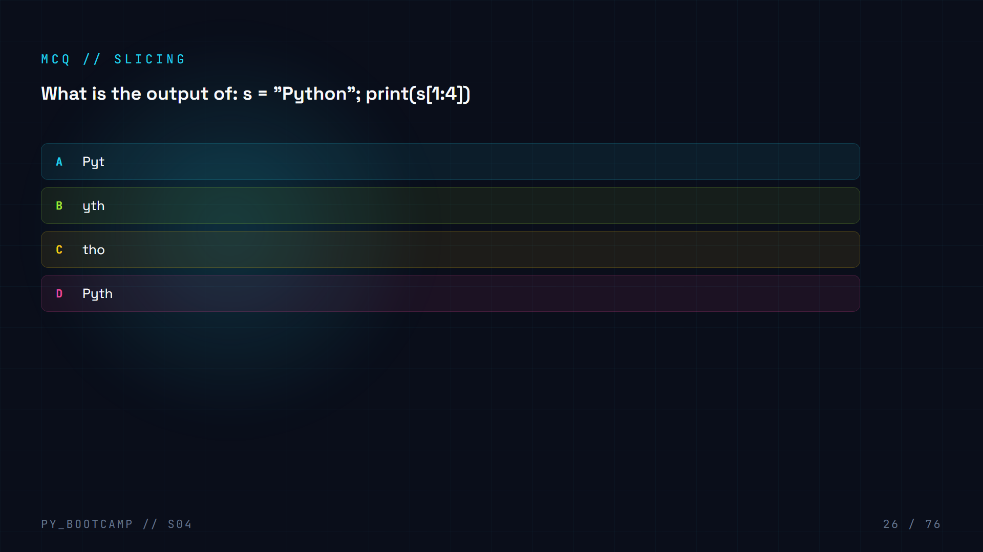

Slide 27
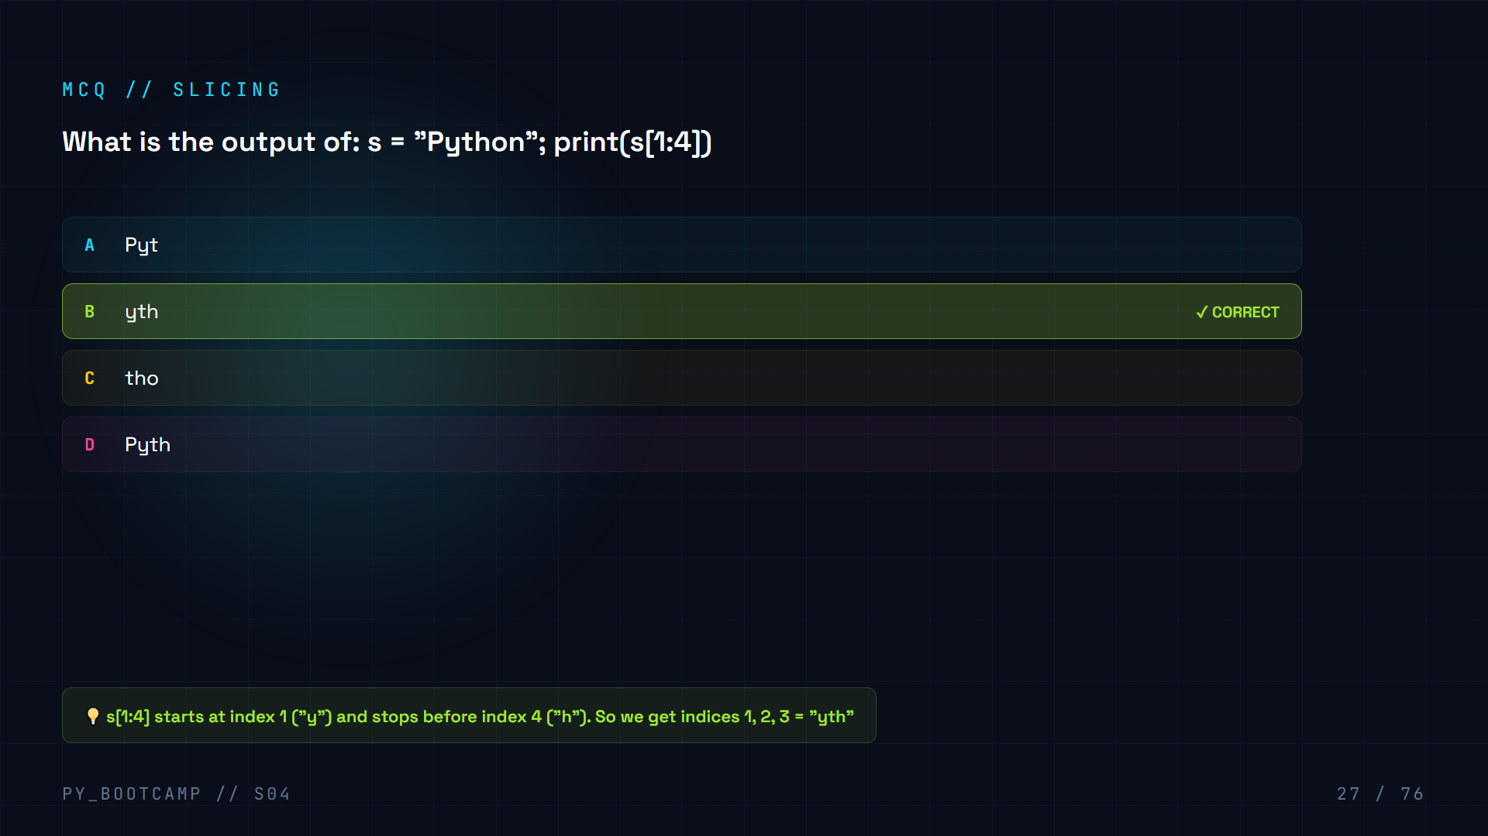

Slide 28
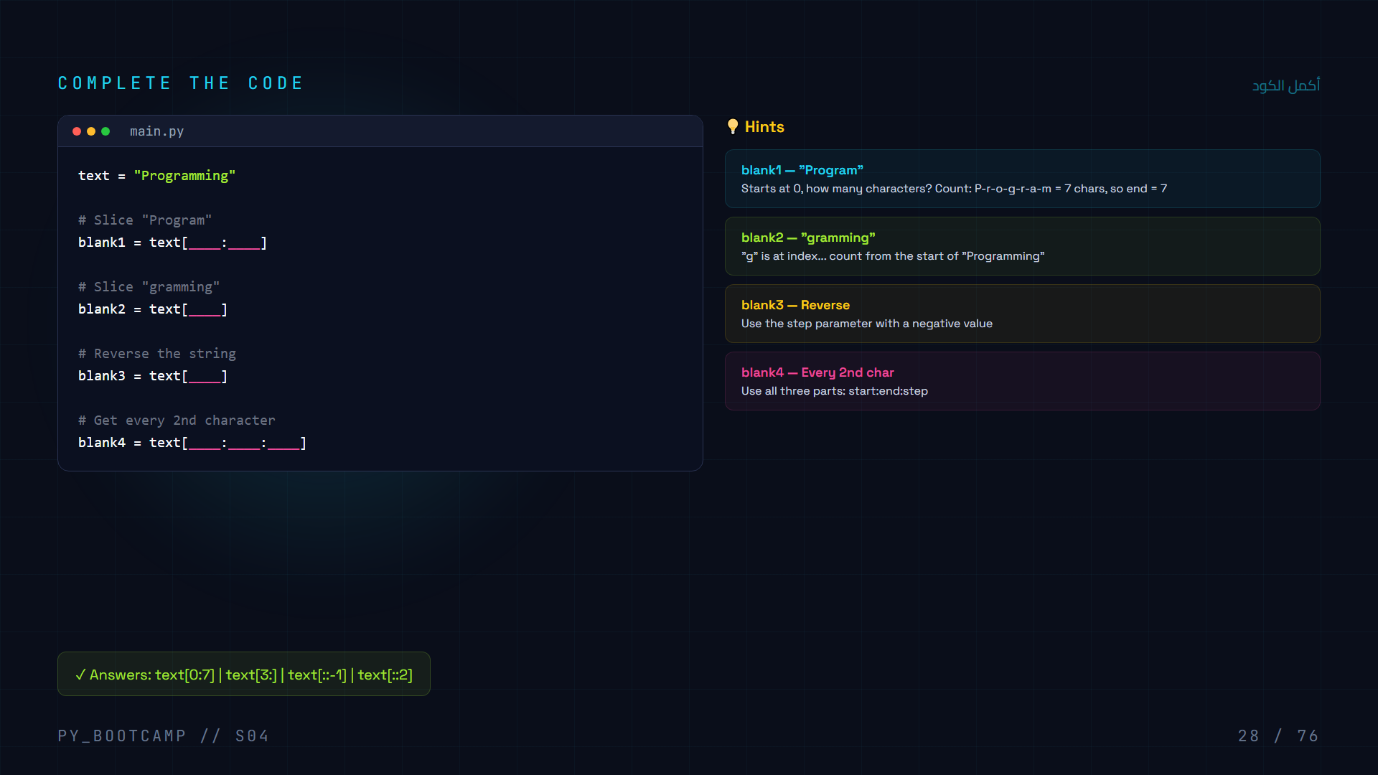
Notes:
Interactive exercise: students fill in the blanks to practice slicing with different parameters.

Slide 29
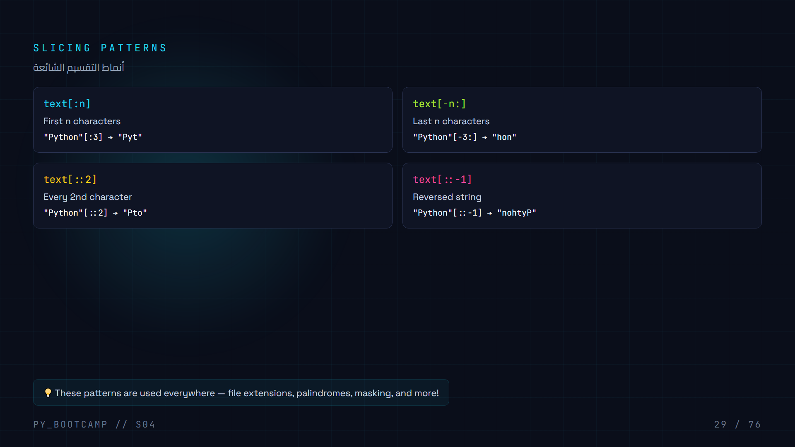

Slide 30
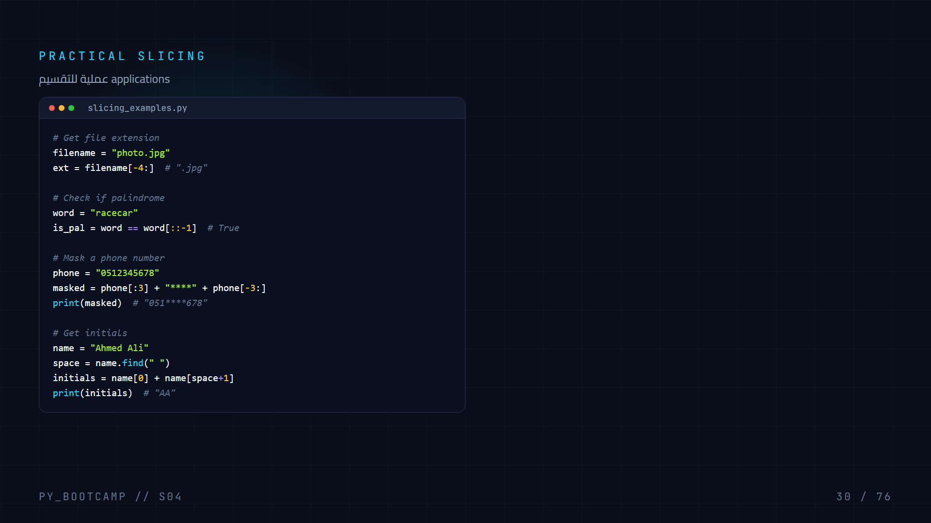

Slide 31
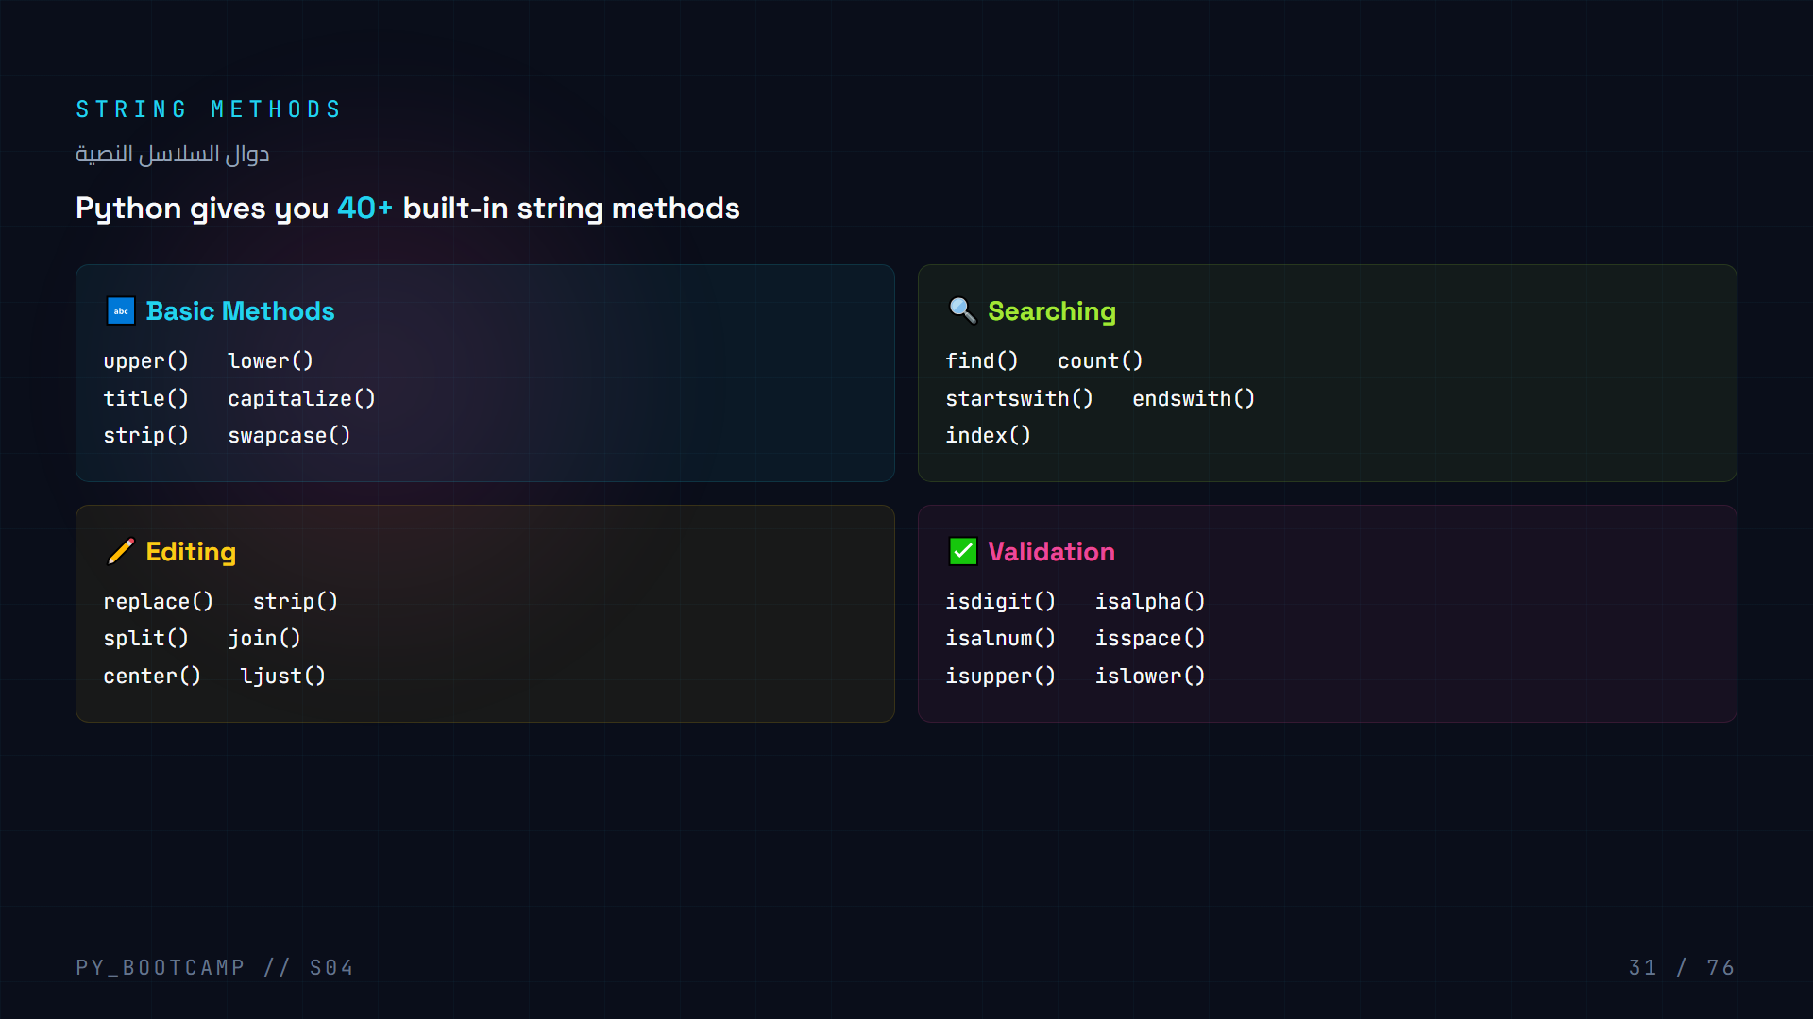

Slide 32
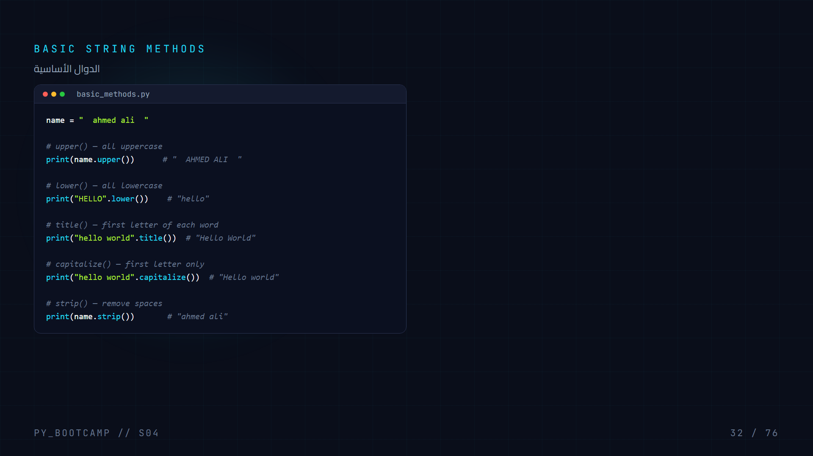

Slide 33
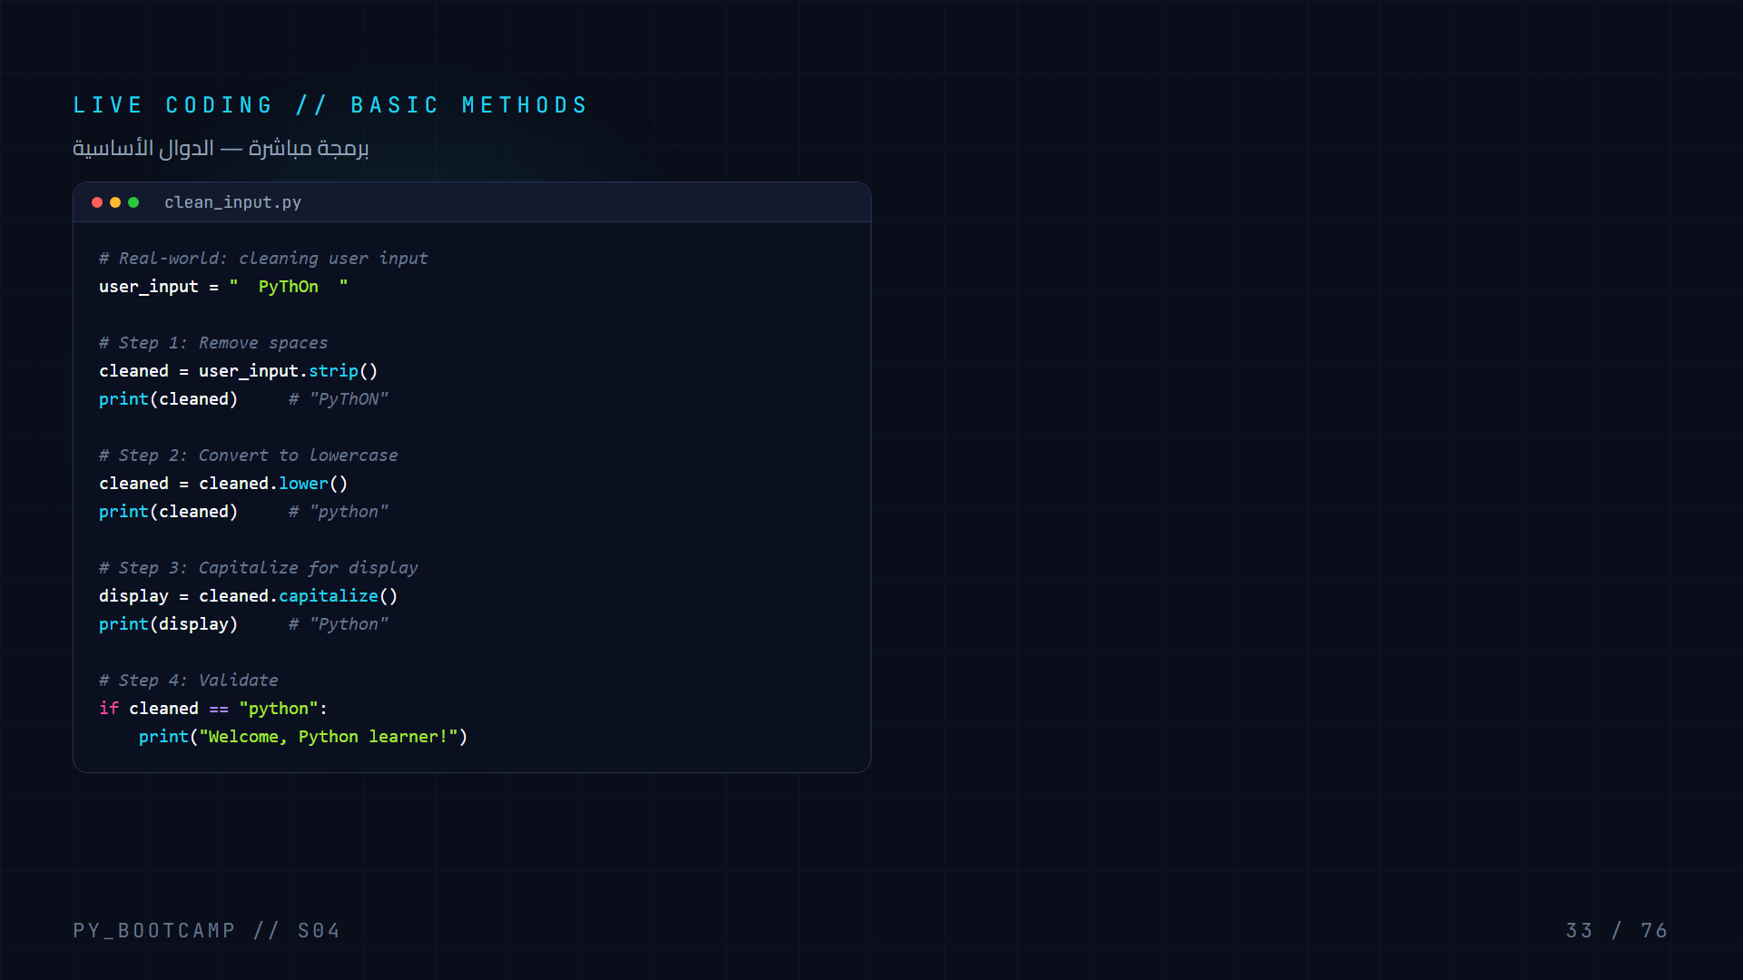

Slide 34
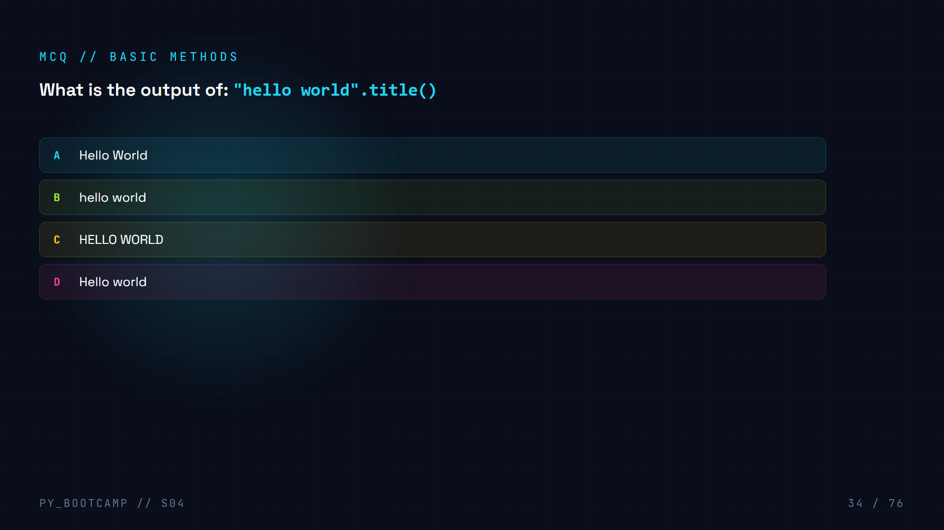

Slide 35
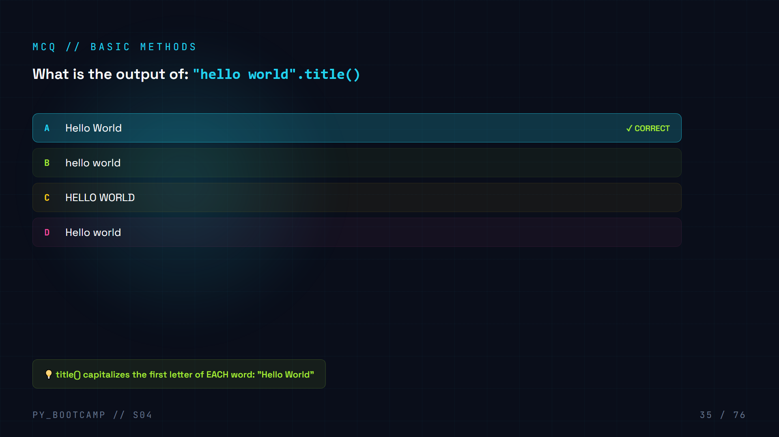

Slide 36
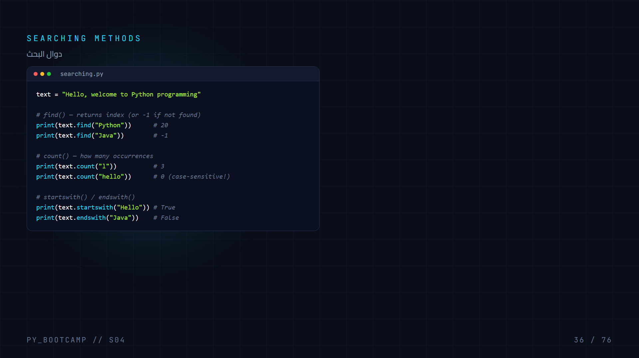

Slide 37
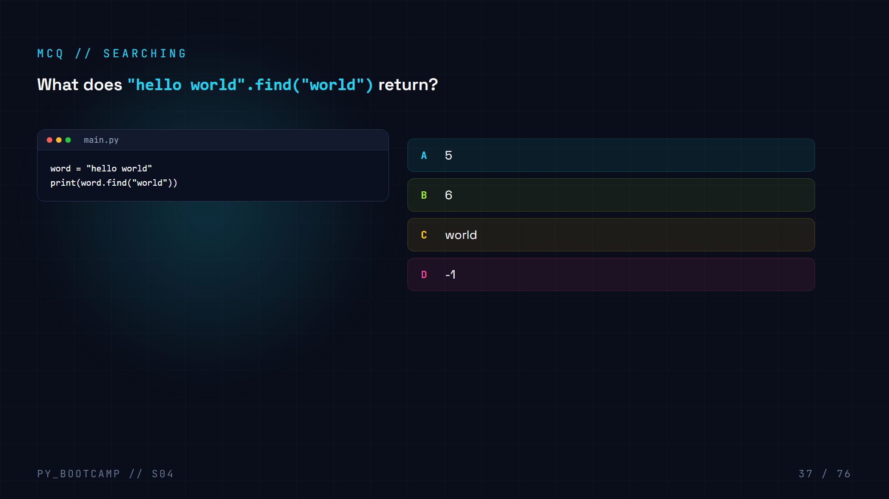

Slide 38
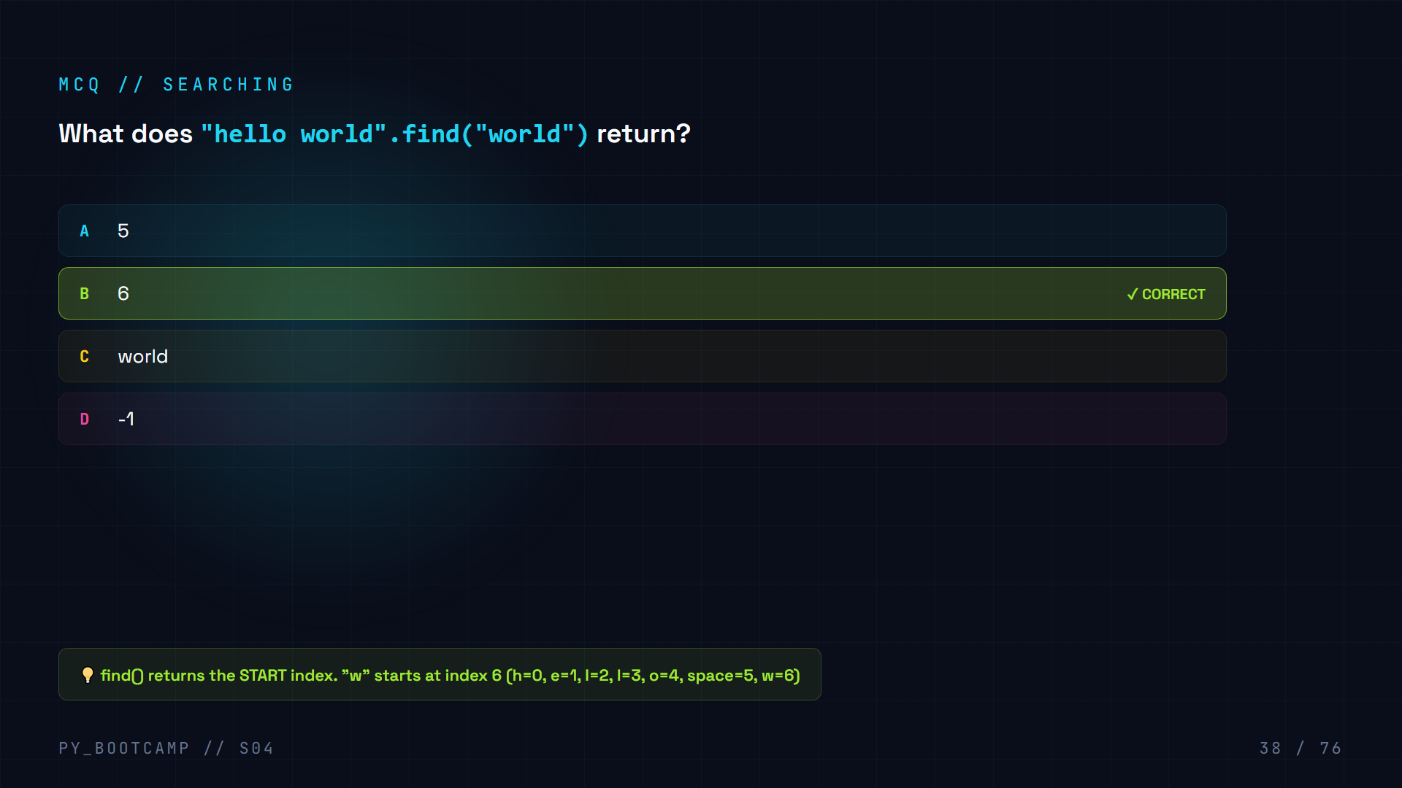

Slide 39
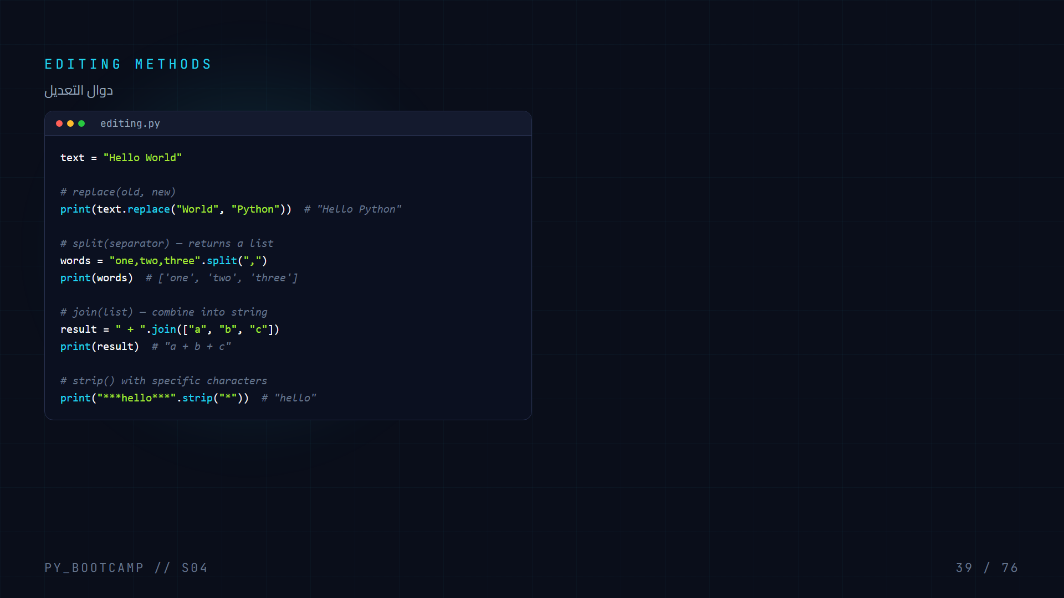

Slide 40
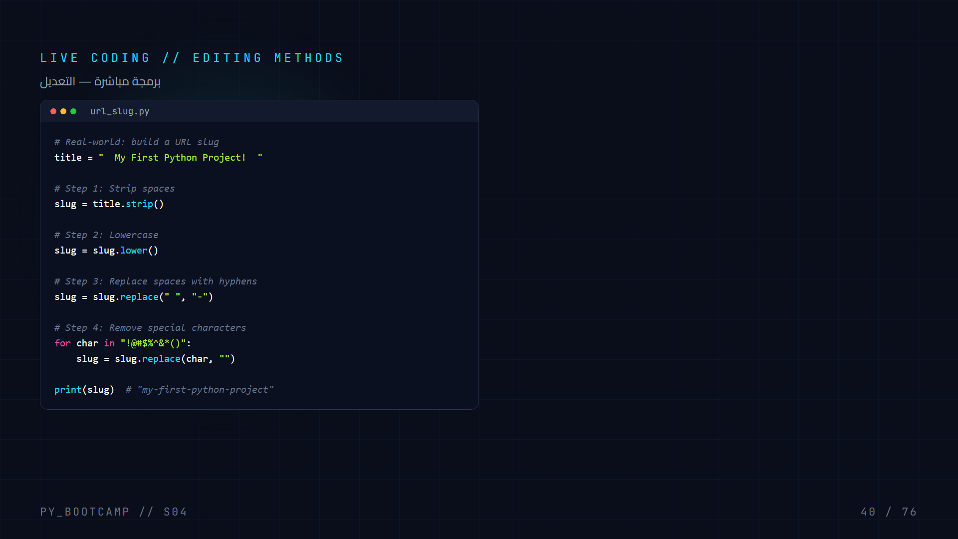

Slide 41
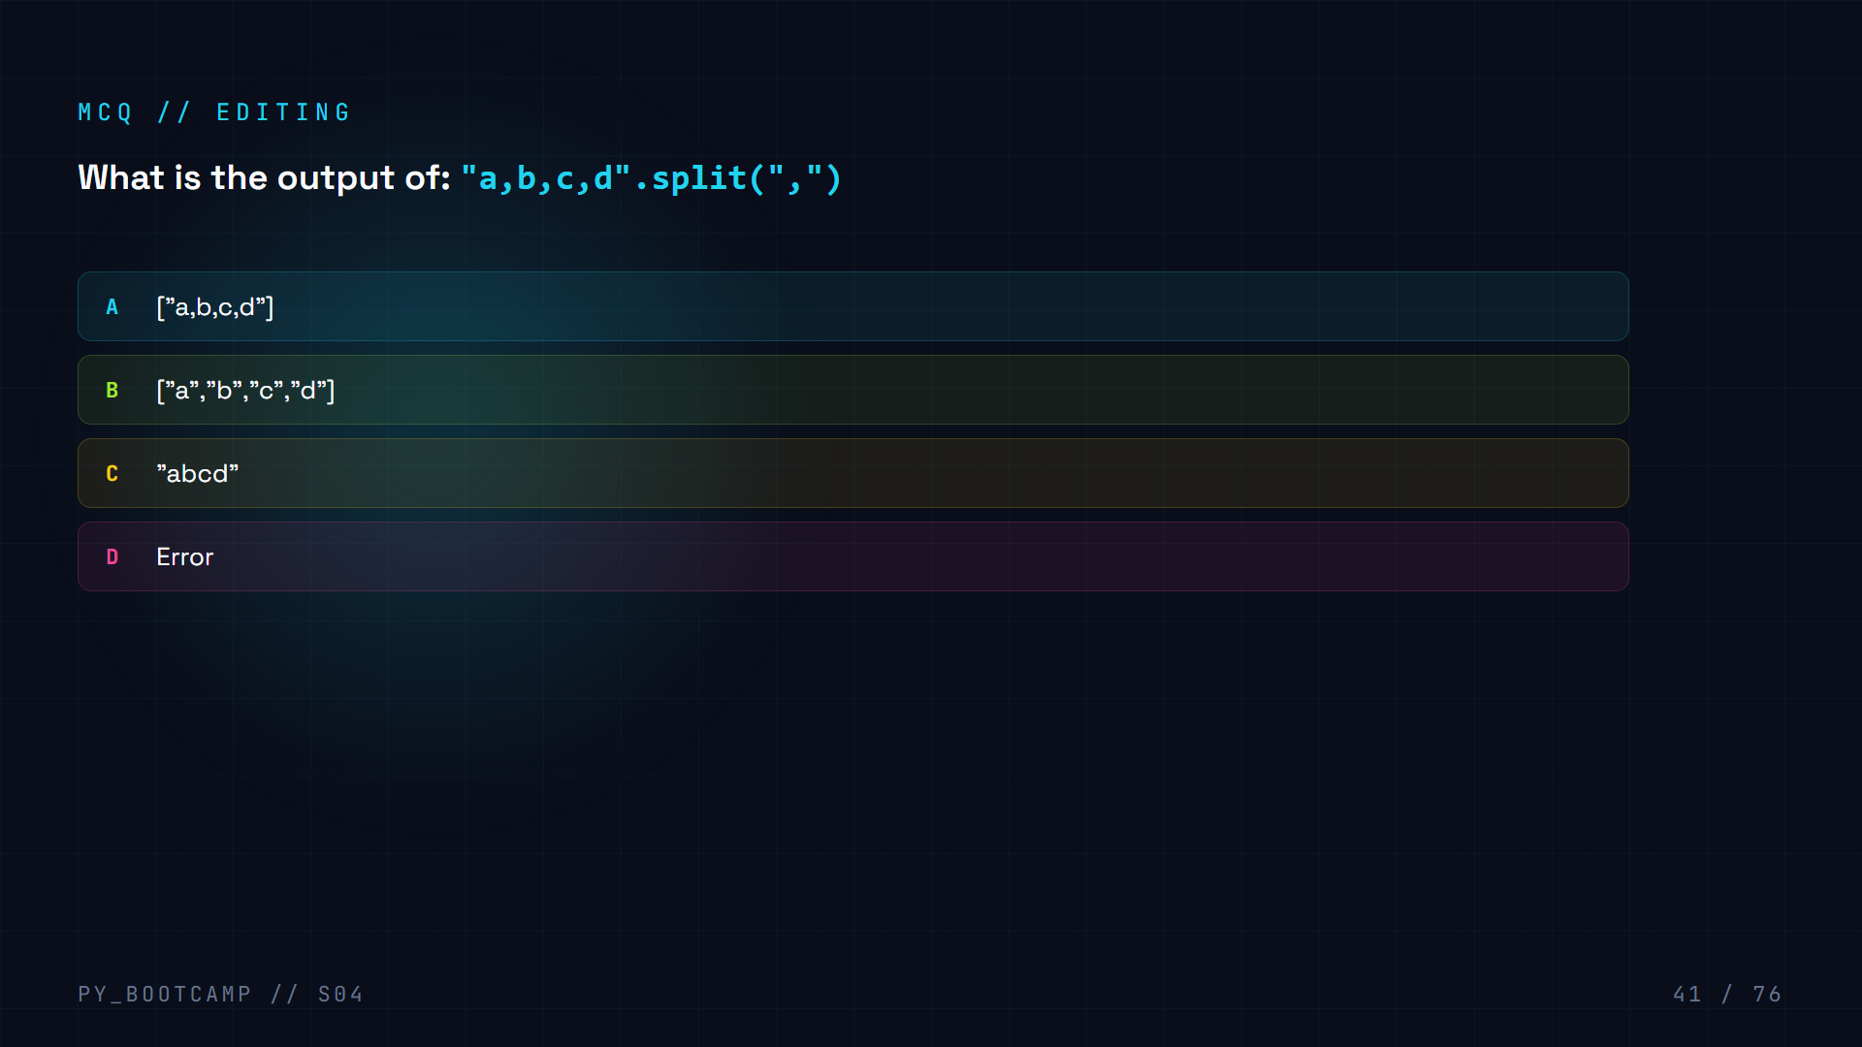

Slide 42
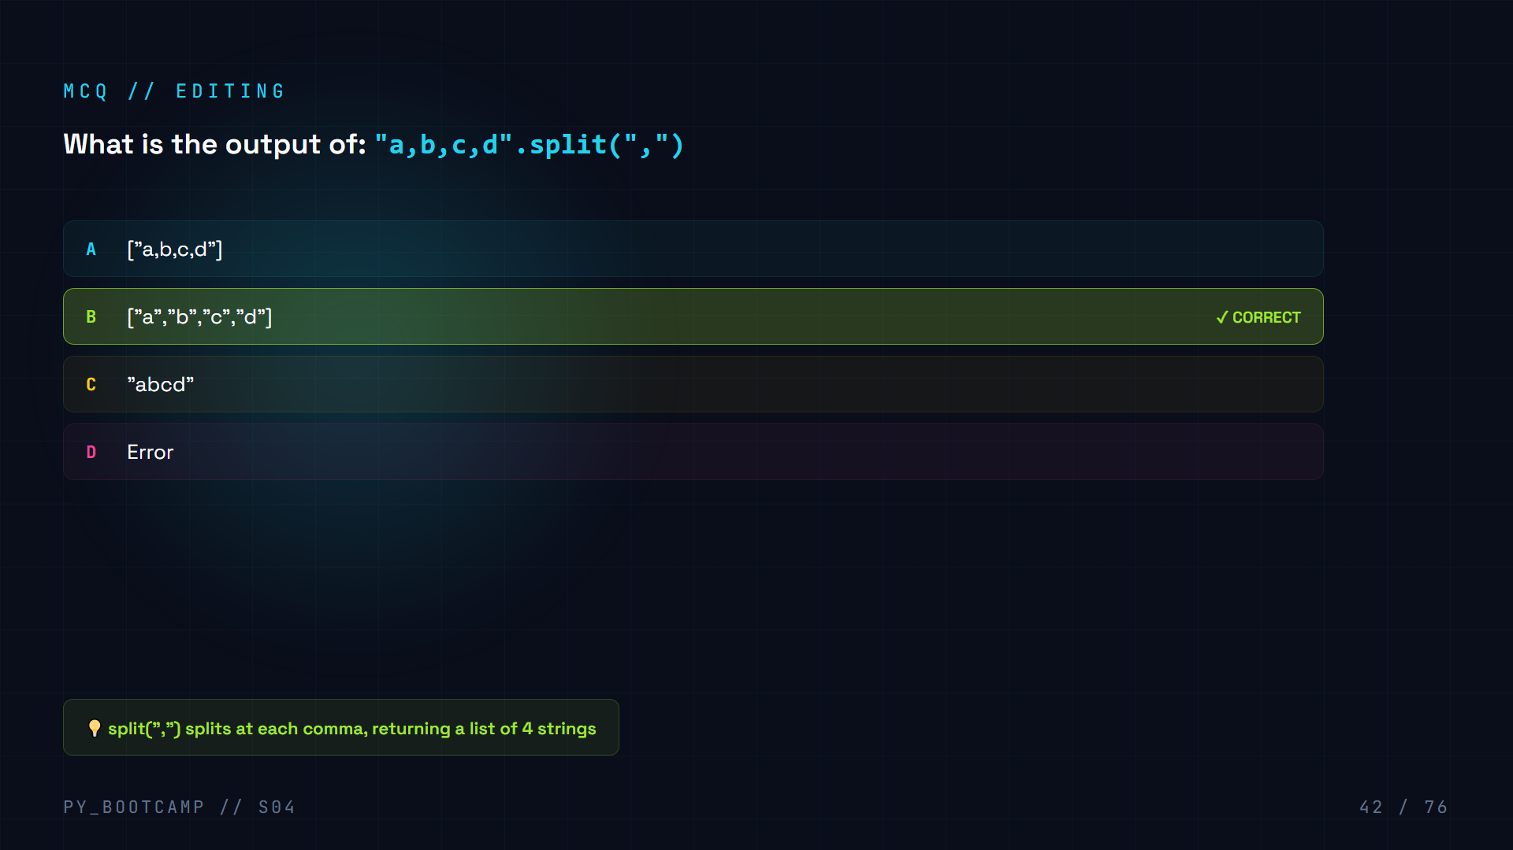

Slide 43
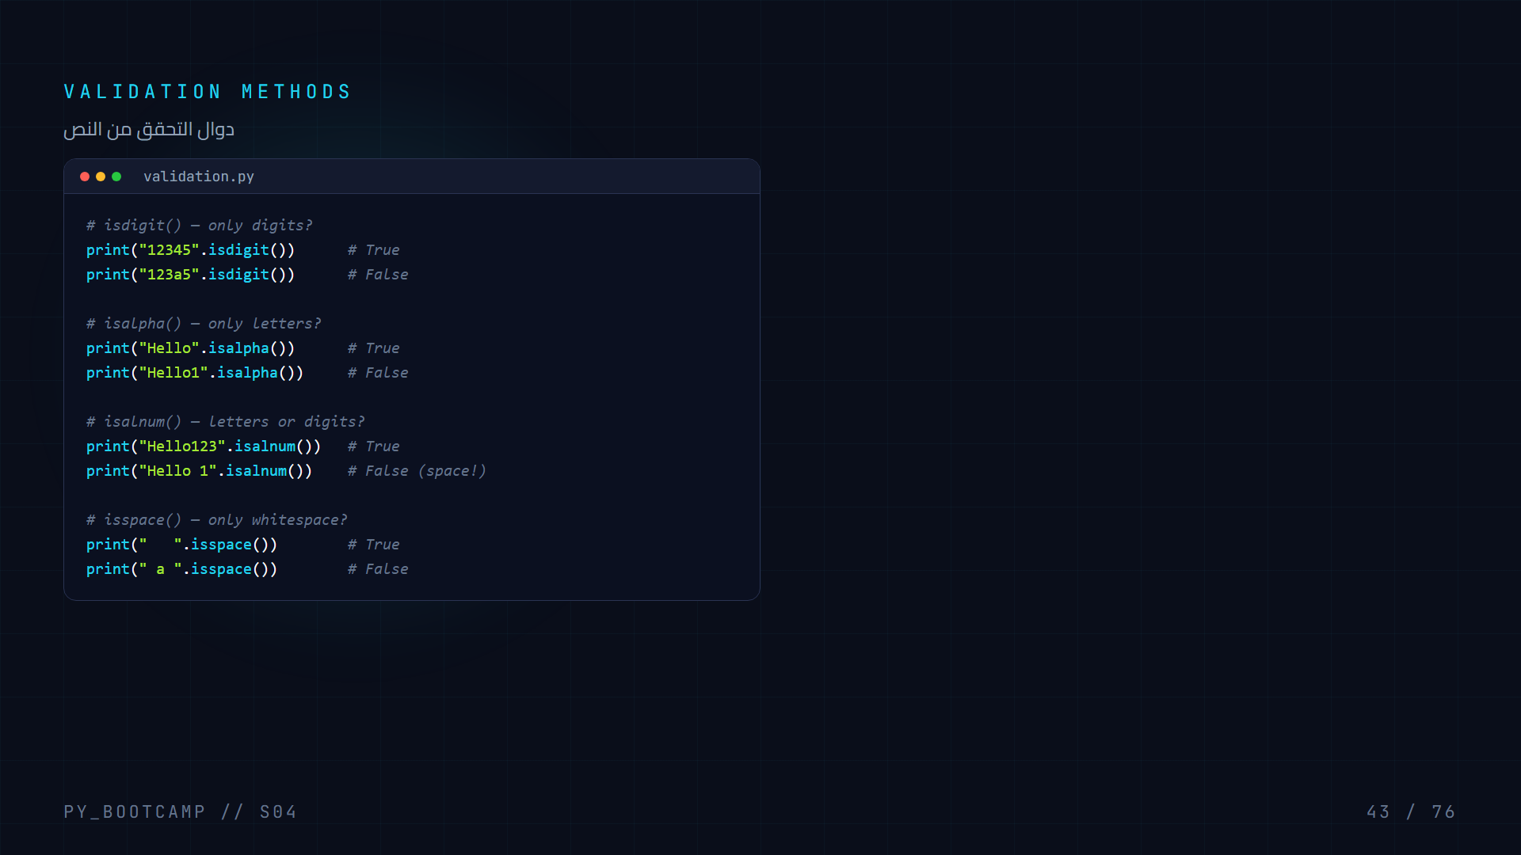

Slide 44


Slide 45


Slide 46
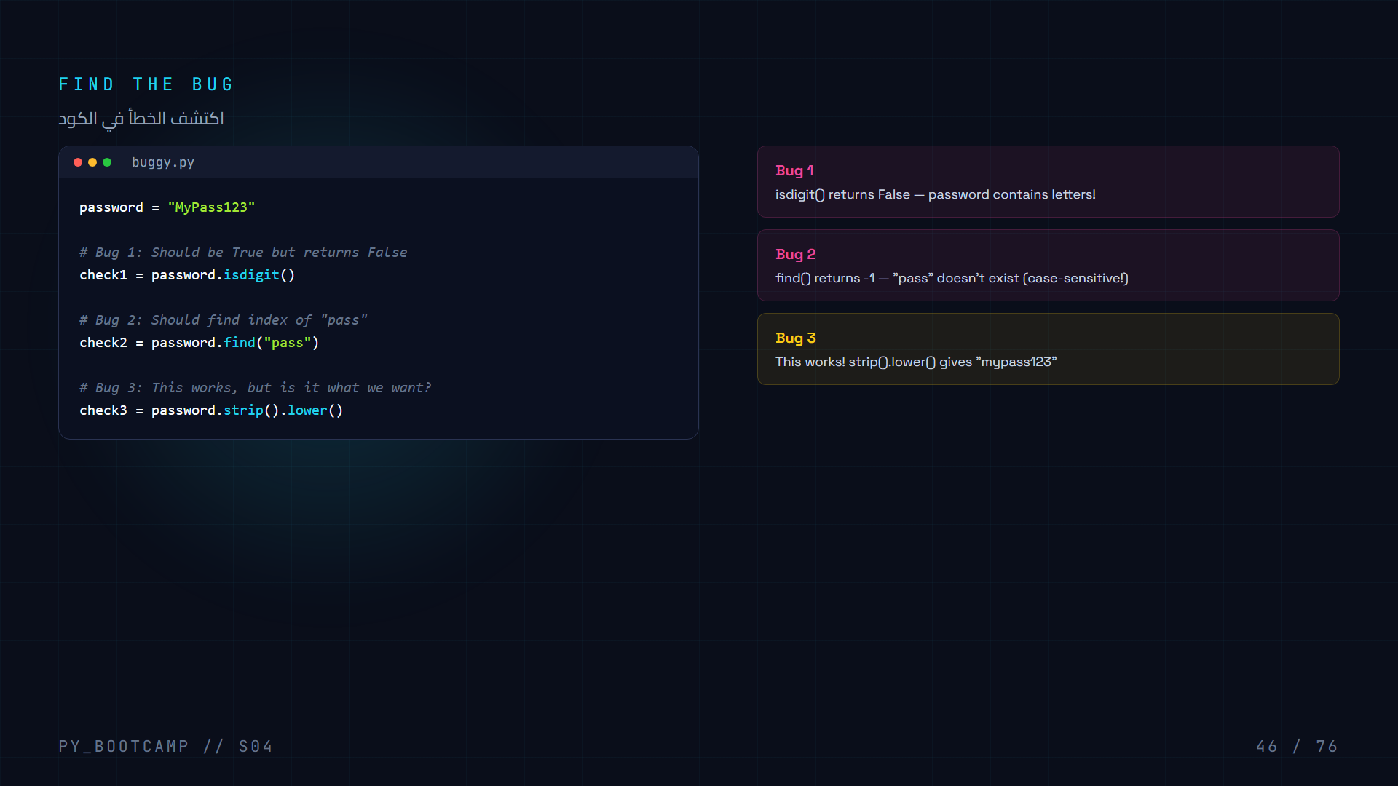

Slide 47
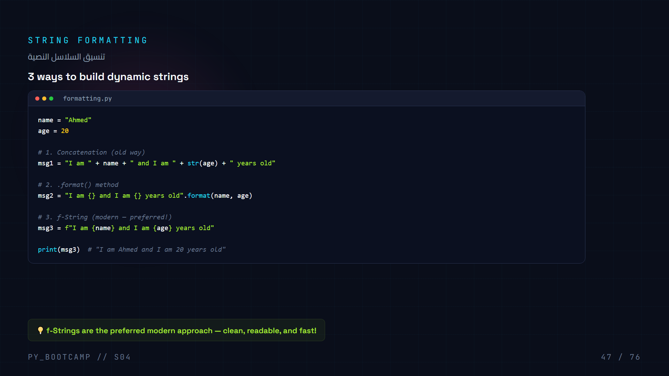

Slide 48
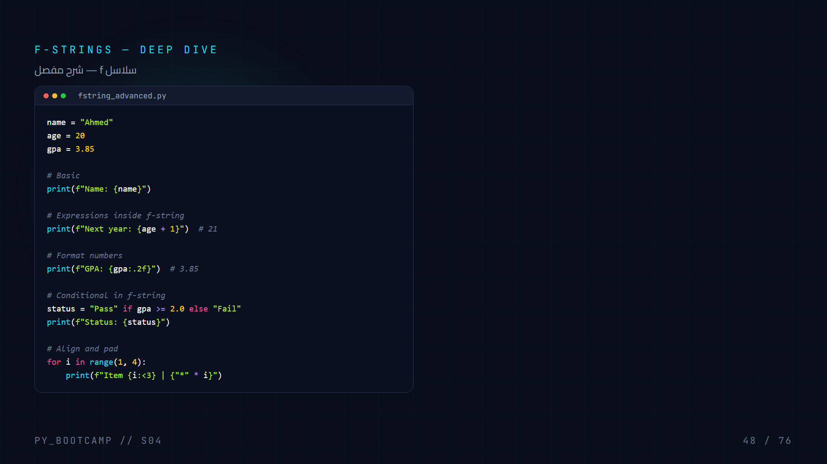

Slide 49
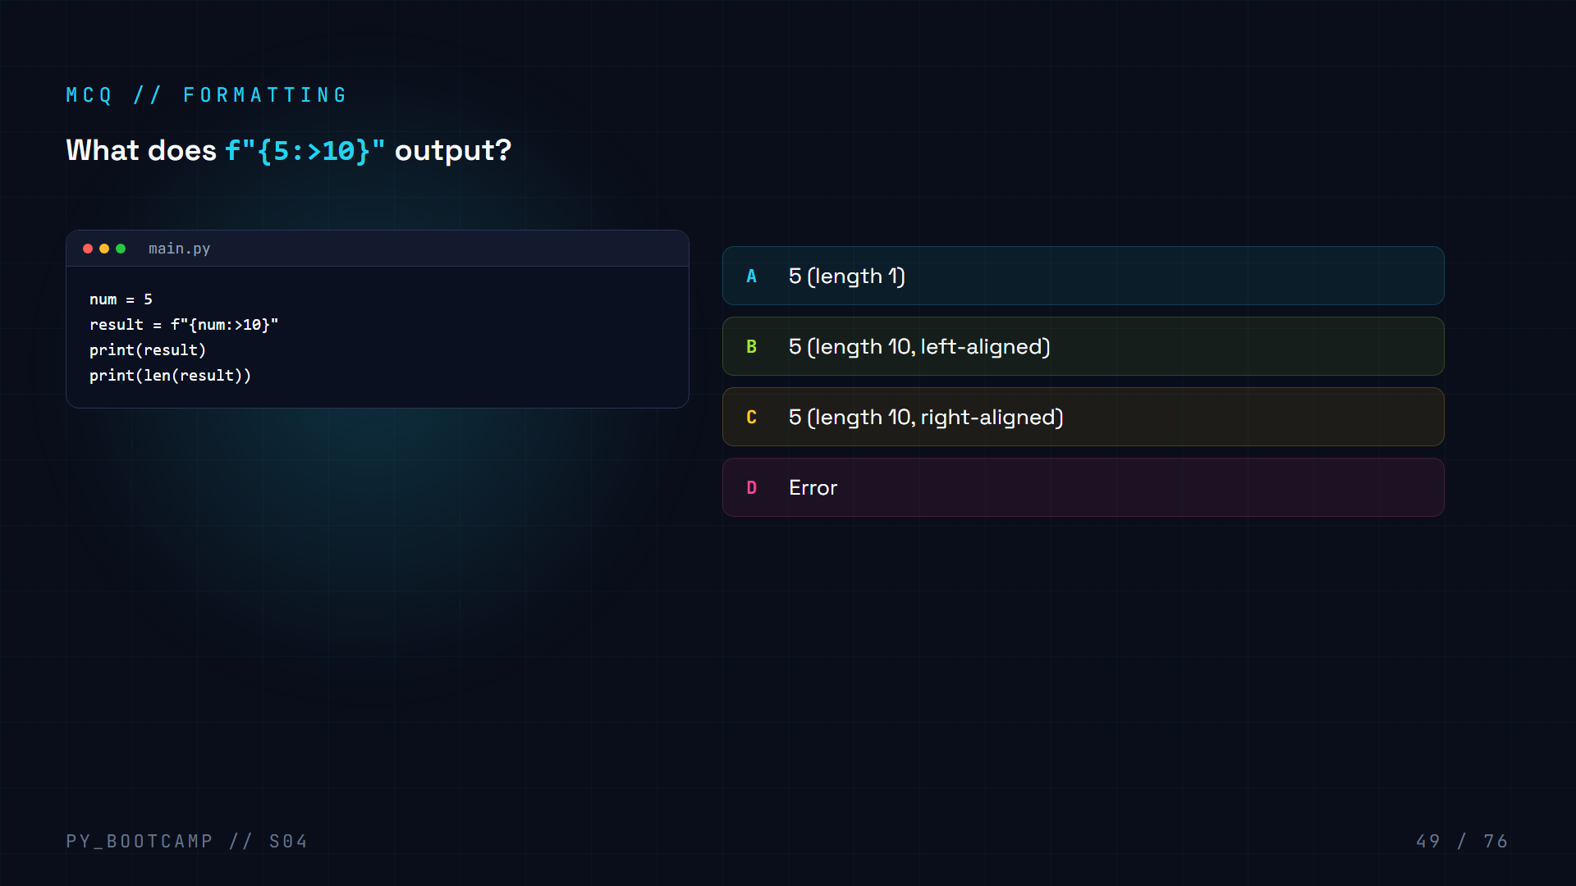

Slide 50
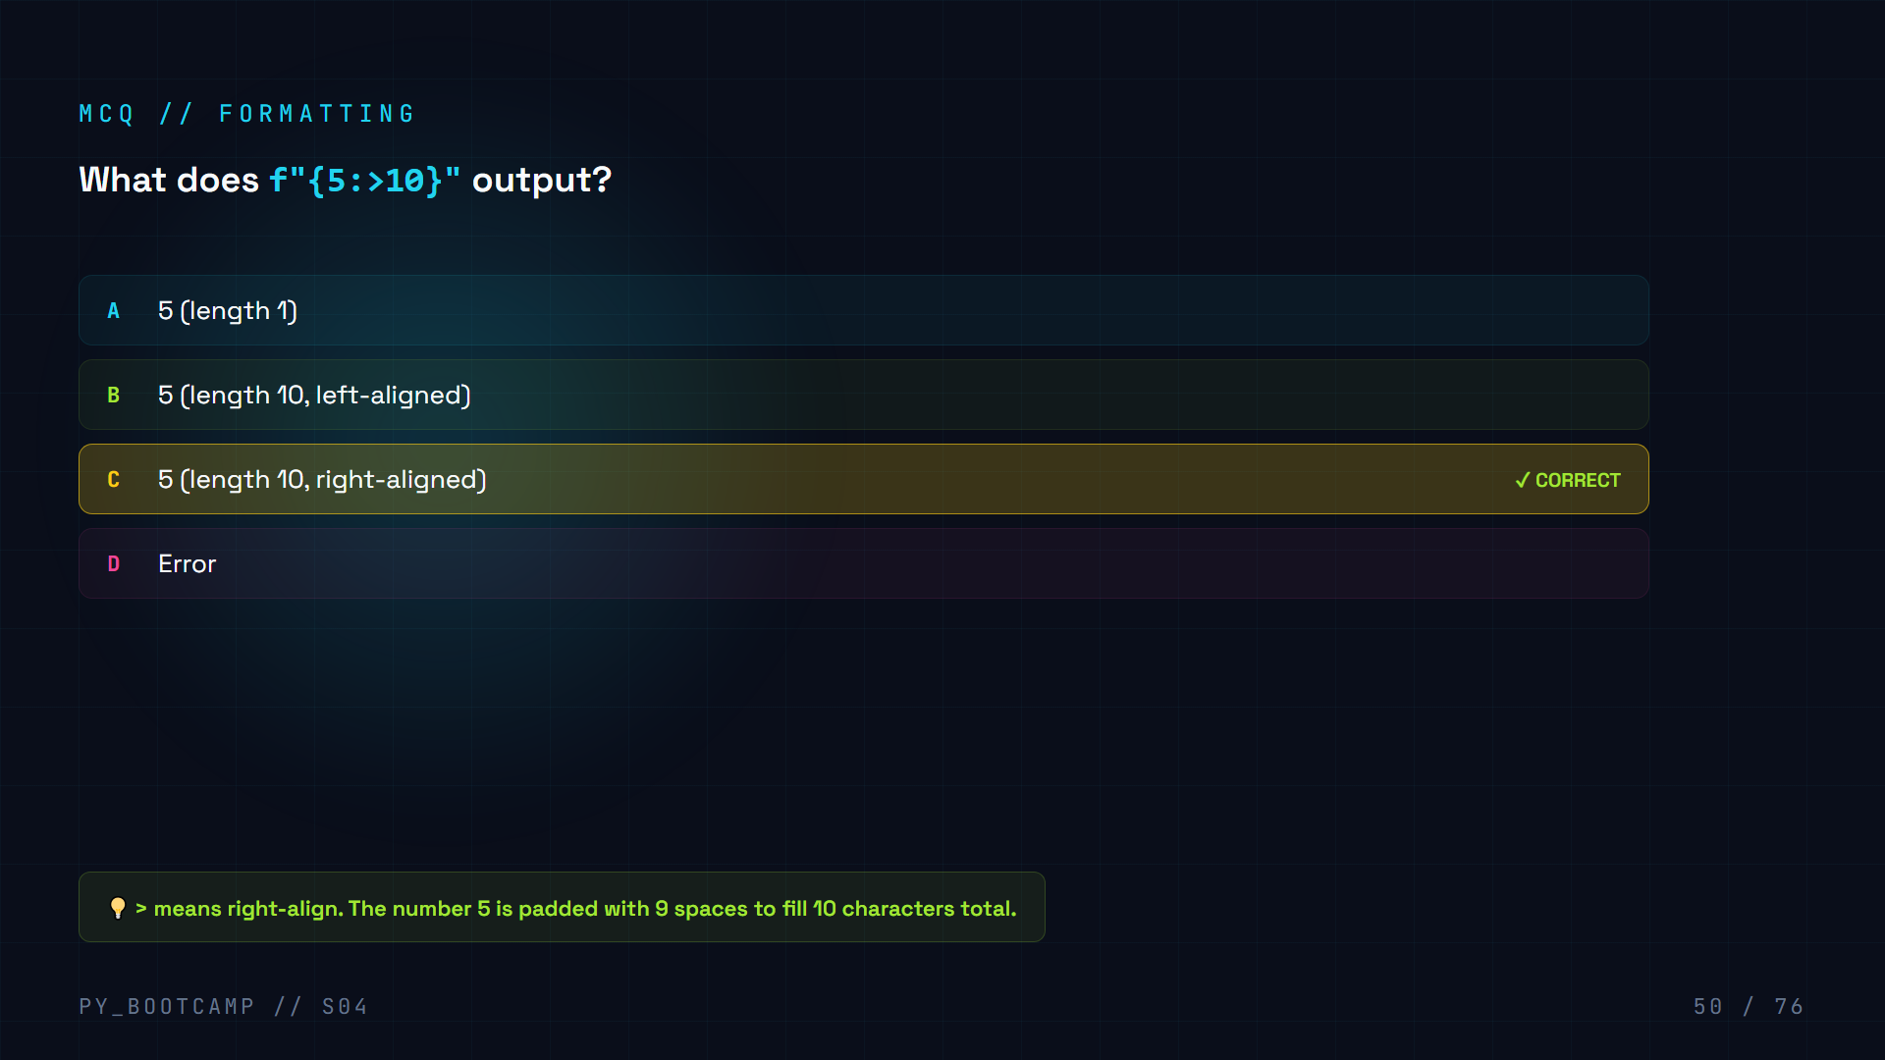

Slide 51
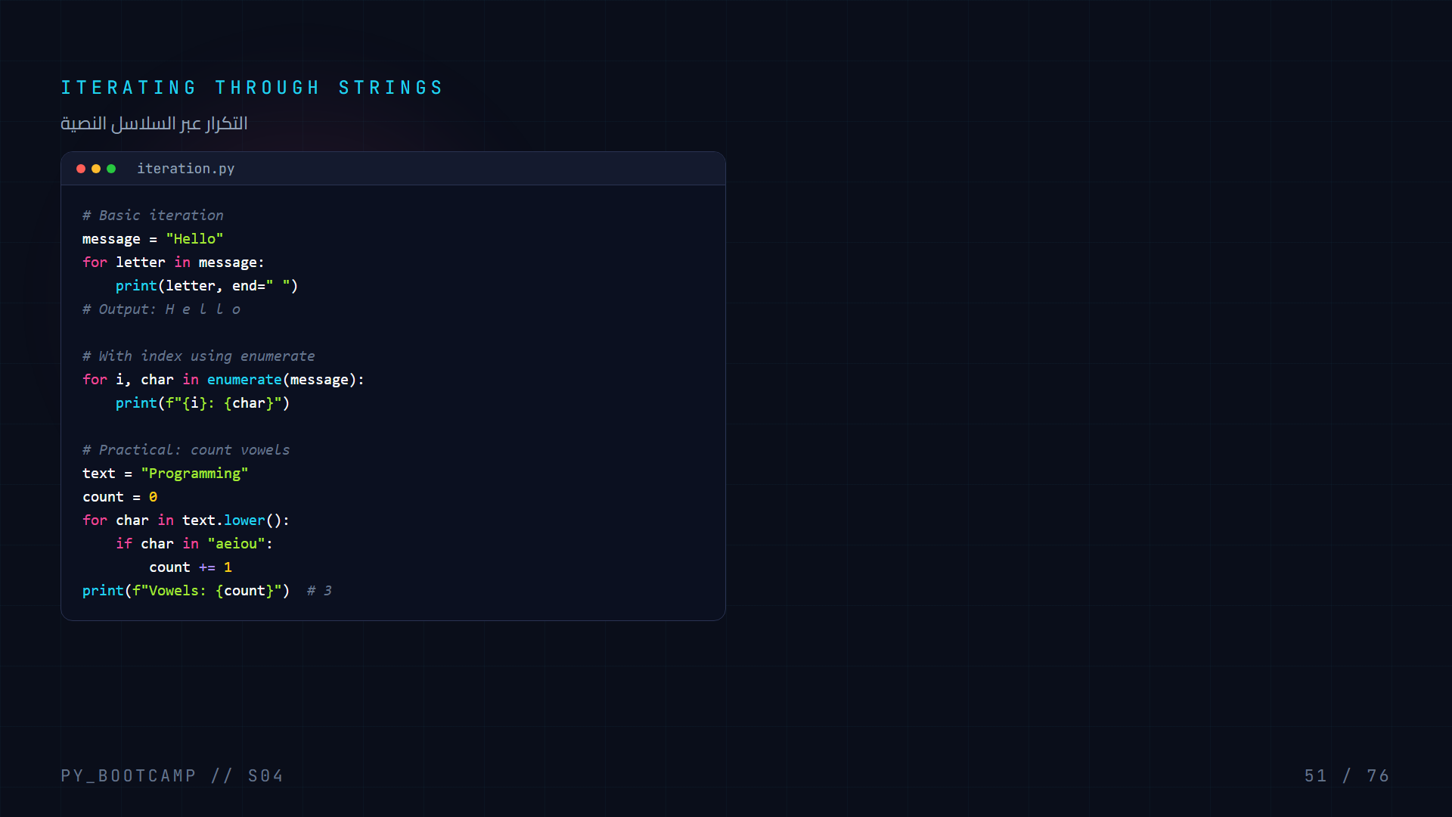

Slide 52
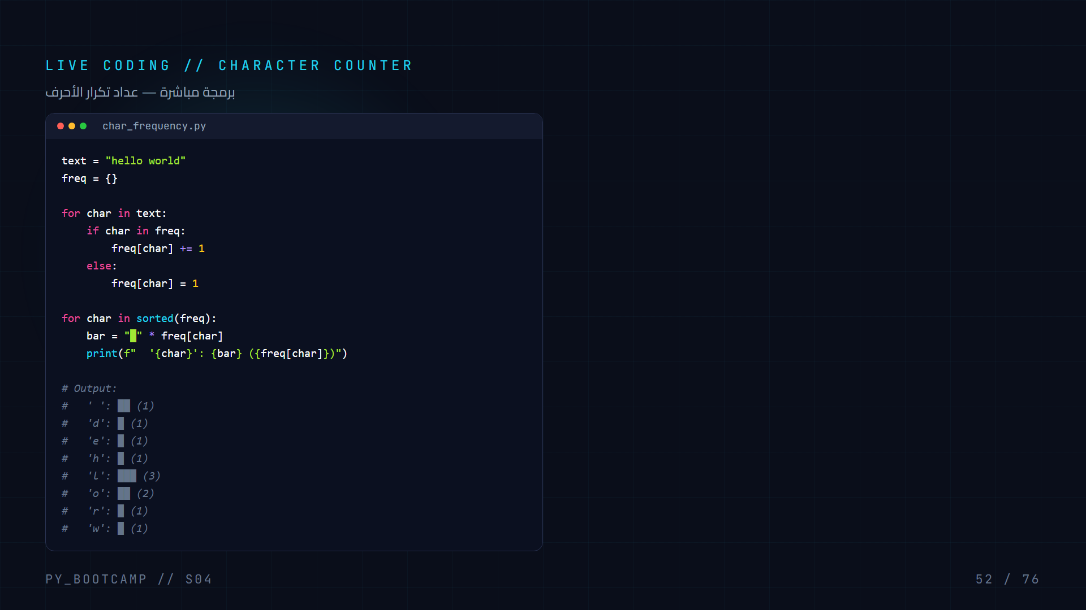

Slide 53


Slide 54


Slide 55


Slide 56


Slide 57


Slide 58


Slide 59


Slide 60


Slide 61


Slide 62


Slide 63


Slide 64


Slide 65


Slide 66


Slide 67


Slide 68


Slide 69


Slide 70


Slide 71


Slide 72


Slide 73


Slide 74


Slide 75


Slide 76


