Slide 1

Notes:
Welcome to Session 05 — Lists and Tuples. Today we cover the two most important collection types in Python: lists (mutable) and tuples (immutable). We build a Student Grade Manager project at the end.

Slide 2
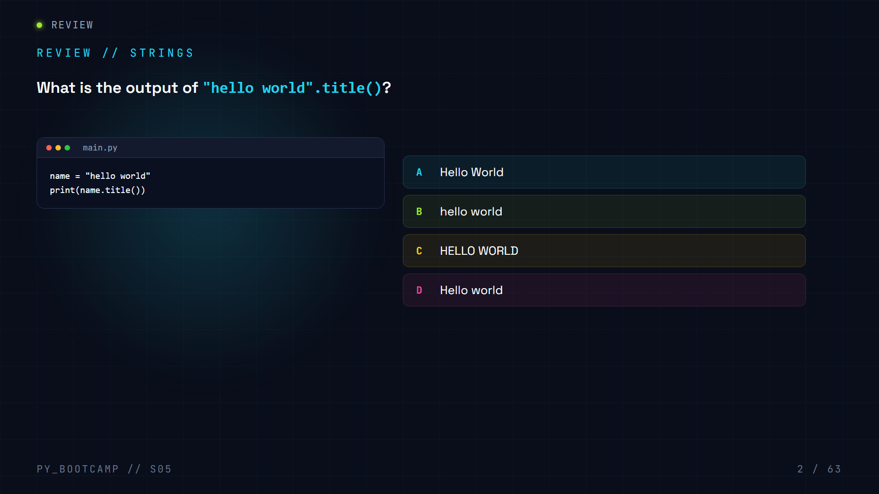

Slide 3
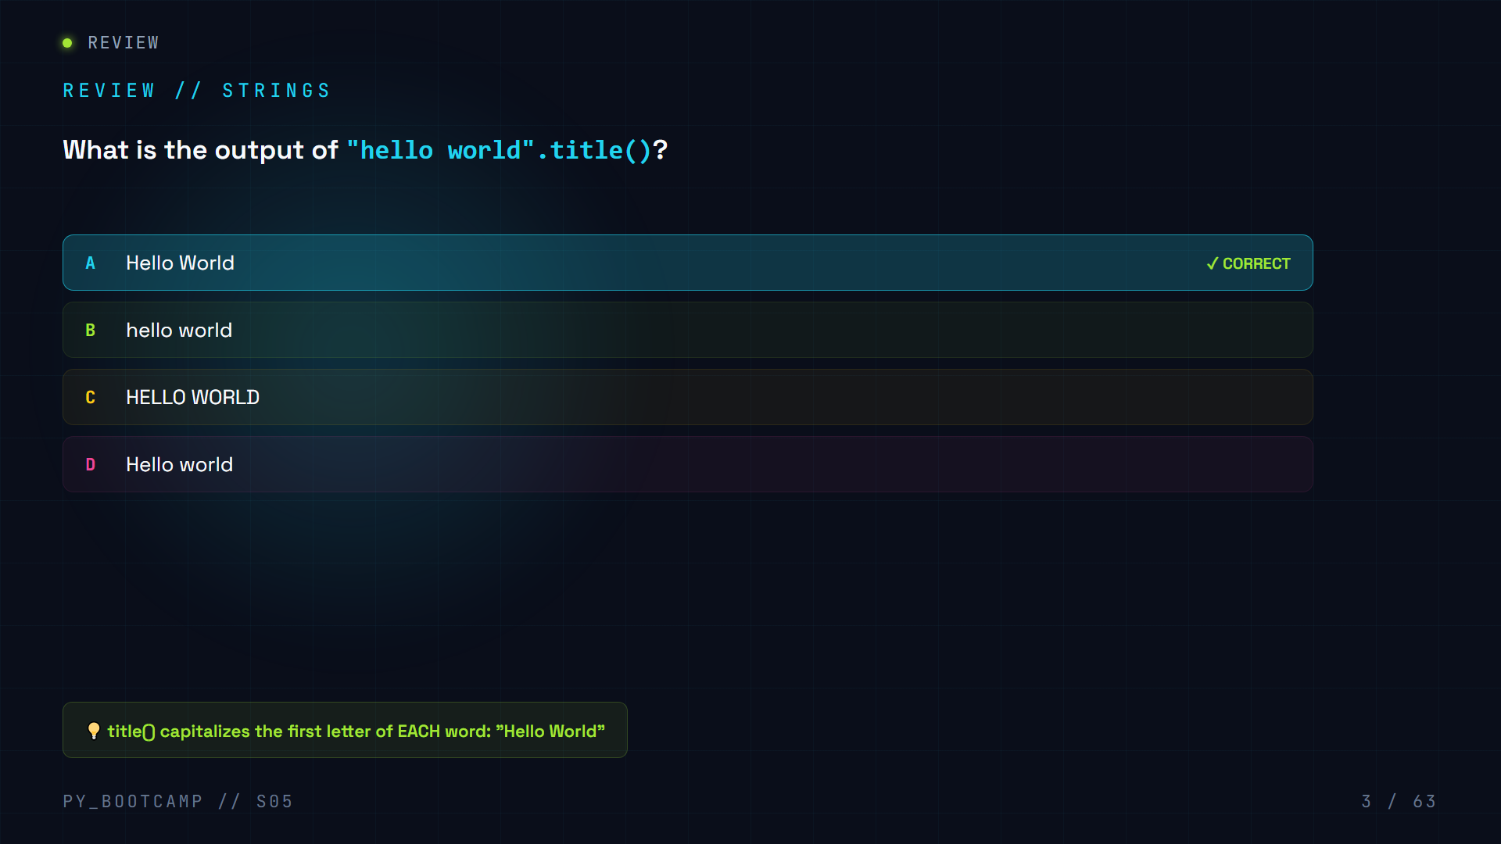

Slide 4
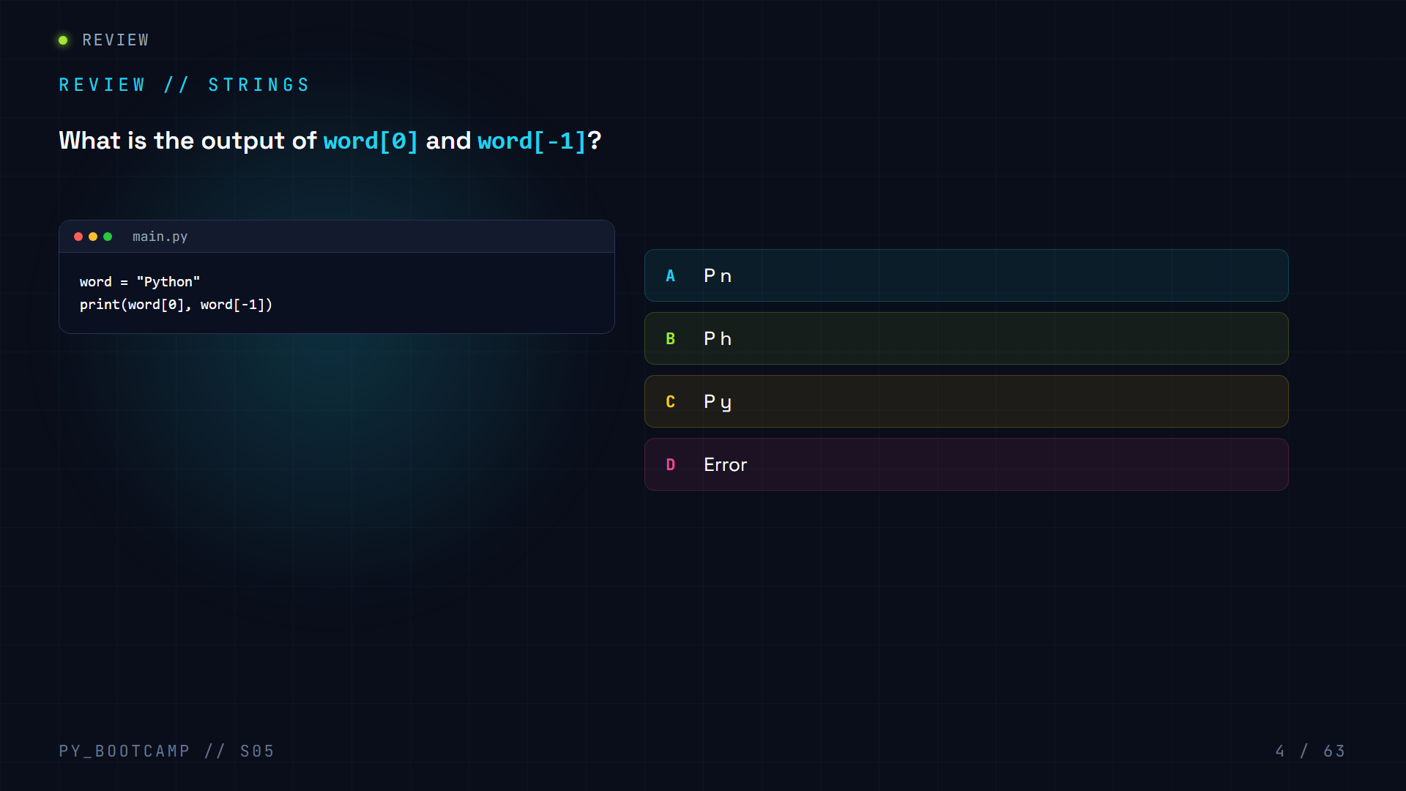

Slide 5
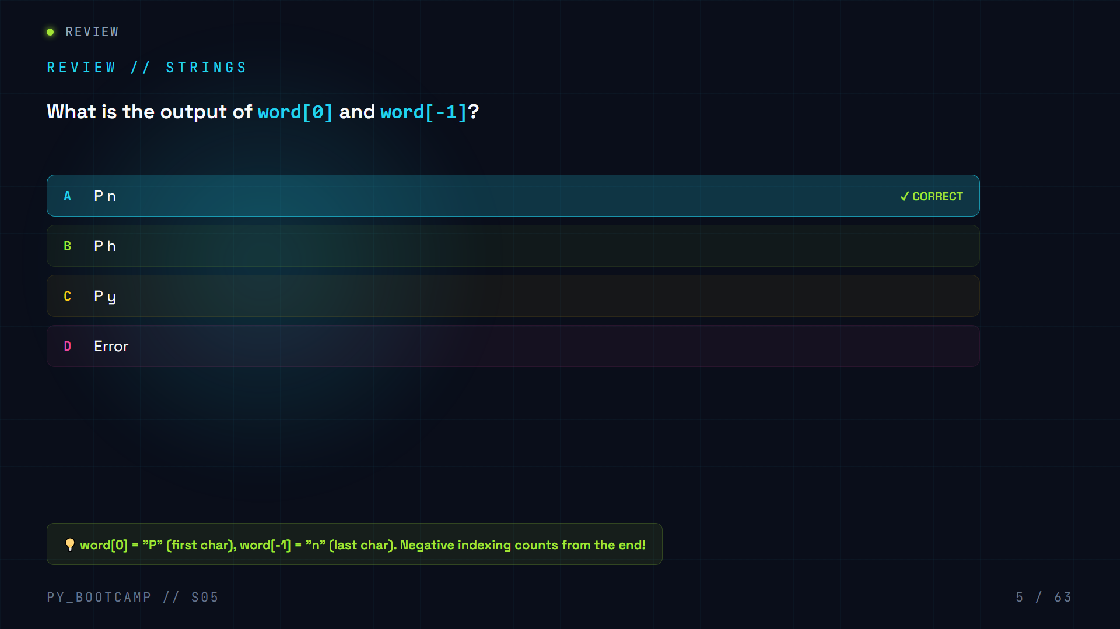

Slide 6
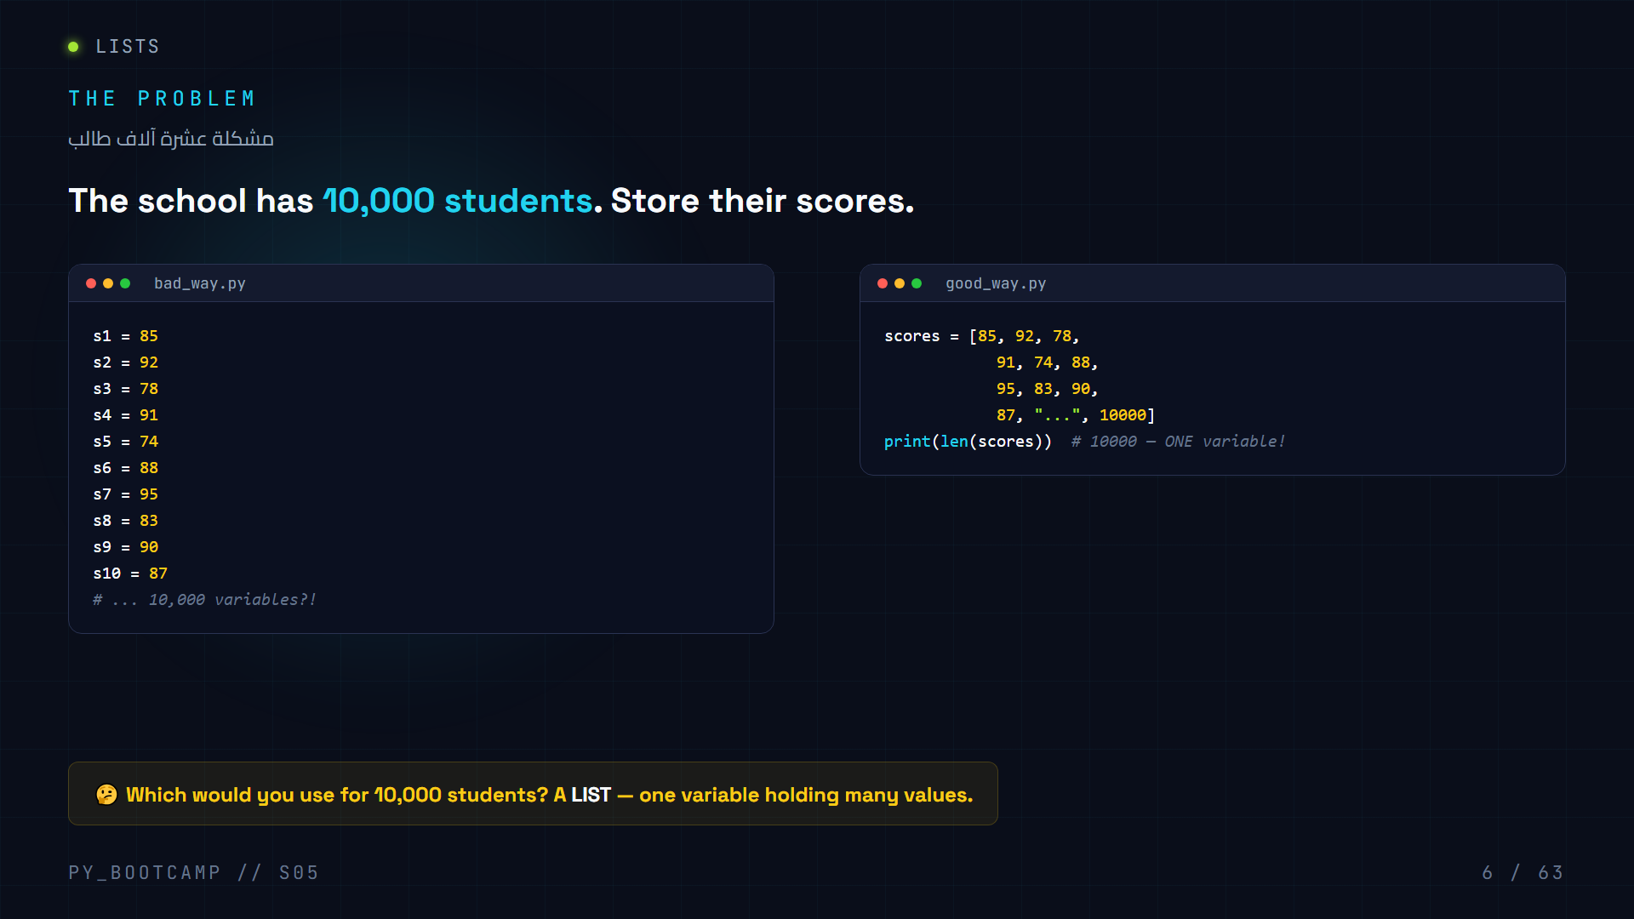
Notes:
Hook: introduce the 10,000-student problem. Separate variables explode; one list stores everything. This motivates the whole session.

Slide 7
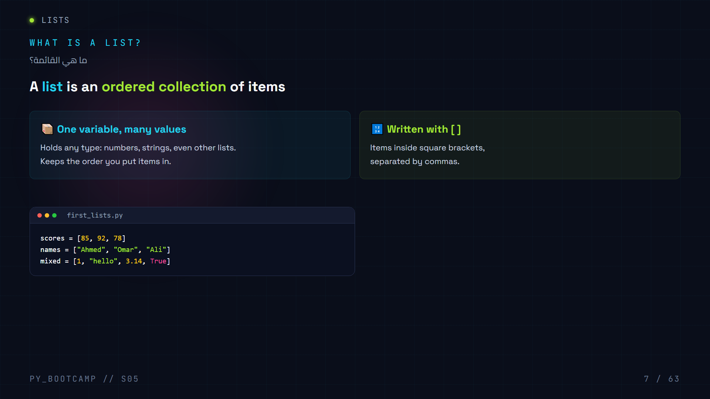
Notes:
Define a list: ordered collection of items, written with square brackets, can hold mixed types.

Slide 8
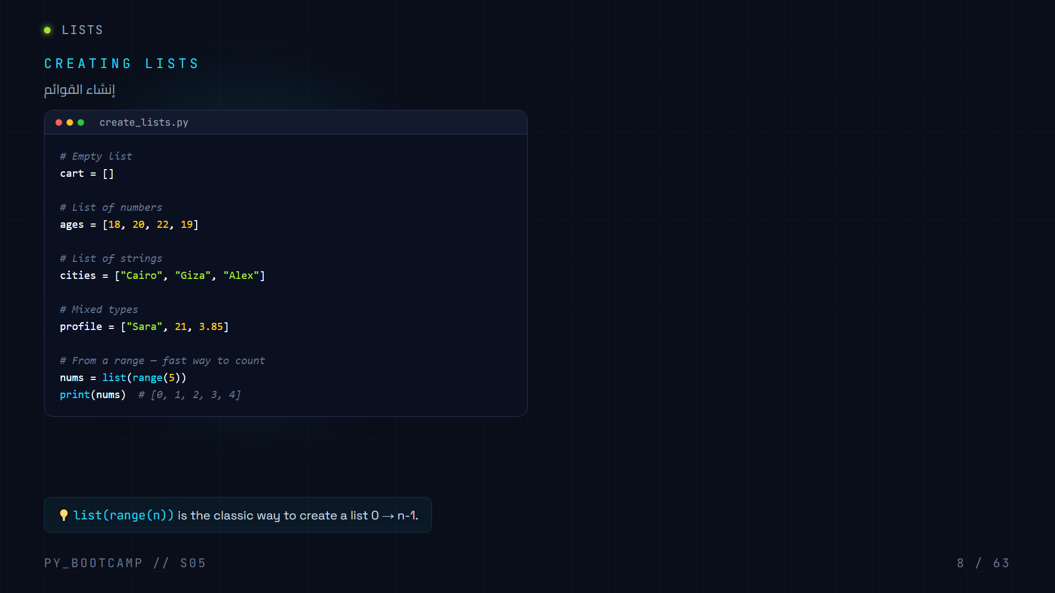
Notes:
Five ways to create lists: empty, numbers, strings, mixed, and from range().

Slide 9
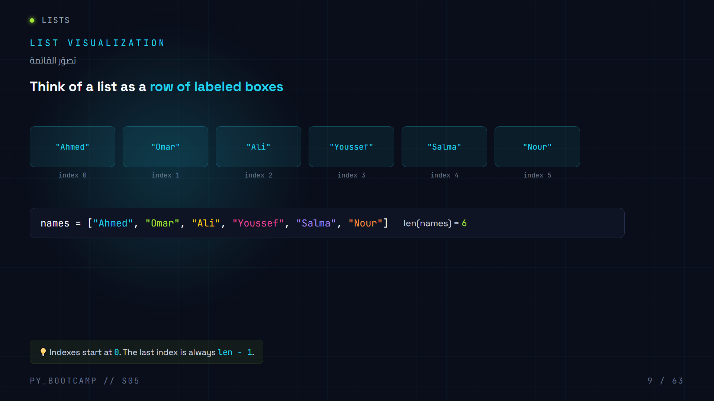
Notes:
Visualize a list as labeled boxes. Emphasize index starts at 0, last index is len-1.

Slide 10
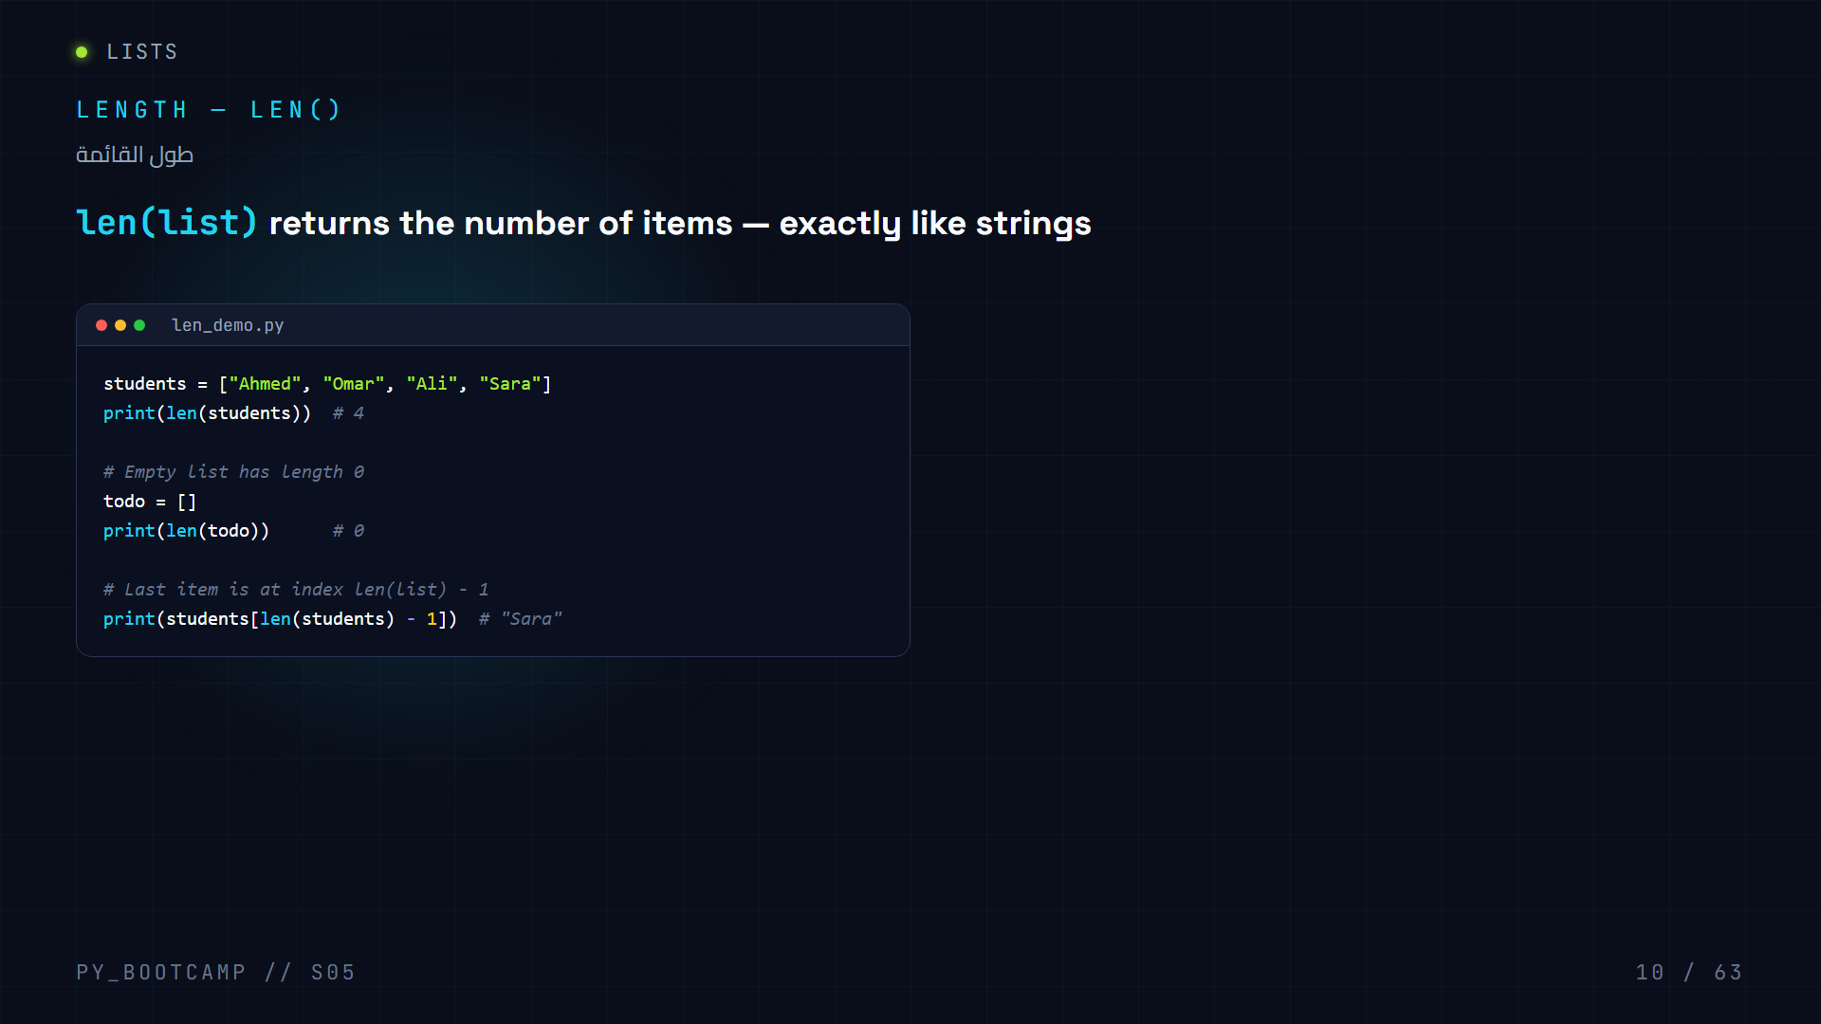
Notes:
len() works on lists exactly like strings. Length of empty list is 0. Last index = len - 1.

Slide 11
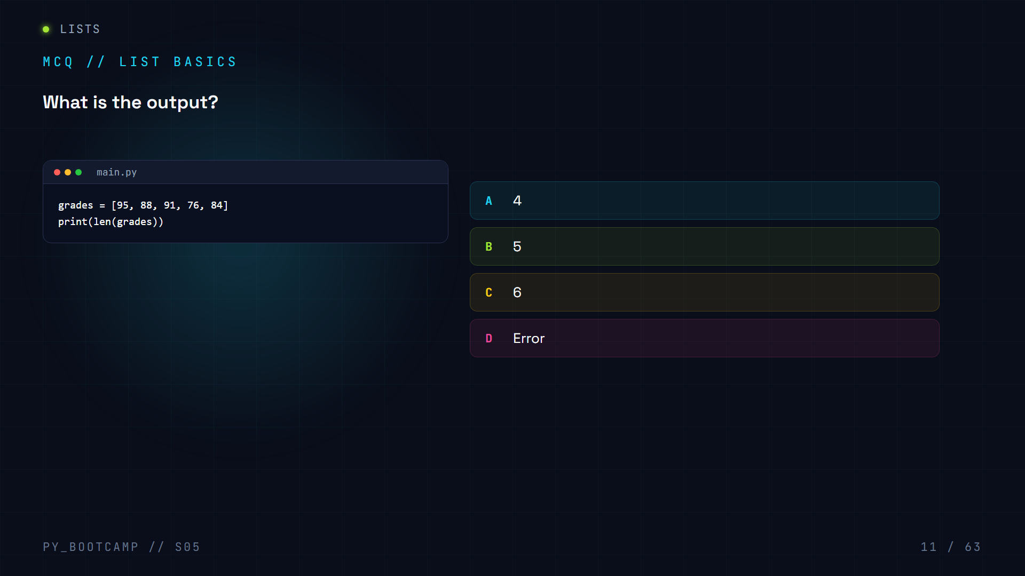

Slide 12
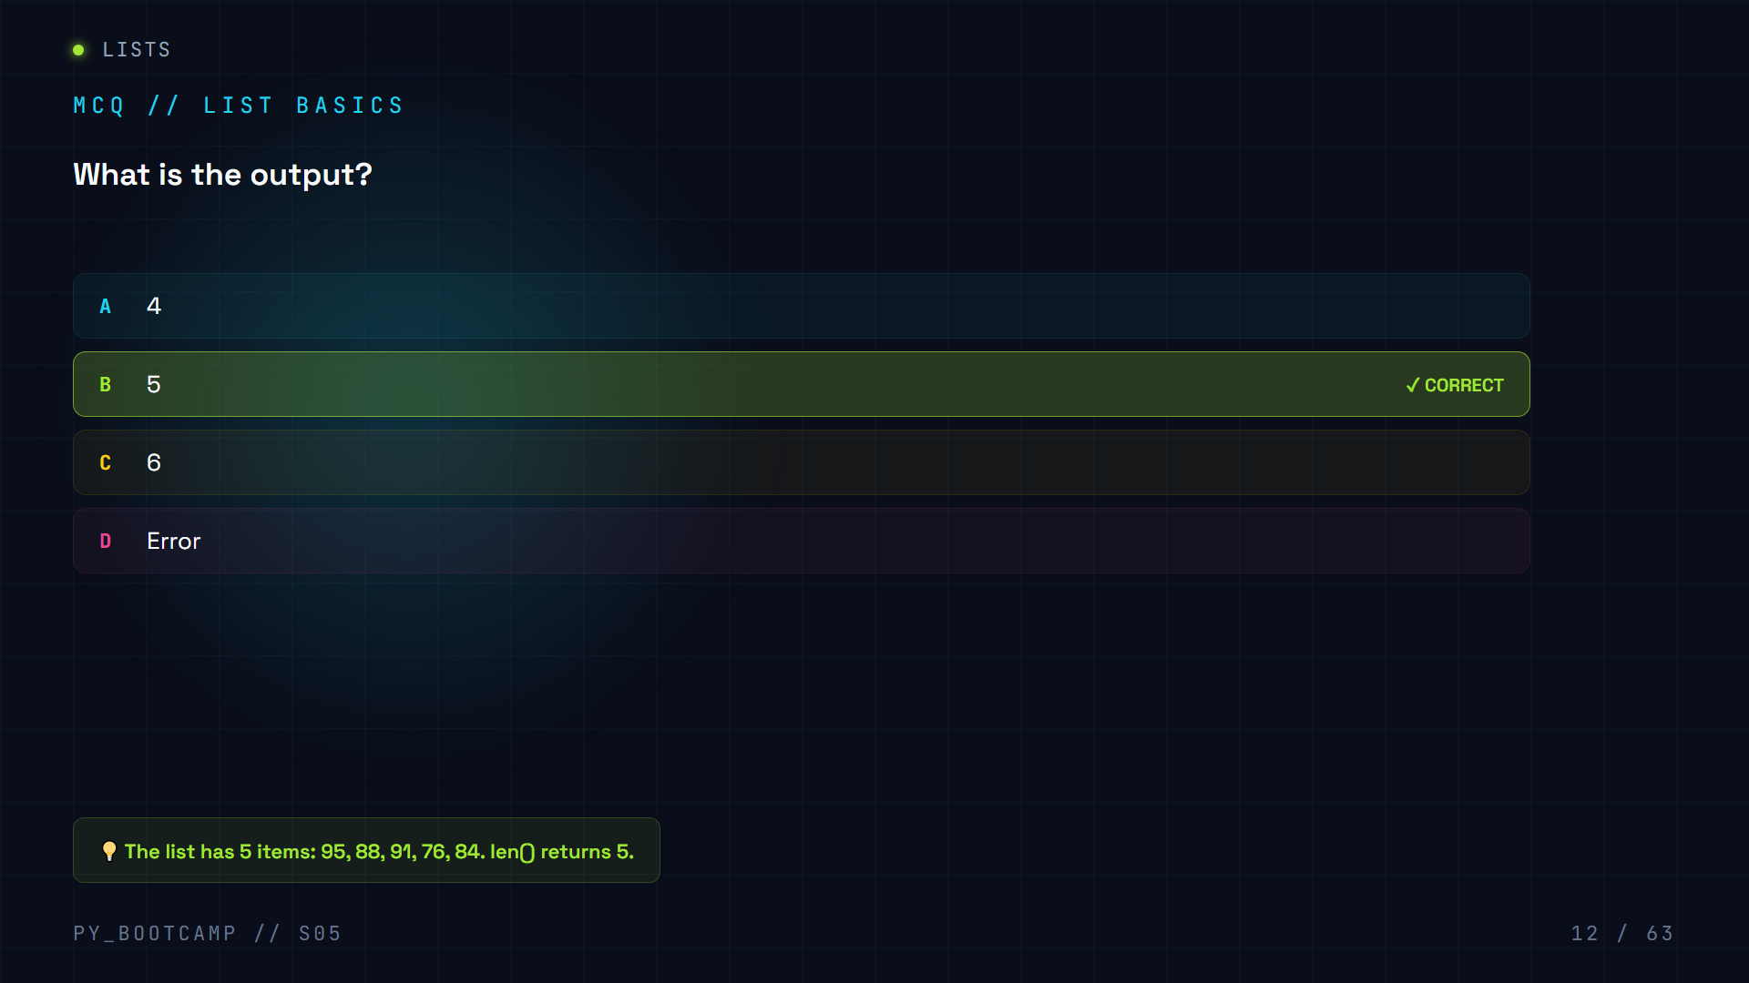

Slide 13
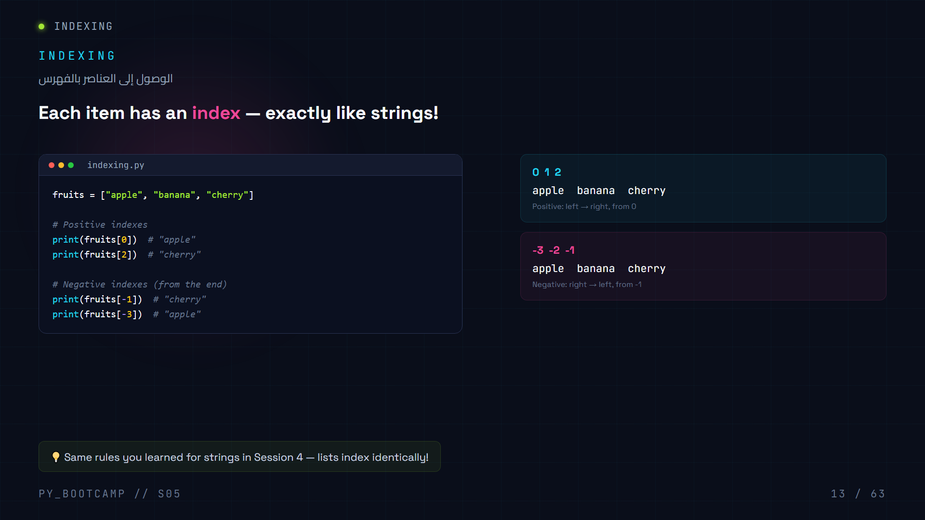
Notes:
Indexing works the same as strings. Positive left-to-right from 0, negative right-to-left from -1.

Slide 14
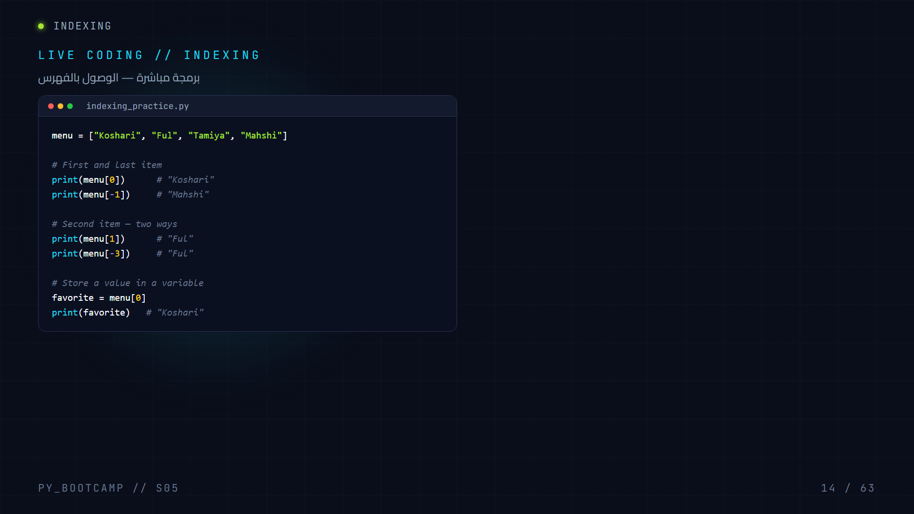
Notes:
Practice indexing with a menu list. First/last, second item both ways, store into variable.

Slide 15
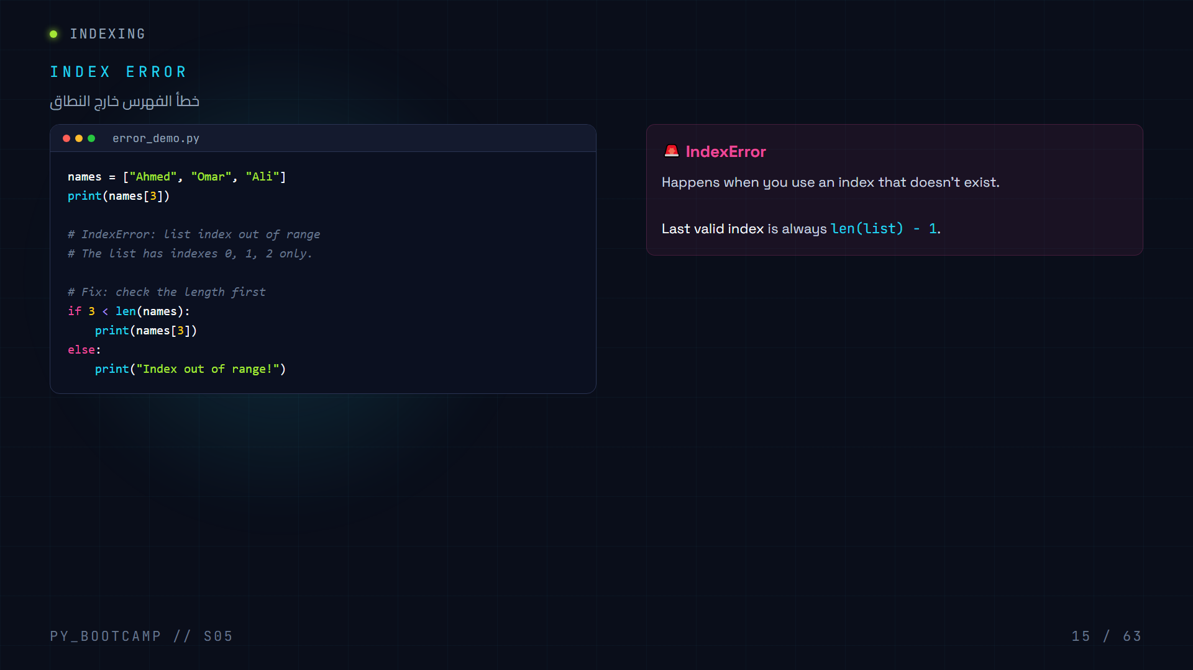
Notes:
IndexError occurs when index is out of range. Fix: guard with len() check or use negative indexes safely.

Slide 16
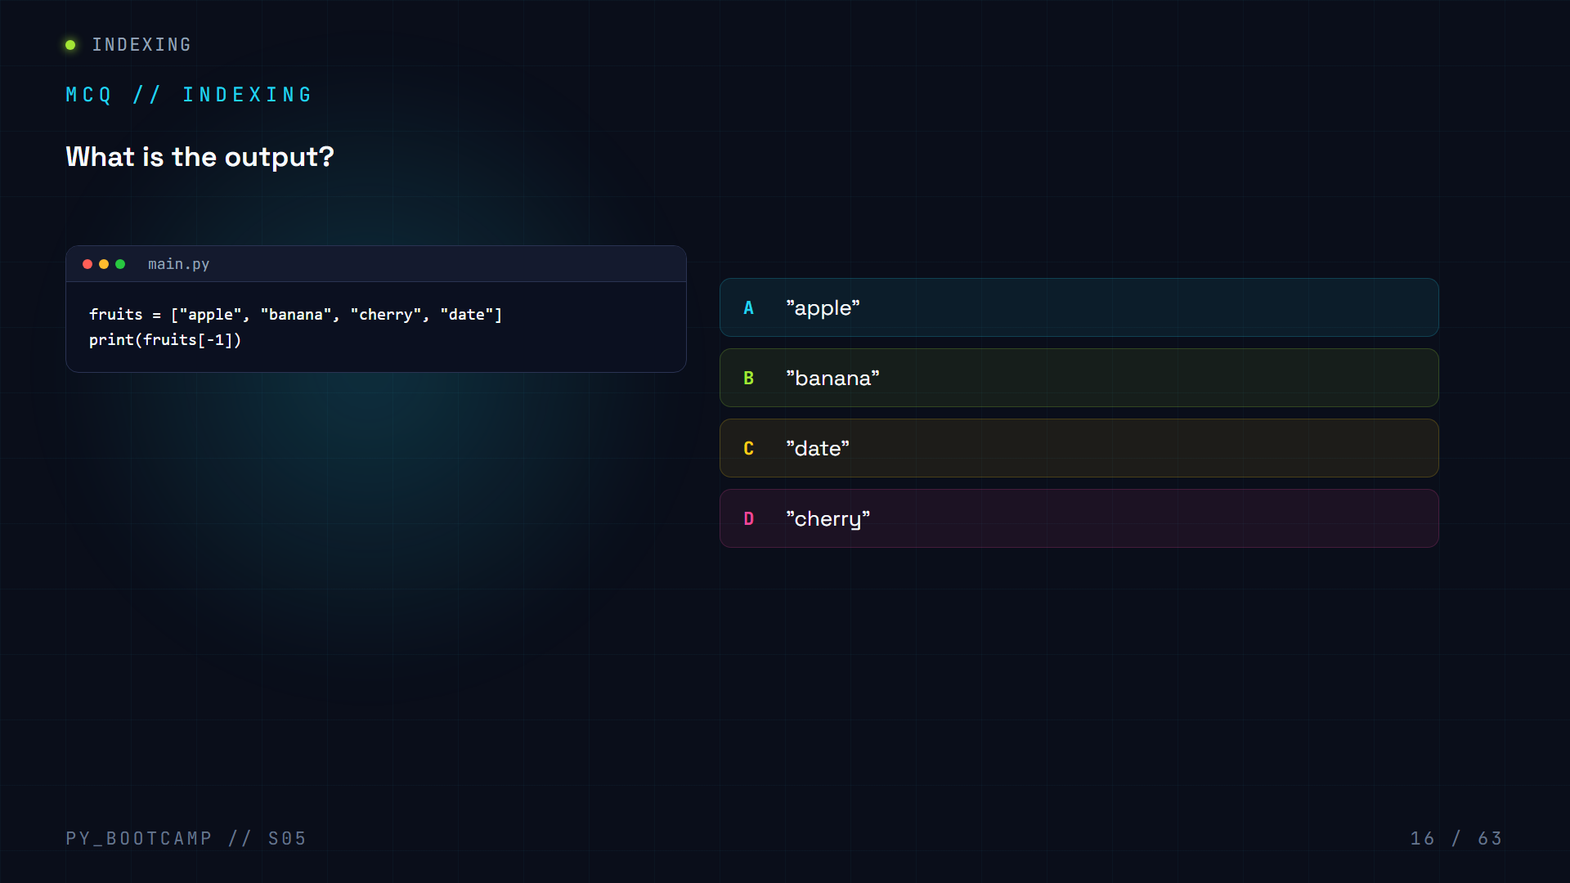

Slide 17
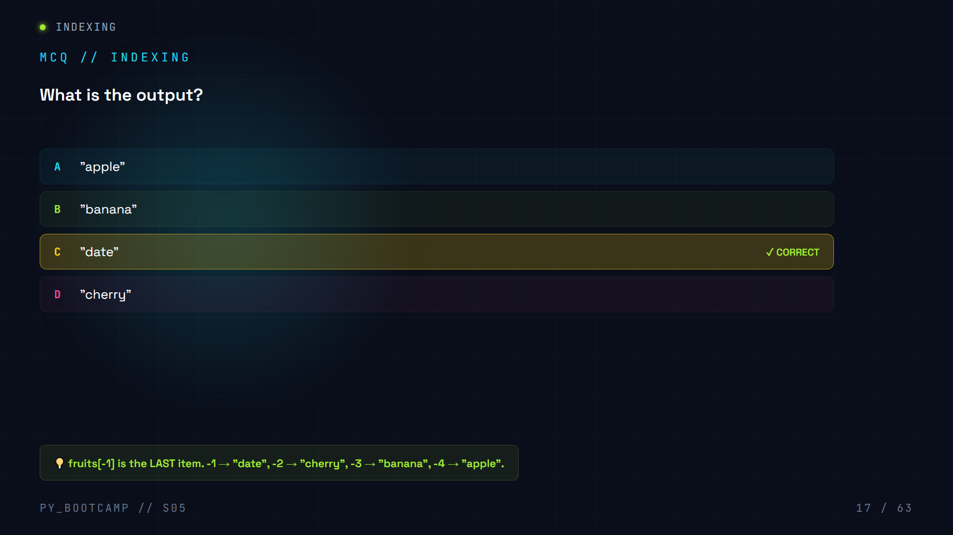

Slide 18
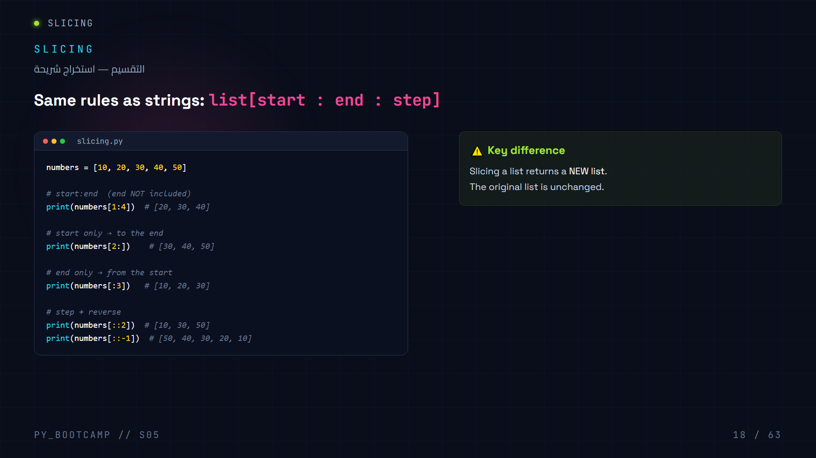
Notes:
Slicing uses the exact same start:end:step rules as strings. Returns a NEW list, original untouched.

Slide 19
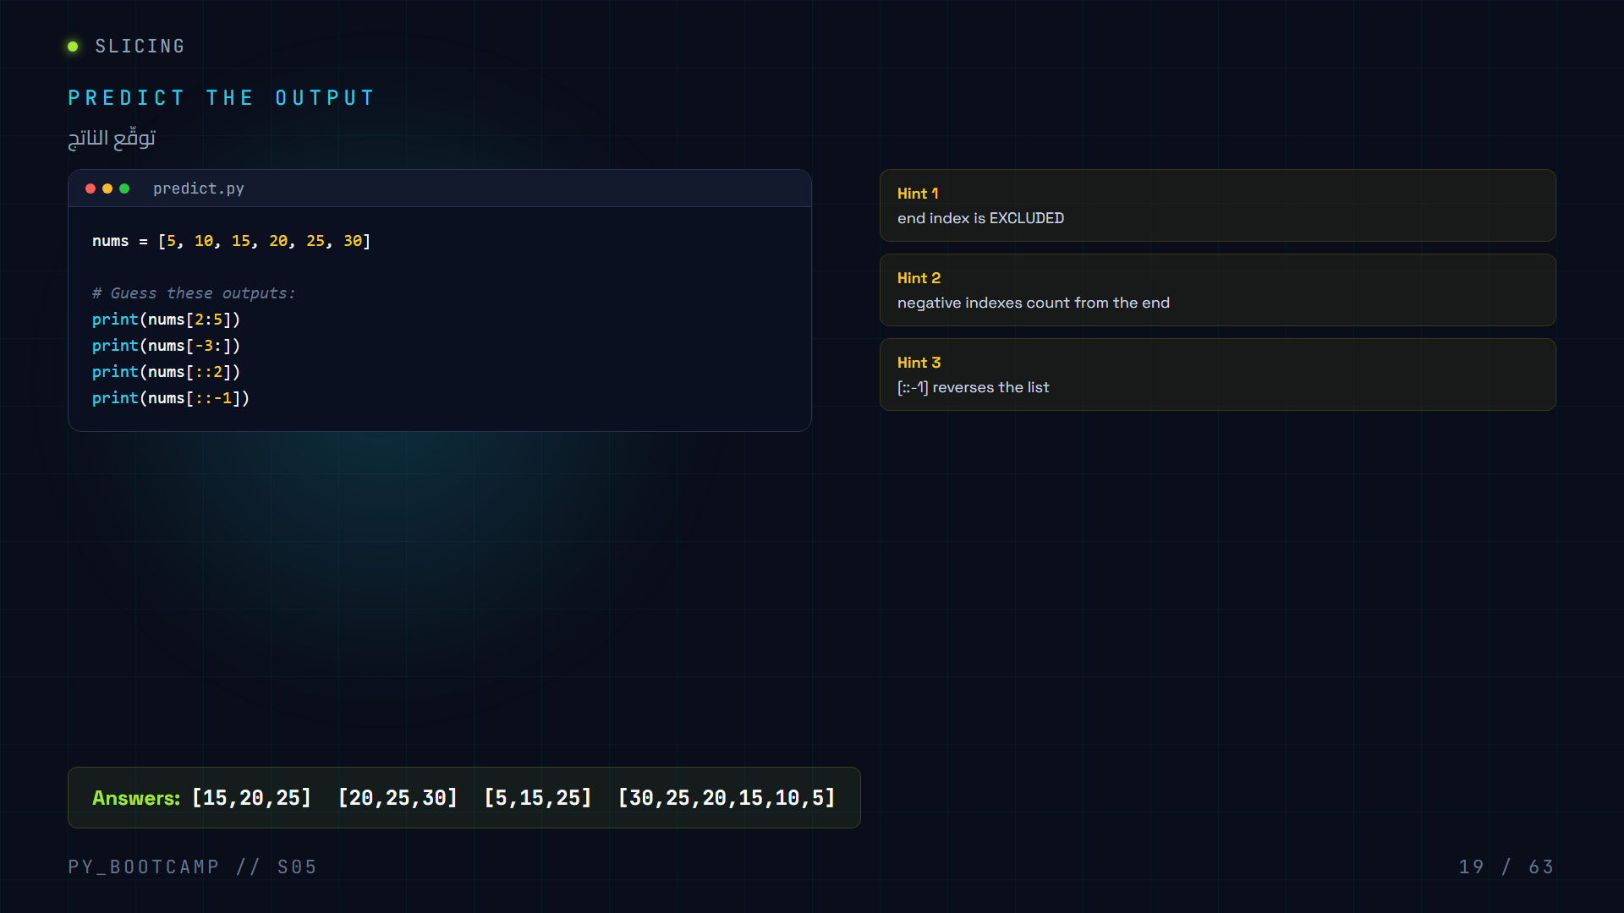
Notes:
Interactive prediction. Answers: nums[2:5]=[15,20,25], nums[-3:]=[20,25,30], nums[::2]=[5,15,25], nums[::-1]=reversed.

Slide 20
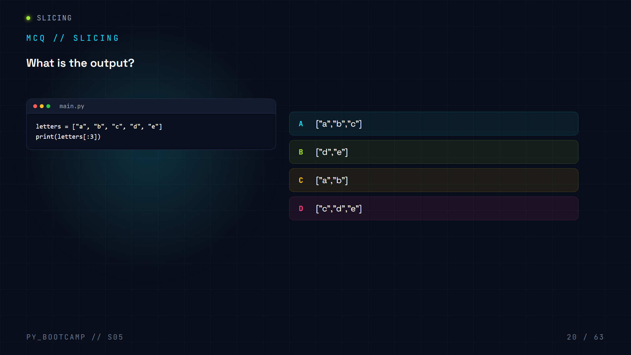

Slide 21
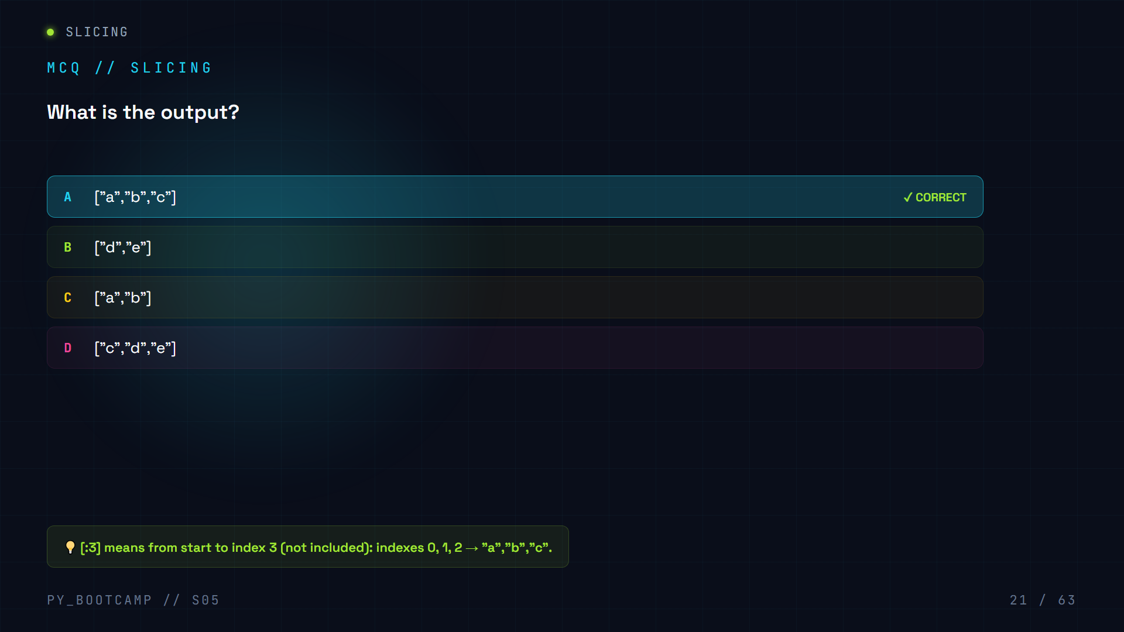

Slide 22
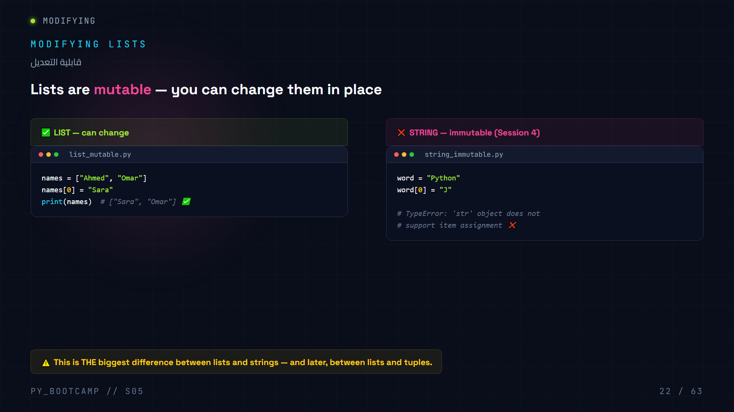
Notes:
Lists are mutable: you can change elements in place. Strings are immutable — item assignment throws TypeError.

Slide 23
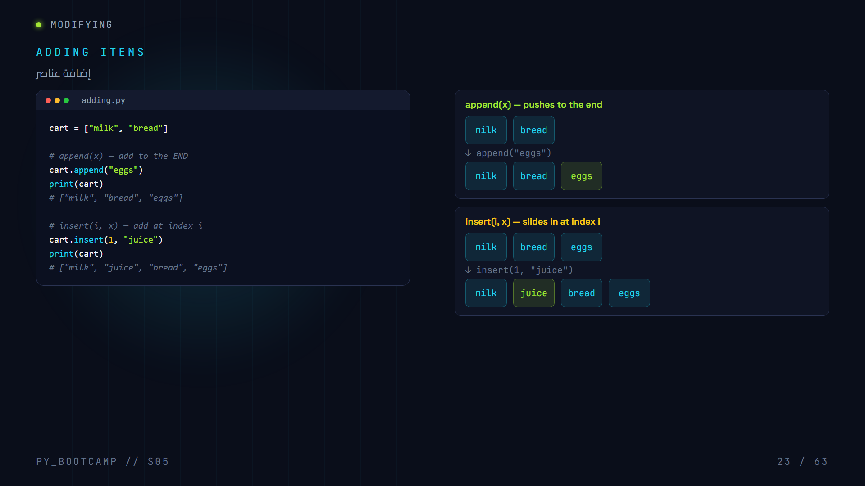
Notes:
append() adds to the end. insert(i,x) adds at position i, shifting the rest right. Show before/after visuals.

Slide 24
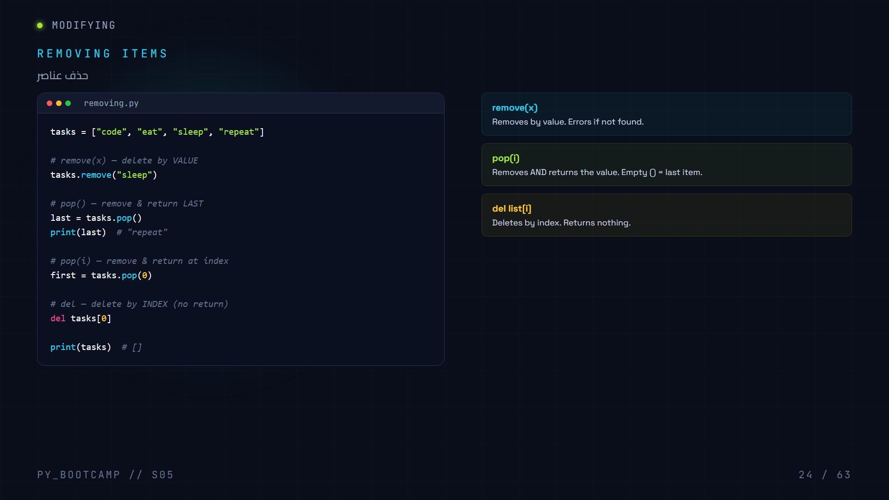
Notes:
Three ways to remove: remove(x) by value, pop() removes+returns, del list[i] by index. Table of differences.

Slide 25
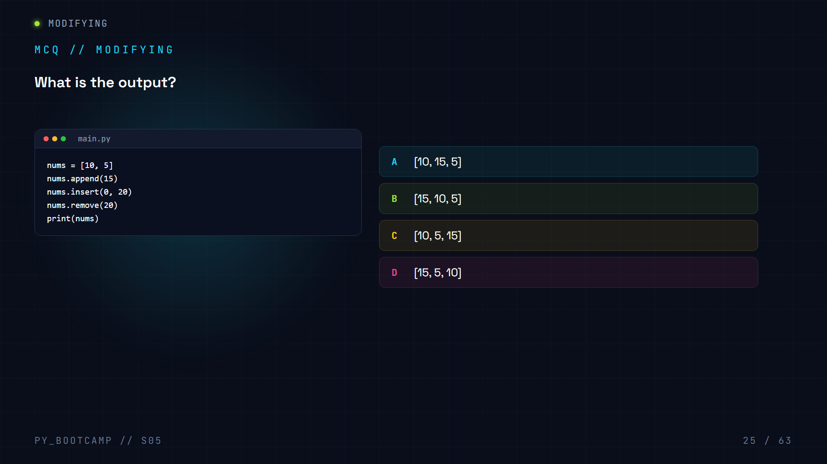

Slide 26
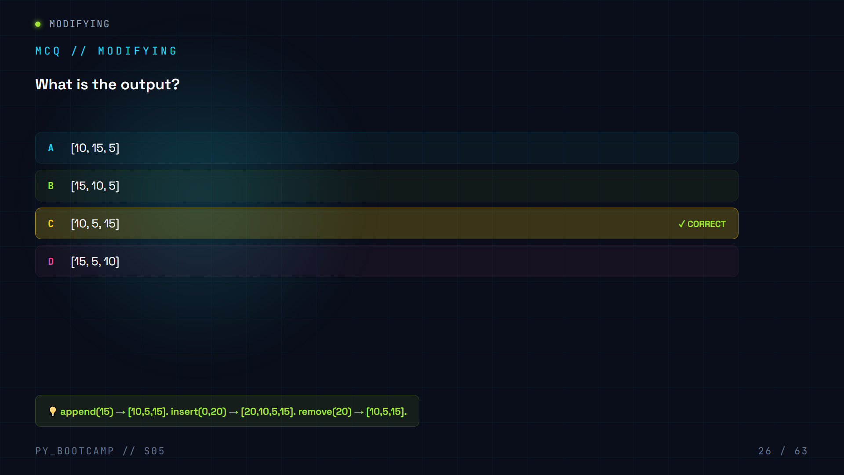

Slide 27
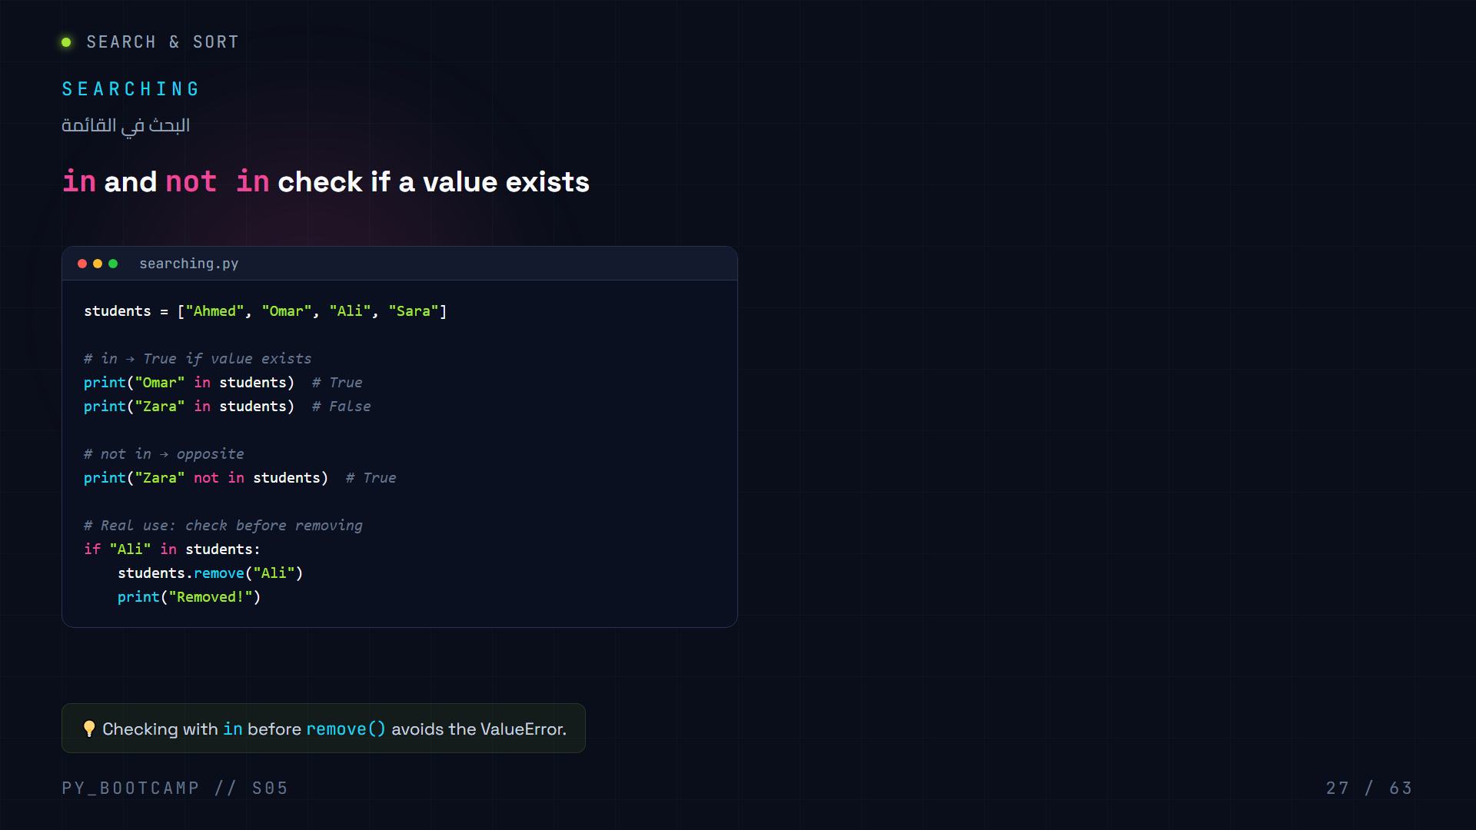
Notes:
in / not in return booleans. Best practice: check with in before remove() to avoid ValueError.

Slide 28
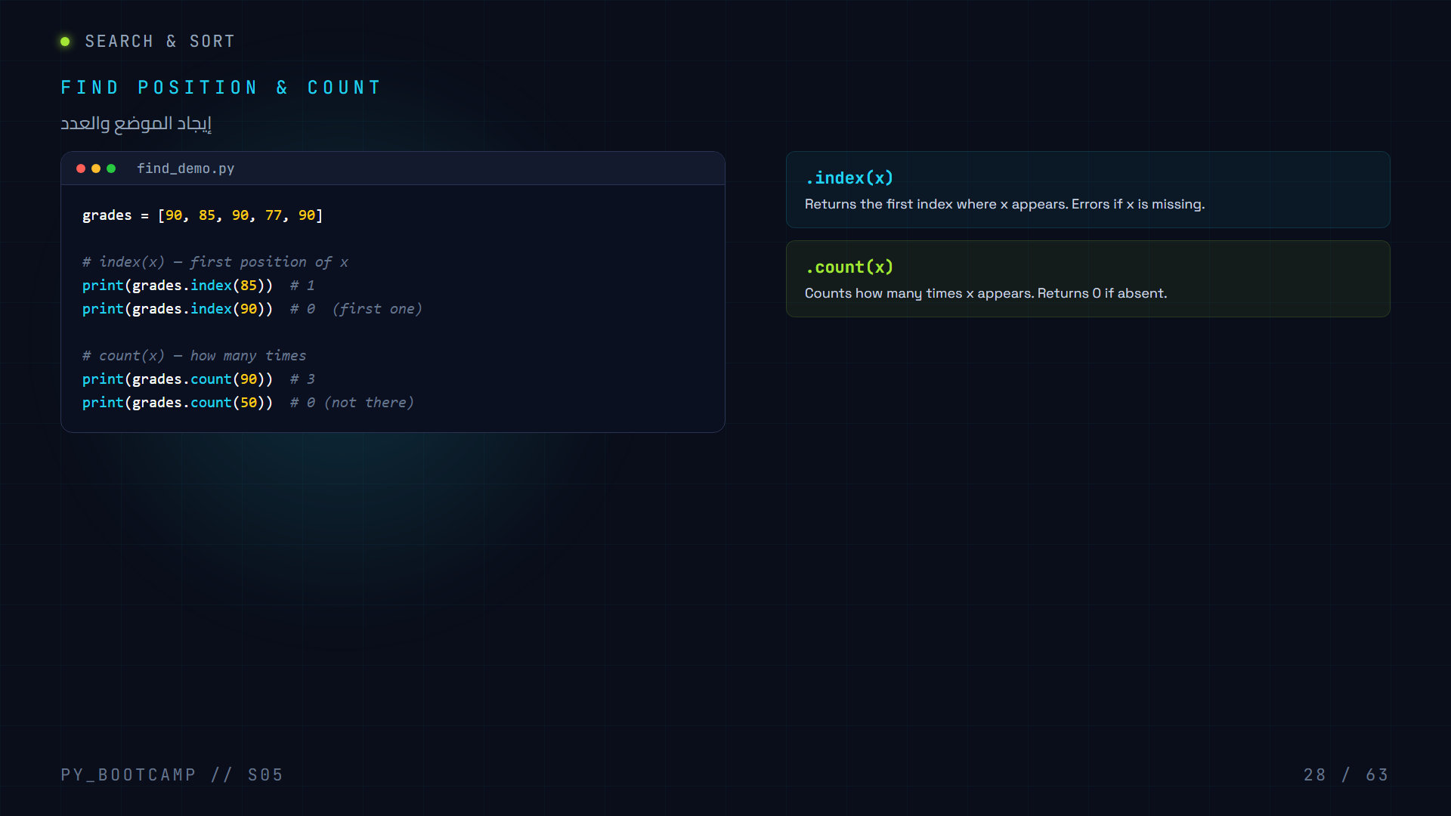
Notes:
index(x) returns first position (errors if missing). count(x) returns number of occurrences (0 if absent).

Slide 29
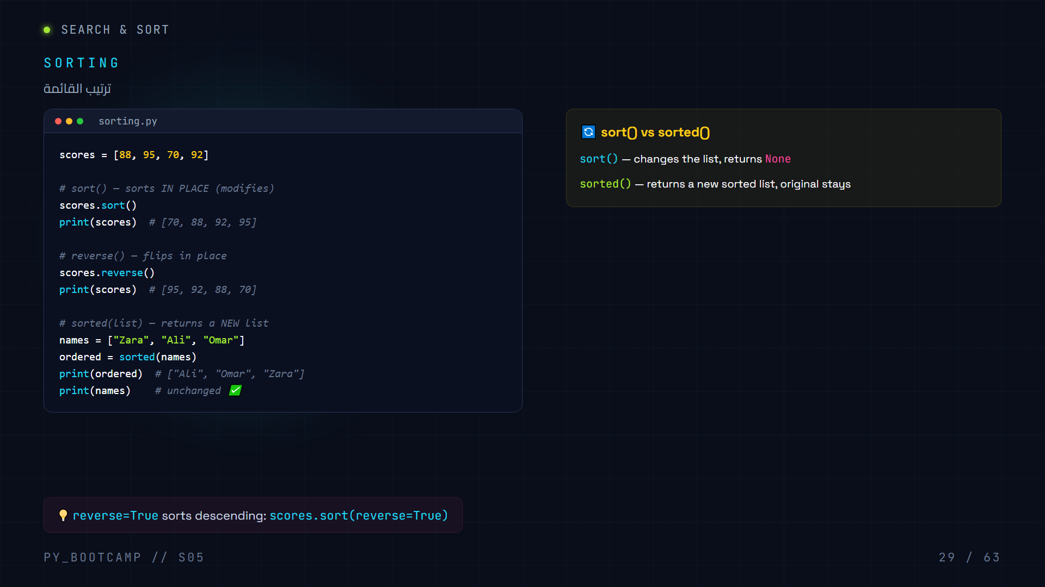
Notes:
sort() sorts in place and returns None. sorted() returns a new sorted list. reverse=True for descending.

Slide 30
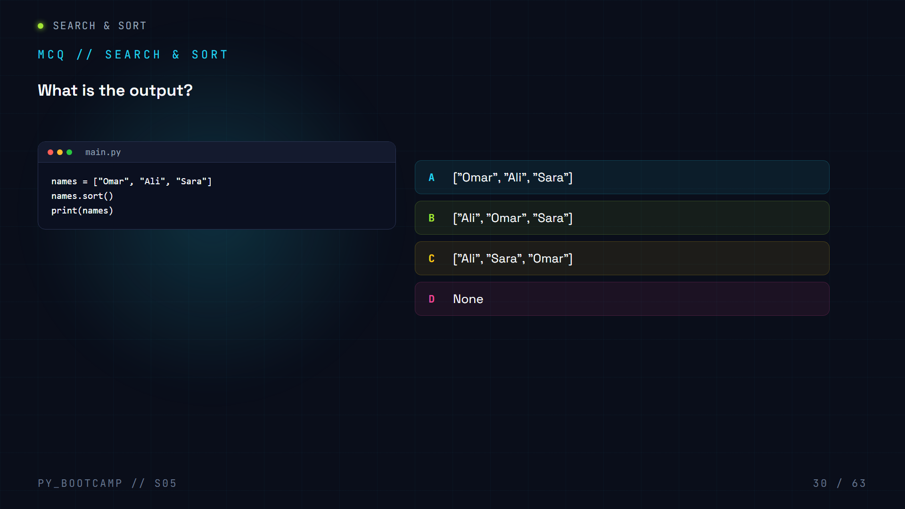

Slide 31
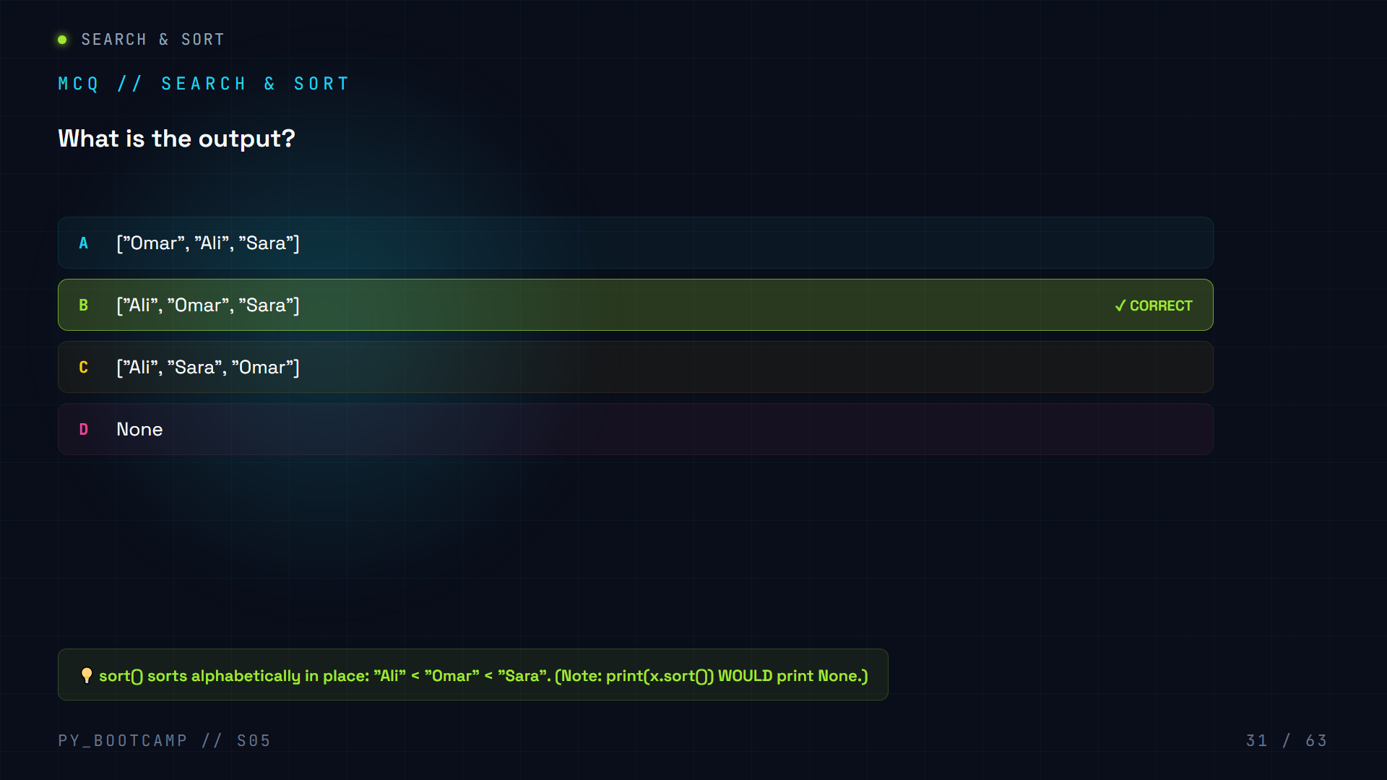

Slide 32
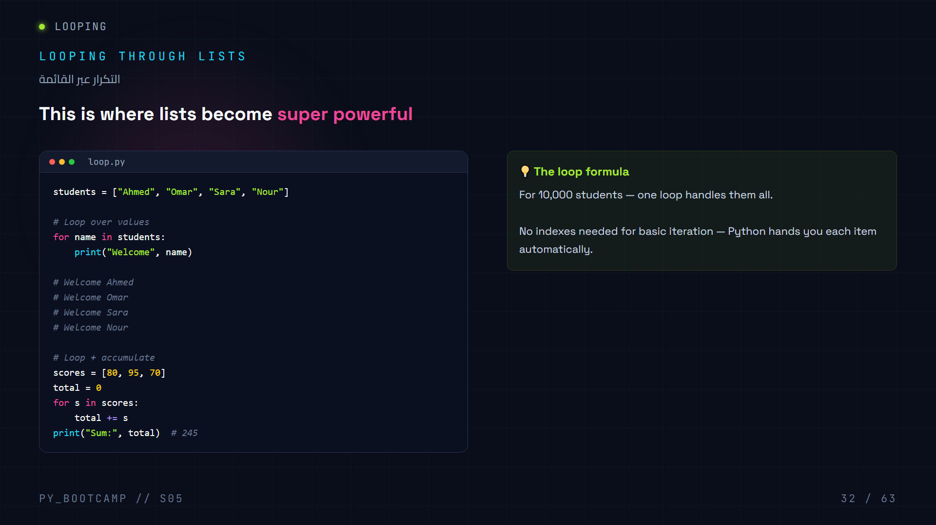
Notes:
for item in list loops over every element. Combine with accumulation for sums. This powers the 10,000 students.

Slide 33
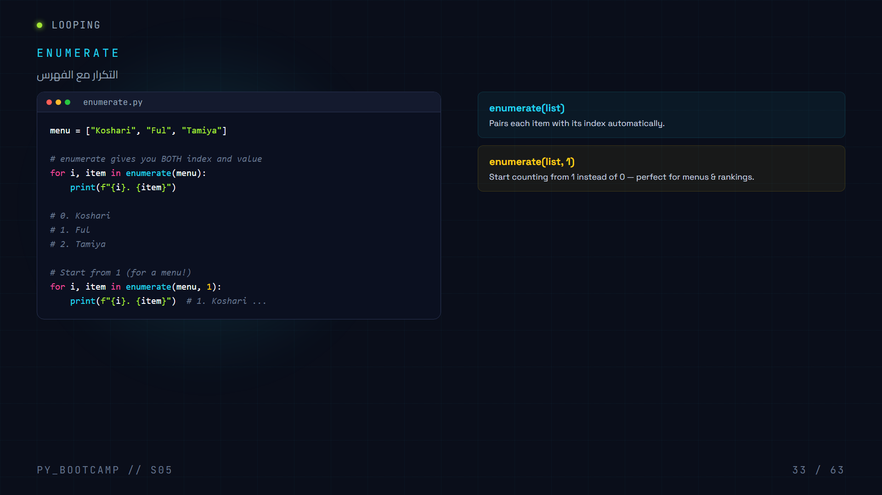
Notes:
enumerate() yields (index, value) pairs. Second argument sets starting number.

Slide 34
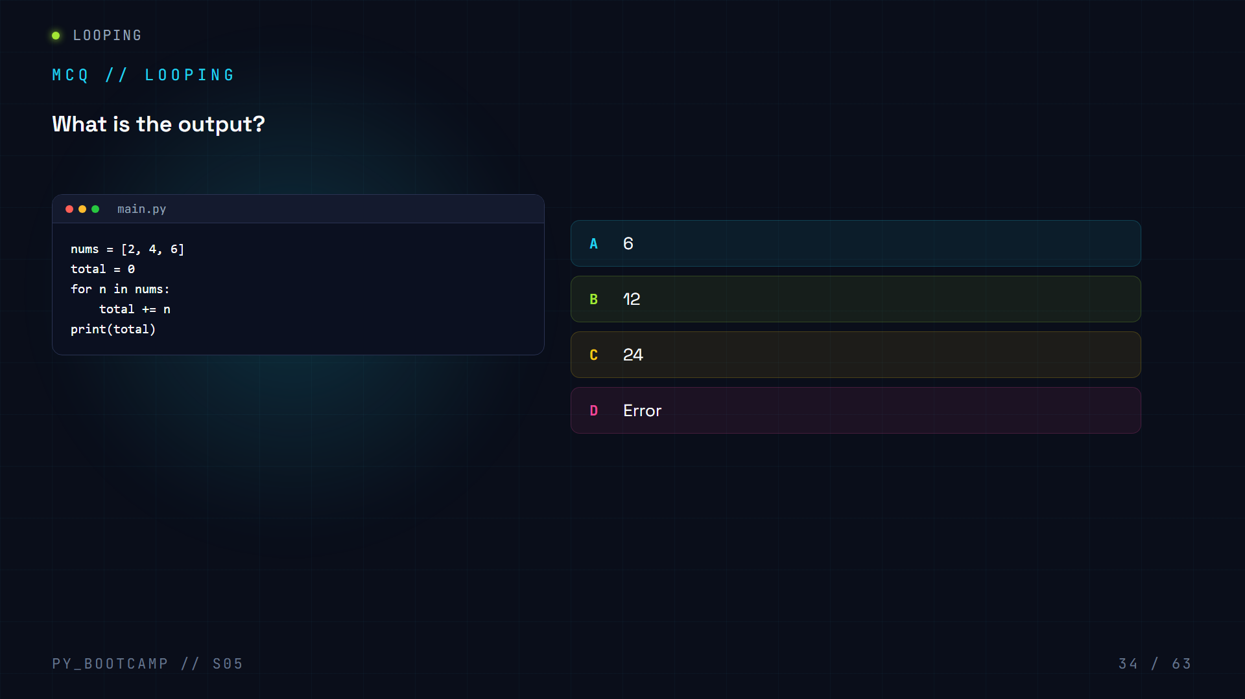

Slide 35
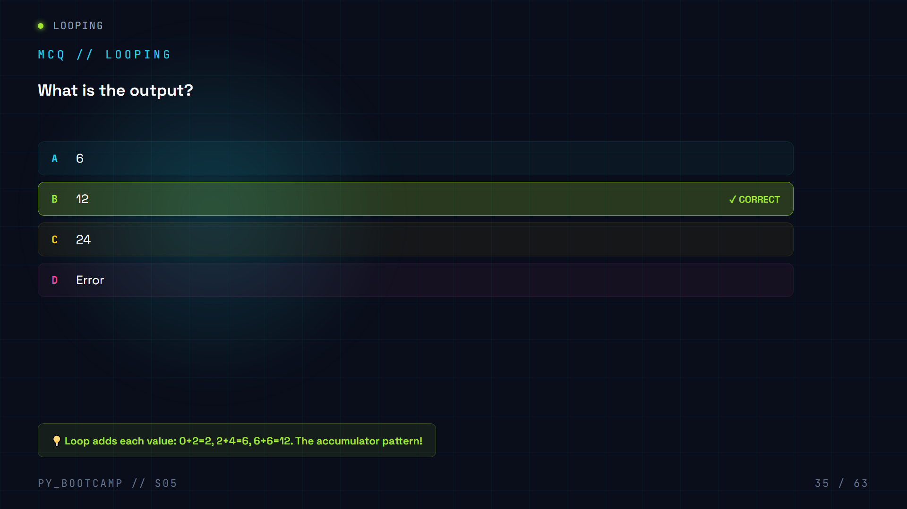

Slide 36
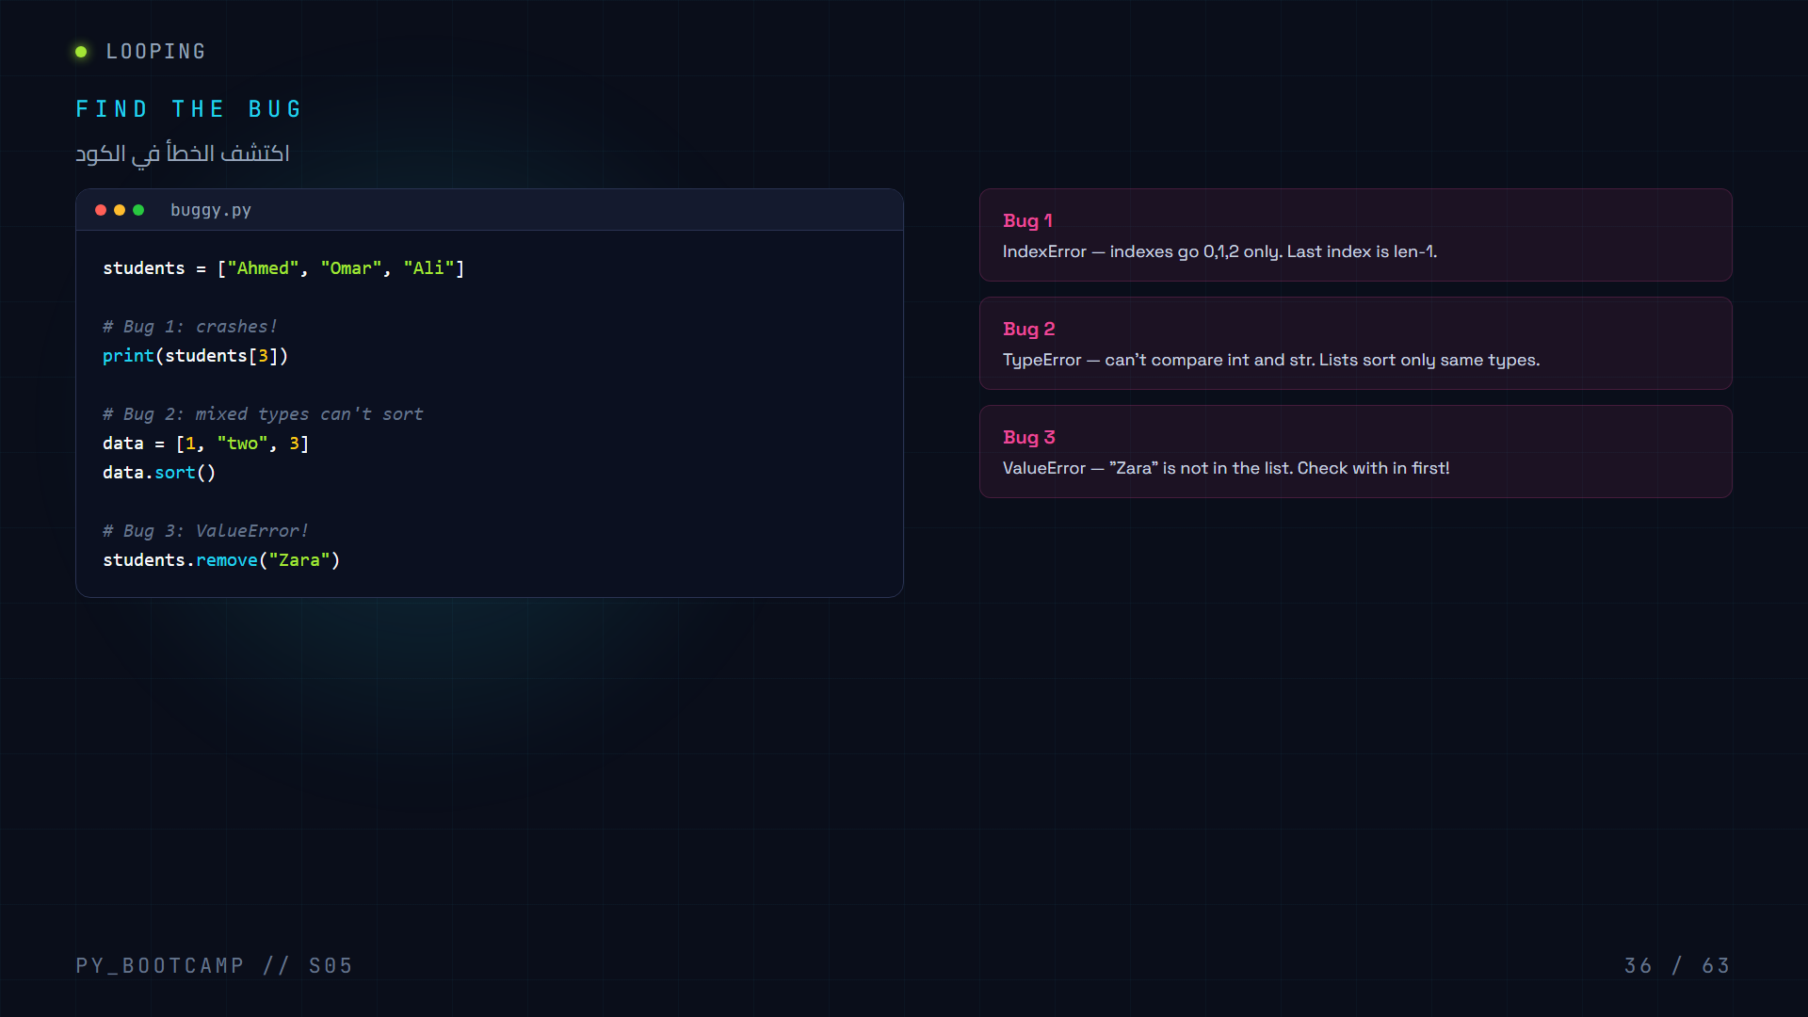
Notes:
Interactive bug hunt. Bug1 IndexError, Bug2 TypeError sorting mixed types, Bug3 ValueError removing missing value.

Slide 37
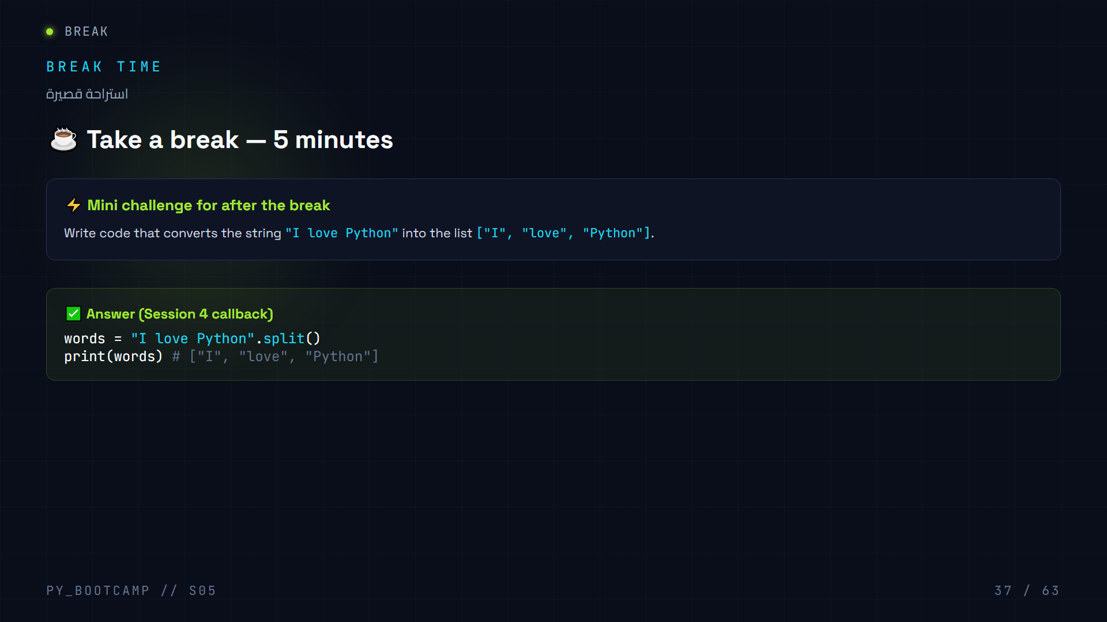
Notes:
Mid-session break. Quick callback challenge: split() a string into a list — bridging Session 4 to Session 5.

Slide 38
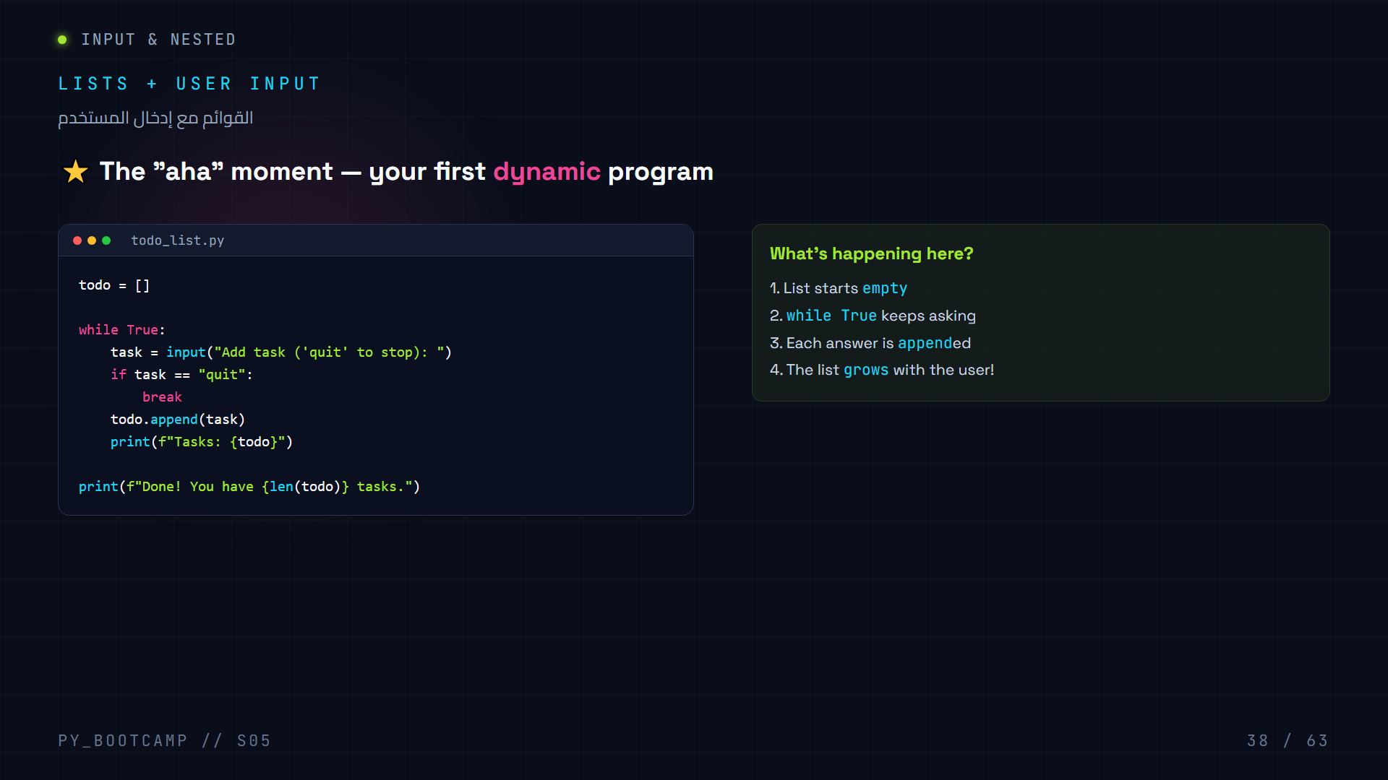
Notes:
Build a to-do list that grows with user input. while True loop + input() + append(). The program reacts to the user — dynamic data.

Slide 39
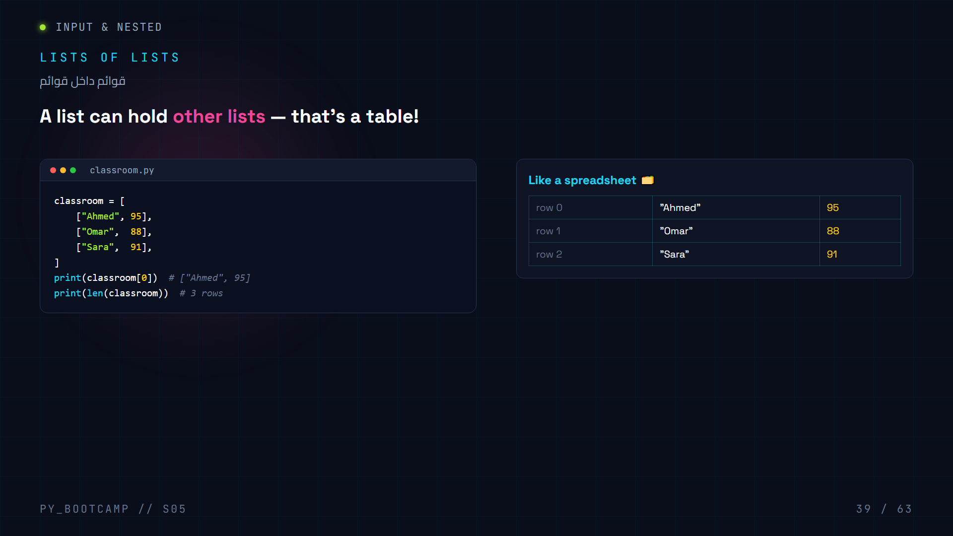
Notes:
Lists of lists = tables/rows. Each inner list is a row; access with [row].

Slide 40
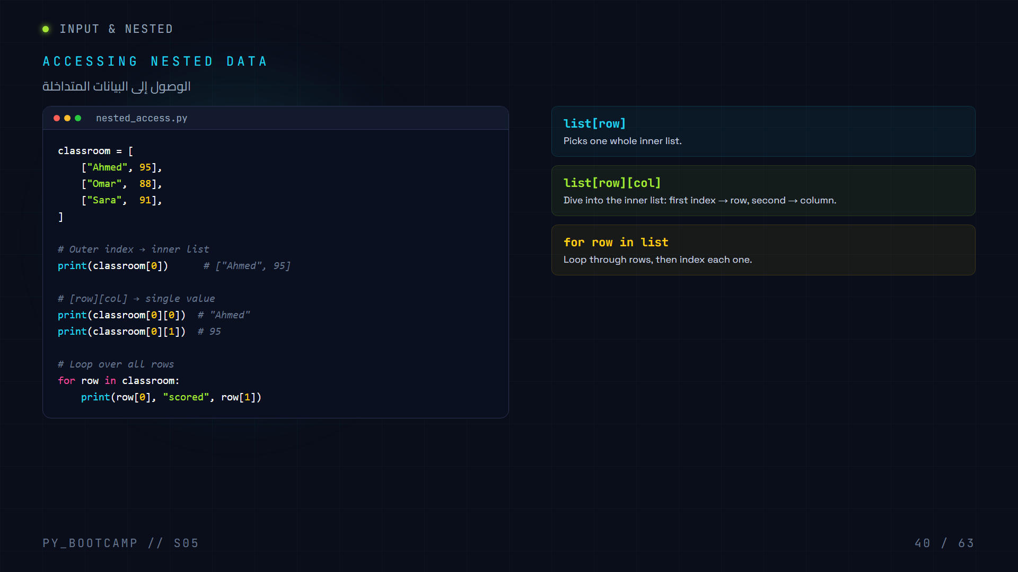
Notes:
Nested access: list[row] returns inner list, list[row][col] returns single value. Loop over rows.

Slide 41


Slide 42
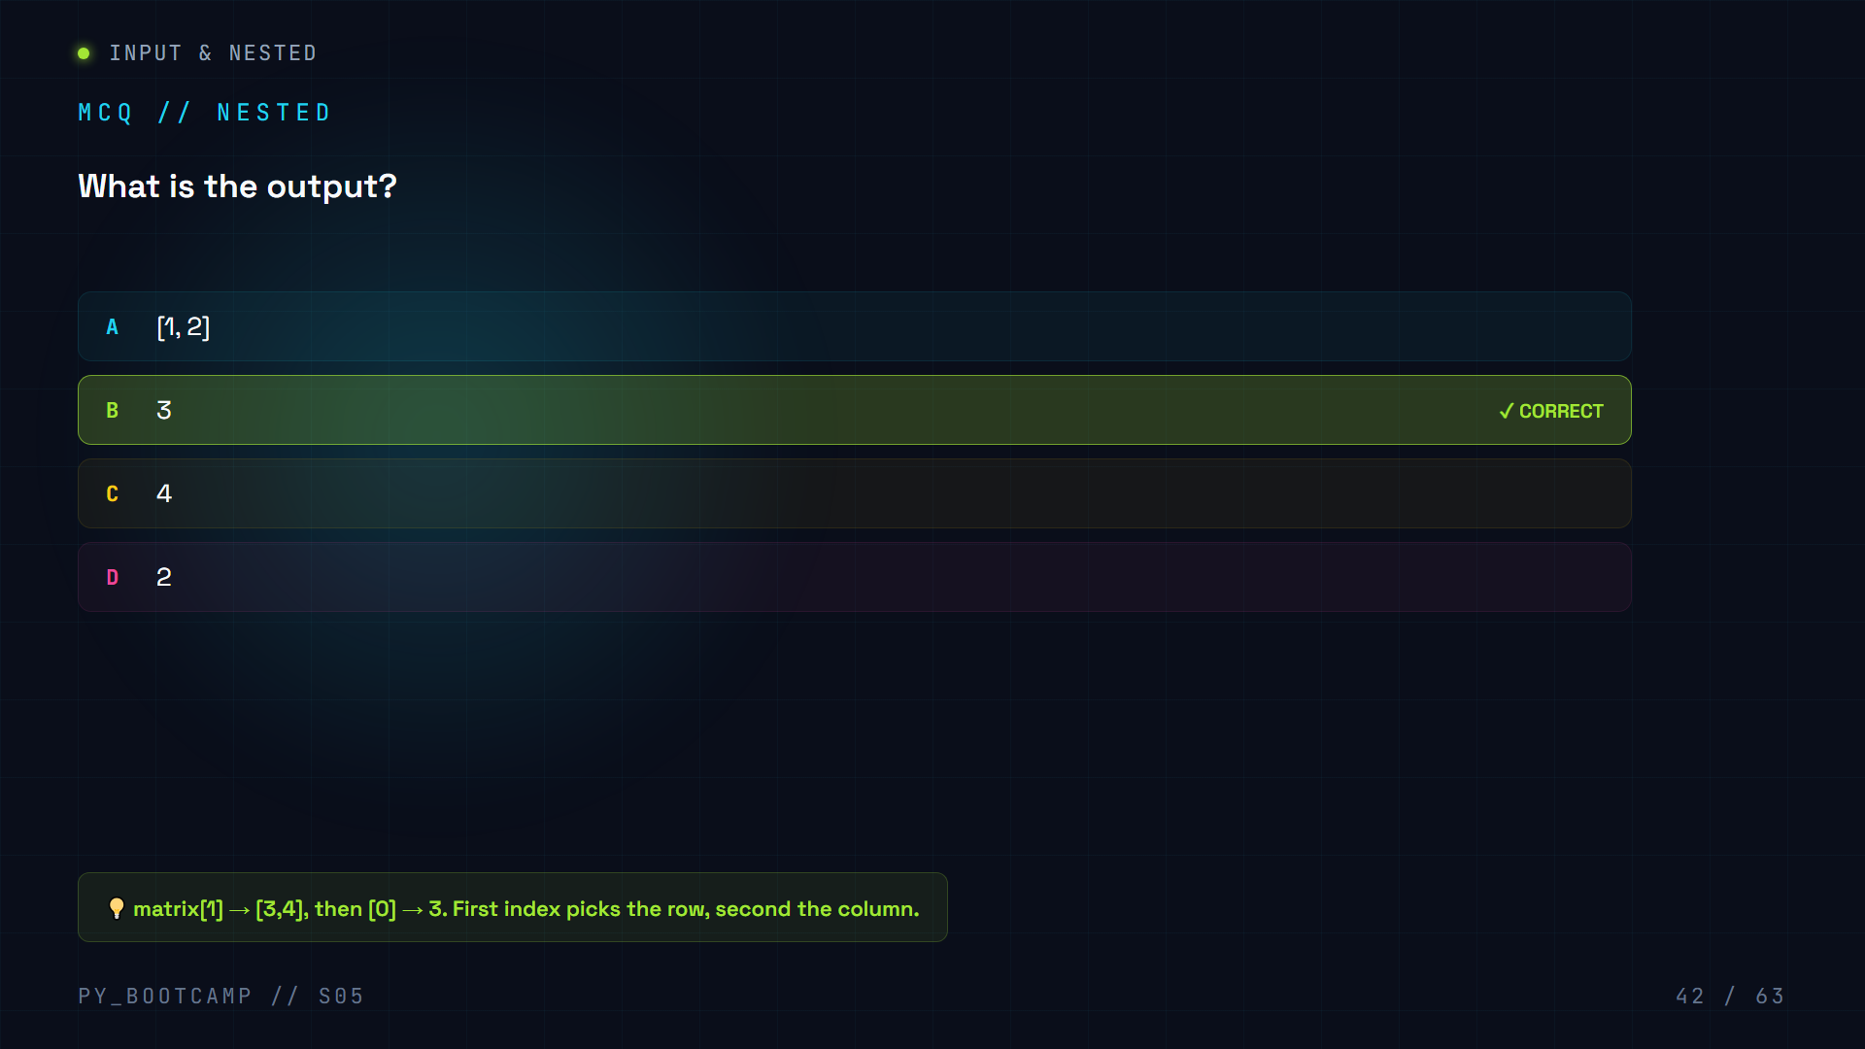

Slide 43
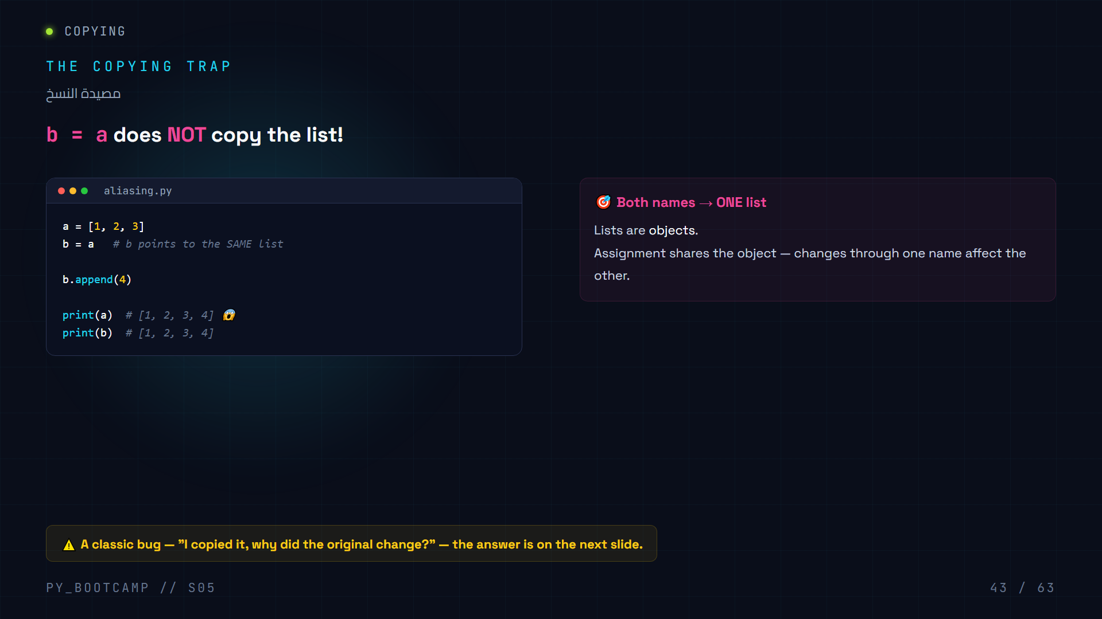
Notes:
b = a does not copy — both variables reference the same list object. Mutating through b also changes a.

Slide 44
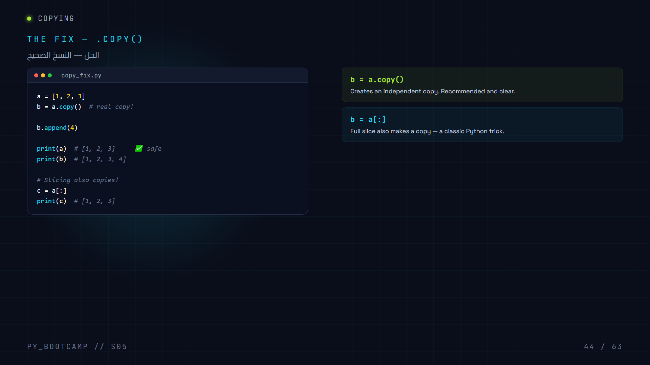
Notes:
Use .copy() (or a[:] full slice) to make real, independent copies. Show both work.

Slide 45
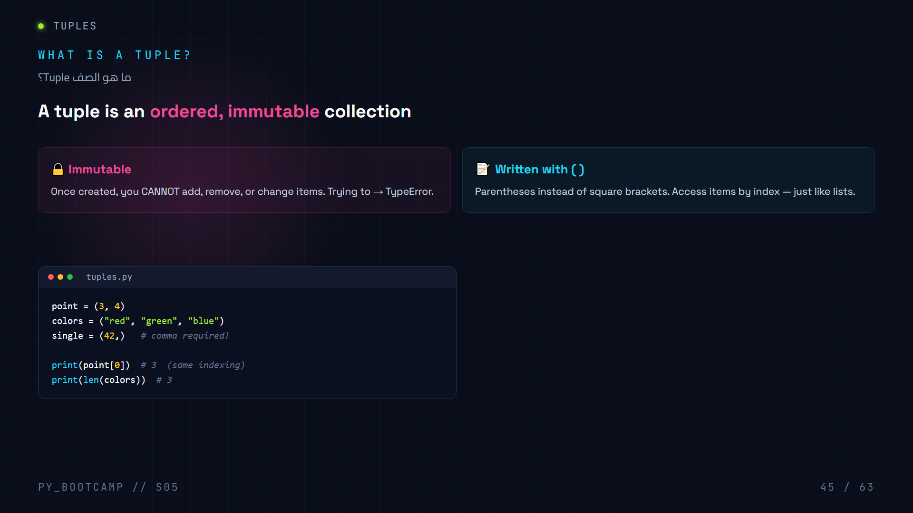
Notes:
A tuple is ordered but immutable. Parentheses, indexable, len() works. Single-item tuple needs a trailing comma.

Slide 46
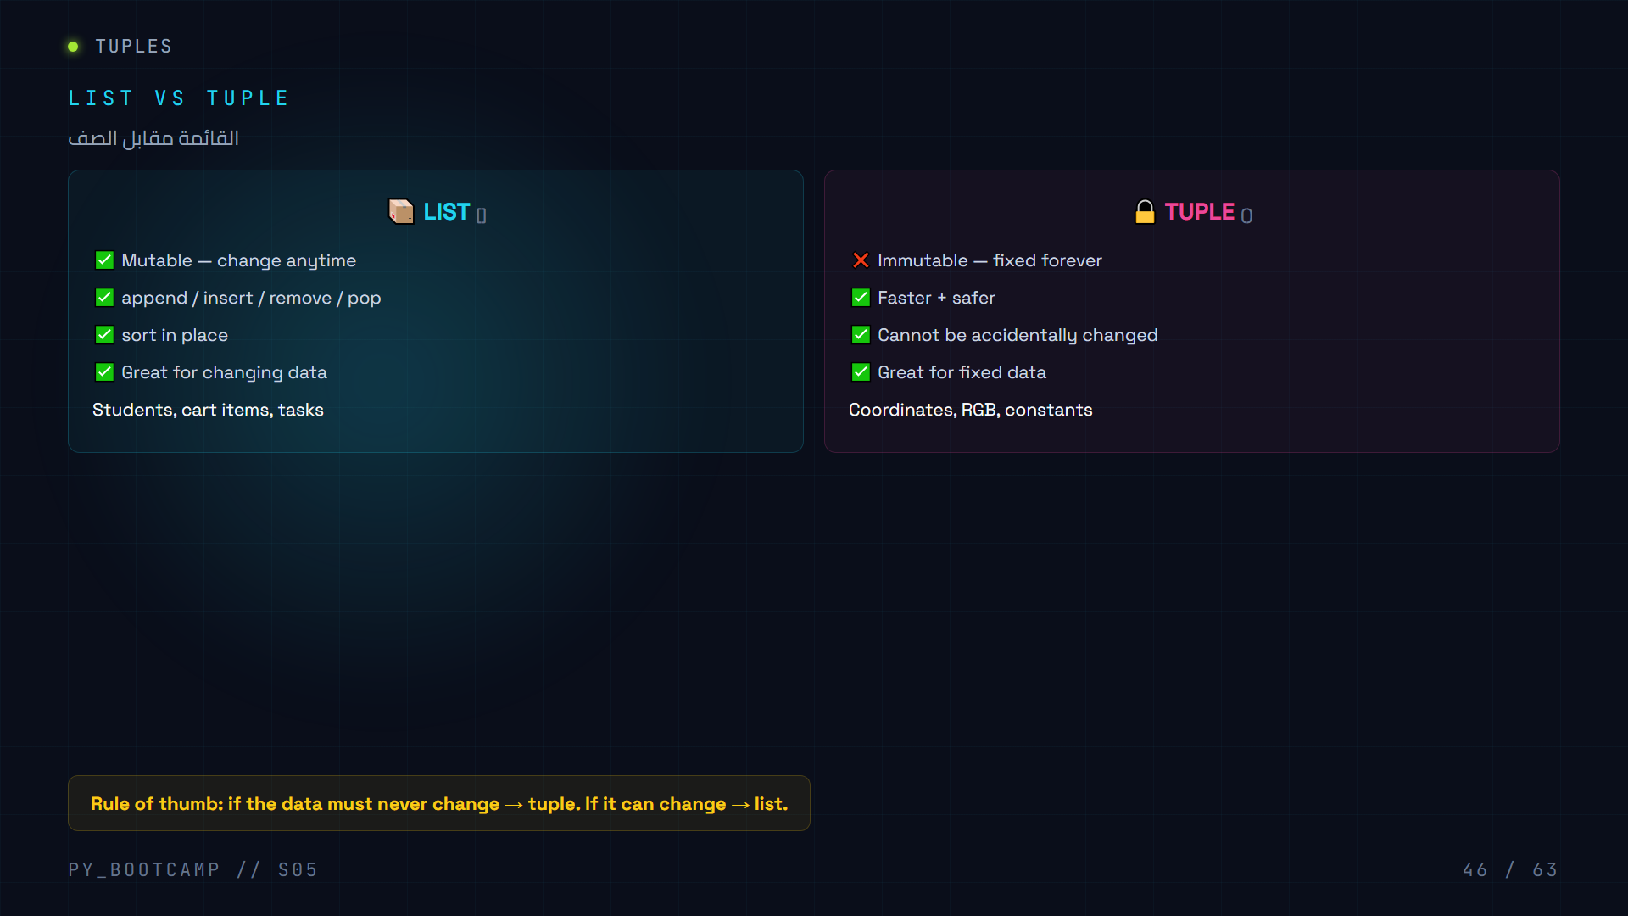
Notes:
Side-by-side comparison: mutable vs immutable, methods, use cases. Rule of thumb: changes → list, fixed → tuple.

Slide 47
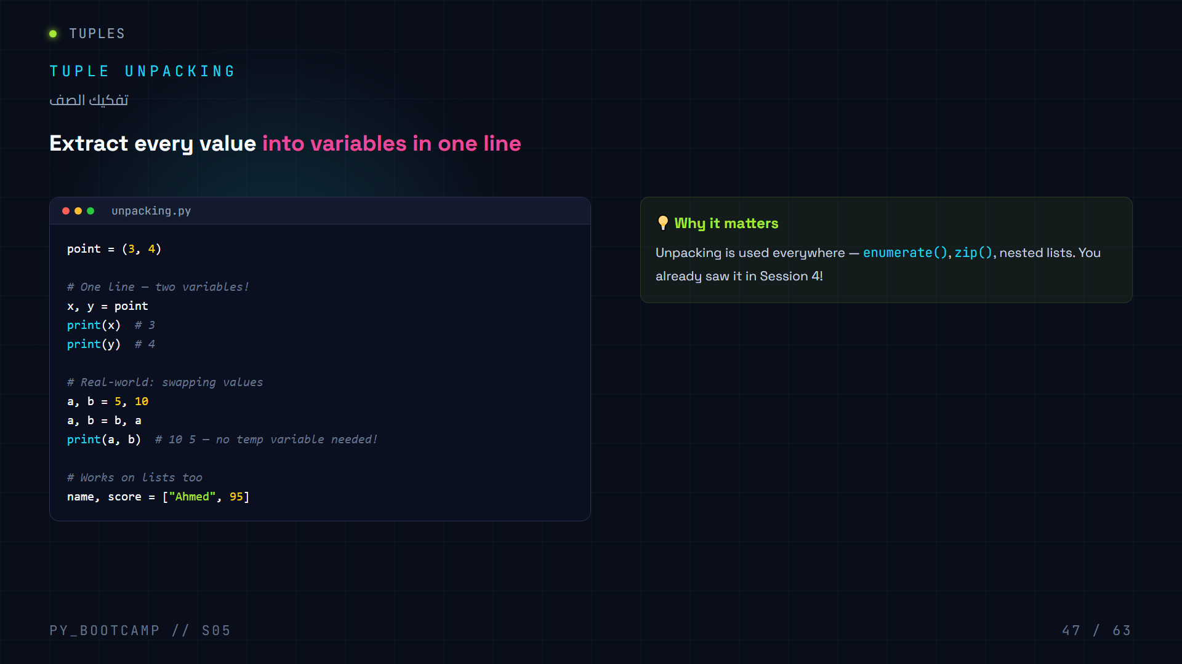
Notes:
Tuple unpacking: assign each element to a variable in one line. Enables the classic Python swap: a,b = b,a.

Slide 48
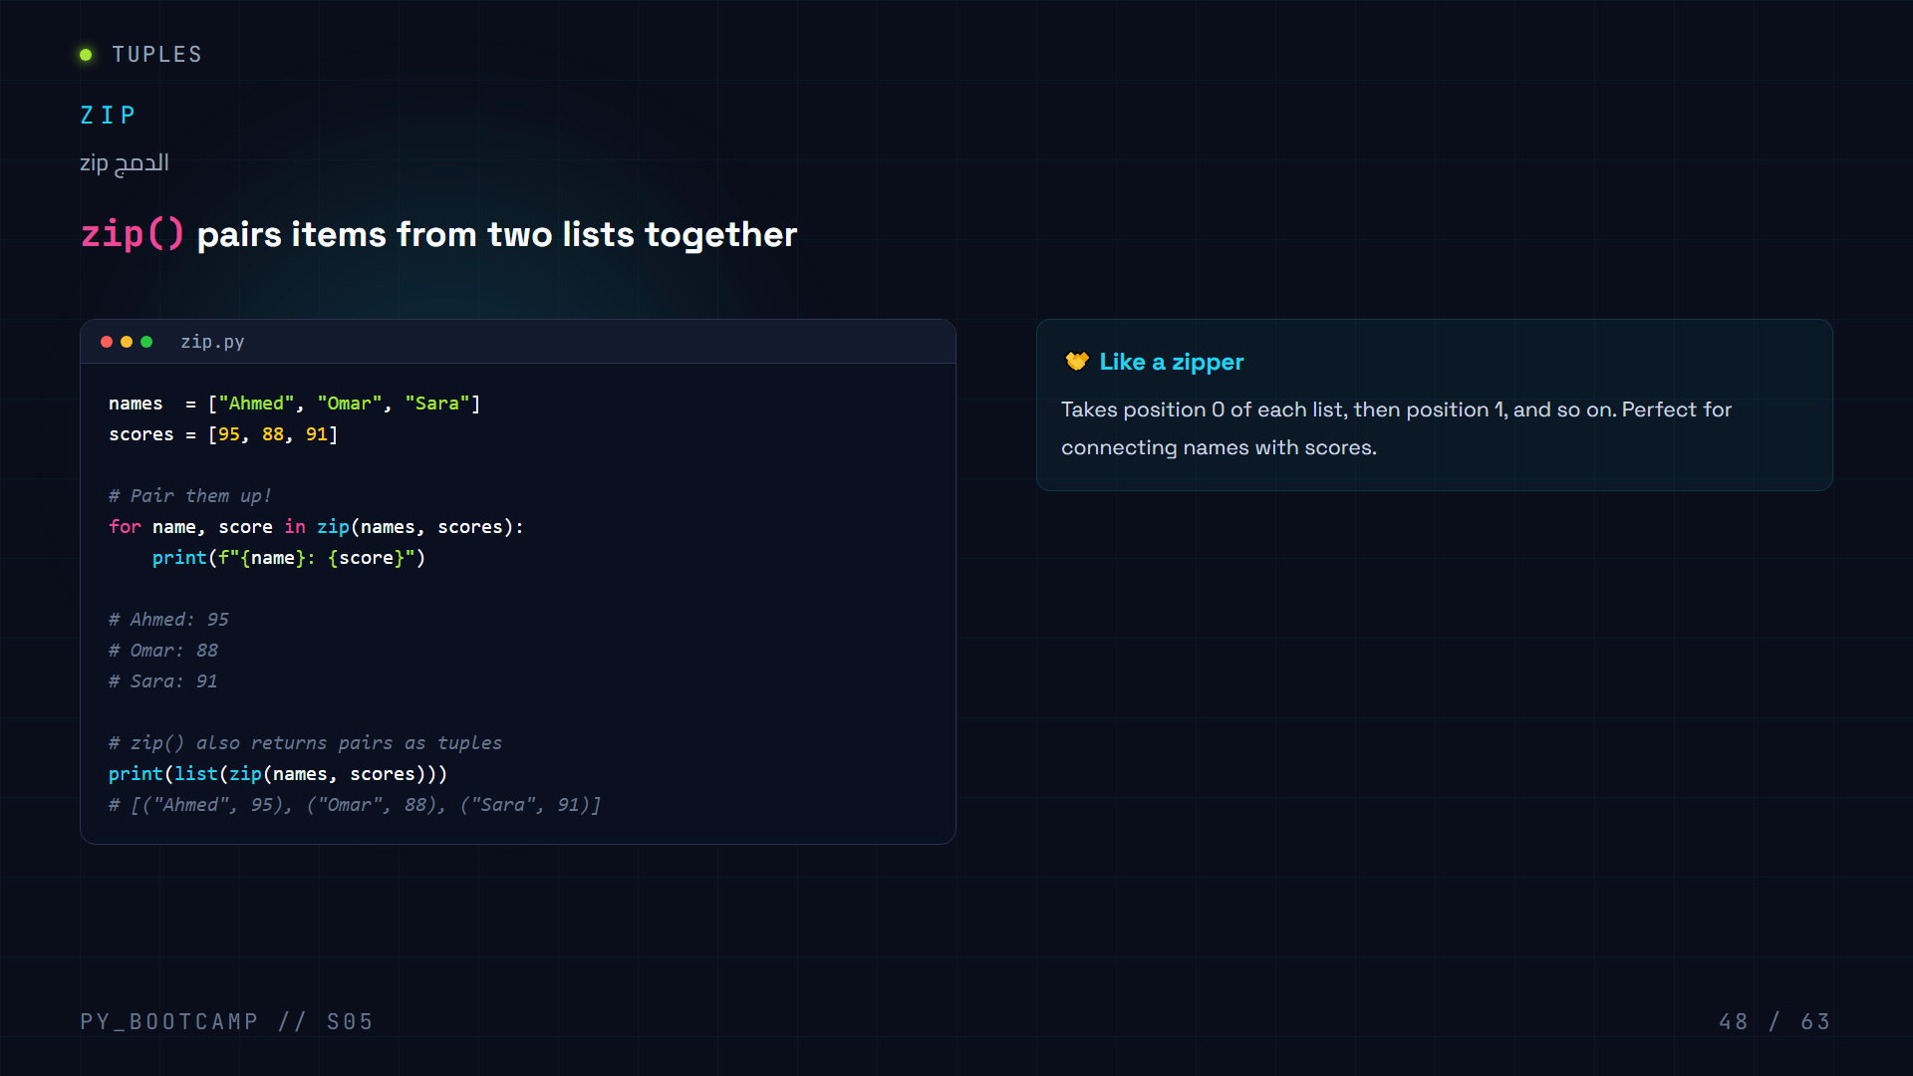
Notes:
zip() pairs up two lists by position. Loop with tuple unpacking, or convert to a list of tuples.

Slide 49
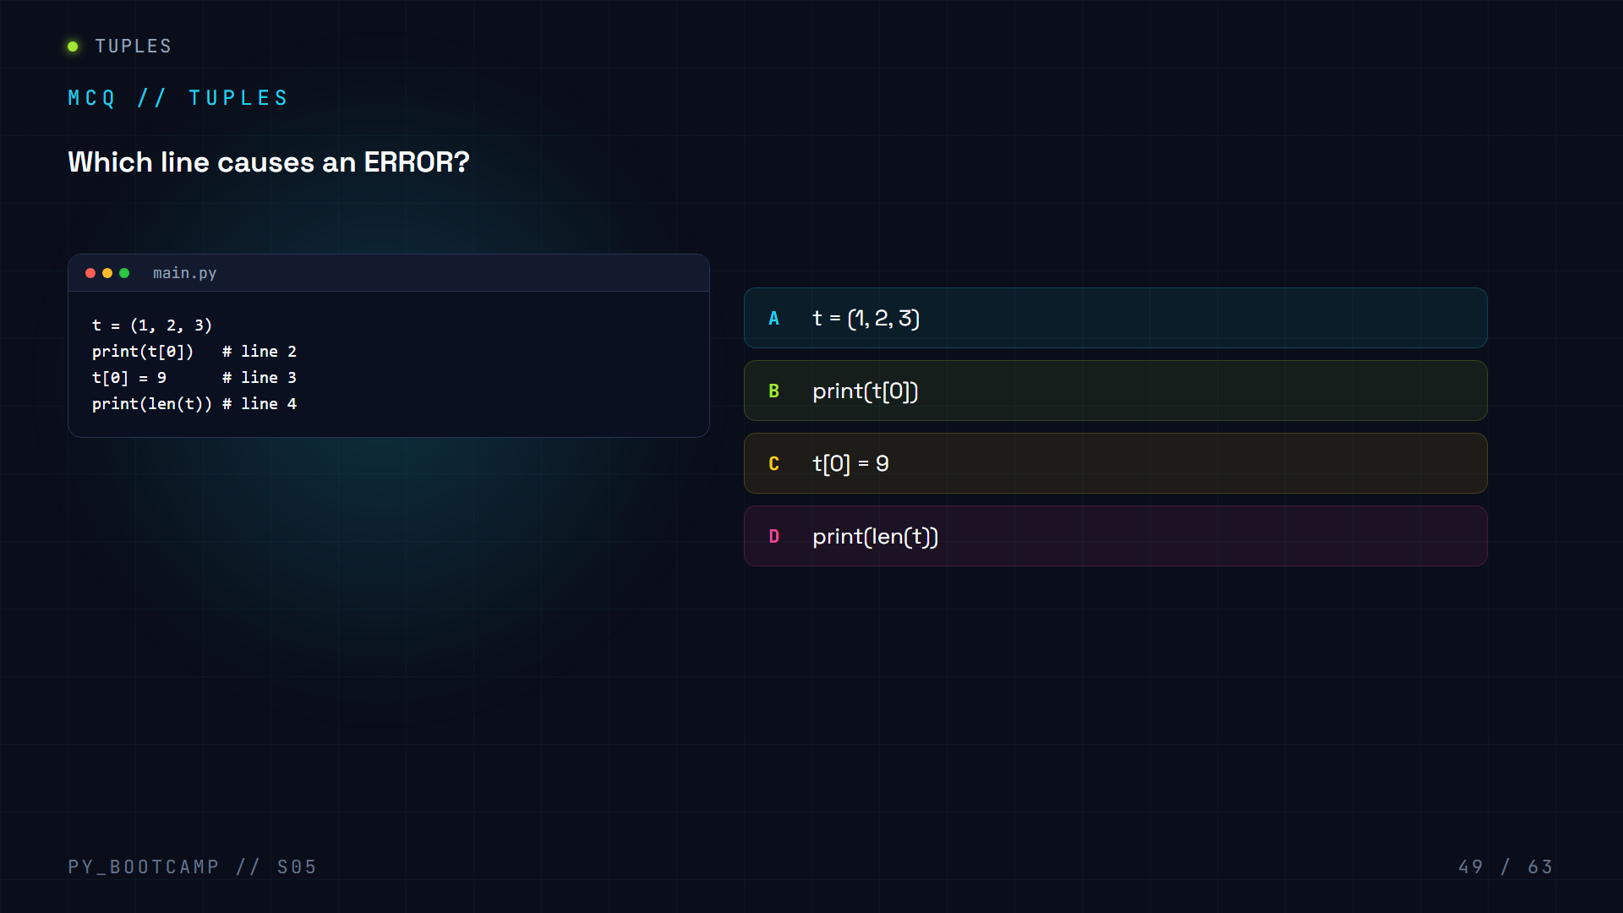

Slide 50
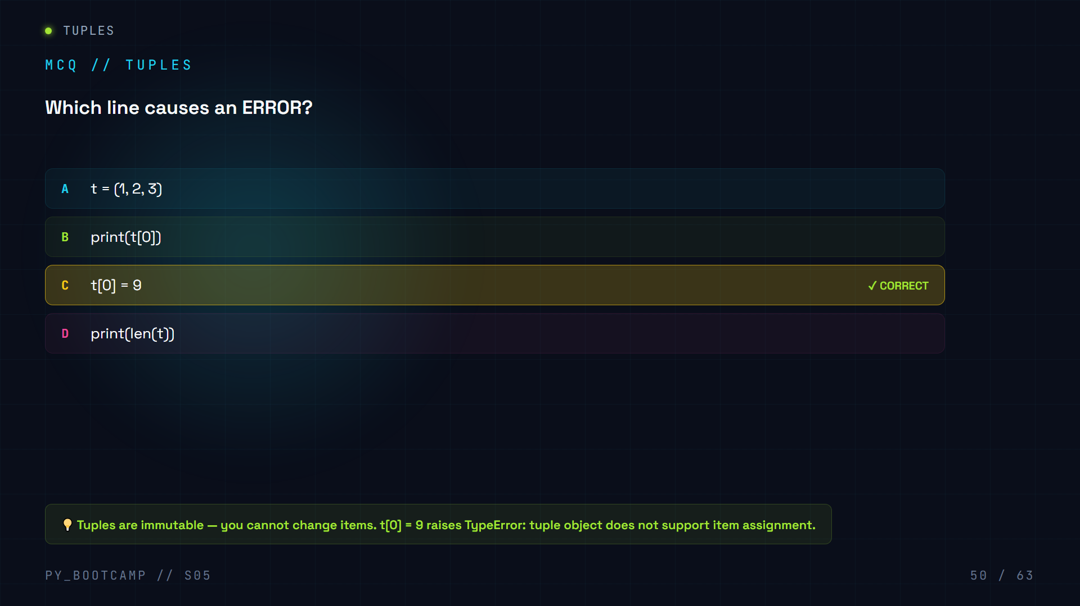

Slide 51
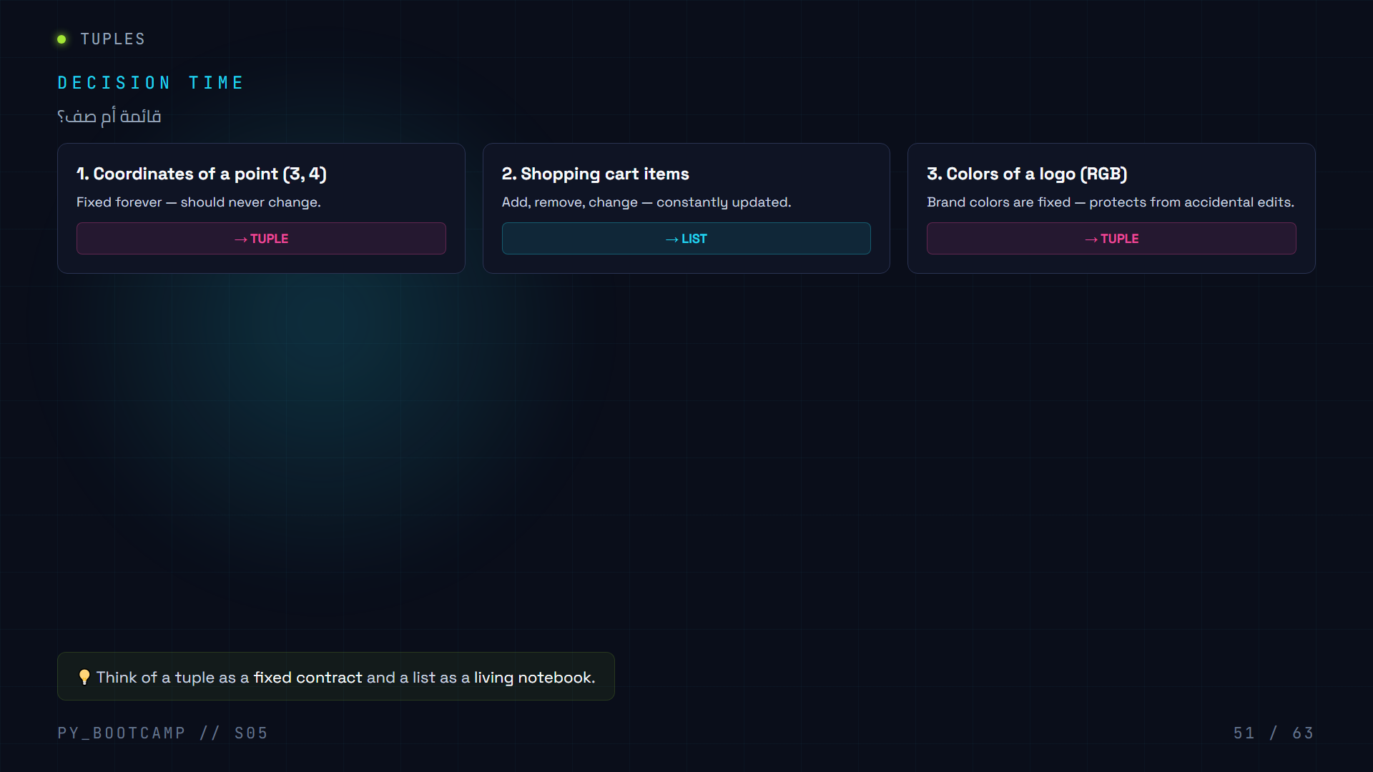
Notes:
Decision practice: fixed data → tuple, changing data → list. Three scenarios with revealed answers.

Slide 52
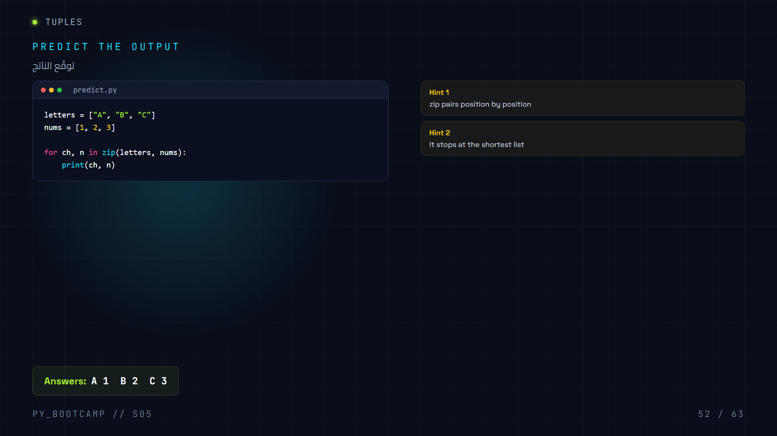
Notes:
Predict zip output: A 1, B 2, C 3. zip stops at the shortest list.

Slide 53

Notes:
Six coding challenges, easy to hard. They build toward the Student Grade Manager project.

Slide 54

Notes:
Project intro: Student Grade Manager. Requirements on the left, skills covered on the right. Build in 2 parts.

Slide 55

Notes:
Project part 1: nested list storage, add_student() with append, show_all() with enumerate.

Slide 56

Notes:
Project part 2: show_average() accumulator pattern, show_top() max pattern, while True menu with break. Complete program!

Slide 57

Notes:
Six common mistakes with fixes: IndexError, sort vs sorted, aliasing, tuple mutation, remove without in, iterating len().

Slide 58

Notes:
Speed round: 5 quick questions with answers. Covers indexing, in, aliasing, tuple immutability, zip.

Slide 59

Notes:
Recap: 4 pillars — lists, search/sort, loops, tuples. Key sentence: lists change, tuples stay fixed.

Slide 60

Notes:
Homework: Shopping Cart in 3 tiers. Easy: basic list ops. Medium: loop + input + enumerate. Hard: full menu app like the Grade Manager.

Slide 61


Slide 62


Slide 63

Notes:
Teaser for Session 6: Sets & Dictionaries. Callback to the char frequency dict used in Session 4.

