Slide 1
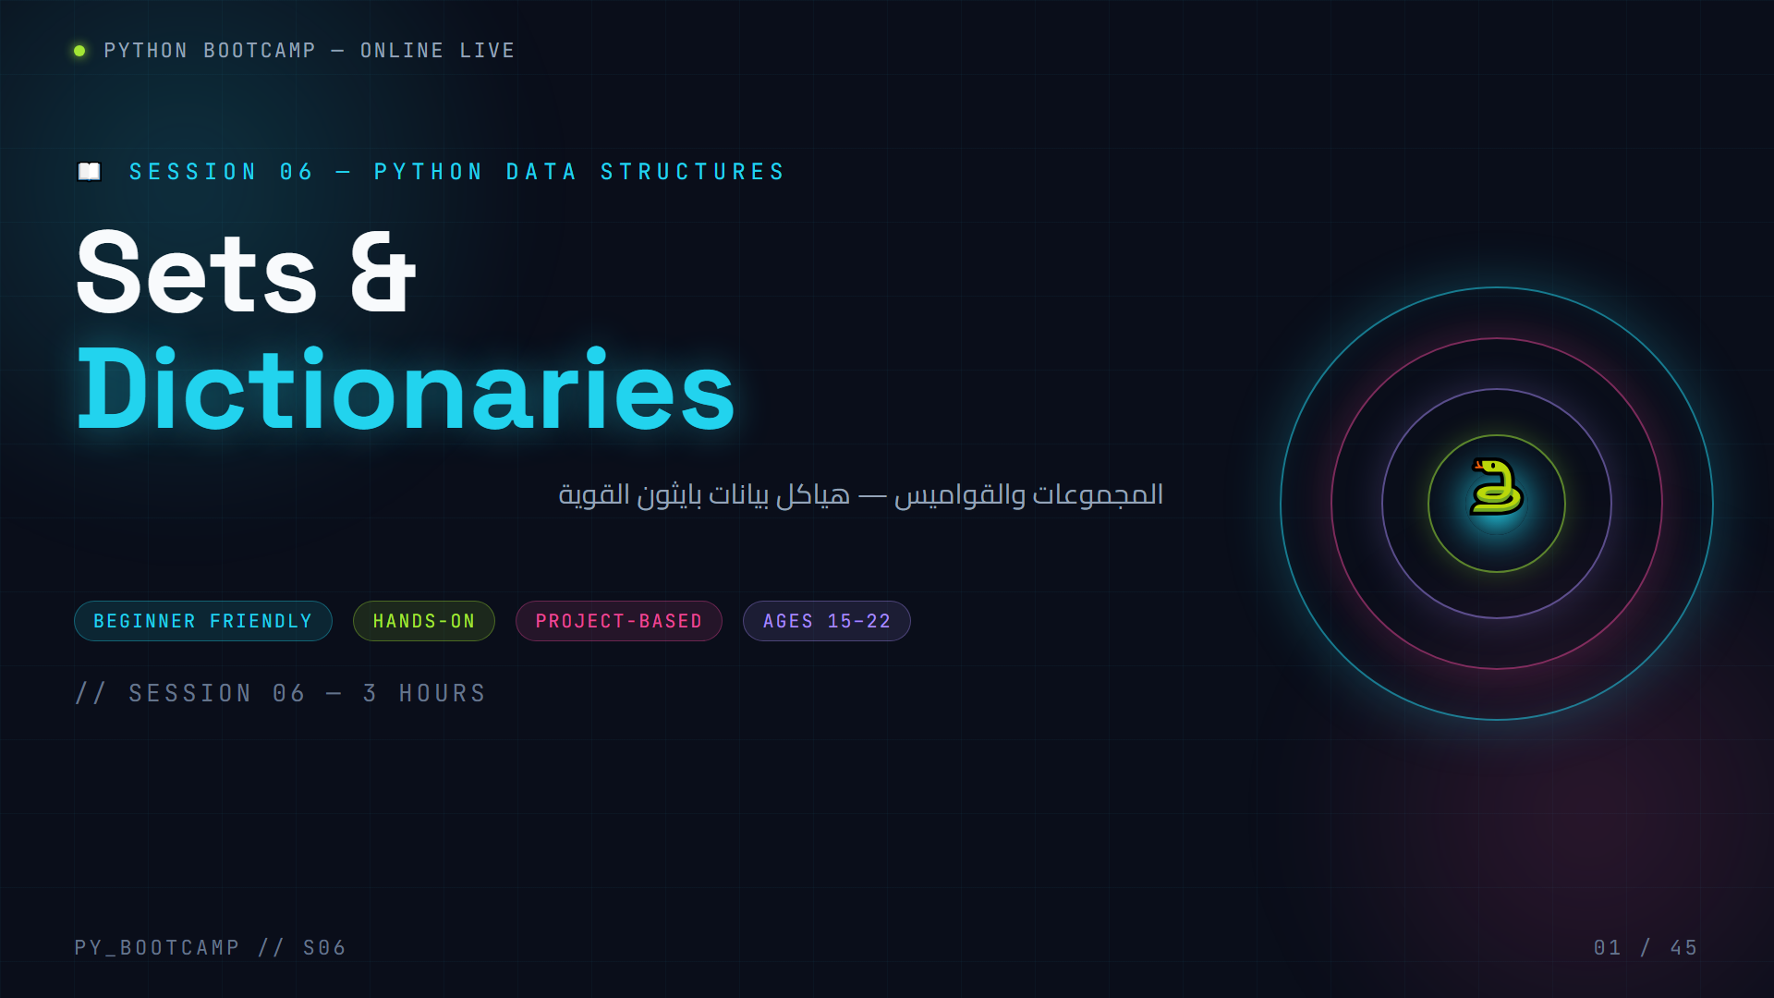
Notes:
**Slide 1 — Cover**
Welcome the class warmly. Say: "Welcome back! Today we level up from lists. Lists store things in order — but **sets** and **dictionaries** are the secret weapons that make real Python powerful. We finish with a working Contact Manager project."
- Point at the glowing orb: "A set is a collection of unique things — no repeats. Like this core: one glowing heart, no copies."
- Give the 3-hour arc: review (10 min) → sets (60 min) → dictionaries (60 min) → project + wrap-up (40 min).
- Set expectations: they will write real code in the first 20 minutes.
Arabic tip: ابدأ بترحيب سريع واسأل: "كم مرة حذفتم التكرارات يدويًّا من قائمة؟" (How often have you removed duplicates by hand?) This primes the sets motivation.

Slide 2
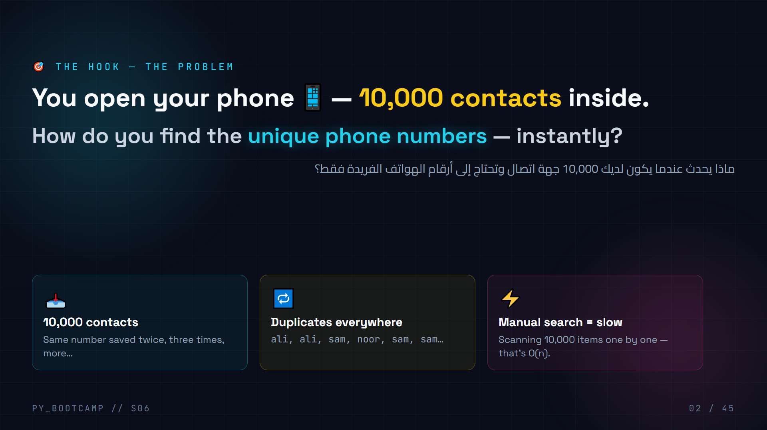
Notes:
**Slide 2 — Hook**
Dramatize this: "Scroll your phone's contacts. Ali appears twice. Sam three times. Finding the *unique* ones by hand takes forever — and you'll make mistakes."
- Build tension: "By the end of this hour you'll write 3 lines of Python that solve it instantly."
- Point at each card as you say it: volume problem → duplicates → slow manual work.
- Reveal the promise: "The tool? A **set** — a collection that refuses duplicates."
Ask: "How many unique numbers do you think are actually in that list?" Let them guess; they'll learn the exact tool soon.
Arabic tip: اشرح كلمة "فريد/فريدة" بالعربية: القيمة الفريدة تعني التي لا تتكرر. اسأل الطلاب: هل رقم والدك مكرر في هواتفك؟ 😄

Slide 3
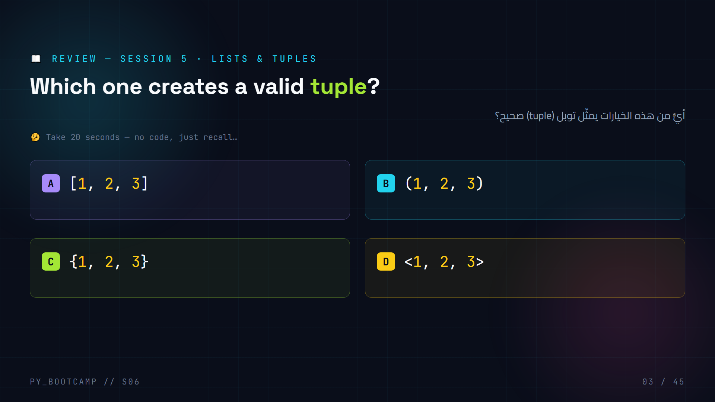
Notes:
**Slide 3 — Review MCQ (Session 5: lists & tuples)**
**Answer: B — `(1, 2, 3)`** is the tuple.
- A `[1, 2, 3]` → a **list** (square brackets, mutable, ordered).
- C `{1, 2, 3}` → a **set** in Python 3 (curly braces) — a sneak peek of today's topic, or a dict.
- D `` → not valid Python.
Explain the bracket memory trick: `[ ]` list, `( )` tuple, `{ }` set/dict.
Say: "This session is the *next chapter* — C is literally where we start today!"
Arabic tip: أعد تذكير الطلاب بجدول الأقواس: القوس المربع قائمة، والقوس الدائري توبل، والقوس المعقوف مجموعة. اكتب الجدول على السبورة.

Slide 4
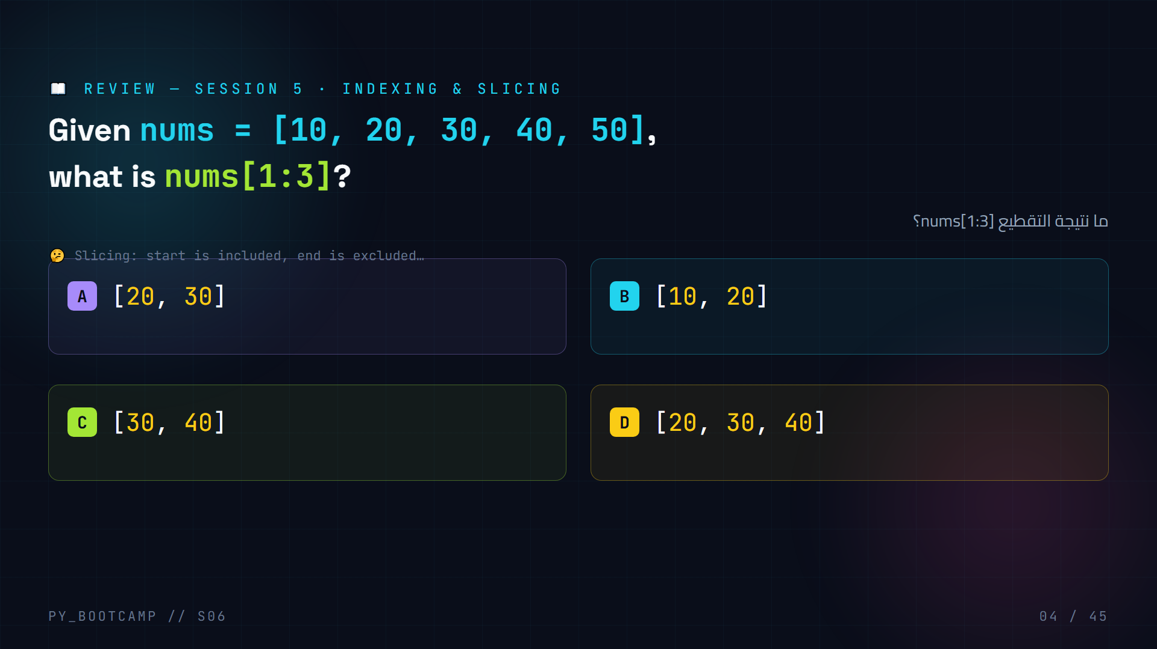
Notes:
**Slide 4 — Review MCQ (indexing & slicing)**
**Answer: A — `[20, 30]`**
- `nums[1:3]` → start at index 1 (`20`), stop before index 3 (`40`). Result `[20, 30]`.
- D `[20, 30, 40]` is the common mistake (forgetting the end index is exclusive).
Visual: draw the indices under the list on the board: `10[0] 20[1] 30[2] 40[3] 50[4]`, then circle 1 and 3.
Say: "Slicing is how we'll later grab words out of a sentence — remember `start included, end excluded`."
Arabic tip: اشرح القاعدة "البداية تدخل، والنهاية لا تدخل" واطلب من طالب أن يعيدها بصوت عالٍ لتثبيتها.

Slide 5
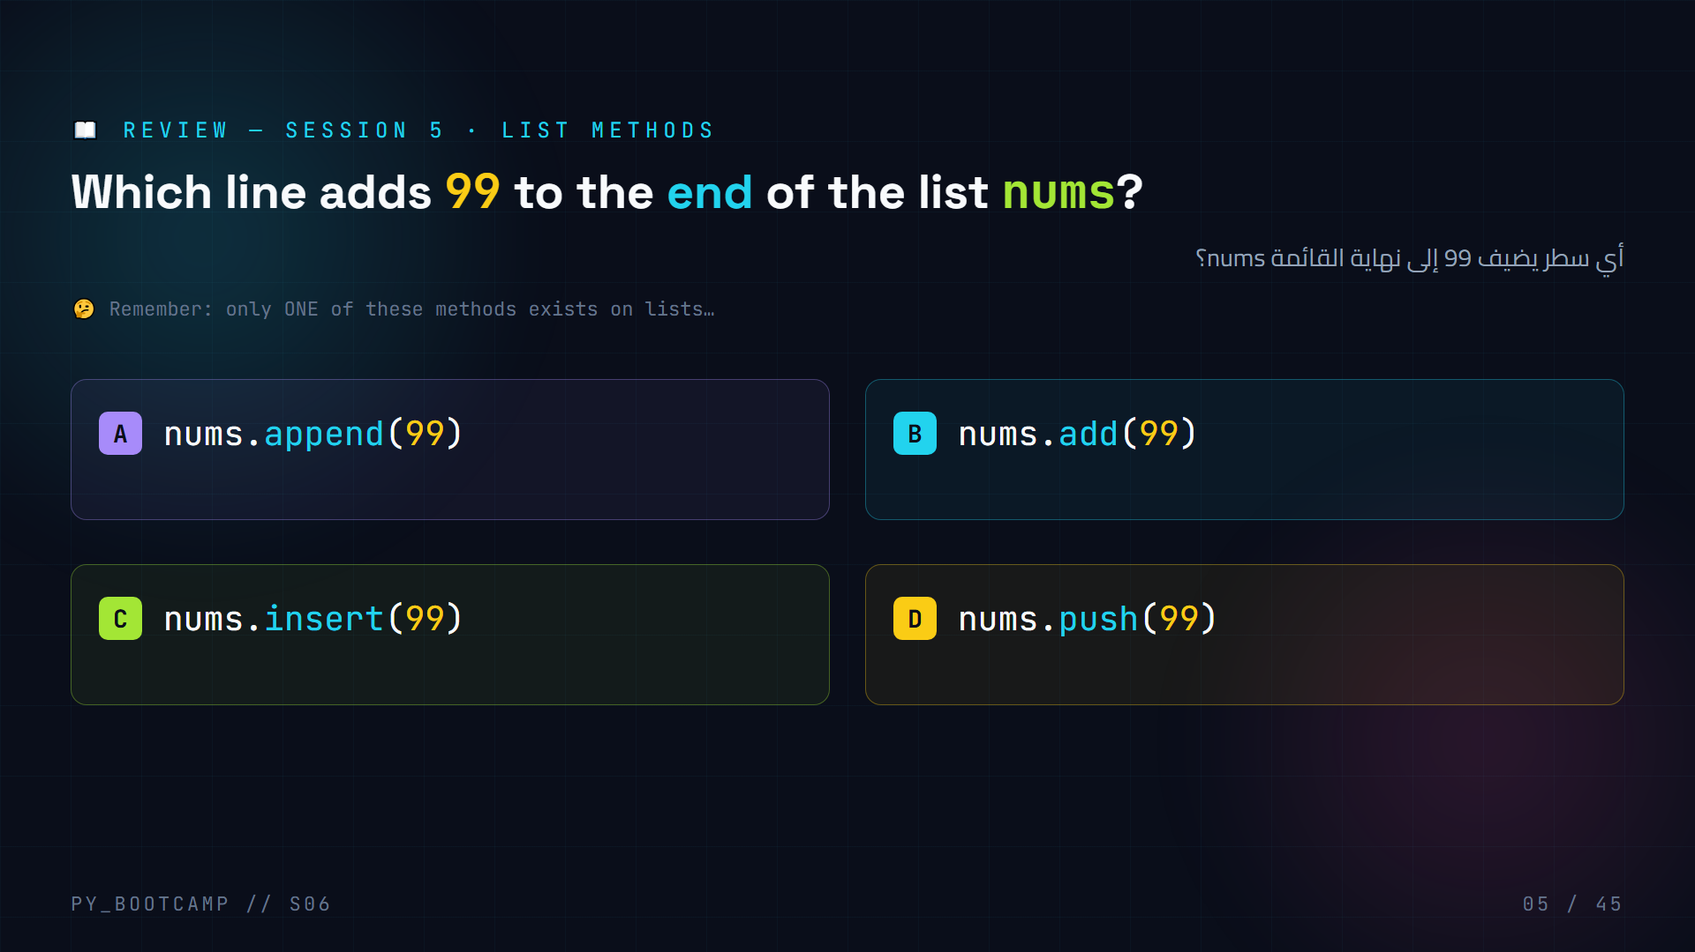
Notes:
**Slide 5 — Review MCQ (list methods)**
**Answer: A — `nums.append(99)`**
- A `append(x)` → adds `x` at the end of a list. ✅
- B `add(x)` → that's a **set** method — a teaser of today's topic!
- C `insert(99)` → `insert` needs an index first: `nums.insert(0, 99)`. This call raises an error.
- D `push(99)` → that's JavaScript — Python lists don't have it.
Say: "Notice B uses `add` — we meet that method in about 15 minutes. Keep it in mind!"
Arabic tip: ذكّر الطلاب بأن لكل نوع (list / set / dict) دوالّه الخاصة، ولا يمكن استدعاء دالة نوع على نوع آخر. هذه نقطة أخطاء شائعة عند المبتدئين.

Slide 6
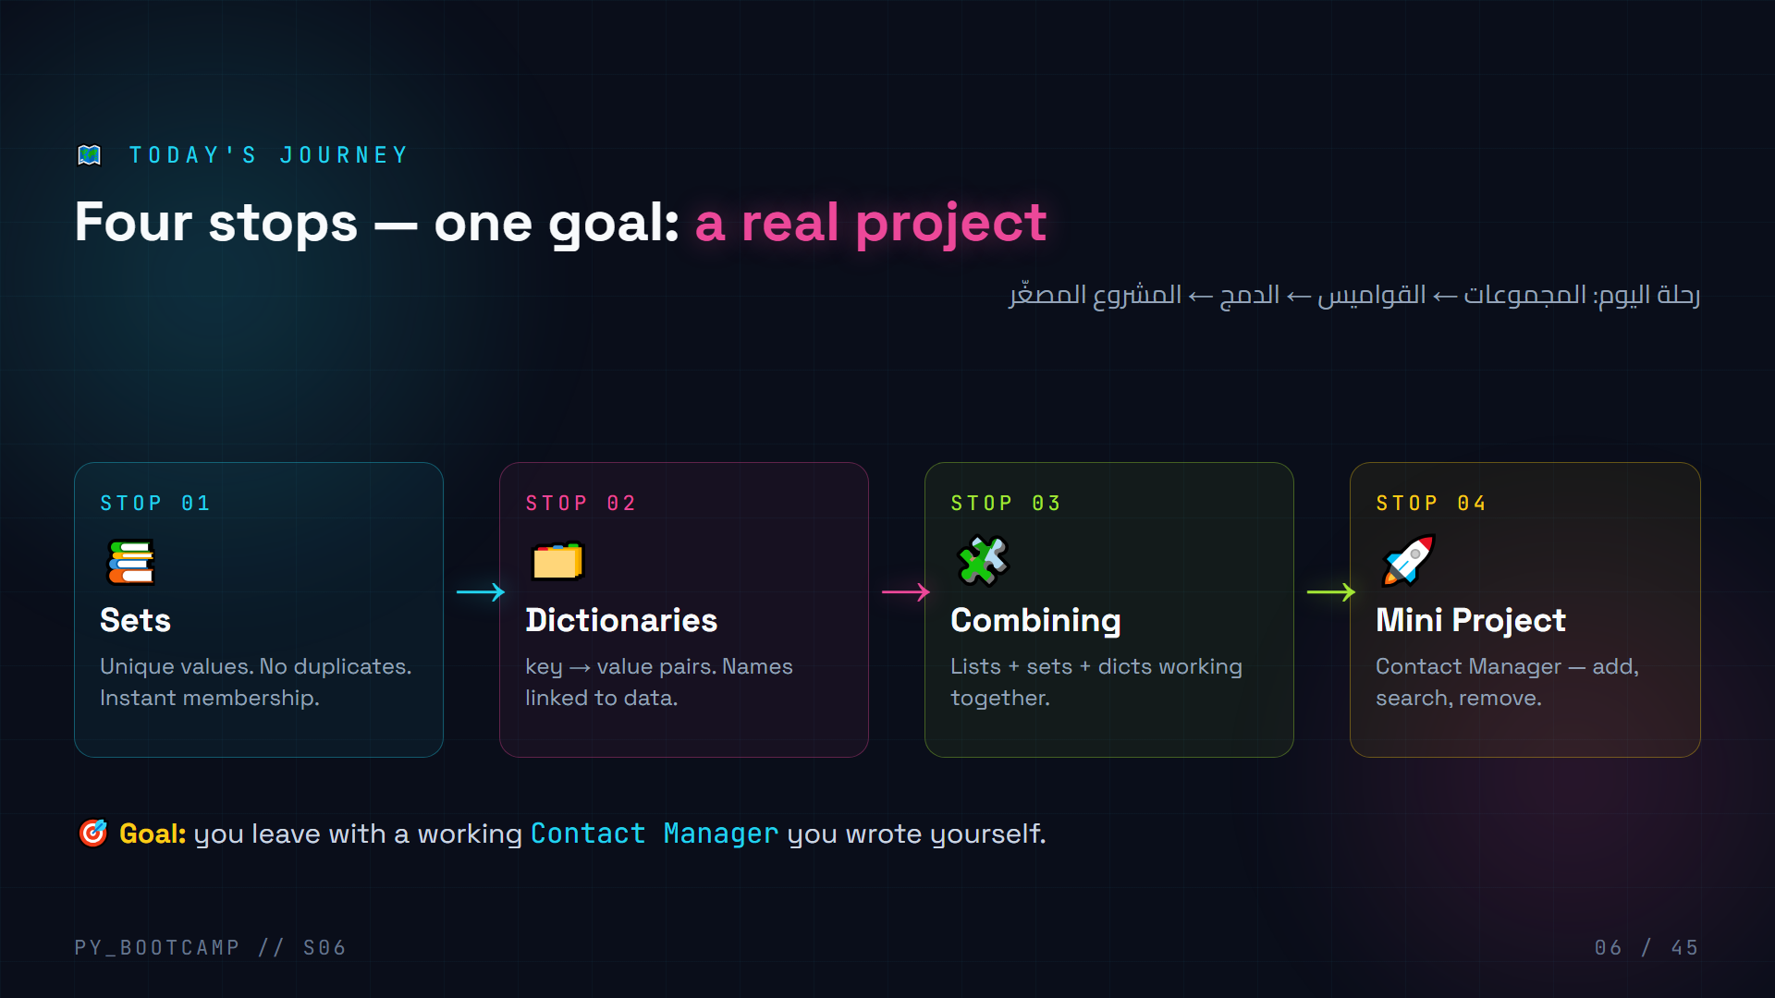
Notes:
**Slide 6 — Session timeline**
Walk through the four stops pointing at each card. Keep it to 30 seconds.
1. **Sets** — the uniqueness superpower (60 min).
2. **Dictionaries** — key→value lookups (60 min).
3. **Combining** — put everything together.
4. **Mini Project** — a Contact Manager you can actually run.
Say: "Every stop ends with a checkpoint question — so stay sharp. There's a break before the project."
Promise: "The Contact Manager will search a contact by name in O(1) — that's the payoff of dictionaries."
Arabic tip: اسأل الطلاب: "أي تطبيق تستخدمونه يوميًّا يخزّن بيانات على شكل أزواج مفتاح-قيمة؟" (مثل دفتر هاتف، تطبيق مراسلة). هذا يهيئهم للقواميس.

Slide 7
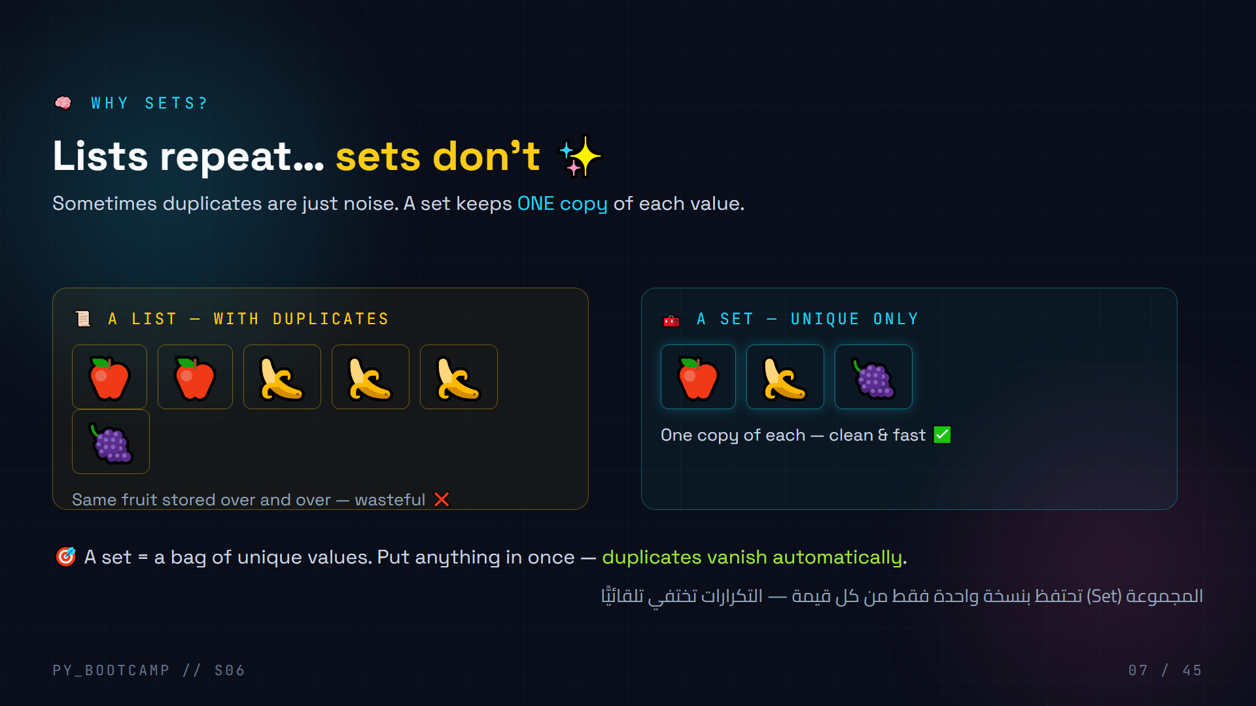
Notes:
**Slide 7 — Why collections beyond Lists**
Side-by-side comparison: a list happily stores the same value many times; a set collapses them.
- Point at the 🍌 repeated three times in the list: "Three bananas — do you *need* three bananas? In a shopping list, maybe. In unique IDs, never."
- Ask: "When do you want ONLY unique values?" Elicit: student IDs, phone numbers, usernames, email addresses.
- Tease the magic: "Feed a list into a set and Python removes the copies for you — we do exactly that on slide 13."
Arabic tip: اربط بالعربية: القائمة مثل "قائمة تسوّق" قد تكرّر فيها صنفًا مرتين، أما المجموعة فهي مثل "شنطة" تحمل كل شيء مرة واحدة فقط.

Slide 8
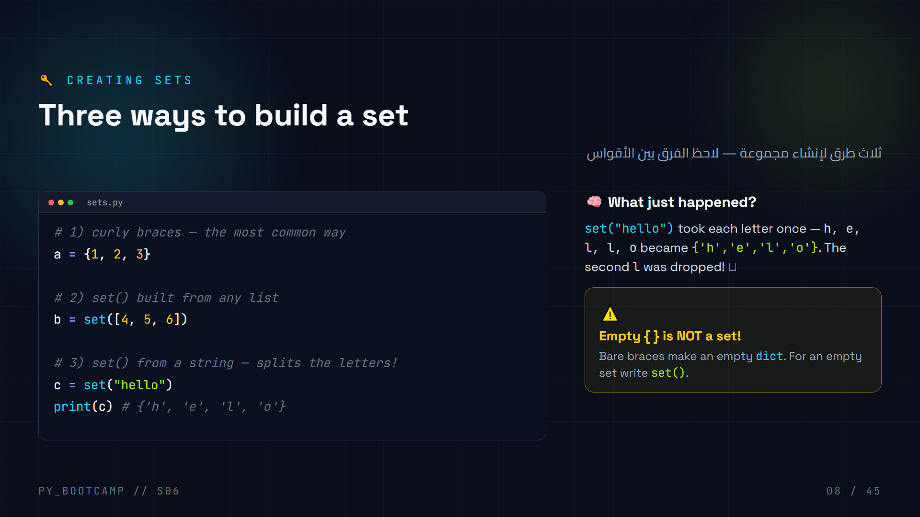
Notes:
**Slide 8 — Creating sets**
Live-code this. Then highlight the surprise: `set("hello")` → `{'h', 'e', 'l', 'o'}` — the second `l` vanished.
- Ask before running: "How many letters are in 'hello'? How many will the set hold?" (5 vs 4)
- Emphasize: the *order* shown is not guaranteed — sets are unordered.
- The ⚠️ card is the classic trap: `{}` is a dict. Teach the rule now so it doesn't bite later.
- Run `type({})` vs `type(set())` in IDLE to prove it.
Arabic tip: قول لهم بالعربية: "الأقواس المعقوفة الفارغة ليست مجموعة — إنها قاموس!" واكتب على السبورة: `{}` قاموس، `set()` مجموعة.

Slide 9
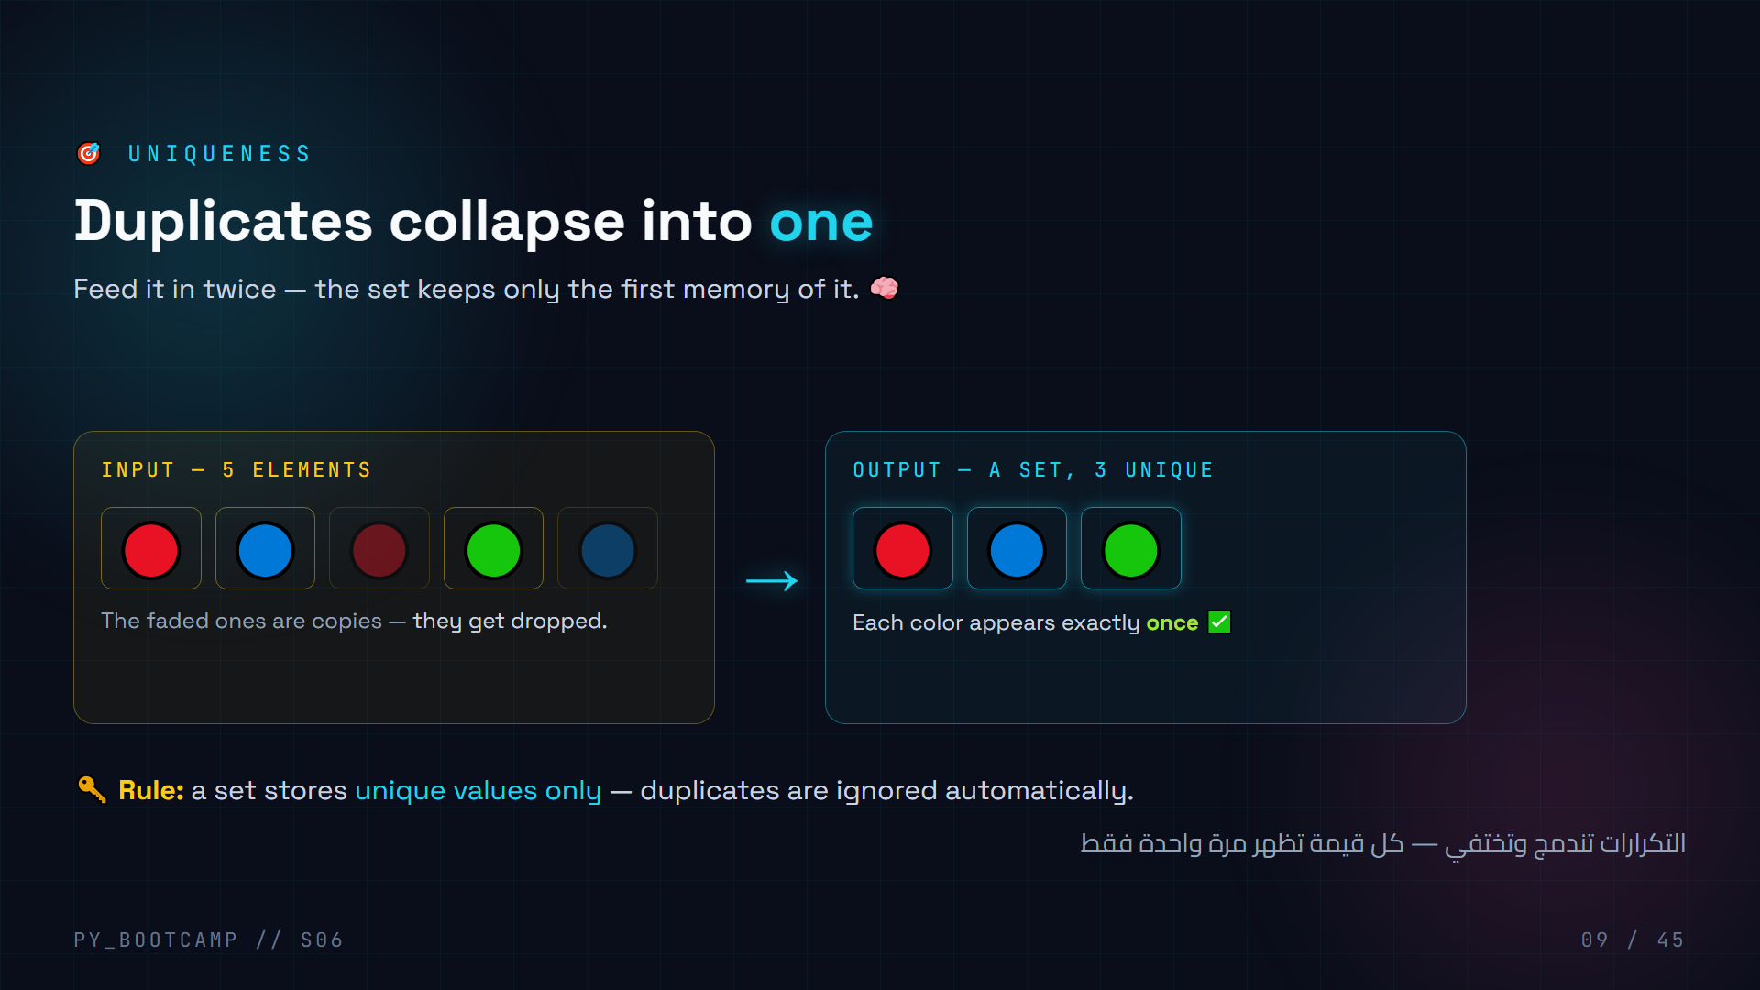
Notes:
**Slide 9 — Set uniqueness (visual)**
The core concept of the hour. Narrate the animation:
- "Five emojis go in. The red copy and the blue copy are identical to earlier ones — the set recognizes them and refuses."
- "Only three come out. That's uniqueness in action."
Demo in the shell: `s = {1, 1, 2, 2, 2, 3}` then `print(s)` → `{1, 2, 3}`.
- Ask: "If I add 1 again — does the set grow?" No, size stays 3.
- Connect to the hook: duplicates of phone numbers collapse the same way.
Arabic tip: اطلب من طالب أن يصف ما حدث بالعربية: "أدخلنا خمس قيم، لكن المكرر منها اختفى وبقيت ثلاث قيم فقط." ثم اربطها بفكرة المجموعات الرياضية.

Slide 10
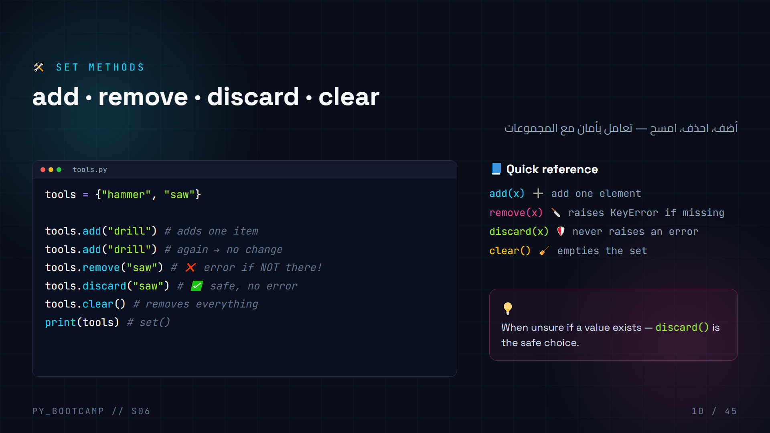
Notes:
**Slide 10 — Set methods**
Live-code, showing each call step by step and `print(tools)` after each:
1. `add("drill")` → `{"hammer", "saw", "drill"}`.
2. `add("drill")` again → **no change** — uniqueness in action.
3. `remove("saw")` → works.
4. Then the money moment: `remove("saw")` again → **KeyError!** Show the scary red traceback, then reassure: "This is why `discard` exists."
Say: "`remove` is strict — it complains loudly. `discard` is chill — it just does nothing if the value is missing."
Get the class to predict: "Which is safer when cleaning user input?" → discard.
Arabic tip: اشرح الفرق بأسلوب مألوف: remove مثل "صرّاف صارم" يرفض العملية إن لم يجد المبلغ، أما discard فهو "متسامح". اسأل: متى تفضّل كل منهما؟

Slide 11
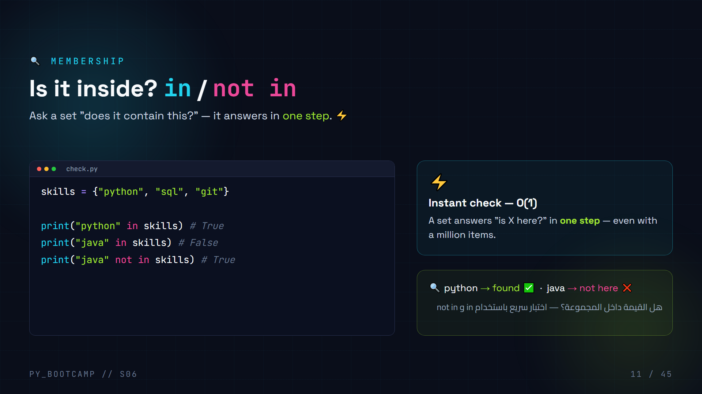
Notes:
**Slide 11 — Membership with `in` / `not in`**
This is THE killer feature of sets. Contrast with lists:
- A list answers `in` by scanning every item (O(n)) — 10,000 steps for 10,000 contacts.
- A set answers in one step (O(1)) — always fast, no matter the size.
Demo in shell with `timeit` (optional, quick): searching a big list vs a big set.
Emphasize the phrase: "If you only need *does it exist?*, a set is the right tool." That's the vocabulary for the project.
Arabic tip: اربط بـ"هل الكلمة موجودة في القاموس؟" بالعربية. القاموس يجد الكلمة مباشرة — نفس فكرة O(1). هذا تمهيد أيضًا للقواميس.

Slide 12
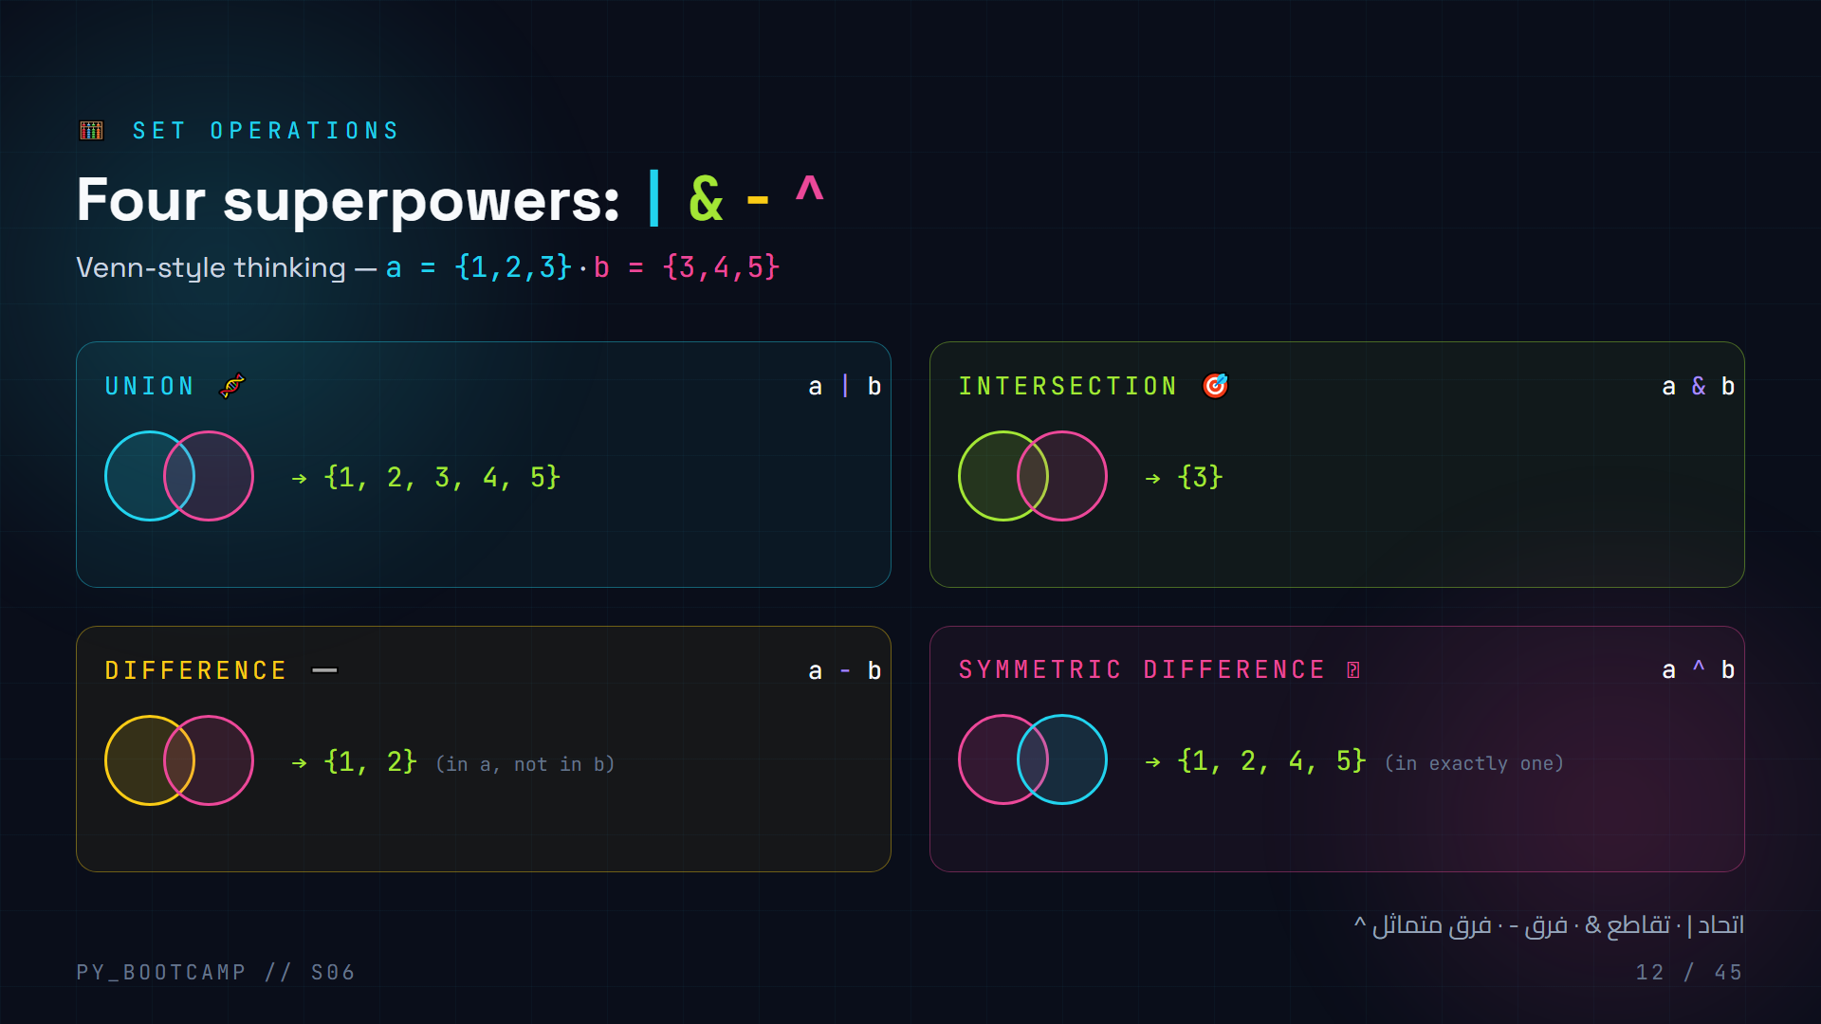
Notes:
**Slide 12 — Set operations (Venn cards)**
Work through each operation with `a = {1, 2, 3}` and `b = {3, 4, 5}`. Draw the two overlapping circles on the board.
- **Union** `a | b` → everything: `{1, 2, 3, 4, 5}`.
- **Intersection** `a & b` → only the shared part: `{3}`.
- **Difference** `a - b` → in `a` but not in `b`: `{1, 2}`. (Direction matters! `b - a` = `{4, 5}`.)
- **Symmetric difference** `a ^ b` → in exactly one: `{1, 2, 4, 5}`.
Ask the class to predict each result *before* showing. The `^` usually surprises people — celebrate it.
Real-world tie-in: "Union = merging contact lists. Intersection = friends in common. Difference = contacts only you have."
Arabic tip: استخدم مثالًا محليًا: "الطلاب الذين يدرسون الرياضيات فقط، الذين يدرسون البرمجة فقط، والذين يدرسون الاثنين معًا" لتوضيح العمليات الأربع.

Slide 13
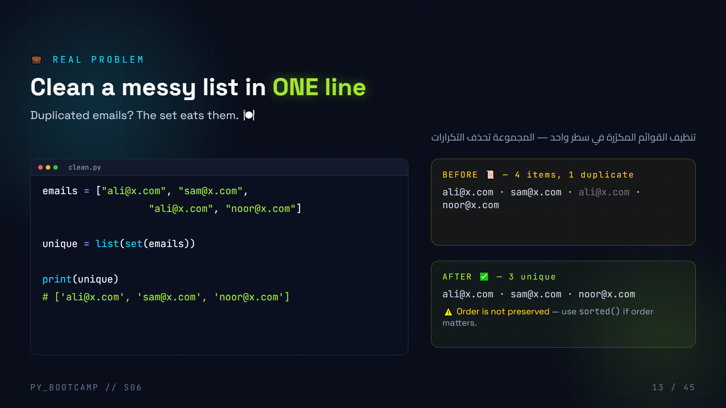
Notes:
**Slide 13 — Remove duplicates from a list**
The most practical recipe of the sets chapter. Read the pattern aloud: **`list(set(mylist))`** — "list of the set of my list."
- Walk through the pipeline: list → set (dedupe) → list (back to a list you can index and sort).
- Highlight the `ali@x.com` in the BEFORE panel: it's the duplicate being eaten.
- The ⚠️ note is essential: set order is not list order. If they need sorted output, show `sorted(set(mylist))`.
Have them type it themselves with their own list of repeated names. Quick check: "What's `list(set([7, 7, 7]))`?" → `[7]`.
Arabic tip: اقرأ السطر كمعادلة: "قائمةٌ من مجموعةِ قائمتي". واطلب من الطلاب ترجمتها بالعربية بأسلوبهم الخاص ليترسّخ المعنى.

Slide 14
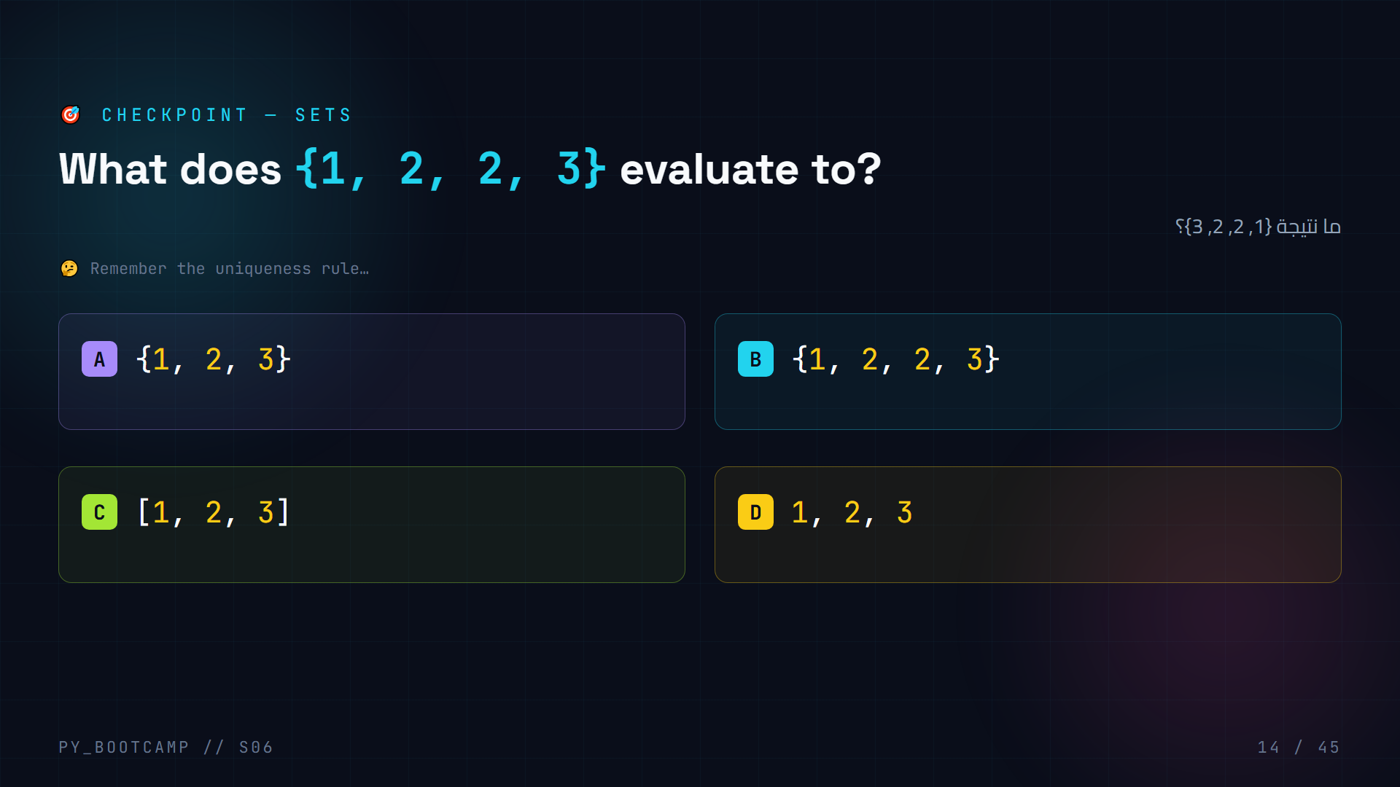
Notes:
**Slide 14 — MCQ: sets (uniqueness)**
**Answer: A — `{1, 2, 3}`**
- The duplicate `2` collapses: `{1, 2, 2, 3}` is the same set as `{1, 2, 3}`.
- B would be true for a list, but a set never keeps duplicates.
- C is a list — wrong brackets.
- D is a tuple — wrong brackets.
Have the class run `print({1, 2, 2, 3})` themselves to see Python print `{1, 2, 3}`.
Say: "If you got this right, you understand the whole point of a set."
Arabic tip: اطلب من الطلاب قراءة السؤال بصوت عالٍ وترجمته: "ما نتيجة مجموعة فيها رقم مكرر؟" ثم أجب بالعربية: "المجموعة تحذف المكرر تلقائيًا."

Slide 15
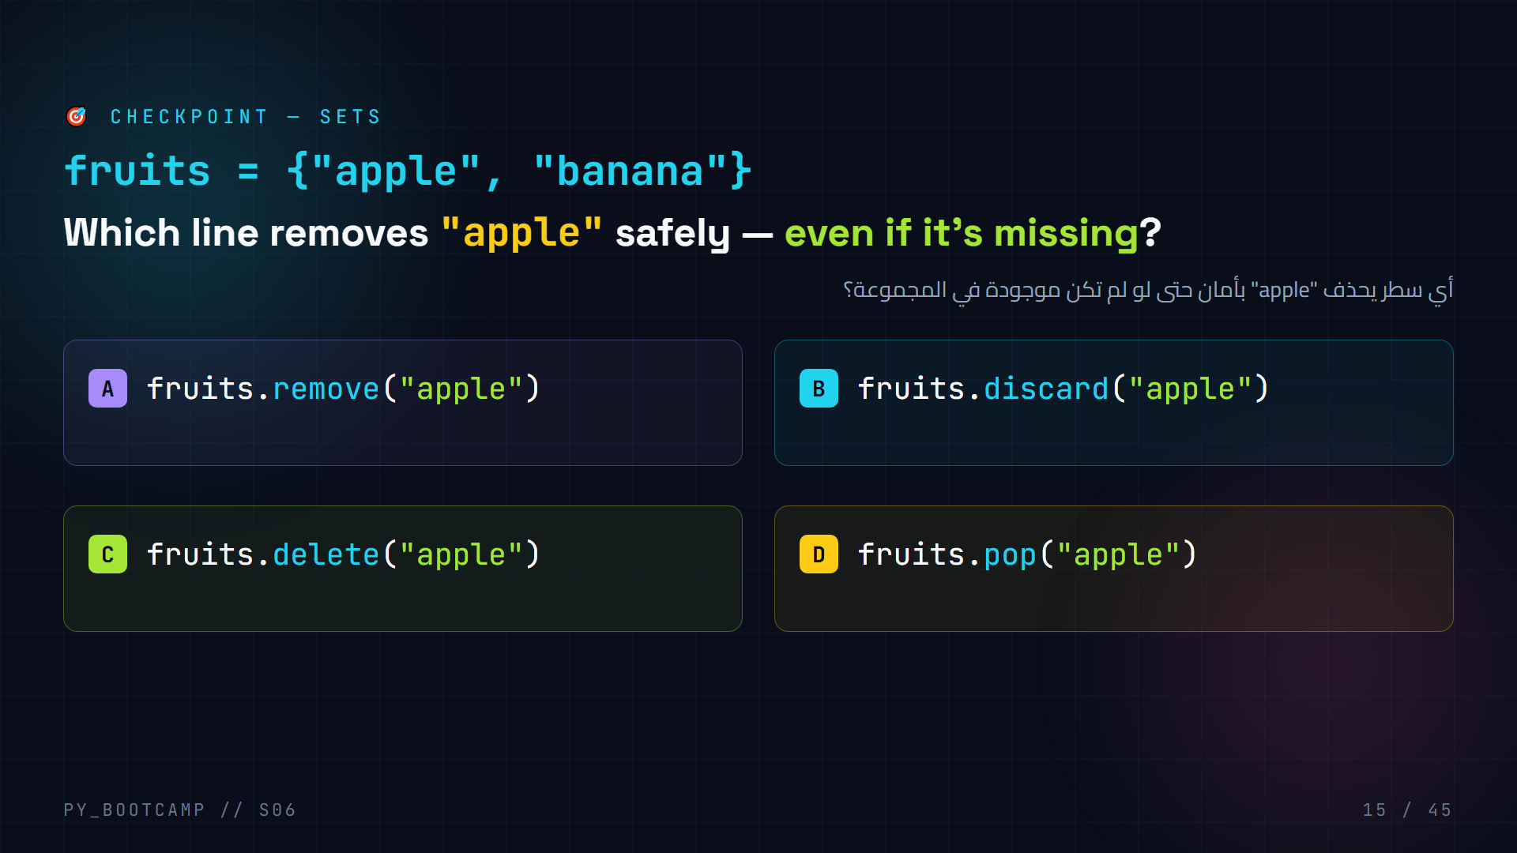
Notes:
**Slide 15 — MCQ: sets (methods)**
**Answer: B — `fruits.discard("apple")`**
- A `remove()` raises a `KeyError` if the value is missing — NOT safe here.
- B `discard()` silently does nothing if missing — the safe choice. ✅
- C `delete()` is not a set method.
- D `pop()` removes and returns an *arbitrary* element — it takes no argument (removing by value isn't what pop does on sets).
Say: "Rule of thumb: if the value might not exist and you don't want to crash → `discard`. If you *want* to know it's missing (catch the error) → `remove`."
Arabic tip: لخّص القاعدة بالعربية: "إذا لم تتأكد من وجود القيمة، استخدم discard حتى لا يتعطل البرنامج."

Slide 16
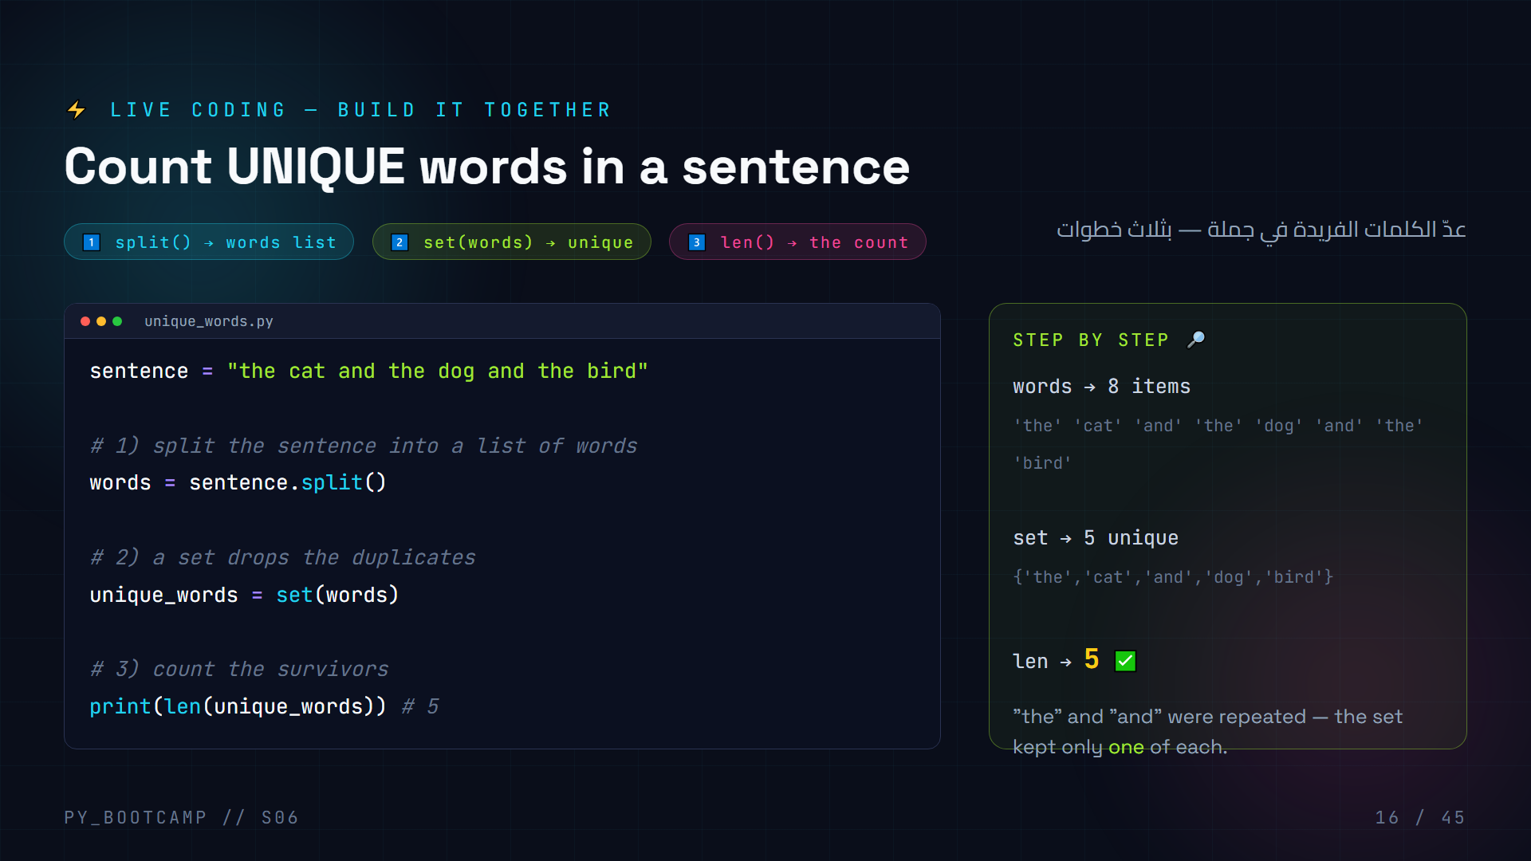
Notes:
**Slide 16 — Live coding: unique word counter**
Have students open their editors and code along. Go line by line, running after each step:
1. **Type** the sentence, print it. Ask: "How many words?" (8).
2. **`split()`** → show the list of 8 words including repeats.
3. **`set(words)`** → print it; the class should *see* duplicates vanish: `{'the', 'cat', 'and', 'dog', 'bird'}`.
4. **`len(...)`** → 5.
Stress the *why*: "This is how you'd count unique visitors, unique hashtags, unique error types."
Extension if time: strip punctuation — `sentence.replace(",", "")` — to show real-world cleanup.
Arabic tip: وجّه الطلاب خطوة بخطوة واجعلهم يتوقعون الناتج قبل التشغيل: "كم كلمة فريدة تتوقعون؟" ثم اربط النتيجة: 8 كلمات كاملة لكن 5 فقط فريدة.

Slide 17
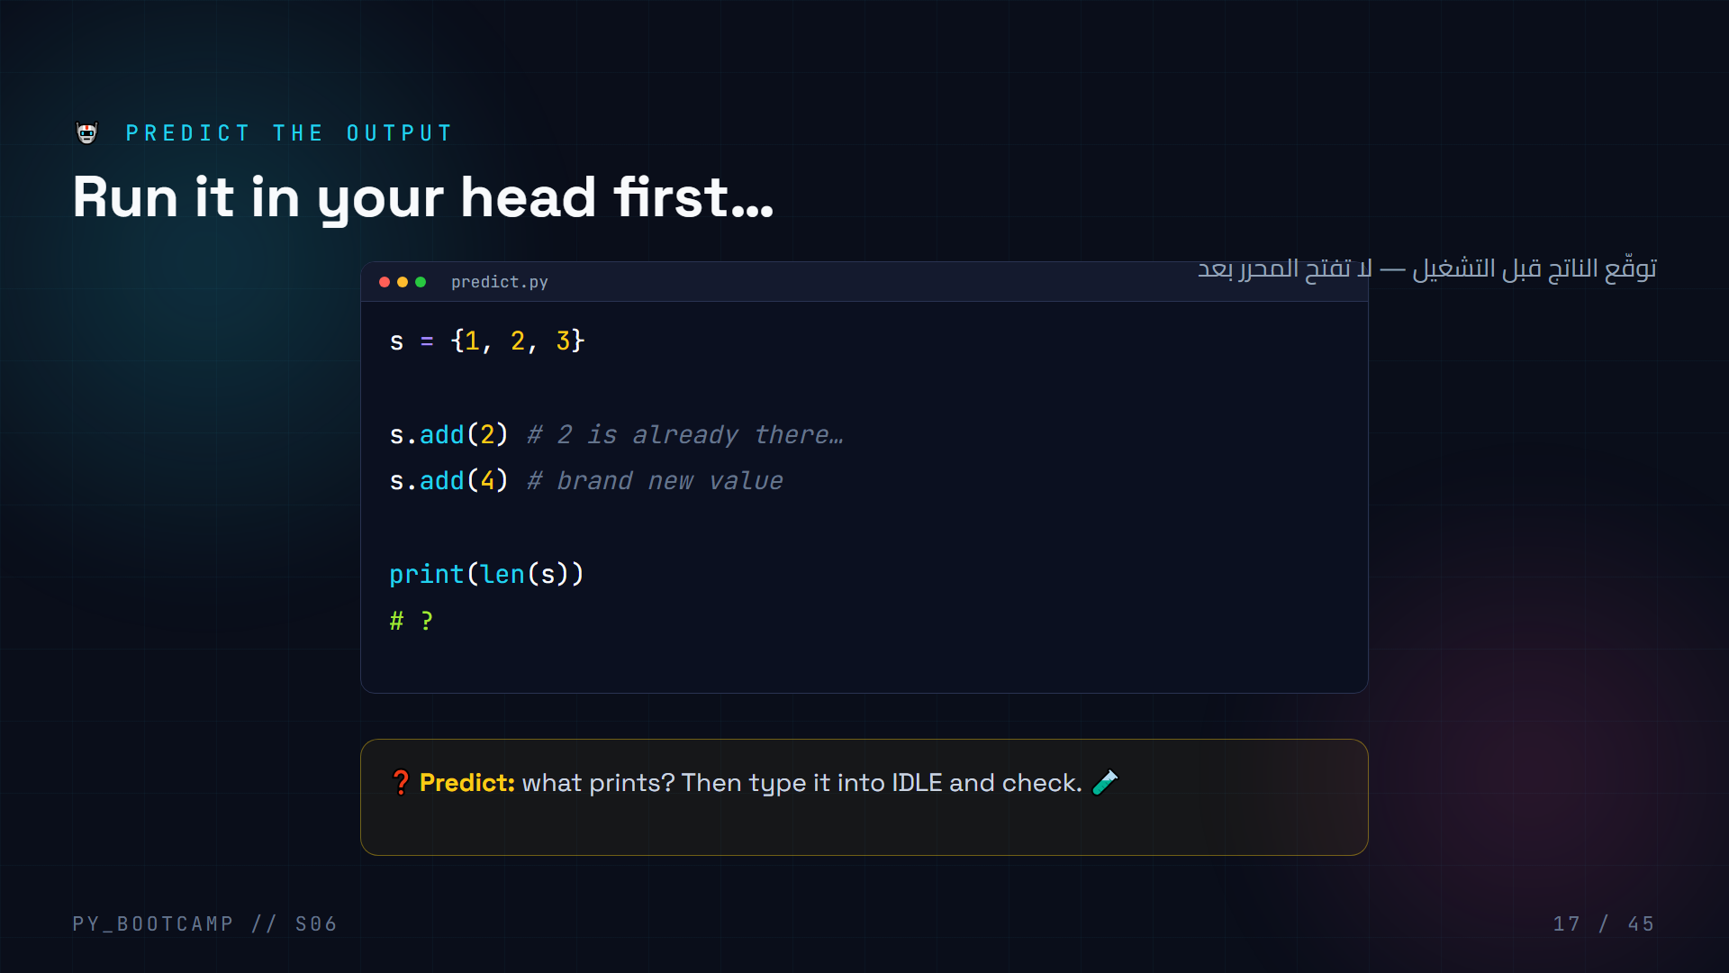
Notes:
**Slide 17 — Predict the output**
**Answer: `4`**
Walk through it:
- `s = {1, 2, 3}` → size 3.
- `s.add(2)` → `2` already exists, **nothing changes** — size stays 3.
- `s.add(4)` → adds `4` — size 4.
- `len(s)` → `4`.
Common wrong answer: "5" (students count `add` as always growing). Emphasize: `add` on an existing value is a silent no-op.
Have them predict aloud before revealing. Then run it to confirm.
Arabic tip: اسأل: "ماذا يحدث إذا أضفنا قيمة موجودة بالفعل؟" أجب: "لا شيء — المجموعة لن تتغير." هذا هو بيت القصيد.

Slide 18
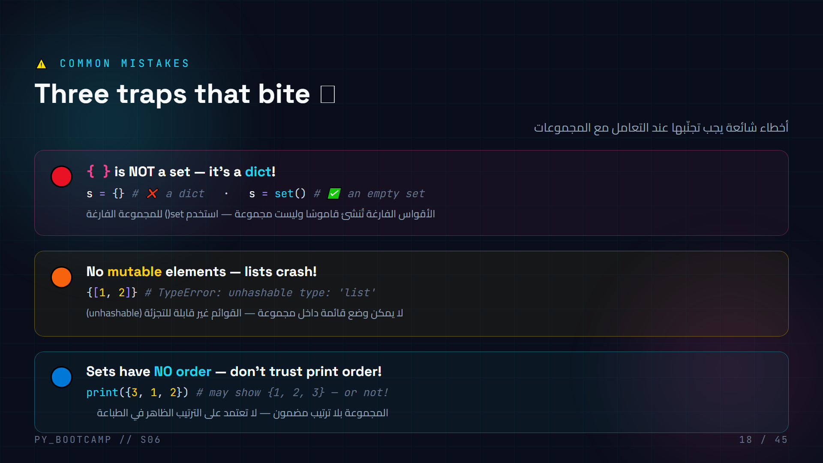
Notes:
**Slide 18 — Common set mistakes**
Go through the three traps with live demos so the errors are *seen*, not just told:
1. **`{}` is a dict.** Run `type({})` → ``, then `type(set())` → ``.
2. **Unhashable list.** Run `{[1, 2]}` and show the `TypeError: unhashable type: 'list'`. Explain simply: "A list can change, so Python can't stamp it — sets need fixed, hashable stamps." (Tuples ARE allowed: `{(1, 2)}` works.)
3. **No order.** Run `print({3, 1, 2})` twice — the order may differ between runs/versions. Rule: if order matters, use a list (or `sorted()`).
Closing line: "Avoid these three and sets will serve you forever."
Arabic tip: اكتب الأخطاء الثلاثة على السبورة واطلب من كل طالب أن يعيد أحدها بأسلوبه: "المجموعة لا تحفظ الترتيب"، "لا تضع قائمة داخل مجموعة"، "الأقواس الفارغة قاموس".

Slide 19
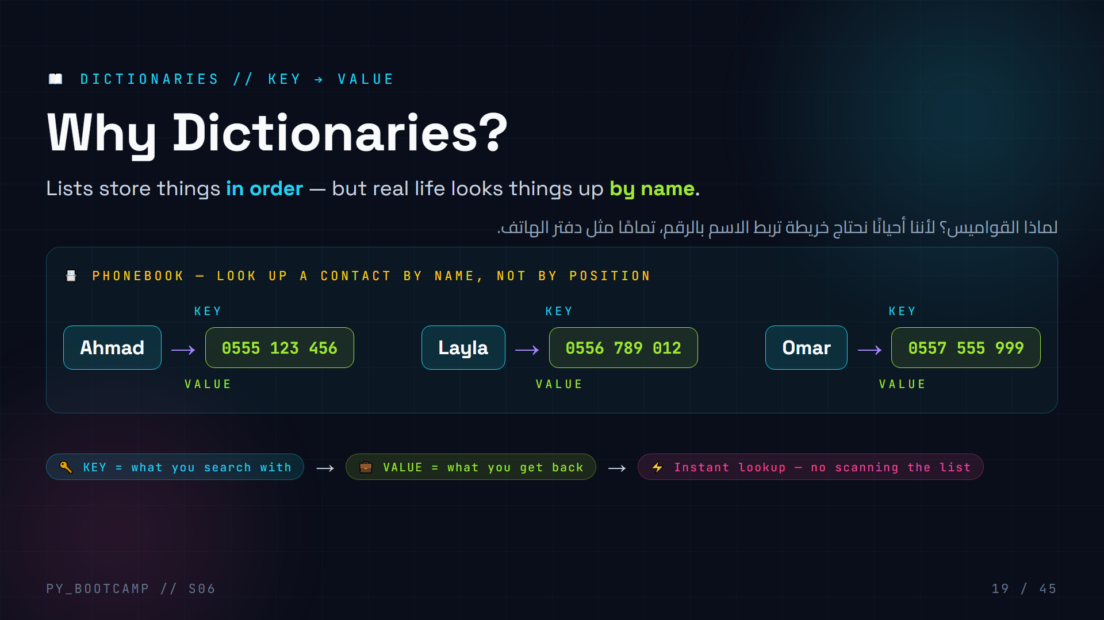
Notes:
# Slide 19 — Why Dictionaries? (Instructor notes)
**What to say**
- Set the scene: "So far every list stores values in a row. But real programs need to look things up BY NAME, not by position."
- Phonebook analogy: you don't scan all 10,000 numbers to find Ahmad — you jump straight to his entry.
- Introduce the vocabulary NOW: KEY (the name you search with) and VALUE (the data you get back). Point at the diagram.
**Key points**
- A dictionary maps each key → exactly one value.
- Keys are unique inside a dict; values may repeat.
- Python calls them "dicts"; other languages call them maps / hash maps / objects (JS).
**Arabic teaching tip**
- ركّز على المصطلحين: المفتاح (key) والقيمة (value). اربطها بفكرة «الاسم ← الرقم» في دفتر الهاتف لتثبيت المفهوم.
**Common confusion**
- Students mix lists and dicts: lists use an index (0, 1, 2), dicts use a key. Emphasize we NEVER use a position to reach a dict value.

Slide 20
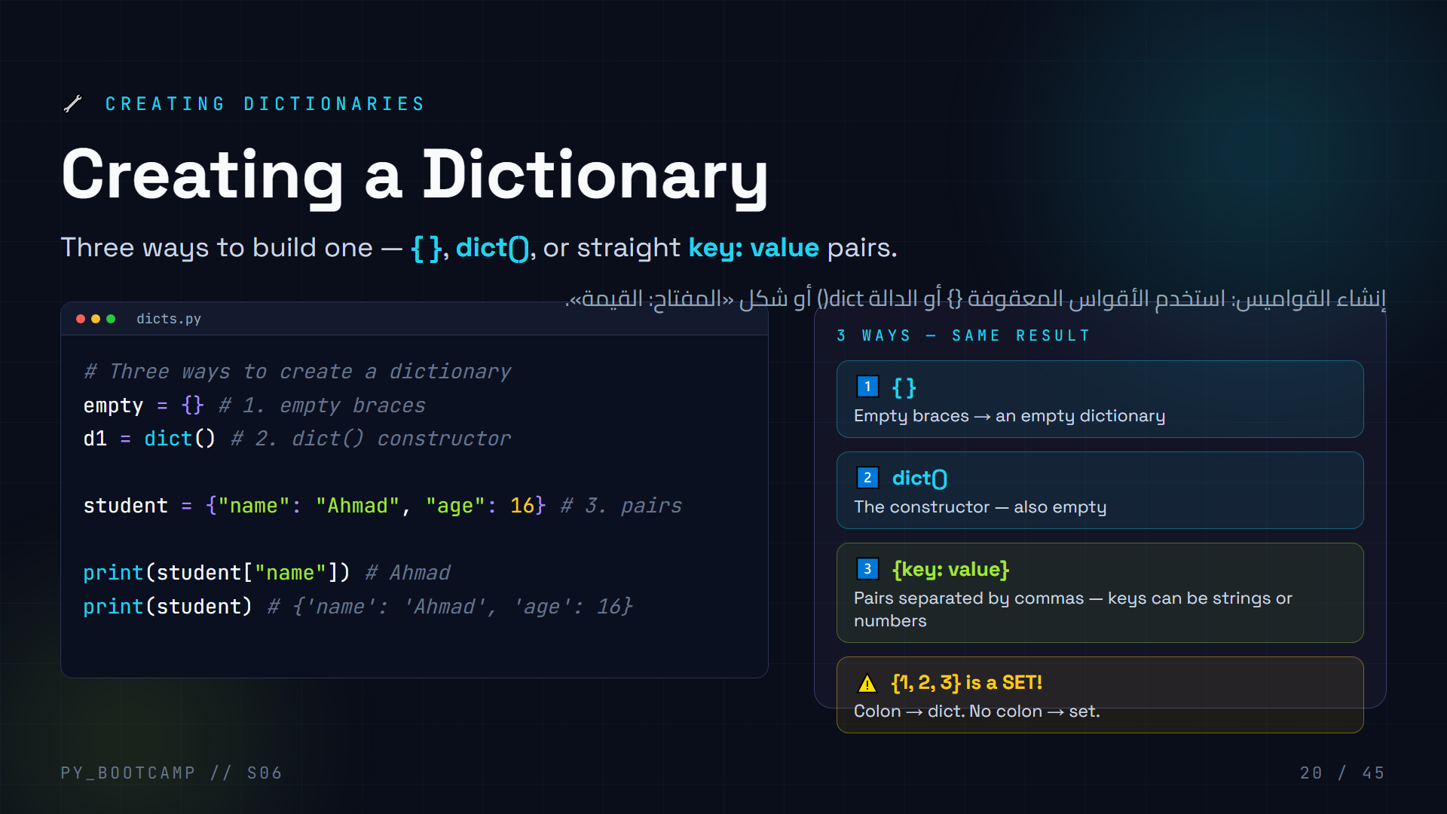
Notes:
# Slide 20 — Creating Dictionaries (Instructor notes)
**What to say**
- "Three doorways into the same room." Walk the class through each line.
- Stress the shape: `{"key": value, "key": value}` — the colon is the glue, the comma separates pairs.
**Live demo (2 min)**
- Type `d = {"name": "Ahmad", "age": 16}` in the REPL, then `d`, then `type(d)` → ``.
- Show `dict()` gives `{}`.
- Watch out: typing `{"Ahmad", 16}` gives a SET, not a dict — this is the #1 trap.
**Common mistakes**
- Students write `{"name": "Ahmad", "age": 16,}` — trailing comma is actually FINE in Python.
- Students try `dict("name", "Ahmad")` → TypeError. The constructor takes keyword args: `dict(name="Ahmad")`.
**Arabic teaching tip**
- ذكّرهم أن شكل القاموس دائمًا «مفتاح: قيمة». علامة النقطتين (:) هي التي تميّز القاموس عن المجموعة (set).

Slide 21
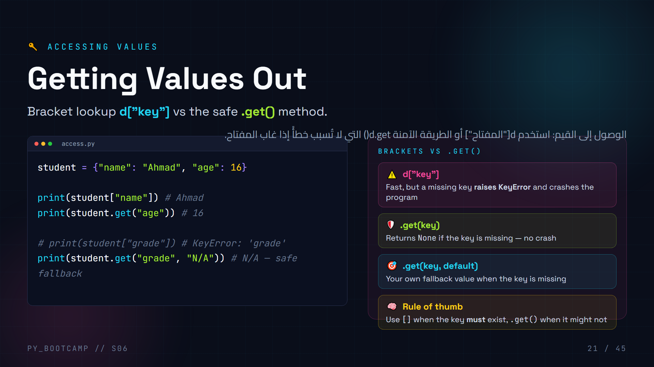
Notes:
# Slide 21 — Accessing Values (Instructor notes)
**What to say**
- Two tools for the same job. `d["key"]` is direct; `.get()` is defensive.
- Explain KeyError precisely: it means "that key is not in this dictionary."
**Live demo (2 min)**
- `student["grade"]` → KeyError. Read the traceback aloud — this is the skill students need.
- Then `student.get("grade")` → None (prints as `None`).
- Then `student.get("grade", "N/A")` → `N/A`.
**Common mistakes**
- Students expect `d["x"]` to return None on a miss — it raises instead. Show both side by side.
- Students forget `.get()` does NOT add the key; the dict stays unchanged.
**Arabic teaching tip**
- اشرح أن «KeyError» تعني «هذا المفتاح غير موجود». استخدم صورة الخزانة: إذا لم يوجد الرف رقم 7، لن تصل إليه.

Slide 22
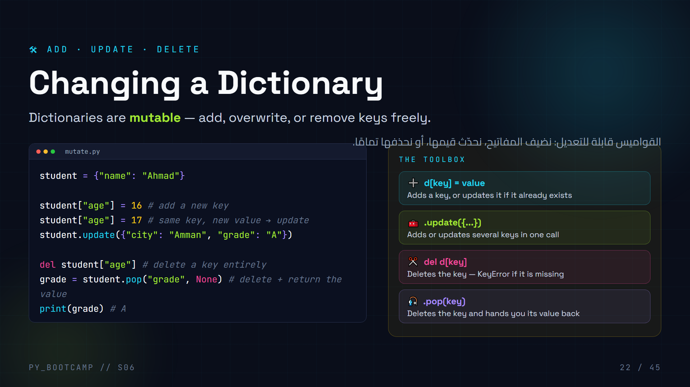
Notes:
# Slide 22 — Changing a Dictionary (Instructor notes)
**What to say**
- Emphasize: the SAME syntax `d[key] = value` both adds AND updates. Nothing is created "new" — the key just lands in the dict.
- `del` throws away the key/value completely; `.pop()` throws it away but returns the value first.
**Live demo (2 min)**
- Build `student` line by line, printing after each mutation so students see the dict grow and change.
- Try `del student["missing"]` → KeyError. Then `student.pop("missing", None)` → None, no crash.
**Common mistakes**
- Students think `d["x"] = v` creates a new dict — it mutates in place.
- Students expect `.pop()` without a key to be safe — it also raises KeyError unless a default is given.
- Students use `del d` (deleting the whole dict!) instead of `del d[key]`.
**Arabic teaching tip**
- شبّه القاموس بلوحة تعليق: يمكنك إضافة بطاقة جديدة، تغيير محتوى بطاقة، أو إزالتها. كل ذلك دون تغيير اللوحة نفسها.

Slide 23
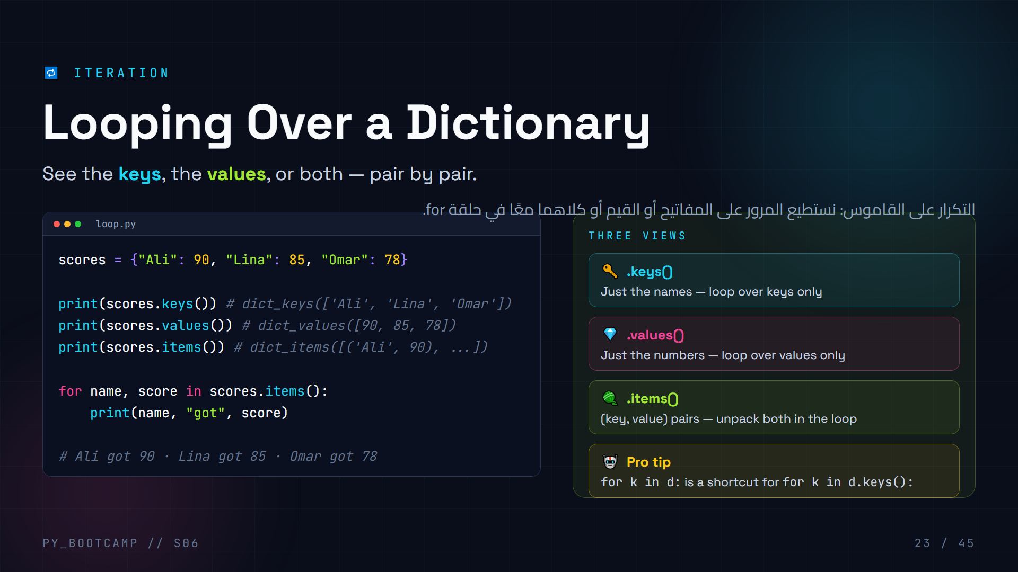
Notes:
# Slide 23 — Looping Over a Dictionary (Instructor notes)
**What to say**
- Three "views" of the same dict: keys, values, pairs.
- `for k in d:` iterates over KEYS by default — say this out loud, students always assume values.
**Live demo (2 min)**
- Loop `for name in scores:` and print `scores[name]` to show the classic key → value pattern.
- Then upgrade to `for name, score in scores.items():`.
**Common mistakes**
- Students write `for name, score in scores:` — this raises "too many values to unpack" because iterating a dict yields only keys. Always `.items()` for both.
- Students print `dict_keys([...])` output and worry — explain it is a view, not a list.
**Arabic teaching tip**
- ذكّرهم: التكرار الافتراضي يمرّ على المفاتيح فقط. إذا أردت المفتاح والقيمة معًا، استخدم `.items()`.

Slide 24
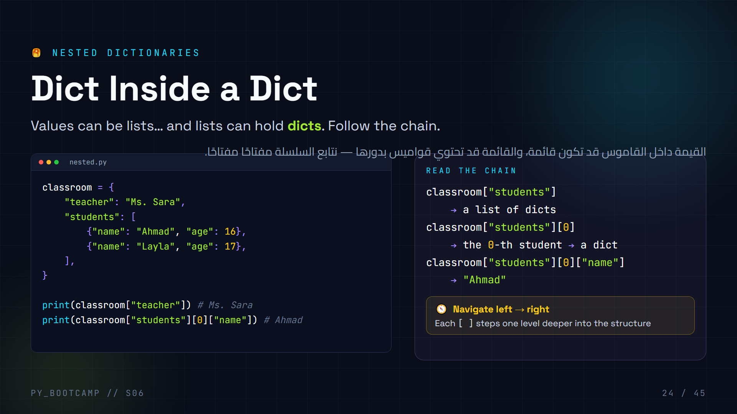
Notes:
# Slide 24 — Nested Dictionaries (Instructor notes)
**What to say**
- "A dict value can be anything — even a list of dicts." Trace the nested structure on the board as a tree.
- The KEY skill: read the chain left to right, one `[ ]` at a time.
**Live demo (3 min)**
- Print each step: `classroom["students"]`, then `...["students"][0]`, then `...[0]["name"]`. Watch it resolve.
- Ask students to predict `classroom["students"][1]["age"]` → 17.
**Common mistakes**
- Students add too many or too few levels: `classroom[0]` fails (classroom has no index 0; use `["students"][0]`).
- Forgetting commas between nested dicts — causes SyntaxError.
- Mixing `()` and `[]` — dicts and lists both use `[]` to access.
**Arabic teaching tip**
- شبه السلسلة بدرج في خزانة: نفتح الدرج الأول (المفتاح)، ثم الرفّ، ثم الصندوق. كل قوس مربّع خطوة نحو الداخل.

Slide 25
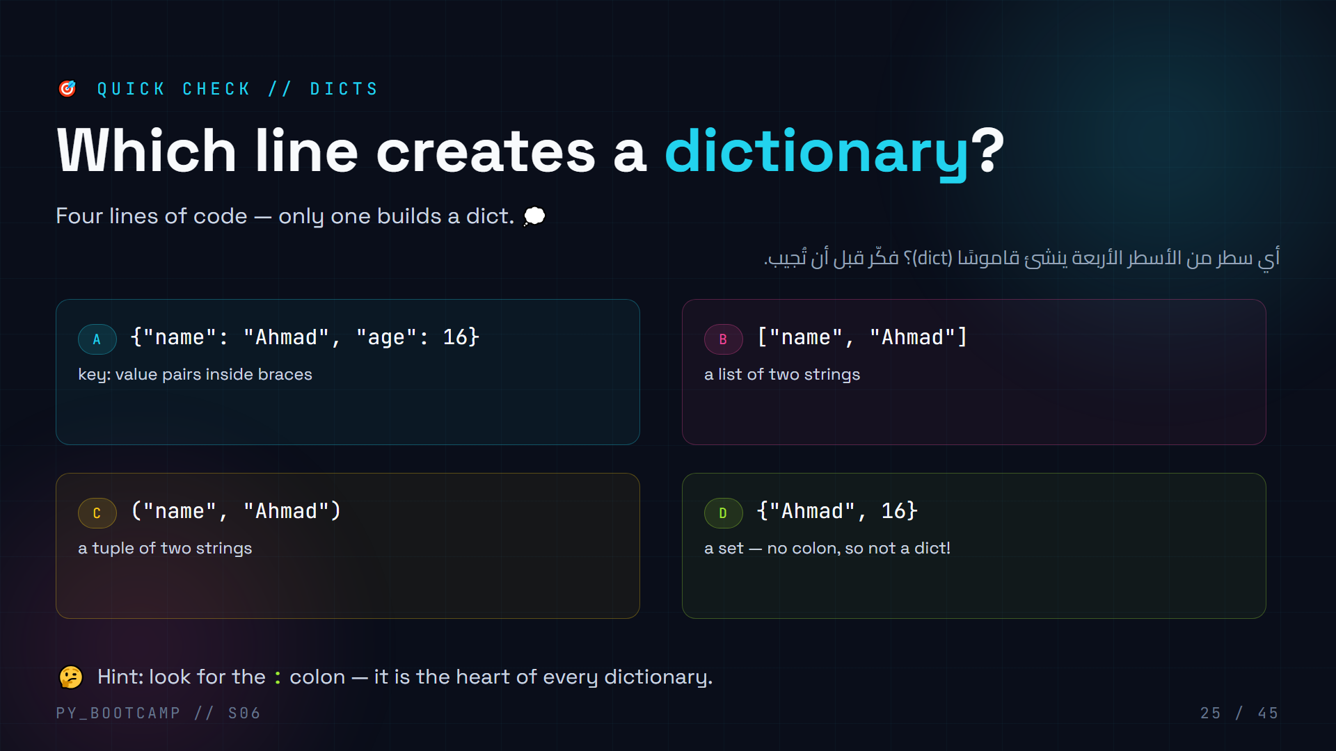
Notes:
# Slide 25 — MCQ: Which creates a dictionary? (Instructor notes)
**Answer: A** — `{"name": "Ahmad", "age": 16}` has `key: value` pairs, so it is a dict.
**Why the others fail**
- **B** `["name", "Ahmad"]` → a list. Elements, no keys.
- **C** `("name", "Ahmad")` → a tuple. Immutable, still no keys.
- **D** `{"Ahmad", 16}` → a SET. The missing colon is the giveaway. This is the most common trap — students see braces and say "dict".
**How to run it**
- `type({"Ahmad", 16})` → `` vs `type({"a": 1})` → ``. Project this and let students call it out.
**Arabic teaching tip**
- اذكر القاعدة: «القاموس فيه نقطتان، المجموعة لا». قاعدة ذهبية تمنع الالتباس بين {} للقاموس و {} للمجموعة.

Slide 26
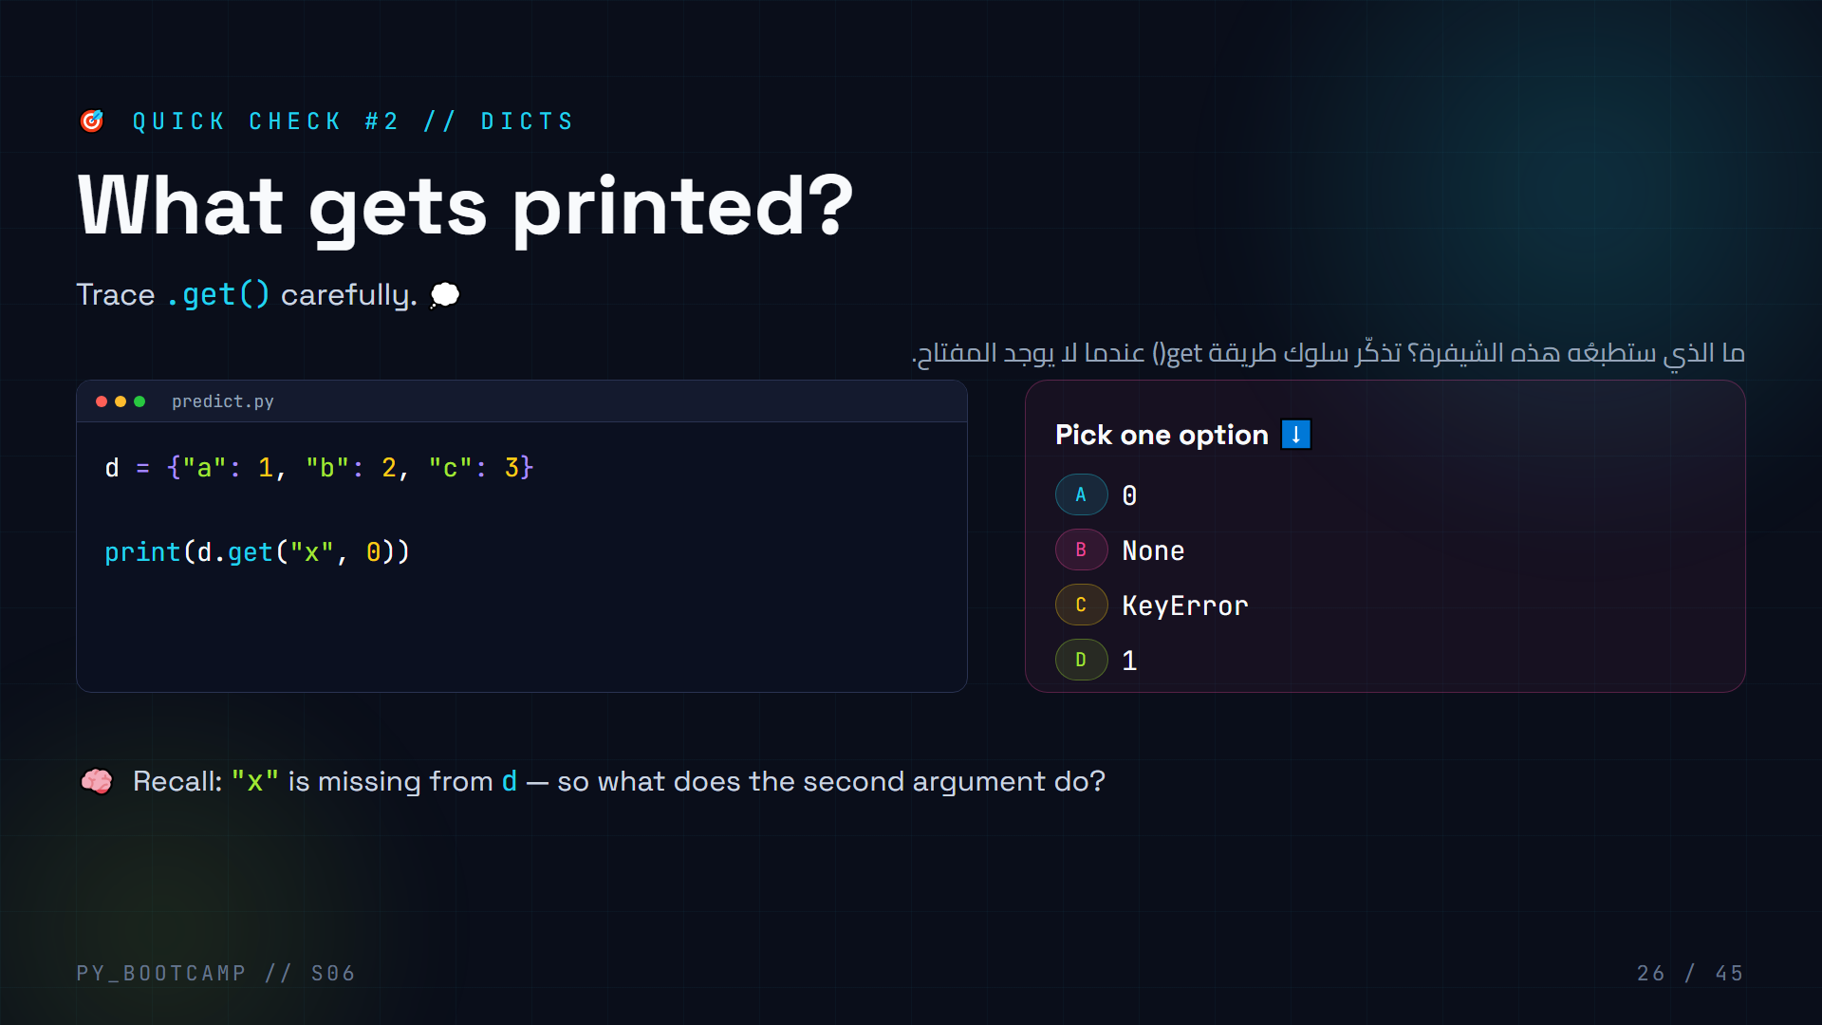
Notes:
# Slide 26 — MCQ: What gets printed? (Instructor notes)
**Answer: A** — `d.get("x", 0)` prints `0`.
**Explain the reasoning**
- `"x"` is NOT a key in `d` (`{"a": 1, "b": 2, "c": 3}`).
- `.get(key, default)` returns `default` when the key is missing. Here default is `0`.
- Without the second argument, `.get("x")` would return `None` (option B).
- Option C (KeyError) would only happen with bracket access `d["x"]`.
- Option D (`1`) is the value of key `"a"` — a distractor.
**Arabic teaching tip**
- أعِد التأكيد: d[key] يرمي خطأً KeyError إذا غاب المفتاح، بينما .get(key, default) يعيد القيمة الافتراضية بهدوء.

Slide 27
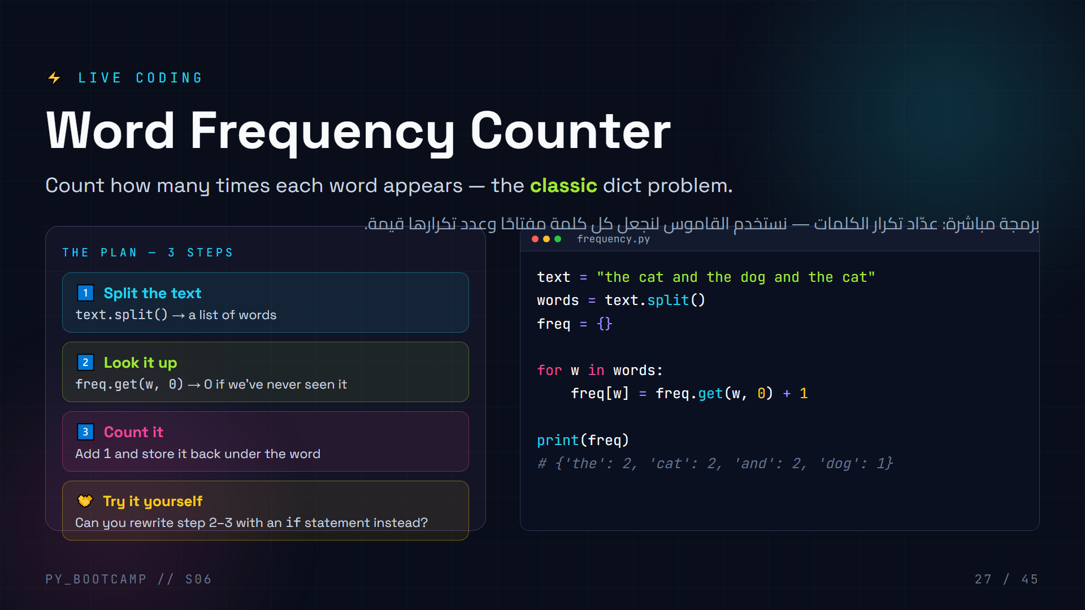
Notes:
# Slide 27 — Live Coding: Word Frequency Counter (Instructor notes)
**Live coding flow (8-10 min)**
1. Type the sentence. Ask: "How many unique words? Which repeats?"
2. Build step by step: `text.split()`, then empty `freq = {}`.
3. First version WITH an `if`:
```python
for w in words:
if w in freq:
freq[w] += 1
else:
freq[w] = 1
```
4. Then refactor to the one-liner `freq[w] = freq.get(w, 0) + 1`. Show that both give the same answer — this is the "aha" moment.
5. Run it; check `'the'` counts to 2, not 3 — the sentence only has two "the".
**Common mistakes**
- Students forget `+ 1` and overwrite with `freq.get(w, 0)` → every count becomes 0.
- Students use `freq[w] = freq[w] + 1` before the key exists → KeyError. The `.get()` version is the fix.
- Students count letters instead of words (skipping `.split()`).
**Extension challenge**
- Count words case-insensitively: lower each word with `w.lower()`.
- Count letters instead: `for ch in text`.
**Arabic teaching tip**
- ذكّرهم أن «freq.get(w, 0)» تقول: «أعطني العدد الحالي، وإن لم يوجد فابدأ من صفر». هذا جوهر التكرار.

Slide 28
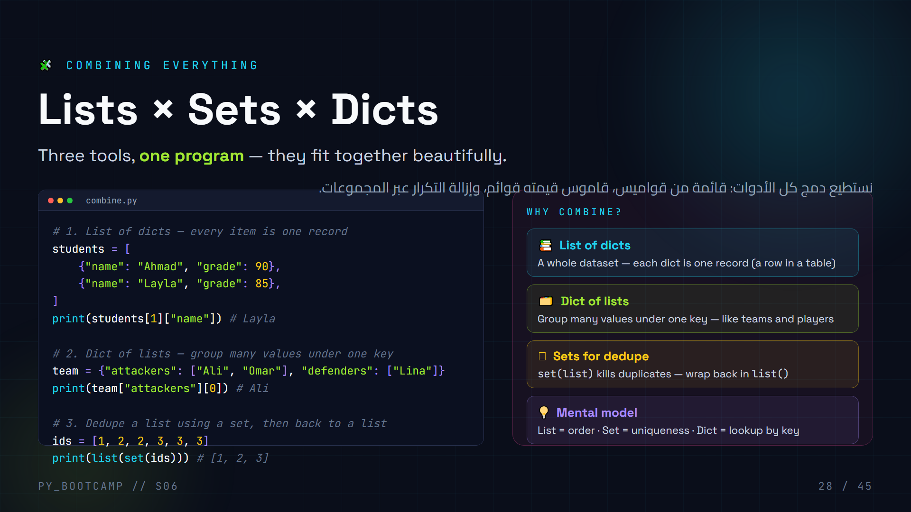
Notes:
# Slide 28 — Combining Lists, Sets, Dicts (Instructor notes)
**What to say**
- This is where the three collections become a system. Real programs rarely use one in isolation.
- Point out the nesting pattern: `students[1]["name"]` mixes list indexing then dict lookup; `team["attackers"][0]` goes the other way.
**Live demo (4 min)**
- Type the whole file and run it. Then mutate live: append a new student dict to the list, dedupe a messier `ids`, show `len(set(ids))`.
- Show `team["defenders"] += ["Sara"]` to demonstrate grouping.
**Common mistakes**
- Students write `students["name"]` forgetting the index — a list has no string keys.
- Students forget that `set(ids)` output ORDER is not guaranteed — it is fine for dedupe but not for "keep order".
- Students try `list[set(ids)]` instead of `list(set(ids))`.
**Arabic teaching tip**
- لخّص القاعدة: «القائمة للترتيب، المجموعة للتفرد، القاموس للبحث بالمفتاح». هذا المثلث يحل معظم المشاكل.

Slide 29
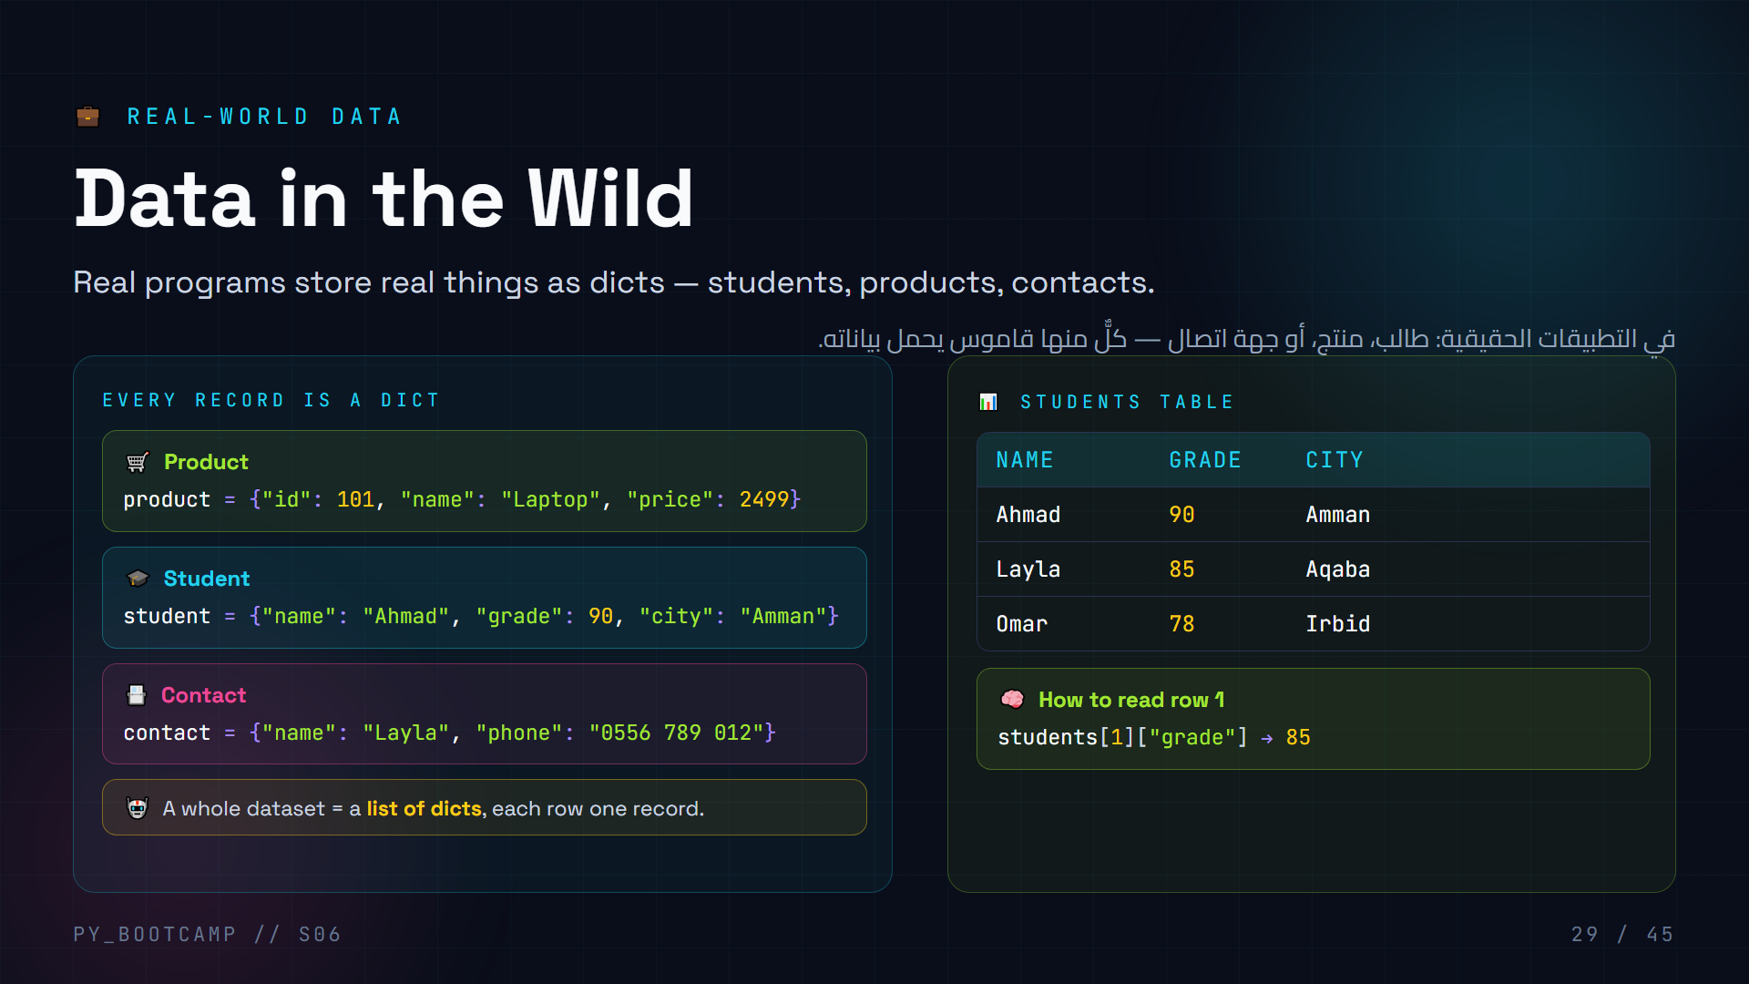
Notes:
# Slide 29 — Real-World Data Modeling (Instructor notes)
**What to say**
- Connect to the phonebook from slide 19: contacts are literally dicts. Now expand to products and students.
- Frame the table: it IS a list of dicts. Every column is a key; every row is one dict. This is how databases think.
**Live demo (4 min)**
- Build `students = [{...}, {...}, {...}]` and print each row with a loop:
```python
for s in students:
print(s["name"], s["grade"], s["city"])
```
- Compute class average with `sum(s["grade"] for s in students) / len(students)`.
- Add a field to one dict mid-program (`.update`) and re-run — data is mutable.
**Common mistakes**
- Students index the table with a string: `students["name"]` — must be `students[0]["name"]`.
- Students forget commas between the dict rows → SyntaxError. Point out the pattern visually.
**Arabic teaching tip**
- اشرح أن الجدول وقائمة القواميس شيء واحد: «العمود = مفتاح، والصف = قاموس». هذا يبني أساسًا قويًا لقواعد البيانات لاحقًا.

Slide 30
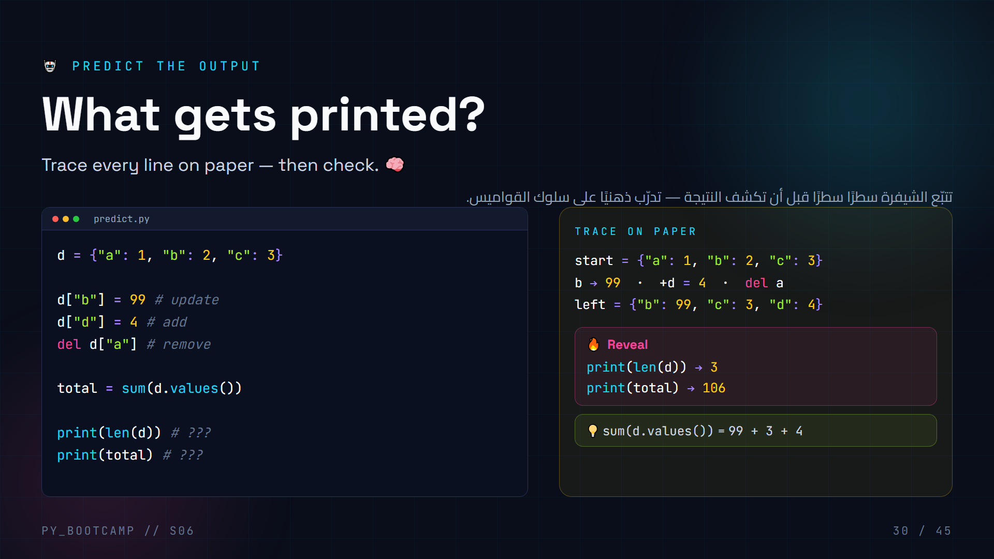
Notes:
# Slide 30 — Predict the Output (Instructor notes)
**Answers**
- `print(len(d))` → **3** — after `del d["a"]`, the keys are `"b"`, `"c"`, `"d"`.
- `print(total)` → **106** — `99 + 3 + 4 = 106`.
**Walkthrough**
1. `d = {"a": 1, "b": 2, "c": 3}` — three keys.
2. `d["b"] = 99` — overwrite b (still 3 keys).
3. `d["d"] = 4` — add d (now 4 keys).
4. `del d["a"]` — remove a (back to 3 keys: b, c, d).
5. `sum(d.values())` = `99 + 3 + 4` = 106.
**How to run the check**
- Have students trace first (2 min, no typing), then run the file and compare. Ask who got both right — and why option mistakes happened.
**Common mistakes**
- Students forget that assigning to an existing key UPDATES instead of adding — count of keys stays the same.
- Students count the original values (1, 2, 3) instead of the mutated ones.
- Students forget `del` removes the entry completely, not sets it to 0.
**Arabic teaching tip**
- شبّه العملية بدفتر سجل: تعديل رقم لا يزيد عدد الأسطر، وحذف سطر يقلّله. العدد (len) يتبع الأسطر الموجودة فقط.

Slide 31
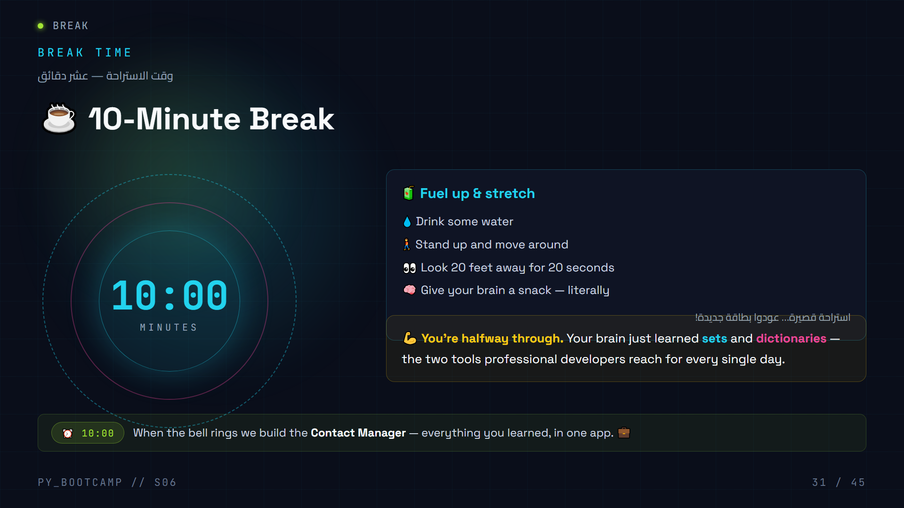
Notes:
Give the FULL 10 minutes — the break sits right after the densest part of the session (sets + dicts theory).
Run a visible countdown timer on the projector (start it as soon as this slide appears).
What to say:
- "Stand up. Water. Stretch. Look away from the screen."
- Tease the second half: "When we come back you'll build a real app — a Contact Manager — using lists, dicts and sets together. That's the part people put in their portfolio."
- If students are energetic, offer the stretch for the whole group for 30 seconds.
While they're away:
- Prepare the live-editor/tab with `contact_manager.py` already open (blank file).
- Double-check the expected output for the demo you'll run.
Arabic tip: شجع الطلاب على الوقوف ومدّ أجسامهم ولو لثوانٍ — الاستراحة القصيرة ترتب المعلومات في الذاكرة. (Encourage standing and stretching briefly — short breaks consolidate memory.)

Slide 32
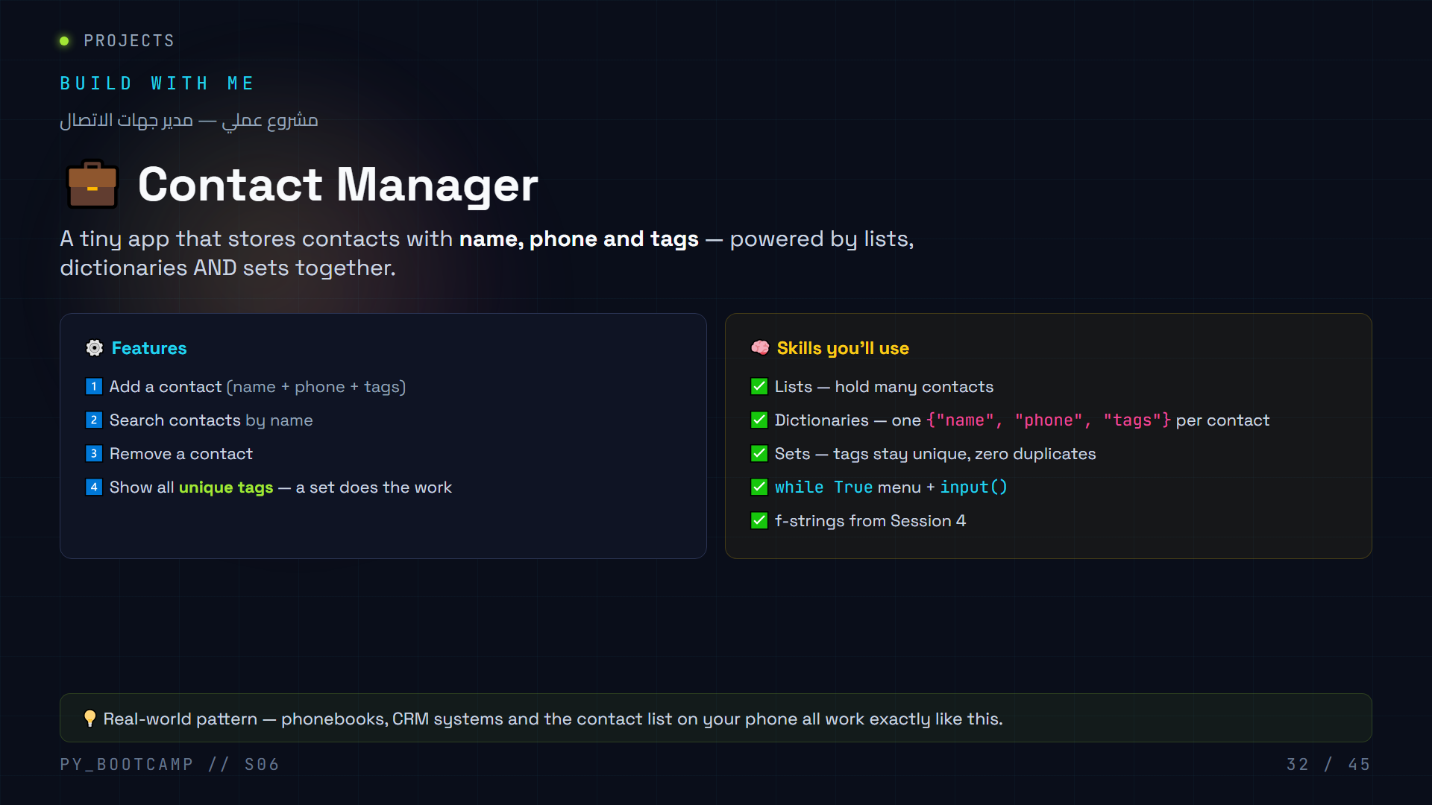
Notes:
Introduce the project: today's final deliverable. It is a text-menu app, so it reuses the `while True` menu pattern from Session 5's Grade Manager — but the data model is the new thing.
Ask-before-show (think-pair-share, 1 min):
- "If I store every contact as a dictionary, what are the keys?" → `name`, `phone`, `tags`.
- "Why is `tags` a SET and not a list?" → so "work, work, friend" becomes {"work", "friend"} — duplicates collapse automatically.
- "Where do the contacts live?" → in a list of dicts.
Set expectations:
- Built in 2 parts. Part 1 = data model + add. Part 2 = search + remove + menu.
- Everyone types along in the live editor. Encourage students who finish early to help their neighbor.
Arabic tip: اسأل الطلاب: لماذا نحتاج القواميس في هذا المشروع؟ أشر إلى أن كل جهة اتصال هي «بطاقة» فيها اسم ورقم وهاشتاقات. (Why do we need dicts here? Each contact is a card with a name, number and hashtags.)

Slide 33
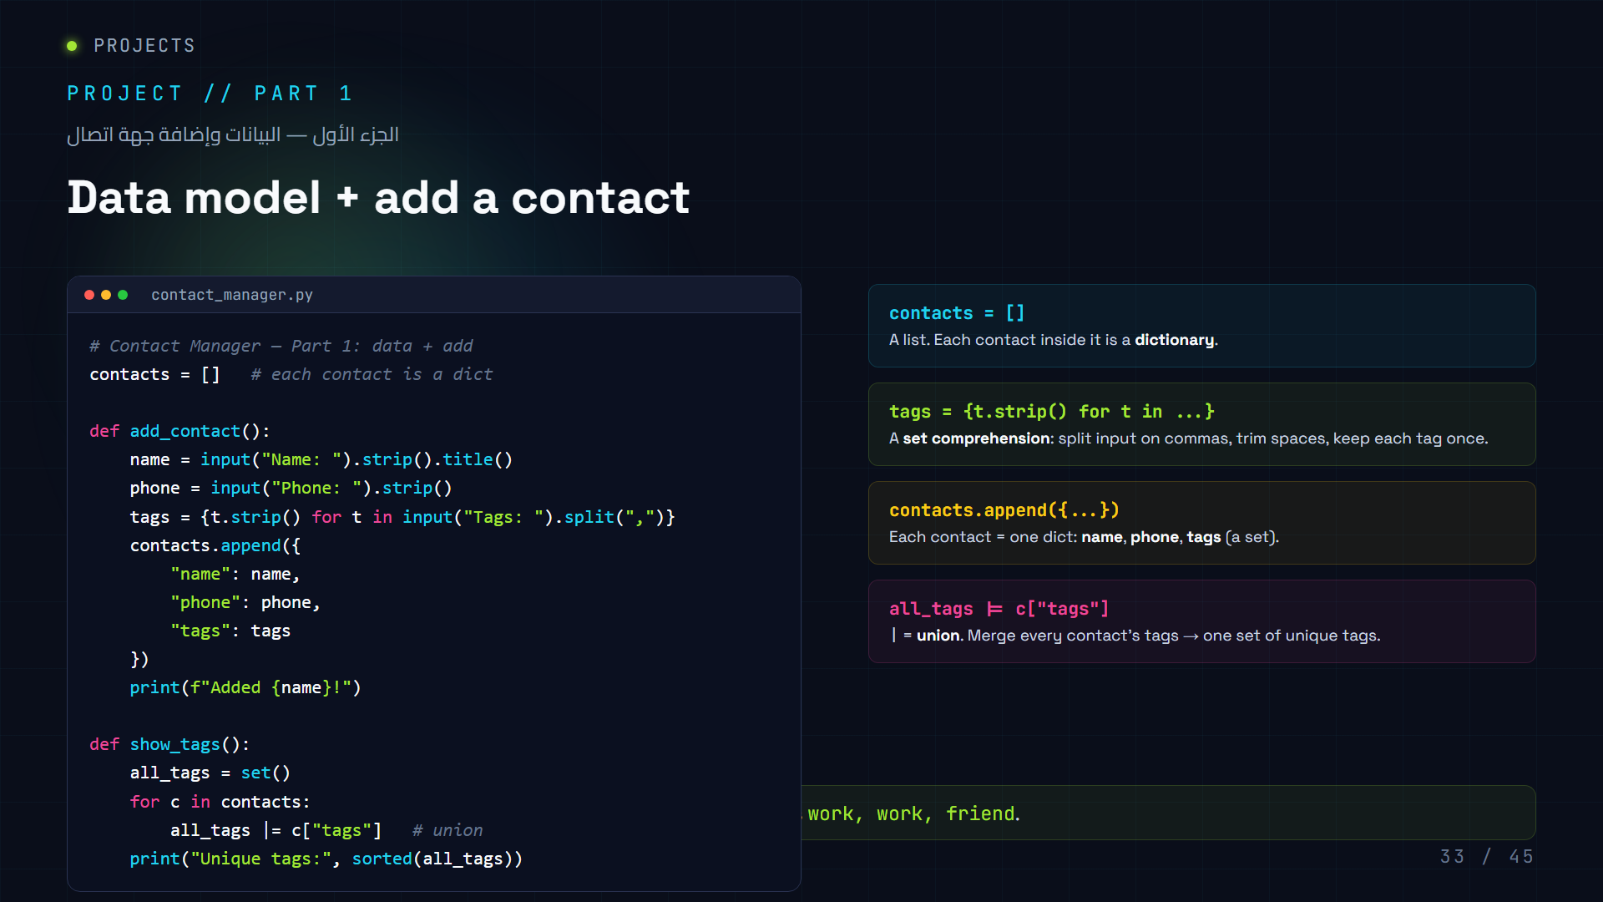
Notes:
LIVE CODING — Part 1 (type it together, ~10 min). Keep the code exactly as on screen so students can follow.
Steps:
1. Create `contact_manager.py`. Start with `contacts = []`.
2. Ask: "What shape is one contact?" → a dict. Type the `add_contact()` function.
3. Highlight `.title()`: makes "sara" → "Sara" so search is forgiving later.
4. The set comprehension line is the star. Explain step by step: `input()` → `"work, friend, work"` → `.split(",")` → `["work", " friend", " work"]` → `t.strip()` removes spaces → `{...}` keeps unique → `{"friend", "work"}`.
5. Run it, add Sara twice, then call `show_tags()` → tags appear only once.
Common mistakes to catch live:
- `input("Tags: ")` without split → one giant string "work, friend" stored as a single tag. Ask students what went wrong.
- Forgetting `contacts.append(...)` → "no contacts" later.
- Using `+=` on a set instead of `|=` (set has no `+` → TypeError). Show the error, then fix.
Expected demo run (for reference):
```
Name: Sara
Phone: 050-1234567
Tags: work, friend
Added Sara!
```
Arabic tip: اشرح خطوة خطوة كيف تتحول الجملة المدخلة إلى مجموعة وسم — الكتابة بالعربية أوضح: «أدخل الوسوم مفصولة بفواصل ثم نفصلها وننظّفها». (Explain the input → split → strip → set chain in Arabic slowly.)

Slide 34
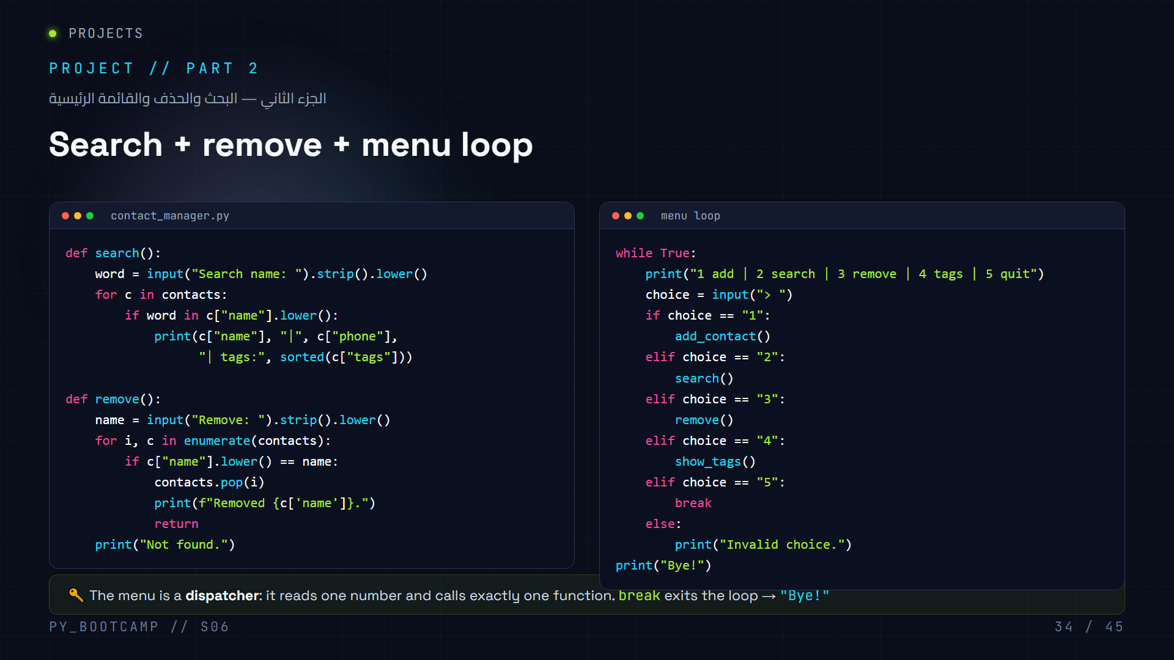
Notes:
LIVE CODING — Part 2 (type it together, ~10 min). Continue in the same `contact_manager.py`.
Steps:
1. `search()`: compare lowercase against lowercase (`c["name"].lower()`) so typing "SARA" finds "Sara". `in` checks *substring* — "sa" finds "Sara" and "Salem". Good for a demo, mention it.
2. `remove()`: `enumerate(contacts)` gives index + contact. When the name matches, `pop(i)` removes it by index. The `return` stops the loop immediately — otherwise you'd keep looping over a changed list.
3. Menu: `while True` + `if/elif` chain calls the right function. Choice `"5"` → `break` → `print("Bye!")`.
Run the full app now. Walk through the whole flow: add 2-3 contacts → search → show tags → remove → quit.
Common mistakes to catch:
- Comparing `c["name"]` (capitalized) to `name` (lowercased) → never matches. Fix with `.lower()` on both sides.
- Removing inside a `for` loop without `return` → skips or re-checks items. Show the bug.
- Indenting the `print("Bye!")` inside the `while` → prints every loop iteration.
Arabic tip: القائمة مثل «قائمة مطعم» — رقم لكل طلب، وكل رقم ينفّذ دالة. كرّر هذا التشبيه بالعربية. (The menu is like a restaurant menu — each number triggers one dish, i.e. one function.)

Slide 35
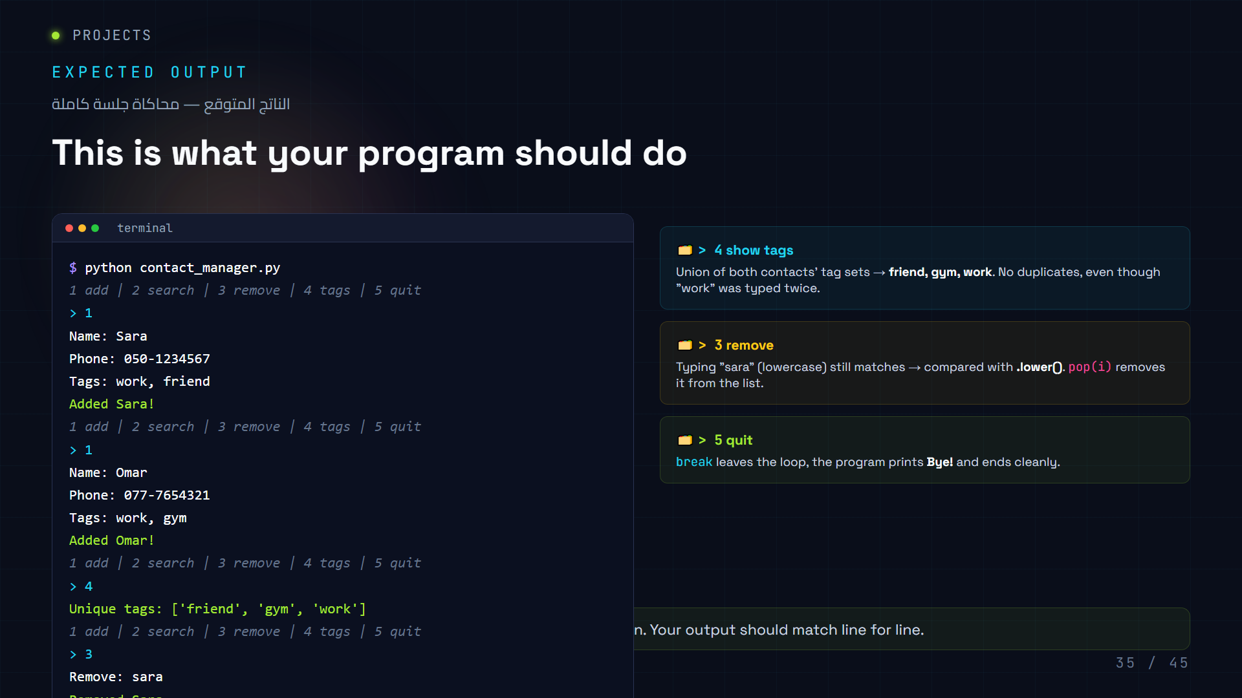
Notes:
Show the expected output and let students self-check. Give 5 minutes for everyone to get their program running and matching this output.
Walk through each block aloud:
1. `> 4` → `['friend', 'gym', 'work']` — ask "where did the set magic happen?" Answer: `show_tags()` union. Note `sorted()` makes the set output stable (sets have no order).
2. `> 3` + typing "sara" — lowercasing on both sides is why it matched. Emphasize case-insensitivity as a *feature*, not a hack.
3. `> 5` → `break` → `Bye!`.
Troubleshooting queue while they run it:
- If tags come back as one long string → they forgot `.split(",")` (compare with slide 33).
- If `Remove` says "Not found." → they compared the raw names without `.lower()`.
- If the menu re-prints after quit → `print("Bye!")` is inside the `while`.
Celebrate: "That's a real, working app. Ten days ago you couldn't write a loop — now you built a phonebook."
Arabic tip: اطلب من طالب يشرح بالعربية ماذا يحدث عند اختيار الرقم ٤ — شرح الزميل يرسّخ الفكرة. (Ask a student to explain in Arabic what happens on option 4 — peer explanation cements the idea.)

Slide 36
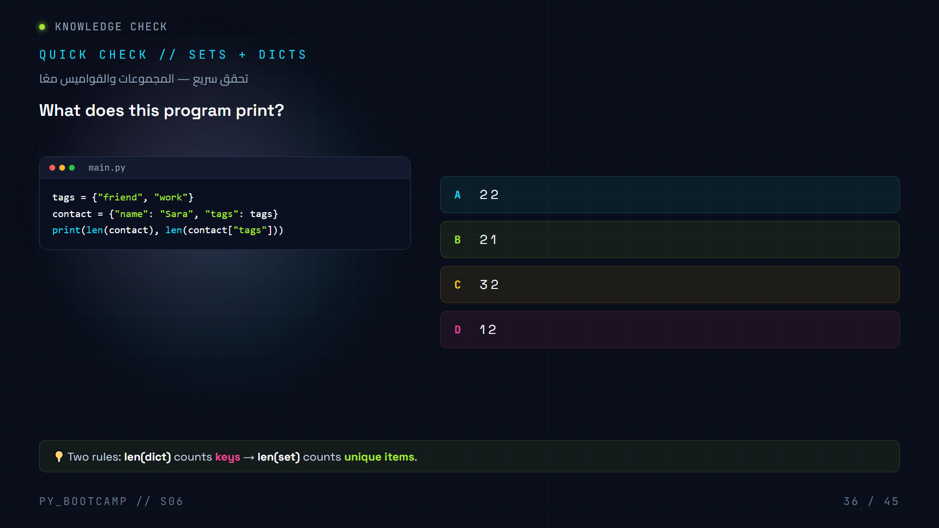
Notes:
Quick knowledge check — 1 minute, no code, just think. Ask students to vote by raising a hand (or typing the letter in chat if online).
Answer: **A — "2 2"**
- `len(contact)` = number of keys in the dict = `"name"` and `"tags"` = 2.
- `contact["tags"]` returns the set `{"friend", "work"}` → `len()` of a set counts unique elements = 2.
Why the distractors work:
- B (2 1): someone who thinks a set with 2 elements is "1" (confusing value+key).
- C (3 2): counting `"name"`, `"Sara"`, `"tags"` as 3 keys (adding values to the key count).
- D (1 2): thinking a dict counts as 1 key total.
After the vote, explain the two `len()` rules aloud. This is the classic "sets vs dicts" trap — good to clear now, before homework.
Arabic tip: اسأل: «كيف نحسب عدد المفاتيح في القاموس؟» ثم «كيف نحسب عدد العناصر الفريدة في المجموعة؟» — إجابتان قصيرتان تكفيان. (Two quick questions: how to count keys, how to count unique items.)

Slide 37
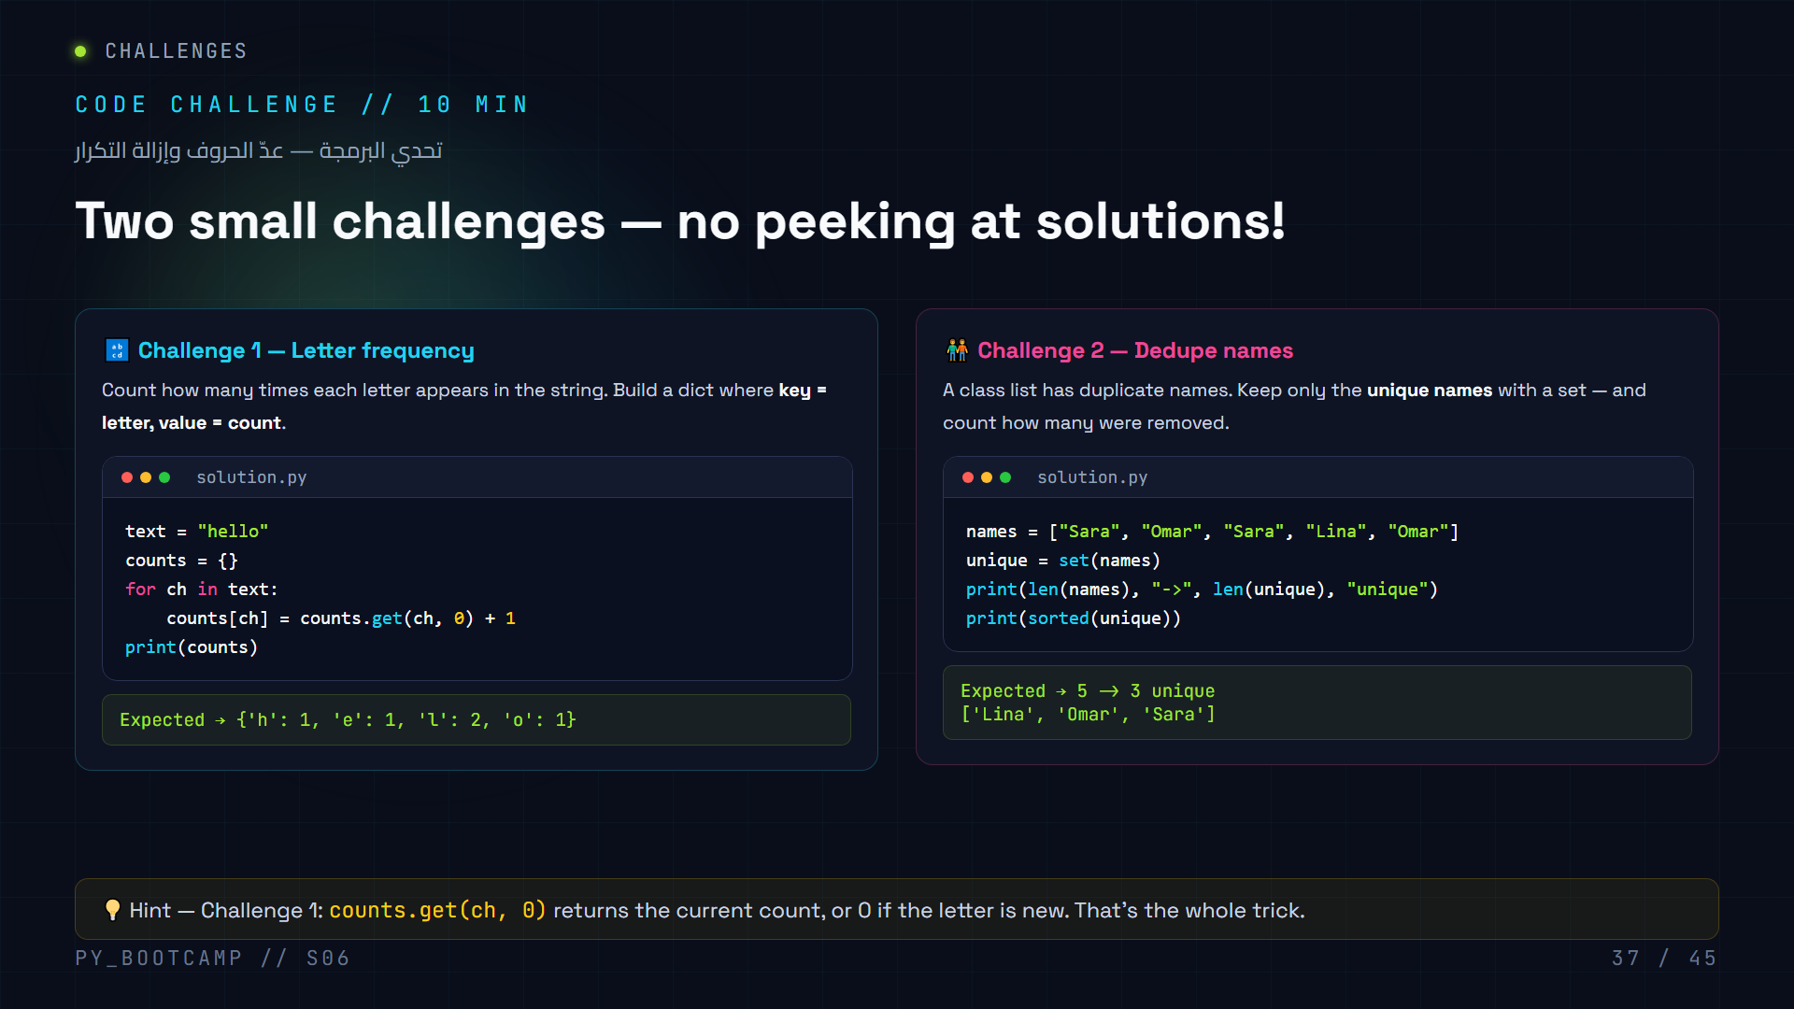
Notes:
10 minutes, work in pairs (screen-share or side-by-side). Both challenges are shown WITH solutions — so the real task is to write them from memory in the editor, then check. Ask students to try first, then compare.
Challenge 1 explainer (only if stuck):
- "For each letter, we need its current count. `counts.get(ch, 0)` gives 0 if it's the first time. Add 1, store it back."
- Common mistake: writing `counts[ch] = 1` (resets every time → each count = 1) or `counts[ch] += 1` without `.get()` → KeyError on the first new letter. Show both errors live.
Challenge 2 explainer:
- `set(names)` drops duplicates instantly. `len(names) - len(unique)` = duplicates removed.
- `sorted(unique)` gives a stable, alphabetical order — sets themselves have no order.
- Common mistake: forgetting that `sorted()` returns a list, printing the set directly and getting a random-looking order.
When done, quickly poll: "Who had all 5 unique? Who found the KeyError? What fixed it?"
Arabic tip: لاحظ أن كل طالبين معًا يحلّان سريعًا — التحدي الثاني (إزالة التكرار) هو نفس فكرة «حذف الأسماء المكررة من قائمة الصف». (Pairs work faster; challenge 2 mirrors deduping the class list.)

Slide 38
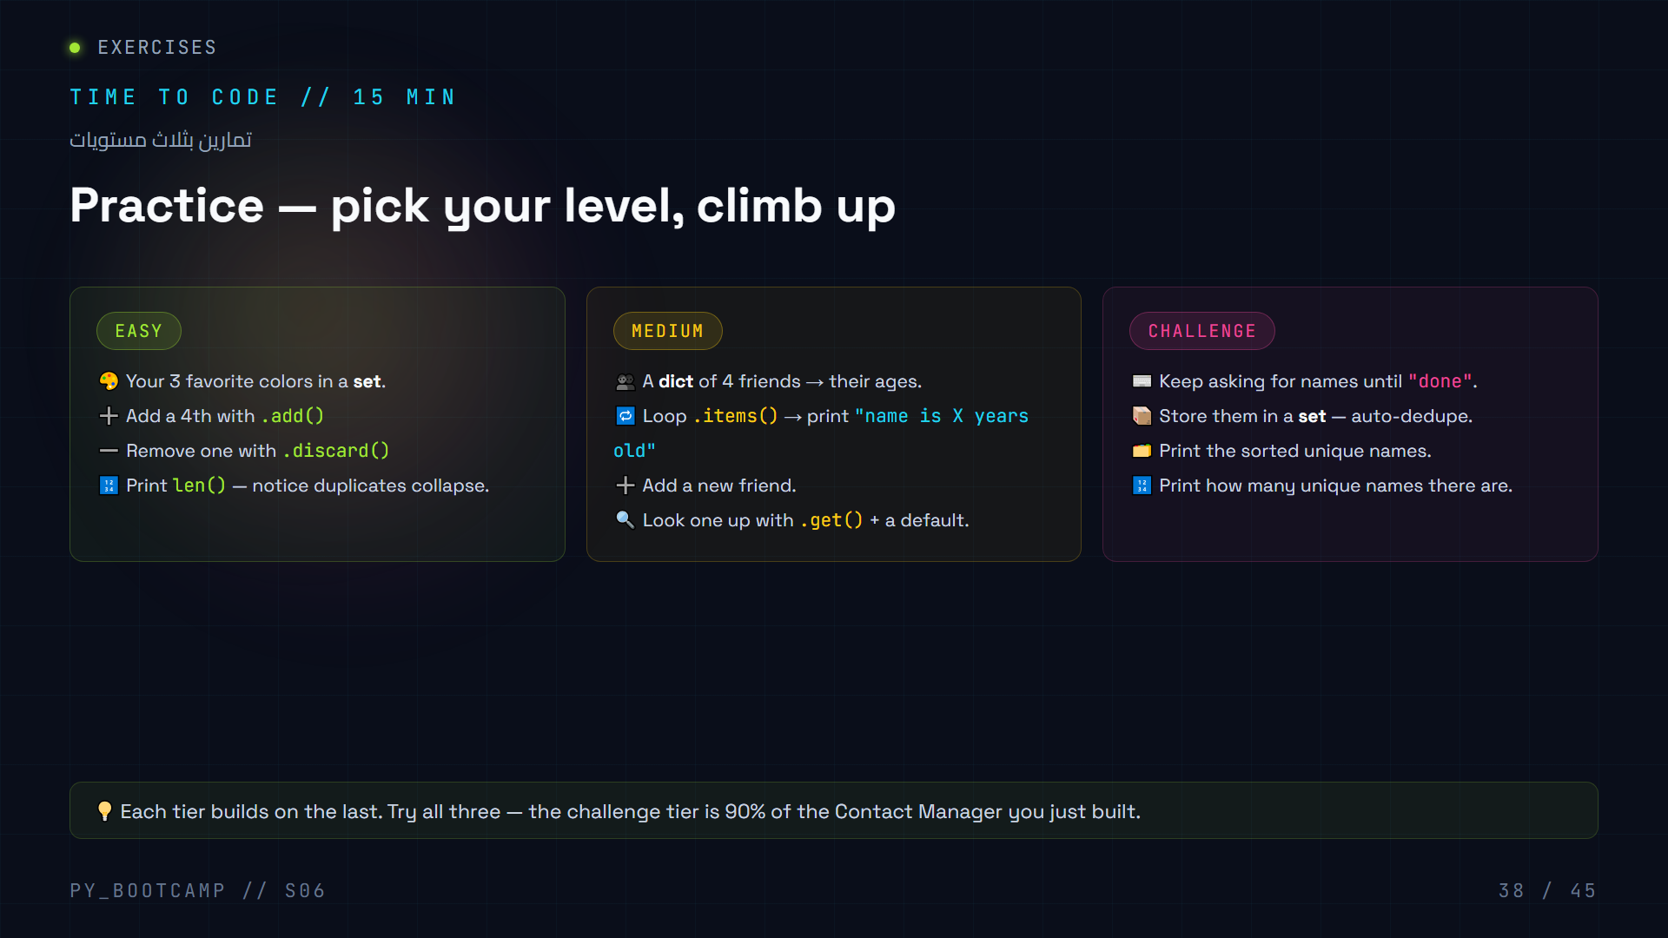
Notes:
15 minutes of independent work. Encourage students to start at EASY even if it feels simple — it warms up the syntax. The goal is to reach the CHALLENGE tier.
Walking solutions to check:
EASY:
```python
colors = {"red", "green", "blue"}
colors.add("orange") # set is {red, green, blue, orange}
colors.discard("green") # no error even if missing
print(len(colors)) # 3
```
Note: `discard()` never errors; `remove()` would raise KeyError if missing. This is a great teaching moment.
MEDIUM:
```python
friends = {"Sara": 16, "Omar": 17, "Lina": 16, "Ali": 18}
for name, age in friends.items():
print(f"{name} is {age} years old")
friends["Nour"] = 15
print(friends.get("Nour", "not found")) # 15
print(friends.get("Zaid", "not found")) # not found
```
CHALLENGE:
```python
names = set()
while True:
n = input("Name (or 'done'): ").strip()
if n == "done":
break
names.add(n)
print(sorted(names))
print(len(names))
```
Emphasize: because it's a SET, adding "Sara" twice still keeps one — no extra if-check needed.
Common mistakes:
- EASY: using `remove()` on a possibly-missing item → KeyError.
- MEDIUM: `friends.get("Nour")` returns `None`, not a default — show the two-argument form.
- CHALLENGE: building a list first then deduping at the end (works, but a set from the start is cleaner).
Arabic tip: ذكّرهم أن اسم التمرين المتوسط «أصدقاء وأعمارهم» — تشبيه القاموس بالدفتر. (The medium task is a friends-and-ages notebook — the classic dict analogy.)

Slide 39
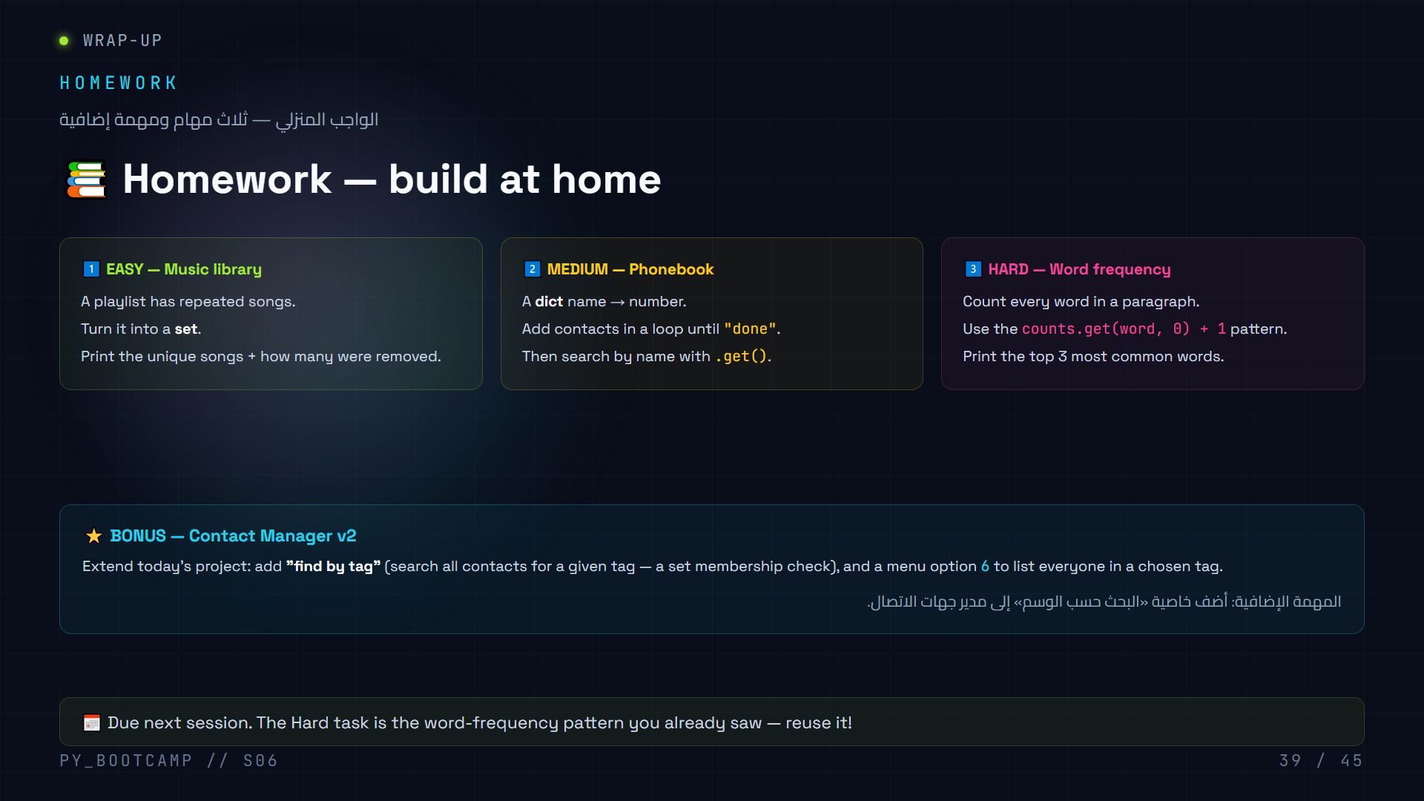
Notes:
Assign homework, set expectations, and give a 2-minute hint for each task.
Hints:
1. EASY: `len(playlist) - len(set(playlist))` = number of duplicate songs.
2. MEDIUM: loop + `input()`, stop on "done", then `phonebook.get(name, "Not found")`.
3. HARD: `.split()` the paragraph into words, then the frequency pattern from slide 37. For "top 3", hint toward `sorted(counts.items(), key=lambda x: x[1], reverse=True)[:3]` — but only show it if they ask. It's a preview of Session 7 (functions + lambda).
BONUS (Contact Manager v2): "find by tag" needs a loop over `contacts` and `"tag" in c["tags"]` — that's the set-membership check from today. This is genuinely the most impressive task; praise anyone who attempts it.
Remind them:
- Submission: paste code in the class channel / drive before next session.
- No AI copy-paste — if you can't explain your code, it's not done.
Arabic tip: ذكّرهم أن المهمة الإضافية اختيارية لكنها «نجمة» في السيرة الذاتية للمبرمج الناشئ. (The bonus is optional but a star for their budding-dev résumé.)

Slide 40
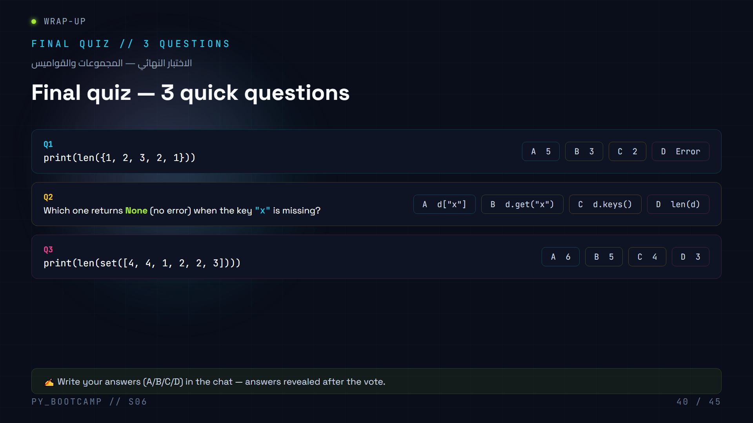
Notes:
Answers: **Q1 → B (3)**, **Q2 → B (d.get("x"))**, **Q3 → C (4)**.
Take all three answers as a chat poll or hand raises, THEN reveal.
Explanations to give:
- Q1: `{1, 2, 3, 2, 1}` is a set → duplicates collapse → `{1, 2, 3}` → len = 3.
- Q2: `d.get("x")` returns `None` if missing; `d["x"]` raises KeyError; `d.keys()` and `len(d)` never touch the key. (Bonus: `d.get("x", default)` returns a custom default.)
- Q3: `set([4, 4, 1, 2, 2, 3])` → `{1, 2, 3, 4}` → len = 4. This is the list→set dedupe trick from slide 13.
Tally the results. If fewer than ~70% get Q2 right, spend 2 minutes re-teaching `.get()` vs `[]` (the single most important dict safety skill). If Q3 is shaky, re-float the dedupe visual.
Arabic tip: اطلب من طالب يشرح إجابة Q3 بالعربية — لماذا صار الطول ٤ وليس ٦. (Have a student explain Q3 in Arabic: why 4, not 6.)

Slide 41
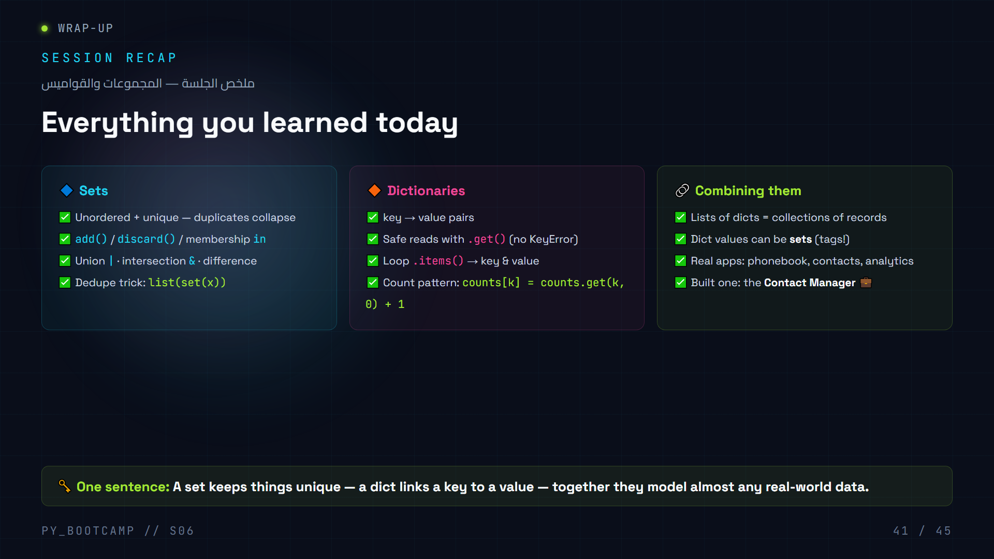
Notes:
Recap in ~3 minutes. Three pillars — keep it fast, this is reinforcement not new content.
Suggested script:
1. Sets: "Give me the sentence for sets." → "No duplicates." Mention union/intersection are how you combine tag sets.
2. Dicts: "Give me the sentence for dicts." → "Key links to a value." Stress `.get()` as the safety skill they must use in homework.
3. Combining: point at the Contact Manager — today they shipped a real app that uses all three data types.
Then read the one-sentence takeaway aloud and ask the class to repeat it. This is the memory anchor for the whole session.
Check understanding: quick show-of-hands "who can explain dedupe in one line?" before moving to the bridge slide.
Arabic tip: اقرأ جملة الخلاصة بالعربية: «المجموعة تحفظ العناصر الفريدة، والقاموس يربط مفتاحًا بقيمة». (Read the takeaway sentence in Arabic.)

Slide 42
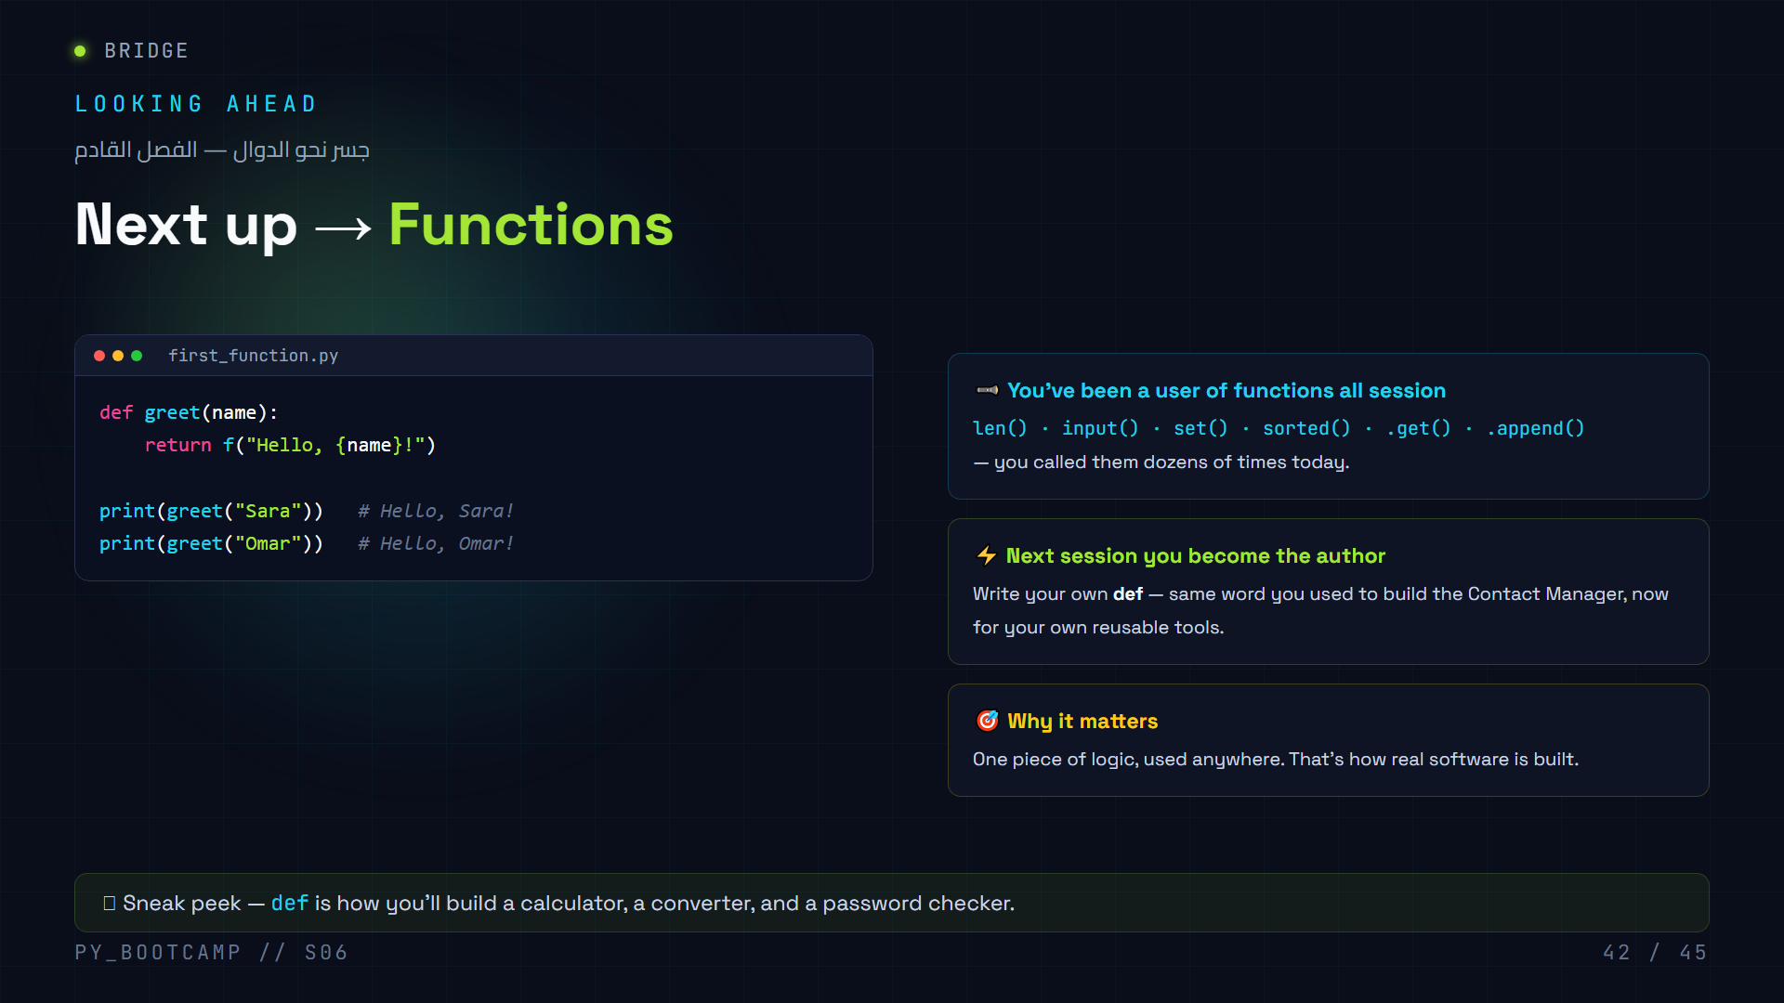
Notes:
Bridge slide — 2 minutes, purely motivational.
Key message: "You've been using functions all day. `len()`, `input()`, `set()`, `sorted()` — someone wrote those with `def`. Next session, that someone is YOU."
Read the `greet` example aloud and trace it: `def` creates the function, `name` is a parameter (input), `return` is the output, then we call it twice with different values.
Connection to today: today's project was built from functions too — `add_contact()`, `search()`, `remove()`, `show_tags()` are all the *result* of `def`. So functions are not new; next session just makes them first-class citizens.
If time: ask "which functions did you call today?" and collect on a whiteboard — it's a fun memory list.
Arabic tip: اسألهم: «مَن كتب دوال اليوم؟» — الجواب: أنتم، داخل مدير جهات الاتصال. هذا يبني الثقة قبل فصل الدوال. (Who wrote functions today? You did, inside the Contact Manager.)

Slide 43
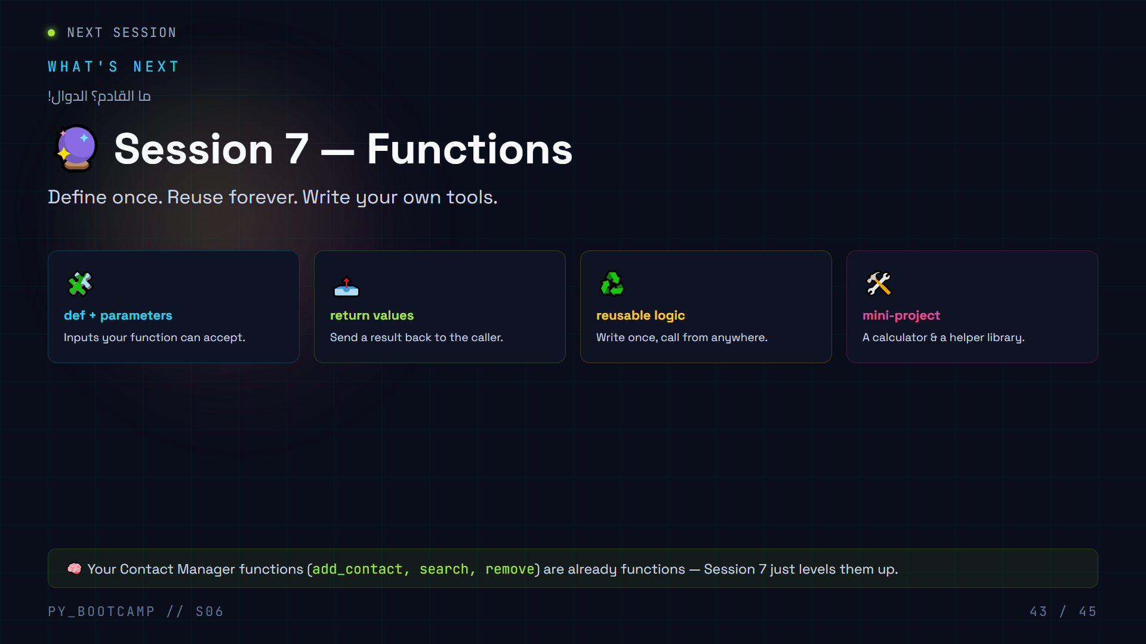
Notes:
Teaser slide — 1 minute, build excitement.
What to say:
- "Everything you did today used functions. Next week, you write your own."
- Callback: "In the Contact Manager, `add_contact()` was a function *you* defined. That's not a fluke — that's the whole point of Session 7."
- Tease the mini-projects: a calculator (user picks operation, function does math) and a helper library of tiny tools.
Don't teach any `def` details here — the bridge slide (42) already showed one line. This is pure hype.
Optionally ask students to write down one function idea they'd want to build (collect ideas — great for the opening of next session).
Arabic tip: اسألهم سؤالًا واحدًا قبل المغادرة: «ما الدالة التي تودّون بناءها؟» — اكتبوا الأفكار على السبورة. (One exit question: which function would you like to build?)

Slide 44
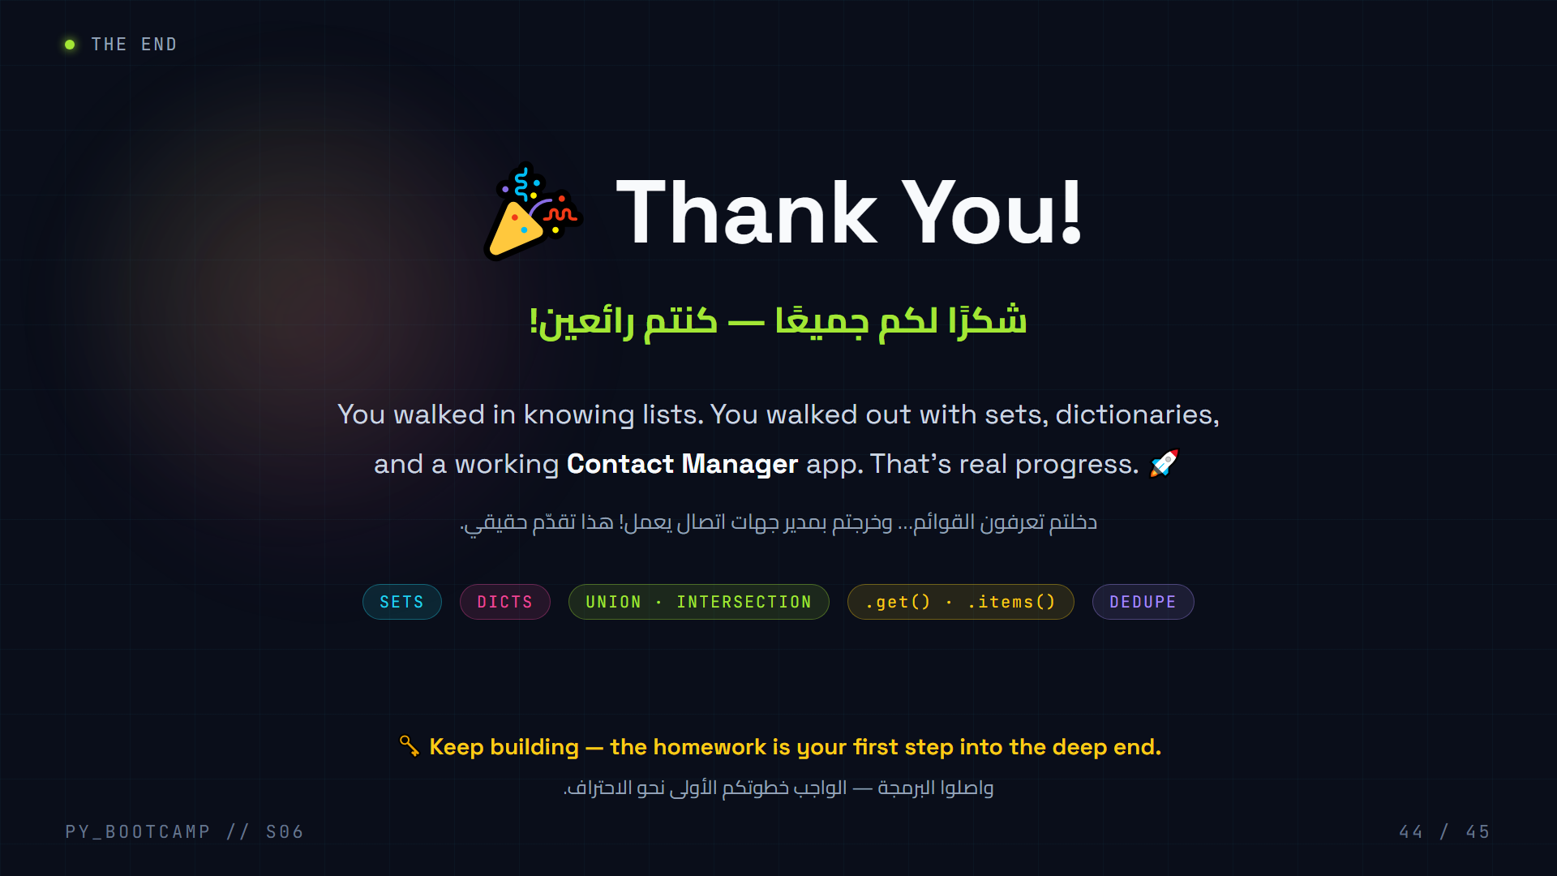
Notes:
Closing — 2 minutes. Celebrate the session and end on a high note.
Script:
- Genuine praise: "Today you shipped a real application. In Session 1 you printed 'Hello World'. Now you built a contact manager. Do you realize how far that is?"
- Remind: homework is due before next session; the bonus task is worth attempting.
- Point forward: Session 7 = Functions (already teased on slides 42-43). Ask the exit question: "Which function would you build?"
- If online: keep the video call open a few minutes for questions; say you'll stay for quick help.
Optional ceremony: ask everyone to unmute and give the class a round of applause; or have students paste one "aha moment" from today in the chat as they leave.
Arabic tip: اختتم بكلمة شكر بالعربية مباشرة: «أفتخر بكم — استراحوا اليوم، وبكرا تكمّلون التحدي». (End with a direct Arabic thank-you and encourage them to rest then finish the challenge tomorrow.)

Slide 45
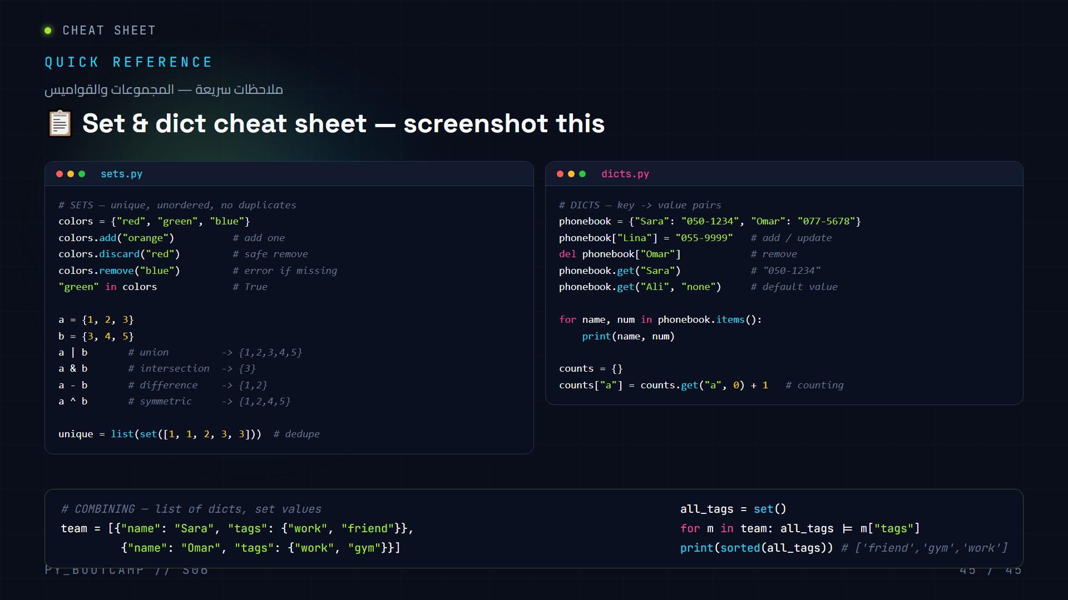
Notes:
Reference slide — leave on screen while students start their homework, or screenshot it.
Use this as the "open-book" moment: tell students they may keep this slide open while doing the homework. Note that it's the ONLY slide they get to look at — the real work is applying these to new problems.
Walk through each block quickly (2 minutes):
1. Sets: add vs discard vs remove (the error difference matters — `.remove` on a missing item raises KeyError).
2. Set math: the four operators and their names. `^` symmetric difference is the least intuitive — one example: `{1,2} ^ {2,3}` → `{1,3}` (everything not shared).
3. Dicts: `.get(key, default)` is the line to remember — it's how you avoid KeyError crashes.
4. Combining: this is the exact pattern from the Contact Manager — a list of dicts whose values can be sets. Read it top to bottom and point at the union loop.
Encourage students to build their own version of this cheat sheet from memory tomorrow morning — recalling syntax beats re-reading it.
Arabic tip: قل لهم: «احفظوا هذا ببناء ورقة مثله من الذاكرة صباحًا — الاسترجاع أقوى من القراءة». (Suggest rewriting the sheet from memory the next morning.)

