Slide 1
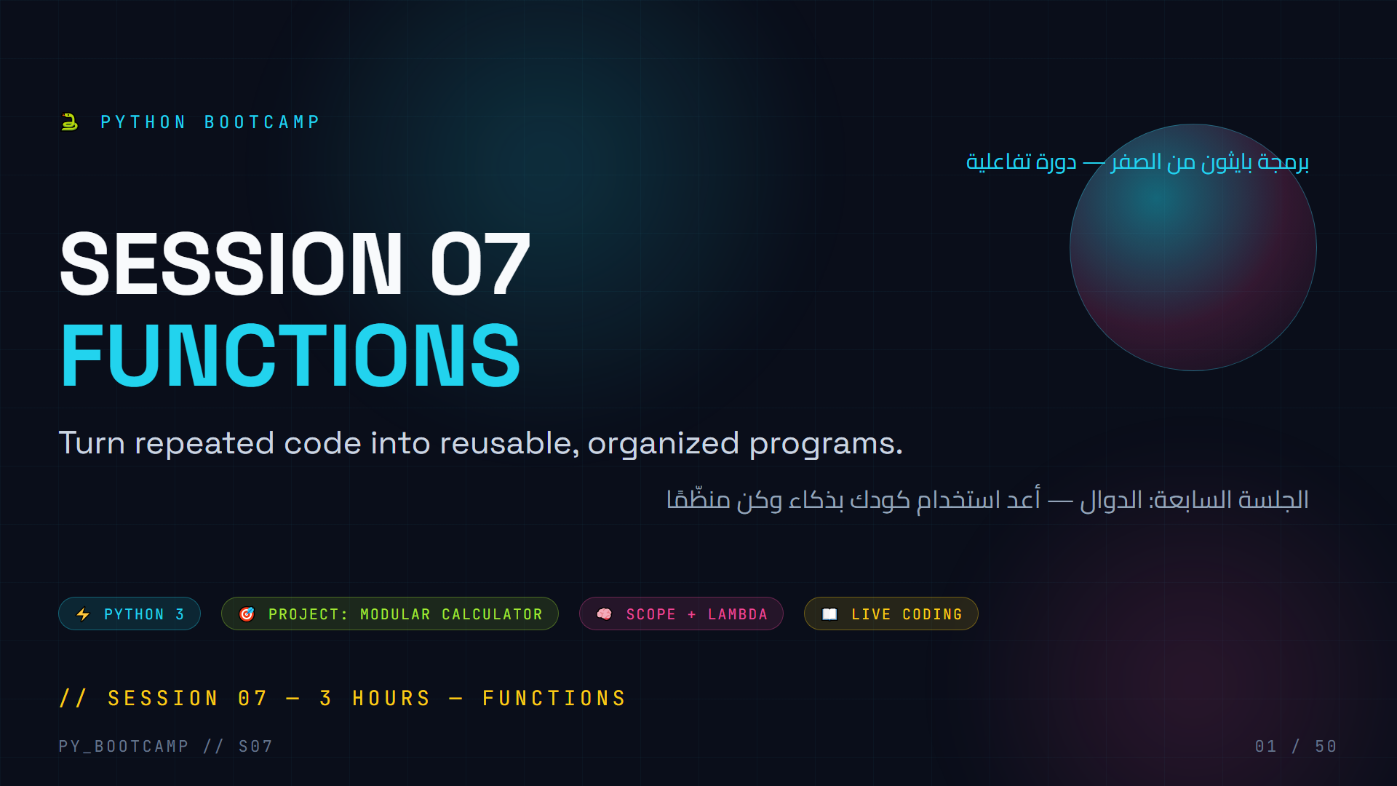
Notes:
- **Welcome**: Greet the class, "Session 7 — today we stop repeating ourselves."
- Ask icebreaker: "Who has copy-pasted code more than 3 times today?" Most hands go up.
- Set expectations: by the end you will write your own reusable functions and build a Modular Calculator.
- Age 15–22, keep energy high, promise lots of live coding + a project.
- Arabic tip: mention that the word for function here is «الدالة» and we'll use it throughout.
- Agenda quick teaser: theory → predict output → live coding → project → homework.

Slide 2
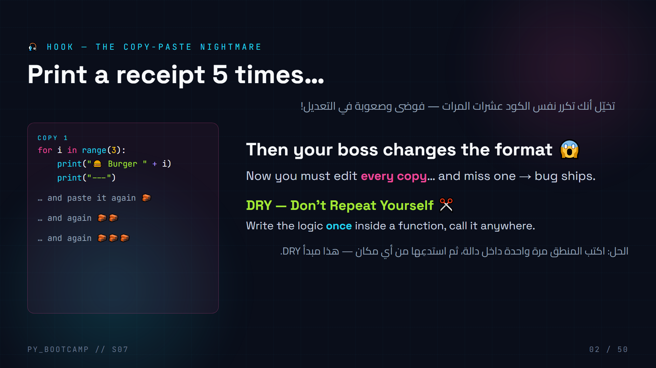
Notes:
- **Hook script**: read the pasted blocks dramatically, build tension.
- Ask: "What happens if the format changes?" → you edit 5 places.
- Point at DRY principle; this is the #1 motivation for functions.
- Fun demo: have a student count duplicated lines in a file if available.
- Live mini-prompt: "What real repetition do you have in your life? A morning routine = a function!"
- Arabic tip: DRY تُقرأ حرفيًا «لا تكرر نفسك».
- Transition: "Today you'll build a machine that you can run anytime."

Slide 3
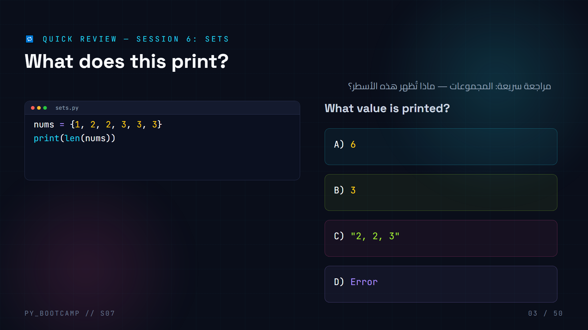
Notes:
- **Answer: B — 3.** A set removes duplicates: {1, 2, 3}, so len() is 3.
- Wait for hands before revealing. Ask a student to explain the dedup rule.
- Recall quick facts: `.add(x)`, `a | b` union, `a & b` intersection, `x in s` is O(1).
- Common confusion: `{}` is an empty DICT, not a set — `set()` makes an empty set.
- Arabic tip: المجموعة لا تسمح بالتكرار — أي عنصر مكرر يُحذف تلقائيًا.
- Connect: "Sets are fast for membership — we'll reuse that idea in functions today."

Slide 4
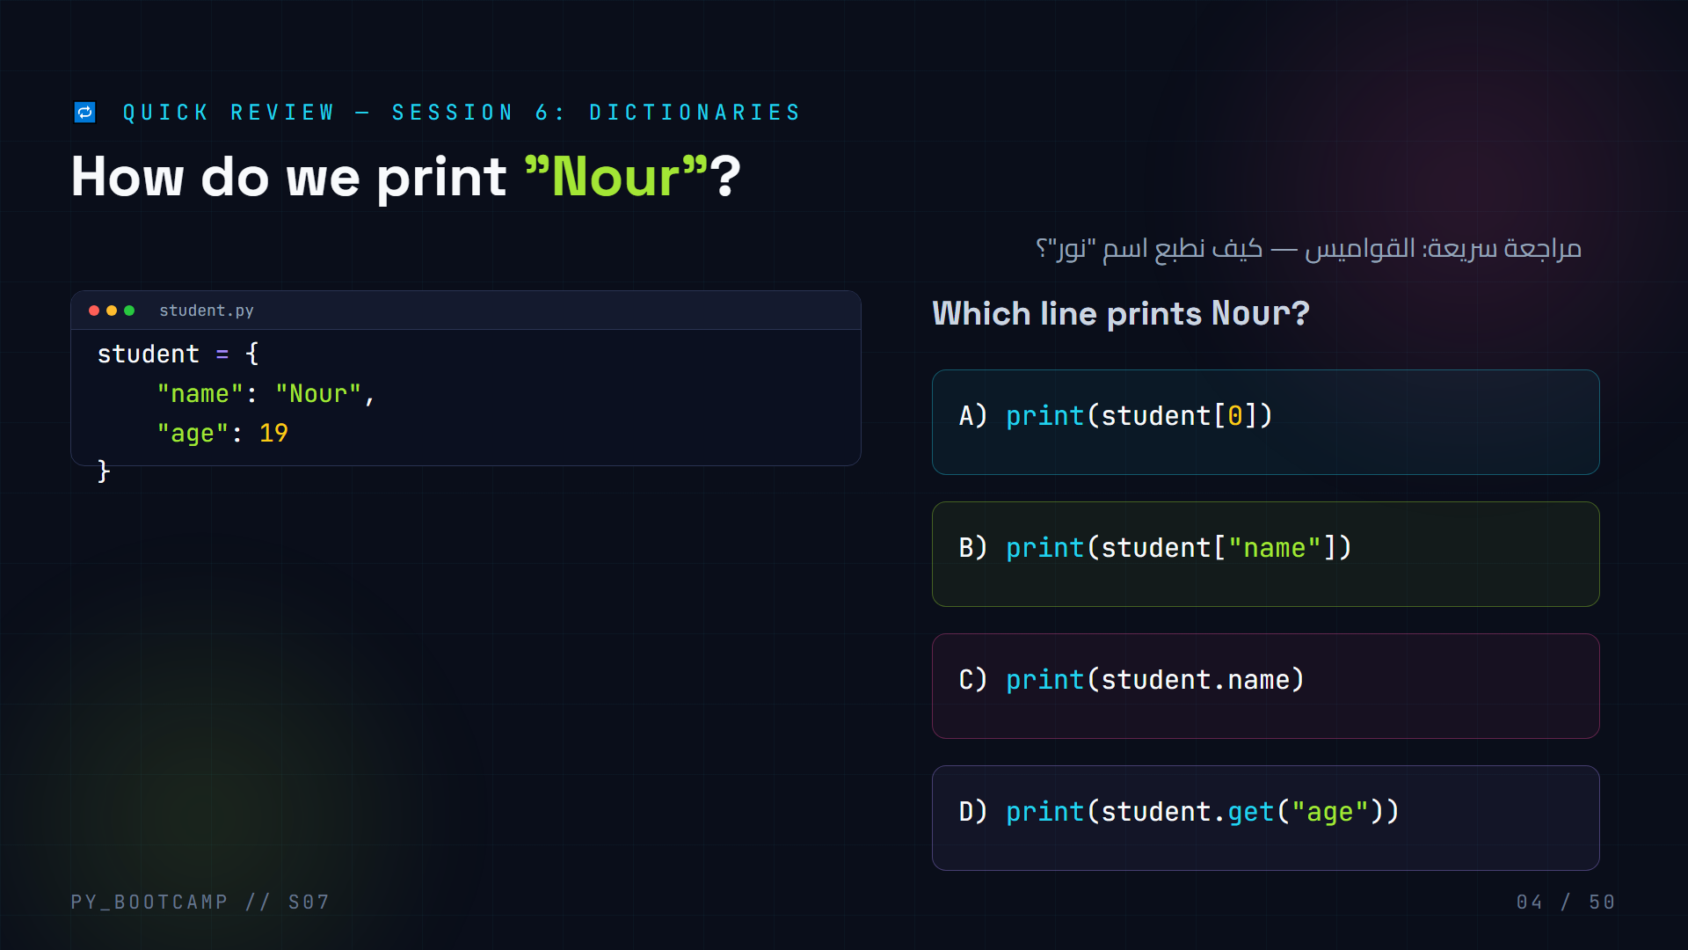
Notes:
- **Answer: B — `student["name"]`.** Dicts are accessed by KEY, never by index.
- A raises KeyError (no key 0); C is invalid Python (dot access doesn't exist for dicts); D prints 19.
- Recall: `student.get("name")` also works and returns None if missing — safe lookup.
- Have a student demo iterating `for key, value in student.items():`.
- Arabic tip: القاموس يعمل بالاسم (المفتاح) وليس بالرقم (الفهرس).
- Bridge: "Today your functions will read and transform dicts like this one."

Slide 5
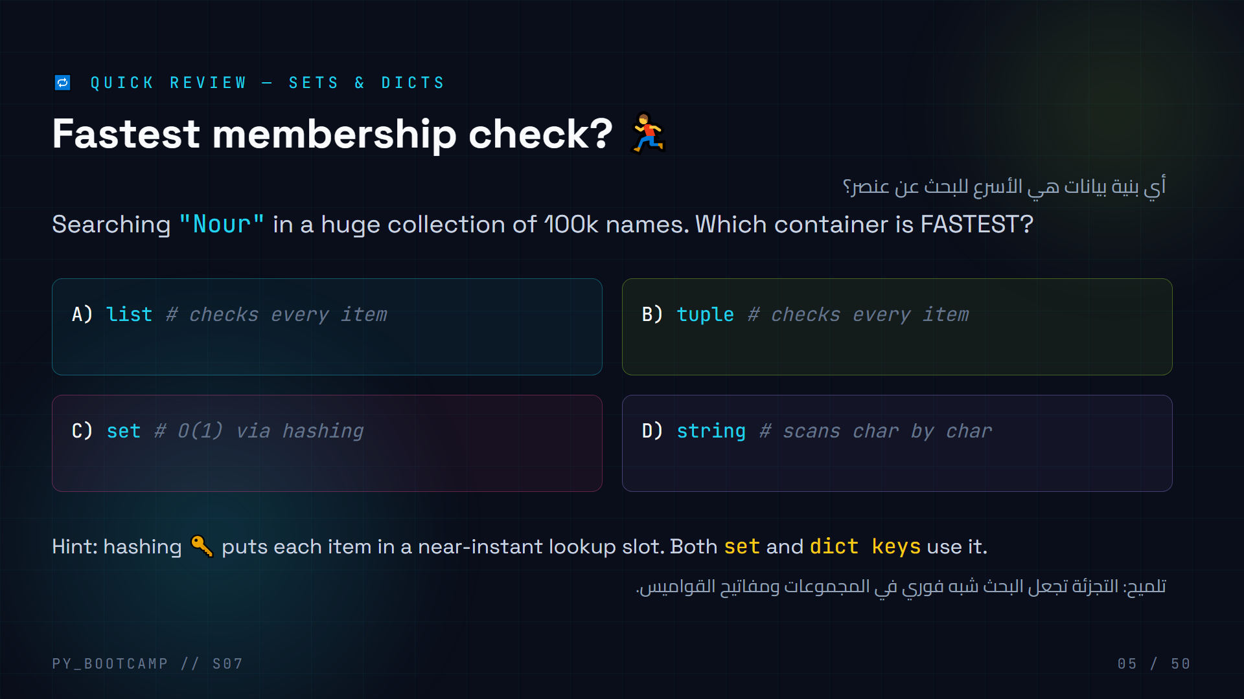
Notes:
- **Answer: C — set (and dict keys are equally fast).** Lists/tuples/strings scan item by item → O(n).
- Demo: `"Nour" in big_set` vs `"Nour" in big_list` with 1M items — the set wins instantly.
- This is WHY dicts and sets feel "magic fast": hashing.
- Connect forward: "Functions let you BUILD such helpers once and reuse them."
- Have students raise hands per option, then reveal.
- Arabic tip: ابحث في مجموعة (set) إذا كنت تريد سرعة فائقة في التحقق من الوجود.
- Keep it light — no formal big-O notation needed, just intuition.

Slide 6
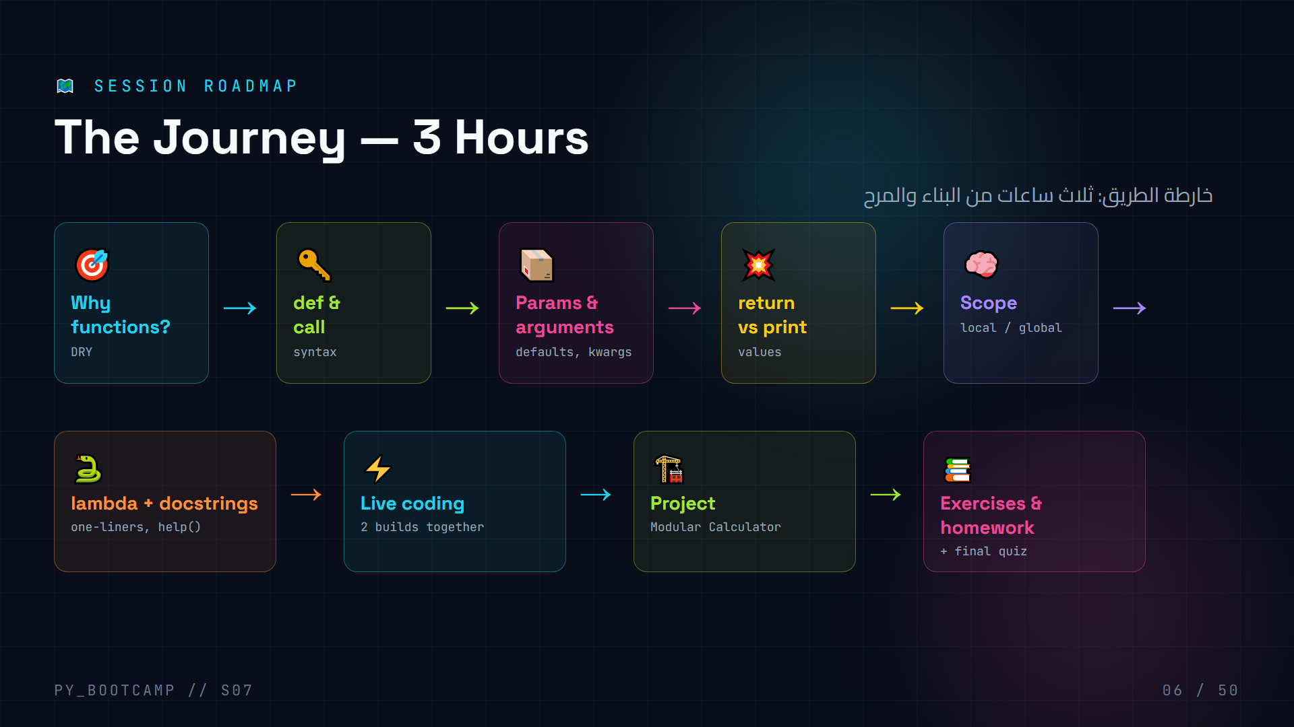
Notes:
- Read the map out loud; tap each box.
- Timing: review 20min → theory+code ~90min → break 10min → live coding 25min → project 45min → exercises/quiz 20min.
- Tell students: "Every box today ends with us BUILDING something."
- Pause at project box: the Modular Calculator is the final boss.
- Arabic tip: قل للطلاب إن «الخريطة» هي فهرس الجلسة — عودوا إليها عند الضياع.
- Keep it to 60 seconds; don't over-explain now, we have 49 more slides.

Slide 7
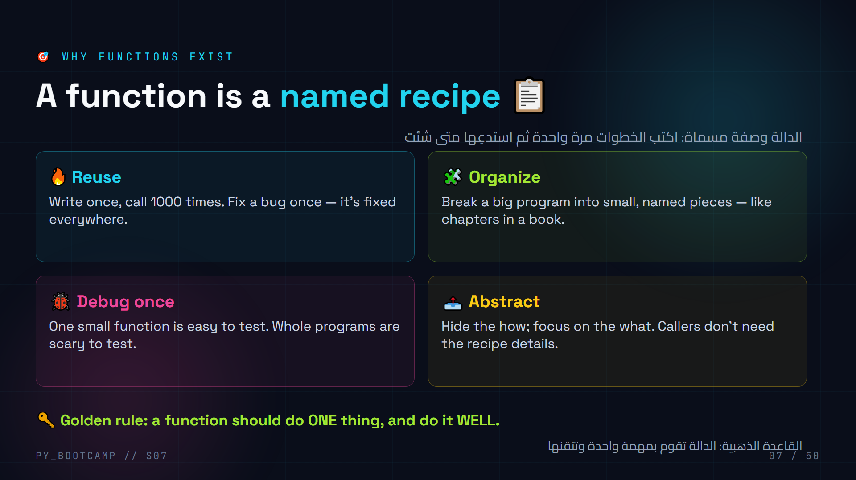
Notes:
- Ask: "What's a recipe?" — ingredients in, steps, dish out. That's a function.
- Use the receipt hook from slide 2 as the running example.
- Emphasize DRY again, but add the ORGANIZATION payoff — bigger projects need structure.
- Real-world mapping: Excel formula, Google Maps "directions" function, a calculator button.
- Arabic tip: شبه الدالة بـ«الوصفة» أو «الآلة» — يسهل على الطلاب تصورها.
- Ask one student to give a one-sentence summary of why functions exist.

Slide 8
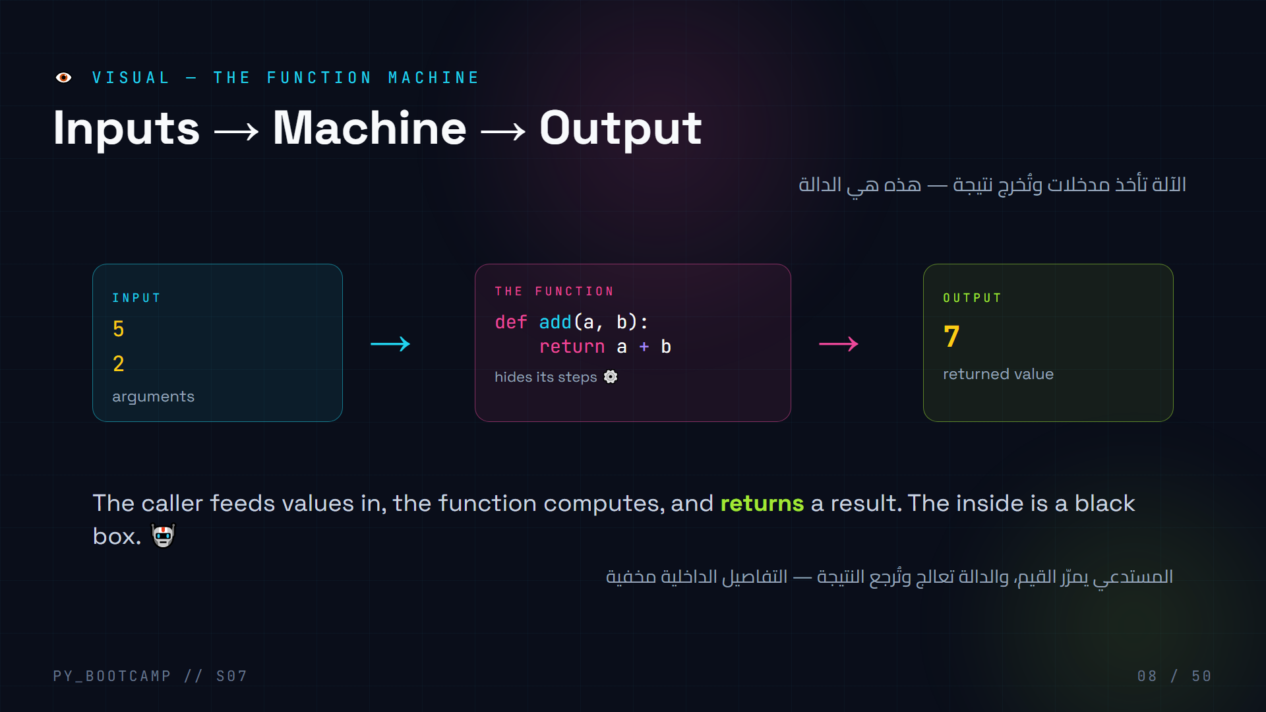
Notes:
- Draw the machine on the board too: f(x) with a gearbox.
- Emphasize the black-box idea: callers care about WHAT, not HOW.
- Demo physically: two students pass "ingredients", one student "cooks" (adds), returns the dish.
- Note the arrow names: input = argument, machine = function, output = return value.
- Ask: "What could go IN a vending machine function?" — money + button; out comes a snack.
- Arabic tip: صوّر الدالة كآلة بيع: تدخل عملة، تخرج قطعة حلوى.
- Transition into code: "Let's write that machine in Python."

Slide 9
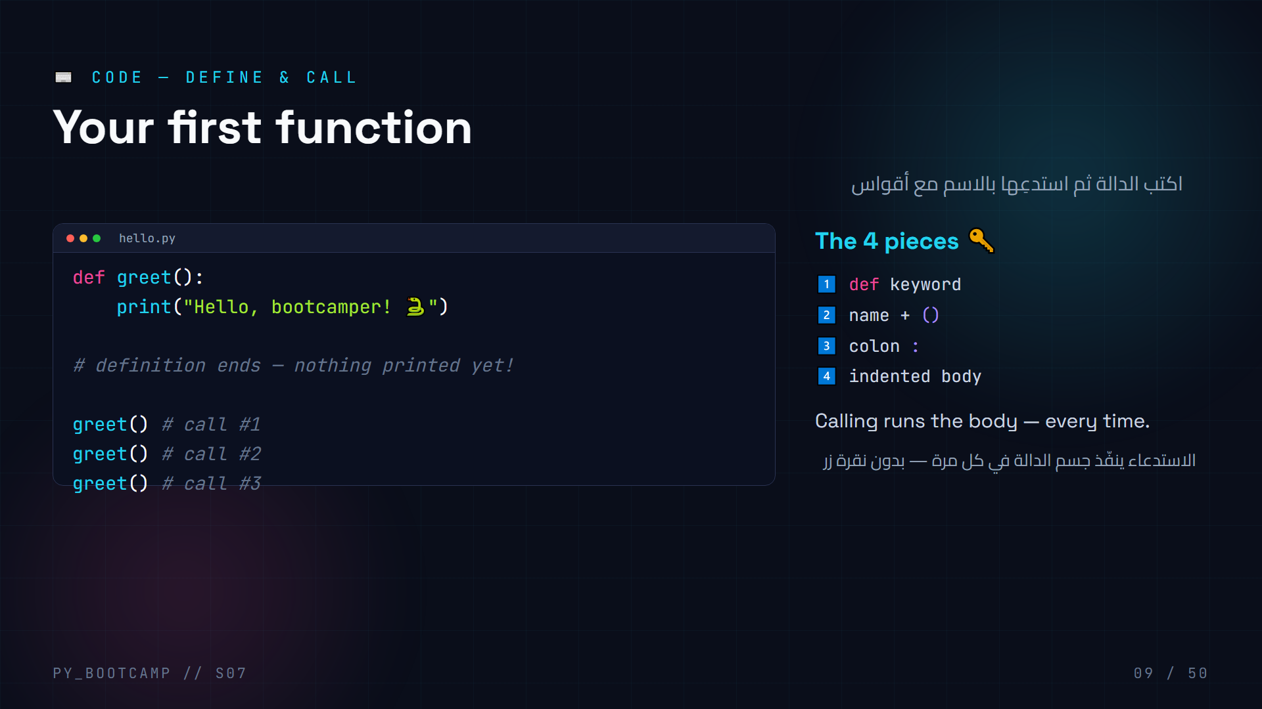
Notes:
- **Live type this**: `def greet():` then indent, `print(...)`, then call it 3 times.
- Key drama: the definition alone does nothing. Only CALLS run the body.
- Common mistake: forgetting the colon → SyntaxError; forgetting indentation → IndentationError.
- Show the two-phase model: Python reads def (stores it) then executes calls.
- Ask a student: "If we call greet() 3 times, how many lines print?" → 3.
- Arabic tip: كلمة def تعني «عَرّف» والاستدعاء هو تنفيذ فعلي.
- Transition: "Now add ingredients — parameters next."

Slide 10
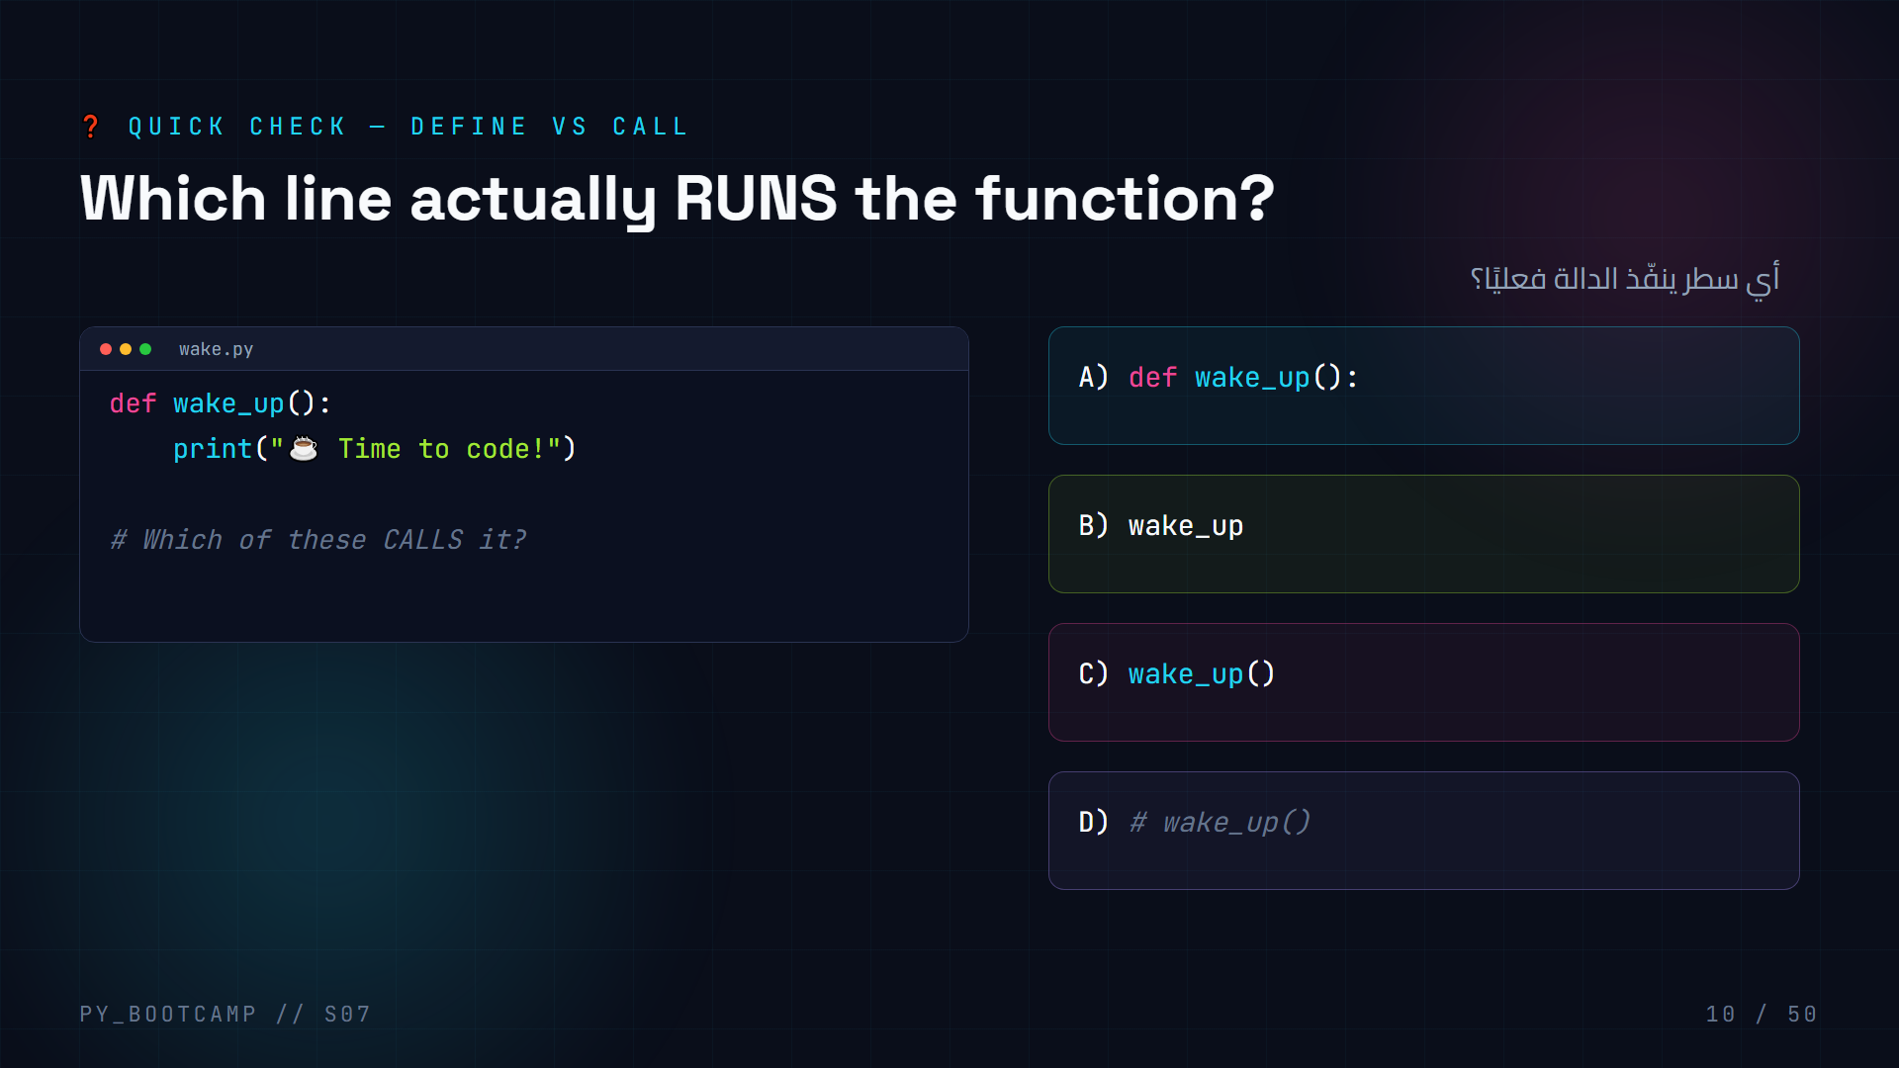
Notes:
- **Answer: C — `wake_up()`.** Parentheses = "run it now!".
- A is the definition (just stores it). B is a bare reference (prints the function object). D is a comment — does nothing.
- Demo B quickly in the REPL to show the `` object — mind = blown.
- Common mistake: defining but forgetting to call → "nothing happened".
- Arabic tip: الأقواس تعني «نفّذ الآن» بينما الاسم وحده مجرد إشارة.
- Have students physically act: stand = define, jump = call.

Slide 11
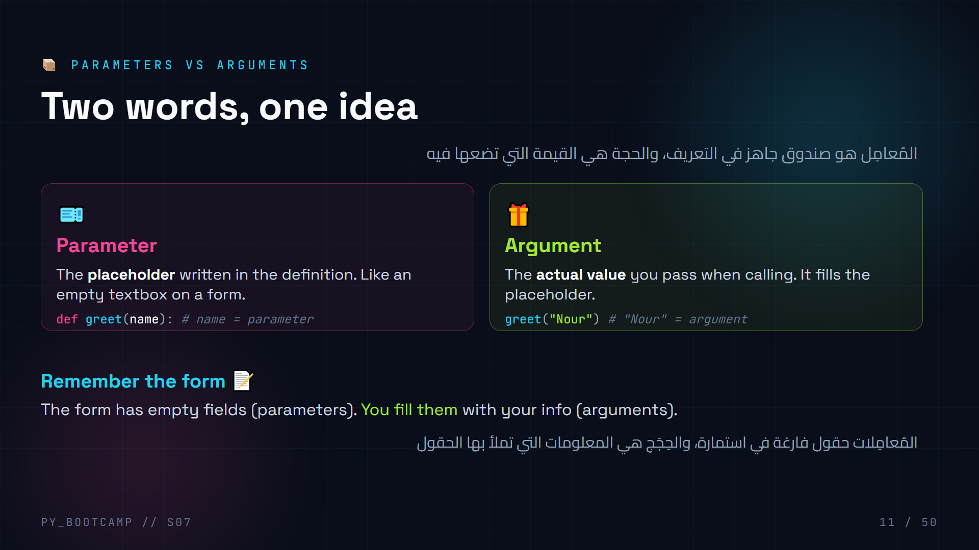
Notes:
- This vocabulary matters: params = in def, arguments = in call.
- Form analogy: a registration form = function; fields = parameters; what you type = arguments.
- Read the two code lines side by side and color-code the pair.
- Have students chant: "Parameters in the definition! Arguments in the call!"
- Common confusion source: many tutorials use the words interchangeably — we won't.
- Arabic tip: «المُعامِل» مقابل «الحجة» — ركّز على مكان ظهور كل منهما.
- Transition: "Now a function with TWO parameters."

Slide 12
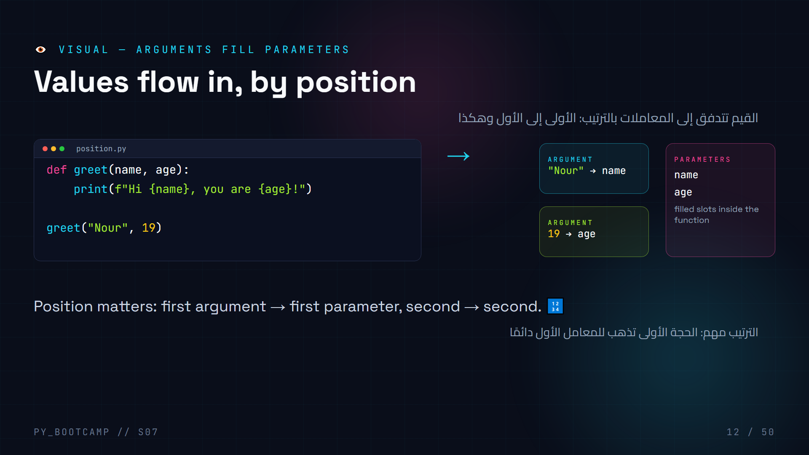
Notes:
- Trace the arrows by hand on screen: "Nour" drops into name, 19 drops into age.
- Switch the values on the board: greet(19, "Nour") → prints "Hi 19, you are Nour!" — funny but broken logic.
- Ask: "What if we pass too few arguments?" → TypeError: missing 1 required positional argument.
- Demo the error live once — students must SEE TypeError.
- Arabic tip: الترتيب كأنك تملىء نموذجًا من الأعلى للأسفل.
- Transition: "Let's write a multi-parameter function together."

Slide 13
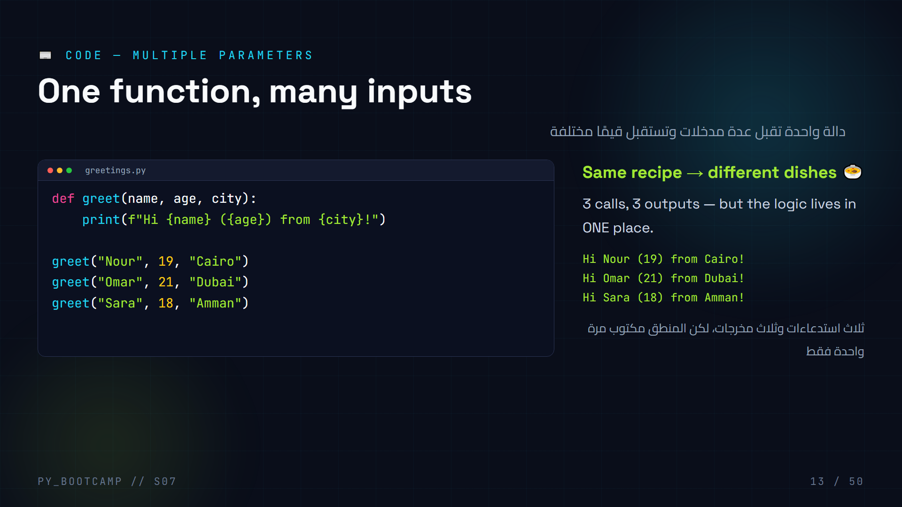
Notes:
- Live type the 3-parameter version; have students shout the arguments.
- Emphasize: parameter ORDER defines the contract — document it in your head.
- Count arguments: "How many arguments in call #2?" → three.
- Show the output column on the right corresponds to each call.
- Common mistake: passing too many/too few → TypeError. Let them hit it once.
- Arabic tip: لاحظ أن القيم تتغير لكن الدالة ثابتة — هذا جوهر إعادة الاستخدام.
- Challenge the class: write a version that returns the string instead of printing (foreshadow).

Slide 14
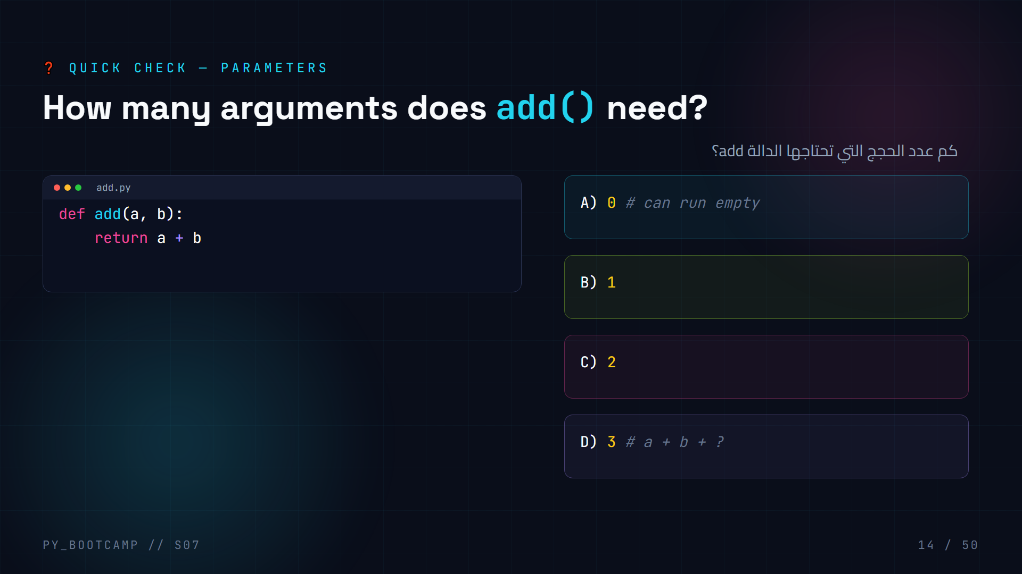
Notes:
- **Answer: C — 2.** The definition has two parameters, so calls must supply two arguments.
- Note: `add(3, 4)` returns 7 (because of `return`), `add()` raises TypeError.
- Live demo of `add(3)` → TypeError: add() missing 1 required positional argument: 'b'.
- Fun: ask what `add(10, 5)` equals; make them compute 15 mentally first.
- Arabic tip: عدد الحجج يجب أن يطابق عدد المعاملات (إلا مع القيم الافتراضية لاحقًا).
- Transition: "Next — the return vs print showdown."

Slide 15
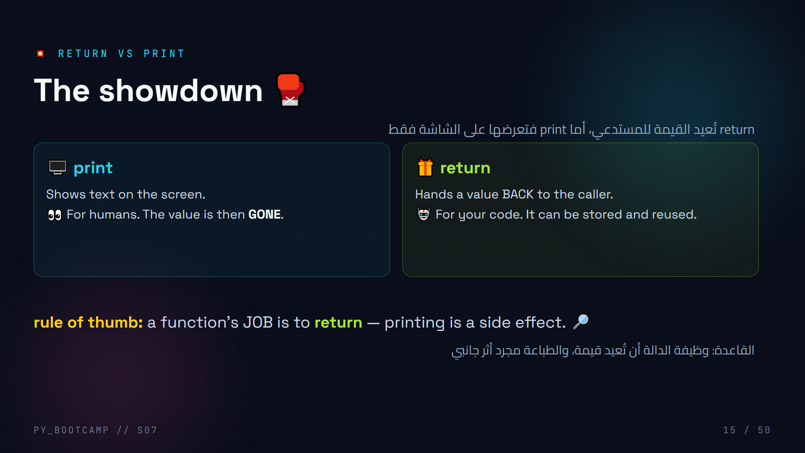
Notes:
- The single most confusing concept of the session — slow down here.
- Analogy: print = speaker announces the result to the room; return = waiter hands the dish to the chef.
- Emphasize: print alone → the calling code receives NOTHING (None).
- "Who can compute with print? Nobody. Who can compute with return? Your program."
- Ask: "If a function only prints, what does the caller get?" → None.
- Arabic tip: اشرحها بالدارجة: return «يرجّع» القيمة، print «يطبعها على الشاشة فقط».
- Transition: "Let's see the difference in code — this is worth memorizing."

Slide 16
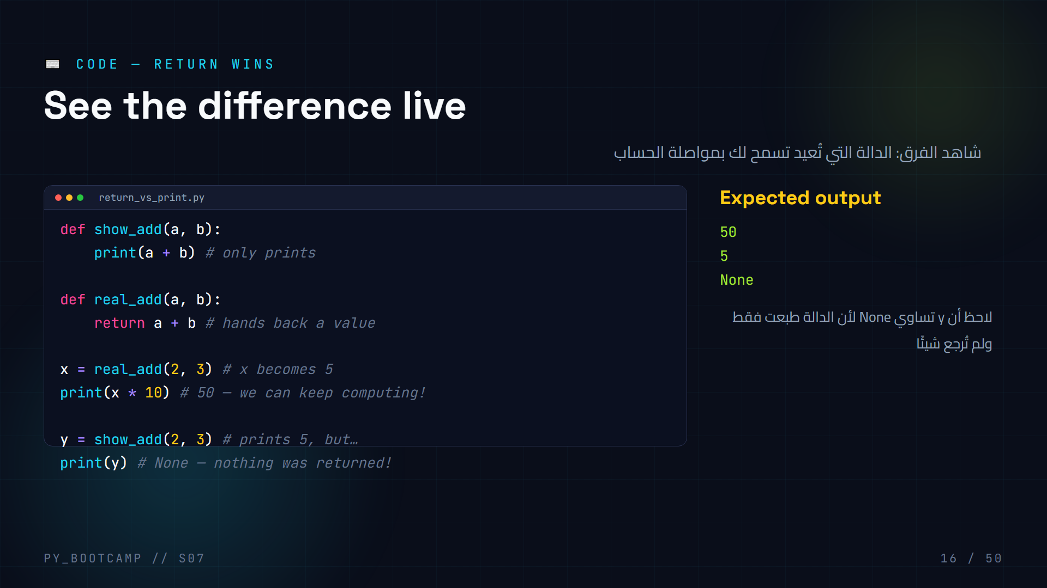
Notes:
- **Run this live** and pause on `y = show_add(2, 3)`: students expect 5.
- Print the mystery: y is None. That's THE lesson.
- Draw the flow: real_add returns 5 → x=5 → x*10=50.
- show_add prints 5 to the console but returns None → y=None.
- Common mistake of the decade: `return` INSIDE a loop returns on first iteration — mention for later.
- Arabic tip: من لا يُرجع قيمة يعطي None — رسالة بايثون الصامتة.
- Challenge: "Change show_add into a function that both prints AND returns."

Slide 17
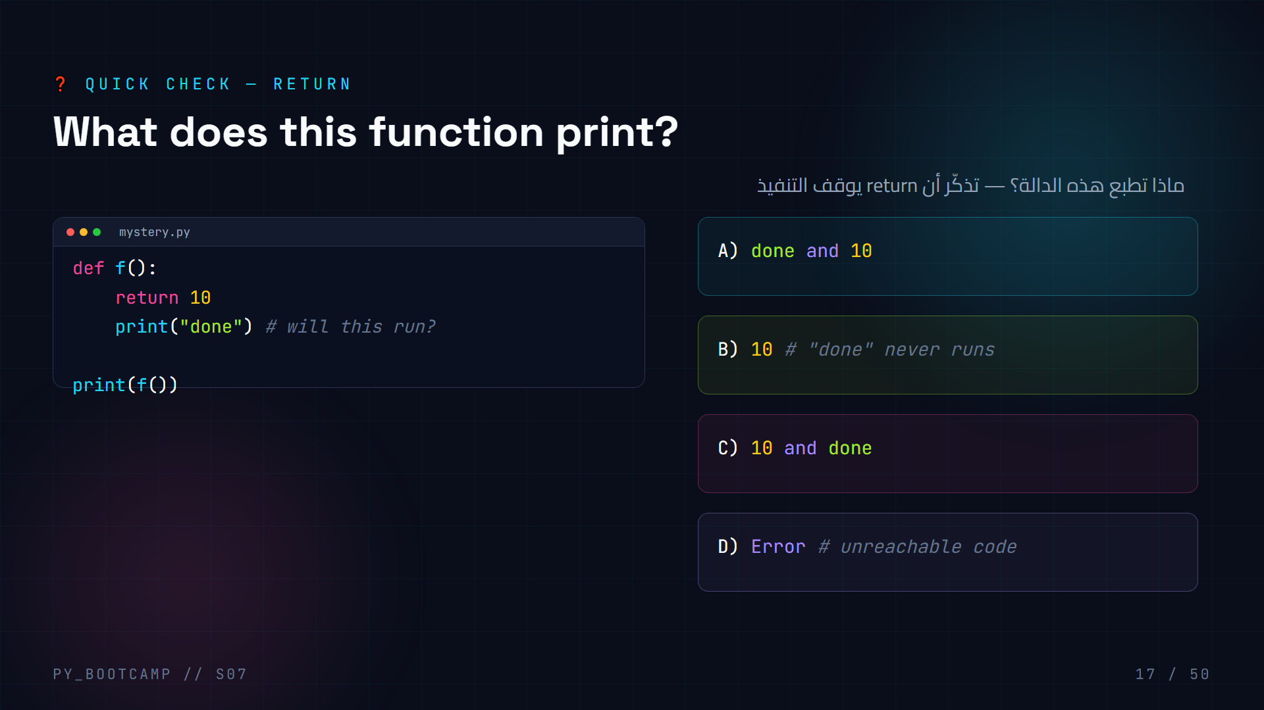
Notes:
- **Answer: B — prints 10.** `return` EXITS the function immediately; "done" is dead code.
- Big insight: code after return is unreachable — Python allows it silently (no error).
- So "done" never prints. Only the caller's print(f()) → 10.
- Ask: "What would change if we moved return to the last line?" → both print.
- Arabic tip: return مثل باب الخروج — بمجرد أن تمرّ منه تنتهي الدالة فورًا.
- Reinforce with real life: a coffee machine returns the cup, then stops working.

Slide 18
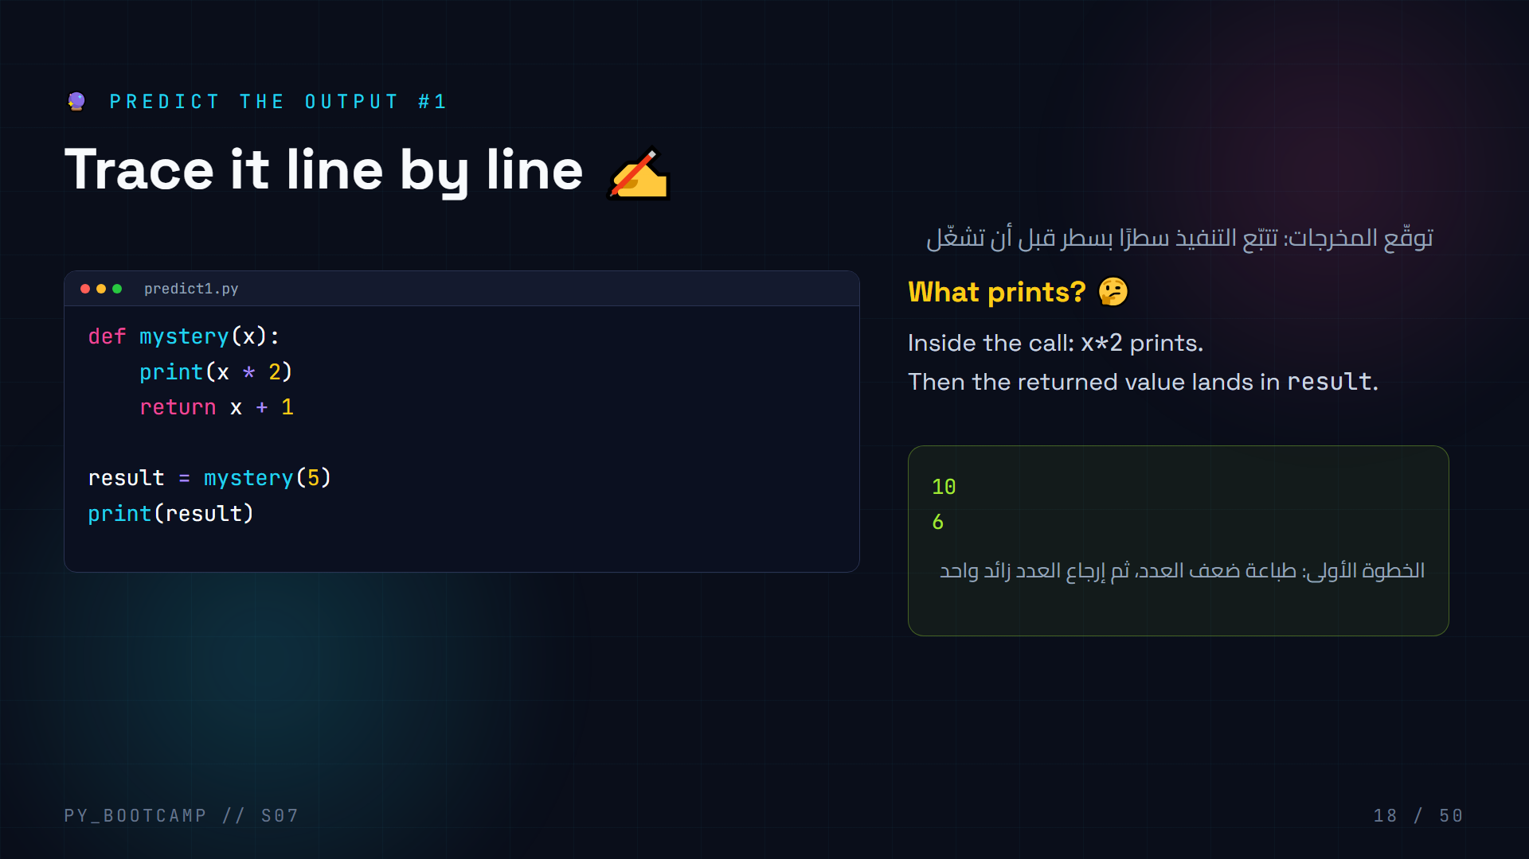
Notes:
- **Answer: 10 then 6.**
- Walk through: call mystery(5) → x=5 → print(5*2)=10 → return 5+1=6 → result=6 → print(result)=6.
- Emphasize the print INSIDE vs the print OUTSIDE happen at different times.
- Cover the answer panel, let students write predictions on paper first.
- Common slip: students print "10, 5" or forget the inner print order.
- Arabic tip: تتبّع القيمة x داخل الدالة ثم عد إلى الخارج.
- Use this as a template for live-coding trace skills later.

Slide 19
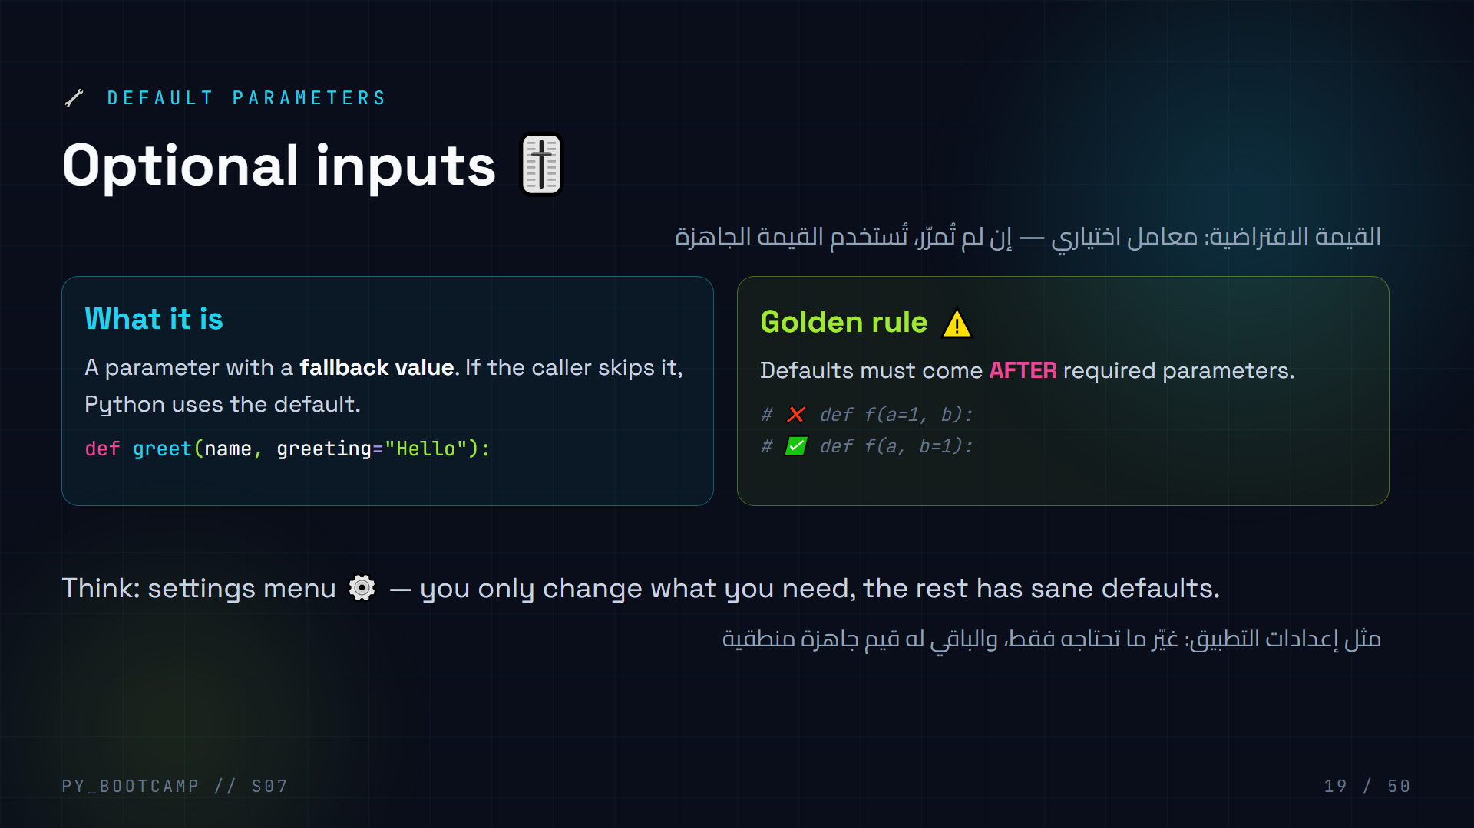
Notes:
- Show a "settings" analogy: volume=50, brightness=70 — you can override one.
- The ordering rule is a common SyntaxError: "non-default argument follows default argument".
- Demo the error once; it's very common for students.
- Emphasize: default is evaluated at def time — brief mention, don't deep dive.
- Arabic tip: القيمة الافتراضية هي «خطة بديلة» عند عدم إرسال شيء.
- Transition: "Now let's USE defaults in code."

Slide 20
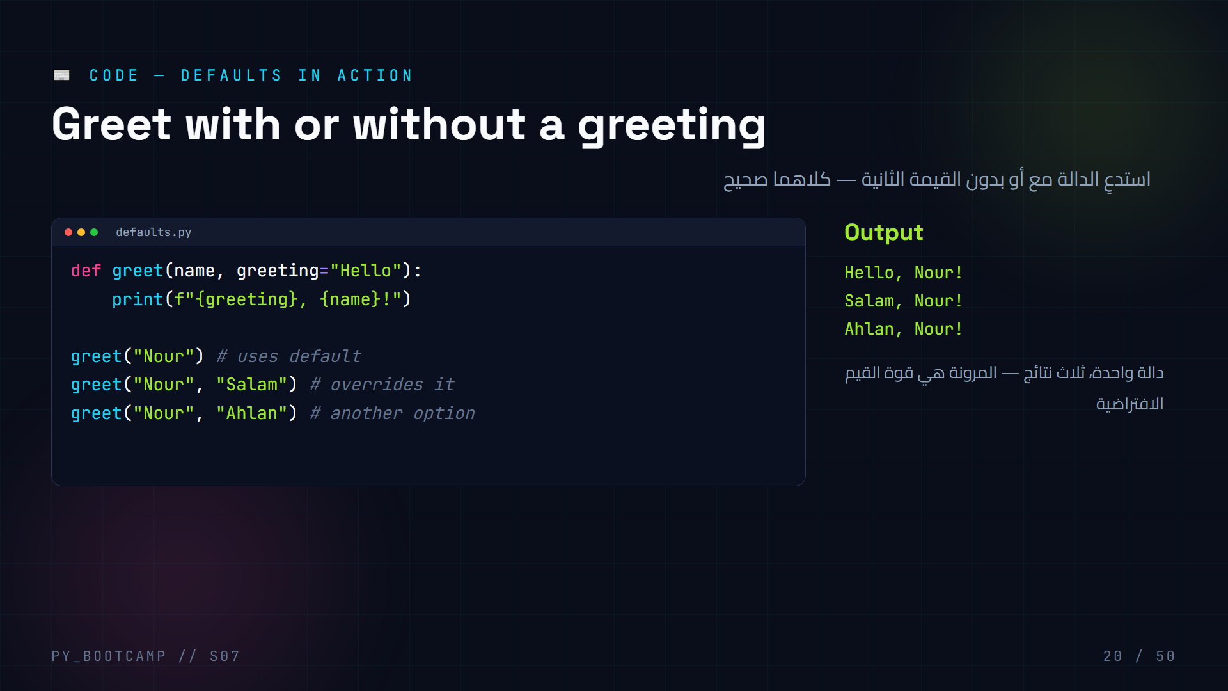
Notes:
- Live type; ask students to predict each line's output BEFORE running.
- Call 1 uses "Hello"; calls 2–3 override the default.
- The SAME function produces 3 different greetings — flexibility without duplication.
- Ask: "How would you make the default 'Salam'?" → change the def line.
- Common mistake: passing defaults as keyword after positional is fine, but never put required args after defaults in def.
- Arabic tip: مرونة الدالة تتيح استخدامات متعددة دون تكرار الكود.
- Extend challenge: add `emoji="🙌"` default param.

Slide 21
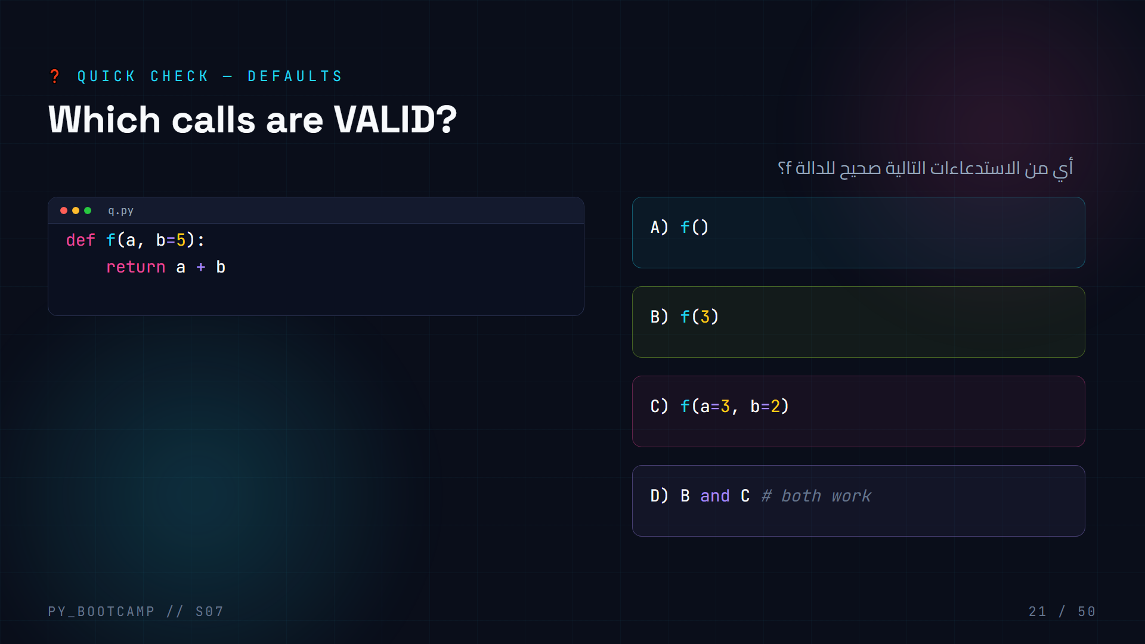
Notes:
- **Answer: D — B and C.** B uses only the required arg; C overrides the default with keywords.
- A is invalid: `a` is required (no default), so f() → TypeError.
- B computes 3+5=8; C computes 3+2=5.
- Have students calculate both results aloud.
- Arabic tip: المعامل المطلوب (a) لا يمكن تركه، بينما الافتراضي (b) اختياري.
- Transition: "You just used keyword arguments — let's give them the spotlight."

Slide 22
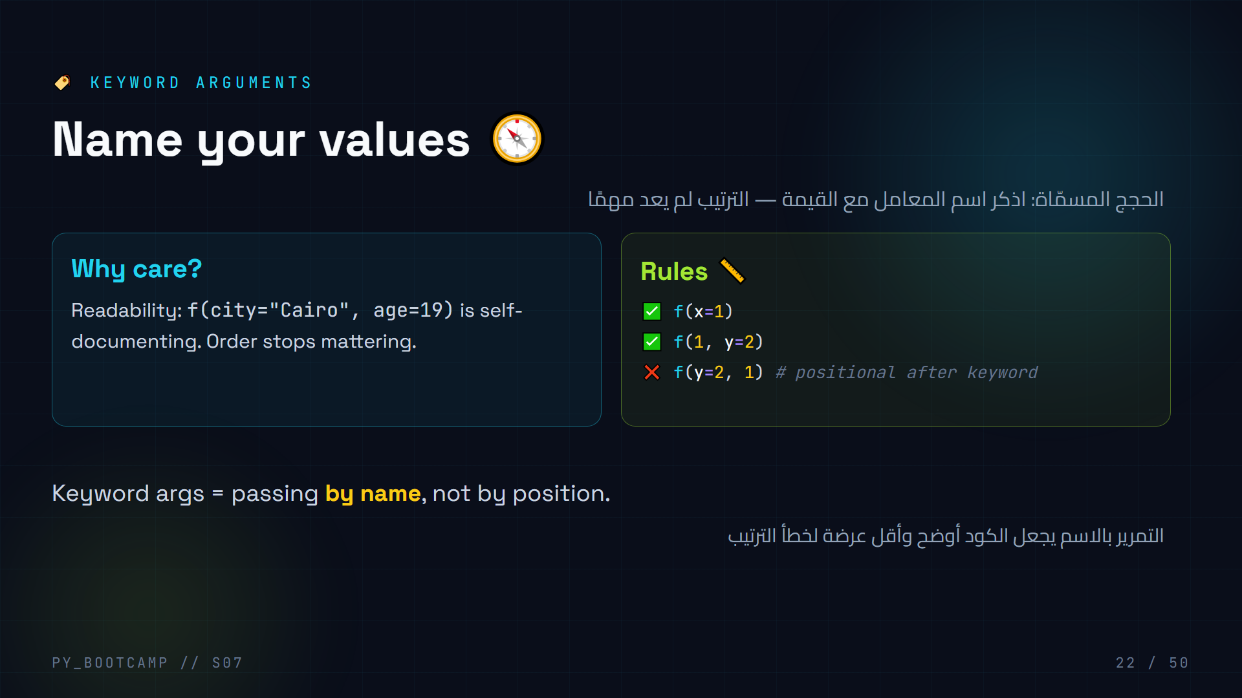
Notes:
- Emphasize the readability win: `profile(age=19, name="Nour")` needs no comment.
- Demo the error: keyword argument before positional → SyntaxError.
- Note: keyword args are how Python libs give you clean settings (e.g., `print(sep=", ")`).
- Ask: "When is positional OK? When names get confusing, use keywords."
- Arabic tip: التمرير بالاسم = «أرسل القيمة باسم الحقل»، تمامًا كملء استمارة واضحة.
- Transition: "Let's shake the order and prove order doesn't matter."

Slide 23
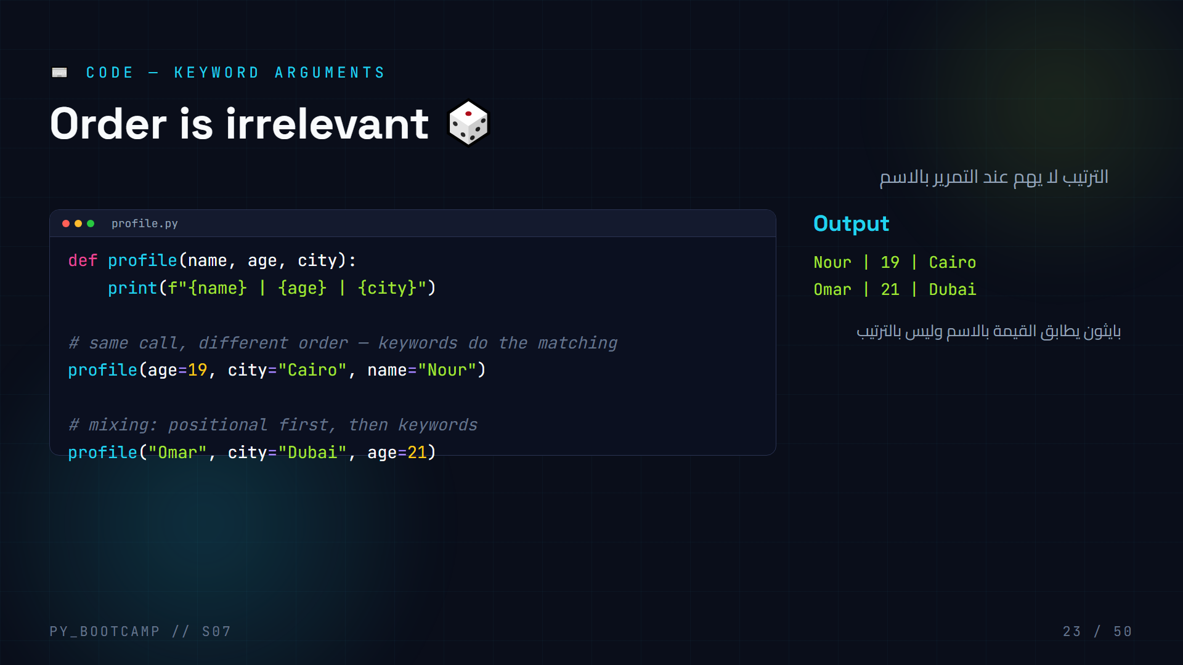
Notes:
- Call 1 scrambles the order entirely — still correct.
- Call 2 mixes: "Omar" → name (positional), then keywords fill city and age.
- The rule: positional args always come FIRST in a call.
- Try in the REPL: `profile(city="Amman", "Sara")` → SyntaxError.
- Ask students to predict output of call 2 before showing.
- Arabic tip: الخلط بين الترتيب والاسم يؤدي لخطأ — اتبع القاعدة: الموضعي أولاً ثم المسمّى.
- Transition: "We're about to see the flexible stars: *args and **kwargs."

Slide 24
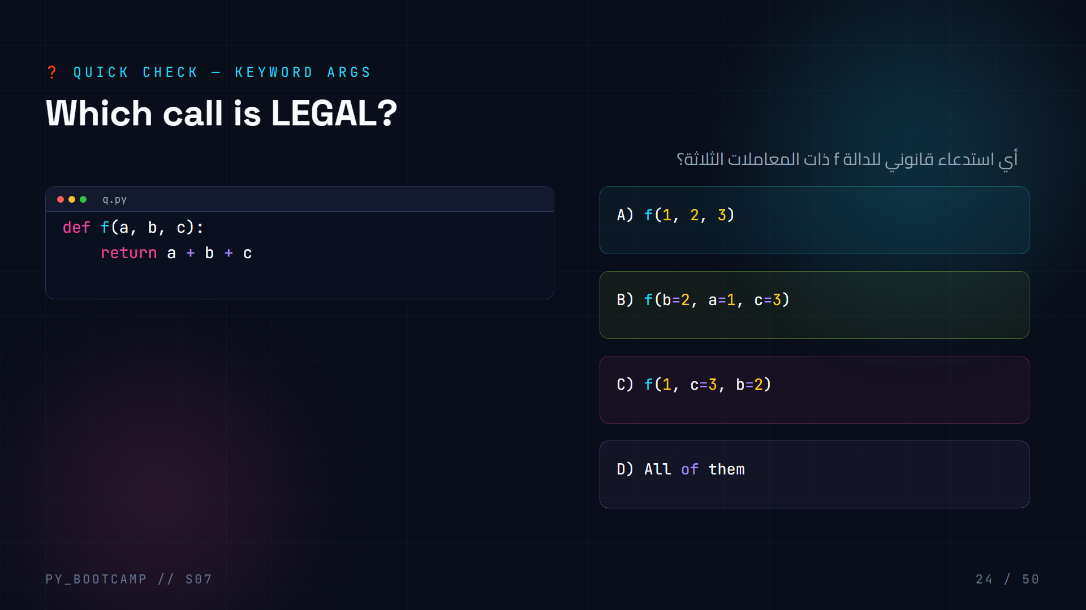
Notes:
- **Answer: D — all of them.** A is fully positional, B fully keyword (any order), C mixed positional-then-keyword.
- All three return 6.
- Illegal would be: `f(c=3, 1, 2)` (keyword before positional) or `f(1, 2)` (missing c).
- Celebrate students who spotted the mixing rule.
- Arabic tip: قواعد الاستدعاء: المسمّى لا يأتي قبل الموضعي، وكل المعاملات يجب أن تُمرَّر.
- Transition: "Now the flexible powers: *args and **kwargs."

Slide 25
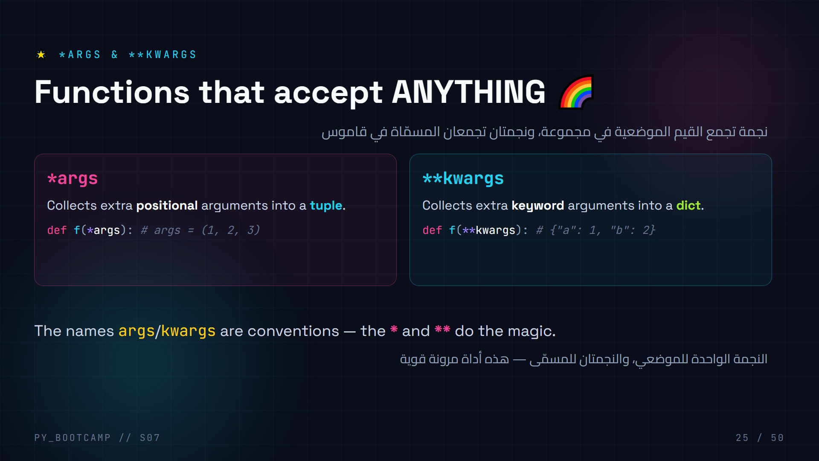
Notes:
- Demystify: the star is the operator; args/kwargs are just conventional names.
- *args → tuple (ordered), **kwargs → dict (named). Reuse earlier tuple/dict knowledge!
- Real use: print(*values), plotting libraries, logging functions with flexible options.
- Keep it light — today is "introduction", not deep wizardry.
- Arabic tip: شبه *args بحقيبة تجميع القيم بالترتيب، و**kwargs بمفاتيح وقيم.
- Transition: "Let's see both in action."

Slide 26
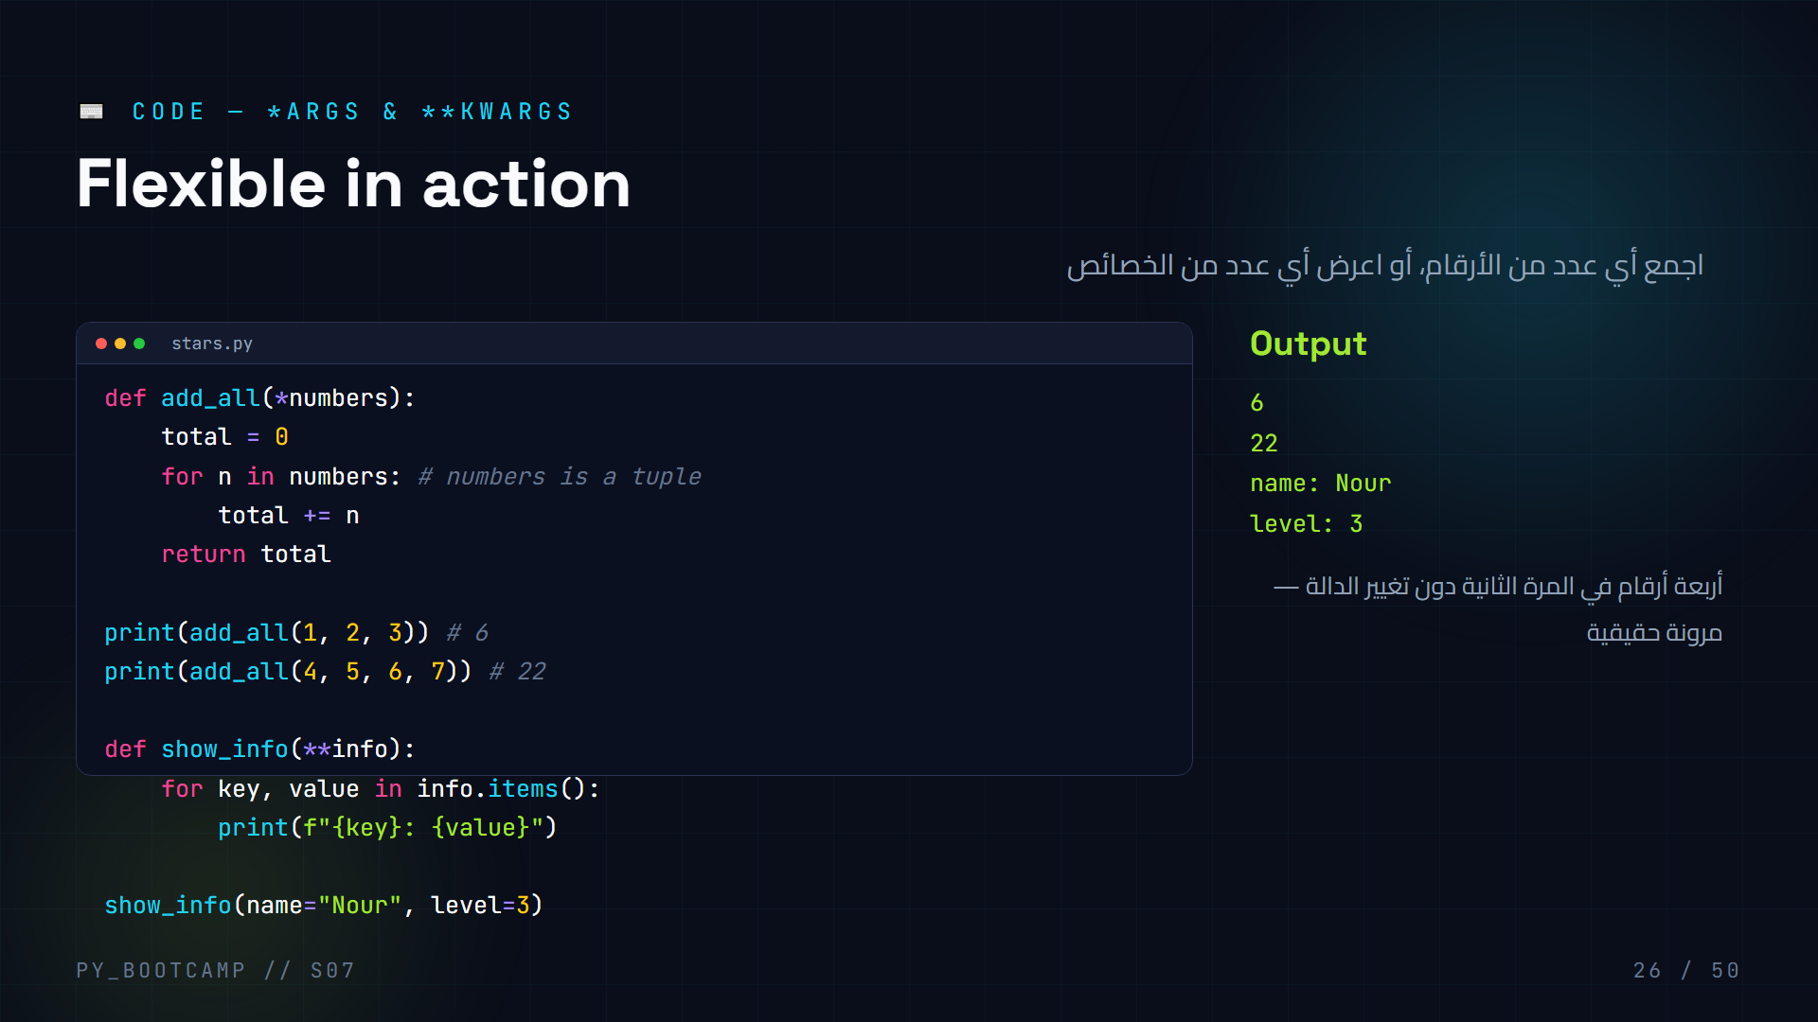
Notes:
- Live-code both; have students count arguments passed each call.
- Point at the loop: we already know tuples and dicts — this is a fresh USE of them.
- show_info(**info): "name" and "level" become dict keys automatically.
- Ask: "What type is `numbers`?" → tuple; "What type is `info`?" → dict.
- Extend challenge: add_all(1, 2, 3, 4, 5, 6) → 21, instantly works.
- Arabic tip: دالة واحدة تخدم أي عدد من المدخلات — توفير كبير في الكود.
- Warn: don't overuse; clear named params beat **kwargs when the interface is fixed.

Slide 27
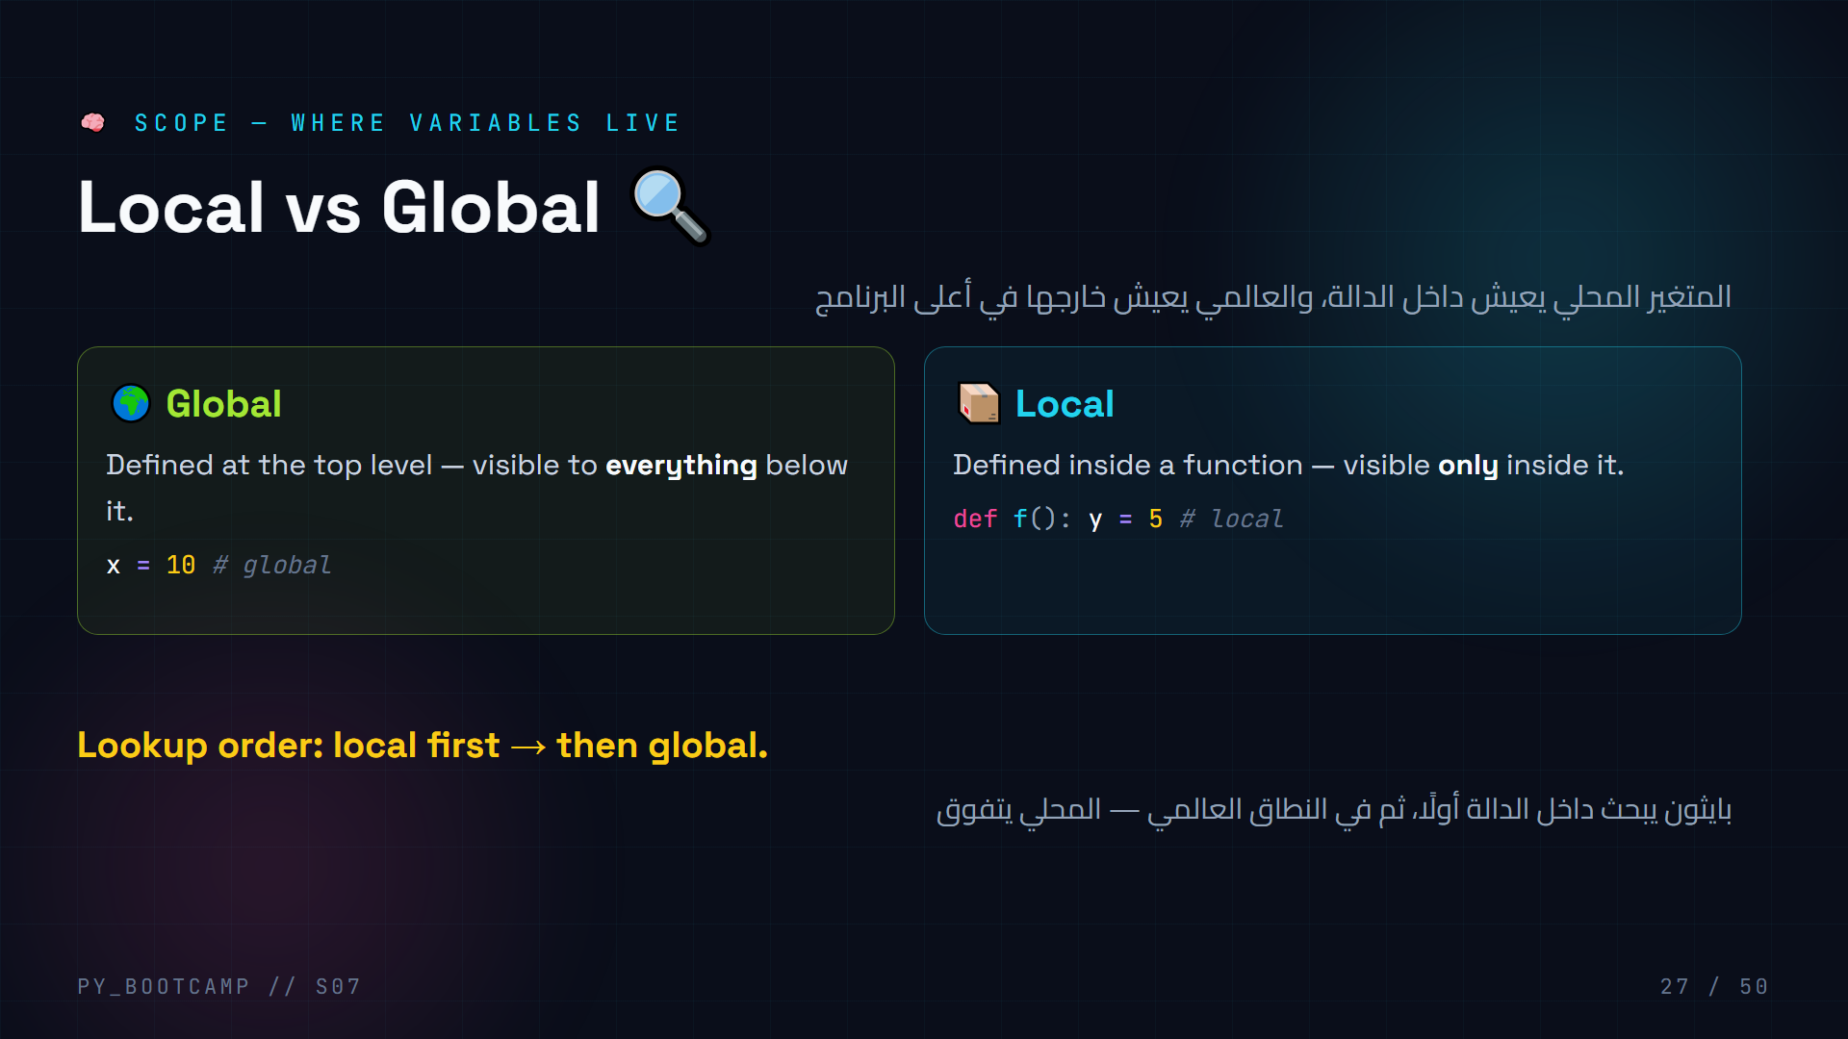
Notes:
- Analogy: the whole class = global scope; a student's backpack = local scope.
- A variable in a backpack (local) can't be used by other students.
- A note on the whiteboard (global) is visible to everyone.
- Emphasize the lookup order rule — it explains many "surprise" bugs.
- Arabic tip: شبه النطاق بالغرفة: ما بداخل غرفة الدالة لا يراه من خارجها.
- Transition: "Let's draw this as boxes."

Slide 28
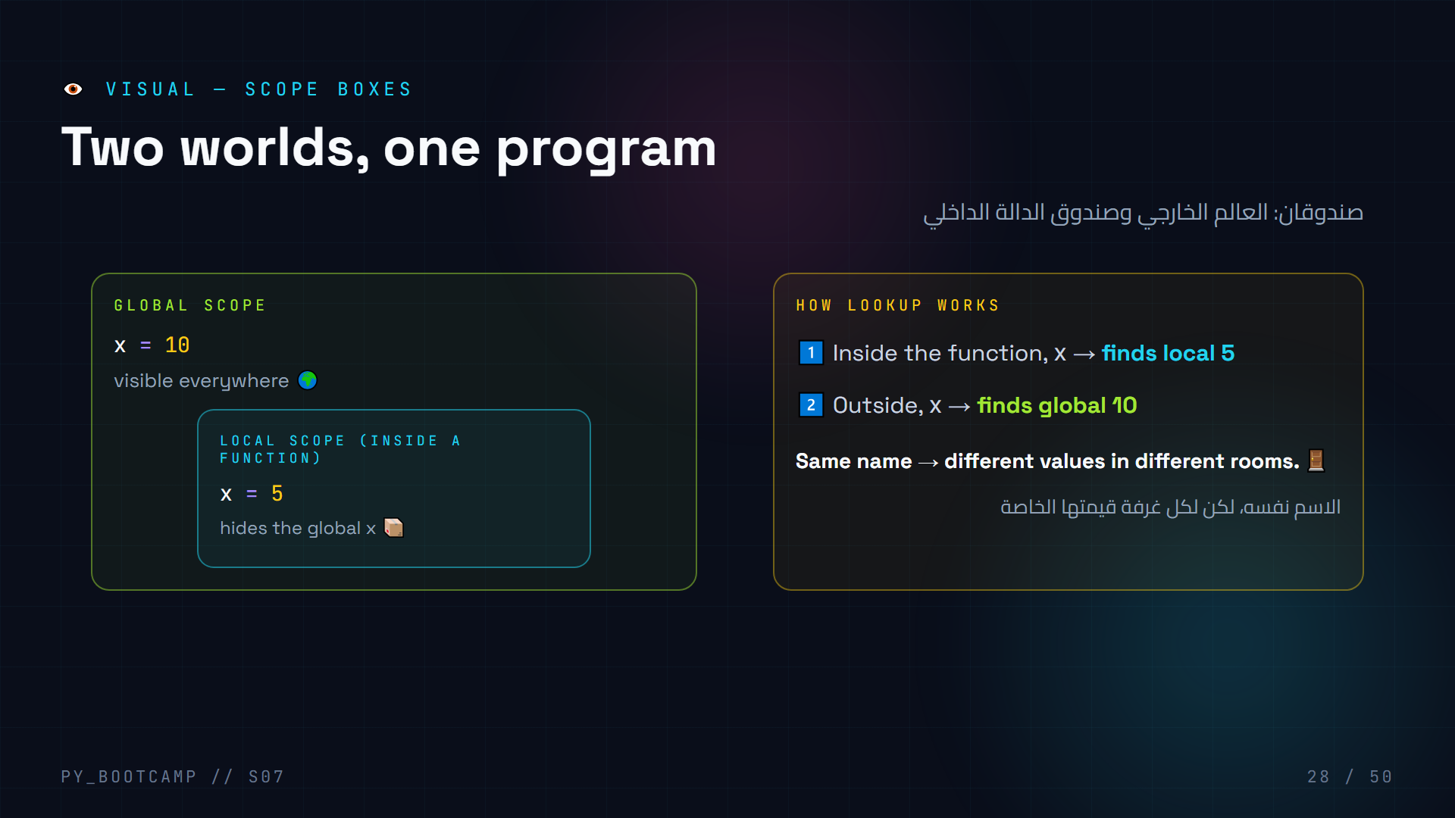
Notes:
- Draw these boxes on the board — the visual sticks with students.
- Local box sits INSIDE the global room in the drawing (nested worlds).
- Step through lookup: local first (finds 5), stops; never reaches global.
- Outside the function, the local x doesn't exist → Python sees global 10.
- Ask: "Does changing local x change global x?" → No. Separate boxes.
- Arabic tip: تغيير النسخة داخل الدالة لا يمسّ النسخة العالمية.
- Transition: "Let's prove it in code."

Slide 29
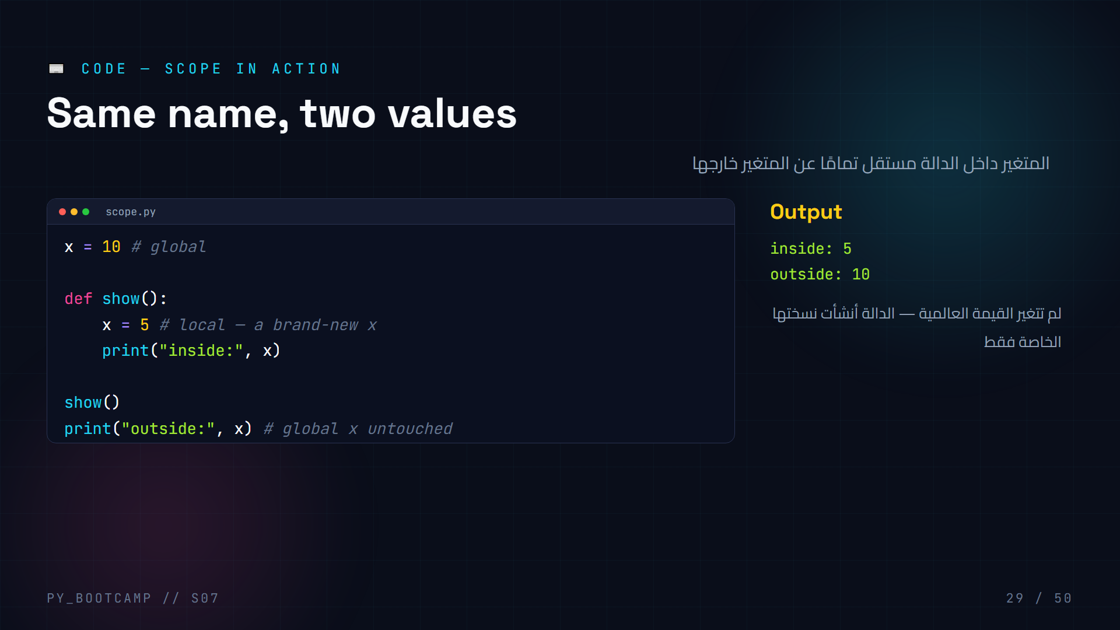
Notes:
- Run and show: two different values with the same name.
- Explain: assignment INSIDE a function creates a local variable.
- This is why students see "surprise" outputs — the local shadows the global.
- Common pitfall: reading a global is fine; ASSIGNING creates local (careful with `global` — teach it exists, discourage it).
- Arabic tip: داخل الدالة x تخص الدالة؛ خارجها x تخص البرنامج.
- Challenge: what happens if we remove `x = 5`? → show() prints 10 (reads global).

Slide 30
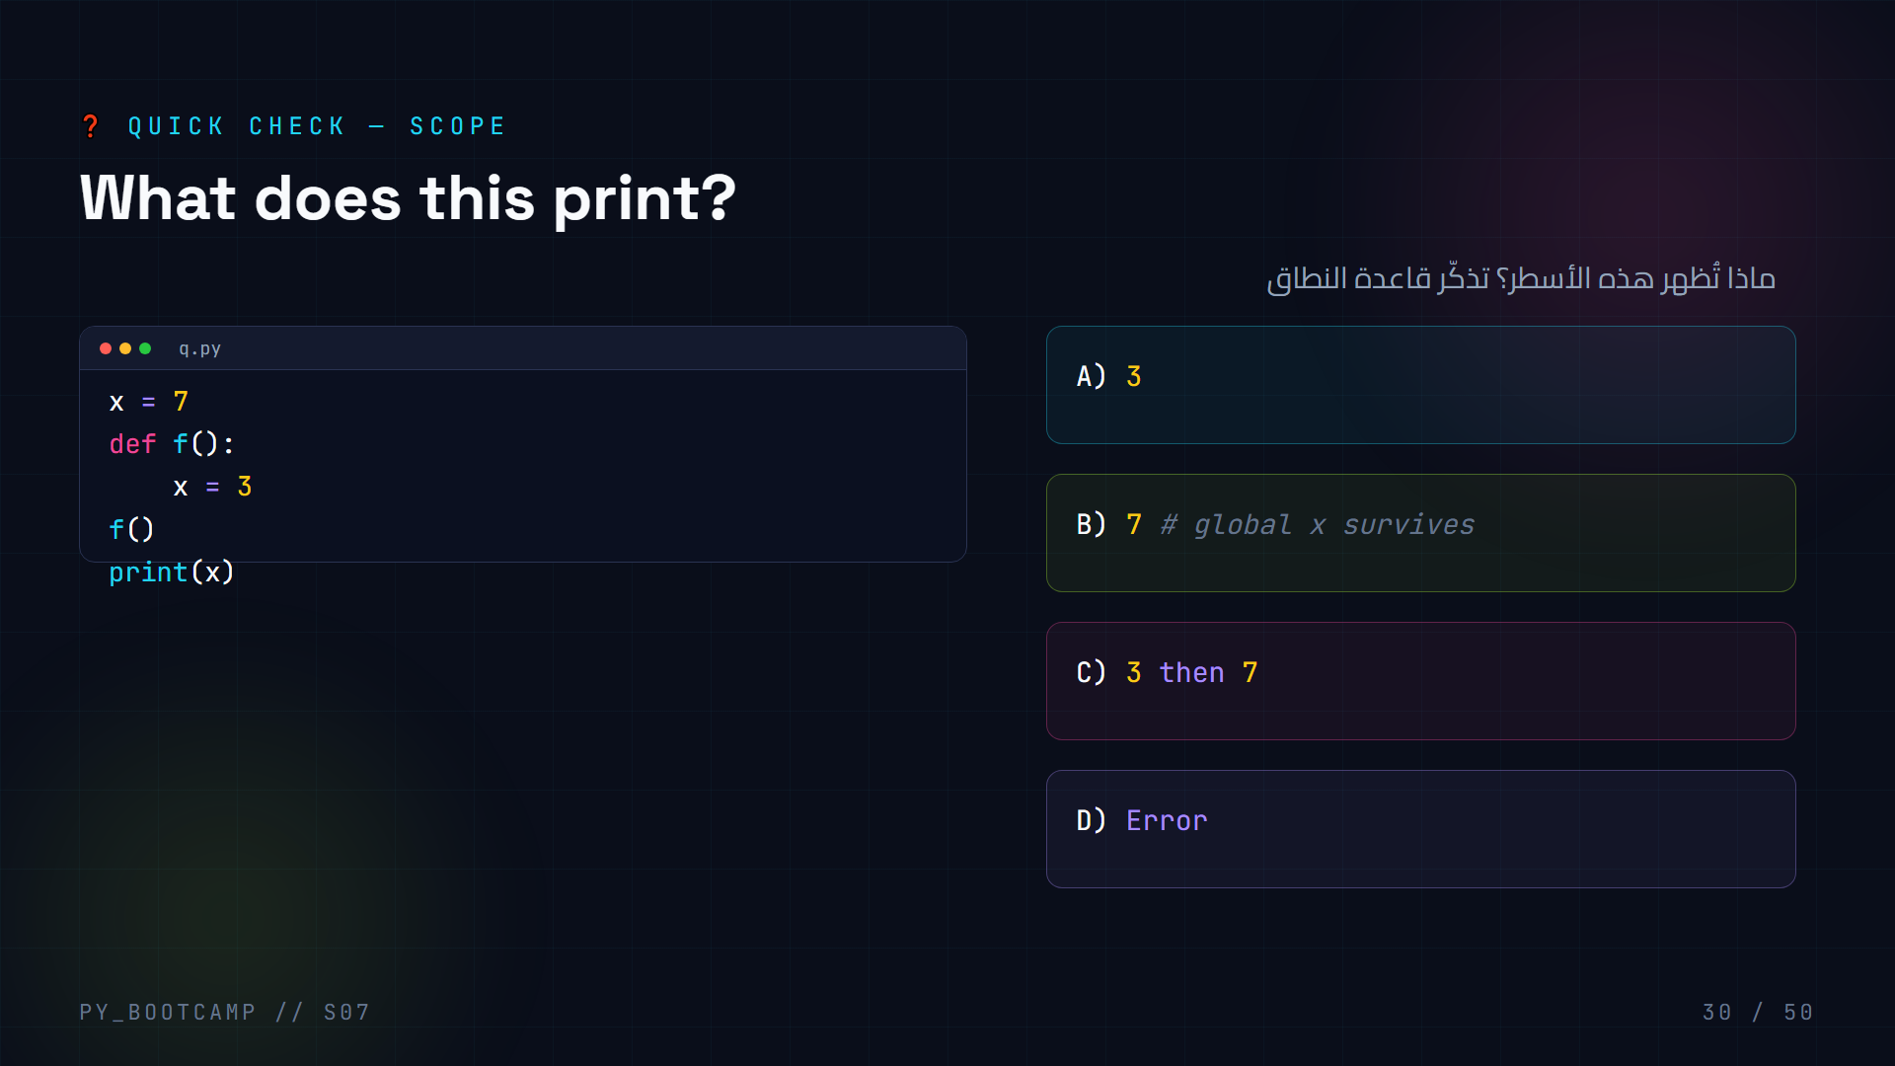
Notes:
- **Answer: B — 7.** f() creates a LOCAL x=3, then discards it; global x stays 7.
- print(x) outside sees the global.
- This exact pattern is the #1 scope gotcha — students answer C or A often.
- Have them explain using the "backpack vs whiteboard" analogy.
- If time: demo `global x` version briefly, warn it's rarely needed.
- Arabic tip: الدالة أنشأت نسخة داخلية لم تلمس النسخة الخارجية.

Slide 31
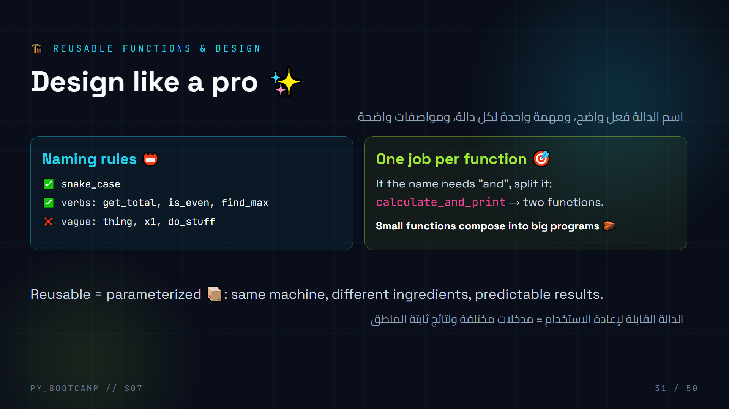
Notes:
- Read names aloud; students should hear the difference between get_total and x1.
- Style tip: verbs for functions (actions), nouns for variables (things).
- "If the function name contains 'and', split it" — memorable rule.
- Why it matters: teams read your code; future-you reads your code.
- Small challenge: rename 3 terrible function names students suggest.
- Arabic tip: الاسم الجيد = كود شبه موثّق بلا تعليقات.
- Transition: "Before the docs, meet the tiny one-line function: lambda."

Slide 32
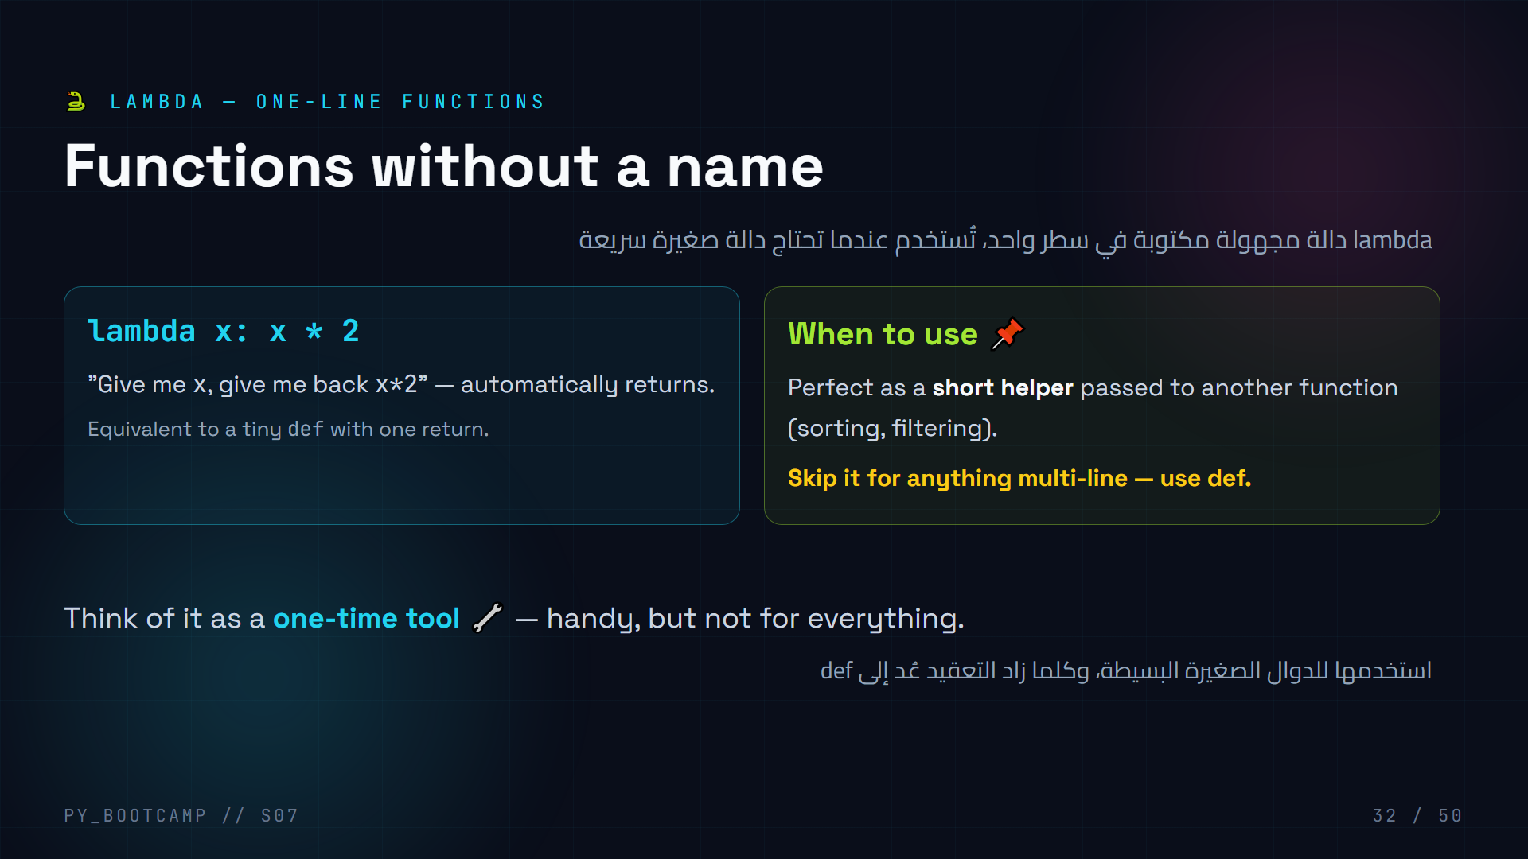
Notes:
- Read the lambda left to right: `lambda x : x * 2`.
- Emphasize: NO def, NO name, NO return keyword — it returns implicitly.
- When to prefer def: anything beyond a single expression.
- Common confusion: lambda is for when a function is passed as an argument.
- Have students write `lambda n: n + 1` from memory.
- Arabic tip: lambda = «دالة لمرة واحدة» — لا تحتاج اسمًا.
- Transition: "The classic use: sorting lists by a key."

Slide 33
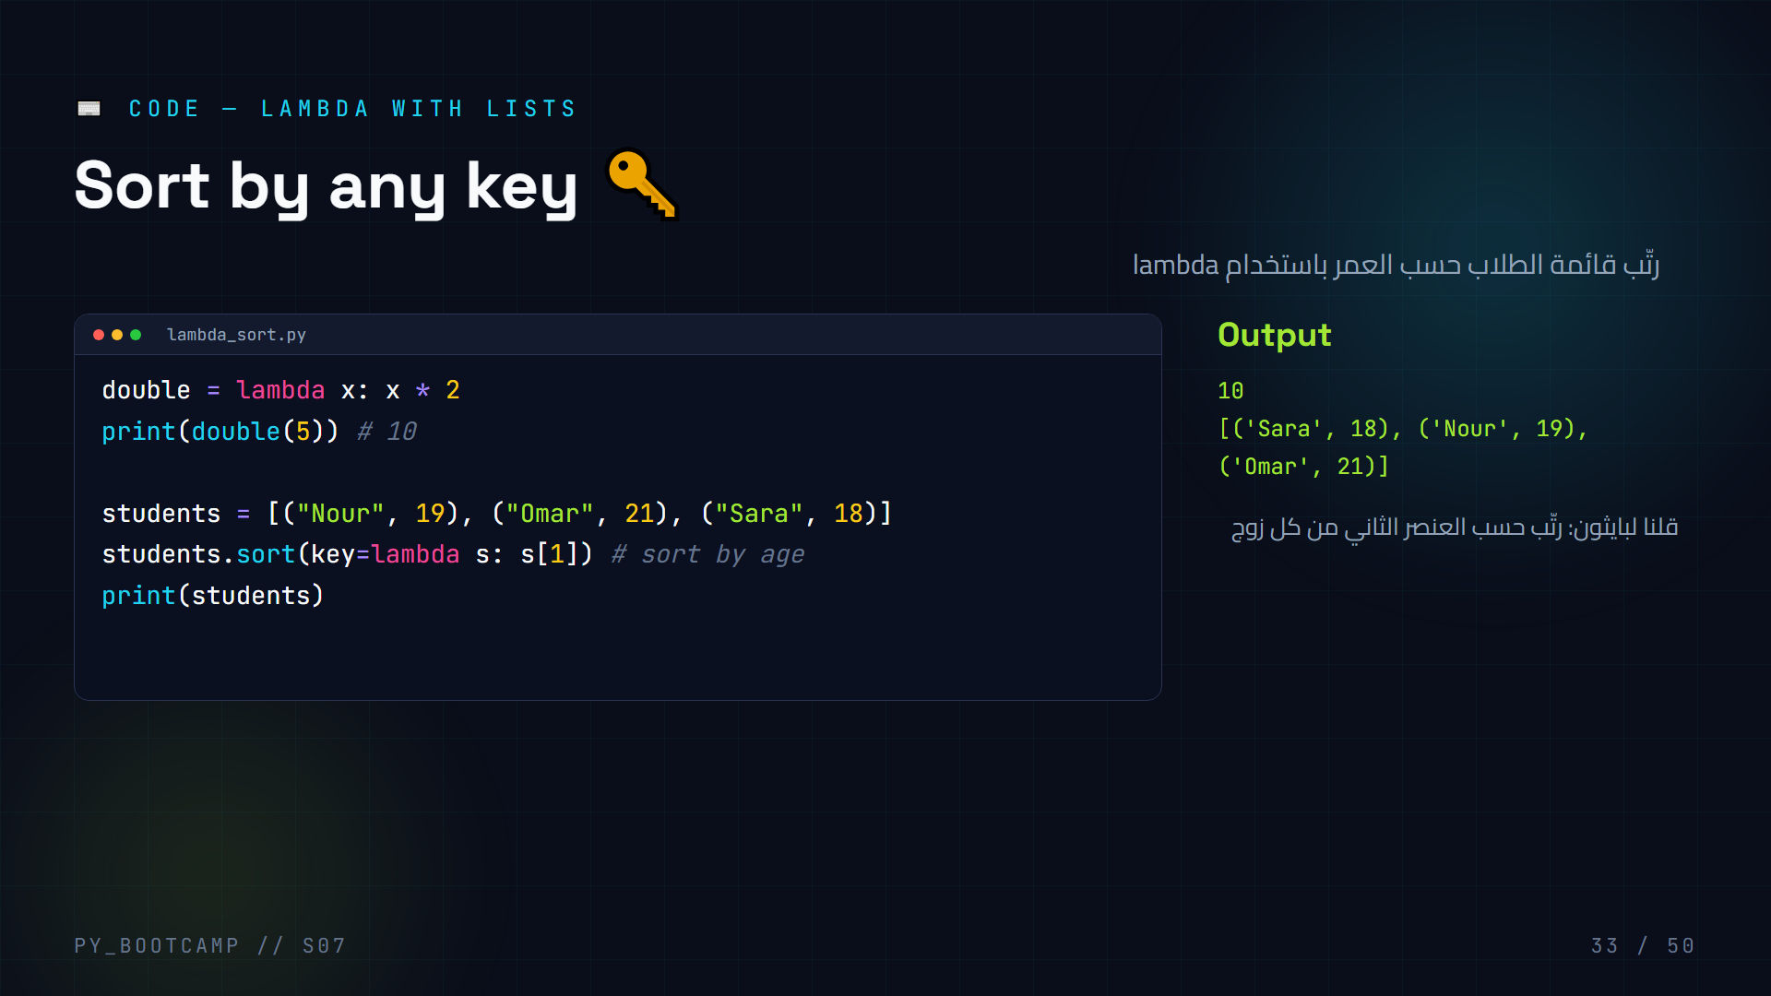
Notes:
- Explain key= : sort() asks "what value do we compare?" → the lambda answers.
- `lambda s: s[1]` → "for each student, use their age".
- Without key, sort() would compare tuples element-by-element (name first).
- Live demo: sort by name instead — `key=lambda s: s[0]`.
- Challenge: sort descending → add `reverse=True`.
- Arabic tip: key مثل «وفق ماذا ترتّب؟» — وهو السؤال الذي تجيبه lambda.
- Transition: "Next, document your functions properly."

Slide 34
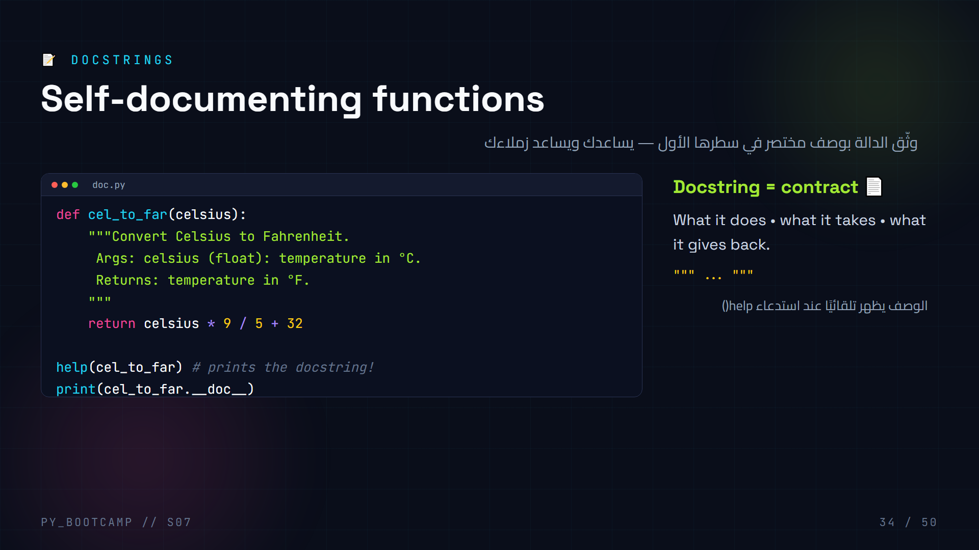
Notes:
- Docstring = the string right after def; Python stores it as __doc__.
- Live demo help(cel_to_far) — the interpreter prints the contract.
- Teach the mini-template: What / Args / Returns.
- Note: a docstring is NOT a comment — it's accessible at runtime.
- Best practice: every function you write today gets a one-line docstring.
- Arabic tip: التوثيق رسالة للآخرين (ولنفسك لاحقًا) — اشرح ماذا تفعل الدالة.
- Transition: "Now let's make functions work with real data: lists and dicts."

Slide 35
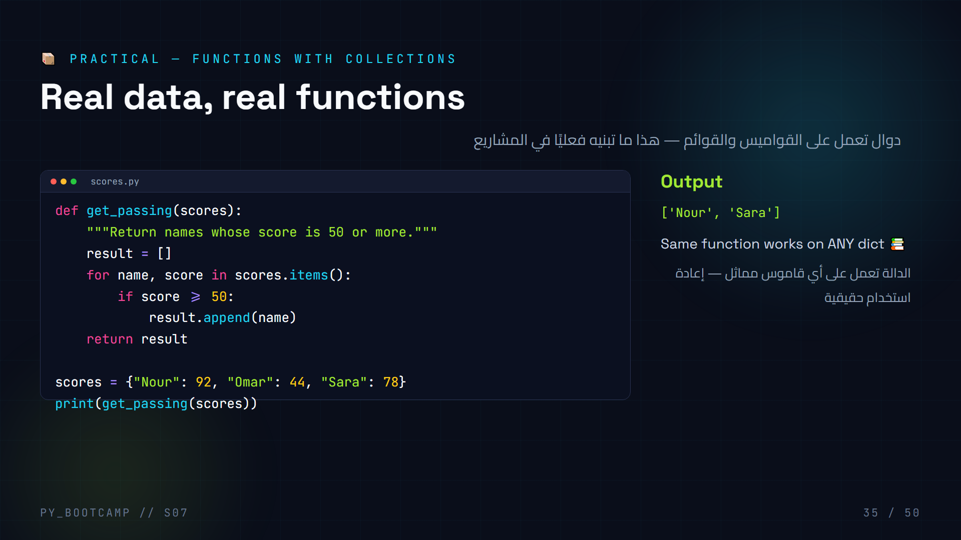
Notes:
- We now COMBINE: loops + dicts + conditionals + functions — the full toolkit.
- Walk the loop: dict.items() → (name, score) pairs; keep names that pass.
- Passing a dict into a function is normal — the function doesn't care who owns it.
- Challenge: add a parameter `minimum=50` so the caller sets the threshold.
- Predict: what if scores has 3 more students? Works unchanged.
- Arabic tip: الدالة تعمل على أي قاموس «مماثل» — هذا جوهر إعادة الاستخدام.
- Transition: "Predict this next output — stars meet defaults."

Slide 36
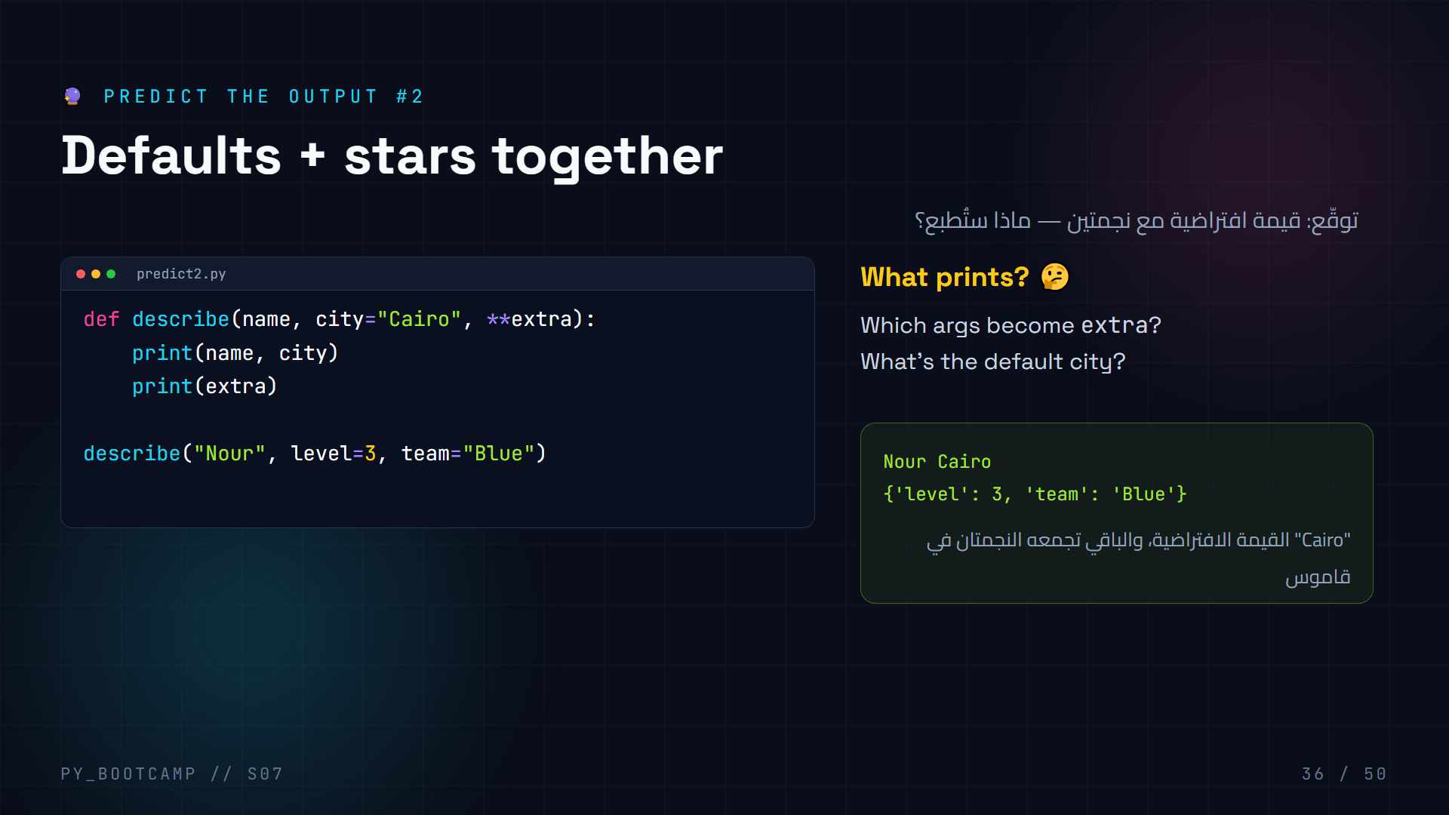
Notes:
- **Answer: "Nour Cairo" then {'level': 3, 'team': 'Blue'}.**
- Nour → name (positional); no city given → default "Cairo"; level/team → extra dict.
- Walk the matching logic: filled params get their args, leftover keywords → **extra.
- Common slip: students expect city to be something else or extra to be a tuple.
- Note: we used print, not return — the function prints and returns None.
- Arabic tip: القيم غير المطابقة تذهب تلقائيًا إلى **kwargs.
- Transition: "Enough reading — let's BUILD. Live coding time!"

Slide 37
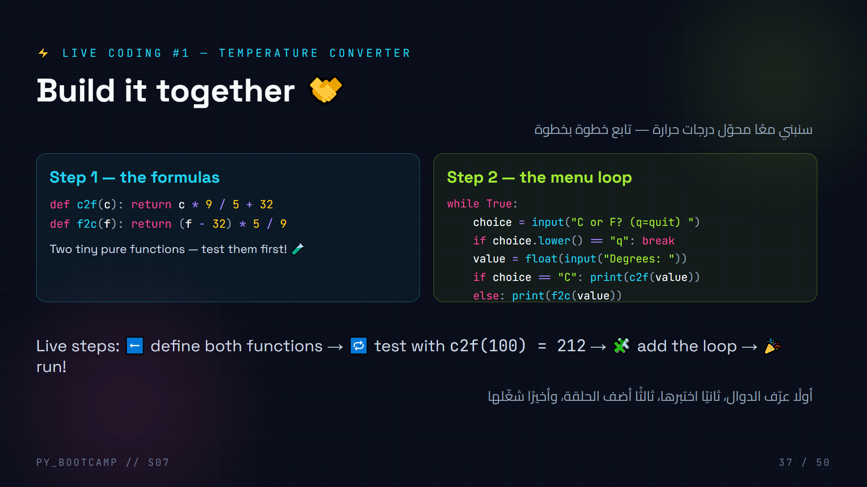
Notes:
- **Live-coding steps (type everything yourself):**
1. Write c2f and f2c; test c2f(100) → 212.0, f2c(32) → 0.0.
2. Add the while loop with input(); handle "q" to quit.
3. Run and let a student pick a conversion.
- Common mistakes to call out: forgetting float() (string errors), comparing "c" vs "C" (use .lower()).
- Extension: guard against invalid choice with an else message.
- Emphasize: we wrote the math ONCE and the loop reuses it.
- Arabic tip: تدرّج: اكتب دالة، اختبرها، ثم استخدمها — لا تكتب كل شيء دفعة واحدة.
- This becomes the pattern for the project.

Slide 38
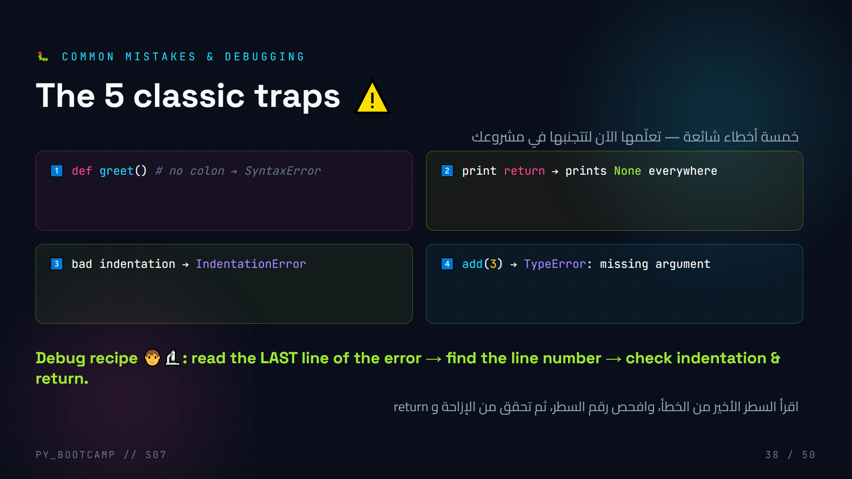
Notes:
- Make these TRAPS fun: "who can find the bug first" rounds.
- Read tracebacks aloud together — the LAST line is the real error.
- #2 is the classic: student prints instead of returns, gets None, is confused.
- Demo trap 4 live: TypeError message literally tells you what's missing.
- Add a bonus trap verbally: calling a function before defining it → NameError.
- Arabic tip: الخطأ ليس عدوًا — إنه رسالة إرشادية من بايثون.
- Transition: "Same recipe, bigger dish — guided practice with student data."

Slide 39
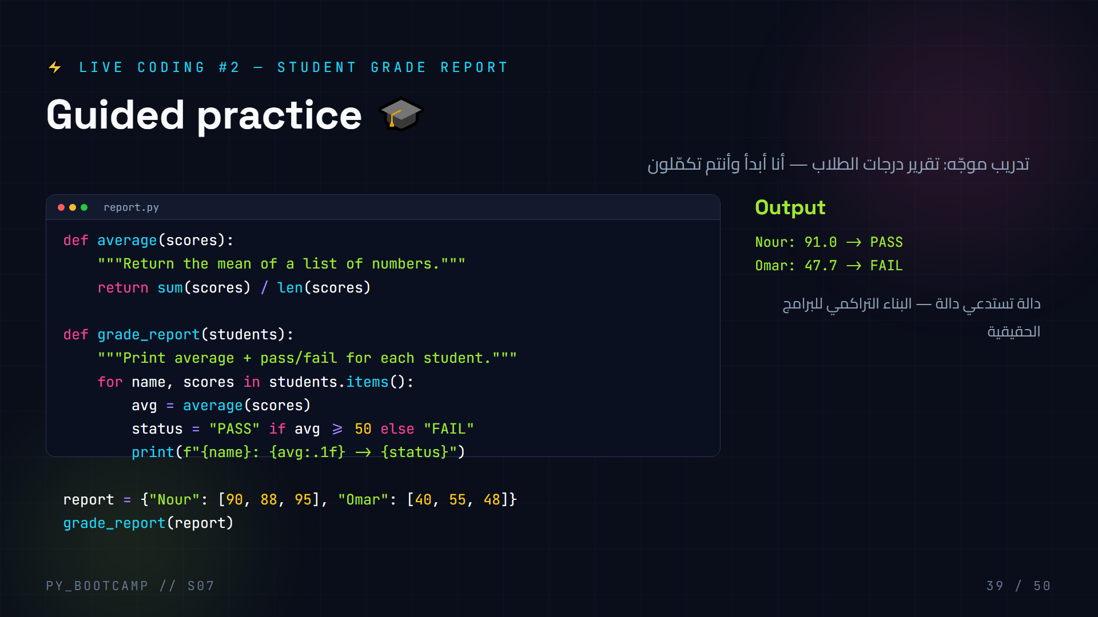
Notes:
- **Guided practice steps:** students write `average()` alone (1 min), then we build grade_report together.
- One function calling another = composability; average() is reusable.
- Point at `f"{avg:.1f}"` — format spec for one decimal.
- Prediction pause: "What average will Nour get? Omar?"
- Extension for strong students: letter grades (A/B/C) based on avg.
- Debug moment: what if a student has an empty score list → ZeroDivisionError (len=0).
- Arabic tip: الوظيفة الكبيرة تُبنى من وظائف صغيرة — البناء التراكمي.
- Transition: "Now the final boss: the Modular Calculator project."

Slide 40
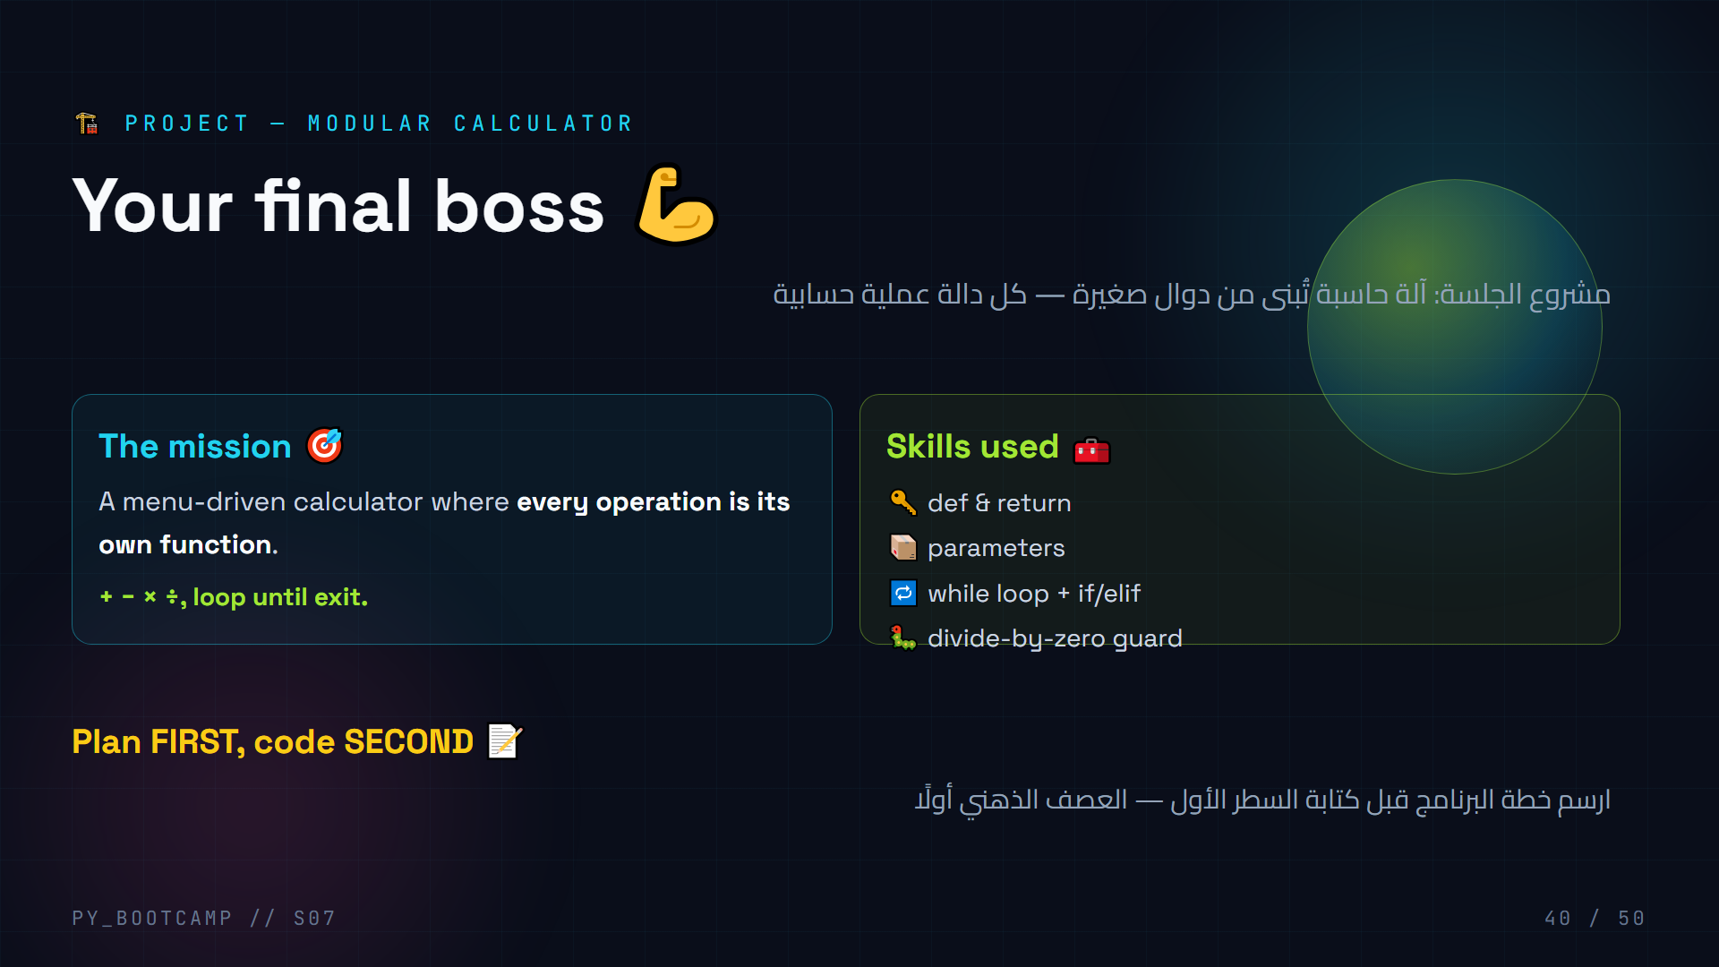
Notes:
- Introduce the project with energy — "final boss of today".
- Have students WRITE the plan before coding: functions needed, menu structure.
- Expected plan: add, subtract, multiply, divide + a main loop with menu.
- Emphasize: this is exactly how real calculators/CLI tools are structured.
- Give 20 minutes; circulate and help with divide-by-zero logic.
- Arabic tip: قبل البرمجة اسأل نفسك: ما الدوال التي أحتاجها؟ ثم اكتب القائمة.
- Transition: "Code part 1 — the operation functions."

Slide 41
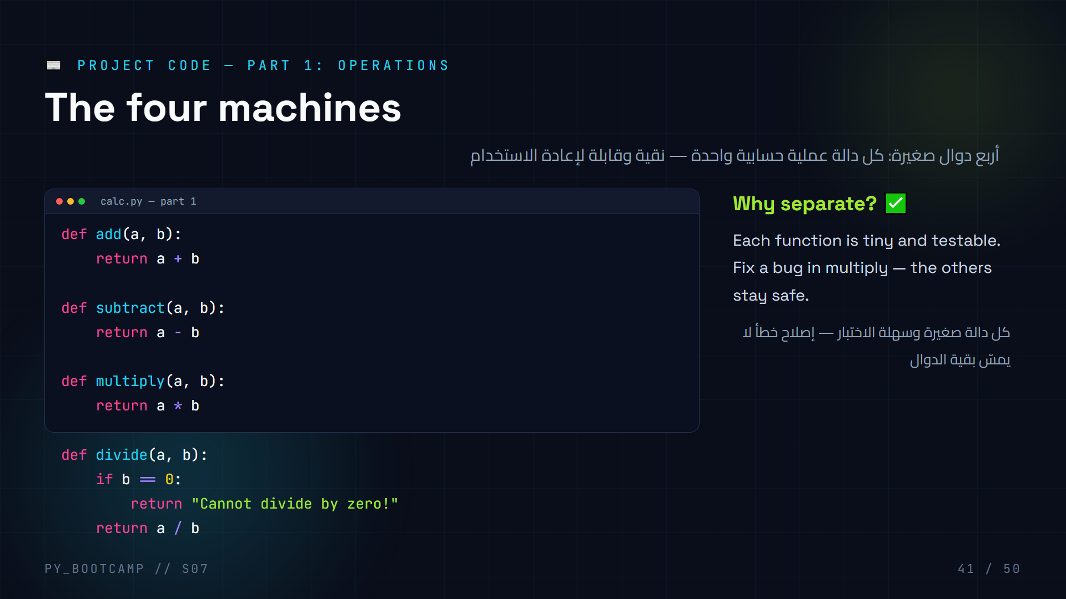
Notes:
- Students type part 1 themselves; circulate to check indentation.
- Emphasize `return` — these are PURE functions, they give values back.
- Highlight the divide() guard: returns a friendly string instead of crashing.
- Test together: add(3, 4) → 7; divide(10, 0) → "Cannot divide by zero!".
- Arabic tip: الدوال النقية تُرجع القيمة ولا تطبعها — سنطبع في القائمة.
- Transition: "Part 2 wires these machines into a menu."

Slide 42
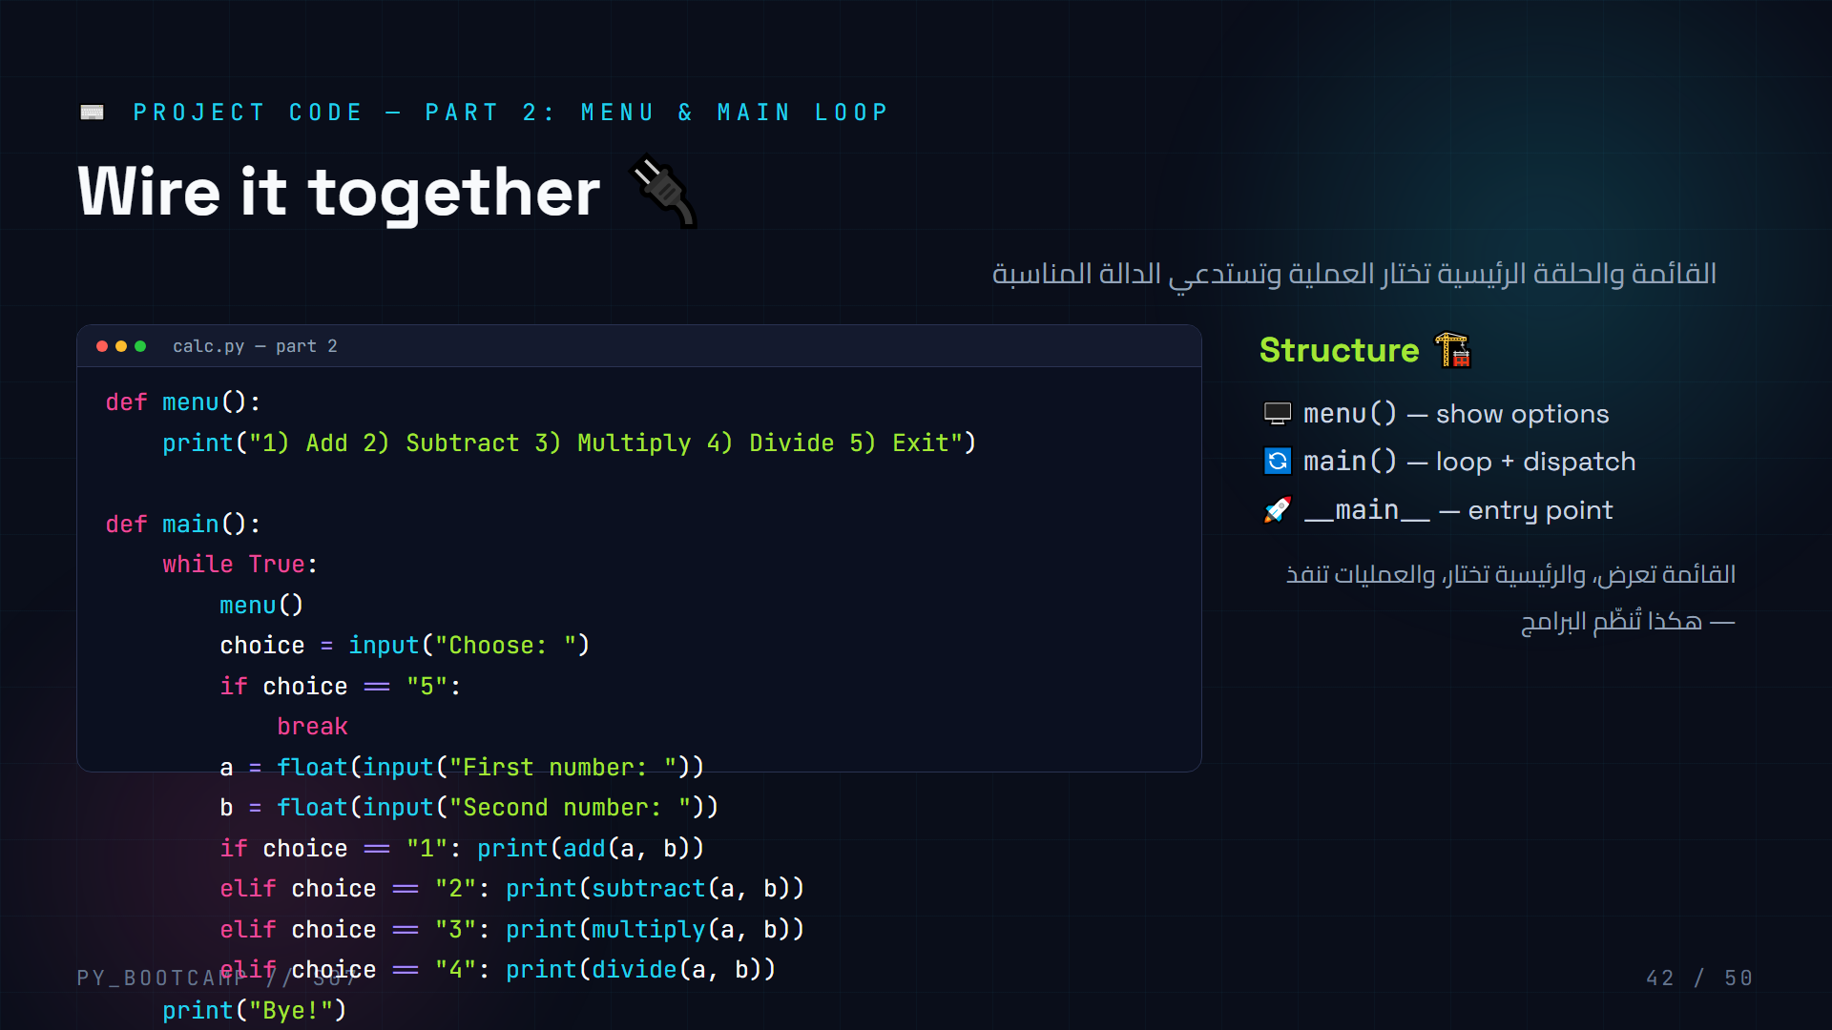
Notes:
- Type part 2 live; students follow. Pause at `__name__ == "__main__"` — brief explanation, it runs main() when the file is executed directly.
- The if/elif chain DISPATCHES to the right function based on choice.
- Common bugs: comparing choice to int instead of string "1"; forgetting float().
- Challenge: add an `else` that says "Invalid choice".
- Notice: operations return, main prints — separation of concerns.
- Arabic tip: القائمة تعرض، الرئيسية تختار، والعمليات تنفذ — هكذا تُنظّم البرامج.
- Transition: "Let's see it run — our calculator is alive!"

Slide 43
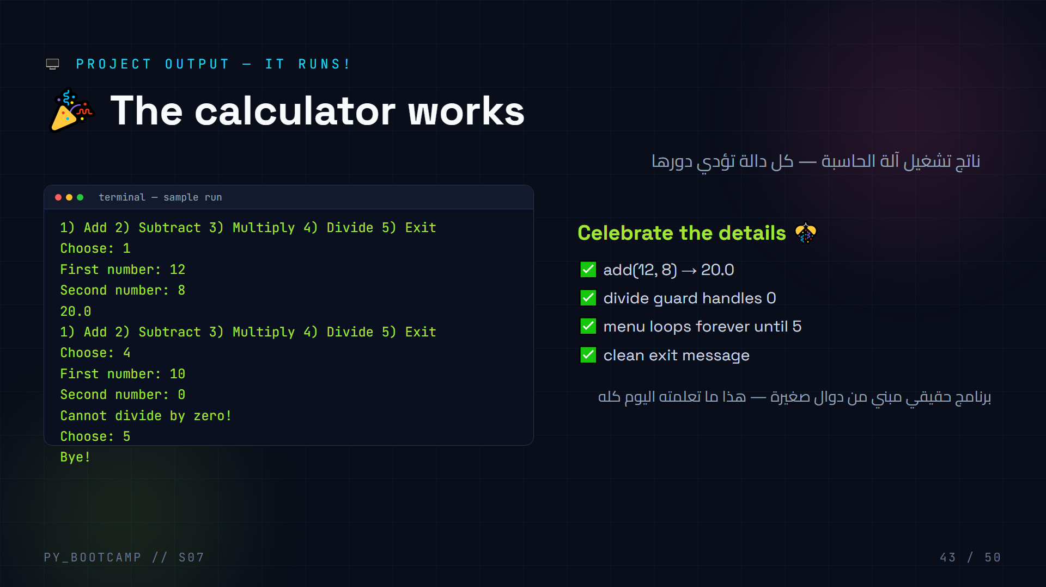
Notes:
- Run the finished program live — celebrate every working branch.
- Point at each output line and which function produced it.
- Have a volunteer try to break it: divide by zero → guard message.
- Discuss the program flow: loop → menu → input → dispatch → print.
- This is the proof: functions made the program modular and readable.
- Arabic tip: كل خطوة في هذا الناتج تقابل دالة أو فرعًا كتبناه — اربط الاثنين.
- Transition: "Time to train on your own — exercises."

Slide 44
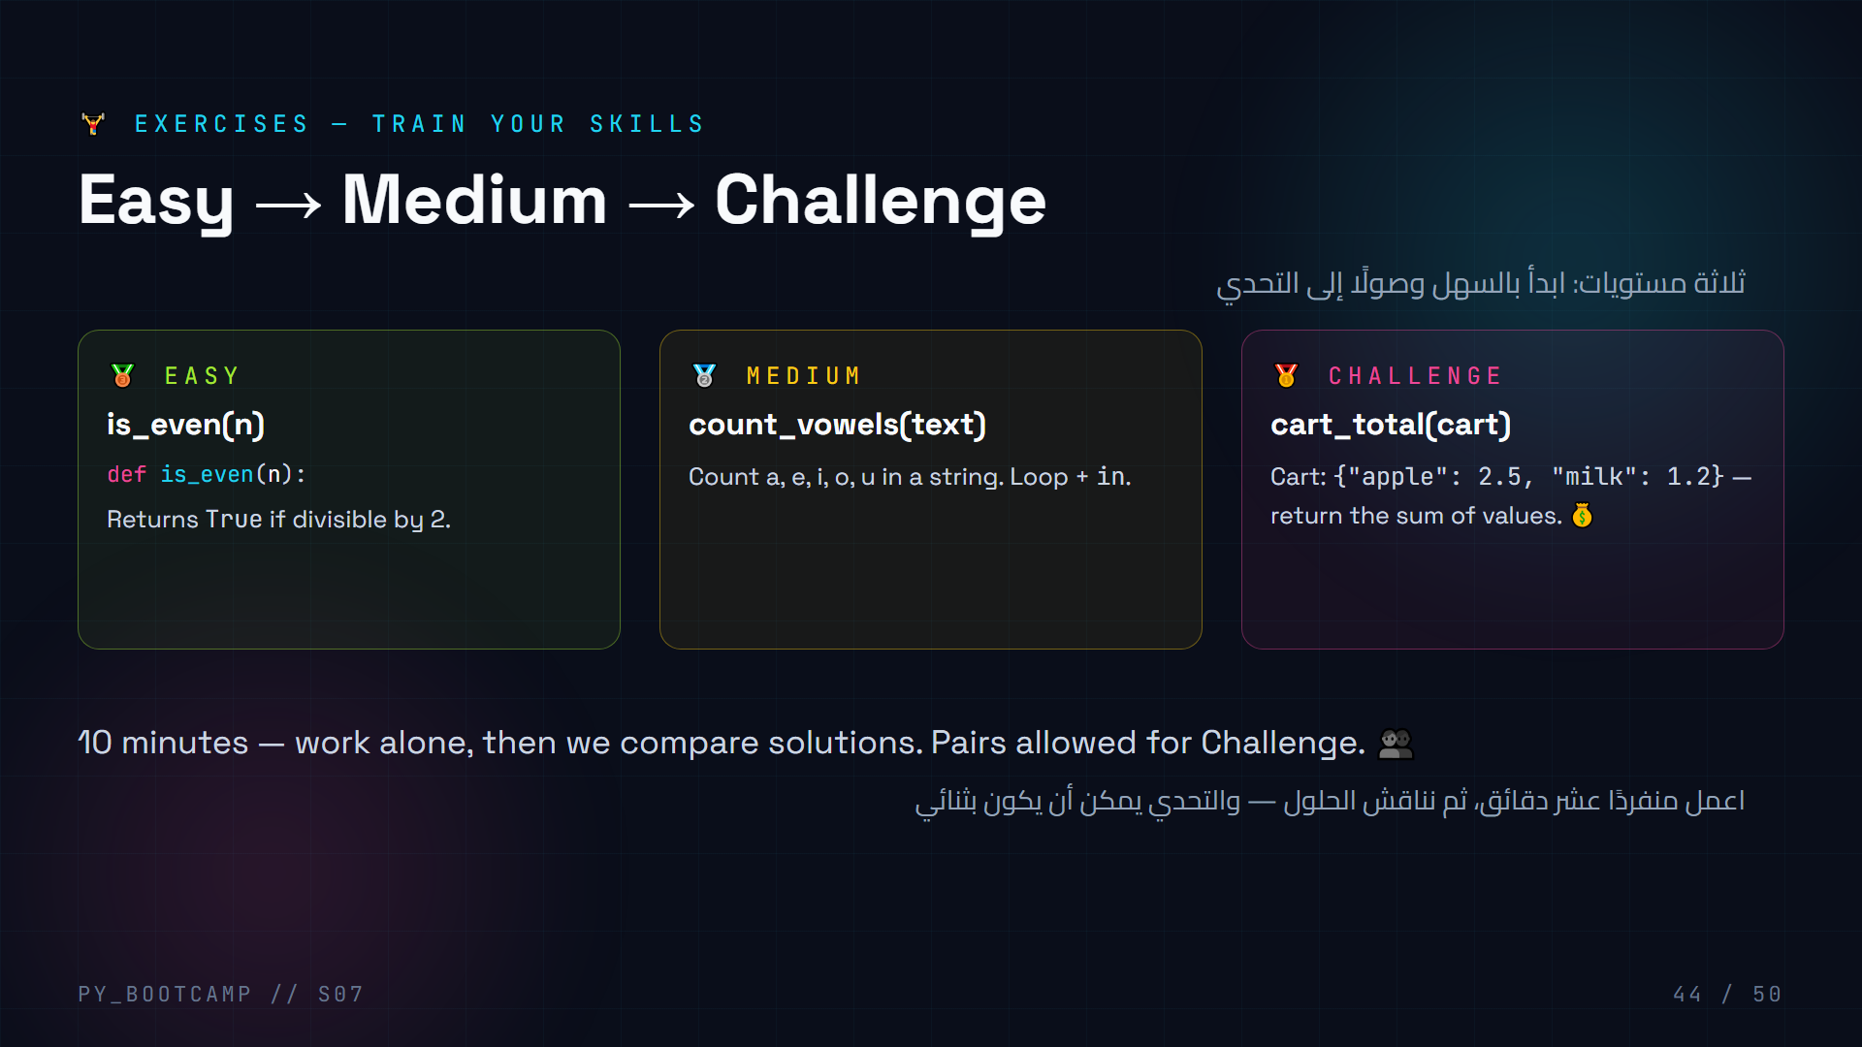
Notes:
- Set a 10-minute timer; encourage starting at Easy even for strong students.
- Solutions:
- Easy: `def is_even(n): return n % 2 == 0`
- Medium: `def count_vowels(t): return sum(1 for ch in t.lower() if ch in "aeiou")` — or a loop version.
- Challenge: `def cart_total(c): return sum(c.values())`
- Pause and have 2–3 students share approaches; celebrate alternative solutions.
- Common slip on Medium: uppercase vowels — mention `.lower()`.
- Arabic tip: لا تنسَ الحروف الكبيرة عند عدّ الحروف المتحركة.
- Transition: "Tonight's homework builds on these muscles."

Slide 45
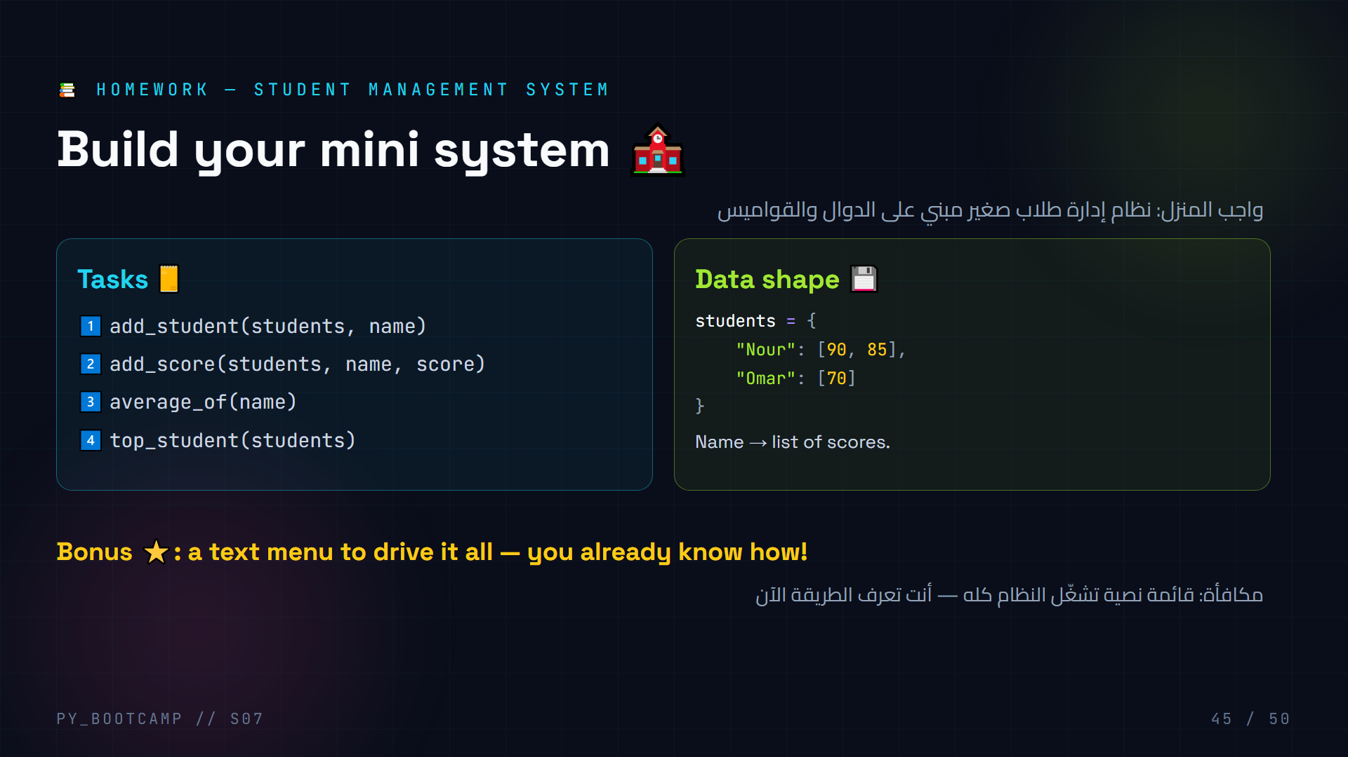
Notes:
- Homework = the project pattern applied to a student database.
- Walk the data shape: dict of name → list of scores.
- Tips: top_student compares averages; use .get() for missing names.
- Suggest they reuse average() from live coding.
- Expected solutions:
- add_student: `students.setdefault(name, [])` or `if name not in students: students[name] = []`
- average_of: `sum(scores)/len(scores)`
- top_student: loop through students, track max average.
- Deadline: next session. Encouragement: this is portfolio material.
- Arabic tip: نفّذ الوظائف واحدة واحدة واختبرها قبل الانتقال للتالية.
- Transition: "Final quiz — prove your mastery!"

Slide 46
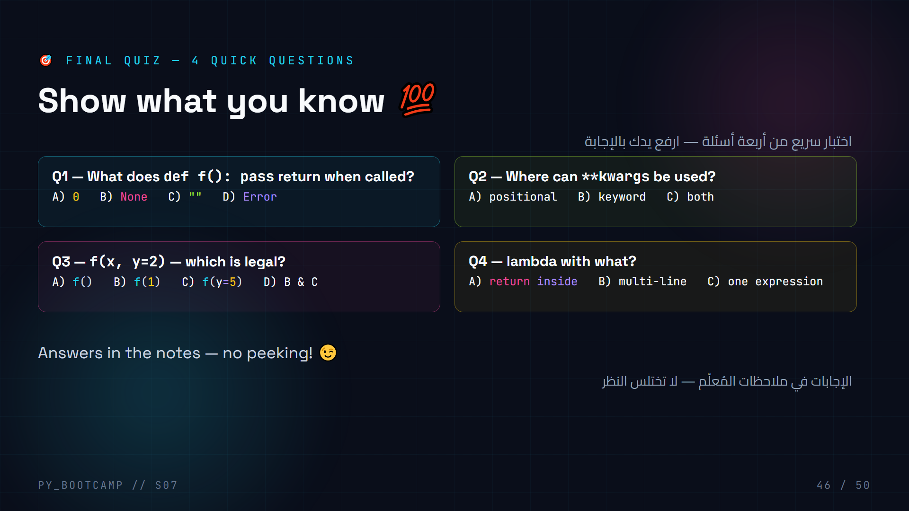
Notes:
- **Answers: Q1-B (None), Q2-B (keyword args only), Q3-D (f(1) and f(y=5); f() fails because x is required), Q4-C (one expression).**
- Run as a quick hands-up poll; correct together with explanations.
- Q1: functions without return return None by default.
- Q2: *args = positional, **kwargs = keyword — mixing the two is a classic slip.
- Q3: y has a default but x doesn't, so f() fails.
- Q4: lambda is a single expression — that's its limit.
- Award a shout-out for perfect scores; review any missed concept right away.
- Arabic tip: اشرح إجابة كل سؤال بمثال مصغّر حتى يفهمها الجميع.
- Transition: "Let's lock it all in with a recap."

Slide 47
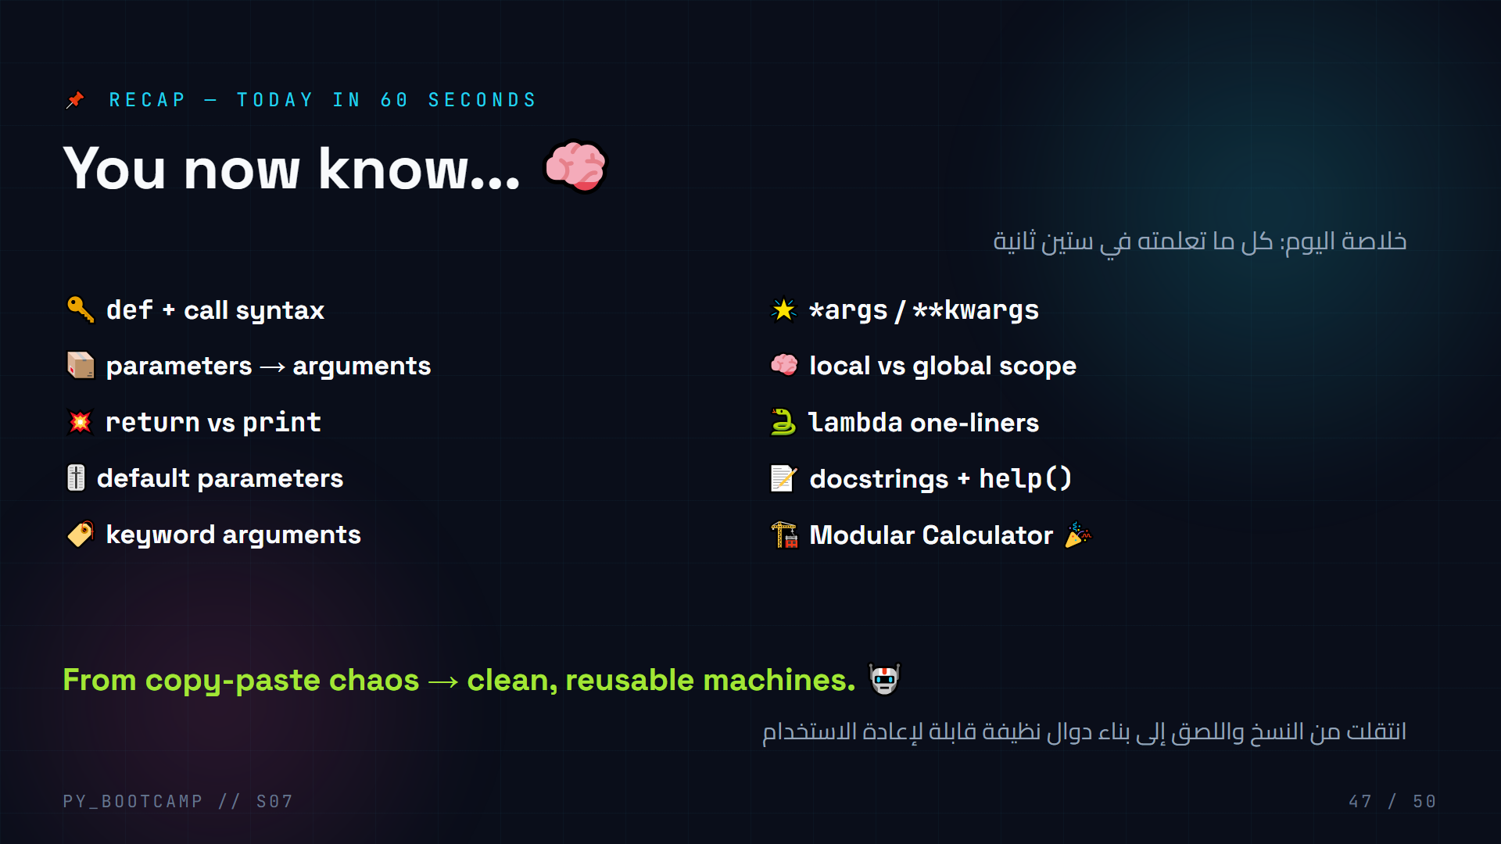
Notes:
- Rapid-fire recap: read each line, students shout "got it!" or ask.
- Connect back to the hook: the receipt problem is now a function.
- Ask for one "aha" moment from today — share 2–3 out loud.
- Reinforce that the Modular Calculator used EVERY concept on this slide.
- Arabic tip: اطلب من طالب أن يلخص «الدرس الأكبر» بكلمة واحدة.
- Transition: "Next session, your functions meet files and JSON."

Slide 48
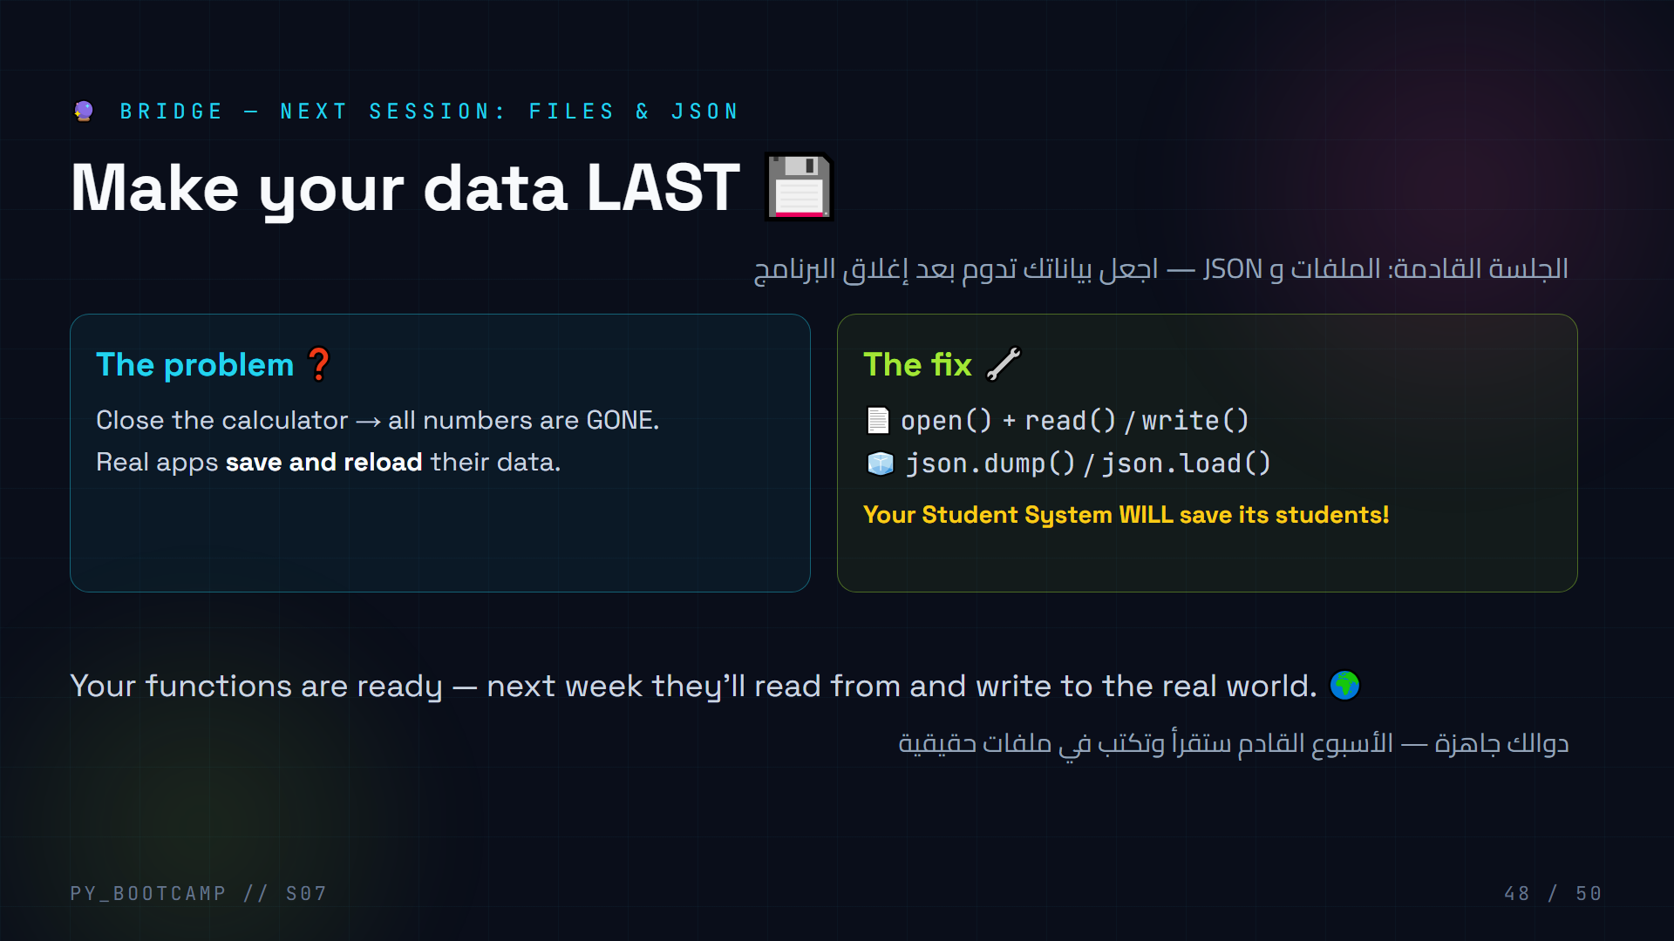
Notes:
- Bridge with curiosity: "What happens to your calculator's numbers when you close it?"
- Ask: "Which apps save data?" — games, notes, social media → all files + JSON.
- Tease a concrete win: their homework system will save students between runs.
- Preview only — no file syntax yet, just the payoff.
- Arabic tip: الملفات هي «الذاكرة طويلة الأمد» للبرامج.
- Encourage: bring your homework solution to extend it next session.
- Transition: "Wrap-up time — you earned this."

Slide 49
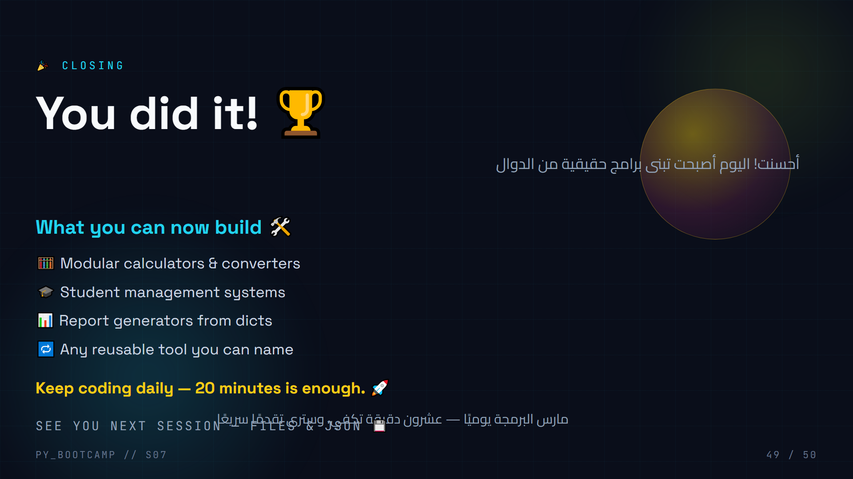
Notes:
- Closing energy: congratulations, applause.
- Ask each student to name ONE thing they'll build this week.
- Reiterate: practice beats theory — 20 minutes daily.
- Remind about homework: Student Management System, due next session.
- Hand out a "certificate" moment: everyone who ran the calculator passes today's mission.
- Arabic tip: امدح كل من أكمل المشروع — المكافأة المعنوية مهمة.
- Transition: "One last gift — your cheat sheet. Save it!"

Slide 50
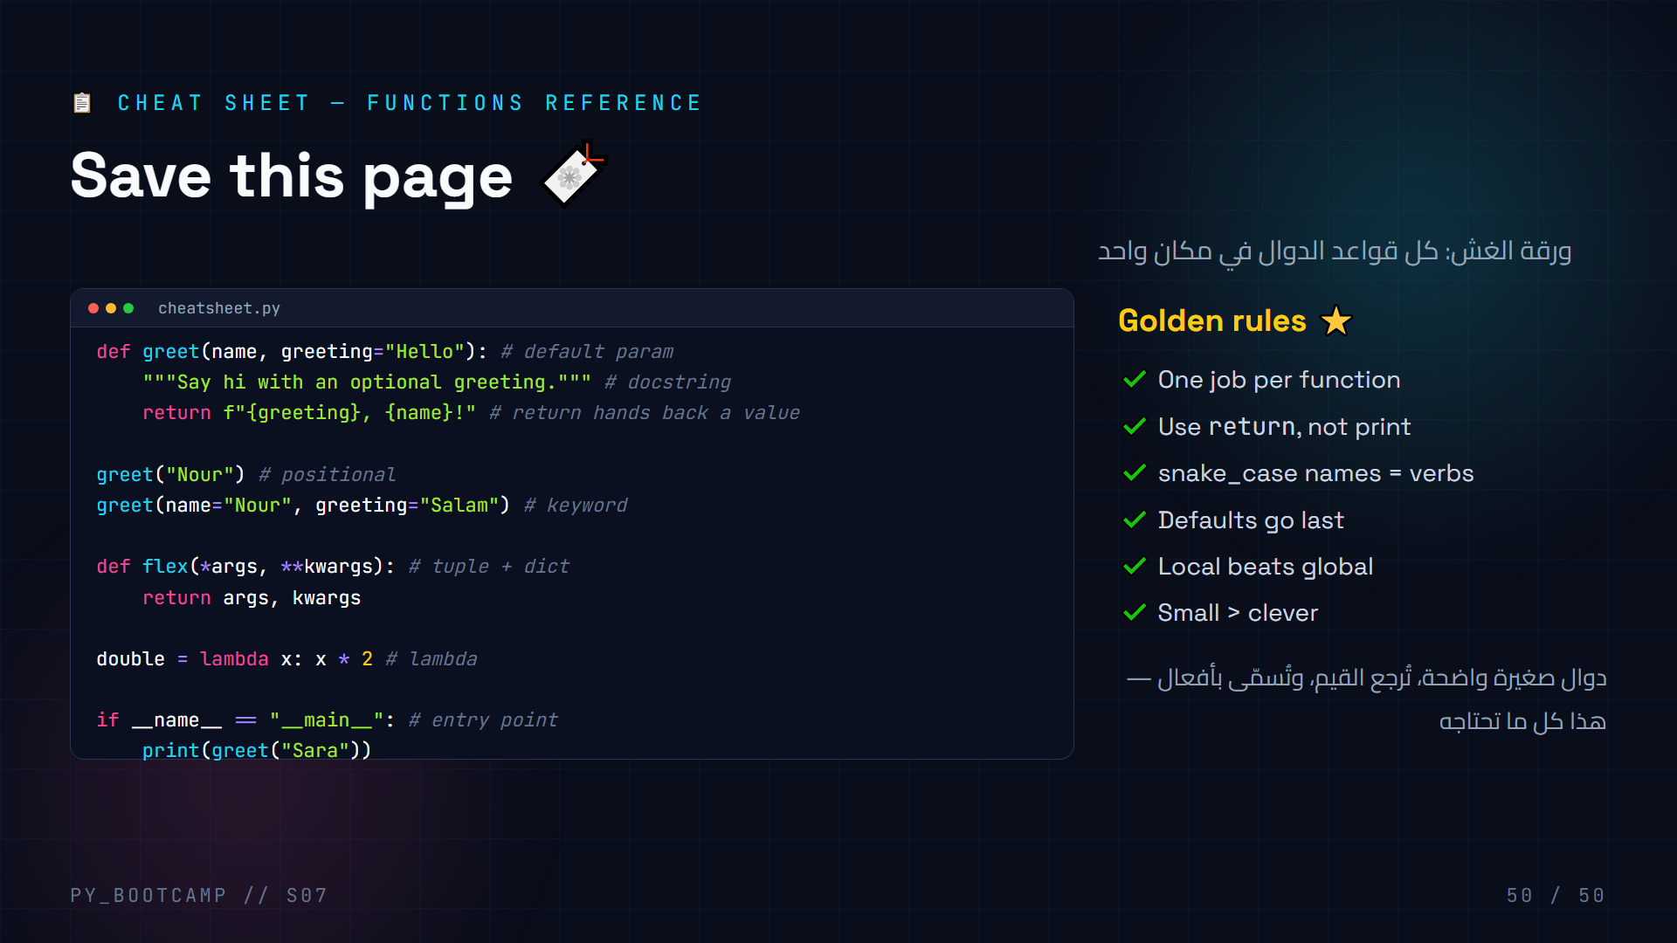
Notes:
- Have students save/screenshot this slide — it's the reference for homework.
- Quick run-through of each line, pointing to the concept it demonstrates.
- Note the `flex(*args, **kwargs)` line uses tuple unpacking knowledge from earlier.
- Remind: `__main__` guard makes the file importable AND runnable.
- Final question time: clear any remaining doubts before they leave.
- Arabic tip: شجّعهم على تعليق هذه الورقة أمام شاشتهم أثناء حل الواجب.
- End on motivation: "See you next session for Files & JSON — build something great this week!"

