Slide 1
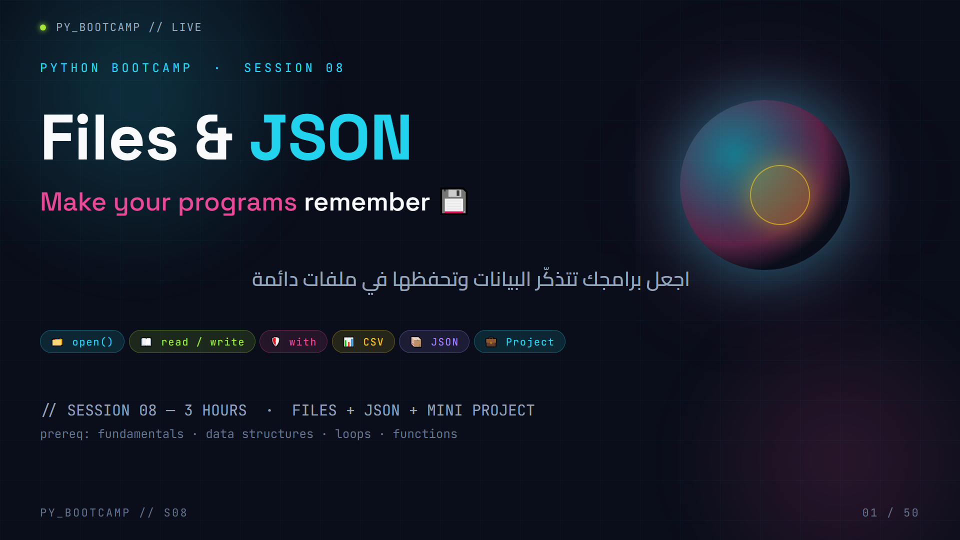
Notes:
**Cover — 2 min.**
Say: "Welcome back, bootcamp! Today we turn scripts into *real software* — software that remembers."
- Open with the money line: "Everything you've built so far is wiped the second the program closes. Today we fix that."
- Walk the chips: open(), read/write, with, CSV, JSON, and a full mini project.
- Mention this is a 3-hour session and that by the end they'll have a notes manager that survives restarts.
Arabic tip: Read the Arabic subtitle aloud — «اجعل برامجك تتذكّر البيانات» (make your programs remember data). Ask them to guess what "persistence" means before you reveal it.

Slide 2
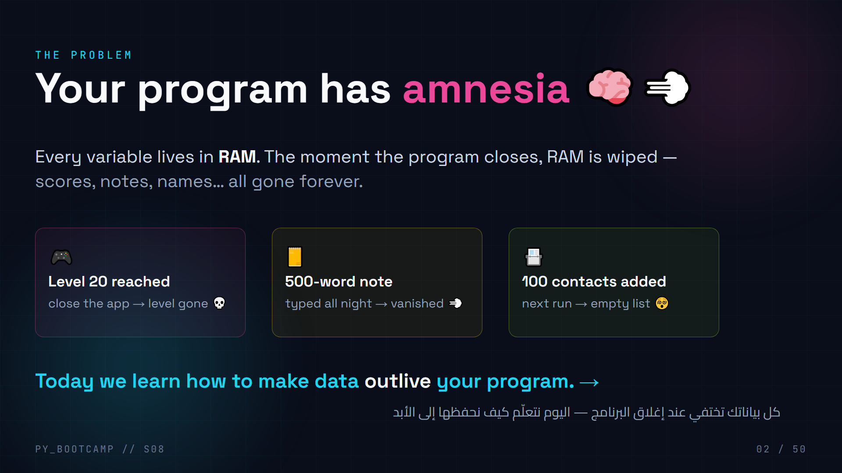
Notes:
**Hook — 5 min.**
Tell three short stories that happened "to your friend": a game losing a save, a note lost, contacts wiped. Let students groan — that groan is the motivation.
- Ask: "Has anything like this ever happened to you?" (games saves are the universal answer).
- Write on the board: RAM = memory of a goldfish. Disk = memory of an elephant.
- End with the promise: "By the end of today your programs will have an elephant's memory."
Arabic tip: say «الذاكرة تُمحى» (memory is wiped) and «الملف يبقى» (the file stays). Get them to repeat the pair.

Slide 3
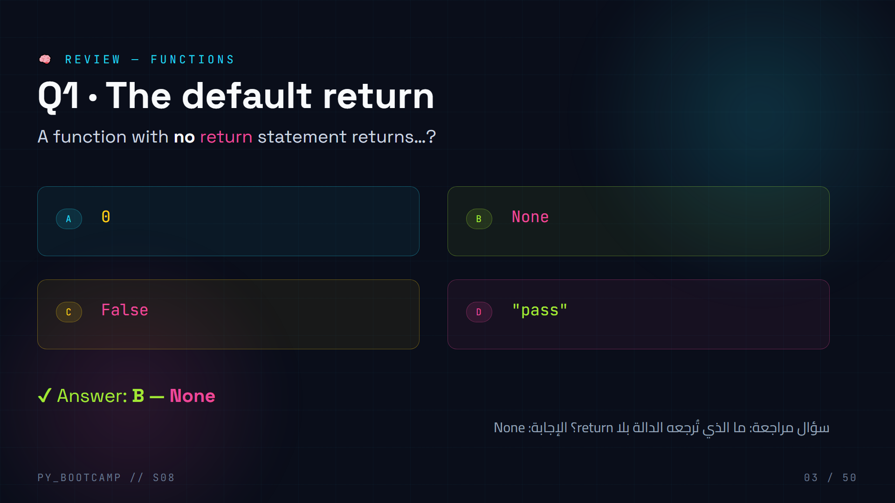
Notes:
**Review MCQ 1 — 2 min.**
`def greet(name): print("hi")` → calling `x = greet("Nour")` → `x is None`.
- Common mistake: students think a function that only prints returns nothing special, but Python *always* returns something — the default is `None`.
- Quick rule: no `return` → `None`.
- Arabic tip: «الوظيفة بلا return تُرجع None» — say it twice, students repeat.

Slide 4
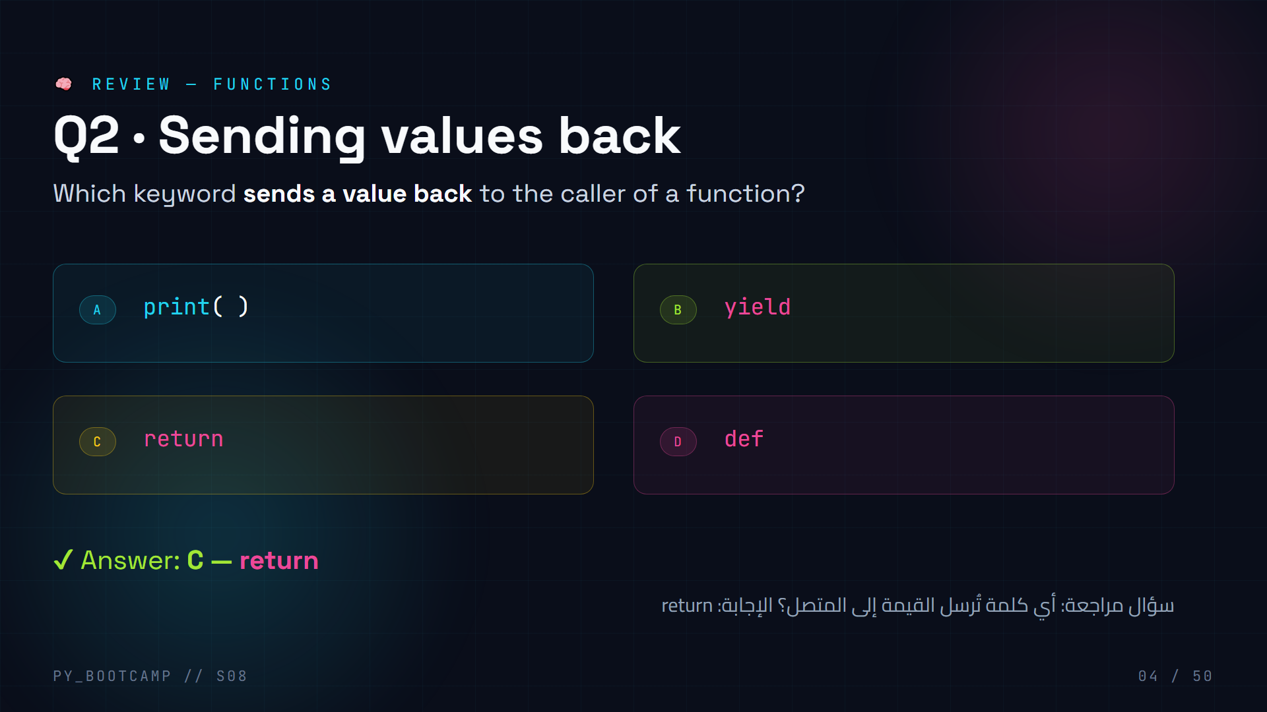
Notes:
**Review MCQ 2 — 2 min.**
`return` is the only way a function hands a value back to its caller (print only displays it).
- Clarify the classic trap: `print` shows text, `return` gives a value you can store in a variable. `yield` is for generators — not needed yet.
- Follow-up: `result = add(2,3)` → `result` holds `5` because `add` used `return`.
- Arabic tip: «return يُرجِع القيمة، print يَعرض فقط».

Slide 5
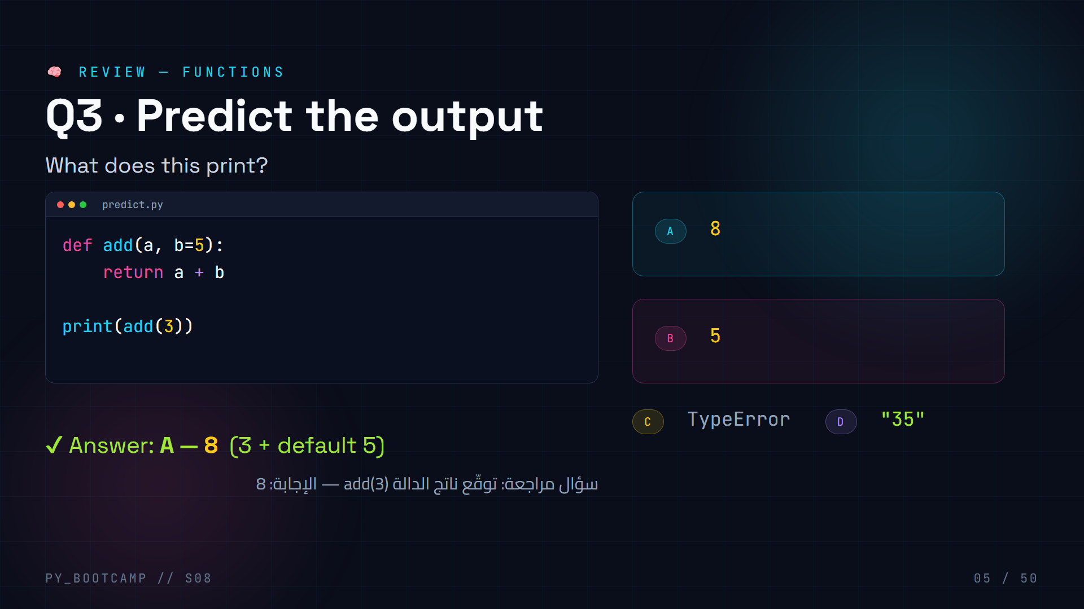
Notes:
**Review MCQ 3 — 2 min.**
`add(3)` uses the default `b=5`, so `3 + 5 = 8`.
- Common mistake: students answer `35` thinking string concatenation — but both are ints, so it's arithmetic.
- Reinforce default parameter idea: it kicks in when the argument is missing.
- Arabic tip: «المُعامل الافتراضي يُستخدَم إذا لم تُمرَّر قيمة».

Slide 6
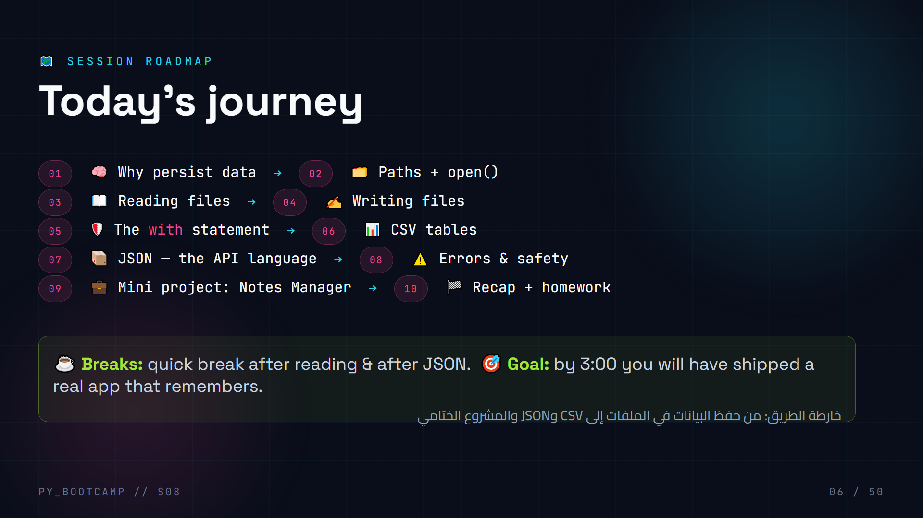
Notes:
**Timeline — 3 min.**
Set the pace and expectations for a 3-hour session.
- Show the 10 stops. Point out the two big "aha" moments: `with` (safety) and JSON (the API language).
- Give the break plan and the end-goal ("you will have shipped a real app").
- Encourage: today has 2 live-coding blocks and 1 mini project — keyboards down while they watch, up when they type.
- Arabic tip: read the roadmap heading «خارطة الطريق» and point at the arrow between stops.

Slide 7
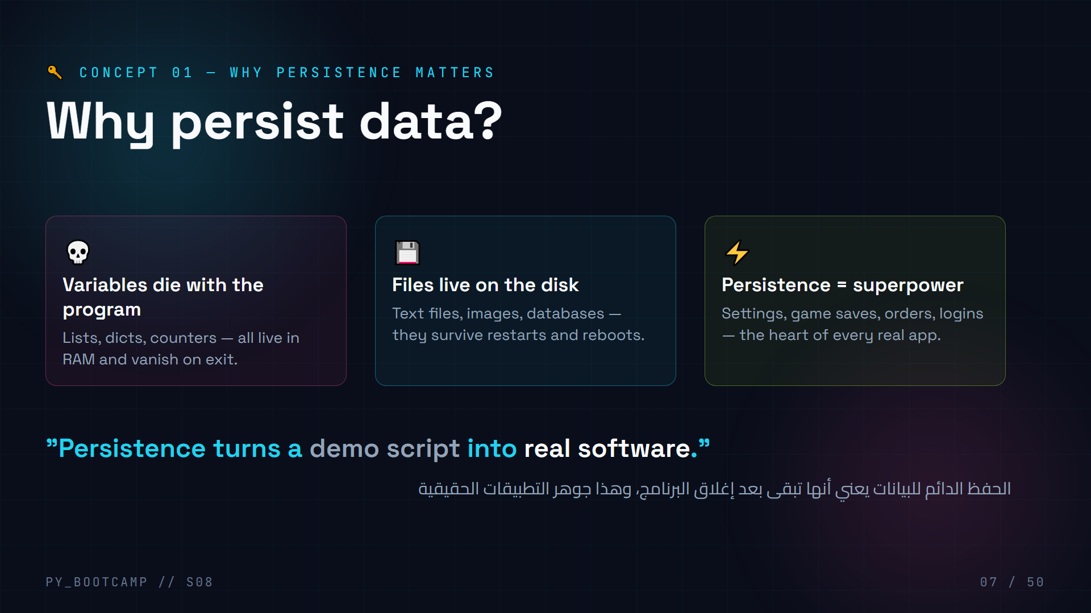
Notes:
**Why persistence matters — 5 min.**
- Contrast: a variable is a post-it note; a file is a notebook. Close the program → post-its fly away, the notebook stays.
- Ask for real apps they use that MUST remember: WhatsApp chats, game saves, Instagram likes.
- Reframe: everything they built in sessions 1–7 forgot everything. Today = memory.
- Arabic tip: «البيانات تبقى بعد إغلاق البرنامج إذا حُفظت في ملف» — repeat and have them say "persistence".

Slide 8
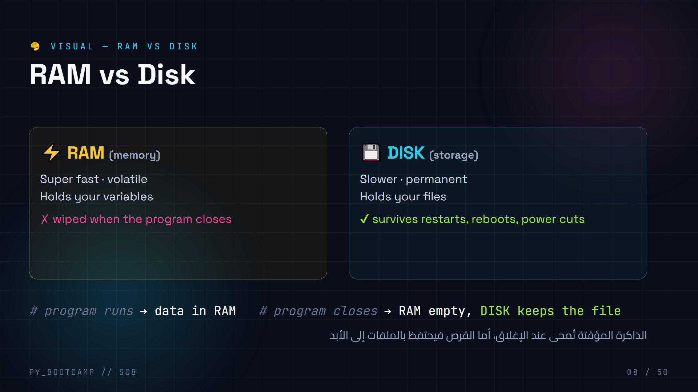
Notes:
**RAM vs Disk visual — 4 min.**
- Draw the life-cycle: run → read file from disk into RAM → work → write back to disk → close. Without step 3, data is lost.
- Analogy: RAM is a whiteboard, disk is your notebook. You copy homework from the whiteboard into the notebook *before* the class ends.
- Common misunderstanding: "why not keep everything in RAM?" → because RAM is expensive and volatile.
- Arabic tip: «الذاكرة عشوائية، القرص دائم» (RAM is random/volatile, disk is permanent).

Slide 9
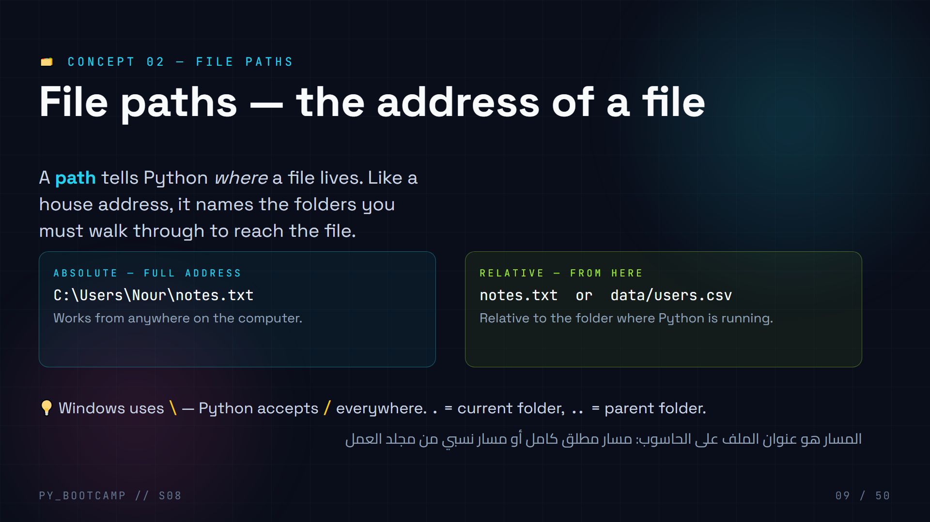
Notes:
**File paths — 5 min.**
- Ask: "How do you tell a friend where your house is?" Either the full country→street address (absolute) or "from school, walk 2 blocks" (relative). Same idea.
- Emphasize: most bootcamp work uses relative paths — the file sits next to your `.py`.
- Note the backslash gotcha: on Windows prefer `/` in Python strings so you don't need double backslashes.
- Arabic tip: «المسار هو عنوان الملف» — have them translate "absolute" and "relative" back to you.

Slide 10
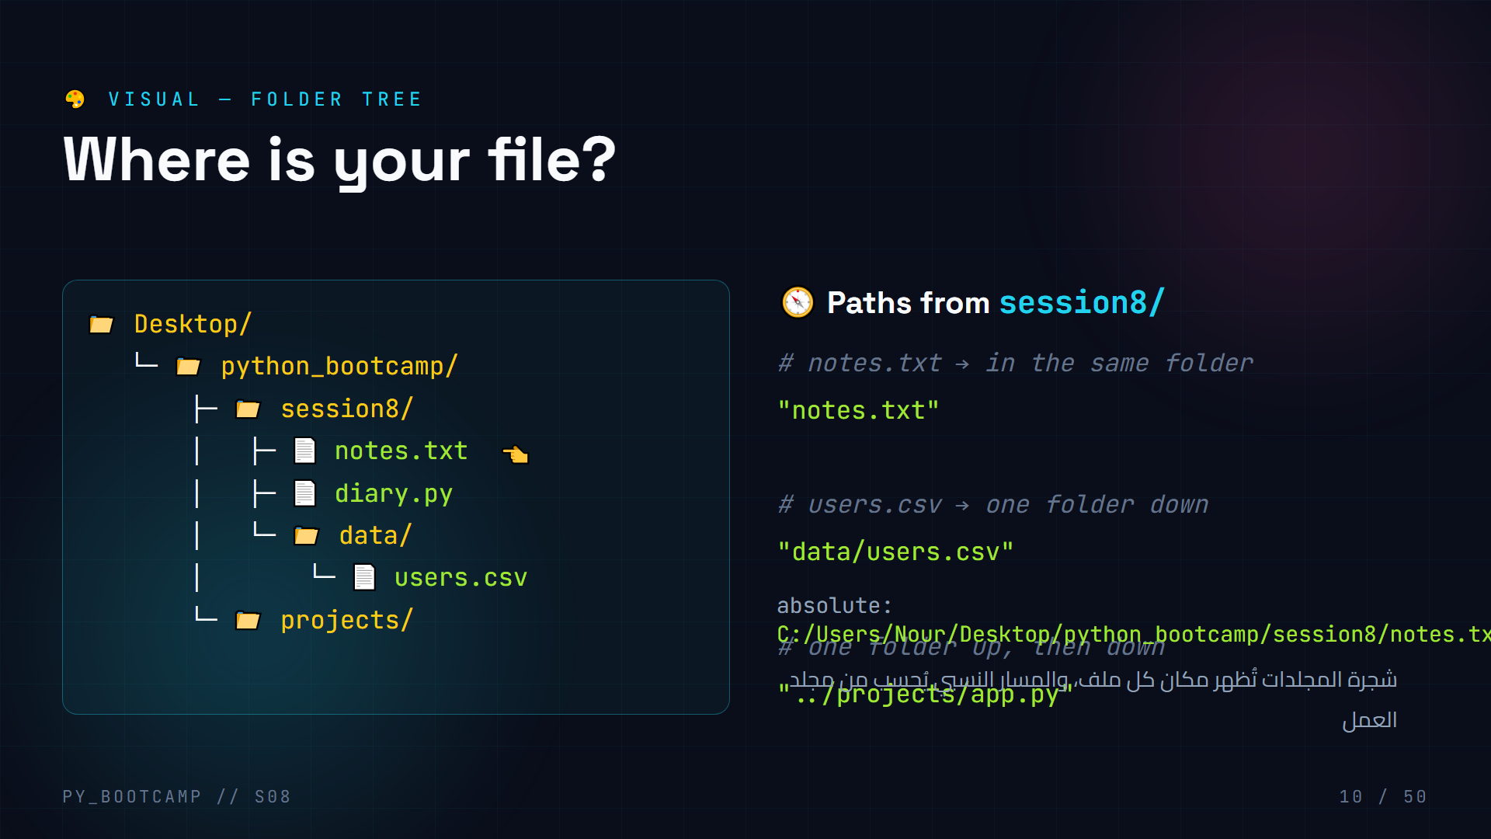
Notes:
**Folder tree visual — 4 min.**
- Walk the tree together: from Desktop you dive into python_bootcamp → session8 → notes.txt.
- Point out: relative paths are written *as if you're standing inside* the running folder (here `session8/`).
- Ask students to "climb" the tree: what path reaches `projects/app.py` from `session8`? → `../projects/app.py`.
- Arabic tip: «شجرة المجلدات» (folder tree) — have students point at the tree while saying each folder name.

Slide 11
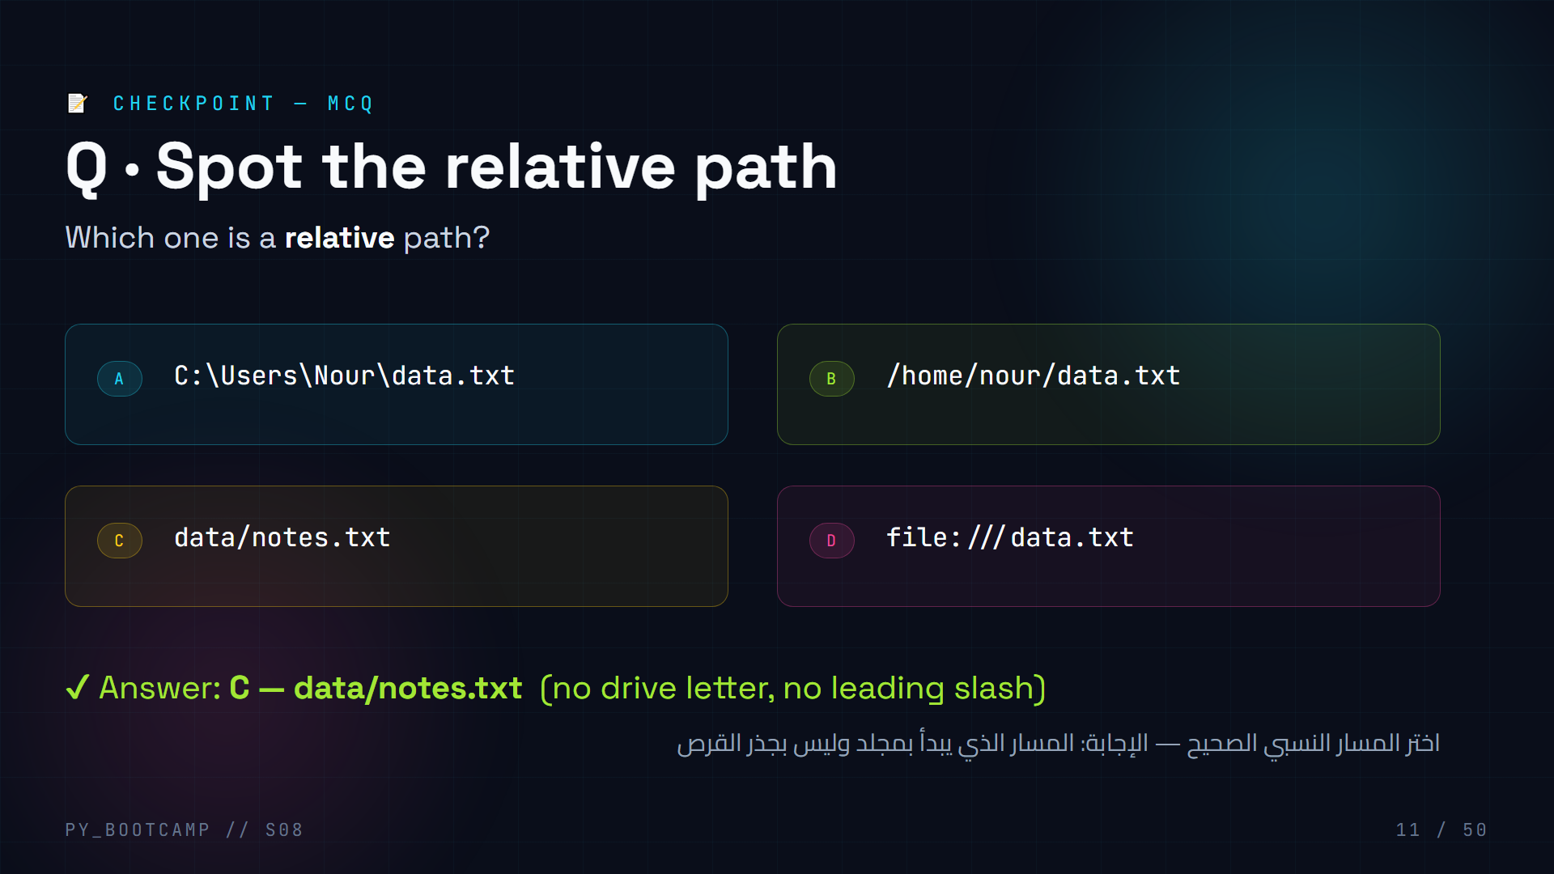
Notes:
**Path MCQ — 2 min.**
- A = absolute (starts with drive letter), B = absolute (starts at root `/`), C = relative, D = URL scheme (not even a path).
- Rule of thumb: starts with a drive/root → absolute. Starts with a folder or filename → relative.
- Live demo: ask a student for their desktop path, show both forms.
- Arabic tip: «المسار النسبي لا يبدأ من جذر القرص» (a relative path doesn't start at the disk root).

Slide 12
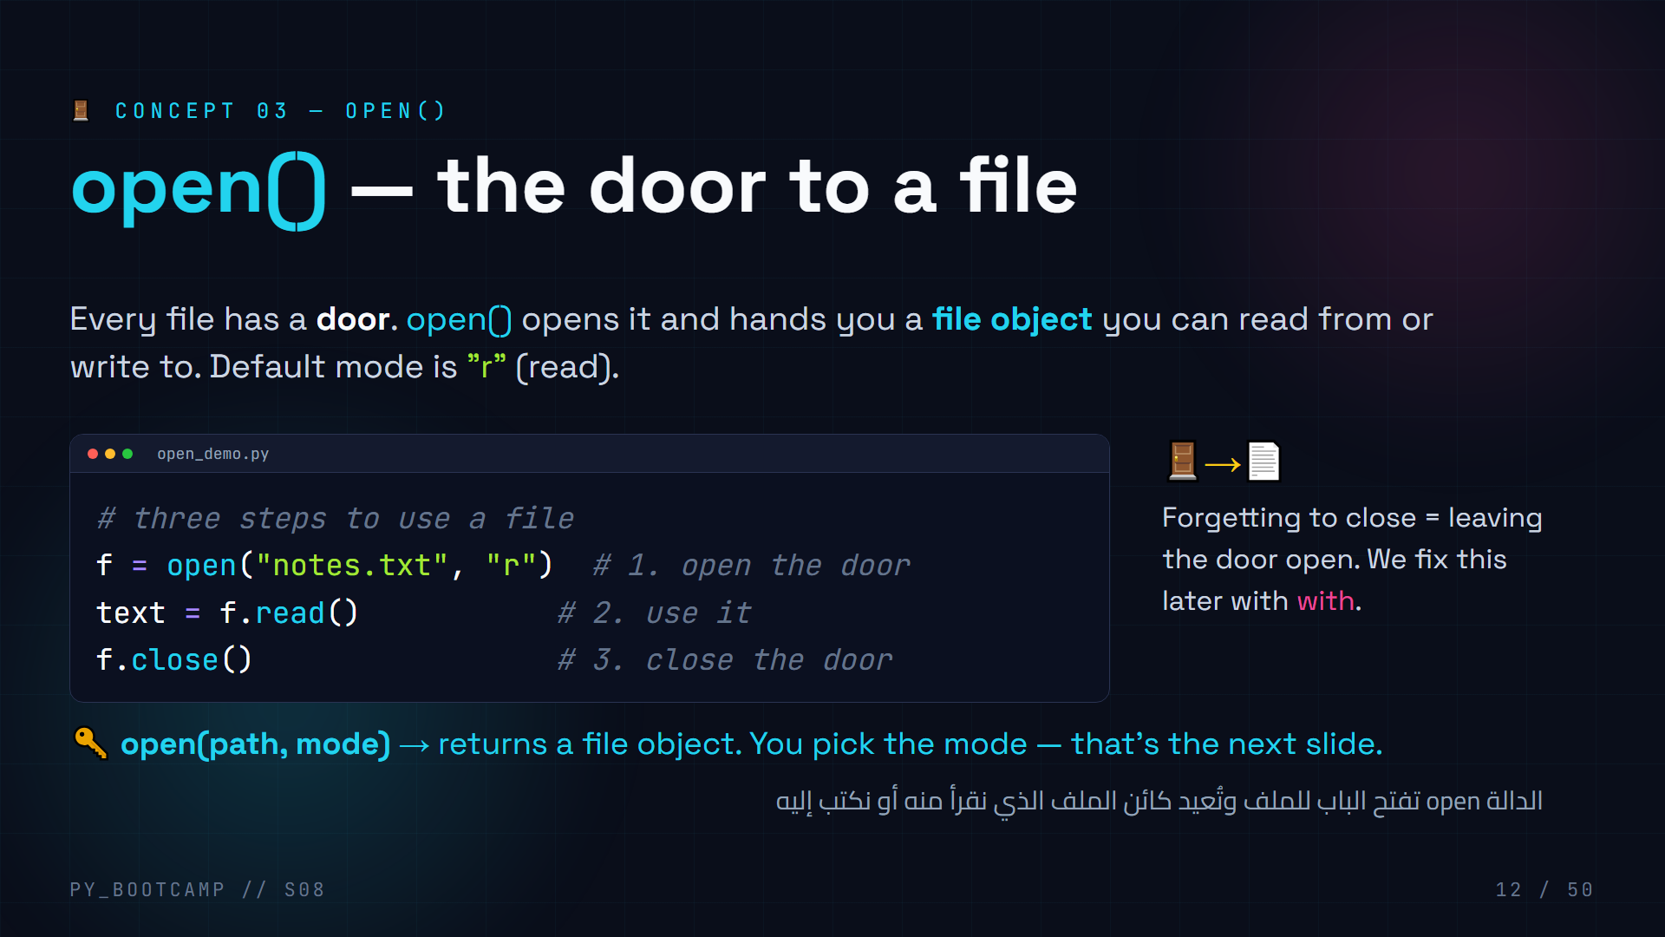
Notes:
**open() — 5 min.**
- Walk the three steps out loud: open → use → close. Use the door metaphor physically (knock, walk in, close).
- Show that `open("notes.txt")` works without the mode because `"r"` is the default.
- Preview: `with` will replace the manual close — but we still need to understand what close means.
- Live demo: open a file in the interpreter and show the `` object.
- Arabic tip: «افتح ثم استخدم ثم أغلق» (open, use, close) — three-word chant.

Slide 13
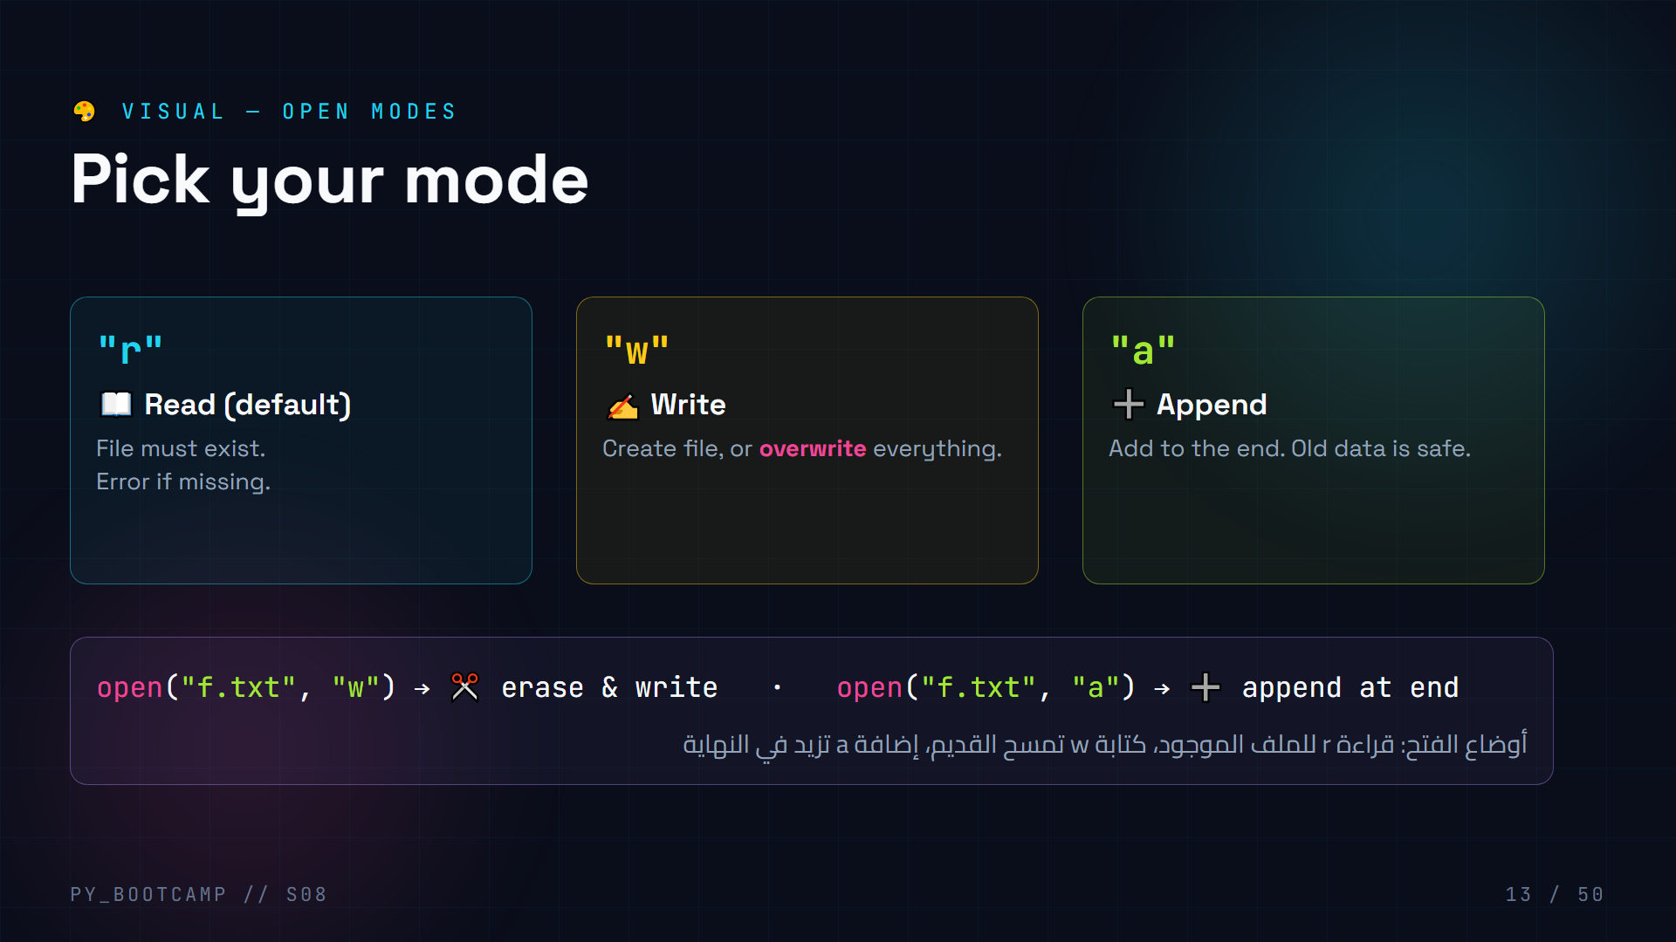
Notes:
**Open modes visual — 4 min.**
- Hammer the three letters: r read, w write (wipes!), a append (safe).
- The `w` warning is the most common data-loss bug in the class — make them gasp.
- Mention `r+` (read+write) exists but we keep it simple today.
- Arabic tip: «r قراءة، w كتابة، a إضافة» — students chant modes with you.

Slide 14
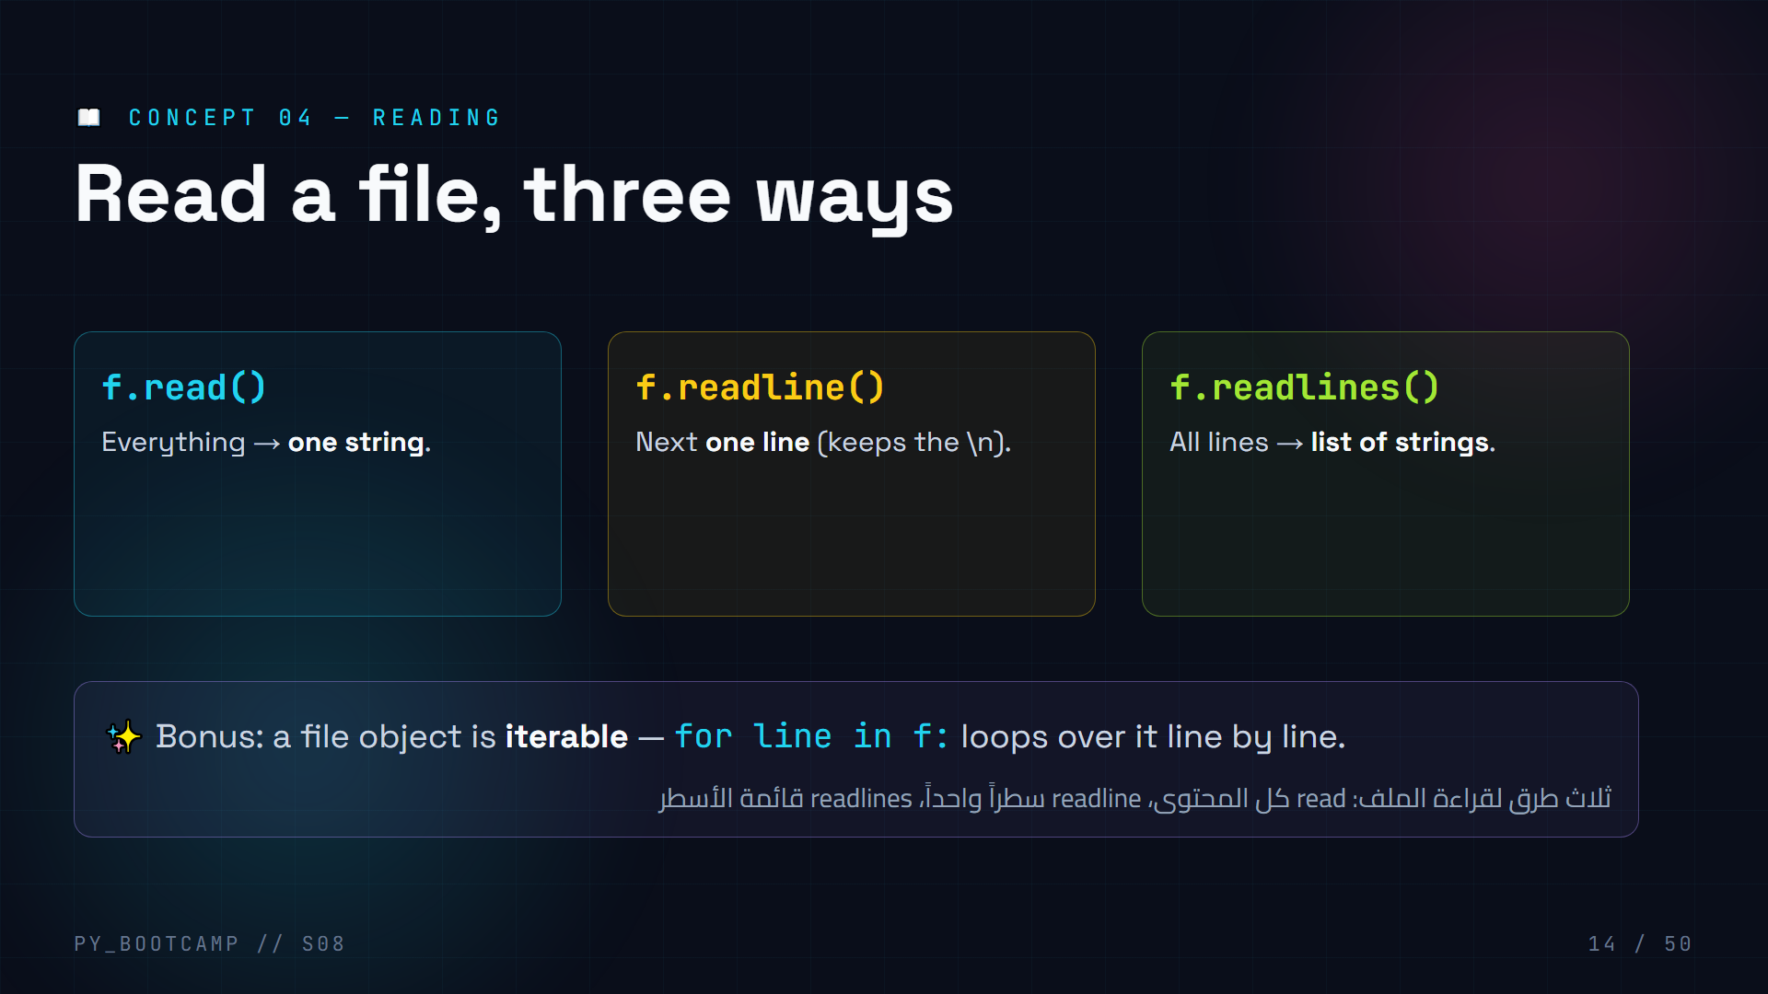
Notes:
**Reading functions — 4 min.**
- read = whole book, readline = next page, readlines = table of contents as a list.
- Warn about the `\n` newline that comes WITH each line — we'll strip it with `.strip()`.
- `for line in f:` is the everyday pattern for big files (memory friendly).
- Arabic tip: «read كاملة، readline سطر، readlines قائمة».

Slide 15
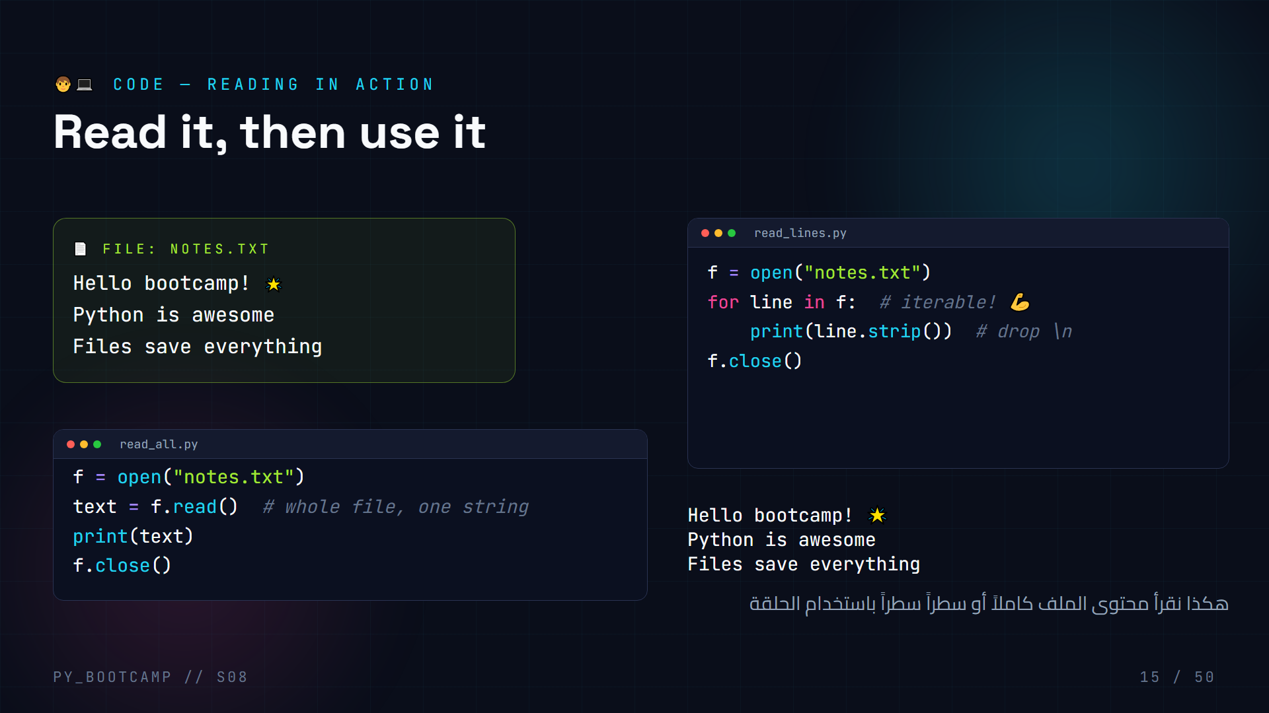
Notes:
**Read code — 6 min.**
Live code both variants.
1. `read_all.py`: run it, show the whole file printed as one block.
2. `read_lines.py`: run it — same visual output, but note we processed line-by-line.
- Emphasize `.strip()`: removes the trailing `\n` so lines don't double-space.
- Challenge: what does `print(len(text))` give? (character count of whole file).
- Arabic tip: «نقرأ السطر وننظّفه بـ strip» (read the line and clean it with strip).

Slide 16
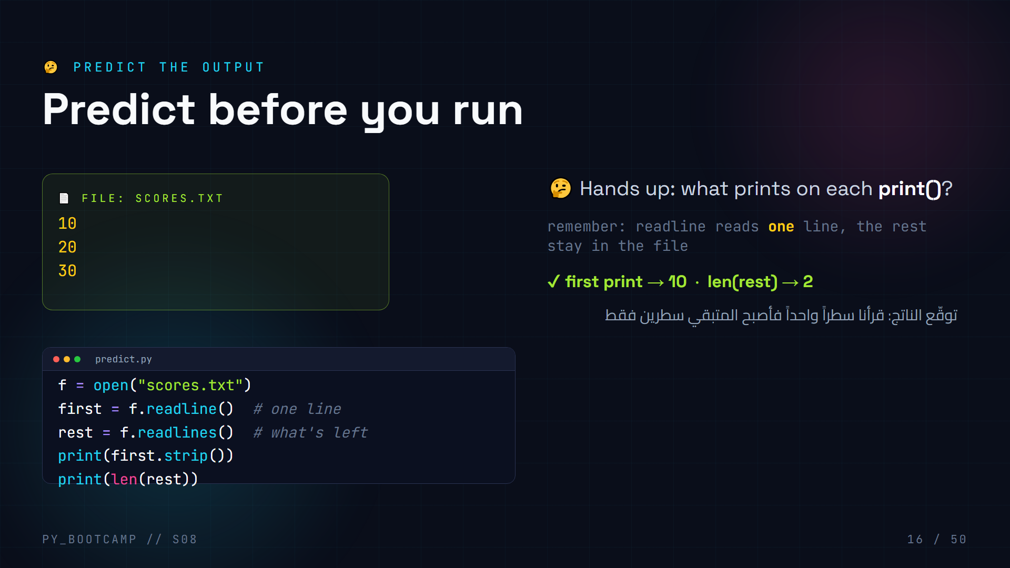
Notes:
**Predict output #1 — 3 min.**
- The file has 3 lines. `readline()` consumes the FIRST line ("10\n"), so `readlines()` returns only the remaining two → `len(rest) == 2`.
- Common error: students say 3. It's a cursor metaphor: the file remembers where you stopped reading.
- Run it live to confirm. Then ask: "what would len(rest) be if we never called readline?" (3).
- Arabic tip: «المؤشر يتحرك مع كل قراءة» (the cursor advances with each read).

Slide 17
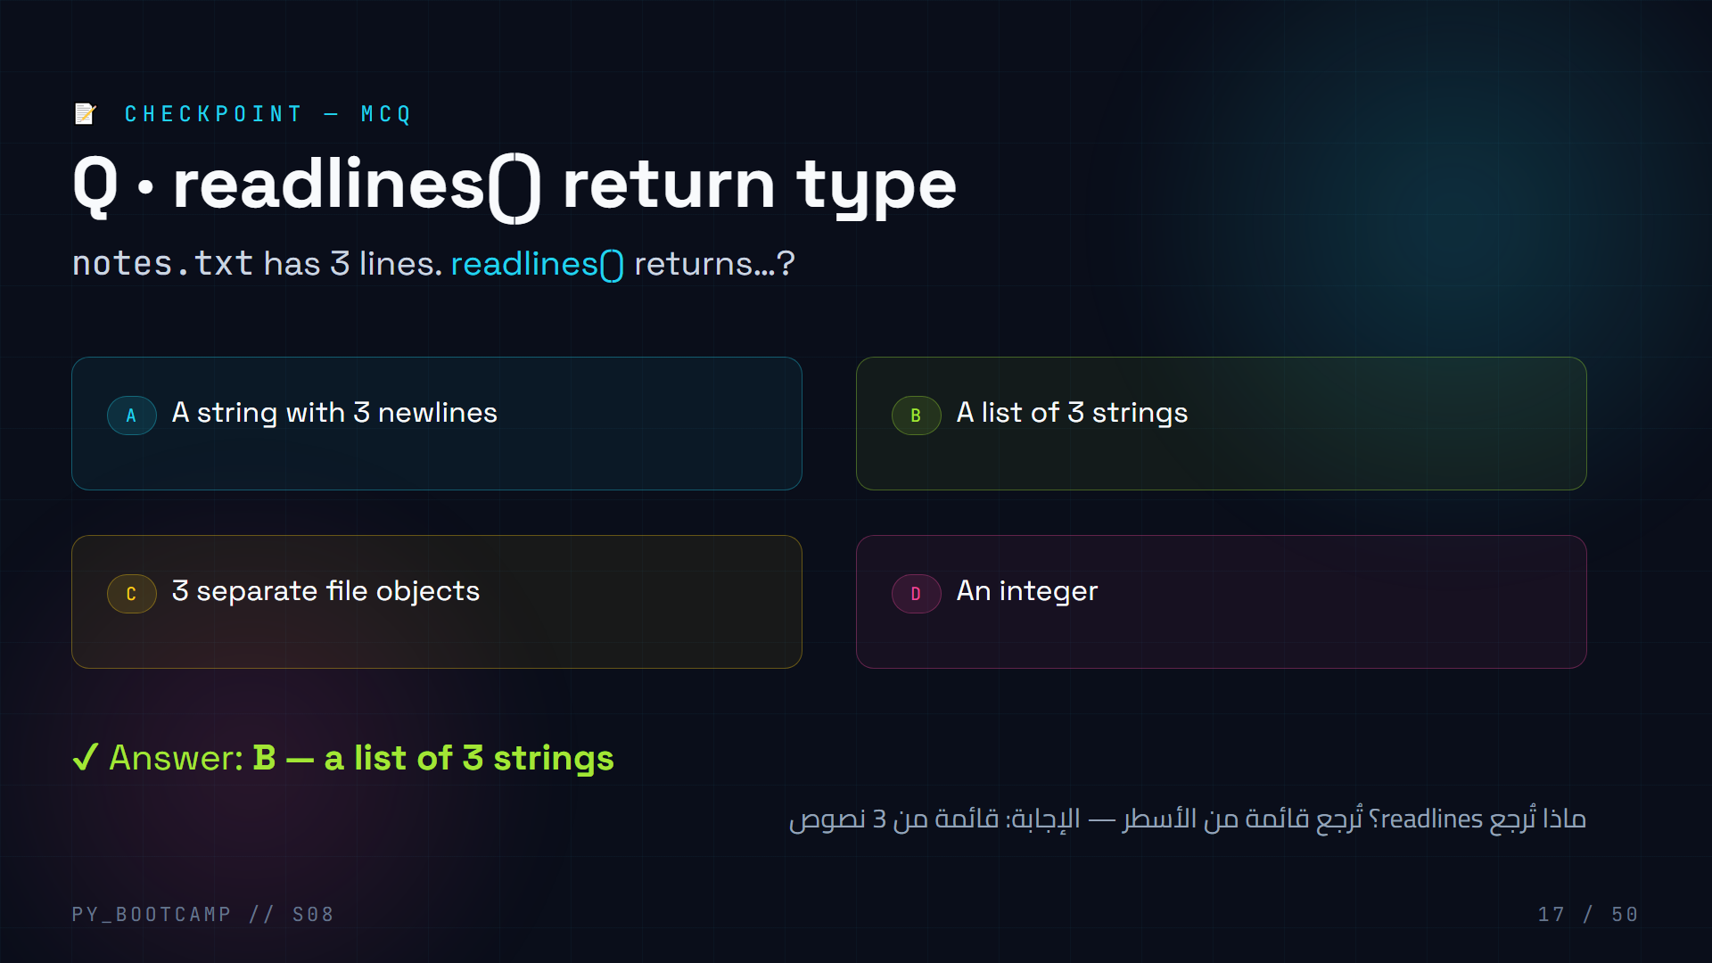
Notes:
**Read MCQ — 2 min.**
- `readlines()` → list, `read()` → string, `readline()` → string. Traps: A confuses read with readlines, D is nonsense.
- Follow-up: "how would you print the 2nd line?" → `lines[1].strip()`.
- Arabic tip: «readlines تُرجع قائمة» (readlines returns a list).

Slide 18
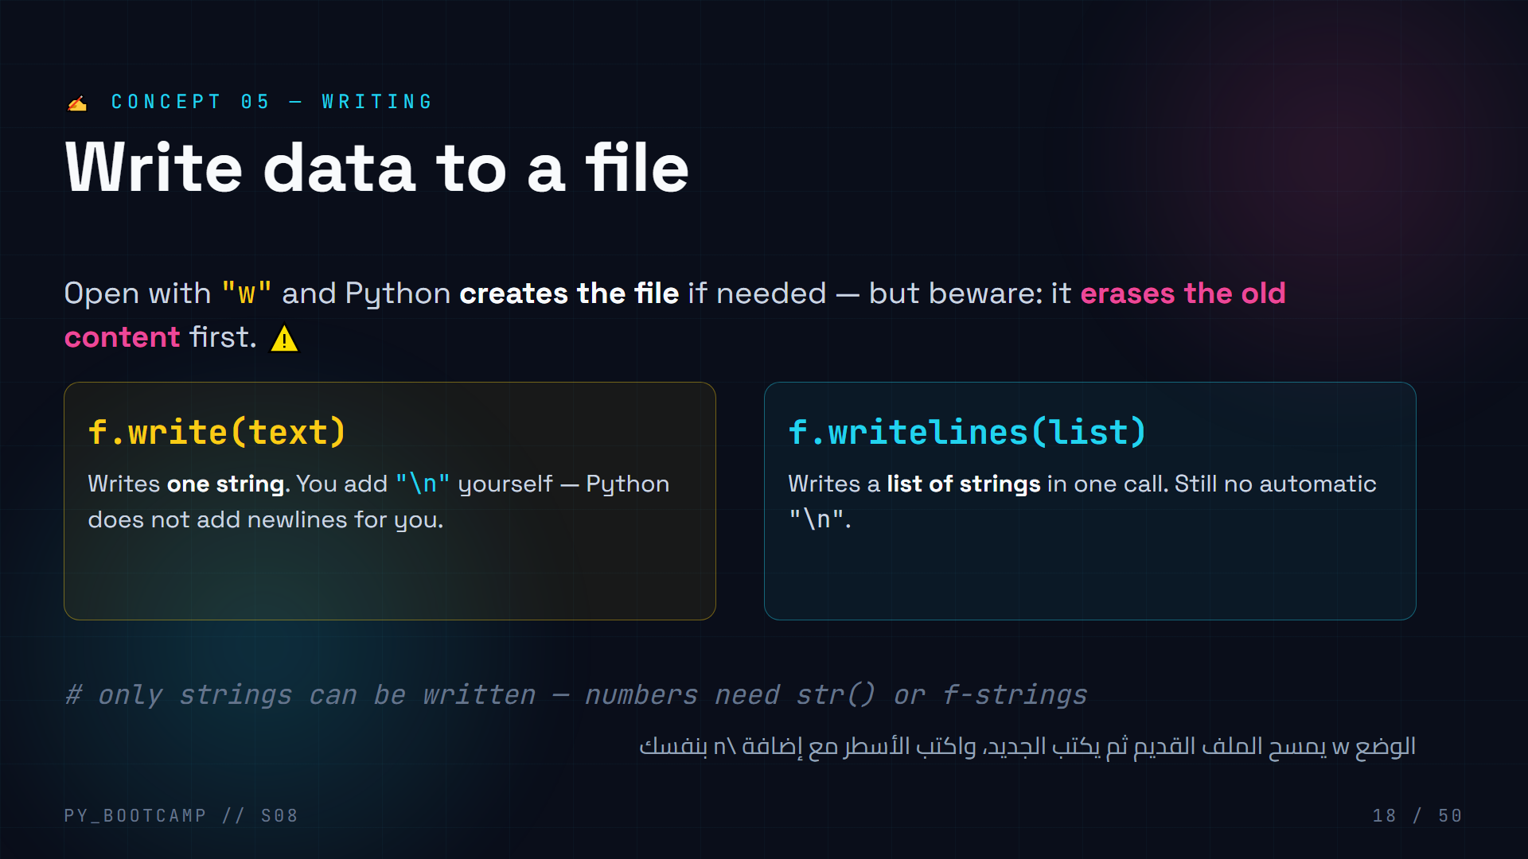
Notes:
**Writing functions — 4 min.**
- Big warning board: opening with "w" on an existing file = instant wipe. Demo it with a precious file (or a fake one) to make the point stick.
- `write` takes exactly one string. Newlines are NOT automatic — that's the #1 "why is it all on one line" bug.
- Arabic tip: «w يمسح، a يُبقي» (w erases, a keeps).

Slide 19
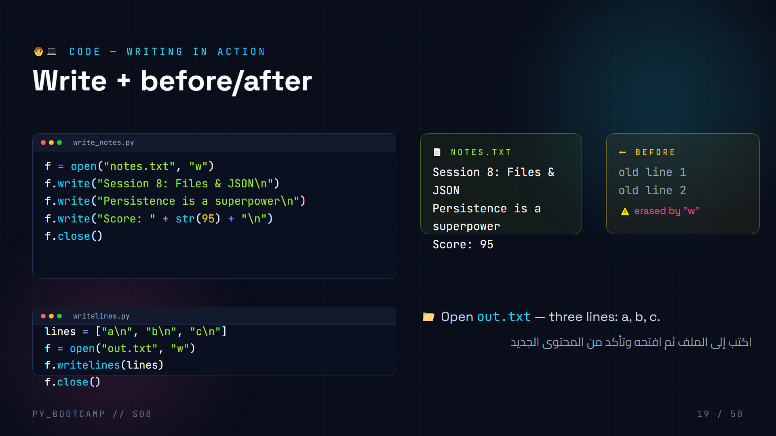
Notes:
**Write code — 6 min.**
Live code `write_notes.py`, then open the file in the editor to PROVE it wrote.
- Walk: str(95) — writing numbers needs conversion to string.
- Then `writelines.py`: emphasize the list literal and that each element still needs `\n`.
- Demo the destructive part: run the same program twice; second run wipes and rewrites (same result), then try writing fewer lines to see truncation.
- Arabic tip: «افتح الملف وتأكد» (open the file and verify) — verification is a habit.

Slide 20
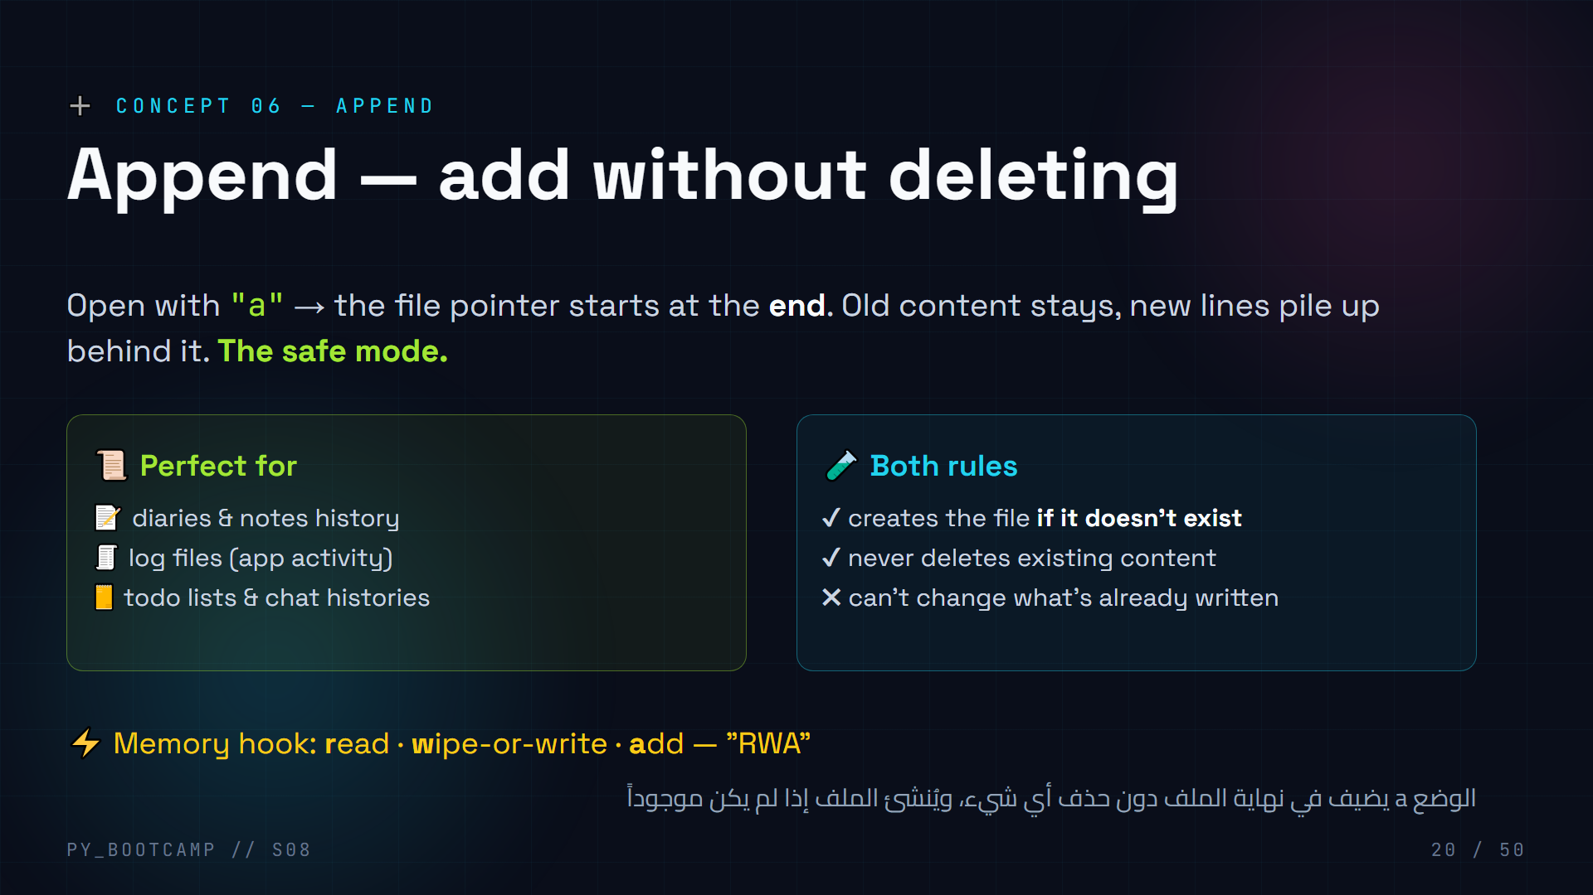
Notes:
**Append — 4 min.**
- Contrast with "w": same position on the keyboard, opposite destiny. w = reset button, a = "keep going".
- Ask students for use cases (logs, chat, diary) and tie to real apps.
- Clarify "a" never rewrites old lines — you can only add at the tail.
- Arabic tip: «أضف دون حذف» (add without deleting) — append's slogan.

Slide 21
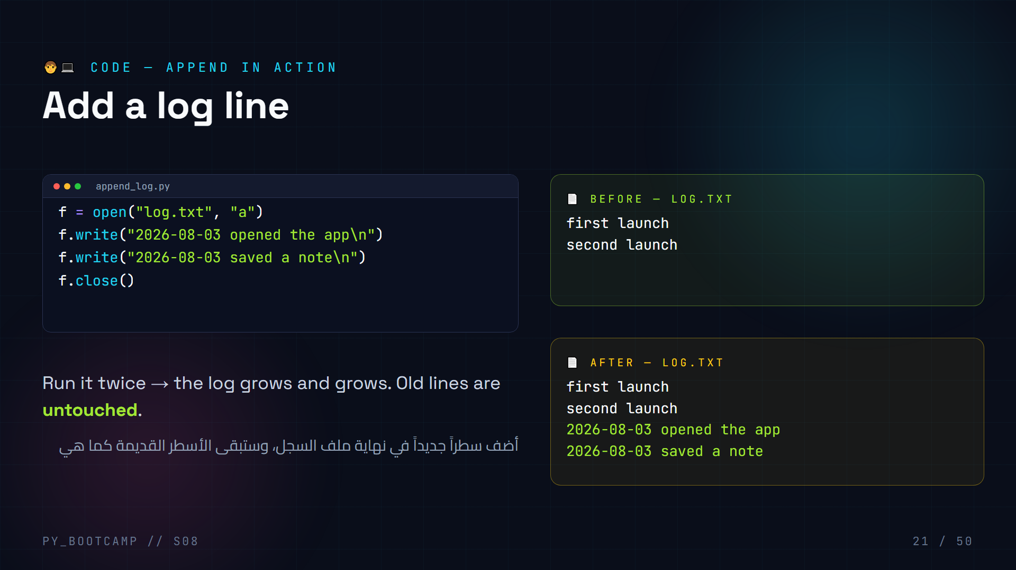
Notes:
**Append code — 5 min.**
Live code and run TWICE.
- First run creates log.txt; second run shows both new lines appended after old ones.
- Let a student predict the before/after content before you run.
- Compare with a version using "w" that would keep only the last two lines — dramatic contrast.
- Arabic tip: «شغّلها مرتين لترى النمو» (run twice to see it grow).

Slide 22
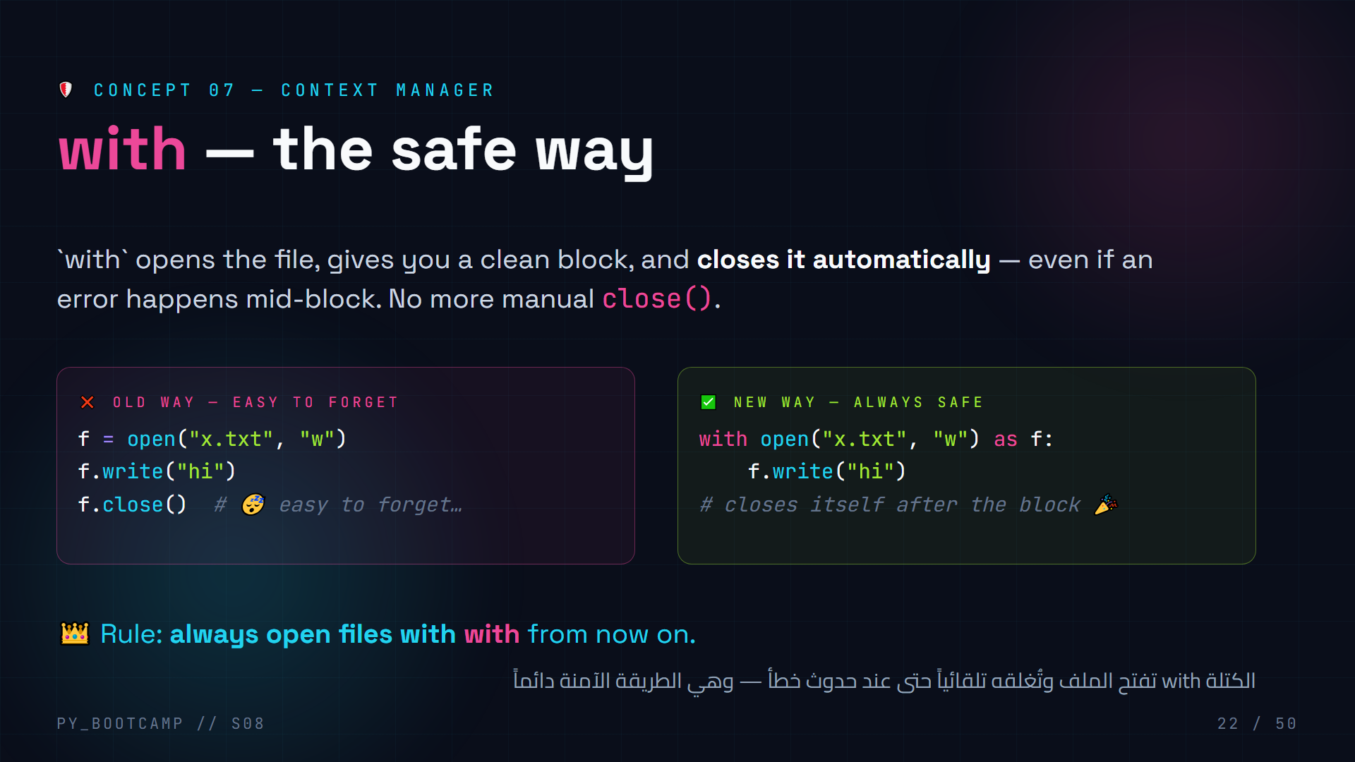
Notes:
**with statement — 5 min.**
- Story: "forgot to close() your file → the write may never hit the disk, and open handles leak."
- `with` is a context manager: it runs setup (open) and guaranteed cleanup (close).
- Rule going forward: always `with`. Show how the indented block is the only place `f` is alive.
- Arabic tip: «with تُغلق بنفسها» (with closes itself) — students repeat.

Slide 23
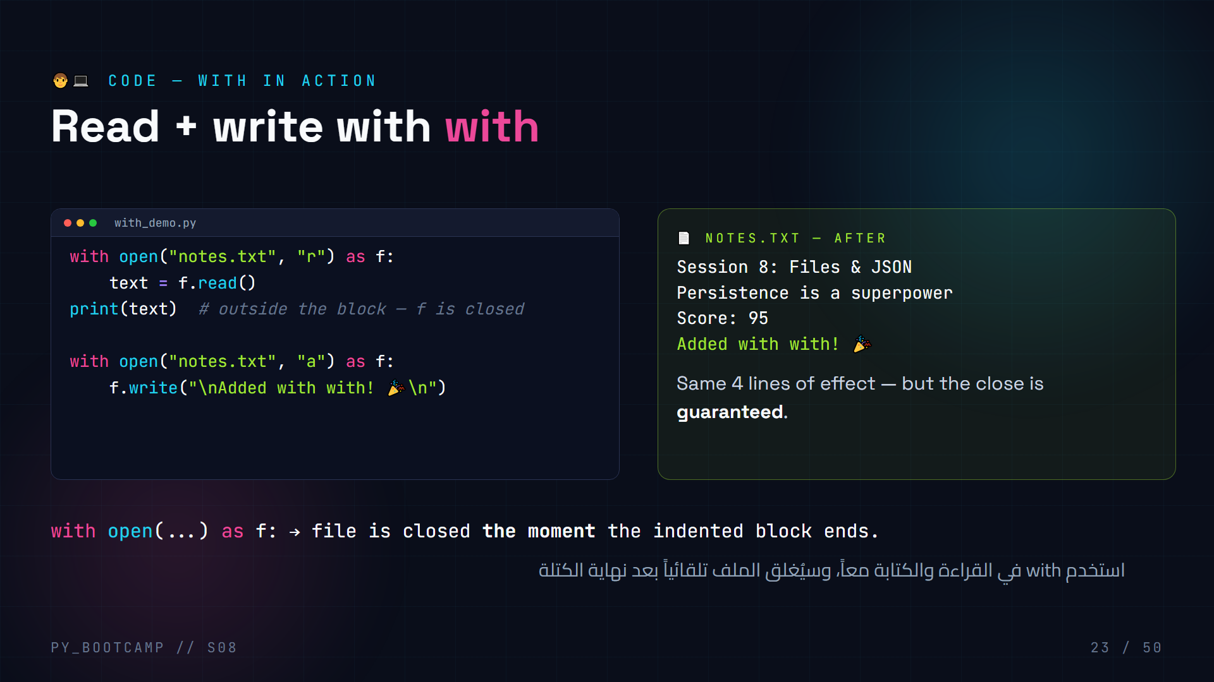
Notes:
**with code — 5 min.**
- Type both blocks; emphasize that reading inside the first block and writing in the second happen as independent sessions.
- Try: use `f` AFTER the with block → NameError/ValueError? Actually f still exists but closed; demonstrate reading → error "I/O operation on closed file" to prove auto-close.
- Arabic tip: «بعد الكتلة الملف مقفول» (after the block, the file is locked).

Slide 24
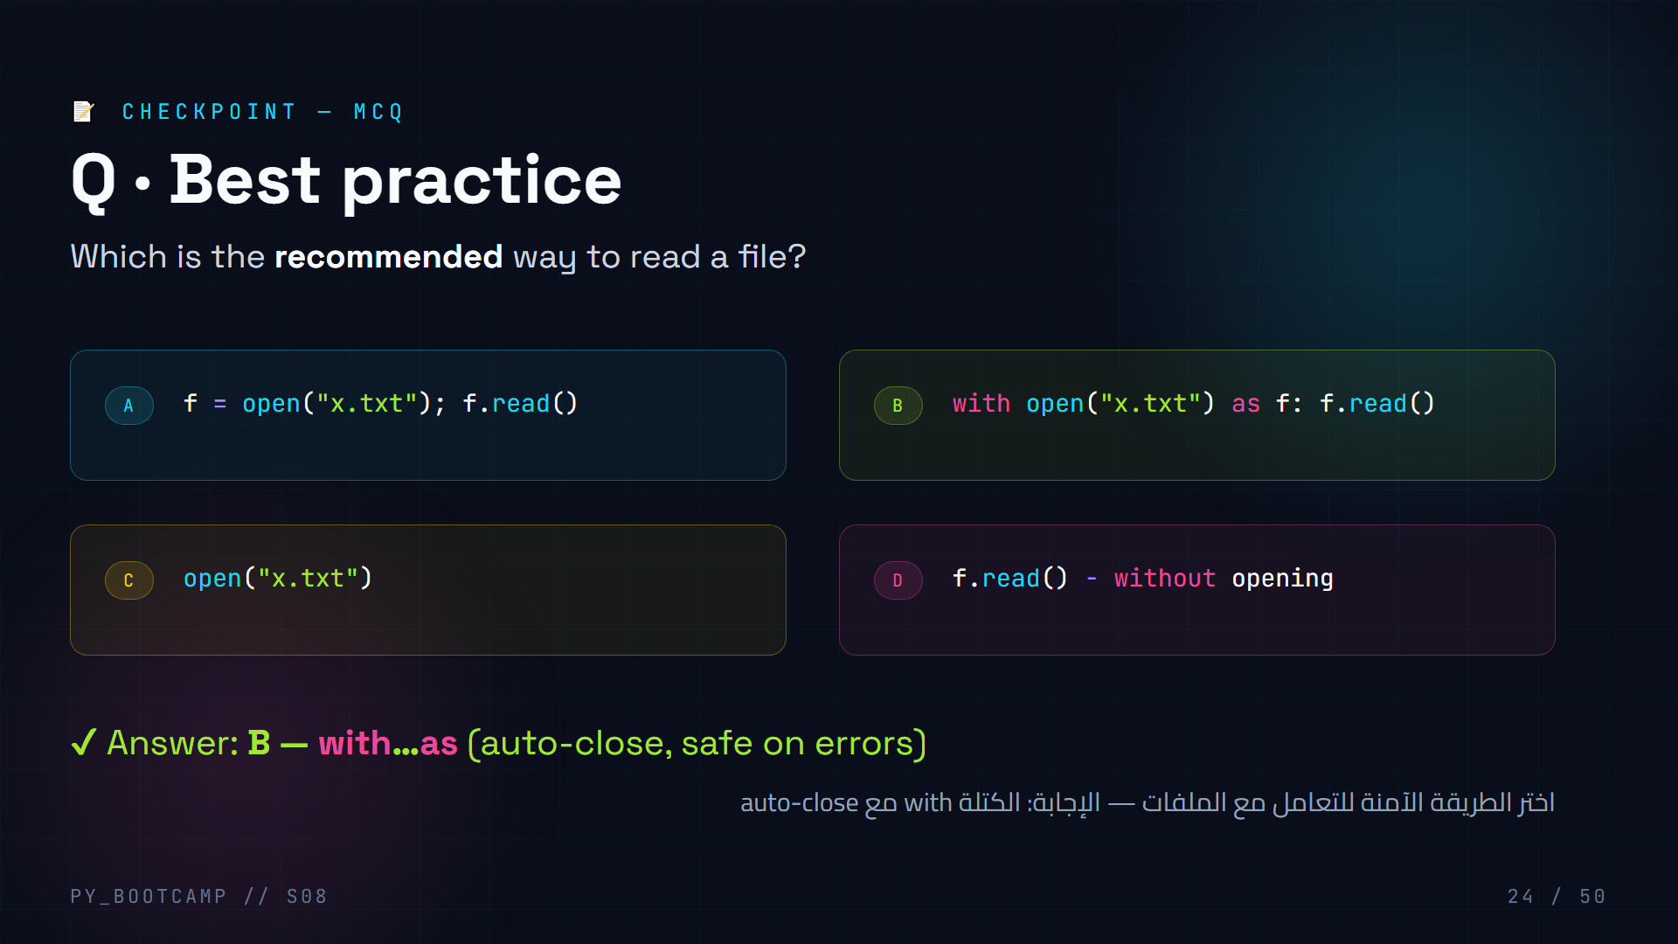
Notes:
**with MCQ — 2 min.**
- A forgets close(), C doesn't even store the object, D is impossible. B is the professional standard.
- Poll: raise hands for each letter before revealing.
- Arabic tip: «with = سلامة» (with = safety).

Slide 25
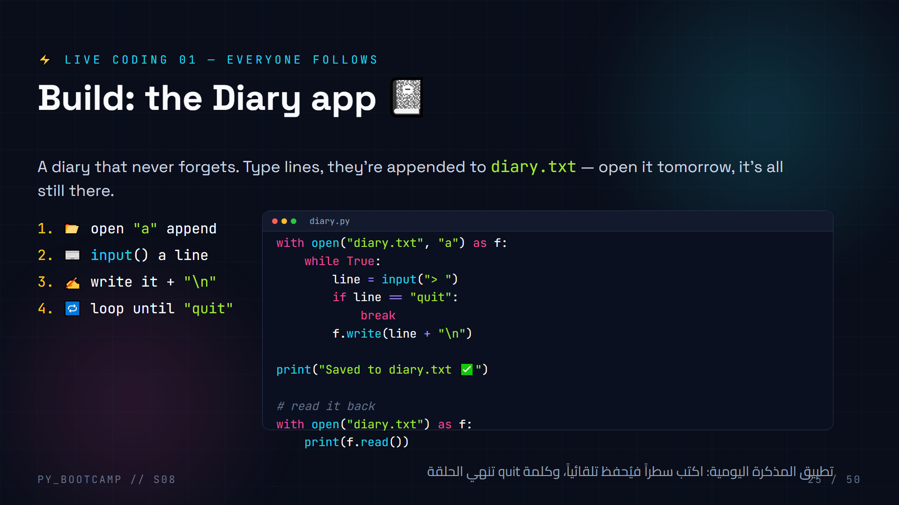
Notes:
**Live coding 1 — 12 min.** Type together, slowly. Keep the pace: keyboard-up when they watch, keyboard-down when they type.
Steps:
1. Create `diary.py`. Start with the `with open("diary.txt","a")` line — ask: why append not write? (never lose old lines).
2. Add the infinite `while True` and `input()`.
3. Add the `quit` break — predict what happens without it (infinite loop).
4. `f.write(line + "\n")` — ask why `\n` is needed.
5. Run it, type 3 lines + quit. Re-run and show history is preserved. Open diary.txt in the editor.
6. Add the read-back block so the diary "prints itself" at the end.
Common mistakes: forgetting `\n`, infinite loop without break, writing when file opened "r".
Arabic tip: «المذكرة تحفظ كل جلسة» (the diary saves every session) — remind them the file is the memory.

Slide 26
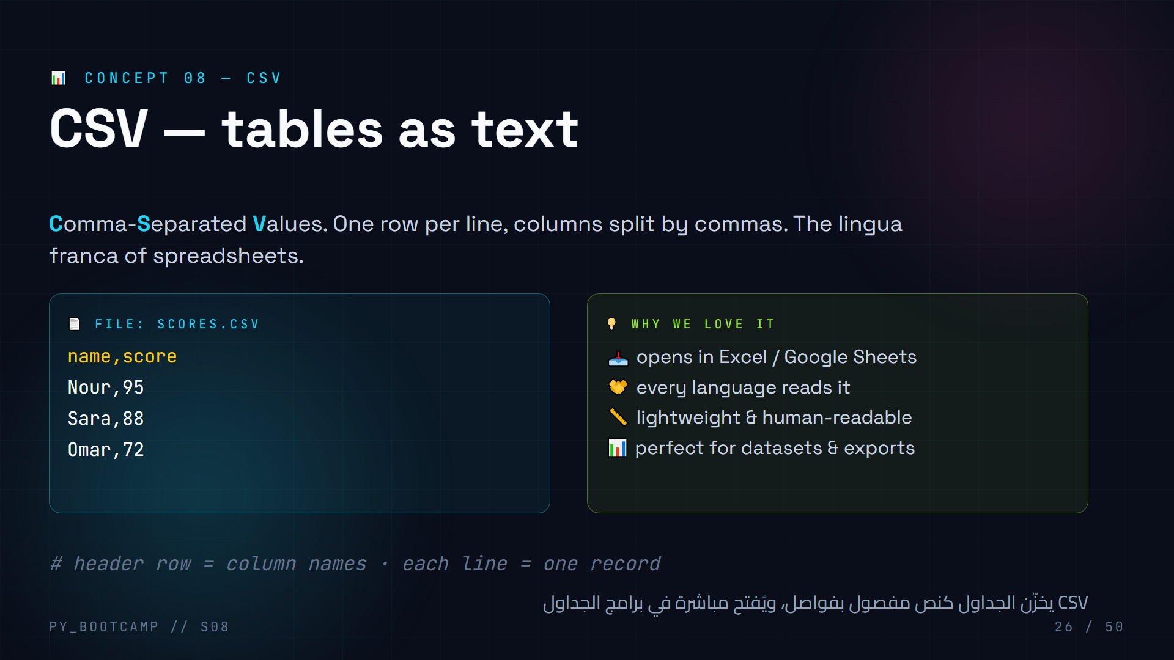
Notes:
**CSV concept — 5 min.**
- Show the file then the mental table: header row + 3 data rows.
- Connect: this is how you'd export a Google Sheet and bring it into Python.
- Keep it simple per the brief: no csv module deep-dive — split(",") is enough today.
- Arabic tip: «فاصلة = فاصل» (comma = separator) — the whole format in one phrase.

Slide 27
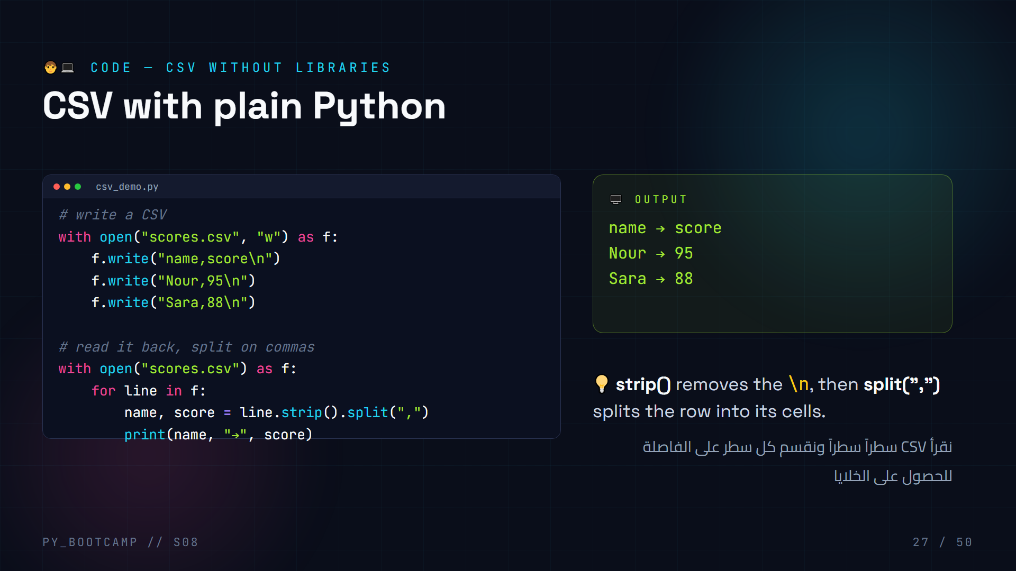
Notes:
**CSV code — 8 min.**
- Write + read in one file. When reading, walk the unpacking: `name, score = row.split(",")`.
- Note `strip()` before `split` — otherwise the last column keeps a `\n`.
- CSV gotcha: the header row is read too. For numeric math, skip it: `header = f.readline()` once, or guard with `if line.strip() == "name,score": continue`. The demo above intentionally prints every row (including the header).
- Extend: convert score to int and compute the average of scores — tiny math win.
- Keep csv module mention one line ("there's a fancier csv module for real projects").
- Arabic tip: «قسّم على الفاصلة» (split on the comma) — the reading mantra.

Slide 28
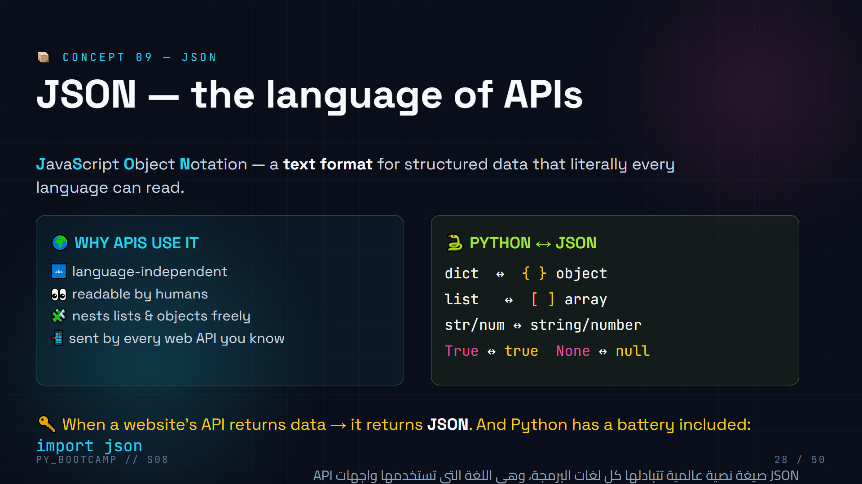
Notes:
**JSON concept — 5 min.**
- Get excited: "Everything modern runs on JSON" — Instagram feeds, weather apps, game stats.
- Show the Python↔JSON mapping table; the surprises are True→true and None→null.
- Note `import json` needs no installation (stdlib).
- Arabic tip: «JSON لغة عالمية» (JSON is a universal language).

Slide 29
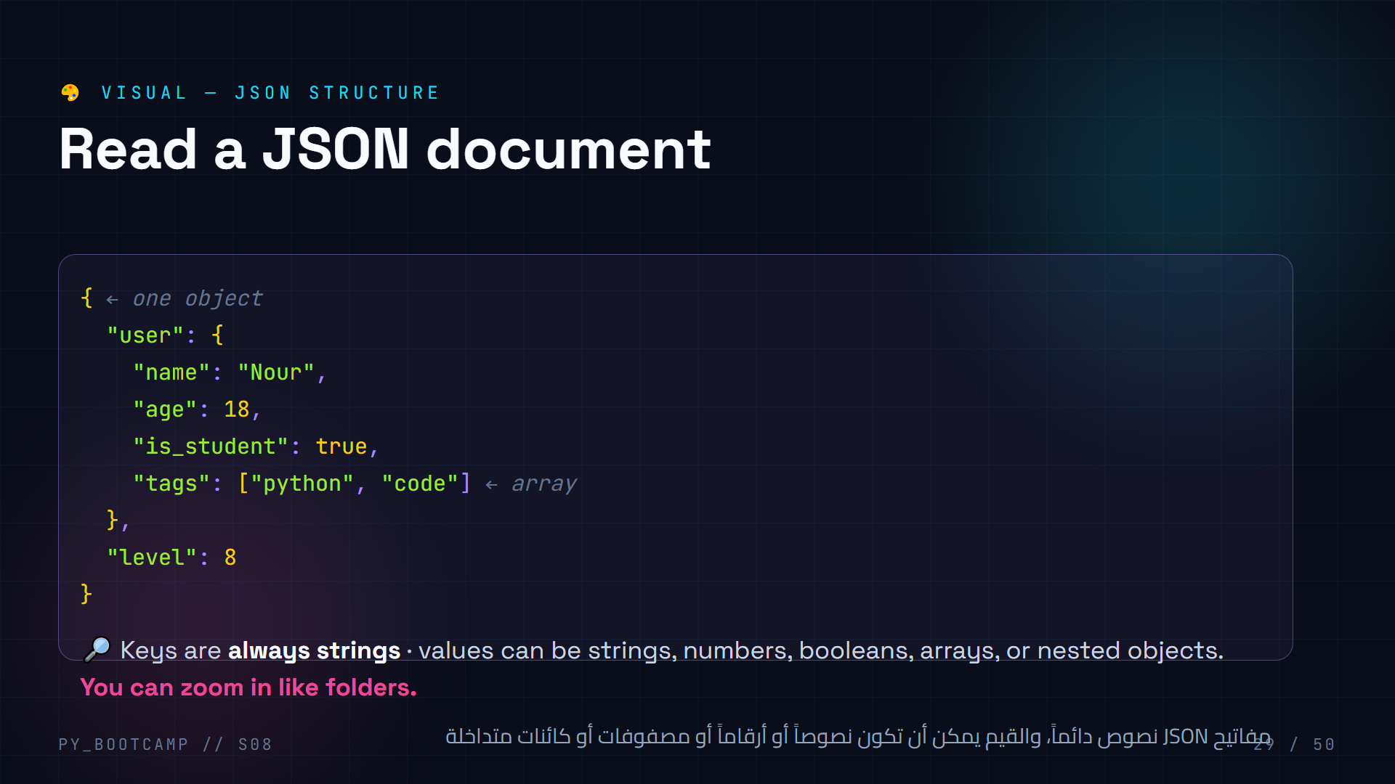
Notes:
**JSON visual — 4 min.**
- Read the document out loud as a sentence: "user has name Nour, age 18, is a student, tags python and code, level 8."
- Point out nesting: object inside object, array of strings.
- This is exactly what they'll parse from APIs next session.
- Arabic tip: «المفتاح نص، والقيمة أي نوع» (key is text, value can be any type).

Slide 30
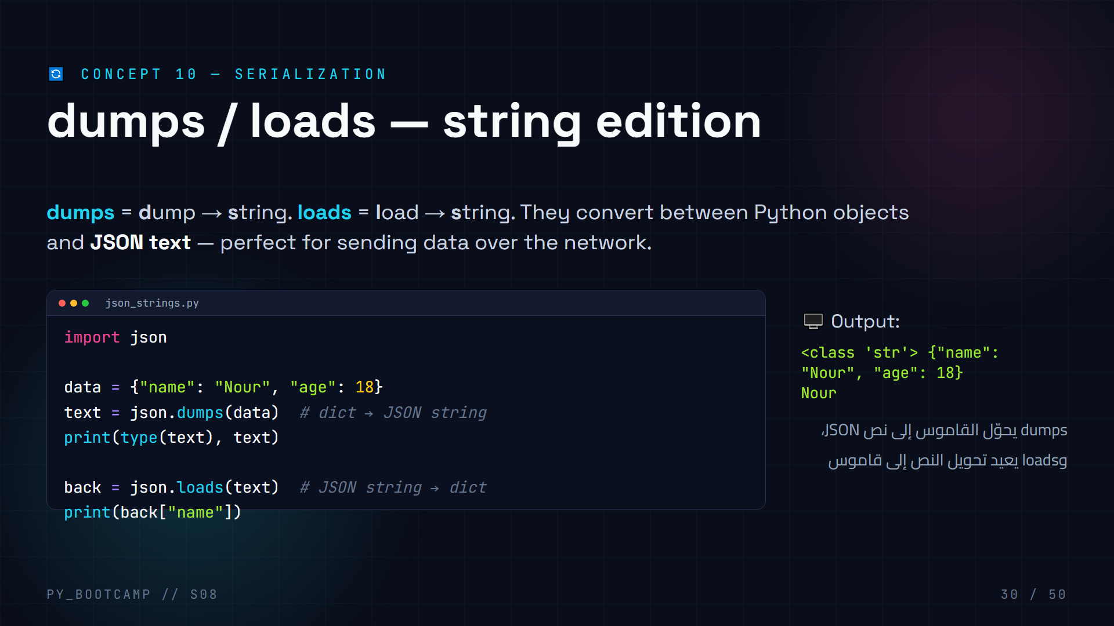
Notes:
**dumps / loads — 6 min.**
- mnemonic: the **s** in dumps/loads = **s**tring. dump/load (no s) = **f**ile. Save this slide for the cheat sheet.
- Live demo: print `type(text)` → str; then loads brings the dict back and we index `back["name"]`.
- Show what happens with `indent=2` for pretty printing.
- Arabic tip: «s تعني نص» (s means string).

Slide 31
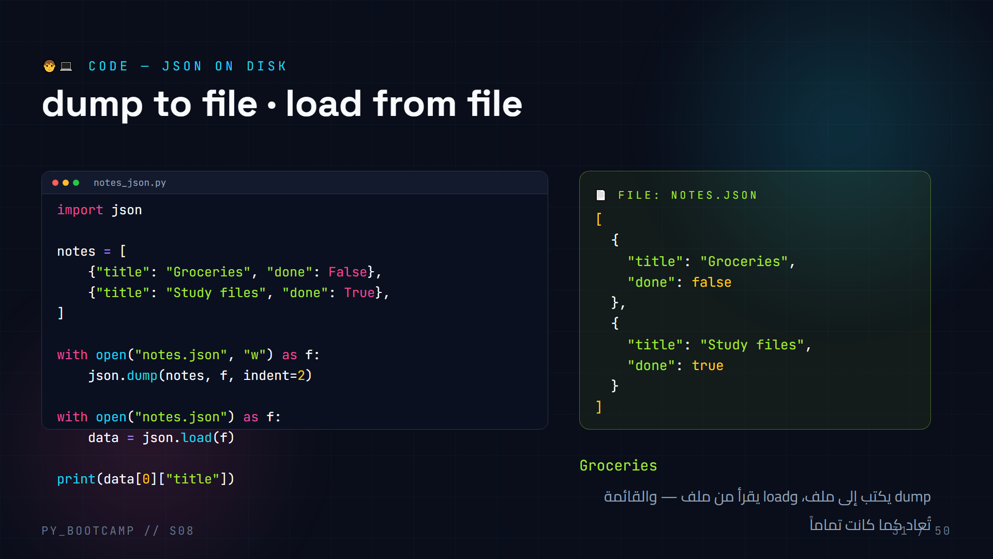
Notes:
**dump/load on disk — 8 min.**
- This is THE core pattern of the whole session. Type it live, then open notes.json in the editor to show the pretty output.
- Point out `False` became `false`, `True` → `true` — JSON's lowercase booleans.
- `indent=2` = readable file; without it, one long line.
- Ask: why does the list of dicts come back perfectly? Because JSON stores the structure, not just text.
- Arabic tip: «dump للكتابة، load للقراءة» (dump writes, load reads).

Slide 32
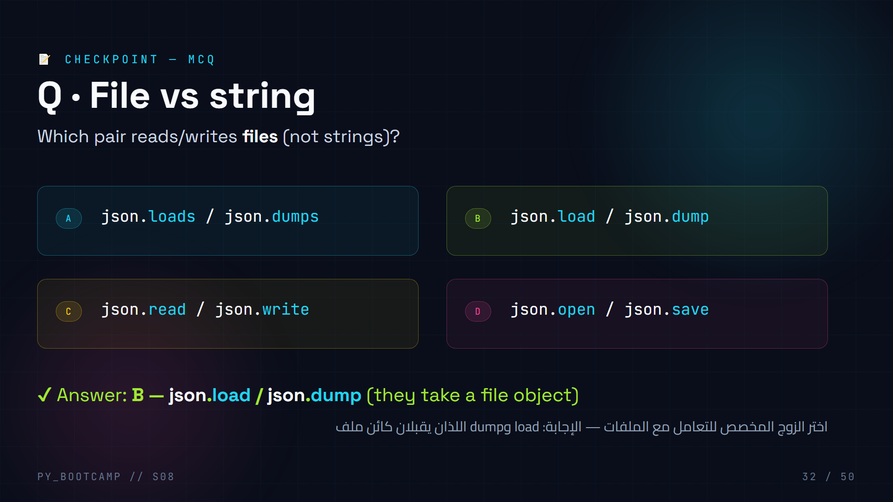
Notes:
**JSON MCQ — 2 min.**
- Memory hook: the **s**-versions work on **s**trings; the no-s versions take a **file object**.
- C and D are fake functions — teach them to notice "does this function even exist?"
- Arabic tip: «مع s نص، بدون s ملف» (with s = string, without s = file).

Slide 33
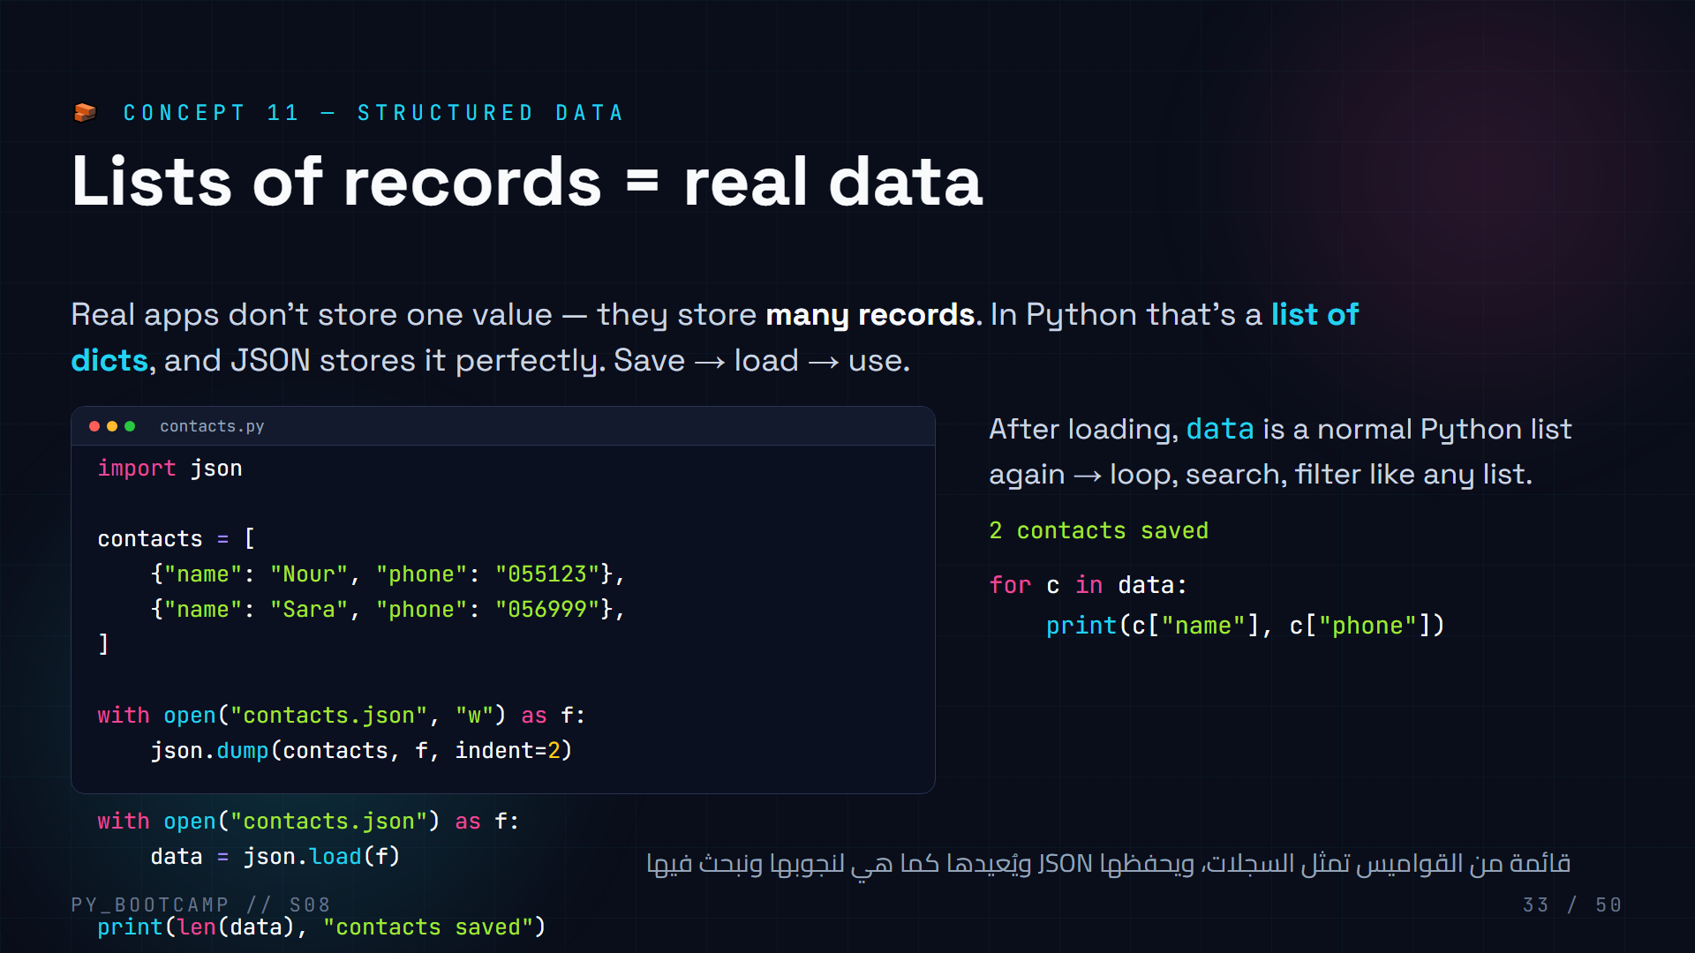
Notes:
**Structured data — 7 min.**
- Framing: a phone is not one contact; it's a list of dicts. Same for orders, scores, chat messages.
- Emphasize round-trip: what you dump is exactly what you load (types preserved: dict↔object, list↔array).
- Quick win: loop over loaded data and print both fields.
- Arabic tip: «السجل = قاموس» (a record = a dict) — the building block.

Slide 34
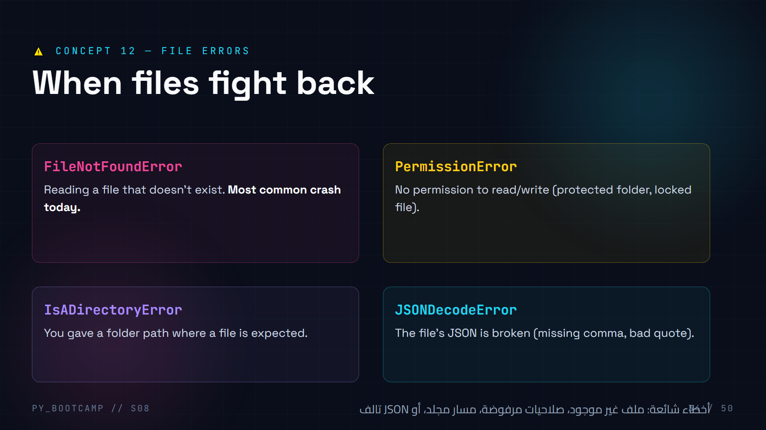
Notes:
**File errors — 4 min.**
- Teach the error name → cause mapping. Don't read the whole traceback; read the LAST line.
- Demo: `open("does_not_exist.txt")` live and let them see FileNotFoundError.
- Preview: next slide's try/except is the medicine. Sessions 9 covers exceptions deeply — today we just need the bandage.
- Arabic tip: «اقرأ آخر سطر من الخطأ» (read the last line of the error).

Slide 35
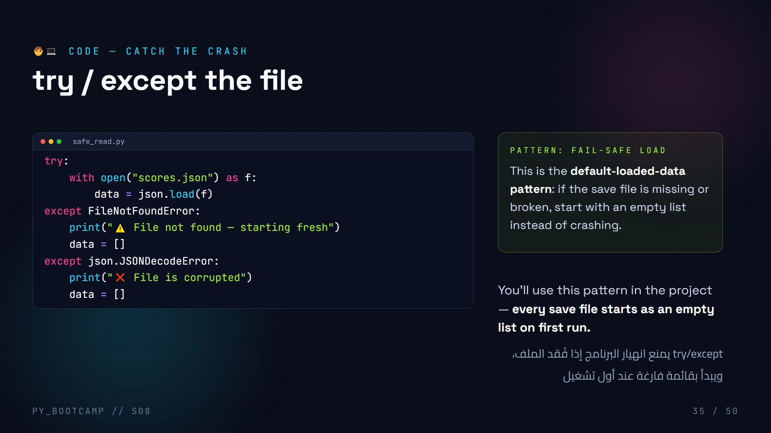
Notes:
**try/except code — 6 min.**
- Type it; the "fail-safe load" is the single most reused snippet in file-based apps.
- Run three scenarios live: 1) no file → prints warning, data = []; 2) valid file → loads; 3) corrupt file → "corrupted".
- Mention: full exceptions course comes next session — today we just need FileNotFoundError + JSONDecodeError.
- Arabic tip: «شبكة الأمان» (safety net) — that's what try/except is.

Slide 36
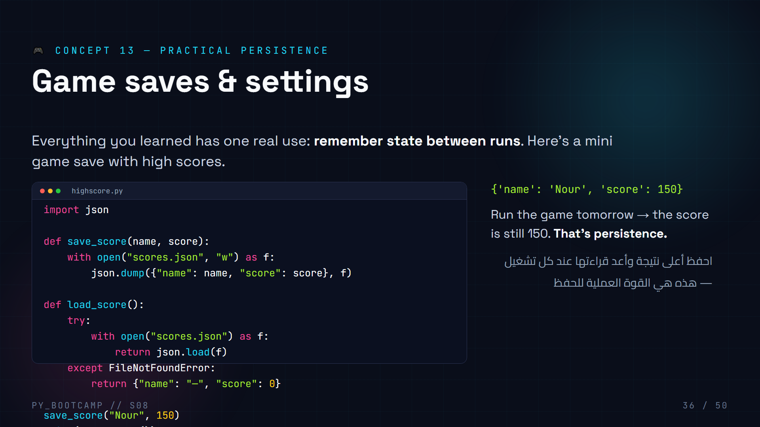
Notes:
**Practical persistence — 7 min.**
- Framing: "every game you've played does exactly this on the save button."
- Walk save_score/load_score: save always overwrites, load uses fail-safe with a default score of 0.
- Extend idea: settings files (theme, volume, language) are the same pattern.
- Arabic tip: «احفظ الحالة» (save the state) — the phrase of the day.

Slide 37
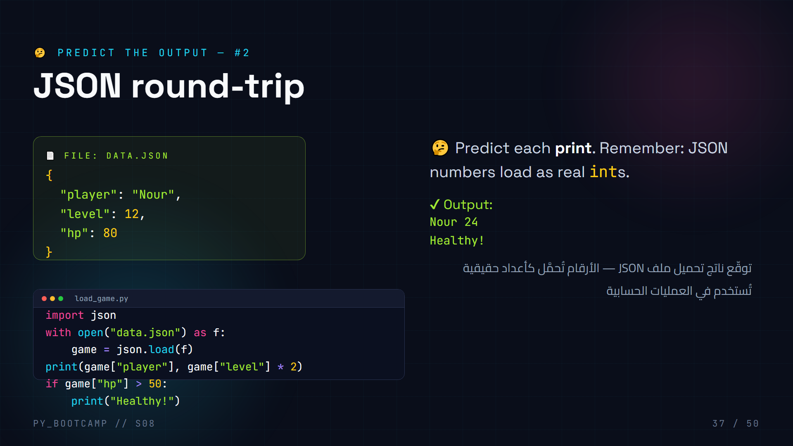
Notes:
**Predict output #2 — 3 min.**
- level loaded as int → 12*2 = 24, printed after "Nour".
- hp 80 > 50 → "Healthy!" printed too.
- Trap: students may print the level as a string ("1212") if they forget JSON converts numbers properly.
- Arabic tip: «الأرقام تبقى أرقاماً» (numbers stay numbers) after json.load.

Slide 38
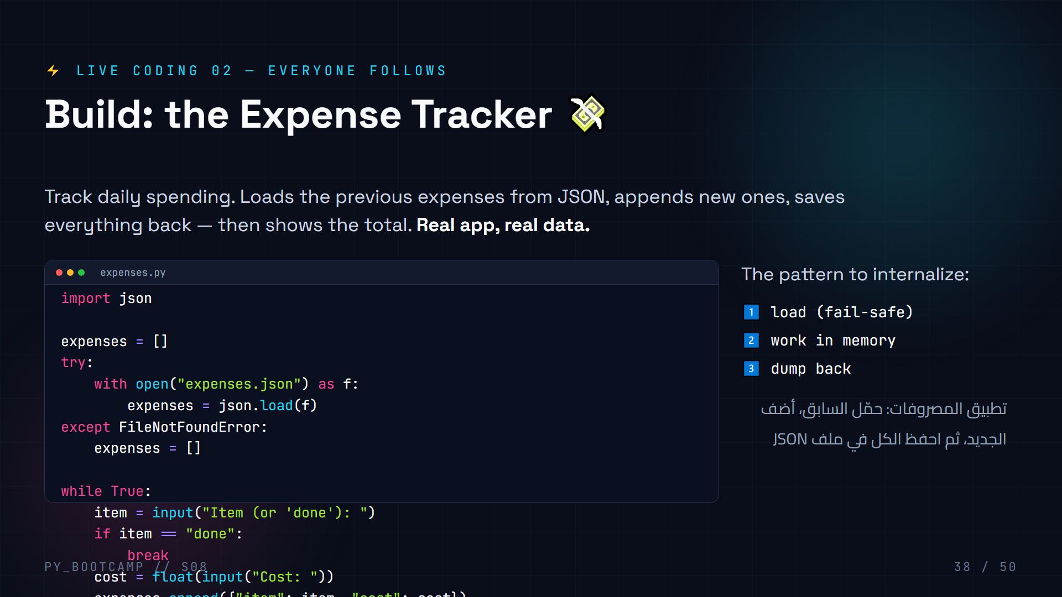
Notes:
**Live coding 2 — 15 min.** Build the expense tracker step by step; students type along.
1. Start with imports + empty list. Ask: where do previous expenses come from? → the JSON file.
2. Add the fail-safe load (reuse from slide 35).
3. Loop with input; add `float()` conversion — warn: typing text crashes, we accept that for now.
4. Append a dict per expense.
5. Save with dump + indent=2.
6. Compute total with a generator in sum().
7. Run twice: second run still shows the first session's expenses — prove persistence.
Extension: print each expense with an index so they see the loaded data.
Arabic tip: «حمّل · عدّل · احفظ» (load · edit · save) — the three-step rhythm.

Slide 39
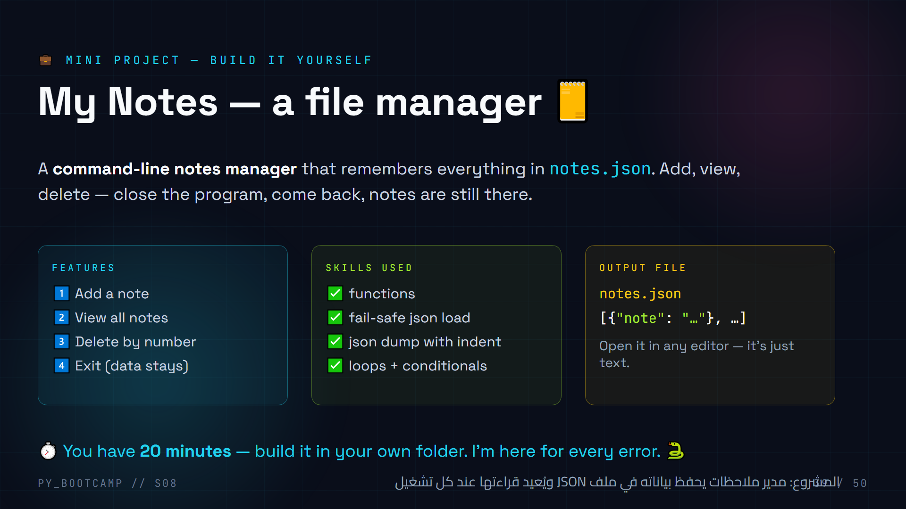
Notes:
**Project intro — 4 min.**
- Set the mission: 20 minutes, build "My Notes" from scratch. They can look at slides 35 & 38 patterns.
- Walk features: add / view / delete by number / exit.
- Show notes.json will be plain text they can inspect — demystify the "file" part.
- Motivate: "This is the same skeleton as real note apps and todo apps."
- Arabic tip: «المشروع يحفظ نفسه» (the project saves itself) — punchline before they code.

Slide 40
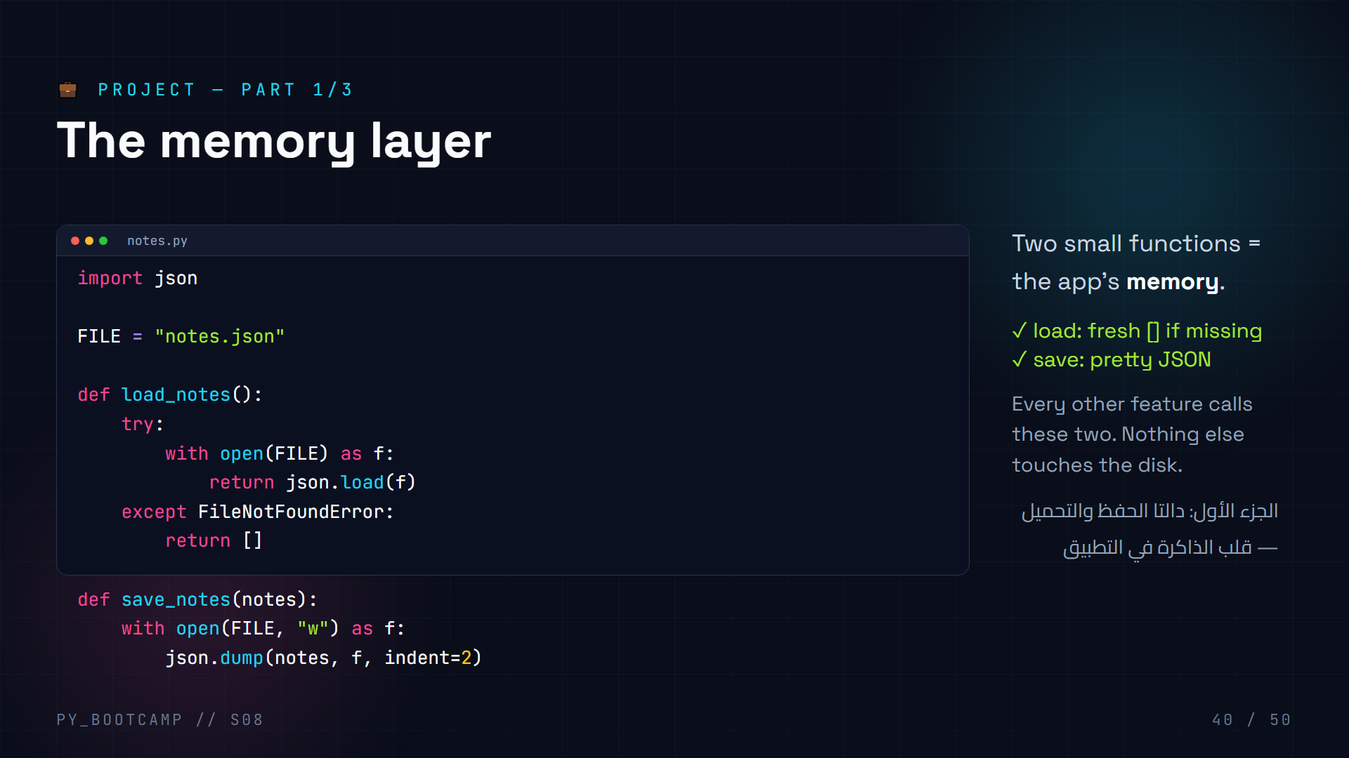
Notes:
**Project part 1 — 5 min.**
- Explain the separation: load_notes/save_notes own ALL file interaction. Adding features later = zero file code.
- Ask: why fail-safe? (first run has no file yet → must not crash).
- Have students run just this part: call load_notes() in the interpreter → []; then save_notes([{"note":"test"}]) and open notes.json.
- Arabic tip: «التخزين في مكان واحد» (storage in one place) — good architecture habit.

Slide 41
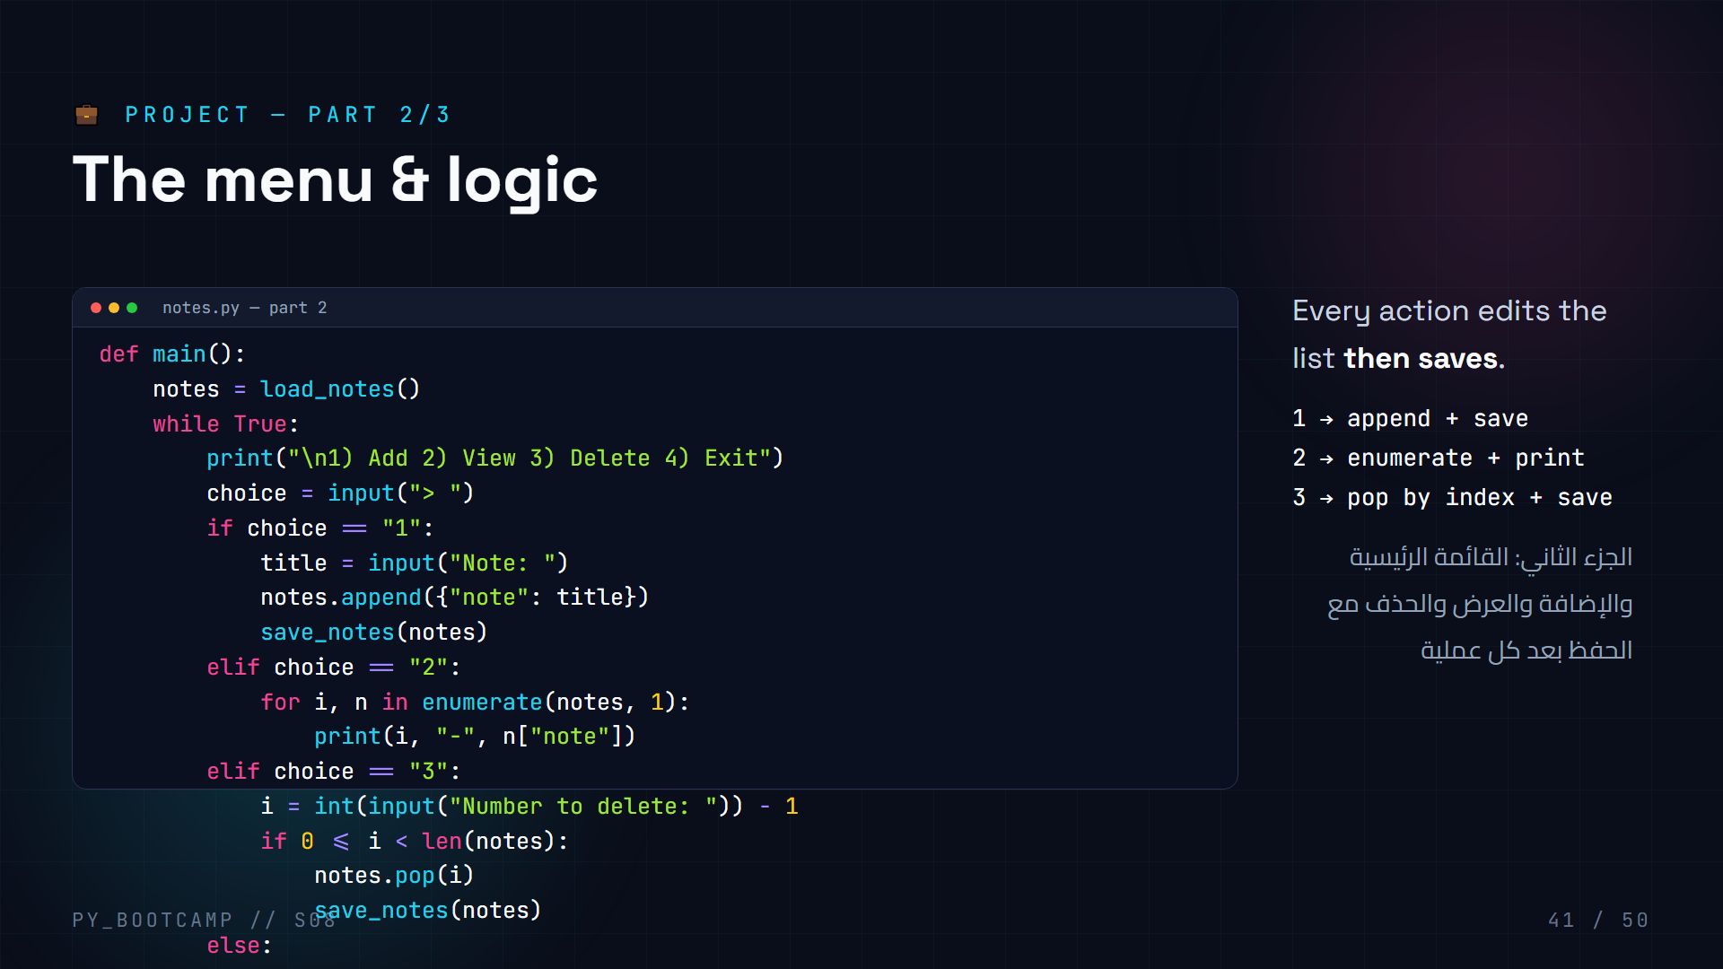
Notes:
**Project part 2 — 8 min.**
- This is the menu loop. Emphasize the invariant: any change to the list is followed by save_notes().
- enumerate(notes, 1) gives 1-based numbering for humans; pop uses 0-based index → subtract 1.
- Watch for the off-by-one bug; guard with `0 <= i < len(notes)` before popping.
- Let students run, add 3 notes, exit, re-run → notes persist.
- Arabic tip: «عدّل ثم احفظ فوراً» (edit then save immediately).

Slide 42
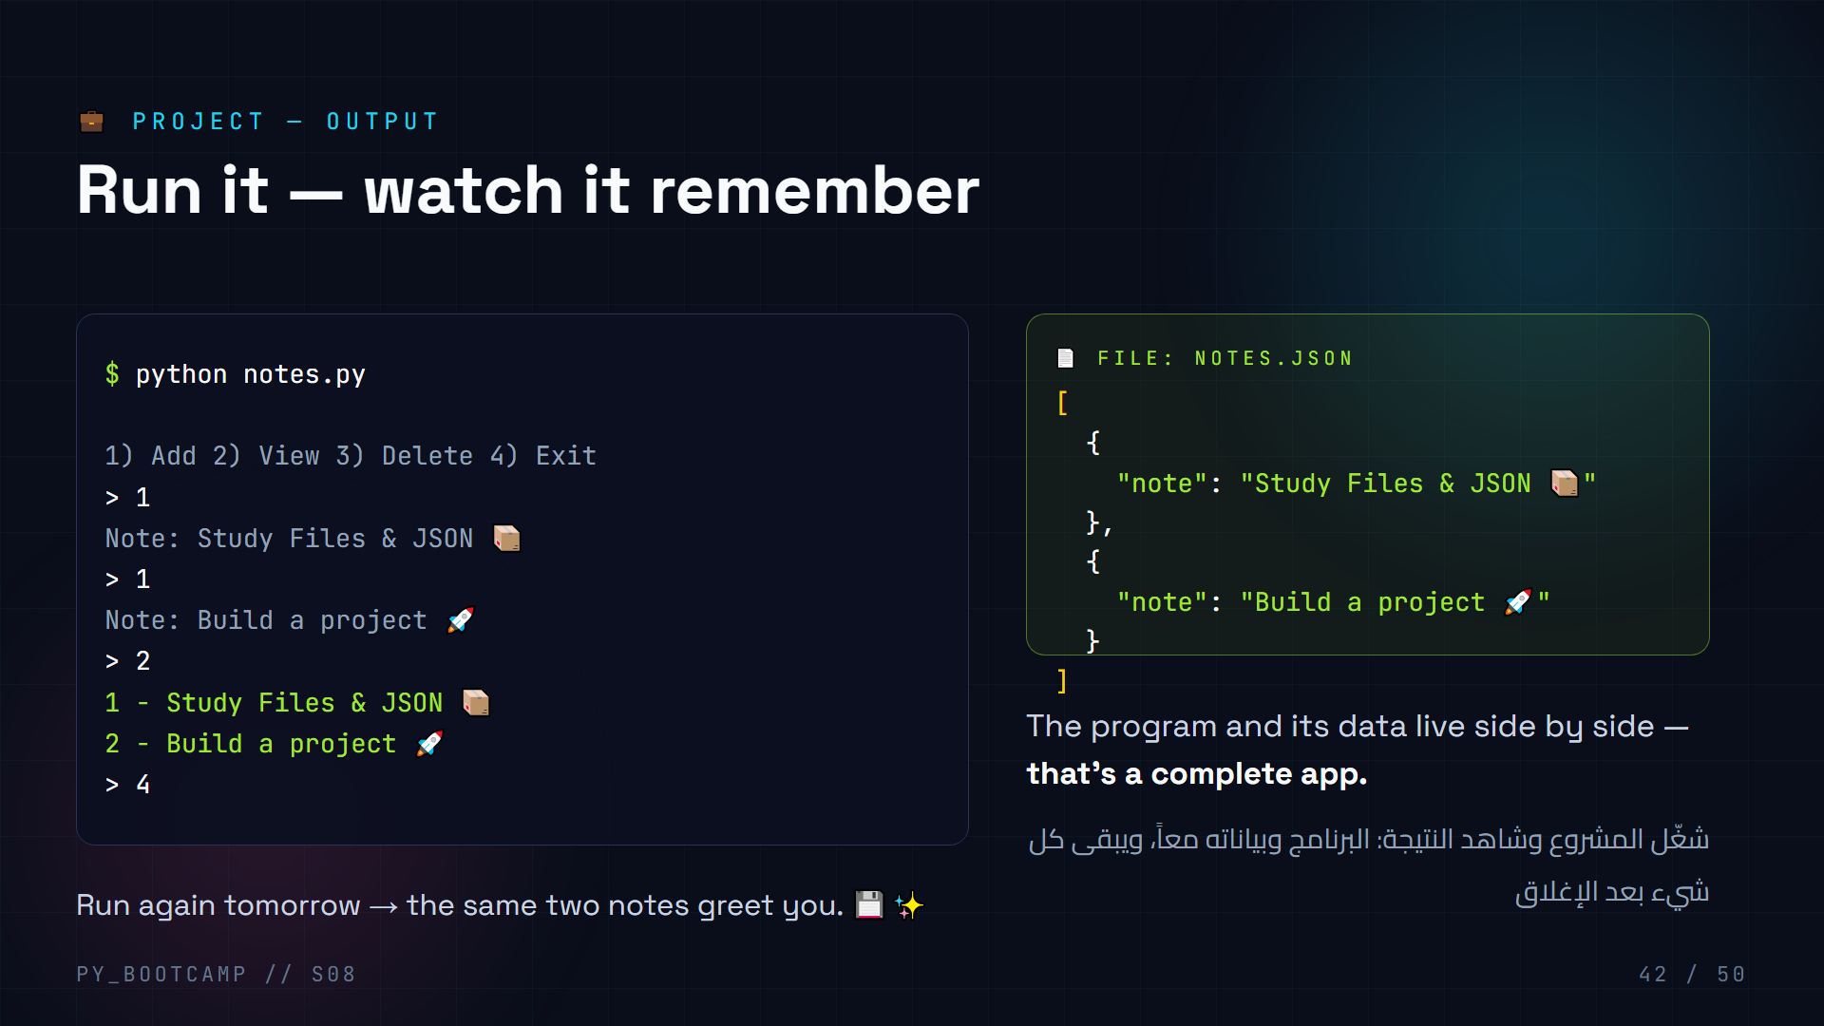
Notes:
**Project output — 4 min.**
- Run a student's completed notes.py on the projector. Add notes, view, delete one, exit.
- Open notes.json side-by-side to connect terminal → file.
- Then relaunch: the data survived. Cue the applause — this is the session's payoff.
- Arabic tip: «البيانات نجت من الإغلاق» (data survived closing) — celebrate in Arabic.

Slide 43
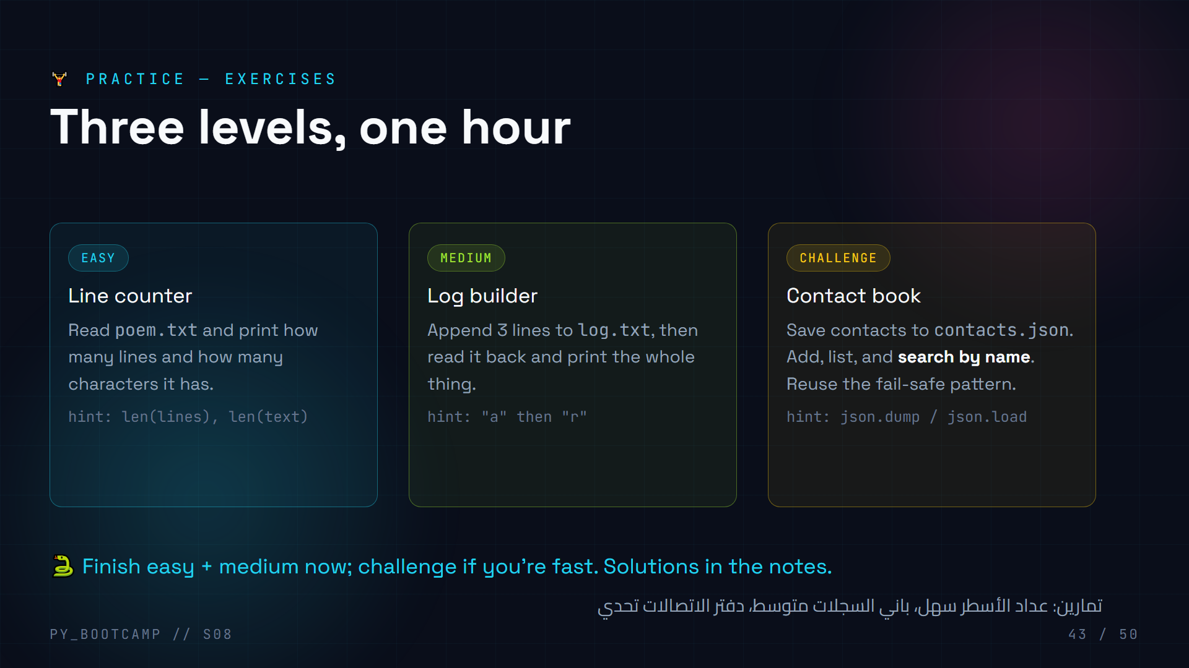
Notes:
**Exercises — 25 min.**
Easy solution:
```python
with open("poem.txt") as f:
lines = f.readlines()
print("lines:", len(lines))
print("chars:", sum(len(l) for l in lines))
```
Medium solution:
```python
with open("log.txt", "a") as f:
f.write("line 1\nline 2\nline 3\n")
with open("log.txt") as f:
print(f.read())
```
Challenge: contact book reusing load/save + a loop comparing `c["name"] == search`.
Coach around: forgetting `\n`, and FileNotFoundError on first run. Arabic tip: «جرّب ثم أعد المحاولة» (try, then try again).

Slide 44
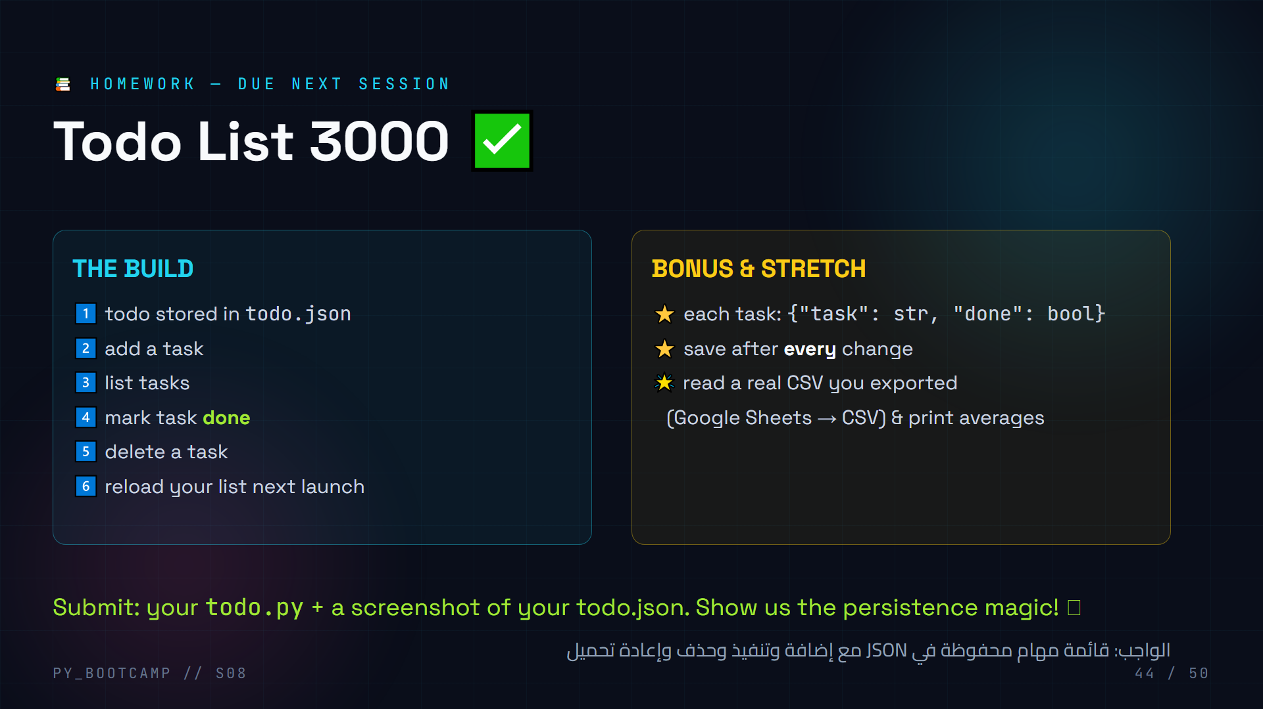
Notes:
**Homework — 3 min.**
- Clear acceptance criteria: todo.json persists; every change saves; done flag works.
- The CSV bonus is the "real world" task — many will be amazed a Sheet becomes a file.
- Give a starter tip: copy load_notes/save_notes from the project and rename.
- Arabic tip: «قائمة المهام» (to-do list) — assign confidently, it's within their skills now.

Slide 45
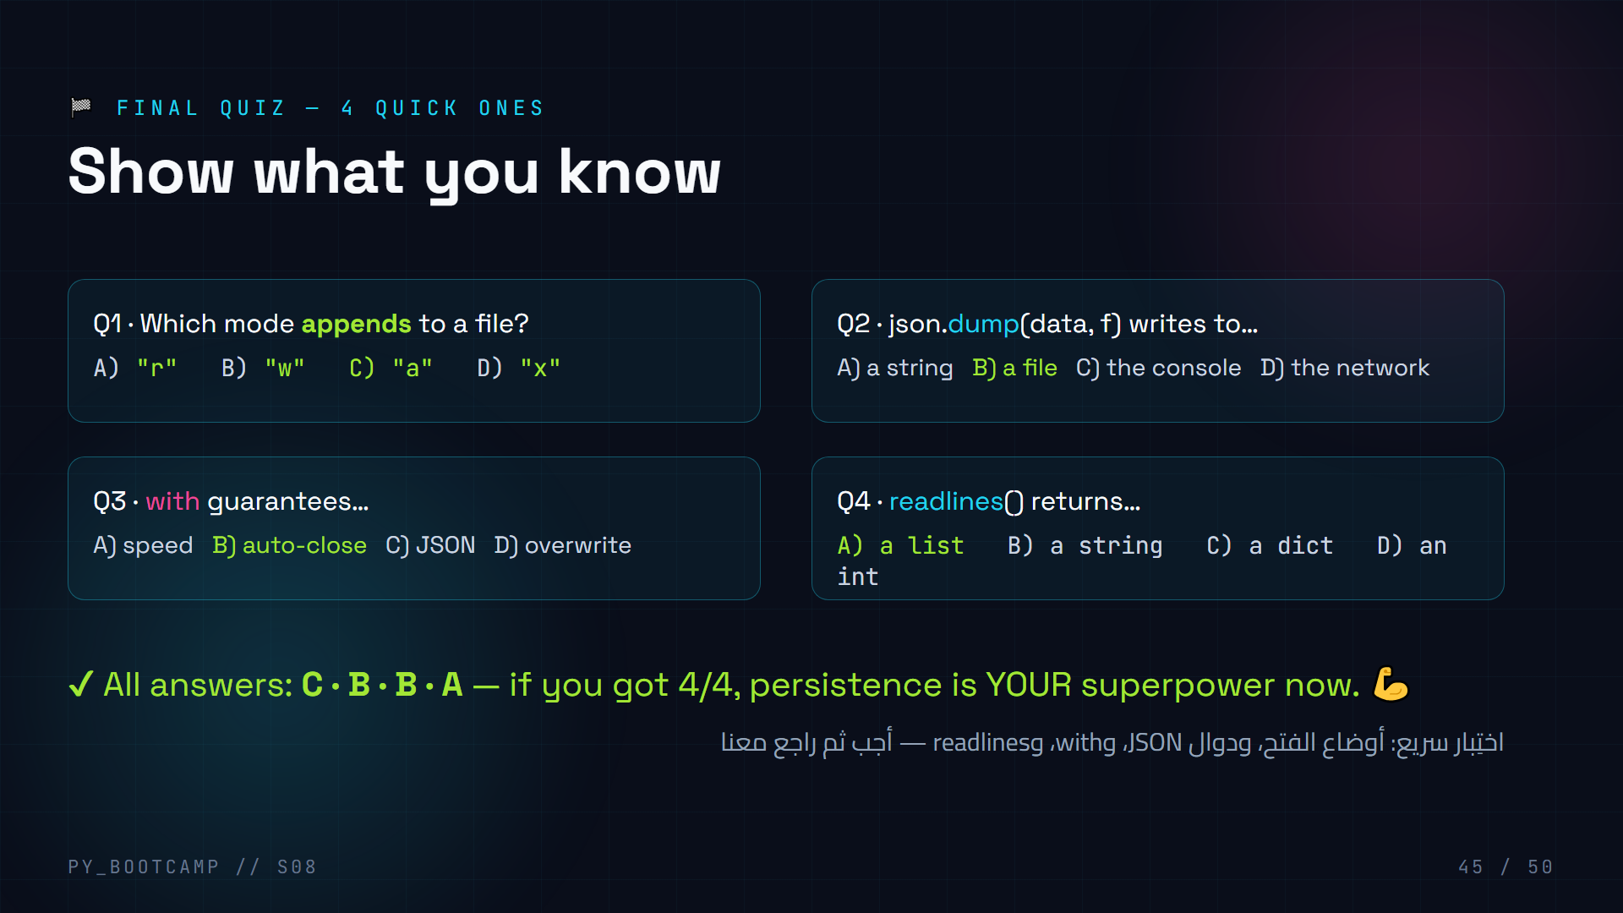
Notes:
**Final quiz — 5 min.**
- Run as a quick-fire: read Q, count to three, students show 1-4 fingers.
- Q1: append = "a". Q2: dump = file (dumpS would be string). Q3: with = auto-close. Q4: readlines = list.
- Review each wrong answer briefly; celebrate perfect scores.
- Arabic tip: «واحد اثنان ثلاثة» countdown with fingers.

Slide 46
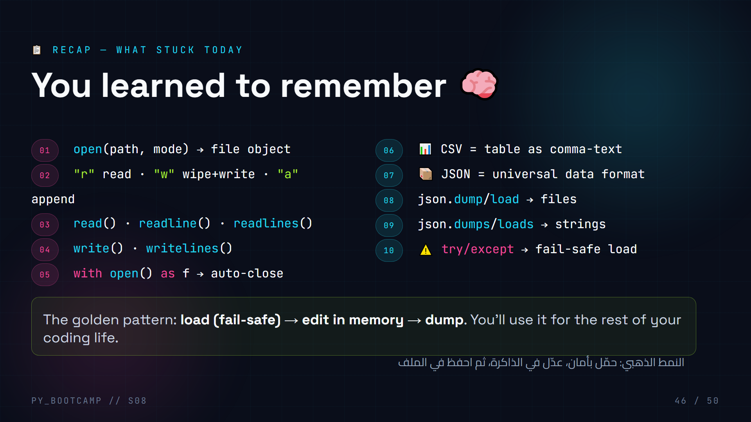
Notes:
**Recap — 3 min.**
- Rapid-fire the 10 bullets; students shout the answers before you read them.
- End on the golden pattern — this one sentence is the course's takeaway.
- Arabic tip: «النمط الذهبي» (the golden pattern) — let it land.

Slide 47

Notes:
**Bridge — 3 min.**
- Sell the next session hard: exceptions = bulletproof code, modules = clean code, pip = the entire internet of libraries.
- Connect: today's JSON work becomes API work next session.
- Ask who's excited to fetch live data — build the anticipation.
- Arabic tip: «سنقرأ بيانات حية من الإنترنت» (we'll read live data from the internet).

Slide 48
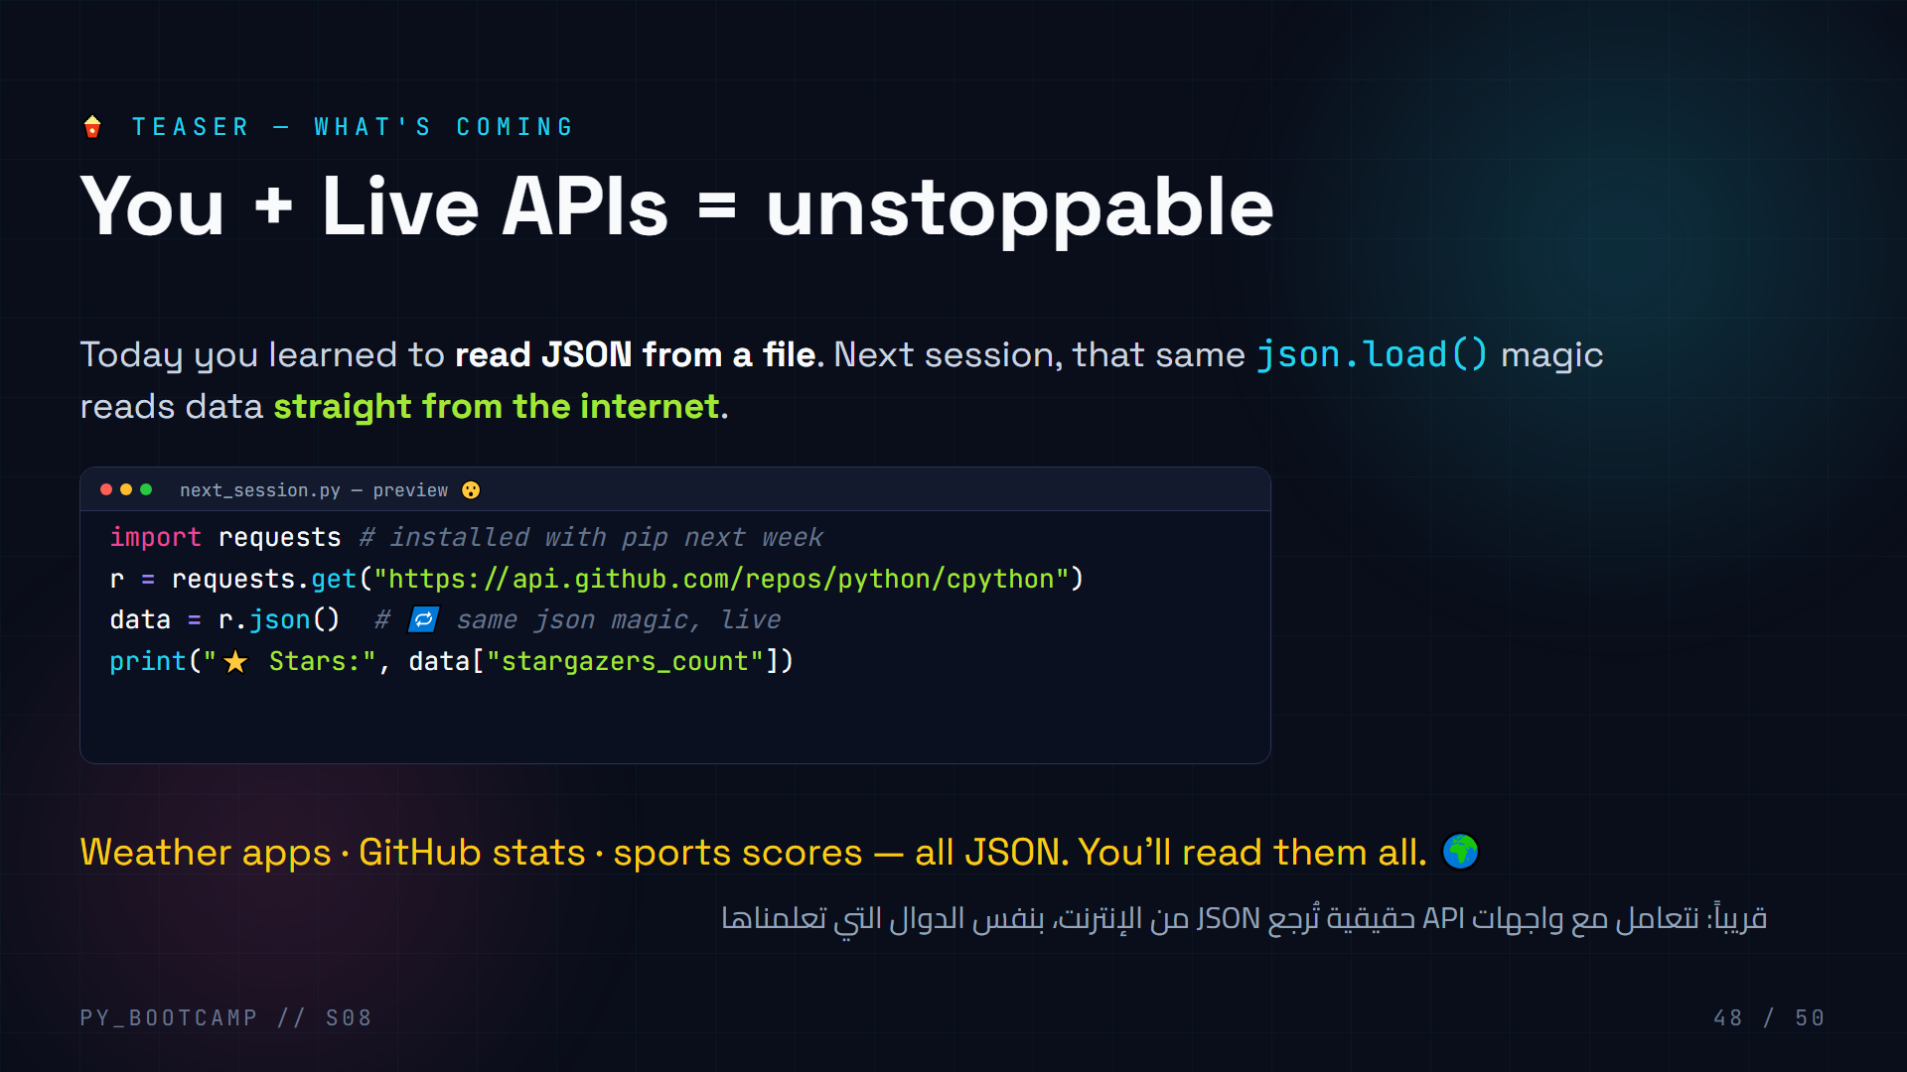
Notes:
**Teaser — 3 min.**
- Show the preview: requests.get + .json() — note how familiar json.load feels.
- Set expectations: "same data format, now from the whole internet."
- Ask them to dream up apps: weather, movies, stock prices, football stats.
- Arabic tip: «الإنترنت يرسل JSON» (the internet sends JSON) — simple and memorable.

Slide 49
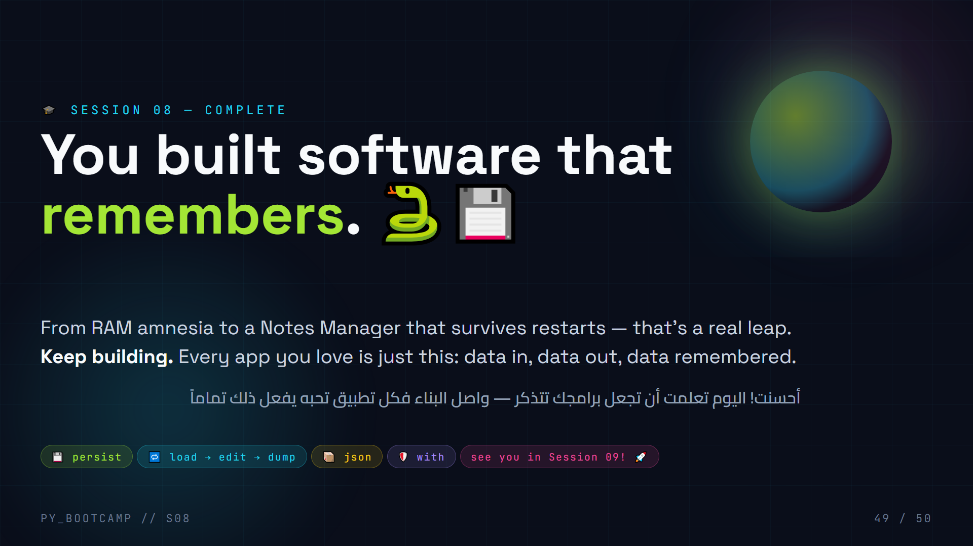
Notes:
**Closing — 3 min.**
- Congratulations + quick emotional beat: "Two hours ago your programs forgot everything. Now they don't."
- Encourage them to actually USE the notes manager all week.
- Preview the wave goodbye to Session 09 and remind them of homework.
- Arabic tip: say «أحسنت» (well done) — a warm close in Arabic.

Slide 50
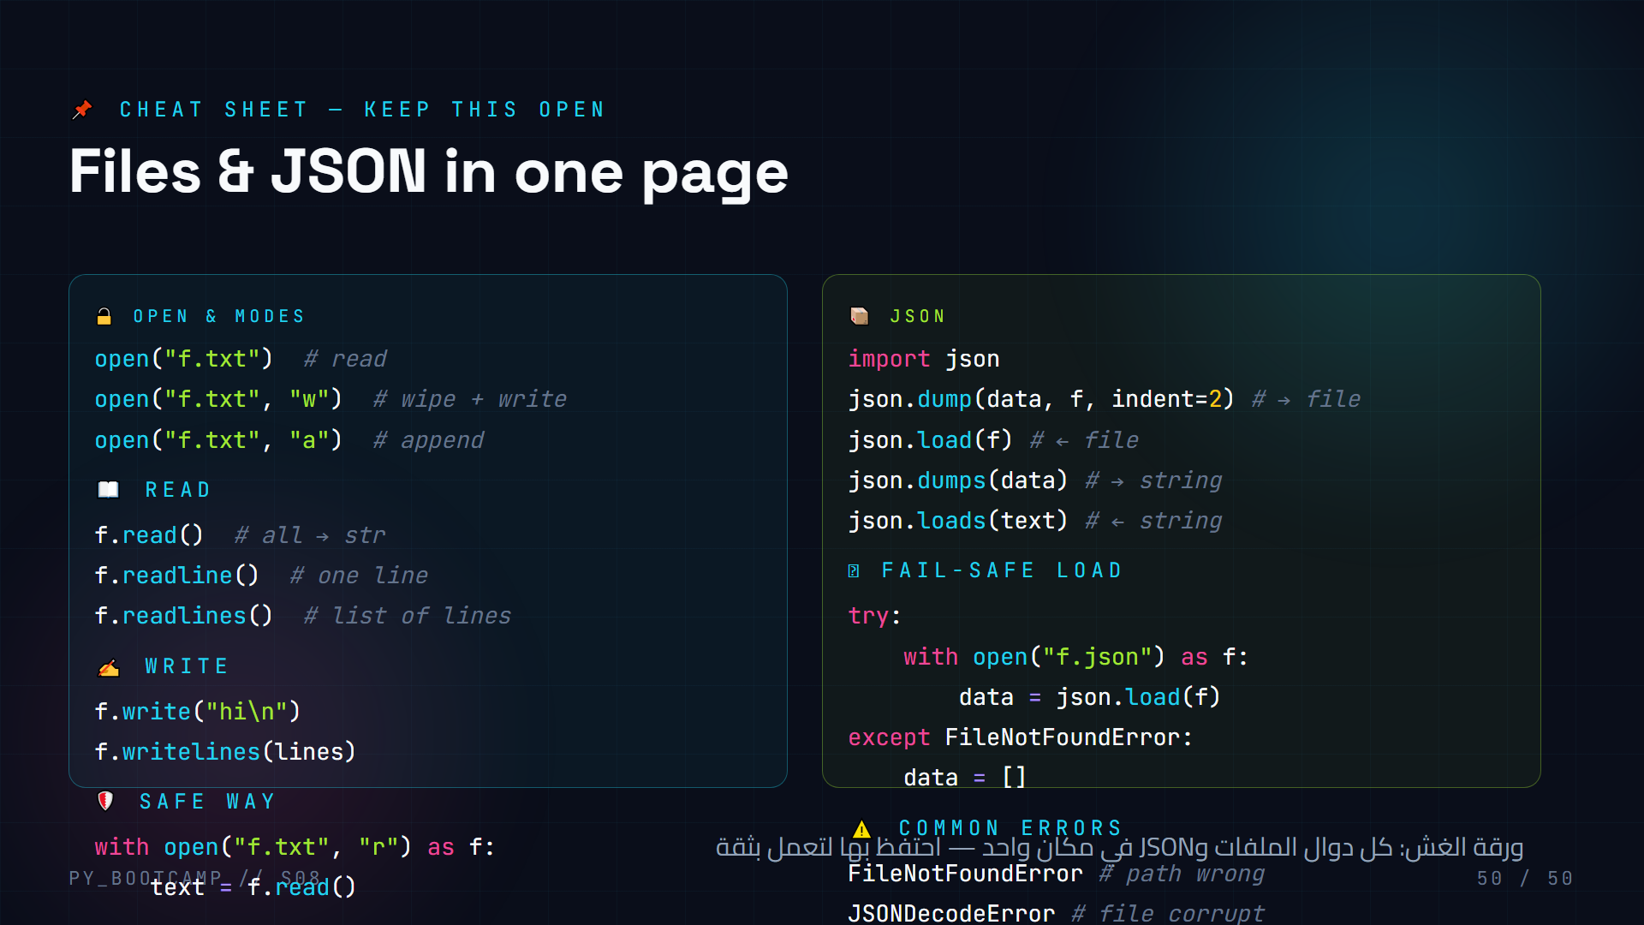
Notes:
**Cheat sheet — close of session.**
- Encourage screenshotting or saving this slide as a reference while coding.
- Read through once quickly; point at the fail-safe load as "the one you'll paste most."
- Remind: dumps/loads for strings (the s), dump/load for files.
- Arabic tip: «الورقة المرجعية» (the reference sheet) — tell them to keep it handy.

