Slide 1
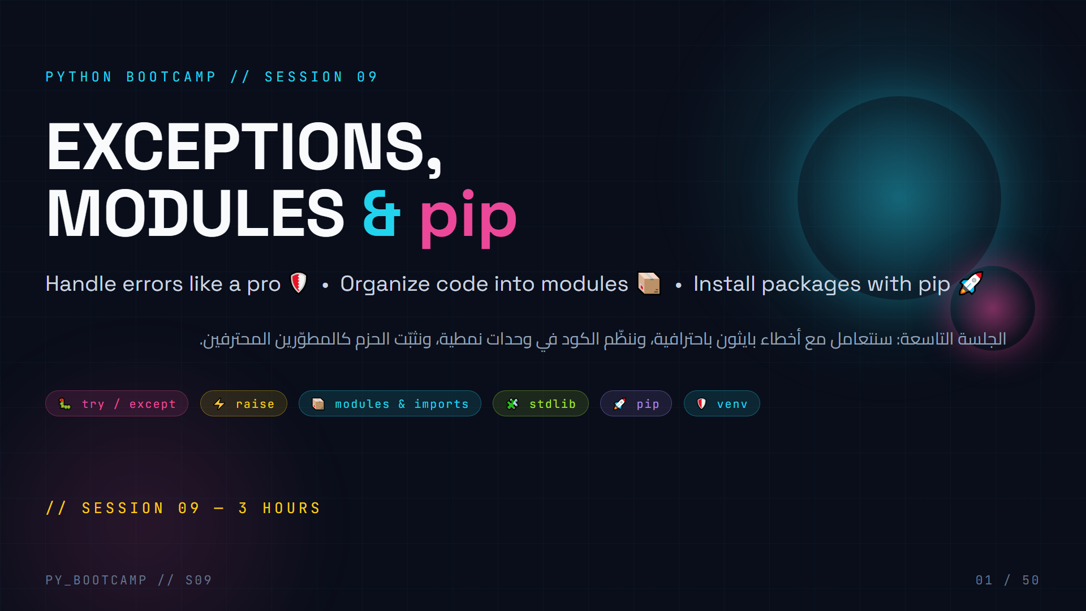
Notes:
## Cover — Exceptions, Modules & pip
**Greeting (2 min).** Welcome the class back. Celebrate that they already finished Files & JSON — that means they can persist data. Today we make their programs *unbreakable*.
**What today feels like.** "Last session you learned to save data to files. But what happens when a file doesn't exist? When someone types 'banana' into a number field? Today you learn to handle that like a real developer."
**Hook the energy.** Ask: "Raise your hand if a program of yours ever crashed on you." (Most hands go up.) "By the end of today, your programs will catch every one of those crashes."
**3-hour plan in one line.** Errors first, then defense (try/except), then organizing code (modules), then the real-world toolchain (pip + venv), then we build one big robust CLI app together.
**Arabic tip:** start with a quick poll in Arabic: من منكم تعرّض لخطأ في برنامجه؟ (Who has ever hit an error?) Builds instant relevance.

Slide 2
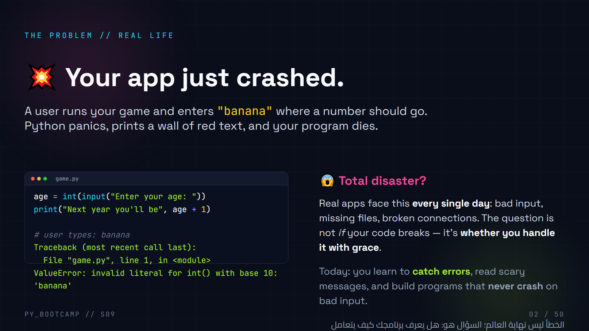
Notes:
## Hook — the crash moment
**Read the code out loud.** Walk through `int(input(...))` and the user typing "banana". Have a volunteer "act as the user" and type banana.
**Make it visceral.** Ask: "How does it feel when an app you use crashes and loses your work?" (Rage.) "Now imagine YOUR users feeling that because you didn't handle one line of input."
**Frame today's promise:** After today, the same program will print a friendly "That's not a number, try again" and keep running.
**Live option (1 min):** actually run `int("banana")` in IDLE/terminal and show the real traceback so students see it's real, not stage magic.
**Arabic tip:** قرّب الفكرة بمثال حياة يومية: المايكروويف الذي يصرخ عند إدخال رقم خاطئ — أي برنامج جيد يتعامل مع الخطأ بدون انهيار. (A microwave that beeps instead of exploding is error handling.)

Slide 3
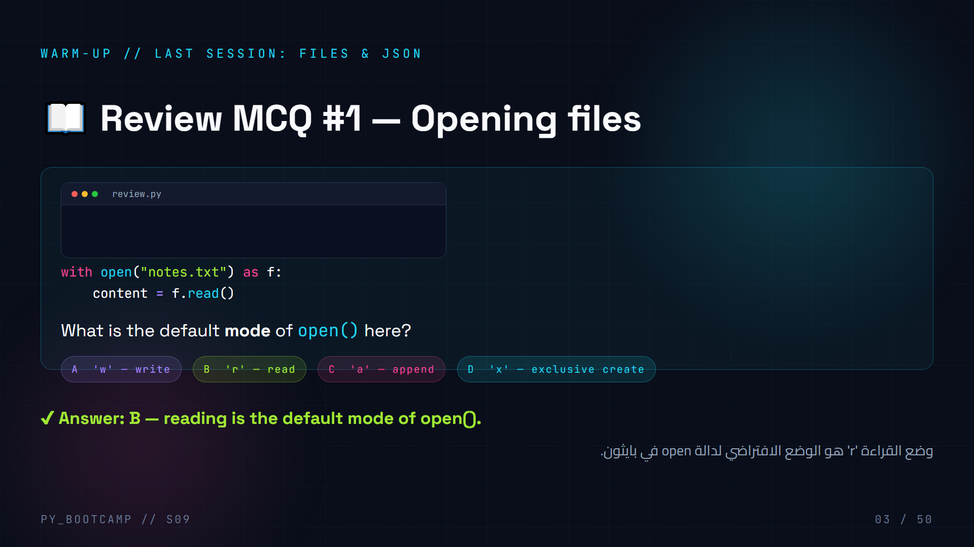
Notes:
## Review MCQ #1 — file modes
**Ask the class (30 sec), then reveal.** Let them vote with fingers (1-4) before showing the answer.
**Explain briefly:** `open("notes.txt")` defaults to mode `'r'` (read). `'w'` overwrites and truncates, `'a'` appends, `'x'` creates but errors if the file exists. This ties directly into today: FileNotFoundError happens when reading a file that doesn't exist.
**Bridge:** "Why do I care about file modes today? Because when a file is missing, Python raises an exception — and today is ALL about exceptions."
**Arabic tip:** كلمة "افتراضي" (default) — ذكّرهم أن open() تقرأ افتراضيًا، لذلك أغلب الأخطاء تأتي من ملفات غير موجودة.

Slide 4
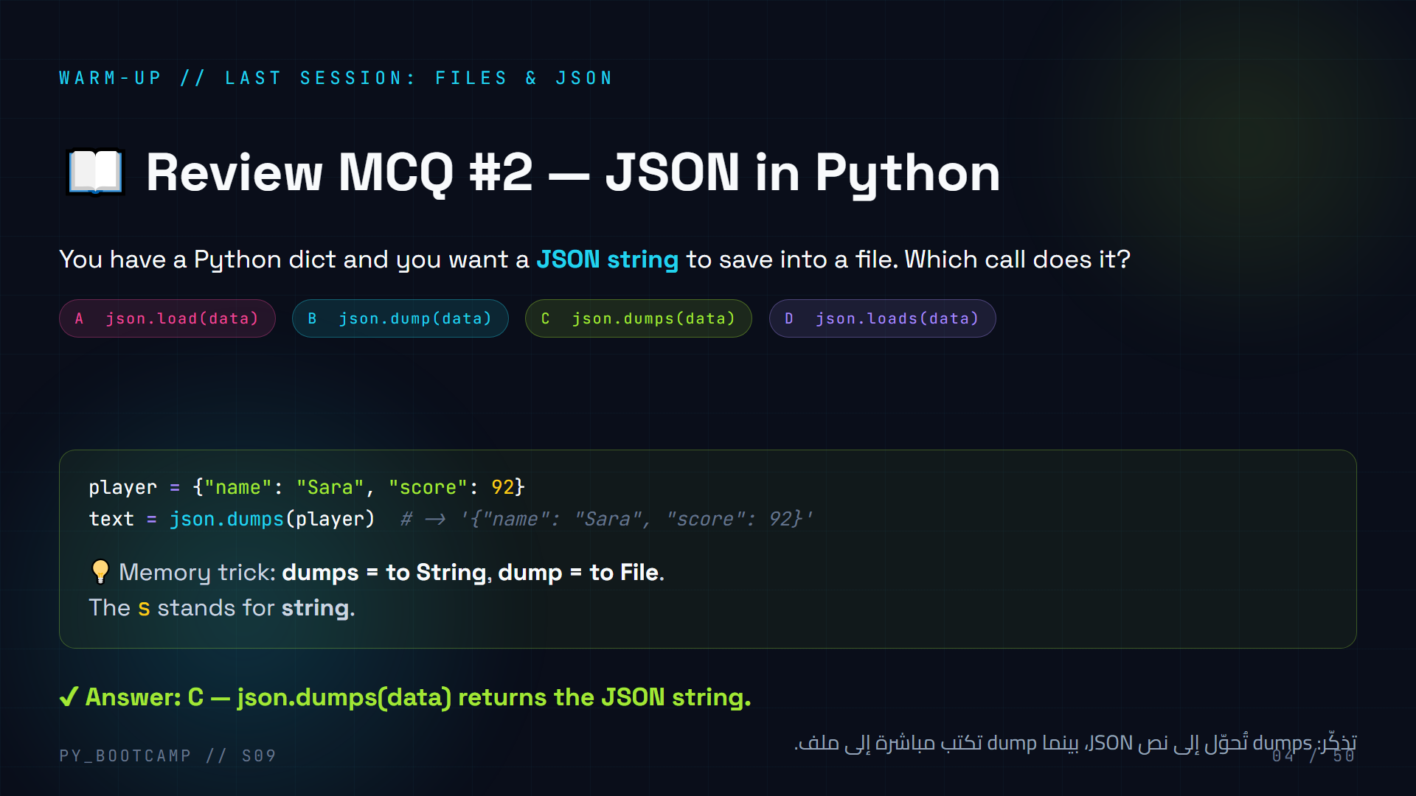
Notes:
## Review MCQ #2 — json.dumps vs json.dump
**Have them answer first** (A-D), then reveal C.
**Key teaching point:** `json.dumps` → string (think "s" for string), `json.loads` → parse a string; `json.dump`/`json.load` work on **files**. Students mix these up constantly — hammer the "s" memory trick.
**Connection to today:** json.loads / json.load can both raise errors — if the JSON file is corrupt you get a `json.JSONDecodeError`. Today we learn to catch exactly that.
**Arabic tip:** اربط "s" بكلمة "نص/سلسلة" (string). ركّز على أن الحرف s يعني نصًا وليس ملفًا.

Slide 5
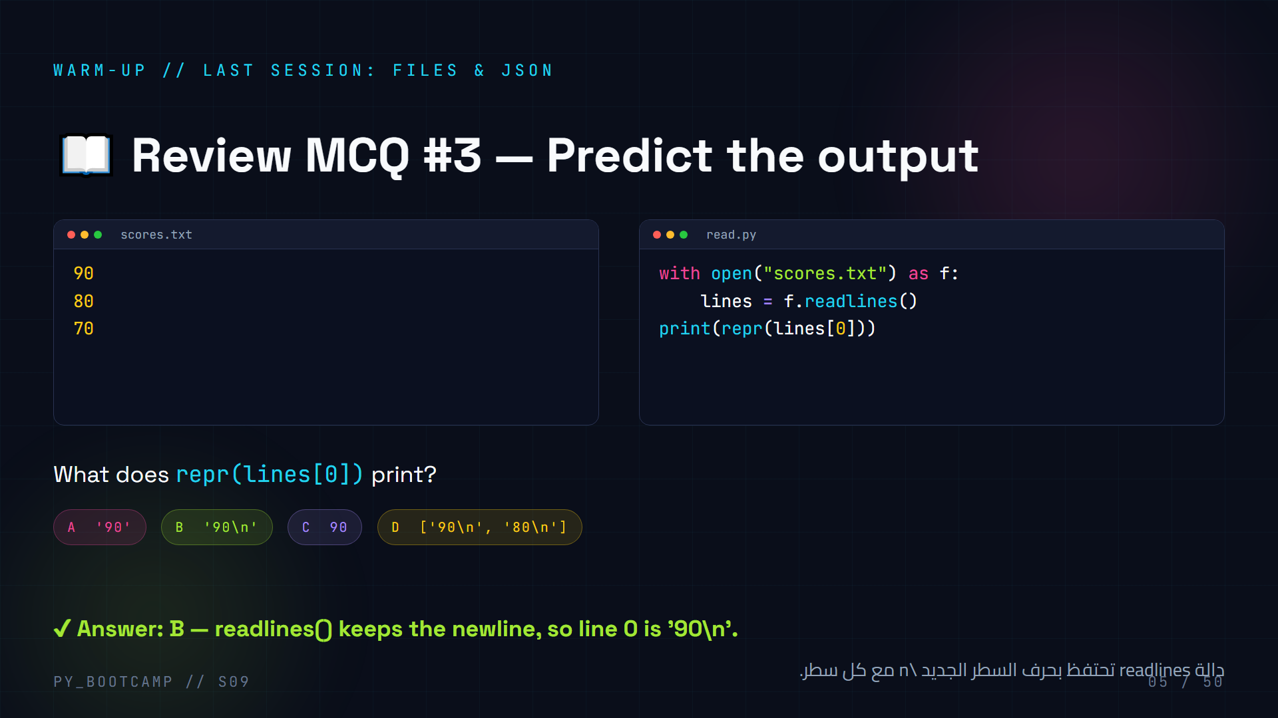
Notes:
## Review MCQ #3 — readlines keeps newlines
**Predict first.** Give 20 seconds, then reveal B.
**Explain why:** `readlines()` splits the file into lines but keeps each line's trailing `\n`. So `lines[0]` is the string `'90\n'`. Using `repr()` makes the hidden newline visible — a neat debugging trick to teach now (it will pay off when we debug tracebacks later).
**Note:** if they picked D — clarify `lines[0]` is ONE line, not a list; D describes the whole `lines` list.
**Arabic tip:** علّمهم أن الحرف \n جزء من النص ولا يُرى عند الطباعة العادية؛ استخدم repr() لإظهاره.

Slide 6
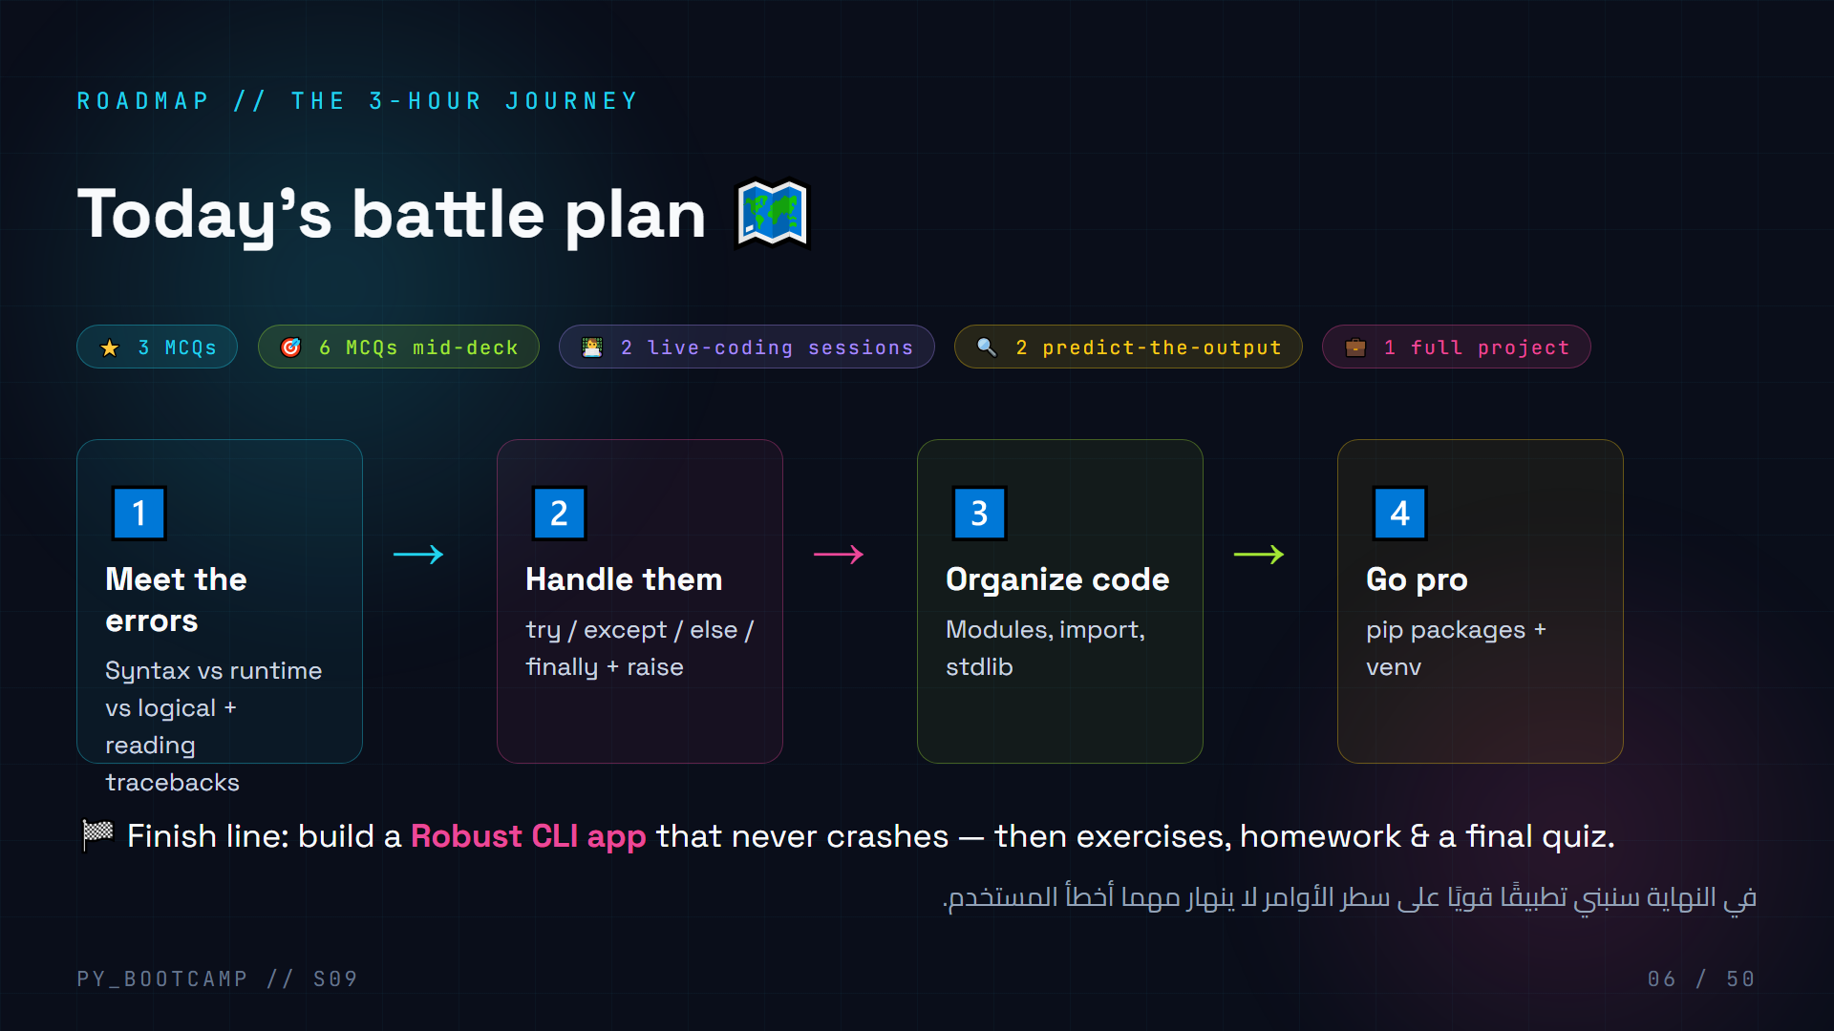
Notes:
## Timeline — the session map
**Give them the map (1 min).** Show the four islands: errors → handling → modules → pip/venv. Tell them the finish line is the Robust CLI project.
**Pacing promise:** "Two live-coding blocks, six quick MCQs, two predict-the-output challenges — you won't just listen, you'll build."
**Nudge motivation:** "Everything today is used daily by real developers. If you ship one robust CLI app today, you've done a full day of professional work."
**Arabic tip:** اسأل من يحب التحدي في نهاية الخريطة، وذكّرهم أن المشروع الختامي هو "تطبيق لا ينهار أبدًا".

Slide 7
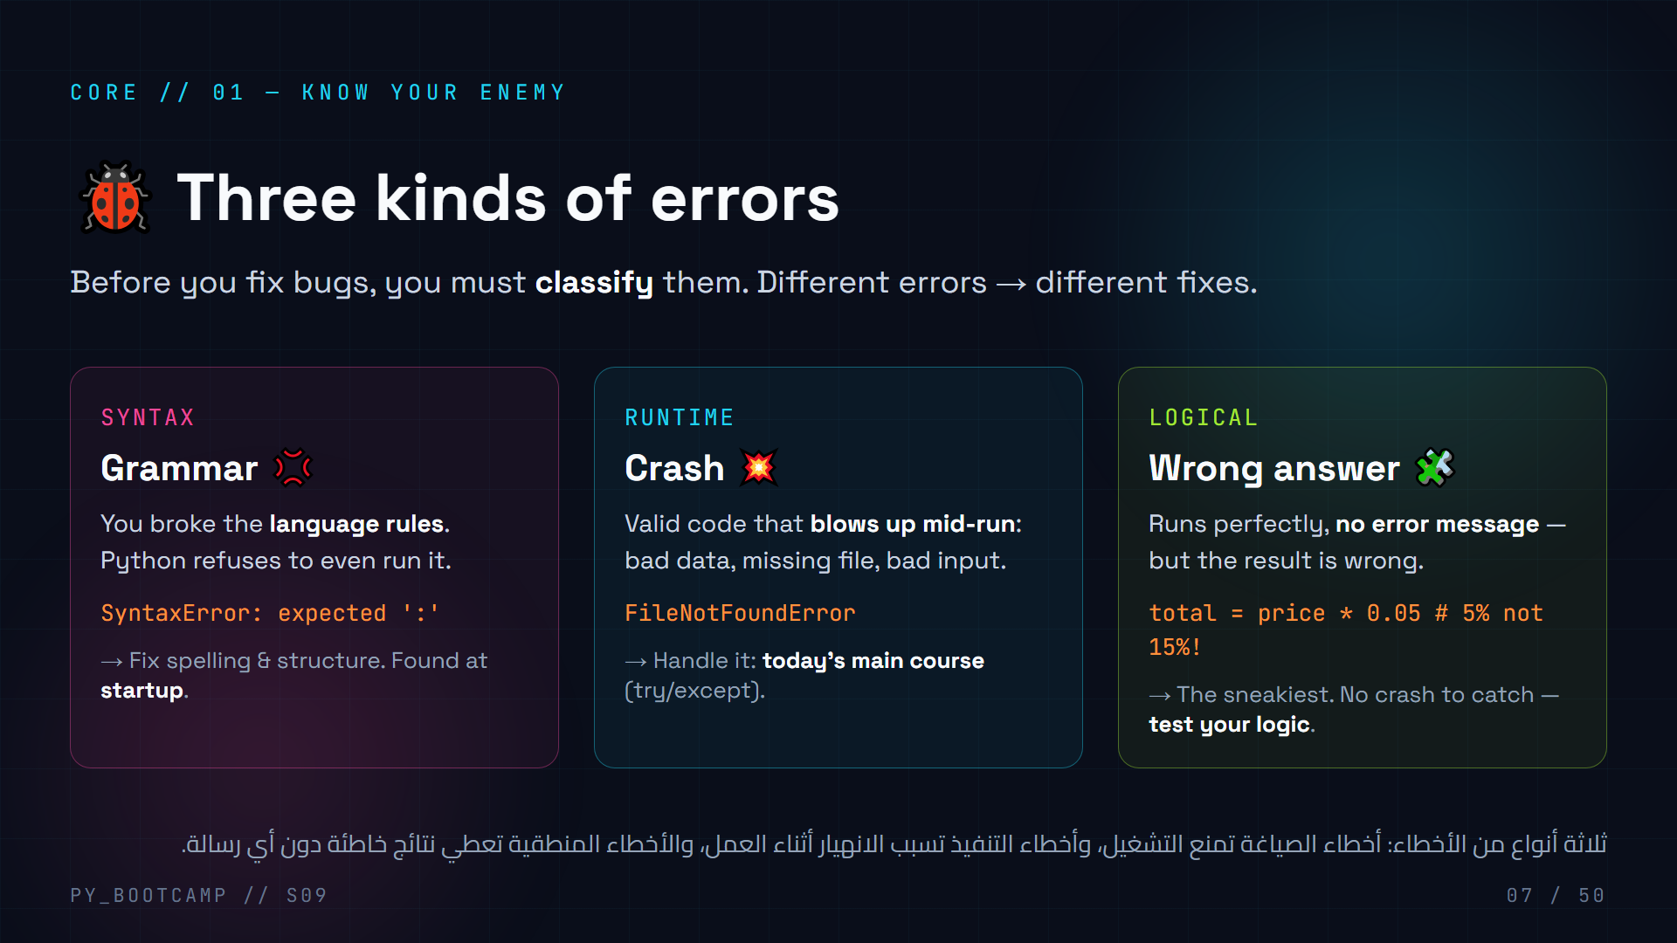
Notes:
## Three kinds of errors
**Big idea (4 min):** All bugs fall into 3 buckets. When you see an error, first ask "which bucket?"
1. **Syntax** — like a grammar mistake in a sentence. Python can't even understand it, so it stops before running. Fix: look at the line, fix the structure (missing colon, unclosed quote, wrong indentation).
2. **Runtime** — the code is legal but crashes while running (bad input, missing file, dividing by zero). THIS is what today is about: catch and handle.
3. **Logical** — no crash at all, but wrong output. This is the hardest because Python gives no help. Example: wrong tax rate in a formula.
**Live demo idea:** type `if True print("hi")` → SyntaxError; `print(1/0)` → ZeroDivisionError; `print(5*3 - 1)` vs `print(5*(3-1))` → logical "bug" no error.
**Arabic tip:** استخدم استعارة "الجرامر": خطأ صياغة = جملة مكسورة، خطأ تنفيذ = طعام محروق، خطأ منطقي = وجبة جاهزة لكن الطعم خاطئ.

Slide 8
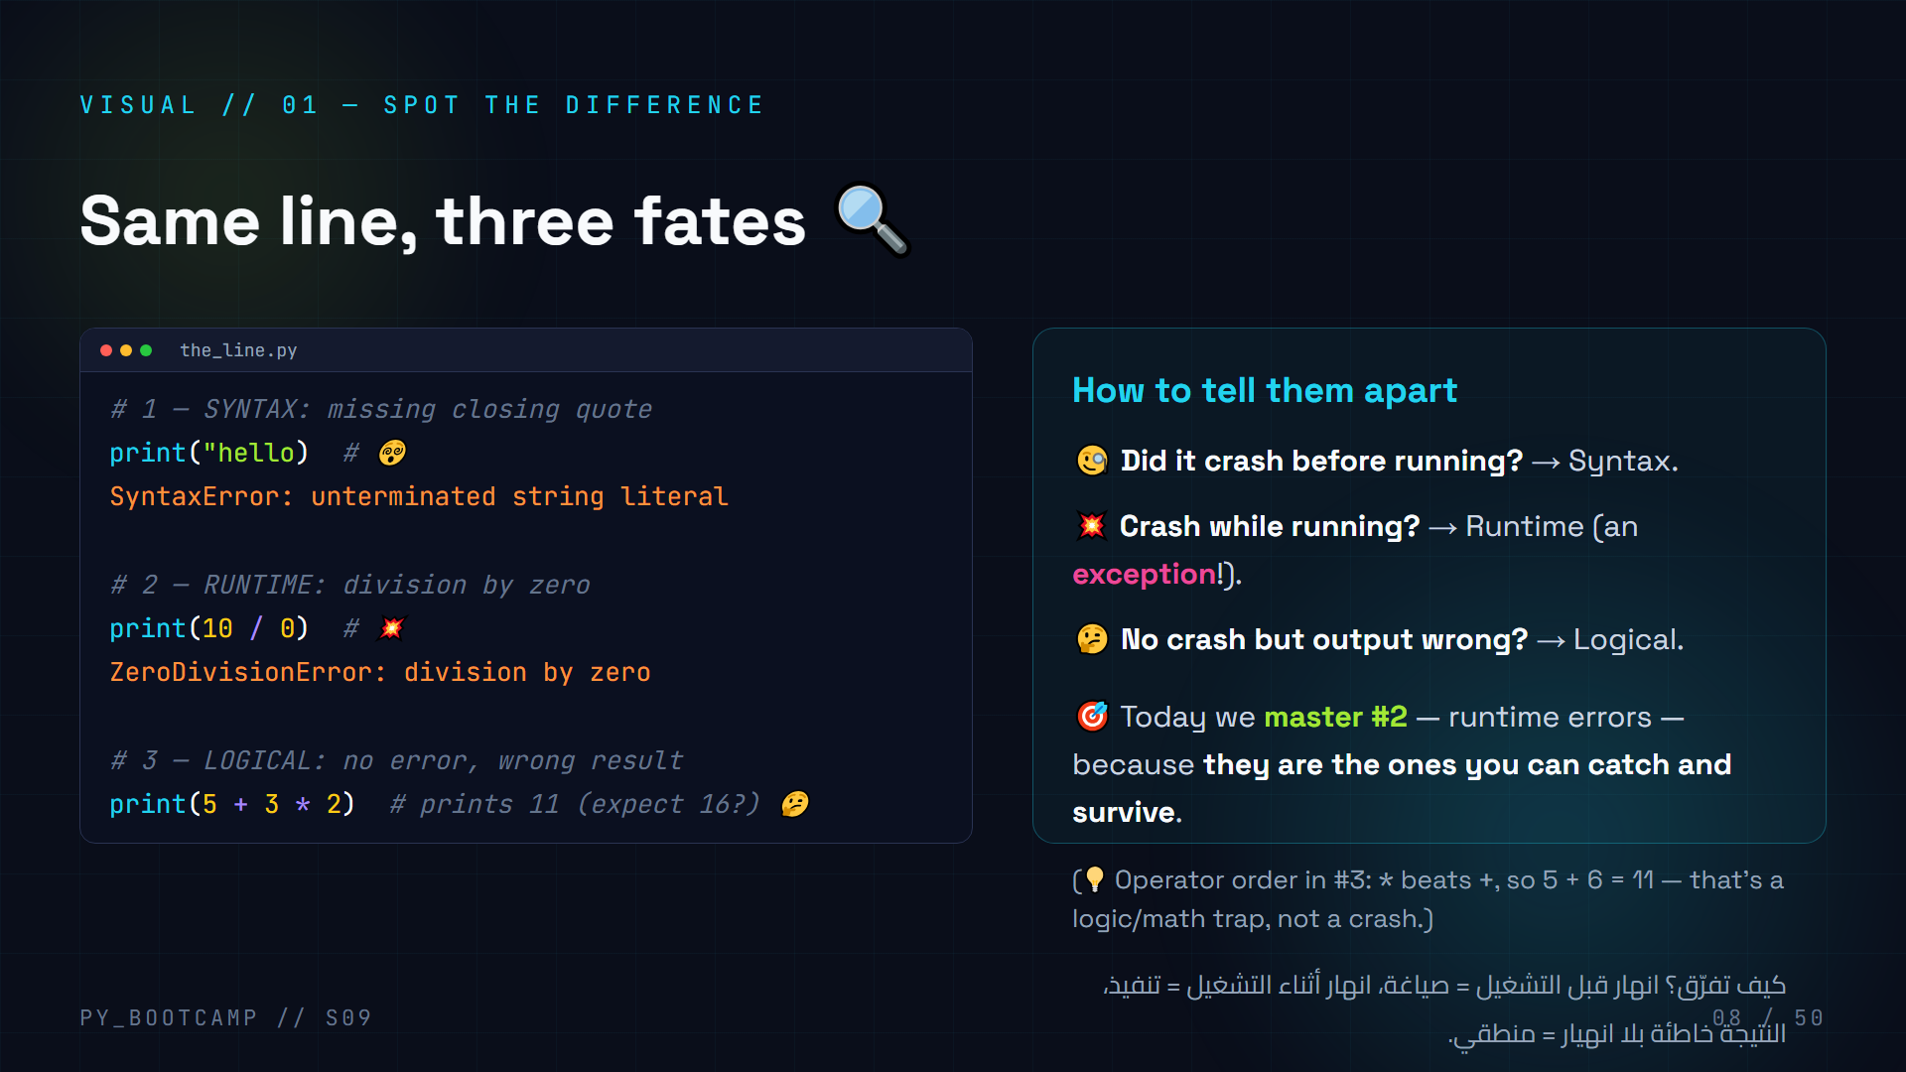
Notes:
## Visual — same line, three fates
**Walk the code window (3 min).** Point to each example:
1. Missing quote → Python can't even tokenize it → SyntaxError before anything runs.
2. `10 / 0` → ZeroDivisionError mid-run — this is the runtime exception class.
3. `5 + 3 * 2` → runs, prints 11; if you expected 16 you've got a logic bug. No traceback, no help — you must reason.
**Ask a student:** "What bucket does each fall into?" Quick choral answer.
**Reinforce the key discriminator:** crash-time vs run-time vs wrong-result. That single question classifies almost every bug.
**Arabic tip:** درّبهم على هذا السؤال الثلاثي بالعربية: هل انهار؟ متى انهار؟ هل النتيجة صحيحة؟ — سؤال واحد يصفّي معظم الأخطاء.

Slide 9
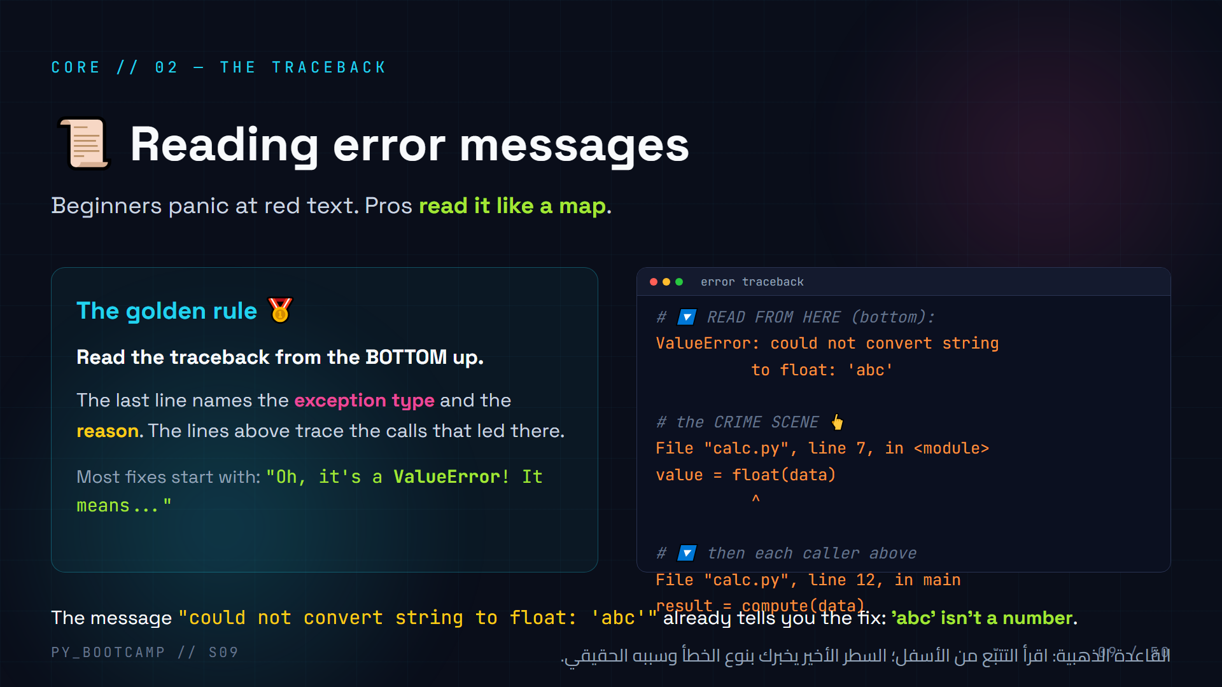
Notes:
## Reading error messages / tracebacks
**Reframe the fear (3 min):** "The traceback is not punishment — it's Python's diagnosis report. Doctors read reports to find the illness; you read tracebacks to find the bug."
**Golden rule:** read from the BOTTOM. Last line = exception type + reason. Middle lines = the exact line where it blew up (the "crime scene", marked with `^`). Top lines = the chain of calls (the "accomplices").
**Walk the example:** float('abc') → ValueError. The caret points at `float(data)`. The caller `compute()` on line 12 is where the value came from. Fix could be at the caller (validate input) OR at the crime scene (catch the error).
**Common beginner mistake:** reading top-down and getting lost in the "File ... in ..." chain. Teach bottom-up reading like a reflex.
**Arabic tip:** شبّه التتبّع بالتقارير الطبية: آخر سطر هو التشخيص، والسطر الذي تحته علامة ^ هو موضع الجرح.

Slide 10
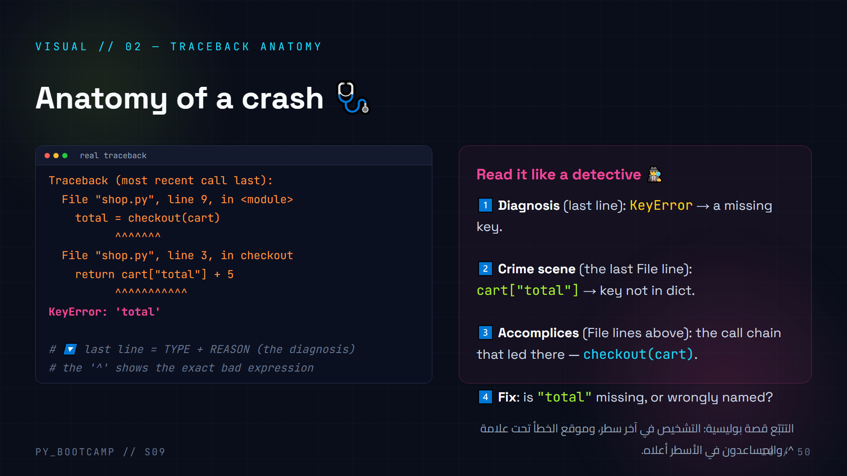
Notes:
## Visual — traceback anatomy
**Read it like a detective.** This slide gives the full mental model. Do it step by step:
1. Last line: `KeyError: 'total'` — the exception type and what was missing.
2. Crime scene: `cart["total"]` with `^^^^` under it — the exact expression that failed.
3. Accomplices: the call chain, `main` → `checkout` → boom.
4. Fix: the key "total" doesn't exist in the cart dict — check how `cart` was built.
**Hands-on tip:** tell students the FIRST thing they do on any error: read the last line aloud. If they can say "it's a KeyError, key 'total' is missing", they're already debugging like a pro.
**Live demo suggestion:** create a dict `cart = {"name": "laptop"}`, try `cart["total"]` and compare the traceback shape to this slide — it will match almost exactly.
**Arabic tip:** علّمهم عادة قول نوع الخطأ بصوت عالٍ قبل أي شيء — نصف الحل في فهم النوع.

Slide 11
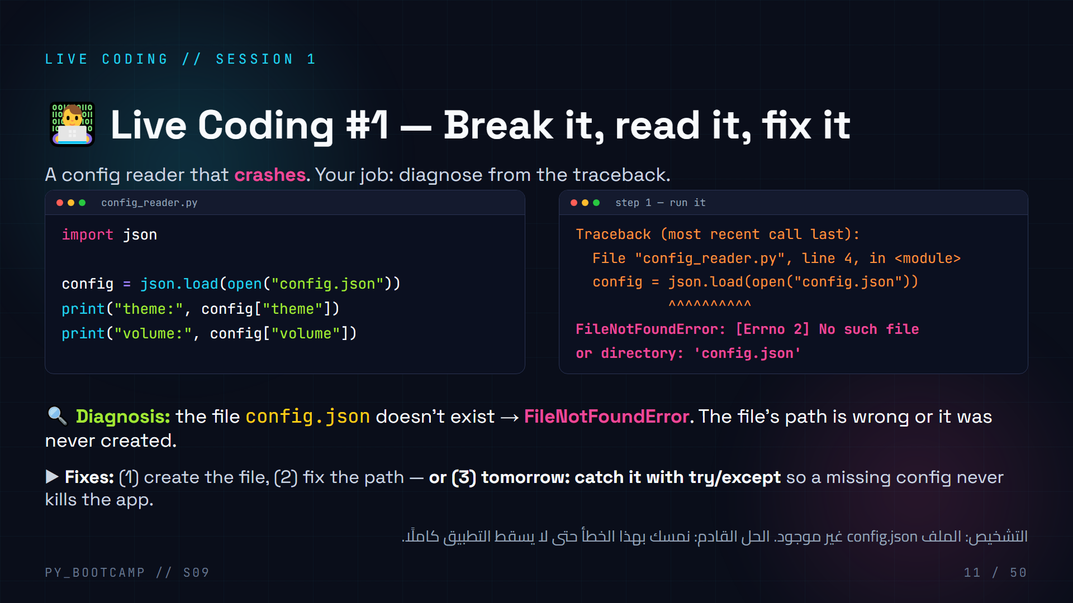
Notes:
## Live coding #1 — break it, read it, fix it (12 min)
**Setup (2 min):** create `config.json` with {"theme": "dark", "volume": 7} in the project folder. Run `config_reader.py` — it works. Then **rename/delete the file** and run again. Cue dramatic crash.
**Step 1 — read the traceback aloud (3 min):** last line → FileNotFoundError, missing config.json. Caret under `open("config.json")`. Ask students to state the diagnosis in their own words.
**Step 2 — fix options (5 min):**
- Fix the environment (recreate the file) — demonstrate.
- Fix the code to look in the right place (path) — demonstrate with a wrong subfolder.
- Preview the real solution: wrap in try/except (we build that next).
**Step 3 — debrief (2 min):** "You just debugged like a pro: diagnose first, fix second. We did NOT rewrite the whole program."
**Arabic tip:** أخبرهم: لا تحذف البرنامج وتبدأ من الصفر عند أي خطأ — اقرأ، شخّص، أصلح. ثلاث كلمات فقط.

Slide 12
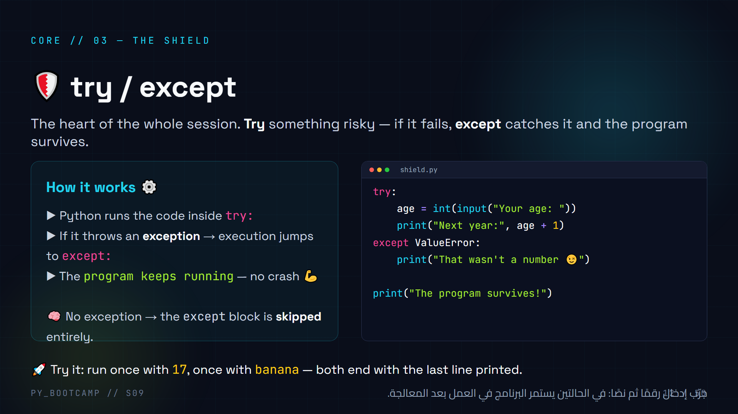
Notes:
## try / except — the shield
**This is the anchor concept.** Give it energy and clarity (6 min).
**Narrative:** try = "I'm about to do something risky." except = "if it blows up, here's my escape plan." The program does NOT die.
**Teach the control flow precisely:** draw it on the board — try block runs → if error, skip to except → after except, execution continues normally below the whole block. No exception → except is skipped.
**Catch specificity note:** here we catch `ValueError` specifically (int() raises it on bad text). Bare `except:` catches everything — warn it's a sledgehammer; you'll usually name a specific type (next slides).
**Live (5 min):** type the code together, run twice (17 then banana). Ask: "what would have happened with bare input before today?" (crash).
**Arabic tip:** اشرح كأنك تحكي: "حاول" ثم "إلا إذا حصل خطأ فافعل". كرّر المصطلحين بالإنجليزي والعربي معًا.

Slide 13
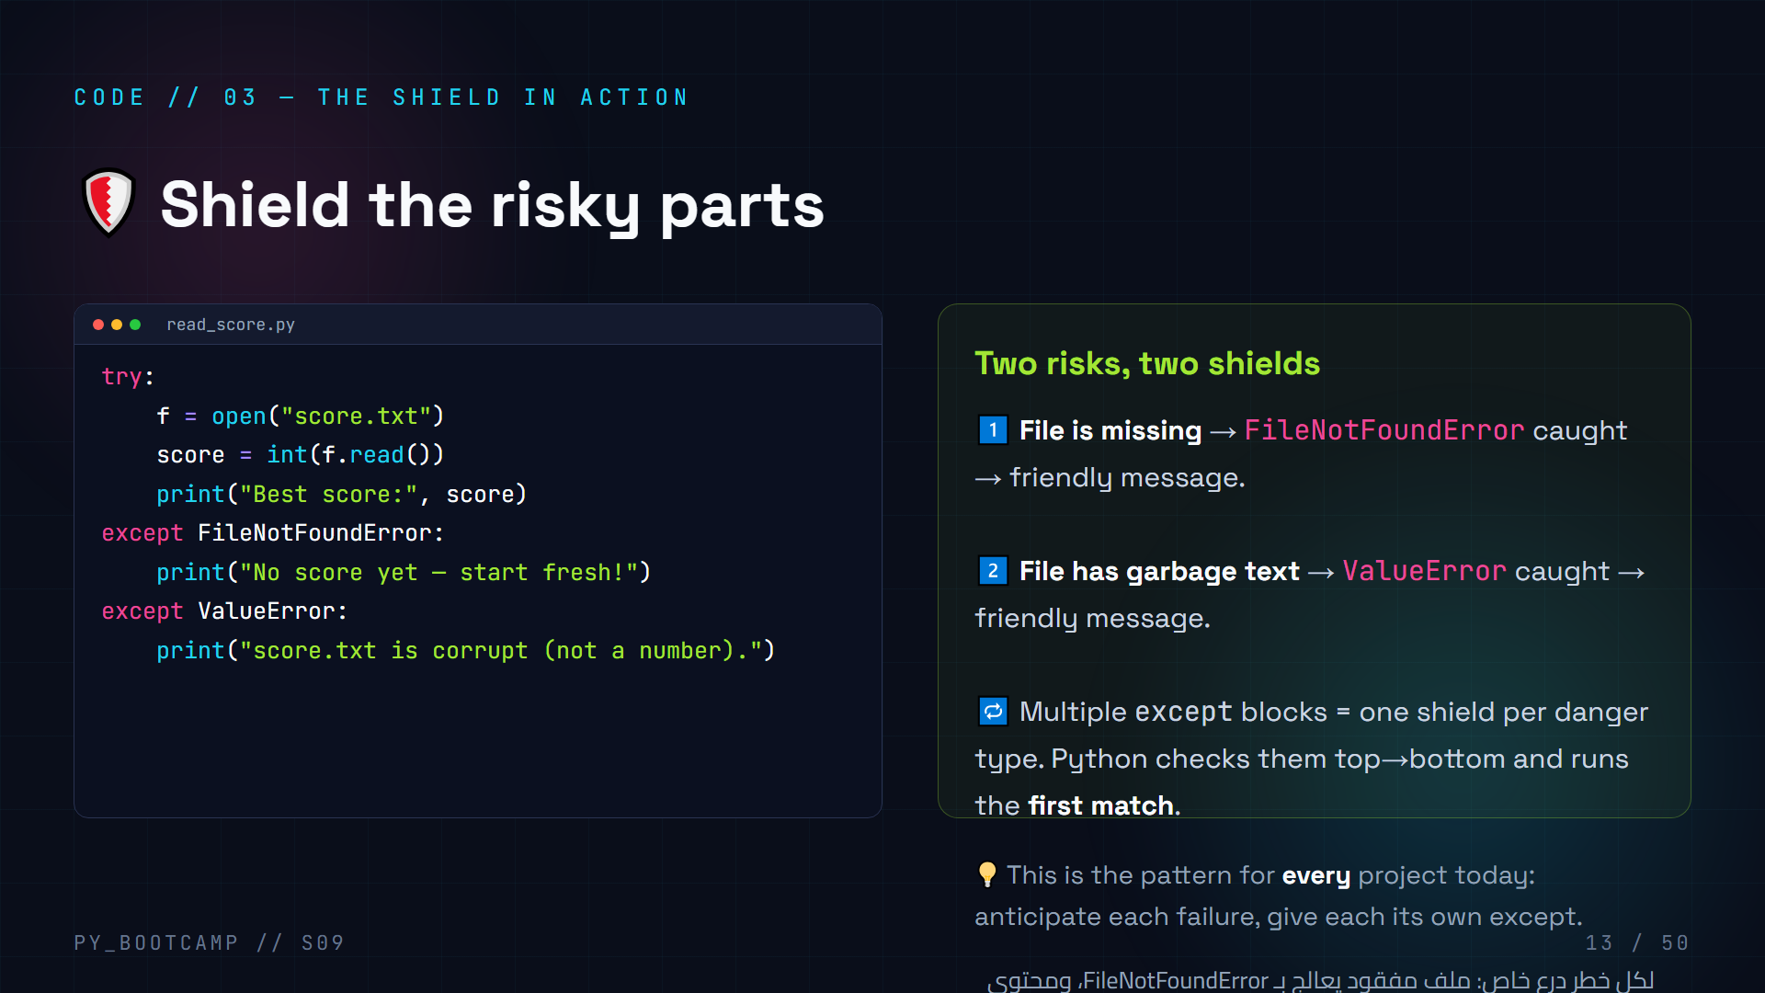
Notes:
## Code — try/except in action
**Type this together (6 min).** This is the canonical example: reading a score from a file. Two distinct failure modes, two except blocks.
**Explain control flow:** try block runs top to bottom. If `open` fails → jump to FileNotFoundError except, skip the rest of try. If file exists but `int("garbage")` fails → jump to ValueError except. If all good → both excepts skipped.
**Order matters:** Python matches the FIRST except whose type fits. Keep most specific first (FileNotFoundError is a subtype of OSError — if you had `except OSError` first, FileNotFoundError would be swallowed by it).
**Live test:** create score.txt with "95" → works. Delete it → "No score yet". Write "abc" in it → "corrupt". Three runs, three outcomes, zero crashes.
**Arabic tip:** اكتب السيناريوهات الثلاثة على السبورة وشغّل كلًا منها أمامهم — الرؤية المباشرة تُثبت الفكرة.

Slide 14
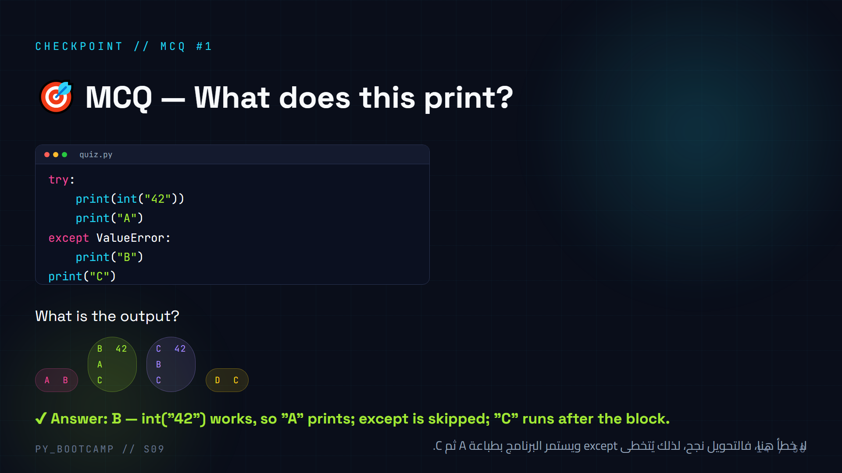
Notes:
## MCQ #1 — try/except flow
**Predict first, reveal after (2 min).** Common wrong answers: A (they think the except always runs) and C (they think "A" still prints after an error).
**Explain the correct trace:** int("42") is fine → prints 42 → prints "A" → no exception → except skipped → prints "C". Output: `42\nA\nC`.
**Contrast to make it stick:** "What if the string were 'banana'? Then output would be B then C." Write both versions side by side.
**Arabic tip:** اربط بالنشاط: اطلب منهم تتبع تنفيذ السطور بأصابعهم — أي خط ينفّذ وأي خط يُتخطى.

Slide 15
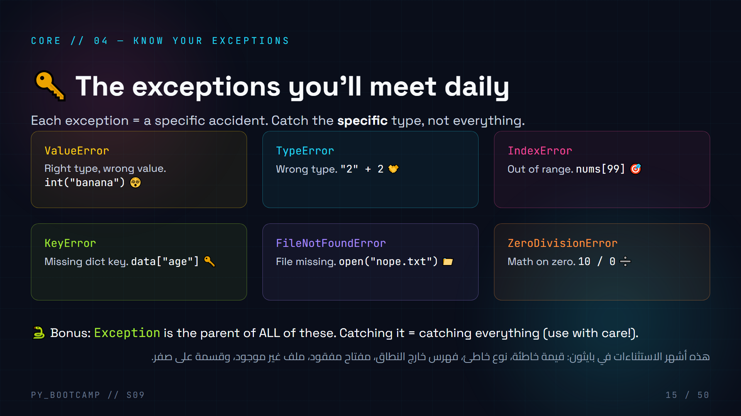
Notes:
## Common exception types
**Rapid-fire (4 min).** Six exceptions, six one-line accidents. Go fast — this is vocabulary, and vocabulary needs repetition.
- ValueError: the value is invalid for the operation (int("banana")).
- TypeError: wrong type involved ("2" + 2 — str + int).
- IndexError: index out of bounds on a list/string.
- KeyError: dict key doesn't exist.
- FileNotFoundError: open() on a nonexistent file.
- ZeroDivisionError: dividing by zero.
**Memory hooks:** each card has an emoji (😵 🤝 🎯 🔑 📁 ➗). Ask students to recall each exception from the emoji.
**Pro tip:** you can catch each one specifically. Mention that later slides (16) show the actual raised messages.
**Arabic tip:** ذكّرهم: اسم الاستثناء بالإنكليزية هو "التشخيص" — احفظ الاسم تعرف العلاج.

Slide 16
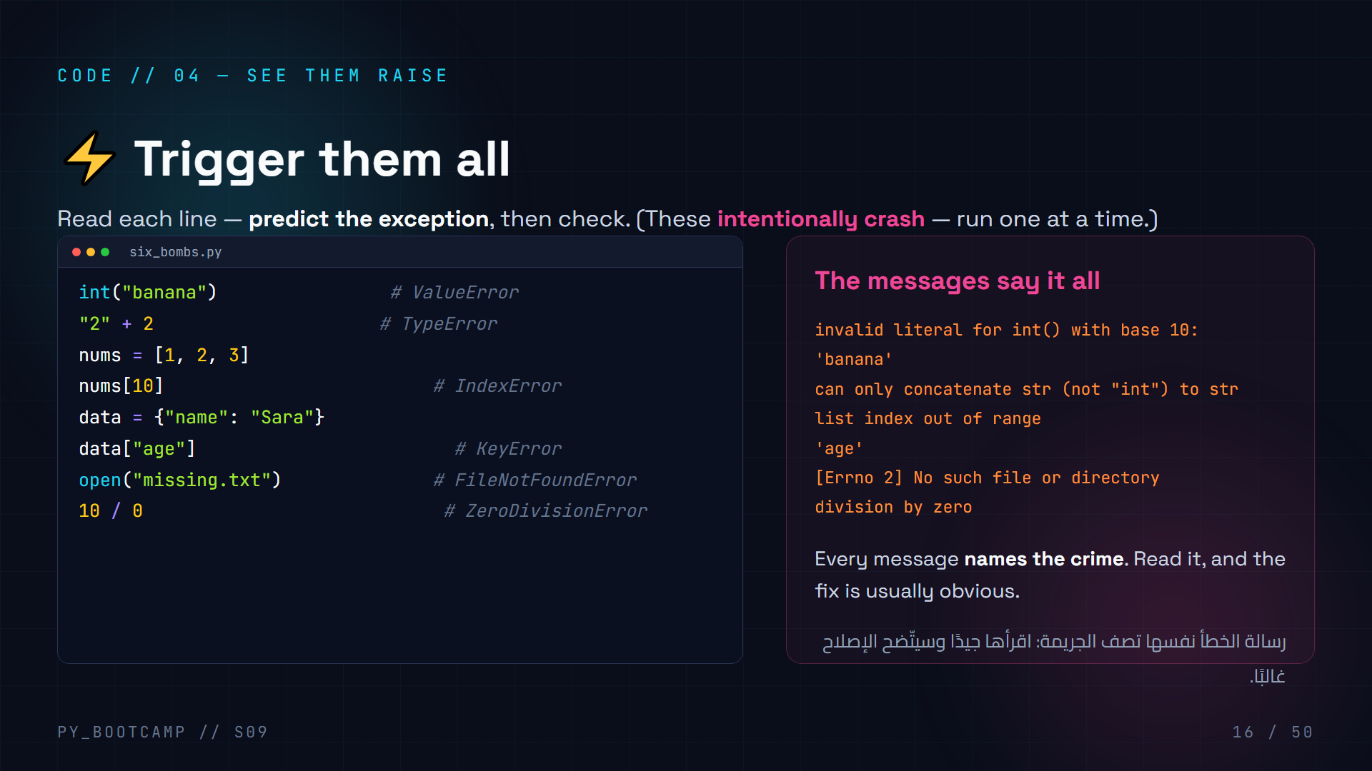
Notes:
## Code — trigger them all
**Interactive (5 min).** Go line by line. For each line, ask a different student: "What will this raise?" Then run it and show the actual message. Emphasize that the message text is the diagnosis.
**Note the exact message strings** on the right — reading these fluently is the skill. e.g. `list index out of range`, `division by zero`.
**Caveat:** these all crash if run in one script. Show them running one at a time, or wrap them one at a time in try/except as a stretch demo.
**Challenge:** "Now, from memory, write the six exception names on paper." Quick recall drill.
**Arabic tip:** اجعلها لعبة تخمين سريعة: "من سيشخّص هذا السطر؟" — التكرار السريع يبني الطلاقة.

Slide 17
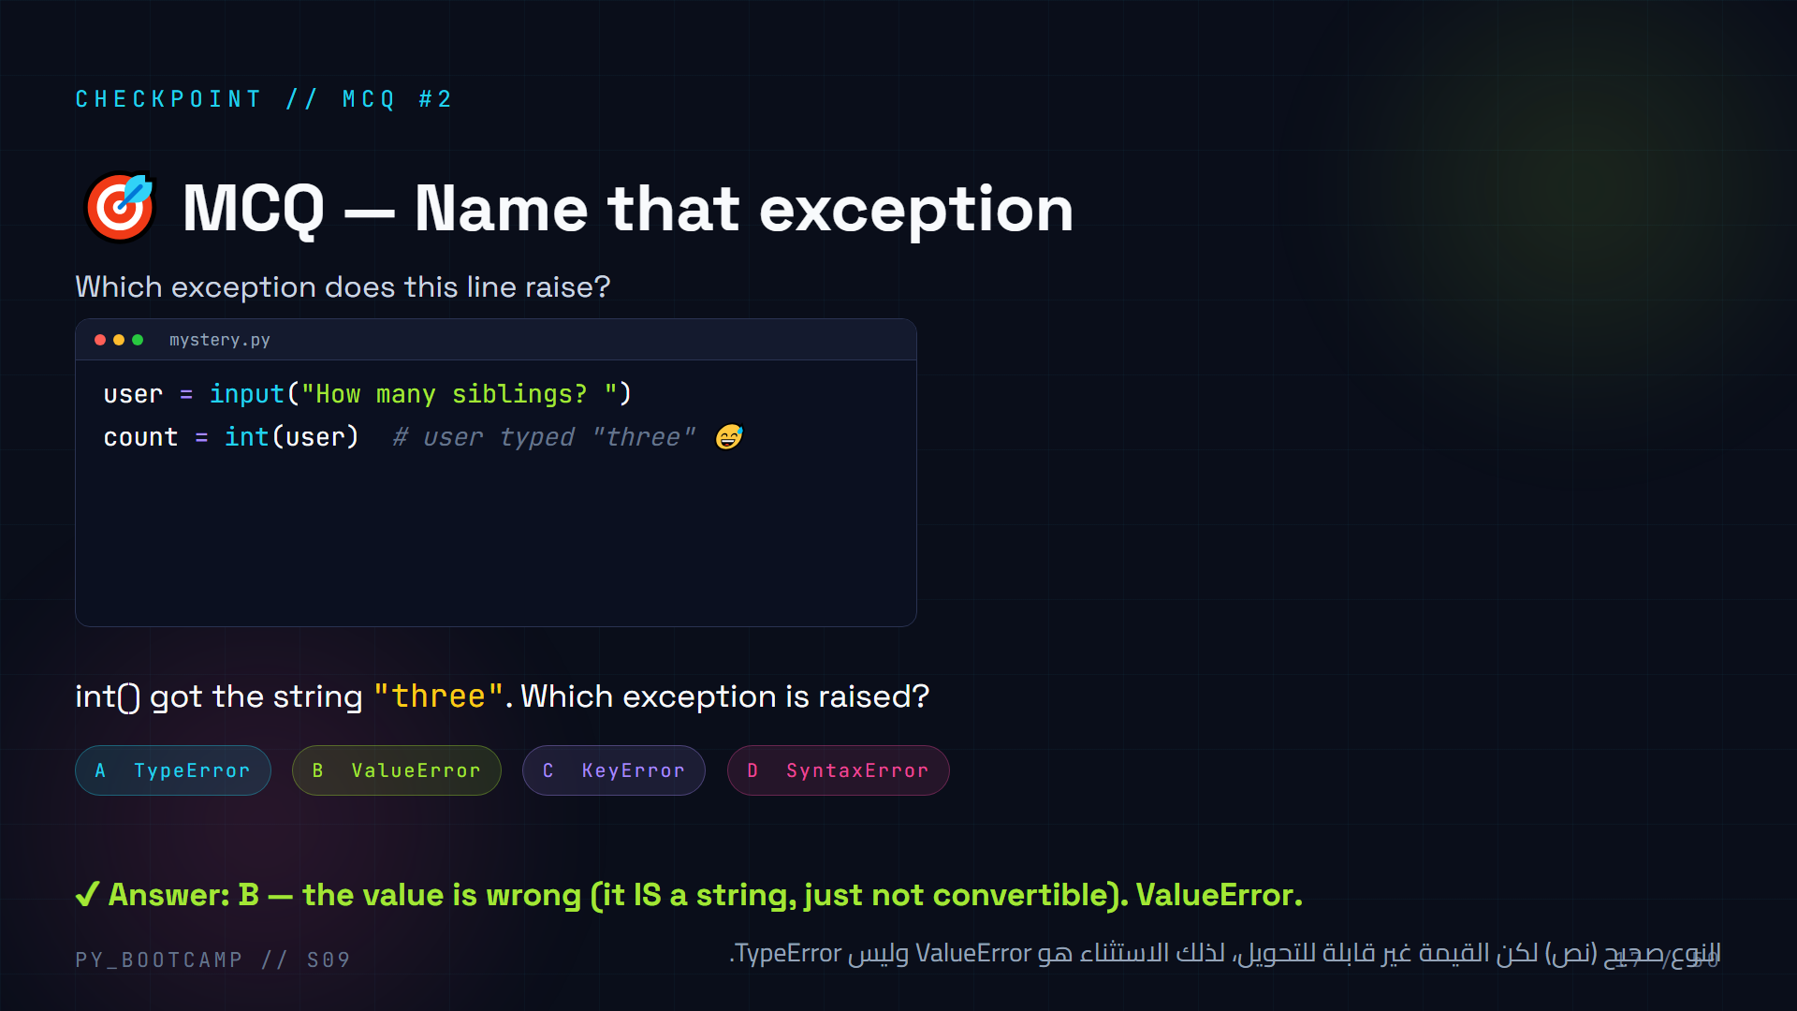
Notes:
## MCQ #2 — name that exception
**Trap alert:** students often confuse ValueError with TypeError here. Distinguish:
- TypeError = wrong TYPE of thing ("2" + 2 → mixing str and int).
- ValueError = right type, unacceptable VALUE ("three" is a valid string, but not a valid number for int()).
**Rule of thumb to teach:** if `int()` can't convert it, that's ValueError. If you're mixing incompatible types, that's TypeError.
**Extra drill (1 min):** quick-fire: `float("NaN")` → ValueError; `len(5)` → TypeError; `[1,2][5]` → IndexError.
**Arabic tip:** كلمة السر: ValueError = قيمة غير مقبولة، TypeError = نوع غير متوافق. القيمة والنوع شيئان مختلفان.

Slide 18
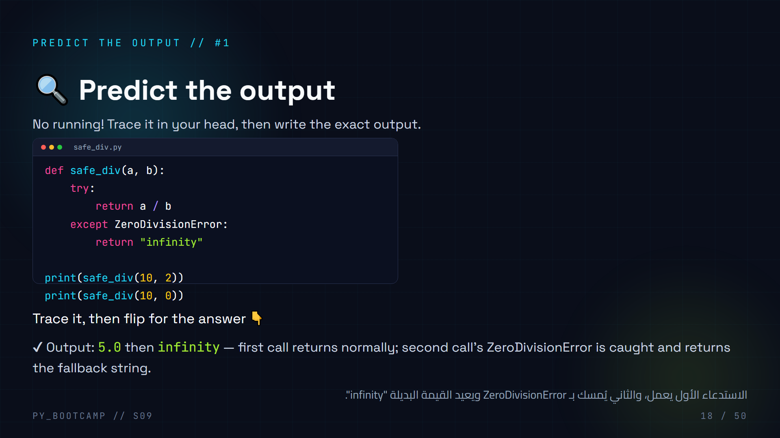
Notes:
## Predict the output #1
**Give 90 seconds, no running.** Have students write the two output lines. Common traps:
- Forgetting that `10 / 2` prints as `5.0` (float division).
- Thinking the second call CRASHES — no! safe_div catches ZeroDivisionError and returns "infinity".
**Key teaching point:** try/except inside a function works the same — the exception is caught, the return happens, the function is "safe". This is a pattern they'll reuse in the project.
**Reveal and walk line by line.** Ask: "What happens on line 3 when b is 0?" → ZeroDivisionError → jumps to except → returns "infinity".
**Arabic tip:** ذكّرهم أن القسمة في بايثون تعطي دائمًا عددًا عشريًا (float) مثل 5.0.

Slide 19
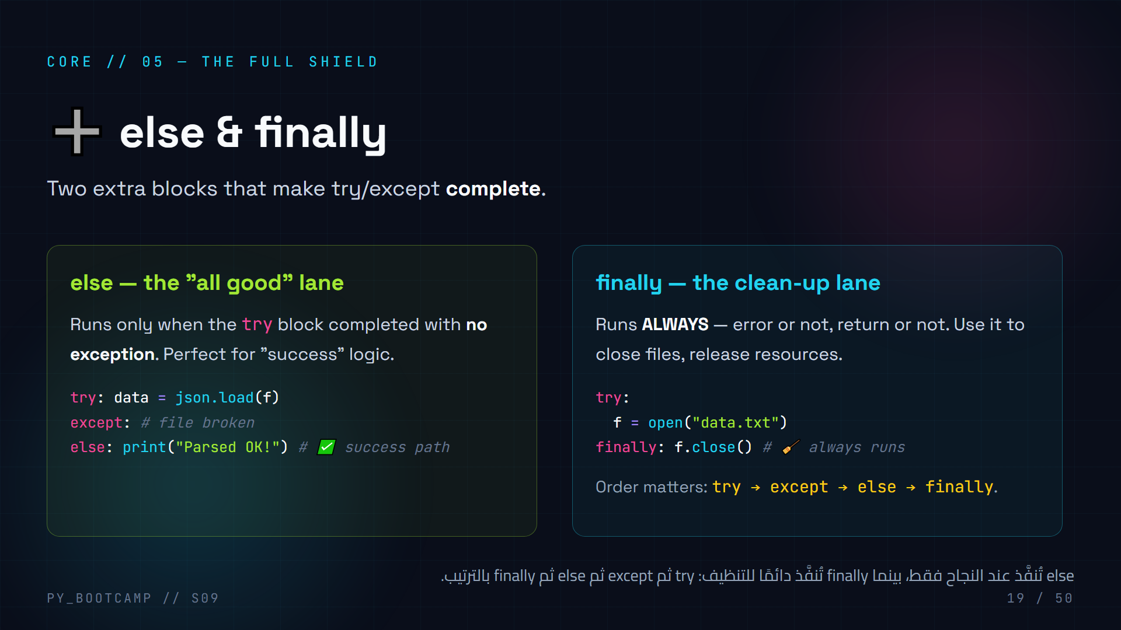
Notes:
## else & finally
**Teach as two "lanes" (5 min):**
- **else** = the success lane: runs only if try finished without exception. Why use it instead of just putting code in try? Because then success-logic can't accidentally trigger an except. It's about clarity.
- **finally** = the guarantee: always runs, even if an exception occurred or a return happened inside try. Used for cleanup (closing files, connections). Reminder: `with open()` already auto-closes, so finally matters most for resources that need manual cleanup.
**Order recap:** try → except → else → finally. except and else are optional-ish (you need at least try), finally optional but powerful.
**Common exam trap to warn about:** finally runs even after a `return` inside try. Show this later in code slide 20.
**Arabic tip:** "else مثل الطريق الناجح، وfinally مثل التنظيف المضمون مهما حدث."

Slide 20
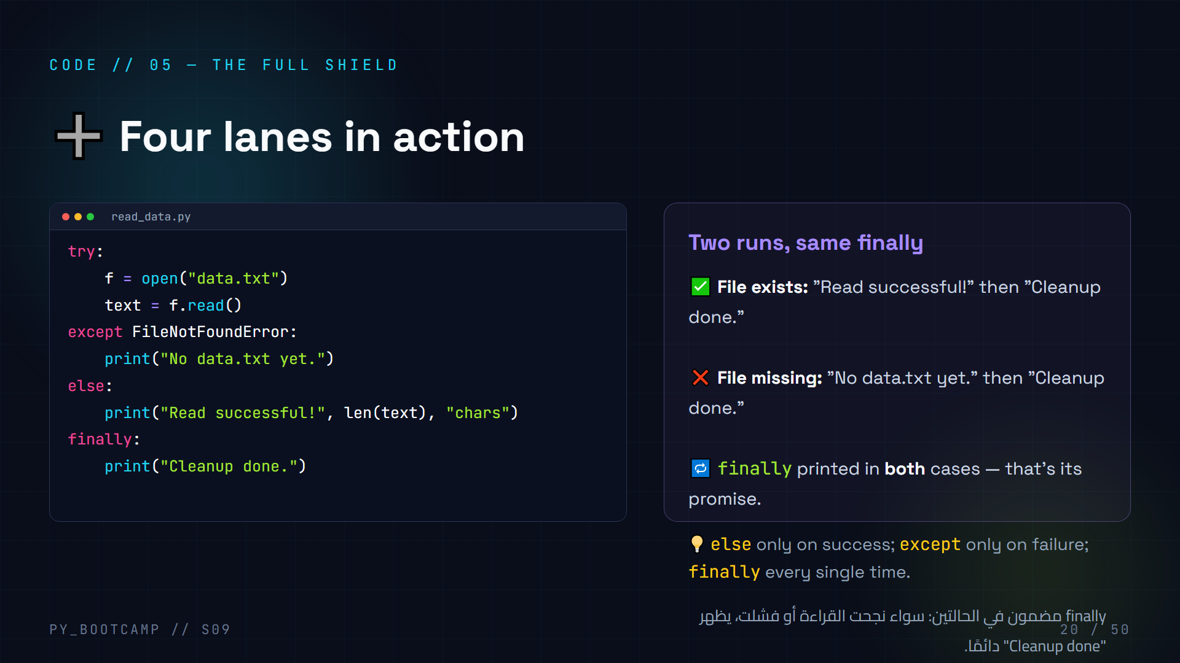
Notes:
## Code — four lanes in action
**Type & run (6 min).** First with data.txt present, then delete it and run again. Both runs print "Cleanup done." because finally always runs.
**Predict before running:** ask students to write the output for the two scenarios BEFORE you run them. Then verify.
**Pro discussion:** "Why bother with else here instead of putting print in try?" Answer: code in else can't raise the exception we're handling, and it signals intent — "this is the success path". Good practice, keeps try small.
**Real-world finally:** closing a database connection or a network socket even when the request failed. Today `with open()` handles files, but the concept generalizes.
**Arabic tip:** اجعلهم يحفظون الترتيب بالتلوين: else للنجاح، finally دائمًا، كأنه ضمان التنظيف.

Slide 21
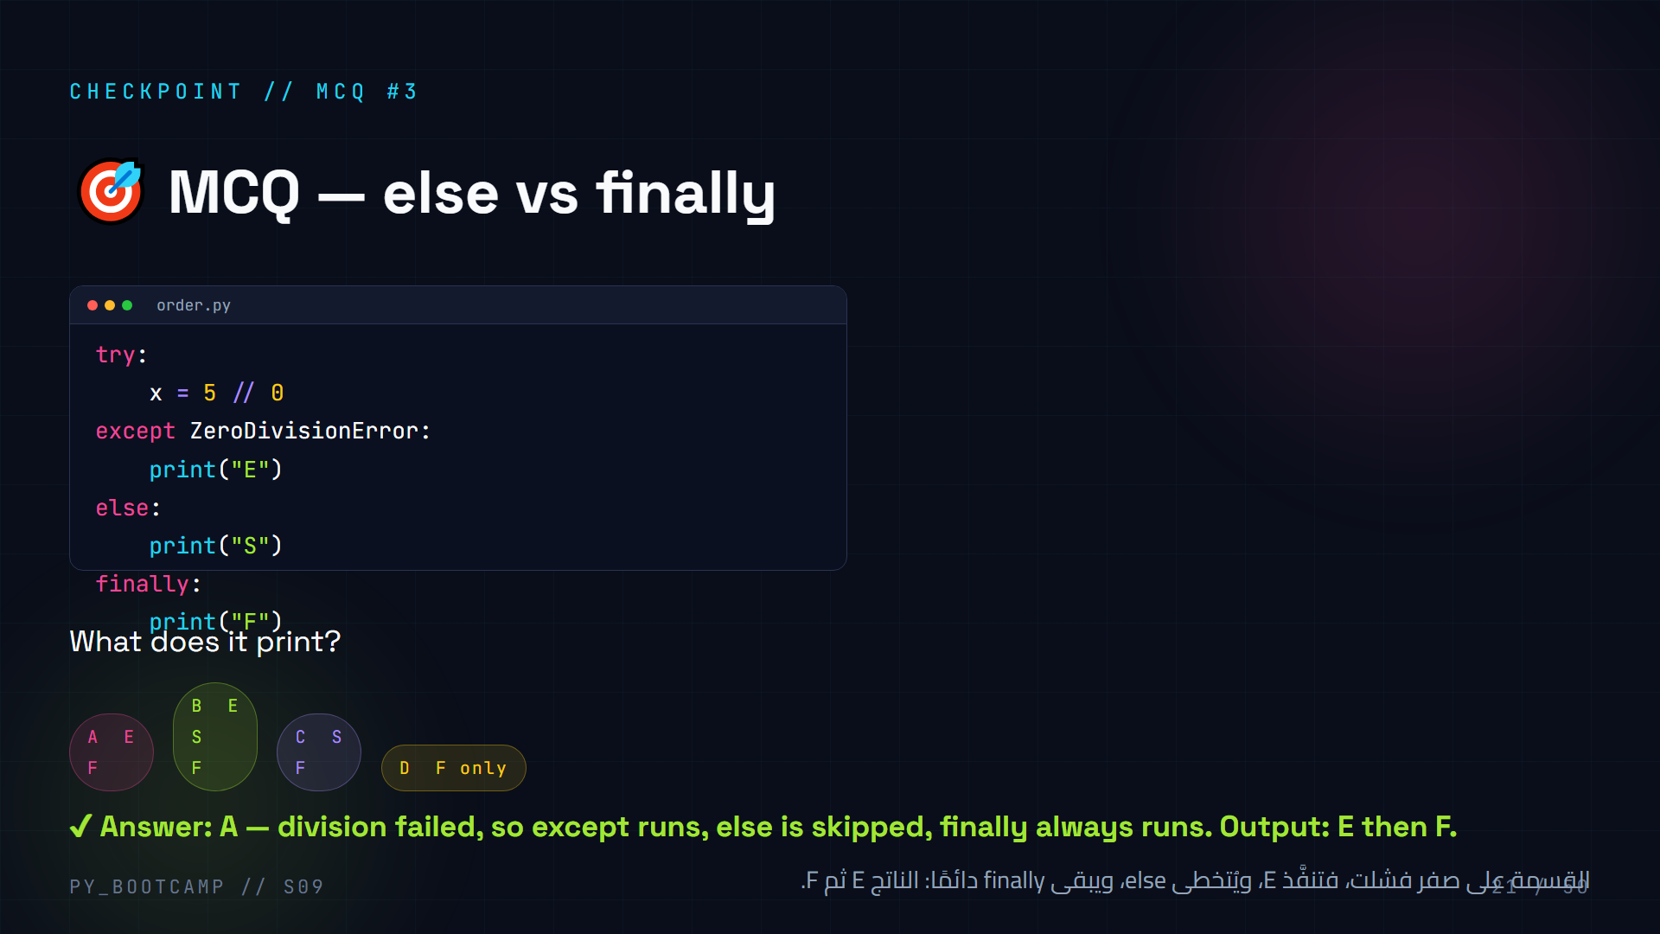
Notes:
## MCQ #3 — else vs finally
**Predict first (2 min).** The trap: thinking else runs when an exception is caught (it does NOT — else runs only when try succeeds). finally always runs.
**Walk it:** `5 // 0` raises ZeroDivisionError → except prints "E" → else skipped (try failed) → finally prints "F". Output E, F.
**Variations to drill:** if line were `x = 5 // 2` → output "S" then "F". Contrast the two outputs on the board.
**Arabic tip:** اختبرهم شفهيًا: "متى يعمل else؟" — فقط عند نجاح try. "متى يعمل finally؟" — دائمًا.

Slide 22
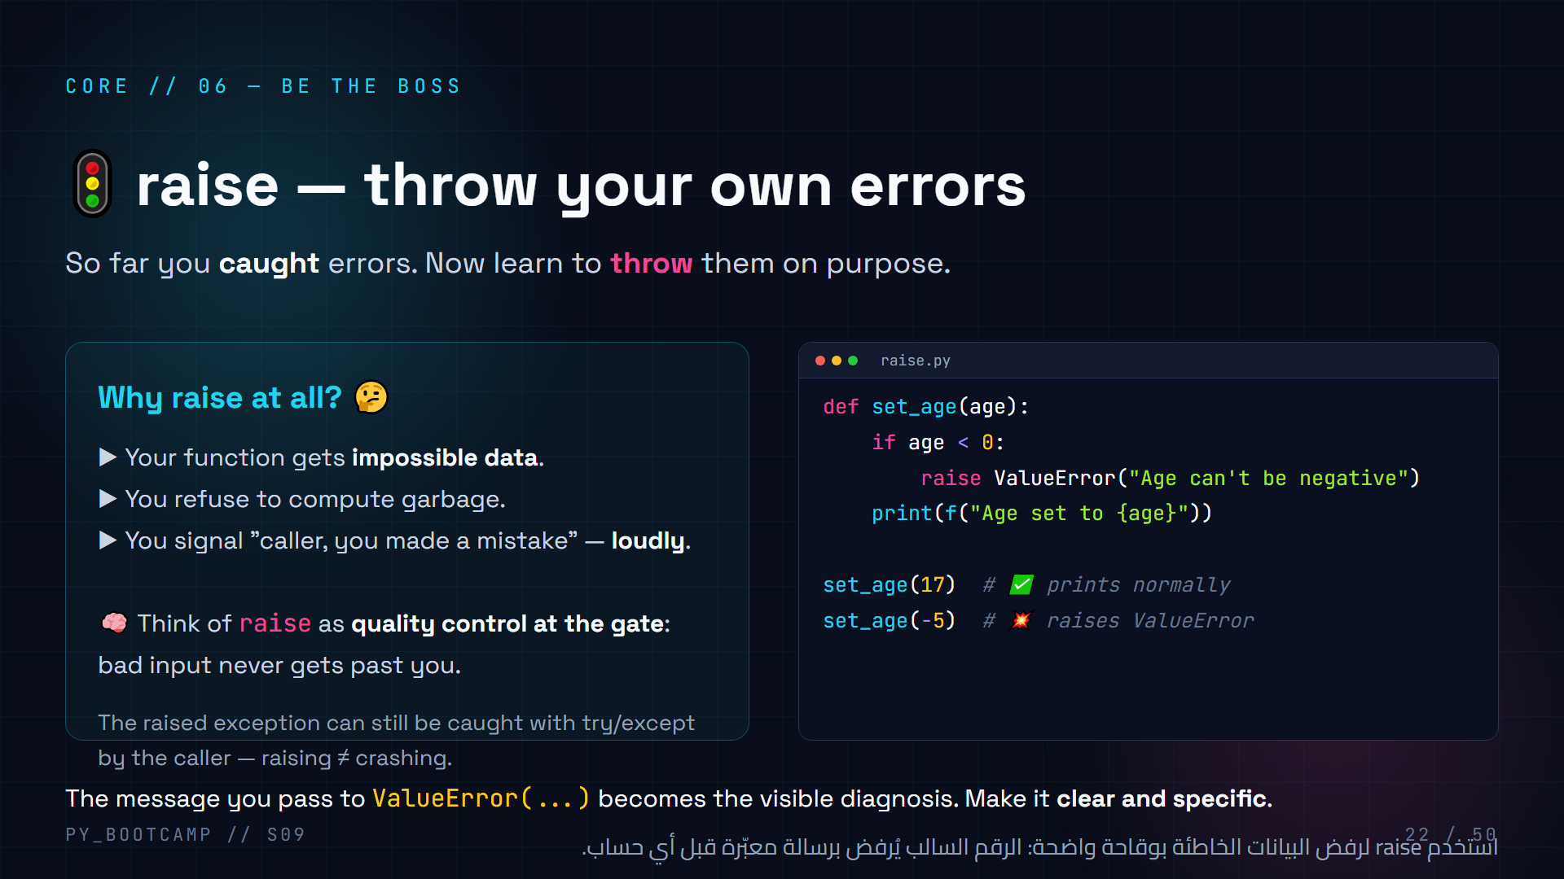
Notes:
## raise — throw your own errors
**Mindset shift (5 min):** Catching is DEFENSE. Raising is OFFENSE — you declare "this value is unacceptable, I refuse to proceed." Real libraries do this constantly.
**Anatomy:** `raise ExceptionType("message")`. The message is what users/debuggers see — write it like a sentence ("Age can't be negative"), not a code.
**Key subtlety:** raising doesn't have to crash the program — if the CALLER wraps the call in try/except, they catch your raise and handle it. So raise is also a way to hand control back up the stack.
**Live (3 min):** call set_age(-5) and let it crash to show the custom message. Then wrap the call in try/except ValueError to show catching your own raise.
**Arabic tip:** اشرح المفهوم كأنك "ضابط جودة": raise = رفض البضاعة التالفة عند البوابة قبل دخولها المصنع.

Slide 23
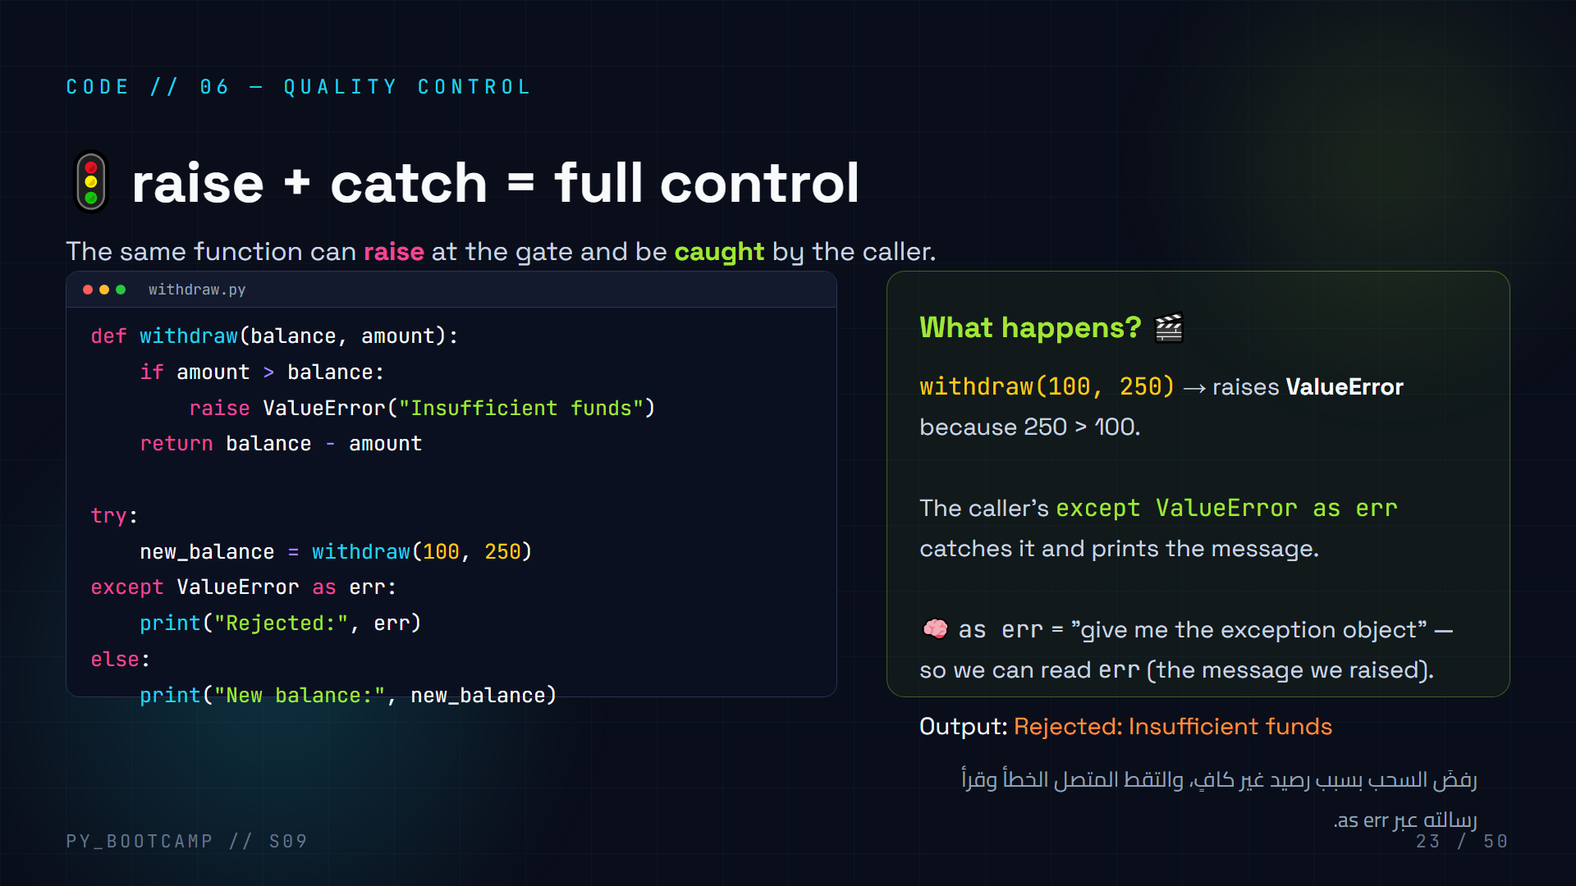
Notes:
## Code — raise + catch
**Live code (6 min).** Build a tiny bank-account demo. `withdraw(100, 250)` must not silently return a negative balance — it RAISES "Insufficient funds". The caller catches it and prints a friendly message.
**Teach `as err`:** `except ValueError as err` binds the exception object; `err` (or `e`) holds the message. Print it — you get exactly the string passed to ValueError(...).
**Emphasize the pattern:** functions validate with raise; callers handle with try/except. This is exactly how professional libraries communicate errors.
**Stretch question:** "What would `except Exception as err` do here?" — catches anything, prints the message; useful for debugging, dangerous for production.
**Arabic tip:** كلمة "as err" تعني "أعطني كائن الخطأ" — من خلاله نقرأ رسالة الخطأ نفسها.

Slide 24
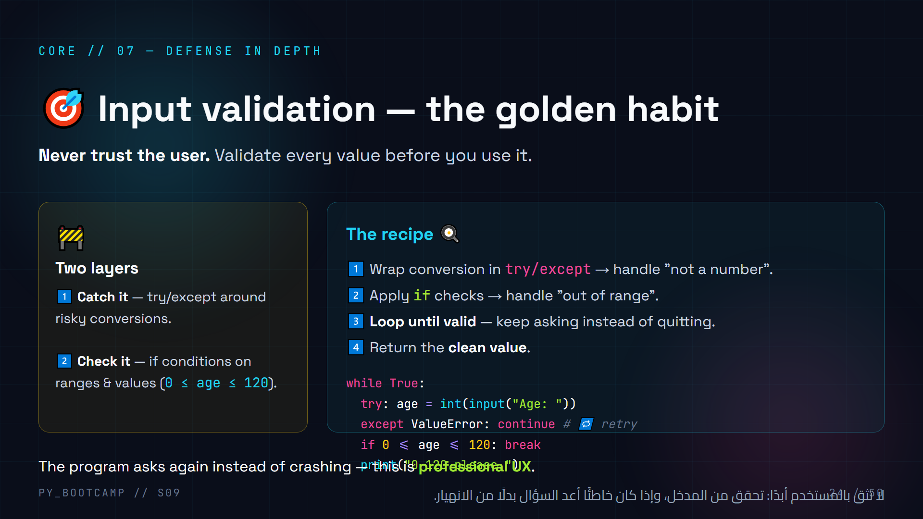
Notes:
## Input validation — golden habit
**Big rule (3 min):** "Never trust the user." Input is the #1 source of crashes. Two layers of defense: catch conversions (try/except) and check ranges (if).
**Walk the recipe loop:** while True → try int() → except ValueError continue (retry) → check 0–120 → break when valid. Emphasize that `continue` re-asks without crashing, `break` exits with a valid value.
**This is the pattern for the whole project.** Reference it: "We'll use this exact loop in the Robust CLI."
**Live demo idea (5 min):** run the loop, feed it "abc", then "200", then "17" — show each rejection and final acceptance.
**Arabic tip:** "لا تثق بالمستخدم" — عبارة يحفظونها ويرددونها في كل مشروع قادم.

Slide 25
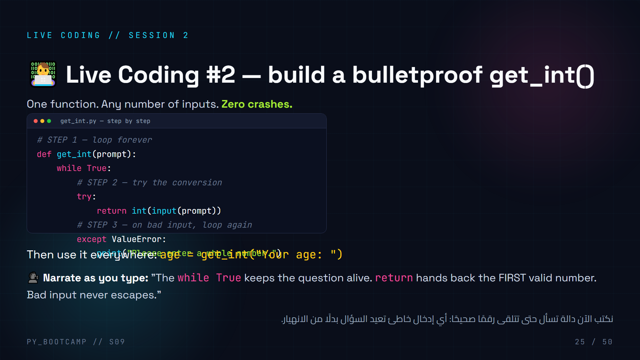
Notes:
## Live coding #2 — bulletproof get_int (15 min)
**Build it line by line — never paste:**
1. Define `get_int(prompt)`.
2. `while True:` — the loop that never quits until valid.
3. Inside, `try: return int(input(prompt))` — note: `return` exits the function AND the loop on success.
4. `except ValueError:` print a friendly nudge — loop repeats automatically.
**Point out the elegance:** there's no `break` — the `return` does the job. Any invalid input just cycles the loop.
**Test together (3 min):** "banana" → message → loops. "12.5" → message (not an integer!). "42" → returns 42. Show the golden habit paying off.
**Stretch:** add min/max parameters: `get_int(prompt, low, high)` using the range check from slide 24. This becomes the heart of the project.
**Arabic tip:** اطلب منهم كتابة السطر الأول بأنفسهم ثم قارن معك — المشاركة النشطة تثبّت الحلقة while.

Slide 26
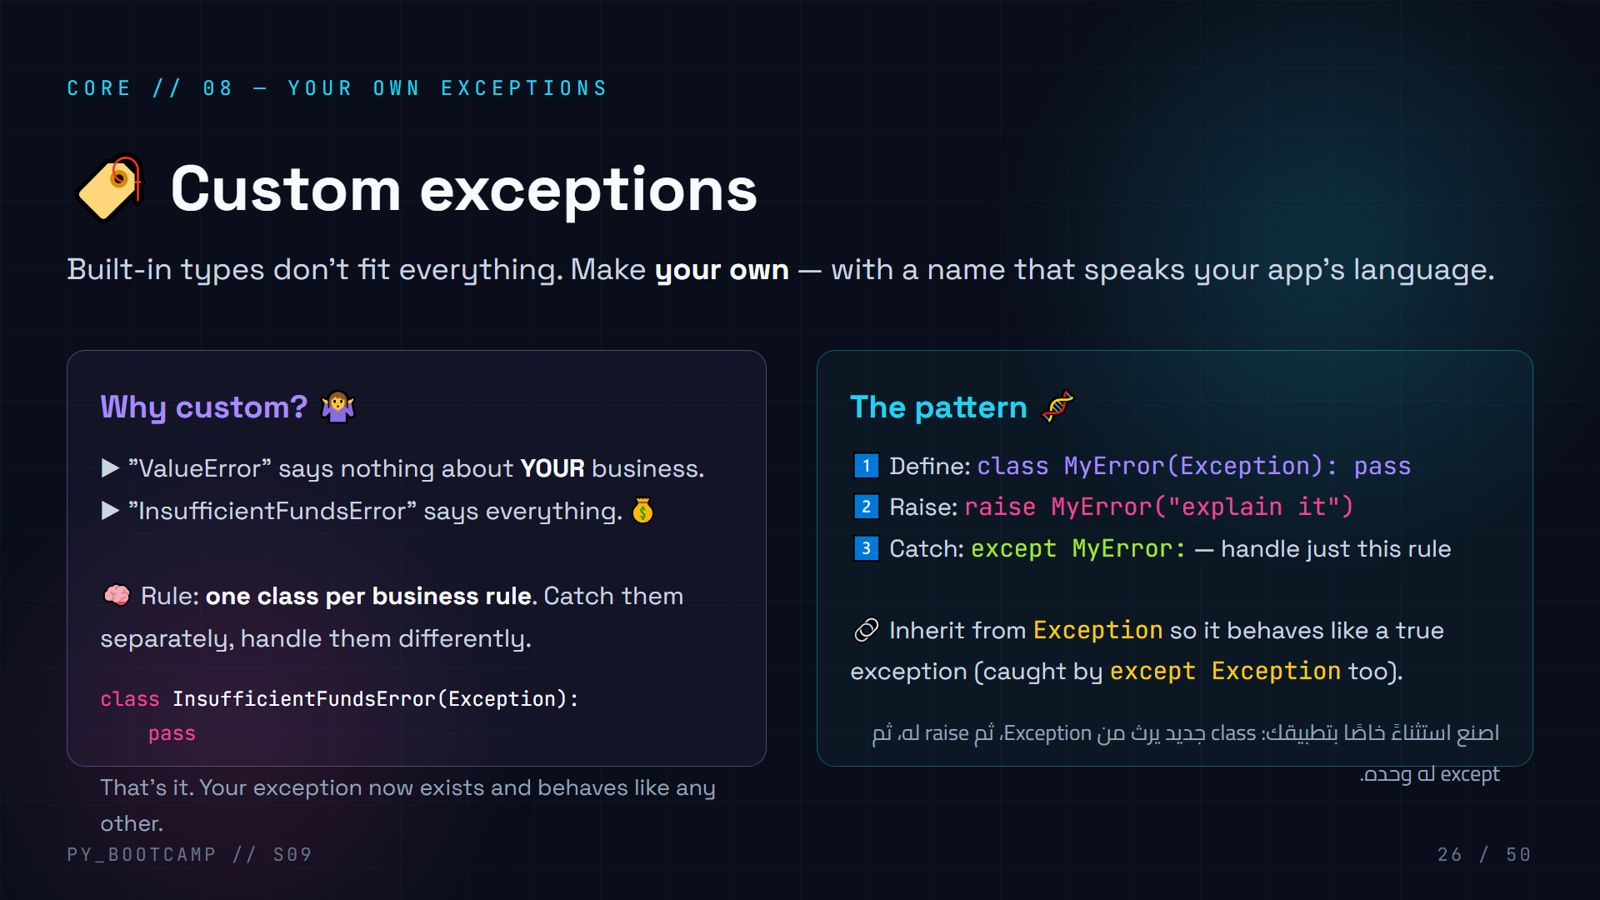
Notes:
## Custom exceptions
**Big idea (4 min):** exception names are a language. "ValueError" is generic; "InsufficientFundsError" tells you exactly which business rule failed. Naming is clarity.
**Syntax is tiny:** `class Name(Exception): pass` — one line, usually with `pass` (no custom behavior needed). It inherits everything from Exception.
**Pattern to memorize:** define → raise → catch. Show all three on the board.
**Real-world pitch:** libraries like requests define their own exceptions (requests.exceptions.ConnectionError). That's how you know precisely what failed and what to do about it.
**Arabic tip:** شبّه الاسم بأنه "رمز النداء" الخاص بقاعدة عملك — اسم واضح = تشخيص سريع.

Slide 27
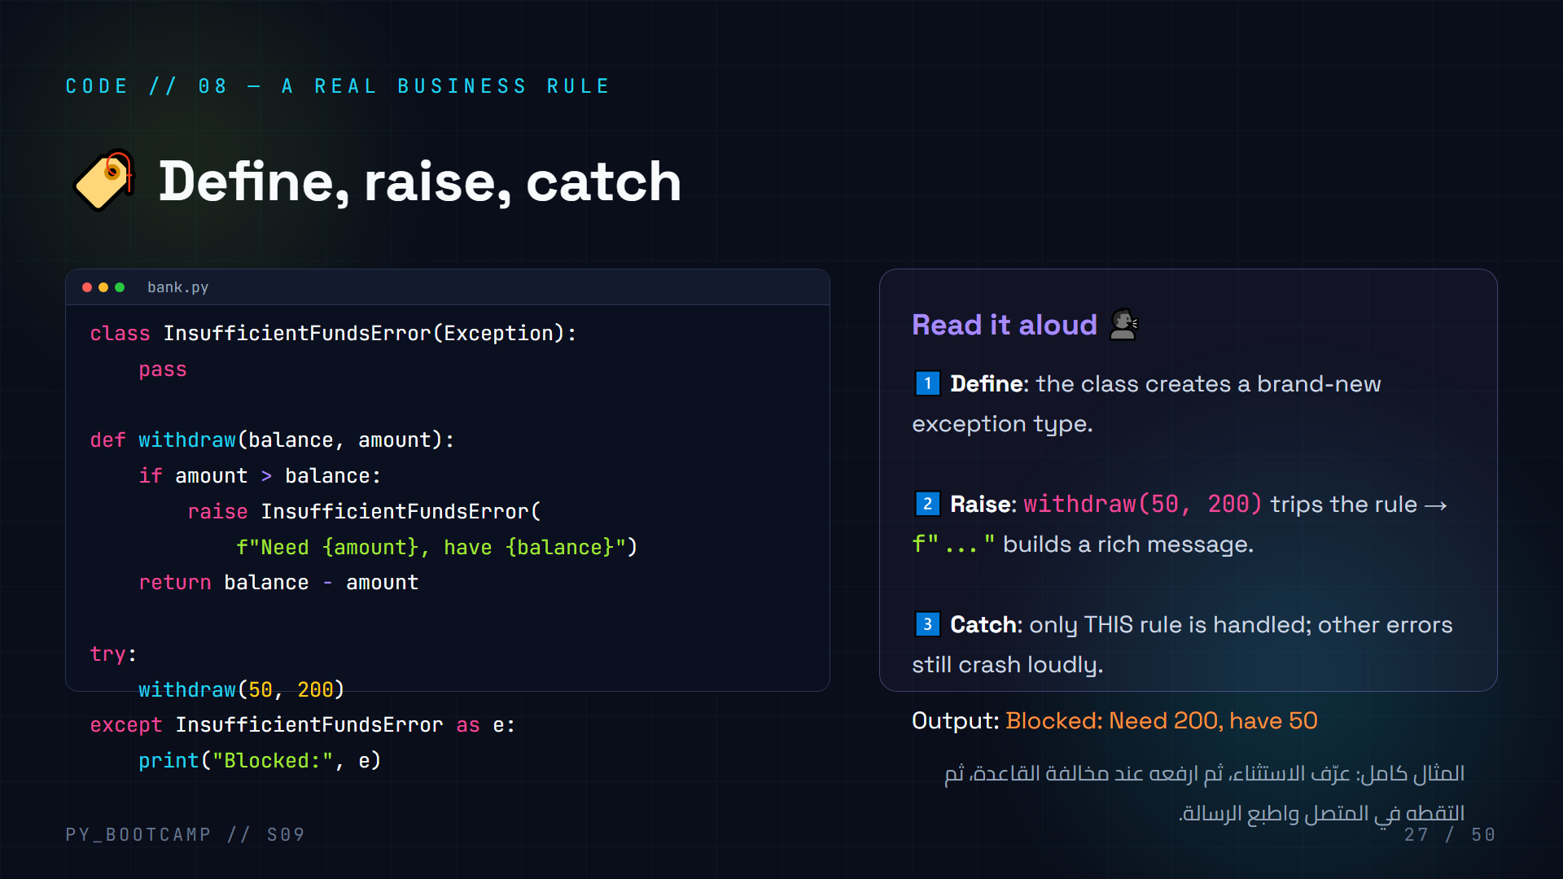
Notes:
## Code — define, raise, catch
**Type together (7 min).** A mini bank that refuses over-withdrawals with a domain-specific exception.
**Walk the three lines of the message:** f-string interpolation builds "Need 200, have 50" — this is why messages should be informative. When this error is logged, a human instantly understands.
**Contrast with before:** slide 23 used generic ValueError; today the name itself carries meaning. Both work; custom names scale to big apps.
**Stretch:** catch `InsufficientFundsError` AND `ValueError` separately to show both rules coexisting.
**Arabic tip:** اطلب من طالب أن "يرفع" الاستثناء بصوت مرتفع عند السحب الزائد — تمثيل حي يثبّت الفكرة.

Slide 28
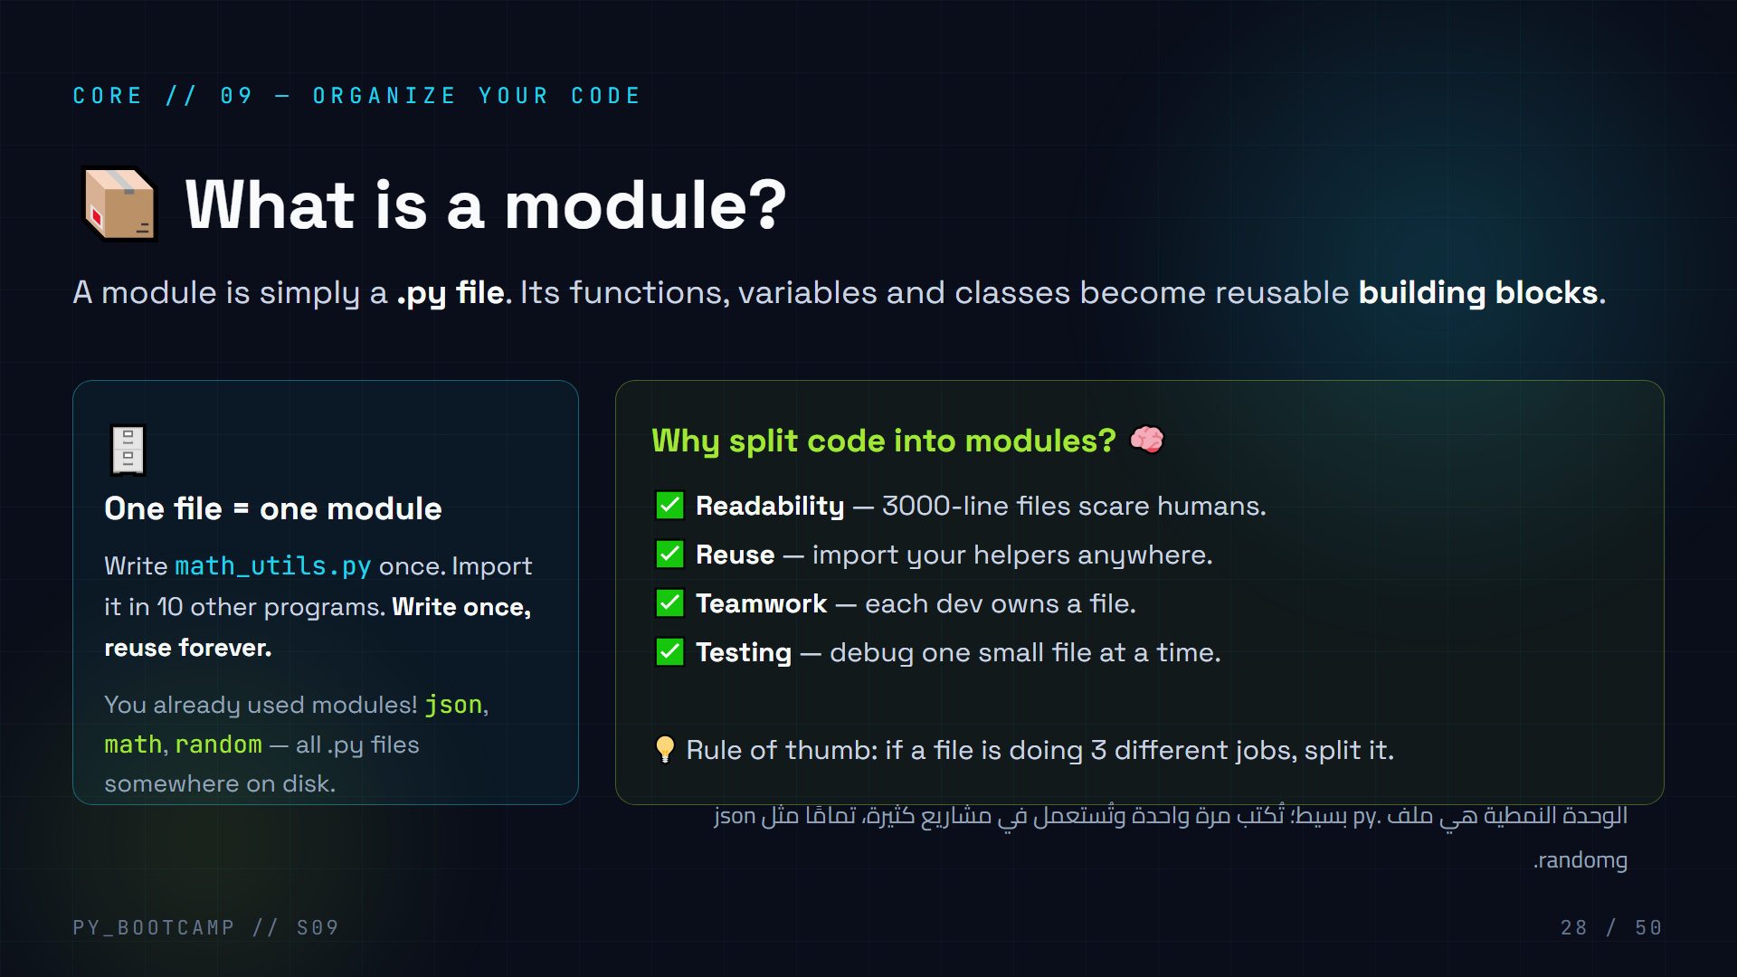
Notes:
## What is a module?
**Demystify (3 min):** A module is literally a .py file. Nothing magic. Your game.py is a module! The magic is that other files can import it.
**They've used modules already:** json (session 8!), math, random. Point out that those are just .py files that ship with Python (stdlib) — the SAME mechanism they'll use for their own files.
**Why modularize:** readability, reuse, teamwork, testability. Use a real analogy: a book split into chapters vs one giant wall of text.
**Demo idea:** show `print(math.__file__)` — it prints the actual path of math.py on disk. Students love seeing the real file.
**Arabic tip:** "الوحدة = ملف بايثون واحد." كرّر هذا التعريف لأنه يزيل كل الغموض.

Slide 29
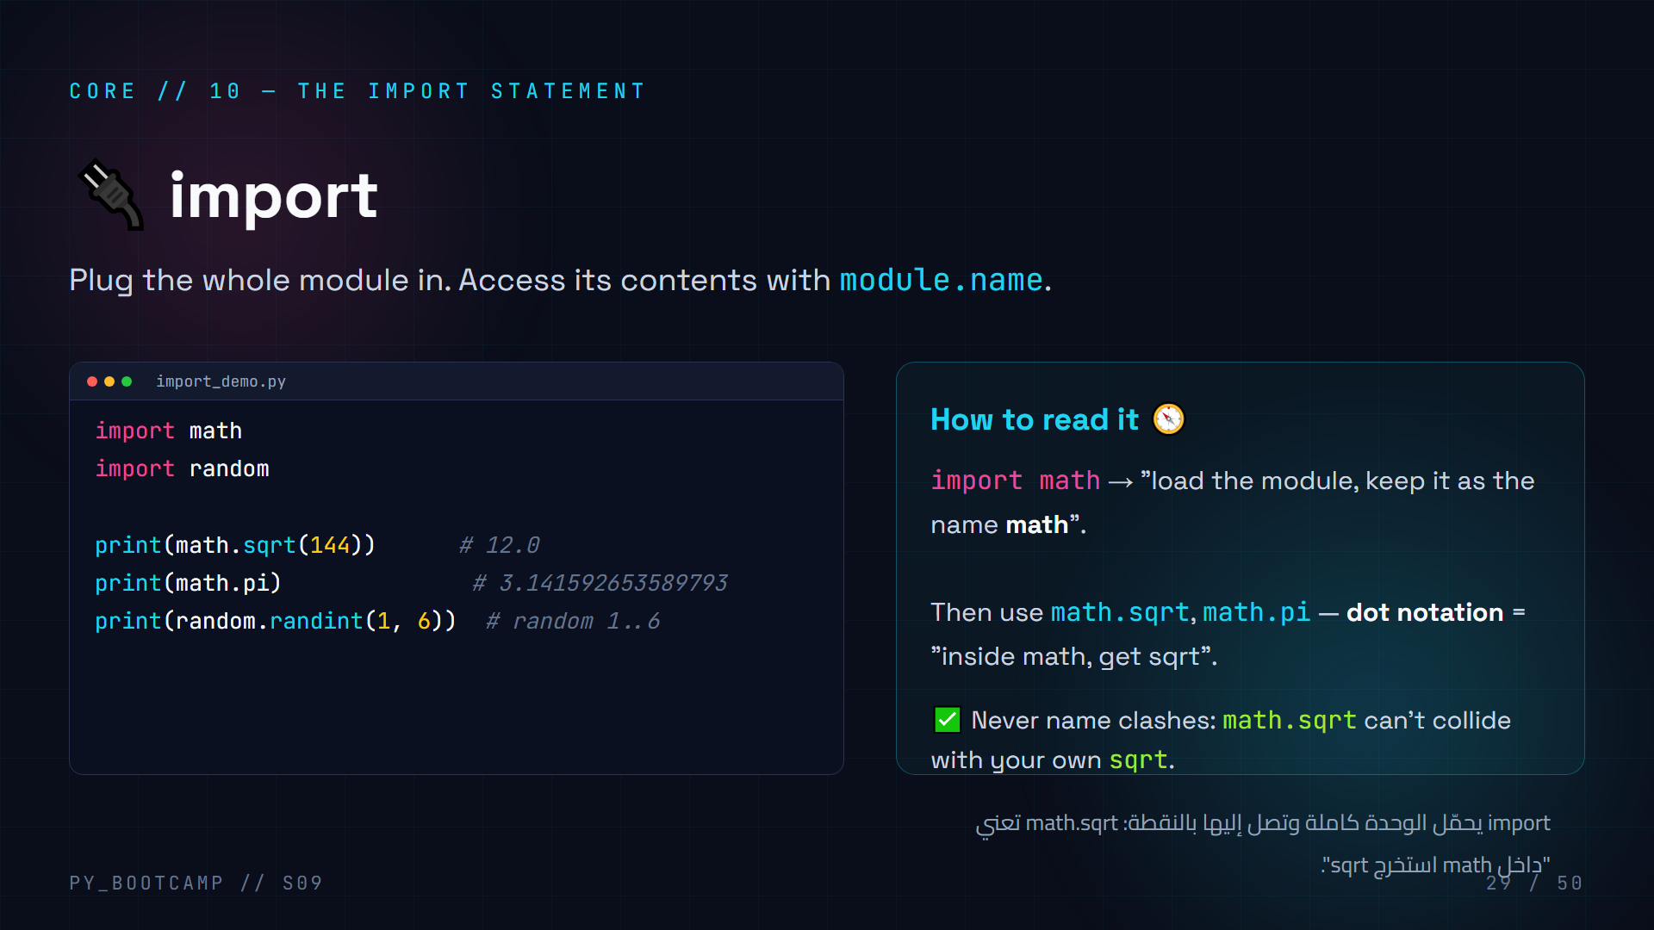
Notes:
## import
**The mental model (4 min):** `import math` loads the whole file and binds it to the name `math`. Everything in it — functions, constants — becomes `math.xxx` (dot notation).
**Dot notation explanation:** `math.sqrt(144)` reads as "math's sqrt". The module is like a labeled box: you reach inside with a dot.
**Why import (whole module) is safe:** names are namespaced — your own `sqrt` variable won't conflict with math.sqrt.
**Live (3 min):** import math, print math.pi, math.sqrt(144). Then show `dir(math)` — the treasure list inside the module. Students find it fascinating.
**Arabic tip:** شبهها بالصندوق المُعنوَن: النقطة تعني "افتح الصندوق وخذ هذا العنصر".

Slide 30
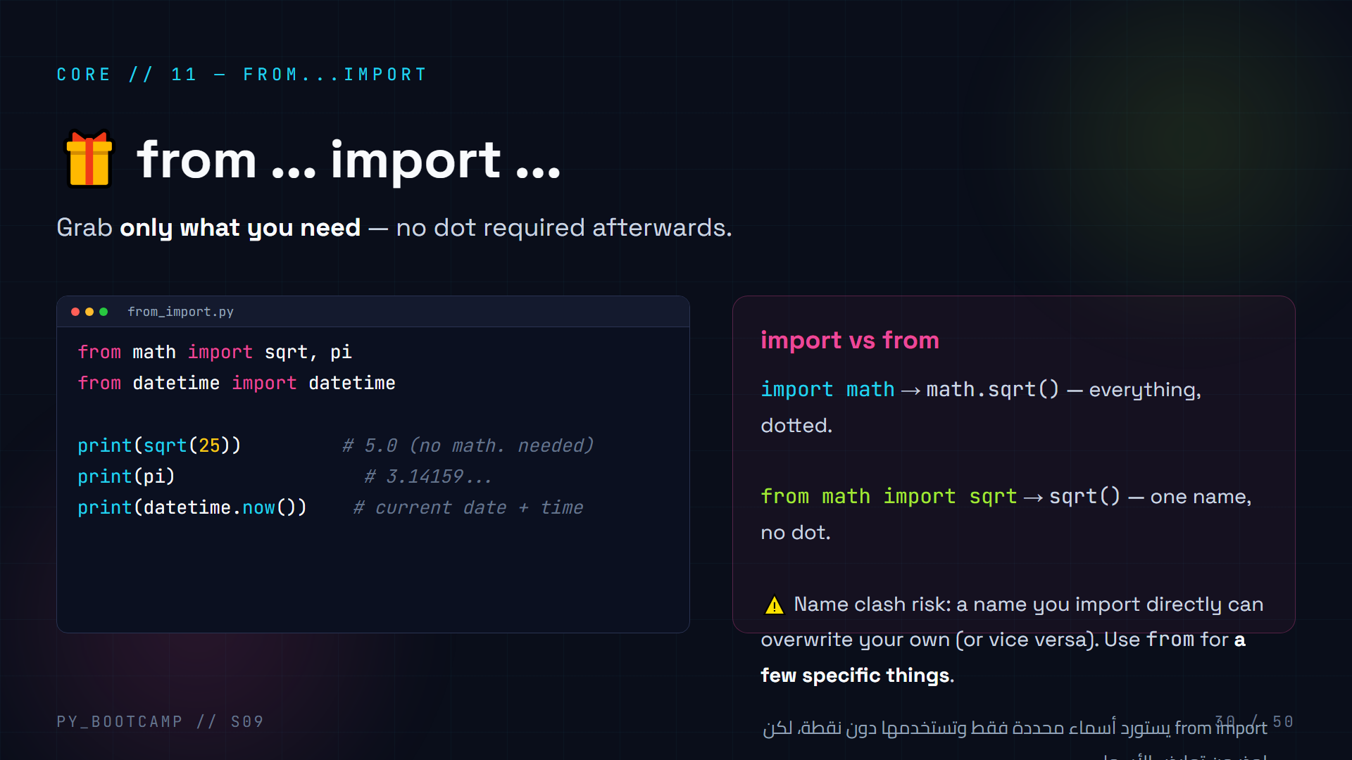
Notes:
## from ... import ...
**Compare (4 min):** two import styles on one slide. import = the whole box; from import = pick only sqrt and pi. After `from math import sqrt`, you call sqrt(25) directly — no dot.
**Clash warning is the key safety lesson:** `from math import sqrt` then later define your own `sqrt`? Your definition wins and silently shadows the import. That's why importing the whole module is safer. Teach the rule: prefer `import module`; use `from` for a few specific names.
**Live (3 min):** show both styles for datetime; note the difference between `import datetime` (datetime.datetime.now()) vs `from datetime import datetime` (datetime.now()). This nesting confuses beginners — clarify the module/class distinction lightly.
**Arabic tip:** "import = تأخذ الصندوق كله، from = تأخذ ما تحتاج فقط." الاختيار يعتمد على الموقف.

Slide 31
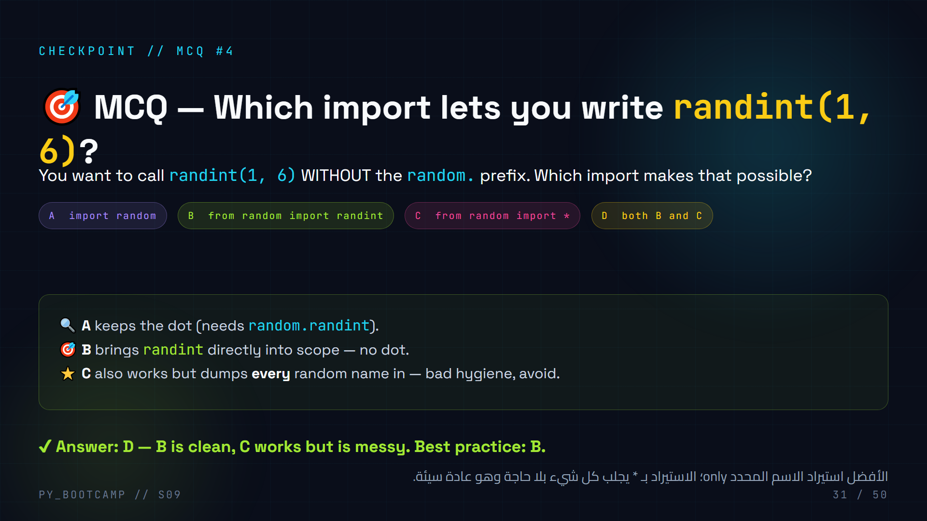
Notes:
## MCQ #4 — import vs from
**Explain the trap (3 min):** A keeps the prefix. B and C both allow bare `randint`. D is correct because B is the clean way and C technically works.
**Warn against `import *`:** it dumps every public name of the module into your namespace — silent name clashes become likely. "You don't empty a toolbox on the floor; you grab the wrench you need." (B is the wrench.)
**Rule to leave them with:** prefer `import random` when using several functions; prefer `from random import randint` when you need one or two specific names.
**Arabic tip:** "لا تُفرغ صندوق العدة على الأرض" — استيراد ما تحتاجه فقط.

Slide 32
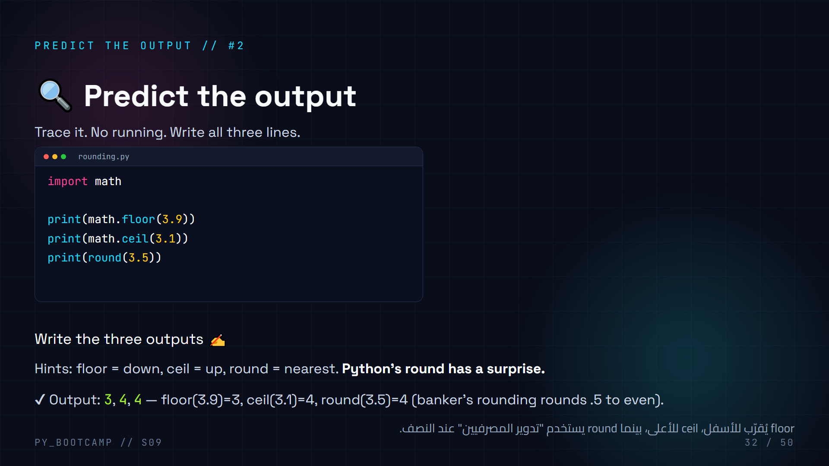
Notes:
## Predict the output #2 — math module
**90 seconds, no running.** Students write three lines: 3, 4, then... the surprise.
**Banker's rounding surprise:** `round(3.5)` is 4, but `round(4.5)` is ALSO 4 (rounds to even). This trips everyone once. `math.floor`/`math.ceil` always behave as expected (down/up). If you need classic "always round half up", you'd use `math.floor(x + 0.5)` or the Decimal module (mention, don't go deep).
**Teaching point:** knowing your stdlib functions avoids reinventing wheels — and knowing their edge cases avoids bugs.
**Arabic tip:** "round(4.5) = 4" مفاجأة يحفظونها — علّمهم أن بايثون تختار العدد الزوجي عند النصف.

Slide 33
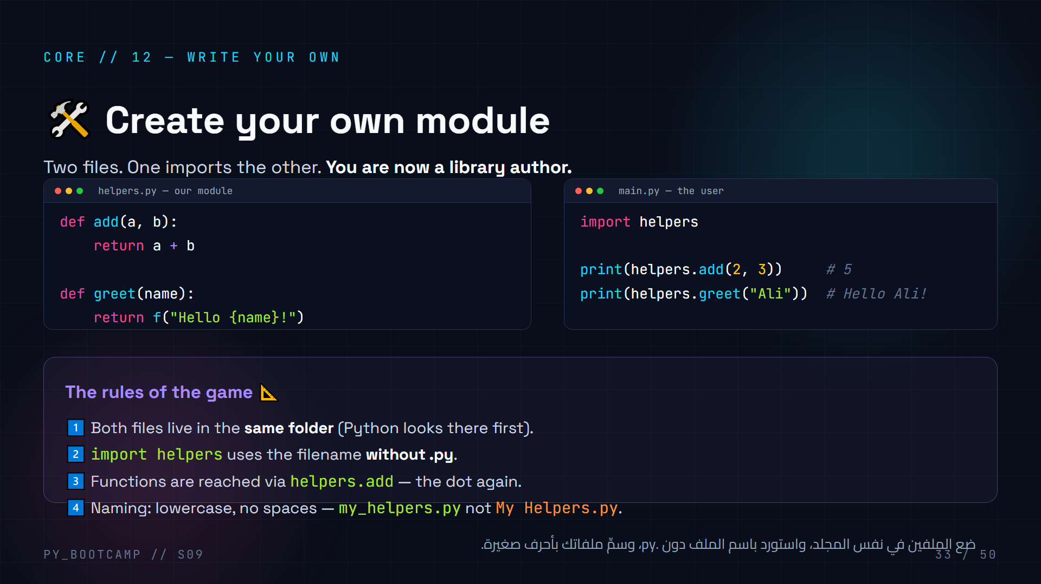
Notes:
## Create your own module
**Live (8 min):** create helpers.py with add() and greet(). Create main.py that imports it. Run main.py — works!
**Key gotcha to demo:** put the files in DIFFERENT folders → import fails with ModuleNotFoundError. Shows that location matters. (Same folder = simplest.)
**Import filename:** `import helpers` — NO ".py". Students always forget this. Also, import filename must be a valid identifier (no dashes/spaces).
**Demo value:** "You just wrote a library." Suddenly the stdlib imports make total sense — math.py is just someone else's helpers.py.
**Arabic tip:** اربط: "أنت الآن مؤلف مكتبات" — كل وحدة في المكتبة القياسية هي مجرد ملف مثل ملفك.

Slide 34
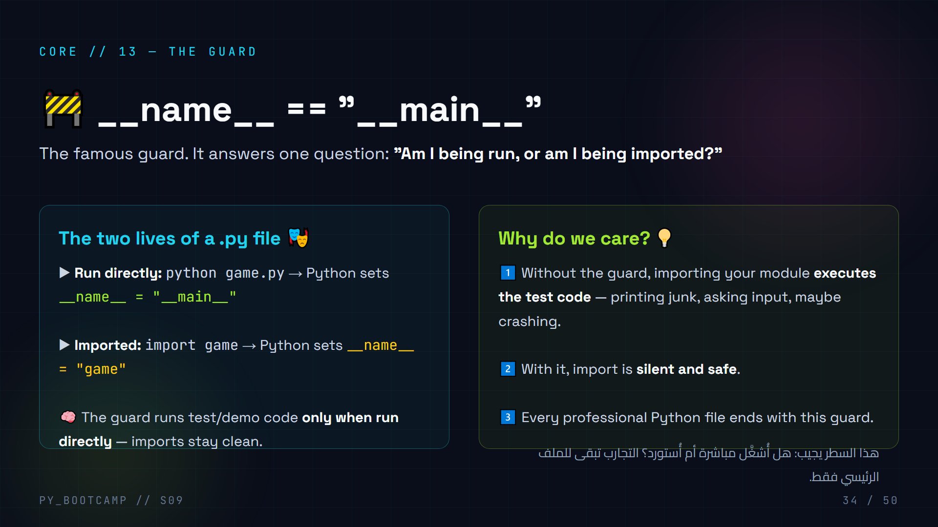
Notes:
## __name__ == "__main__"
**This is THE confusing line for beginners — teach it as a drama (5 min):**
Every .py file has a built-in variable `__name__`.
- Run directly (`python game.py`): Python sets `__name__` to `"__main__"`.
- Imported (`import game`): Python sets `__name__` to `"game"` (the module's name).
**The guard pattern:** `if __name__ == "__main__":` — "run this only when I'm the main program." So test code, demos and `main()` calls go inside the guard.
**Concrete demo:** helpers.py with a `print("helpers loaded")` at top. Import it from main.py → you see "helpers loaded" — proof the import executes module code. Then put the print inside the guard → importing stays quiet, running directly prints it.
**Arabic tip:** "الممثل الرئيسي" و"الممثل الضيف": __main__ = الرئيسي، وأي استيراد = ضيف لا يشغّل الكواليس.

Slide 35
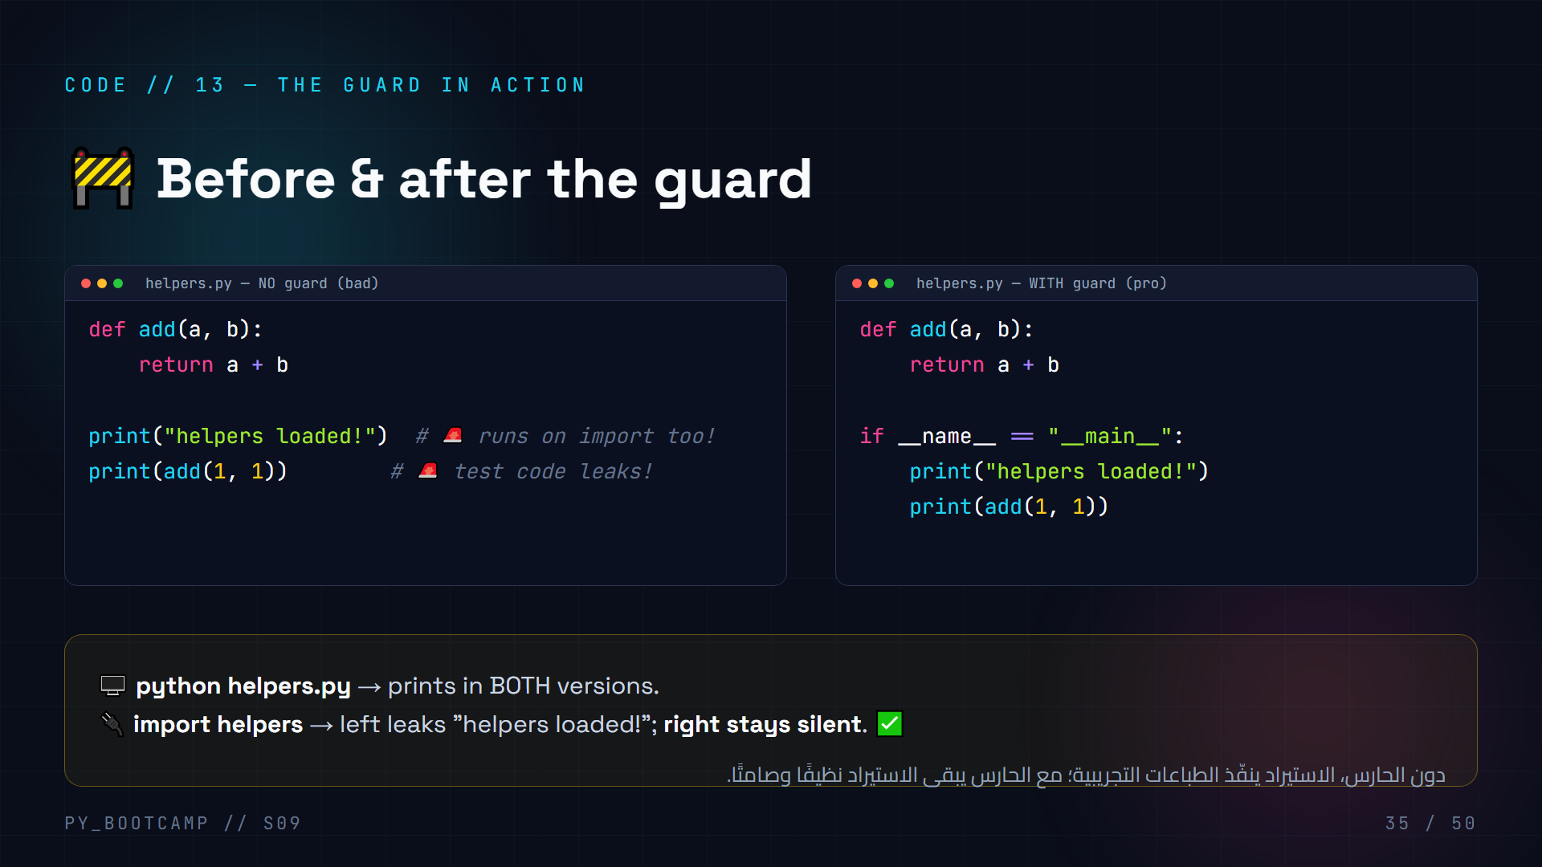
Notes:
## Code — the guard in action
**Live demo (7 min):** this is a "show, don't tell" slide.
1. Write helpers.py WITHOUT the guard (with print statements at module level).
2. Write main.py that imports helpers and calls add(2,3).
3. Run main.py → "helpers loaded!" prints — proof the import executed the module's top-level code. The test prints leak into your clean program.
4. Fix by wrapping the prints in the guard. Re-run → import is silent; `python helpers.py` still shows the messages.
**The insight to land:** every top-level statement in a module runs on import. The guard is the bouncer that decides which statements are allowed to run.
**Arabic tip:** "الحارس هو البواب: عند الاستيراد لا يدخل أحد، عند التشغيل المباشر يُفتح الباب."

Slide 36
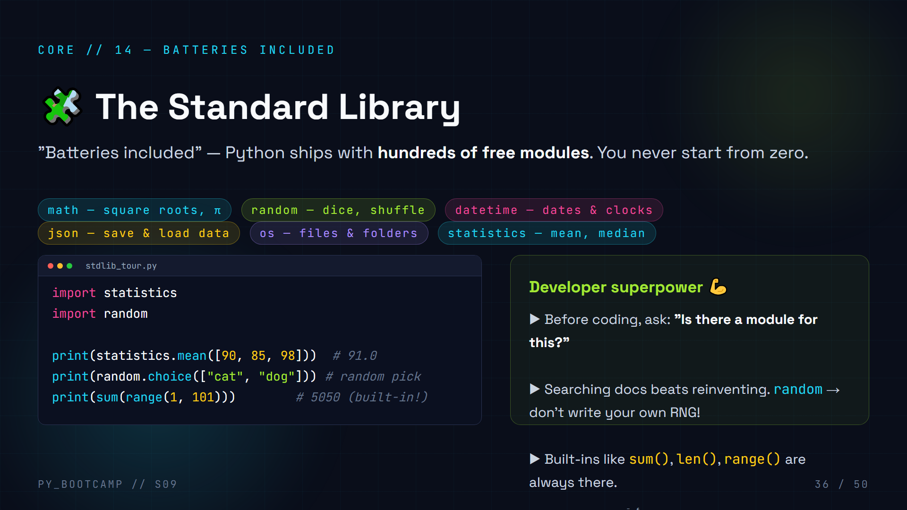
Notes:
## The Standard Library
**Concept (4 min):** Python ships with a huge stdlib — modules for math, randomness, dates, files, statistics, and hundreds more. "Batteries included" is the official motto.
**Powerful habit to install:** before writing any helper function, ask "does a module already do this?" Then `import` it. This is how pros save hours.
**Live (4 min):** import statistics and random, run mean/choice. Mention `dir(statistics)` lists everything available.
**Name-drop os/pathlib for files** — they'll see these in projects. Keep it light; don't deep-dive.
**Arabic tip:** "بطاريات مشمولة" — بايثون تأتي جاهزة، ابحث أولًا ثم ابرمج.

Slide 37
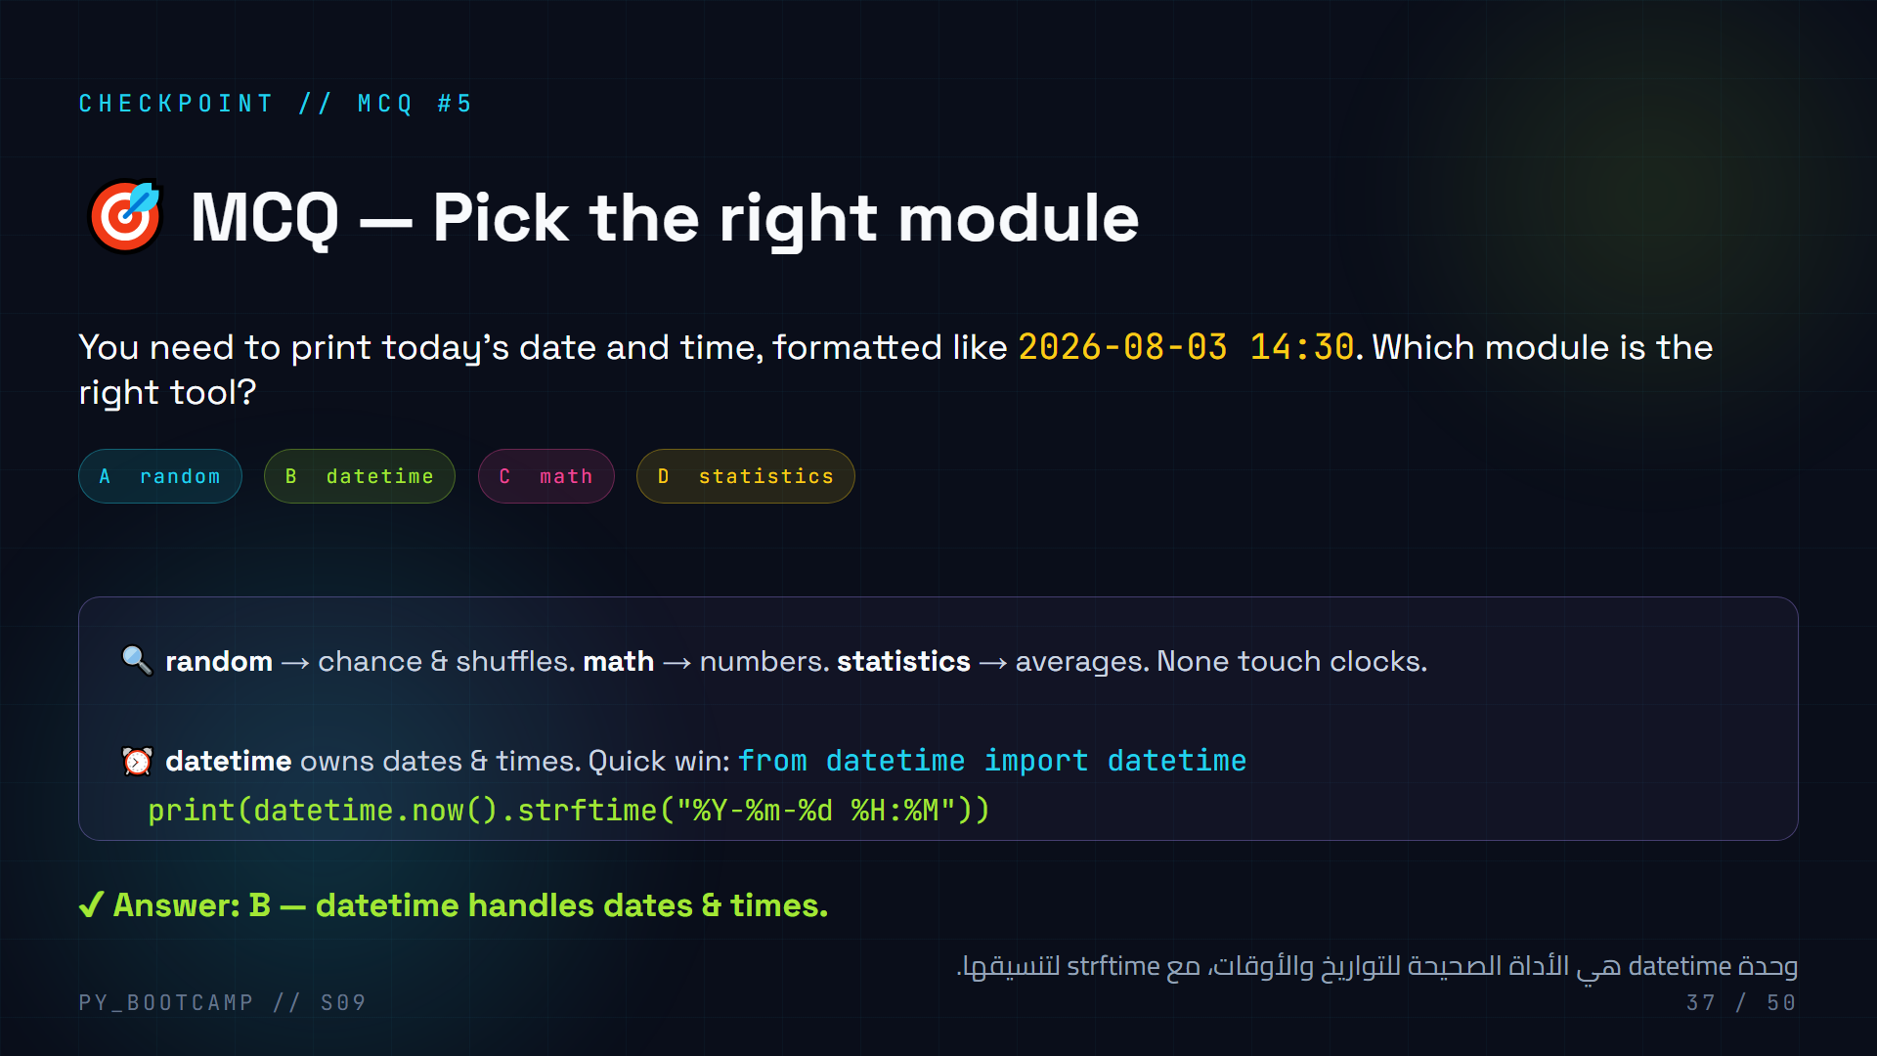
Notes:
## MCQ #5 — pick the right module
**Quick round (2 min):** students match the tool to the job. This tests the "ask which module" habit, not syntax.
**Show the one-liner win:** `from datetime import datetime` then `datetime.now().strftime("%Y-%m-%d %H:%M")`. Explain strftime codes briefly (Y=year, m=month, d=day, H=hour, M=minute).
**Extension:** ask reverse — "want a random password? → random / secrets." Gives them more module vocabulary.
**Arabic tip:** علّمهم "اختيار الأداة" قبل كتابة الكود: أي وحدة تصلح للمهمة؟ نصف الحل اختيار صحيح.

Slide 38
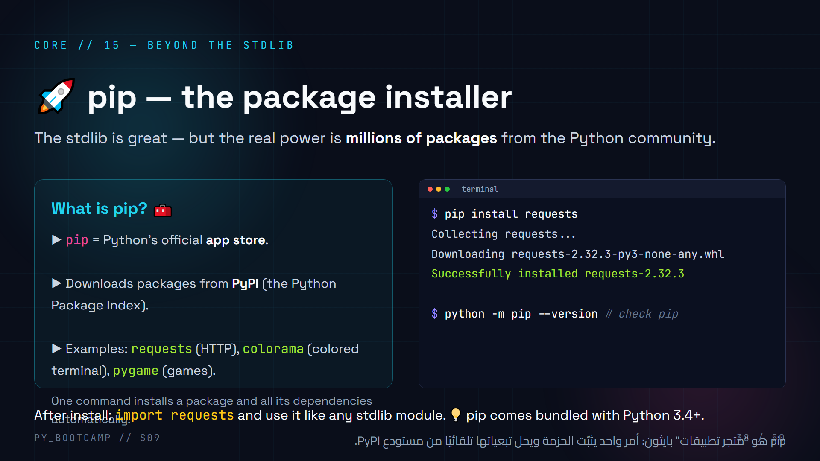
Notes:
## pip — the package installer
**Concept (4 min):** pip = the package manager. Think "App Store for Python". It pulls code from PyPI into your machine, ready to import.
**Show the command:** `pip install requests` → downloads, installs, done. Then `import requests` just works.
**Naming:** pip = "Pip Installs Packages". It ships with Python since 3.4, so no separate install needed.
**Live (5 min):** `pip --version` to confirm, then install a tiny, safe package like `colorama` and print colored text. Keep the install quick; don't block on network issues — pre-warn students they'll do the big installs in the venv section and homework.
**Mention modern best practice:** on some systems `python -m pip install` is preferred to avoid path issues. Show both.
**Arabic tip:** "pip هو متجر التطبيقات" — تعلمه أسهل مما تظن: pip install اسم_الحزمة.

Slide 39
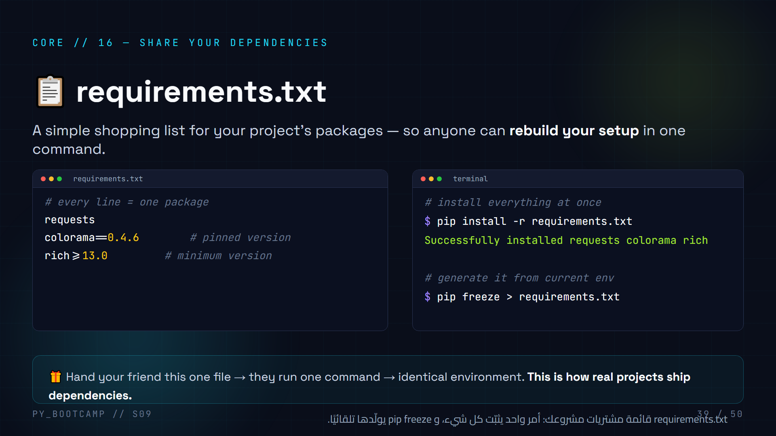
Notes:
## requirements.txt
**Concept (4 min):** a plain text file, one package per line. Version formats: bare name, pinned (==), minimum (>=). Pinning versions = reproducibility (tomorrow's code breaks when packages change).
**The two commands:**
- `pip install -r requirements.txt` — install everything on a fresh machine.
- `pip freeze > requirements.txt` — auto-generate the file from the currently installed packages.
**Demo (5 min):** create requirements.txt with colorama, run the install, run pip freeze to see the generated list.
**Connect to next session (Git):** "Next session you'll share code with Git — requirements.txt travels with the code so anyone can run it. This file is part of professional hygiene."
**Arabic tip:** "قائمة المشتريات" — كل سطر حزمة. لا تكتبها يدويًا أحيانًا، pip freeze ينشئها.

Slide 40
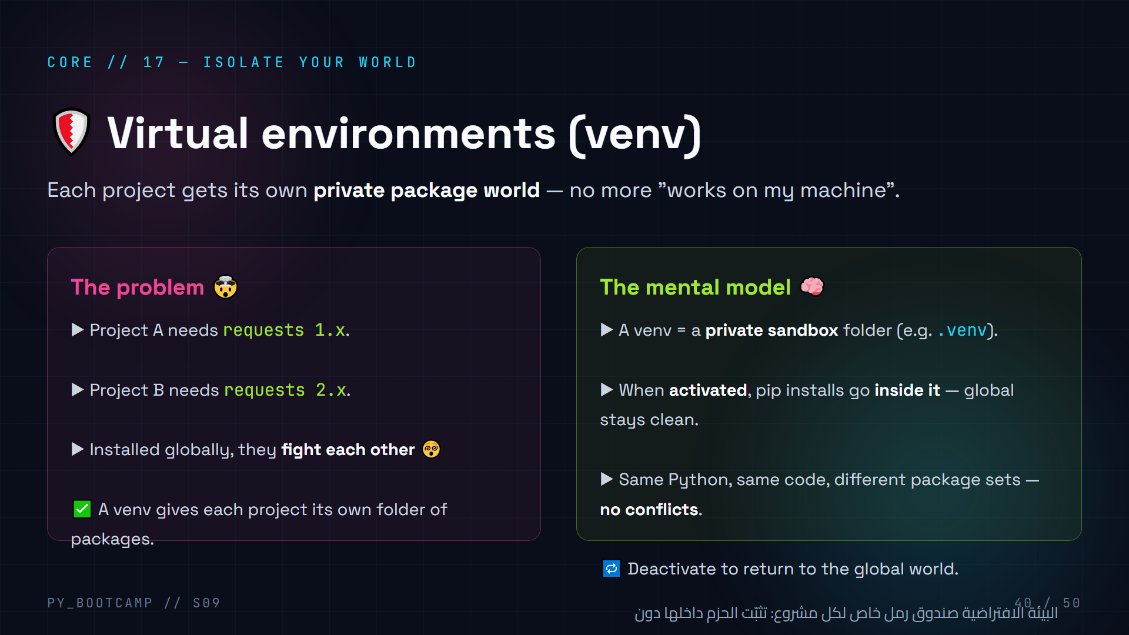
Notes:
## Virtual environments — the concept
**Story (4 min):** two projects need different versions of the same package. Global install → conflict. Solution: each project gets its own sandbox where pip installs go. The venv is just a folder (usually named .venv).
**Mental model:** "activated venv = pip and python now point inside .venv". Global remains untouched. Deactivate returns to normal.
**When to create one:** for every real project. Not for quick single-file experiments (mention it's fine to skip for tiny scripts — keep it pragmatic).
**Demo (5 min):** create a venv in a demo folder, show pip freeze inside vs outside (different lists), install colorama inside, deactivate, show the global pip freeze did NOT change. Very convincing.
**Arabic tip:** "كل مشروع له غرفته الخاصة" — البيئة الافتراضية تمنع الحزم من التصارع.

Slide 41
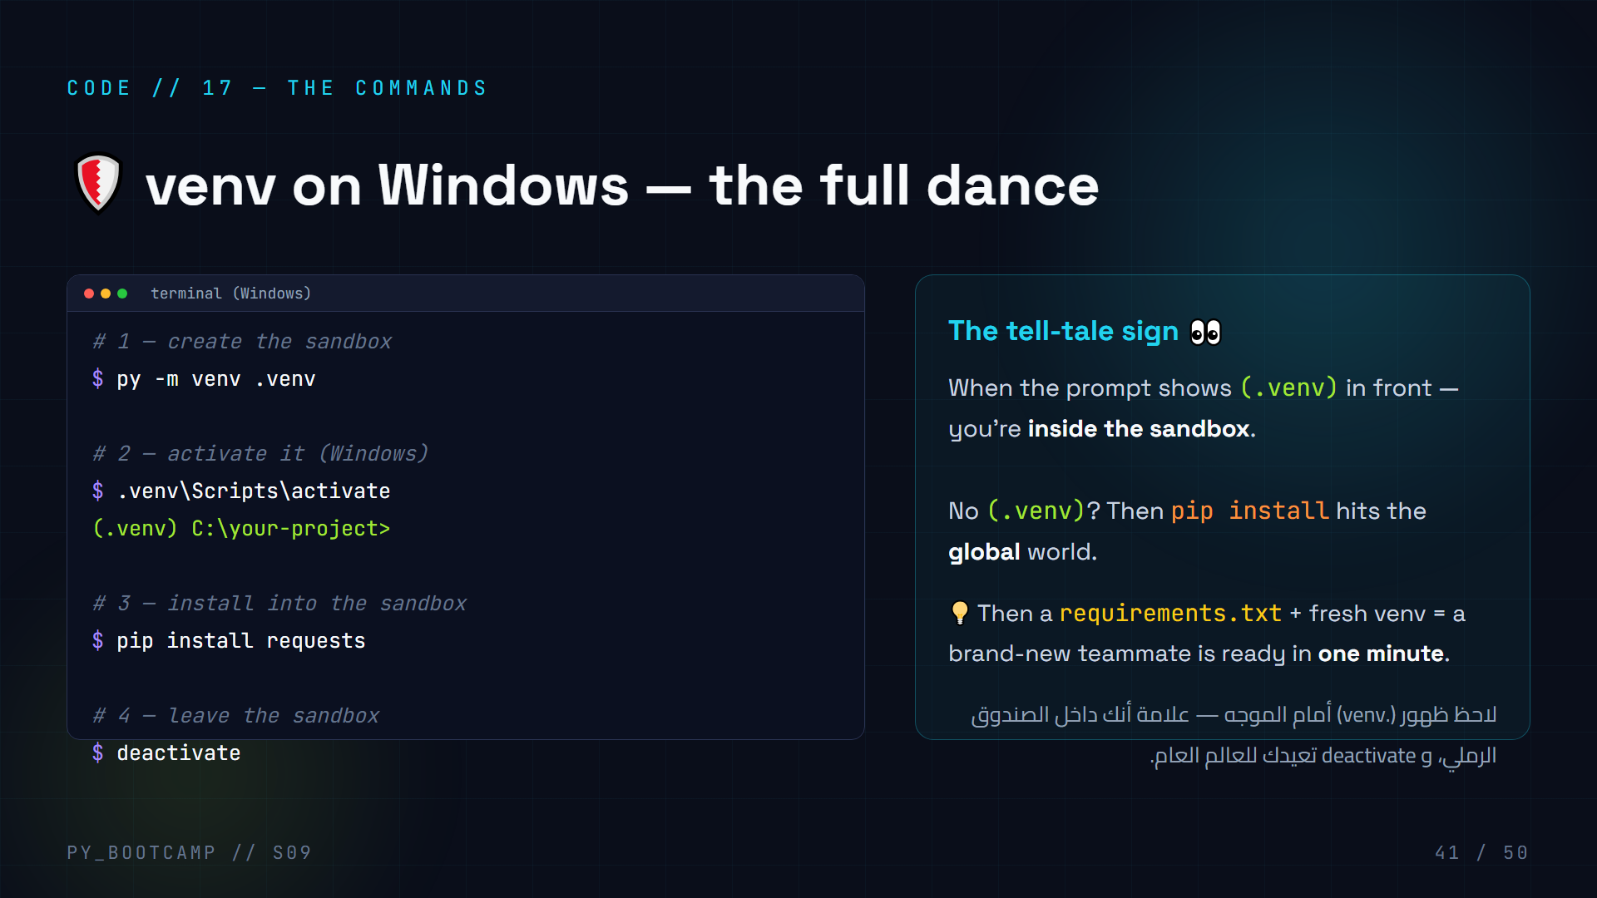
Notes:
## venv commands — live (15 min)
**This is hands-on — students type along:**
1. `py -m venv .venv` — creates the sandbox folder (takes a few seconds). Note: `py` is the Windows launcher; on macOS/Linux it's `python3`.
2. `.venv\Scripts\activate` — the prompt changes to `(.venv)`.
3. `pip install requests` — notice it installs into .venv. Compare `pip freeze` before and after.
4. `deactivate` — prompt returns to normal.
**Point out the prompt change** as the visual confirmation they're inside. Common mistake: forgetting to activate → packages go global. The (.venv) prefix is their check.
**macOS/Linux note (30 sec):** `source .venv/bin/activate`. Don't dwell; this class is Windows.
**Arabic tip:** علامة (.venv) هي بوصلتكم — إن ظهرت فأنتم داخل البيئة، وإلا فالتثبيت سيكون عامًا.

Slide 42
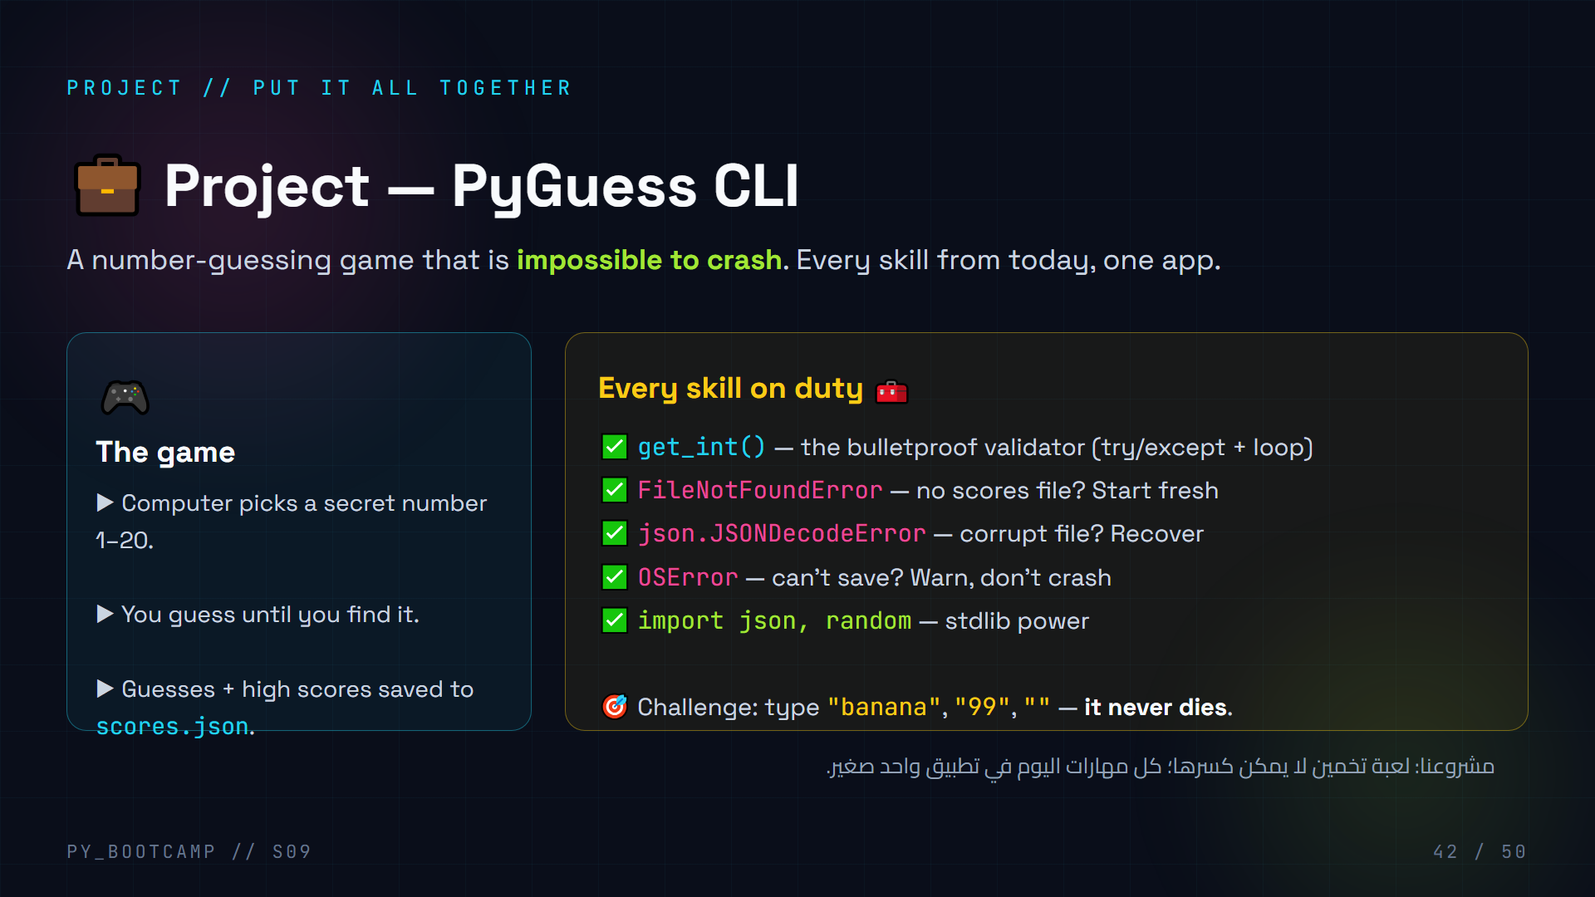
Notes:
## Project intro — PyGuess CLI (announce, 3 min)
**Announce the build:** "We've been collecting tools all day. Now we assemble them into one real app."
**Set expectations:** ~20 minutes, code split across two files/slides, then we run it and attack it with garbage input to prove it's unbreakable.
**Highlight the skill mapping:** get_int (validation), FileNotFoundError & JSONDecodeError (file robustness), OSError (save robustness), import (modules). Students should recognize their own day.
**Tease the attack test:** "After we finish, I will try to crash it. banana, 99, nothing at all. Watch — it will keep going. That's today's win."
**Arabic tip:** اربط كل جزء من المشروع بجزء من اليوم: المدخلات، الملفات، الاستيراد — كل شيء تجمّع هنا.

Slide 43
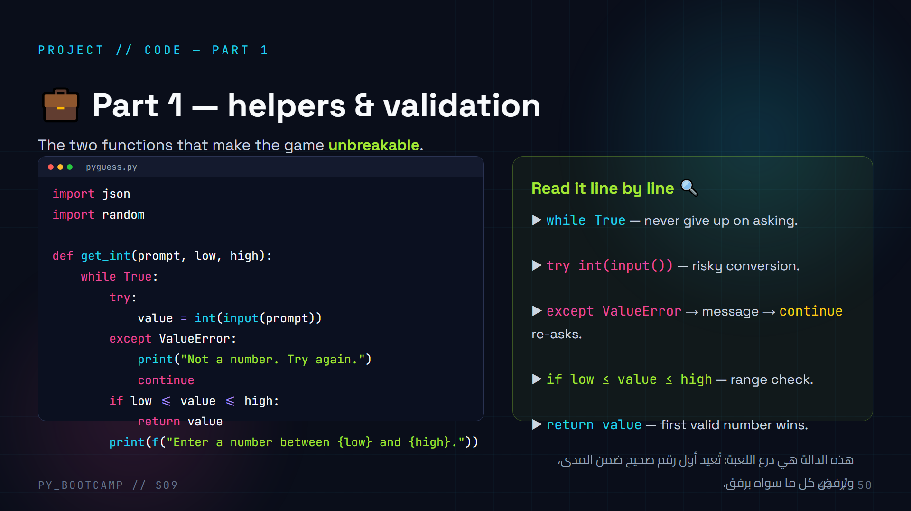
Notes:
## Project code part 1 — get_int (8 min)
**Type it with them.** This is the upgraded get_int from live-coding #2, now with range parameters low/high.
**Walk the flow with example inputs:**
- "banana" → int() fails → ValueError → message → continue (loop again).
- "99" (with high=20) → passes int() → range check fails → message → loop again.
- "7" → passes both → return 7.
**Why continue:** restarts the while loop — clean way to "ask again". Without continue, the code would fall through to the range check with a bad value... actually no — the except block catches, then execution continues after the try; continue prevents the range check. Point this out explicitly.
**Checkpoint (2 min):** have each student write the function, then pair-compare. Fast class: also write `load_scores()` from the next slide.
**Arabic tip:** اختبرهم: "ماذا يحدث مع banana؟ مع 99؟ مع 7؟" — تتبعوا المسارات الثلاثة معًا.

Slide 44
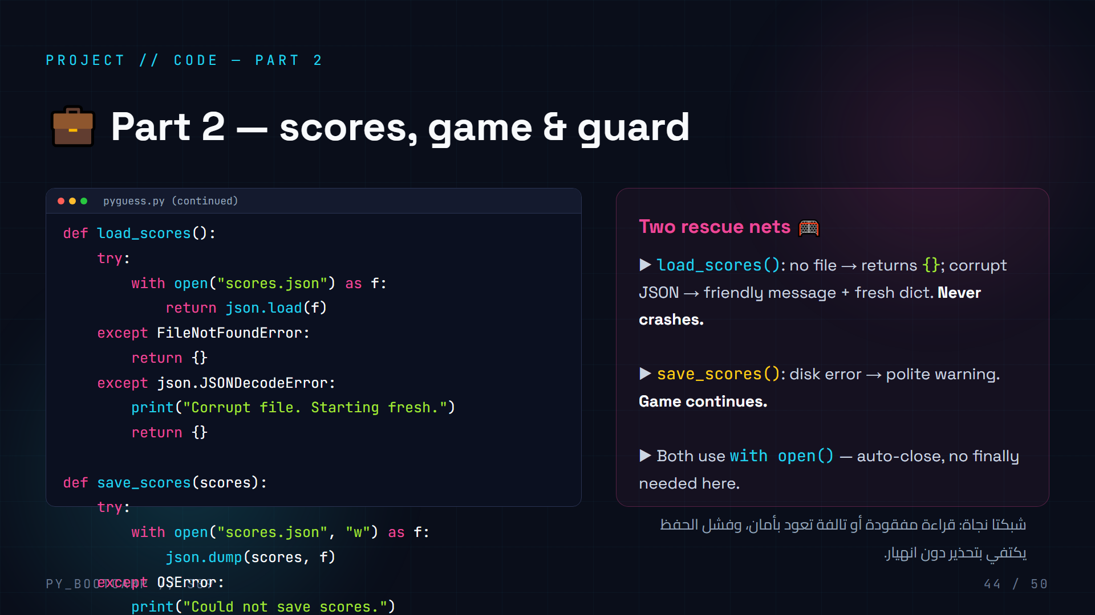
Notes:
## Project code part 2 — load/save scores (8 min)
**Type the load_scores function with them.** Emphasize the two failure modes:
- FileNotFoundError → no file yet (first run) → return empty dict. Normal, not an error!
- json.JSONDecodeError → file exists but garbage inside → warn + start fresh.
**Save robustness:** OSError is the parent of file errors; catching it covers permission/disk issues. The game continues even if saving fails — resilience over perfection.
**Ask students:** "Why do we not need `finally` with `with open()`?" → because `with` auto-closes the file. finally shines for non-file resources.
**Fast finish:** complete the main() game loop + `if __name__ == "__main__"` guard (from slide 35) on the board. Then slide 45 shows the full run.
**Arabic tip:** "مع with، لا نحتاج finally لإغلاق الملف — with يغلقه بنفسه."

Slide 45
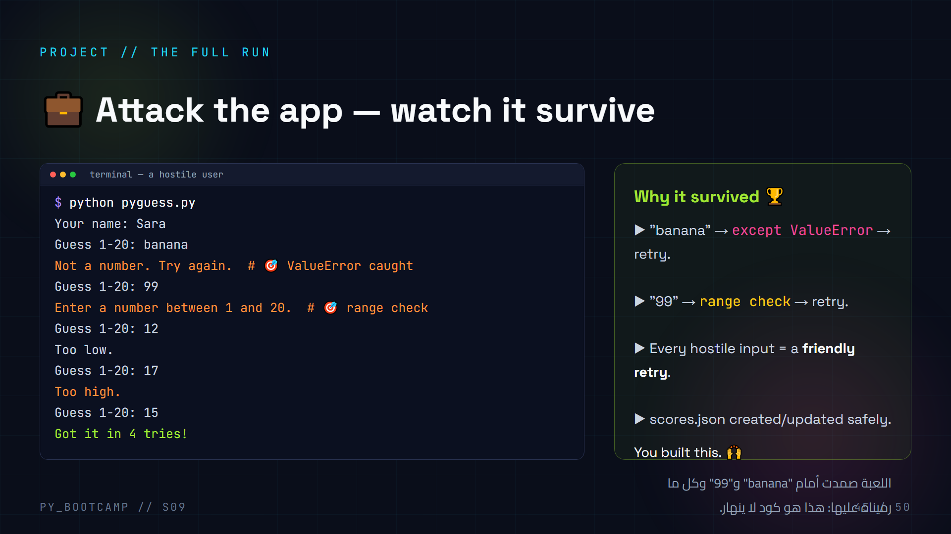
Notes:
## Project output — attack it (10 min)
**Run the finished app in front of the class.** Then become the hostile user: type "banana", "99", empty string, "17.5", a negative number. Every single one gets a friendly retry and the game continues. This is the payoff moment of the session.
**Narrate each recovery:** "banana → ValueError → caught → retry. 99 → range check → retry." Students should be able to predict which shield catches which attack by now — let them call it out.
**Bonus robustness demo:** after the game, corrupt scores.json (open it, type "not json"), run again → "Corrupt file. Starting fresh." Another shield they built themselves.
**Close the loop:** "Remember slide 2's crash? That same 'banana' now glides past our shields. Compare — this is the whole session in one run."
**Arabic tip:** اجعل التخريب لعبة: طالب يعطي مدخلًا خاطئًا، وآخر يتنبأ بأي درع سيحمي اللعبة.

Slide 46
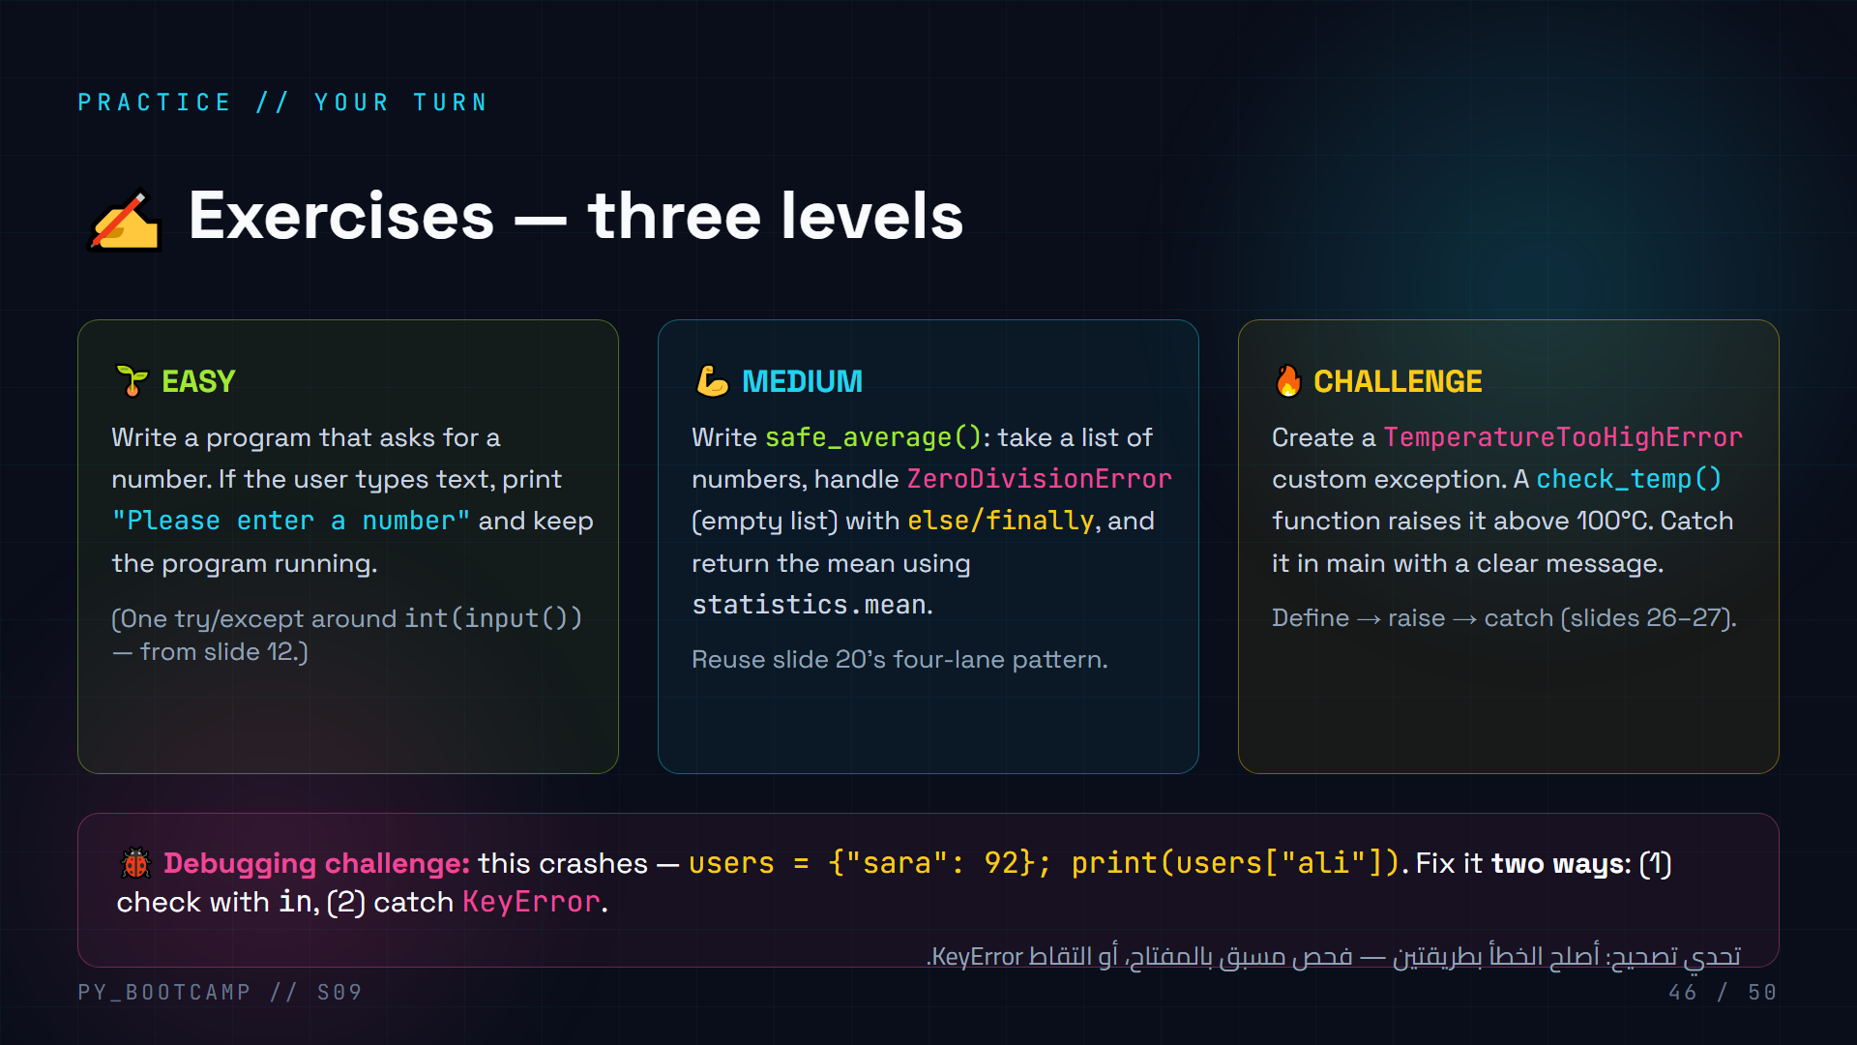
Notes:
## Exercises — three levels (15 min)
**Let students choose level; encourage climbing.** Give 10 minutes, then quickly go over all three solutions.
**Easy solution:**
```python
while True:
try:
num = int(input("Number: "))
break
except ValueError:
print("Please enter a number")
print("Got:", num)
```
**Medium solution sketch:** safe_average uses try/except ZeroDivisionError; else prints the mean; finally prints "done". Note: statistics.mean([]) raises StatisticsError (a ValueError subclass) — the exercise's "empty list" handling can catch ZeroDivisionError if they compute manually, or Exception — keep guidance flexible.
**Challenge solution:** `class TemperatureTooHighError(Exception): pass`; `if temp > 100: raise TemperatureTooHighError("Too hot!")`; wrap call in try/except.
**Debugging challenge (3 min):** solution 1 `if "ali" in users:`; solution 2 `try: print(users["ali"]) except KeyError: print("not found")`. Ask which is better and why (context).
**Arabic tip:** شجّعهم: "المتوسط سهل، والتحدي يبني تطبيقك القادم." لا تترك أحدًا عالقًا على المستوى السهل.

Slide 47
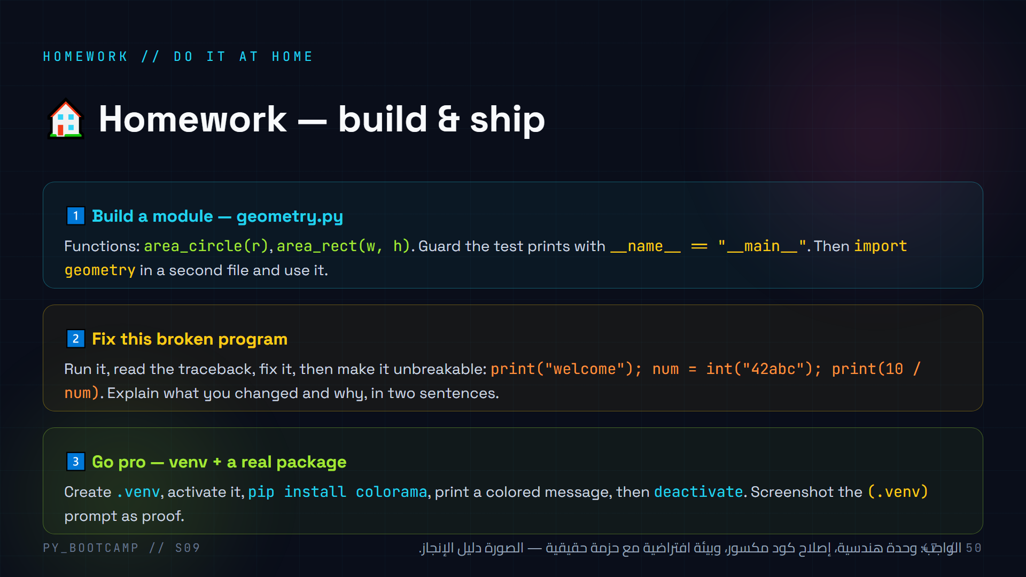
Notes:
## Homework (5 min to brief)
**Go through all three tasks.**
1. **geometry.py** — exercises everything from the modules half: functions, import, guard. Accept any naming as long as it works. Watch for ModuleNotFoundError (files must be in same folder).
2. **Fix the broken program** — traceback reading practice. `int("42abc")` → ValueError; `10 / num` with num=0 → ZeroDivisionError. Two fixes, then wrap in try/except. The two-sentence explanation builds the "explain your debugging" habit.
3. **venv + colorama** — the pipeline they'll use for every future project. Screenshot proves they saw the (.venv) prompt. Warn about activation path on Windows (.venv\Scripts\activate).
**Deadline & sharing:** next session, quick 3-minute share. Praise any attempt — especially the screenshot.
**Arabic tip:** ذكّرهم أن الواجب يقسّم على ثلاث "مهارات محترف": الوحدات، قراءة الأخطاء، والبيئة الافتراضية.

Slide 48
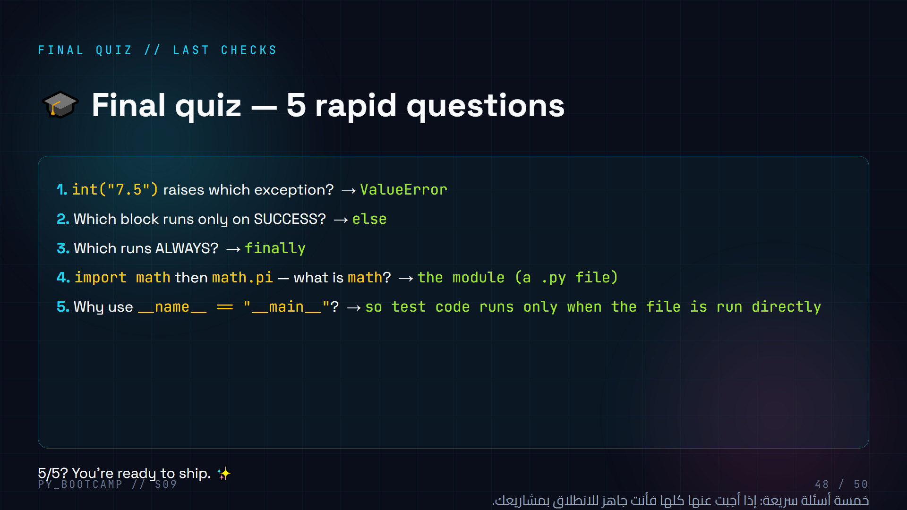
Notes:
## Final quiz — 5 rapid questions (5 min)
**Run it as a call-out quiz.** Read each question, wait 5 seconds, let them shout answers, confirm. Fast, energizing, confidence-building.
**Watch for:** question 1 (int("7.5") → ValueError, not TypeError — the value is wrong for int, not the type); question 4 (math is a module = a file). If students stumble, re-teach the one point on the spot.
**Arabic tip:** اجعلها مسابقة فرق — فريقي "try" و"except" يتنافسان على أسرع إجابة صحيحة.

Slide 49
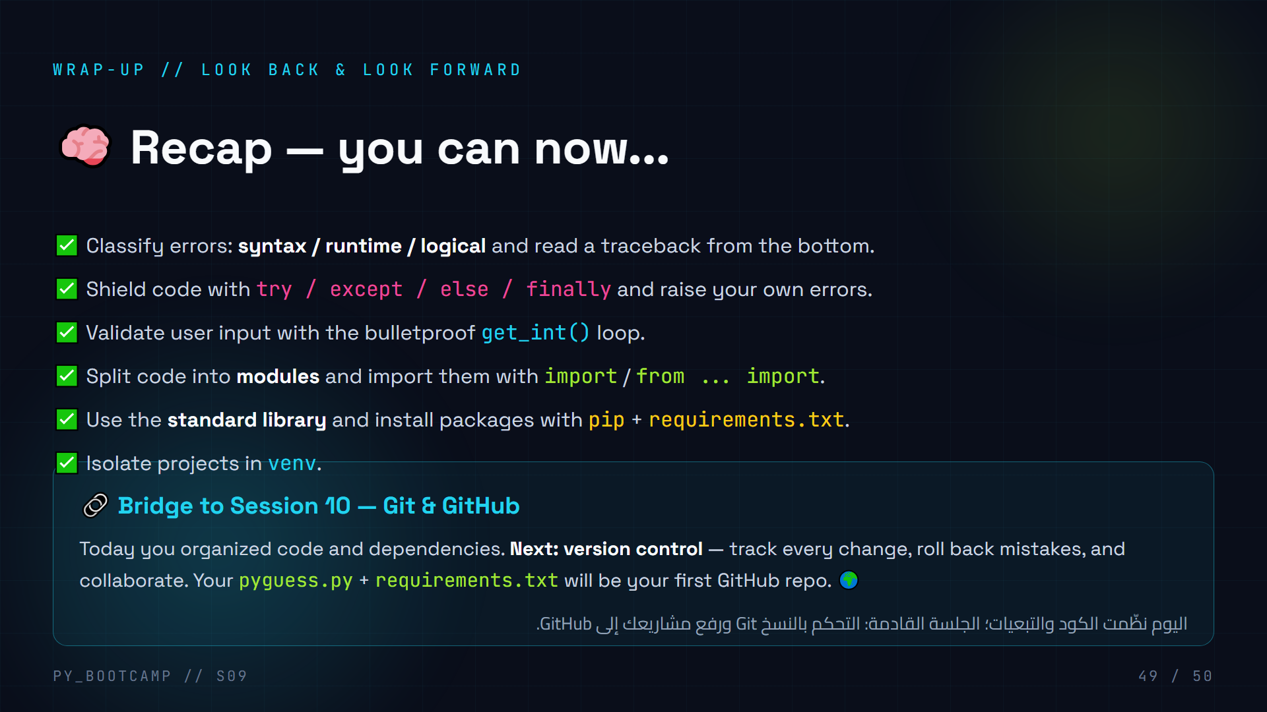
Notes:
## Recap + bridge to Git & GitHub (4 min)
**Celebrate first:** read the recap checklist with energy — they genuinely achieved all of it today. Ask for a show of hands per line.
**Bridge:** "You now write code that doesn't crash and organize it professionally. But how do you SAVE your progress across versions? How do you share code with a team? That's Git — and it's our next session."
**Set the hook:** their PyGuess project + requirements.txt will become their first GitHub repository. Version control is the final pillar of a professional developer. Tease: "Imagine breaking your code and pressing 'undo' for an entire project."
**Arabic tip:** اربط بالواقع: "Git هو زر التراجع العملاق لمشروعك كاملًا" — وداعًا للنسخ المكررة من الملفات.

Slide 50
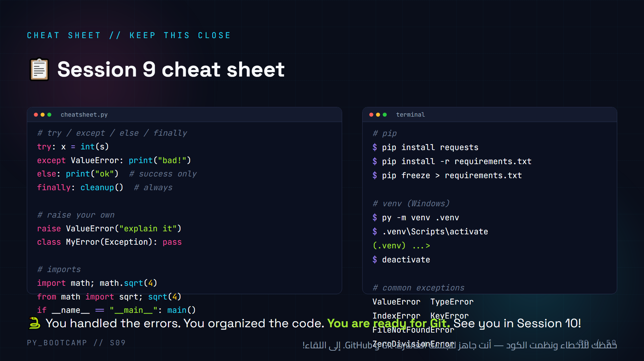
Notes:
## Cheat sheet + closing (3 min)
**Point them to this slide as a reference** they can screenshot. It condenses the whole session into one screen: the try/except/else/finally skeleton, raise, imports, guard, pip, venv, and the six common exceptions.
**Closing message:** celebrate the journey from slide 2 (the crash) to the bulletproof PyGuess. "Today's lesson wasn't about syntax — it was about resilience. Real code crashes; great code survives."
**Next session teaser:** Git & GitHub — version control, rollback, and their first open-source-style repository.
**Final encouragement (Arabic):** "الكود القوي ليس الذي لا يخطئ أبدًا، بل الذي ينهض بعد كل خطأ." (Strong code isn't code that never errs — it's code that survives every error.)
**Ask them to save slide 50** — it will be their quick reference for every project from now on.

