Slide 1


CANDEV Data Challenge
Building an Intelligent Curriculum Framework (C426)
Presented by: Team 2113
Faculté de genie | Faculty of Engineering
uOttawa.ca

Slide 2
Outline
Background information
Issues
Data analysis
Algorithms selection

Slide 3
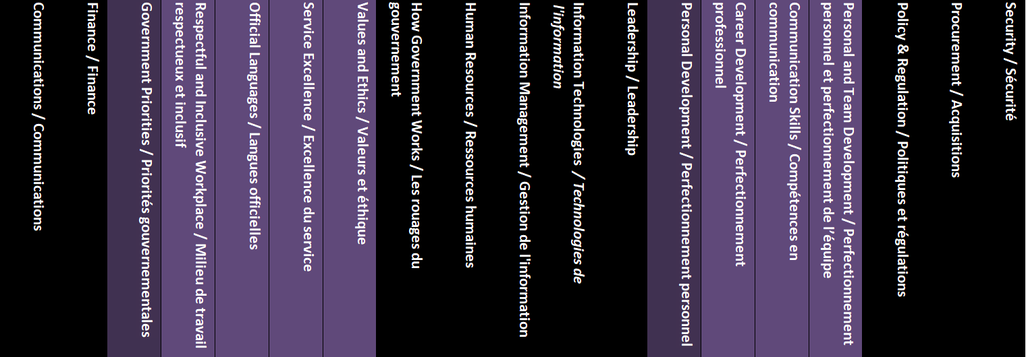
Background information
The CSPS’ curriculum has 1117 learning products
Covering 19 Topics

Slide 4
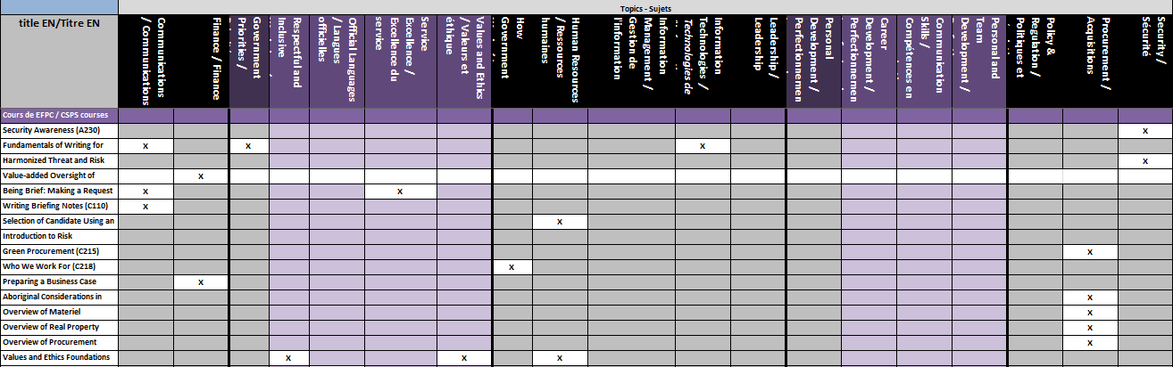
Issues
Topics are artificially selected
Sometimes are misclassified or inaccurate
Need a smart classification method based on course description

Slide 5
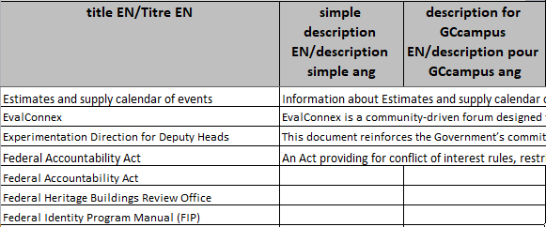
Data analysis
1/3 courses have no description or just one sentence description
Few courses(1117 ) vs. Lots of topics(19)

Slide 6
Algorithms selection
LDA(unsupervised)
RAKE(unsupervised)
LSTM(supervised)
Unsupervised learning discard original labels and therefore, the result grouping is incomprehensive
Supervised learning keeps the meaningful original classification(e.g. Finance, communications…)

Slide 7
Algorithms selection
Ideas: Although the existing classification is not good enough, it can be used as most courses are correctly classified. After LSTM model being trained, most courses are correctly classified and courses that are misclassified are prompted.
Each time a new course is added or deleted, LSTM model will recommend topics with high probability. Then the model will be retrained based on the new data.

