Slide 1
SpaceX Falcon 9 First Stage Landing Prediction
IBM Applied Data Science Capstone Presentation
Prepared by AaShIrVaD-kV | June 2026

Slide 2
INTRODUCTION
Project Context & Scope
• Core Goal: Predict whether the Falcon 9 first stage booster will land successfully.
• Reusable Systems: Recovering first stages saves SpaceX millions per launch (~$62M vs competitors' $165M+).
• Strategic Value: Allows competitors to estimate launch bidding costs and insurances.

Slide 3
EXECUTIVE SUMMARY
Executive Summary: Objective & Method
• Ingestion Pipeline: Cleaned API response data and scraped flight tables into 90 records.
• GIS Proximity: Analyzed launch site coordinates relative to coastlines and transportation facilities.
• Machine Learning: Tuned 4 classifiers using GridSearchCV to optimize landing predictions.

Slide 4
BUSINESS CONTEXT
The Business Problem: Reusable Launch Systems
• Capital Conservation: Rocket engine recovery preserves ~70% of production value.
• Pricing Disruption: SpaceX offers launch pricing 60%+ lower than conventional expendable providers.
• Prediction Utility: Quantifying landing risk improves business intelligence.

Slide 5
DATA COLLECTION
Data Ingestion Pipeline
• REST API Retrieval: Extracted flight records and mapped nested resource details.
• Wikipedia Web Scraping: Parsed launch tables to cross-reference data.
• Data Consolidation: Normalization in Pandas and export to SQLite.

Slide 6
DATA WRANGLING
Data Wrangling & Imputation
• Filtering: Excluded early Falcon 1 flights to establish a uniform 90-flight Falcon 9 dataset.
• Imputation: Calculated mean payload mass ($6,104.96$ kg) to impute missing rows.
• Target Labeling: Engineered binary class variables based on descriptive landing text outcomes.

Slide 7
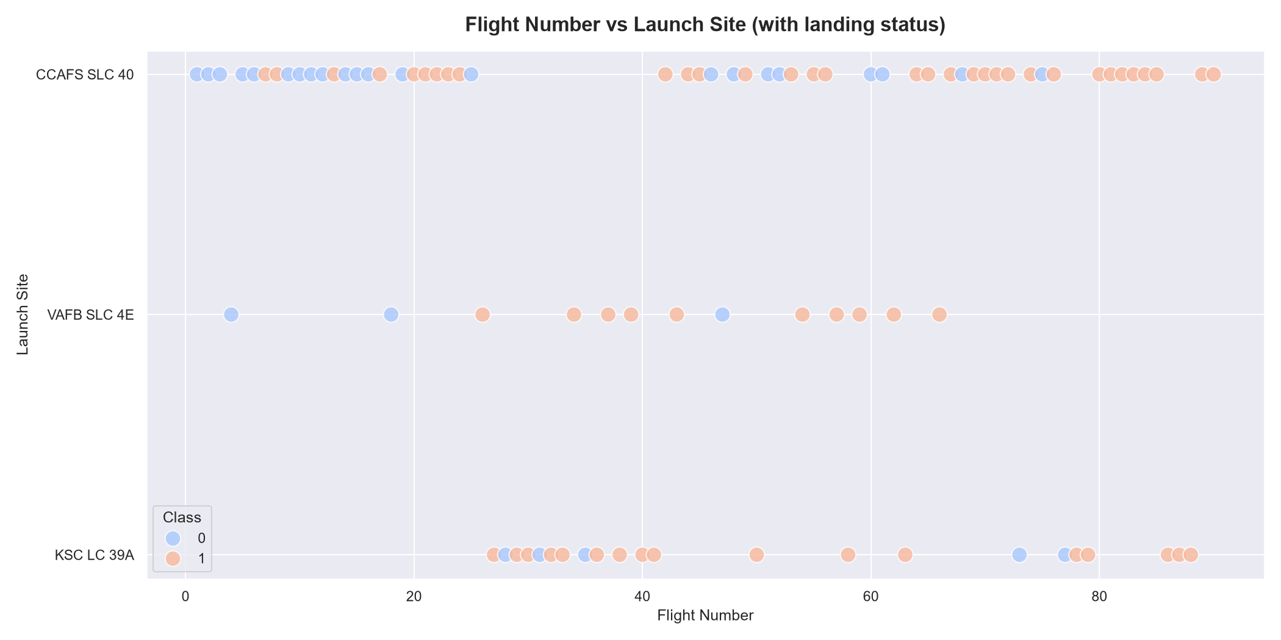
EDA
Chart 1: Flight Number vs Launch Site
• Observation: Early launches are centered at CCAFS LC-40.
• Technology Maturity: Launch successes (blue dots) dominate late flights across all locations.
• Strategic Insight: Confirms improvement in recovery procedures over time.

Slide 8
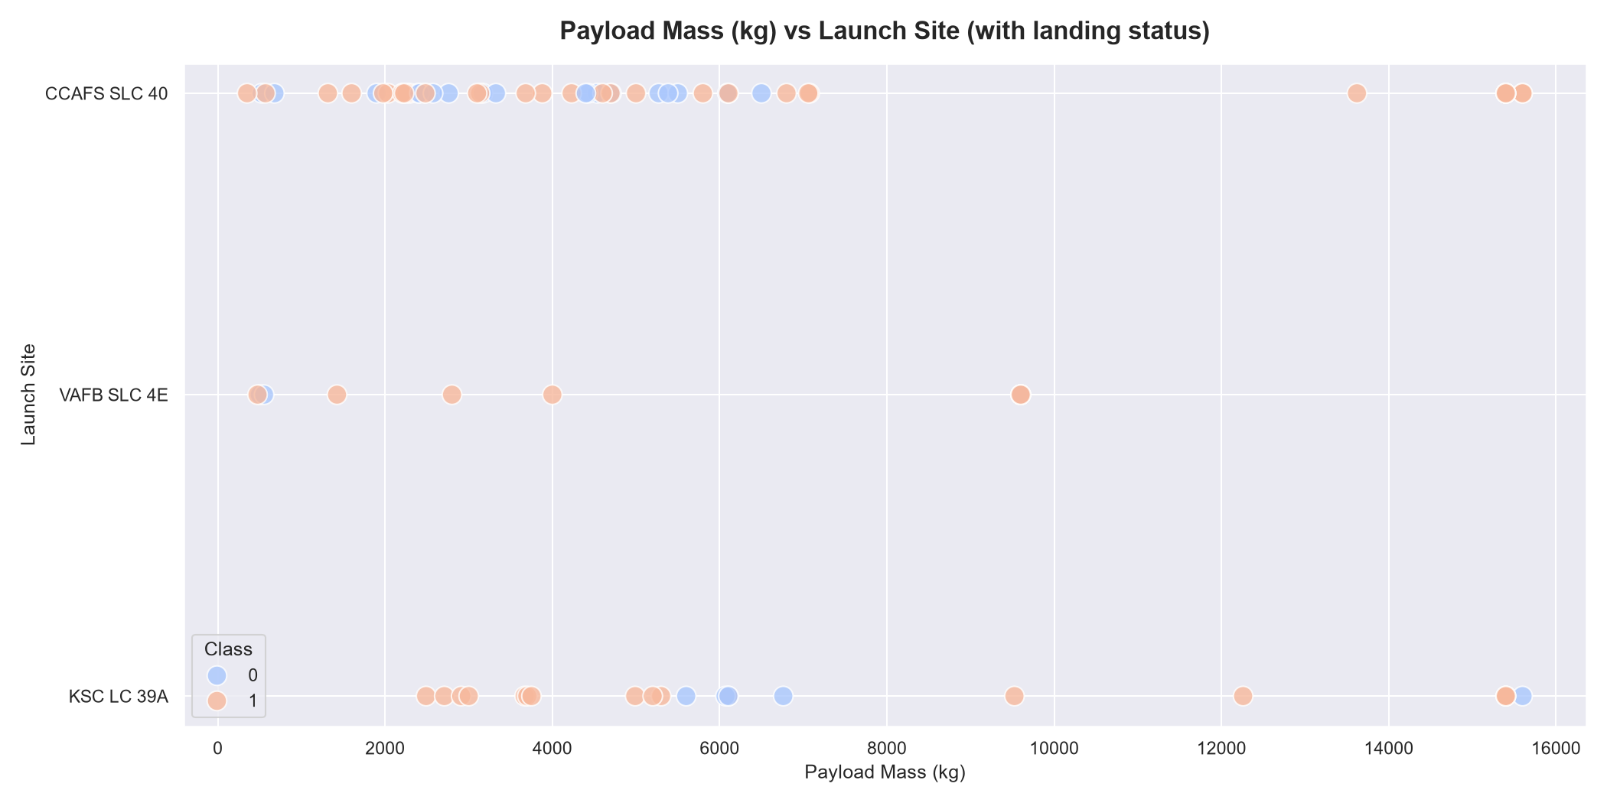
EDA
Chart 2: Payload Mass vs Launch Site
• Observation: Heavy payloads (above 10,000 kg) are launched from Florida sites.
• Site Restrictions: VAFB SLC-4E payloads are consistently capped below 10,000 kg.
• Recovery Rationale: Heavy launches show stable landing success records on later flights.

Slide 9
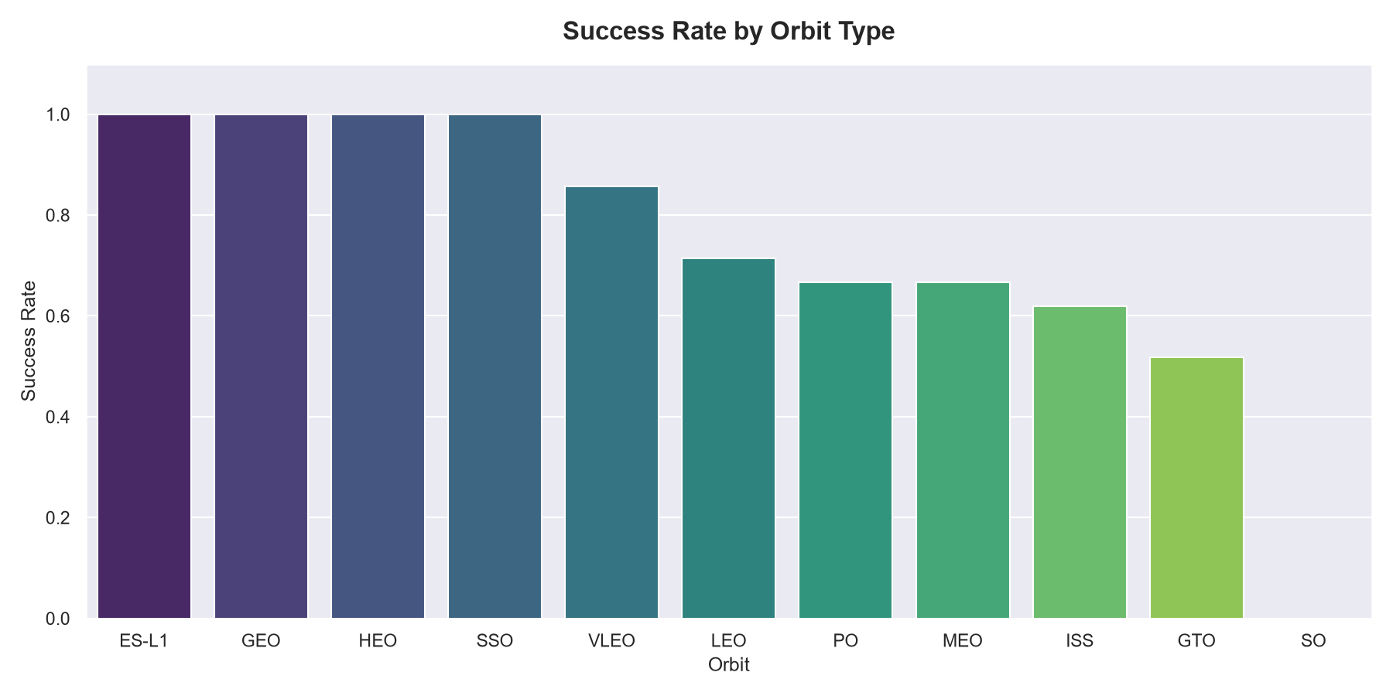
EDA
Chart 3: Success Rate by Orbit Type
• High Success Orbits: ES-L1, GEO, HEO, and SSO maintain a 100% success rate.
• High Energy Orbits: GTO has lower landing success (~50%).
• Delta-v limitations: Higher entry speeds leave less fuel for recovery burns.

Slide 10
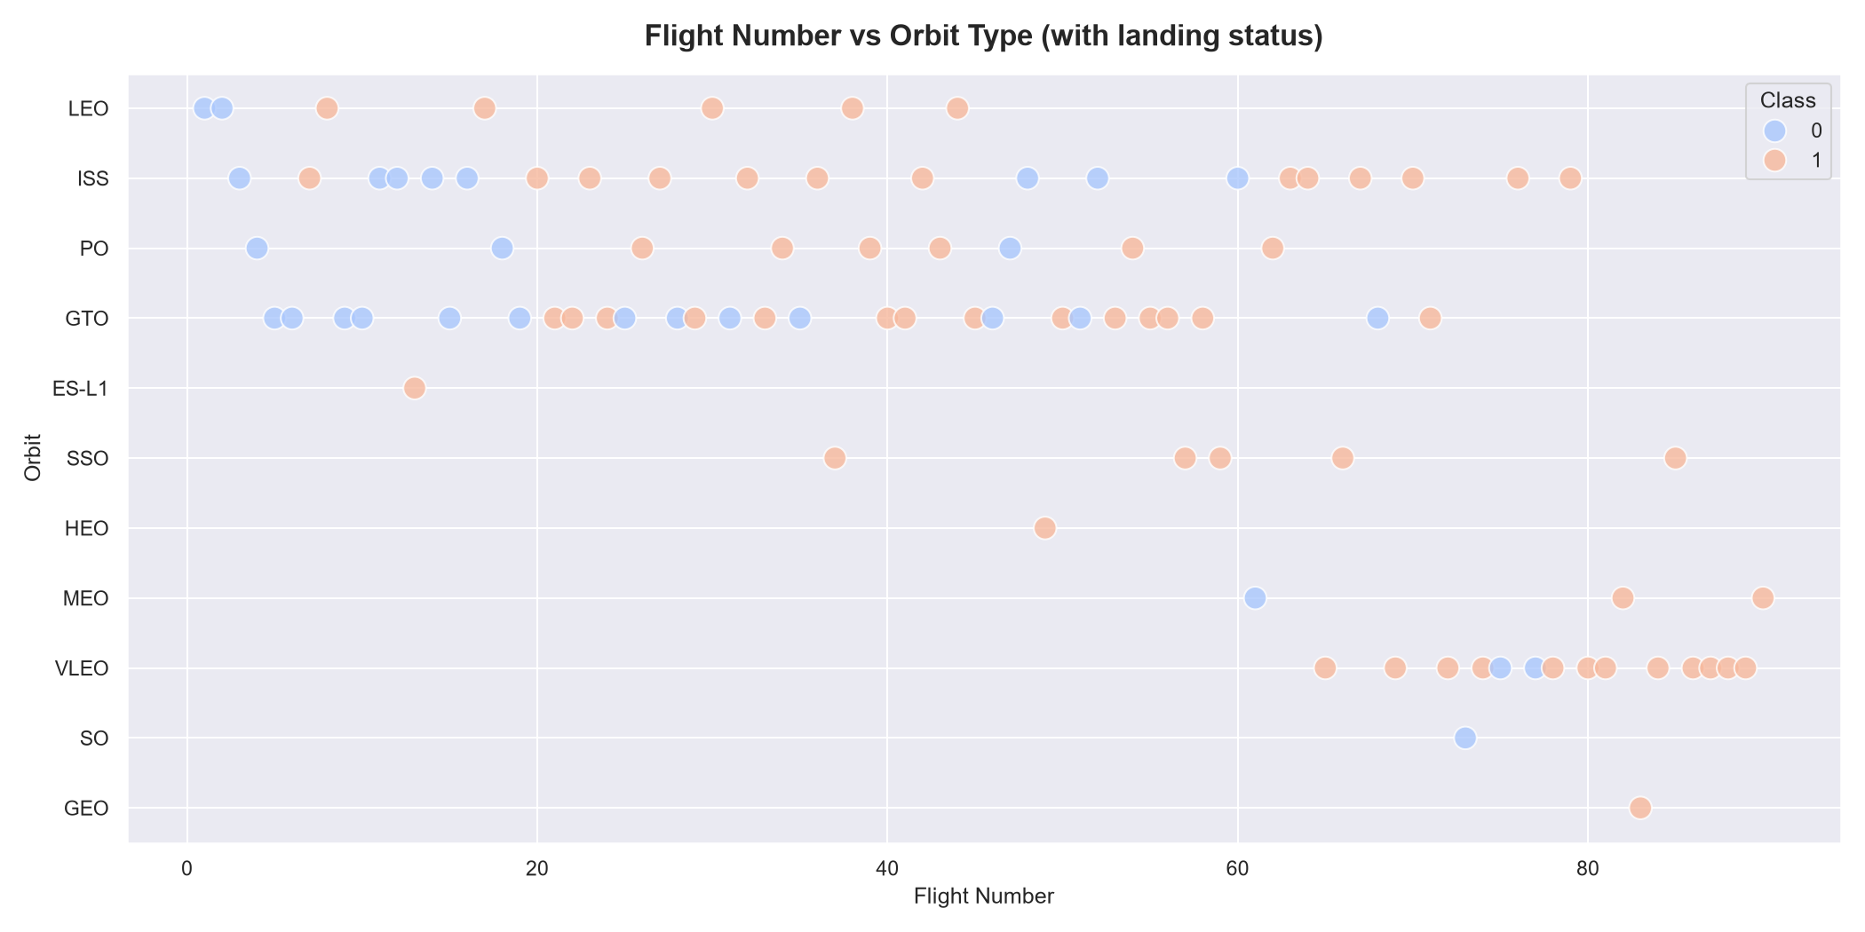
EDA
Chart 4: Flight Number vs Orbit Type
• Trend: Early flights were targeted at low LEO orbits.
• Evolution: Later flights expanded to high-altitude GTO and polar orbits.
• Business growth: Reflects maturity from ISS cargo hauling to global telecommunication constellations.

Slide 11
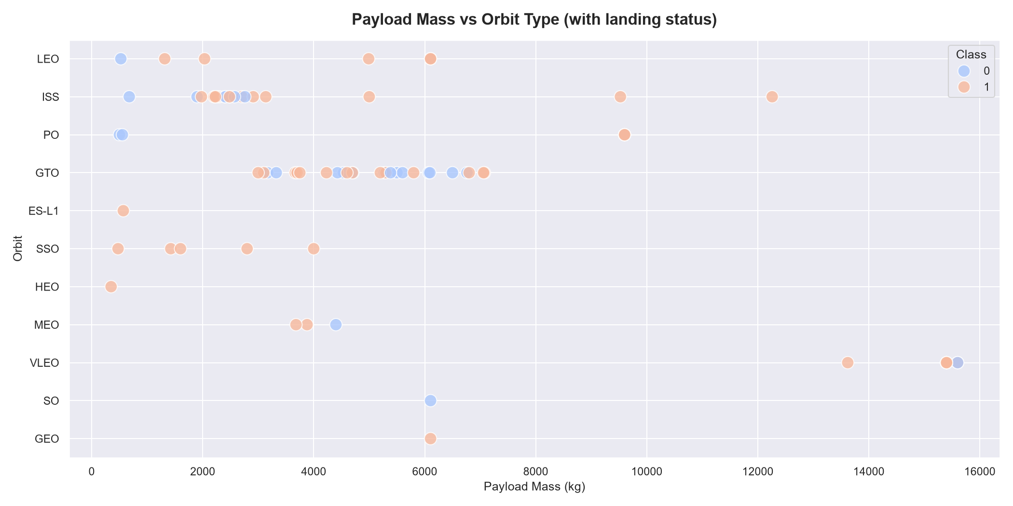
EDA
Chart 5: Payload Mass vs Orbit Type
• Mass clusters: Polar orbits have payload weights clustered near 9,600 kg.
• GTO distribution: Heavy commercial telecom payloads range from 3,000 to 6,000 kg.
• LEO variation: Low-Earth orbit launches carry payload masses up to 15,600 kg.

Slide 12
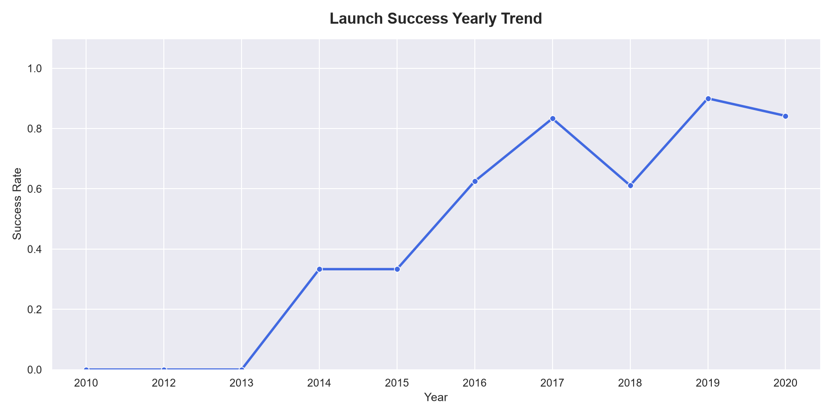
EDA
Chart 6: Launch Success Yearly Trend
• Trend Line: Rapid growth in success rates after 2015.
• Stabilization: Exceeds 80% success rate by 2020.
• Verification: Confirms booster reuse is economically and technically viable.

Slide 13
SQL ANALYSIS
SQL Queries: Auditing the Launch Database
• Query 1: Verified CCAFS, KSC, and VAFB launch pad configurations.
• NASA CRS contracts: Delivered a total of 45,596 kg to the ISS.
• Booster versions: Average payload for F9 v1.1 is 2,928.4 kg.
• Max Payload: Starlink flights carry maximum payloads of 15,600 kg.

Slide 14
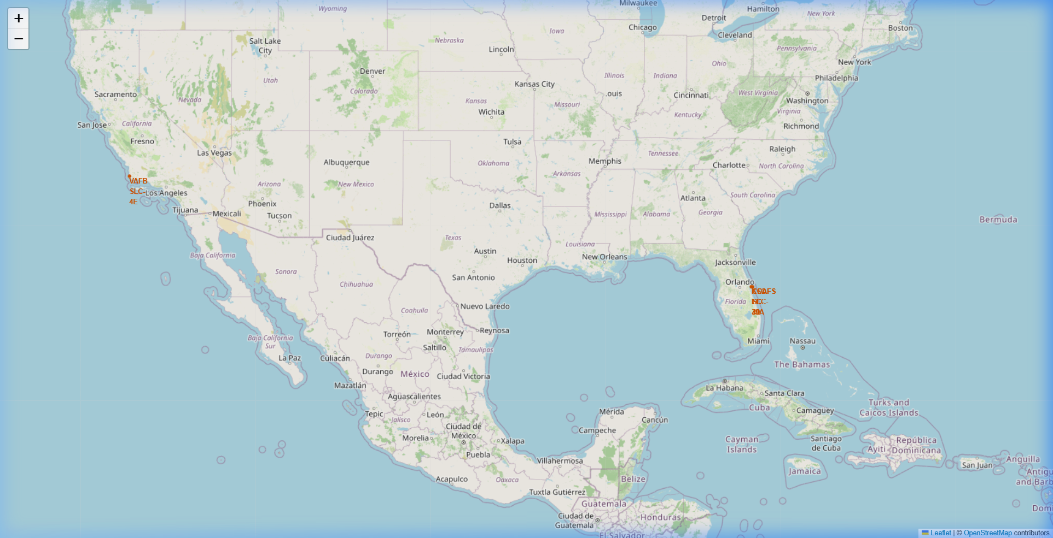
FOLIUM GIS MAP
Geographical Mapping & Proximity Heuristics
• Coastline distance: 0.58 KM. Placed close to oceans for overwater trajectories.
• Highway/Railway proximity: Located within 1.3 KM to facilitate heavy logistics transport.
• City distance: 18.0 KM. Isolated from residential populations for safety.

Slide 15
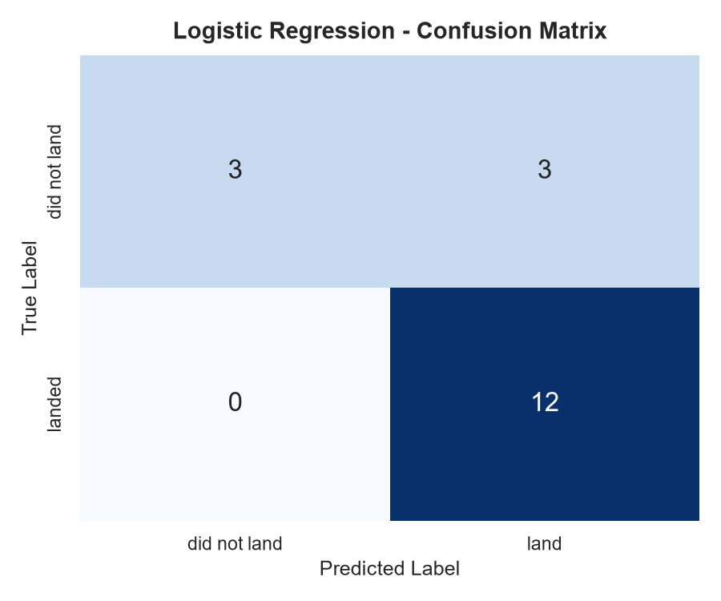
MACHINE LEARNING
Classifier 1: Logistic Regression
• Tuning Grid: Regularization C and L2 solver optimization.
• Best Parameters: {'C': 0.01, 'penalty': 'l2', 'solver': 'lbfgs'}.
• Performance: Test Accuracy of 83.33%.

Slide 16
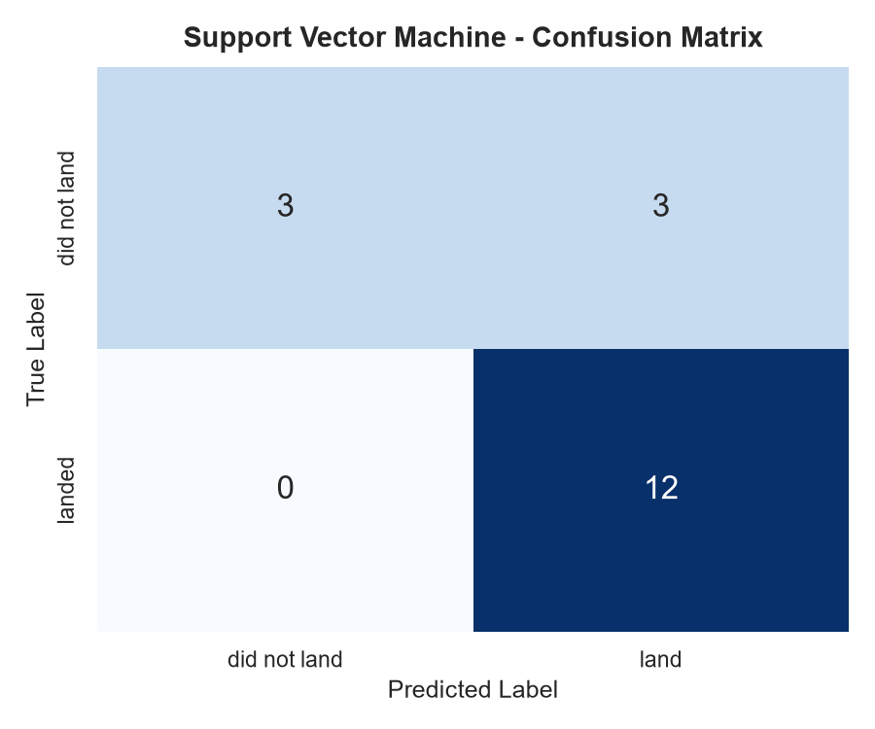
MACHINE LEARNING
Classifier 2: Support Vector Machine (SVM)
• Tuning Grid: Regularization, kernel (linear, rbf, sigmoid) and gamma scaling.
• Best Parameters: {'C': 1.0, 'gamma': 0.0316, 'kernel': 'sigmoid'}.
• Performance: Test Accuracy of 83.33%.

Slide 17
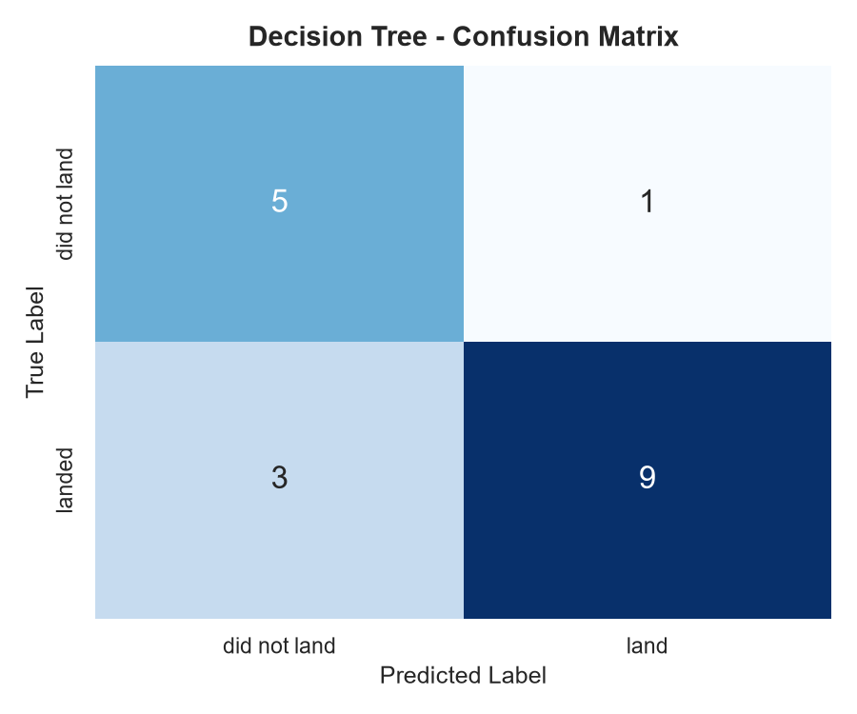
MACHINE LEARNING
Classifier 3: Decision Tree Classifier
• Tuning Grid: Criterion, max depth, splitter, and sample leaf limits.
• Best Parameters: {'criterion': 'gini', 'max_depth': 6, 'max_features': 'sqrt', 'min_samples_leaf': 1, 'min_samples_split': 10, 'splitter': 'random'}.
• Performance: Test Accuracy of 77.78% (indicates overfitting).

Slide 18

MACHINE LEARNING
Classifier 4: K-Nearest Neighbors (KNN)
• Tuning Grid: Neighbor size, search algorithm, and distance metric.
• Best Parameters: {'algorithm': 'auto', 'n_neighbors': 10, 'p': 1}.
• Performance: Test Accuracy of 83.33%.

Slide 19
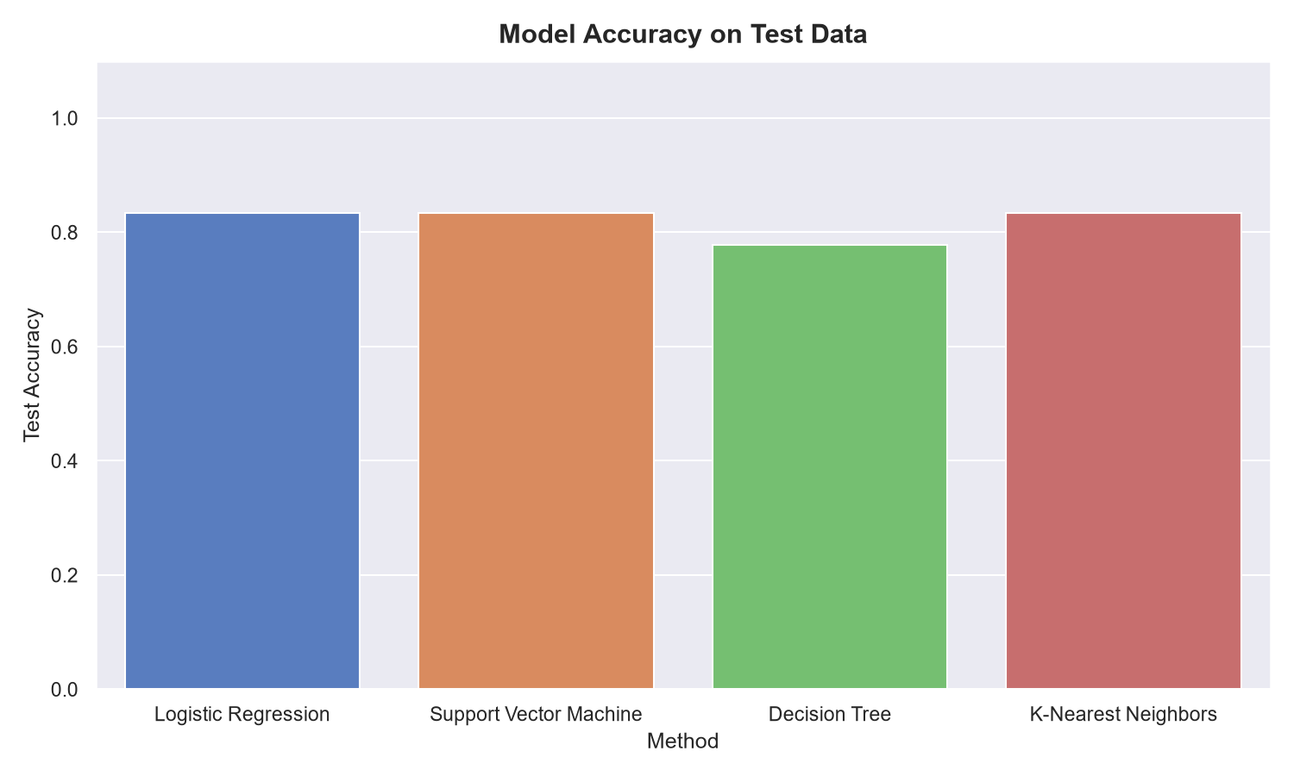
MACHINE LEARNING
Model Accuracy Performance Comparison
• Validation Accuracy: Decision Tree scored highest on training folds (87.50%).
• Test Performance: LR, SVM, and KNN tied at 83.33% accuracy.
• Selection: SVM is selected due to its optimal margin boundaries.

Slide 20
CONCLUSION
Strategic Recommendations
• Bidding Strategy: Leverage recovery probabilities to adjust launch bids.
• Insurance Risk: Adjust GTO premiums due to lower landing success margins (~50%).
• Future Enhancements: Incorporate atmospheric wind telemetry to refine models.

